Slide 1
1–2 Timothy; Titus; Philemon

Slide 2
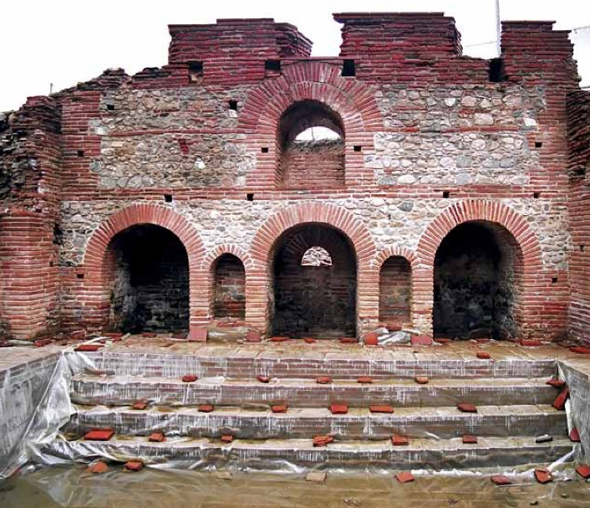
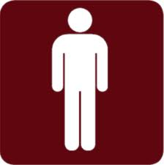
Guidelines and Responsibilities
1 Timothy

Slide 3
Pastoral Epistles
Before writing this epistle, Paul had been released from his two-year imprisonment (house arrest) in Rome and was likely traveling widely, visiting regions where he had previously established branches of the Church.
The books of 1 Timothy, 2 Timothy, and Titus are known as the pastoral Epistles because they contain instruction to help leaders regulate the Church.
Macedonia
Black Sea
Rome
Italy
Adriatic Sea
Mysia
Ephesus
Cilicia
Sicily
Antioch
Paul wrote this epistle to Timothy, who had served with Paul during his second missionary journey.
Syria
Crete
Cyprus
Mediterranean Sea
Jerusalem
(1)

Slide 4
Timothy
His name means Honored of God, and sometimes referred in the New Testament as Timotheus (Greek form)
He was a trusted young companion to Paul and mentioned 7 times in the New Testament and 17 more times as Timotheus
Paul’s names for him: “my workfellow”, “my own son in faith”, “my beloved son, and faithful in the Lord”, “our fellow labourer in the gospel of Christ”
Timothy served as Paul’s emissary or companion in multiple projects
He was, at one point, imprisoned, and then set free. (Hebrews 13:23)
He was considered an example of living the gospel of Christ and a faithful missionary and Church leader
Timothy received a letter from Paul while he was serving in Ephesus
(2)

Slide 5
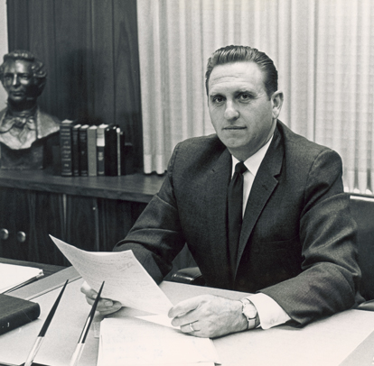
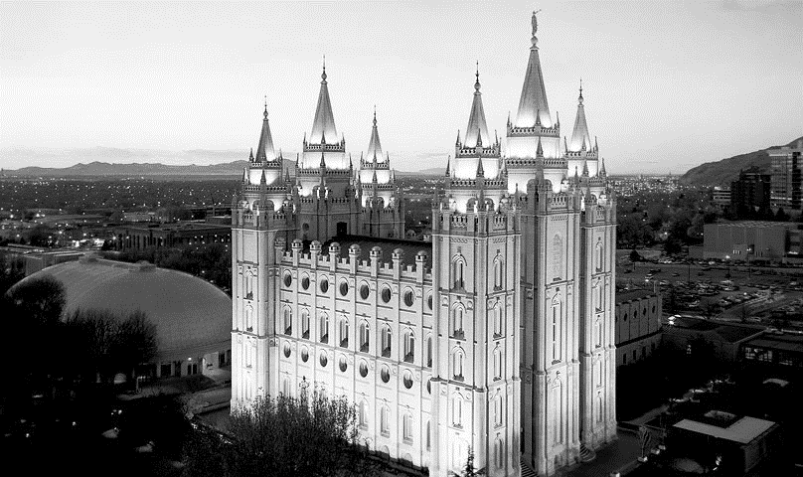
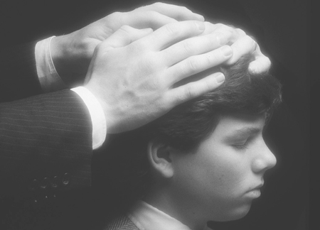
Unauthorized Practice
“I’m reminded of an experience I had many years ago when I served as a bishop. During the opening exercises of our priesthood meeting one Sunday morning, we were preparing to ordain a young man to the office of priest.
Visiting our ward that day was a high councilor who also served as a temple worker.
As I prepared to have the young man sit down to face the congregation so that we could proceed with the ordination, the high councilor stopped me and said, ‘Bishop, I always have those being ordained turned to face the temple.’
He repositioned the chair so that the young man would be facing in the direction of the temple. I immediately recognized an unauthorized practice.”
As bishop, President Monson, rather than the high councilor, was authorized to preside over the Lord’s work in his ward.
(3)

Slide 6
Apostolic Calling
“an apostle of Jesus Christ by the commandment of God”
The bishop is the presiding high priest and presides over all the members in his ward. In addition, he is the president of the priests quorum and, together with his counselors, is responsible to watch over and nurture the young men and young women in the ward.
A bishop/branch presidents are called by inspiration of the Lord and ordained by a stake president/stake mission president under the direction of the First Presidency of the Church and the Quorum of the Twelve.
Bishops and branch presidents are called to care for the spiritual well-being of the members of their Church units.
1 Timothy 1:3
(4)

Slide 7
Responsibilities
Paul instructed Timothy to stay in Ephesus and protect the Church from false teachings
Fables = false teachings; heeding
“endless genealogies” = the false tradition that salvation came only to those of the chosen seed of Abraham, who were often known by their lengthy or endless genealogies;
“vain jangling” = pointless discussion
Priesthood leaders have the responsibility to ensure that true doctrine and correct practices are taught
1 Timothy 1:3-7
(4)

Slide 8
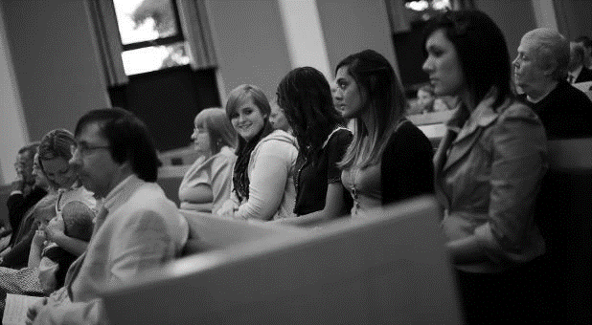
Authority
“I could see the potential for it to become more widespread in practice. Although much younger than the high councilor, I knew what needed to be done. I turned the chair back so that it was again facing the congregation and said to him, ‘In our ward, we face the congregation”.
“I have spoken before about the importance of keeping the doctrine of the Church pure, and seeing that it is taught in all of our meetings. … Small aberrations in doctrinal teaching can lead to large and evil falsehoods.”
(5)
(3)

Slide 9
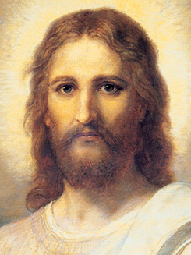
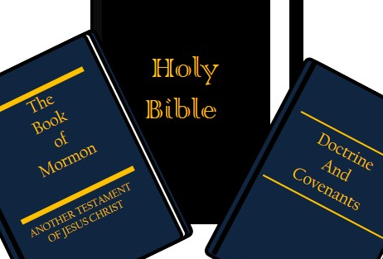
True or False Doctrine?
How Do You Know?
The Light of Christ. “The Light of Christ … prompts all rational individuals throughout the earth to distinguish truth from error, right from wrong. It activates your conscience.”
The Holy Ghost. “The Spirit of truth … will guide you into all truth”
(John 16:13).
Scriptures. “God uses scripture to unmask erroneous thinking, false traditions, and sin with its devastating effects.” The Book of Mormon is especially important in this regard, for it “exposes the enemies of Christ. It confounds false doctrines and lays down contention. (2 Ne. 3:12.)”
Modern prophets. “[A prophet’s] responsibility is to make known God’s will and true character to mankind. … A prophet denounces sin and foretells its consequences.”
Education. “A saint … seeks learning by study, and also by faith. Education … enables one to discern truth from error, particularly through studying the scriptures. ( D&C 88:118.)”
1 Timothy 1:3-7
(5)

Slide 10
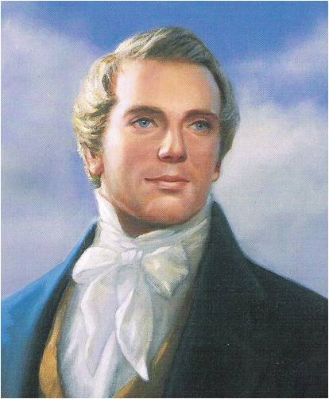
The Law
“The Church is not a debating society; it is not searching for a system of salvation; it is not a forum for social or political philosophies. It is, rather, the Lord’s kingdom with a commission to teach his truths for the salvation of men” (6)
Paul warned against those who desired to be teachers of God’s law but did not have a correct understanding of it.
?
Holy Bible
Without law all must certainly fall into chaos... [It is] for this reason, that law is beneficial to promote peace and happiness among men. And as before remarked, God is the source from whence proceeds all good; and if man is benefited by law, then certainly, law is good; and if law is good, then law, or the principle of it emanated from God; for God is
the source of all good; consequently, then,
he was the first Author of law, or the principle
of it, to mankind. (7)
The
Book
of
Mormon
Doctrine
And
Covenants
ANOTHER TESTAMENT
OF JESUS CHRIST
1 Timothy 1:3-7

Slide 11
Sinning In Ignorance
Paul taught that he had obtained mercy from Jesus Christ because he had acted in ignorance.
One of the gospel’s great eternal truths is that the Lord will not hold anyone accountable for sins committed in ignorance.
For behold, and also his blood atoneth for the sins of those who have fallen by the transgression of Adam, who have died not knowing the will of God concerning them, or who have ignorantly sinned. Mosiah 3:11
Mercy and grace are gifts the Lord gives to those who, in their weakness, are striving to be holy.
And if men come unto me I will show unto them their weakness. I give unto men weakness that they may be humble; and my grace is sufficient for all men that humble themselves before me; for if they humble themselves before me, and have faith in me, then will I make weak things become strong unto them. Ether 12:27
1 Timothy 1:13-16
(1)

Slide 12
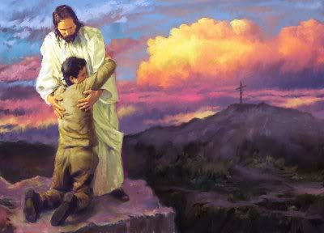
Our Mediator
A mediator is one who intervenes between two parties, usually to restore peace and friendship.
The Joseph Smith Translation provides the insight that Jesus Christ was “ordained to be a Mediator between God and man”
Because He took our sins upon Himself, Jesus Christ can redeem us and reconcile our relationship with the Father, allowing us to return to His presence.
Restored scripture attests that Jesus is the Mediator of the new covenant. He justifies men and women and then perfects them.
These are they who are just men made perfect through Jesus the mediator of the new covenant, who wrought out this perfect atonement through the shedding of his own blood.
D&C 76:69
1 Timothy 2:5-6; JST 1 Timothy 2:4
(1)

Slide 13
Warnings to Women and Men

Slide 14
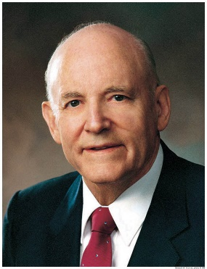
Women
“The girl who chooses to be modest chooses to be respected. A boy who is honest with himself will admit that he likes a girl who is modest in speech, conduct, and dress.
Modesty is one of the great virtues he looks for in the girl he hopes to marry. Most of us know what is modest, and most of us know when modesty ends and immodesty commences.
We know that nothing detracts from the loveliness of a young lady more than immodesty in speech or immodesty in conduct.
A girl fools only herself if she thinks she is impressing a boy by immodest conduct.
The young lady who dresses in an immodest manner ceases to be attractive and embarrasses the young man.
She has called his attention to the person rather than the personality. The girl who chooses to be modest, chooses to be respected.” (8)
Adorn themselves with modest apparel
1 Timothy 2:9-10

Slide 15
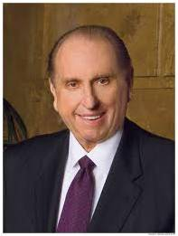
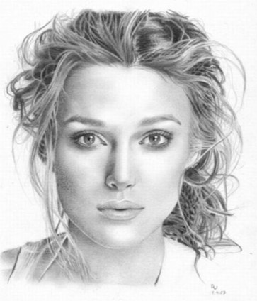
Three goals for Women
Study diligently
Pray earnestly
Serve willingly
“God planted within women something divine that expresses itself in quiet strength, in refinement, in peace, in goodness, in virtue, in truth, in love.”
—President Gordon B. Hinckley (3)
(3)

Slide 16
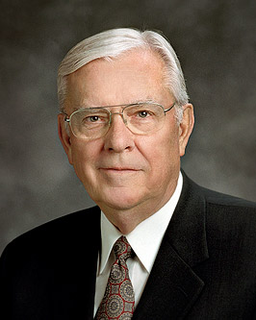
Women in the Church
Some people have taken these verses to mean that women were not allowed to speak in church in Paul’s day. However, his recommendation that women “learn in silence” may have been an effort to correct a specific problem where some women were usurping the authority of Church leaders. (1)
“Let your women keep silence in the churches: for it is not permitted unto them to speak; but they are commanded to be under obedience, as also saith the law.” 1 Corinthians 14:34
JST: rule
“Every sister in this Church who has made covenants with the Lord has a divine mandate to help save souls, to lead the women of the world, to strengthen the homes of Zion, and to build the kingdom of God.” (9)
1 Timothy 2:11-12

Slide 17
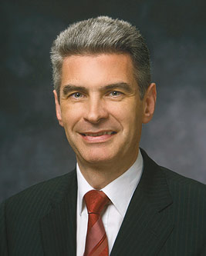
A Bishop
The title “bishop” is derived from the Greek word episcopos—epi, which means “over” (as in the epicenter of an earthquake, or the spot over which the quake centers), and scopos, meaning “look” or “watch.” Therefore, an episcopos, or bishop, is one who watches over the flock as an overseer or supervisor
“You must be men of integrity. You must stand as examples to the congregations over which you preside. You must stand on higher ground so that you can lift others. You must be absolutely honest, for you handle the funds of the Lord. …(5)
1 Timothy 3:1-3
Bishop Gérald Caussé

Slide 18
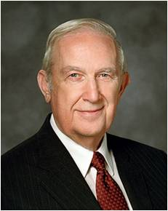
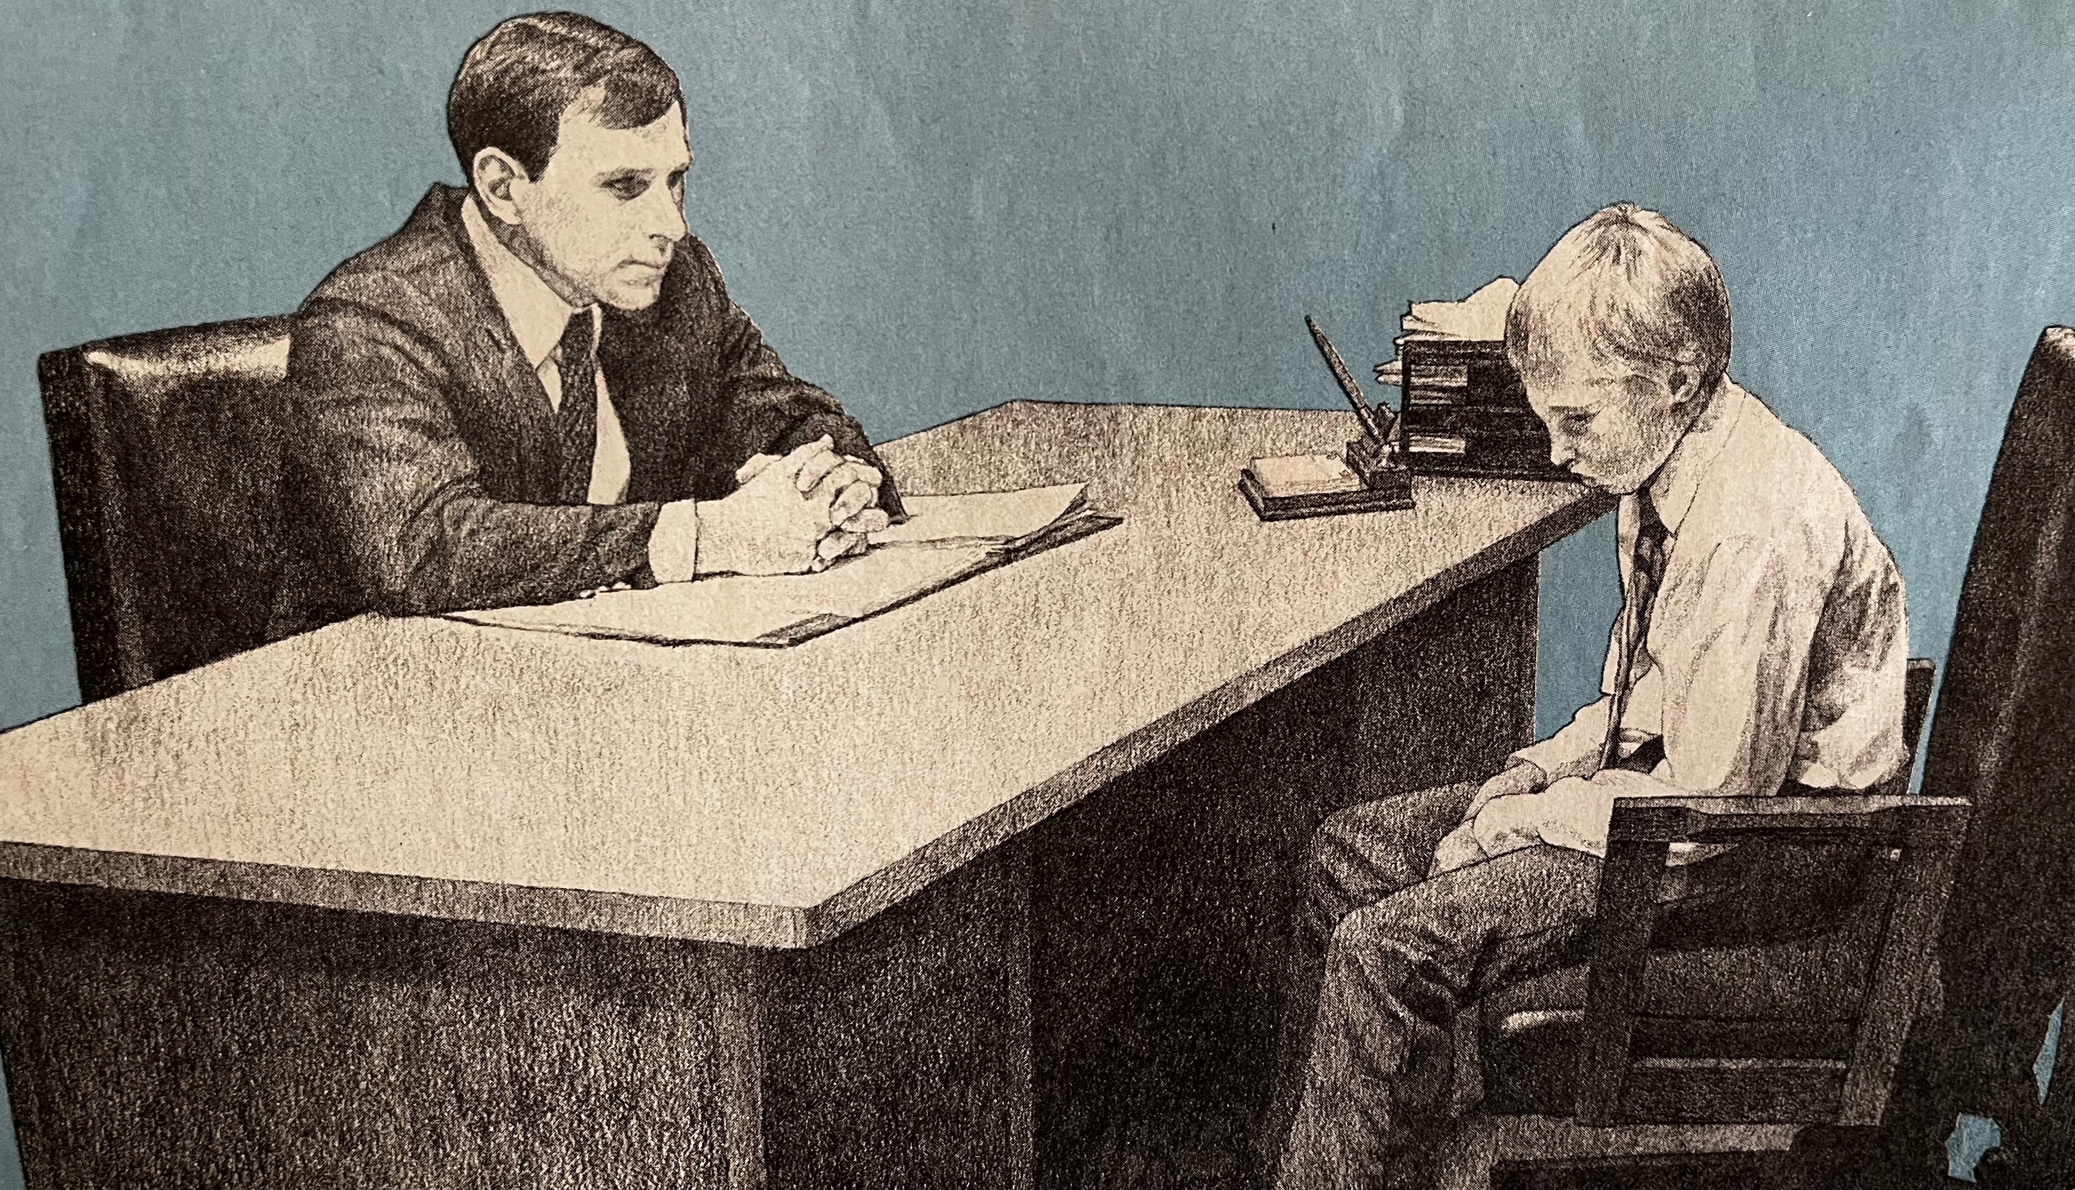
Going to the Bishop with a serious sin…
Serious transgression such as immorality requires the help of one who holds keys of authority, such as a bishop or stake president, to quietly work out the repentance process to make sure that it is complete and appropriately done.
(13)

Slide 19
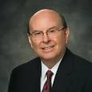
The Good Work of a Bishop
The bishop has five principal responsibilities in presiding over a ward:
He is the presiding high priest in the ward.
He is president of the Aaronic Priesthood.
He is a common judge.
He coordinates the work of salvation and exaltation, including caring for those in need.
And he oversees records, finances, and the use of the meetinghouse.
In his role as presiding high priest, the bishop is the ward’s “spiritual leader.” He is a “faithful disciple of Jesus Christ.” …
The bishop has a paramount role in serving as a shepherd to guide the rising generation, including young single adults, to Jesus Christ.
(14)

Slide 20
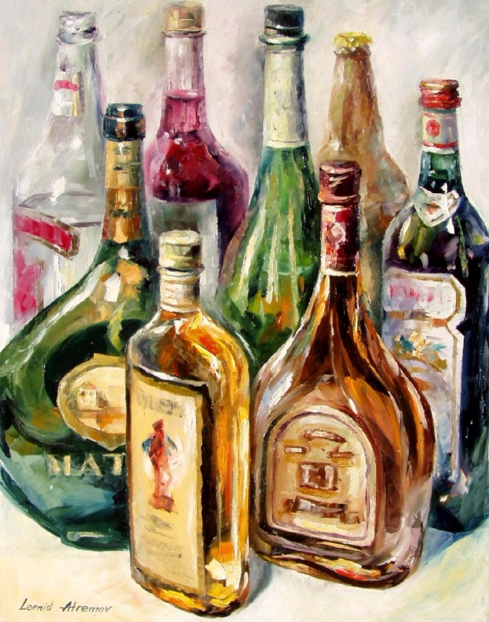
“Filthy Lucre”
Filthy lucre is blood money; that which is obtained through theft and robbery. It is that obtained through gambling or the operation of gambling establishments.
Filthy Lucre is that had through sin or sinful operations and that which comes from the handling of liquor, beer, narcotics
Filthy Lucre is also money that comes from bribery, and from exploitation.
1 Timothy 3:3

Slide 21
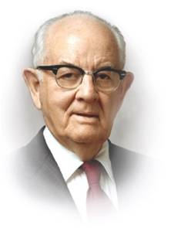
“Compromise money is filthy, graft money is unclean, profits and commissions derived from the sale of worthless stocks are contaminated as is money derived from other deceptions, excessive charges, oppression to the poor and compensation which is not fully earned.
I feel strongly that men who accept wages or salary and do not give commensurate time, energy, devotion, and service are receiving money that is not clean. Certainly those who deal in the forbidden are recipients of filthy lucre.” (10)

Slide 22
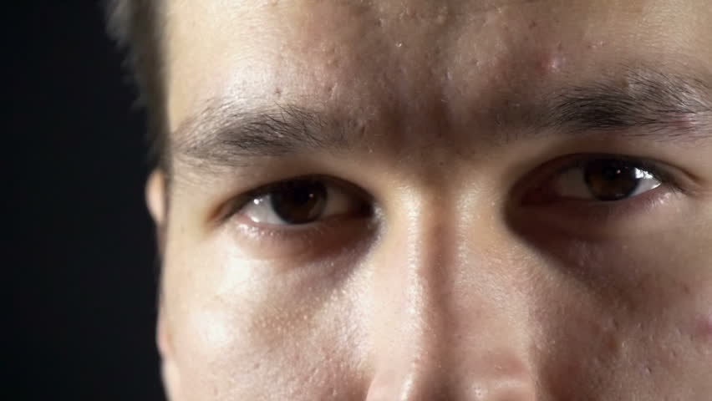
Men
“One that ruleth well his own house, having his children in subjection with all gravity;”
“(For if a man know not how to rule his own house, how shall he take care of the church of God?”
With a knowledge of the plan of salvation as a foundation, a man who holds the priesthood looks upon marriage as a sacred privilege and obligation…
A man who holds the priesthood has reverence for motherhood…
Honor your wife’s unique and divinely appointed role as a mother in Israel and her special capacity to bear and nurture children.
You share, as a loving partner, the care of the children. Help her to manage and keep up your home. Help teach, train, and discipline your children.
A man who holds the priesthood regards the family as ordained of God. Your leadership of the family is your most important and sacred responsibility. The family is the most important unit in time and in eternity and, as such, transcends every other interest in life. (11)
1 Timothy 3:3

Slide 23
Qualities of Today's Woman
Choosing righteousness
Taking responsibility for your choices
Having Gratitude in your hearts
Having a desire for Education
Building a strong relationship with your family
Choosing friends with high standards
Serving others
Physically fit
Willing to pay tithes and offerings
Dressing modestly, and unblemished by body piercings and tattoos
Choosing uplifting entertainment
Not using crude, profane or vulgar language or gestures.
Keeping sexually pure
Repentant
Honest
Sabbath observer
Upholding Priesthood Authority
Having a Faith in Jesus Christ

Slide 24
Qualities of Today's Man
Choosing righteousness
Taking responsibility for your choices
Having Gratitude in your hearts
Having a desire for Education
Building a strong relationship with your family
Choosing friends with high standards
Serving others
Physically fit
Willing to pay tithes and offerings
Dressing modestly, and unblemished by body piercings and tattoos
Choosing uplifting entertainment
Not using crude, profane or vulgar language or gestures.
Keeping sexually pure
Repentant
Honest
Sabbath observer
Upholding priesthood covenants
Having a Faith in Jesus Christ

Slide 25
If the paper clip represents a person, what might the magnet represent?
Influences
1 Timothy 4

Slide 26
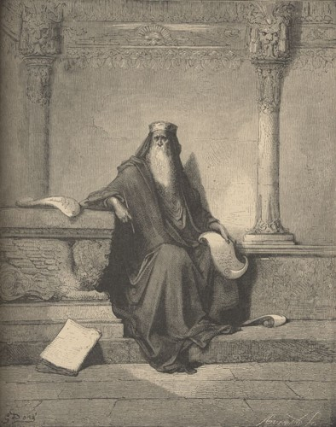
Forbidding to Marry
In Paul’s day, extreme asceticism—the practice of abstaining from physical pleasures in an effort to overcome desires of the flesh—was a threat to the Church.
Paul taught that bishops and deacons should be married and serve as good fathers, that capable adults should provide for the temporal needs of their family, that married women should love their husbands and children and care for their household, and that the last days would be characterized by disobedience to parents. (1)
1 Timothy 4:1-11; 5:8, 14 Titus 1:6-7; 2:4-5

Slide 27
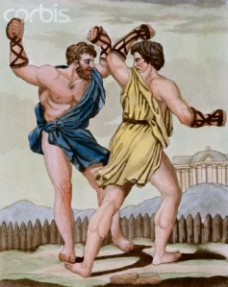
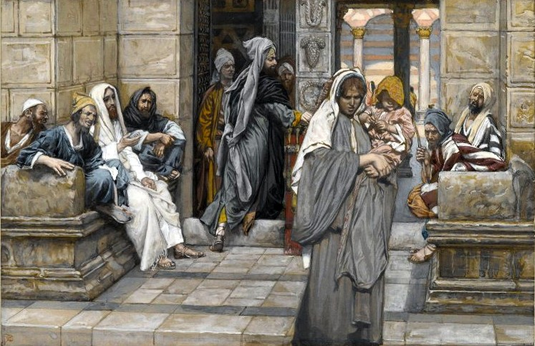
To Be An Example
Staying in Physical Shape
Paul rejected the overvaluation of physical fitness and taught that reading, exhortation, doctrine, and cultivating gifts of the Spirit should take higher priority…Remember this was Roman influences.
Caring for others
Paul taught true principles about welfare assistance.
If family members would assist widows, the Church could avoid becoming “burdened down”
1 Timothy 4:13-16; 5:4,10

Slide 28
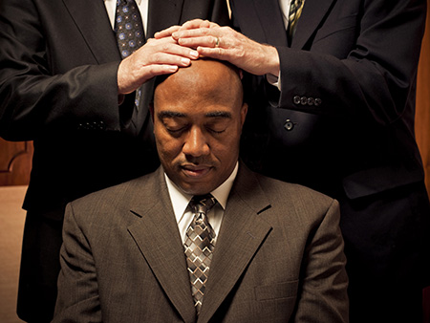
“Lay Hands Suddenly On No Man”
Men were not to be ordained without proper preparation. That preparation included ensuring that the one to be ordained was spiritually mature and worthy and seeking the Lord’s guidance.
1 Timothy 3:1-7; 5:22

Slide 29
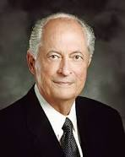
The Wealthy
Paul warned Timothy of the destructive influence that riches can have on those whose hearts are set on the things of the world. Paul’s warnings can be summarized by his statement that “the love of money is the root of all evil.”
Paul also spoke about people who had “coveted after” money and as a result had “erred from the faith, and pierced themselves through with many sorrows” (1)
The love of money leads to unrighteousness and apostasy
“Our world is fraught with feelings of entitlement. Some of us feel embarrassed, ashamed, less worthwhile if our family does not have everything the neighbors have. As a result, we go into debt to buy things we can’t afford—and things we do not really need….”
1 Timothy 6:10

Slide 30
“There is nothing inherently evil about money. The Good Samaritan used the same coinage to serve his fellowman that Judas used to betray the Master. It is ‘the love of money [which] is the root of all evil.’
The critical difference is the degree of spirituality we exercise in viewing, evaluating, and managing the things of this world.”
1 Timothy 6:10

Slide 31
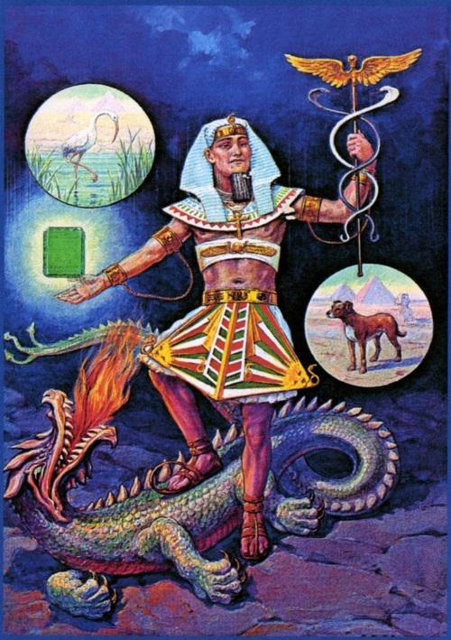
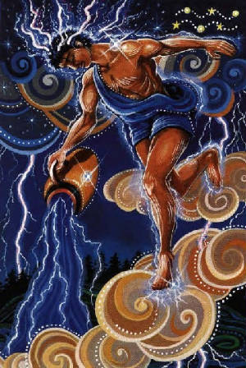
Avoid Vain Babblings
Paul told Timothy to avoid “profane and vain babblings, and oppositions of science”.
“Science” is a translation of the Greek term gnōseōs, = “knowledge,” and the term was probably referring specifically to the Gnostic movement that was then finding its way into early Christianity.
Gnostics believed that salvation was obtained by being instructed in secret knowledge (called gnosis). Gnosticism was a major source of controversy in second-century Christianity.
1 Timothy 6:20

Slide 32
Sources:
New Testament Institute Student Manual Chapter 47
Who’s Who in the New Testament by Richard J. Allen p 190
President Thomas S. Monson (“Opening Remarks” [worldwide leadership training meeting, Nov. 2010], lds.org/broadcasts). Nov. 2007 Ensign “Three Goals to Guide You”
Duties and Blessings of the Priesthood: Basic Manual for Priesthood Holders Lesson 8
Teachings of Gordon B. Hinckley [1997], 620. Bishops (“The Shepherds of Israel,” Ensign or Liahona, Nov. 2003, 60–61).
Elder Bruce R. McConkie (Doctrinal New Testament Commentary, 3 vols. [1965–73], 3:71).
Teachings of the Prophet Joseph Smith, selected and arranged by Joseph Fielding Smith [Salt Lake City: Deseret Book Co., 1976], 55.)
The Teachings of Howard W. Hunter, edited by Clyde J. Williams [Salt Lake City: Bookcraft, 1997], 123.) Husbands- Being a Righteous Husband and Father Oct. 1994 Gen. Conf.
Elder M. Russell Ballard ‘Great Indignation Meeting,’ Deseret Evening News, 15 Jan. 1870, 2)” (“Women of Righteousness,” Ensign, Apr. 2002, 70).
Spencer W. Kimball Conference Report Oct 1953
Elder Robert D. Hales (“Becoming Provident Providers Temporally and Spiritually,” Ensign or Liahona, May 2009, 8–10).
Elder Dallin H. Oaks (“Spirituality,” Ensign, Nov. 1985, 63).
Richard G. Scott, “The Power of Righteousness,” Ensign, Nov. 1998, 69–70
Quentin L. Cook, “Bishops—Shepherds over the Lord’s Flock,” Liahona, May 2021, 58
Jeffrey R. Holland, “Lord, I Believe,” Ensign or Liahona, May 2013, 94
Presentation by ©http://fashionsbylynda.com/blog/

Slide 33
Paul’s First Letter to Timothy Written from Macedonia to Ephesus sometime between A.D. 64 and 65 (1 Timothy)
Teach Only True Doctrine | 1:1–11
Christ Came to Save Repentant Sinners | 1:12–17
Timothy’s Responsibility | 1:18–20
Prayers of Thanks Are Pleasing to Our Mediator | 2:1–8
The Conduct of Women in Worship Services | 2:9–15
Requirements for a Bishop | 3:1–7
Description of a Worthy Deacon | 3:8–13
The Mystery of Godliness | 3:14–16
Signs of Latter-day Apostasy | 4:1–11
“Be Thou an Example of the Believers” | 4:12–16
Saints Commanded to Care for Their Worthy Poor | 5:1–16
The Responsibility of Elders | 5:17–25
Slaves Are to Respect Their Masters | 6:1, 2
Sound Teaching About Wealth | 6:3–10
Timothy—Fight the Good Fight | 6:11–21
Concerned for Reliable Bishops 1 Timothy 1:3:
"Paul's concern for reliable bishops suggests his purpose in writing. The earliest post-apostolic letters picture the bishop as the critical leader in the fight against apostasy. Paul said that he had excommunicated two who apparently spoke against the constituted authorities, 'whom I have delivered unto Satan, that they may learn not to blaspheme' (1 Tim. 1:20). Paul told Timothy to remain at Ephesus; the apostle was on his way to Macedonia, perhaps to visit the Philippian branch again (1 Tim. 1:3). He had assigned Timothy 'so you may command certain people not to teach different doctrines' (1 Tim. 1:3, literal trans.). Thus, true priesthood is linked with true doctrine. In these critical needs Paul not only instructed but planned to return 'shortly' to throw his strength into the battle (1 Tim. 3:14). There is an urgency in 1 Timothy from the opening warning about rebuking false teachers to the closing language of command. 'O Timothy, guard what has been entrusted to you' (1 Tim. 6:20, RSV) is spoken in sober warning against those reforming the revealed gospel." (Richard Lloyd Anderson, Understanding Paul [Salt Lake City: Deseret Book Co., 1983], 317.)
Fables and Endless Genealogies 1 Timothy 1:4; 4:7:
“‘The Jews had scrupulously preserved their genealogical tables, till the advent of Christ … but we are told that Herod destroyed the public registers: he, being an Idumean, was jealous of the noble origin of the Jews: and that none might be able to reproach him with his descent, he ordered the genealogical tables, which were kept among the archives in the temple, to be burned. …
From this time the Jews could refer to their genealogies only from memory, or from those imperfect tables which had been preserved in private hands; and to make out any regular line from these, must have been endless and uncertain. It is probably to this the apostle refers; I mean the endless and useless labor which the attempt to make out these genealogies, must produce; the authentic tables being destroyed.’
“So we may well conclude that Paul’s denunciation was towards doubtful and untruthful genealogies which had been tampered with for improper purposes.” (Smith, Answers to Gospel Questions, 1:214–15.)
Paul may also have had reference to the Jewish tendency to take great pride in their ancestry and in their belief that genealogical descent was a proof of God’s favor (John 8:37–45). This, Paul says, is a fable. God’s favor is given on the basis of righteousness, not ancestry. Life and Teachings of Jesus and His Apostles Chapter 44
"Paul was living in a time of conflict and confusion. False teachers abounded, preaching false doctrines and fables. Two specific problems existed relating to genealogies:
"(1) Some apostate teachers recited their genealogies to give credence to their claims as coming with authority. Many Jews had become arrogant because of their illustrious ancestors. Some even flaunted their lineage when opposing the Savior himself: "We be Abraham's seed" (John 8:33), they said, as if to indicate that they were thereby natural inheritors of the truth.
"(2) Some of the apostate Jewish teachers were guilty of manufacturing their own genealogies-creating them in hopes of giving the added weight of authority to their teachings. George H. Fudge, "I Have a Question," Ensign, Mar. 1986, 49
Life and Teachings of Jesus and His Apostles Chapter 44

Slide 34
Those Who Teach 1 Timothy 1:3-7, 18-20:
Those who teach must make sure the doctrine remains pure and that it is taught. Teach by the Spirit, using the scriptures and the approved curriculum. Do not introduce or dwell on speculative and questionable topics…In a word that is filled with sin, conflict, and confusion, we can find peace and safety in knowing and living the revealed truths of the gospel. Elder M. Russell Ballard Conf. Report Oct 1993, 104; or Ensign, Nov. 1993, 77
‘May women speak in church? Yes, in the sense of teaching, counseling, testifying, exhorting, and the like; no, in the sense of assuming rule over the Church as such, and in attempting to give direction as to how God’s affairs on earth shall be regulated: ‘A woman has no right to found or organize a church—God never sent them to do it.’
Paul is here telling the sisters they are subject to the priesthood, that it is not their province to rule and reign, that the bishop’s wife is not the bishop.”—Bruce R. McConkie “Doctrines of the New Testament Commentaries” pg 2:387-88
Women 1 Timothy 2:14:
“It was Eve who first transgressed the limits of Eden in order to initiate the conditions of mortality. Her act, whatever its nature, was formally a transgression but eternally a glorious necessity to open the doorway toward eternal life. Adam showed his wisdom by doing the same. And thus Eve and ‘Adam fell that men might be’ [2 Nephi 2:25].
“Some Christians condemn Eve for her act, concluding that she and her daughters are somehow flawed by it. Not the Latter-day Saints! Informed by revelation, we celebrate Eve’s act and honor her wisdom and courage in the great episode called the Fall. … Joseph Smith taught that it was not a ‘sin,’ because God had decreed it (see The Words of Joseph Smith, ed. Andrew F. Ehat and Lyndon W. Cook, [1980], p. 63). …
“Modern revelation shows that our first parents understood the necessity of the Fall. Adam declared, ‘Blessed be the name of God, for because of my transgression my eyes are opened, and in this life I shall have joy, and again in the flesh I shall see God’ (Moses 5:10).
“Note the different perspective and the special wisdom of Eve, who focused on the purpose and effect of the great plan of happiness: ‘Were it not for our transgression we never should have had seed, and never should have known good and evil, and the joy of our redemption, and the eternal life which God giveth unto all the obedient’ (v. 11). In his vision of the redemption of the dead, President Joseph F. Smith saw ‘the great and mighty ones’ assembled to meet the Son of God, and among them was ‘our glorious Mother Eve’ (D&C 138:38–9)” Elder Dallin H. Oaks (“The Great Plan of Happiness,” Ensign, Nov. 1993, 73).
Bishop Gérald Caussé, of France, was named the presiding bishop of The Church of Jesus Christ of Latter-day Saints on October 9, 2015. He filled the vacancy created by Gary E. Stevenson, who became a member of the Quorum of the Twelve Apostles on October 3, 2015.
Prior to this assignment, Bishop Caussé served as the first counselor in the Presiding Bishopric since March 2012. He previously served as as a General Authority Seventy and as a counselor in the Europe Area Presidency. He is the third presiding bishop born outside the United States and the first for whom English is a second language.
Bishop Caussé received a master’s degree in business from ESSEC in 1987. His career has been in the food industry, where he worked with several supermarket chains and food distribution companies. At the time of his call as a General Authority Seventy, he was the general manager of Pomona, a food distribution company in France.
Bishop Caussé has served in numerous Church callings, including elders quorum president, bishop’s counselor, stake president’s counselor, stake president, and Area Seventy.
Gérald Caussé was born in Bordeaux, France, on May 20, 1963. He married Valérie Lucienne Babin in August 1986. They are the parents of five children. Lds.org General Authorities and General Officers
Forbidding to Marry 1 Timothy 4:1-5:
“False prophets and false teachers … attempt to change the God-given and scripturally based doctrines that protect the sanctity of marriage, the divine nature of the family, and the essential doctrine of personal morality. They advocate a redefinition of morality to justify fornication, adultery, and homosexual relationships. Some openly champion the legalization of so-called same-gender marriages. To justify their rejection of God’s immutable laws that protect the family, these false prophets and false teachers even attack the inspired proclamation on the family issued to the world in 1995 by the First Presidency and the Twelve Apostles” (“Beware of False Prophets and False Teachers,” Elder M. Russell Ballard Ensign, Nov. 1999, 64; see also D&C 49:15).

Slide 35
Riches and Wealth 1 Timothy 6:10:
“Our world is fraught with feelings of entitlement. Some of us feel embarrassed, ashamed, less worthwhile if our family does not have everything the neighbors have. As a result, we go into debt to buy things we can’t afford—and things we do not really need. Whenever we do this, we become poor temporally and spiritually. We give away some of our precious, priceless agency and put ourselves in self-imposed servitude. Money we could have used to care for ourselves and others must now be used to pay our debts. What remains is often only enough to meet our most basic physical needs. Living at the subsistence level, we become depressed, our self-worth is affected, and our relationships with family, friends, neighbors, and the Lord are weakened. We do not have the time, energy, or interest to seek spiritual things. …
“… When faced with the choice to buy, consume, or engage in worldly things and activities, we all need to learn to say to one another, ‘We can’t afford it, even though we want it!’ or ‘We can afford it, but we don’t need it—and we really don’t even want it!’ …
“Whenever we want to experience or possess something that will impact us and our resources, we may want to ask ourselves, ‘Is the benefit temporary, or will it have eternal value and significance?’ Truthfully answering these questions may help us avoid excessive debt and other addictive behavior” Elder Robert D. Hales (“Becoming Provident Providers Temporally and Spiritually,” Ensign or Liahona, May 2009, 8–10).

Slide 36
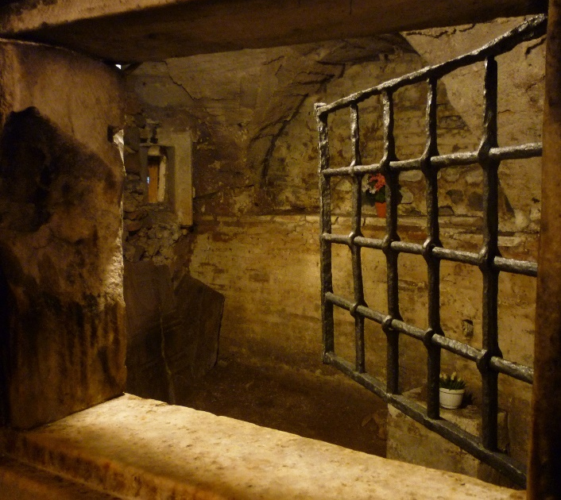
Paul’s Last Words
2 Timothy
“I have fought a good fight, I have finished my course, I have kept the faith”
2 Timothy 4:7

Slide 37
2 Timothy
Paul wrote the epistle during his second imprisonment in Rome shortly before his martyrdom
At the end of his letter, Paul requested that Timothy and Mark visit him and bring him a few items that he had left behind. Although Paul’s letter was addressed specifically to Timothy, its counsel can be applied to those who live in “the last days” because Paul taught of challenges and solutions that are relevant to our day as well as his.
During his imprisonment Paul was in chains . He was likely in a cell or dungeon and exposed to the elements, and his friends struggled to locate him.
Luke was apparently his only regular visitor, and Paul expected that his life was coming to an end.
2 Timothy 1:16-17; 2:9; 4:13,21; 4:6-8

Slide 38
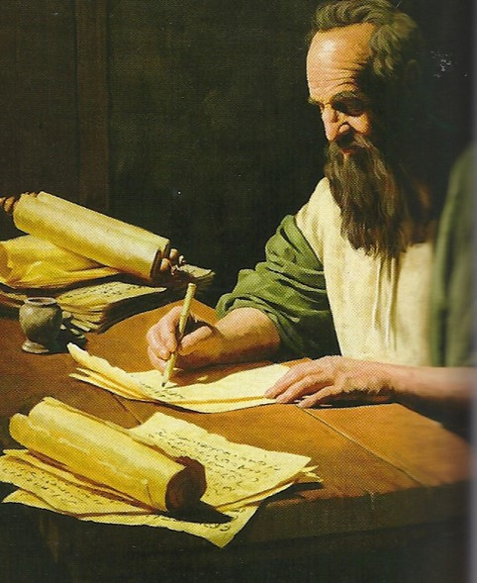
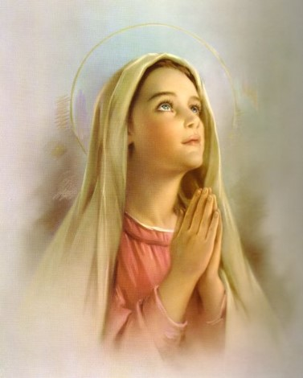
Promised Joy
Paul counsels on how to successfully complete your life’s journey and secure the deep joy promised by the Savior.
“Hitherto have ye asked nothing in my name: ask, and ye shall receive, that your joy may be full.”
—John 16:24
2 Timothy 1:4

Slide 39
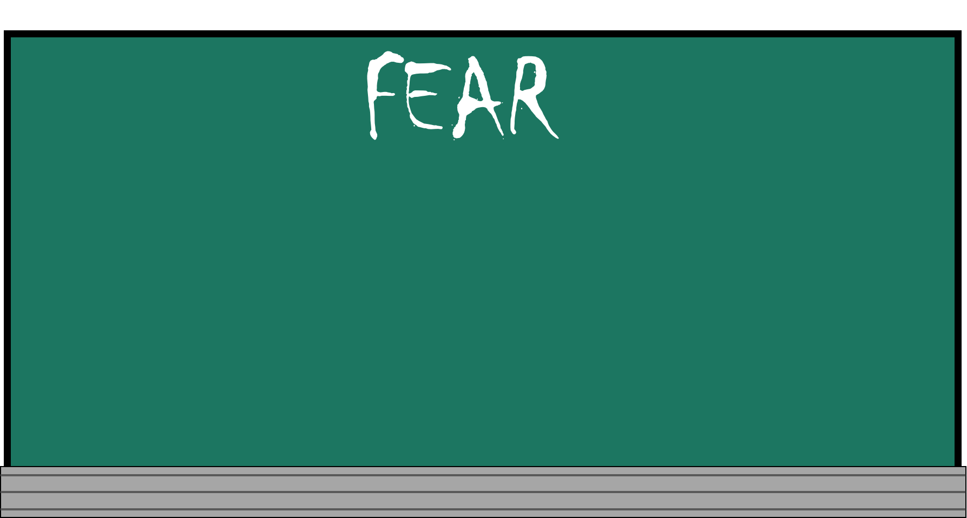
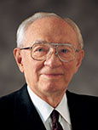
“Who among us can say that he or she has not felt fear?
I know of no one who has been entirely spared. Some, of course, experience fear to a greater degree than do others. Some are able to rise above it quickly, but others are trapped and pulled down by it and even driven to defeat.
We suffer from the fear of ridicule, the fear of failure, the fear of loneliness, the fear of ignorance. Some fear the present, some the future. Some carry the burden of sin and would give almost anything to unshackle themselves from those burdens but fear to change their lives” (2)
How could fear affect our ability to live the gospel?

Slide 40
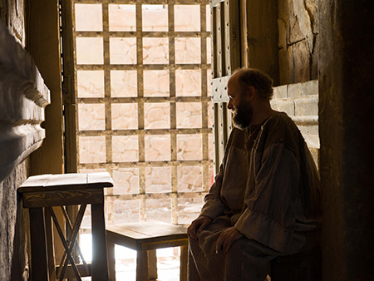
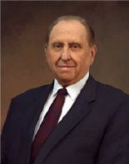
Stir Up-Rekindle
Paul admonished Timothy to rekindle the gift of the Holy Ghost, or to earnestly seek to have the Holy Ghost to be with him.
“The history of the Church in this, the dispensation of the fulness of times, is replete with the experiences of those who have struggled and yet who have remained steadfast and of good cheer as they have made the gospel of Jesus Christ the center of their lives. This attitude is what will pull us through whatever comes our way.
It will not remove our troubles from us but
rather will enable us to face our challenges,
to meet them head on, and to emerge victorious.”
(3)
2 Timothy 1:6-7

Slide 41
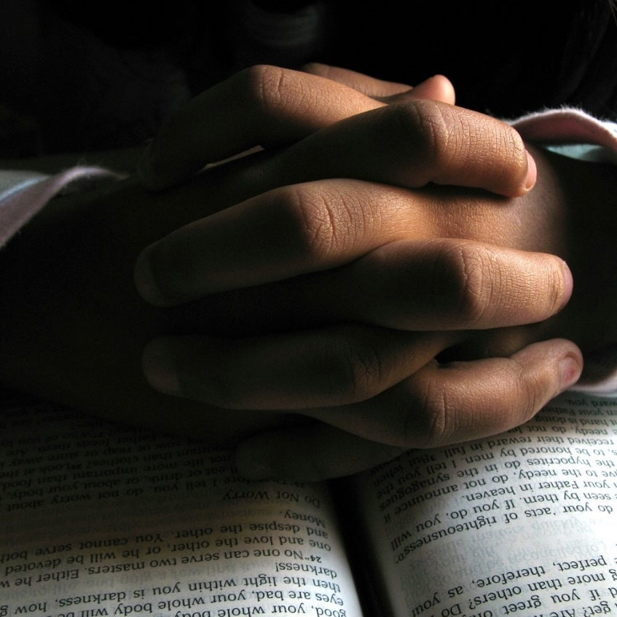
Worldly Fear VS Godly Fear
Wordily fear creates anxiety, uncertainty, and alarm and differs from what the scriptures refer to as “the fear of the Lord”
To fear the Lord is “to feel reverence and awe for Him and to obey His commandments”
2 Timothy 1:7-9

Slide 42
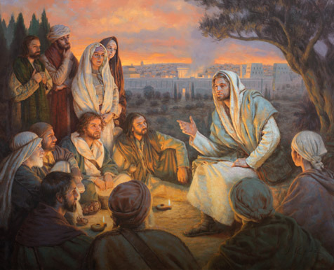
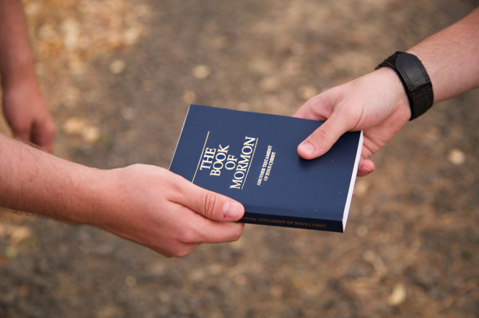
Be Not Ashamed and Hold Fast
Paul anticipated that he would soon be put to death by the Romans, yet he knew that Jesus Christ had “abolished death.” (1)
“If we were called upon to stand before God and give an accounting of ourselves, could we do it without embarrassment? This is Paul's great plea to his young friend. It is his plea to each of you.” (2)
2 Timothy 1:8-10

Slide 43
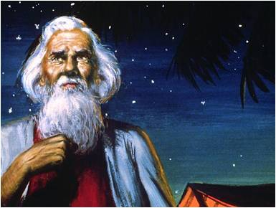
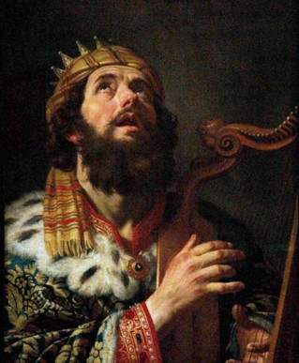
The Holy Calling
“Who hath saved us, and called us with an holy calling…
…before the world began”
To Abraham:
“…the intelligences that were organized before the world was; and among all these there were many of the noble and great ones;”
“…These I will make my rulers; for he stood in the midst of them, and he said: These I will make my rulers…”
Abraham was chosen before he was born.
Abraham 3:22-23
2 Timothy 1:9

Slide 44
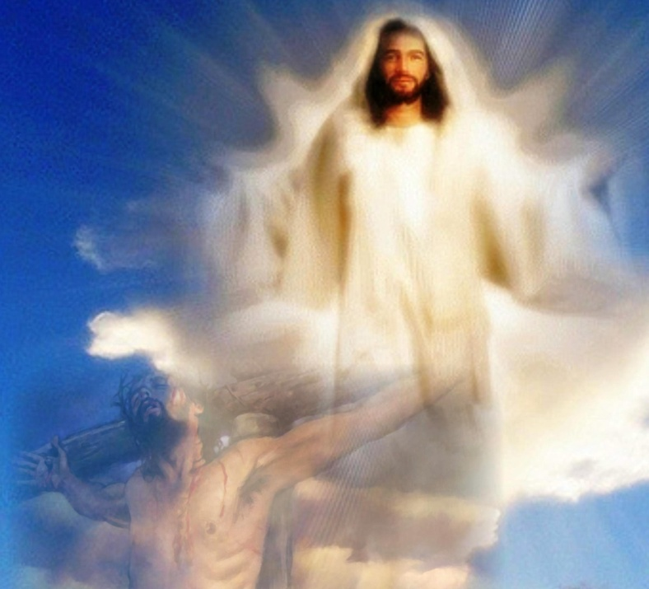
Bringing Life and Immortality to Light
“…our Saviour Jesus Christ, who hath abolished death…
…brought life and immortality to light through the gospel:”
2 Timothy 1:10

Slide 45
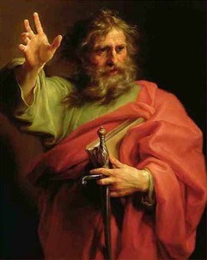
Paul Was Called an Apostle
“Whereunto I am appointed a preacher, and an apostle, and a teacher of the Gentiles.”
2 Timothy 1:11

Slide 46
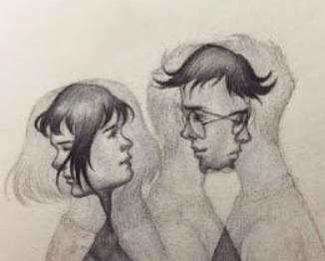
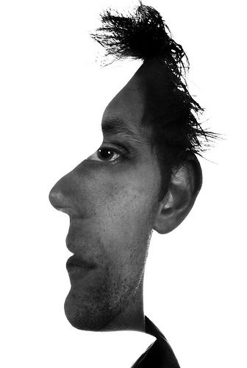
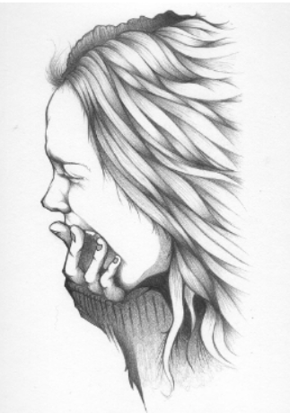
Perils
Without natural affection
Incontinent
Heady
“Highminded”
Behaviors associated with a lack of feeling or caring, feelings of hatred and contempt, or with lustful desires that lead to sexual immorality
Without self-control
puffed up, conceited
rash, reckless
2 Timothy 2:3-4

Slide 47
Having a form of godliness, but denying the power
Lovers of pleasure
Lovers of own self
Traitors, heady, high-minded
covetousness
Despisers of those that are good
Iniquities
boasters
fierce
prideful
incontinent
False accusers
blasphemers
Disobedient
to parents
trucebreakers
natural affection
unthankful
unholy
2 Timothy 3:1-5

Slide 48
Paul used the metaphors of a soldier, an athlete, and a husbandman (or farmer) to teach Timothy how to remain strong in the faith despite hardship.
A good soldier dutifully endures hardships and sets aside other affairs to please his or her superior
A farmer must work hard to enjoy the fruits of his or her labors
An athlete can be victorious only if he or she obeys the rules.
2 Timothy 2:3-6

Slide 49
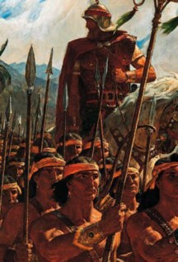
Nephi’s Testifies
“…Wherefore, if ye shall be obedient to the commandments, and endure to the end, ye shall be saved at the last day…”
“And, if you keep my commandments and endure to the end you shall have eternal life, which gift is the greatest of all the gifts of God.”
--D&C 14:7
1 Nephi 22:31

Slide 50
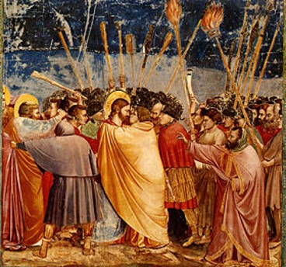
A General Apostasy
There is evidence that the Church in Paul’s day was falling away from the truth.
2 Timothy 3; Nephi 22:31

Slide 51
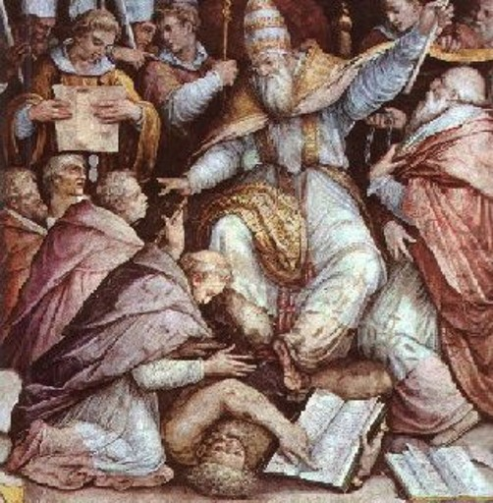
When would Apostasy take place?
Acts 20:31
“…Three years I ceased not to warn everyone night and day with tears.”

Slide 52
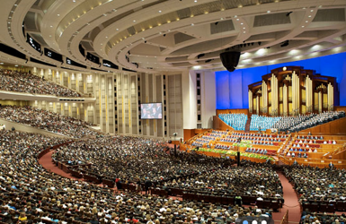
Church Continues
Although some may apostatize in our day, the church will not be withdrawn from the earth again.
“…and it shall stand for ever.”
Daniel 2:44-45
“Wherefore, may the kingdom of God go forth…”
D&C 65:2-6 Read all verses

Slide 53
“There are still those, not a few, who criticize and rebel, who apostatize and lift their voices against this work…
I suppose we always will have them as long as we are trying to do the work of the Lord. The honest in heart will detect that which is true and that which is false…
We are a body of Christian solders “marching as to war, with the cross of Jesus going on before.”
(2)

Slide 54
“…the word of God, as found in the scriptures, in the words of living prophets, and in personal revelation, has the power to fortify the Saints and arm them with the spirit so they can resist evil, hold fast to the good, and find joy in this life.”
(4)

Slide 55
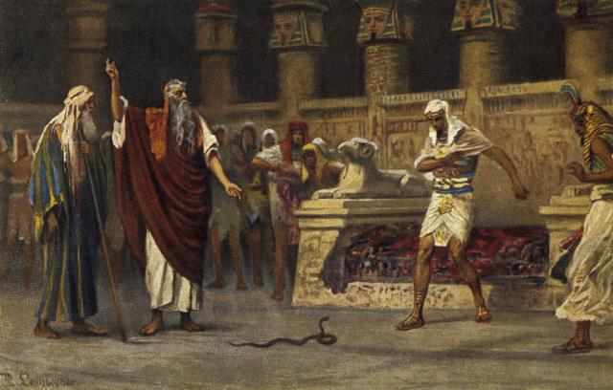
Jannes and Jambres
According to a Jewish tradition, Jannes and Jambres were the names of the two magicians in Pharaoh’s court who opposed Moses and Aaron
Then Pharaoh also called the wise men and the sorcerers: now the magicians of Egypt, they also did in like manner with their enchantments.
For they cast down every man his rod, and they became serpents: but Aaron’s rod swallowed up their rods.
Exodus 7:11-12
2 Timothy 3:8
(1)

Slide 56
Doctrinal Mastery
And that from a child thou hast known the holy scriptures, which are able to make thee wise unto salvation through faith which is in Christ Jesus.
All scripture is given by inspiration of God, and is profitable for doctrine, for reproof, for correction, for instruction in righteousness:
That the man of God may be perfect, throughly furnished unto all good works.
2 Timothy
3:15-17

Slide 57
Scriptures Provide
According to Paul, “the holy scriptures … are able to make thee wise unto salvation” and “all scripture is given by inspiration of God, and is profitable for doctrine, for reproof, for correction, for instruction in righteousness”
“In moments of fear or doubt or troubling times, hold the ground you have already won. … When those moments come and issues surface, the resolution of which is not immediately forthcoming, hold fast to what you already know and stand strong until additional knowledge comes.” (5)
2 Timothy 3:15-16

Slide 58
If we continue in the truths we have learned from trusted sources and in the scriptures, we can overcome the spiritual peril of the last days.
How can relying on the scriptures and on the truths we have learned help us overcome the perils of our day?

Slide 59
Holy Bible
As we study the scriptures, we can learn doctrine and receive correction and instruction that will help us grow toward perfection
The
Book
of
Mormon
Doctrine
And
Covenants
ANOTHER TESTAMENT
OF JESUS CHRIST
Doctrine, Correction, or Instruction
In what ways has the scriptures help you?
(1) to understand a doctrine of the gospel;
(2) by offering reproof or correction concerning something in their thinking, choices, or behavior that was not right; or
(3) by providing an answer to a prayer or giving instruction on how they might solve a problem.

Slide 60
“Don’t yield to Satan’s lie that you don’t have time to study the scriptures. Choose to take time to study them. Feasting on the word of God each day is more important than sleep, school, work, television shows, video games, or social media. You may need to reorganize your priorities to provide time for the study of the word of God. If so, do it!
“… As you dedicate time every day, personally and with your family, to the study of God’s word, peace will prevail in your life.” (6)
2 Timothy 3:16-17

Slide 61
False Teachers
Paul’s words foreshadow the coming of the Great Apostasy, when people would “not endure sound doctrine” but instead would seek after false teachers who would say what their listeners’ “itching ears” wanted to hear.
“itching ears”
Those who choose to listen only to those things that they wish to hear.
2 Timothy 4:1-5

Slide 62
I Have Fought a Good Fight
Paul was ready to be offered
“Enduring to the end means that we have planted our lives firmly on gospel soil, staying in the mainstream of the Church, humbly serving our fellow men, living Christlike lives, and keeping our covenants.
Those who endure are balanced, consistent, humble, constantly improving, and without guile. Their testimony is not based on worldly reasons—it is based on truth, knowledge, experience, and the Spirit.” (7)
2 Timothy 4:7-8

Slide 63
Crowned With Righteousness
A reference to the crowns of olive branches that were given to the victors in ancient Greek athletic contests.
Paul then pointed out that an eternal crown will be given to all Saints who righteously endure to the end and prepare for the Second Coming of the Lord.
Paul testified that throughout his persecution, “the Lord stood with [him], and strengthened” him as he preached the gospel. (1)
“Paul’s calling and election had been made sure. He was sealed up unto eternal life. He had kept the commandments, been tried at all hazards, and the Lord had given him the promise: ‘Son, Thou shalt be exalted.’ And since no man is or can be exalted alone, this is one of the crowning reasons why we know Paul was married.” (8)
2 Timothy 4:8; 17

Slide 64
Offer to the Faithful
For behold, I, God, have suffered these things for all
Enduring to the end is definitely not a do-it-yourself project. … It requires the Savior’s redemptive power.
(9)
Because of Jesus Christ, all who faithfully endure to the end will receive eternal life.
Enduring to the end is a process filling every minute of our life, every hour, every day, from sunrise to sunrise. It is accomplished through personal discipline following the commandments of God. (10)
2 Timothy 4:8; D&C 19:16

Slide 65
Sources:
New Testament Institute Student Manual Chapter 47
President Gordon B. Hinckley (“God Hath Not Given Us the Spirit of Fear,” Ensign, Oct. 1984, 2). ("Converts and Young Men," Ensign, May 1997, 49); Gordon B. Hinckley Apr. 1996 Conf. Report or Ensign May 1996
President Thomas S. Monson (“Be of Good Cheer,” Ensign or Liahona, May 2009, 89).
President Ezra Taft Benson “The Power of the Word” Ensign May 1986
Elder Jeffrey R. Holland (“Lord, I Believe,” Ensign or Liahona, May 2013, 93–94).
Elder Richard G. Scott (“Make the Exercise of Faith Your First Priority,” Ensign or Liahona, Nov. 2014, 93).
Elder Joseph B. Wirthlin (“Press On,” Ensign or Liahona, Nov. 2004, 101).
Elder Bruce R. McConkie DNTC, 3:116.
L. Tom Perry, “The Gospel of Jesus Christ,” Ensign or Liahona, May 2008, 46
Dieter F. Uchtdorf “Have We Not Reason to Rejoice” Nov. 2007 Ensign pg. 18-21
Presentation by ©http://fashionsbylynda.com/blog/

Slide 66
The Second Letter of Paul to Timothy in Ephesus Written from Roman Imprisonment, sometime between A.D. 64 and 65
Timothy’s Gifts of the Spirit | 1:1–18
How Timothy Should Face Hardships | 2:1–7
Christ Gives Eternal Glory to the Elect | 2:8–13
Shun Contention, Seek Godliness | 2:14–26
Dangers of the Last Days | 3:1–13
Scriptures Guide Man to Salvation | 3:14–17
Timothy Exhorted to “Preach the Word” | 4:1–5
Paul and All Saints Assured of Exaltation | 4:6–22
Christ had Abolished Death 2 Timothy 1:10:
We bear record that he is the only mediator between man and God; that through his atoning sacrifice fallen man may be reconciled with God; and that he "hath abolished death, and hath brought life and immortality to light through the gospel" (2 Tim. 1:10).
...There is no salvation in worshiping false gods; there is no salvation in false religion; there is no salvation in error in any form.
Man alone cannot save himself. No man can call forth his own crumbling dust from the grave and cause it to live again in immortal glory. No man can create a celestial heaven whose inhabitants shall dwell in eternal splendor forever.
All the idols and icons and images combined, since the world began until the end of time, will never have power to cleanse and perfect a single human soul.
...But those who turn to Christ, who believe his gospel, and join his church, and live his laws, and who thereby worship the Father in his holy name-such shall find peace and safety and salvation. In the world men shall have tribulation; in Christ they shall find peace (see John 16:33). Elder Bruce R. McConkie ("The Lord God of the Restoration," Ensign, Nov. 1980, 51)
Life and Teachings of Jesus and His Apostles Chapter 45
Be Not Ashamed 2 Timothy 1:8:
It is not God who has given us the spirit of fear; this comes from the adversary. So many of us are fearful of what our peers will say, that we will be looked upon with disdain and criticized if we stand for what is right. But I remind you that "wickedness never was happiness" (Alma 41:10). Evil never was happiness. Sin never was happiness. Happiness lies in the power and the love and the sweet simplicity of the gospel of Jesus Christ.
We need not be prudish. We need not slink off in a corner, as it were. We need not be ashamed. We have the greatest thing in the world, the gospel of the risen Lord. Paul gives us a mandate: "Be not thou therefore ashamed of the testimony of our Lord" (2 Tim. 1:8). President Gordon B. Hinckley ("Converts and Young Men," Ensign, May 1997, 49)
Grandmother 2 Timothy 1:5:
"The word 'grandmother' appears in the Bible but once-in connection with Lois, the grandmother of Timothy. Paul addressed this same Timothy as 'my dearly beloved son.' (2 Tim. 1:2.) The one verse in the Bible that mentions Lois and her daughter Eunice, Timothy's mother, is surpassingly beautiful, illuminating not only the faith of Timothy but eloquently painting a picture of family fidelity for three generations. Paul writes, 'When I call to remembrance the unfeigned faith that is in thee, which dwelt first in thy grandmother Lois, and thy mother Eunice; and I am persuaded that in thee also. ...' (2 Tim. 1:5.)
"The hope of every mother and grandmother is underscored in these few words. As a woman seeks to increase in faith and good works she does so not to her own glory, but to fashion a legacy for her children and her children's children to inherit. Lois and Eunice lived in a generation when the gospel was a fresh, bright gift, newly restored from God in the person of his son Jesus Christ. How they must have rejoiced as they received its truth into their lives. Their home was Lystra, a city in the Roman province of Galatia. Eunice was a Jewess married to a Greek, whose name is not given. We may infer that she was a widow much of her life. Ties of kinship strengthened the family in that day where a grandmother and mother joined forces and faith to train their choice son. Ann N. Madsen, "Cameos: The Women of the New Testament," Ensign, Sept. 1975, 43)

Slide 67
The House of Onesiphorus 2 Timothy 1:16:
"Another Ephesian friend of the Apostle was the noble-minded and warm-hearted Onesiphorus, who was probably one of his numerous converts. How touchingly St. Paul speaks of him to Timothy when comparing his devotedness with the defection of the cowardly Asiatics, among whom he singles out the two men Phygellus and Hermogenes! Onesiphorus had come to Rome for some purpose of which we have no knowledge, but being aware that Paul was somewhere in that city as a prisoner, he diligently searched for him, and did not cease to do so till he had found him in his prison cell (II Tim. 1:15-17). During the Apostle's first Roman imprisonment it would have been always easy to trace him, for he dwelt then in his own hired house, or preached as publicly as a prisoner could do, and was doubtless known by name not only to all Christians but also to very many of the Pagan residents of the city. It was, however, quite another thing during his second and final imprisonment in A. D. 66. There he had no liberty whatever, and it is just possible that his actual whereabouts was not known even to many of the Roman Christians. He had comparatively few friends who visited him at that time while confined in the dreaded Mamertine dungeon, for, as Dr. Farrar puts it,-'in a city thronged with prisoners and under a government rife with suspicions, upon which it acted with the most cynical unscrupulousness, it was by no means a safe or pleasant task to find an obscure, aged, and deeply implicated victim.' Onesiphorus was, however, above such base timidity, and his search for his friend was eventually rewarded, and when he had found him, this staunch and bold fellow-Christian was not satisfied with a single visit, but readily faced the dangers which attended such interviews and went again and again. The Apostle told Timothy that Onesiphorus 'oft refreshed him' by his loving visits and companionship... This servant of the Lord proved himself to be in very truth to the aged Apostle in his time of calamity and desertion, what his Greek name (Onesiphorus) implies, namely a 'Profit Bringer.'" (St. Paul's Companions in Rome. by Col. R. M. Bryce-Thomas., Improvement Era, 1909, Vol. Xii. August, 1909. No. 10)
These last days 2 Timothy 3:1:
"In this last dispensation there will be great tribulation. (See Matt. 24:21.) We know that there will be wars and rumors of wars (see D&C 45:16) and that the whole earth will be in commotion (see D&C 45:26). All dispensations have had their perilous times, but our day will include genuine peril. (See 2 Tim. 3:1.) Evil men will flourish (see 2 Tim. 3:13), but then evil men have very often flourished. Calamities will come and iniquity will abound. (See D&C 45:27.)
"Inevitably the natural result of some of these kinds of prophecies is fear, and that is not fear limited to a younger generation. It is fear shared by those of any age who don't understand what we understand.
"But I want to stress that these feelings are not necessary for faithful Latter-day Saints, and they do not come from God. To ancient Israel, the great Jehovah said:
'Be strong and of a good courage, fear not, nor be afraid of them: for the Lord thy God, he it is that doth go with thee; he will not fail thee, nor forsake thee. ...
And the Lord, he it is that doth go before thee; he will be with thee, he will not fail thee, neither forsake thee: fear not, neither be dismayed.' (Deut. 31:6, 8.)" President Howard W. Hunter "An Anchor to the Souls of Men," Ensign, Oct. 1993, 71)
Jannes and Jambres: 2 Timothy 3:8-9:
"For assuredly Moses, being sent by God into Egypt, did many miracles, which the Lord commanded him to do before Pharaoh king of Egypt. And there were there Jannes and Jambres, servants of Pharaoh, and they also did not a few of the miracles which Moses did; and the Egyptians took them to be gods-this Jannes and this Jambres. But, since the miracles which they did were not of God, both they and those who believed in them were destroyed." (New Testament Pseudepigrapha, The Gospel of Nicodemus, The Acts of Pilate, chap. 5)
Scripture Knowledge 2 Timothy 3:15-17:
“The scriptures contain the words of Christ and are a reservoir of living water to which we have ready access and from which we can drink deeply and long. You and I must look to and come unto Christ, who is ‘the fountain of living waters’ (1 Nephi 11:25; compare Ether 8:26; 12:28), by reading (see Mosiah 1:5), studying (see D&C 26:1, searching (see John 5:39; Alma 17:2), and feasting (see 2 Nephi 32:3) upon the words of Christ as contained in the holy scriptures. By so doing, we can receive both spiritual direction and protection during our mortal journey” Elder David A. Bednar (“A Reservoir of Living Water” [Church Educational System fireside for young adults, Feb. 4, 2007], 1; si.lds.org).

Slide 68
All false doctrines are fables. 2 Timothy 4:4:
Stories which have been imagined, fabricated, and invented as opposed to the gospel which is real and true. (2 Pet. 1:16.) Apostasy consists in turning from true doctrine to fables.” (McConkie, Mormon Doctrine, p. 261.)
“I Have Fought a Good Fight” 2 Timothy 4:7-8:
“In life, we are not brought to earth just to be born into mortality. We came with a mission and a purpose, and that is to endure to the end. …
“If you have taken missteps in your youth, don’t let discouragement overcome you. The Lord’s judgments are not spiritual grade-point averages—with past sins and mistakes averaged into the final grade. He has promised that ‘he who has repented of his sins, the same is forgiven, and I, the Lord, remember them no more’ (D&C 58:42).
“So, if you are not where you want to be, decide today to get there.
“Our lifetime degree will be graded on how well we live up to the covenants made in our saving ordinances—baptism, receiving the Holy Ghost, washings, anointings, endowments, and sealings.
“You can cross the finish line with everyone else.
“‘Go forward and not backward. Courage, … and on, on to the victory!’ (D&C 128:22)”
Elder Robert D. Hales (“Ten Axioms to Guide Your Life,” Ensign, Feb. 2007, 29).
Was Paul to Be Martyred before His Time? 2 Timothy 4:6, 7.
“It will be recalled that Peter was released from prison by an angel and protected in many ways ’till his work was finished. And Paul likewise. No violence could take his life until he had borne his testimony to Rome and Greece and other lands. But finally he made the prophetic statement to Timothy: ‘For I am now ready to be offered, and the time of my departure is at hand. I have fought a good fight, I have finished my course, I have kept the faith.’ (2 Tim. 4:6, 7.) There was no fear in his approach to eternity—only assurance and calm resignation to the inevitable martyrdom which he faced. He did not want to die but was willing thus to seal his testimony of the Redeemer,” (Spencer W. Kimball in CR, Apr. 1946, p. 46.)
Paul’s Death:
The New Testament does not say when or how Paul died. There is an early tradition found in the writing of Ignatius, probably around 110 AD, that Paul was martyred. Dionysius of Corinth, in a letter to the Romans (166–174 AD), stated that Paul and Peter were martyred in Italy. Eusebius also cites the Dionysius passage.
The Acts of Paul, an apocryphal work written around 160, describes the martyrdom of Paul. According to the Acts of Paul, Nero condemned Paul to death by decapitation. The date of Paul's death is believed to have occurred after the Great Fire of Rome in July 64, but before the last year of Nero's reign, in 68. A legend later developed that his martyrdom occurred at the Acquae Salviae, on the Via Laurentina. According to this legend, after Paul was decapitated, his severed head rebounded three times, giving rise to a source of water each time that it touched the ground, which is how the place earned the name "San Paolo alle Tre Fontane" ("St Paul at the Three Fountains"). Also according to legend, Paul's body was buried outside the walls of Rome, at the second mile on the Via Ostiensis, on the estate owned by a Christian woman named Lucina. It was here, in the fourth century, that the Emperor Constantine built a first church. Then, between the fourth and fifth centuries it was considerably enlarged by the Emperors Valentinian I, Valentinian II, Theodosius I, and Arcadius. The present-day Basilica of Saint Paul Outside the Walls was built there in 1800.
Tertullian in his Prescription Against Heretics (200 AD) writes that Paul had a similar death to that of John the Baptist, who was beheaded.
Eusebius of Caesarea in his Church History (320 AD) testifies that Paul was beheaded in Rome and Peter crucified. He wrote that the tombs of these two apostles, with their inscriptions, were extant in his time; and quotes as his authority a holy man of the name of Caius.
Lactantius wrote that Nero "crucified Peter, and slew Paul." (318 AD)
Jerome in his De Viris Illustribus (On Illustrious Men) (392 AD) states that Paul was beheaded at Rome.
John Chrysostom (c. 349–407) wrote that Nero knew Paul personally and had him killed.
Sulpicius Severus says Nero killed Peter and Paul. (403 AD). Wikipedia
Crown of Righteousness Symbol 2 Timothy 4: 8:
A crown of laurels is a wreath or garland of laurel leaves worn in ancient Greek and Roman times as a symbol of victory or status. The laurel tree was sacred to the god Apollo, and a wreath of laurel leaves was given as the prize at the Pythian games, a forerunner of the modern Olympic games held in honor of Apollo.
The symbolic importance of the laurel tree has been passed down to modern times in a number of ways. The expression "resting on his laurels" is commonly used to describe a person who is so satisfied with his past achievements that he is no longer trying to accomplish anything new. It is also the source of the word "baccalaureate," indicating academic achievement. The terms "poet laureate" and "Nobel laureate" also derive directly from the practice of bestowing a laurel garland for a victory or a notable achievement. The laurel tree, also known a bay laurel, was very important to the ancient Greeks. It is the source of bay leaves, a popular herb commonly used for seasoning soups and sauces. Several traditional medicines are made from bay laurel extract, and the essential oil of bay laurel is reputed to relieve arthritis and rheumatism. World view reference.com

Slide 69
Titus
An Epistle of Obedience

Slide 70
Titus
The book of Titus was written by Paul and addressed to Titus
Titus was a Greek convert and a faithful fellow laborer with Paul in spreading the gospel and organizing the Church
He helped gather donations for the poor in Jerusalem and accompanied Paul to the Jerusalem council
Paul entrusted Titus to take to Corinth Paul’s first epistle to the Saints living there
Paul wrote to Titus to strengthen him in his assignment to lead and care for the branch of the Church in Crete in spite of opposition
Titus is the Epistle of Obedience
Titus was ordained the first bishop of the Church of the Cretians, from Nicopolis of Macedonia.

Slide 71
Background
*After Paul’s release from his 1st imprisonment Paul visited the Island of Crete with Titus.
*Paul left the island and Titus stayed to set the Church in order.
*This letter was written about A.D. 64.
Macedonia
Black Sea
Rome
Italy
Adriatic Sea
Mysia
Cilicia
Sicily
Antioch
Syria
Crete
Cyprus
Mediterranean Sea
Jerusalem

Slide 72
Titus—the Bishop
Titus presided over the branch of the Church on the Greek island of Crete and thus had authority to call bishops to oversee Church members.
Qualities of a Bishop
Blameless = Faithful and True
Self-willed = Follows the Lord’s gospel and doctrine, not his own
Not soon angry = patient
Not given to wine = does not drink
No striker = Not a contentious person
Not given to Filthy lucre = Does not take money that doesn’t belong to him
Lover of hospitality, good men = Hospitable, and charitable
Convince the gainslayers = taking the responsibility to make sure correct doctrine is taught.
Titus 1:7-9

Slide 73
A Bishop Must Be Blameless
Be kind regarding human frailty—your own as well as that of those who serve with you in a Church led by volunteer, mortal men and women.
Except in the case of His only perfect Begotten Son, imperfect people are all God has ever had to work with.
That must be terribly frustrating to Him, but He deals with it.
So should we. And when you see imperfection, remember that the limitation is not in the divinity of the work. … So be patient and kind and forgiving.
(15)
Titus 1:7

Slide 74
Self-Willed and Filthy Lucre
self-willed = obstinate or arrogant
“filthy lucre” = money that is obtained through dishonest or otherwise unrighteous means
Old Anglo-Saxon word “gegn” meaning contrary to or in opposition of.
Against
Gainslayer= those who speak against something in order to enrich oneself at the expense of others.
Titus 1:7-8

Slide 75
Your (bishops) personal behavior must be impeccable. You must be a man of integrity, above reproach of any kind. Your example will set the tone for the direction your people follow. You must be fearless in denouncing evil, willing to take a stand for the right, uncompromising in your defense of truth. While all of this requires firmness, it must be done with kindness and love. (2)
Titus 1:7-9

Slide 76
Beware of False Ministers and Doctrines
“True doctrine, understood, changes attitudes and behavior.
“The study of the doctrines of the gospel will improve behavior quicker than a study of behavior will improve behavior. … That is why we stress so forcefully the study of the doctrines of the gospel.” (3)
Titus 1:9

Slide 77
Liars, Evil Beasts, and Slow Bellies
Paul condemns the false teachers on Crete for perverting the gospel in order to make money.
False Teachers = Priestcraft:
He commandeth that there shall be no priestcrafts; for, behold, priestcrafts are that men preach and set themselves up for a light unto the world, that they may get gain and praise of the world; but they seek not the welfare of Zion.
2 Nephi 26:29
“For there are many unruly and vain talkers and deceivers, specially they of the circumcision:”
“Whose mouths must be stopped, who subvert whole houses, teaching things which they ought not, for filthy lucre’s sake.”
Titus 1:10-11

Slide 78
Cretans and Slow Bellies
Their reputation for lying became so commonly know that the name became both a verb (kretidzein=to speak like a “cretan” or to “lie”
“slow bellies”= idle bellies=lazy gluttony that leads to extreme obesity.
Titus 1:12

Slide 79
Fables
“Not giving heed to Jewish fables, and commandments of men, that turn from the truth.”
The Jewish kept genealogical records, but Herod destroyed the public register…He being an Idumean, was jealous of the noble origin of the Jews:
The Jews then had to refer to their genealogies from memory, or from imperfect tables which had been preserved in private hands.
Titus 1:14

Slide 80
Pure in Heart
“Unto the pure all things are pure; but unto them that are defiled and unbelieving is nothing pure; but even their mind and conscience is defiled.”
Purity of body and mind. “The pure in heart are those who are free from moral defilement or guilt; who have bridled their passions, put off the natural man and become saints through the atonement…”
—Mosiah 3:19
Titus 1:15

Slide 81
Perceiver VS Perceived
The apostle Paul recognized that faults may lie in the mind of the perceiver as much as in the person being perceived.
"The person who is bothered by evil thoughts may see others as being evil...
Some people... look so hard for faults and evil that they can see them in almost everything.
As with projection, the faults lie in the eye of the judge more than in the person being judged. (4)
Titus 1:15

Slide 82
Men, Women, Young Women, and Young Men
Men, Young and Old = Titus 2:2, 6-8
Women = Titus 2:3-5
Followers of Jesus Christ are to be good examples for others.
To be holy in all things
To not gossip or lie
To teach the young woman
To teach righteousness in the home and to be obedient to the Lord in all things
To have faith and charity and patience
To be sober minded
Be of service and sincere
Sound mind and speech
To be a good example
Righteous in all things
Titus 2:

Slide 83
The Servant
Purloin = put far away from another = to appropriate something of another’s for one’s own use. (8)
It is more of a secret than an open theft.
Servants are exhorted by Paul not to take for their own use the things which belong to their masters…they are to be trustworthy.
Titus 2:10

Slide 84
Worldly Lusts
“Teaching us that, denying ungodliness and worldly lusts, we should live soberly, righteously, and godly in this present world”
Beware of worldly lusts. They stimulate the senses but enslave the soul. Those caught in the web of sensuality find that it is not easliy broken. (5)
Titus 2:12

Slide 85
I looked [peculiar] up in a modern dictionary. It is currently defined as "unusual" or "eccentric"; "strange," "queer," "odd"; "standing apart from others"; "exclusive" or "unique."
But the term peculiar as used in the scriptures means something quite different.
In the Old Testament, the Hebrew term from which peculiar was translated is cgullah, which means "valued property," or "treasure."
In the New Testament, the Greek term from which peculiar was translated is peripoiesis, which means "possession," or "an obtaining."
With that understanding, we can see that the scriptural term peculiar does not mean "queer" or "odd" at all. It signifies "valued treasure," "made" or "selected by God."
Thus, for us to be identified by servants of the Lord as his peculiar people is a compliment of the highest order. (7)
Old Testament
New Testament
Titus 2:14

Slide 86
Righteous Living
Regeneration = Improvement= baptism in water
“Not by works of righteousness which we have done, but according to his mercy he saved us, by the washing of regeneration (baptizing in water) and renewing of the Holy ghost;”
“There are no good works which men may do which—standing alone—will cause them to be resurrected or to gain eternal life. Immortality and eternal life come through the atonement of Christ, the one being a free gift, the other being offered freely to all who will be baptized and who then keep the commandments.” (6)
Titus 3:5

Slide 87
Avoid Foolish Talk
“But avoid foolish questions, and genealogies, and contentions and striving about the law; for they are unprofitable and vain.”
The missionaries are taught to teach the gospel, not argue the details of the gospel.
Read D&C 19:20-31
They are to teach and explain the basic doctrines of salvation and not engage in contentions and striving about the doctrines of sectarianism.
Titus 3:9

Slide 88
Heresy
“A man that is an heretick after the first and second admonition reject; Knowing that he that is such is subverted, and sinneth, being condemned of himself.”
Heretic=one who belongs to the church yet adheres to any religious opinion which is contrary to the official doctrine of the church.
Heresy=the belief and espousal of false doctrine.
Titus 3:10-11

Slide 89
Maintain Good Works
“And let ours also learn to maintain good works for necessary uses, that they be not unfruitful.”
We recognize that we do not earn our salvation…all the good works in the world cannot save a single man, but as small as it might be in total equation, we must contribute the best we have to offer.
Titus 3:14

Slide 90
Let Your Light Shine
“Let your light so shine before men, that they may see your good works, and glorify your Father which is in heaven.”—Matthew 5:16
Our lives should be examples of goodness and virtue as we try to emulate His example to the world. (9)

Slide 91
Sources:
New Testament Institute Student Manual Chapter 47
President Gordon B. Hinckley ("The Shepherds of the Flock," Ensign, May 1999, 52-53)
President Boyd K. Packer (“Little Children,” Ensign, Nov. 1986, 17).
Gospeldoctrine.com
Bishop Keith B. McMullin “An Invitation with Promise” May 2011 Ensign
Bruce R. McConkie DNTC 3:126-27
Elder Russell M. Nelson ("A More Excellent Hope," Ensign, Feb. 1997, 62-63)
Life and Teachings of Jesus and His Apostles Chapter 45
L. Tom Perry “Perfect Love Casteth Out Fear”(Oct. 2011 Gen. Conf.)
Presentation by ©http://fashionsbylynda.com/blog/

Slide 92
A LETTER FROM PAUL TO TITUS WRITTEN FROM MACEDONIA TO CRETE, CA. A.D. 67–68 (TITUS)
Paul Foreordained to Gain Eternal Life | 1:1–4
Appointment of Bishops | 1:5–9
Opposing False Teachers | 1:10–16
Instruction in Moral Living | 2:1–15
How to Live After Baptism | 3:1–8a
Personal Advice to Titus | 3:8b–15
Cretians Titus 1:12:
As Paul warned about false and greedy teachers among Titus’s own people, he pointed out that the people of Crete—“Cretians”—had a reputation for being “liars, evil beasts,” and “slow bellies” (Titus 1:12). Ancient writers such as Cicero, Livy, Plutarch, and Polybius similarly reported that the people of Crete were greedy. Historically, the word Cretan came to be synonymous with dishonesty. The term “slow bellies” in this verse is better translated as “idle bellies” and carries the idea of lazy gluttony. (1)
This Witness is True Titus 1:12-13:
Paul does not agree with the statement of this false prophet. His heart is full of charity; he does not have such a negative view of his fellowmen. When the epistle says "This witness is true," Paul is saying that he knows such false prophecies have been among them. With a tone if incredulity, Paul wants Titus to set things straight. The Christians of Crete could not spread the gospel to their neighbors if they really thought all the non-members were lazy liars. The tone of self-righteousness was alarming to Paul. Gospeldoctrine.com
Life and Teachings of Jesus and His Apostles Chapter 45
Be subject to principalities and powers Titus 3:1
As Church members, we live under the banner of many different flags. How important it is that we understand our place and our position in the lands in which we live! We should be familiar with the history, heritage, and laws of the lands that govern us. In those countries that allow us the right to participate in the affairs of government, we should use our free agency and be actively engaged in supporting and defending the principles of truth, right, and freedom. Elder L. Tom Perry ("A Meaningful Celebration," Ensign, Nov. 1987, 72)
against
late Old English agan, from earlier ongean (prep.) "toward; opposite, against, contrary to; in exchange for," as an adverb "in the opposite direction, back, to or toward a former place or position," from on "on" (see on (prep.) and compare a- (1)) + -gegn "against, toward," from Germanic root *gagina (source also of Old Norse gegn "straight, direct;" Danish igen "against;" Old Frisian jen, Old High German gegin, German gegen "against, toward," entgegen"against, in opposition to") In Old English, eft (see eftsoons) was the main word for "again," but this often was strengthened by ongean, which became the principal word by 13c. Norse influence is responsible for the hard -g-. Differentiated from against (q.v.) 16c. in southern writers, again becoming an adverb only, and against taking over as preposition and conjunction, but again clung to all senses in northern and Scottish dialect (where against was not adopted). Of action, "in return," early 13c.; of action or factr, "once more," late 14c.
Etomology Dictionary
Titus 2:2-8: Specific groups within the church need advice as much today as they did in Paul's time. That is why President Ezra Taft Benson specifically addressed different groups over a period of General Conference addresses in the late 1980's. These are landmark guidelines which are reminiscent of Paul's concern for specific counsel and direction.
Conference addresses from President Ezra Taft Benson:
To the "Youth of the Noble Birthright" Ensign, May 1986, 43-45
To the Young Women of the Church Ensign, Nov. 1986, 81-85
To the Home Teachers of the Church Ensign, May 1987, 48-51
To the Fathers in Israel Ensign, Nov. 1987, 48-51
To the Single Adult Brethren of the Church Ensign, May 1988, 51-53
To the Single Adult Sisters of the Church Ensign, Nov. 1988, 96-97
To the Children of the Church Ensign, May 1989, 81-83
To the Elderly in the Church Ensign, Nov. 1989, 4-7

Slide 93
Regeneration Titus 3:5:
What is the regeneration? I should call it an improvement, or an advancement in the things of God. By some it is said to be the change and renovation of the soul by the Spirit and grace of God. Then, again, it is called the new birth. Titus [is] somewhat more explicit upon the subject. [Paul] says, "But after that the kindness and love of God our Savior toward man appeared, not by works of righteousness which we have done, but according to his mercy he saved us, by the washing of regeneration, and the renewing of the Holy Ghost; which he shed on us abundantly, through Jesus Christ our Savior; that being justified by his grace, we should be made heirs according to the hope of eternal life." And our Savior speaking to Nicodemus, says, "Verily I say unto thee, except a man be born again, he cannot see the kingdom of God." In another place Jesus says:-"Verily I say unto you, that ye which followed me in the regeneration, when the Son of Man shall sit on the throne of his glory, ye also shall sit upon twelve thrones, judging the twelve tribes of Israel."-Matthew 19:28. Many other passages might be quoted to show how the doctrine of regeneration was taught by Christ and his Apostles, but these will be sufficient for my purpose at the present. I know that we, the Elders of Israel, are walking with Jesus in the regeneration, and we are becoming regenerated in Christ Jesus, and the blessings of the kingdom are being multiplied unto us day by day, and we shall continue to be enriched for ever and for ever. What! in property? Yes, and in every thing that is good. If it were not so, how could you possess all things, which are certainly promised through progression and faithfulness. (Journal of Discourses, 26 vols. [London: Latter-day Saints' Book Depot, 1854-1886], 10: 77.)Heber C. Kimball
Heretick Titus 3:10:
Every individual in the Church is free to think as he pleases, but when an individual speaks openly and actively and takes measures to enlist others in opposition to the Church and its programs and doctrines, then we feel there is cause for action. (Teachings of Gordon B. Hinckley [Salt Lake City: Deseret Book Co., 1997], 96.)
The Footnote at end of Titus:
"The King James footnote to Titus says that Paul wrote this letter from Nicopolis, but that is a late manuscript addition with no historical value, apparently added because of the mention of Nicopolis in the letter. However, the letter itself mentions the probable messengers carrying it: 'Zenas the lawyer,' a fascinating reference to one otherwise unknown, and Apollos, the talented and dynamic fellow laborer so prominent at the end of Acts 18 and throughout 1 Corinthians. He was still faithful and working under Paul's direction." (Richard Lloyd Anderson, Understanding Paul [Salt Lake City: Deseret Book Co., 1983], 345 - 346.)
Avoid Arguments Titus 3:9:
At some time or another, most Latter-day Saints have been involved in an argument over a gospel subject. But, as Professor Richard Lloyd Anderson has said, "Argument is a poor tool for discovering truth because it defends a narrow position but usually lacks breadth. Anyone can make a 'case' for or against anything."
Argument is never an appropriate way to resolve differences about the content or application of gospel principles. It is Satan who stirs up the hearts of people to contend over points of doctrine. (D&C 10:63.)
Elder Russell M. Nelson has taught, "Divine doctrine of the Church is the prime target of attack by the spiritually contentious. . . . Dissecting doctrine in a controversial way in order to draw attention to oneself is not pleasing to the Lord." (The Lord's Way [Salt Lake City: Deseret Book Co., 1991], 148.)

Slide 94
The Pauline epistles to Timothy and Titus have similar purposes and messages. Both were regional authorities, leading under Paul's direction. Both had been converted by him early in the Christian Era, and Paul loved to them as sons. Timothy was Paul's, "own son in the faith" and "my dearly beloved son," while Titus was called, "mine own son after the common faith." (1 Tim. 1:2; 2 Tim. 1:2; Titus 1:4) The timing and circumstances of each epistle are similar-local authority is being challenged, local congregations need to be set in order, the qualities and requirements of bishops are set forth, and practical advice is given for priesthood leaders. A review of the following similarities suggests that these two epistles may have been written about the same time. J. Lewis Taylor writes, "1 Timothy and Titus were written possibly between the time of Paul's first and second imprisonments in Rome, between A.D. 62 and 66; whereas 2 Timothy was written when his death was imminent, about A.D. 67 or 68." (J. Lewis Taylor, "New Testament Backgrounds: 1 Timothy, 2 Timothy, Titus," Ensign, Apr. 1976, 57)
Epistle | 1 Timothy | Epistle | Titus
1 Tim 1:2 | "my own son in the faith: Grace, mercy, and peace, from God our Father and Jesus Christ" | Titus 1:4 | "mine own son after the common faith: Grace, mercy, and peace, from God the Father and the Lord Jesus Christ"
1 Tim 1:3 | Protect against false doctrines | Titus 1:10-11 | Beware of false teachings and deceivers
1 Tim 1:4 | "Neither give heed to fables and endless genealogies, which minister questions" | Titus 3:9 | "Avoid foolish questions, and genealogies, and contentions, and strivings about the law"
1 Tim 3:1-7 | "A bishop then must be blameless..." | Titus 1:7-9 | Bishops virtues and qualities again listed
1 Tim 6:1-2 | Servants should be subject to their masters | Titus 2:9 | "Exhort servants to be obedient unto their own masters"
1 Tim 2:1-3 | Be thankful for and pray for kings and those that are in authority | Titus 3:1 | "Be subject to principalities and powers, to obey magistrates"
1 Tim 2:9-10; 5:14 | Counsel for women | Titus 2:3-5 | "teach the young women to be sober, to love their husbands"
1 Tim 4:11-12 | "These things command and teach. Let no man despise thy youth" | Titus 2:15 | "exhort, and rebuke with all authority. Let no man despise thee."

Slide 95
How Honest Are You?
Included in this quiz are some “small” things that really are not honest.
Take home paper, pencils, pens, or equipment or use the company photocopier for unauthorized personal items?
Take another person’s ideas and present them as your own?
Manipulate the facts when you fail to complete an assigned task or meet a specified goal?
Call in sick when you are not really sick?
Fail to give a day’s work for a day’s pay if you work?
Maybe you wouldn’t break into someone’s house and take his possessions, but would you—
Write a check for your purchases when you know you don’t have enough money in your account to pay for them?
Take others’ thoughts and ideas by copying their answers on a test?
Borrow from your neighbor and not return the items, or return them in worse shape than when you borrowed them?
Maybe you wouldn’t steal from the Church or the Lord, but would you—
Fail to pay a full tithe, a generous fast offering, and other Church assessments?
Fail to magnify your priesthood and/or Church responsibilities?
Maybe you wouldn’t physically assault or abuse someone, but would you—
Rob them of their virtue or any part of it?
Spread damaging rumors, lies, gossip, or half-truths to harm a person’s reputation?
Maybe you wouldn’t lie to your bishop or stake president, but would you—
Manipulate the feelings of others to make you feel good about yourself?
Sign a contract or make an oral promise and then fail to live up to it?
A Matter of Honesty
By Marshall B. Romney July 1984 Ensign
Modified for Seminary Students

Slide 96
Chains That Bind You—
Repentance and Forgiveness
Philemon 1

Slide 97
Philemon
He was one of the Colossian Saints (probably Greek) and a convert brought into the Church by Paul
He resided in Colosse
He was the owner of the slave Onesimus
His slave, Onesimus, had deserted his post and taken some valuables
Paul wrote a private letter to Philemon and asked him to receive Onesimus back as a brother in the gospel

Slide 98
Onesimus
His name means “useful” or “profitable”
He was a faithful messenger mention by Paul in his epistle to the Colossians (Colossians 4:6-9)
He had deserted his post with Philemon and gone to seek Paul
He was sent back to his master, Philemon with a message from Paul

Slide 99
Slavery in the Roman Empire
1st Century---human life was cheap---half of the total population of the empire were slaves.
Some wealthy Roman possessed as many as 20,000 slaves
Most of the slaves were those conquered in war. Some of those captured were more educated than their captors. Sometimes Greek slaves became schoolteachers for the family of their masters.

Slide 100
Roman Law
Slaves did not have the rights or protection such as he enjoyed under the Hebrew legislation.
“The attitude of the law toward the slave was expressed in the formula:
servile caput nullum jus habet; in other words: the slave has no right...

Slide 101
…The master’s power was unlimited. He might mutilate, torture, or kill the slave at his pleasure…
Augustus Caesar had 30,000 slaves crucified during his reign.

Slide 102
…Tracking fugitive slaves was a trade. Recovered runaway slaves were branded on the forehead with the letters:
C.F. representing “Cave furem” meaning:
Beware the thief
C.F.

Slide 103
The Law allowed that the slave could be reinstated with mercy, through the intercession of a special friend of the master.

Slide 104
Paul Writes to Philemon
10.I beseech thee for my son Onesimus, whom I have begotten in my bonds;”
11. Which in time past was to thee unprofitable, but now profitable to thee and to me:
12. Whom I have sent again: thou therefore receive him, that is, mine own bowels:
13. Whom I would have retained with me, that in thy stead he might have ministered unto me in the bonds of the gospel:

Slide 105
Paul Asks Philemon to Forgive
14. But without thy mind would I do nothing; that thy benefit should not be as it were of necessity, but willingly.
15. For perhaps he therefore departed for a season, that thou shouldest receive him for ever;
16. Not now as a servant, but above a servant, a brother beloved, specially to me, but how much more unto thee, both in the flesh, and in the Lord?
17. If thou count me therefore a partner, receive him as myself.

Slide 106
Paul Will ‘repay it’
18. If he hath wronged thee, or oweth thee ought, put that on mine account;
19. I Paul have written it with mine own hand, I will repay it: albeit I do not say to thee how thou owest unto me even thine own self besides.
20. Yea, brother, let me have joy of thee in the Lord: refresh my bowels in the Lord.

Slide 107
“Wherefore, I say unto you, that ye ought to forgive one another; for he that forgiveth not his brother his trespasses standeth condemned before the Lord; for there remaineth in him the greater sin.”—D&C 64:9
Read D&C 64:10-11

Slide 108
Equality
We are brothers and sisters in the gospel.
“…for the preacher was no better than the hearer, neither was the teacher any better than the learner; and thus they were all equal…”
Alma 1:26
Read D&C 88:107

Slide 109
“I have always been uplifted by reading the short epistle of Paul to Philemon; it teaches us a principle and a spirit concerning gospel brotherhood. …
“It is an inspiration and joy to see this same spirit at work throughout the Church, to see the Saints embrace and help and assist and pray for those who daily enter the kingdom of our Lord. Continue to reach out to each other—and the many more who will enter the Church.
Welcome them and love and fellowship them.
“Sadly, there have been occasional incidents where some among us have not done so, accounts of some who have rejected those whom the Lord has accepted by baptism.
If the Lord was ‘not ashamed to call them brethren’ (Heb. 2:11), let us, therefore, … take our brothers and sisters by the hand and lift them up into our circles of concern and love.”
(4)

Slide 110
Is their someone you need to fellowship?

Slide 111
Is their someone you need to forgive?

Slide 112
Sources:
New Testament Institute Student Manual Chapter 47
Who’s Who in the New Testament by Richard J. Allen pp. 133, 141-142
3. Historical: Frank E. Gaebelein, Philemon the Gospel of Emancipation Page 17
A.T. Robertson, Epochs in the Life of Paul page 278
Gaebelien, op cit page 18,19
President Spencer W. Kimball (“Always a Convert Church: Some Lessons to Learn and Apply This Year,” Ensign, Sept. 1975, 4).
The Footnote: "The problem in the subscription at the end of Philemon is caused by the translation of the Greek word dia-rendered as 'by' in English-which suggests that Onesimus may have composed the letter. Actually, in the context of this Greek passage and in its genitive case, dia means 'through' or 'by means of' Onesimus. Hence, the subscription in Greek does not state that Onesimus composed the letter (which would contradict verse nineteen), but that the letter was written by means of or through Onesimus-as Paul's... messenger who delivered it." (Max H Parkin, "I Have a Question," Ensign, Sept. 1991, 61)
Presentation by ©http://fashionsbylynda.com/blog/

Slide 113
Paul writes to His Friend Philemon while his first Imprisonment in Rome about A.D. 60-62
Gospel Changes a Servant into a Brother | 1–25
Who Were Apphia and Archippus? Philemon 2
It is highly probable that these two persons were members of the church in Colossae and friends, perhaps converts, of Paul during his stay in Ephesus on his third mission. Some have even suggested that Apphia was Philemon’s wife and Archippus, his son. Nothing more is said of Apphia in Paul’s writings, but the letter to the Colossians, written about this same time, admonishes Archippus as follows: “Take heed to the ministry which thou hast received in the Lord, that thou fulfill it.” (Colossians 4:17.)
Precisely what this ministerial call was is unknown. There is an ancient tradition which holds that Philemon became bishop of Colossae and, during the persecution under Nero when Peter and Paul met their deaths, was martyred in Colossae with his wife, Apphia, his son Archippus, and his slave, OnesimusL
ife and Teachings of Jesus and His Apostles Chapter 43
Life and Teachings of Jesus and His Apostles Chapter 43
Philemon:
This epistle gives one of the finest pictures of the meaning of forgiveness and repentance that can be found in Paul’s writings. The apostle stands revealed as a model of Christ-like love and compassion. Encased in prison walls, Paul’s tender feelings reveal themselves as he pleads the cause of a poor runaway who has naught but Paul to recommend him. The letter is poignant in its beauty. “The epistle is tactfully and sweetly written and does more to reveal the personal feelings of its author than to contribute to the body of Christian doctrine.” (McConkie, DNTC, 3:129.)
Convenience Philemon 8
It may seem strange that Paul would appeal to Philemon to accept Onesimus back on the basis of “convenience.” The word chosen by the King James translators, however, has changed from its original meaning. The Greek word is formed from the verb which means “to come up to” and carries with it the idea of measuring up to a certain mark or standard. Paul’s choice of the word gives the delicate hint that Philemon’s forgiveness of his runaway slave would be the most fitting or becoming thing a true follower of Christ could do.
Life and Teachings of Jesus and His Apostles Chapter 43
Slavery was not viewed as evil within the New Testament Judeo-Christian culture and was supported by Roman law. Punishments for runaway slaves included being severely beaten, branded on the forehead, or even killed. After running away, Onesimus had encountered the Apostle Paul.
Roman Slavery Philemon 16:
In the days of Philemon and Onesimus, slaves were completely at the mercy of their owners. Even trivial offenses were often punished in the most cruel manner. Indicative of the unrestricted authority enjoyed by the masters is this statement by Vincent: “The attitude of the law toward the slave was expressed in the formula servile caput nullum jus gabet; the slave has no right. The master’s power was unlimited. He might mutilate, torture, or kill the slave at his pleasure.
Pollio, in the time of Augustus, ordered a slave to be thrown into a pond of voracious lampreys. Augustus interfered, but afterward ordered a slave of his own to be crucified on the mast of a ship for eating a favorite quail. Juvenal describes a profligate woman ordering a slave to be crucified. Some one remonstrates. She replies: ‘So then a slave is a man, is he! “He has done nothing,” you say. Granted. I command it. Let my pleasure stand for a reason’ (vi., 219). Martial records an instance of a master cutting out a slave’s tongue. The old Roman legislation imposed death for killing a plough-ox; but the murderer of a slave was not called to account.
Tracking fugitive slaves was a trade. Recovered slaves were branded on the forehead, condemned to double labor, and sometimes thrown to the beasts in the amphitheatre. The slave population was enormous. Some proprietors had as many as twenty thousand.” (Vincent, Word Studies in the New Testament, 2:921.)
Bowels Philemon 1:7, 12, 20:
The Greek word translated as bowels refers to one’s inner parts. It is a figurative reference to a person’s center of feelings, affections, and sympathy. The word heart is sometimes similarly used.
The Name Onesimus means useful or “profitable” (verse 11) (see Arthur A. Rupprecht, “Philemon,” in The Expositor’s Bible Commentary, ed. Frank E. Gaebelein, 12 vols. [1976–1992], 11:461). Onesimus may have been “unprofitable” (verse 11) to Philemon because Onesimus had run away and couldn’t perform his duties or because he may have stolen something from Philemon when he fled (see verse 18). However, Paul said that Onesimus had since become “profitable” to both Philemon and Paul (verse 11). In Paul’s case, Onesimus may have been profitable because he could assist Paul while Paul was in prison (see verse 13).

Slide 114
Options for Onesimus:
"What were Philemon's options when Onesimus returned? Merely probing them shows why Paul protected his new convert with letters to Philemon and to the Colossian branch of the Church... The fragments of preserved laws on the subject show Paul's legal duty to send Onesimus back: 'Anyone who has hidden a runaway slave is guilty of theft.' There were legal options to report to authorities or to return 'to the owners.'
The process of formal return hints at how masters might treat returning slaves: 'Carefully guarding them may even include chaining them up.' Second-century laws prevented owners from killing their slaves, but first-century masters seem to have been free to inflict almost anything to break a slave from deserting.
"'Do not torment him,' the senator Pliny wrote a friend, asking for leniency for an offending household servant. 'Make some concession to his youth, his tears, and to your own kind heart.' Such an appeal is admirable but superficial when comparing that request for human decency with Paul's bold testimony of equality: '[Onesimus] departed for a while for this purpose, that you might receive him forever, no longer as a slave but more than a slave, as a beloved brother' (Philem. 1:15-16, NKJB).
Such a request would not work unless Philemon really believed in eternal brotherhood. So Paul labors deftly but plainly for Philemon's conversion to that principle. He writes with the obvious goal of softening Philemon's heart." (Richard Lloyd Anderson, Understanding Paul [Salt Lake City: Deseret Book Co., 1983], 241 - 242.)
Repentance:
"Sincere repentance certainly involves righting the wrong, giving satisfaction to the person sinned against. And when that is done, the major duty shifts to the person wronged. Revelation warns the person sinned against to overcome his resentment through forgiveness: 'He that forgiveth not his brother his trespasses standeth condemned before the Lord; for there remaineth in him the greater sin' (D&C 64:9).
This is the principle dramatized by Jesus in the parable of the unforgiving servant (Matt. 18:21-35), and Paul's letter calls on Philemon to forgive. Paul and Onesimus did their duty to return Philemon's 'property.'
But Paul makes perfectly clear that the master legally owns only the slave's service, not his person. This tension between mortal law and God's higher morality makes this short letter a fascinating challenge to complacency.
For it highlights the duty of every believer in God to respect every child of God, of whatever age, sex, race, or social or economic level. The letter to Philemon admits the wrongdoing of the runaway slave but guards against the further sin of the master in how he takes him back. In short, the letter is really about potential offenses to others from those who have been in the right.
"Slavery was a reality in Paul's world. Cruel war had produced heartless enslavement of enemies, but Paul was on the high end of the social spectrum with the privilege of Roman citizenship. This meant that he was personally untouched by slavery and could have comfortably ignored it. But his Christian convictions did not allow that, for several of his letters command righteous treatment of slaves. Nevertheless, the legal system supported slavery as an institution. (Richard Lloyd Anderson, Understanding Paul [Salt Lake City: Deseret Book Co., 1983], 240 - 241.)

