Slide 1
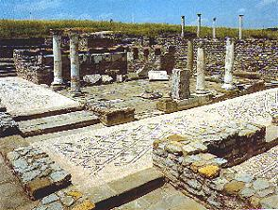
2 Corinthians 1-7

Slide 2
In Him I Shall Find Comfort
2 Corinthians 1-3
"I will try to be contented with my lot knowing that God is my friend. In him I shall find comfort.“
--Joseph Smith’s Teachings

Slide 3
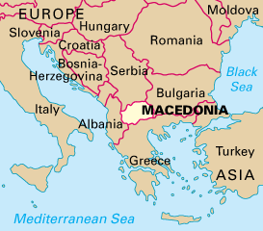
2 Corinthians
*A riot developed in Ephesus in opposition to Paul’s teaching while he waited for word of a close friend Titus who visited Corinth after the 1st letters.
*Paul fled to Macedonia, and Titus joined him while he heard news from Corinth
*Teachers from Corinth had accused Paul of taking money that was collected for the poor in Jerusalem. They also challenged Paul’s authority as an Apostle.
Paul is the author of 2 Corinthians
2nd Corinthians is a follow-up letter. It is to the same Church members and also to the Saints living in Achaia a Roman province comprising all of Greece.
The ruins of the ancient city of Heraclea Lyncestis in Bitola, Macedonia.
Acts 19:23-41

Slide 4
Letters to Corinth
The letter reveals that Paul wrote for at least five reasons:
A growing discontent due to accusations of false teachers. On his third mission Paul writes to answer these accusations and reassures the Saints in their faith.
To express gratitude to and strengthen the Saints who had responded favorably to his previous letter
To warn of false teachers who corrupted the pure doctrines of Christ
To defend his personal character and authority as an Apostle of Jesus Christ
To encourage the Corinthian Saints to
make a generous financial offering to the impoverished Saints of Jerusalem
To speak of an impending third visit to Corinth

Slide 5
The Letter Carriers
When the letter was completed, and there is good evidence to suggest that it was written in haste, Paul sent it with Titus on a return journey to Corinth.
Titus was accompanied by two companions one of whom may have been Luke.
Paul commends Titus and his party strongly to the Corinthians and urges them to make “proof” of their love and of Paul’s boasting in their behalf by making a generous contribution for the poor and sending it back with Titus. (2)
2 Corinthians 8:18, 22, 24; 9:5

Slide 6
Forgive and Comfort
Blessed be God, even the Father of our Lord Jesus Christ, the Father of mercies, and the God of all comfort;
Who comforteth us in all our tribulation, that we may be able to comfort them which are in any trouble, by the comfort wherewith we ourselves are comforted of God.
"For anyone seeking the courage to repent and change, I remind you that the Church is not a monastery for the isolation of perfect people. It is more like a hospital provided for those who wish to get well. Do whatever you have to do to come into the fold and be blessed.” (3)
2 Corinthians 1:4-5

Slide 7
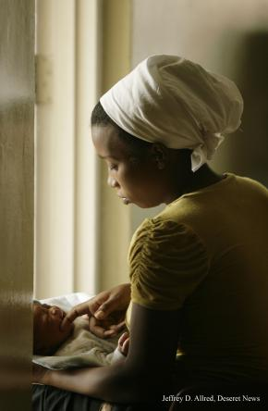
One of our many consolations in Christ is that our sufferings for His cause never go unnoticed.
When Heavenly Father comforts us in our tribulations, we are able to help others receive His comfort
Church response on 13 January 2010:
“We express our sympathy and prayers on behalf of the citizens of Haiti following the recent devastating earthquake. The Church of Jesus Christ of Latter-day Saints is immediately shipping humanitarian relief, including personal hygiene kits and supplies for newborns. Efforts are underway to determine further humanitarian response in coordination with government and disaster relief organizations.”
2 Corinthians 1:4-5

Slide 8
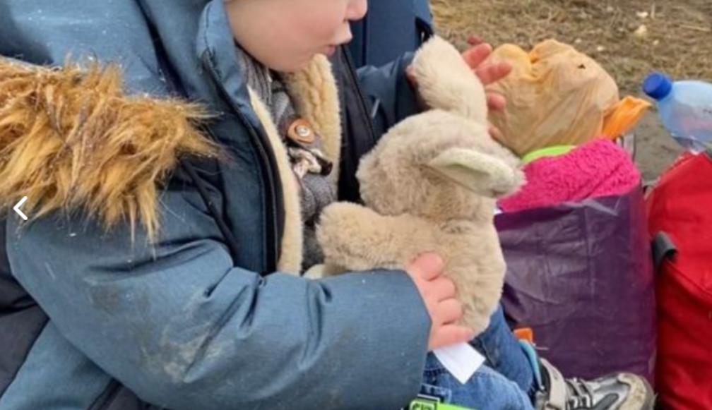
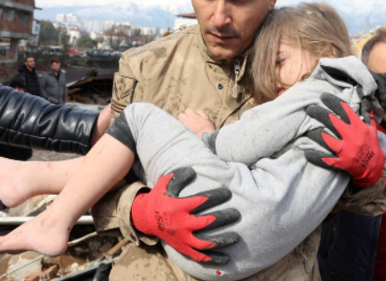
2022
Members of The Church of Jesus Christ of Latter-day Saints in Moldova supply refugees with blankets at the Ukrainian border.
2023:
The Church of Jesus Christ of Latter-day Saints is sending an initial shipment of food, clothes, blankets, medical supplies, medicines, shelters, water and sanitation kits and other items to victims of the February 6 earthquakes (7.8 and 7.6 magnitude) in Türkiye and Syria.

Slide 9
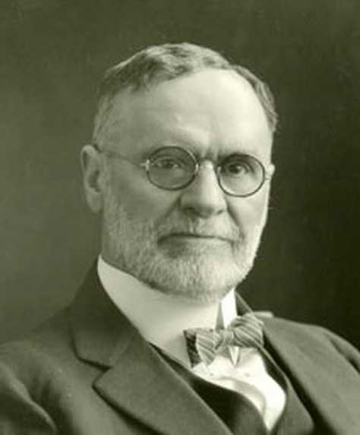
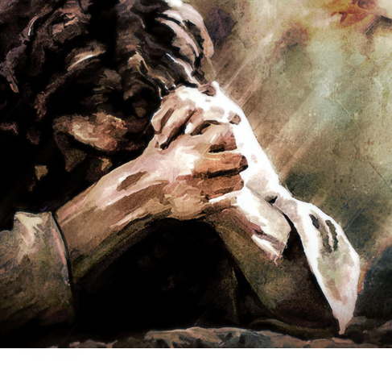
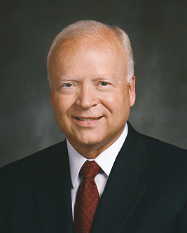
“… Is not this God’s purpose in causing his children to suffer? He wants them to become more like himself.
God has suffered far more than man ever did or ever will, and is therefore the great source of sympathy and consolation.” (4)
“Much of our suffering is not necessarily our fault. Unexpected events, contradicting or disappointing circumstances, interrupting illness, and even death surround us and penetrate our mortal experience. Additionally, we may suffer afflictions because of the actions of others.
Opposition is part of Heavenly Father’s plan of happiness. We all encounter enough to bring us to an awareness of our Father’s love and of our need for the Savior’s help.
The Savior is not a silent observer. He Himself knows personally and infinitely the pain we face.” (5)
And he cometh into the world that he may save all men if they will hearken unto his voice; for behold, he suffereth the pains of all men, yea, the pains of every living creature, both men, women, and children, who belong to the family of Adam.
2 Nephi 9:21
2 Corinthians 1:4-5

Slide 10
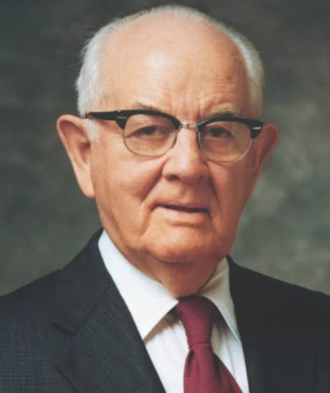
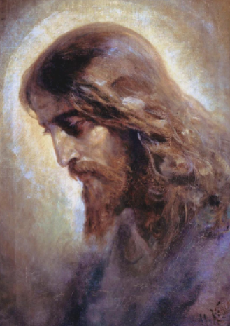
God does notice us, and he watches over us.
But it is usually through another person that he meets our needs.
Therefore, it is vital that we serve each other in the kingdom.
(13)

Slide 11
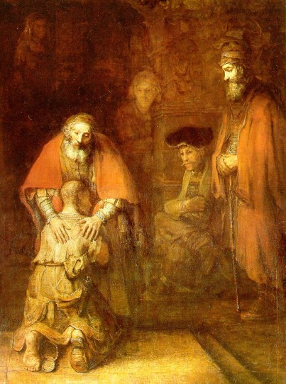
“And whether we be afflicted, it is for our consolation and salvation…
…which is effectual in the enduring of the same sufferings which we also suffer…”
2 Corinthians 1:6

Slide 12
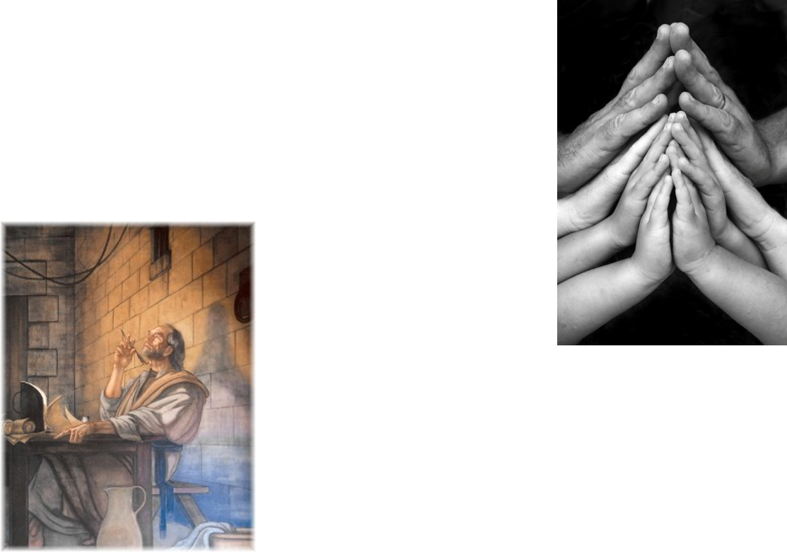
Paul and Companion’s Trials
“Ye also helping together by prayer for us, that for the gift bestowed upon us by the means of many persons thanks may be given by many on our behalf.”
2 Corinthians 1:9-11

Slide 13
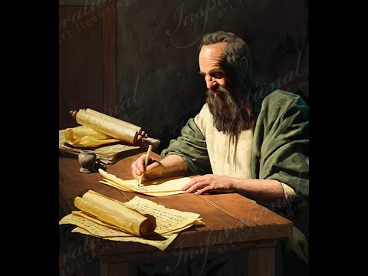
Change of Plans
Paul responded to those who found fault with him when he changed his plans to visit them. Some of Paul’s critics seemed to say that because Paul changed his travel plans they could no longer trust him or his teachings. Paul declared that the message of the gospel was true, regardless of his change in plans.
2 Corinthians 1:15-24

Slide 14
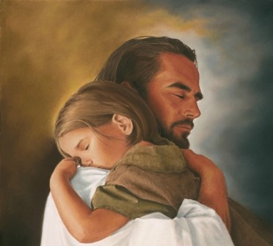
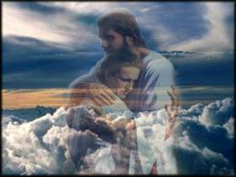
Comforter—Holy Spirit
earnest = “a pledge or security
“And I will pray the Father, and he shall give you another Comforter, that he may abide with you for ever.”
“I will not leave you comfortless: I will come to you.”
2 Corinthians 1:22; John 14:16

Slide 15
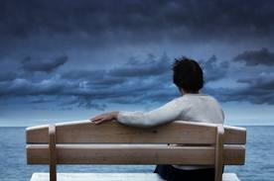
Where Can I Turn For Peace?
“Peace I leave with you, my peace I give unto you: not as the world giveth, give I unto you. Let not your heart be troubled, neither let it be afraid.”
2 Corinthians 1:22; John 14:27

Slide 16
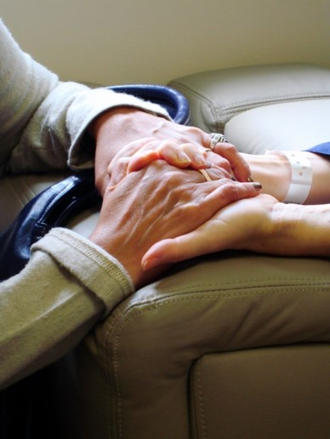
Consolation—
Comfort, soothing, relief from grief
“And our hope of you is stedfast, knowing, that as ye are partakers of the suffering, so shall ye be also of the consolation.”
John 14:27

Slide 17
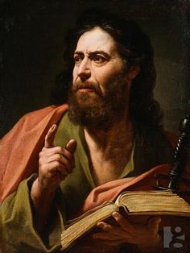
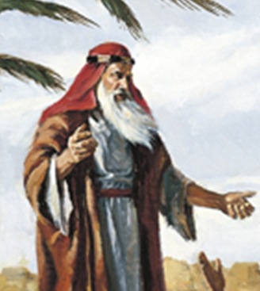
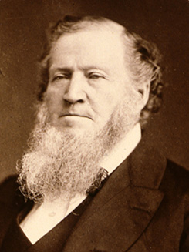
Harshness In Paul’s Writings
Paul acknowledged that some of his writings in a previous epistle could have seemed harsh because he was chastening the members.
Prophets of all ages have carried the responsibility to teach, warn, and correct God’s children.
“At times I may to many of the brethren appear to be severe. I sometimes chasten them; but it is because I wish them to live so that the power of God, like a flame of fire, will dwell within them and be around about them.” (6)
2 Corinthians 2:1-4
(1)

Slide 18
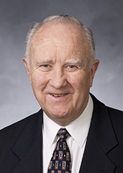
“When we take the position of withholding forgiveness from our fellow men, we are attempting to block his progress towards salvation.
This position is … not Christlike.
We are endeavoring to impede the progress of a living soul and deny him the forgiving blessings of the atonement.
This philosophy is saturated with impure motives that are designed to destroy the soul.” (7)
2 Corinthians 2:1-4

Slide 19
To Forgive
“So that contrariwise ye ought rather to forgive him, and comfort him,…
… lest perhaps such a one should be swallowed up with overmuch sorrow.”
2 Corinthians 2:7

Slide 20
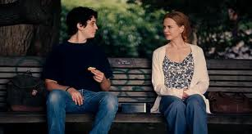
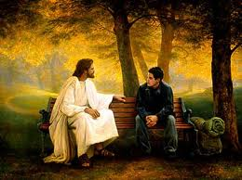
Obedient in all things
“To whom ye forgive any thing, I forgive also: for if I forgave any thing…
…to who I forgave it, for your sakes forgave I it in the person of Christ;”
Forgiving others does not mean that the sinner should not be held accountable for his or her actions. Nor does it mean putting ourselves in situations in which people can continue to mistreat us. Rather, forgiving others means treating with love those who have mistreated us and harboring no resentment or anger toward them. We are commanded to forgive all men. (10)
2 Corinthians 2:9-11

Slide 21
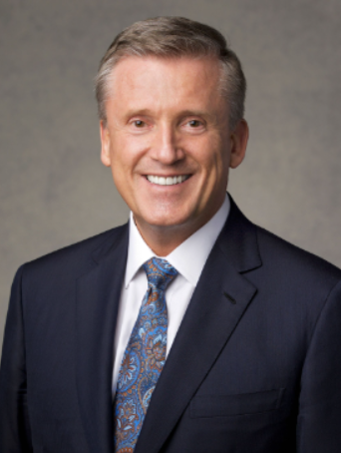
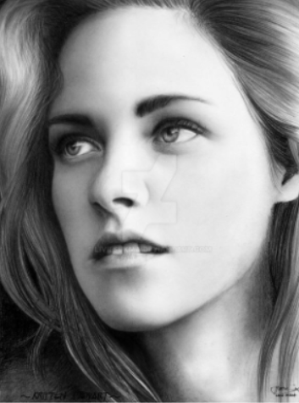
I am convinced that most of us want to forgive, but we find it very hard to do. When we have experienced an injustice, we may be quick to say, “That person did wrong.
They deserve punishment. Where is the justice?”
We mistakenly think that if we forgive, somehow justice will not be served and punishments will be avoided.
This simply is not the case. God will mete out a punishment that is fair, for mercy cannot rob justice.
God lovingly assures you and me: “Leave judgment alone with me, for it is mine and I will repay. [But let] peace be with you”.
(14)
And be ye kind one to another, tenderhearted, forgiving one another, even as God for Christ’s sake hath forgiven you.
Alma 42:25; D&C 82:23

Slide 22
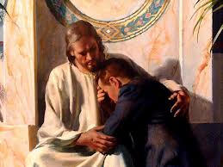
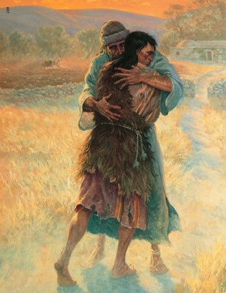
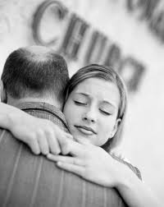
A Greater Sin
“…that ye ought to forgive one another; for he that forgiveth not his brother his trespasses standeth condemned before the Lord; for there remaineth in him the greater sin.”
“I, the Lord, will forgive whom I will forgive, but of you it is required to forgive all men.”
D&C 64:9-10

Slide 23
Satan’s Devices
“to get advantage over us”
Paul knew that if the Corinthian Saints failed to forgive the man who had received Church disciplinary action, there would be increased discord among them..
“Satan’s most strenuous opposition is directed at whatever is most important to the Father’s plan. Satan seeks to discredit the Savior and divine authority, to nullify the effects of the Atonement, to counterfeit revelation, to lead people away from the truth, to contradict individual accountability, to confuse gender, to undermine
marriage, and to discourage childbearing
(especially by parents who will raise children in righteousness)” (8)
2 Corinthians 2:11

Slide 24
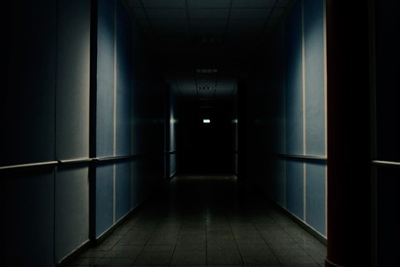
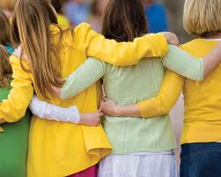
Satan uses the unforgiving spirit as a device to cause division between people.
If we do not forgive others, Satan will have an advantage over us
“True compassion for one’s fellow men is a mark of a true saint. It consists in sorrow for their sufferings, in having pity and sympathy for them, and in exhibiting mercy, tenderness and kindness towards them.” (9)

Slide 25
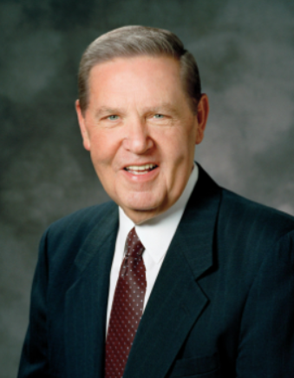
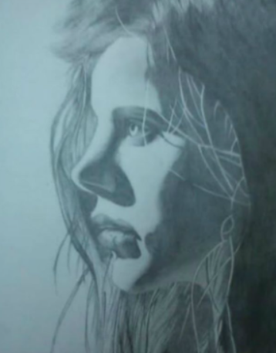
[Jesus Christ] did not say, “You are not allowed to feel true pain or real sorrow from the shattering experiences you have had at the hand of another.”
Nor did He say, “In order to forgive fully, you have to reenter a toxic relationship or return to an abusive, destructive circumstance.”
But notwithstanding even the most terrible offenses that might come to us, we can rise above our pain only when we put our feet onto the path of true healing.
(3)

Slide 26
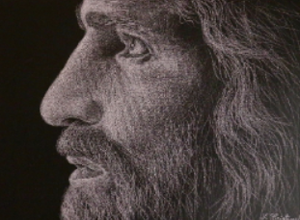
Forgiveness is the very reason God sent His Son, so let us rejoice in His offering to heal us all.
The Savior’s Atonement is not just for those who need to repent; it is also for those who need to forgive.
If you are having trouble forgiving another person or even yourself, ask God to help you. Forgiveness is a glorious, healing principle.
We do not need to be a victim twice. We can forgive. (14)
Cristinel Fartadi

Slide 27
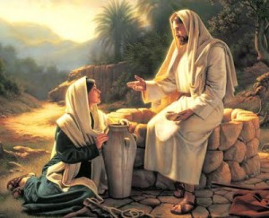
Character of Christ
To Christ’s enemies, the sweet fragrance of the Saints and their witness of Christ was like the savor of death, but to those who accepted the Apostles and their teachings, it was the savor of life.
Albin Veselka
"Those who partake of the spirit breathed by the saints, the spirit of the gospel, the sweet influence that results from obedience to God's laws, gain eternal life; those who reject it inherit eternal death.
That is, the gospel is an instrument of life and of
death, of life to the obedient, of death to the
disobedient." (9)
2 Corinthians 2:16

Slide 28
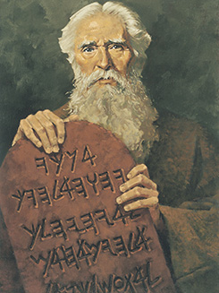
Living Epistles of the Truth
During Paul’s absence from Corinth, some false teachers began to oppose Paul’s teachings and tried to discredit Paul by telling the converts that they still needed to follow the law of Moses.
In response to those who tried to discredit him, Paul asked the members of Corinth rhetorically if he needed to provide them with a “[letter] of commendation” that testified of his character and his legitimacy as a true Apostle of Jesus Christ.
Ted Henninger
“In the ultimate sense, the gospel is not written on tablets of stone or in books of scripture, but in the bodies of faithful and obedient persons; the saints are, thus, living epistles of the truth, the books of whose lives are open for all to read.” (9)
2 Corinthians 3:1-2

Slide 29
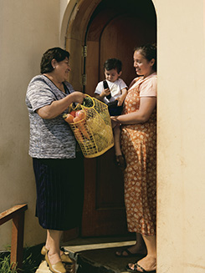
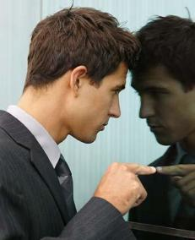
Judging the Church By Its Members
Many people throughout the world have kind feelings toward the Church because of the acts of kindness and service they see manifest in the lives of Church members. (1)
"Ye shall know them by their fruits. Do men gather grapes of thorns, or figs of thistles? Even so every good tree bringeth forth good fruit; but a corrupt tree bringeth forth devil fruit. A good tree cannot bring forth evil fruit, neither can a corrupt tree bring forth good fruit. Every tree that bringeth not forth good fruit is hewn down, and cast into the fire. Wherefore by their fruits ye shall know them.“ Matthew 7:16-21
2 Corinthians 3:2-3

Slide 30
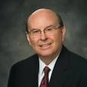
The Letter Killeth But the Spirit Liveth
Paul declared to the Corinthian Saints that he was a minister of the “new testament,” meaning the new covenant of the gospel of Jesus Christ.
He referred to the old covenant, which was the law of Moses, as the “letter” and the new covenant as “the spirit.”
Why ?
What ?
How ?
“Doctrine usually answers the question ‘why?’
Principles usually answer the question ‘what?’
Whenever we emphasize how to do something without reference to why we do it or what we do, we risk looking beyond the mark.” (11)
2 Corinthians 3:6

Slide 31
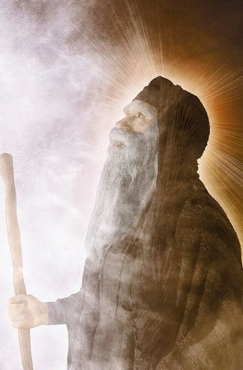
Veil Done Away With In Christ
Paul states that they are ministers of the new covenant of Christ, which does away with the old.
Paul refers to the scriptural records when he talks of the reading of the old testament, he is not using it in the same sense we think of the Old Testament, but rather in the sense of the Mosaic law, or the old covenant. (2)
2 Corinthians 3:14-15

Slide 32
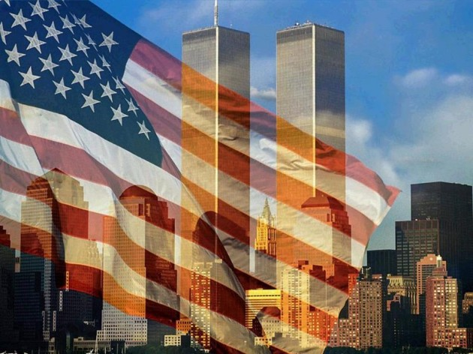
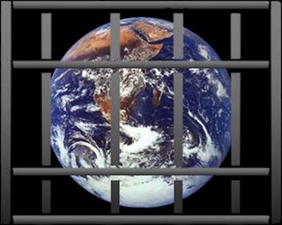
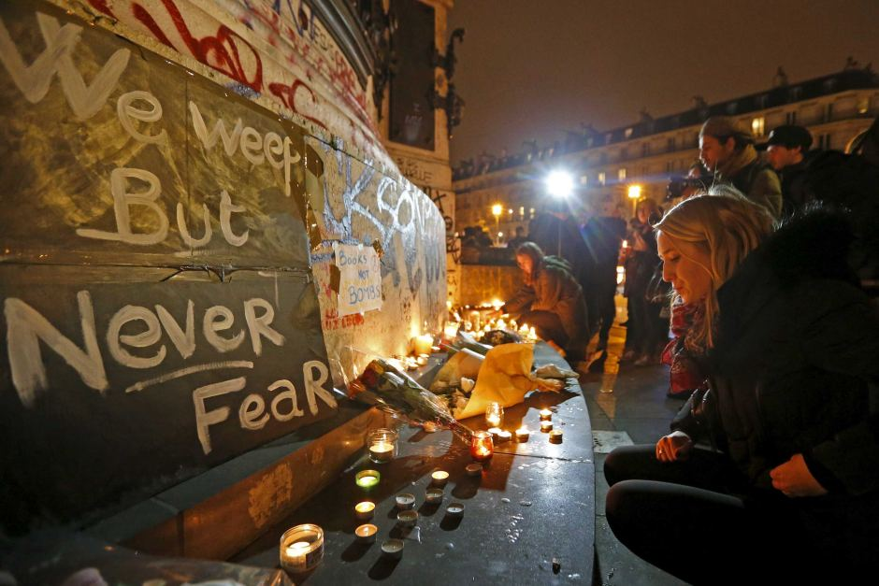
Spirit Brings Liberty
It is Satan, not God, who seeks to destroy agency and liberty
“Since Satan always seeks to destroy the agency of man, he influences churches and governments to deny freedom of worship and to force man to perform acts contrary to the divine will.
“Governments and churches which curtail or deny man the power to worship God according to the dictates of his own conscience, are not of God; they are not directed by the power of his Spirit” (9)
2 Corinthians 3:17

Slide 33
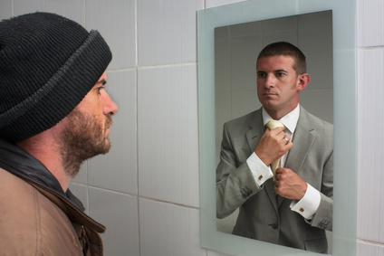
Change and Transformed
The Spirit is the means by which God gradually transforms us into glorious beings like Him.
"As a mirror reflects the likeness of a person, so the saints should reflect the image of Christ, and as they progress in obedience and personal righteousness, they attain this image; by the power of the Spirit, they become like Christ." (9)
2 Corinthians 3:18

Slide 34
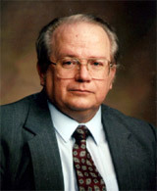
"For Latter-day Saints the focal point of this life must be coming to Christ and beginning the process, but we also look forward to that greater moment in eternity when we shall finally be like him.
And toward that glorious day as faithful sons and daughters we consecrate ourselves in the everyday unfolding of our lives, that by our labors we might close the gap between us.
When we use the term coming to Christ in describing conversion, it is a figure of speech that describes our intent and our desires.
But the ultimate realization of coming to Christ is in actually closing the distance between us by becoming what He is through doing what He does." (12)
2 Corinthians 3:18

Slide 35
Sources:
Title Page: (Encyclopedia of Joseph Smith's Teachings, edited by Larry E. Dahl and Donald Q. Cannon [Salt Lake City: Bookcraft, 1997], "Comfort".)
New Testament Institute Student Manual Chapter 39
Life and Teachings of Jesus and His Apostles Chapter 37
Elder Jeffrey R. Holland ("Come unto Me," Ensign, Apr. 1998, 18-19); The Ministry of Reconciliation,” Ensign or Liahona, Nov. 2018, 79
Elder Orson F. Whitney (“A Lesson from the Book of Job,” Improvement Era, Nov. 1918, 7; see also James E. Faust, “Refined in Our Trials,” Ensign or Liahona, Feb. 2006, 5).
Elder Kent F. Richards The Atonement Covers All Pain April 2011 Gen. Conf.
(Discourses of Brigham Young, sel. John A. Widtsoe [1954], 115).
Elder C. Max Caldwell (Sacred Truths of the Doctrine and Covenants, 2 vols. [1993], 1:314; see also D&C 64:9–11).
Elder Dallin H. Oaks (“The Great Plan of Happiness,” Ensign, Nov. 1993, 72).
Elder Bruce R. McConkie Mormon Doctrine p. 152. (Doctrinal New Testament Commentary, 3 vols. [Salt Lake City: Bookcraft, 1965-1973], 2: 413-416
(See Guide to the Scriptures, “Forgive,” scriptures.lds.org; D&C 64:9–11.)
Elder Quentin L. Cook (“Looking beyond the Mark,” Ensign, Mar. 2003, 44).
Stephen E. Robinson, Following Christ: The Parable of the Divers and More Good News [Salt Lake City: Deseret Book Co., 1995], 69 - 70.)
Teachings of Presidents of the Church: Spencer W. Kimball [2006], 82
Kevin R. Duncan, “The Healing Ointment of Forgiveness,” Ensign or Liahona, May 2016, 33–34
Presentation by ©http://fashionsbylynda.com/blog/

Slide 36
Second Letter of Paul to the Saints at Corinth— Written from Macedonia about AD 57
God Cares for the Saints | 1:1–24
Saints Love and Forgive One Another | 2:1–17
The Gospel Is Greater Than the Law of Moses | 3:1–18
Judging the Church By Its Members 2 Corinthians 3:2:
“The only things that can ever embarrass this work are acts of disobedience to its doctrine and standards by those of its membership. That places upon each of us a tremendous responsibility. This work will be judged by what the world sees of our behavior. God give us the will to walk with faith, the discipline to do what is right at all times and in all circumstances, the resolution to make of our lives a declaration of this cause before all who see us” President Gordon B. Hinckley (“This Thing Was Not Done in a Corner,” Ensign, Nov. 1996, 51).
Testament 2 Corinthians 3:6:
"'Testament' here is a Greek legal term (diatheke) for the binding promise of a will, but it was used in the Greek translation of the Old Testament for God's covenant with Israel. Thus, Paul's 'new testament' is the Lord's new covenant with the Saints wherein their sins are forgiven through the atonement of Christ. And 2 Corinthians 3 takes its joyful tone not from the disappearance of divine commands but from the rejoicing of the believer that the 'letter'-the searching by study and the multiplicity of Mosaic rules-had been replaced by Christ's atonement and gospel, in which 'my yoke is easy, and my burden is light' (Matt. 11:30). The King James Version uses 'covenant' and 'testament' interchangeably as Paul teaches that the work of Christ fulfills the laws of Moses." (Richard Lloyd Anderson, Understanding Paul [Salt Lake City: Deseret Book Co., 1983], 134.)
Life and Teachings of Jesus and His Apostles Chapter 37
Trials 2 Corinthians 1:1-5:
“In order to be tested, we must sometimes face challenges and difficulties. At times there appears to be no light at the tunnel’s end—no dawn to break the night’s darkness. We feel surrounded by the pain of broken hearts, the disappointment of shattered dreams, and the despair of vanished hopes. We join in uttering the biblical plea ‘Is there no balm in Gilead?’ [Jeremiah 8:22.] We are inclined to view our own personal misfortunes through the distorted prism of pessimism. We feel abandoned, heartbroken, alone. If you find yourself in such a situation, I plead with you to turn to our Heavenly Father in faith. He will lift you and guide you. He will not always take your afflictions from you, but He will comfort and lead you with love through whatever storm you face” (“Looking Back and Moving Forward,” President Thomas S. Monson Ensign or Liahona, May 2008, 90).
The Veil: "Moses descended Mount Sinai twice with the law of the Lord in his hands. The first descent ended with Moses destroying the tablets of stone upon which the law was written (see Exodus 32:19). On the second descent Moses came 'with the two tables of testimony in [his] hand,' but he did not realize 'that the skin of his face shone while [the Lord] talked with him' (Exodus 34:29). The rulers of Israel were afraid to approach Moses because of his appearance. He therefore 'put a vail on his face' until he had finished speaking with them (v. 33). When Moses entered the tabernacle to speak with the Lord, 'he took the vail off' (v. 34).
"Fifteen hundred years later the Apostle Paul lamented that the Israelites of his day could not see the glory of the gospel of Christ because a 'vail [was] upon their heart' when they read the books of Moses (2 Corinthians 3:15). He said that the veil that blinded their minds in the days of Moses 'until this day remaineth . . . untaken away in the reading of the old testament' (v. 14). Nevertheless, he gave the children of Israel a solution to that problem: 'When [their heart] shall turn to the Lord,' he said, 'the vail shall be taken away' (v. 16). (Robert England Lee, The Lord of the Gospels: The 1990 Sperry Symposium on the New Testament, ed. by Bruce A. Van Orden and Brent L. Top, [Salt Lake City: Deseret Book Co., 1991], 102)
Corrupt 2 Corinthians 2:17:
Here it is taken from the Greek word for a peddler. “The term included dealers in victuals and all sorts of wares, but was especially applied to retailers of wine, with whom adulterations and short measures were a matter of course.” (Vincent, Word Studies, 2:813.) This class of merchants had such an unsavory reputation for unscrupulousness and dishonesty in their trading that in some cases they were barred from holding public office. False teachers in the church were of the same mentality, watering down or changing the word of God at will so they could further their own selfish ends. Thus we get a picture of Paul, who is not only capable of slowing great love but is also able to demonstrate great sharpness in condemning those who would bring havoc upon the church. (2)

Slide 37
Something of Interest—Short History of Macedonia
Macedonia is located in the center of the Southern Balkans, north of ancient Hellas (Greece), east of Illyria, and west of Thrace. The name "Macedonia" is the oldest surviving name of a country on the continent of Europe. The ancient Macedonians were a distinct nation, ethnically, linguistically, and culturally different from their neighbors. Their origins are in the ancient Brygian (Phrygian) substratum that occupied the whole of Macedonian territory and in Indo-European superstratum, which settled here at the end of the 2nd millennium. Archaeological evidence shows that old European civilization flourished in Macedonia between 7000 and 3500 BC.
[808-399 BC] Caranus establishes the ancient Macedonian kingdom and is the first known Macedonian king (808-778 BC). Alexander I "Philhellene" (498-454 BC) expend the kingdom and fight as Persian ally in the Greek-Persian wars. Alexander’s son Perdiccas II (453 - 413 BC) instigates a conflict between Athens and Sparta which turns into a 27 year long Peloponnesian War resulting in a near exhaustion of almost every Greek city-state. Archelaus (413-399 BC) turns Macedonia into an economic power and reorganizes the Macedonian army.
[359-336 BC] Philip II (359-336 BC) raises Macedonia into the greatest European Power after subduing all of Macedonia's neighbors - Illyrians, Thracians, and Greeks. The Battle of Chaeronea where the Macedonians defeat the Greeks on August 2, 338 BC, marks an end of Greek history and the beginning of the Macedonian Era. The ancient Greek writer Theopompus declares Philip “the greatest man that Europe had ever given.”
[336-323 BC] Philip’s son Alexander III the Great (356-323 BC) carries the Macedonian armies into Asia and conquers the Persian Empire. Macedonia becomes the world’s largest Empire stretching from Europe, to North Africa and India.
323-300 BC] The death of Alexander the Great plunges the Macedonian nation into a civil war as the leading Macedonian generals fight over the rule of the Empire. By 300 BC, the Macedonian Empire is carved up between the dynasties of Alexander’s generals Antigonus I (Macedonia and Greece), Ptolemy I (Egypt), and Seleucus I (Asia).
[300-146 BC] Under Antigonus II Gonatas (276-239), the grandson of Antigonus I, Macedonia achieves a stable rule and strengthens its occupation of Greece. His grandson Philip V (222-179 BC) clashes with Rome that begun expanding eastward. The two "Macedonian Wars" against the Romans end up in defeat of Philip V’s armies. Macedonia loses the whole of Greece and is reduced to its original borders. In the third "Macedonian War", Rome defeats the Macedonian army under the last Macedonian king, Philip's son Perseus (179-168 BC). Perseus dies prisoner in Italy, a rebellion against the Roman rule fails, and by 146 Macedonia is a Roman province.
[65 BC] Rome conquers the Seleucid Macedonian kingdom in Asia under its last king Antiochus XII
[30 BC] The Roman victory over Cleopatra VII puts an end to the last of the Macedonian descendants in Egypt, and with it to the last remains of the Macedonian Empire.
AD 51-63 “And a vision appeared to Paul in the night; There stood a Macedonian man, and prayed him, saying, Come over into Macedonia, and help us" (Bible, Acts 16:9). Apostle Paul and his epistles preach Christianity for the first time on European soil, in the Macedonian towns Philippi, Thessalonica, and Beroea. The first European to convert to Christianity is a Macedonian girl by the name of Lydia.
[1993] Macedonia is admitted to the United Nations.
1995] Macedonia becomes a member of the Council of Europe. The Human Rights Watch condemns Greece for the oppression of its large ethnic Macedonian minority, which Greece denies it exists. Both Amnesty International and the European Parliament also urge Greece to recognize the existence of the Macedonian language and stop the oppression of the ethnic Macedonians on the Macedonian territory it appropriated in 1913.
http://www.historyofmacedonia.org/ConciseMacedonia/timeline.html

Slide 38
The Bigger Picture
2 Corinthians 4-5
For behold, this is my work and my glory—to bring to pass the immortality and eternal life of man.
Moses 1:39

Slide 39
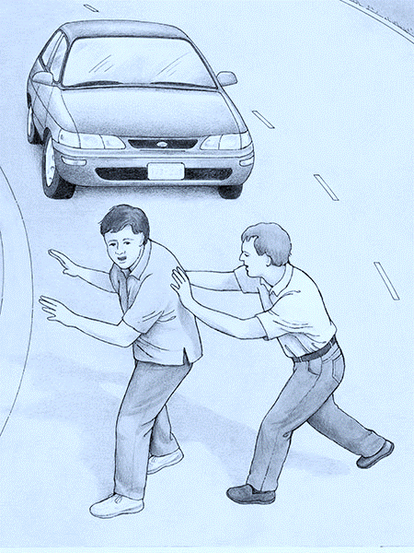
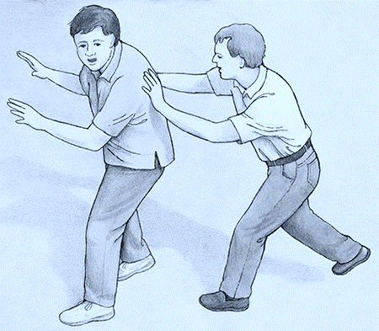
Seeing the bigger picture, does this change your judgment on that person?
What might the person being pushed think about the person who is pushing him?
Paul wrote to the Corinthian Saints to help them see the larger context of their tribulations.

Slide 40
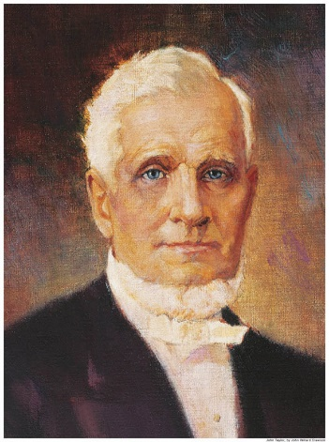
The God of This World
The “god of this world” is Satan, who blinds people’s eyes and hides the gospel from those who are spiritually lost. (1)
"[Satan] exerts an invisible agency over the spirits of men, darkens their minds, and uses his infernal power to confound, corrupt, destroy and envelope the world in confusion, misery, and distress; and, although deprived personally of operating with a body, he uses his influence over the spirits of those who have bodies, to resist goodness, virtue, purity, intelligence, and the fear of God; and consequently, the happiness of man; and poor erring humanity is made the dupe of his wiles.” (2)
2 Corinthians 4:4

Slide 41
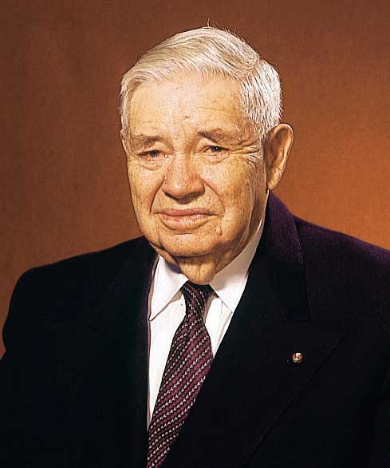
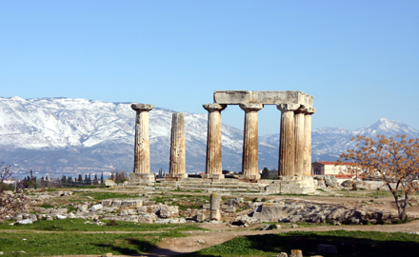
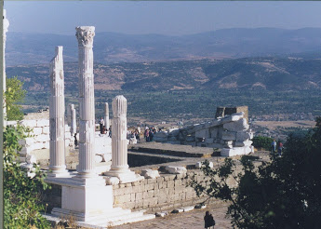
The Image of God
"Paul time and time again declared that Christ was in the image and likeness of God.
To the Corinthians he said Christ 'is the image of God.'
To the Colossians he exclaimed in exaltation of Christ, he 'is the image of the invisible God.'
To the Hebrews he affirmed that Christ is 'the express image of his person'
Corinth
Pergamum and Colossia
2 Corinthians 4:4; Colossians 1:15; Hebrews 1:3
Ancient Jerusalem
(3)

Slide 42
Treasure of the Light
Paul compared himself and his fellow ministers of the gospel to ordinary-looking clay jars that contain the “treasure” of “the light of the knowledge of the glory of God”.
Paul stated that the contrast between humble, unimpressive missionaries and the light they bear—the gospel of Jesus Christ—reveals a divine purpose: “That the excellency of the power may be of God, and not of us”
(1)
Earthen vessels” in modern-day Israel
It is a privilege that can be enjoyed in mortality-while still inhabiting an 'earthen vessel.‘
Of all the treasures of godliness, of all the rewards of righteousness, this is the greatest-even a personal knowledge of
'the only true God, and Jesus Christ, whom [he] hast sent'
2 Corinthians 4:6-7; John 17:3

Slide 43
Troubled On Every Side
Yet Not Distressed
Though many of these perils were extreme, Paul testified that because he was always supported by God, he was able to continue to be of service to God and the Saints. (1)
2 Corinthians 4:8-9

Slide 44
"[While a prisoner of the Missouri mob] Notwithstanding that every avenue of escape seemed to be entirely closed, and death stared me in the face, and that my destruction was determined upon, as far as man was concerned, yet, from my first entrance into the camp [of displaced saints], I felt an assurance that I, with my brethren and our families, should be delivered.
Yes, that still small voice, which has so often whispered consolation to my soul, in the depths of sorrow and distress, bade me be of good cheer, and promised deliverance, which gave me great comfort.
And although the heathen raged, and the people imagined vain things, yet the Lord of Hosts, the God of Jacob was my refuge; and when I cried unto Him in the day of trouble, He delivered me; for which I call upon my soul, and all that is within me, to bless and praise His holy name.
For although I was 'troubled on every side, yet not distressed; perplexed, but not in despair; persecuted, but not forsaken; cast down, but not destroyed.' (4)
Liz Lemon Swindle
2 Corinthians 4:8-9

Slide 45
Death is Temporary
Paul taught that even though some people would die for the gospel of Jesus Christ, their death would be temporary.
Physical death is the separation of the spirit from the mortal body.
In the spirit world, the spirits of the righteous “are received into a state of happiness, which is called paradise, a state of rest, a state of peace, where they shall rest from all their troubles and from all care, and sorrow”
When the physical body dies, the spirit continues to live.
2 Corinthians 4:11-14
(5)

Slide 46
Spirit Prison
A place called spirit prison is reserved for “those who [have] died in their sins, without a knowledge of the truth, or in transgression, having rejected the prophets.”
(D&C 138:32).
The spirits in prison are “taught faith in God, repentance from sin, vicarious baptism for the remission of sins, the gift of the Holy Ghost by the laying on of hands, and all other principles of the gospel that [are] necessary for them to know” (D&C 138:33-34).
If they accept the principles of the gospel, repent of their sins, and accept ordinances performed in their behalf in temples, they will be welcomed into paradise.
The soul shall be restored to the body, and the body to the soul; yea, and every limb and joint shall be restored to its body; yea, even a hair of the head shall not be lost; but all things shall be restored to their proper and perfect frame. Alma 40:23
2 Corinthians 4:11-14
(5)

Slide 47
Light of Affliction
Paul was beaten, stoned, shipwrecked, imprisoned, and experienced many other trials.
… Every trial and experience you have passed through is necessary for your salvation” (6)
Ron DiCianni
It is not the passing things of this world, but the lasting things, the things not seen with mortal eyes, that are eternal.
2 Corinthians 4:17-18

Slide 48
Our trials and afflictions in this life are small compared to the everlasting blessings and growth that come as we faithfully endure them.
Because temporary afflictions can bring about eternal growth and glory, we need not despair in times of trouble.
There is eternal purpose in our afflictions, even when we cannot see it in mortality.
2 Corinthians 4:17-18

Slide 49
Clothed Upon
Our earthly tabernacle will be “clothed upon” during our resurrection
“Our bodies are our temples.
We are not less but more like Heavenly Father because we are embodied. I testify that we are His children, made in His image, with the potential to become like Him.
Let us treat this divine gift of the body with great care.
Someday, if we are worthy, we shall receive a perfected, glorious body—pure and clean like my new little granddaughter, only inseparably bound to the spirit. And we shall shout for joy to receive this gift again for which we have longed.
2 Corinthians 5:1-4
(7)

Slide 50
Walking By Faith
Because we are separated from God in mortality, we are to walk by faith and not by sight
“When we get to the other side of the veil, we shall know something. We now work by faith. We have the evidence of things not seen. The resurrection, the eternal judgment, the celestial kingdom, and the great blessings that God has given in the holy anointings and endowment in the temples, are all for the future, and they will be fulfilled, for they are eternal truths. We will never while in the flesh, with this veil over us, fully comprehend that which lies before us in the world to come. It will pay any man to serve God and to keep His commandments the few days he lives upon the earth.”
2 Corinthians 5:5-7
(8)

Slide 51
How Can We Walk By Faith?
Missionary
By deciding to serve a mission
By keeping the standards of the Church and keeping the Commandments
By sharing your testimony, not just in church but to your friends and family
(8)

Slide 52
Appear Before Christ
To Be Judged
“The Son, not the Father, is the Judge of the whole earth, but his judgment is made in accordance with the will of the Father and therefore is just [see John 5:22, 30]. …
“Because Jesus is the Son of Man of Holiness he has been given the power to execute judgment, to sit in judgment at the great and last day, to call all men forth in immortality to stand before his bar.” (9)
And hath given him authority to execute judgment also, because he is the Son of man. John 5:27
2 Corinthians 5:8-11
(8)

Slide 53
Believers—New Creatures in Christ
The Atonement changes everyone who accepts it; those who choose to follow Jesus Christ no longer “live unto themselves, but unto him which died for them, and rose again.” They become a “new creature” (1)
We can be reconciled to God and become new creatures through the Atonement of Jesus Christ.
“…True conversion brings a change in one’s beliefs, heart, and life to accept and conform to the will of God and includes a conscious commitment to become a disciple of Christ.
“… As we honor the ordinances and covenants of salvation and exaltation ‘press forward with a steadfastness in Christ’, and endure in faith to the end), we become new creatures in Christ.”
2 Corinthians 5:15-17
(10)

Slide 54
Reconciled To God
After teaching that all people are accountable for their actions and will one day stand before Jesus Christ to be judged, Paul pleaded with the Corinthian Saints to be reconciled to God through the Atonement of Christ.
There are only a few biblical verses that explicitly state that Jesus Christ was completely without sin
For he hath made him to be sin for us, who knew no sin; that we might be made the righteousness of God in him.
As a result of His Atonement, Jesus Christ can say to us, “I will take your sins and I will give you my righteousness.” Jesus Christ became a vicarious sacrifice for our sins, meaning that all of our sins were laid upon Him and He bore them, even though He had never sinned.
Because of this great sacrifice, upon condition of our repentance, we can share in the Savior’s righteousness.
Howard Lyon
2 Corinthians 5:18-21
(1)

Slide 55
If you have felt the influence of the Holy Ghost today, you may take it as evidence that the Atonement is working in your life.
(11)

Slide 56
Sources:
New Testament Institute Student Manual Chapter 39
John Taylor (The Government of God [Liverpool: S. W. Richards, 1852], 32 - 33.)
J. Reuben Clark Jr. (Behold the Lamb of God [Salt Lake City: Deseret Book Co., 1991], 194.)
Prophet Joseph Smith (History of The Church of Jesus Christ of Latter-day Saints, 7 vols. 3:329)
LDS Topics (Physical Death)
President Brigham Young (Teachings of Presidents of the Church: Brigham Young [1997], 261–62). Photograph by Charles R. Savage
Susan W. Tanner (“The Sanctity of the Body,” Ensign or Liahona, Nov. 2005, 13, 15).
President Wilford Woodruff (Teachings of Presidents of the Church: Wilford Woodruff [2004], 154).
Elder Bruce R. McConkie Doctrinal New Testament Commentary 1:192, 195
Elder David A. Bednar (“Converted unto the Lord,” Ensign or Liahona, Nov. 2012, 107).
Henry B. Eyring, “Gifts of the Spirit for Hard Times,” Ensign, June 2007, 23
Presentation by ©http://fashionsbylynda.com/blog/

Slide 57
Second Letter of Paul to the Saints at Corinth— Written from Ephesus, ca. Spring, A.D. 57
The Gospel Light Shines Through the Darkness | 4:1–6
Mortal Trials and Eternal Hopes | 4:7–18
Saints Seek Tabernacles of Immortal Glory | 5:1–11
The Gospel Reconciles Man to God | 5:12–21
Scripture of Jesus Christ—He is without sin
Hebrews 4:14-15 | Seeing then that we have a great high priest, that is passed into the heavens, Jesus the Son of God, let us hold fast our profession. For we have not an high priest which cannot be touched with the feeling of our infirmities; but was in all points tempted like as we are, yet without sin.
1 Peter 2:22 | Who did no sin, neither was guile found in his mouth:
1 John 3:5 | And ye know that he was manifested to take away our sins; and in him is no sin.
2 Corinthians 5:21 | For he hath made him to be sin for us, who knew no sin; that we might be made the righteousness of God in him.
Life and Teachings of Jesus and His Apostles Chapter 37
Troubled on Every Side 2 Corinthians 14:8-9:
“On some days we will have cause to remember the unkind treatment [the Savior] received, the rejection he experienced, and the injustice—oh, the injustice—he endured. When we, too, then face some of that in life, we can remember that Christ was also troubled on every side, but not distressed; perplexed, but not in despair; persecuted, but not forsaken; cast down, but not destroyed…
To those who stagger or stumble, he is there to steady and strengthen us. In the end he is there to save us, and for all this he gave his life. However dim our days may seem they have been darker for the Savior of the world." (see 2 Cor. 4:8–9)” Elder Jeffrey R. Holland (“This Do in Remembrance of Me,” Ensign, Nov. 1995, 69).
President George A. Smith (1817–75) of the First Presidency received counsel in the spirit of Paul’s inspiring words from his cousin the Prophet Joseph Smith at a time of great difficulty: “He told me I should never get discouraged, whatever difficulties might surround me. If I was sunk in the lowest pit of Nova Scotia and all the Rocky Mountains piled on top of me, I ought not to be discouraged but hang on, exercise faith, and keep up good courage and I should come out on the top of the heap at last” (Teachings of Presidents of the Church: Joseph Smith [2007], 235).
“Reconciliation is the process of ransoming man from his state of sin and spiritual darkness and of restoring him to a state of harmony and unity with Deity. Through it God and man are no longer enemies. Man, who was once carnal and evil, who lived after the manner of the flesh, becomes a new creature of the Holy Ghost; he is born again; and, even as a little child, he is alive in Christ” Elder Bruce R. McConkie (Doctrinal New Testament Commentary, 2:422–23; see also the commentary for Romans 5:11).

Slide 58
People of Faith
Hebrews 11:7 | Noah | By faith Noah, being warned of God of things not seen as yet, moved with fear, prepared an ark to the saving of his house; by the which he condemned the world, and became heir of the righteousness which is by faith.
Alma 32:27 | Alma Teaches | But behold, if ye will awake and arouse your faculties, even to an experiment upon my words, and exercise a particle of faith, yea, even if ye can no more than desire to believe, let this desire work in you, even until ye believe in a manner that ye can give place for a portion of my words
Luke 8:48 | The woman who touches Jesus’ hem | And he said unto her, Daughter, be of good comfort: thy faith hath made thee whole; go in peace.
Mark 10:52 | Jesus Heals the blind man | And Jesus said unto him, Go thy way; thy faith hath made thee whole. And immediately he received his sight, and followed Jesus in the way.
Enos 1:8 | Enos | And he said unto me: Because of thy faith in Christ, whom thou hast never before heard nor seen. And many years pass away before he shall manifest himself in the flesh; wherefore, go to, thy faith hath made thee whole.
Moroni 10:4 | Moroni | And when ye shall receive these things, I would exhort you that ye would ask God, the Eternal Father, in the name of Christ, if these things are not true; and if ye shall ask with a sincere heart, with real intent, having faith in Christ, he will manifest the truth of it unto you, by the power of the Holy Ghost.
Ether 12:7 | Ether Teaches | For it was by faith that Christ showed himself unto our fathers, after he had risen from the dead; and he showed not himself unto them until after they had faith in him; wherefore, it must needs be that some had faith in him, for he showed himself not unto the world.
Ether 12:20 | The Brother of Jared recorded by Ether | And behold, we have seen in this record that one of these was the brother of Jared; for so great was his faith in God, that when God put forth his finger he could not hide it from the sight of the brother of Jared, because of his word which he had spoken unto him, which word he had obtained by faith.
Daniel 6:23 | Daniel in the Lion’s Den | So Daniel was taken up out of the den, and no manner of hurt was found upon him, because he believed in his God.
Hebrews 11:23-30 | Moses | By faith Moses, when he was born, was hid three months of his parents, because they saw he was a proper child; and they were not afraid of the king’s commandment; By faith Moses, when he was come to years, refused to be called the son of Pharaoh’s daughter; By faith he forsook Egypt, not fearing the wrath of the king: Through faith he kept the passover, By faith they passed through the Red sea as by dry land: By faith the walls of Jericho fell down.
Joseph Smith—History 1:11-17 | Joseph Smith | By Faith Joseph Smith Went to the woods to pray

Slide 59
Godly Sorrow VS Worldly Sorrow
2 Corinthians 6-7
I beseech of you that ye do not procrastinate the day of your repentance until the end; for after this day of life, which is given us to prepare for eternity, behold, if we do not improve our time while in this life, then cometh the night of darkness wherein there can be no labor performed.
Alma 34:33

Slide 60
“Workers Together with Christ”
In an acceptable time have I heard thee, and in a day of salvation have I helped thee: and I will preserve thee, and give thee for a covenant of the people, to establish the earth, to cause to inherit the desolate heritages;
Isaiah 49:8
A Day to Prepare to Meet God
Individuals who do not honor their gospel covenants in this life should not assume that they will have a second chance in the life to come. (1)
2 Corinthians 6:1-2

Slide 61
Giving No Offence
"When my sister was in the Young Women program, she, like many girls then and now, enjoyed talking with her friends and being silly whenever she had a chance.
On one occasion a teacher finally got fed up and told her,
'Leave the class and don't come back until you can behave.'
My sister left and never did come back. That was 30 years ago.
"As Proverbs 18:19 reminds us, 'A brother offended is harder to be won than a strong city.' It is so easy to offend someone-and so dangerous
2 Corinthians 6:3
(2)

Slide 62
No Offence in Any Thing
The Apostle Paul, knowing how a thoughtless action or comment could affect a member's attitude about the Church, urged us to give 'no offence in any thing, that the ministry be not blamed'
"...This leads us to the other side of the issue: we have a responsibility to avoid taking offense and to freely forgive, even when we have not been asked to do so.
One of the most frequently reported reasons for Church inactivity is 'Someone offended me.'
We need to exercise patience with others. If we allow ourselves to be offended, any excuse will do."
2 Corinthians 6:3
(2)

Slide 63
Qualities of Those Who Are Called to Minister
Therefore, O ye that embark in the service of God, see that ye serve him with all your heart, might, mind and strength, that ye may stand blameless before God at the last day.
Patience
Love
Kindness
Diligence
Knowledge
Humility
Godliness
Charity
Virtue
Faith
…qualify him for the work.
Ask, and ye shall receive; knock, and it shall be opened unto you. Amen.
2 Corinthians 6:4-6; D&C 4:2, 5-7

Slide 64
Straitened In Your Own Bowels
To restrict or withhold love
Bowels = often refers to the inner source of pity, love, and kindness, because when we feel love or compassion we often experience strong internal feelings.
Rembrandt Harmensz van Rijn
Paul was telling the Corinthian Saints that there was no lack of love on his part, despite the fact that some of the Saints were apparently withholding their love from him.
2 Corinthians 6:12
(1)

Slide 65
Be Ye Separate
Touch No Unclean Things
Concord
Belial
Infidel
Temple
Wickedness- one of the names of Satan
An unbeliever or one who believes in other gods
Them as a people
Harmony
2 Corinthians 6:14-18
(1)

Slide 66
Paul Reprimands
Paul continued his defense against those who sought to discredit him.
He assured the Corinthian Saints that he had not wronged or defrauded anyone.
He pointed out that news of their well-being had brought him such joy that he was able to endure serious trials in Macedonia.
HOWEVER:
There are those who will say they are sorry, but continue in the offence.
2 Corinthians 7:2-7
(1)

Slide 67
What is Repentance?
Not doing the offence again?
A constant groaning over a past sin?
Saying : “I’m sorry”?
I’m Sorry
NO
2 Corinthians 7:8-11

Slide 68
Worldly Sorrow
Godly Sorrow
Being caught and punished for actions
Saying : “I’m sorry”?
Stopping the sin
Knowing we have offended God
We are sorry because we know that we have alienated God from our lives
Besides stopping the sin it requires a broken heart and a contrite spirit.
2 Corinthians 7:8-11

Slide 69
Worldly Repentance
Sometimes people think that they can sin and then do a few outward things, such as:
Offer apologies
Say a few prayers
Pay tithing
Attend all church meeting
These are important HOWEVER…
(3)

Slide 70
Godly Repentance
Repentance is:
a broken heart and contrite spirit
(3 Nephi 9:20)
bringing a deep sorrow for our sins
a renewal of our covenants with the Lord
determining to serve him to the end
(4)
(3)

Slide 71
[Godly sorrow means] to feel profound sadness and remorse for behavior that added pain and suffering to the Savior, as our soul removes any denial or excuse. …
Perhaps the greatest awakening of this life to a spiritually sensitive son or daughter of God is the uniquely personal realization that Jesus Christ’s payment for sin is very real and that His suffering is not just for everyone else—but also for you and me! …
As we spiritually understand that He has suffered for our sins, we feel sadness for our part of His pain. We realize that it is part of the plan of our Father, but we are overwhelmed with the gift He is offering to us.
This wonder, this appreciation, this adoration of a Savior who has done this for us, takes us to our knees as our spirit is filled with godly sorrow.
Debbie Clark
(10)

Slide 72
Repentance and the Holy Spirit
The Spirit will cleanse us
The Spirit will bring peace of conscience
The Spirit will help us to lose the desire for sin
The Spirit will teach us how we can continue to draw near to the Lord
The Spirit gives us strength to keep the covenants we have made.
(3)

Slide 73
“A man loses a lot of things
and sometimes finds them again,
but it’s my duty to inform you,
and you’ll do well to remember it,
if once your sense of shame gets lost
it will never again be found.” (6)
“Pride prefers cheap repentance, paid for with shallow sorrow. Unsurprisingly, seekers after cheap repentance also search for superficial forgiveness instead of real reconciliation.
Thus, real repentance goes far beyond simply saying, ‘I’m sorry’” (7)

Slide 74
The Desire For Godly Sorrow
“For Godly sorrow worketh repentance to salvation not to be repented of: but the sorrow of world worketh death”
“We are willing to do anything and everything that God asks of us.”
“We cease doing things our way and learn to do them God’s way instead.”
2 Corinthians 7:10
(7)

Slide 75
Read: Alma 42:29-30
“Godly Sorrow …changes, transforms, and saves. …Repentance of the gold type means that one comes to recognize the sin and voluntarily and without pressure from outside sources begins his transformation.”
(9)

Slide 76
“Godly sorrow inspires change and hope through the Atonement of Jesus Christ. Worldly sorrow pulls us down, extinguishes hope, and persuades us to give in to further temptation.
Godly sorrow leads to conversion and a change of heart. It causes us to hate sin and love goodness. It encourages us to stand up and walk in the light of Christ’s love.
True repentance is about transformation, not torture or torment. Yes, heartfelt regret and true remorse for disobedience are often painful and very important steps in the sacred process of repentance.
But when guilt leads to self-loathing or prevents us from rising up again, it is impeding rather than promoting our repentance.
(5)

Slide 77
Sources:
New Testament Institute Student Manual Chapter 39
Denise Turner, "If Any Man Offend Not," Ensign, Aug. 1998, 46-47
Old Testament Manual Hosea 6 (Repentance)
Elder U. Soares “Abide in the Lord’s Territory” 2012 April General Conference
5. Dieter F. Uchtdorf, “You Can Do It Now!,” Ensign or Liahona, Nov. 2013, 56)
Jose Hernandez—Poet—”Martin Fierro”
Bruce D. Porter “A Broken Heart and a Contrite Spirit” 2007 Oct. General Conference
Elder Neal A. Maxwell (“Repentance,” Ensign, Nov. 1991, 31).
Spencer W. Kimball “The Miracle of Forgiveness” page 153.
Neil L. Andersen, The Divine Gift of Forgiveness [2019], 149, 150.
Presentation by ©http://fashionsbylynda.com/blog/

Slide 78
Second Letter of Paul to the Saints at Corinth— Written from Macedonia
How God’s Ministers Gain His Approval | 6:1–10
Avoid Union with Nonbelievers | 6:11–18
Godly Sorrow Leads to Repentance | 7:1–16
Temple of the Living God 2 Corinthians 6;16:
"Virtue is protected by modesty and should garnish the thoughts and adorn the lives of our people, young and old, that we may be known for our decency, propriety, culture, and integrity. Let our thoughts, words, dress, and general deportment indicate our belief in the sanctity of the body as the temple of God even as Paul declared it to be: '... for ye are the temple of the living God; as God hath said, I will dwell in them, and walk in them; and I will be their God, and they shall be my people.'" Hugh B. Brown (The Abundant Life [Salt Lake City: Bookcraft, 1965], 73.)
First Presidency Message:
"You who have observed the law of chastity have kept the temples of God undefiled. You can stand unabashed before the Lord. He loves you. He will bestow honor and reward upon you. Every overcoming of temptation brings strength and glory to the soul. May the Lord continue to bless and prosper you in all your works of righteousness." (James R. Clark, comp., Messages of the First Presidency of The Church of Jesus Christ of Latter-day Saints, 6 vols. (Salt Lake City: Bookcraft, 1965-75), 6: 175.)
Life and Teachings of Jesus and His Apostles Chapter 37
Bowels 2 Corinthians 6:12:
As used in scripture, the word bowels very often refers to the center of pity or kindness. When we feel love or compassion for someone or something, we usually experience pain within. “Let thy bowels be full of charity towards all men” (D&C 121:45) means, “Demonstrate a Christlike love for others.” As used here the word bowels is part of a larger expression, “ye are straitened in your own bowels.”
It is simply Paul’s way of telling the Corinthians that they had not been restricted by any lack of affection on his part but rather by their own failure to show a proper love and compassion. Similar uses of the word in the New Testament are found in Philippians 1:8; 2:1; Colossians 3:12; and 1 John 3:17. Life and Teachings of Jesus and His Apostles Chapter 37
True Repentance 2 Corinthians 7:8-10:
“Often people indicate that they have repented when all they have done is to express regret for a wrong act. But true repentance is marked by that godly sorrow that changes, transforms, and saves. To be sorry is not enough. Perhaps the felon in the penitentiary, coming to realize the high price he must pay for his folly, may wish he had not committed the crime. That is not repentance. The vicious man who is serving a stiff sentence for rape may be very sorry he did the deed, but he is not repentant if his heavy sentence is the only reason for his sorrow. That is the sorrow of the world.
“The truly repentant man is sorry before he is apprehended. He is sorry even if his secret is never known. … Repentance of the godly type means that one comes to recognize the sin and voluntarily and without pressure from outside sources begins his transformation.” (Kimball, Miracle of Forgiveness, p. 153.)
“not unequally yoked together with unbelievers” 2 Corinthians 6:14:
“You are taking a desperate chance if you say, ‘Well, maybe he will join after we are married. We will go ahead and try it and see.’ It is a pretty serious thing to take a chance on. …
“Over the years many times women have come to me in tears. How they would love to train their children in the Church, in the gospel of Jesus Christ! But they were unable to do so. How they would like to accept positions of responsibility in the Church! How they would like to pay their tithing! How they would love to go to the temple and do the work for the dead, to do work for themselves, to be sealed for eternity, and to have their own flesh and blood, their children, sealed to them for eternity! …
“No implication is here made that all members of the Church are worthy and that all nonmembers are unworthy, but eternal marriage cannot be had outside of the temple, and nonmembers are not permitted to go into the temple. …
“Paul said: ‘Be ye not unequally yoked together with unbelievers: for what fellowship hath righteousness with unrighteousness? and what communion hath light with darkness?’ (2 Cor. 6:14). Perhaps Paul wanted them to see that religious differences are fundamental differences” President Spencer W. Kimball (“The Importance of Celestial Marriage,” Ensign, Oct. 1979, 3–4).
“Godly sorrow is a gift of the Spirit. It is a deep realization that our actions have offended our Father and our God. It is the sharp and keen awareness that our behavior caused the Savior, He who knew no sin, even the greatest of all, to endure agony and suffering. Our sins caused Him to bleed at every pore. This very real mental and spiritual anguish is what the scriptures refer to as having ‘a broken heart and a contrite spirit.’ Such a spirit is the absolute prerequisite for true repentance.” President Ezra Taft Benson (“A Mighty Change of Heart,” Ensign, Oct. 1989, 4).

