Slide 1
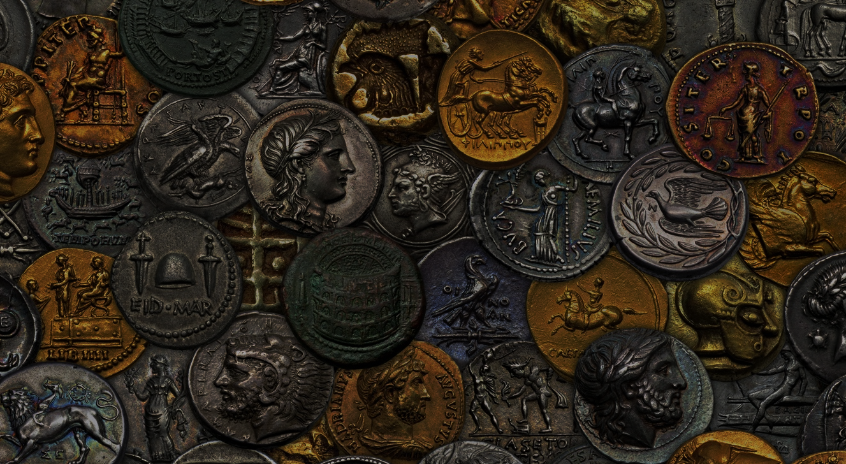
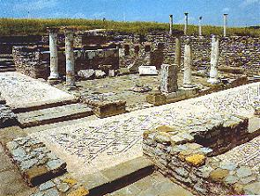
2 Corinthians 8-13

Slide 2
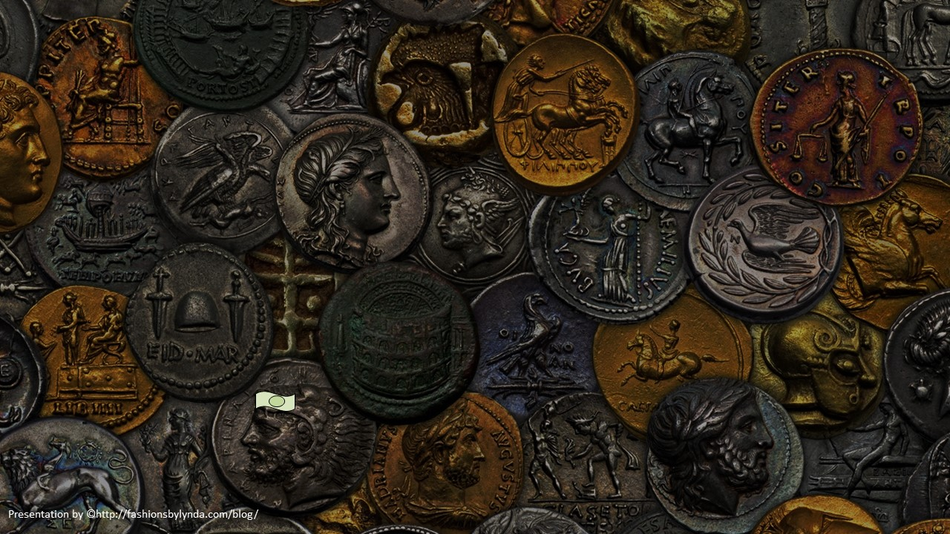
Offerings For The Poor
2 Corinthians 8-9
He hath dispersed, he hath given to the poor; his righteousness endureth for ever; his horn shall be exalted with honour.
Psalms 112:9

Slide 3
What is the Great Challenge?
“Down through history, _____ has been one of humankind’s greatest and most widespread challenges.
Its obvious toll is usually physical, but the spiritual and emotional damage it can bring may be even more debilitating.”

Slide 4
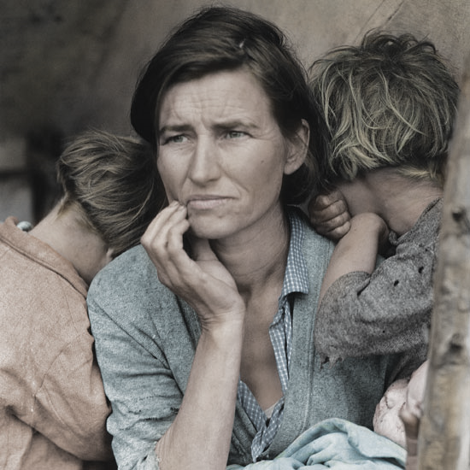
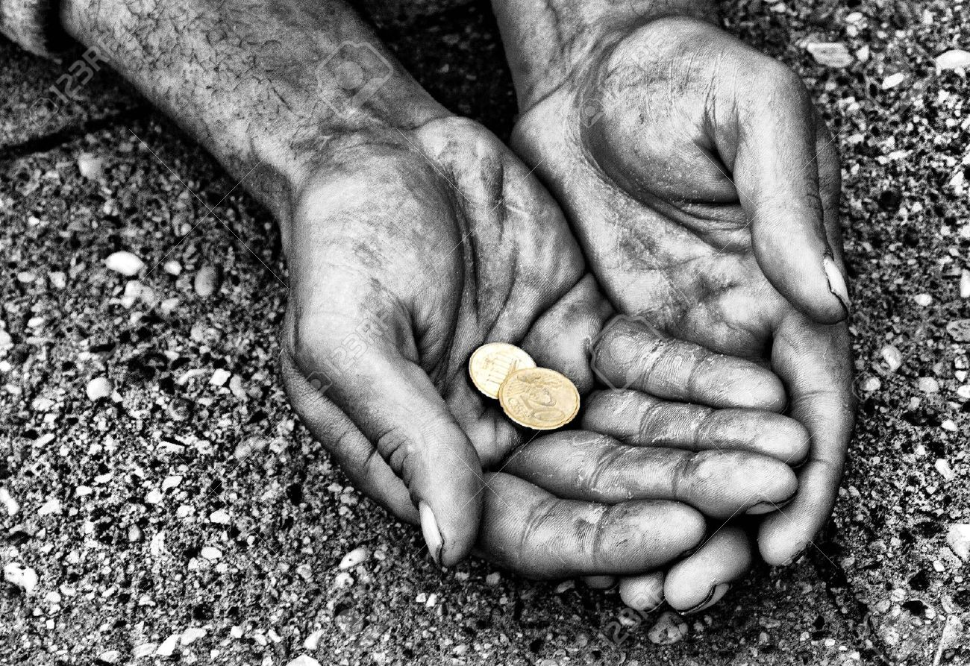
POVERTY
The condition of having little or no money, goods, or means of support.

Slide 5
Macedonia--Generous
Paul told the Corinthian Saints that Church members in Macedonia had given generously to help the poor in their temporal needs.
Macedonia
Black Sea
Rome
Italy
Adriatic Sea
The Macedonian members did so because they desired to do the will of God.
Paul encouraged the Saints of Corinth to follow this example of providing for the needs of others out of sincere love.
Mysia
Sicily
Corinth
Crete
Mediterranean Sea
2 Corinthians 8:1-8

Slide 6
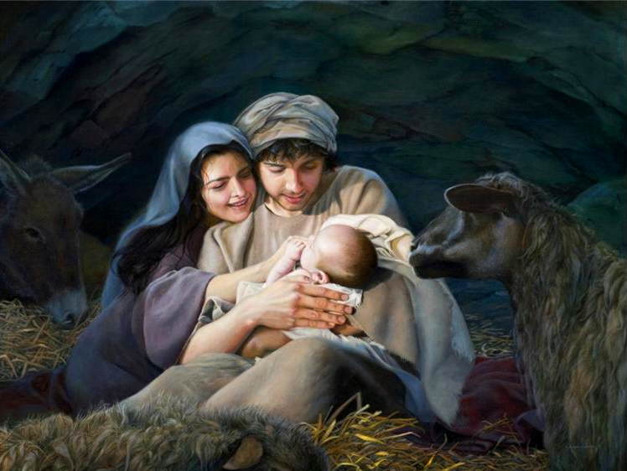
Rich VS Poor
In what ways was Jesus Christ rich in the premortal life?
In what ways might He have been considered poor during His time in mortality?
Jesus Christ was the Firstborn of the Father in the spirit and even before He was born in mortality. Jesus Christ was a God who stood next to Heavenly Father in authority, power, and glory and created many worlds under the direction of the Father.
He left His position of glory to be born in and live among lowly circumstances on earth
2 Corinthians 8:9

Slide 7
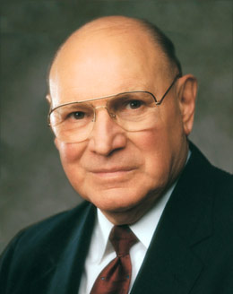
Fast Offering
What is the 2nd Great Commandment?
Thou shalt love thy neighbor as thyself
In The Church of Jesus Christ of Latter-day Saints, members are encouraged to fast whenever their faith needs special fortification and to fast regularly once each month on fast day. On that day, we go without eating or drinking for two consecutive meals, commune with our Heavenly Father, and contribute a fast offering to help the poor. The offering should be at least equal to the value of the food that would have been eaten. (2)
2 Corinthians 8:10-11

Slide 8
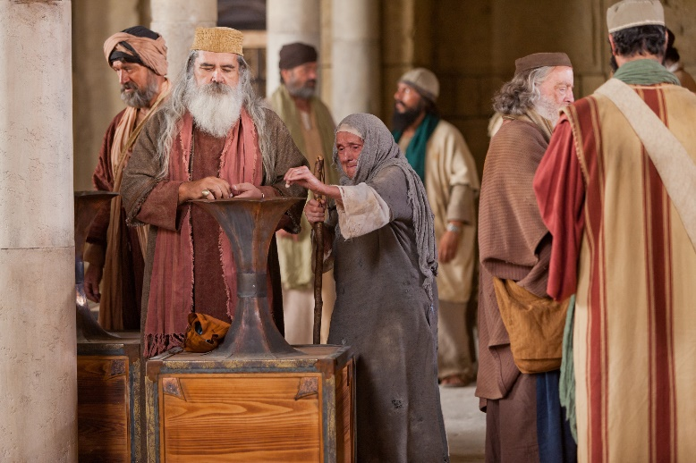
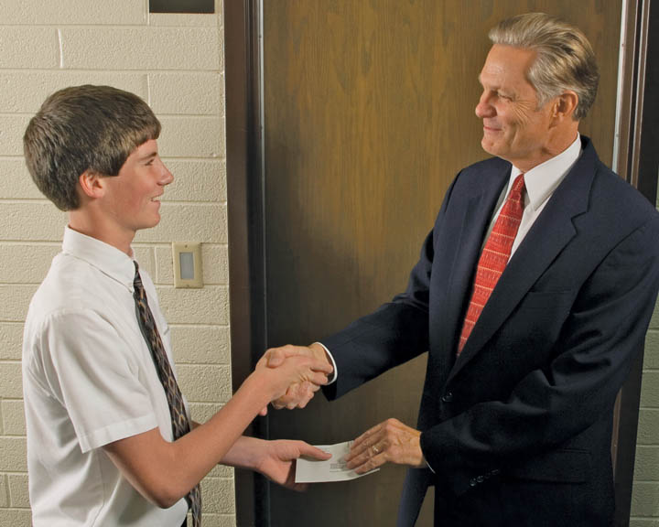
Do Unto Others
Paul admonished the Saints to fulfill their previous commitment to give what they could to the poor Saints, just as the Savior had given eternal riches to them.
"Those who abound in faith and the attributes of godliness are the ones who impart liberally of their substance for the temporal welfare of their brethren in the kingdom." (3)
As we come to understand all the Savior has given us, we will be more willing to give of our substance to others
2 Corinthians 8:10-11

Slide 9
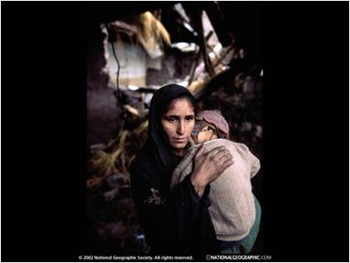
“Rich or poor, we are to ‘do what we can’ when others are in need” (4)
“…that now at this time your abundance may be a supply for their want, that their abundance also may be a supply for your want: that there may be equality.”
Paul was asking the Corinthian Saints to help those in Jerusalem who were less fortunate.
2 Corinthians 8:12-15

Slide 10
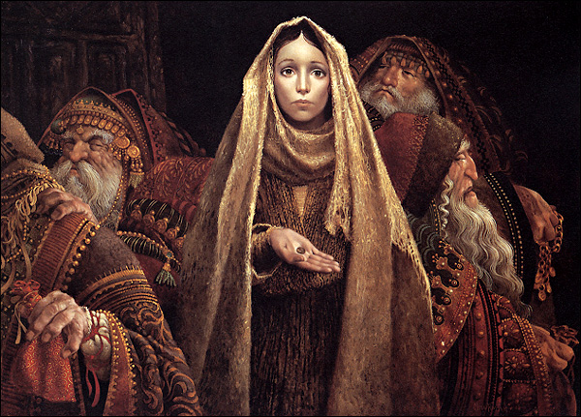
Desire to Give
God wants us to be willing to give even when we may not have anything to give
“I don’t know exactly how each of you should fulfill your obligation to those who do not or cannot always help themselves.
But I know that God knows, and He will help you and guide you in compassionate acts of discipleship if you are conscientiously wanting and praying and looking for ways to keep a commandment, He has given us again and again”
James C. Christensen
2 Corinthians 8:12-15

Slide 11
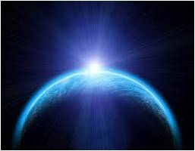
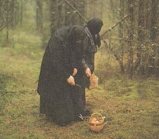
The Earth is full and there is enough and to spare…
“As it is written, He that had gathered much had nothing over; and he that had gathered little had no lack.”
Everything on the earth belongs to the Lord.
Read D&C 104:12-18
2 Corinthians 8:15

Slide 12
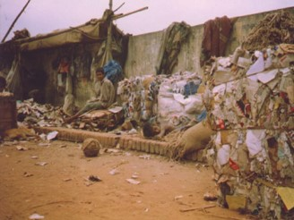
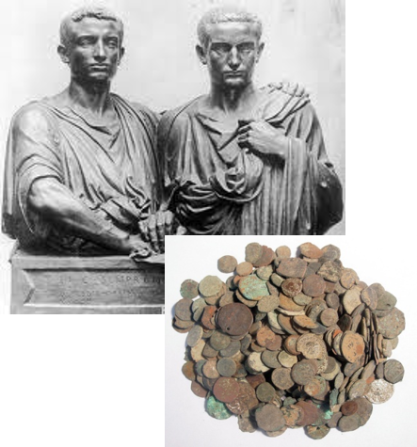
Remember the Poor
“If thou lovest me…thou will remember the poor, and consecrate of thy properties for their support”
“And remember in all things, the poor and the needy, the sick and the afflicted, for he that doeth no these things, the same is not my disciple.”
D&C 42:30; D&C 52:40

Slide 13
Enoch Built a Zion Society
“And the Lord called his people Zion, because they were of one heart and one mind, and dwelt in righteousness; and there was no poor among them”
Moses 7:18

Slide 14
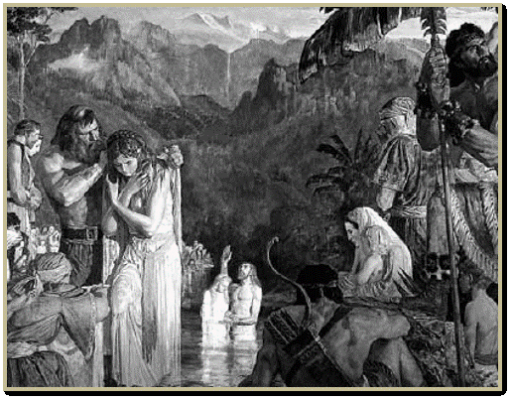
Prosperous In Their Circumstance
An account of Alma, son of Alma and the people.
“And they did impart of their substance, every man according to that which he had, to the poor, and the needy, and the sick, and the afflicted, and they did not wear costly apparel, yet they were neat and comely.”
1 Alma 1:27

Slide 15
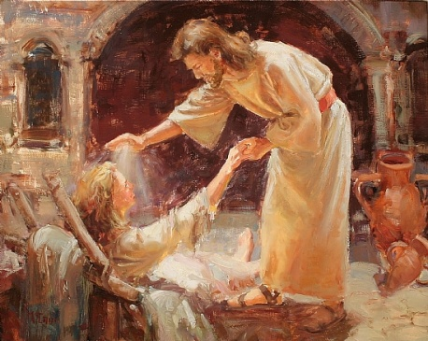
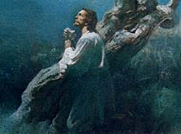
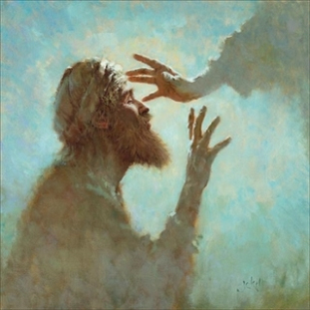
The Savior’s Two Great Missions
2. The work He did among His brethren and sisters in the flesh by way of relieving their sufferings.
The Messiahship---the atonement for the fall---the fulfillment of the law
(5)

Slide 16
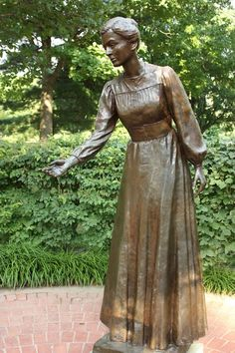
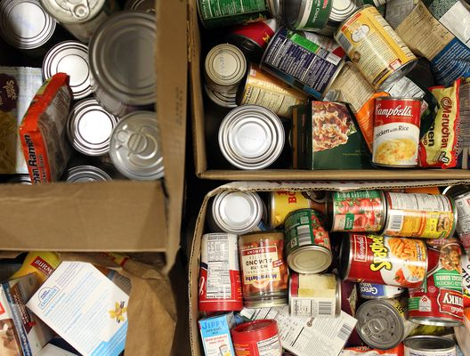
A Law Of Consecration
"In the early part of both this and the meridian dispensations, the saints attempted to live the full law of consecration.
That is, they consecrated their temporal means and spiritual abilities to the Lord's work.
All of their talents, strength, time, properties, and monies were made available for use in the establishment of the Lord's earthly Church and kingdom.
In this dispensation the organizational arrangement where under the principles of consecration operated was the United Order.
The New Testament contains only passing allusions of how the system operated in that day.
(3)
2 Corinthians 9:6-7

Slide 17
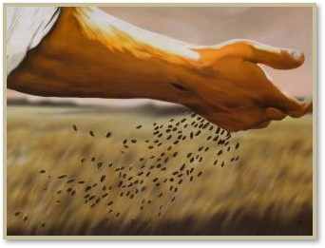
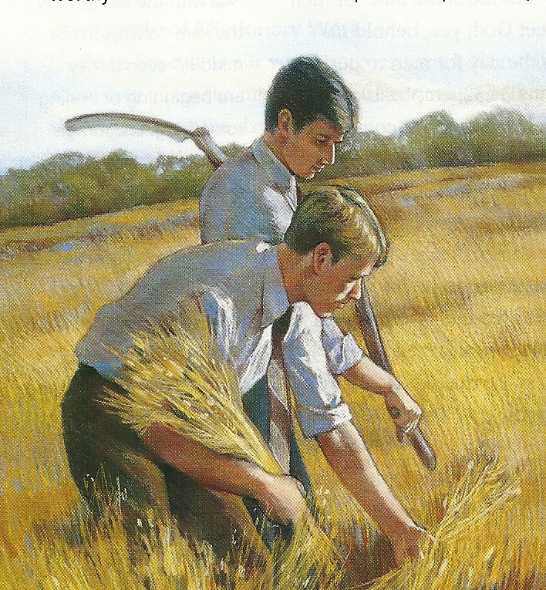
Soweth Bountifully---Reap Bountifully
“Every man according as he purposeth in his heart, so let him give…
…not grudgingly, or of necessity; for God loveth a cheerful giver
If we give to those in need with a cheerful heart, God will generously bless us
2 Corinthians 9:7

Slide 18
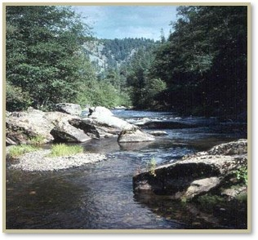
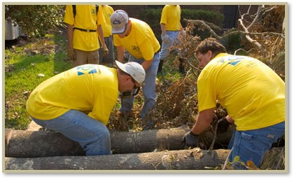
Priesthood Organization—Welfare Program
“The Lord’s way is not to sit at the side of the stream and wait for the water to pass before we cross…
…it is to come together, roll up our sleeves, go to work, and build a bridge or a boat to cross the waters of our challenges.”
(6)

Slide 19
Not Only Tithing and Fast Offerings do we contribute:
Our Time
Our Talents
Our Means
Ourselves
Food

Slide 20
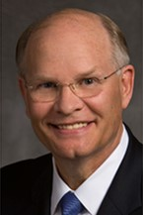
Each of us has received gifts that we could not provide for ourselves, gifts from our Heavenly Father and His Beloved Son, including redemption through the atoning sacrifice of Jesus Christ.
We have received life in this world; we will receive physical life in the hereafter, and eternal salvation and exaltation—if we choose it—all because of Heavenly Father and Jesus Christ.
Every time we use, benefit from, or even think of these gifts, we ought to consider the sacrifice, generosity, and compassion of the givers.
Reverence for the givers does more than just make us grateful. Reflecting on Their gifts can and should transform us.
(8)

Slide 21
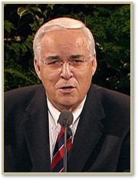
“The Savior wants us to love others as He loves them.
It is not necessary for us to lay down our life for others as He did.
But like the Savior, we should bless the lives of others by giving of what our life is made up of—our time, our talents, our means, and ourselves.”
(7)

Slide 22
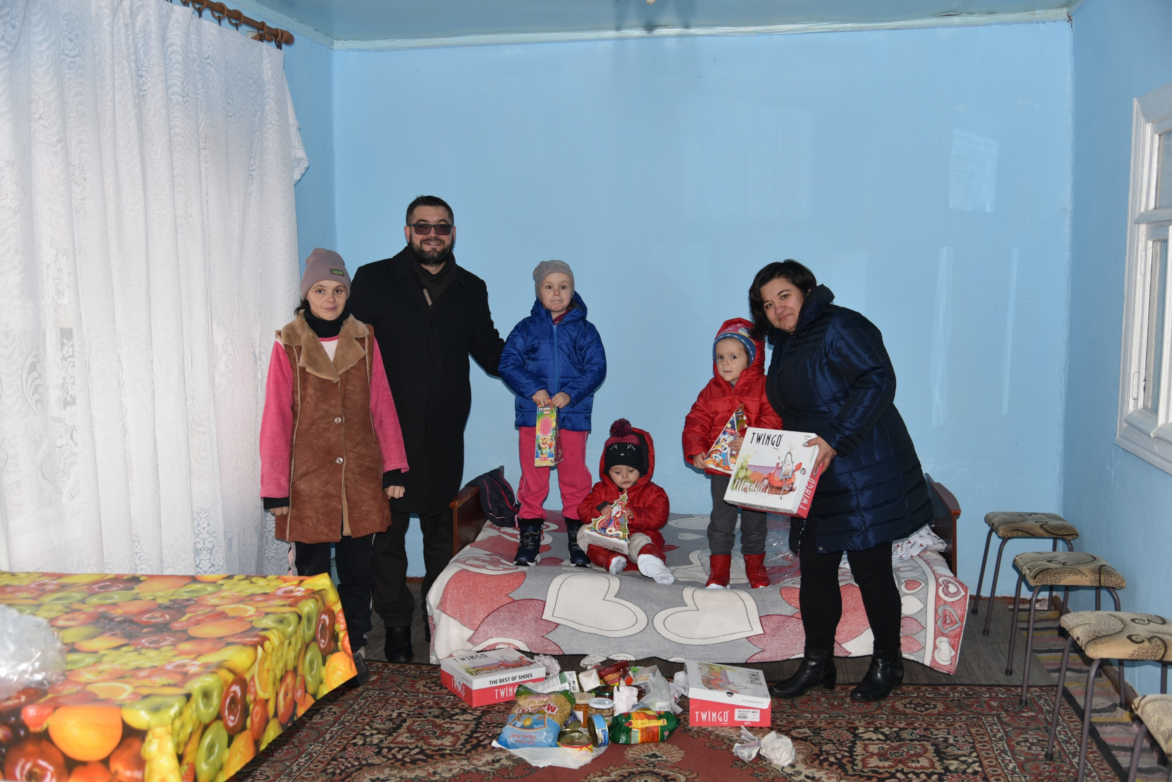
Latter-day Saint Charities has provided more than two billion dollars in aid to assist those in need throughout the world.
This assistance is offered to recipients regardless of their church affiliation, nationality, race, sexual orientation, gender, or political persuasion.
Coats and Shoes for the children in Orhei, Moldova 2022
That is not all. To assist members of the Lord’s Church in distress, we love and live the ancient law of the fast.
We go hungry to help others who are hungry. One day each month, we go without food and donate the cost of that food (and more) to help those in need.
Food donated to Ukraine during War 2022
(9)
Isaiah 58:3–12

Slide 23
Sources:
New Testament Institute Student Manual Chapter 39
Elder Joseph B. Wirthlin The Law of the Fast April Gen. Conf. 2001
Elder Bruce R. McConkie (Doctrinal New Testament Commentary, 3 vols. [Salt Lake City: Bookcraft, 1965-1973], 2:433; 2:57)
Elder Jeffrey R. Holland (“Are We Not All Beggars?” 41).
J. Reuben Clark Jr. Conference Report April 1937
Dieter F. Uchtdorf Conference Report October 2011 “Providing in the Lord’s Way”
Elder Robert J. Whetten “How Can I Help?” April 1999 Conference “True Followers”
Dale G. Renlund, “Consider the Goodness and Greatness of God,” Ensign or Liahona, May 2020, 42
Russell M. Nelson, “The Second Great Commandment,” Ensign or Liahona, Nov. 2019, 97–98
Presentation by ©http://fashionsbylynda.com/blog/

Slide 24
Second Letter of Paul to the Saints at Corinth— Written from Macedonia
Saints Impart Substance to Poor | 8:1–24
The Blessings of True Charity | 9:1–15
Providing 2 Corinthians 8:14:
“This very hour there are many members of the Church who are suffering. They are hungry, stretched financially, and struggling with all manner of physical, emotional, and spiritual distress. They pray with all the energy of their souls for succor, for relief.
“Brethren, please do not think that this is someone else’s responsibility. It is mine, and it is yours. We are all enlisted. ‘All’ means all—every Aaronic and Melchizedek Priesthood holder, rich and poor, in every nation. In the Lord’s plan, there is something everyone can contribute” (“Providing in the Lord’s Way,” Ensign or Liahona, Nov. 2011, 54).
Life and Teachings of Jesus and His Apostles Chapter 37
Give to the Poor 2 Corinthians 8:10-11:
“‘I am a firm believer that you cannot give to the Church and to the building up of the kingdom of God and be any poorer financially. I remember … when Brother [Melvin J.] Ballard laid his hands on my head and set me apart to go on a mission. He said in that prayer of blessing that a person could not give a crust to the Lord without receiving a loaf in return. That’s been my experience. If the members of the Church would double their fast-offering contributions, the spirituality in the Church would double. We need to keep that in mind and be liberal in our contributions.’ Marion G. Romney (Welfare Agricultural Meeting, 3 Apr. 1971, p. 1.)” (in L. Tom Perry, “The Law of the Fast,” Ensign, May 1986, 32).
Welfare Donations to Jerusalem 2 Corinthians 9:1-15:
"Paul explains at some length that his purpose in going to Judea was to take a welfare donation from Macedonia and Achaia to the 'poor saints which are at Jerusalem.' ...in 2 Corinthians 9:1-15...Paul urges the Corinthian saints to get their donation ready beforehand so that he could obtain it when he arrived. The emphasis on these things brings us to another significant feature. Acts 11:27-30 makes scant reference to Paul as a welfare worker and mentions one occasion when with Barnabas he took a donation to the saints in Jerusalem. This was about A.D. 41 or 44 and was possibly Paul's earliest experience with welfare as a Church program. However, as indicated above, his epistles give evidence that in the years that followed he became a diligent welfare worker, collecting donations throughout Galatia (see 1 Cor. 16:1), Macedonia (see Rom. 15:25-26), and Greece (see 2 Cor. 9:1-5) for the Judean saints." (Robert J. Matthews, "St. Paul Writes about the Church," New Era, Apr. 1977, 33, 35)
Lesson in Giving What We Can:
"The widow's mite, how large it is on the ledgers of heaven!
"Out of their surplus, without sacrifice, often with selfish motives, frequently amid the blare of trumpets, rich men are sometimes wont to give to worthy causes. Meanwhile, the poor, out of their penury, unknown to their fellowmen, but because their hearts are right, sometimes give unheralded 'mites' to like worthy causes.
"Gift giving...must be measured in terms of capacity to give. The widow who cast in less than a half cent in American coinage, proportionately gave more than all the rich whose surpluses crammed the coffers in the temple court. See Luke 14:25-33.
"This episode in Jewish life-and Jesus deliberately took occasion to call attention to it that it's lesson might be preserved-teaches that the giver is greater than the gift; that sacrifice of all, though such be small in amount, is greater than the largess of kings who neither miss nor need that which they give away; and that it is the intent of the heart, not the value of the gift, which counts on the eternal ledgers. 'For if there be first a willing mind, it is accepted according to that a man hath, and not according to that he hath not.' (2 Cor. 8:12.)" Elder Bruce R. McConkie (Doctrinal New Testament Commentary, 3 vols. [Salt Lake City: Bookcraft, 1965-1973], 1: 628.)
Cheerfulness Giving 2 Corinthians 9:7:
"We say to the Saints, do not pay Tithing, unless you want to; do not help to build up this Temple unless you want to; do not put forth your hands to one day's work, unless you want to. . . . If you grudgingly put forth your means to help to gather the Saints, it will be a curse to you.“ President Brigham Young (Hugh Nibley, Brother Brigham Challenges the Saints, p. 460)
"The Lord loveth a cheerful giver-one who can go to the bishop and say: 'Bishop, I feel all right. I want to help the Church. I am going to do all I can. Here is my tithing, my full tithing. I want to build up this work and be the means of helping it.' If he goes in that spirit, thankful for what he has received, he will obtain the blessing. But let him not give something merely in the hope of getting more in return, for that spirit will not do at all. Let him give in this spirit: 'Lord, thou hast blessed me. Here is thy portion. Of all that thou wilt give unto me, I will surely give a tenth unto thee.'" Charles W. Nibley (Conference Report, October 1927, Afternoon Meeting. 90 - 91.)

Slide 25
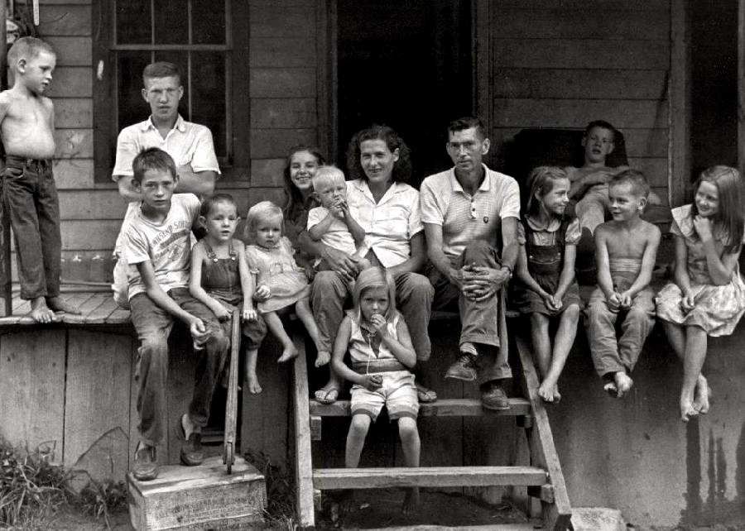
Something of Interest
Apalachia was a pocket of poverty in America. This photograph was taken in Leatherwood, Perry County, Kentucky, in 1964. It shows the Cornett family on the porch of their mountain cabinet. The parents Willie and Vivian Cornett had twelve children. Here we have a question of what is poverty. The children look well fed and they have adequate if shabby shelter. We suspect that they also had a car, refrigerator, and television set.
Yet most Americans would classify the family as living in poverty.
2011
http://histclo.com/eco/cou/na/us/use-pov.html

Slide 26
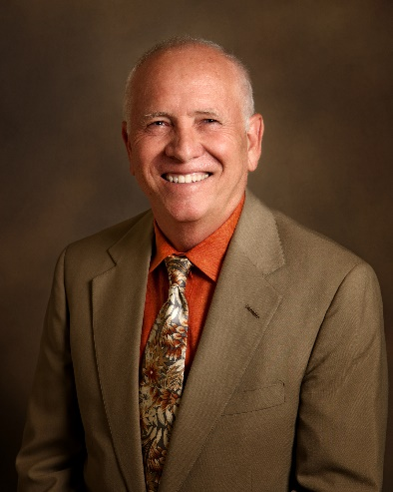
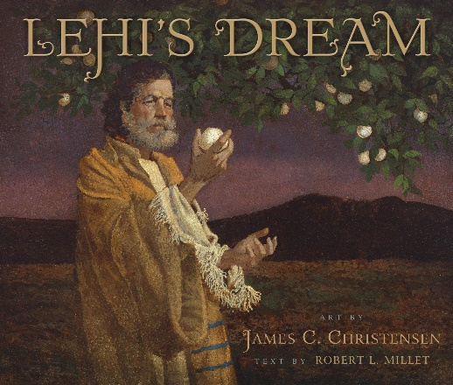
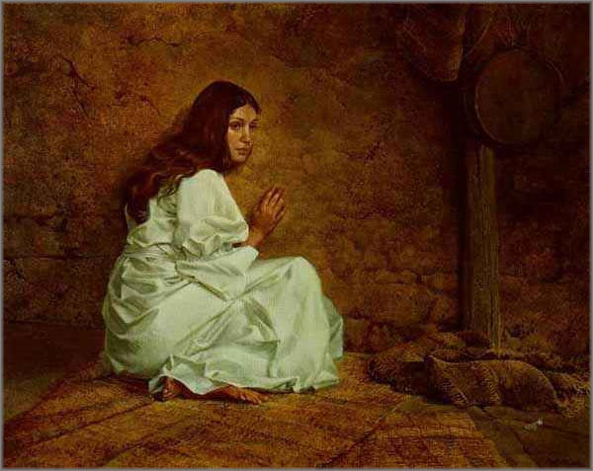
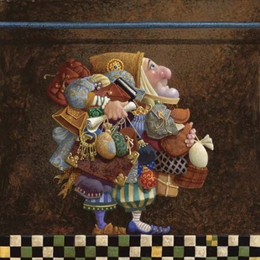
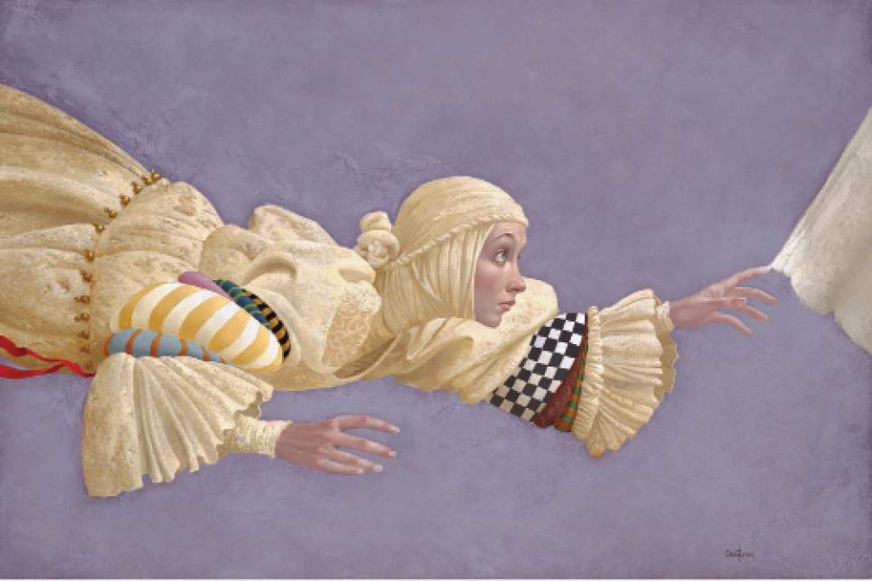
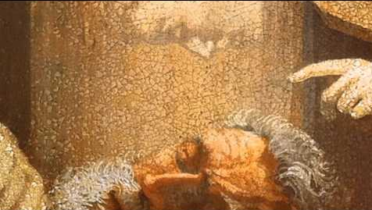
Something of Interest:
In searching for artwork I find inspiration in these artists. One of my favorite artists was James C. Christensen. Author of Website—L.B.
Mormon artist James C. Christensen dead at 74
The Salt Lake Tribune
James C. Christensen, a painter renowned for religious- and fantasy-based imagery, and a former art professor at Brigham Young University, died Sunday, January 8, 2017, in Orem from the effects of cancer. He was 74.
Christensen was born Sept. 26, 1942, and was raised in Culver City, Calif. He served a two-year mission to Uruguay for The Church of Jesus Christ of Latter-day Saints, then attended the University of California at Los Angeles for a time before moving to Utah and graduating from BYU.
He taught at the LDS Church-owned Provo school for 21 years, and had his work featured in shows throughout the West, as well as in publications such as Spectrum, American Illustration Annual and Japan's Outstanding American Illustrators.
His works were often based on myths, fables and spirituality, though he told The Salt Lake Tribune in 2008 that connections between his faith and his art were not always overt.
"When you live your religion," he said, "it permeates your life and influences what you choose to do and not to do."
Christensen published three books of his work. He also received myriad honors throughout his life, including from the World Science Fiction and Fantasy Convention as well as from the Association of Science Fiction and Fantasy Arts. He received the Governor's Award for Art by the Utah Art Council and was named one of Utah's Top 100 Artists by the Springville Museum of Art.
"The passing of my friend and mentor James Christensen has rekindled fond memories of his positivity and enthusiasm in the classroom and on study abroad where, with his encouragement and because of his example, I made a commitment at age 24 to pursue a life in art," fellow Provo artist Kent Christensen (no relation) wrote on Facebook. "I drew Jim on May 15th, 1981, the way I always think of him: sketching curbside in some European city. That day it was Segovia. Those weeks spent with him changed my life."
Christensen is survived by his wife, Carole, and their five children.

Slide 27
Trial of Your Faith
2 Corinthians 10-13
I have heard their prayers, and will accept their offering; and it is expedient in me that they should be brought thus far for a trial of their faith.
D&C 105:19

Slide 28
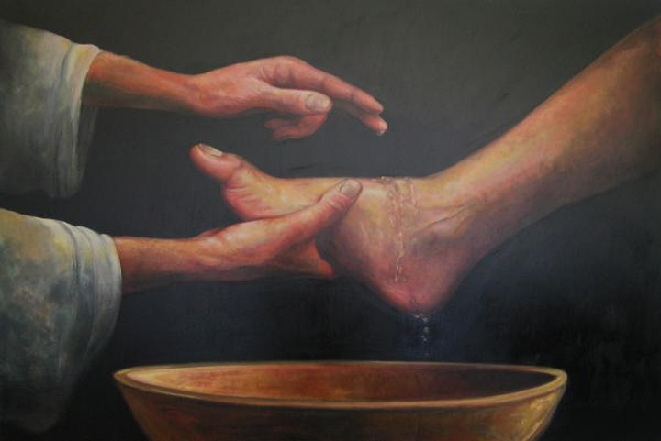
Meekness
“The Greek rendition of the word meek in the New Testament, by the way, is 'gentle and humble.‘”
“One cannot develop those other crucial virtues-faith, hope, and charity-without meekness.”
Wherefore, if a man have faith he must needs have hope; for without faith there cannot be any hope.
And again, behold I say unto you that he cannot have faith and hope, save he shall be meek, and lowly of heart.
Moroni 7:42-43
2 Corinthians 10:1
(2)

Slide 29
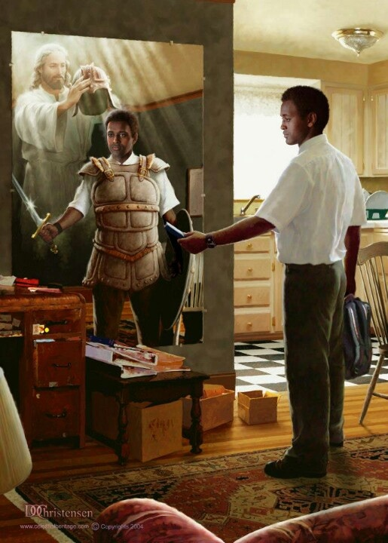
Spiritual Warfare
A war of words, a war of ideas, a war of testimony, and a war of faith.
We do not go against our principles, and the covenants (baptisms) we have taken.
Doc Christensen
Doc Christensen
Our fight is fought with words, faith, testimony, and the Spirit. It is a fight to the death-to the spiritual death of Satan and his forces.
And yet, ironically, while our enemy fights to increase the spiritual casualties on both sides of the conflict, our goal is to destroy only Satan and to save the rest of enemy from becoming 'angels to a devil‘ (3)
2 Corinthians 10:3-6

Slide 30
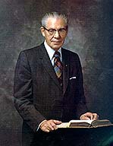
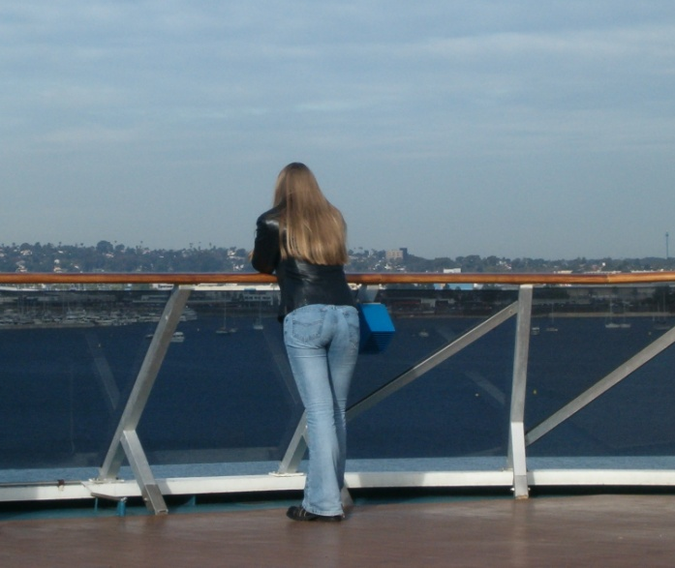
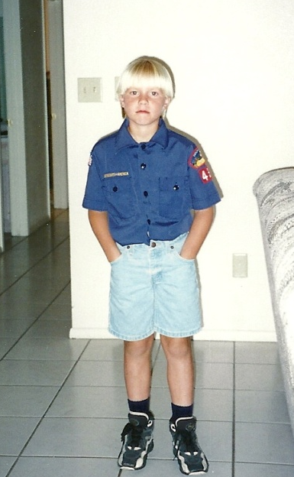
“It is important that we make up our minds early in life as to what we will do and what we will not do.
Long before the moment of temptation comes, we should have determined that we will resist anything that will keep us from enjoying the companionship of the Spirit of the Lord.”
(4)

Slide 31
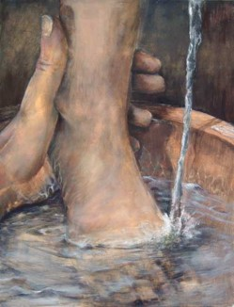
Casting Down Imaginations
humble yourselves
and control your thoughts and actions
2 Corinthians 10:5

Slide 32
“And having in a readiness to revenge all disobedience, when your obedience is fulfilled.”
“For as he thinketh in his heart, so is he…”
—Proverbs 23:7
2 Corinthians 10:6

Slide 33
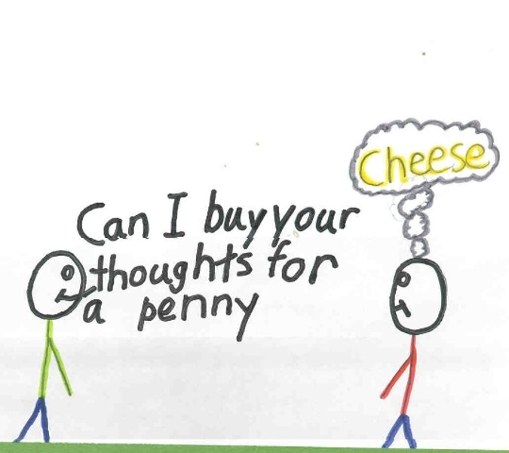
“Yea, I tell thee, that thou mayest know that there is none else save God that knowest thy thoughts and the intents of thy heart.”
D&C 6:16

Slide 34
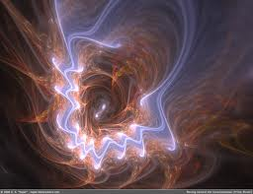
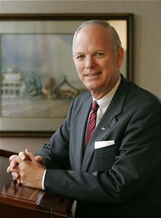
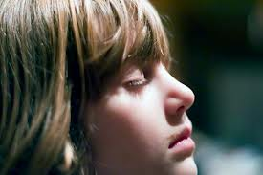
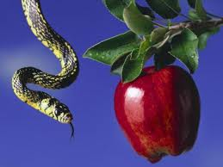
“Look unto me in every thought; doubt not, fear not.”
“…learn to control your thoughts…there will always be temptations.”
D&C 6:36
(5)

Slide 35
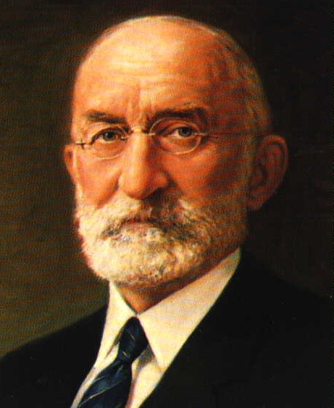
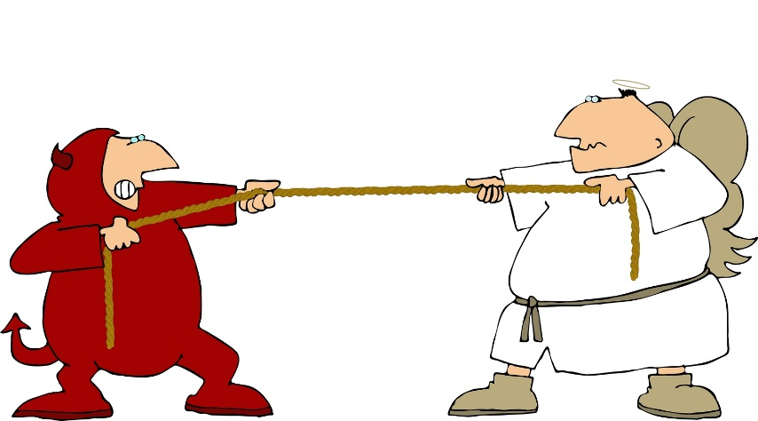
“There is a line of demarcation well defined between the Lord’s territory and the devil’s territory. If you will remain on the Lord’s side of the line, the adversary cannot come there to tempt you.
…But …if you cross onto the devil’s side of the line, you are in his territory…and he will work on you to get you just as far from that line as he possibly can…
(6)

Slide 36
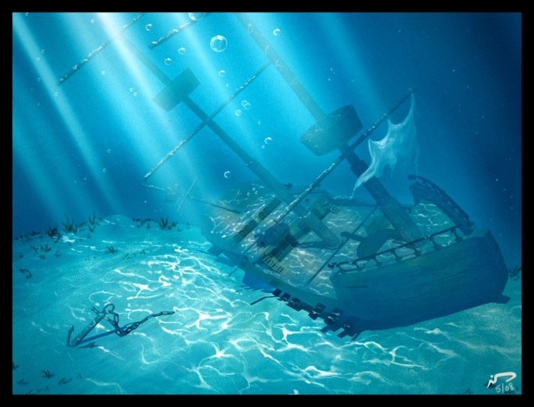
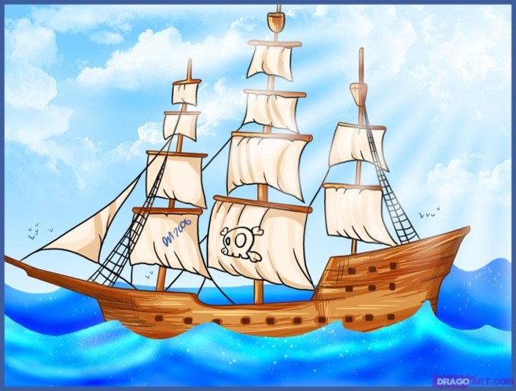
“All the water in the world,
However hard it tried,
Could never sink the smallest ship
Unless it gets inside…
…And all the evil in the world,
The blackest kind of sin,
Can never hurt you the least bit
Unless you let it in.”
(7)

Slide 37
Satan’s Power to Deceive
“But I fear, lest by any means, as the serpent beguiled Eve through his subtilty, so your minds should be corrupted from the simplicity that is in Christ.”
2 Corinthians 11:3

Slide 38
Another Spirit
“For if he (Satan) that cometh preacheth another Jesus, who we have not preached, or if ye receive another spirit, which ye have not received…
…or another gospel, which ye have not accepted, ye might well bear with him.”
2 Corinthians 11:4

Slide 39
Satan Transforms
Satan can transform himself into an angel of light in order to deceive.
Hebrew word for "serpent“ is
"luminous"
or "shining."
Lucifer was seeking to usurp the role
of Christ
by appearing to
Adam and Eve
as the "Messiah.”
2 Corinthians 11:14

Slide 40
Ministers of Righteousness
--those who deceive--
Without the proper priesthood authority, those who follow Satan may pretend to be ministers of light for the same purpose.
“…it is no great thing if his ministers also be transformed as the ministers of righteousness; whose end shall be according to their works.”
2 Corinthians 11:15

Slide 41
Book of Mormon--Korihor
Korihor deceives many Nephites
“…But the devil hath deceived me; for he appeared unto me in the form of an angel…”
Alma 30:50-53

Slide 42
Looking At The Future
“For many shall come in my name, saying, I am Christ; and shall deceive many.”
“No man nor sect of men without the regular constituted authorities, the Priesthood and discerning of spirits, can tell true from false spirits.”
Mark 13:6
(8)

Slide 43
“Many men are depending upon their own research to find out God…they are not seeking for the Spirit of the Lord; they are not striving to know God in the manner in which he has marked out by which he may be know; but they are walking in their own way, believing in their own man-made philosophies, teaching the doctrines of devils and not the doctrines of the Son of God.” (9)
“Today the world is full of alluring and attractive ideas that can lead even the best of our members into error and deception.” (10)

Slide 44
Wise as Serpents
“Therefore, be ye as wise as serpents and yet without sin; and I will order all things for your good, as fast as ye are able to receive them. Amen”
“We wrestle against the rulers of darkness….against spiritual wickedness in high places.”—Ephesians 6:12
D&C111:11
2 Corinthians 11:15

Slide 45
The Holy Spirit As Our Guide
Using the scriptures and the prophets and the Holy Spirit as a guide can help eliminate the many deceptions that Satan has revealed to us.
Paul was teaching the saints how to discern between false prophets and the true living gospel of Christ.
2 Corinthians 11:15

Slide 46
The Third Heaven
The man whom Paul knew was Paul himself.
“Paul ascended into the third heavens, and he could understand the three principal rounds of Jacob’s ladder—the telestial, the terrestrial, and the celestial glories or kingdoms, where Paul saw and heard things which were not lawful for him to utter.” (8)
Paul reinforced his authority as an Apostle of Jesus Christ
Read Genesis 28:10-15
2 Corinthians 12

Slide 47
The Ladder is Not An Escalator
A Ladder requires climbing
You must make the effort to climb it
The ladder to Heaven is on the ground right next to where you are standing, but you have to take hold of it, step up on it, and ascend.
You are not supposed to just stand still.
http://www.clarion-call.org/yeshua/jacob/ladder.htm

Slide 48
Thorns in Your Life
What do you think is the purpose of the thorns on a rose bush?
In life, we have many wonderful experiences that can be compared with a rose.
However, we also face trials and challenges that could be compared with the thorns.
What are some trials and challenges that people may face in life?
(2)

Slide 49
Painful Thorns Among Beauty
Thorns on roses are technically called prickles. Thorns are a harder growth and prickles are softer, and they can be very sharp.
There is a good reason for these thorns, they weren’t just created to annoy, they have a purpose and are very important to the rose’s wellbeing because the thorns protect the flower from predators.
Thorns are very unpleasant but, they guarantee the roses’ survival from the threatening humans and animals. They often curve downwards to prevent animals from climbing up and eating the rose. The thorns keep the flower beautiful.
Those prickly, painful times we go through are really the ones that bring out the beauty in us.
Rose thorns have been recognized for a long time as a symbol of adversity as well as sacrifice.
(15)
L. Blau

Slide 50
Thorn in the Flesh
A thorn or splinter that causes significant irritation
Small, non lasting irritations
HOWEVER…
“…some challenges in life will not be resolved here on earth.
Paul pled thrice that ‘a thorn in the flesh’ be removed. The Lord simply answered, ‘My grace is sufficient for thee: for my strength is made perfect in weakness’ .
He gave Paul strength to compensate so he could live a most meaningful life. He wants you to learn how to be cured when that is His will and how to obtain strength to live with your challenge when He intends it to be an instrument for growth. In either case the Redeemer will support you.”
Sliver in the skin
Canker in the mouth
Pebble in a shoe
Ringing in the Ear
2 Corinthians 12:7-8
(11)

Slide 51
God is willing for us to undergo that challenge. Yet He promises us that His grace is sufficient for us.
He even indicates that some of the weaknesses and infirmities given to us can actually become a strength to us.
It is in our weakness and extremity that God's power is fully felt.
Only when, of ourselves, we are helpless is His help truly appreciated."
2 Corinthians 12:9-10; Ether 12:26-27
(2)

Slide 52
Those Who Are Critical
The Saints in Corinth were publicly critical of Paul.
Paul called them to repentance with strong language.
President George Q. Cannon gave a warning that I pass on to you as my own. I believe he spoke the truth: “… No man … can speak evil of the Lord’s anointed and find fault with God’s authority on the earth without incurring His displeasure.
The Holy Spirit will withdraw himself from such a man, and he will go into darkness.
This being the case, do you not see how important it is that we should be careful?”
(16)
2 Corinthians 13:1-2

Slide 53
It takes faith to believe that [Jesus Christ] knows the people He calls perfectly, both their capacities and their potential, and so makes no mistakes in His calls.
That may bring a smile or a shake of the head to some in this audience—both those who think their own call to serve might have been a mistake as well as those who picture some they know who seem poorly suited to their place in the Lord’s kingdom.
My counsel to both groups is to delay such judgments until you can better see what the Lord sees.
The judgment you need to make, instead, is that you have the capacity to receive revelation and to act on it fearlessly.
(16)

Slide 54
Sustaining
Have I thought or spoken of human weakness in the people I have pledged to sustain?
Have I looked for evidence that the Lord is leading them?
Have I conscientiously and loyally followed their leadership?
Have I spoken about the evidence I can see that they are God’s Servants?
Do I pray for them regularly by name and with feelings of love?
Those questions will, for most of us, lead to some uneasiness and a need to repent. (16)

Slide 55
Finding Fault With the Church
[If a man] rises up to condemn others, finding fault with the Church, saying that they are out of the way, while he himself is righteous, then know assuredly, that that man is in the high road to apostasy; and if he does not repent, will apostatize, as God lives.
(8)

Slide 56
But I Have a Question
Is it all right to have questions about the Church or its doctrine? My dear young friends, we are a question-asking people … because we know that inquiry leads to truth. …
… Some might feel embarrassed or unworthy because they have searching questions regarding the gospel, but they needn’t feel that way. Asking questions isn’t a sign of weakness; it’s a precursor of growth. …
Fear not; ask questions.
Be curious but doubt not! Always hold fast to faith and to the light you have already received. Because we see imperfectly in mortality.
Not everything is going to make sense right now.
(17)

Slide 57
Trial of Your Faith
“Examine yourselves, whether ye be in the faith; prove your own selves. Know ye not your own selves, how that Jesus Christ is in you, except ye be reprobates?”
Reprobates: Corrupt or Immoral; Those who are unworthy
The Lord may not always remove our challenges, but we can be strengthened by His grace as we endure them faithfully.
2 Corinthians 13:5

Slide 58
Fiery Trials
“…think it not strange concerning the fiery trial which is to try you, as though some strange thing happened unto you:”
The Fiery Trials are to make you stronger, but they have the potential to diminish or even destroy your trust in the Son of God, and to weaken your resolve to keep your promises to Him.
2 Corinthians 13:5; 1 Peter 4:12
(12)

Slide 59
Gift of Faith
“The gift of faith is a priceless spiritual endowment.”
“Our faith is centered in God, our Father, and in His Son, Jesus Christ, our Savior and Redeemer.”
2 Corinthians 13:5
(12)

Slide 60
1. Immerse yourself in the very things that helped build your core of faith.
8. Ask for a Priesthood blessing to ease your trial.
2. Don’t step away from the Church…this is your sanctuary to protect your faith.
Remaining Faithful during trials:
7. If you are able to partake of sacrament, do so with the atonement in mind.
3. Pray to find answers.
6. Share or read your testimony, the one that converted you.
4. Read and ponder scriptures and what the Savior teaches.
5. Serve one another. Service helps take your mind off of yourself.
2 Corinthians 13:5
(12)

Slide 61
Overcome
“When you are faced with a test of faith, stay within the safety and security of the household of God.”
(12)

Slide 62
Peace
“Peace I leave with you, my peace I give unto you: not as the world giveth, give I unto you. Let not your heart be troubled, neither let it be afraid.”
“No trial is so large we can’t overcome it.
2 Corinthians 13:11; John 14:27

Slide 63
Wall of Faith
“Every (person) eventually is backed up to the wall of faith, and there…must make his stand.”
(12)

Slide 64
Covenants
“There may be anguish, confusion, sleepless nights, and pillows wet with tears.
But our trials need not be spiritually fatal.
They need not take us from our covenants or from the household of God.”
(12)

Slide 65
Submit to all things
“As it must be with anyone who seeks sainthood, Paul had to be ‘willing to submit to all things which the Lord seeth fit to inflict upon him.’”
Read Mosiah 3:19
(2)

Slide 66
Moroni
“…I would show unto the world that faith is things which are hoped for and not seen; wherefore, dispute not because ye see not for ye receive no witness until after the trial of your faith.”
Ether 12:6

Slide 67
Passing Through
“Hold on… , fear not…, for God shall be with you forever and ever.”
“We may pass through the fiery furnace…we shall emerge from all these trials and difficulties the better and purer for them, if we only trust in our God and keep His commandments.”
D&C 122:9
(13)

Slide 68
Sources:
New Testament Institute Student Manual Chapter 39
Elder Neal A. Maxwell ("Meekness-A Dimension of True Discipleship," Ensign, Mar. 1983, 70) ;(All These Things Shall Give Thee Experience [Salt Lake City: Deseret Book Co., 1979], 31.
Gospeldoctrine.com
N. Eldon Tanner “Put on the Whole Armor of God” 1979 April General Conference
W. Dahlquist II “Who’s on the Lord’s Side?” 2007 April General Conference
George Albert Smith Oct. Conference Report 1945
Boyd K. Packer Nov. Ensign 1999 “The Spirit of Revelation”
Joseph Smith “Teachings of the Prophet Joseph Smith” page 213; 304–5; Teachings of Presidents of the Church: Joseph Smith [2007], 318
Joseph Fielding Smith “Doctrines of Salvation” vol. 3 pg. 275
Ezra T. Benson “The Teachings of Ezra Taft Benson” pg. 302, 303
Elder Richard G. Scott (“To Be Healed,” Ensign, May 1994, 7).
Elder Neil L. Anderson “Trial of Your Faith” 2012 October General Conference
Ezra T. Benson Teaching of Presidents of the church: Joseph Smith (2007)
14. George Q. Cannon (Remarks: Deseret Evening News, Mar. 7 1891) also found in: Jeffrey R. Holland “Come unto Me,” Ensign April 1998
15. Taken from an excerpt by Susanna of Littlemiracles
16. Henry B. Eyring, “The Power of Sustaining Faith,” Ensign or Liahona, May 2019, 59; “The Lord Leads His Church,” Ensign or Liahona, Nov. 2017, 82
17. Dieter F. Uchtdorf, “The Reflection in the Water” [Church Educational System devotional for young adults, Nov. 1, 2009
Presentation by ©http://fashionsbylynda.com/blog/

Slide 69
Second Letter of Paul to the Saints at Corinth— Written from Macedonia
Paul Glories in the Lord | 10:1–18; 11:1–11
Satan’s False Apostles | 11:12–15
Paul’s Sufferings for Christ | 11:16–33
The Third Heaven | 12:1–6
Strength in Weakness | 12:7–10
Signs of an Apostle | 12:11–21; 13:1–4
Saints Should Prove Themselves | 13:5–14
Compare and Measure Ourselves 2 Corinthians 10:12, 18:
“At its core, pride is a sin of comparison, for though it usually begins with ‘Look how wonderful I am and what great things I have done,’ it always seems to end with ‘Therefore, I am better than you.’
“When our hearts are filled with pride, we commit a grave sin, for we violate the two great commandments [see Matthew 22:36–40]. Instead of worshipping God and loving our neighbor, we reveal the real object of our worship and love—the image we see in the mirror.
“Pride is the great sin of self-elevation. …
“This sin has many faces. It leads some to revel in their own perceived self-worth, accomplishments, talents, wealth, or position. They count these blessings as evidence of being ‘chosen,’ ‘superior,’ or ‘more righteous’ than others. This is the sin of ‘Thank God I am more special than you.’ At its core is the desire to be admired or envied. It is the sin of self-glorification.” President Dieter F. Uchtdorf (“Pride and the Priesthood,” Ensign or Liahona, Nov. 2010, 56).
Life and Teachings of Jesus and His Apostles Chapter 37
Control Your Thoughts and Actions 2 Corinthians 10:3-6:
“Young Latter-day Saints, shape up! Face up! Take hold of your lives!
Take control of your mind, your thoughts!
If you have friends that are not a good influence, make changes, even if you face loneliness, even rejection.
If you have already made bad mistakes, there are ways to fix things up, and eventually it will be as though they never happened.
Sometimes guilt controls our minds and takes us prisoner in our thoughts. How foolish to remain in prison when the door stands open. Now, don’t tell yourself that sin really doesn’t matter. That won’t help; repentance will.
Take charge of yourself. How wonderful to be a young Latter-day Saint in this wonderful, challenging time.” Boyd K. Packer Nov. Ensign 1999 “The Spirit of Revelation.”
Satan as an Angel 2 Corinthians 11:14:
"When the Prophet Joseph Smith and a company of brethren were journeying to Kirtland from Missouri, they camped at McIlwaine's Bend on the Missouri River. There Elder William W. Phelps 'in open vision by daylight, saw the destroyer in his most horrible power, ride upon the face of the waters; others heard the noise, but saw not the vision.' (D.H.C., Vol. 1, p. 203.) The Savior declared that Satan had the power to bind bodies of men and women and sorely afflict them. (Matthew 7:22-23; Luke 13:16.) If Satan has power to bind the bodies, he surely must have power to loose them. It should be remembered that Satan has great knowledge and thereby can exercise authority and to some extent control the elements, when some greater power does not intervene. Paul, writing to the Ephesian Saints called Satan 'The prince of the power of the air, the spirit that now worketh in the children of disobedience.' (Ephesians 2:2.)" Joseph Fielding Smith (Answers to Gospel Questions, 5 vols. [Salt Lake City: Deseret Book Co., 1957-1966], 1: 178.)
Angel of Light (Satan) 2 Corinthians 11:14:
"There have also been ministering angels in the Church which were of Satan appearing as an angel of light. A sister in the state of New York had a vision, who said it was told her that if she would go to a certain place in the woods, an angel would appear to her. She went at the appointed time, and saw a glorious personage descending, arrayed in white, with sandy colored hair; he commenced and told her to fear God, and said that her husband was called to do great things, but that he must not go more than one hundred miles from home, or he would not return; whereas God had called him to go to the ends of the earth, and he has since been more than one thousand miles from home, and is yet alive. Many true things were spoken by this personage, and many things were false. How, it may be asked, was this known to be a bad angel? By the color of his hair; that is one of the signs that he can be known by, and by his contradicting a former revelation." Joseph Smith(History of The Church of Jesus Christ of Latter-day Saints, 7 Vols. 4:581)

Slide 70
Trials of Paul 2 Corinthians 11:24:
In Deuteronomy 25:1–3, Moses set down the principle that a guilty man could be lashed forty times. The Jewish rabbis had reduced that to thirty-nine, lest there should be a miscount and he be whipped more than forty times. (Moses warned against exceeding that number, and so the extra caution.) By Paul’s time this had developed into a brutally painful punishment meted out with great precision. To anyone familiar with the Jewish scourging, Paul’s claim that he endured such punishment five times is an impressive claim indeed, for often the victim died under the lashing. Farrar has given us a detailed description of the practice.
“Both of [the victim’s] hands were tied to … a stake a cubit and a half high. The public officer then tore down his robe until his breast was laid bare. The executioner stood on a stone behind the criminal. The scourge consisted of two thongs, one of which was composed of four strands of calf-skin, and one of two strands of ass’s-skin, which passed through a hole in a handle. … The prisoner bent to receive the blows, which were inflicted with one hand, but with all the force of the striker, thirteen on the breast, thirteen on the right, and thirteen on the left shoulder. While the punishment was going on, the chief judge read aloud [Deuteronomy 28:58, 59; 24:9; and Psalms 78:38, 39 which dealt with God’s commandments, the punishment for their nonobservance, and the Lord’s compassion on the sinner] … If the punishment was not over by the time that these three passages were read, they were again repeated, and so timed as to end exactly with the punishment itself. Meanwhile a second judge numbered the blows, and a third before each blow exclaimed ‘Hakkehu’ (strike him).” (Farrar, The Life and Works of St. Paul, pp. 715–16.)
“To have refused to undergo it by sheltering himself under the privilege of his Roman citizenship would have been to incur excommunication, and finally to have cut himself off from admission into the synagogue.” (Farrar, St. Paul, p. 717).
2 Corinthians 12:7–9 “There Was Given to Me a Thorn in the Flesh”
The word Paul uses here literally means “a Pale” (as in impaled) or “a stake.” It was used to refer to sharpened stakes, to surgical instruments, or to fishhooks. The very term suggests something that was extremely painful and troublesome to Paul. There have been endless debates on what such an infirmity might be, and the suggestions have included a bitter and shrewish wife who turned against Paul at his conversion, epilepsy, a serious eye affliction, malaria, and some spiritual weakness with which he was constantly troubled. There is no way of knowing from the present records what Paul meant. What we can be sure of is that each of us has weaknesses, spiritual as well as physical, which Satan will use to challenge us.
Elder Harold B. Lee said: “The Lord has told us in the scriptures that Satan is an enemy of all righteousness; because of that fact, those who are standing in high places in our Father’s kingdom will become the objects of his attacks. You may well expect, as the Apostle Paul understood, that you who preside in the various places in our Father’s kingdom will be subject to the devil’s onslaughts.
“… Sometimes there is given infirmity, difficulty, hardship upon you to try your souls; and the powers of Satan seem to be enrolled against you, watching and trying to break down your powers of resistance: but your weakness, through those infirmities, will give you the power of God that shall rest upon you even as the Apostle Paul was reconciled and comforted by the thought that through his trials the power of God might rest upon him.” (CR, Oct. 1949, 57.)
To Be Healed 2 Corinthians 12:9-10:
“Although the Savior could heal all whom He would heal, this is not true of those who hold His priesthood authority. Mortal exercises of that authority are limited by the will of Him whose priesthood it is. Consequently, we are told that some whom the elders bless are not healed because they are ‘appointed unto death’ (D&C 42:48). Similarly, when the Apostle Paul sought to be healed from the ‘thorn in the flesh’ that buffeted him (2 Corinthians 12:7), the Lord declined to heal him.”
“The healing power of the Lord Jesus Christ—whether it removes our burdens or strengthens us to endure and live with them like the Apostle Paul—is available for every affliction in mortality.” Elder Dallin H. Oaks (“He Heals the Heavy Laden,” Ensign or Liahona, Nov. 2006, 7).
2 Corinthians 12:2–4 “I Knew a Man in Christ … Caught up to the Third Heaven”
The man whom Paul knew was Paul himself. Joseph Smith reports: “Paul ascended into the third heavens, and he could understand the three principal rounds of Jacob’s ladder—the telestial, the terrestrial, and the celestial glories or kingdoms, where Paul saw and heard things which were not lawful for him to utter.” (Teachings, pp. 304–5.)

