Slide 1
Acts 1-5
Acts 1
(The Sequel)
The Acts of the Apostles forms a bridge between the record of Jesus Christ’s life and teachings in the four Gospels and the writings and labors of His Apostles.

Slide 2
Luke was the author of Acts as a sequel to his Gospel.
Acts was written after the Book of Luke, around 60 AD and 85 AD.
The Book of Acts adds the account of the Lord’s Apostles declaring this gospel message throughout all the world.
Luke directed this book to a man named Theophilus, who may have been a Roman official.
The account starts in Jerusalem and ends up in Rome.
Luke served with Paul as a companion.

Slide 3
*Background:
The events occurred over a period of about 30 years, under the rule by Rome.
The Book focuses on ministries of Peter and Paul.
Acts concludes about A.D. 62 with an account of Paul’s preaching at Rome while under house arrest.

Slide 4
In the Book of Acts:
*Lives of the early Church leaders and their lives.
*Early ministry and the operation of the Holy Spirit.
*Story of how the Apostles preached the gospel and organized the Church in Jerusalem while the Lord prepared messengers to preach to an ever-widening audience.
Acts
(The
Sequel)

Slide 5
President Ezra Taft Benson
“…It is the spirit that matters most.”
The Apostles were to take up their ministry only after they had been
“endued with power from on high” Luke 24:49
Endued = Power from on high = clothed

Slide 6
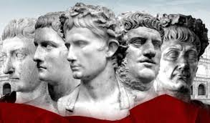
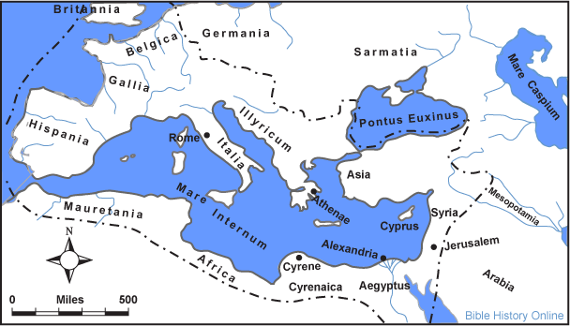
Political State At That Time
Rome ruled most of known world
Rome was the center of empire
It was composed of independent cities, states, and territories. Each was subject to an emperor and a senate.

Slide 7
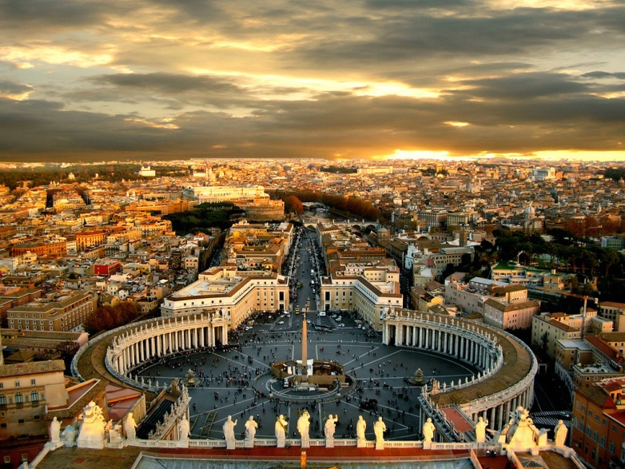
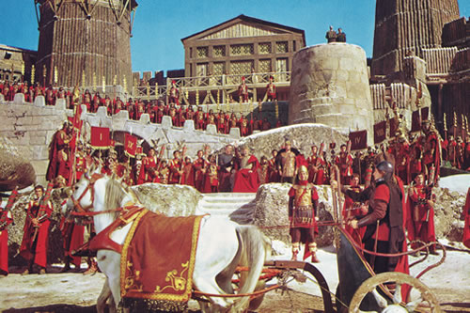
Roman Government
Provinces: Macedonia, Asia, Bithynia, Cilicia
Proconsuls: Peaceful Provinces…independent decision making but accountable to Rome. (Deputies)
Proconsuls: more turbulent
Constant Military guard and checked by emperor himself. Palestine was more violent in the days of Jesus and the Apostles. (governors and procurator)

Slide 8
King
Jewish descent under Roman rulers.
Herod the Great---monarch in Palestine at the birth of Jesus—titles: Procurator, tetrarch, and King.
Death of Herod the Great---3 sons:
Archelaeus, Antipas, and Philip
Followed by Agrippa I
Succeeded by son, Agrippa II (ruling more than 50 years)
Felix---Roman Governor (Paul tried, Acts 23:24)
Fetus—Paul appealed to Caesar
(Acts 25:8-13)

Slide 9
King Agrippa II
Festus invites King to hear Paul’s case
The King has adequate knowledge of Jewish law
The King was not committed to its religious doctrine, only ceremonial.
“this man might have been set at liberty, if he had not appealed unto Caesar.”
(Acts 26:32)

Slide 10
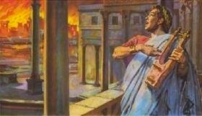
Emperor during New Testament times
Caesar (Nero)---AD 54-68---hated
Paul appears to for trial
(Acts 27:24)
Fire in Rome
More Persecutions of Christians
Peter and Paul meet death during this time period

Slide 11
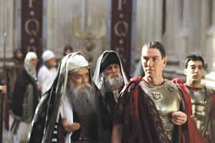
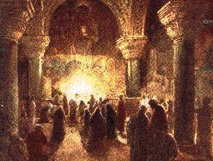
Religion
Jewish leaders openly opposed the message of Jesus in the Savior’s day.
Though His death would “crush the movement”
Jewish rulers conspire to “do away with” the Son of God.
The ‘Movement’ continues to grow despite persecution.
Faith of Christian converts were not based on a dead Savior but on a Living One. One that had risen from the dead.
(Acts 2:23, 32, 5:30-32; Corinthians 15:4-8)
Jew’s counteraction was held in check by Roman law.

Slide 12
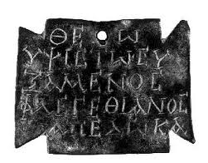
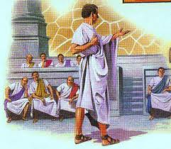
Tolerated by Rome
Political state recognized many gods
There was no interference with religious faith so long as it did not prove subversive to the state.
Judaism was tolerated.
Rome didn’t recognize Christianity as a new movement but rather another division within the Jewish order.

Slide 13
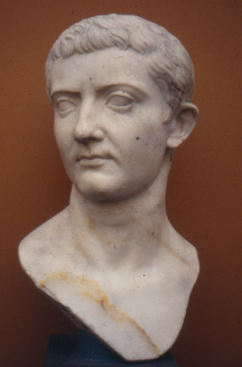
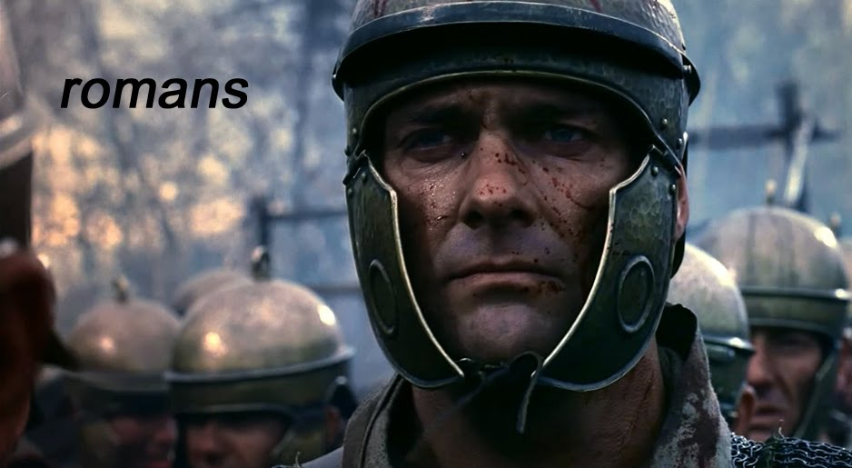
Times Change
New church expanded and grew while the tolerance changed.
The Emperor was personified as divine.
The Romans were subject to give allegiance to the Emperor as god, as well as their own deities.
Nero titles:
theos (god)
soter (savior)
Domitian (AD 81-96) title:
Dominus et Deus (Lord and God)
Greek word for Latin dominus---kurios, or Lord
Common title applied to Jesus
(700 times in New Testament)

Slide 14
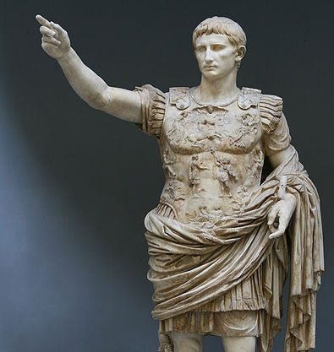
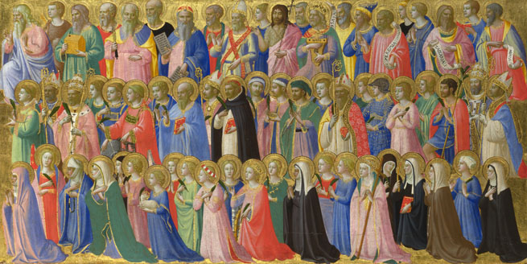
Christians Refusal to bow
Emperor was addressed as:
“God”
“The Son of God”
“the Holy One”
“Lord”
“Savior”
Central causes of Persecution was the refusal to respect the Emperor in these titles given to him, and brought on many of the saints to martyrdom.

Slide 15
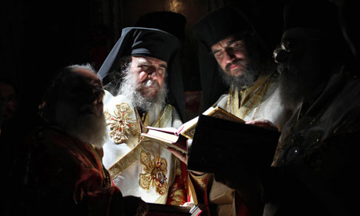
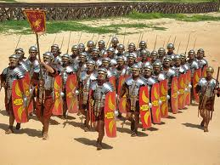
Greek influence:
Hellenism:
idle witnesses to Roman domination.
Romans:
built roads
established postal system
sought for law and order
Greeks:
thinking
planning
philosophizing society
“If Rome conquered Greece with its armies, Greece conquered Rome with its ideas.”
Greek slaves were often better educated than the Roman masters whom they served.

Slide 16
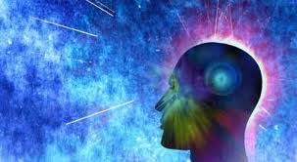
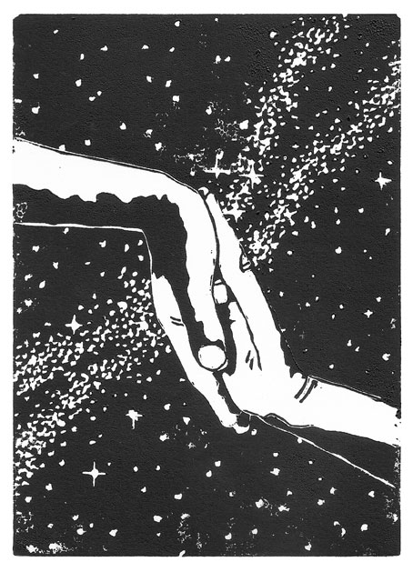
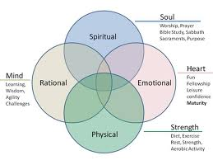
Greek religion and human existence:
Creation of men’s minds:
Power of independent thought =
Ability to examine the mysteries of the universe understanding sufficient to formulate satisfactory explanation.
“The Athenians and strangers which were there spent their time in nothing else, but either to tell, or hear some new thing.”
(Acts 17:21)

Slide 17
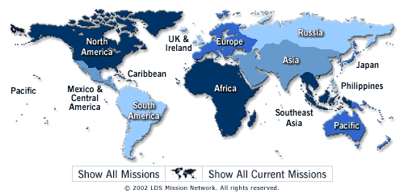
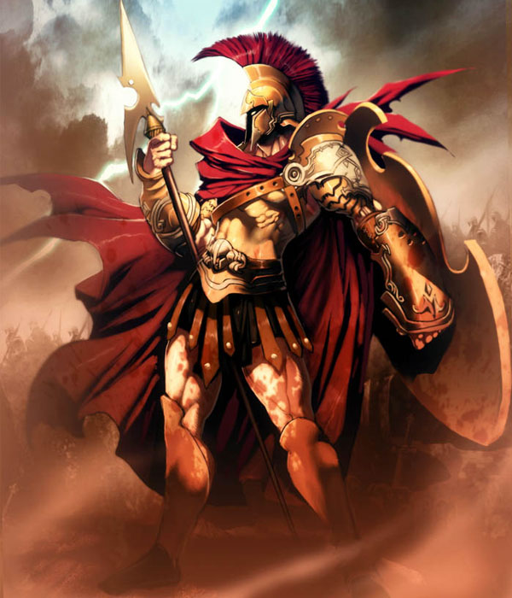
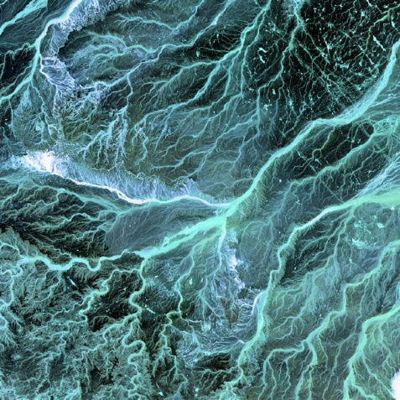
The Good, the Bad, and the Ugly Greek influence:
The Good:
Provided a medium through which the teaching of Jesus and his apostles could be spread rapidly.
The Bad:
Men could not resist the temptation to embellish the Christian revelation with their own interpretations.
The Ugly:
A new Christianity altogether. Trying to keep the gospel message pure and free from false philosophies. “The Great Apostasy”.

Slide 18
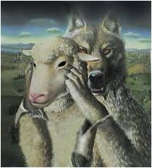
Christian Truth and pagan philosophy:
“For I know this that after my departing shall grievous wolves enter in among you, not sparing the flock.”
“Also of your own selves shall men arise, speaking perverse things, to draw away disciples after them.” (Acts 20:29, 30)

Slide 19
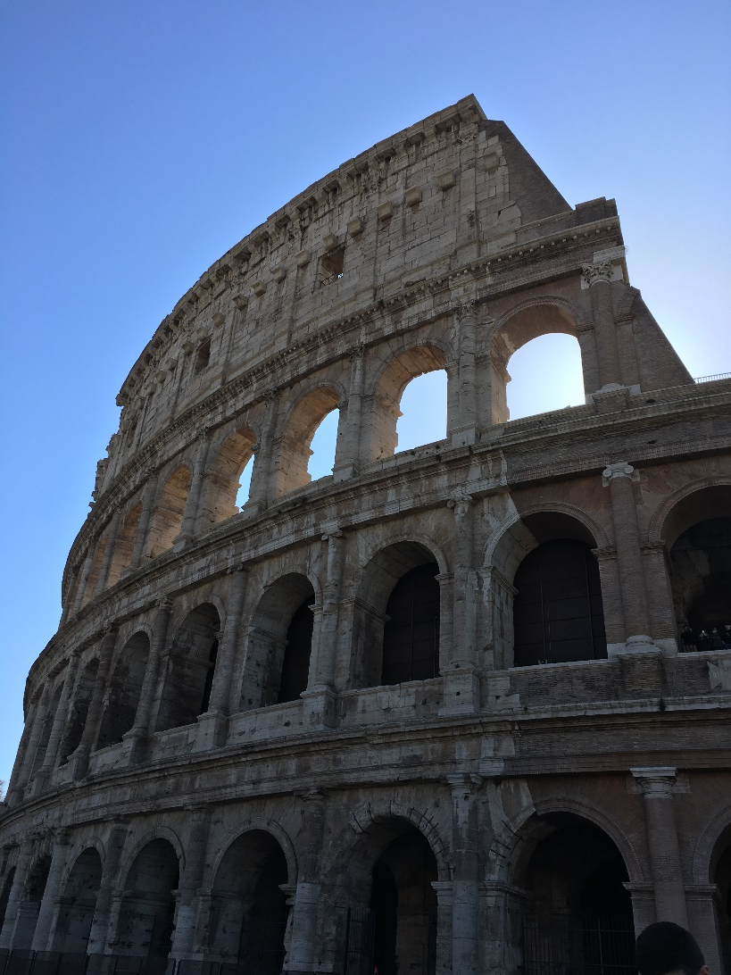
What good comes from these Societies?
Roman road literally opened avenues for Christian missionary work in the empire.
Roman toleration made it possible the practice and spread of Christianity.
The spirit of Greek rationalism and language provided opportunities where men gathered.
The Jewish dispersion made possible for Jewish-Christians to enter synagogues everywhere and preach the “good news” of Jesus Christ to all who opened their hearts and listen.

Slide 20
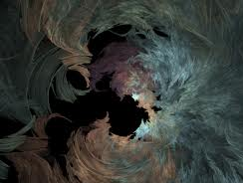
However:
Negative Attitudes:
World government-sponsored religions.
Not in total harmony.
Greeks considered doctrines of atonement and resurrection “foolishness”. (1 Corinthians 1:23)
Mocking Paul’s attempts to win their hearts to Christ. (Acts 17:32)
Jews hold it to be a threat to their
Mosaic institutions. (John 11:48)
Romans, in time, regard Christianity as an illicit cult, deserving neither sanction nor favor from the state.

Slide 21
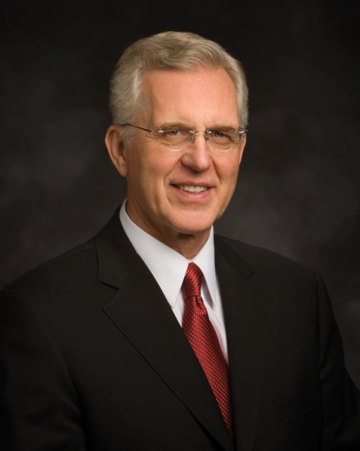
Meridian of Time
“The Savior taught His doctrine in the meridian of time, and his Apostles struggled mightily to preserve it against a barrage of false tradition and philosophy.
New Testament Epistles cite numerous incidents demonstrating that serious and widespread apostasy was already under way during the Apostles ministry.”
(3)

Slide 22
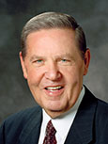
Direction Through the Holy Ghost
Jesus Christ directs His Church by revealing His will to His Apostles through the Holy Ghost
“From the first verse [of the book of Acts], the declaration is that the Church will continue to be divinely led, not mortally led. …
Indeed, a more complete title for the book of Acts could appropriately be something like ‘The Acts of the Resurrected Christ Working through the Holy Spirit in the Lives and Ministries of His Ordained Apostles.’ …
“The direction of the Church is the same. The location of the Savior has been altered, but the direction and leadership of the Church is exactly the same.”
Acts 1:1-8
(7)

Slide 23
Peter
John
Stephen
Phillip
Paul

Slide 24
“In our day the Lord has called 15 special witnesses to testify of His divinity before all the world. Theirs is a unique calling; they are Apostles of the Lord Jesus Christ, chosen and commissioned by Him. They have been commanded to bear witness of His living reality by the power and authority of the holy apostleship in them vested.”
Acts 1:4; 2:33; Luke 24:49
(8)

Slide 25
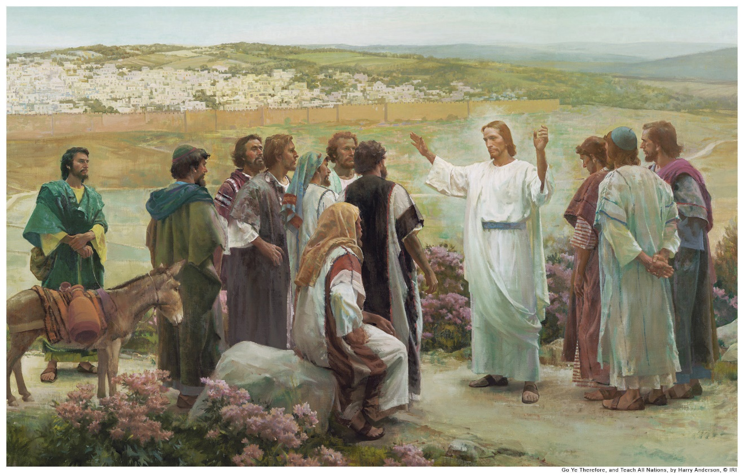
The Promise of the Father
Near the end of the Savior’s 40-day ministry with His disciples, He “commanded them that they should not depart from Jerusalem, but wait for the promise of the Father”
Harry Anderson
This referred to the gift of the Holy Ghost, which was given to the Apostles on the day of Pentecost:
(4)
Acts 1:4; 2:33; Luke 24:49

Slide 26
The Power
1 Corinthians 12:1-10
But the manifestation of the Spirit is given to every man to profit withal.
This power would have included:
The Spirit the word of wisdom
knowledge
faith
gifts of healing
Working of miracles
Prophecies
Discerning of spirts
Gift of tongues and interpretation of tongues
Acts 1:6-8 See also Moroni 10:9-17; D&C 46:13-26

Slide 27
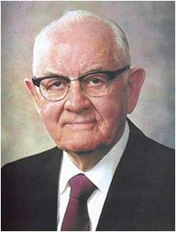
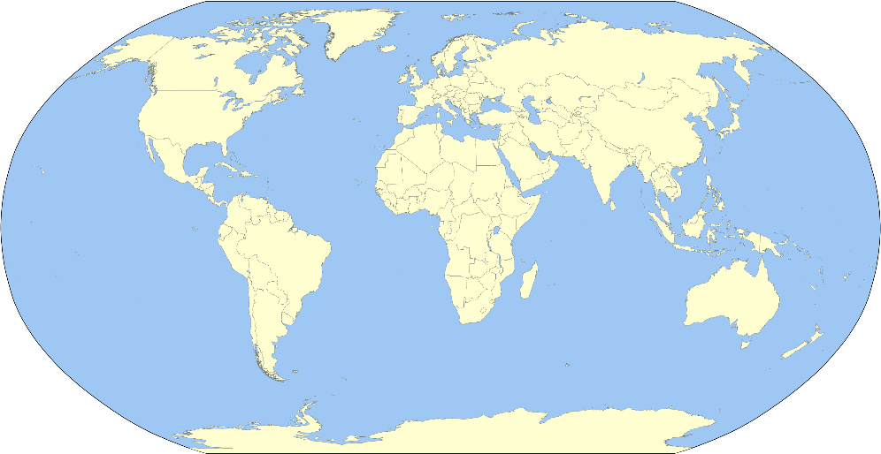
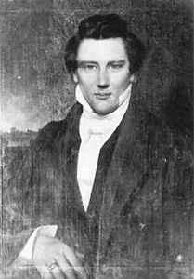
To Be A Witness—Here, There, and Everywhere
"Our work is to preach the gospel to the world. It is not self-imposed. We are under divine commandment.
The Prophet Joseph Smith preached, 'After all has been said, the greatest and most important duty is to preach the gospel.' All the other programs are extremely important but, of course, we cannot influence people much by those programs until we get them in the Church.
Acts 1:8
(6)

Slide 28
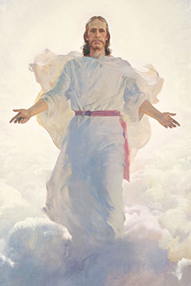
True or False?
Jesus Christ will return to the earth in the latter days.
True
And the Lord said unto Enoch: As I live, even so will I come in the last days, in the days of wickedness and vengeance, to fulfil the oath which I have made unto you concerning the children of Noah;
Moses 7:60

Slide 29
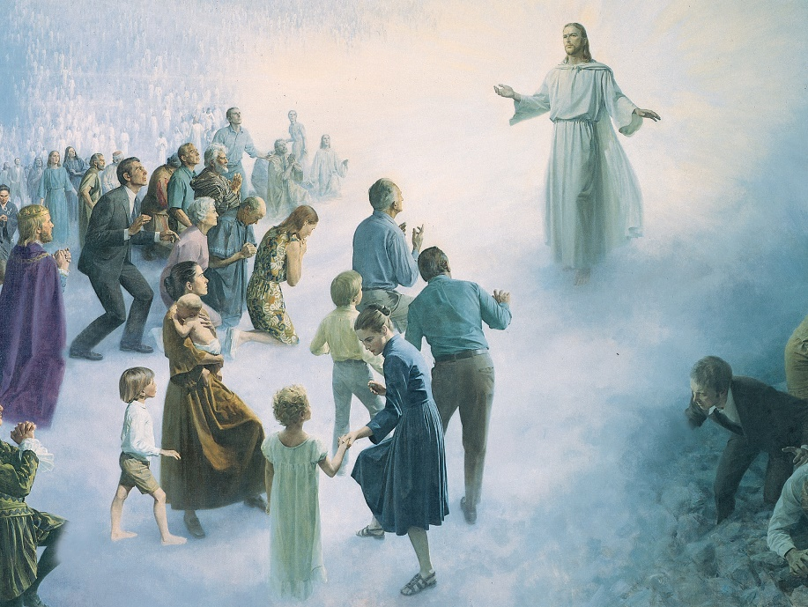
True or False?
At His Second Coming, Jesus Christ will appear only to righteous people.
False
For as the light of the morning cometh out of the east, and shineth even unto the west, and covereth the whole earth, so shall also the coming of the Son of Man be.
JST Matthew 1:26
And prepare for the revelation which is to come, when the veil of the covering of my temple, in my tabernacle, which hideth the earth, shall be taken off, and all flesh shall see me together.
D&C 101:23

Slide 30
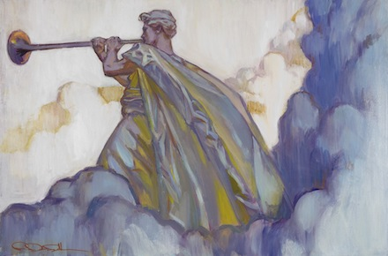
True or False?
Because Jesus Christ will be in disguise when He comes again, most people will not realize that the Second Coming has occurred.
False
And again, verily I say unto you, that the Son of Man cometh not in the form of a woman, neither of a man traveling on the earth.
Wherefore, be not deceived, but continue in steadfastness, looking forth for the heavens to be shaken, and the earth to tremble and to reel to and fro as a drunken man, and for the valleys to be exalted, and for the mountains to be made low, and for the rough places to become smooth—and all this when the angel shall sound his trumpet.
D&C 49:22-23
Rose Detac Dall

Slide 31
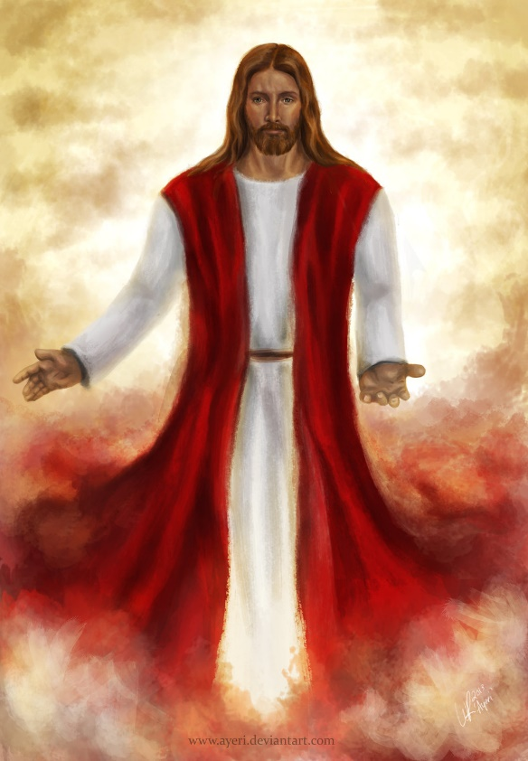
Two Holy Men
Two angels told them that Jesus Christ would return to the earth in “like manner” as He had ascended.
ayeri
This announcement makes clear to all mankind what they are to watch for in connection with the Savior’s Second Coming and protects them against deception.
Acts 1:9-10
(5)

Slide 32
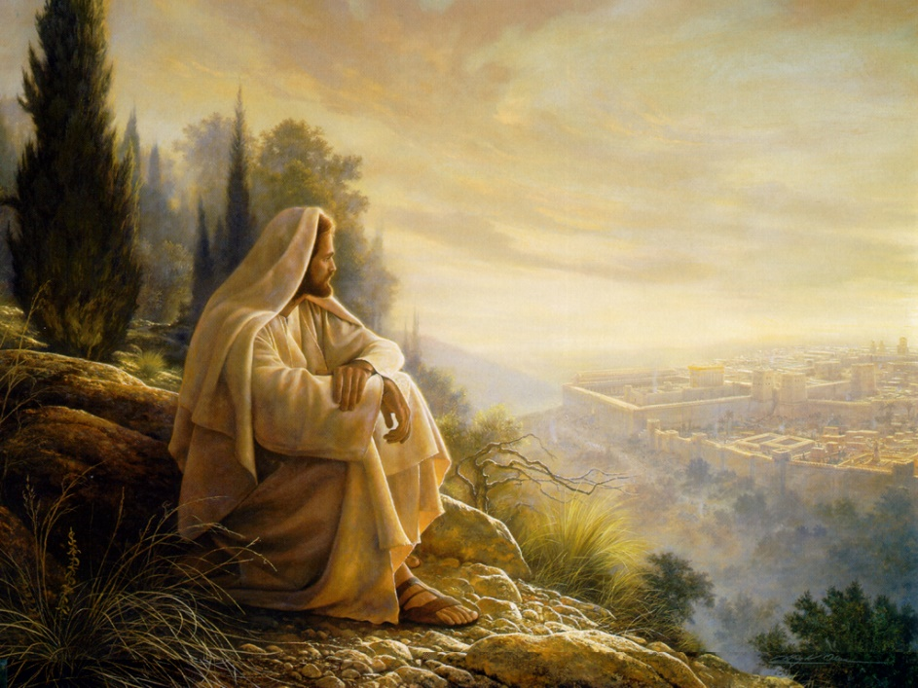
Again On Mt. Olive
The Savior’s Ascension took place on the Mount of Olives.
When the Savior comes again, one of His appearances will be when He will descend and actually stand on the Mount of Olives.
And his feet shall stand in that day upon the mount of Olives, which is before Jerusalem on the east, and the mount of Olives shall cleave in the midst thereof toward the east and toward the west, and there shall be a very great valley; and half of the mountain shall remove toward the north, and half of it toward the south.
Zechariah 14:4
This will be before His great and grand appearance to the world
And the glory of the Lord shall be revealed, and all flesh shall see it together: for the mouth of the Lord hath spoken it.
Isaiah 40:5
Acts 1:12
(6)

Slide 33
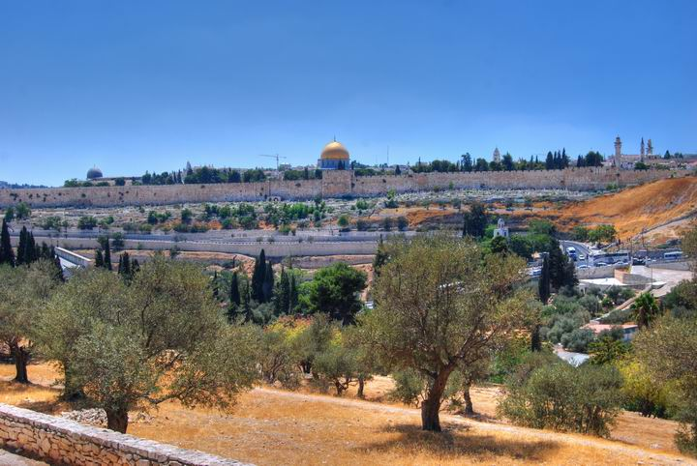
A Sabbath’s Days Journey
According to Jewish oral traditions, a Sabbath day’s journey was the distance a Jew was permitted to walk on the Sabbath.
Later rabbinic sources give this as 2,000 cubits—a distance of about 3,600 feet (about 1,100 meters).
It was about that distance from the city wall of Jerusalem to the Mount of Olives. (9)
Acts 1:12
(5)

Slide 34
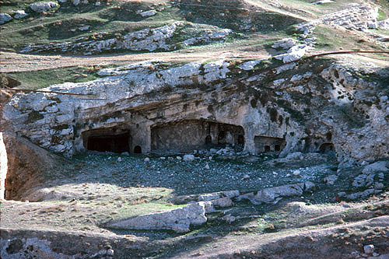
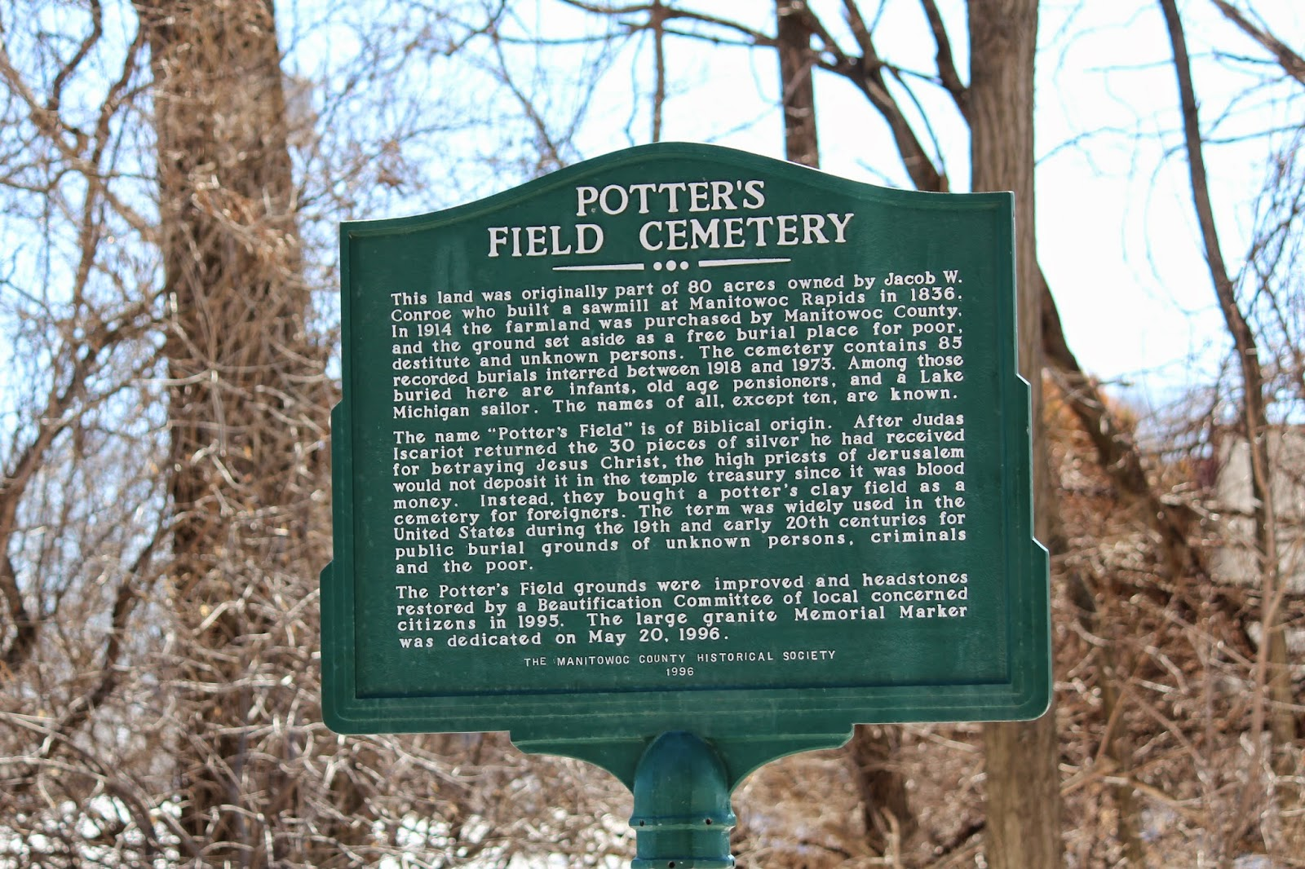
A Field of Blood
Following the suicide of Judas Iscariot (“this man”), the chief priests took the 30 pieces of silver that Judas had cast down in the temple (“the reward of iniquity”) and purchased “the potter’s field,” wherein strangers were later buried.
Field of Blood caves, tombs above the Hinnom Valley
(5)
Acts 1:13-14
Modern Day Potter’s Field

Slide 35
Matthias
Peter stood before 120 disciples and recounted the death of Judas Iscariot. Because Judas had been one of the Twelve Apostles, the disciples gathered to choose a new Apostle.
“they gave forth their lots”
casting lots was a faithful means of making a decision that showed trust in God directing the outcome
The lot is cast into the lap; but the whole disposing thereof is of the Lord.
Proverbs 16:33
Acts 1:26
(5)

Slide 36
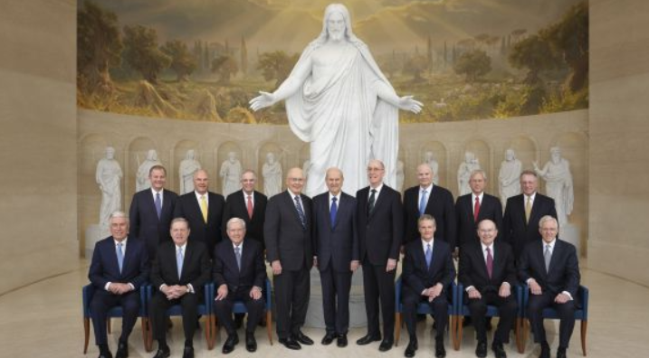
Called By Revelation
We as members of the Lord’s Church know who stands at its head: Jesus Christ Himself. …
So, what’s in a name?
When it comes to the name of the Lord’s Church, the answer is “Everything!” Jesus Christ directed us to call the Church by His name because it is His Church, filled with His power.
I know that God lives. Jesus is the Christ. He leads His Church today.
(10)
Acts 1:21-26

Slide 37
Sources:
1. The Life and Teachings of Jesus Christ and the Apostles.
2. Institute course manual 7.7
Elder D. Todd Christofferson The Doctrine of Christ 2012 April General Conference
President Boyd K. Packer (“The Cloven Tongues of Fire,” Ensign, May 2000, 7).
New Testament Institute Manual Chapter 29
President Spencer W. Kimball President Kimball Speaks Out [Salt Lake City: Deseret Book Co., 1981], 33-34.
Elder Jeffrey R. Holland (“Therefore, What?” [Church Educational System conference on the New Testament, Aug. 8, 2000], 6, si.lds.org).
President Gordon B. Hinckley (“Special Witnesses of Christ,” Ensign, Apr. 2001, 4).
D. Kelly Ogden, Where Jesus Walked: The Land and Culture of New Testament Times [Salt Lake City: Deseret Book Co., 1991], 4.
Russell M. Nelson, “The Correct Name of the Church,” Ensign or Liahona, Nov. 2018, 88–89
Presentation by ©http://fashionsbylynda.com/blog/

Slide 38
Place | Church Activity and Missionary Work Accounts in Acts | Scripture
Jerusalem | After Ascension | Acts 1:10-14
 | Calling of Matthias | Acts 1:15-26
 | Missionary work and Spirit on the day of Pentecost | Acts 2:1-13
 | Peter’s declaration of the Divinity of Jesus Christ | Acts 2:22-37
 | 3,000 People baptized | Acts 2:37-47
 | 2 Occasions the Sanhedrin refused to accept the Apostle’s testimonies: The arrest of Peter and John A large number of converts coming into the Church and rejection of the apostolic doctrines | Acts 3:1-4; Acts 4 Acts 5 Acts 5:17-42
Bible Dictionary

Slide 39
Elder Jeffrey R. Holland on The Book of Acts:
“The direction of the Church is the same. The location of the Savior has been altered, but the direction and leadership of the Church is exactly the same. Then, having made that point, as if to prove in this most remarkable string of spiritual experiences all the way through the book, we get manifestations of the Lord’s power through the Holy Ghost at every turn. … The first teaching in the book of Acts from the resurrected Christ to the Twelve is that they ‘shall be baptized with the Holy Ghost not many days hence’ (Acts 1:5), and that ‘ye shall receive power, after that the Holy Ghost is come upon you’ (v. 8; italics added).
“After [Jesus] ascends to heaven before their very eyes, Peter gets the Church together—all one hundred and twenty of them. Can you see what an impact the troubles and the Crucifixion and the opposition had had on them? One hundred and twenty people gather and Peter says, ‘Men and brethren, this scripture must needs have been fulfilled, which the Holy Ghost by the mouth of David spake before concerning Judas’ (v. 16; italics added). In filling Judas’s vacancy in the Twelve, they prayed exactly the way the Quorum of the Twelve and First Presidency pray today: ‘Thou, Lord, which knowest the hearts of all men, shew whether of these … thou hast chosen’ (v. 24; italics added). … And Matthias was called.
“But that first chapter of turning heavenward, so clearly marking the divine guidance that would continue to direct the Church, is only a warm-up to chapter 2” (“Therefore, What?” [Church Educational System conference on the New Testament, Aug. 8, 2000], 6; si.lds.org).
The Day of Pentecost Acts 2:2-4:
“That power was not long in coming. On the day of Pentecost, the Twelve were assembled in a house:
“‘Suddenly there came a sound … of a rushing mighty wind, …
“‘And there appeared unto them cloven tongues like as of fire, and it sat upon each of them.
“‘And they were all filled with the Holy Ghost’ [Acts 2:2–4].
“With that the Twelve were fully empowered”
President Boyd K. Packer (“The Cloven Tongues of Fire,” Ensign, May 2000, 7).
PENTECOST also called feast of Weeks or feast of Harvest One of Three feasts everyone present Exodus 23:14-17, Deuteronomy 16:16; 1. Passover Leviticus 23:5-6; 2. Pentecost Leviticus 23:15-17; 3. Tabernacles Leviticus 23:34
The name “Pentecost,” was from the Greek language and it means “Fiftieth.” It was the fiftieth day after the Passover. Leviticus 23:15-16;. The Jews had called it the “Feast of Weeks,” “Harvest Festival” and the “Festival of the First Fruits.” It began on the Sunday the 1st day after the Sabbath which is a Saturday or 7th day, 7 weeks or 49 days after the Passover
18 Scripture n Leviticus 23:16 “Count off fifty days up to the day after the seventh Sabbath, and then present an offering of new grain to the LORD” n Numbers 28:26 “`On the day of firstfruits, when you present to the LORD an offering of new grain during the Feast of Weeks, hold a sacred assembly and do no regular work.”
The Day of Pentecost Published by Jonathon Catlow
A Witness: Acts 1: 1-8
“An eyewitness was not enough. Even the witness and testimony of the original Apostles had to be rooted in the testimony of the Holy Ghost. [President Joseph Fielding Smith] has told us that the witness of the Holy Ghost makes an impression on our soul that is more significant than ‘a visitation of an angel.’ (Joseph Fielding Smith, Doctrines of Salvation, comp. Bruce R. McConkie, Salt Lake City: Bookcraft, 1954, 1:44.) And the Bible shows that when we testify on the basis of this witness, the Holy Ghost testifies to those who hear our words.” Elder Dallin H. Oaks (“Witnesses of Christ,” Ensign, Nov. 1990, 30).
The Feast of Pentecost:
Fifty days (Lev. 23:16) after the Feast of the Passover, the Feast of Pentecost was kept. During those 50 days the harvest of wheat was being gathered in. It is called (Ex. 23:16) “the feast of harvest, the firstfruits of thy labours” and (Deut. 16:10) “the feast of weeks.” The feast lasted a single day, which was a day of holy convocation (Lev. 23:21); and the characteristic rite was the new meal offering; that is, two loaves of leavened bread made of fine flour of new wheat. Special animal sacrifices (Lev. 23:18) and freewill offerings (Deut. 16:10) were also made. The festival was prolonged in later times, and huge numbers of Jews attended it. Of this the narrative in Acts 2 is sufficient proof. It had the same evil reputation as the Feast of the Passover for tumults and massacres. We have no record of the celebration of this feast in the Old Testament. Bible Dictionary
The Gift of the Holy Ghost Acts 1:9-10
“The gift of the Holy Ghost … quickens all the intellectual faculties, increases, enlarges, expands, and purifies all the natural passions and affections, and adapts them, by the gift of wisdom, to their lawful use. It inspires, develops, cultivates, and matures all the fine-toned sympathies, joys, tastes, kindred feelings, and affections of our nature. It inspires virtue, kindness, goodness, tenderness, gentleness, and charity” Parley P. Pratt (Key to the Science of Theology [1978], 61).

Slide 40
Something of Interest:
Hugh Nibley:
"Recently I collected all the references I could find-I have twice as many now-of the forty-day mission of Christ. Whenever you find a very early Christian text, it almost always has a title referring to 'the secret teachings of the Lord to the Apostles during the forty days.' The fifty texts available to me then had four things in common.
"The first was secrets, what the Lord taught the apostles after the forty days. When he came after the resurrection, he visited them and taught them. This was the really important thing, we're told. They didn't understand anything until then, yet in the Bible we are told hardly a word of what he taught them. Why not? It was secret.
"The second point is that they all asked the Lord, 'What's going to happen to us? What's going to happen to the Church?' And he tells them that it is going to be on earth for two generations; these things are not going to be handed down; they are to be buried; they are to be kept secret. They are not to be passed on to the world. That's why we didn't get them. We are just finding them now.
"Third, he taught the strange doctrines the Christian world did not like at all, the things we have been talking about: other worlds, things like that. That was out of bounds to the Christian doctors, because it wasn't Aristotle.
"The fourth was the main thing he came to do. He took them through the temple, he taught them temple ordinances. Only the apostles and the general authorities, the seventies, were instructed in these-things to be handed down, not divulged to the public. Though they were very carefully kept from the public, we have these ordinances now as they are described here, and this I have talked about in the temple on occasion.
I just mention here these generalities, the importance of these documents, what they meant to those people. The person who receives these becomes a son. He both gives and receives...the signs and the tokens of the God of Truth while demonstrating the same to the Church, all in the hopes that these ordinances may some day become realities." (Hugh Nibley, Old Testament and Related Studies, edited by John W. Welch, Gary P. Gillum, and Don E. Norton [Salt Lake City and Provo: Deseret Book Co., Foundation for Ancient Research and Mormon Studies, 1986], 159-160.)
Casting Lots Acts 1:26:
“If they cast lots, it was an instance in which the Lord chose the result. More probably, however, ‘they gave forth their votes,’ presumably ‘sustaining votes’ to uphold him whom God had chosen to serve in the holy apostleship” (Bruce R. McConkie, Doctrinal New Testament Commentary, 3 vols. [1965–73], 2:32).
Modern Day Potter’s Field:
The land was originally part of 80 acres owned by Jacob W. Conroe who built a sawmill at Manitowoc Rapids in 1856. In 1914 the farmland was purchased by Manitowoc County and the ground set aside as a free burial place for poor destitute and unknown persons. The cemetery contains 85 recorded burials interred between 1918 and 1973. Among those buried here are infants, old age pensioners, and a Lake Michigan sailor. The names of all, except ten, are known. The name "Potter's Field" is of Biblical origin. After Judas Iscariot returned the 30 pieces of silver he had received for betraying Jesus Christ, the high priests of Jerusalem would not deposit it in the temple treasury since it was blood money. Instead, they bought a potter's clay field as a cemetery for foreigners. The term was widely used in the United States during the 19th and early 20th centuries for public burial grounds of unknown persons, criminals and the poor. The Potter's Field grounds were improved and headstones restored by a Beautification Committee of local concerned citizens in 1995. The large granite Memorial Marker was dedicated on May 20, 1996.
The marker is located on eastbound Meadow Lane, just west of its intersection with Broadway Street, near 3854 Meadow Lane, Manitowoc, Wisconsin 54220.

Slide 41
Event | Acts
Kingdom to Be Restored to Israel | 1:1–8
Mount of Olives: Christ Ascends to Heaven | 1:9–14
Jerusalem: Apostles Choose Successor to Judas | 1:15–26
The Holy Ghost and the Day of Pentecost | 2:1–21
Peter Testifies of Jesus’ Resurrection | 2:22–36
How to Gain Salvation | 2:37–40
All Things in Common | 2:41–47
Peter Heals Man Lame from Birth | 3:1–16
Age of Restoration Is Prior to Christ’s Second Coming | 3:17–24
The Children of the Covenant | 3:25, 26
Salvation Comes Only Through Christ | 4:1–12
Sadducees Seek to Silence Apostles | 4:13–22
Saints Glory in Testimony of Jesus | 4:23–31
Saints Practice United Order | 4:32–37
Fate of Deceivers | 5:1–11
Event | Acts
Apostles Continue Miracles of Jesus | 5:12–16
Angels Deliver Apostles from Prison | 5:17–26
Apostles Testify of Christ | 5:27–32
Persecution Is Not of God | 5:33–42
Seven Chosen to Assist Apostles | 6:1–6
Stephen Transfigured Before the Sanhedrin | 6:7–15
Stephen Preaches about Israel | 7:1–36
Moses—A Prototype of Christ | 7:37–40
Stephen Testifies of Apostasy in Israel | 7:41–53
Stephen Sees the Father and the Son | 7:54–60; 8:1
Saul Persecutes the Church | 8:1–4
Samaria: Philip Works Miracles, Converts Simon | 8:5–13
Apostles Confer Gift of the Holy Ghost | 8:14–17
Simon Seeks to Buy Gift of the Holy Ghost | 8:18–25
Toward Gaza: Philip Preaches Christ, Baptizes Eunuch | 8:26–40
The Acts of The Apostles, Written by Luke to Theophilus, 61-63 AD
The Events That Occurred 33-36 AD (1-8)
Life and Times of Jesus Christ Section 7 Chapter 29

Slide 42
The Work Continues Through The Holy Spirit
Acts 2
And it came to pass when they were all baptized and had come up out of the water, the Holy Ghost did fall upon them, and they were filled with the Holy Ghost and with fire.
3 Nephi 19:13
Day of Pentecost

Slide 43
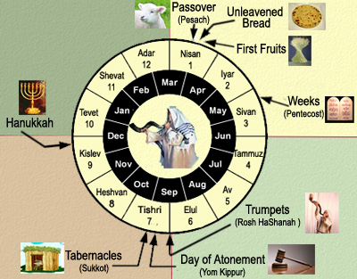
Pentecost--A Pilgrimage Festival
“And when the day of Pentecost was fully come, they were all with one accord in one place.”
7 weeks after the death and resurrection of Jesus, and about 1 week after the Savior ascended into heaven.
50 days after the Feast of the Passover.
A new meat offering (Leviticus 23:16)
Acts 2:1
(1)

Slide 44
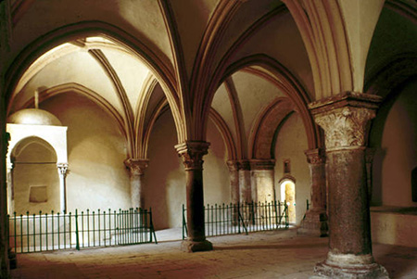
Pentecost Upper Room In Jerusalem
The interior of the traditional site of the “upper room” in Jerusalem where the Apostles and early members of the Church met to pray after the Savior’s Ascension and where the Spirit was poured out on the day of Pentecost.
Though this room was built in A.D.1335, it is located on the site of earlier structures that date to Roman times.
D. Kelly Ogden
Acts 2
(2)

Slide 45
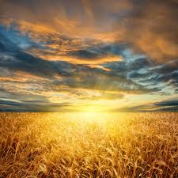
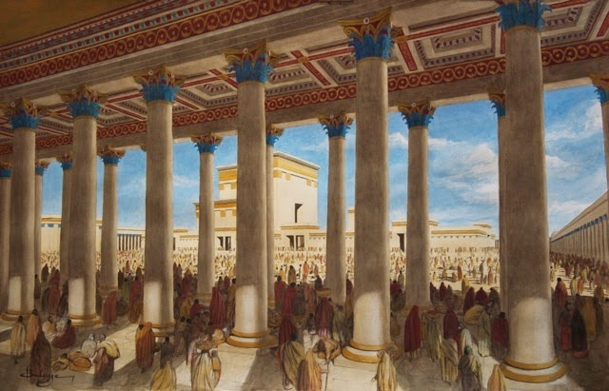
During which those 50 days the harvest of corn was being gathered in called the “Feast of the harvest, the firstfruits of thy Labours”
(Exodus 23:16)
“Three times in a year all thy males shall appear before the Lord God.”
(Exodus 23:17)

Slide 46
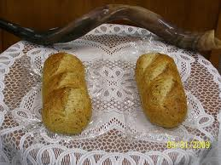
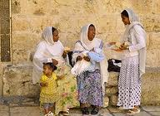
Just Before the Day of Pentecost
“The feast of weeks” lasting a single day of holy convocation. The seven sabbaths shall be complete.”
(Deut. 16:10) and (Leviticus 23:21)
The new meal offering:
2 loaves of leavened bread made of fine flour of new wheat.

Slide 47
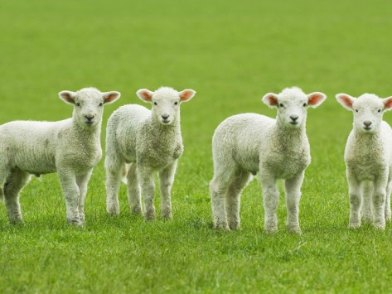
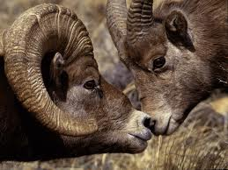
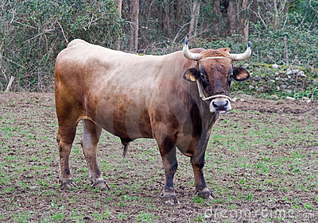
Special animal sacrifices were made.
(Leviticus 23:18)
For a meat and drink offering:
7 lambs without blemish of the first year, one young bullock, and two rams.

Slide 48
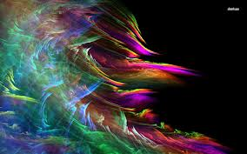
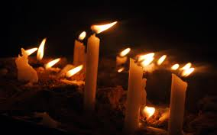
“And suddenly there came a sound from heaven as of a rushing mighty wind…
…and it filled all the house where they were sitting.”
Acts 2:2

Slide 49
Revelation From Heaven
“The very name Pentecost comes into the Christian vocabulary as synonymous with breathtaking spiritual manifestations and a divine outpouring of the Holy Ghost upon all the people. Revelation came from heaven with the sound ‘as of a rushing mighty wind, and it filled all the house’ and it filled the brethren.” (8)
Prophet Joseph Smith prayed for a special outpouring the Spirit from on high:
This plea was fulfilled, not just once, but several times during the days following the initial dedicatory services. Joseph Smith recorded that on one occasion, “a noise was heard like the sound of a rushing mighty wind, which filled the [Kirtland] Temple, and all the congregation simultaneously arose, being moved upon by an invisible power; many began to speak in tongues and prophesy; others saw glorious visions; and I beheld the Temple was filled with angels, which fact I declared to the congregation.” (9)
Acts 2:2; D&C 109:36-37

Slide 50
Cloven tongues—The Gift of Tongues
Anciently, fire often symbolized the divine presence or influence.
This was a sign that the disciples had received the gift of the Holy Ghost, promised by the Savior.
“And there appeared unto them cloven tongues like as of fire…
Tongues that are cloven or forked, or that have the appearance of the flame of a fire
…and it sat upon each of them.”
Acts 2:3

Slide 51
Fire—Environment of Heaven Brought to Earth
And the angel of the Lord appeared unto him in a flame of fire out of the midst of a bush;
Exodus 3:2
And it came to pass that Nephi and Lehi were encircled about as if by fire…
And when they saw that they were encircled about with a pillar of fire, and that it burned them not…
Helaman 5:23-24
And the Lord went before them by day in a pillar of a cloud, to lead them the way; and by night in a pillar of fire, to give them light; to go by day and night:
Exodus 13:21
…they saw that they were encircled about, yea every soul, by a pillar of fire.
And behold, the Holy Spirit of God did come down from heaven, and did enter into their hearts, and they were filled as if with fire,…
Helaman 5:43, 45
And the sight of the glory of the Lord was like devouring fire on the top of the mount in the eyes of the children of Israel.
Exodus 24:17
The divine fire can be described as the “everlasting burnings of God; for God dwells in everlasting burnings.” (9)
Acts 2:3

Slide 52
“And they were all filled with the Holy Ghost, and began to speak…
'The gift of tongues by the power of the Holy Ghost in the Church, is for the benefit of the servants of God to preach to unbelievers, as on the day of Pentecost.' (9)
“Be not so curious about tongues, do not speak in tongues except there be an interpreter present; the ultimate design of tongues is to speak to foreigners, and if persons are very anxious to display their intelligence, let them speak to such in their own tongues [that is in the tongues of the foreigners].' (10)
…with other tongues, as the Spirit gave them utterance.
Acts 2:4

Slide 53
Speaking to them in their own language
Parthians
Medes
Elamites
Mesopotamia
Judaea
Cappadocia
Pontus
Asia
Cretes
Arabians
The gift of tongues was given to the early Apostles on the day of Pentecost so they could preach the gospel in multiple languages. (2)
All those dwelling at Jerusalem, Jews, devout men, out of every nation could hear and understand the words of the Apostle Peter.
Acts 2:5-11

Slide 54
Peter Declares
“…I will pour out of my Spirit upon all flesh…
…and your sons and your daughters shall prophesy…
Acts 2:17; Joel 2:28

Slide 55
Peter Continues
…and your young men shall see visions…
…and your old men shall dream dreams.”
Acts 2:17; Joel 2:28

Slide 56
The Coming of the Lord
Wonders in heaven
Signs beneath the earth
Blood, fire and vapour of smoke
The sun turned to darkness
The moon into blood
The sun has not yet been darkened. We are informed that this will be one of the last acts just preceding the coming of the Lord.“ (11)
“…whosoever shall call on the name of the Lord shall be saved.”
Acts 2:19-20; Joel 2:30-31

Slide 57
Peter Testifies of Christ
Jesus’ miracles and wonders and signs.
Him who was crucified and slain
Him who was raised up after His pains and death
Acts 2:22-24

Slide 58
The Promise of the Holy Ghost
“Therefore being by the right hand of God exalted, and having received the Father the promise of the Holy Ghost…
…he hath shed forth this, which ye now see and hear.”
Acts 2:33

Slide 59
Receiving the Gift the Holy Ghost
“Before baptism, all honest and sincere seekers of truth can feel the influence of the Holy Ghost from time to time. However, the opportunity to receive the constant companionship of the
Holy Ghost…is available only to
worthy, baptized members who
receive the gift of the Holy Ghost
by the laying on of hands through
those holding the priesthood
authority of God.”
(3)

Slide 60
Who is the Holy Ghost?
“The Holy Ghost is the third member of the Godhead, and, as such, like God the Father and Jesus Christ.”
(3)

Slide 61
What Does the Holy Ghost Do?
A director: a spiritual Liahona
“Life is no labyrinth; mortality is no maze if a man possesses the gift of the Holy Ghost to guide him.”
(6)

Slide 62
What Does the Holy Ghost Know?
He knows our thoughts and the intents of our hearts
“Yea, I tell thee, that thou mayest know that there is none else save God that knowest thy thoughts and the intents of thy heart.”
D&C 6:16
(3)

Slide 63
What does the Holy Ghost Know?
“Next to God Himself, the Holy Ghost knows more about your gifts, your strengths, and your weakness…”
Ramona Seminary 2012-13
(5)

Slide 64
What does the Holy Ghost want for us?
He loves us just like Heavenly Father and Jesus and wants us to be happy.
“He knows the challenges we will face, He can guide us and teach us all things we must do to return and live with our Heavenly Father once again.”
(3)

Slide 65
How do I know I have the Gift of the Holy Ghost?
“…thus when it becomes necessary to speak to us, he is able to do so by acting through the other Spirit, that is, through the Light of Christ.”
(7)

Slide 66
“The Holy Ghost does not become operative in our lives merely because hands are placed upon our heads. …
As we receive this ordinance [confirmation], each of us accepts a sacred and ongoing responsibility to desire, to seek, to work, and to so live that we indeed ‘receive the Holy Ghost’ and its attendant spiritual gifts.”
(13)

Slide 67
How Does the Holy Ghost Communicates
“The Holy Spirit communicates through feelings and impressions.”
“Silent Promptings---to act upon without delay.”
(3)

Slide 68
How Do You Recognize the Holy Ghost?
“The Holy Ghost speaks with a voice that you feel more than you hear...While we speak of ‘listening’ to the whisperings of the Spirit, most often one describes a spiritual prompting by saying, ‘I had a feeling..’”
(4)

Slide 69
What is the purpose of the Holy Ghost?
“…bear witness of God the Father and of His Son, Jesus Christ, and to teach us the truth of all things.”
“And by the power of the Holy Ghost ye may know the truth of all things.”
(Moroni 10:5)
(3)

Slide 70
What Can I Do?
“For behold, again I say unto you that if ye will enter in by the way, and receive the Holy Ghost, it will show unto you all things what ye should do.”
A daily prayer and scripture reading to invite the Holy Ghost for direction.
2 Nephi 32:5

Slide 71
Other Names for the Holy Ghost:
The Comforter---gives hope, and peace.
The Spirit of Fire---burning feeling
The teacher and revelator---enlightens our minds and quickens our understanding, causing truth to be written in our souls and a change in our hearts.
“For the Holy Ghost shall teach you in the same hour what ye ought to say.”
(Luke 12:12) (D&C 11:13)
(3)

Slide 72
What shall we do?
“Now when they heard this, they were pricked in their heart…
Peter’s words had “pierced” them, bringing grief and remorse. As the people came to the terrible realization that they had crucified their Messiah, they may have feared that they had lost hope of salvation. (2)
…Men and brethren, what shall we do?”
Acts 2:37

Slide 73
“…Repent, and be baptized…in the name of Jesus Christ for the remission of sins…
…and ye shall receive the gift of the Holy Ghost.”
Acts 2:38

Slide 74
“Repentance takes care of the past, faith in the future, and the Holy Ghost helps us with today.”
(4)

Slide 75
The Promise to the Children
"I call attention to the universality of this promise. It was made to those who were listening to the apostles, but not to them alone, it extended to their children, to them also that were afar off-to those who were a hundred years off, or five hundred, or five to ten thousand years off; the promise was to them; and as if this was not sufficiently universal, the apostle adds, 'even as many as the Lord our God shall call'-call to what? to as many of course, as are called to yield obedience to the Gospel-to all such the promise extends." (12)
Acts 2:39

Slide 76
3,000 Souls Saved
“Then they that gladly received his word were baptized…
How about that for missionary work?
Acts 2:41

Slide 77
Sources:
Bible Dictionary King James Version
New Testament Institute Manual Chapter 29
“An Unspeakable Gift from God” by Elder Craig C. Christensen Oct. 2012 General Conference
With quotes from Boyd K. Packer
Eve and the Mortal Journey by Beverly Campbell
The Neal A. Maxwell Quote Book
Doctrines of Salvation—Joseph Fielding Smith with quotes from President Joseph F. Smith
Elder Jeffrey R. Holland (“Therefore, What?” 6; si.lds.org).
Prophet Joseph Smith (History of the Church,2:428; 6:317);(Teachings, p. 195.)
Elder Bruce R. McConkie (Teachings, pp. 247-248.) (Doctrinal New Testament Commentary, 3 vols. [Salt Lake City: Bookcraft, 1965-1973], 2: 33.)
(The Way to Perfection [Salt Lake City: Genealogical Society of Utah, 1949], 280.)
B.H. Roberts (The Gospel and Man's Relationship to Deity [Salt Lake City: Deseret News, 1901], 178.)
Elder David A. Bednar (“Receive the Holy Ghost,” Ensign or Liahona, Nov. 2010, 95).
Presentation by ©http://fashionsbylynda.com/blog/

Slide 78
The Gift of the Holy Ghost Acts 2:3:
"You may have the administration of angels, you may see many miracles; you may see many wonders in the earth; but I claim that the gift of the Holy Ghost is the greatest gift that can be bestowed upon man.
"You may surround any man or woman with all the wealth and glory that the imagination of man can grasp, and are they satisfied? No. There is still an aching void. On the other hand, show me a beggar upon the streets, who has the Holy Ghost, whose mind is filled with that spirit and power, and I will show you a person who has peace of mind, who possesses true riches, and those enjoyments that no man can obtain from any other source." (The Discourses of Wilford Woodruff, edited by G. Homer Durham [Salt Lake City: Bookcraft, 1969], 5.)
Gift of Tongues Acts 2:5-11:
“The true gift of tongues is made manifest in the Church more abundantly, perhaps, than any other spiritual gift. Every missionary who goes forth to teach the gospel in a foreign language, if he [or she] is prayerful and faithful, receives this gift” President Joseph Fielding Smith (Answers to Gospel Questions, 5 vols. [1957–66], 2:29).
Prophecy of Joel Acts 2:16-17
This Spirit which you now see resting upon these Apostles of Jesus of Nazareth, is that same Spirit which your Prophet Joel says will, in the last days, be poured out upon all flesh. Obviously he did not mean that this occasion of the Apostles receiving the Holy Ghost was a complete fulfilment of Joel's prediction…
Joel's prophecy for its complete fulfilment requires that the Spirit of the Lord, the Holy Ghost, shall be poured out upon all flesh; and undoubtedly refers to that time which shall come in the blessed millennium when the enmity shall not only cease between man and man, but even between the beasts of the forests and of the fields; and between man and beast, as described by Isaiah in the following language:
'The wolf also shall dwell with the Lamb, and the leopard shall lie down with the kid; and the calf and the young lion and the fatling together; and a little child shall lead them. And the cow and the bear shall feed; their young ones shall lie down together: and the lion shall eat straw like the ox. And the suckling child shall play on the hole of the asp, and the weaned child shall put his hand on the cockatrice' den. They shall not hurt nor destroy in all my holy mountain; for the earth shall be full of the knowledge of the Lord, as the waters cover the sea.' (Isa. 11:6-9)
…Joel was speaking of the last days indeed, and not of a circumstance that occurred in connection with a period more properly designated as the Dispensation of the Meridian of Time...therefore at some time future from the days of the Apostles, we may look forward to a universal outpouring of God's Holy Spirit upon all flesh, resulting in a universal peace and widespread knowledge of God.“ Joseph Smith (History of The Church, 1: xxxiii.)
The Effect of the Holy Ghost On the Apostles Acts 2:4:
"The early chapters of Acts record the activities of the coming of the Holy Ghost at the feast of Pentecost. It was the gift of the Holy Ghost that they received on that occasion, for the Twelve and the other members of the Church had already enjoyed the power of the Holy Ghost, else they would not have had testimonies of the Savior and of the gospel. They would not have responded to the gospel in the first place had not the Spirit borne witness to their souls. But now they had the full power and gift of the Holy Ghost." (Robert J. Matthews, Selected Writings of Robert J. Matthews: Gospel Scholars Series [Salt Lake City: Deseret Book Co., 1999], 282.)
Latter-day Pentecost:
"(Sunday, March 27, 1836) I met the quorums in the evening and instructed them respecting the ordinance of washing of feet, which they were to attend to on Wednesday following; and gave them instructions in relation to the spirit of prophecy, and called upon the congregation to speak, and not to fear to prophesy good concerning the Saints...Do not quench the Spirit, for the first one that opens his mouth shall receive the spirit of prophecy.
"Brother George A. Smith arose and began to prophesy, when a noise was heard like the sound of a rushing mighty wind, which filled the temple, and all the congregation simultaneously arose, being moved upon by an invisible power; many began to speak in tongues and prophesy; others saw glorious visions; and I beheld the temple was filled with angels, which fact I declared to the congregation. The people of the neighborhood came running together (hearing an unusual sound within, and seeing a bright light like a pillar of fire resting upon the temple), and were astonished at what was taking place. This continued until the meeting closed at eleven p.m.
"The number of official members present on this occasion was four hundred and sixteen, being a greater number than ever assembled on any former occasion." Joseph Smith (History of the Church 2:428.)

Slide 79
Signs of the Times Acts 2:19:
Following the destruction of the Twin Towers in New York City, President Gordon B. Hinckley also quoted Joel 2:28-32 (See Conference Report, Nov. 2001, 4). Certainly, an event so apocalyptic and dramatic would seem to warrant mention in the scriptures. But just as Peter's reference to Joel's prophecy does not mean that the entire passage has been fulfilled (see commentary for Acts 2:16-17), President Hinckley's use of the same passage does not mean that all of Joel's prophecy has been fulfilled. His reference certainly means that the destruction of the twin towers in New York City was one of the signs of the times. That 'blood, and fire, and pillars of smoke' (Joel 2:30) is an excellent description of that fateful and tragic event. But just as Joel's prophecy about the Lord pouring out his spirit has multiple fulfillments, we can expect more 'blood, and fire, and pillars of smoke' before the sun darkens, the moon is turned to blood, and the stars fall from the heavens.
Prior to Sep. 11, 2001, Elder Neal A. Maxwell prophetically commented:
"Has any generation seen such ominous 'vapours of smoke' as ours, with its atomic mushroom clouds over the pathetic pyres of Hiroshima and Nagasaki? (See D&C 45:41; Joel 2:30-31; Matthew 24:24; Acts 2:19.) But, alas, even these may fall short of later fulfillments." (If Thou Endure It Well [Salt Lake City: Bookcraft, 1996], 12.)
Pricked in Their Hearts Acts 2:37:
“True conversion comes through the power of the Spirit. When the Spirit touches the heart, hearts are changed. When individuals … feel the Spirit working with them, or when they see the evidence of the Lord’s love and mercy in their lives, they are edified and strengthened spiritually and their faith in Him increases. These experiences with the Spirit follow naturally when a person is willing to experiment upon the word. This is how we come to feel the gospel is true.” Elder Russell M. Nelson (“Now Is the Time,” Ensign, Nov. 2000, 75).
All Things in Common Acts 2:44:
"We hear of this unique arrangement first in the days of Enoch, one of the greatest prophets who ever lived on this earth...He gathered his people together in the city of Enoch, about which the scripture says: 'And the Lord called his people Zion, because they were of one heart and one mind, and dwelt in righteousness; and there was no poor among them.' (Moses 7:18.)
"We might try to imagine a society in which there were no poor, no slums, no idlers, and no sinners. Apparently this idea worked pretty well in the entire city of Enoch, for all its people were eventually translated and taken up into heaven.
"This economic order was also practiced for a time in the days of Jesus. In Acts 2:44 we find this reference: 'And all that believed were together, and had all things common.' The scripture also says: 'And the multitude of them that believed were of one heart and of one soul: neither said any of them that ought of the things which he possessed was his own, but they had all things common.' (Acts 4:32.)
"There was also a period of great righteousness among the Nephites. Of them the record says: 'And they had all things common among them; therefore there were not rich and poor, bond and free, but they were all made free, and partakers of the heavenly gift.' (4 Ne. 1:3)
"This program would mean a utopia among us if we had the righteousness and self-control to make it work...But because of human weaknesses, this system has never seemed to work very well for very long. We have too much selfishness and too many idlers to make any common program work very well. There are too many people who want to take more out of life than they put in.
"To make this higher law really work, everyone would need to be ambitious, virtuous, and love his neighbor as himself. It would be necessary for each one to live as near to the top of his condition as possible. Because we haven't been able to qualify for the United Order, the Lord has instituted some lesser laws, including tithing, fast offerings, and other welfare programs. However, because of our personal weaknesses and lack of faith, even these lesser laws are not obeyed very well." Sterling W. Sill (The Wealth of Wisdom[Salt Lake City: Deseret Book Co., 1977], 208 - 210.)
King David Acts 2:29-31
"Peter had the keys of eternal judgment. And he saw David in Hell and knew for what reason, and that David would have to remain there until the resurrection at the coming of Christ.
"Even David must wait for those times of refreshing [Acts 3:19-20] before he can come forth and his sins be blotted out. For Peter speaking of him says, 'David hath not yet ascended into heaven, for his sepulchre is with us to this day.' His remains were then in the tomb. Now we read that many bodies of the Saints arose at Christ's resurrection, probably all the Saints. But it seems that David did not. Why? Because he had been a murderer." (Kent P. Jackson, comp. and ed., Joseph Smith's Commentary on the Bible [Salt Lake City: Deseret Book Co., 1994], 144.)
Concerning King David’s eternal inheritance, Elder Bruce R. McConkie of the Quorum of the Twelve Apostles taught that David “received the promise that his soul would not be left in hell, that is, he would not be a son of perdition, he would not be cast out eternally with the devil and his angels.
Rather, when death and hell deliver up the dead which are in them, he shall come forth from the grave and receive that inheritance which he merits. See Rev. 20:11–15” Elder Bruce R. McConkie (Doctrinal New Testament Commentary,3 vols. [1965–73], 2:39).

Slide 80
Event | Acts
Kingdom to Be Restored to Israel | 1:1–8
Mount of Olives: Christ Ascends to Heaven | 1:9–14
Jerusalem: Apostles Choose Successor to Judas | 1:15–26
The Holy Ghost and the Day of Pentecost | 2:1–21
Peter Testifies of Jesus’ Resurrection | 2:22–36
How to Gain Salvation | 2:37–40
All Things in Common | 2:41–47
Peter Heals Man Lame from Birth | 3:1–16
Age of Restoration Is Prior to Christ’s Second Coming | 3:17–24
The Children of the Covenant | 3:25, 26
Salvation Comes Only Through Christ | 4:1–12
Sadducees Seek to Silence Apostles | 4:13–22
Saints Glory in Testimony of Jesus | 4:23–31
Saints Practice United Order | 4:32–37
Fate of Deceivers | 5:1–11
Event | Acts
Apostles Continue Miracles of Jesus | 5:12–16
Angels Deliver Apostles from Prison | 5:17–26
Apostles Testify of Christ | 5:27–32
Persecution Is Not of God | 5:33–42
Seven Chosen to Assist Apostles | 6:1–6
Stephen Transfigured Before the Sanhedrin | 6:7–15
Stephen Preaches about Israel | 7:1–36
Moses—A Prototype of Christ | 7:37–40
Stephen Testifies of Apostasy in Israel | 7:41–53
Stephen Sees the Father and the Son | 7:54–60; 8:1
Saul Persecutes the Church | 8:1–4
Samaria: Philip Works Miracles, Converts Simon | 8:5–13
Apostles Confer Gift of the Holy Ghost | 8:14–17
Simon Seeks to Buy Gift of the Holy Ghost | 8:18–25
Toward Gaza: Philip Preaches Christ, Baptizes Eunuch | 8:26–40
The Acts of The Apostles, Written by Luke to Theophilus, 61-63 AD
The Events That Occurred 33-36 AD (1-8)
Life and Times of Jesus Christ Section 7 Chapter 29

Slide 82
“Silver and Gold Have I None…”
Peter and John heal a lame man at the Gate Beautiful
Acts 3:1-11

Slide 83
“Now Peter and John went up together into the temple…
…at the hour of prayer, being the ninth hour.”
Acts 3:1

Slide 84
Prayers 3 times a day
3rd hour---9:00 AM
6th hour---12:00 noon
9th hour---3:00 PM

Slide 85
Prayers 3 times a day
“Cry unto him in your houses, yea, over all your household, both morning, mid-day, and evening.” (Alma 34:21)
Daniel prayed 3 times a day
Now when Daniel knew that the writing was signed, he went into his house; and his windows being open in his chamber toward Jerusalem, he kneeled upon his knees three times a day, and prayed, and gave thanks before his God, as he did aforetime.
Daniel 6:10
Their prayers were to be toward the temple. (Psalms 5:7)

Slide 86
3rd hour:
Jesus is crucified--- (Mark 15:25)
Pentecost where all were filled with the Holy Ghost, (cloven tongues) (Acts 2:3-4)

Slide 87
6th hour:
“Darkness over all the land” (Mark 15:33-34) and (Matthew 27:45)
Peter prays on the housetop and has a vision (Acts 10:9)

Slide 88
9th hour:
Jesus dies on the cross
(Luke 23:44-46)
Peter and John go to temple and heal a lame man.
(Acts 3:1-11)
Cornelius fasts and prays and sees a man in bright clothing.
(Acts 10:30)

Slide 89
Ninth Hour: A fixed time of prayer is a fixed time of prayer of the Divine Office of almost all the traditional Christian liturgies. It consists mainly of psalms and is said around 3 p.m. Its name comes from Latin and refers to the ninth hour of the day after dawn.
This hour is now described more generally as the "midafternoon prayer" and may be said whenever convenient during the day, or omitted entirely. However, bishops and priests are still expected to recite the full sequence of hours, as closely as possible to the traditional time of day.

Slide 90
Hours of Prayer
These Prayers were a vital part of one’s spiritual value system.
They would have had the same “order of service” for their prayers.
One such prayer is found in Psalm 5 and 117:
Hear the right, O Lord, attend unto my cry, give ear unto my prayer, that goeth not out of feigned lips…
Give ear to my words, O Lord, consider my meditation…

Slide 91
Question?
If the custom was to pray three times a day, were they at the synagogues praying during Jesus’ crucifixion…
If the custom was to pray three times a day, were they at the synagogues praying during the darkness…
If the custom was to pray three times a day, were they at the synagogues praying during Jesus’ death…

Slide 92
Peter Probably Brought a “Gift Offering”
One did not come to the House of the Lord without an offering, especially at the hours of prayer.
“And when any will offer a meat offering unto the Lord, his offering shall be of fine flour; and he shall pour oil upon it, and put frankincense thereon;”
(Lev. 2:1)

Slide 93
Quintessential Gift Offering
Grain, Frankincense, and Oil
Grain: raw and mixed with oil
OR
mixed with oil and cooked into unleavened bread
OR
cooked into wafers and spread with oil.

Slide 94
‘Mincha’ or ‘Minha’ for the Afternoon
Prayer service in Judaism
“Therefore If thou bring thy gift to the altar…Leave there thy gift before the altar…”
(Matthew 5:23-24)
Offering by Cain and Able
(Genesis 4:3-4)

Slide 95
Traditional
Ten such cakes of bread had to be made for each offering. A portion of this was then burnt on the altar, along with the frankincense, while the remainder was allocated to the priests, who were to eat it within the sanctuary.

Slide 96
“And a certain man lame from his mother’s womb was carried…
…whom they laid daily at the gate of the temple…
Acts 3:2

Slide 97
…which is called Beautiful…
This is the only time this gate is mentioned as Gate Beautiful in the Bible.
Acts 3:2

Slide 98
Gate Beautiful
Holy of Holies
Veil
Holy Place:
Altar of Incense
Table of Shewbread
Menorah
Porch
Priest’s storage
4. Nicanor Gate
5. Gate Beautiful
6. Upper Court
7. Laver
8. Alter of Sacrifice
Priests Courtyard
Women’s Court
Leper’s Chamber Court
Chamber of Wood
Chamber of Nazarites
Chamber of Oils
Traditions says it is the gate leading into the women’s court.
Another name: Double Gate, at the southern end of the temple wall

Slide 99
“Who seeing Peter and John about to go into the temple…
Robert T. Barrett
This may have been a good time for a person to receive alms from the people…food for the day.
…asked an alms.”
Acts 3:3

Slide 100
…to ask alms of them that entered into the temple;”
Alms:
money, food, or other donations given to the poor or needy; anything given as charity:
The hands of the beggars were outstretched for alms.
Acts 3:2

Slide 101
Look on us, Recognize me
“And Peter, fastening his eyes upon him with John, said…
Peter and John wanted this man to look at him, see him, see who he was, who they represented.
When we look toward our Savior and understand who He is, and what He can do for us, then can we be healed.
Acts 3:4

Slide 102
“And he gave heed unto them, expecting to receive something of them.”
Because it was a constant custom for all who entered the temple to carry money with them to give to the treasury, or to the poor, or to both. It was on this ground that the friends of the lame man laid him at the gate of the temple, as this was the most likely place to receive alms. (7)
Acts 3:5

Slide 103
“The Peter said, Silver and gold have I none; but such as I have give I thee:…
So poor were the apostles that their had nothing to give, either to the sacred treasury, or to the distressed. (7)
All of us need to ponder those words. Do we, too, have something we need to share?
Yes! We have the gospel of Jesus Christ, the gospel of peace, the gospel of joy. We have truths that can make any person better and more fulfilled, any marriage happier and sweeter, any home more heavenly. We have the priesthood power of God to bless our homes and lives and the lives of others. Yes, it is to ourselves, our homes, our quorums, our classes, our Church assignments that we must carry more energetically those things that we have received. And it is to our nonmember neighbors and associates that we are now asked to also "give such as we have." The Lord has commanded us to do so. We must lengthen our stride and must do it now." (8)
Acts 3:6

Slide 104
“Peter had no money but he had riches: ‘such as he had’ included every key to the kingdom of God on earth, priesthood power to raise the dead, faith to strengthen bones and sinews, a strong right hand of Christian fellowship.
He could not give silver or gold but he could give that which is always purchased ‘without money and without price’ —and he gave it”
Ho, every one that thirsteth, come ye to the waters, and he that hath no money; come ye, buy, and eat; yea, come, buy wine and milk without money and without price.
Isaiah 55:1
(6)

Slide 105
Rise Up and Walk
“And he took him by the right hand, and lifted him up…
“Now note that Peter took him by the right hand and lifted him up. Peter had to reach down to lift the lame man.
We must also reach down.”
Acts 3:6-7
(3)

Slide 106
Lifted Him Up
An act of Healing… “But Jesus took him by the hand, and lifted him up; and he arose.”
“Let us open our hearts, let us reach down and lift up, let us open our purses, let us show a greater love for our fellowmen.” (3)
“Inasmuch as ye have done it unto one of the least of these my brethren, ye have done it unto me.”
Acts 3:7; Mark 9:27; Matthew 25:40

Slide 107
Can You Rescue A Soul?
“You cannot lift another soul until you are standing on higher ground than he is.
You must be sure, if you would rescue the man, that you yourself are setting the example of what you would have him be. You cannot light a fire in another soul unless it is burning in your own soul.”
(9)

Slide 108
“One cannot have adequate faith in a Christ whom he does not adequately know.”
The lame man must have known who these apostles were and who they represented
(2)

Slide 109
In what ways was the blessing this man received greater than the alms he had originally asked for?
…and immediately his feet and ankle bones received strength.”
Acts 3:7

Slide 110
“And he leaping up stood, and walked, and entered with them into the temple…
…walking, and leaping, and praising God.”
Then shall the lame man leap as an hart, and the tongue of the dumb sing: for in the wilderness shall waters break out, and streams in the desert.
Isaiah 36:5
Acts 3:8

Slide 111
“…the scriptures remind us that we don’t have to walk through life alone.
Christ came that we might have life and have it more abundantly.”
(4)

Slide 112
Wonderment and Amazement
People gathered together on the porch of Solomon’s Temple
Without hesitation Peter testified to the Jewish leaders that it was not any mortal power that had healed the lame man—Jesus, whom they had delivered up and killed, had healed the man. (1)
Acts 3:9-11

Slide 113
Wonderment and Amazement
Porch
20 cubits--length
X 10 cubits (breadth)
1 Kings 6:3

Slide 114
Peter Testifies of Christ
Peter was speaking to the people who had called for or consented to the Crucifixion of Jesus Christ.
“[Peter] did not say to them, ‘Repent and be baptized, for the remission of your sins;’ but he said, ‘Repent ye therefore, and be converted, that your sins may be blotted out, when the times of refreshing shall come from the presence of the Lord.’
“… They could not be baptized for the remission of sins for they had shed innocent blood.”
Acts 3:19
(10)

Slide 115
Refreshing--Regeneration
And Jesus said unto them, Verily I say unto you, That ye which have followed me, in the regeneration when the Son of man shall sit in the throne of his glory, ye also shall sit upon twelve thrones, judging the twelve tribes of Israel.
Matthew 19:28
It is the day ‘when the earth shall be transfigured, even according to the pattern which was shown unto mine apostles upon the mount. …’ the Lord says.
It is the day when ‘the earth will be renewed and receive its paradisiacal glory.’
It is the day of the ‘new earth’ that Isaiah saw, the earth which will prevail when wickedness ceases, when the millennial era is ushered in. …
It is the day when men ‘shall beat their swords into plowshares, and hooks’, a day of
universal peace and justice, a
millennial era when Christ shall reign
personally upon the earth.” (11)
Acts 3:19; Isaiah 65:17; Isaiah 2:4; D&C 63:21; Tenth Article of Faith

Slide 116
Restitution--Restoration
When Jesus Christ would visit the earth before His Second Coming
“An age in which God has promised to restore all things that he spoke by the mouth of all his holy prophets since the world began.
“Thus, Christ came once and ministered among men, climaxing his ministry with his atoning sacrifice and ascension to his Father. He is to come again, a second time, in a day of refreshing and renewal, to reign personally upon the earth.
But he cannot come this second time until an age in the earth’s history commences which has the name the times of restitution,
or in other words he cannot come until the age or period of restoration; and in that age or period all essential things that God ever gave in any age of the earth for salvation, betterment, blessing, and edification of his children will be restored again.” (11)
Peter also taught that Jesus Christ would remain in heaven until the “times of restitution of all things”
(1)
Acts 3:21

Slide 117
Sources:
New Testament Institute Manual Chapter 30
Neal A. Maxwell May Ensign 1986 p. 35
Gordon B. Hinckley “Reaching Down to Lift Another.” Oct. General Conf. 2011
Marvin J. Ashton…April 1991 General Conf. “A Voice of Gladness”
Robert Somerville “The Hours of Prayer” Biblical Times of Memorial
Elder Jeffrey R. Holland (“The Lengthening Shadow of Peter,” Ensign, Sept. 1975, 30).
Adam Clarke Commentary
President Spencer W. Kimball ("Always a Convert Church: Some Lessons to Learn and Apply This Year," Ensign, Sept. 1975, 2)
President Harold B. Lee (“Stand Ye in Holy Places,” Ensign, July 1973, 123).
Prophet Joseph Smith (in History of the Church, 6:253).
Elder Bruce R. McConkie in CR, Oct. 1967, p. 43. also in Life and Teachings of Jesus and His Apostles Section 7 Chapter 29
Presentation by ©http://fashionsbylynda.com/blog/

Slide 118
The Miracle of Healing: Acts 3:6-7:
"The greatest miracles I see today are not necessarily the healing of sick bodies, but the greatest miracles I see are the healing of sick souls, those who are sick in soul and spirit and are downhearted and distraught, on the verge of nervous breakdowns. We are reaching out to all such, because they are precious in the sight of the Lord, and we want no one to feel that he is forgotten.
"I read again and again the experience of Peter and John, as they went through the gate beautiful on the way to the temple. Here was one who had never walked, impotent from his birth, begging alms of all who approached the gate. And as Peter and John approached, he held out his hand expectantly, asking for alms. Peter, speaking for this pair of missionaries-church authorities-said, 'Look on us.' And, of course, that heightened his expectation. Then Peter said, 'Silver and gold have I none; but such as I have give I thee: In the name of Jesus Christ of Nazareth rise up and walk.' (Acts 3:4, Acts 3:66.)
"Now in my mind's eye I can picture this man and what was in his mind. 'Doesn't this man know that I have never walked? He commands me to walk.' But the biblical record doesn't end there. Peter just didn't content himself by commanding the man to walk, but he 'took him by the right hand, and lifted him up. . . .' (Acts 3:7.)
"Will you see that picture now of that noble soul, that chiefest of the apostles, perhaps with his arms around the shoulders of this man, and saying, 'Now, my good man, have courage. I will take a few steps with you. Let's walk together, and I assure you that you can walk, because you have received a blessing by the power and authority that God has given us as men, his servants.' Then the man leaped with joy.
"You cannot lift another soul until you are standing on higher ground than he is. You must be sure, if you would rescue the man, that you yourself are setting the example of what you would have him be. You cannot light a fire in another soul unless it is burning in your own soul. You teachers, the testimony that you bear, the spirit with which you teach and with which you lead, is one of the most important assets that you can have, as you help to strengthen those who need so much, wherein you have so much to give. Who of us, in whatever station we may have been in, have not needed strengthening?" President Harold B. Lee (Stand Ye in Holy Places [Salt Lake City: Deseret Book Co., 1974], 186-187.)
The Miracle of Grace:
“Peter did not ask the Lord to heal the cripple; he did not pray to God to pour out his grace and healing virtue upon the lame man. Instead—acting in the Lord’s name and by virtue of a delegation of priestly authority already received—he himself commanded the miracle to occur. Peter was the Lord’s servant, his representative and agent; he stood in the place and stead of Christ, doing what the Master would have done if personally present” (Doctrinal New Testament Commentary, 3 vols. [1965–73], 2:46).
The word "restitution" has more meanings than just a "restoration." Restitution means to make payment for something or to restore something to its original condition. Certainly, the Restoration encompasses all the keys, priesthood, covenants, gospel principles, doctrines, and ordinances necessary for us. But the Lord has much more than this in mind. His plan of restitution includes gathering 'together in one all things in Christ, both which are in heaven, and which are on earth; even in him' (Eph. 1:10). Think of all the things for which restitution has not yet come. All these must occur when the Lord comes again. They include:
1) Restitution made to the righteous saints for their righteousness (Isa. 59:18)-this includes all the blessings of the Christ's Millenial reign
2) Restitution made to the wicked for their wickedness (Isa 40:31; 54:17, DC 45:58)-'for this was the day of vengeance which was in my heart' (DC 133:51).
3) A geographical restitution-meaning a) that the city of Enoch will return to the earth and be joined to Zion (Moses 7:62-64), b) that the continents will return to their original position (DC 133:23), c) mountains shall be broken down and deserts will become pools of living water (DC 133:22, 29).
4) The earth will be renewed and receive its paradisiacal glory as in the days of the Garden of Eden (Isa 51:3). This will include the lamb lying down with the lion (Isa 11:6-9), a return to the pure Adamic language (Zeph. 3:9), and a return to peace and harmony among men and all creatures.
5) Many doctrinal practices will be restored again, including the law of consecration, the law of plural marriage (Isa 4:1), and even some animal sacrifice (DC 13).
6) The promises made to the house of Israel will all be fulfilled. Abraham's descendants will inherit the land promised them (Gen 15:15), Israel will be gathered to Jerusalem and Zion (Isa 51:1), and will finally live in peace as prophesied.
"Although we now live in the 'last days' and much restoration has taken place, in truth, the Restoration has barely begun. Perhaps we have identified the Restoration primarily in terms of priesthood, Church organization, and gospel ordinances as given through the Prophet Joseph Smith. While these were the beginning, and without priesthood none of the other things could occur, the Restoration events yet to take place are more in number and of greater earth-shaking consequence than those that have so far taken place. The Restoration will continue throughout and beyond the Millennium until every soul is resurrected and judged and until all mankind and the earth itself have reached their final status." (Selected Writings of Robert J. Matthews: Gospel Scholars Series [Salt Lake City: Deseret Book Co., 1999], 394.)

Slide 119
Events That Happened During the Hour of Prayer
3rd hour 9:00 AM | 6th Hour 12:00 PM | 9th Hour 6:00 PM
Jesus is Crucified (Mark 15:25) | Darkness in the land (Mark 15:33-34; Matthew 27:45; Luke 23:44) | Jesus dies on the cross (Luke 23:44-46)
Parable of the Vineyard (Matthew 20:3-4) | Parable of the Vineyard (Matthew 20:5) | Parable of the Vineyard (Matthew 20:5)
Peter Preaches at the Pentecost (Acts 2:15) | Preparation for the Passover (John 19:14 | Peter and John heal lame man at temple (Acts 3:1)
 | Jesus at Jacob’s well (John 4:9) | Jesus Cries, “Why Hast Thou Forsaken Me” (Matthew 27:43; Mark 15:34)
 | Peter Prays on the housetop (Acts 10:9) | Cornelius fasts and prays and sees a man in bright clothing. (Acts 10:30)

Slide 120
Acts 3:22-23
Peter Talks About Moses
Did not Moses save Israel from the most powerful military force on the earth? Will not Christ save Israel from an army assembled from all nations? Was not Moses the lawgiver for Israel? Will not Christ dispense the word of the Lord from Jerusalem and the law of the Lord from Zion? Did not Moses offer the children of Israel a land of promise, flowing with milk and honey? Will not Christ establish Israel in their land of promise and supply pools of living water and the bread of life? Did not Moses live with his people, judge them, and lead them in person? Will not Christ become the Great Judge and dwell with his people?
While we don't think about Moses delivery of the children of Israel in apocalyptic terms, we should. Moses' delivery of the children of Israel is a type of Christ's delivery of Israel from a besieging army. Even the destructions which were brought upon Egypt are but a foreshadowing of the way in which his enemies will be destroyed. Indeed, the destruction of Egypt at the hand of Moses shows us how the Lord will destroy Babylon in the last days. Fortunately, he will not need his saints to fight, for he has promised 'I will fight your battles' (DC 105:14) just as he fought their battles in Moses' day (Ex. 14:14).
After the plagues of Egypt are repeated upon the wicked of the last days, the saints will clearly see the connection. Then it will seem most natural to 'sing the song of Moses, the servant of God' in conjunction with 'the song of the Lamb, saying, Great and marvelous are thy works, Lord God Almighty; just and true are thy ways, thou King of saints.' (Rev. 15:3) Then will the saints understand in fullness that the prophet whom the Lord should raise up like unto Moses would be like him in so many ways. For 'it shall come to pass, that every soul, which will not hear that prophet, shall be destroyed from among the people.' (Acts 3:23, see also JS-Hist. 1:40)

Slide 121
Event | Acts
Kingdom to Be Restored to Israel | 1:1–8
Mount of Olives: Christ Ascends to Heaven | 1:9–14
Jerusalem: Apostles Choose Successor to Judas | 1:15–26
The Holy Ghost and the Day of Pentecost | 2:1–21
Peter Testifies of Jesus’ Resurrection | 2:22–36
How to Gain Salvation | 2:37–40
All Things in Common | 2:41–47
Peter Heals Man Lame from Birth | 3:1–16
Age of Restoration Is Prior to Christ’s Second Coming | 3:17–24
The Children of the Covenant | 3:25, 26
Salvation Comes Only Through Christ | 4:1–12
Sadducees Seek to Silence Apostles | 4:13–22
Saints Glory in Testimony of Jesus | 4:23–31
Saints Practice United Order | 4:32–37
Fate of Deceivers | 5:1–11
Event | Acts
Apostles Continue Miracles of Jesus | 5:12–16
Angels Deliver Apostles from Prison | 5:17–26
Apostles Testify of Christ | 5:27–32
Persecution Is Not of God | 5:33–42
Seven Chosen to Assist Apostles | 6:1–6
Stephen Transfigured Before the Sanhedrin | 6:7–15
Stephen Preaches about Israel | 7:1–36
Moses—A Prototype of Christ | 7:37–40
Stephen Testifies of Apostasy in Israel | 7:41–53
Stephen Sees the Father and the Son | 7:54–60; 8:1
Saul Persecutes the Church | 8:1–4
Samaria: Philip Works Miracles, Converts Simon | 8:5–13
Apostles Confer Gift of the Holy Ghost | 8:14–17
Simon Seeks to Buy Gift of the Holy Ghost | 8:18–25
Toward Gaza: Philip Preaches Christ, Baptizes Eunuch | 8:26–40
The Acts of The Apostles, Written by Luke to Theophilus, 61-63 AD
The Events That Occurred 33-36 AD (1-8)
Life and Times of Jesus Christ Section 7 Chapter 29

Slide 123
Defending Our Faith
Your friends ask your opinion about a social issue that is generally popular and supported but is contrary to the teachings of the Church.
A friend posts something untrue about the Church on social media.
A coach schedules a tournament that requires your team to play on Sunday.
What are the challenges we face?

Slide 124
Peter and John Arrested
Sanhedrin:
The Jewish senate and the highest native court in both civil and ecclesiastical matters. Under the presidency of the high priest it regulated the whole internal affairs of the Jewish nation. (3)
After healing the lame man at the temple Peter and John were arrested and taken before the Jewish governing council called the Sanhedrin.
Annas was a Jewish high priest (a Sanhedrin) during the time of Jesus’ crucifixion and Peter and John’s imprisonment. Five of his sons served as high priests.
Joseph Caiaphas was his son-in-law and also a high priest during the reign of the emperor Tiberius. Peter and John appeared before him. Caiaphas served 18 years. (2)
Acts 4:1-6

Slide 125
Judgement
By what power, or by what name, have ye done this?
This is the stone which was set at nought of you builders, which is become the head of the corner.
Ye rulers of the people, and elders of Israel,
Neither is there salvation in any other: for there is none other name under heaven given among men, whereby we must be saved.
If we this day be examined of the good deed done to the impotent man, by what means he is made whole;
Be it known unto you all, and to all the people of Israel, that by the name of Jesus Christ of Nazareth, whom ye crucified, whom God raised from the dead, even by him doth this man stand here before you whole.
Acts 4:7-12

Slide 126
‘None Other Name’
“This is more than just a name we deal with. This relates to spiritual authority and power and lies at the very center of Christian doctrine.
Therefore, whatsoever ye shall do, ye shall do it in my name; therefore ye shall call the church in my name; and ye shall call upon the Father in my name that he will bless the church for my sake.
3 Nephi 27:7
Nathan Buhler
“In the Church that Jesus Christ established, all things are done in his name. Prayers are said, children are blessed, testimonies borne, sermons preached, ordinances performed, sacrament administered, the infirm anointed, graves dedicated.”
Acts 4:12
(4)

Slide 127
Unlearned But Not Ignorant
…by means to bring about his great and eternal purposes; and by very small means the Lord doth confound the wise and bringeth about the salvation of many souls.
Alma 37:7
These “unlearned” fishermen are examples showing that:
and that:
But God hath chosen the foolish things of the world to confound the wise; and God hath chosen the weak things of the world to confound the things which are mighty;
1 Corinthians 1:27
Acts 4:13
(1)

Slide 128
Marveled Yet Concerned
What Shall We Do With These Men?
…that it spread no further among the people, let us straitly threaten them, that they speak henceforth to no man in this name.
Not the news of the miraculous healing of the lame man, but the doctrine and influence which these men preach and exert. More than a thousand people had already professed faith in Christ in consequence of this miracle, and if this teaching should be permitted to go on, probably accompanied with similar miracles, they had reason to believe that all Jerusalem (themselves excepted, who had steeled their hearts against all good) should be converted to the religion of him whom they had lately crucified. (5)
And they called them [Peter and John], and commanded them not to speak at all nor teach in the name of Jesus.
Acts 4:16-18

Slide 129
Boldness and Conviction
'all filled with the Holy Ghost, and they spake the word of God with boldness.'
"The Apostles who there stood with the Son of God responded to this call with faith, boldness, and power.
They had seen a resurrected being, had eaten with him, had felt his hands and feet. They knew, and knowing, they testified:
"Does that commission extend to us as his disciples?
Perhaps we have not seen, in person, the risen Lord.
'For we cannot but speak the things which we have seen and heard.'
Acts 4:20,31
(6)

Slide 130
We Know, We Can Testify
“But the testimony of his chosen witnesses is etched into our hearts by the Holy Spirit. We know, and knowing, we too must testify.
Is there any question in the mind of any of us that this is one of the chief responsibilities we enjoy by reason of our membership in his Church?”
'I have been called of him to declare his word among his people, that they might have everlasting life.' (3 Ne. 5:13.)
Such is the calling of each of us."
Acts 4:20, 31
(6)

Slide 131
Looking Up Instead of Looking Down
“Do what is right even though it seems you will be alone in so doing, that you are going to lose friends, that you will be criticized.
What you will find is that by doing what is right, after a period of testing, the finest friends will be discovered and you can mutually support each other in your resolve to be obedient to all of the commandments of the Lord.”
You will learn that truth.
You will also discover that when you have taken a determined stand for right, when you have established personal standards and made covenants to keep them, when temptations come and you act according to your standards, you will be reinforced and given strength beyond your own capacity, if that is needed.”
Acts 4:19
(7)

Slide 132
Peter and John Were Released
After Peter and John were released, they gathered with other believers and prayed with them.
All Things In Common:
Members of the Church in Jerusalem attempted to live the law of consecration.
They used their excess resources to care for the poor and needy among them.
Acts 4:23-28; 32-35

Slide 133
Barnabas
And Joses, who by the apostles was surnamed Barnabas, (which is, being interpreted, The son of consolation,) a Levite, and of the country of Cyprus,
Having land, sold it, and brought the money, and laid it at the apostles’ feet.
He was a Levite from Cyprus, He was a convert to the church and sold his land to the church
He was one of Paul’s companions
It was he that the disciples sent to Antioch to counsel the Saints and convert there
Paul and Barnabas tarried a year in Antioch, where the disciples were first called “Christians” (Acts 11:26)
Paul and Barnabas separated in their journey when Paul declined to accept John Mark (nephew or cousin of Barnabas) into their circle.
Though Barnabas is not referred to in the New Testament as a member of the Twelve, he is identified by Paul as an Apostle (Acts 14:4, 14; 1 Corinthians 9:6)
Acts 4:36-37
(13)

Slide 134
“We Believe in Being Honest”
Acts 5:1-12

Slide 135
Striving for discipleship
Keeping commitments
Keeping the Law of Chastity
Avoiding Obscenity
Pray once in awhile
Paying a full tithe
Honorable People
Love and service
Only reading scriptures in class
Slacking in discipleship:
Occasional attendance at church
Little to no paying of tithing
Skipping Temple Trips

Slide 136
“But a certain man named Ananias, with Sapphira his wife…
…Sold a possession”
Acts 5:1

Slide 137
These people were righteous people and disciples of Christ.
They probably promised to give all that they had for the building up of the Kingdom of God

Slide 138
“And kept back part of the price, his wife also being privy to it…
…and brought a certain part, and laid it at the apostles’ feet.”
Acts 5:2

Slide 139
Keeping back a portion:
Halfhearted---half obedience
Incomplete testimony
Not fully committed
Don’t care
Uniformed---untaught

Slide 140
“Half obedience will be rejected as readily as full violation…for half rejection and half acceptance is but a sham, an admission of lack of character, a lack of love for Him.
It is actually an effort to live on both sides of the line.”
(8)

Slide 141
“No man can serve two masters”

Slide 142
Afraid:
Losing our friends
Losing our places in the world
Selfishness
Being alone

Slide 143
Law of Consecration:
Dedication
Giving your all
Not holding back
Charity
Love

Slide 144
“Increased consecration is not so much a demand for more hours of Church work as it is for more awareness of whose work this really is!
For now, consecration may not require giving up worldly possessions so much as being
less possessed by them.”
(9)

Slide 145
“But Peter said, Ananias, why hath Satan filled thine heart to lie to the Holy Ghost
…and to keep back part of the price of the land?”
Acts 5:3

Slide 146
“Whiles it remained, was it not thine own?
…and after it was sold, was it not in thine own power?
Acts 5:4

Slide 147
Heavenly Father has given to us all our possessions
“All things were made by him; and without him was not any thing made that was made.”
John 1:3

Slide 148
“Why hast thou conceived this thing in thine heart?
…thou hast not lied unto men, but unto God.”
Acts 5:4

Slide 149
These six things doth the Lord hate:
Proverbs 6:16-19
A lying tongue
Hands that shed innocent blood
A proud look
Making mischief
False witness, speaking lies against another
A wicked heart

Slide 150
“And Ananias hearing these words fell down…
…and gave up the ghost:”
Acts 5:5

Slide 151
“…I have seen some who have spent a long winter of guilt and spiritual starvation…
…emerge into the morning of forgiveness:”
(10)

Slide 152
“Behold, he who has repented of his sins, the same is forgiven, and I, the Lord, remember them no more”
(D&C 58:42)
Unfortunately, Ananias did not have time to repent.

Slide 153
“And great fear came on all them that heard these things.”
“And the young men arose, wound him up, and carried him out, and buried him.”
Kharlamov, Alexei Alexeyevich
Acts 5:5-6

Slide 154
“And it was about the space of three hours after…
…when his wife, not knowing what was done, came in.”
Acts 5:7

Slide 155
“And Peter answered unto her, Tell me whether ye sold the land for so much?
louis glanzman
…And she said, Yea, for so much.”
Acts 5:8

Slide 156
“Then Peter said unto her, How is it that ye have agreed together to tempt the Spirit of the Lord?
…behold, the feet of them which have buried thy husband are at the door, and shall carry thee out.”
Acts 5:9

Slide 157
“Then fell she down straightway at his feet, and yielded up the ghost…
…and the young men came in, and found her dead, and, carrying her forth, buried her by her husband.”
Acts 5:10

Slide 158
“Once it was said among our people that a man’s word was as good as his bond.”
(11)

Slide 159
“In our time those found in dishonesty do not die as did Ananias and Sapphira, but something within them dies:
Conscience chokes
Character withers
Self-respect vanishes
Integrity dies.
Sandy Freckleton Gagan
(11)

Slide 160
“If we who have the gift of the Holy Ghost shall lie or cheat or in other ways resort to dishonesty…we contaminate
ourselves and our relationship
with our Heavenly Father.”
(8)

Slide 161
“And great fear came upon all the church…
…and upon as many as heard these things.”
Acts 5:12

Slide 162
Peter Blesses With Authority
“Faith in Peter’s faith brought the sick into the streets on their beds of affliction ‘that at the least the shadow of Peter passing by might overshadow some of them.’
One wonders if there is a single written line in any other record that stands as a greater monument to the faith and power of one mortal man bearing the holy priesthood of God. …
“With his own sense of urgency, Peter aggressively defied the injunction not to teach in the name of Christ and he returned again and again to the temple, where his safety was never secure.”
Acts 5:12-16
(12)

Slide 163
Put in Prison Again By Sadducees
Sanhedrin-The Jewish senate and the highest native court in both civil and ecclesiastical matters. Under the presidency of the high priest it regulated the whole internal affairs of the Jewish nation.
A party or caste among the Jews. The name is probably derived from Zadok, the high priest in Solomon’s time. The party consisted of old high-priestly families who came to the front during the Maccabean war. They formed the Jewish aristocracy and were powerful, though quite small in numbers.
In their treatment of religious questions they held to the letter of the Mosaic revelation and denied the authority of ancient tradition; they taught complete freedom of the will in moral action; they were opposed to the Pharisees as to the belief in angels and spirits; they refused also to accept the doctrine of immortality as a necessary part of the Jewish faith. It was through their influence that Greek culture spread in Israel.
They opposed the work of the Apostles because they preached the Resurrection. (3)
Acts 5:17

Slide 164
Angel Opens Door
As the Apostles ministered with the power of God and multitudes of people joined the Church, the Jewish leaders once again tried to stop the Church’s progress by putting Peter and John in prison.
With this imprisonment and the earlier arrest of Peter and John following the healing of the lame man, we see a fulfillment of the Savior’s prophecy that His Apostles would be persecuted by those who thought they were serving God.
An angel of the Lord opened the prison doors and let Peter and John go free. (1)
Acts 5:19-20

Slide 165
Gamaliel
He was the grandson of the famous rabbi Hillel.
He was a member of the Sanhedrin and a distinguished scholar of Jewish law.
Paul was tutored by this famous master of the law.
Gamaliel had a reputation for being tolerant and kind, relaxing the standards of the Sabbath observance so they were not so rigorous and encouraging more humane treatment of women in divorce laws.
His wise counsel likely saved the lives of the Apostles, who had been brought again before the Jewish council after being released from prison by an angel.
Acts 5:34-39
(13)

Slide 166
Sources:
New Testament Institute Student Manual Chapter 30
Life and Teachings of Jesus and His Apostles section 7, Chapter 29, pp. 244-245
Bible Dictionary under “Sanhedrin”
President Boyd K. Packer (in Conference Report, Oct. 1967, 128).
Adam Clarke Commentary
Robert L. Backman ("Jesus the Christ," Ensign, Nov. 1991, 8)
Elder Richard G. Scott (“Do What Is Right” [address given at Brigham Young University, Mar. 3, 1996], 5; speeches.byu.edu)
Elder Mark E. Peterson “We Believe in Being Honest” Apr. 1982 General Conference
Elder Neal A. Maxwell “Settle This in Your Hearts” Oct. 1992 General Conference
D. Todd Christofferson “The Divine Gift of Repentance” Oct. 2011 General Conference
11. Elder Gordon B. Hinckley “An Honest Man…” Apr. 1976 General Conference
12. Elder Jeffrey R. Holland “The Lengthening Shadow of Peter,” Ensign, Sept. 1975, 35.
13. Who’s Who in the New Testament by Richard J. Allen pp. 18-19
Presentation by ©http://fashionsbylynda.com/blog/

Slide 167
Event | Acts
Kingdom to Be Restored to Israel | 1:1–8
Mount of Olives: Christ Ascends to Heaven | 1:9–14
Jerusalem: Apostles Choose Successor to Judas | 1:15–26
The Holy Ghost and the Day of Pentecost | 2:1–21
Peter Testifies of Jesus’ Resurrection | 2:22–36
How to Gain Salvation | 2:37–40
All Things in Common | 2:41–47
Peter Heals Man Lame from Birth | 3:1–16
Age of Restoration Is Prior to Christ’s Second Coming | 3:17–24
The Children of the Covenant | 3:25, 26
Salvation Comes Only Through Christ | 4:1–12
Sadducees Seek to Silence Apostles | 4:13–22
Saints Glory in Testimony of Jesus | 4:23–31
Saints Practice United Order | 4:32–37
Fate of Deceivers | 5:1–11
Event | Acts
Apostles Continue Miracles of Jesus | 5:12–16
Angels Deliver Apostles from Prison | 5:17–26
Apostles Testify of Christ | 5:27–32
Persecution Is Not of God | 5:33–42
Seven Chosen to Assist Apostles | 6:1–6
Stephen Transfigured Before the Sanhedrin | 6:7–15
Stephen Preaches about Israel | 7:1–36
Moses—A Prototype of Christ | 7:37–40
Stephen Testifies of Apostasy in Israel | 7:41–53
Stephen Sees the Father and the Son | 7:54–60; 8:1
Saul Persecutes the Church | 8:1–4
Samaria: Philip Works Miracles, Converts Simon | 8:5–13
Apostles Confer Gift of the Holy Ghost | 8:14–17
Simon Seeks to Buy Gift of the Holy Ghost | 8:18–25
Toward Gaza: Philip Preaches Christ, Baptizes Eunuch | 8:26–40
The Acts of The Apostles, Written by Luke to Theophilus, 61-63 AD
The Events That Occurred 33-36 AD (1-8)
Life and Times of Jesus Christ Section 7 Chapter 29

Slide 168
The Stone Acts 4:11:
In this reference, the building up of the kingdom of God is likened unto the building of a house which should have been built up by the ecclesiastical authorities of the day. They had the most experience, training, and knowledge. In laying the foundation, they should have been able to look amongst all the rocks and boulders and select a rock of supreme quality. They would need a perfect stone, one that could support all the weight of the building, one that would make a 'sure foundation' (Jacob 4:16).
Ironically, as they surveyed the scene, they missed this most important stone 'because of their blindness, which blindness came by looking beyond the mark' (Jacob 4:14). Instead of making it their chief cornerstone, they stumbled over it as Isaiah prophesied they would (Isa 8:14). They tripped on it and fell flat on their faces. Angered by their own bruised elbows and scuffed up knees, they cursed and kicked and 'set at naught' this 'rock of offence'. With this blunder of eternal proportions, God himself had to step in to finish the work. God himself would have to take over the construction project. These blind and wounded contractors were fired and the Father placed Christ in his rightful position as the 'head stone of the corner' (Ps. 118:22). We are left to conclude with the psalmist, 'This is the Lord's doing; it is marvelous in our eyes' (Ps 118:23). Gospeldoctrine.com
Honesty Acts 5:1-10
“Honesty is the basis of a true Christian life. For Latter-day Saints, honesty is an important requirement for entering the Lord’s holy temple. Honesty is embedded in the covenants that we make in the temple. Each Sunday as we partake of the holy emblems of the Savior’s flesh and blood, we again renew our basic and sacred covenants—which encompass honesty. … Honesty should be among the most fundamental values that govern our everyday living.” Bishop Richard C. Edgley (“Three Towels and a 25-Cent Newspaper,” Ensign or Liahona, Nov. 2006, 74).
Gamaliel Acts 5:34-39
In his speech before the Jewish leaders, Gamaliel referred to two historical situations that showed how a movement would fail if the Lord was not with it.
The first was a Jewish uprising against the Romans that was led by a man called Theudas, who had gained about 400 followers before he was slain and his followers were scattered. The second occurred in about A.D. 6, when Judas of Galilee and a band of followers revolted against Roman taxation; in the ensuing violence, Judas died and his followers were dispersed.
In effect, Gamaliel’s counsel was, “Let nature take its course. If this movement of Jesus’s followers is of men, it will fail, as did the uprisings of Theudas and Judas. But if it is of God, you cannot overthrow it” (see Acts 5:35–39). (1)
Boldness in Peter Acts 4:13:
"We stand in awe before the great Peter, who had so completely received his total assurances and who had so graciously donned the robe of leadership and the mantle of authority and the courage of the inspired and assured. What strength he had come to have as he led the saints and faced the world with all its persecutors, unbelievers, and difficulties. And, as he rehearsed over and over his absolute knowledge, we glory in his stamina as he faced mobs and prelates, officials who could take his life, and as he boldly proclaimed the resurrected Lord, the Prince of Peace, the Holy One and the Just, the Prince of Life, the Prince and Savior. Peter certainly now was sure, impregnable, never to falter. We should gain much sureness by his certainty." Spencer W. Kimball (Conference Report, April 1969, Afternoon Meeting 28.)
Stand Firm, Be Bold: “The world is constantly crowding in on us. From all sides we feel the pressure to soften our stance, to give in here a little and there a little.
“We must never lose sight of our objective. We must ever keep before us the goal which the Lord has set for us. …
“We must stand firm. We must hold back the world. If we do so, the Almighty will be our strength and our protector, our guide and our revelator. We shall have the comfort of knowing that we are doing what He would have us do.” Pres. Gordon B. Hinckley (“An Ensign to the Nations, a Light to the World,” Ensign or Liahona, Nov. 2003, 82–83).

