Slide 1
Preach to the Gentiles
Acts 10-15

Slide 2
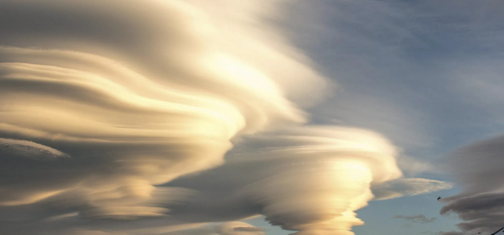
What Do You See?
Why might two people look at the same clouds but see different things?
Why might two people look at another person and see that person differently?
What do you know about how Heavenly Father and Jesus Christ see each of us?

Slide 3

Preach to the Gentiles
Acts 10-11
“Of a truth I perceive that God is no respecter of persons: But in every nation he that feareth him, and worketh righteousness, is accepted with him.” Acts 10:34-35

Slide 4
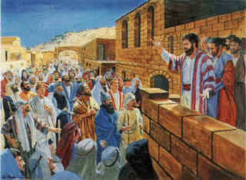
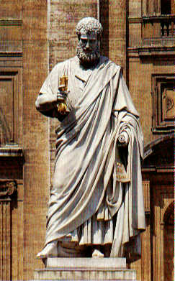
Changes
Up to this point in New Testament times, the gospel had been preached, with a few exceptions, exclusively to Jews as directed by the Savior.
These twelve Jesus sent forth, and commanded them, saying, Go not into the way of the Gentiles, and into any city of the Samaritans enter ye not:
But go rather to the lost sheep of the house of Israel.
Matthew 10:5-6
However…
The Savior also told His disciples that after the Holy Ghost came upon them they would preach the gospel “unto the uttermost part of the earth” Acts 1:18

Slide 5
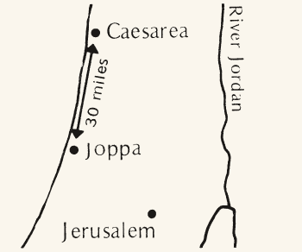
Up on the Housetop…
The word is to be preached among the Gentiles
Acts 10

Slide 6
A certain man in Caesarea called Cornelius
Cornelius was a Roman centurion (the leader of one hundred men), living in Caesarea.
He was a Gentile, who was described as being God-fearing, devout, generous, and prayerful.
Cornelius was viewed as a just man...and of good report among all the nation of the Jews…
Yet, by Jewish tradition, a Gentile could not join Christ’s Church without first converting to Judaism, since the gospel was only taken to the Jews.
Acts 10:1-2
(2)

Slide 7
Had an angel come to him in the 9th hour
Acts 10:3-7

Slide 8
Declaring what Cornelius had seen, he sends three to Joppa
Acts 10:7

Slide 9
The 6th hour
It has often been remarked that the houses in Judea were builded with flat roofs, on which people walked, conversed, meditated, prayed, etc. The house-top was the place of retirement; and thither Peter went for the purpose of praying to God. In Bengal, some of the rich Hindoos have a room on the top of the house, in which they perform worship daily. (3)
Acts 10:9-10

Slide 10
Peter sees the heaven’s open
Symbolism
The Lord did not send down the food in a great vessel or basket. He did not offer it on a banquet table, but on a 'great sheet knit at the four corners', symbolizing the four corners of the earth from which the Gentiles would come to receive the gospel.
Acts 10:11-12
(2)

Slide 11
“Letting Down the Sheet”
Three times Peter is asked to preach to the Gentiles
Acts 10:13-17

Slide 12
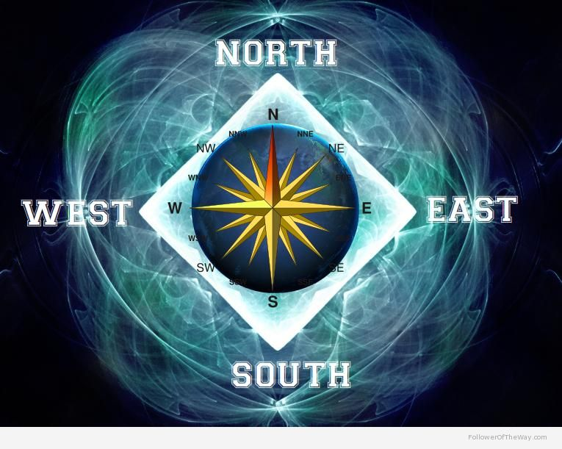
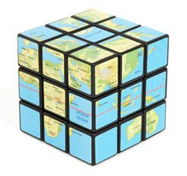
Four Corners of the Earth
'I saw four angels standing on the four corners of the earth, holding the four winds of the earth, that the wind should not blow on the earth, nor on the sea nor on any tree...
'After this I beheld, and, lo, a great multitude, which no man could number of all nations, and kindreds, and people, and tongues, stood before the throne, and before the Lamb, clothed with white robes, and palms in their hands.' (Rev 7:1,9)

Slide 13
Peter Doubts
Men come to Simon’s house
Acts 10:17-20

Slide 14
A Warning From God
They tell Peter about Cornelius
Acts 10:21-23

Slide 15

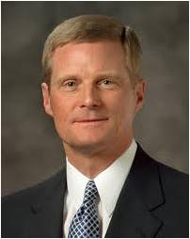
Line Upon Line
The gradual increase of light radiating from the rising sun is like receiving a message from God “line upon line, precept upon precept”
Most frequently, revelation comes in small increments over time and is granted according to our desire, worthiness, and preparation. …
This pattern of revelation tends to be more common than rare.
(11)
2 Nephi 28:30; Acts 10:17

Slide 16
A Meeting With Cornelius
Peter goes with them to Caesarea
Cornelius told Peter about his vision. Cornelius had also gathered his family and friends so Peter could teach them.
Acts 10:23-33

Slide 17
Peter Testifies of Jesus Christ
The gift of the Holy Ghost is poured out to the Gentiles
Acts 10:44-48

Slide 18
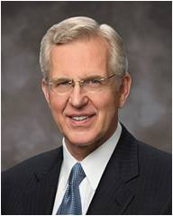
“By this experience and revelation to Peter, the Lord modified the practice of the Church and revealed a more complete doctrinal understanding to His disciples. And so, the preaching of the gospel expanded to encompass all mankind.”
(6)

Slide 19
“…and he inviteth them all to come unto him and partake of his goodness; and he denieth none that come unto him, black and white, bond and free, male and female; and he rememberth the heathen; and all are alike unto God,
both Jew and Gentile.”
(2 Nephi 26:33)

Slide 20
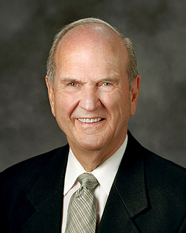

Each of us has a divine potential because each is a child of God. Each is equal in His eyes. The implications of this truth are profound.
Brothers and sisters, please listen carefully to what I am about to say. God does not love one race more than another.
His doctrine on this matter is clear. He invites all to come unto Him, “black and white, bond and free, male and female”
I assure you that your standing before God is not determined by the color of your skin. Favor or disfavor with God is dependent upon your devotion to God and His commandments and not the color of your skin.
(10)

Slide 21
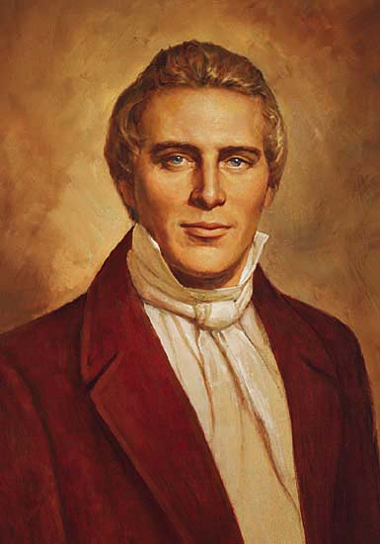
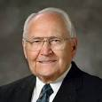
“There is order in the way the Lord reveals His will to mankind.
We all have the right to petition the Lord and receive inspiration through His Spirit within the realm of our own stewardship.
Parents can receive revelation for their own family, a bishop for his assigned congregation, and on up to the First Presidency for the entire Church.
However, we cannot receive revelation for someone else’s stewardship.”
O
R
D
E
R
Prophet Joseph Smith declared:
“‘It is contrary to the economy of God for any member of the Church, or any one, to receive instructions for those in authority, higher than themselves’ (4)
“‘Revelations of the mind and will of God to the Church, are to come through the [First] Presidency.
This is the order of heaven.’
(5)

Slide 22
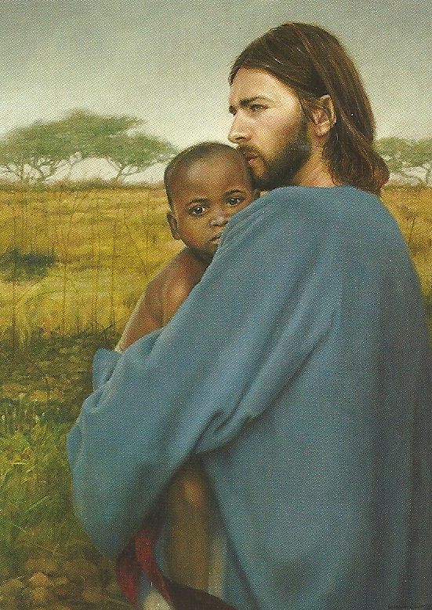
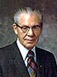
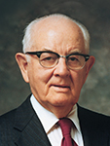
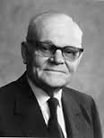
Priesthood Blessings to All Worthy Males
Recognizing Spencer W. Kimball as the prophet, seer, and revelator, and president of The Church of Jesus Christ of Latter-day Saints, it is proposed that we as a constituent assembly accept this revelation as the word and will of the Lord. All in favor please signify by raising your right hand. Any opposed by the same sign.
The vote to sustain the foregoing motion was unanimous in the affirmative.
Salt Lake City, Utah, September 30, 1978.
(7)

Slide 23
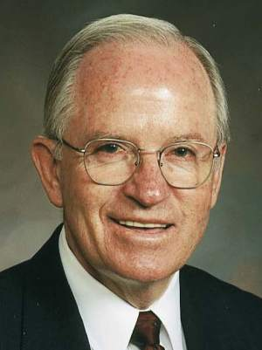
Accepting Change
Peter’s interaction with a Gentile was a major change from past practice, and some members had difficulty accepting this change
“…there are some barriers to creating a greater unity amid our diversity. These barriers include racial and cultural discrimination and attitudes of separatism.
The gospel is marvelously sufficient to create the desired unity, but people are imperfect.
Discomfort because of language barriers, fear of accepting those with differences in skin color, alienation of singles—all have created barriers to unity.
Usually, this mistreatment, isolation, and discrimination is self-justified by the use of labels. Labeling a fellow Church member an intellectual, a less-active member, a feminist, a South African, an Armenian, a Utah Mormon, or a Mexican, for example, seemingly provides an excuse to mistreat or ignore that person.
These problems and many more need to be addressed if we are to create a society such as that which Enoch created.
Change
Acts 11:1-18
(8)

Slide 24
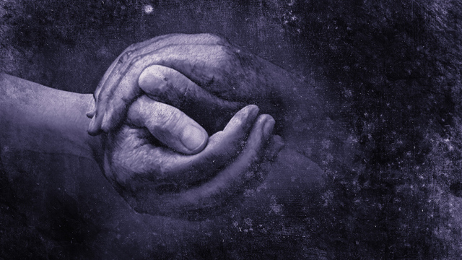
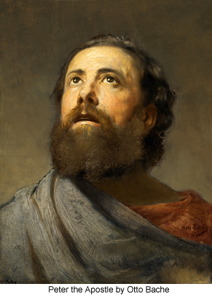
Becoming One With God
“As we become one with God, we will become one with each other. As we become one with each other, we will become one with God.”
What was I, that I could withstand God?”
Peter would not oppose God’s will of giving the Gentiles the opportunity to receive the gospel, repent, and be baptized.
For I have given him the keys of the mysteries, and the revelations which are sealed, until I shall appoint unto them another in his stead.
D&C 28:7
Otto Bache
Acts 11:1-18
(8)

Slide 25
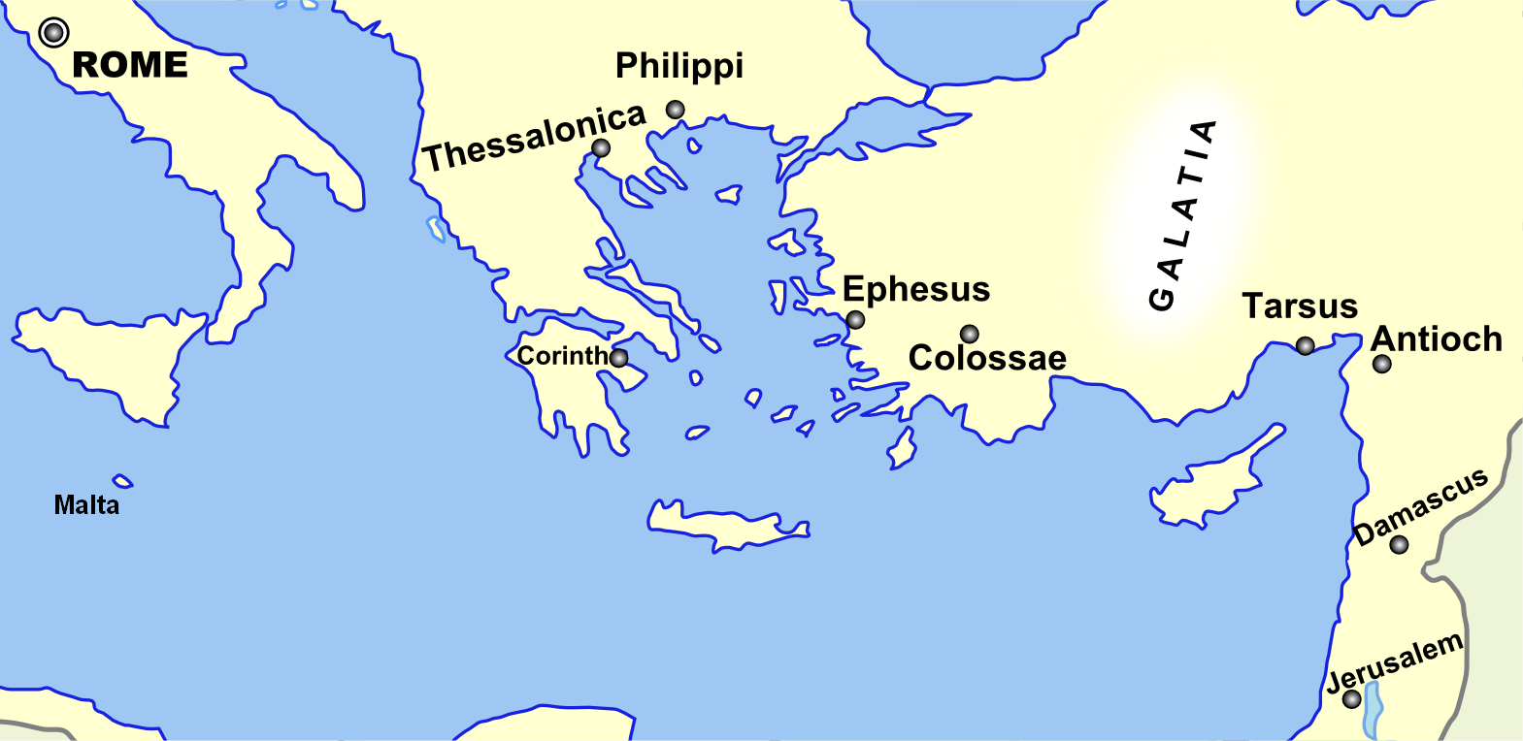
Disciples Scatter
Because of persecution, several disciples were scattered throughout the region but faithfully preached the gospel of Jesus Christ wherever they went.
And it came to pass, that a whole year they assembled themselves with the church, and taught much people. And the disciples were called Christians first in Antioch.
Acts 11:19-26

Slide 26
Christians In The Land of Zarahemla
It is interesting to note that as early as 73 B.C., all Nephites who belonged to the church of Jesus Christ in the land of Zarahemla were known as Christians.
And those who did belong to the church were faithful; yea, all those who were true believers in Christ took upon them, gladly, the name of Christ, or Christians as they were called, because of their belief in Christ who should come. Alma 46:15
In fact, the name of Jesus Christ had been revealed to Jacob and Nephi some five hundred years before his birth, thus leaving the Nephites, at least, in little doubt as to the identity of the Messiah who should save them from their sins.
Read 2 Nephi 10:3 and 25:19
Acts 11:19-26
(9)

Slide 27

Teaching and Acting on Revelation
Heavenly Father will bless us with additional revelation as we follow revelation we receive.
And now, verily, verily, I say unto thee, put your trust in that Spirit which leadeth to do good—yea, to do justly, to walk humbly, to judge righteously; and this is my Spirit.
D&C 11:12
And ye cannot bear all things now; nevertheless, be of good cheer, for I will lead you along. The kingdom is yours and the blessings thereof are yours, and the riches of eternity are yours.
D&C 78:18
Acts 11:19-26

Slide 28
Sources:
New Testament Institute Student Manual Chapter 31
Gospeldoctrine.com
Adam Clarke Commentary
Teachings of Presidents of the Church: Joseph Smith (2007), 197–98.
Elder L. Tom Perry [Teachings: Joseph Smith, 197]” (“We Believe All That God Has Revealed,” Ensign or Liahona, Nov. 2003, 85–86).
Elder D. Todd Christofferson (“The Doctrine of Christ,” Ensign or Liahona, May 2012, 88).
Official Declaration 2
Unity in Diversity By Elder John K. Carmack March 1991 Ensign
The Life and Teaching of Jesus and His Apostles Course Manual Rel. 211-215 Section 7 Chapter 30
Russell M. Nelson, “Let God Prevail,” Ensign or Liahona, Nov. 2020, 94
David A. Bednar, “The Spirit of Revelation,” Ensign or Liahona, May 2011, 88
Presentation by ©http://fashionsbylynda.com/blog/

Slide 29
Official Declaration 2
The Book of Mormon teaches that “all are alike unto God,” including “black and white, bond and free, male and female” (2 Nephi 26:33). Throughout the history of the Church, people of every race and ethnicity in many countries have been baptized and have lived as faithful members of the Church. During Joseph Smith’s lifetime, a few black male members of the Church were ordained to the priesthood. Early in its history, Church leaders stopped conferring the priesthood on black males of African descent. Church records offer no clear insights into the origins of this practice. Church leaders believed that a revelation from God was needed to alter this practice and prayerfully sought guidance. The revelation came to Church President Spencer W. Kimball and was affirmed to other Church leaders in the Salt Lake Temple on June 1, 1978. The revelation removed all restrictions with regard to race that once applied to the priesthood.
To Whom It May Concern:
On September 30, 1978, at the 148th Semiannual General Conference of The Church of Jesus Christ of Latter-day Saints, the following was presented by President N. Eldon Tanner, First Counselor in the First Presidency of the Church:
In early June of this year, the First Presidency announced that a revelation had been received by President Spencer W. Kimball extending priesthood and temple blessings to all worthy male members of the Church. President Kimball has asked that I advise the conference that after he had received this revelation, which came to him after extended meditation and prayer in the sacred rooms of the holy temple, he presented it to his counselors, who accepted it and approved it. It was then presented to the Quorum of the Twelve Apostles, who unanimously approved it, and was subsequently presented to all other General Authorities, who likewise approved it unanimously.
President Kimball has asked that I now read this letter:
June 8, 1978
To all general and local priesthood officers of The Church of Jesus Christ of Latter-day Saints throughout the world:
Dear Brethren:
As we have witnessed the expansion of the work of the Lord over the earth, we have been grateful that people of many nations have responded to the message of the restored gospel, and have joined the Church in ever-increasing numbers. This, in turn, has inspired us with a desire to extend to every worthy member of the Church all of the privileges and blessings which the gospel affords.
Aware of the promises made by the prophets and presidents of the Church who have preceded us that at some time, in God’s eternal plan, all of our brethren who are worthy may receive the priesthood, and witnessing the faithfulness of those from whom the priesthood has been withheld, we have pleaded long and earnestly in behalf of these, our faithful brethren, spending many hours in the Upper Room of the Temple supplicating the Lord for divine guidance.
He has heard our prayers, and by revelation has confirmed that the long-promised day has come when every faithful, worthy man in the Church may receive the holy priesthood, with power to exercise its divine authority, and enjoy with his loved ones every blessing that flows therefrom, including the blessings of the temple. Accordingly, all worthy male members of the Church may be ordained to the priesthood without regard for race or color. Priesthood leaders are instructed to follow the policy of carefully interviewing all candidates for ordination to either the Aaronic or the Melchizedek Priesthood to insure that they meet the established standards for worthiness.
We declare with soberness that the Lord has now made known his will for the blessing of all his children throughout the earth who will hearken to the voice of his authorized servants, and prepare themselves to receive every blessing of the gospel.
Sincerely yours,
Spencer W. Kimball
N. Eldon Tanner
Marion G. Romney
The First Presidency

Slide 30
Discrimination in Prayers Acts 10:4:
…God hears and answers prayers. The second is that he hears and answers the prayers of all of his children-even Gentiles. Today, we are occasionally guilty of the same narrow-mindedness. Do we really believe that the Lord is just as willing to answer the prayers of non-members as he is for Church members? If not, then we imply that God is a respecter of persons, an unjust judge, and a bigot. The words of the angel, 'Thy prayers and thine alms are come up for a memorial before God,' prove that prejudice and bigotry are exclusively mortal attributes.
Through the years, discrimination based on ethnic or religious identity has led to senseless slaughter, vicious pogroms, and countless acts of cruelty. The face of history is pocked by the ugly scars of intolerance." (Russell M. Nelson, Perfection Pending, and Other Favorite Discourses, 67.)
Cornelius and the Gift of the Holy Ghost Acts 10:45:
Luke records that the Gentiles received "the gift of the Holy Ghost" prior to their baptism or confirmation by the laying on of hands. But they did not receive "the gift of the Holy Ghost" in the same sense as the term is used today. Rather, the power of the Holy Ghost temporarily came upon them in a manner reminiscent of the way it had come upon the disciples on the day of Pentecost (Acts 2). Such a powerful bestowal of the Holy Ghost was necessary to show the Jews then present that the Gentiles were worthy of the greatest blessings of the gospel. Yet, the gift which would give them the privilege of constant companionship had not yet been bestowed upon them, for they had neither been baptized, nor had they received the laying on of hands. (2)
"There is a difference between the Holy Ghost and the gift of the Holy Ghost. Cornelius received the Holy Ghost before he was baptized, which was the convincing power of God unto him of the truth of the gospel. But he could not receive the gift of the Holy Ghost until after he was baptized. And had he not taken this sign [or] ordinances upon him, the Holy Ghost, which convinced him of the truth of God, would have left him until he obeyed those ordinances and received the gift of the Holy Ghost by the laying on of hands, according to the order of God.“ Joseph Smith (Kent P. Jackson, comp. and ed., Joseph Smith's Commentary on the Bible, p. 150.)
Hunger and Trance Acts 10:10:
The dinner among the ancients was a very slight meal; and they had no breakfast: their supper was their principal meal. And, in very ancient times, they ate only once in the day. Supper was the meal at which they saw their friends, the business of the day being then finished.
At first he felt keen hunger; but, being earnestly engaged with God, all natural appetites became absorbed in the intense application of his soul to his Maker. While every passion and appetite was under this Divine influence, and the soul, without let or hinderance, freely conversing with God, then the visionary and symbolical representation mentioned here took place. (3)
Revelation Given to Those in Authority Acts 11:
“The gradual increase of light radiating from the rising sun is like receiving a message from God ‘line upon line, precept upon precept’ (2 Nephi 28:30). Most frequently, revelation comes in small increments over time and is granted according to our desire, worthiness, and preparation. Such communications from Heavenly Father gradually and gently ‘distil upon [our souls] as the dews from heaven’ (D&C 121:45). This pattern of revelation tends to be more common than rare” (“The Spirit of Revelation,” Ensign or Liahona, May 2011, 88).
Prejudices Acts 10:13-15:
"The prejudices were deep rooted in Peter, and it took a vision from heaven to help him cast off his bias. The voice had commanded: 'Rise, Peter; kill, and eat,' when the vessel descended from the heaven containing all manner of beasts, reptiles, and fowls. Punctilious Peter expressed his lifelong prejudices and habits in saying, 'Not so, Lord; for I have never eaten anything that is common or unclean.' Then the heavenly voice made clear that the program was for all. 'What God hath cleansed,' it said, 'that call not thou common.' Peter's long sustained prejudices finally gave way under the power of the thrice-repeated command. When the devout gentile Cornelius immediately thereafter appealed to him for the gospel, the full meaning of the vision burst upon Peter and he exclaimed, '. . . God hath shewed me that I should not call any man common or unclean.' (Acts 10:13-15, 28.)“
President Spencer W. Kimball (Faith Precedes the Miracle, 294.)
The Name Christians Acts 11:26:
“Christians is an obvious name for the followers of Christ, for those who believe he is the Son of God and that salvation of all degrees comes because of him and his atoning sacrifice. Since there have been followers of Christ in successive gospel dispensations from Adam to the present, these all would have been known as Christians or some equivalent, synonymous term. By saying the saints were called Christians first in Antioch means that for the first time in the meridian dispensation there was a sufficient church membership so that nonmembers recognized the saints as a separate and distinct organization, one severed and apart from the Jewish synagogue and community.” (McConkie, DNTC, 2:112.)

Slide 31
Events in Acts 10 and 11
Event | Acts
Caesarea, Judea The Vision of Cornelius | 10:1–8
Peter: A Vision of the Unclean | 10:9–20
The Gospel Is Sent to the Gentiles | 10:21–35
Teachings of Witnesses | 10:36–43
The Holy Ghost Poured Out on the Gentiles | 10:44–48
Jerusalem, Judea Peter’s Report | 11:1–18
Antioch, Syria Disciples are Called Christians | 11:19–26
Agabus Prophecies of Famine | 11:27–30
The Life and Teachings of Jesus and His Apostles Chapter 30

Slide 32

Making Right Decisions
Acts 12
Hearken unto me, ye that know righteousness, the people in whose heart is my law; fear ye not the reproach of men, neither be ye afraid of their revilings.
Isaiah 51:7
N
W
E
S

Slide 33

A compass always points north
How would this magnet influence the behavior of the compass needle?
N
W
E
The needle will point to the nearby magnet because it interferes with magnetic north.
S
How would this magnet affect your ability to make the right choice about what direction you should go?

Slide 34
King Herod Agrippa I
He was the grandson of the Herod the Great who was king at the time of the Messiah's birth; and he was the nephew of the Herod who killed John the Baptist (Luke 9:9)
It is revealed that Herod Agrippa's wickedness was not unlike his predecessors.
Herod the Great
Aristobulus
Archelaus
Herod Antipas
Philip
Herod Agrippa l
Herodias
Wife of Philip Who became Antipas wife
(Matthew 14:1-6)
Herod Agrippa II
Bernice
Drusilla
Wife of Agrippa II
Acts 25:13; 23;
26:30
Wife of Gov. Felix
Acts 24:24

Slide 35
King Herod Agrippa II
He was the son of Herod Agrippa I, and the seventh and last king of the Herodian dynasty.
Herod the Great
Aristobulus
Archelaus
Herod Antipas
Philip
Herod Agrippa l
Herodias
Wife of Philip Who became Antipas wife
(Matthew 14:1-6)
Herod Agrippa II
Bernice
Drusilla
Wife of Agrippa II
Acts 25:13; 23;
26:30
Wife of Gov. Felix
Acts 24:24

Slide 36
Vexing the Church
About 44 AD
King Herod Agrippa I kills James, brother of John the beloved, with a sword
King Herod Agrippa I puts Peter into prison
James was killed by Herod’s order, but Peter was rescued from prison by an angel sent from God
four quaternions of soldiers = 4 soldiers
Acts 12:1-4

Slide 37
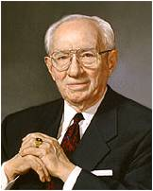
Herod’s Desire to Please Others
How did Herod’s desire to please others rather than God affect Herod’s direction in life?
Herod planned to publicly put Peter to death.
“One who seeks to please his Heavenly Father will serve the needs of our Father’s kingdom.
If each of us is to please our Father in Heaven, we must be responsive to the needs of His kingdom.”
Acts 12:1-4
(2)

Slide 38
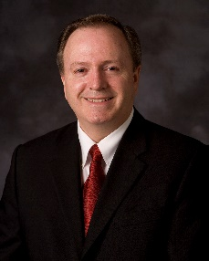
Putting God First
Peter and James put God first in their lives, regardless of the punishment they might receive.
“Trying to please others before pleasing God is inverting the first and second great commandments. It is forgetting which way we face. And yet, we have all made that mistake because of the fear of men.
Jacob quotes Isaiah
…and they were in the attitude of mocking and pointing their fingers towards those who had come at and were partaking of the fruit.
And after they had tasted of the fruit they were ashamed, because of those that were scoffing at them; and they fell away into forbidden paths and were lost.
Nephi 8:27-28
Hearken unto me, ye that know righteousness, the people in whose heart I have written my law, fear ye not the reproach of men, neither be ye afraid of their revilings.
2 Nephi 8:7

Slide 39
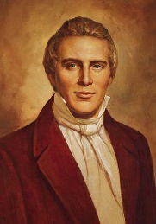
Prayer Without Ceasing
"The greatest temporal and spiritual blessings...always come from faithfulness and concerted effort, [not from] individual exertion or enterprise." (4)
The power of united prayer of the entire church is a power unequalled in the world. The Lord will not be slow to answer the prayers of his saints unless they have been disobedient.
Yet, we often underestimate this great power because we underestimate the Lord's willingness to bless us according to our desires.
Abinadi to King Noah
And it shall come to pass that except this people repent and turn unto the Lord their God, they shall be brought into bondage; and none shall deliver them, except it be the Lord the Almighty God.
Yea, and it shall come to pass that when they shall cry unto me I will be slow to hear their cries; yea, and I will suffer them that they be smitten by their enemies.
Mosiah 11:23-24
Acts 12:5

Slide 40
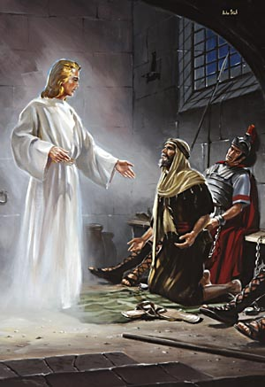
Peter Chained To Two Soldiers
And, behold, the angel of the Lord came upon him, and a light shined in the prison: and he smote Peter on the side, and raised him up, saying, Arise up quickly. And his chains fell off from his hands.
And the angel said unto him, Gird thyself, and bind on thy sandals. And so he did. And he saith unto him, Cast thy garment about thee, and follow me.
When they were past the first and the second ward, they came unto the iron gate that leadeth unto the city; which opened to them of his own accord: and they went out, and passed on through one street; and forthwith the angel departed from him.
And he went out, and followed him; and wist not that it was true which was done by the angel; but thought he saw a vision.
Acts 12:7-10

Slide 41
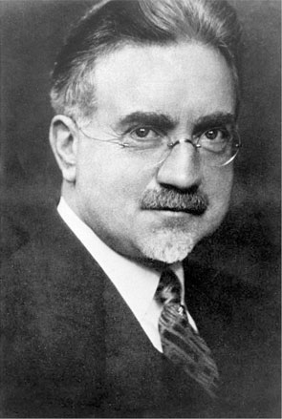
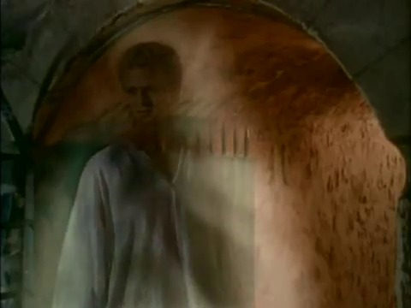
"Undoubtedly angels often guard us from accidents and harm, from temptation and sin.
They may properly be spoken of as guardian angels.
Many people have borne and may bear testimony to the guidance and protection that they have received from sources beyond their natural vision.
Without the help that we receive from the constant presence of the Holy Spirit, and from possible holy angels, the difficulties of life would be greatly multiplied.”
Acts 12:5
(6)

Slide 42
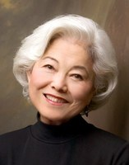
Mary’s House
John Mark, commonly known as Mark, is probably the author of the Gospel According to St. Mark.
He was the son of a woman named Mary, one of the leading women in the early Church in Jerusalem.
Believers assembled at her home, and Peter returned there after being freed from prison.
“To actually accept the miracle by looking at it was the last thing they did, and then they were so overwhelmed with their own reactions that they couldn't even welcome Peter properly. Their prayer of faith brought the miracle to their doorstep, but for a long, suspenseful moment they lacked the final ounce of faith to open the door and let the miracle enter."
Acts 12:11-15, 25; Acts 13:5
(1,7)

Slide 43
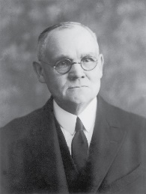
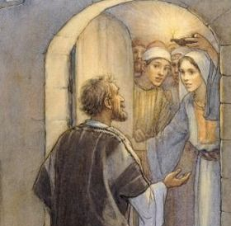
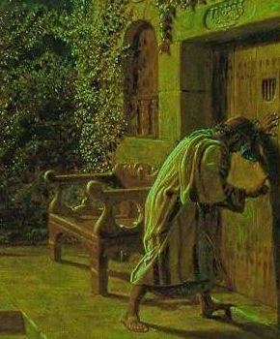
"Peter kept knocking, and at last they opened the door, and were astonished to find him safe.
Why should they be so surprised, when they had been praying for that very blessing? One might think that their hearts would be so full of thanksgiving that there would be no room for astonishment.
"Yet we to-day feel surprised when the Lord manifests His power to us in any strong or otherwise remarkable manner; our greatest cause for wonderment would seem to lie in the contemplation of His mercy, that He will interpose in behalf of such weak and sinful mortals as many of us are.
He is as willing to-day as ever in the past to assist His servants, and that too, by what we call miraculous means should it be necessary."
Acts 12:16
(8)

Slide 44
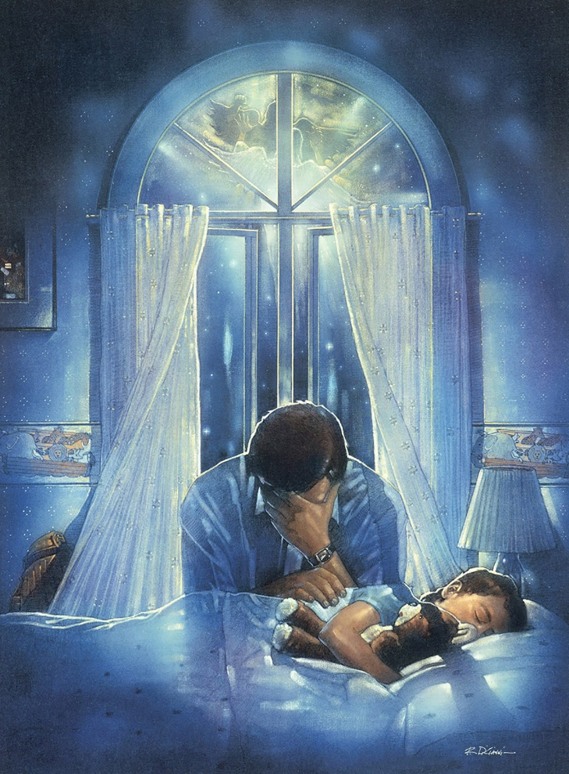
“Prayer is the act by which the will of the Father and the will of the child are brought into correspondence with each other.
The object of prayer is not to change the will of God but to secure for ourselves and for others blessings that God is already willing to grant but that are made conditional on our asking for them.
Blessings require some work or effort on our part before we can obtain them. Prayer is a form of work and is an appointed means for obtaining the highest of all blessings.”
Ron DiCianni
Acts 12:16
(9)

Slide 45
Herod’s Fate
Agrippa died at the age of 54, in A.D. 44, the same year James was martyred.
Luke saw Agrippa’s sudden death as divine retribution, administered by an angel of the Lord.
And immediately the angel of the Lord smote him, because he gave not God the glory: and he was eaten of worms, and gave up the ghost.
Acts 12:18-25
(1)

Slide 46
Sources:
New Testament Institute Student Manual Chapter 31
President Gordon B. Hinckley To Please Our Heavenly Father April 1985 Gen. Conf.
Elder Lynn G. Robbins (“Which Way Do You Face?” Ensign or Liahona, Nov. 2014, 9).
Joseph Smith (Teachings, p. 183)
Gospeldoctrine.com
John A. Widstoe (Evidences and Reconciliations, p. 402.)
Chieko Okazaki, Sanctuary, 34
James E. Talmage (Brian H. Stuy, ed., Collected Discourses, 5 vols. [Burbank, Calif., and Woodland Hills, Ut.: B.H.S. Publishing, 1987-1992], 3: June 25, 1893.)
Bible Dictionary
Presentation by ©http://fashionsbylynda.com/blog/

Slide 47
THE ACTS OF THE APOSTLES—EVENTS OCCURRED CA. A.D. 40–44 (10–13:1–5)
Jerusalem, Judea Peter is Freed from Prison | 12:1–19
Caesarea: Herod Dies of Disease | 12:20–23
Antioch, Syria Saul and Barnabas Called to the Ministry | 12:24, 25; 13:1–5
Jerusalem, Judea Peter is Freed from Prison | 12:1–19
Caesarea: Herod Dies of Disease | 12:20–23
Antioch, Syria Saul and Barnabas Called to the Ministry | 12:24, 25; 13:1–5
Death of James The Apostle Acts 12:1-2:
"This martyrdom of James is one of the strongest testimonies to his prominence and importance among the Apostles, and does much to correct the impression naturally formed by the lack of prominent mention of him by the evangelists. Surely, since Herod undertook this persecution for the sake of gaining the favor of the Jews, and since, no doubt, he could choose the victim, he would surely select one of the most influential and prominent of the Apostles. His selection of James, therefore, is a high tribute to the Apostle's worth and dignity." (Willard Done, "Lives of the Apostles", Improvement Era, 1899, Vol. ii. February, 1899. No. 4. .)
Easter Acts 12:4:
"The term Easter as used here by King James translators is an anachronism, for there was no Easter celebration as such for many, many years following the Savior's death and resurrection. The Greek word pascha, equivalent to the Hebrew Payach, translates itself as Passover. Early Christians changed the Hebrew custom of celebrating Passover into their own commemoration of the resurrection of Jesus, whom they regarded as the true Paschal lamb of God and the first fruits of the resurrection." (Institute Manual, The Life and Teachings of Jesus & his Apostles, 2nd ed., p. 253)
"The word Easter is from Eastre, a Norse goddess whose pagan festival was observed at the spring equinox. The association of this pagan goddess with the celebration of the resurrection of Jesus Christ was only by adaptation and synthesis. There is no real connection. Jesus being the Lamb of God, was crucified at the Passover time and is the true Passover (see 1 Cor. 5:7).“ Bible Dictionary
Life and Teachings of Jesus and His Apostles Section 7 Chapter 30
Peter Chained to Two Soldiers Acts 12:7-10
"The fisherman apostle lay in the dungeon, the last night before he was to be brought before the people, and probably to be put to death. He was sleeping peacefully; why should he not rest when his conscience was void of offense? What was death to him? it meant an escape from the cruel persecutions of his enemies, and a reunion with the Master who had died so bravely on the cross, and whom he had learned to love so well. He was chained to two soldiers, one lying on either side of him as he slept; he could not move without disturbing his guards. The door of the prison was fastened, and before it other guards were stationed, and beyond these again was the great gate that divided the prison grounds from the city. The guards were vigilant, for it was in accordance with Roman law, that if a soldier ever allowed a prisoner to escape from his custody, the soldier should be subject to the extreme penalty that the prisoner would have received." James E. Talmage (Brian H. Stuy, ed., Collected Discourses, 5 vols. [Burbank, Calif., and Woodland Hills, Ut.: B.H.S. Publishing, 1987-1992], 3: June 25, 1893.)
Who Was John Mark? Acts 12:12:
According to early Christian sources, Mark was not among the original disciples of Jesus Christ, but he later converted, became an assistant to the Apostle Peter, and wrote his Gospel based on what he learned from Peter.
Mark (also called John Mark) and his mother, Mary, lived in Jerusalem; their home was a gathering place for some of the earliest Christians. New Testament Institute Manual Chapter 11
Death of Herod Acts 12:18-25: "The Roman Emperor Claudius had obtained great victories in Great Britain. On his return to Rome there was great rejoicing. Herod thought he would gain great favor with the emperor by a grand festival in his honor in Caesarea, to which he hastened from Jerusalem. On the morning of the second day the theatre was filled with a mass of human beings to witness the inhuman exhibition of gladiators who fought one another for public amusement. Herod appeared in a magnificent robe, sparkling with silver. As the rays of the early morning sun fell upon him, the eyes of the beholders were dazzled by the brilliant robe. Flattered by their foolish cries of admiration he made an oration to the people who gave a shout, crying, 'It is the voice of a God and not of a man.' He was willing to be so called, though this was blasphemy, giving to a man what belongs to God alone. 'Immediately the angel of the Lord smote him because he gave not God the glory.' This was very different from the experience of Peter in prison when the angel of the Lord came upon him, and smote him upon the side; and led him from death.
"The smiting of Herod by the angel was with a dreadful disease such as had caused the death of his grandfather. He was carried from the theatre to his palace where he, lingered five days in agony until death closed his life in the fifty-fourth year of his age. It was the fourth year of his reign over the region where had ruled his grandfather, whose wicked example he had followed to a like inglorious end.
"When in the theatre the scene was suddenly changed from the gladiatorial and other wicked amusements to the judgment on the king, the multitude fled, rending their clothes according to the custom in horror." (Ancient Apostles, 158-9.)

Slide 48
Herodian Family
The Herodian family were Idumeans by birth but had become converts to the Jewish faith. Their object was to found, under the protection of Rome, a semi-independent kingdom. By his marriage with Mariamne, Herod the Great allied himself with the family of the Maccabees, who had been for several generations the leaders of the patriotic party among the Jews.
Herod (The Great) was a successful ruler and was on terms of friendship with Augustus, the Roman Emperor. In order to gain favor with his subjects, with whom he was most unpopular, he rebuilt the temple at an immense cost
His reign was disgraced by many acts of cruelty. In a fit of jealousy he had his wife, whom he dearly loved, put to death; later on he had her two sons, Alexander and Aristobulus, also murdered. In the same year in which he gave the order for the massacre of the infants at Bethlehem, he had Antipater, another of his own sons, put to death. A few months later Herod himself died. His kingdom was then divided between three of his sons: Archelaus, who received Judea, Idumea, and Samaria; Antipas, who had Galilee and Perea; and Philip, who had the northeast districts of Palestine.
Herod Agrippa II:
Herod Agrippa I’s son (Agrippa II), was allowed by the Emperor Claudius to succeed to only a small part of his father’s dominions. He never ruled Jerusalem. He was the 7th king and last king of the Herodian Dynasty. He is mentioned in Acts 25:13.
He was only seventeen when his father died. Claudius kept him in Rome, and sent Cuspius Fadus to govern the Roman province of Judea. While in Rome, he voiced support for the Jews to Claudius, and spoke against the Samaritans.
The Jews only came in contact with him because he supervised the temple and appointed the high priests. In the New Testament he is mentioned as having paid a visit to Festus, the procurator, at Caesarea, where Paul delivered a speech before him in 60 A.D.
His sister, Berenice became Emperor Titus’ mistress. His sister Drusilla, married Roman procurator Felix, and also heard Paul speak (Acts 24:24).
Between 52 and 60 A.D., he arbitrarily appointed several high priests, which angered the Jews. The Jews also hated him for adopting heathen emblems on his coins.
The Apostle Paul pleaded his case at Caesarea Maritima before Herod Agrippa II and his sister Berenice, possibly in 59 A.D. The Roman procurator, Festus, was also present. Paul presented his salvation testimony. He also gave an impassioned plea for his audience to consider the Lordship of Jesus Christ. Herod Agrippa II mocked Paul for trying to make him a Christian, but he rejected his personal need for salvation.
According to Photius, Agrippa died, childless, at the age of seventy.
Dr. Merrill's Seminary Papers and other Reflections
Herod (Antipas) After a reign of nine years Archelaus was deposed by Augustus, and Judea was attached to the Roman province of Syria, being governed by a prefect. Antipas (called in the New Testament “Herod the tetrarch”) built as his capital Tiberias on the Sea of Galilee; he is frequently mentioned in the Gospels.
He took as his wife Herodias, the wife of his half-brother Philip. He was deposed by the Emperor Caligula and banished to Lugdunum in Gaul, A.D. 39. Philip made Caesarea Philippi (previously called Panias) his capital and remained in possession of his tetrarchy until his death in A.D. 33. His territory then became part of the province of Syria, but in A.D. 37 it was given by Caligula, along with Abilene (the tetrarchy of Lysanias), to Agrippa, who was allowed to assume the title of king.
Herod Agrippa I:
On the deposition of Antipas he obtained the tetrarchy of Galilee, and in A.D. 41, on the accession of the Emperor Claudius, he received Judea and Samaria as well, and so became ruler of the whole territory governed by his grandfather. He lived in Jerusalem and was anxious to be regarded as an orthodox Jew. He began a persecution of the Church and put James to death, Peter escaping by a miracle (Acts 12:1–23). His death is described in Acts 12:20–23.
Bible Dictionary

Slide 49

Missionary Life
Yesterday and Today
Acts 13-14
And he shall come into the world to redeem his people; and he shall take upon him the transgressions of those who believe on his name; and these are they that shall have eternal life, and salvation cometh to none else.
Alma 11:40

Slide 50

The Beginning of Missionary Life
Set Apart by Peter to Preach (Acts 2, 3)
Set Apart by Stake Presidents
Training—a year in Antioch
(Acts 11:26)
Training—MTC
Transportation—walking, biking, car
Transportation—walking, sailing (Acts 13:4)
Preaches---in homes, and on the streets, door to door
Preaches first to the Jews in the Synagogues
(Acts 13:5)

Slide 51
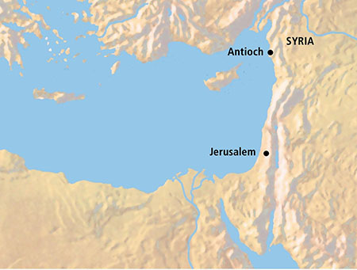
First Journey
After they were set apart, Saul and Barnabas traveled from Antioch to the island of Cyprus and preached in a synagogue in the city Salamis.
Cyprus
Paphos
From there they traveled to the other side of the island to the city Paphos.
Acts 13:1-6

Slide 52
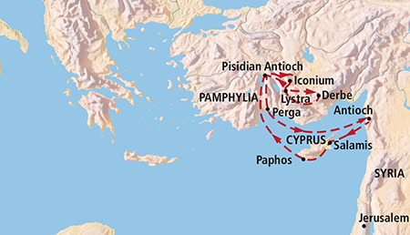
John Mark, Mark, or Marcus
He was the cousin of Barnabas and he accompanied Saul and Barnabas at the beginning of their first missionary journey.
John Mark’s unexpected departure from the other missionaries at Perga caused a later disagreement between Saul and Barnabas as they prepared to leave on their second mission.
The scriptures do not mention the reason Mark left the mission field. But he later accompanied Barnabas to Cyprus, was with Timothy at Ephesus, and is probably the Marcus whom Peter spoke of as “my son”.
Thus, Mark became a powerful force for good in the early Church. (1)
Acts 13:13; Acts 15:37-40; Colossians 4:10

Slide 53
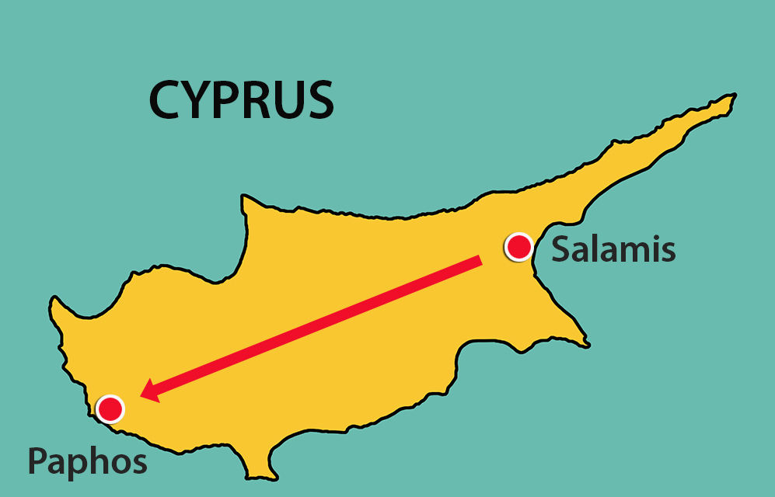
Finding Sergius Paulus
Sergius Paulus, who was the Roman deputy of the country
“Desired to hear the word of God”
False Prophet--Elymas the sorcerer, seeks to turn away the faith of Sergious Paulus
Paul (Saul) used harsh words because Elymas was attempting to keep another person from receiving salvation.
Saul cursed him with blindness
Acts 13:7-11

Slide 54
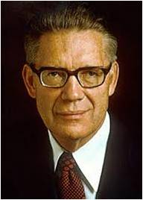
“Cursings as well as blessings may be administered by the power and authority of the priesthood … , but the Lord’s earthly agents are sent forth primarily to bless and not to curse, and no curse should ever be decreed except by direct revelation from the Lord commanding such to be done.”
And whosoever shall not receive you, nor hear your words, when ye depart out of that house or city, shake off the dust of your feet.
Matthew 10:14
From Verse 9 Saul is now referred to as Paul
Acts 13:7-11
(2)

Slide 55
Challenges of Missionary Life
Finding false prophets (Acts 13:6)
Coming across antagonists
Spake against those things and contradicting them
(Acts 13:45)
Arguing against doctrine
Others who have heard only the negative things about the church
Stirring up devout men and women in persecution
(Acts 13:50)
Turned away by others
Being kicked out of their cities (Acts 13:50)

Slide 56
In Antioch
In Antioch in Pisidia (not to be confused with Antioch in Syria, where Church members were first called Christians), Paul preached both to Jews and to others who “feared God”
God-fearers were Gentiles who accepted Jehovah as their God and lived various aspects of Judaism but did not fully convert to Judaism by undergoing the rite of circumcision.
Many of Paul’s Gentile converts were God-fearers who worshipped in synagogues, knew the Jewish scriptures (the Old Testament), and were in a state of readiness to accept the gospel message.
Acts 13:13
(1)

Slide 57
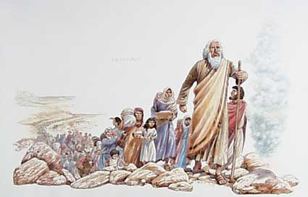
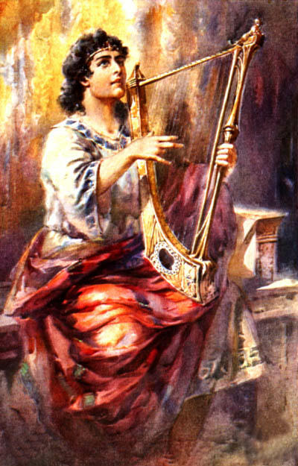
History of the Israelites
The God of this people of Israel chose our fathers, and exalted the people when they dwelt as strangers in the land of Egypt, and with an high arm brought he them out of it.
…he raised up unto them David to be their king; to whom also he gave testimony, and said, I have found David the son of Jesse, a man after mine own heart, which shall fulfil all my will.
David
Bathsheba
Nathan
“The sure mercies of David” = refer to the promises God made to David of the resurrection
41 Generations
Mary
Jesus
Acts 13:14-37
(1)

Slide 58
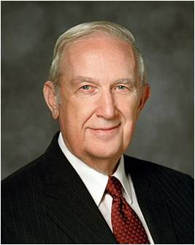
Repentance and Remission of Sins
Paul taught that “forgiveness of sins” comes only through Jesus Christ
“Whether the violation be great or small, the solution is the same: full repentance through faith in Jesus Christ and His Atonement with obedience to His commandments. …
“I testify that of all the necessary steps to repentance, the most critically important is for you to have a conviction that forgiveness comes in and through Jesus Christ. It is essential to know that only on His terms can you be forgiven. You will be helped as you exercise faith in Christ.
That means you trust Him and His teachings.”
Acts 13:38-39; 2 Nephi 9:22-24; Alma 11:40
(4)

Slide 59
Justified and Found Guiltless, Receive Joy
justified, = “to be pardoned [or forgiven] from punishment for sin and declared guiltless”
“Jesus suffered and gave His life to atone for sin. The power of His Atonement can erase the effects of sin in us. When we repent, His atoning grace justifies and cleanses us (see 3 Nephi 27:16–20). It is as if we had not succumbed, as if we had not yielded to temptation.”
Acts 13:38-39
(5)

Slide 60
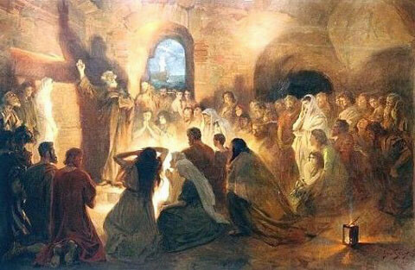
Blasphemy
Blasphemy as “contemptuous speech concerning God or concerning something that stands in a sacred relation toward God, such as His temple, His law, or His prophet.”
“Turn to the Gentiles”
This moment foreshadowed what would increasingly happen in the missionary work of the Church as many Jews opposed the gospel and Gentile conversions. After this event, as Paul traveled to other areas, he typically continued to teach the gospel “to the Jew first, and also to the Greek” (Romans 1:16),
…but when Jews rejected his message, Paul readily “turned to” the Gentiles, finding many ready to receive the gospel.
Acts 13:45-46
(6)

Slide 61
The Joys of Missionary Life
Having some Jews and Gentiles believe
(Acts 13:48)
Having converts believe and join the church
The Word of the Lord was “published” (witnessed) throughout the region
(Acts 13:49)
Being a witness of Christ through testimony
The joy of knowing a person will come unto the Lord
Disciples filled with joy, and the Holy Ghost
(Acts 13:52)

Slide 62
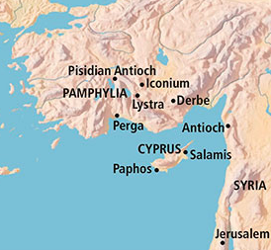
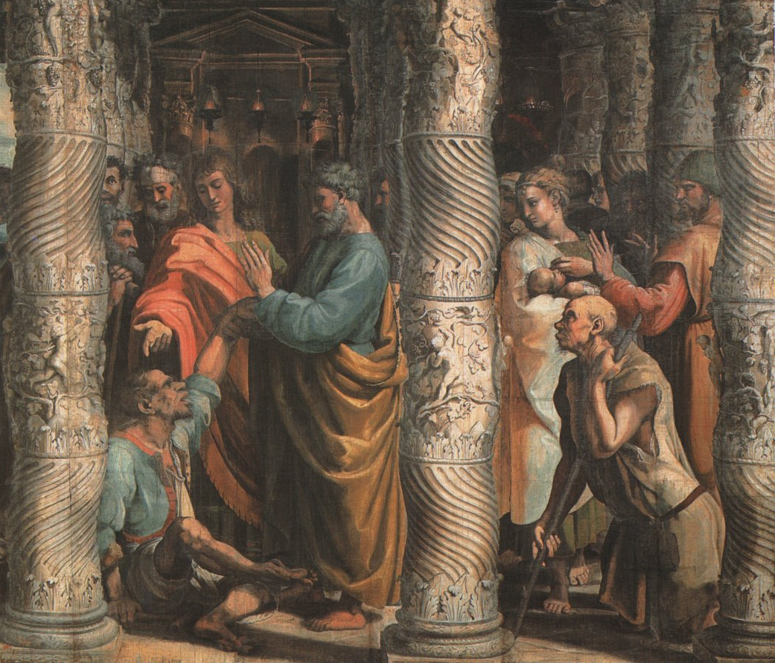
Persecution and Miracles
When Paul and Barnabas learned of a plot against their lives in Iconium, they departed to Lystra and Derbe.
In Lystra, they met a man who had been crippled from birth. Perceiving that the man “had faith to be healed,” Paul commanded the man to walk, which he did.
Unbelieving Jews stir up the Gentiles against Paul and Barnabas.
After Paul heals a crippled man, the people in Lystra think Paul and Barnabas are Greek gods and attempt to offer sacrifice to them
Acts 14:1-19
(1)

Slide 63
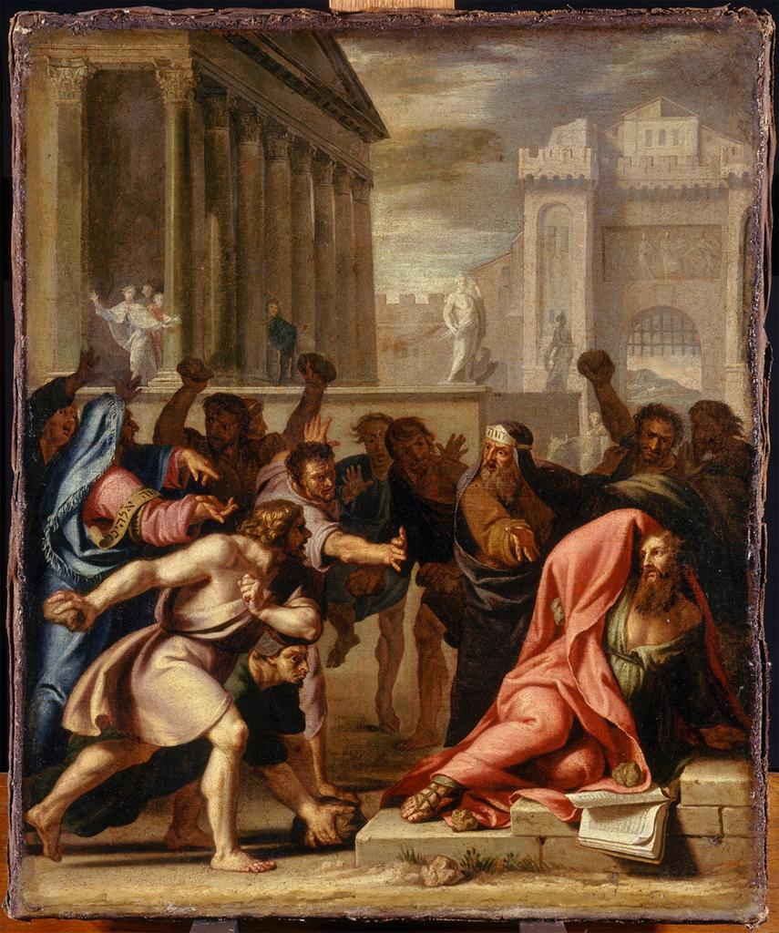
Persecution and Miracles
Paul is stoned and revived
Why does the Lord allow good people to experience difficult trials?
Acts 14:19

Slide 64
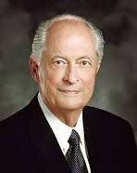
“There is meaning and purpose in our earthly challenges. Consider the Prophet Joseph Smith: throughout his life he faced daunting opposition—illness, accident, poverty, misunderstanding, false accusation, and even persecution.
One might be tempted to ask, ‘Why didn’t the Lord protect His prophet from such obstacles, provide him with unlimited resources, and stop up the mouths of his accusers?’
The answer is, Each of us must go through certain experiences to become more like our Savior. In the school of mortality, the tutor is often pain and tribulation, but the lessons are meant to refine and bless us and strengthen us, not to destroy us.”
Acts 14:19
(7)

Slide 65
The Miracles of Missionary Life
A man crippled is healed
(Acts 14:8-10)
Priesthood healings and anointings
Paul was stoned but revived
(Acts 14:19)
Blessings of Health
Having the doors open for the gospel to be spread
Opening the doors of faith with the Gentiles

Slide 66

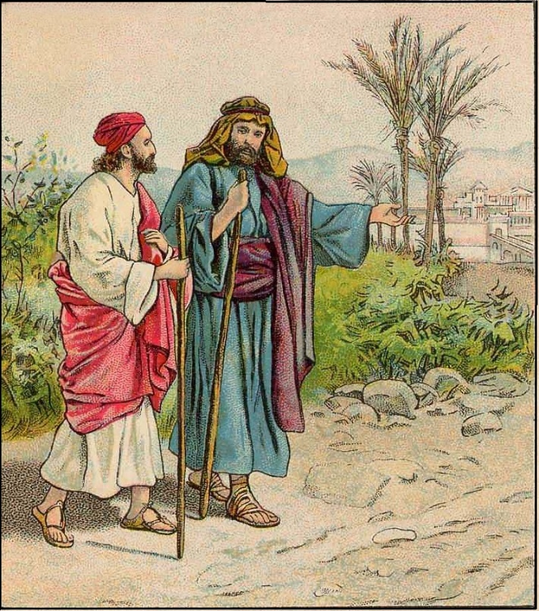
Confirming Souls and Establishing Branches
When Paul and Barnabas returned to Lystra, Iconium, and Antioch, they were following their general pattern of returning to cities where they had established branches of the Church, “confirming the souls of the disciples, and exhorting them to continue in the faith.” (1)
“With the ever-increasing number of converts, we must make an increasingly substantial effort to assist them as they find their way.
Every one of them needs three things: a friend, a responsibility, and nurturing with ‘the good word of God’ (Moro. 6:4).
It is our duty and opportunity to provide these things. …
This is a work for everyone. It is a work for home teachers and visiting teachers. It is a work for the bishopric, for the priesthood quorums, for the Relief Society, the young men and young women, even the Primary.”
Acts 14:19
(8)

Slide 67
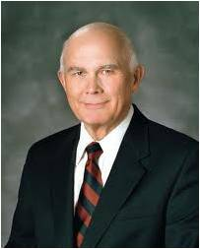
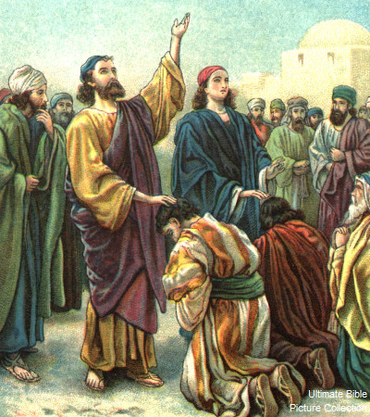
Ordained Many
Paul and his companions called and set apart faithful men to lead the Church in the various cities where branches of the Church were established and then “commended them to the Lord” Paul later exhorted Church members to honor and respect their local leaders. (1)
“The Lord told the early members of His Church that the voice of His servants is the voice of the Lord, and that the hand of His servants is the hand of the Lord.
I testify to the truthfulness of that principle, which imposes a solemn duty upon the members of this Church to be loyal to their leaders and faithful in following their direction. I affirm that the Lord will bless us for doing so.”
Acts 14:22-23; D&C 1:38, 36:2)
(9)

Slide 68
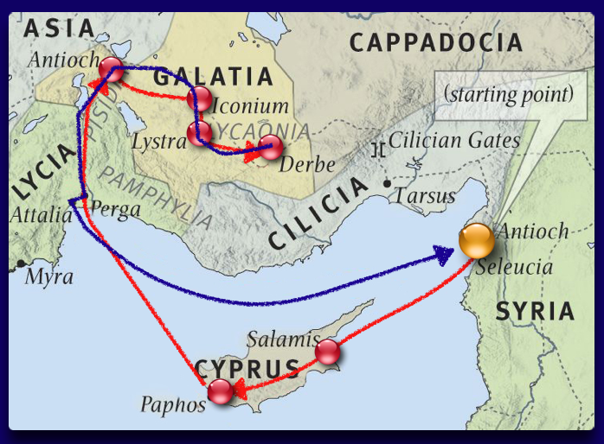
Last Part of Their First Mission
Paul and Barnabas continued their first missionary journey by visiting several additional cities that lie within present-day Turkey and Cyprus.
They concluded this journey by returning to Antioch in Syria, where they had begun their mission over two years earlier.
Acts 14:26-27
(1)

Slide 69
After the Mission
Prayed for those who had received the Word of God (Acts 14:26)
Pray for those people whom they had touched
Report to Stake President and to his ward the testimony he/she received
Gathered together with the church and rehearsed all that God had done with them.
(Acts 14:27)
Going home into the world
Rested from their labors
(Acts 14:28)

Slide 70
Sources:
New Testament Institute Student Manual Chapter 32
Elder Bruce R. McConkie (Mormon Doctrine, 2nd ed. [1966], 175–76.
Gospeldoctrine.com
Elder Richard G. Scott (“Peace of Conscience and Peace of Mind,” Ensign or Liahona, Nov. 2004, 16–17).
Elder D. Todd Christofferson (“That They May Be One in Us,” Ensign or Liahona, Nov. 2002, 71).
Bible Dictionary
Elder Robert D. Hales (“Faith through Tribulation Brings Peace and Joy,” Ensign or Liahona, May 2003, 17).
President Gordon B. Hinckley (“Converts and Young Men,” Ensign, May 1997, 47–48).
Elder Dallin H. Oaks (“Bishop, Help!” Ensign, May 1997, 23).
Presentation by ©http://fashionsbylynda.com/blog/

Slide 71
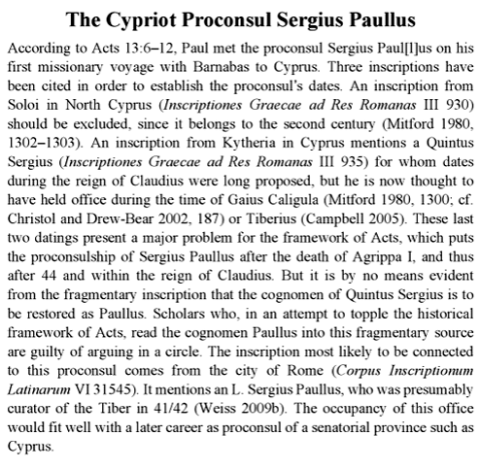
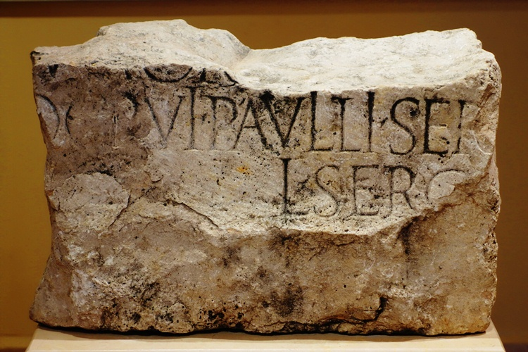
To Curse Someone Acts 13:10-11:
“To ceremonially shake the dust from one’s feet as a testimony against another was understood by the Jews to symbolize a cessation of fellowship and a renunciation of all responsibility for consequences that might follow. It became an ordinance of accusation and testimony by the Lord’s instructions to His apostles as cited in [Matthew 10:14]. In the current dispensation, the Lord has similarly directed His authorized servants to so testify against those who wilfully and maliciously oppose the truth when authoritatively presented” James E. Talmage (Jesus the Christ, 345; see also D&C 24:15; 75:18–22; 84:92–96).
Because of its serious nature, however, this should never be done except under the direction of the First Presidency and Quorum of the Twelve Apostles.(1)
Setting Apart Acts 13:3-4:
“The setting apart is an established practice in the Church and men and women are ‘set apart’ to special responsibility, in ecclesiastical, quorum, and auxiliary positions. …
“To some folk the setting apart seems a perfunctory act while others anticipate it eagerly, absorb every word of it, and let their lives be lifted thereby.
“The setting apart may be taken literally; it is a setting apart from sin, apart from the carnal; apart from everything which is crude, low, vicious, cheap, or vulgar; set apart from the world to a higher plane of thought and activity. The blessing is conditional upon faithful performance. …
“In my experience there have been numerous people who like Saul … have, through the setting apart, received ‘largeness of heart,’ extended influence, increased wisdom, enlarged vision, and new powers.” President Spencer W. Kimball (in Conference Report, Oct. 1958, 57).
Facing Opposition:
Many missionaries have had discussions with those who would teach false doctrine for their own benefit. These discussions are rarely amicable. At times, one might feel like cursing those who are contentious-as Saul cursed Elymas. Yet, how does one know when to say something like, 'Thou child of the devil...thou shalt be blind'? Obviously Saul was acting according to the Spirit for he was 'filled with the Holy Ghost.' Furthermore, the cursing came from God, not because Saul was angry or frustrated, but because it served the purposes of the Lord. The Lord does not curse these anti-Christs or false prophets out of maliciousness, but so that others may believe. Notice verse 12, 'Then the deputy, when he saw what was done, believed, being astonished at the doctrine of the Lord.'
From the Book of Mormon, we see the same pattern. Korihor was struck dumb while contending with Alma, but the result was that 'they were all convinced of the wickedness of Korhior; therefore they were all converted again unto the Lord' (Alma 30:58). Similarly, Sherem was smitten by the Lord while contending with Jacob. But the Lord did not smite him for Jacob's benefit but so that the people would not be deceived. After hearing Sherem's confession, 'the multitude...were overcome that they fell to the earth...And it came to pass that peace and the love of God was restored again among the people; and they searched the scriptures, and hearkened no more to the words of this wicked man' (Jacob 7:21-23). (3)

Slide 72
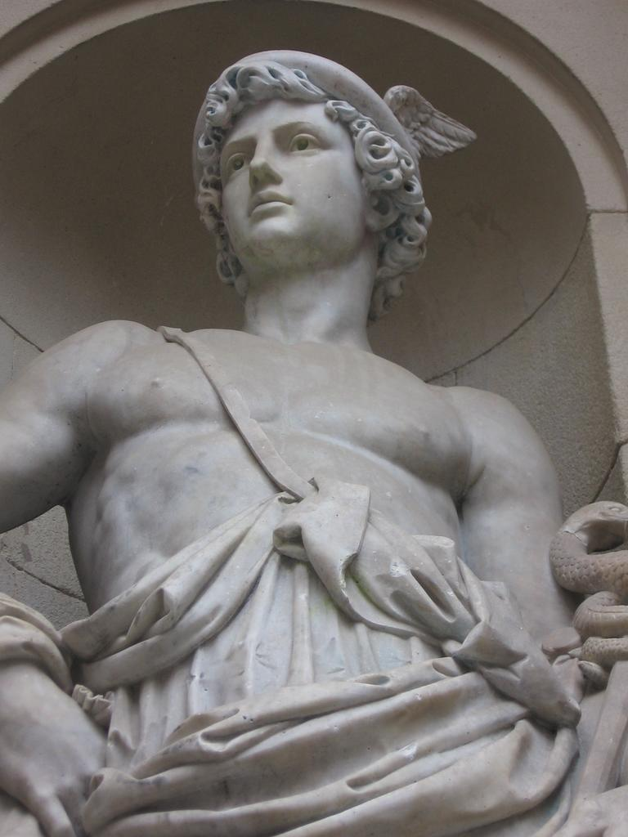
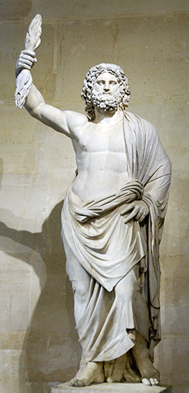
Justification Acts 13:38-39:
Justification is a gift from the Savior. He declares that a person is guiltless, free from the full demands of justice, being put back into a right relationship with God so that progress toward perfection can continue. (1)
A brief review of Greek and Roman mythology is in order.
The Romans adopted much of Greek culture, including their gods. Their mythology and powers remained the same but their names were changed. Jupiter was the Roman god of the sky who ruled the other gods. He is the Roman equivalent of the Greek god Zeus. Mercury, or the Greek god, Hermes, was the god of commerce and acted as the messenger of the gods. Barnabas was probably larger in stature than Paul (Joseph Smith taught that Paul was only five feet tall) and was therefore was assumed to be Jupiter. Paul, it seems, did most of the talking-making him "the messenger of the gods.“
From a latter-day perspective, the idea that these apostles were Greek gods is absurd. But the influence of Greek culture, Hellenism, on the people of Asia Minor cannot be overemphasized. While the theocracy of Hellenism as adopted by the Roman world seems to us like a polytheistic caricature, much of the rest of Greek culture has withstood the test of time. Of the powerful influence of Hellenism, Alfred Edersheim noted:
"Jews of the West are known by the term Hellenists...it was, in the nature of things, impossible that the Jewish communities in the West should remain unaffected by Grecian culture and modes of thought...Witness here the many converts to Judaism among the Gentiles; witness also the evident preparedness of the lands of this 'dispersion' for the new doctrine which was to come from Judaea...That restless, searching subtle Greek intellect would penetrate everywhere, and flash its light into the innermost recesses of his home and Synagogue...when the Jew stepped out of the narrow circle which he had drawn around him, he was confronted on every side by Grecianism. It was in the forum, in the market, in the counting-house, in the street; in all that he saw and in all to whom he spoke. It was refined; it was elegant; it was profound; it was supremely attractive."
(Alfred Edersheim, The Life and Times of Jesus the Messiah, 12-14)
Paul and Barnabas were Apostles Acts 14:1-6, 14:
Paul was an ordained apostle, and without question he took the place of one of the other brethren in [the Council of the Twelve]” Joseph Fielding Smith (Doctrines of Salvation, comp. Bruce R. McConkie, 3 vols. [1954–56], 3:153).
A vacancy in the Council of the Twelve was probably created because one of the other Apostles had been put to death. (1)
Acts 14:12
Mercurius
Jupter
This ancient statue of the Greek god Zeus (the chief Greek deity and equivalent of the Roman god Jupiter) was discovered in 1680 at Smyrna.

Slide 73

THE ACTS OF THE APOSTLES—EVENTS OCCURRED CA. A.D. 45–51 (13:6–18:23) PAUL’S FIRST AND SECOND MISSIONARY JOURNEYS
Paphos, Cyprus Paul Curses a False Prophet | 13:6–12
Anitoch, Pisidia The Savior Was of the Lineage of David | 13:13–25
The Gospel Is Offered to Israel | 13:26–41
Paul and Barnabas Teach the Gentiles | 13:42–49
Iconium, Galatia Jews Persecute Paul and Barnabas | 13:50–52; 14:1–7
Paphos, Cyprus Paul Curses a False Prophet | 13:6–12
Anitoch, Pisidia The Savior Was of the Lineage of David | 13:13–25
The Gospel Is Offered to Israel | 13:26–41
Paul and Barnabas Teach the Gentiles | 13:42–49
Iconium, Galatia Jews Persecute Paul and Barnabas | 13:50–52; 14:1–7
Lystra, Galatia Paul and Barnabas Hailed as Gods | 14:8–18
Paul Stoned, Revived, Preaches | 14:19–28
Life and Teachings of Jesus and His Apostles Chapter 33

Slide 74

Jerusalem Conference
and the Priesthood in the Church
Acts 15

Slide 75

An Issue is decided in Jerusalem by the apostles
Apostles and elders come together to consider the matter of circumcision and keeping the Law of Moses
Jehovah instituted the practice of circumcision among Abraham and his descendants as a token of their covenant with Jehovah. The token reminded them of their obligations and of the sacred and eternal blessings given to all who served the Lord in righteousness
Acts 15:2-6; Abraham 2:8–11; Genesis 17

Slide 76

The Debate
In the new covenant instituted by Jesus Christ, the token of circumcision was replaced by the ordinance of baptism. In a revelation given to Mormon and recorded in the Book of Mormon, Jesus Christ said:
“The law of circumcision is done away in me”
(Moroni 8:8)
The debate over circumcision concerned not only the interpretation and application of doctrine, but also the accepting of new revelation through Church leaders.
Acts 15:6-11

Slide 77



Jerusalem Conference
“put no difference between us [the converted Jews] and them [the converted Gentiles]”
“‘I have no hesitancy in giving you the assurance, if you will confer in council as you are expected to do, God will give you solutions to the problems that confront you’
“God called a grand council in the premortal world to present His glorious plan for our eternal welfare. The Lord’s church is organized with councils at every level, beginning with the Council of the First Presidency and the Quorum of the Twelve Apostles and extending to stake, ward, quorum, auxiliary, and family councils.
Acts 15:9

Slide 78

A United Effort
“… When we act in a united effort, we create spiritual synergism, which is increased effectiveness or achievement as a result of combined action or cooperation, the result of which is greater than the sum of the individual parts.”
(3)
Acts 15:9

Slide 79

No Disputations
No doctrinal principle is important enough to argue over. When a doctrinal debate leads to an argument with the spirit of contention, both sides are at fault, and the Spirit of the Lord is grieved. Understandably, the ancient apostles let their zeal for the truth preempt their love of peace and harmony, but the Lord has said:
…'there shall be no disputations among you, as there have hitherto been; neither shall there be disputations among you concerning the points of my doctrine, as there have hitherto been.
'For verily, verily I say unto you, he that hath the spirit of contention is not of me, but is of the devil, who is the father of contention, and he stirreth up the hearts of men to contend with anger, one with another.
'Behold, this is not my doctrine, to stir up the hearts of men with anger, one against another; but this is my doctrine, that such things should be done away.'
(3 Ne 11:28-30)
The
Book
of
Mormon
ANOTHER TESTAMENT
OF JESUS CHRIST
Acts 15:9

Slide 80
James of the Jerusalem Council
"In A.D. 44, the first Herod Agrippa 'stretched forth his hands to vex certain of the church.' (Acts 12:1.) He imprisoned Peter and 'killed James the brother of John with the sword.' (Acts 12:2.)
This vacancy in the leading three was soon filled by another James, whom Paul, in writing to the Galatians about A.D. 56, said was the brother of Jesus...
John is prominent with Peter in the first half of Acts, but afterward James the brother of the Lord is the prominent leader at Jerusalem, where he is mentioned often in association with Peter. When the angel released Peter from prison, the chief Apostle sent word to 'James, and to the brethren.' (Acts 12:17.)
Because of James's leading position, later Christian writers titled him Bishop of Jerusalem, but they wrote in an era that knew no higher authority than bishop. James's specific responsibility included decisions on doctrine for the whole Church, which went far beyond the calling of any New Testament bishop.
This is apparent in the prominent role James played at the Jerusalem Council, the meeting of the Apostles and elders to determine whether gentile converts needed circumcision as well as baptism. Peter spoke first in favor of the gentiles, Paul and Barnabas supported him, and James proposed the details of the solution."
Acts 15:13
(4)

Slide 81
Trouble Them Not…
…or not make living the gospel harder for the converted Gentiles, and not require them to perform the rituals of the law of Moses before joining the Church.
James was supporting the decision given earlier by Peter.
The Apostles decided to send an epistle to the Church members declaring that circumcision was not required for salvation.
Acts 15:22-27
(4)

Slide 82


Revelation and Order
“Behold, mine house is a house of order, saith the Lord God, and not a house of confusion.”
All things are done in order
Acts 20:68
Acts 15:9; D&C 132:8

Slide 83


Order of Keeping Proper Records
D&C 20:64 D&C 85:1

Slide 84


Order of the Priesthood
“And when they had ordained them elders in every church…” (Acts 14:23)
“Every elder, priest, teacher, or deacon is to be ordained…”
D&C 20

Slide 85


“When we officiate in the priesthood, we always do it in the name of the Lord. When we act according to proper order of things, we act for the Lord…”
(4)

Slide 86


United
“…by vote of the church…”
D&C 20:63-64

Slide 87

Working Together
By counseling together and seeking revelation from God, Church leaders receive inspiration about difficult problems
The leader [of a council] encourages members to speak openly and honestly.
The diverse backgrounds, ages, experiences, and viewpoints of council members enrich the council.
Members share suggestions and listen to each other respectfully.
As they seek to know the Lord’s will, a spirit of inspiration and unity can prevail.
(6)
D&C 20:63-64

Slide 88

When we convene as a Council of the First Presidency and Quorum of the Twelve, our meeting rooms become rooms of revelation.
The Spirit is palpably present. As we wrestle with complex matters, a thrilling process unfolds as each Apostle freely expresses his thoughts and point of view.
Though we may differ in our initial perspectives, the love we feel for each other is constant. Our unity helps us to discern the Lord’s will for His Church.
In our meetings, the majority never rules! We listen prayerfully to one another and talk with each other until we are united.
Then when we have reached complete accord, the unifying influence of the Holy Ghost is spine-tingling!
We experience what the Prophet Joseph Smith knew when he taught, “By union of feeling we obtain power with God.
No member of the First Presidency or Quorum of the Twelve would ever leave decisions for the Lord’s Church to his own best judgment!
(7)
The Quorum of the Twelve Conference Room inside the Church Administration Building in Salt Lake City on Monday, September 18, 2017. Photo by Adam Fondren
Teachings of Presidents of the Church: Joseph Smith (2007), 393–94

Slide 89




Uniting as One Unto the Lord
“Wherefore, now let every man learn his duty, and to act in the office in which he is appointed, in all diligence.”
D&C 107:99

Slide 90


“It seemed good unto us, being assembled with one accord, to send chosen men unto you with our beloved Barnabas and Paul.”
“And again, the elders, priests and teachers of this church shall teach the principle of my gospel…”
Acts 15:25 D&C 42:11

Slide 91






“The Priesthood, which is always associated with God’s work…

Slide 92
The Message Delivered to Antioch
“being prophets also themselves,”
Judas, surname Barsabas
Silas
Antioch
Silas was probably the “Silvanus” mentioned by Paul in several of his letters. (2 Corinthians 1:19; 1 Thessalonians 1:1; 2 Thessalonians 1:1)
Silas was apparently the scribe for the book of 1 Peter
(1 Peter 5:12).
D&C 84:35-40
(1)

Slide 93
Companions
Silas and Paul
Barnabas and Mark, surname John
Cilicia
Syria
Antioch
Cyprus
D&C 84:36-41
(1)

Slide 94
Sources:
New Testament Institute Student Manual Chapter 32
Stephen L. Richards (in Conference Report, Oct. 1953, p. 86)
Elder M. Russell Ballard (“Strength in Counsel,” Ensign, Nov. 1993, 76–77).
Richard Lloyd Anderson, "The First Presidency of the Early Church: Their Lives and Epistles," Ensign, Aug. 1988, 16
President Boyd K. Packer “What Every Elder Should Know…and Every Sister as Well”: A Primer on Principles of Priesthood Government” Feb. 1993 Ensign
General Handbook: Serving in The Church of Jesus Christ of Latter-day Saints, 4.4.3, ChurchofJesusChrist.org
Russell M. Nelson, “Revelation for the Church, Revelation for Our Lives,” Ensign or Liahona, May 2018, 95
Something of Interest: The Church’s Administration Building
https://www.churchofjesuschrist.org/church/news/see-inside-church-administration-buiding-now-in-its-centennial-year?lang=eng
Presentation by ©http://fashionsbylynda.com/blog/

Slide 95
Principles used by Effective Councils in Acts 15
Verse 7 | Members of the council were free to voice their opinions. (“There had been much disputing.”)
Verses 7–11 | The presiding authority explained his thoughts and referred to previous revelation. (Peter, the chief Apostle, presided over the council and, by referring to revelation he had already received, clarified that Gentiles need not be circumcised.)
Verses 13–21 | Council members expressed their opinions. (James expressed his support of Peter’s counsel not to require circumcision of Gentile converts and offered his opinions about related problems.)
Verses 22, 28 | The council came to a united decision, which was confirmed by the Holy Ghost. (The council’s decisions “seemed good to the Holy Ghost, and to us.”)
Verses 22–30 | The decision was communicated to those involved. (The decree was sent to the Gentiles in Antioch, Syria, and Cilicia.)
Verses 13–21 | Council members expressed their opinions. (James expressed his support of Peter’s counsel not to require circumcision of Gentile converts and offered his opinions about related problems.)
“The action of the Jerusalem council involved a significant policy decision. … Peter’s unmistakable experience with Cornelius makes it clear that the Brethren understood that the law of Moses was fulfilled in Christ, but evidently many members of the church did not understand. It was a matter of doctrine, tradition, culture, and emotion. Even though the Brethren had settled the matter doctrinally a decade before, considerable time passed before the matter was settled culturally and emotionally in the minds of some Jewish Christians. Furthermore, at least ten years after the council, many Jewish Christians in Jerusalem were still following the law of Moses. (Acts 21:17–25.)
“The decision of the Jerusalem council was not definitive and did not forthrightly say that the law of Moses should be discontinued. Although it declared that Gentiles did not need circumcision for salvation, it did not say that Jewish members of the church need not circumcise their sons.”
(“Unto All Nations,” in Studies in Scripture, Volume Six: Acts to Revelation, ed. Robert L. Millet [1987], 39).
New Testament Institute Manual Chapter 32

Slide 96
Circumcision Acts 15:1, 5, 24:
The law of Moses directed that every male child was to be circumcised when he was eight days old (see Leviticus 12:3) “that thou mayest know forever that children are not accountable before me [the Lord] until they are eight years old” (Joseph Smith Translation, Genesis 17:11 [in the Bible appendix]). In New Testament times it was common to refer to Jews as being of the circumcision and to Gentiles as being of the uncircumcision (see Acts 10:45; Romans 3:30; Galatians 2:7–9; Ephesians 2:11).(1)
"This problem would always plague Paul and be a topic in many letters...The problem was not salvation by faith alone; it was not a question of freedom from gospel requirements and ordinances. Instead, it was a question of whether Gentile converts to Christianity had also to obey the law of Moses.
As we have seen, the Gentile 'disciples' had already been baptized and taught strictly to 'continue in the faith' as a condition of salvation (Acts 14:22). But this did not satisfy Jewish Christians strictly observing the Law of Moses. Circumcision symbolized this issue, but Judaizers were talking about hundreds of obligations beyond circumcision. The orthodox Jews count 613 commandments in the five books of Moses, and the Rabbinical rules of the Mishnah multiply the commandments to thousands. So it is a gross simplification to see Paul advocating a gospel without rules.
Instead, he opposed a tradition of too many rules." (Richard Lloyd Anderson, Understanding Paul [Salt Lake City: Deseret Book Co., 1983], 51)
The importance of this council, often referred to as the Jerusalem Council, cannot be overstated. A living church is capable of inspired change; a dead church is only capable of decay. "Similar problems today in most churches have no solution-only an uncomfortable truce between conservatives and liberals or a split into two churches. The solution of the Early Church was to take the question to the inspired general authorities for an answer." (Richard Lloyd Anderson, Understanding Paul, 52)
This assembly of major figures in the Early Church is a rare and important event. We get a rare glimpse into the doctrinal considerations and policy making procedures of the early Apostles. Furthermore, this account of the Jerusalem Council demonstrates many different elements of appropriate church councils. They will be emphasized throughout the rest of the chapter as they are important principles for us to learn and apply today. Gosepldoctrine.com
"...there is a great need in the Church for leaders, particularly stake presidents, bishops, and parents, to understand and harvest the spiritual power of the council system. There is no problem in the family, ward, or stake that cannot be solved if we look for solutions in the Lord's way by counseling-really counseling-with one another...God, the Master Organizer, has inspired the creation of a system of committees and councils. If understood and carefully implemented and utilized, that system will lessen the burden on any one individual leader and extend the reach and impact of his or her ministry by bringing together the judgment, talents, and wisdom of many leaders who are entitled to the guidance and inspiration of the Holy Spirit." M. Russell Ballard (Counseling with Our Councils: Learning to Minister Together in the Church and in the Family [Salt Lake City: Deseret Book Co., 1997], 8-9.)
James Acts 15:13:
Likely, he took the martyred James' place as one of the three leading apostles. (The "First Presidency" of the Early Church acted within the quorum of the twelve apostles and was not separate from it as it is today.) Nevertheless, Peter's preeminent role as the leader of the church is not overshadowed by James. Notably, Peter's comments put an end to the disputations and were so powerful that the council was silent thereafter (v. 6-12). It is apparent that James final decision closely reflected the ideas that Peter put forth. From a latter-day standpoint, we would say that Peter presided over the Jerusalem Council and James conducted the meeting.
"Uninspired commentators and others who are unaware of the true system of apostolic succession falsely assume that James was making a decision in the case and therefore was head of the Church in Jerusalem, having some pre-eminence over Peter. Some Protestants have argued that Peter could not have fathered a church in Rome because James and not Peter is in fact here shown to be the chief officer of the Christian kingdom. Interesting as this may be, the fact is Peter was the presiding officer in the Church and had in fact rendered and announced judgment on the issue of circumcision. (Verses 7-11.) James is simply proposing the detailed instructions to put in force the decision already announced by Peter." Elder Bruce R. McConkie (Doctrinal New Testament Commentary, 2:143)
Unity: "My brethren and sisters, above all things, therefore, we should seek for this spirit of union and love. It should be sought for in our councils, and we should not contend. Now, suppose that I should take it into my head to say that a certain doctrine is true, and I contend for it, determined to have it so; does my contention make it true? Suppose that I should contend from now until the Savior came that it is true, would my contention make it true? Certainly not. I cannot change a principle of truth. Then why contend or dispute, or argue about it?...There can be no change wrought in doctrine and in truth by our contention. But I will tell you where there is room for differences of opinion--in regard to the policy to be pursued. There ought to be no contention, however. God speaks against it. We have no right to be a disputing, contentious people. And whenever I dispute with my brother I am likely to grieve the Spirit of the Lord and darken my own mind. Therefore, let us avoid contention, in our councils and in all our intercourse one with another." (Collected Discourses 1886-1898, ed. by Brian Stuy, vol. 4, George Q. Cannon, Apr. 7, 1895)

Slide 97
Holding Councils Acts 15:22-27:
“These same patterns are followed today in the restored Church of Jesus Christ. The President of the Church may announce or interpret doctrines based on revelation to him (see, for example, D&C 138). Doctrinal exposition may also come through the combined council of the First Presidency and Quorum of the Twelve Apostles (see, for example, Official Declaration 2). Council deliberations will often include a weighing of canonized scriptures, the teachings of Church leaders, and past practice. But in the end, just as in the New Testament Church, the objective is not simply consensus among council members but revelation from God. It is a process involving both reason and faith for obtaining the mind and will of the Lord” Elder D. Todd Christofferson (“The Doctrine of Christ,” Ensign or Liahona, May 2012, 88).
Paul and Barnabas were chosen to travel to Antioch and report on the Jerusalem council’s decision. Acts 15:32-39:
They took with them two Church leaders, Judas and Silas, “being prophets also themselves,” who helped preach and strengthen Church members in Antioch (Acts 15:32). After some time, Paul suggested to Barnabas that they return to the cities they had preached in during their first missionary journey in order to visit their converts “and see how they do” (Acts 15:36).
However, a disagreement between Paul and Barnabas began when Barnabas suggested that John Mark join them. John Mark, Barnabas’s cousin (or nephew), had accompanied Paul and Barnabas on their first mission but had departed from them early on (see Acts 13:13). Though little is known about why John Mark left or what impact it had on the other missionaries, apparently Paul was still apprehensive about him. Ultimately Paul and Barnabas separated, with Paul choosing Silas as his new missionary companion and Barnabas choosing John Mark. Paul and John Mark were later reconciled, as evidenced in 2 Timothy 4:11 and in Colossians 4:10. Barnabas took John Mark and sailed to Cyprus (see Acts 15:39), and Paul and Silas journeyed to cities on the mainland.
(1)

Slide 98
The Church of Jesus Christ of Latter-day Saints Organization
The First Presidency
President of Church
1st Counselor-----2nd Counselor
The Quorum of
Twelve Apostles
First Quorum of the Seventy
Presiding Bishopric
Presiding Bishop
1st Counselor-----2nd Counselor
(General Authorities)
Full-time positions
(serve part-time still working reg. job)
Area Authorities
Seventies
Stake Presidency
Stake President
1st Counselor----2nd Counselor
High Council
Stake Patriarch
High Priest’s Quorum
Ward Bishopric
Bishop
1st Counselor----2nd Counselor
Priest’s Quorum
Elder’s Quorum
Teacher’s Quorum
Deacon’s Quorum

Slide 99



