Slide 1
Acts 16-21

Slide 2
The Promptings of the Spirit
Acts 16
And the Spirit giveth light to every man that cometh into the world; and the Spirit enlighteneth every man through the world, that hearkeneth to the voice of the Spirit. D&C 84:46

Slide 3
A prompting refers to feelings or impressions we receive from the Holy Ghost to say or do something.

Slide 4
I have often pondered and prayed about the Savior’s great commission to His disciples … to “go ye therefore, and teach all nations, baptizing them in the name of the Father, and of the Son, and of the Holy Ghost.”
I wrestled with the question “How can we, as members and disciples of Christ, best fulfill that great commission in our daily lives?”
Today I invite you to ponder that same question in your heart and mind.
(8)
The Lord can lead us to those He has prepared to receive His gospel
Matthew 28:19

Slide 5
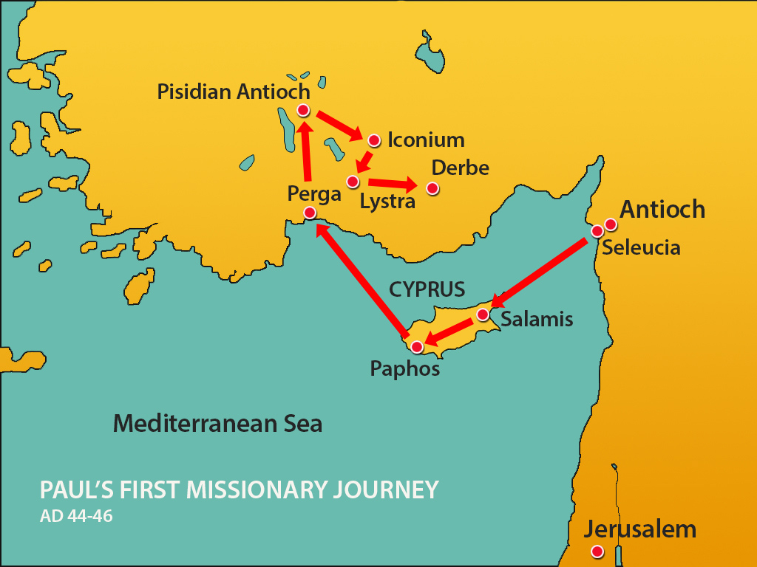
Previously…
Paul’s Companions
First Mission
John also called Mark
Acts 12:25
Barnabas Acts 11:30

Slide 6
Paul’s Companions—2nd Mission
Paul is inspired to return to the cities he taught on his first mission
While in Derbe and Lystra they met Timothy
Macedonia
Black Sea
Philippi
Troas
Galatia
Mysia
Blithynia
Phrygia
Asia
Antioch
Iconium
Lystra
Derbe
Cilicia
Antioch
Cyprus
Syria
Timotheus (Timothy)
Acts 16:1-4
Mother Jewish, Father Greek
Mediterranean Sea
Israel
Silas
Acts 15:40
Jerusalem
Acts 16:1-8

Slide 7
Forbidden to Preach in Asia
"Here the Lord commands his missionaries not to preach the gospel in Asia or Bithynia, but instead to go to Macedonia.
Why? It is simply a matter of sending missionaries where there are more receptive people.
Of course, those in Asia and elsewhere were entitled to hear the truth; all men are; but every man in his day and time and season.
The Lord establishes his own system of priorities and since the laborers are few and cannot be everywhere, they are sent, by revelation, to those peoples who in God's wisdom deserve to hear the truth first."
Macedonia
Black Sea
Philippi
Blithynia
Asia
Cilicia
Cyprus
Syria
Mediterranean Sea
Israel
Jerusalem
Acts 16:6
(2)

Slide 8
God does not need you to “sell” the restored gospel or the Church of Jesus Christ. He simply expects you not to hide it under a bushel.
And if people decide the Church is not for them, that is their decision.
It does not mean you have failed.
You continue to treat them kindly.
Nor does it exclude that you invite them again.
The difference between casual social contacts and compassionate, courageous discipleship is—invitation!
(8)

Slide 9
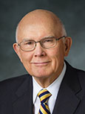
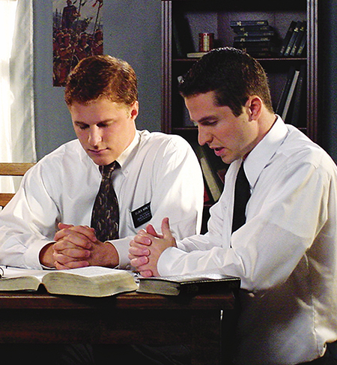
How Do I Find People to Teach?
“We must pray for the Lord’s help and directions so we can be instruments in His hands for one who is now ready—one He would have us help today.
Then, we must be alert to hear and heed the promptings of His Spirit in how we proceed.
“Those promptings will come.
We know from countless personal testimonies that in His own way and His own time the Lord is preparing persons to accept His gospel.
Such persons are searching, and when we are seeking to identify them, the Lord will answer their prayers through answering ours.
He will prompt and guide those who desire and who sincerely seek guidance in how, where, when, and with whom to share His gospel.”
Greg Olsen
(5)

Slide 10
Paul’s Vision
While in Troas the Lord calls them to preach in Macedonia
The beloved physician herein becomes one of Paul's associates, making him an eyewitness to most of the rest of the story.
At this point, the missionary entourage is made up of a foursome: Paul, Silas, Timothy, and Luke.
Acts 16:9-15

Slide 11
What can you learn about Heavenly Father from this account that can help you in your efforts to find those the Lord has prepared to receive His gospel?
How have you seen the Lord preparing others to receive His gospel?
How has He prepared or how can He prepare you to find individuals who are seeking Him?

Slide 12
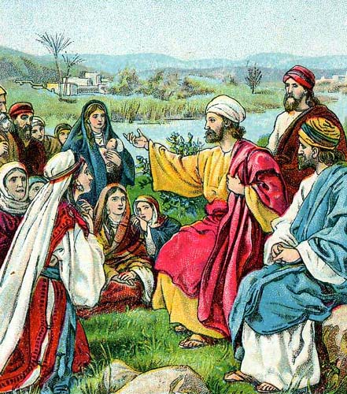
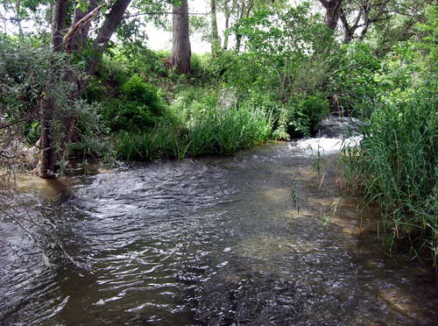
Sabbath Day—no synagogue
"Philippi was named for its refounder Philip, the father of Alexander the Great, the world conqueror.
But a different world conqueror came when Paul arrived with his small missionary group in obedience to the vision of the pleading man of Macedonia... 'Colony' was a technical term for Romans settled outside Rome.
That Philippi was a colony implies that it had civic rights of Rome and the honor of modeling its local government after that of the mother city.
The old Roman virtues were loyalty and reliability. These qualities certainly summarize the remarkable faithfulness of the Philippian Christians." (3)
They went to the river side and sat down and spoke to the women
Acts 16:11-13

Slide 13
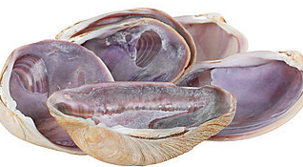
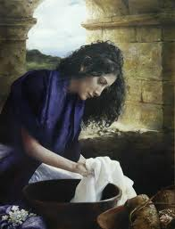
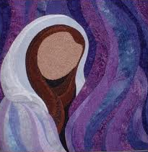
Lydia—a seller of Purple
Dyer of purple cloth
While Paul and his companions were ministering in Philippi, they met a woman named Lydia from Thyatira, a city that was famous for its purple textiles. The best natural purple dye was extracted from the shells of mollusks, and the process was very expensive.
The Lord had opened her heart
Therefore, in ancient times, the color purple became associated with royalty or saintliness.
She has the distinction of being Paul’s first known European convert and the first person mentioned by name who joined the Church as a result of Paul’s second mission. She appears to have been a wealthy woman who owned her own house and had servants, who were part of “her household”
Acts 16:12-15
(1)

Slide 14
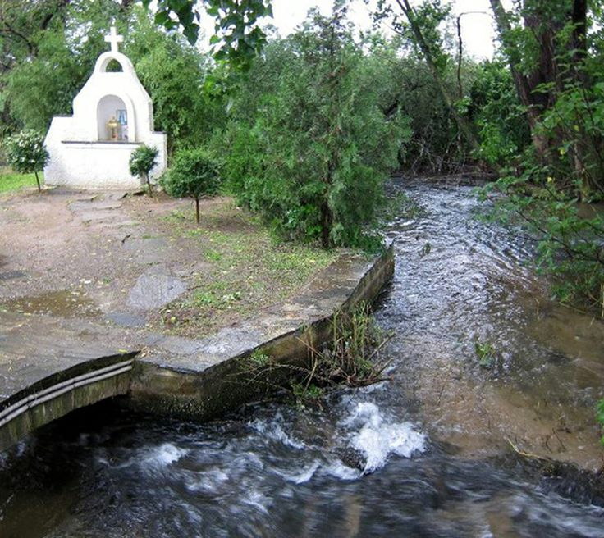
Lydia—a seller of Purple
Lydia and her household were converted and baptized and invites the missionaries to stay in her household.
Traditional site of where Lydia was baptized as of today
Later, believers gathered at her home for worship and instruction
Acts 16:15

Slide 15
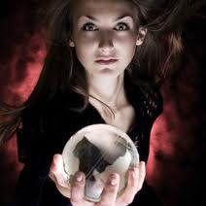
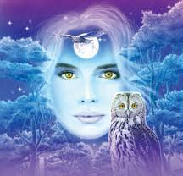
“Spirit of Divination”
Divination is the act of foretelling, or pretending to foretell, the future by using occult practices. Divination, which is also called soothsaying, was and is forbidden to the Lord’s people.
She foretold of “These men” being servants of the most high God.
She told a truth.
The missionaries encounter a “certain damsel possessed”
She brought her masters much gain by “soothsaying”
Acts 16:16-17; Deuteronomy 18:9-14; Joshua 13:22

Slide 16
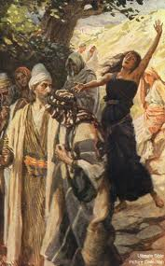
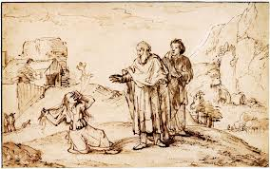
Truth From the Wrong Source
Paul recognized that she had a truth, but it came from the wrong source.
“The testimony of the devil-led damsel was true. Paul and Silas were prophets; they had the words and power of salvation. But true testimony from Satan’s servants does not lead to salvation.
In effect the damsel was saying: ‘Go ahead and believe in Paul and Silas and this Jesus whom they preach. I agree they and their Master are of God; and since we are now united on that point, you can also continue to follow me and enjoy the fruits of my divination.’
And how many other practitioners of false religions there are who give lip service to Jesus and his doctrines so that people will the more readily follow them and their special brand of ‘saving’ grace. It was for the very reason here involved that Jesus himself forbade the devils whom he cast out to testify that he was the Son of God (Luke 4:41.)” (2)
“…But Paul, being grieved, turned and said to the spirit, I command thee in the name of Jesus Christ to come out of her.”
Acts 16:18

Slide 17
Why Cast Out Her Gift?
It is important for us to understand why this woman's actions grieved Paul so.
This spirit claimed to know certain truths of God and to "prophecy" about them, but it was the wrong spirit.
Someone can say something that is true, but still be demonically inspired.
Paul was able to discern the spirit operating behind those words. This is why God tells us to test the spirits (1 John 4:1).
Even truths spoken in the wrong spirit is not the “Way of the Lord”
1 John 4:1
“Beloved, believe not every spirit, but try the spirits whether they are of God: because many false prophets are gone out into the world.”

Slide 18
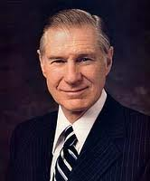
“It is not good practice to become intrigued by Satan and his mysteries.
No good can come from getting close to evil.
The only safe course is to keep well distanced from him and any of his wicked activities or nefarious practices.
The mischief of devil worship, sorcery, casting spells, witchcraft, voodooism, black magic, and all other forms of demonism should be avoided like the plague.”
(4)

Slide 19
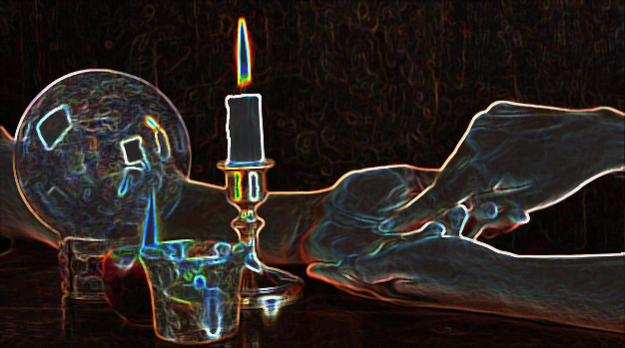
“These days we really need to be careful about everything we see and hear. It can seem spiritual, knowledgeable, and even mention an actual truth we are sure of. But that does not mean it is leading us in God’s truths.
The only way we will ever be able to figure out if we’re being misled is to actually become grounded in God’s word.” (6)
“For I say unto you that whatsoever is good cometh from God, and whatsoever is evil cometh from the devil.”
Alma 5:40

Slide 20
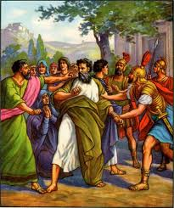
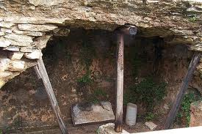
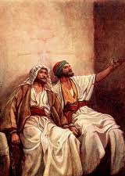
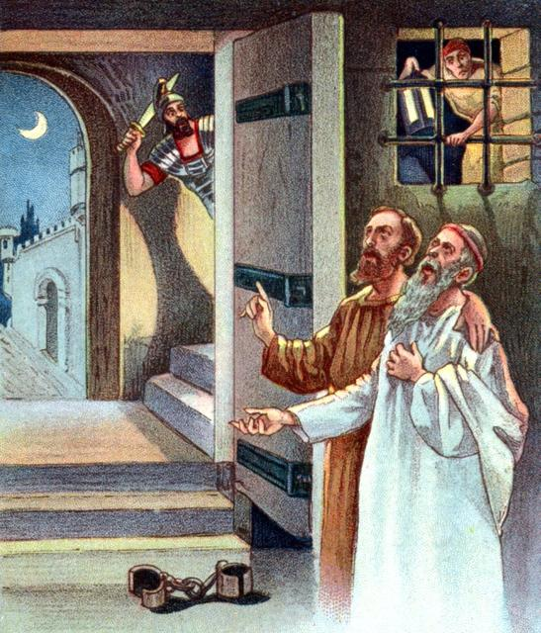
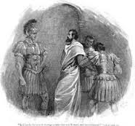
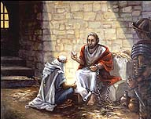
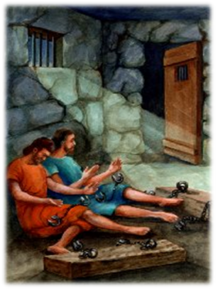
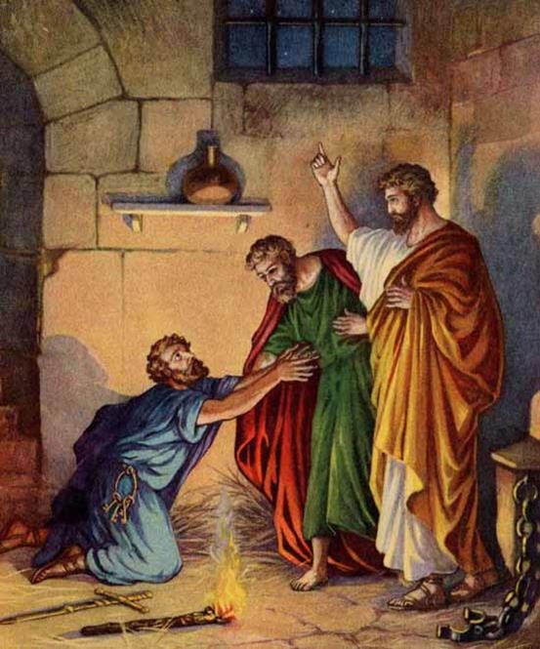
Paul and Silas are Thrown in Prison
They are taken before the rulers and beaten
A jailor is put in charge of them and “made feet fast in the stocks.”
Acts 16:25
Acts 16:26
Acts 16:27-28
Acts 16:29-30
Acts 16:31-32
Acts 16:33-34
Paul washed their wounds, and he was baptized and his household

Slide 21
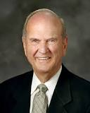
Salvation
“What must I do to be saved?”
Salvation requires believing in Jesus Christ, and we manifest our belief in Him by being baptized.
“To be saved—or to gain salvation—means to be saved from physical and spiritual death. Because of the Resurrection of Jesus Christ, all people will be resurrected and saved from physical death. People may also be saved from individual spiritual death through the Atonement of Jesus Christ, by their faith in Him, by living in obedience to the laws and ordinances of His gospel, and by serving Him.
Salvation is an individual matter.”
For ye are all the children of God by faith in Christ Jesus.
For as many of you as have been baptized into Christ have put on Christ. Galatians 3:26-27
(6)

Slide 22
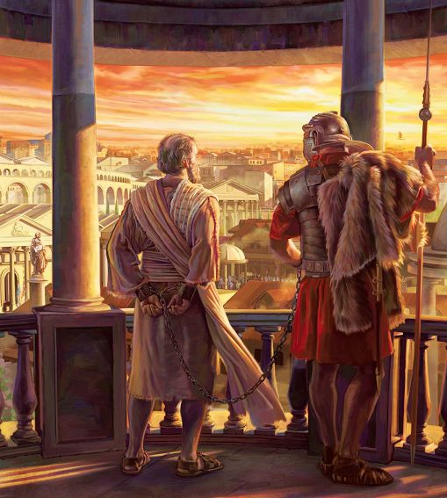
Paul’s Release
Magistrates sent word to the prison guard to let Paul and Silas go. Paul refused to go because he knew his rights as a Roman citizen and knew that their treatment of him was unjust. It was unlawful to beat a Roman citizen without first holding a trial.
When the magistrates found out that Paul and Silas were Romans, they were frightened because they knew that if their superiors discovered they had treated a Roman citizen as they did, they could be punished, even with death. The magistrates came to the prison, released Paul and Silas, and asked them to leave the city.
Paul’s second missionary journey lasted about three years and covered about 3,000 miles. This journey began in Antioch in Syria.
Paul likely wrote both epistles to the Thessalonians after he arrived in Corinth.
Acts 16:27-34

Slide 23
Missionaries in Prison
Acts 16:23-40
Paul and Silas
Praising and Singing
Other prisoners hear
Earthquake
Foundation falters and Bands loosened
Jailor and household converted
Alma 14:17-29
Alma and Amulek
Judged and questioned
Broke free of cords with strength from the Lord
Earthquake
Walls rent in twain and fell to earth
All slain except Alma and Amulek
Fear came and people fled
Missionaries continued their mission and baptized Zeezrom in the next city
Helaman 5:21-52
Nephi and Lehi
Crying repentance
Other prisoners hear
Pillar of fire surrounds them
Earthquakes and darkness
Wall falls
Aminadab recognizes the Spirit
About 300 “Convinced”

Slide 24
Sources:
New Testament Institute Student Manual Chapter 33
Bruce R. McConkie (Doctrinal New Testament Commentary, 2: 147, 149.
Richard Lloyd Anderson, Understanding Paul [Salt Lake City: Deseret Book Co., 1983], 291
James E. Faust: “The Great Imitator” General Conference 1987 Oct.
Elder Dallin H. Oaks (“Sharing the Gospel,” Ensign, Nov. 2001, 8).
Spirit of divination 2: http://123hallelujah.wordpress.com/2010/10/25/a-spirit-of-divination/
Elder Russell M. Nelson Salvation and Exaltation April 2008 Gen. Conf.
Dieter F. Uchtdorf, “Missionary Work: Sharing What Is in Your Heart,” Ensign or Liahona, May 2019, 15–16; Dieter F. Uchtdorf, “Your Great Adventure,” Ensign or Liahona, Nov. 2019, 88
Presentation by ©http://fashionsbylynda.com/blog/

Slide 25
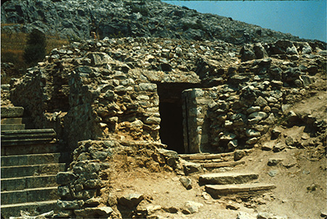
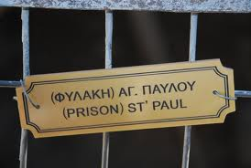
THE ACTS OF THE APOSTLES—EVENTS OCCURRED CA. A.D. 45–51 (13:6–18:23) PAUL’S FIRST AND SECOND MISSIONARY JOURNEYS
The Holy Ghost Directs Paul’s Labors | 16:1–15
Thyatira, Asia An Evil Spirit Cast Out | 16:16–18
Philip, a Jailor, Receives Christ | 16:19–40
Life and Teachings of Jesus and His Apostles Section 7 Chapter 32
Timothy and Circumcision Acts 16:1-3:
"Although Paul was opposed to circumcision as essential for salvation and he emphatically declared that it was not needful for Titus to be circumcised (Gal. 2:1-3), soon after the Jerusalem council Paul circumcised the young Timothy before taking him as a companion on the second mission (Acts 16:1-3). This action provides an insight into Paul's thinking. He saw a difference between necessity and convenience. With Titus, the question was whether or not circumcision was essential for salvation; thus, Paul opposed it. With Timothy it was a matter of rendering him acceptable to the non-Christian Jews where he would do missionary work. Paul was willing to allow circumcision as a concession, but not as a requirement, so that the Jews would be willing to listen to Timothy teach the gospel. This distinction reveals something of Paul's mind and method." (Robert J. Matthews, Studies in Scripture, Vol. 6: Acts to Revelation, edited by Robert L. Millet, [Salt Lake City: Deseret Book Co., 1987], 41.)
Ruins of what may have been the jail in Philippi where Paul and Silas were kept

Slide 26
Spirit of Divination:
"The Shaker will whirl around on his heel, impelled by a supernatural agency or spirit, and think that he is governed by the Spirit of God; and the Jumper will jump and enter into all kinds of extravagances. A Primitive Methodist will shout under the influence of that spirit, until he will rend the heavens with his cries; while the Quakers (or Friends) moved as they think, by the Spirit of God, will sit still and say nothing. Is God the author of all this? If not of all of it, which does He recognize? Surely, such a heterogeneous mass of confusion never can enter into the kingdom of heaven.
"Every one of these professes to be competent to try his neighbor's spirit, but no one can try his own, and what is the reason? Because they have not a key to unlock, no rule wherewith to measure, and no criterion whereby they can test it...If Satan should appear as one in glory, who can tell his color, his signs, his appearance, his glory, or what is the manner of his manifestation? Who can detect the spirit of the French prophets with their revelations and their visions, and power of manifestations? Or who can point out the spirit of the Irvingites, with their apostles and prophets, and visions and tongues, and interpretations, etc. Or who can drag into daylight and develop the hidden mysteries of the false spirits that so frequently are made manifest among the Latter-day Saints?
We answer that no man can do this without the Priesthood, and having a knowledge of the laws by which spirits are governed; for as no man knows the things of God, but by the Spirit of God, so no man knows the spirit of the devil, and his power and influence, but by possessing intelligence which is more than human, and having unfolded through the medium of the Priesthood the mysterious operations of his devices; without knowing the angelic form, the sanctified look and gesture, and the zeal that is frequently manifested by him for the glory of God, together with the prophetic spirit, the gracious influence, the godly appearance, and the holy garb, which are so characteristic of his proceedings and his mysterious windings.
"A man must have the discerning of spirits before he can drag into daylight this hellish influence and unfold it unto the world in all its soul-destroying, diabolical, and horrid colors; for nothing is a greater injury to the children of men than to be under the influence of a false spirit when they think they have the Spirit of God." (Teachings of the Prophet Joseph Smith, 204-5.)
Not Rooted in the Revelations of Heaven Acts 16:19:
"Why, we ask, would a woman possessed with an evil spirit bear a positive testimony of the gospel message and the servants commissioned to bear it? Because that testimony would eventually give her credibility among believers, thus placing her in a position to do much harm. Her testimony was not rooted in the revelations of heaven, and no other source for the testimony of Christ is acceptable." (Joseph Fielding McConkie, Watch and Be Ready: Preparing for the Second Coming of the Lord [Salt Lake City: Deseret Book Co., 1994], 60)
Paul—A Roman Citizen:
Paul never wearied of using his Roman citizenship to his advantage (see Acts 22:22-30; 25:11). He has no qualms about embarrassing those who were responsible for his scabbing and weeping wounds. To his oppressors Paul appeared to be a Jew, but he had Roman citizenship by virtue of his birth in Tarsus. This entitled him to due process under Roman law. Gospeldoctrine.com
This means that the freedom of Rome (which ruled all those countries at that time) had been given to the freemen of Tarsus. This freedom had been granted because the men of Tarsus had defended two emperors of Rome during a rebellion against them. Thus, Saul, though a Jew, was a freeborn Roman citizen." (Ancient Apostles [Salt Lake City: Deseret Book Co., 1964], 144)
Salvation Acts 16:30:
"Is belief alone enough to bring salvation to the contrite soul? Assuredly yes, if by belief is meant the ringing declaration of him who, baptizing our Lord, then testified: 'He that believeth on the Son hath everlasting life' (John 3:36); or if by belief is meant the pronouncement of Jesus: 'He that believeth on me, the works that I do shall he do also; and greater works than these shall he do' (John 14:12); or if by belief is meant that pure, perfect faith in Christ which presupposes and in fact cannot exist without the works of righteousness. (Mormon Doctrine, 2nd ed., pp. 78-80; See Heb. 11:1-3.) But belief alone is scarcely the beginning of that course leading to a celestial inheritance if it is isolated as a thing apart, if it is supposed that it does not embrace within its folds both baptism and a subsequent course of enduring to the end. (2 Ne. 31:15-21.) And in the very case at hand, Paul and Silas teach the gospel to the whole group, baptize them, and without question give them the gift of the Holy Ghost, thus starting them out in the direction of salvation. Elder Bruce R. McConkie (Doctrinal New Testament Commentary, 2:151.)

Slide 27
Places During Paul’s 2nd Mission
City | Description | Scripture | More About…
Derbe | A city in the Roman province of Galatia in Asia Minor, and in the ethnic region of Lycaonia | Acts 14:6, 20 Acts 16:1. | In Roman times it struck its own coins, of which a few are extant. The apostles Paul and Barnabas came to Derbe after escaping a disturbance and attempted stoning in Iconium, about 60 miles away, and successfully evangelized there. Paul and Barnabas returned there after being stoned again in Lystra. On these experiences, Paul commented, "We must through many tribulations enter the kingdom of God." He and Silas later visited Derbe again.
Lystra | A city in central Anatolia, now part of present-day Turkey. It is mentioned five times in the New Testament. | Acts 14:6,8,21 Acts 16:1-2 2 Timothy 3:11 | Lystra was visited several times by the Apostle Paul, along with Barnabas or Silas. There Paul met a young disciple, Timothy, whose parents lived there. The Roman Empire made Lystra a colony in 6 BC. Lystra apparently had no synagogue, although Timothy and his mother were Jewish
Iconium | Iconium—latin name A district in the center of Asia Minor, inhabited by tribes from Gaul who settled there in the 3rd century B.C. (Galatia was also the Greek name for Gallia, or Gaul.) | Acts 13;51 Acts 14:1-5 Acts 14:21 Acts 16:6 Acts 18:23 | Excavations have shown that the region was inhabited during the Late Copper Age, around 3000 BC. The city came under the influence of the Hittites around 1500 BC. These were overtaken by the Sea Peoples around 1200 BC. The apostles Paul and Barnabas preached in Iconium during their first Missionary Journey in about 47–48 and It was visited by Paul on his second and third journeys (Acts 16:6; 18:23). Konya, was known in classical antiquity. It is the center of the largest province, and is among the largest cities in the country. It is the seventh most populated city in Turkey today.
Phrygia | It was a kingdom in the west central part of Anatolia, in what is now Turkey, centered on the Sakarya River | Acts 2:10 Acts 16:6 Acts 18:23 Col. 1:1, 7 Col. 4:12-13 | The town of Phrygia, in the valley of the Lycus, near Laodicea and Hierapolis, and close to the great road that led from Ephesus to the Euphrates. When Paul wrote his epistle to the Colossians he had probably not yet visited the place. Epaphras and perhaps Timothy were its first Christian teachers.
Mysia | A region in the northwest of ancient Asia Minor or Anatolia (part of modern Turkey) A district forming the northern part of the Roman province of Asia. | Acts 16:7,8 | In ancient times it was inhabited by the Mysians, Phrygians, Aeolian Greeks, and other groups. The apostles Paul, Silas and Timothy came to (or passed by) Mysia during Paul's second missionary journey. The narrative suggests that they were uncertain where to travel during this part of the journey, being 'forbidden by the Holy Spirit to preach the word in Asia'. Shortly afterwards Paul had a vision of a 'man of Macedonia' who invited the apostles to travel westwards to Macedonia.
Troas | Alexandria Troas, southwest of Troy on the seacoast, a Roman colony. There is circuit of the old walls that can still be traced today. | Acts 16:8,11 Acts 20:5-6 2 Cor. 2:18 2 Timothy 4:13 | A lad at Troas who fell from a window and was restored by Paul. . Paul sailed for Europe for the first time from Alexandria Troas and returned there from Europe (it was there that the episode of the raising of Eutychus later occurred). Ignatius of Antioch also paused at this city before continuing to his martyrdom at Rome

Slide 28
Ready to Receive
Acts 17
Black Sea
Thessalonica
Berea
And those who receive it in faith, and work righteousness, shall receive a crown of eternal life;
D&C 20:14
Athens
Cyprus
Mediterranean Sea
Israel
Jerusalem

Slide 29
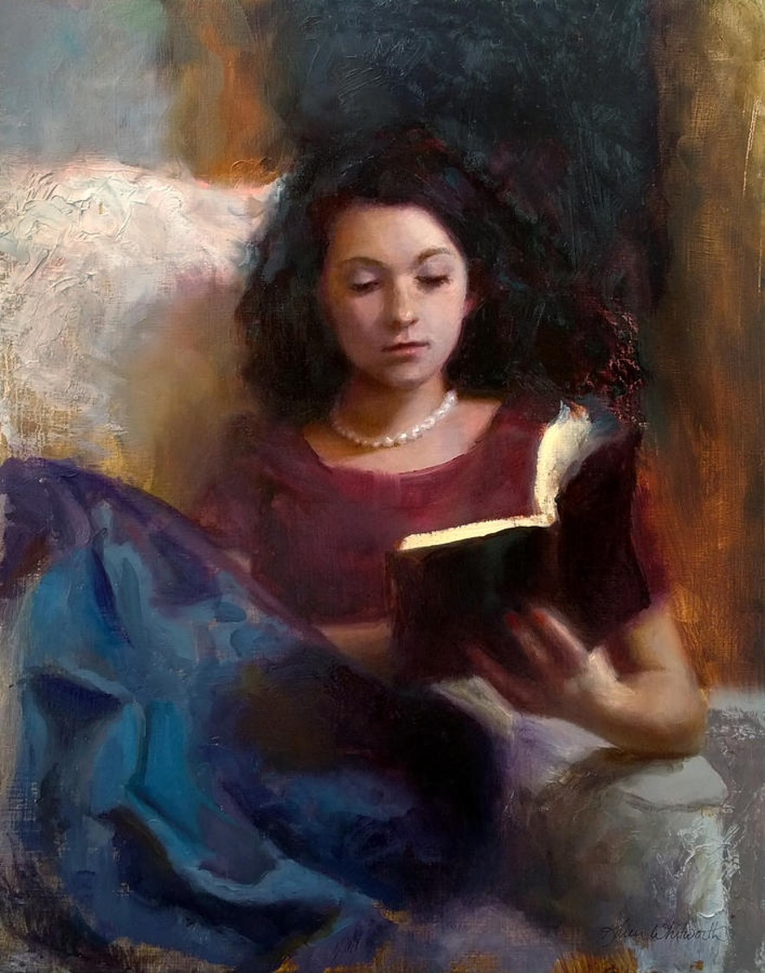
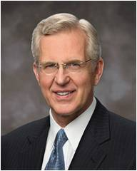
In the end, the central purpose of all scripture is to fill our souls with faith in God the Father and in His Son, Jesus Christ—faith that They exist; faith in the Father’s plan for our immortality and eternal life; faith in the Atonement and Resurrection of Jesus Christ, which animates this plan of happiness; faith to make the gospel of Jesus Christ our way of life; and faith to come to know “the only true God, and Jesus Christ, whom [He has] sent ( John 17:3).”
(5)
Why Do We Read the Scriptures?
To enlarge our memory
To convince us of error
To bring us the knowledge of Christ
To bring us to repentance
The scriptures testify of Jesus Christ and His divine mission

Slide 30
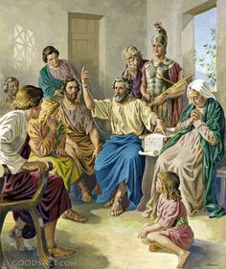
“Opening and Alleging”
To show or declare
Paul used scriptural passages to declare or show that Jesus is the Christ.
He alleged that Christ had died and risen from the dead
Acts 17:1-3

Slide 31
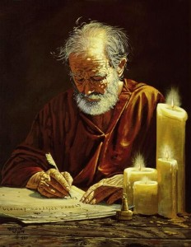
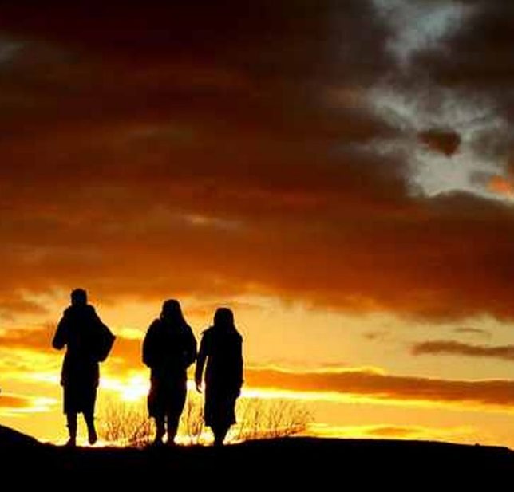
Consorted and Lewd
Consorted = Gathered with or joined
Lewd = evil
Paul and Silas left Thessalonica at night because they were being persecuted by the Jews.
A mob of unbelievers tried to find Paul and Silas. When they could not find them, the mob went to the rulers of Thessalonica and claimed that Paul’s teachings threatened Caesar’s authority.
Later Paul wrote letters which are in 1 and 2 Thessalonians
Acts 17:5-13

Slide 32
Are You Ready to Receive?
The people in Berea received Paul’s words with all readiness of mind—They had searched the Scriptures
If we receive the words of God’s servants with all readiness of mind and search the scriptures daily, then our belief in their words will be strengthened
Acts 17:5-13

Slide 33
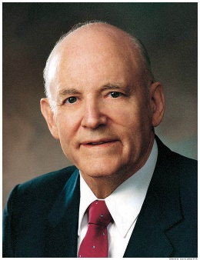
Study Time
“It is certain that one who studies the scriptures every day accomplishes far more than one who devotes considerable time one day and then lets days go by before continuing.
Not only should we study each day, but there should be a regular time set aside when we can concentrate without interference. …
Studying the scriptures regularly can prepare us to recognize and believe truth.
It would be ideal if an hour could be spent each day; but if that much cannot be had, a half hour on a regular basis would result in substantial accomplishment.
A quarter of an hour is little time, but it is surprising how much enlightenment and knowledge can be acquired in a subject so meaningful.” (2)
Acts 17:5-13
(2)

Slide 34
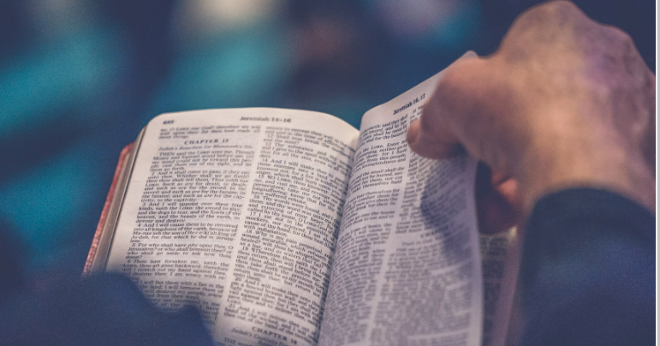
1 Nephi 15:24
2 Nephi 32:3
Jacob 2:8
Helaman 3:29–30
Joseph Smith—Matthew 1:37
What blessings have you experienced through regularly studying God’s words in the scriptures?

Slide 35
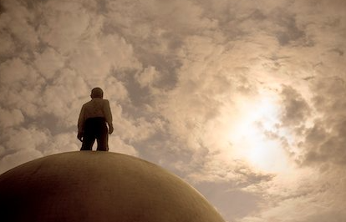
My dear brothers and sisters, I promise that as you prayerfully study the Book of Mormon every day, you will make better decisions—every day.
I promise that as you ponder what you study, the windows of heaven will open, and you will receive answers to your own questions and direction for your own life.
I promise that as you daily immerse yourself in the Book of Mormon, you can be immunized against the evils of the day, even the gripping plague of pornography and other mind-numbing addictions.
(6)

Slide 36
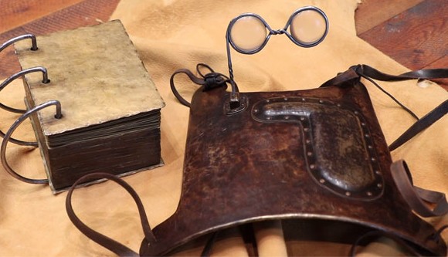
We do not overstate the point when we say that the scriptures can be a Urim and Thummim to assist each of us to receive personal revelation.
Because we believe that scripture reading can help us receive revelation, we are encouraged to read the scriptures again and again.
By this means, we obtain access to what our Heavenly Father would have us know and do in our personal lives today.
That is one reason Latter-day Saints believe in daily scripture study.
(4)

Slide 37
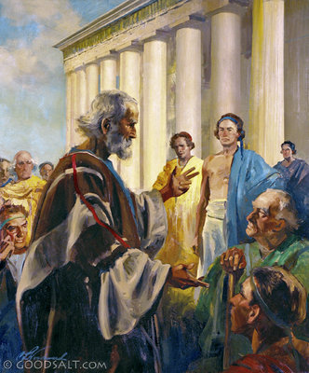
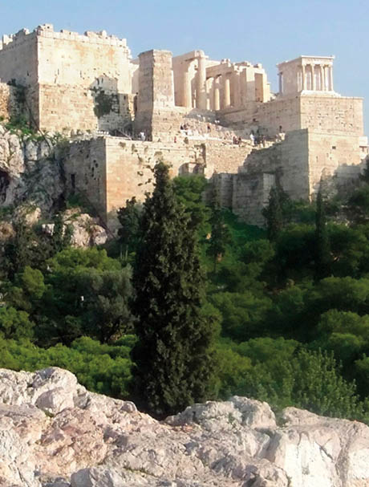
Paul Flees to Athens
The temples in Athens were used for worshipping false gods.
Inside the temples were man-made statues of gods.
Outside were altars on which sacrifices to false gods were offered.
By New Testament times, Athens had lost much of its former greatness and glory, but still contained statues and monuments to many gods and goddesses, including the “Unknown God”
Acts 17:16

Slide 38
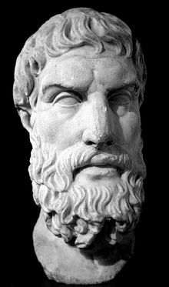
Epicureans
Epicureanism was named for Epicurus (341–270 B.C.).
According to his philosophy, the world came into existence by chance and was without purpose or design.
Epicureans believed that the gods, if they did exist, did not involve themselves in the lives of humans and that happiness was to be found in the absence of cares and pain and the enjoyment of pleasures in moderation.
Acts 17:18

Slide 39
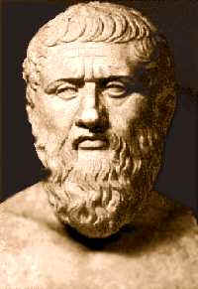
Stoicks--Stoics
“Stoicism began with the teachings of a man named Zeno (333–264 B.C.). Stoicism held that all things were created, ordered, and set in motion by divine reason.
Stoics believed that man was endowed with a spark of reason and should seek harmony with the divine order of things, overcome passions, and live a moral and upright life.”
Acts 17:18

Slide 40
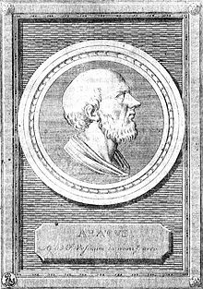
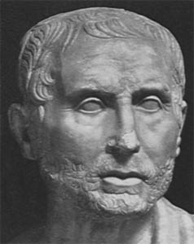
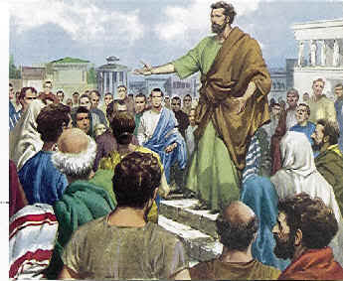
Mars Hill
In his famous address on Mars Hill, Paul quoted from the “Phaenomena,” a work by Aratus, a Cilician poet:
“As certain also of your own poets have said, For we are also his [i.e., God’s] offspring.” Almost these identical words occur in the “Hymn to Zeus” written by Cleanthes.
Both men were Stoics. In citing such poets, Paul was probably not attempting to impress his audience with his intellect and training; no doubt he was trying to place himself on a common footing with his listeners in order to gain their confidence and thus win a listening ear for his message.
Acts 17:28
(3)

Slide 41
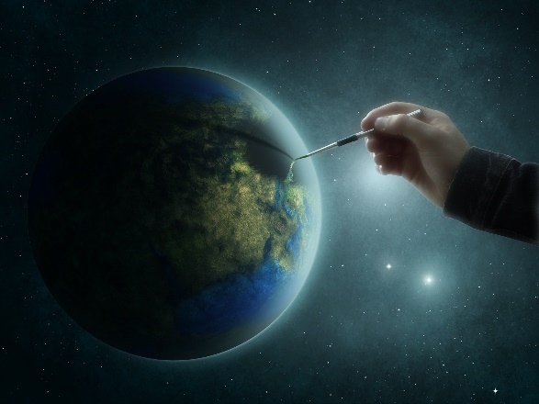
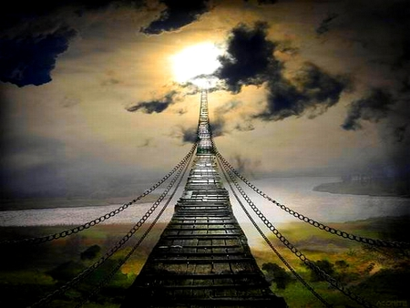
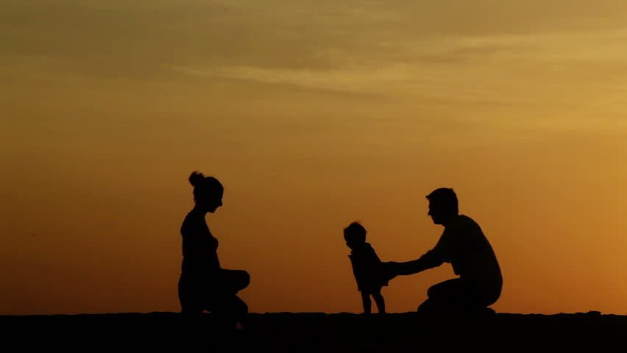
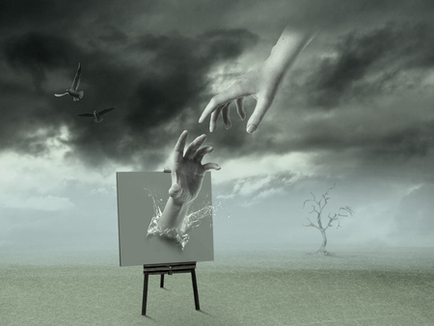
Paul’s Sermon
If we are willing to seek God, we will find that He is not far from us
God Created the World
God gives life to all things
God governs all life
We are God’s offspring
We were created in God’s image
God commands everyone to repent
God will judge us; God will raise all people from the dead
Acts 17:24-31

Slide 42
Offspring of God
The foundational fact of heavenly parentage is not just my truth or your truth.
It is eternal truth. It is written in big, bold, capital letters. Understanding this truth—really understanding it and embracing it—is life changing.
It gives you an extraordinary identity that no one can ever take away from you.
But more than that, it should give you an enormous feeling of value and a sense of your infinite worth.
Finally, it provides you a divine, noble, and worthy purpose in life.
(6)
Acts 17:29

Slide 43
Who Are You?
“Be careful how you characterize yourself. Don’t characterize or define yourself by some temporary quality.
The only single quality that should characterize us is that we are a son or daughter of God.
That fact transcends all other characteristics, including race, occupation, physical characteristics, honors, or even religious affiliation.”
(4)

Slide 44
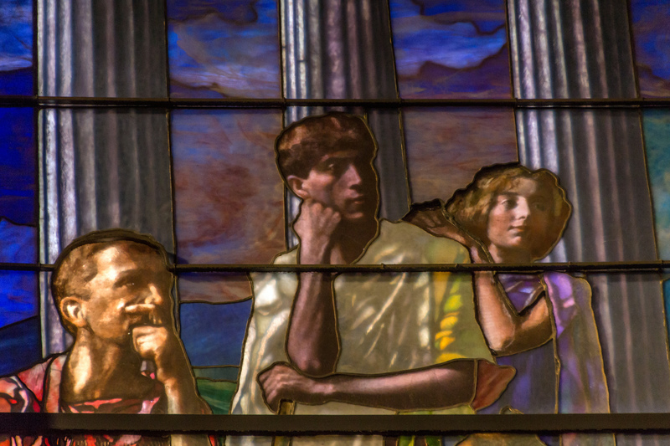
Greeks Mock Paul
After Paul finished his address on Mars Hill, some Greeks mocked his teaching about the resurrection of the dead.
During the first century A.D., popular Greek philosophy held that the physical body was part of what made the soul of man impure. According to Platonic dualism, the soul of man was imprisoned in a body of flesh.
John La Farge
The teaching that Jesus Christ had a resurrected physical body would have seemed foolish to many Greeks because they believed God to be pure and perfect.
Acts 17:32; 1 Corinthians 1:23
(1)

Slide 45
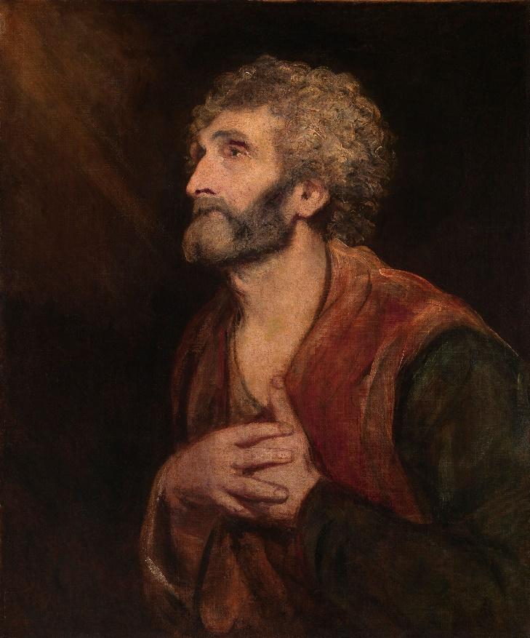
Dionysius
Dionysius was one of those who believed Paul’s teaching.
He was called “the Areopagite,” probably meaning that he was a member of the Areopagus, the judicial council that met at Mars Hill.
According to tradition, he became a bishop in the Church in Athens.
In later years a church named after Dionysius was built on the north slope of the hill, remains of which can be seen today.
Sir Joshua Reynolds
Acts 17:34
(1)

Slide 46
Sources:
New Testament Institute Student Manual Chapter 33
President Howard W. Hunter (“Reading the Scriptures,” Ensign, Nov. 1979, 64).
New Testament Student Manual [Church Educational System manual, 2014], 315–16; see also Bible Dictionary, “Epicureans,” “Stoics”).
Elder Dallin H. Oaks (“How to Define Yourself,” New Era, June 2013, 48). Dallin H. Oaks, “Scripture Reading and Revelation,” Ensign, Jan. 1995, 8
D. Todd Christofferson, “The Blessing of Scripture,” Ensign or Liahona, May 2010, 34
Russell M. Nelson, “The Book of Mormon: What Would Your Life Be Like without It?,” Ensign or Liahona, Nov. 2017, 62–63; M. Russell Ballard, “Children of Heavenly Father” [Brigham Young University devotional, Mar. 3, 2020], 2, speeches.byu.edu
For Extra Reading:
Paul and the Athenian Intellectuals By Richard Lloyd Anderson Feb. 1972 Ensign
Presentation by ©http://fashionsbylynda.com/blog/

Slide 47
Cities of Paul’s 2nd Mission
Cities | Description | Scriptures | More About…
Thessalonica | The second-largest city in Greece and the capital of Greek Macedonia. It was a major transportation hub for the rest of southeastern Europe. The city was founded in 315 BC by Cassander of Macedon. The name of the city came from a princess, Thessalonike, a half sister of Alexander the Great, and princess of Macedon as daughter of Philip II. | Acts 17: 1,11,13 Acts 27:2 2 Timothy 4:10 Philippian 4:16 | Paul, Silas, and Timothy fled for their lives and went to Berea. There are two books of the Thessalonians in the New Testament. They were originally letters that Paul wrote to the Thessalonians while he was in Corinth during his first visit to Europe around A.D. 50. His work in Thessalonica is described in Acts 17. Paul wanted to return to Thessalonica.
Berea | It was a city of the Hellenic and Roman era now known as Veria (or Veroia) in Macedonia, northern Greece. The city was also the first city of the Macedonian region to fall to the Roman Empire, following the Battle of Pydna in 168 B.C. | Acts 17: 10,13 Acts 20:4 | Paul, Silas and Timothy travelled to Berea by night after fleeing from Thessalonica. went to the synagogue of the Jews to preach, and the Bereans were very accepting. They administered there around 54-55 AD Thessalonians stirred up trouble for the disciples and Paul fled to Athens. They administered there around 54-55 AD. Onesimus, formerly Philemon's slave, was its first bishop according to the Apostolic Constitutions (see Colossians 4:9 and Philemon 1:10)
Athens | It is one of the oldest named cities in the world, having been continuously inhabited for at least 5000 years. The name of Athens, connected to the name of its patron goddess Athena | Acts 17:15,16,22 Acts 18:1 1 Thessalonians 3:1 | Athena (Greek Mythology) created the olive tree, symbolizing peace and prosperity Damaris is a woman mentioned in the New Testament, living around 55 AD in Athens, Greece. According to the Acts of the Apostles she embraced the Christian faith following the speech of Paul of Tarsus. It was a center of literature, philosophy (Greek philosophy), and the arts (Greek theatre). In Athens at this time, the political satire of the Comic poets at the theaters had a remarkable influence on public opinion
Wikipedia and Bible Dictionary

Slide 48
THE ACTS OF THE APOSTLES—EVENTS OCCURRED CA. A.D. 45–51 (13:6–18:23) PAUL’S FIRST AND SECOND MISSIONARY JOURNEYS
Thessalonica, Macedonia Paul and Silas Flee Persecution | 17:1–14
Athens, Greece Paul Preaches the Unknown God | 17:15–34
Offspring of God Acts 17:29:
“The Apostle Paul told the Athenians on Mars’ Hill that ‘we are the offspring of God’ [Acts 17:29]. Since we know that our physical bodies are the offspring of our mortal parents, we must probe for the meaning of Paul’s statement. The Lord has declared that ‘the spirit and the body are the soul of man’ [D&C 88:15]. Thus, it is the spirit which is the offspring of God. The writer of Hebrews refers to Him as ‘the Father of spirits’ [Hebrews 12:9]” President Thomas S. Monson (“The Race of Life,” Ensign or Liahona, May 2012, 91).
What Was the Significance of Paul’s Visit to Athens?
The city of Athens, capital of Greece, was one of the wonders of the ancient world. Although in a state of general decline by the time of Paul’s visit, Athens had formerly been the proud possessor of more intellectual genius, more philosophical inquiry, and more architectural splendor than any other city of ancient times. Its inhabitants, even during the period of decline, prided themselves on their brilliant heritage. Vigorous attempts were made to preserve and restore Athens to its former grandeur.
By the time of the first century A.D., Athens was literally a free city-state, privileged to enjoy the protection of Rome. Many of its most noted buildings were still standing. Famed among them was the Agora, or Marketplace. The chief men of the city gathered there each day to hear debates, to conduct the city’s business, to learn, if possible, something new (Acts 17:21). Since Paul’s message was new, he was assured of a crowd from the very first. At length, Paul was conducted to the famed Areopagus [i.e., Mars Hill], with his escorts saying, “May we know what this new doctrine, whereof thou speakest, is?” (Acts 17:19.) Although Paul’s message was largely rejected, at least one member of the High Court, Dionysius the Areopagite, and Damaris, a local woman, with others unidentified, believed (Acts 17:34). (Life and Teachings of Jesus and His Apostles Chapter 32)
Life and Teachings of Jesus and His Apostles Chapter 32
Jason of Tarsus Acts 17:5 was a Jewish convert and early Christian believer mentioned in the New Testament in Acts 17:5-9 and Romans 16:21. In Acts 17 his house in Thessalonica was used as a refuge by the apostles Paul, Silas, and Timothy. Non-believing Jews in Thessalonica stirred up a riot and Jason was arrested when the city authorities could locate neither Paul nor Silas and was made to post bail.
Paul referred to Jason, Lucius and Sosipater as his 'countrymen' (Greek: οι συγγενεις μου) in Romans 16:21, and Jason is therefore referred to as 'Jason of Tarsus'. Both references to Jason point 'very probably' to the same person. Jason is venerated as a saint in Catholic and Orthodox traditions. … Wikipedia
…with the help of some ruffians in the market-places they formed a mob and set the city in an uproar. While they were searching for Paul and Silas to bring them out to the assembly, they attacked Jason’s house.
Ready to Receive:
President Dieter F. Uchtdorf of the First Presidency taught:
“The more we incline our hearts and minds toward God, the more heavenly light distills upon our souls. And each time we willingly and earnestly seek that light, we indicate to God our readiness to receive more light. Gradually, things that before seemed hazy, dark, and remote become clear, bright, and familiar to us” (“Receiving a Testimony of Light and Truth,” Ensign or Liahona, Nov. 2014, 22).
Who are You?
“… may I ask each of you again the question, ‘Who are you?’ You are all the sons and daughters of God. Your spirits were created and lived as organized intelligences before the world was. You have been blessed to have a physical body because of your obedience to certain commandments in that premortal state. You are now born into a family to which you have come, into the nations through which you have come, as a reward for the kind of lives you lived before you came here and at a time in the world’s history, as the Apostle Paul taught the men of Athens and as the Lord revealed to Moses, determined by the faithfulness of each of those who lived before this world was created.” President Harold B. Lee (CR, Oct. 1973, p. 7.)

Slide 49
Something of Interest
The Phaenomena appears to be based on two prose works—Phaenomena and Enoptron (Ἔνοπτρον "Mirror", presumably a descriptive image of the heavens)—by Eudoxus of Cnidus, written about a century earlier. We are told by the biographers of Aratus that it was the desire of Antigonus to have them turned into verse, which gave rise to the Phaenomena of Aratus; and it appears from the fragments of them preserved by Hipparchus, that Aratus has in fact versified, or closely imitated parts of them both, but especially of the first.
The purpose of the Phaenomena is to give an introduction to the constellations, with the rules for their risings and settings; and of the circles of the sphere, amongst which the Milky Way is reckoned. The positions of the constellations, north of the ecliptic, are described by reference to the principal groups surrounding the north pole (Ursa Major, Ursa Minor, Draco, and Cepheus), whilst Orion serves as a point of departure for those to the south. The immobility of the earth, and the revolution of the sky about a fixed axis are maintained; the path of the sun in the zodiac is described; but the planets are introduced merely as bodies having a motion of their own, without any attempt to define their periods; nor is anything said about the moon's orbit. The opening of the poem asserts the dependence of all things upon Zeus. From the lack of precision in the descriptions, it would seem that Aratus was neither a mathematician nor observer or, at any rate, that in this work he did not aim at scientific accuracy. He not only represents the configurations of particular groups incorrectly but describes some phenomena which are inconsistent with any one supposed latitude of the spectator, and others which could not coexist at any one epoch. These errors are partly to be attributed to Eudoxus himself, and partly to the way in which Aratus has used the materials supplied by him. Hipparchus (about a century later), who was a scientific astronomer and observer, has left a commentary upon the Phaenomena of Eudoxus and Aratus, accompanied by the discrepancies which he had noticed between his own observations and their descriptions.
Wikipedia

Slide 50
“Hold Not Thy Peace”
Acts 18-19
Including:
Aquila and Priscilla
Justus and Crispus
Apollos

Slide 51
About 50 AD
Paul traveled to Corinth, where he worked in his trade as a tentmaker to support himself.
Black Sea
Corinth
Achaia
Cyprus
Syria
He may have worked in his trade in other cities in order to avoid being a burden on the Saints he served.
Mediterranean Sea
Israel
Jerusalem

Slide 52
Aquila and Priscilla
A Jew, native of Pontus, settled in Rome as a tentmaker, married to Priscilla or Prisca
They were expelled from Rome by decree of Claudius, and settled in Corinth where Paul met them, and then moved to Ephesus.
At Ephesus Aquila and Priscilla instructed Apollos in the faith, and their house seems to have been a center of Church activity.
From references it appears that they returned to Rome, but later on we find them again at Ephesus.
Acts 18:1-3, 26; 1 Corinthians 16:19; Romans 16:3; 2 Timothy 4:19
(2)

Slide 53
Shook His Raiment
In so doing, Paul was following the Israelite custom of enacting his blamelessness from the sins of those he taught.
“Your blood be upon your own heads; I am clean”.
And we did magnify our office unto the Lord, taking upon us the responsibility, answering the sins of the people upon our own heads if we did not teach them the word of God with all diligence; wherefore, by laboring with our might their blood might not come upon our garments; otherwise their blood would come upon our garments, and we would not be found spotless at the last day. Jacob 1:19
O, my beloved brethren, remember my words. Behold, I take off my garments, and I shake them before you; I pray the God of my salvation that he view me with his all-searching eye; wherefore, ye shall know at the last day, when all men shall be judged of their works, that the God of Israel did witness that I shook your iniquities from my soul, and that I stand with brightness before him, and am rid of your blood.
2 Nephi 9:44
Therefore, as I said unto you that I had served you, walking with a clear conscience before God, even so I at this time have caused that ye should assemble yourselves together, that I might be found blameless, and that yourblood should not come upon me, when I shall stand to be judged of God of the things whereof he hath commanded me concerning you.
Mosiah 2:27
c
“I will go unto the Gentiles,” he was stating that the Jews would no longer be his top priority in teaching the gospel
Acts 18:5-6
(1)

Slide 54
Justus and Crispus
Crispus, the chief ruler of the synagogue, believed on the Lord with all his house; and many of the Corinthians hearing believed, and were baptized.
Justus and his household also joined the church
Paul continued to preach in Corinth for a year and a half
Acts 18:7-11

Slide 55
Hold Not Thy Peace
"The Lord will sustain members in their missionary responsibility if they just have the faith to try
Share with them the joy they will experience by finding and fellowshipping friends and neighbors. (3)
"As a Church, we have not yet caught that missionary vision. Members are not bringing several hundred thousand members into the Church each year. We have not yet met this challenge of a living prophet. We are still on some of the same plateaus." (4)
Acts 18:9-10

Slide 56
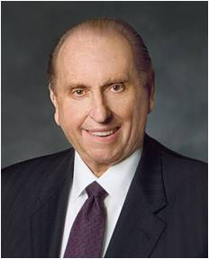
If we live worthily, the Lord will be with us as we do His work
“Now, some of you may be shy by nature or consider yourselves inadequate to respond affirmatively to a calling.
Remember that this … is the Lord’s work, and when we are on the Lord’s errand, we are entitled to the Lord’s help. Remember that the Lord will shape the back to bear the burden placed upon it.” (5)
Acts 18:10

Slide 57
Gallio
The name Gallio (ΓΑΛΛΙΩ) can be seen in the center of the fourth line of this ancient inscription. Paul was accused before the Roman official Gallio. This inscription establishes that Gallio served in Corinth in A.D. 51–52. It is one of the most valuable historical artifacts for determining the dates of Paul’s missions and epistles.
A group of Jews tried to stop Paul’s preaching by accusing him of wrongdoing before the Roman official Gallio, “the deputy of Achaia.”
Gallio told them that their accusations against Paul were not matters to concern him and “drave them from the judgment seat.”
Paul continued his ministry in Corinth for some time, and his departure from that city marked the end of his second mission.
Acts 18:12-17
(2)

Slide 58
Shaving One’s Head
Paul had his hair shaved off as the symbolic end of a vow. Anciently, vows or oaths, could be lifelong, as in the case of one who is set apart as a Nazarite.
Alternatively, vows could be temporary, as in this particular case.
We do not know the nature of Paul's vow, and it may well have been personal, but the scripture indicates that during the time of the vow, he did not cut his hair according to the Nazarite tradition.
Therefore, having his head shorn meant that he was no longer bound by the vow. (2,5)
Acts 18:18

Slide 59
Paul Concludes His Second Mission
Black Sea
Aquila and Priscilla, accompanied Paul to Ephesus.
Paul visited congregations he had established in his first two journeys, and spent three years at Ephesus, a location he had not previously visited
Leaving the couple in Ephesus, Paul traveled to the Jerusalem area and then north to Antioch.
At Antioch, he concluded his second missionary journey.
Phrygia
Corinth
Ephesus
Galatia
Antioch
Cyprus
Mediterranean Sea
Cæsarea
Israel
Jerusalem
During this mission Paul wrote 1 and 2 Corinthians, Romans, and perhaps others of his epistles.
Acts 18:18-22
(2)

Slide 60
Apollos
He was an Alexandrian Jew and contemporary of the Apostle Paul who was know for his eloquence and scriptural mastery
He was taken aside by Aquila and Priscilla in Ephesus and “expounded” a more fuller knowledge about the ministry of the Savior
He journeyed to the Grecian province of Achaia with a recommendation from the Church leaders at Ephesus
He preach in Corinth the gospel message
Church members admired Apollos for his eloquence in proclaiming and upholding gospel truths, but he became the unwitting cause of a degree of dispute among some of them
Some of the saints began to fix themselves on the mortal gospel heroes rather than on the Savior
He is also mentioned in Titus 3:13 along with Zenas, the lawyer in Crete
Some modern-day scholars have taken the position that Apollos may have played a role in writing of the epistle to the Hebrews, although such cannot be confirmed
(2,6)

Slide 61
Paul’s Third Mission
Black Sea
Corinth
Ephesus
This was the longest of his missions, both in terms of duration (three and a half to four years, about A.D. 54–58) and in distance covered (over 3,500 miles or 5,600 kilometers
Antioch
Cyprus
Mediterranean Sea
Israel
Jerusalem
Paul returned to some of the cities he had been to before
Acts 18:23-Acts 19:10

Slide 62
Baptism
Paul returned to Ephesus
“It seems … that some sectarian Jew had been baptizing like John [the Baptist], but had forgotten to inform them that there was one to follow by the name of Jesus Christ, to baptize with fire and the Holy Ghost:—which showed these converts that their first baptism was illegal, and when they heard this they were gladly baptized, and after hands were laid on them, they received the gifts, according to promise.”
Why did some of the people at Ephesus need to be rebaptized?
Acts 19:1-6
(7)

Slide 63
Baptism must be performed by an authorized servant of God.
In order for baptism to be complete, it must be accompanied by the reception of the Holy Ghost
“You might as well baptize a bag of sand as a man, if not done in view of the remission of sins and getting of the Holy Ghost.
Baptism by water is but half a baptism, and is good for nothing without the other half—that is, the baptism of the Holy Ghost.”
Acts 19:1-6
(7)

Slide 64
In coming days, it will not be possible to survive spiritually without the guiding, directing, comforting, and constant influence of the Holy Ghost.
My beloved brothers and sisters, I plead with you to increase your spiritual capacity to receive revelation.
Let this [day] be a defining moment in your life.
Choose to do the spiritual work required to enjoy the gift of the Holy Ghost and hear the voice of the Spirit more frequently and more clearly.
(10)

Slide 65
Healed By the Touch of a Handkerchief
Items that Paul had handled were taken to the sick, and they were healed.
So that from his body were brought unto the sick handkerchiefs or aprons, and the diseases departed from them, and the evil spirits went out of them.
“Healings come by the power of faith; there is no healing virtue or power in any item of clothing or other object, whether owned by Paul or Jesus or anyone. But rites and objects may be used to help increase faith”
In our day, the ordinance of anointing the sick with consecrated oil helps to increase the faith of those involved and helps them call upon God’s power and mercy.
Acts 19:11-12
(8)

Slide 66
Healed by a Handkerchief
“While waiting for the ferry-boat, a man of the world, knowing of the miracles which had been performed, came to [Joseph Smith] and asked him if he would not go and heal two twin children of his, about five months old, who were both lying sick nigh unto death. They were some two miles from Montrose.
The Prophet said he could not go; but, after pausing some time, he said he would send some one to heal them; and he turned to me and said:
‘You go with the man and heal his children.’ He took a red silk handkerchief out of his pocket and gave it to me, and told me to wipe their faces with the handkerchief when I administered to them, and they should be healed. …
I went with the man, and did as the Prophet commanded me, and the children were healed”
One way God manifests His power is through His authorized servants
photograph of Joseph Smith’s handkerchief by Cody Bell,
(9)
Acts 19:11-12

Slide 67
Seven Sons of Sceva
They were casting out evil spirits in the name of Jesus
Why did the evil spirit not recognize the sons of Sceva?
They were not authorized to minister in the name of Jesus Christ.
After:
They confessed and forsook their evil practices by burning their books associated with those practices.
Acts 19:8-20

Slide 68
Worshippers of False Gods
Part of the economy in Ephesus was driven by the worship of Diana, who was a false Roman goddess.
Paul’s success in bringing people to Christ’s Church negatively affected the economy of Ephesus, which relied upon income from visitors to the Temple of Artemis.
Artemis was the Greek name for the Roman goddess Diana, and the temple built to her in Ephesus was one of the seven wonders of the ancient world.
It drew pilgrims from all over the empire, as well as local merchants who earned their living selling temple visitors food, lodging, dedicatory offerings, and souvenirs.
Acts 19:21-41
(1)

Slide 69
Two Hour Chant
Craftsmen who made and sold images of the goddess provoked a public uprising against Paul and his message. A large crowd gathered in the theater at Ephesus, which could hold 24,000 people, and chanted for two hours, “Great is Diana of the Ephesians.”
Paul wanted to address the crowd, but he was dissuaded by Church members and government authorities who were concerned for his safety.
Shortly thereafter, Paul left the city, traveling through Greece and Macedonia and strengthening Church members.
Acts 19:23-34
(1)

Slide 70
Ephesus Theater

Slide 71
Sources:
New Testament Institute Student Manual Chapter 33
Bible Dictionary
(Mission Presidents Seminar, Provo, Utah, 25 June 1986.)
President Ezra Taft Benson (The Teachings of Ezra Taft Benson [Salt Lake City: Bookcraft, 1988], 210-11.)
President Thomas S. Monson (“To Learn, to Do, to Be,” Ensign or Liahona, Nov. 2008, 62).
Who’s Who in the New Testament by Richard J. Allen p. 10
Prophet Joseph Smith (“Baptism,” editorial published in Times and Seasons, Sept. 1, 1842, 904; spelling modernized; Joseph Smith was the editor of the periodical). Teachings of Presidents of the Church: Joseph Smith[2007], 95.
Elder Bruce R. McConkie Doctrinal New Testament Commentary, 2:169
(Wilford Woodruff, Leaves from My Journal [1881], 65).
Russell M. Nelson, “Revelation for the Church, Revelation for Our Lives,” Ensign or Liahona, May 2018, 96
Presentation by ©http://fashionsbylynda.com/blog/

Slide 72
THE ACTS OF THE APOSTLES—EVENTS OCCURRED CA. A.D. 45–51 (13:6–18:23) PAUL’S FIRST AND SECOND MISSIONARY JOURNEYS
Corinth, Greece Jew and Greek Hear the Gospel | 18:1–11
The Jews Take Paul to Court | 18:12–23
All Asia Heard the Gospel | 19:8–10
Miracles of Healing | 19:11, 12
Exorcists Cannot Cast Out Devils | 19:13–20
Ephesus The Silversmiths’ Riot—Priestcraft Fights True Religion | 19:21–41
Tentmaker Acts 18:1-3:
“Jesus was a carpenter, Peter a fisherman, Matthew a tax collector; Brigham Young was a carpenter, painter, and glazier, Heber J. Grant a businessman, David O. McKay a teacher; Paul and Aquila were tentmakers. … Work is honorable, indeed is an essential part of one’s mortal probation” Elder Bruce R. McConkie (Doctrinal New Testament Commentary, 2:163).
Life and Teachings of Jesus and His Apostles Chapter 32 and 34
Jews Leave Rome Acts 18:1-3:
"In A.D. 41, Claudius restored responsibility to the imperial office [as emperor of the Roman Empire], reigning until A.D. 54. These were the years of the dramatic missions of Paul to Asia Minor and Greece. (See Acts 13-18.) The book of Acts indicates that Paul's main enemies then were Jewish conservatives who stirred up mobs and assaulted the successful Christian missionaries. Such agitation brought Paul before city governments and even provincial governors such as Gallio in Corinth. Secular history verifies this climate, for Claudius wrote in one stern letter to Alexandria bitter complaints against Jewish disorders, and the historian Seutonius reported Jewish-instigated riots involving Christians: "Since the Jews constantly made disturbances at the instigation of Chrestus, he [Claudius] expelled them from Rome." (Claudius 25.) This is evidently the same Jewish expulsion reported in Acts 18:1." (Richard Lloyd Anderson, "The Church and the Roman Empire," Ensign, Sept. 1975, 12)
Shook His Raiment Acts 18:6: "...he literally shook his garments before them to show that was free of their blood and was going to leave them and go to the Gentiles. He was through with the Jewish community at Corinth. It's a dramatic gesture. On Mars Hill in Athens the chief priest would shake a scarlet robe when a person was banished, to shake him off and get rid of him. It's like shaking the dust off your feet from a rebellious town or a wicked people." (Hugh Nibley, Teachings of the Book of Mormon, 1988--1990 [Provo: FARMS] 306.)
Hold Not Thy Peace Acts 18:10:
"...Jewish conversions brought intense ill will; Paul was forced to testify plainly and to leave off preaching to Jews. Was he to leave Corinth at this point? He had left three cities in northern Greece in similar circumstances. But a vision of the Lord came in the midst of this genuine need, for there are no pointless miracles in Paul's ministry. The Lord commanded, 'Do not be afraid, but speak, and do not keep silent; for I am with you, and no one will attack you to hurt you; for I have many people in this city' (Acts 18:9-10, NKJB)...Acts lays the background for the powerful Corinthian drama." (Richard Anderson, Understanding Paul [Salt Lake City: Deseret Book Co., 1983], 58 - 59.)

Slide 73
Shorn Acts 18:18:
"A specific example of a vow was the Nazarite consecration. The Nazarite, literally one 'separated' or 'set apart,' was a person (male or female) who took a vow of holiness, an oath of abstinence from the world. Such a vow could last anywhere from a short period to an entire lifetime. Abstinence from fruit of the vine (e.g., grapes, grape juice, wine, raisins) was enjoined on the initiate. In addition, he was not to cut his hair nor touch a dead person (even a family member) during the time of separation (Num. 6:1-18). Notable Nazarites include Samson (Judg. 13:5), Samuel (1 Sam. 1:11), and John the Baptist (Luke 1:15). It appears that Paul the Apostle also participated in vows of this sort (Acts 18:18)." (Kent P. Jackson and Robert L. Millet, eds., Studies in Scripture, Vol. 3: Genesis to 2 Samuel [Salt Lake City: Randall Book, 1985], 181 - 182.)
Gallio Acts 18:12-17:
Luke speaks of a Gallio who was proconsul of Achaia. Scholars doubted his existence because it didn’t appear anywhere in the history books and no artifacts had been found bearing his name. But in 1905 a doctoral student sifted through some inscriptions collected from Delphi. He discovered nine fragments that formed a message from Emperor Claudius. In the text Claudius writes “Gallio, my fr[iend] an[d procon]sul….”
The inscription was etched into a stone that was likely attached to the Temple of Apollo.
The text is dated between April to July AD 52, which means Gallio probably occupied the chair of proconsul from July 1 AD 51 to July 1 AD 52 (proconsuls usually took office on July 1, and their tenure was generally limited to one year).
It turns out that Gallio was the brother of Seneca, who was a philosopher and the tutor of Emperor Nero.
https://theosophical.wordpress.com/2011/09/23/biblical-archaeology-43-the-gallio-inscription/
Something of Interest
Goddess Diana:
In Roman mythology, Diana was the goddess of the hunt, the moon, and nature being associated with wild animals and woodland, and having the power to talk to and control animals. She was eventually equated with the Greek goddess Artemis, though she had an independent origin in Italy. Diana was worshipped in ancient Roman religion and is revered in Roman Neopaganism and Stregheria. Diana was known to be the virgin goddess of childbirth and women. She was one of the three maiden goddesses, along with Minerva and Vesta, who swore never to marry.
Oak groves were especially sacred to her as were deer. According to mythology (in common with the Greek religion and their deity Artemis), Diana was born with her twin brother, Apollo, on the island of Delos, daughter of Jupiter and Latona. She made up a triad with two other Roman deities: Egeria the water nymph, her servant and assistant midwife; and Virbius, the woodland god. Wikipedia
False Priests Acts 19:8-20:
“In imitation of the true order whereby devils are cast out of people, false ministers (having no actual priesthood power) attempt to cast them out by exorcism. This ungodly practice was probably more common anciently than it is now, because few people today believe either in miracles or in the casting out of literal devils. But over the years it has not been uncommon for so-called priests to attempt to expel evil spirits from persons or drive them away from particular locations by incantations, conjuration, or adjuration.’” Elder Bruce R. McConkie (Mormon Doctrine, 2nd ed. [1966], 259).

Slide 74
Cities of Paul’s 2nd and 3rd Mission
City | Description | Scripture | More About…
Corinth | The ancient Greek city-state of Corinth was strategically located in the center of the isthmus joining northern Greece to the Peloponnesus on the south... Because of its location, it was inseparably connected with the sea and derived its wealth primarily from shipping and trade... eventually Corinth became the leader of the Achaian Confederacy, which came into conflict in the second century B.C. with the expanding military might of Rome. As a result of Roman supremacy and of Corinth's leading role in opposition, the Greek city was captured and burned by Rome in 146 B.C. and its citizens either killed or sold into slavery. | Acts 18:1 Acts 19:1 2 Corinthians 1,2, 23 2 Timothy 4:20 | Corinth in Paul's time was not the ancient Greek city but rather a Roman colony founded by decree of Julius Caesar in 44 B.C. on the ancient site, which had lain virtually desolate for more than a century. Its new population initially consisted of freedmen from Italy who were soon joined by Greeks and other foreigners, including many Jews, from the East. As in the past, Corinth quickly became an important center of industry and commerce, a center that in A.D. 27 became the capital of the Roman province of Achaia. Like any port city in ancient or modern times, Corinth at the time of Paul had the reputation of being cosmopolitan, worldly, and promiscuous-full of both philosophies and practices from every corner of the world."
Ephesus | It was an ancient Greek city It was built in the 10th century BC on the site of the former Arzawan capital by Attic and Ionian Greek colonists. During the Classical Greek era it was one of the twelve cities of the Ionian League. The city flourished after it came under the control of the Roman Republic in 129 BC. | Acts 18:19,24 Acts 19:1,17,26,35 Ephesian 1:1 1 Corinthians 15:32 1 Corinthians 16:8 1 Timothy 1:3 2 Timothy 1:18 2 Timothy 4:12 Revelation 1:11 Revelation 2:1 | The city was famed for the nearby Temple of Artemis (completed around 550 BC), one of the Seven Wonders of the Ancient World. Among many other monumental buildings are the Library of Celsus, and a theatre capable of holding 25,000 spectators. Ephesus was one of the seven churches of Asia that are cited in the Book of Revelation. there must have been a community of Jewish Christians in Ephesus. Paul introduced about twelve men to the 'baptism with the Holy Spirit' who had previously only experienced the baptism of John the Baptist, and later became embroiled in a dispute with some artisans whose livelihood depended on selling statuettes of Artemis (Latin: Diana) in the Temple of Artemis
David R. Seely, Studies in Scripture, Vol. 6: Acts to Revelation, ed. by Robert L. Millet [Salt Lake City: Deseret Book Co., 1987], 57 - 58.)
Wikipedia

Slide 76
Third Mission
Macedonia
Black Sea
Rome
Italy
Adriatic Sea
During Paul’s third missionary journey, he spent time in Macedonia,
Greece,
and Asia Minor.
Greece
Asia Minor
Troas
Ephesus
Cilicia
Sicily
Antioch
Syria
Crete
Cyprus
Mediterranean Sea
Jerusalem
He felt impressed to return to Jerusalem– For Pentecost
Acts 20:1-6

Slide 77
Young Man in the Window
The night before his departure from Troas, on the new Sabbath (Sunday), Paul and the disciples came together to partake of the sacrament.
Paul then spoke with the Saints long into the night.
A young man named Eutychus after he fell asleep during Paul’s sermon.
The young man fell down from the third loft and was taken up dead.
And Paul went down, and fell on him, and embracing him said, Trouble not yourselves; for his life is in him.
Acts 20:7-12

Slide 78
Have you ever felt to complain because church meetings last for three hours?
Have you ever been frustrated with a speaker whose talk inconsiderately rambled on for 20 or 30 minutes longer than scheduled?
Have your eyelids ever been heavy during an early morning meeting?
If you have experienced any of these feelings, then you can relate-in the smallest degree-to the situation of poor Eutychus.
The young man, like many of our Aaronic Priesthood brethren, lost interest in Paul's talk. If Paul's talks were anything like his epistles, then the content was likely too complex for the younger crowd. Besides, Paul could talk for a long time… (2)
…and as Paul was long preaching
Acts 20:7-12

Slide 79
Paul’s Farewell to Elders in Ephesus
He knew he put his life in danger by returning to Jerusalem
He bore his testimony of the Holy Spirit
And now, behold, I go bound in the spirit unto Jerusalem, not knowing the things that shall befall me there:
Knowing of the Apostasy that would soon begin among the Ephesian Saints, Paul admonished Church leaders to “feed the church of God”
Acts 20:13-27

Slide 80
“Most people don’t come to church looking merely for a few new gospel facts or to see old friends, though all of that is important.
They come seeking a spiritual experience.
They want peace.
They want their faith fortified and their hope renewed.
They want, in short, to be nourished by the good word of God, to be strengthened by the powers of heaven.
Those of us who are called upon to speak or teach or lead have an obligation to help provide that, as best we possibly can.”
(3)

Slide 81
Paul’s Warning
Grievous Wolves and Perverse Things
Apostasy—both inside (our own selves) and outside the Church
Apostasia = Greek for “Falling Away”
Or “rebellion, revolution” (2 Thessalonians 2:3)
Church members themselves contributed to the Great Apostasy by rebelling against Church leaders and doctrine
Priestcraft was an important element of this internal rebellion.
Acts 20:28-31
(1)

Slide 82
“Not only would outsiders ingratiate themselves with the saints for purposes of selfish gain—wolves entering in, and not sparing the flock,—but schisms and divisions were imminent;…
…and these dissensions were to come through some then present—men who would aspire to leadership, and who would set up their own doctrines, thus drawing disciples away from the Church and unto themselves.”
Acts 20:28-31
(4)

Slide 83
Silver or Gold or Apparel
Yea, ye yourselves know, that these hands have ministered unto my necessities, and to them that were with me.'
"One of the plainest examples of Paul's integrity was his insistence on working with his own hands for his financial support.
He explained that as an 'apostle' he could have required support from the Saints, but that he preferred not to be burdensome (1 Thes. 2:5-9).
To the Corinthians he wrote: 'What is my reward then? Verily that, when I preach the gospel, I may make the gospel of Christ without charge, that I abuse not my power in the gospel.' (1 Cor. 9:18.)
And again: 'Even unto this present hour we both hunger, and thirst, and are naked, and are buffeted, and have no certain dwelling place; and labour, working with our own hands' (1 Cor. 4:11-12)."
One of Paul’s prime concerns on the third journey was to collect funds for the poor in Jerusalem.
Acts 20:33-34
(5)

Slide 84
More Blessed To Give Than Receive
Saints throughout the world provide service to others, they follow the Savior’s admonition.
Saints in Russia
Fire in Chile
War in Ukraine 2022
Acts 20:35
(1)

Slide 85
Tyre and Caesarea
Paul was determined to go in person to deliver the donations he had gathered for the poor Jerusalem Saints.
Sidon
When Paul stopped in a city called Tyre, some disciples—evidently concerned for Paul’s safety—advised Paul not to go to Jerusalem
Tyre
In Caesarea, a prophet named Agabus prophesied concerning what would happen to Paul in Jerusalem.
Region of Decapolis
Caesarea
…So shall the Jews at Jerusalem bind the man that owneth this girdle, and shall deliver him into the hands of the Gentiles.
Jerusalem
Girdle and Binding = symbolic act
Acts 21:1-11
(1)

Slide 86
Phillip and 4 Women
And now, he imparteth his word by angels unto men, yea, not only men but women also.
Alma 32:23
“Though men are appointed to hold rule in the home and in the Church, women are not one whit behind them in spiritual endowments. They prophesy, receive visions, entertain angels, enjoy the gifts of the Spirit, and qualify with their husbands for full exaltation in the highest heaven.” (7)
Acts 21:9
(1)

Slide 87
Misunderstood Paul’s Teachings
Paul arrived in Jerusalem and gave a report of his missionary labors to local Church leaders. Paul went to the temple, and when a group of Jews who knew Paul from his missionary journeys saw him, they proclaimed that Paul was a false teacher who taught against the law of Moses and unlawfully brought Gentiles into the temple.
Because of this accusation, a mob removed Paul from the temple and began beating him. Roman soldiers intervened and carried him away to be tried. While on the stairs of the Antonia Fortress
Acts 21:17-21

Slide 88
Purifications Rights
To help dispel ill feelings toward Paul, Church leaders encouraged Paul to participate in the weeklong temple purification rites that observant Jews customarily underwent after traveling in Gentile lands.
Paul’s public observance of these temple rites would demonstrate that he did not teach against the law of Moses or the temple, as was rumored. (1)
The Temple rituals would occupy seven days of purification and sacrifice. Paul would pay for the four lambs and eight pigeons used for sacrifice and would attend the four men in their Temple appearances and rituals. … In so doing the Apostle would be obliged to cross the Court of the Gentiles and the Court of the Women, enter the Court of Israel, and finally approach the altar on which burnt offerings were made. He was bound to be in full view of either friend or foe in these Temple areas.” (6)
Acts 21:17-21

Slide 89
The Roman Captain
Claudius Lysias, and several soldiers broke up the mob that was assaulting Paul and took Paul into custody
Realizing that Paul was not a rebel, the Roman captain allowed Paul to address the crowd who had assailed him. The crowd at the temple listened to Paul tell his conversion story until he mentioned being sent to the Gentiles.
At that point, they reacted with animosity, casting off their outer cloaks and throwing dust into the air—acts by which Jews commonly expressed abhorrence and indignation.
Acts 21:26, 39-22:23
(1)

Slide 90
Paul--A Roman Citizen
The Roman chief captain could not understand Paul’s speech, which was delivered in Aramaic, nor could he discover why the crowd was angry at Paul.
Therefore the captain ordered that Paul be scourged, or whipped, and questioned. A scourge, which was a whip or lash made of long strips of leather that were studded with bits of metal or bone and fastened in a wooden handle, was a weapon of torture that could maim and even kill.
Simon H. Vedder
In response to the order, Paul protested that he was a Roman citizen and was therefore protected from examination by torture. Roman citizenship carried with it important privileges and was not easily obtained, as made clear by the conversation recorded in Acts 22:24–30.
Acts 21:24-26
(1)

Slide 91
Sources:
New Testament Institute Student Manual Chapter 33, 34
Gospeldoctrine.com
Elder Jeffrey R. Holland (“A Teacher Come from God,” Ensign, May 1998, 26; see also commentary for John 21:15–17).
James E. Talmage (The Great Apostasy [1968], 28).
Robert J. Matthews, Behold the Messiah, 335
Sidney B. Sperry(Paul’s Life and Letters [1955], 208–9).
McConkie, DNTC,2:181.
Presentation by ©http://fashionsbylynda.com/blog/

Slide 92
PAUL’S Third MISSIONARY JOURNEY
Troas Paul Raises Eutychus from Death | 20:1–12
Miletus Farewell, Testimony, Counsel | 20:13–38
Toward Jerusalem Agabus’ Prophetic Warnings | 21:1–17
Jerusalem The Gradual Process of Conversion | 21:18–26
Paul Persecuted, Arrested, Bound | 21:27–39
The Story of Paul’s Conversion | 21:40; 22:1–16
Jerusalem The Gradual Process of Conversion | 21:18–26
Paul Persecuted, Arrested, Bound | 21:27–39
Life and Teachings of Jesus and His Apostles Chapter 34, 42

Slide 93
Sacrament Acts 20:7:
Paul participated in the ordinance of the sacrament with other Christians. In celebration of the Resurrection of Jesus Christ, Christians partook of the sacrament on the first day of the week (see verse 7; see also John 20:1). This same pattern is followed in the Church today
Misunderstood Acts 21:17-25:
“the Church under direction of Peter and the Twelve, and acting under the guidance of the Spirit, declared that circumcision was not obligatory for gentile converts. However, it apparently did not settle the matter of whether or not Jewish members of the Church should have their children circumcised. As one reads the scriptures on the matter, it becomes evident that the real issue was not circumcision only but also the larger question as to continued observance of the law of Moses by members of the Church. …
“The Jewish part of the church membership, especially in Jerusalem, appears to have been very reluctant to cease from the rituals and ceremony of the law of Moses (Acts 21:17–25). This is a marked contrast to the Church among the Nephites, in which there seems to have been a cessation of the law immediately upon their awareness of the death and resurrection of Jesus Christ. (3 Ne. 15:1–4; Moro. 8:8)” (Bible Dictionary, “Circumcision”).
It is evident from Acts 21:21 that Jewish Christians in Jerusalem had misunderstood Paul’s teachings about the law of Moses. Even though Paul and the other Apostles had taught that circumcision was not a requirement for Gentile coverts, they had not discouraged Jewish converts from following the practice or from observing other aspects of the law of Moses. Jewish Christians continued to worship in the temple (see Acts 2:46; 3:1; 5:19–25, 42), and Paul still considered himself an observant Jew. (1)
Elders Acts 20:17:
"The term 'elders' is used in many other passages of Scripture. In some instances, the apostle is called an elder, as Paul and John allude to themselves personally as elders. In some places the term is used in reference to the aged, as in I Timothy 5:1, 2: 'Rebuke not an elder, but entreat him as a father, and the younger men as brethren, the elder women as mothers, the younger as sisters, with all purity.' Yet the quotations made will be ample to prove that the office of Elder was an order anciently in the organization of the Church of Christ." (Cowley's Talks on Doctrine [Chattanooga: Ben. E. Rich, 1902], 65.)
Results of Evil Men—Apostasy Acts 20:28-31:
“In time all ordinances of the gospel were changed, commandments were broken, and the simple principles of the gospel were mixed with pagan philosophy by the ‘grievous wolves’ and apostate disciples who displaced the prophets and apostles who had divine communion with the heavens. Spiritual darkness set in, and unrighteous men took command and closed the heavens against themselves. Visions and contact with the heavens ceased, and the gifts of the spirit came to an end. The blessings and presence of the Twelve Apostles ceased, and the cry went forth that they were no longer needed” President Joseph Fielding Smith (Answers to Gospel Questions, 5 vols. [1957–66], 5:177).
Egyptian? Acts 21:38:
A Roman captain, later identified as Claudius Lysias (see Acts 23:26), and several soldiers broke up the mob that was assaulting Paul and took him into custody. The chief captain questioned Paul, mistakenly believing that Paul was an Egyptian rebel. About three years prior to that time, an Egyptian Jew had raised a large following in the wilderness and brought them to the Mount of Olives. He promised his followers that the walls of Jerusalem would crumble when they approached and that they would be able to drive out the Romans with ease. Felix, the Roman governor, met them with his army and defeated them, but he was unable to capture their leader, who still remained a fugitive.
Fire in Chile:
An April fire in the city of Valparaiso, Chile, devastated homes and left many homeless. Not long after the fire thousands of Church members and missionaries cleaned the charred remains of homes and gathered clothes for the victims. The Newsroom Blog
Saints in Russia:
Mormons in Saint Petersburg, Russia, participate in a day of service in a public park earlier this month. Similar service was also provided by Latter-day Saints in Moscow, Podolsk, Yaroslavl, Tomsk and other Russian cities. Mormon Newsroom
Saints in Kiev, Ukraine
On February 24, 2022, Russia sent missiles into Ukraine starting the war between Russia and Ukraine. Stores ran out of food, homes were bombed, and over 4 million evacuated to various countries. Food donations began to arrive in Ukraine in March of 2022. The Kiev Branch Chapel was used as a staging station for foods. Members helped divide food into packages when pallets of donated food arrived at the church. Member drivers would then load up vans and cars and distribute to the people around the country.

