Slide 1
Acts 6-9

Slide 2
What Would The Lord Want You to Know?
Acts 6-7
Stephen the Apostle

Slide 3
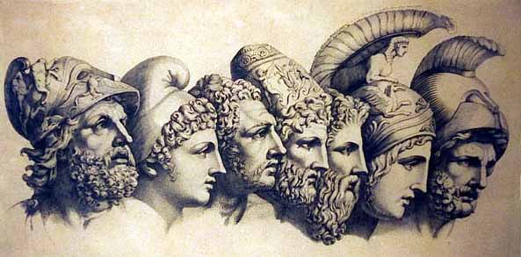
Grecians VS Hebrews
The Grecians “were Greek-speaking Jewish-Christians”
The Hebrews “were Palestinian Jewish-Christians”
“The ancient Greek religion like many others of their time, shared some basic theological views. However, the ancient Hebrew religion differed in many ways. First of all, the Hebrews believed in one God, while the Greeks believed in a pantheon of gods. This pantheon was usually warring with each other. Humans could also thwart the plans of the Greek gods, whereas the God of the Hebrews plans could never be thwarted. Moreover, the Greeks supposed that the sacrifices they gave their gods’ strengthened the gods in some way like nourishment. Yet, Yahweh does not need the sacrifices that the Hebrews gave him. These are only some of the differences between these two religions. It is interesting to note that in the ancient era there are no other religions like the one of the Hebrews.” (3)
(2)
Acts 6:1

Slide 4
7 Men Are Called
To address the growing need to care for widows and others, seven men were called and given authority to assist the Twelve.
These men served under the direction of the Twelve with the specific task of caring for the poor and needy. It is not known what priesthood office the seven men held.
Timon
Nicanor
Prochorus
Stephen, a man full of faith and of the Holy Ghost
Philip
Nicolas a proselyte of Antioch
Parmenas
…they laid their hands on them—Setting Apart
(2)
Acts 6:2-6

Slide 5
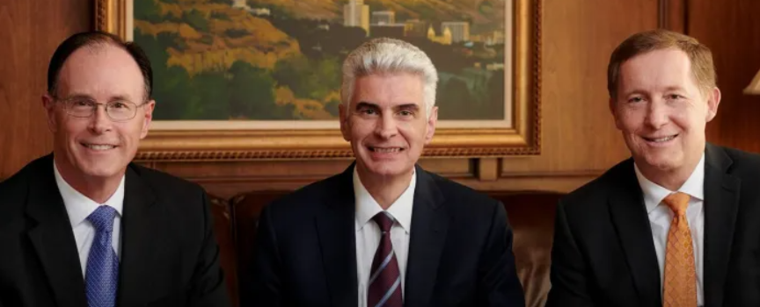
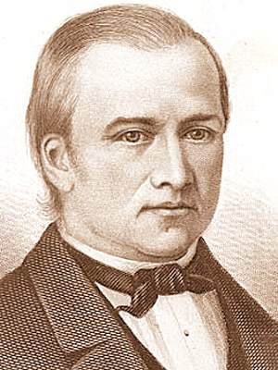
Being Called
“The bishop has a divine mandate to seek out and care for the poor.
He directs the welfare work in the ward. His goal is to help members help themselves and become self-reliant. (In branches, the branch president has these same welfare responsibilities.)
The bishop determines whom to assist, how much to give, and how long to assist.”
Presiding Bishopric of the Church (left to right):
Bishop W. Christopher Waddell
Presiding Bishop Gérald Caussé;
Bishop W. Christopher Waddell, second counselor.
2023
Each individual circumstance is different and requires inspiration and is guided by the Spirit…
“Bishops are blessed with the gift of discernment to understand how best to help those in need.
And the bishop, Newel K. Whitney, also should travel round about and among all the churches, searching after the poor to administer to their wants by humbling the rich and the proud.
D&C 84:12
(4)

Slide 6
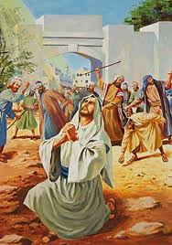
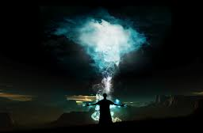
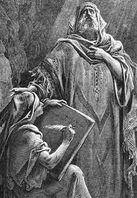
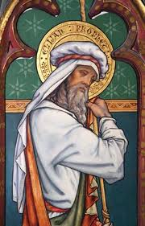
Who was Stephen?
He was a man of faith and power
He was filled with the Holy Ghost
He did great wonders and miracles
He was ordained by priesthood power
Acts 6:5-9

Slide 7
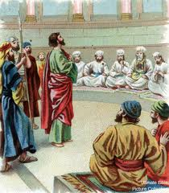
Blasphemous Words?
Those who opposed Stephen were from one or more synagogues where Jews from foreign lands worshipped:
Libertines were former slaves who had gained their freedom.
Cyrenians were Jews from Northern Africa.
Alexandrians were Jews from the Egyptian city of Alexandria.
Cilicia was a Roman province of Asia Minor.
Stephen was taken to Council for Preaching
It appears that his opponents were angered by his teachings that the coming of Jesus Christ had redefined basic Jewish concepts regarding the land of Israel, the law of Moses, and the temple of Jerusalem. Stephen’s opponents “suborned men” meaning that they persuaded men to commit perjury.
Acts 6:12-15
(1)

Slide 8
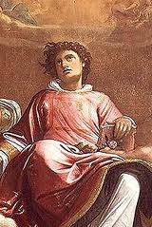
Face of an Angel
“And all that sat in the council, looking stedfastly on him, saw his face as it had been the face of an angel.”
Stephen was transfigured. This holy transfiguration was one way God showed the people that He approved of Stephen and his message.
Acts 6:15
(5)

Slide 9
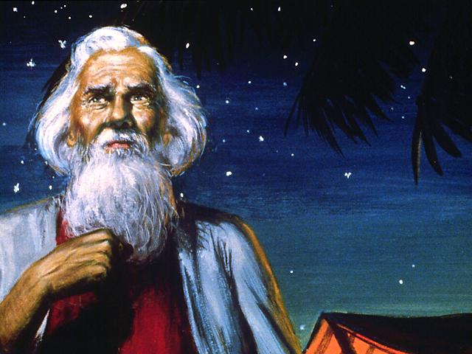
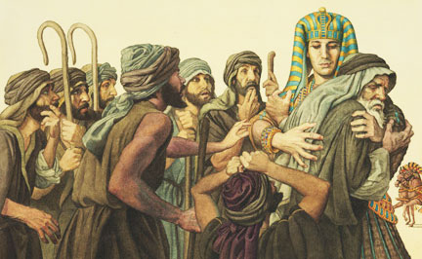
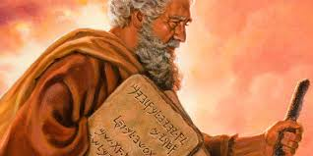
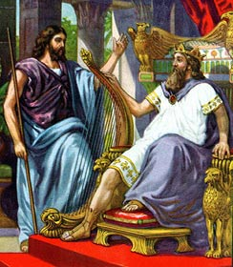
Stephen Recounts Israel’s History
Joseph in Egypt
Glory of God appearing to Abraham
Israel rejects Moses
David and Solomon
The Jews were aware of the promise that the Lord would send them a prophet like unto Moses. (1)
Acts 7:1-50

Slide 10
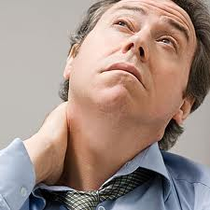
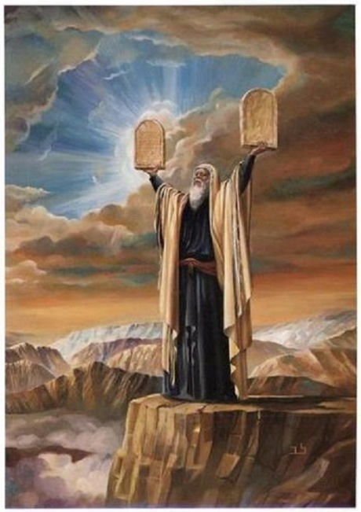
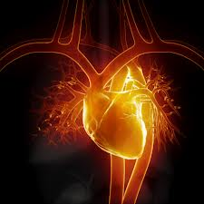
3 Accusations
“stiffnecked”
and rejected the influence of the Holy Ghost
“resist the Holy Ghost: as your fathers did, so do ye.”
“uncircumcised in heart and ears”
They rejected and slew the Just one, Jesus Christ
They received the law of Moses but didn’t live it
Acts 7:51-53

Slide 11
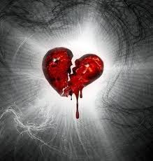
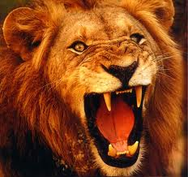
When they heard these things:
“cut to the heart”
“gnashed on him with their teeth.”
Resisting the Holy Ghost can lead to rejecting the Savior and His prophets
The Holy Ghost testifies of Jesus Christ and witnesses of the truth of His words and the words of His prophets. Therefore, resisting the Holy Ghost will weaken someone’s testimony and his or her resolve to follow the Savior and His prophets.
Acts 7:52-54

Slide 12
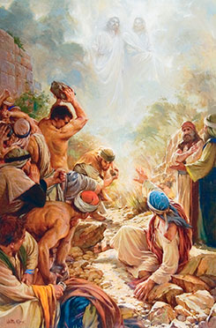
Looking to Heaven—3 Separate Beings
Stephen’s Vision
…saw the glory of God, and Jesus standing on the right hand of God,”
“But he, being full of the Holy Ghost…
Heavenly Father, Jesus Christ, and the Holy Ghost are three separate and distinct beings
“he fell asleep”
Acts 7:55-56

Slide 13
“Many Christians reject the idea of a tangible, personal God and a Godhead of three separate beings.
They believe that God is a spirit and that the Godhead is only one God.
In our view these concepts are evidence of the falling away we call the Great Apostasy.”
Acts 7:55-56
(6)

Slide 14
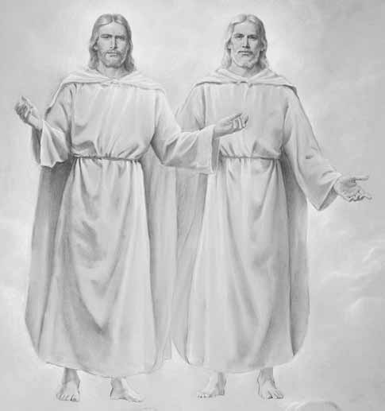
The Godhead
The Father has a body of flesh and bones as tangible as man’s
But the Holy Ghost has not a body of Flesh and bone, but is a personage of Spirit.
The Son also (has a body of flesh and bones)
D&C 130:22

Slide 15
What We Believe
“…we believe in a Godhead of Father, Son, and Holy Ghost. However, we testify that these three members of the Godhead are three separate and distinct beings. We also testify that God the Father is not just a spirit but is a glorified person with a tangible body, as is His resurrected Son, Jesus Christ”
Elder Dallin H. Oaks

Slide 16
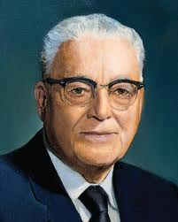
“If you want to know what the Lord would have the Saints know and to have his guidance and direction for the next six months, get a copy of the proceedings [of the last] conference, and you will have the latest word of the Lord as far as the Saints are concerned.”
(7)

Slide 17
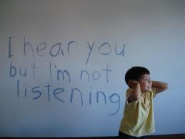
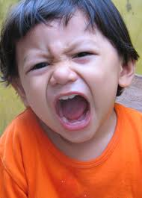
Persecution
“…cried out with a loud voice…
…stopped their ears”
…and ran upon him with one accord”
Acts 7:57

Slide 18
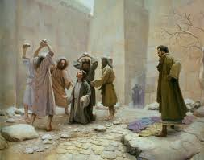
Cast out
From the city
Witnesses laid down their clothes at Saul’s feet
Acts 7:58

Slide 19
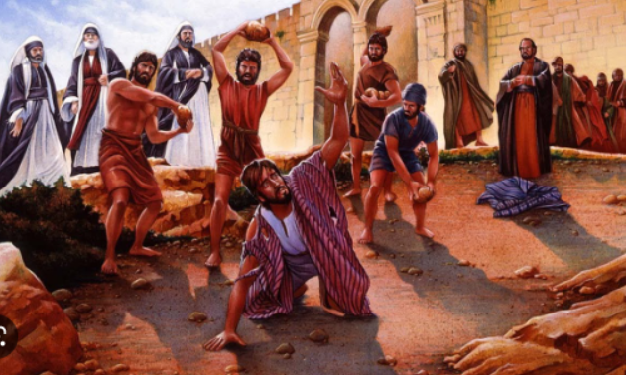
Stoning of Stephen
He calls upon God to receive his spirit
“…Lord, lay not this sin to their charge.
“…and when he had said this, he fell asleep.”
Acts 7:59-60

Slide 20
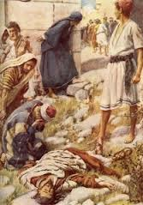
A Martyr
Stephen is generally considered the first Christian martyr.
In addition, he can be seen as a type of Christ, as both he and the Savior stood before a council to be tried, declared truths in the face of their enemies, gave their lives in a righteous cause, and even uttered similar expressions as they suffered death.

Slide 21
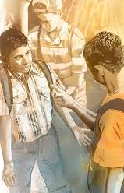
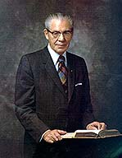
"Our Lord gave us an example of the true spirit of forgiveness when he said from the cross,
'... Father, forgive them; for they know not what they do.'
(Luke 23:34.)
We read also of that faithful disciple, Stephen, who was persecuted and stoned, 'And he kneeled down, and cried with a loud voice, Lord, lay not this sin to their charge. And when he had said this, he fell asleep.'
"How important it is for us to apply in our lives those great principles of repentance and forgiveness. Let us always remember that the one who carries a grudge or ill feelings toward a neighbor and does not forgive is the
one who is uncomfortable and unhappy and ill
at ease, and continuing in this course will
canker his soul, and in him will remain the
greater sin.
Acts 7:60
(8)

Slide 22
Sources:
New Testament Institute Student Manual Chapter 30
New Testament Student Manual [Church Educational System manual, 2014
Peter Bianchi (Blog) Oct. 2013
(Providing in the Lord’s Way: Summary of a Leader’s Guide to Welfare[booklet, 2009], 4–5).
Bruce R. McConkie, Doctrinal New Testament Commentary, 3 vols. (1965–73), 2:67.])
Dallin H. Oaks 1995 Apr. Conference Report or May 1995 Ensign
Harold B. Lee 1973 Oct. Conference Report or Jan 1974 Ensign
Elder N. Eldon Tanner ("The Importance of Prayer," Ensign, May 1974, 53)
Presentation by ©http://fashionsbylynda.com/blog/

Slide 23
Grecian VS Hebrew Acts 6:1
"What distinction was made in New Testament times between Greeks and Grecians?
"...Jews of the dispersion who adopted Hellenists' customs and who spoke Greek (Acts 6:1; 9:29) were called Grecians. New Testament references to Greeks refer to persons of Greek lineage." (Church News: Question of the Week, LDS Church News, 1994, 10/22/94)
"But the difference between the 'Grecians' and the 'Hebrews' was far deeper than merely of language, and extended to the whole direction of thought. There were mental influences at work in the Greek world from which, in the nature of things, it was impossible even for Jews to withdraw themselves... it was only natural that the Hellenists, placed as they were in the midst of such hostile elements, should intensely wish to be Jews, equal to their Eastern brethren. On the other hand, Pharisaism, in its pride of legal purity and of the possession of traditional lore, with all that it involved, made no secret of its contempt for the Hellenists, and openly declared the Grecian far inferior to the Babylonian 'dispersion.' That such feelings, and the suspicions which they engendered, had struck deep into the popular mind, appears from the fact, that even in the Apostolic Church, and that in her earliest days, disputes could break out between the Hellenists and the Hebrews, arising from suspicion of unkind and unfair dealings grounded on these sectional prejudices (Acts 6:1)." (Edersheim, Alfred, Life and Times of Jesus the Messiah, 5-6)
Great Company Acts 6:7
"Some scholars have recently suggested that this great company may have been such a band of holy men as we find described in the newly discovered Dead Sea Scrolls and related documents, if not a group actually named in one of them. These men were prepared by their tradition to receive the gospel when they heard it. Without that tradition and training the preaching to them might have fallen on deaf ears."
Hugh Nibley (The World and the Prophets, 3rd ed. [Salt Lake City and Provo: Deseret Book Co., Foundation for Ancient Research and Mormon Studies, 1987], 220.)
Blasphemous Words Acts 6:11-15:
"It is certain that Stephen said something about the law of Moses being fulfilled and being no longer in force, or his enemies would not have accused him of being contrary to Moses and saying that Jesus (already dead) would change the customs of the law (see Acts 6:13).
Stephen was something of an eastern Abinadi, who testified that salvation was dependent on the atonement of Jesus Christ, notwithstanding the law of Moses. And like Abinadi, he gave his life for his testimony of Jesus Christ. And like Abinadi, his face shone like an angel's." (Selected Writings of Robert J. Matthews: Gospel Scholars Series [Salt Lake City: Deseret Book Co., 1999], 286.)
Face of An Angel Acts 6:15
“Stephen was transfigured before them, visible witness thus being given that God was with him. In a lesser degree, it was with Stephen as it had been with Moses, the skin of whose face shone visibly after he had communed with the Lord for forty days on the mountain (Ex. 34:29–35.)” (Doctrinal New Testament Commentary, 2:67).
On occasion the Spirit will have such a powerful influence on the individual as to transform their being into a source of light. Like the stones that illuminated the Jaredite ship after being touched by Jehovah, the faces of the prophets become luminescent with the power of God. We remember the instance when the face of Moses shone after conversing with the Lord (Ex. 34:29). The brothers Nephi and Lehi had the same experience while conversing with angels, their 'faces...did shine exceedingly, even as the faces of angels' (Hel 5:36). And then Abinadi, whose mission was reminiscent of Stephen's, became so full of the Spirit that 'his face shone with exceeding luster' (Mosiah 13:5).
The Prophet Joseph Smith was noted to have a transcendent luminescence to his countenance when he was particularly full of the Spirit. The following are the accounts of those who witnessed this magnificent transformation:
"Emmeline B. Wells: 'The power of God rested upon him to such a degree that on many occasions he seemed transfigured. His expression was mild and almost childlike in repose; and when addressing the people, who loved him it seemed to adoration, the glory of his countenance was beyond description. At other times the great power of his manner, more than of his voice (which was sublimely eloquent to me) seemed to shake the place on which we stood and penetrate the inmost soul of his hearers, and I am sure that then they would have laid down their lives to defend him.'
"Mary Ann Winters: 'I stood close by the Prophet while he was preaching to the Indians in the Grove by the Temple. The Holy Spirit lighted up his countenance till it glowed like a halo around him, and his words penetrated the hearts of all who heard him and the Indians looked as solemn as Eternity.'" (Truman Madsen, Joseph Smith the Prophet, pp. 89-90)
Laid Their Hands On Them, Setting Apart Acts 6:6:
"The priesthood ordinance of setting apart is the formal process of giving authority to members called to labor in specific responsibilities. It involves a specific priesthood procedure, including the laying on of hands. It has been a practice of the Lord's servants since Old Testament times, even though in some scriptural references it is not clear whether the wording refers to being ordained, set apart, or both. In fact, it may be that earlier dispensations made very little distinction between these two practices.
"...In other Old Testament passages, the word separate seems to refer to the procedure of designating someone for the Lord's work. For example, 1 Chronicles 23:13 [1 Chr. 23:13], we read that 'Aaron was separated, that he should sanctify the most holy things, he and his sons for ever, to burn incense before the Lord, to minister unto him, and to bless in his name for ever.'
"In the New Testament we find clearer instances of individuals being set apart. In the ancient Church when seven men were chosen to assist the Apostles, they were 'set before the apostles: and when they had prayed, they laid their hands on them.' (Acts 6:6.) Also, when Barnabas and Saul were selected for the Lord's work, the Church leaders fasted and prayed, and 'the Holy Ghost said [to them], Separate me Barnabas and Saul for the work whereunto I have called them.' (Acts 13:2.) The Church leaders then 'laid their hands on them,' after which they sent Saul and Barnabas out to do the work. (Acts 13:3.)" (Rex Allred, "I Have a Question," Ensign, Mar. 1983, 67)

Slide 24
The History Lesson Acts 7:1-50:
"In answer to the charge, [Stephen] delivered an address, which on critical analysis appears to have been extemporaneous, nevertheless it is strikingly logical and impressive in argument. The delivery was abruptly terminated, however, by a murderous assault. In effective epitome Stephen traced the history of the covenant people from the time of Abraham down, showing that the patriarchs, and in turn Moses and the prophets, had lived and ministered in progressive preparation for the development of which those present were witnesses...It is plain to be seen that Stephen's speech was not one of vindication, and far from a plea in his own defense; it was a proclamation of the word and purposes of God by a devoted servant who had no thought for personal consequences.“ James E. Talmage (Jesus the Christ, 660.)
Cut to the Heart Acts 7:35:
"...we are told that the multitude 'were cut to the heart' when Stephen accused them of rejecting what had been brought 'by the disposition of angels' (Acts 7:53-54). But the last straw was when he had the effrontery to say, 'Behold, I see the heavens opened, and the Son of man standing on the right hand of God. Then they cried out with a loud voice, and stopped their ears, and ran upon him with one accord, and cast him out of the city, and stoned him' (Acts 7:56-58).
If Stephen had spent his life, as innumerable philosophers have, denouncing the vices and follies of the age, he might have died peacefully in bed. But those fatal words, 'I see,' were his death warrant. And what did Paul say to make the Jews cry out in utter horror: 'Away with such a fellow from the earth: for it is not fit that he should live,' as 'they . . . cast off their clothes, and threw dust into the air?' (Acts 22:22-23.) What indeed? These were the unforgivable words that made him unfit to live: 'Suddenly there shone from heaven a great light round about me. And I fell unto the ground, and heard a voice saying unto me, Saul, Saul, why persecutest thou me? And I answered, Who art thou, Lord? And he said unto me, I am Jesus of Nazareth, whom thou persecutest' (Acts 22:6-8). Paul could have won his audience over by speaking as a scholar, but when he bore witness to what he had seen and heard, he was asking for trouble." Hugh Nibley (The World and the Prophets, 3rd ed. [Salt Lake City and Provo: Deseret Book Co., Foundation for Ancient Research and Mormon Studies, 1987], 14 - 15.)
Israel’s Inheritance Acts 7:5:
"The promise of Israel's inheritance reaches into eternity when the earth is to be cleansed and made fit for the habitation of the righteous, otherwise the promise to Abraham and Israel would have failed, for, as pointed out by the martyr, Stephen, the Lord gave this land of Palestine to Abraham for him and his posterity forever, and yet in his lifetime Abraham received 'not so much as to set his foot on: yet he promised that he would give it to him for a possession, and his seed after him, when as yet he had no child.'-Acts 7:5.“ Joseph Fielding Smith (The Restoration of All Things [Salt Lake City: Deseret News Press, 1945], 138 - 139.)
Stephen Gives More Information on Moses Acts 7:20-30:
In recounting Jewish history, Stephen gives us bits of information about Moses which are not contained in the Exodus account. Like Josephus, the ancient historian, Stephen was privy to more complete records. His record tells us about:
Moses' natural good looks (v. 20),
his education among the Egyptians (v. 22),
his mighty deeds and words while amongst the Egyptians (v. 22),
his age of 40 at the time he left Egypt (v. 23),
his understanding of his mission to deliver Israel long before his epiphany on Sinai (v. 25), and
his age of 80 when the Lord appeared to him on Sinai (v. 30).
Josephus is a good source for some of this complimentary information.
"Clearly, Stephen and Paul had more information about Moses than we have in our present Old Testament. From them we learn, among other things, that Moses, years before being called at the burning bush, knew of his own identity and of his mission." (Robert J. Matthews, A Bible! A Bible! [Salt Lake City: Bookcraft, 1990], 58 - 59.)
Gospeldoctrine.com
Heavens Open Acts 7:56:
"The gateway of death may not be governed by a door as heavy and shut as it seems. It may be softly veiled by a billowy curtain or a delicate drape. The Prophet Joseph Smith referred to the 'veil of death.' Certainly communication through the gateway between this world and the next is not closed. Prophets and apostles treat such transfer of intelligence as a very sacred matter, and rarely speak openly about it.“ Elder Russell M. Nelson (The Gateway We Call Death [Salt Lake City: Deseret Book Co., 1995], 94.)
Godhead Acts 7:56:
"Clement of Rome wrote about A.D. 96 and said that God formed man in the 'likeness of his own image.' In the opening of Hebrews Christ is clearly distinct from God, standing 'on the right hand of the Majesty on high' (Heb. 1:3). Commentators too smugly say that 'no literal location is intended.' Yet the mother of James and John had a location in mind when she wanted them to sit at Christ's right and left hand in eternity (Matt. 20:21-23). But Christian scholars believe that 'God has no physical right hand or material throne where the ascended Christ sits beside Him.' They interpret the 'right hand' as merely descriptive of status or power, but how do they draw the line between explaining and explaining away? Stephen saw Christ at the right hand of God (Acts 7:55-56), as did Joseph Smith in 1820 in the First Vision. A half dozen times Paul speaks of Christ at the right hand of the Father and never hints at less than literalism." (Richard Lloyd Anderson, Understanding Paul [Salt Lake City: Deseret Book Co., 1983], 202.)

Slide 25
7 Men called to continue the work
Parmenas (Greek: Παρμενᾶς) was one of the Seven Deacons. He is believed to have preached the gospel in Asia Minor. Parmenas suffered martyrdom in 98, under the persecution of Trajan. He is one of the 4 out of 7 deacons jointly celebrated on July 28th.
Christian tradition identifies him as the Bishop of Soli. Some take this to be Soli, Cyprus, while others interpret it as Soli, Cilicia.
Nicanor (/naɪˈkeɪnər/; Greek: Nικάνωρ, romanized: Nikánōr) was one of the Seven Deacons. He was martyred in 76. He is one of the 4 out of 7 deacons of the Seventy collectively feasted on July 28.
Nicholas, who came from Antioch, was described in Acts as a convert to Judaism. The adherents were called Nicolaitans, Nicolaitanes, or Nicolaites. They were considered heretical by the mainstream early Christian church. According to Revelation 2:6 and 15,^{[1]} they were known in the cities of Ephesus and Pergamum. In this chapter, the church at Ephesus is endorsed for "[hating] the works of the Nicolaites, which I also hate"; and the church in Pergamos is rebuked: "So thou hast also some [worshiping in their midst] who hold the teaching of the Nicolaites".
Prochorus (Latin form of the Greek: Πρόχορος, Prochoros) was one of the Seven Deacons chosen to care for the poor of the Christian community in Jerusalem (Acts 6:5). According to later tradition he was also one of the Seventy Disciples sent out by Jesus in Luke 10.
Tradition calls Prochorus the nephew of Stephen the Protomartyr. St Prochorus accompanied the holy Apostle Peter, who ordained him to be the bishop in the city of Nicomedia. He is also thought to have been a companion of John the Apostle, who consecrated him bishop of Nicomedia in Bithynia. Some modern scholars dispute him to have been the author of the apocryphal Acts of John, which is dated by them to the end of the 2nd century. According to the late tradition he was the bishop of Antioch and ended his life as a martyr in Antioch in the 1st century.
In Orthodox iconography he is depicted as a scribe of St John the Evangelist. He is one of 4 out of the 7 deacons of the 70 Apostles to be jointly celebrated on July 28.
Timon was one of the seven deacons appointed by the Apostles (Acts 6:5) to minister to destitute Christian widows. Later, he was chosen bishop of the city of Bosra in Syria, where he led many to Christianity. St. Timon was later appointed by the Apostles as bishop of the city of Bostra in Arabia and suffered from the Jews and pagans for preaching the Gospel. He was thrown into a red-hot furnace and received the crown of martyrdom. Another version is that he was thrown into a furnace, but by the power of God he came out of it unharmed. The tradition of the Roman Church says that St. Timon died by crucifixion.

Slide 26
Event | Acts
Kingdom to Be Restored to Israel | 1:1–8
Mount of Olives: Christ Ascends to Heaven | 1:9–14
Jerusalem: Apostles Choose Successor to Judas | 1:15–26
The Holy Ghost and the Day of Pentecost | 2:1–21
Peter Testifies of Jesus’ Resurrection | 2:22–36
How to Gain Salvation | 2:37–40
All Things in Common | 2:41–47
Peter Heals Man Lame from Birth | 3:1–16
Age of Restoration Is Prior to Christ’s Second Coming | 3:17–24
The Children of the Covenant | 3:25, 26
Salvation Comes Only Through Christ | 4:1–12
Sadducees Seek to Silence Apostles | 4:13–22
Saints Glory in Testimony of Jesus | 4:23–31
Saints Practice United Order | 4:32–37
Fate of Deceivers | 5:1–11
Event | Acts
Apostles Continue Miracles of Jesus | 5:12–16
Angels Deliver Apostles from Prison | 5:17–26
Apostles Testify of Christ | 5:27–32
Persecution Is Not of God | 5:33–42
Seven Chosen to Assist Apostles | 6:1–6
Stephen Transfigured Before the Sanhedrin | 6:7–15
Stephen Preaches about Israel | 7:1–36
Moses—A Prototype of Christ | 7:37–40
Stephen Testifies of Apostasy in Israel | 7:41–53
Stephen Sees the Father and the Son | 7:54–60; 8:1
Saul Persecutes the Church | 8:1–4
Samaria: Philip Works Miracles, Converts Simon | 8:5–13
Apostles Confer Gift of the Holy Ghost | 8:14–17
Simon Seeks to Buy Gift of the Holy Ghost | 8:18–25
Toward Gaza: Philip Preaches Christ, Baptizes Eunuch | 8:26–40
The Acts of The Apostles, Written by Luke to Theophilus, 61-63 AD
The Events That Occurred 33-36 AD (1-8)
Life and Times of Jesus Christ Section 7 Chapter 29

Slide 27
Similarities Between Moses and Jesus Christ
MOSES | JESUS CHRIST
Acts 7:18–21. Moses was saved from slaughter in Egypt while he was an infant. | Matthew 2:13–16. Jesus’s family fled to Egypt so that He would not be slain as an infant.
Acts 7:22. Moses was “learned in all the wisdom of the Egyptians, and was mighty in words and in deeds.” | Mark 6:2. Many were astonished at Christ’s teachings in the synagogue.
Acts 7:25. Moses “supposed his brethren would have understood … but they understood not.” | John 1:10–11; John 6:66. “The world knew him not. … His own received him not.”
Acts 7:29. Moses fled to the wilderness of Midian before delivering the people. | Matthew 4:1–11. Jesus retired to the wilderness to be with God before His mortal ministry.
Acts 7:30–34. Moses returned to his people after those who sought his life were dead. | Matthew 2:20. Jesus Christ’s family returned to the land of Israel following Herod’s death.
Acts 7:34. Ancient Israel was in bondage to the Egyptians; Moses was sent to deliver them. | John 8:33–36. The Jews were in bondage to sin; Jesus came to deliver them.
Acts 7:35. “This Moses whom they refused, … the same did God send to be a ruler.” | Matthew 21:33–39. Jesus Christ, who was the “heir” of the Father, was rejected by the Jews (see also Mark 15:1–2).
Acts 7:36. Moses “shewed wonders and signs in the land of Egypt.” | Matthew 4:23. “Jesus went about … healing all manner of sickness.”
Acts 7:39. “In their hearts,” the people “turned back again into Egypt.” | John 6:66. “From that time many of his disciples went back, and walked no more with him.”
New Testament Institute Manual Chapter 30

Slide 28
The Gospel is Spread Beyond Jerusalem
Acts 8
Including:
Philip’s Mission
Simon, the Sorcerer

Slide 29
What is something you would purchase with the money?
Some people believe that money can buy anything.
However, some of the most valuable things in life cannot be purchased.

Slide 30
Persecutions For the Members Of the Church
Saul watches as Stephen is stoned.
Saul causes havoc for the Church Members…
Therefore the members were scattered.
Acts 8:1-4
(1)

Slide 31
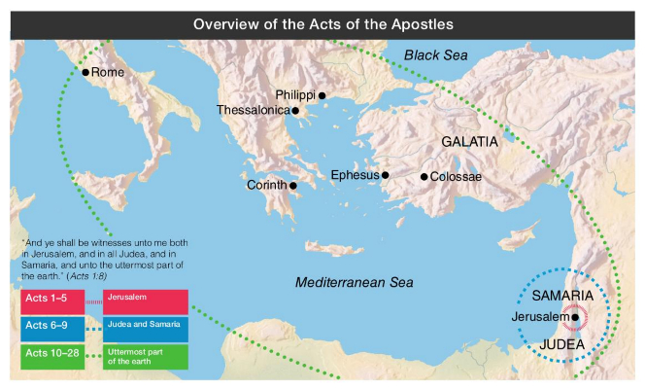
The Gospel Went Forth From Jerusalem
A Silver Lining in the Darkest Storm Clouds
Behold, he that keepeth Israel shall neither slumber nor sleep. Psalm 121:4
Because of this persecution, many of the followers of Jesus Christ traveled beyond Judea for safety, where they continued to preach the gospel and accelerate its expansion.
Acts 8:5
(1)

Slide 32
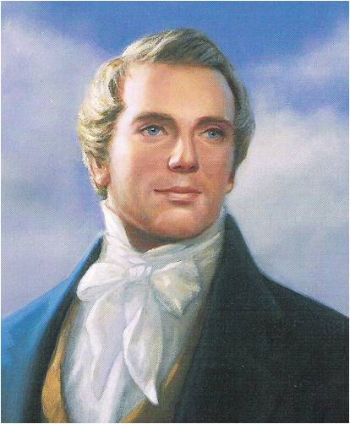
“The Standard of Truth has been erected; no unhallowed hand can stop the work from progressing; persecutions may rage, mobs may combine, armies may assemble, calumny may defame, but the truth of God will go forth boldly, nobly, and independent, till it has penetrated every continent, visited every clime, swept every country, and sounded in every ear, till the purposes of God shall be accomplished, and the Great Jehovah shall say the work is done.”
(3)

Slide 33
Philip
He was one of the “seven chosen” to care for the needs of the widows and perform other works of service
He was visited by an angel
He preached in Samaria, baptized an Ethiopian eunuch, and ended up in Caesarea
He preached, baptized, cast out unclean spirits, and performed other miracles
Philip appears to have ministered as a holder of the Aaronic Priesthood—he had the authority to baptize but did not have the authority to give the gift of the Holy Ghost . Those whom Philip baptized had to wait for the arrival of Peter and John, holders of the Melchizedek Priesthood, to receive the gift of the Holy Ghost. (1)
Had 4 unmarried daughters who had the gift of prophecy (Acts 21:9)
Later Paul stayed with Philip in Caesarea
(2)

Slide 34
Sorcery of Simon
Sorcery = use of power gained from the assistance or control of evil spirits
Simon, a Samaritan sorcerer who had been baptized by Philip, saw Peter and John exercising priesthood authority and supposed that he could purchase this authority.
“We believe that a man must be called of God, by prophecy, and by the laying on of hands by those who are in authority, to preach the Gospel and administer in the ordinances thereof.” (5th Article of Faith)
Acts 8:12-24

Slide 35
Deception
“Simon the sorcerer so convincingly portrayed his satanic powers as divine that many people, 'from the least to the greatest, [said], This man is the great power of God.'
In 1830, Hiram Page, one of the eight witnesses of the Book of Mormon, claimed to receive 'revelations' for the Church from a certain stone he had obtained.
Although these 'revelations' contradicted those Joseph Smith had received from the Lord, his manner of receiving them deceived several members of the Church, including Oliver Cowdery.
The Lord commanded Oliver to tell Brother Page 'that those things which he hath written from that stone are not of me and that Satan deceiveth him.‘
Eight years later, Hiram Page left the Church.
Obviously in these cases, Satan gave men mighty power so similar to that manifested by true servants of God that many were deceived."
Acts 8:10; D&C 28:11
(4)

Slide 36
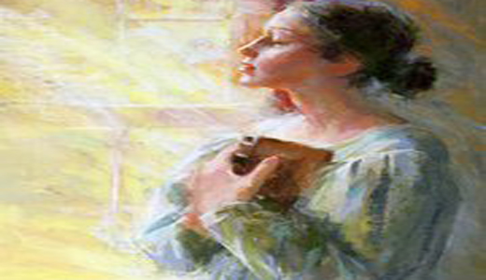
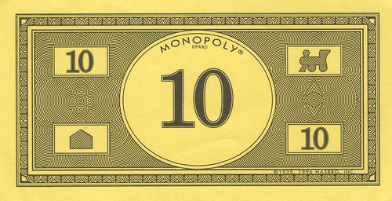
“To avoid being deceived, we must also follow the promptings of that Spirit.
“That which the Spirit testifies unto you even so I would that ye should do in all holiness of heart, walking uprightly before me, considering the end of your salvation, doing all things with prayer and thanksgiving, that ye may not be seduced by evil spirits, or doctrines of devils, or the commandments of men. …
“Wherefore, beware lest ye are deceived; and that ye may not be deceived seek ye earnestly the best gifts, always remembering for what they are given” (D&C 46:7–8).
The Holy Ghost will protect us against being deceived, but to realize that wonderful blessing we must always do the things necessary to retain that Spirit. We must keep the commandments, pray for guidance, and attend church and partake of the sacrament each Sunday. And we must never do anything to drive away that Spirit.
Monopoly is a game of deception, loopholes, and no court hearings. If the other player doesn't know the rules all you need to do is convince them that you are right even though you are lying
(5)

Slide 37
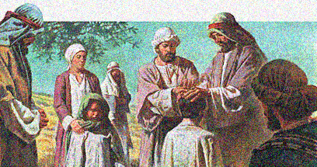
Apostles Hear of Success
Peter and John came to Samaria after hearing that the people there had accepted the word of God.
They prayed that the converted Samaritans would receive the gift of the Holy Ghost.
Acts 8:14-17

Slide 38
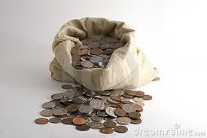
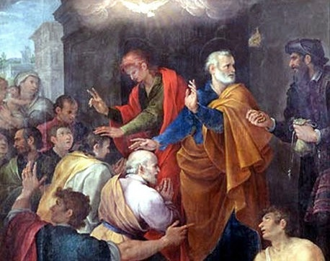
The Sorcerer’s Heart
“…Thy money perish with thee, because thou hast thought that the gift of God may be purchased with money.”
Offers money for the Priesthood
What did Peter teach Simon about the priesthood?
Acts 8:18-20

Slide 39
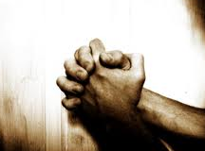
Repentance Of Simon
“…for thy heart is not right in the sight of God.”
Simon:
“…Pray ye to the Lord for me, that none of these things which ye have spoken come upon me.”
Acts 8:21-24

Slide 40
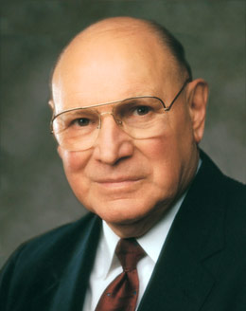
“The gift of the Holy Ghost, which is the right to receive the Holy Ghost as a constant companion, is obtained only upon condition of faith in Christ, repentance, baptism by immersion, and the laying on of hands by authorized servants endowed with the Melchizedek Priesthood.
It is a most precious gift available only to worthy members of the Lord’s Church.”
Acts 8:21-24
(6)

Slide 41
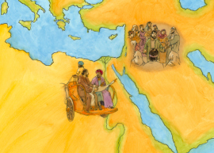
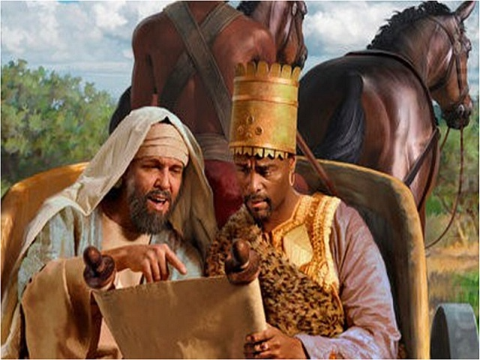
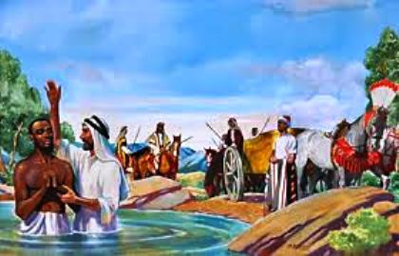
Philip Goes South to Gaza
Man from Ethiopia (an eunuch)
And hears man reading Esaias (Isaiah)
Philip taught about Jesus
and baptized the man from Ethiopia
Philip continued on to preach in all cities
Acts 8:26-40

Slide 42
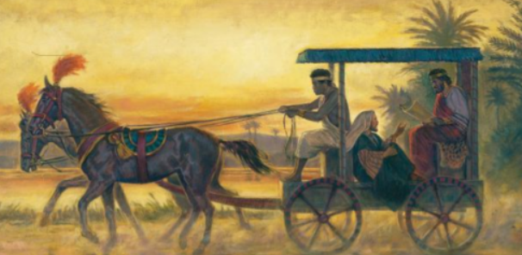
In what ways did the Lord guide Philip? Why is it important to follow the Lord’s promptings as we try to help others come unto Him?
How was Philip able to use his knowledge of the scriptures to teach the Ethiopian about Jesus Christ?
What lessons stand out to you in this account?

Slide 43
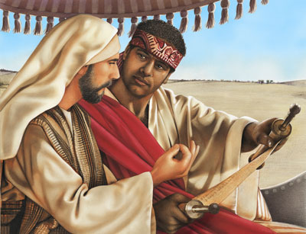
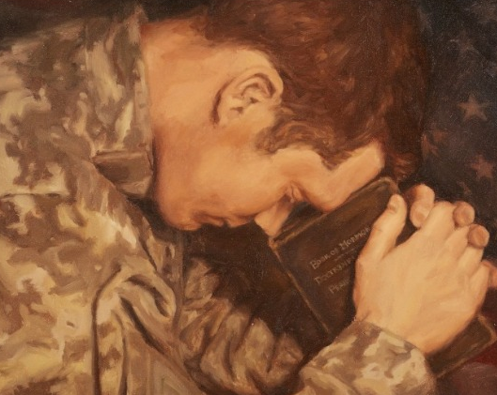
‘No greater responsibility can rest upon any man [or woman] than to be a teacher of God’s children.’
“We are, in fact, all somewhat like the man of Ethiopia to whom Philip was sent. Like him, we may know enough to reach out for religion.
We may invest ourselves in the scriptures.
We may even give up our earthly treasures, but without sufficient instruction we may miss the meaning of all this and the requirements that still lie before us.
So we cry with this man of great authority, ‘How can [we understand,] except some [teacher] should guide [us]?’”
(7)
Kalisha Dawn Harmon, Age: 18, Utah

Slide 44
Sources:
New Testament Institute Student Manual Chapter 31
Who’s Who in the New Testament by Richard J. Allen p. 143-144
Teachings of Presidents of the Church: Joseph Smith [2007], 142.
William E. Berrett, "I Have a Question," Ensign, Oct. 1979, 30
Elder Dallin H. Oaks Be Not Deceived Oct. 2004 Gen. Conf.
Elder Joseph B. Wirthlin (“The Unspeakable Gift,” Ensign or Liahona, May 2003, 26; see also D&C 20:38, 41).
Elder Jeffrey R. Holland (“A Teacher Come from God,” Ensign, May 1998, 25). And quoting David O. McKay [in Conference Report, Oct. 1916, 57
Presentation by ©http://fashionsbylynda.com/blog/

Slide 45
Saul Acts 8:1-4:
"Among the disputants who, when defeated in discussion, conspired against Stephen and brought about his death, were Jews from Cilicia. Associated with them was a young man named Saul, a native of the Cilician city of Tarsus. This man was an able scholar, a forceful controversialist, an ardent defender of what he regarded as the right, and a vigorous assailant of what to him was wrong. Though born in Tarsus he had been brought to Jerusalem in early youth and had there grown up a strict Pharisee and an aggressive supporter of Judaism. He was a student of the law under the tutelage of Gamaliel, one of the most eminent masters of the time; and had the confidence of the high priest. His father, or perhaps an earlier progenitor, had acquired the rank of Roman citizenship, and Saul was a born heir to that distinction. Saul was a violent opponent of the apostles and the Church, and had made himself a party to the death of Stephen by openly consenting thereunto and by holding in personal custody the garments of the false witnesses while they stoned the martyr.“ elder James E. Talmage (Jesus the Christ, 661
One With Authority Acts 8:14-15:
"The laying on of hands is the divinely-authorized method of administering spirit baptism...The laying on of hands for the gift of the Holy Ghost was an ordinance in the Christian church for centuries. The ordinance remained with the church much longer than did the Holy Ghost. Cyprian mentions it in the third century; Augustine in the fourth. Gradually, however, it began to be neglected, until finally some of the sects repudiated it, while others, retaining the 'form of godliness,' denied 'the power thereof.'" Orson F. Whitney (Gospel Themes[Salt Lake City: n.p., 1914], 63.)
Philip eagerly Joins the Others and Preaches the Gospel Acts 8:29-30:
"We can be of so much service to others in many 'thou shalt' ways. Of course, the problem is that rendering such service takes time and we are all so busy. Some situations may call for service that somehow seems to be beneath us. Besides, we have other things to do. The 'thou shalts' are so convenient to put off. Who will notice the procrastination anyway? After all, we are not robbing a bank. Or are there forms of withholding which constitute stealing? (quotes Acts 8:26-21)
"...How many times are we too busy to 'come up and sit' (v. 31) with someone who needs conversation? You and I have divine promptings all the time encouraging us to do good, but we often deflect them instead of doing like Philip, who 'ran thither.'" Elder Neal A. Maxwell ("The Pathway of Discipleship," Ensign, Sept. 1998, 10)
Saul’s part in the Death of Stephen Acts 8:1-4:
The angry mob dropped their cloaks at Saul’s feet. Cursing and yelling, they began to hurl stones at Stephen for preaching about Jesus. The rocks bruised and cut Stephen’s body. Wounded, he knelt on the ground and cried with a loud voice, “Lord, lay not this sin to their charge,” and died.
Saul was unmoved by the innocent man’s dying words of forgiveness. He thought Christians were wicked, and he worked hard to rid the empire of them. He searched the towns and homes, and when he found any men or women who believed in Christ, they were put into prison.
So great was Saul’s vengeance that he went to the high priest and obtained letters to take to the synagogues in Damascus. The letters gave Saul the authority to take prisoner any Christian he found on his journey.
Carrying the letters, Saul started for Damascus, determined to destroy the Christians.
Scriptural Giants: Saul Becomes Paul
By Sherrie Johnson found in Friend (Sept. 1986)
Eunuch:
A class of emasculated men attached to the courts of eastern rulers. They were employed to watch over the harems and also were often given positions as trusted officials. They served as soldiers, guarded the royal harems, and often held trusted positions within the court. Eunuchs are mentioned in 2 Kgs. 20:18; Isa. 39:7; 56:4; Jer. 38:7–13; 41:16; Matt. 19:12; Acts 8:27–38. Bible Dictionary
"Philip-saintly, valiant, a powerful preacher, a mighty worker of miracles-held only the Aaronic Priesthood! Peter and John must yet come from Jerusalem to Samaria to confer the Holy Ghost upon his baptized converts. (Acts 8:14-17.) And yet Philip, magnifying his calling, casts out devils, commands the lame to leap and the sick to rise from their beds of affliction. Miracles are wrought by the power of faith, and a righteous man need not hold the Melchizedek Priesthood to have power and influence with his Creator. As Joseph Smith said, 'If a priest understands his duty, his calling, and ministry, and preaches by the Holy Ghost, his enjoyment is as great as if he were one of the Presidency.‘ Elder Bruce R. McConkie (Teachings, p. 112.)" (Doctrinal New Testament Commentary, 3 vols. [Salt Lake City: Bookcraft, 1965-1973], 2: 81.)

Slide 46
Event | Acts
Kingdom to Be Restored to Israel | 1:1–8
Mount of Olives: Christ Ascends to Heaven | 1:9–14
Jerusalem: Apostles Choose Successor to Judas | 1:15–26
The Holy Ghost and the Day of Pentecost | 2:1–21
Peter Testifies of Jesus’ Resurrection | 2:22–36
How to Gain Salvation | 2:37–40
All Things in Common | 2:41–47
Peter Heals Man Lame from Birth | 3:1–16
Age of Restoration Is Prior to Christ’s Second Coming | 3:17–24
The Children of the Covenant | 3:25, 26
Salvation Comes Only Through Christ | 4:1–12
Sadducees Seek to Silence Apostles | 4:13–22
Saints Glory in Testimony of Jesus | 4:23–31
Saints Practice United Order | 4:32–37
Fate of Deceivers | 5:1–11
Event | Acts
Apostles Continue Miracles of Jesus | 5:12–16
Angels Deliver Apostles from Prison | 5:17–26
Apostles Testify of Christ | 5:27–32
Persecution Is Not of God | 5:33–42
Seven Chosen to Assist Apostles | 6:1–6
Stephen Transfigured Before the Sanhedrin | 6:7–15
Stephen Preaches about Israel | 7:1–36
Moses—A Prototype of Christ | 7:37–40
Stephen Testifies of Apostasy in Israel | 7:41–53
Stephen Sees the Father and the Son | 7:54–60; 8:1
Saul Persecutes the Church | 8:1–4
Samaria: Philip Works Miracles, Converts Simon | 8:5–13
Apostles Confer Gift of the Holy Ghost | 8:14–17
Simon Seeks to Buy Gift of the Holy Ghost | 8:18–25
Toward Gaza: Philip Preaches Christ, Baptizes Eunuch | 8:26–40
The Acts of The Apostles, Written by Luke to Theophilus, 61-63 AD
The Events That Occurred 33-36 AD (1-8)
Life and Times of Jesus Christ Section 7 Chapter 29

Slide 48
A Chosen Vessel
Acts 9
Go thy way: for he is a chosen vessel unto me, to bear my name before the Gentiles, and kings, and the children of Israel
Acts 9:15

Slide 50
Saul—Paul (Latin)
He was born in 1-3 AD, the son of Tarsus, and born a free Roman citizen
He was brought up a Jew and trained as a Pharisee under the study of Gamaliel in Jerusalem
He was from the Tribe of Benjamin (Philemon 3:5)
His father was a tentmaker, so more than likely he was too
He was a persecutor of the Saints, took part in the martyrdom of Stephen, then on his way to Damascus was visited by the Lord Jesus and was ‘reborn’
He lived in Arabia for 3 years and came back to begin his mission for the Savior
He traveled to the east and north of the Mediterranean and wrote many letters (Epistles) to specific cities
He died after his 5th missionary journey in 65-68 AD-- tradition says he was beheaded in Rome by emperor Nero (The New Testament does not say when and how he died)
2,3,4

Slide 51
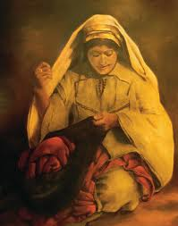
Other family members of Saul
Saul had a sister, and her son saves the Apostle’s life.
Acts 23:16

Slide 52
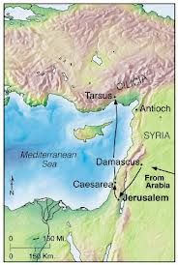
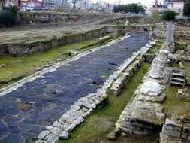
Tarsus
Capital of Cilicia
One of 3 greatest centers of learning during Saul’s days.

Slide 53
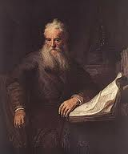
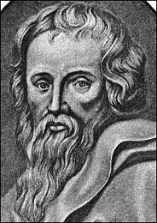
Training and Education of Saul
Learned in the Sacred Law
Jewish upbringing with Greek influence. Hebrew tongue (Aramaic), and Greek
Taught by Gamaliel…a celebrated Jewish teacher
It was an honor to study in the “Beth Hammidrash” or “House of Interpretation”
(3)

Slide 54
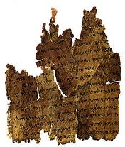
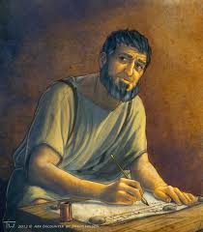
Studies
Halachah---Precepts of the law---legal code
Haggada---historical events of the scriptures, using parables and allegories
Possibly trained as a Rabbi
(3)

Slide 55
Meeting Saul---Luke Records
The young man present at the stoning of Stephen
“…and a witnesses laid down their clothes at a young man’s feet, whose name was Saul.”
Acts 7:58

Slide 56
Persecution of the Church Members
“And Saul was consenting unto his (Stephen’s) death.”
“As for Saul, he made havock of the church, entering into every house, and haling men and women committed them to prison.”
Acts 8:1-4

Slide 57
Confession of Saul
“…and many of the saints did I shut up in prison, having received authority from the chief priests; and when they were put to death, I gave my voice against them.”
“And I punished them oft in every synagogue…I persecuted them even unto strange cities.”
Acts 26:10-11

Slide 58
On the Road to Damascus
Light from Heaven
Falls to the earth
“…Saul, Saul, why persecutest thou me?”
Acts 9:3-4

Slide 59
Are we waiting on the road to Damascus?
“…They stand at the waters of baptism but do not enter.
They wait at the threshold of testimony but cannot bring themselves to acknowledge the truth.
Instead of taking small steps of faith on the path of discipleship, they want some dramatic event to compel them to believe.”
(5)

Slide 60
Damascus
Present Day capital of Syria
A Roman Province of Syria in days of Apostles
Terminating points for trade in the Near East
By prophecy (Isaiah) it was destroyed and then rebuilt
Present day…Christian quarter located on street named “Straight”
Northeast of Damascus
(6)

Slide 61
Damascus--City
Street bazaars
Damascus Steel
Famous treasured cloth “damask”
City wall surrounding City where Paul escapes in a basket (Acts 9:23-25)
Saul was on his way to Damascus to persecute the saints
(6)

Slide 62
Who Art Thou, Lord?
“And the Lord said, I am Jesus whom thou persecutest…
Acts 9:5

Slide 63
Kick against the pricks
During the time of Jesus, many people were farmers and used oxen to till the soil. A prick, or goad, was a pointed shaft sharpened to a point on one end, much like a metalwork prick. This was held up to an ox by the driver in such a way that if the ox turned in the wrong direction, it would get pricked. Sometimes an ox would attempt to kick the irritant away, which would only drive it in deeper.
“Goud”
A sharp spear used to prick the hides of animals to make them move ahead
The tendency when kicked is to “Kick back”, to retaliate
Acts 9:5
(6)

Slide 64
What wilt thou have me to do?
“…Arise, and go into the city, and it shall be told thee what thou must do.”
Men with him are speechless
Acts 9:6

Slide 65
Ananias a Disciple
Has a vision
“Behold, I am here, Lord.”
“…Go into the street which is called Straight, and enquire in the house of Judas for one called Saul…”
Acts 9:10-11

Slide 66
A Chosen Vessel
Ananias has heard about the persecution by this man, Saul
“…Go thy way; for he is a chosen vessel unto me, to bear my name before the Gentiles, and kings, and the children of Israel:”
Acts 9:13-15

Slide 67
Saul’s Companions
In this account, we are told that Paul's associates heard the voice of Jesus.
However, a later account of Paul's conversion conflicts with this version. Paul stated that they 'saw indeed the light, and were afraid; but they heard not the voice of him that spake to me‘.
…surely the voice and message of the Lord was for Paul alone, although his companions in travel might be permitted to see the light and thereby be assured of the unusual event that was taking place."
Acts 9:9; Acts 22:9
(7)

Slide 68
Saul is Blinded—3 Days
We are taught by latter-day scriptures that the impure cannot withstand the presence of God.
Moses declared, 'mine own eyes have beheld God; but not my natural, but my spiritual eyes, for my natural eyes could not have beheld; for I should have withered and died in his presence' (Moses 1:11).
Furthermore, the scriptures declare that the priesthood is necessary in order for a man to see God the Father.
Yet remarkably, Saul was allowed to see the Son without being destroyed-even though his actions had been wicked and he held no priesthood.
But Saul could not withstand the presence of the Son unscathed-there had to be an effect upon his physical body.
Acts 9:9; D&C 84:21-22
(9)

Slide 69
Using Priesthood Authority
“…Brother Saul, the Lord, even Jesus, that appeared unto thee in the way as thou camest, hath sent me, that thou mightest receive thy sight, and be filled with the Holy Ghost.”
Acts 9:12

Slide 70
Sight Restored
“And immediately there fell from his eyes as it had been scales…
“and he received sight forthwith, and arose, and was baptized.”
Acts 9:18

Slide 71
“When the Savior was to choose a missionary of zeal and power, He found him not among His advocates but amidst His adversaries.
The experience of Damascus’s way changed Saul.
Of him the Lord declared, ‘He is a chosen vessel unto me, to bear my name before the Gentiles, and kings, and the children of Israel.
Saul the persecutor became Paul the proselyter.”
(8)

Slide 72
Saul Leaves For Arabia
We learn in Galatians that after Saul’s conversion he left Damascus and journeyed to Arabia.
It is not recorded why Saul went there, but he may have gone for study and reflection.
or he may have fled there for safety
He sojourned in Arabia for as long as three years. While there, Saul likely deepened his understanding of how Jesus Christ fulfilled many Old Testament prophecies. After his time in Arabia, he returned to Damascus for a short period of time before journeying to Jerusalem to see Peter and other Church leaders.
Galatians 1:17; Acts 9:23-25
(1)

Slide 73
Barnabas—Tribe of Levi
He sold property to the church.
He welcomed Paul, the former persecutor of the Saints.
He was sent to Antioch
Church leaders in Jerusalem sent him to minister in Antioch (in Syria) because a large number of people there had been converted to the gospel.
These conversions occurred because Church members who were persecuted in Jerusalem after Stephen’s death fled to Antioch and preached there.
* Note that Acts includes references to two different Antiochs—Antioch in Syria and Antioch in Pisidia. Both Antiochs lie within present-day Turkey.
Acts 9:26–31; 11:22–30
(1)

Slide 74
Barnabas Seeks Saul
From Antioch, Barnabas traveled to Tarsus to seek Saul, for Saul had fled there to escape persecution in Jerusalem, and the two men returned to Antioch to teach the gospel.
They were chosen to take donations from the Saints in Antioch to members of the Church in Judea, who were suffering during a famine.
Barnabas later became Saul’s missionary companion during his first mission.
Acts 9:26–31; 11:22–30
(1)

Slide 75
Peter Heals
While ministering in Lydda and Joppa, Peter healed Aeneas and Tabitha (also called Dorcas)
Luke’s care in recording these similar events reflects one of his purposes: to affirm continuity between Jesus Christ and the Church and show a continuation of Jesus Christ’s power and authority in Peter.
The raising of Tabitha parallels the Savior’s raising of Jairus’s daughter
Sandra F. Gagon
Giclee
Acts 9:32-43
(1)

Slide 76
Tabitha’s “good works and almsdeeds” likely included the sewing of clothing for the poor.
“To me the scriptural reference to Tabitha, which describes her as a woman ‘full of good works and almsdeeds,’ defines some of the fundamental responsibilities of Relief Society; namely, the relief of suffering, the caring for the poor, and all which that implies.”
Caroline Augusta Lord
Acts 9:32-43
(8)

Slide 77
Acts 8-11 Events
Acts 8:5-25
Acts 9:30
Acts 8:28-38
Acts 10:9-18
Acts 8:1-3;
Acts 9:1-2
Acts 10:24-33
Acts 9:3-19
Acts 11
Galatians 1:17
Acts 11:19

Slide 78
Sources:
New Testament Institute Student Manual Chapter 31
Who’s Who in the New Testament by Richard J. Allen pp. 134-136
Paul’s Life and Letters by Dr. Sidney B. Sperry
Bible Dictionary
Dieter F. Uchtdorf “Waiting on the Road to Damascus” April 2011 General Conference
The Life and Teachings of Jesus and his Apostles pg. 246-247, 256-258
Robert J. Matthews, Joseph Smith Memorial Sermons, p. 10
8. President Thomas S. Monson (“Choose You This Day,” Ensign or Liahona, Nov. 2004, 69). ” (“Be Thou an Example,” Ensign, Nov. 2001, 99).
9. Gospeldoctrine.com
Presentation by ©http://fashionsbylynda.com/blog/

Slide 79
CHRONOLOGY OF EVENTS IN PAUL’S LIFE AND MINISTRY
About A.D. 1–3 | Born in Tarsus of the tribe of Benjamin—a Pharisee and a Roman citizen by birth | Acts 9:11; 22:3, 27–28; Philippians 3:5
About A.D.19–29 | Taught by Gamaliel in Jerusalem | Acts 22:3
A.D. 33 | Witnessed the martyrdom of Stephen and persecuted Christians in the Jerusalem area | Acts 7:54–8:4; Philippians 3:6
A.D. 33 | On the road to Damascus, saw a vision of Jesus Christ, was converted, and preached of Christ in Damascus | Acts 9:1–25
A.D.33–35 | Fled Damascus to Arabia | Galatians 1:17
A.D. 35 | Returned to Damascus and briefly preached the gospel | Galatians 1:17
A.D. 35 | After three years visited Jerusalem and spoke with Peter and James, the Lord’s brother | Acts 9:26–29; Galatians 1:18–19
A.D.35–49 | Spent 14 years in Syria-Cilicia (part of that time on his mission with Barnabas). Tarsus, Paul’s hometown, was located in Cilicia. | Acts 9:30; 11:19–26; Galatians 2:1, 21
A.D.46–49 | First missionary journey (with Barnabas) | Acts 13:1–14:28
A.D. 49 | Attended the Jerusalem Conference | Acts 15:12; Galatians 2:1–2
A.D.49–53 | Second missionary journey | Acts 15:36–18:20
A.D. 53 | Visited Jerusalem | Acts 18:21–22
About A.D.54–58 | Third and final mission | Acts 18:23; 19:1–20:38
About A.D. 58 | Farewell visit to Greece; traveled to Jerusalem to deliver offerings for the poor | Acts 21:1–16
Spring A.D. 58 | Reported to presiding Brethren in Jerusalem, had misunderstandings at the temple, and was arrested | Acts 21:17–23:22
Spring A.D.58–60 | Imprisoned in Caesarea | Acts 23:23–26:3
Fall A.D.60–Spring A.D. 61 | While under arrest, traveled by sea to Rome. Shipwrecked and spent winter months on the island of Melita (Malta) just south of Sicily. | Acts 27:1–28:1
About A.D.61–63 | Under house arrest in Rome | Acts 28:16–3
A.D.63–66 | Possible ministry in Rome and other locations in Italy | Acts 28:30–3
 | Second Imprisonment in Rome
About A.D. 68 | Died
New Testament Institute Manual Chapter 31

Slide 80
Damascus:
"Claiming to be the world's oldest city having continuous habitation, Damascus, present-day capital of Syria, was also in the Roman province of Syria in the days of the apostles. Situated some 130 miles northeast of Jerusalem and approximately 65 miles from the Mediterranean Sea, Damascus lies in the heart of a fertile plain.
"The supremacy of Damascus among ancient cities is clearly found in the fact of its location. It was the terminus point for three principal trade routes of the ancient Near East. Its close proximity to Jerusalem made Damascus a city of great importance to ancient Israel and Judah." (The Life and Teachings of Jesus & His Apostles, (1979 Institute Manual), p. 257)
The Roman ruins in the desert oasis of Palmyra to the towering Crusader castle known as the Crac des Chevaliers near the Mediterranean coast. The nation's capital, Damascus, is also one of the oldest continually inhabited cities in the world.
An enemy to the Church:
“Saul was foreordained; nothing he had done on earth qualified him for what was ahead; but his native spiritual endowment, nurtured and earned in pre-existence, prepared him for the coming ministry.” Elder Bruce R. McConkie (Doctrinal New Testament Commentary, 2:91).
The Chosen Vessel Acts 9:15:
"It is given to but few to wield a more powerful influence over Christian history than to Saul of Tarsus, the persecutor who became a prophet, the Pharisee who became the apostle to the Gentiles. The life and teachings of the Apostle Paul stand as bright reminders of the power of Christ to transform the souls of men and women, to remake the human heart, and to refocus one's misdirected zeal into the way of the Master. When the risen Lord appeared in vision to Ananias of Damascus and instructed him to send for the stricken and blinded Saul, Ananias answered: 'Lord, I have heard by many of this man, how much evil he hath done to thy saints at Jerusalem: and here he hath authority from the chief priests to bind all that call on thy name.' The response that followed bespeaks the Redeemer's insight into the wonders that would be done at Paul's hand: 'Go thy way: for he is a chosen vessel unto me, to bear my name before the Gentiles, and kings, and the children of Israel' (Acts 9:11-15; emphasis added)....[Paul] taught with a power, a persuasion, and a holy zeal known only to those who, like Alma and the sons of Mosiah, have gone from darkness to light and whose whole soul yearns to lead others to that same light." (Selected Writings of Robert L. Millet: Gospel Scholars Series, p. 69.)
“Kick Against the Pricks” Acts 9:5:
We must remember that the King James Version of the Bible was written in 17th century English. Hence, the meaning of certain phrases requires some explanation. 'To kick against the pricks' is an expression meaning to persecute the Church (see DC 121:38). That it was 'hard for [Saul]' doesn't mean that he lacked the tendency or the natural ability, but that his efforts were hard on him in ways he did not yet understand. In essence, Saul's efforts were destroying himself more than they were destroying the Church.
' . . Those who kick at the goad, that stifle and smother the convictions of conscience, that rebel against God's truths laws, that quarrel with His providences, that persecute and oppose His ministers, because they reprove them . . . and fly in the face of their reprovers, they kick against the pricks, and will have a great deal to answer for.' (Commentaries by Henry M. Scott.)
"A goad is defined as a spear or a sharp pointed stick used to sting or prig. The burro who kicks the sharp instrument with which he is being prodded is kicking at the pricks. His retaliation does little damage to the sharp stick or to him who wields it but brings distress to the foot that kicks it.
"I well remember in my youth a neighbor who moved about some days on crutches. He was evasive when asked the cause of his misfortune, but an ear witness told me, as he chuckled: 'John stubbed his toe on a chair in the night and in his quick, fierce anger, he kicked the chair and broke his toe.' The rocking chair rocked on and on, and perhaps smiled at the stupidity of man.“ Spencer W. Kimball (Conference Report, April 1955, p. 94.)
"In this figure of speech is captured the essence of rebellion against God; we can only hurt ourselves. If one is pricked by a goad and angered by the pain, he may foolishly strike out at the source of irritation, only to suffer even more." (Faith Precedes the Miracle, p. 305.)
Saul's’ Physical Appearance by Joseph Smith:
“[Paul] is about five feet high; very dark hair; dark complexion; dark skin; large Roman nose; sharp face; small black eyes, penetrating as eternity; round shoulders; a whining voice, except when elevated, and then it almost resembles the roaring of a lion. He was a good orator” (in “Extracts from William Clayton’s Private Book,” p. 4, Journals of L. John Nuttall, 1857–1904, L. Tom Perry Special Collections, Brigham Young University; copy in Church History Library, Salt Lake City).

