Slide 1
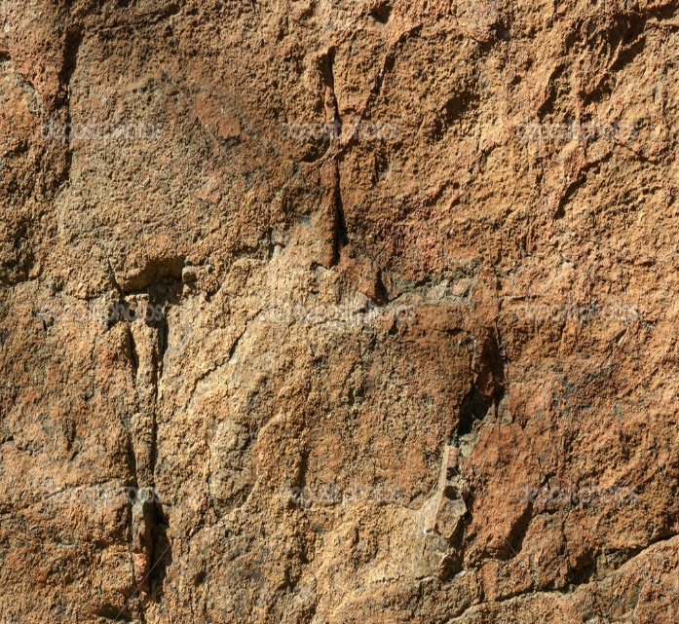
Ephesians 2-6

Slide 2
Saved By Grace
Ephesians 2-3
Behold, how good and how pleasant it is for brethren to dwell together in unity!
Psalm 133:1

Slide 3
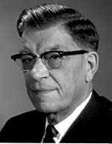
Prince of Power of the Air
The Spirit that works in the children of disobedience
Half truths
Complete Lies
The Work of the Adversary
Persuasion
Wherefore, he maketh war with the saints of God, and encompasseth them round about. D&C 76:29
The Adversary Makes War
Subtle Deceit
Enticing
Fear
Force
Eat, drink, and be merry; nevertheless, fear God—he will justify in committing a little sin; yea, lie a little, take the advantage of one because of his words, dig a pit for thy neighbor; there is no harm in this; and do all these things, for tomorrow we die; and if it so be that we are guilty, God will beat us with a few stripes, and at last we shall be saved in the kingdom of God. 2 Nephi 28:8
Ephesians 2:1-3
(3)

Slide 4
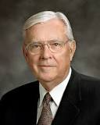
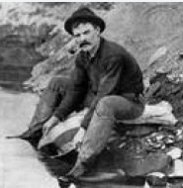
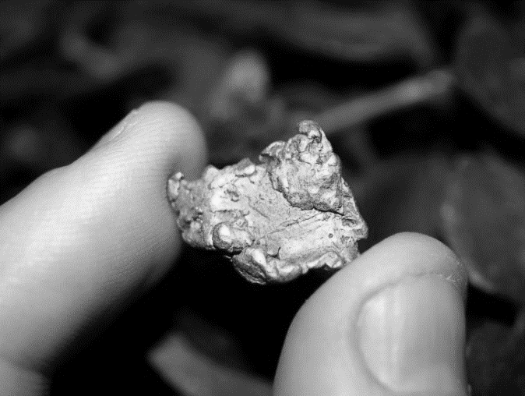
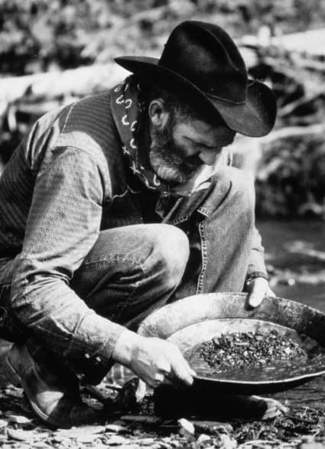
Flecks of Gold
Oftentimes we are like the young merchant from Boston, who in 1849, as the story goes, was caught up in the fervor of the California gold rush.
He sold all of his possessions to seek his fortune in the California rivers, which he was told were filled with gold nuggets so big that one could hardly carry them.
Day after endless day, the young man dipped his pan into the river and came up empty.
His only reward was a growing pile of rocks. Discouraged and broke, he was ready to quit until one day an old, experienced prospector said to him, “That’s quite a pile of rocks you are getting there, my boy.”
The young man replied, “There’s no gold here. I’m going back home.”

Slide 5
Walking over to the pile of rocks, the old prospector said, “Oh, there is gold all right. You just have to know where to find it.”
He picked two rocks up in his hands and crashed them together.
One of the rocks split open, revealing several flecks of gold sparkling in the sunlight.
Noticing a bulging leather pouch fastened to the prospector’s waist, the young man said, “I’m looking for nuggets like the ones in your pouch, not just tiny flecks.”
The old prospector extended his pouch toward the young man, who looked inside, expecting to see several large nuggets. He was stunned to see that the pouch was filled with thousands of flecks of gold.
The old prospector said, “Son, it seems to me you are so busy looking for large nuggets that you’re missing filling your pouch with these precious flecks of gold. The patient accumulation of these little flecks has brought me great wealth.”
(10)
Ephesians 2:4-5

Slide 6
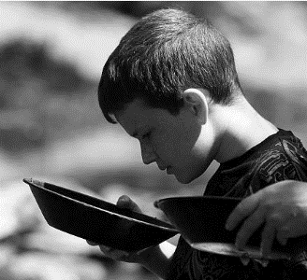
Finding Truth in the Scriptures
Some truths in the scriptures are more difficult to find than others.
Look for words, phrases, or verses that seem especially important. Consider marking them in your scriptures.
Summarize the main idea of these words, phrases, or verses.
Form what you learned into a statement of truth that you can apply in your life.
Ephesians 2:4-5

Slide 7
Heavenly Places
Quickened = made alive
Heavenly places = to realms in heaven that people inherit
After Conversion:
The Lord had quickened them, or made them alive, from their spiritually dead and sinful state
As we exercise faith in Jesus Christ, we are saved by His grace
James C. Christensen
Grace = help or strength, given through the bounteous mercy and love of Jesus Christ.
Ephesians 2:6
(3)

Slide 8
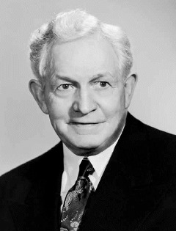
Not By Works Alone
“‘He who would ascend the stairway leading upward to eternal life must tread it step by step from the base stone to the summit of its flight.
Not a single stair can be missed, not one duty neglected, if the climber would avoid danger and delay and arrive with all safety and expedition at the topmost landing of the celestial exaltation.’
The responsibility is upon each individual to choose the path of righteousness, of faithfulness and duty to fellow men.
If he choose otherwise and as a result meets failure, misery, and death, he alone is to blame.”
Ephesians 2:8-10
(5)

Slide 9
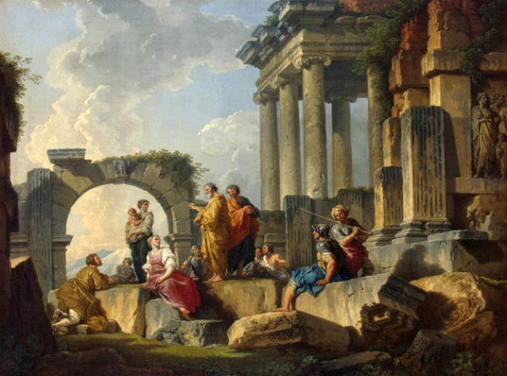
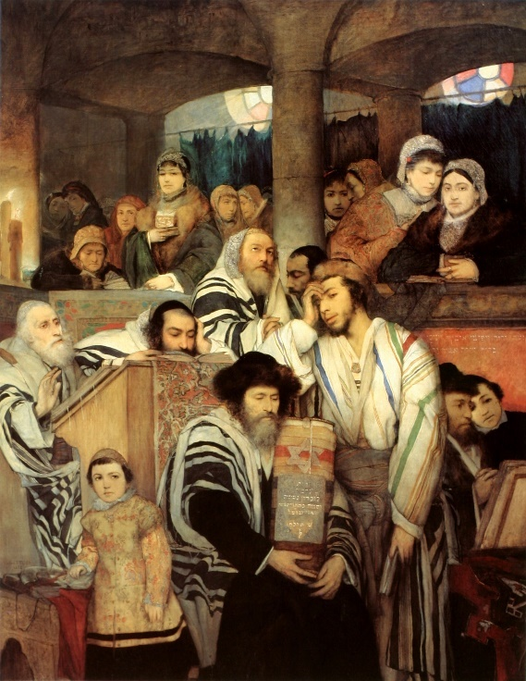
Jews VS Gentiles
Is one group more favored than another?
Some Jews believed that because they were Israelites by birth and had been circumcised, they were more favored by God and superior to Gentile converts
Gentiles who accepted the gospel were no longer to be regarded as aliens, strangers, and foreigners—they were now of “the household of God,” part of God’s covenant people. (1)
Ephesians 2:12-18

Slide 10
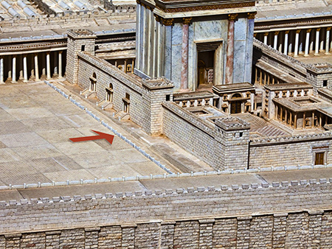
Middle Wall Partition
In the great temple of Jerusalem, the temple proper was shielded from gentile influences.
A special barrier was erected, and if a gentile passed beyond it, he could be put to death.
Archaeologists have even found one of the marble blocks of this barrier with this inscription: “let no foreigner enter within the screen and enclosure surrounding the sanctuary. Whosoever is taken so doing will be the cause that death overtaketh him.”
It will be remembered that it was the accusation that Paul had ignored this warning and brought gentiles beyond the barrier that led to the riot and his arrest (Acts 21:28).
Ephesians 2:14
(2)

Slide 11
Unified
"To be a fellowcitizen with the Saints has great meaning. All can receive that citizenship through the ordinance of baptism, if they will repent and prepare themselves. Then, as members of The Church of Jesus Christ of Latter-day Saints, they never need be alone.
"In this church the individual is regarded as a son or daughter of God. Family members are taught to sustain one another.
In such families there is some fulfillment of the statement, 'The Saints securely dwell.' Then the family structure is marvelously fitted into the setting of Church organization."
Ephesians 2:15
(6)

Slide 12
Access to God
By accepting the gospel of Jesus Christ through faith, repentance, baptism, and the gift of the Holy Ghost, both Jewish and Gentile members of the Church had access to God. (1)
In modern times, we enjoy the same blessings when we are baptized and live worthily.
The “walls” between us and the Lord are removed, and we gain full access to God’s blessings. We also become members of “the household of God”.
This painting depicts a man being baptized in the Dnieper River near Kyiv, Ukraine
Ephesians 2:20

Slide 13
Building a Foundation
Cornerstone = A large stone laid at the corner of a foundation to give strength and stability to the entire structure.
“The apostolic and prophetic foundation of the Church was to bless in all times, but especially in times of adversity or danger, times when we might feel like children, confused or disoriented, perhaps a little fearful, times in which the devious hand of men or the maliciousness of the devil would attempt to unsettle or mislead. …
In New Testament times, in Book of Mormon times, and in modern times these officers form the foundation stones of the true Church, positioned around and gaining their strength from the chief cornerstone, ‘the rock of our Redeemer, who is [Jesus] Christ, the Son of God’
Jesus Christ is the Chief cornerstone
… Such a foundation in Christ was and is always to be a protection in days ‘when the devil shall send forth his mighty winds, yea, his shafts in the whirlwind, yea, when all his hail and his mighty storm shall beat upon you.’”
Ephesians 2:20
(7)

Slide 14
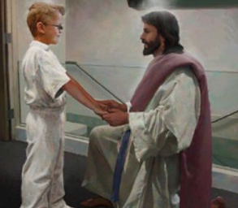
The Mysteries of God
Mystery = a sacred truth made known by revelation.
The mystery Paul wrote about is that both Jews and Gentiles can become heirs of the gospel covenant through Christ. This was a doctrine that “in other ages was not made known unto the sons of men”
Paul taught that all those who follow Christ take upon themselves His name and become His seed and “heirs of the kingdom of God.”
Doc Christensen
His prayer for the Ephesian Saints was that Christ would “dwell in [their] hearts by faith” and that they would come to know the love of Christ.
Ephesians 3:3-6; 17
(1)

Slide 15
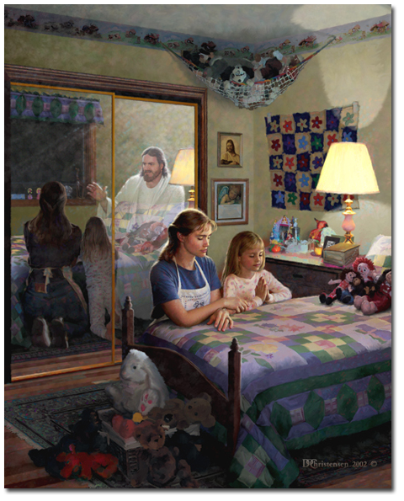
Seeking God’s Help
Paul taught that through Jesus Christ and our faith in Him, we can “have boldness and access [to God] with confidence.”
The word “boldness” can be understood as confidence in the presence of God.
Because of the Savior, in this life we can freely approach God the Father through prayer in the name of Jesus Christ, and in the next life we can enter God’s presence with confidence.
Doc Christensen
Ephesians 3:11-12
(1)

Slide 16
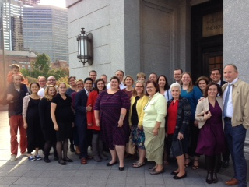
The Whole Family
"So we see that there is a family organization in heaven, and part of it on earth, but in both places it is named after God the Father of Jesus Christ. And why not, since those in heaven and all on earth who have made the covenant are his heirs?" (8)
"...people are more important than organizations. We are trying to teach principles and guidelines more than programs as we seek to strengthen the inner person with the Spirit of God. Our effectiveness can be judged best by the way that inner strength is translated into action. What our religion really is can best be judged by our lives. (9)
West Chester Ward Family
Ephesians 3:15
(1)

Slide 17
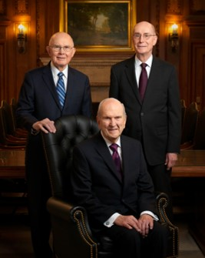
The First Presidency
The First Presidency is the highest governing body of the Church. Its members are special witnesses of the name of Jesus Christ, called to teach and testify of Him throughout the world. Members of the First Presidency travel around the world to speak to members and local leaders; when not traveling, they counsel together and with other general Church leaders on matters affecting the worldwide Church, such as missionary work, temple building and spiritual and temporal welfare.
The current First Presidency is:
President Russel M. Nelson (President)
President Dallin H. Oaks (First Counselor)
President Henry B. Eyring (Second Counselor)
2019

Slide 18
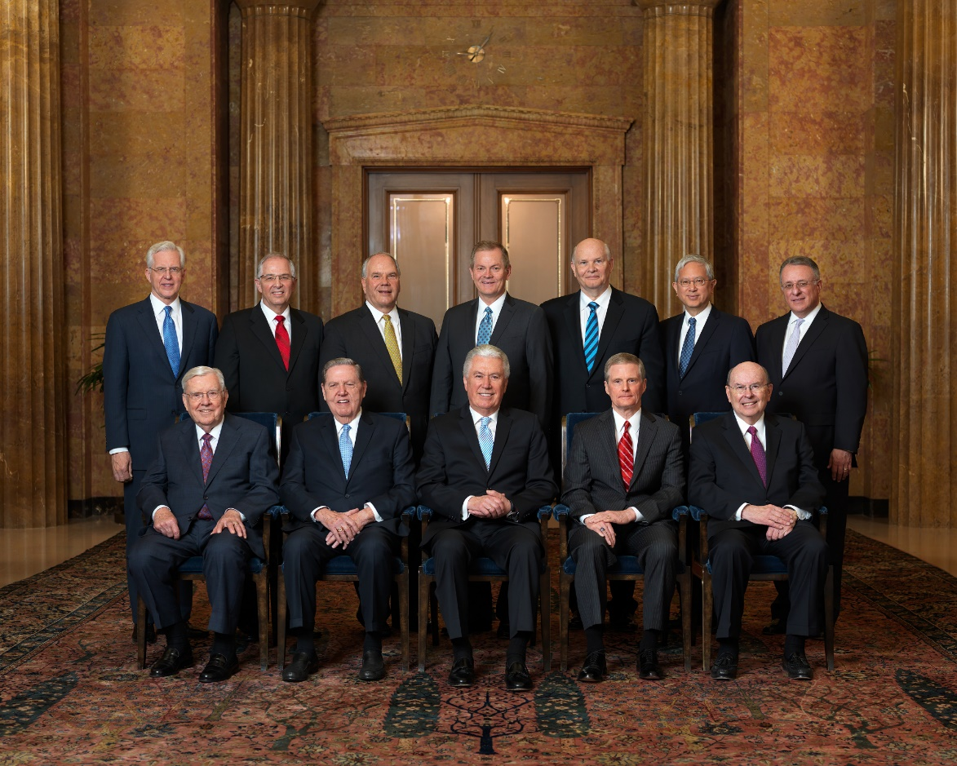
Quorum of the Twelve Apostles
The Quorum of the Twelve Apostles is the second-highest presiding body in the government of the Church. Its members travel the world as special witnesses of the name of Christ and serve under the direction of the First Presidency.
The current Quorum of the Twelve Apostles is:
President M. Russell Ballard
Elder Robert D. Hales
Elder Jeffrey R. Holland
Elder Dieter F. Uchtdorf
Elder David A. Bednar
Elder Quentin L. Cook
Elder D. Todd Christofferson
Elder Neil L. Andersen
Elder Ronald A. Rasband
Elder Gary E. Stevenson
Elder Dale G. Renlund
Elder Gerrit W. Gong
Elder Ulisses Soares
2022

Slide 19
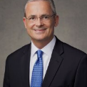
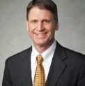
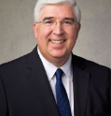
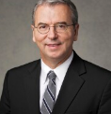
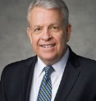
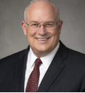
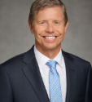
Presidency of the Seventy
The Presidency of the Seventy consists of seven General Authority Seventies who are called by the First Presidency and given authority to preside over the various Quorums of the Seventy.
The current Presidency of the Seventy is:
Elder Patrick Kearon
Elder Carl B. Cook
Elder Jose Teixeira
Elder Carlos A. Godoy
Elder Brent H. Neilson
Elder Paul V. Johnson
Elder S. Mark Palmer
2022

Slide 20
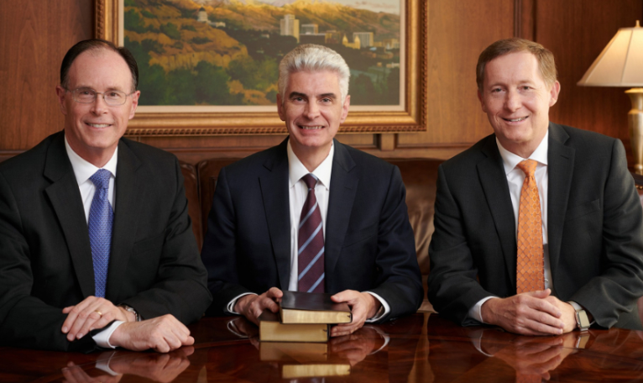
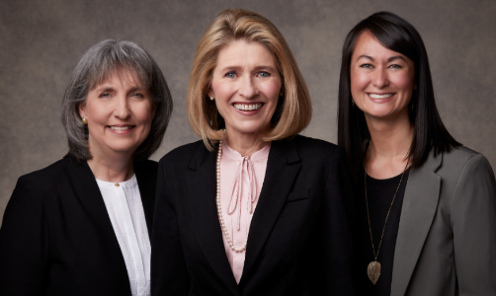
Under the direction of the First Presidency, the Relief Society presidency oversees the activities of all Mormon women ages 18 and over. These leaders travel frequently to help guide and support the women of the Church. The Relief Society is one of the oldest and largest women’s organizations in the world.
The current Relief Society general presidency is:
Sister Camille N. Johnson (President)
Sister Anette Dennis (First Counselor)
Sister Kristin M. Lee(Second Counselor)
2022
The Presiding Bishopric consists of the Presiding Bishop and his two counselors. Each holds the office of bishop, and they serve under the direct supervision of the First Presidency. The Presiding Bishopric is responsible for many of the Church’s temporal affairs. (2020)
The current Presiding Bishopric is:
Bishop Gérald Caussé (Bishop)
Bishop W. Christopher Waddell (First Counselor)
Bishop L. Todd Budge (Second Counselor)

Slide 21
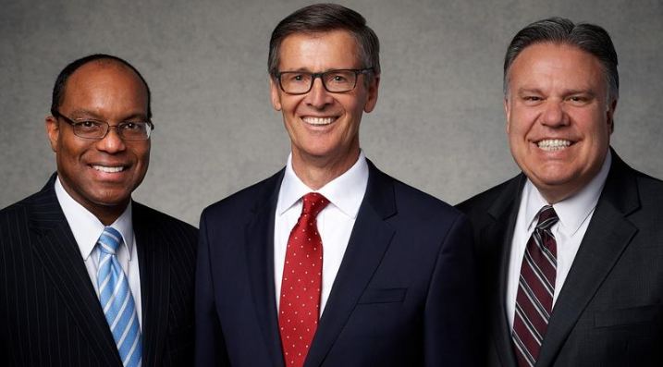
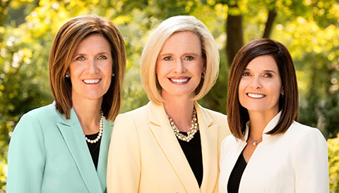
The Young Women presidency provides instruction, encouragement and support in living the gospel of Jesus Christ for female Church members ages 12 through 17. These leaders serve under the direction of the First Presidency and travel frequently to help guide and support the young women of the Church. (2022)
The current Young Women general presidency is:
Sister Bonnie H. Cordon (President)
Sister Michelle D. Craig (First Counselor)
Sister Becky Craven (Second Counselor)
The Young Men presidency provides instruction, encouragement and support in living the gospel of Jesus Christ for male Church members ages 12 through 18. These leaders serve under the direction of the First Presidency and travel frequently to help guide and support the young men of the Church. (2022)
The current Young Men general presidency is:
Brother Steven J. Lund (President)
Brother Ahmad Corbitt (First Counselor)
Brother Bradley R. Wilcox (Second Counselor

Slide 22
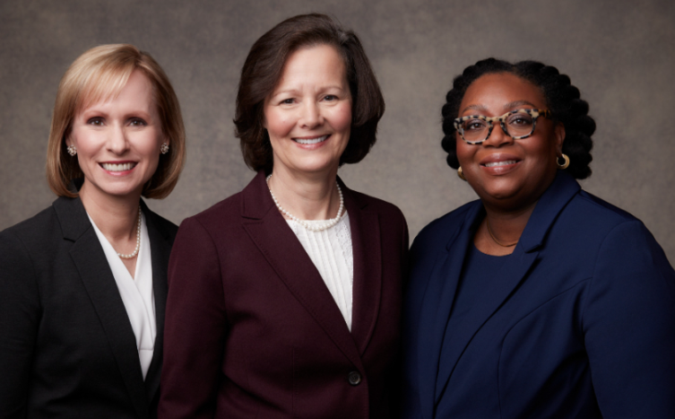
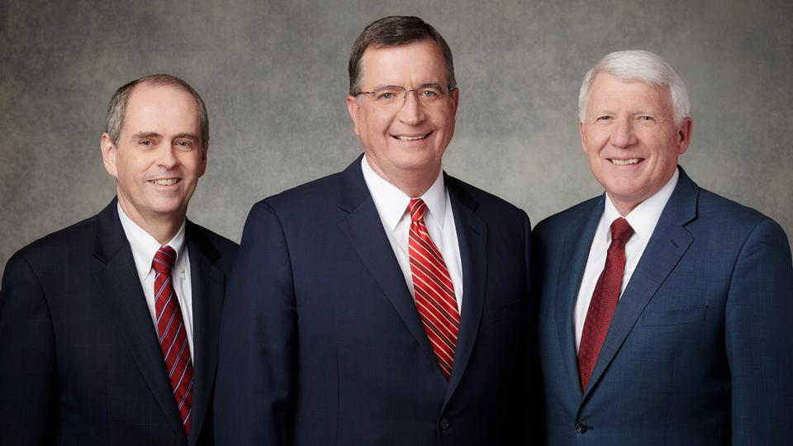
The current general president of the Sunday School Presidency is: (2022)
Brother Mark L. Pace (President)
Brother Milton Camargo (First Counselor)
Brother Jan E. Newman (Second Counselor)
The Primary presidency oversees the Church’s organization that teaches children ages 18 months to 11 years the gospel of Jesus Christ and helps them live its principles. These leaders serve under the direction of the First Presidency and travel frequently to help guide and support the children and their local leaders. (2022)
The current Primary general presidency is:
Sister Sharon H. Porter (President)
Sister Amy Wright (First Counselor)
Sister Tracy Y. Browning (Second Counselor)

Slide 23
The Lord has called apostles, prophets, and other Church leaders to help perfect the Saints and protect them from false doctrine.

Slide 24
Doctrinal Mastery
Ephesians 2:19-20
Now therefore ye are no more strangers and foreigners, but fellow citizens with the saints, and of the household of God;
And are built upon the foundation of the apostles and prophets, Jesus Christ himself being the chief corner stone;

Slide 25
Sources:
New Testament Institute Student Manual Chapter 44
Life and Teachings of Jesus Christ and His Apostles Chapter 43
Elder ElRay L. Christiansen The Adversary Sept. 1975 New Era
Bible Dictionary
David O. McKay in CR, Apr. 1957, p. 7
Elder Boyd K. Packer (Let Not Your Heart Be Troubled [Salt Lake City: Bookcraft, 1991], 183.)
Elder Jeffrey R. Holland (“Prophets, Seers, and Revelators,” Ensign or Liahona, Nov. 2004, 7).
President Joseph Fielding Smith The Way to Perfection [Salt Lake City: Genealogical Society of Utah, 1949], 256.
President James E. Faust (Church Section, Deseret News, May 25, 1974, p. 2.)" (To Reach Even unto You [Salt Lake City: Deseret Book Co., 1980], 12.)
M. Russell Ballard, “Finding Joy through Loving Service,” Ensign or Liahona, May 2011, 46
Presentation by ©http://fashionsbylynda.com/blog/

Slide 26
PAUL’S LETTERS TO THE SAINTS AT EPHESUS AND TO PHILEMON OF COLOSSAE WRITTEN FROM HIS IMPRISONMENT IN ROME, CA. A.D. 61–63 (EPHESIANS; PHILEMON)
Salvation Through Grace and Faith | 2:1–10
Jew and Gentile Reconciled Through Christ | 2:11–18
Gentile Converts Become Fellow Heirs | 2:19–22; 3:1–13
Love Christ and Gain God’s Fulness | 3:14–21
The War With Satan: Ephesians 2:1-3
In this war against the Saints, Satan does not hesitate to use power. “Force,” President David O. McKay has said, “emanates and comes from Lucifer himself.” (Gospel Ideals [Improvement Era publication, 1953], p. 302.) Satan often rules people through dictatorships and other forms of compulsion and force. When Satan’s power is strong in government, severe restrictions are imposed on worship, travel, communications, and other precious rights and activities. Even where more democratic governments operate he remains active in sponsoring criminal gangs, witchcraft, Satan worship, evil and secret organizations, and other groups that run counter to the principles of the gospel. These groups all attempt to use force and fear to achieve their ends.
However, if force will not achieve his ends, Satan is quick to use more subtle and enticing means. He presents his principles and arguments in the most approved style, with great charm and grace. He is very careful to integrate himself into the favor of the powerful and influential among mankind. He unites with popular movements and programs, only to use them as a means of doing that which ultimately oppresses and takes away God-given freedoms. (See Discourses of Brigham Young, [Deseret Book Co., 1954], p. 69.)
Satan will not ordinarily appear himself to do his dirty work. Rather, he will most often act through friends or acquaintances in whom we have confidence. Being disobedient themselves, they will attempt to persuade us to violate the standards of the Church and the commandments of God. Moreover, Satan will, as President Joseph Fielding Smith has written, “place thoughts in our minds and … whisper to us in unspoken impressions to entice us to satisfy our appetites or desires and in various ways he plays upon our weaknesses and desires.” (Answers to Gospel Questions [Deseret Book Co., 1972], 3:81.) This the prophet Nephi beheld in our day and, enlightened by the Spirit of God, wrote of it:
“And there shall also be many which shall say: Eat, drink, and be merry; nevertheless, fear God—he will justify in committing a little sin; yea, lie a little, take the advantage of one because of his words, dig a pit for thy neighbor; there is no harm in this; and do all these things, for tomorrow we die; and if it so be that we are guilty, God will beat us with a few stripes, and at last we shall be saved in the kingdom of God.
“And others will he pacify, and lull them away into carnal security, that they will say: All is well in Zion; yea, Zion prospereth, all is well—and thus the devil cheateth their souls, and leadeth them away carefully down to hell.” (2 Ne. 28:8, 21.)
The Adversary
by Elder ElRay L. Christiansen Sept. 1975 New Era
Life and Teachings of Jesus and His Apostles Chapter 43
Grace: Ephesians 2:4-6:
It is through the grace of the Lord Jesus, made possible by His atoning sacrifice, that mankind will be raised in immortality, every person receiving his body from the grave in a condition of everlasting life. It is likewise through the grace of the Lord that individuals, through faith in the Atonement of Jesus Christ and repentance of their sins, receive strength and assistance to do good works that they otherwise would not be able to maintain if left to their own means. This grace is an enabling power that allows men and women to lay hold on eternal life and exaltation after they have expended their own best efforts.
Divine grace is needed by every soul in consequence of the Fall of Adam and also because of man’s weaknesses and shortcomings. However, grace cannot suffice without total effort on the part of the recipient. Hence the explanation, “It is by grace that we are saved, after all we can do” (2 Ne. 25:23). It is truly the grace of Jesus Christ that makes salvation possible. This principle is expressed in Jesus’ parable of the vine and the branches (John 15:1–11). See also John 1:12–17; Eph. 2:8–9; Philip. 4:13; D&C 93:11–14. Bible Dictionary

Slide 27
The Gift of Grace Ephesians 2:7-10:
“Because we have all ‘sinned, and come short of the glory of God’ [Romans 3:23] and because ‘there cannot any unclean thing enter into the kingdom of God’ [1 Nephi 15:34], every one of us is unworthy to return to God’s presence. …
“… We cannot earn our way into heaven; the demands of justice stand as a barrier, which we are powerless to overcome on our own.
“But all is not lost.
“The grace of God is our great and everlasting hope.
“Through the sacrifice of Jesus Christ, the plan of mercy appeases the demands of justice [see Alma 42:15] ‘and [brings] about means unto men that they may have faith unto repentance’ [Alma 34:15].
“Our sins, though they may be as scarlet, can become white as snow [see Isaiah 1:18]. Because our beloved Savior ‘gave himself a ransom for all’ [1 Timothy 2:6], an entrance into His everlasting kingdom is provided unto us [see 2 Peter 1:11].
“The gate is unlocked! …
“To inherit this glory, we need more than an unlocked gate; we must enter through this gate with a heart’s desire to be changed—a change so dramatic that the scriptures describe it as being ‘born again; yea, born of God, changed from [our worldly] and fallen state, to a state of righteousness, being redeemed of God, becoming his sons and daughters’ [Mosiah 27:25]. …
“Grace is a gift of God, and our desire to be obedient to each of God’s commandments is the reaching out of our mortal hand to receive this sacred gift from our Heavenly Father.” President Dieter F. Uchtdorf (“The Gift of Grace,” Ensign or Liahona, May 2015, 108, 110).
Unity Ephesians 2:19:
"We all look upon one another as brothers and sisters, regardless of the land we call home. We belong to what may be regarded as the greatest society of friends on the face of the earth.
"When the emperor of Japan was in the United States some few years ago, I attended a luncheon for him in San Francisco. We sat at a table with three other couples who had had extensive experience in Japan and who had resided there at one time or another while working in government, business, or educational employment. One of the gentlemen said to me, 'I have never seen anything like your people. We had many Americans come to Japan while we were there, and most of them experienced a severe cultural adjustment and much loneliness and homesickness. But whenever we had a Mormon family come, they had many instant friends. Members of your church in Japan seemed to know when they were expected and were there to welcome them. They and their children were immediately integrated socially as well as into your religious community. There seemed to be no culture shock and no loneliness. My wife and I talked about it many times.'
"That is the way it should be. We must be friends. We must love and honor and respect and assist one another. Wherever Latter-day Saints go, they are made welcome, because Latter-day Saints are mutual believers in the divinity of the Lord Jesus Christ and are engaged together in his great cause.
"We speak of the fellowship of the Saints. This is and must be a very real thing. We must never permit this spirit of brotherhood and sisterhood to weaken. We must constantly cultivate it. It is an important aspect of the gospel. ("Fear Not to Do Good," Ensign, May 1983, pp. 79-80.)" (Teachings of Gordon B. Hinckley [Salt Lake City: Deseret Book Co., 1997], 223.)
Corner Stone Ephesians 2:20:
A cornerstone is a massive stone that is laid at the corner of a foundation to give strength and stability to the entire structure. A cornerstone can also be used to connect two adjoining walls to form a corner. Paul used this imagery to explain that Jesus Christ provides strength and stability to the whole Church and that through Jesus Christ, Jewish and Gentile members of the Church are bound together (see Jacob 4:15–16; Psalm 118:22; Isaiah 28:16). All members become united, “fitly framed together [growing] unto an holy temple in the Lord.” All of this is made possible through the Atonement of Jesus Christ, who is the “chief corner stone” (Ephesians 2:20–21).
(1)
Rooted and Grounded Ephesians 3:17:
"We must deepen our faith until it becomes the real thing. Otherwise, when the heat of the day comes, if we are not, to use Peter and Paul's words, 'grounded,' 'rooted,' 'established,' and 'settled,' we will wither under the scorching summer of circumstances." Neal A. Maxwell (We Talk of Christ, We Rejoice in Christ [Salt Lake City: Deseret Book Co., 1984], 10.)
Be Filled With Fulness of God Ephesians 3:19:
"All the prophets taught this truth about God, and their prime purpose was not to argue or try to prove the existence of God but to be his witnesses, to testify that he lives and to make his will known among men. Christ revealed the Father in his life and teachings and parables. Through his Son the Father was not only bringing salvation and making eternal life possible for all men, but was offering the ultimate opportunity for men to know God himself. Elder Marion D. Hanks "Trust in the Lord," Ensign, May 1975, 13-14)

Slide 28
One Lord, One Faith, One Baptism
Ephesians 4
So we, being many, are one body in Christ, and every one members one of another. Romans 12:5

Slide 29
Only One
In Paul’s day, as in ours, there is only one true Church of Jesus Christ upon the earth.
And also those to whom these commandments were given, might have power to lay the foundation of this church, and to bring it forth out of obscurity and out of darkness, the only true and living church upon the face of the whole earth, with which I, the Lord, am well pleased, speaking unto the church collectively and not individually— D&C 1:30
Ephesians 4:1-6

Slide 30
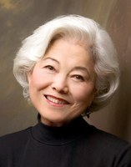
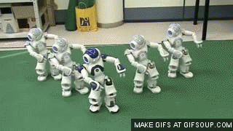
Unity of Spirit
"Yes, unity is important in the Church. But sometimes we misread these strong messages for unity as instructions to look alike, talk alike, dress alike, think alike, have the same number of children, keep house a certain way, have prayers at certain times,…
Complete conformity in our personalities and styles of living is not the same thing as unity of spirit, unity of testimony, and unity of faith in the Savior."
Ephesians 4:1-6
(2)

Slide 31
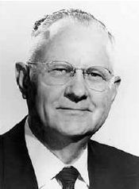
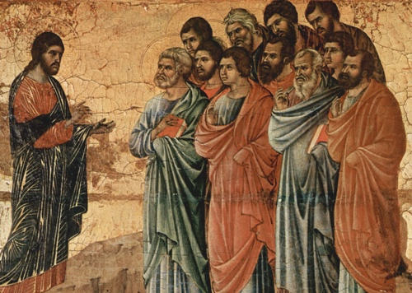
Unity of Doctrine
“After Jesus put his apostles in charge of the Church anciently, they preached the same unity of doctrine and practiced the same ordinances which Jesus had given them. …
“… As long as they remained on the earth, functioning under the authority Jesus gave them, unity of doctrine and uniformity of the ordinances prevailed.
The gospel message, which they were commanded to take to all the world, was the same to everyone everywhere.
People were not taught different gospels and then given a choice. There was only one plan for all.
Duccio Di Buoninsegna
Ephesians 4:1-6
(3)

Slide 32
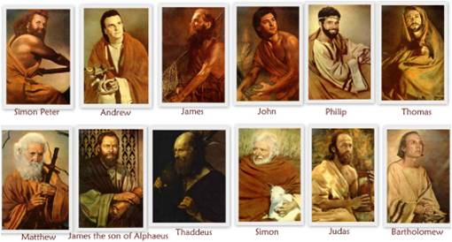
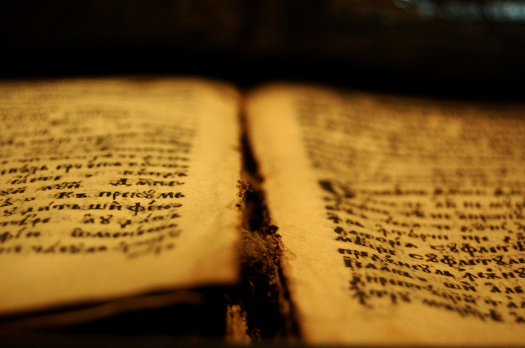
Unified
“One church, one authorized ministry, one orthodox gospel doctrine, and one Holy Ghost characterized the church of Jesus Christ in His time.
‘For God is not the author of confusion, but of peace, as in all churches of the saints.’
Thus God’s revelation to leaders of the Church of Jesus Christ was reasonable, consistent, and unified.
“It was only after the death of Christ’s apostles that revelation ceased.
The pure doctrines Christ taught became diluted with the philosophy of the world, and profane innovations appeared in the ordinances of the church.
Eventually, that which had once been clear and understandable became mythical and confusing.”
Ephesians 4:4-5; 1 Corinthians 14:33
(3)

Slide 33
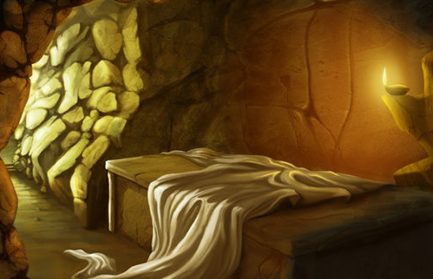
Captivity Captive
“[Jesus Christ] overcame death; all men were the captives of death until Christ captured the captivator and made death subject to him,…
Thou hast ascended on high, thou hast led captivity captive: thou hast received gifts for men; yea, for the rebellious also, that the Lord God might dwell among them.
Psalm 68:18
"Now that Christ is ascended to heaven, we understand that he first came to earth, descending below all things in suffering the pains of every creature which belongeth to the family of Adam.
"He is the same being that has now ascended to his rightful place at the right hand of the Father, who through the atonement, has taken the captivity of sin and death captive and given his gifts unto men, that he might fulfill all things which the Father hath given him."
Ephesians 4:8
(4)

Slide 34
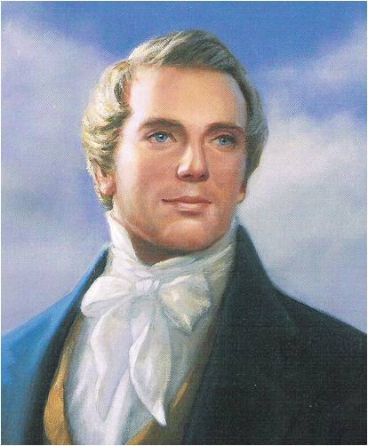
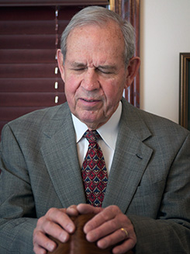
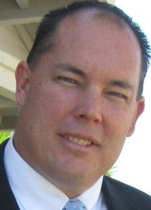
Evangelists and Pastors
Titles in Paul’s Day are not the same as the titles given today
“An evangelist is a Patriarch. … Wherever the Church of Christ is established in the earth, there should be a Patriarch for the benefit of the posterity of the Saints, as it was with Jacob in giving his patriarchal blessing unto his sons” (5)
A pastor is a shepherd or one who leads a flock—a fitting description of modern-day bishops, branch presidents, and stake and district presidents. (1)
Ephesians 4:11; 1 Peter 5:2-4

Slide 35
The Lord has called apostles, prophets, and other Church leaders to help perfect the Saints and protect them from false doctrine
Ephesians 4:12-14

Slide 36
Church Callings
Apostles
Prophets
Patriarchs
Bishops
Teachers
The work of a Hebrew prophet was to act as God’s messenger and make known God’s will.
A Bishop is an ordained office in the Aaronic Priesthood and a bishop is a common judge in Israel
…to preach repentance and remission of sins through Jesus Christ, by the endurance of faith on his name to the end. Amen. Moroni 3:3
To watch over the Church D&C 53:20
The calling of an Apostle is to be a special witness of the name of Jesus Christ in all the world, particularly of His divinity and of His bodily resurrection from the dead
A patriarch is called an evangelist in. As such, patriarch is an ordained office in the Melchizedek Priesthood.
(6)

Slide 37
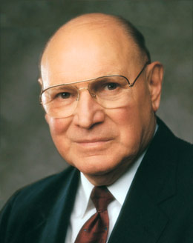
Tossed To and Fro
The winds of false doctrine that are blowing today both outside and a few within the Church are far more dangerous to the ultimate salvation of mankind than are earthquakes, hurricanes, typhoons, volcanic eruptions, and other natural disasters.
These winds can uproot people if their roots are not firmly anchored to the Rock of our salvation, which is the teachings and the gospel of Jesus Christ.
"We, as a people, are to live our religion and its principles and follow the leadership of our prophet, seer, and revelator regardless of what the world does."
How do the teachings of apostles, prophets, and other Church leaders help followers of God navigate these troubled waters and return safely to Heavenly Father?
Ephesians 4:14-15
(7)

Slide 38
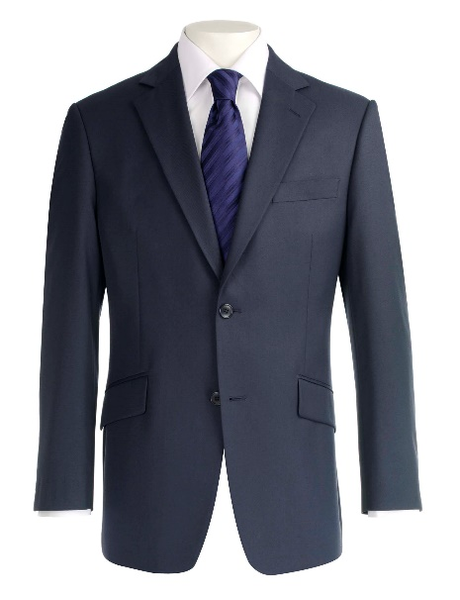
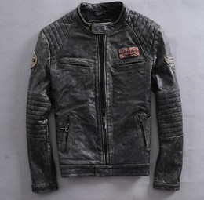
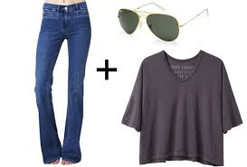
The unrighteous practices the Saints should abandon, and defining the higher, more saintly manner of living they should adopt
Put on the New Man
Setting aside old clothing and clothing oneself in righteousness.
Which outfits would be appropriate for a very nice event?
Dressing appropriately shows respect for the occasion and those that have put the occasion together.
Ephesians 4:22-24
(1)

Slide 39
The old ways, so pleasing to the carnal man, are really hard to set aside. Actually, these ways are not really fulfilling and not really satisfying. But they are preoccupying, for pleasing the natural man is a full-time business. He sees to that!
"Of course, what is really to be jettisoned, put off, is anger, selfishness, malice, injustice, impatience, filthy communication, and so forth, while we put on kindness, meekness, long-suffering, and so on.”
Ephesians 4:14-15
(8)

Slide 40
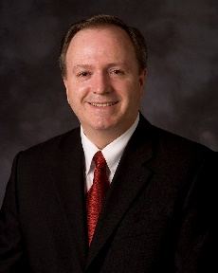
“Be ye angry, and sin not” = “Can ye be angry, and not sin?”
But I say unto you, That whosoever is angry with his brother without a cause shall be in danger of the judgment:
Matthew 5:22
“‘He made me mad.’ This is another phrase we hear, also implying lack of control or agency.
This is a myth that must be debunked. No one makes us mad. Others don’t make us angry.
There is no force involved. Becoming angry is a conscious choice, a decision; therefore, we can make the choice not to become angry.
We choose!”
“A cunning part of [Satan’s] strategy is to dissociate anger from agency, making us believe that we are victims of an emotion that we cannot control.
We hear, ‘I lost my temper.’ Losing one’s temper is an interesting choice of words that has become a widely used idiom.
To ‘lose something’ implies ‘not meaning to,’ ‘accidental,’ ‘involuntary,’ ‘not responsible’—careless perhaps but ‘not responsible.’
Ephesians 4:27-32 (JST)
(9)

Slide 41
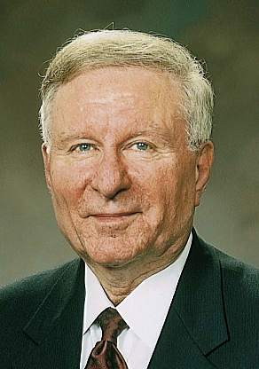
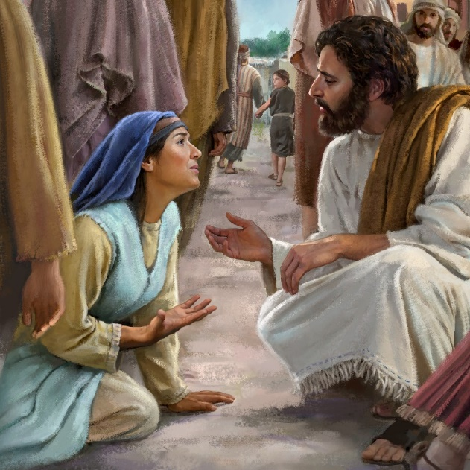
Communication—To Not Be Corrupted
Paul encouraged the Saints to avoid “corrupt communication,” which includes all forms of inappropriate speech: lying, deceit, vulgar or profane expressions, gossip, irreverent or disrespectful speech, and offensive, corrupt, degrading, belittling, or profane language, among others.
"Christlike communications are expressions of affection and not anger, truth and not fabrication, compassion and not contention, respect and not ridicule, counsel and not criticism, correction and not condemnation.
They are spoken with clarity and not with confusion. They may be tender or they may be tough, but they must always be tempered.“
Ephesians 4:29
(10)

Slide 42
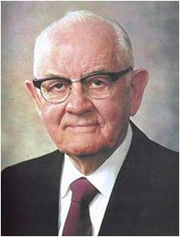
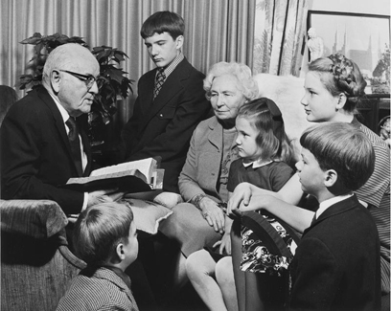
Therefore, I Was Taught
"In such homes, where we are 'kind one to another, tenderhearted, forgiving one another,’ where we are holding our family meetings, discussions, and councils, where we are praying, working, and playing with love as our chief motive, where we are trying to share the gospel with others and fulfill the other purposes of the Lord-in those homes there will dwell a powerful spirituality and unity that will be a lifelong strength to all family members."
The Kimball’s with grandchildren
Ephesians 4:32
(11)

Slide 43
Sources:
New Testament Institute Student Manual Chapter 44
Chieko N. Okazaki (Aloha! [Salt Lake City: Deseret Book Co., 1995], 96.)
Elder Delbert L. Stapley (“What Constitutes the True Church,” Ensign, May 1977, 22).
Elder Bruce R. McConkie (Doctrinal New Testament Commentary, 2:509).
Teachings of Presidents of the Church: Joseph Smith [2007], 140
Bible Dictionary
Elder Joseph B. Wirthlin ("Deep Roots," Ensign, Nov. 1994, 77)
Elder Neal A. Maxwell (That Ye May Believe [Salt Lake City: Bookcraft, 1992], 18.)
Elder Lynn G. Robbins (“Agency and Anger,” Ensign, May 1998, 80).
Elder L. Lionel Kendrick ("Christlike Communications," Ensign, Nov. 1988, 24)
President Spencer W. Kimball ("Therefore I Was Taught," Ensign, Jan. 1982, 5)
Presentation by ©http://fashionsbylynda.com/blog/

Slide 44
PAUL’S LETTERS TO THE SAINTS AT EPHESUS AND TO PHILEMON OF COLOSSAE WRITTEN FROM HIS IMPRISONMENT IN ROME, CA. A.D. 61–63 (EPHESIANS; PHILEMON)
The Organization of Christ’s Church | 4:1–16
Christ’s People Live New Lives | 4:17–32; 5:1–21
Gifts Given, Evangelists and Pastors Ephesians 4:11:
"We now ask, all Christendom who profess to be Saints, whether they are perfect or imperfect? The general answer is, 'we are imperfect.' How do you expect to become perfect, if you do away out of your churches inspired apostles, prophets, and other officers? These are the only gifts and officers by which the Saints can be perfected. Have you got them in your midst? Millions answer 'no: we do not believe in prophets in our day.' But do you believe in 'pastors and teachers?' O yes, they are necessary. Who told you to reject the most important gifts of the church and to retain the rest? 'No one has told us to do this but our ministers, and they must be good men, and they say that apostles and prophets are no longer necessary, but that evangelists, pastors and teachers are'...Know assuredly that there never was any other plan adopted in the gospel to perfect the Saints than through apostles, prophets and other gifts." (Orson Pratt's Works [Salt Lake City: Deseret News Press, 1945], 163 - 165.)
Life and Teachings of Jesus and His Apostles Chapter 43
Authorities of the Church Ephesians 4:14:
“The authorities which the Lord has placed in his Church constitute for the people of the Church a harbor, a place of refuge, a hitching post, as it were. No one in this Church will ever go far astray who ties himself securely to the Church Authorities whom the Lord has placed in his Church. This Church will never go astray; the Quorum of the Twelve will never lead you into bypaths; it never has and never will. There could be individuals who would falter; there will never be a majority of the Council of the Twelve on the wrong side at any time. The Lord has chosen them; he has given them specific responsibilities. And those people who stand close to them will be safe. And, conversely, whenever one begins to go his own way in opposition to authority, he is in grave danger. I would not say that those leaders whom the Lord chooses are necessarily the most brilliant, nor the most highly trained, but they are the chosen, and when chosen of the Lord they are his recognized authority, and the people who stay close to them have safety.” (Spencer W. Kimball in CR, Apr. 1951, 104.)
Ministry Ephesians 4:14-15:
“The ministry of the Apostles—the First Presidency and the Twelve—is to bring about that unity of the faith and to proclaim our knowledge of the Master. Our ministry is to bless the lives of all who will learn and follow the ‘more excellent way’ of the Lord [1 Corinthians 12:31; Ether 12:11]. And we are to help people prepare for their potential salvation and exaltation” Elder Russell M. Nelson (“Salvation and Exaltation,” Ensign or Liahona, May 2008, 7–8).
“In the Church today, just as anciently, establishing the doctrine of Christ or correcting doctrinal deviations is a matter of divine revelation to those the Lord endows with apostolic authority” Elder D. Todd Christofferson (“The Doctrine of Christ,” Ensign or Liahona, May 2012, 86).
One Lord, One Faith Ephesians 4:5:
"Now, others may insist that this is not the true church. That is their privilege. But to claim that it does not exist anywhere, that it does not even need to exist, is to deny the scriptures.
"The New Testament teaches of 'one Lord, one faith, one baptism' and speaks of ' [all coming] in the unity of the faith' (Eph. 4:5, 13) and of a 'restitution of all things, which God hath spoken by the mouth of all his holy prophets since the world began' (Acts 3:21.)
"We did not invent the doctrine of the only true church. It came from the Lord. Whatever perception others have of us, however presumptuous we appear to be, whatever criticism is directed to us, we must teach it to all who will listen." Pres. Boyd K. Packer ("The Only True Church," Ensign, Nov. 1985, 82)

Slide 45
Apostle:
The word means “one sent forth.” It was the title Jesus gave (Luke 6:13) to the Twelve whom He chose and ordained (John 15:16) to be His closest disciples during His ministry on earth and whom He sent forth to represent Him after His Ascension into heaven.
Jesus is referred to as an Apostle in Heb. 3:1–2, a designation meaning that He is the personal and select representative of the Father.
Bishop:
Greek episkopos, meaning “overseer,” an office or position of responsibility. Hence, Jesus is called the “Bishop of your souls” (1 Pet. 2:21–25). Judas is also spoken of as having a “bishoprick,” reflecting the fact that the Twelve are overseers (Acts 1:20; D&C 114).
Bishop is also an ordained office in the Aaronic Priesthood (D&C 20:67), and a bishop is a common judge in Israel (D&C 107:74). The desirable qualifications of a bishop are listed in 1 Tim. 3:1–7; Titus 1:7–9.
Prophet:
The work of a Hebrew prophet was to act as God’s messenger and make known God’s will….It was therefore part of the prophetic office to preserve and edit the records of the nation’s history; and such historical books as Joshua, Judges, 1 and 2 Samuel, 1 and 2 Kings were known by the Jews as the former Prophets.
It was also the prophet’s duty to denounce sin and foretell its punishment and to redress, so far as he could, both public and private wrongs. He was to be, above all, a preacher of righteousness. When the people had fallen away from a true faith in Jehovah, the prophets had to try to restore that faith and remove false views about the character of God and the nature of the divine requirement.
In certain cases prophets predicted future events, such as the very important prophecies announcing the coming of Messiah’s kingdom; but as a rule a prophet was a forthteller rather than a foreteller. In a general sense a prophet is anyone who has a testimony of Jesus Christ by the Holy Ghost, as in Num. 11:25–29; Rev. 19:10.
Teacher:
…to preach repentance and remission of sins through Jesus Christ, by the endurance of faith on his name to the end. Amen. Moroni 3:3
A teacher’s duty is to watch over the church: (D&C 20:53)
The Ministry:
The work of the ministry is to do the work of the Lord on the earth—to represent the Lord among the people, preach the gospel, and administer the ordinances thereof. The chosen servants and appointed officers in the Church of Jesus Christ are put on earth by Him to conduct the work necessary for the salvation of mankind. A minister “called of God, as was Aaron” (Heb. 5:4), and endowed with the holy priesthood, represents the Lord when he is performing his official duties and is the Lord’s agent. Therefore, what he does “according to the will of the Lord is the Lord’s business” (D&C 64:29). The Lord has given apostles, prophets, evangelists, high priests, seventies, elders, bishops, priests, teachers, deacons, helps, and governments “for the perfecting of the saints, for the work of the ministry, for the edifying of the body of Christ” (the Church), until all have reached the spiritual stature of Christ, the whole body being “fitly joined together” by that which every part supplieth.
Patriarch:
A patriarch is called an evangelist in D&C 107:39–52. As such, patriarch is an ordained office in the Melchizedek Priesthood. The fathers from Adam to Jacob were all patriarchs of this kind. The word as used in the Bible seems to denote also a title of honor to early leaders of the Israelites, such as David (Acts 2:29) and the 12 sons of Jacob (Acts 7:8–9). The word is of Greek derivation and means father-ruler; the Hebrew word it translates is simply father.
Bible Dictionary

Slide 46
By the word of truth, by the power of God, by the armour of righteousness on the right hand and on the left,
2 Corinthians 6-7

Slide 47
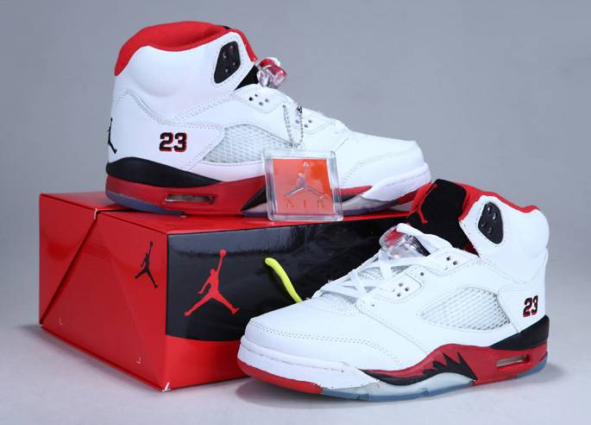
Something New
How do we typically treat things that are new?

Slide 48
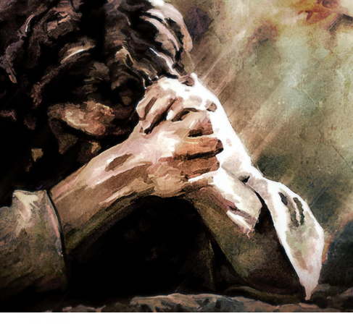
Sweet smelling Savour
Paul taught about how Christ had offered Himself as an offering and a sacrifice
And walk in love, as Christ also hath loved us, and hath given himself for us an offering and a sacrifice to God for a sweetsmelling savour.
And thou shalt burn the whole ram upon the altar: it is a burnt offering unto the Lord: it is a sweet savour, an offering made by fire unto the Lord.
Exodus 29:18
“Even as each sacrifice offered anciently, as it prefigured the coming sacrifice of the Lamb of God, was ‘a sweet savour … unto the Lord’, so was Christ’s offering of himself a pleasing thing to God.
The sweet smell of the burning sacrifices in Israel symbolized the pleasing blessings flowing from our Lord’s personal offering.”
Ephesians 5:2

Slide 49
The World’s Evil
Fornication = sexual intercourse between people not married to each other.
Covetousness = having or showing a great desire to possess something, typically something belonging to someone else.
Filthiness = unclean and impure in mind and body
Foolish talking or jesting = gossip, cruel joking, rudeness
Whoremonger or unclean person = guilty of sexual sin, in or out of marriage
Idolater = a worshiper of idols
Ephesians 5:3-7

Slide 50
Walk As Children of Light
Household Codes
Wives should submit to their husbands “as unto the Lord”—this does not mean that the husbands are to rule over them with unrighteous desires.
Children should obey their parents “in the Lord”
Parents are instructed to raise their children “in the nurture and admonition of the Lord”
Husbands are to love their wives “as Christ also loved the church, and gave himself for it”
Ephesians 5:21-6:9

Slide 51
Husbands and Wives
“submit” = sustaining, supporting, and respecting her husband as she does the Lord.
A husband’s divinely appointed role = preside or watch over the family, just as the Savior watches over and leads His Church (1)
Paul’s counsel that wives should submit to their husbands does not justify male dominion.
People in Greco-Roman society regarded the father as being the head of the extended family and the absolute authority over the entire household. Therefore, Paul’s teachings represented a dramatic change to these traditional ideas because he defined husbands’ and fathers’ roles in terms of Christ’s love and sacrifice for the Church. (1)
“‘Happiness in marriage is not so much a matter of romance as it is an anxious concern for the comfort and well-being of one’s companion.
Any man who will make his wife’s comfort his first concern will stay in love with her throughout their lives and through the eternity yet to come’ (3)
Ephesians 5:22

Slide 52
Children and Parents
“Honor your parents by showing love and respect for them.
Obey them as they lead you in righteousness.
Willingly help in your home.
Participate in wholesome family activities and traditions.
Join your family in family prayer, family scripture study, and family home evenings.
Keeping these commandments strengthens and unifies families”.
(11)

Slide 53
We do not find the Savior leading the Church with a harsh or unkind hand. We do not find the Savior treating His Church with disrespect or neglect.
We do not find the Savior using force or coercion to accomplish His purposes.
Nowhere do we find the Savior doing anything but that which edifies, uplifts, comforts, and exalts the Church.
… I say to you with all soberness, He is the model we must follow as we take the spiritual lead in our families.
Particularly is this true in your relationship with your wife.“ (4)
Judith Mehr
Ephesians 5:25

Slide 54
One Flesh
United Physically, Emotionally, and Spiritually
We can follow the example of the Savior in how we treat members of our family.
'The Bible celebrates sex and its proper use, presenting it as God-created, God-ordained, God-blessed. It makes plain that God himself implanted the physical magnetism between the sexes for two reasons: for the propagation of the human race, and for the expression of that kind of love between man and wife that makes for true oneness.
His commandment to the first man and
woman to be one flesh was as important as
his command to be fruitful and multiply.' (5)
Ephesians 5:31

Slide 55
What are some ways the Savior showed His love for the Church and gave Himself for it?
How does knowing how Christ gave Himself for the Church make you feel about Him?
How should a husband feel toward his wife if he follows the example of how the Savior feels toward His Church?
What counsel did Paul give that can apply equally to both husbands and wives? other members of the family?
What can you do now to prepare to one day treat your spouse the way the Savior would treat them?
How can obeying and honoring your parents help you become more like Jesus Christ?

Slide 56
Servants and Masters
Masters are to deal with their servants while remembering their “Master also is in heaven.”
Paul’s words remind us that our relationship with Christ should guide and define our relationships with all others.
Paul taught that the cultural separations that existed between Jews and Gentiles, slaves and masters, or men and women should no longer divide people in the gospel of Jesus Christ. Each member’s covenant relationship with Jesus Christ creates unity among all members.
Ephesians 6:5-9; Galatians 3:28-29
(1)

Slide 57
Moroni closes his record with an invitation--
“Yea, come unto Christ, and be perfected in him, and deny yourselves of all ungodliness…
…and if ye shall deny yourselves of all ungodliness, and love God with all your might, mind and strength…”
Moroni 10:32

Slide 58
Paul’s 2nd half of Ephesians is similar--
“Finally, my brethren, be strong in the Lord, and in the power of his might.”
Be strong in the Savior’s doctrines, and obey divinely called leaders, and using God-given principles to protect from the attacks of Satan.
Ephesians 6:10

Slide 59
Standing against the wiles
“Put on the whole armour of God, that ye may be able to stand against the wiles of the devil.”
Are we at war?
Who are we at war with? (Revelations 12:9)
How much experience does our enemy have in this war?
Yes
Satan
Give examples
Ephesians 6:11

Slide 60
The Last Days
“And the dragon (Satan) was wroth (angry) with the woman (the church), and went to make war with the remnant of her seed (the Saints in the last days), which keep the commandments of god, and have the testimony of Jesus Christ(who make and keep covenants with God).”

Slide 61
Making War
“…For we beheld Satan, that old serpent, even the devil, who rebelled against God, and sought to take the kingdom of our God and his Christ…
…Wherefore, he maketh war with the saints of God, and encompasseth them round about.”
D&C 76:28-29

Slide 62
Internal Weaknesses
“For we wrestle not against flesh and blood, but against:
Principalities (Our own beliefs),
powers (pride),
the rulers of the darkness of this world (Secret Combinations),
spiritual wickedness (unrighteous government) in high places.”
Ephesians 6:12

Slide 63
Who Is Our Enemy?
“Our most deadly contest in life is not with human enemies.”
Are we strong enough to defend ourselves on our own?
(6)

Slide 64
God’s Protection
“Wherefore take unto you the whole armour of God, that ye may be able to withstand in the evil day, and having done all, to stand.”
…Stand therefore, having your loins girt about with truth, and having on the breastplate of righteousness.”
Ephesians 6:13-14

Slide 65
I like to think of this spiritual armor not as a solid piece of metal molded to fit the body but more like chain mail.
Chain mail consists of dozens of tiny pieces of steel fastened together to allow the user greater flexibility without losing protection.
I say that because it has been my experience that there is not one great and grand thing we can do to arm ourselves spiritually.
True spiritual power lies in numerous smaller acts woven together in a fabric of spiritual fortification that protects and shields from all evil.
(12)

Slide 66
Feet, Shield, and Helmet
“And your feet shod with the preparation of the gospel of peace”
“Above all, taking the shield of faith, where with ye shall be able to quench all the fiery darts of the wicked.”
“And take the helmet of salvation, and the sword of the spirit, which is the word of God.”
Ephesians 6:15-17

Slide 67
Physical Armor
Sash or belt
Breastplate
Footwear
Shield
Helmet
Sword
Spiritual Armor
Truth
Righteousness
The gospel of peace
Faith
Salvation
The word of God

Slide 68
4 Areas that the armor protects:
Head—thoughts
Heart—feelings or attitudes
Loins—virtue and chastity
Feet—goals and the direction we are headed

Slide 69
Our Thoughts:
“..and let virtue garnish they thoughts unceasingly…”
“But this much I can tell you, that if ye do not watch yourselves, and your thoughts, and your words, and your deeds,…”-Mosiah 4:30
D&C 121:45

Slide 70
For as a man thinketh so is he.
“I have come to know that thoughts, like water, will stay on course if we make a place for them to go. Otherwise, our thoughts follow the course of least resistance, always seeking the lower levels.”
(7)

Slide 71
Our Hearts:
“Attitude can make all the difference in our lives, and we control our attitude. It can make us miserable or happy, content or dissatisfied.
To a great degree, it can make us strong or weak.”
(8)

Slide 72
Our Virtue and Chastity:
Remaining pure and clean before marriage
“Moral purity is an eternal principle. The spirit of god “cannot dwell in an unclean tabernacle” (Mosiah 2:37)
“We covenant to live the law of chastity. The law of chastity is virtue and sexual purity.
(Thou shalt love thy wife will all thy heart, and shalt cleave unto her and none else. And he that looketh upon a woman to lust after her shall deny the faith, and shall not have the Spirit…)—D&C 42:22
(9)

Slide 73
Our Goals and Direction:
“Use boldness, but not overbearance; and also see that ye bridle all your passions, that ye may be filled with love; see that ye refrain from idleness.”
“You can’t be right by doing wrong; you can’t be wrong by doing right.”
(8)

Slide 74
Final Piece of Armor?
“Praying always with all prayer and supplication in the Spirit, and watching thereunto with all perseverance and supplication for all saints.”
“There are no restrictive “office hours.” But it is we who must arise and go to Him!”
Ephesians 6:18
(10)

Slide 75
“It is Difficult, if not impossible, for the devil to enter a door that is closed. He seems to have no keys for locked doors. But if a door is slightly ajar, he gets his toe in, and soon this is followed by his foot, then by his leg and his body and his head, and finally he is in all the way.”
…Lucifer readily becomes the master when one succumbs to his initial blandishments (flattery). Soon then the conscience is stilled completely, the evil power has full sway, and the door to salvation is closed until a thorough repentance opens it again.”
(5)

Slide 76
“The war goes on.
it is as it was in the beginning…
it is an ongoing battle.
We cannot be unclean and expect the help of the Almighty.
If we put on the whole armor of God, we will be able to withstand evil.
(3)

Slide 77
“You cannot afford of things that will weaken your minds and your bodies:
Cocaine
‘crack’
Alcohol
Tobacco
You cannot be involved in immoral activity
You cannot do these things and be valiant as warriors in the cause of the Lord.
(4)

Slide 78
“…We are engaged in a great eternal struggle that concerns the very souls of the sons and daughters of God.
We are not losing.
We are winning.
We will continue to win if we will be faithful and true.
We can do it.
We must do it.”
(4)

Slide 79
Sources:
New Testament Institute Student Manual Chapter 44
Elder Bruce R. McConkie (Doctrinal New Testament Commentary, 2:516.
Gordon B. Hinckley (Anchorage, Alaska, regional conference, 18 June 1995)” (“Speaking Today: Excerpts from Recent Addresses of President Gordon B. Hinckley,” Ensign, Apr. 1996, 72); Gordon B. Hinckley Conference Report Oct. 1986, or Ensign Nov. 1986
President Ezra Taft Benson "To the Fathers in Israel," Ensign, Nov. 1987, 50.
5. President Spencer W. Kimball (Ensign, May, 1974, pp. 7-8; italics added.)" (R. Lanier Britsch and Terrance D. Olson, eds., Counseling: A Guide to Helping Others, 2 vols. [Salt Lake City: Deseret Book Co., 1983-1985], 2: 137.); “The Miracle of Forgiveness” p. 215-16
Harold B. Lee “Stand Ye in Holy Places” p. 330
Boyd K. Packer conference Report Oct 1973 or Ensign Jan. 1974
Thomas S. Monson “Teachings of Thomas S. Monson” p. 23
Ezra T. Benson “The Teachings of Ezra T. Benson” p. 278-279
Neal A. Maxwell “Lest Ye Be Wearied and Faint in Your Minds” May 1991 Ensign
For the Strength of Youth [booklet, 2011], 14–15
M. Russell Ballard, “Be Strong in the Lord,” Ensign, July 2004, 8
Presentation by ©http://fashionsbylynda.com/blog/

Slide 80
PAUL’S LETTERS TO THE SAINTS AT EPHESUS AND TO PHILEMON OF COLOSSAE WRITTEN FROM HIS IMPRISONMENT IN ROME, CA. A.D. 61–63 (EPHESIANS; PHILEMON)
Love Between Husbands and Wives | 5:22–33
Relationships of Parents and Children | 6:1–4
The Judgment of Servants and Masters | 6:5–9
Girding for the Spiritual Battle | 6:10–24
Submit Ephesians 5:22:
"...when women forget their pettiness and selfishness and submit themselves to their own righteous husbands as unto the Lord, and when they are subject to their husbands as the Church is expected to be subject unto Christ, then will the divorce rate reduce, and families will grow, and children will be happy, laughing children. God created male and female with special talents, powers, responsibilities, and with the ability to perform their special tasks.
"When men come home to their families and women devote themselves to their children, the concept will return, that to be a mother is her greatest vocation in life. She is a partner with God. No being has a position of such power and influence. She holds in her hands the destiny of nations, for to her comes the responsibility and opportunity of molding the nation's citizens.
"In a California stake I heard a mother give this sermon: 'I am grateful that I am a woman. I am grateful that I am a wife. I am grateful that I am a mother. I am grateful that I am a Latter-day Saint.' This I thought was a powerful sermon. Motherhood is the greatest vocation." President Spencer W. Kimball ("Why Call Me Lord, Lord, and Do Not the Things Which I Say?" Ensign, May 1975, 7)
"Let this [Relief] Society teach women how to behave towards their husbands, to treat them with mildness and affection. When a man is borne down with trouble, when he is perplexed with care and difficulty, if he can meet a smile instead of an argument or a murmur-if he can meet with mildness, it will calm down his soul and soothe his feelings; when the mind is going to despair, it needs a solace of affection and kindness. . . .
"When you go home, never give a cross or unkind word to your husbands, but let kindness, charity and love crown your works henceforward." (Discourses of the Prophet Joseph Smith, compiled by Alma P. Burton [Salt Lake City: Deseret Book Co., 1977], 208.)
Life and Teachings of Jesus and His Apostles Chapter 43
Wives and Husbands Ephesians 5:22, 25, 28:
For wives, this means submitting themselves to their husbands as they would to the Lord; for husbands, this means loving their wives as Christ loved the Church and gave Himself for it. If couples are truly united, then any sacrifice made on behalf of one’s spouse inevitably brings blessings to oneself; thus, “he that loveth his wife loveth himself.” (1)
"A woman need have no fear of being imposed upon or of any dictatorial measures or of any improper demands when the husband is self-sacrificing and worthy. Certainly, no intelligent woman would hesitate to give submission to her own truly righteous husband in everything. We are sometimes shocked to see the wife take over the leadership, naming the one to pray, the place to be, the things to do.
"Husbands are commanded: '... love your wives, even as Christ also loveth the church, and gave himself for it.' (Eph. 5:25.)
"Christ loved the church and its people so much that he voluntarily endured persecution for them, suffered humiliating indignities for them, stoically withstood pain and physical abuse for them, and finally gave his precious life for them.
"When the husband is ready to treat his household in that manner, not only the wife but all the family will respond to his leadership.
"Certainly, if fathers are to be respected, they must merit respect-if they are to be loved, they must be consistent, lovable, understanding, and kind, and they must honor their priesthood." President Spencer W. Kimball ("Home: The Place to Save Society," Ensign, Jan. 1975, 5)

Slide 81
Husbands Ephesians 5:23:
"There is no higher authority in matters relating to the family organization, and especially when that organization is presided over by one holding the higher Priesthood, than that of the father. The authority is time honored, and among the people of God in all dispensations it has been highly respected and often emphasized by the teachings of the prophets who were inspired of God. The patriarchal order is of divine origin and will continue throughout time and eternity. There is, then, a particular reason why men, women and children should understand this order and this authority in the households of the people of God, and seek to make it what God intended it to be, a qualification and preparation for the highest exaltation of his children. In the home the presiding authority is always vested in the father, and in all home affairs and family matters there is no other authority paramount." (Brent A. Barlow, "Strengthening the Patriarchal Order in the Home," Ensign, Feb. 1973, 30)
"Holding the priesthood does not mean that a man is a power-broker, or that he sits on a throne, dictating in macho terms, or that he is superior in any way. Rather, he is a leader by authority of example. Paul's counsel to the Ephesians included, 'Husbands, love your wives, even as Christ also loved the church, and gave himself for it' (Eph. 5:25). As Christ lifts us all, so must we, rather than put down women or anyone.
"Nowhere does the doctrine of this Church declare that men are superior to women. Paul said to the Corinthians, 'Nevertheless neither is the man without the woman, neither the woman without the man, in the Lord' (1 Cor. 11:11). Each brings his or her own separate and unique strengths to the family and the Church. Women are not just cooks, stewards of our homes, or servants. They are much more. They are the enrichment of humanity." Pres. James E. Faust ("The Highest Place of Honor," Ensign, May 1988, 36)
"Many women carry heavy burdens raising children and attending to household responsibilities. They often accomplish near-miracles in balancing all the demands made upon them. A husband who is critical of his wife and communicates censure for what hasn't been done rather than thanks for what has been done fosters discouragement. But if he will give a word of praise or offer a little help, he will see his wife try ever harder to do her part. Criticism has a negative influence on the feelings of love for and interest in one's spouse. Women need love, affection, and emotional support from their husbands.
"Paul has counseled, 'Husbands, love your wives, even as Christ also loved the church, and gave himself for it.' (Eph. 5:25.) In commenting on this counsel, President Kimball provided this important insight:
'Can you think of how [Christ] loved the church? Its every breath was important to him. Its every growth, its every individual, was precious to him. He gave to those people all his energy, all his power, all his interest. He gave his life-and what more could one give? ... When the husband is ready to treat his household in that manner, not only his wife but also his children will respond to his loving and exemplary leadership. It will be automatic. He won't need to demand it. ...
'Certainly if fathers are to be respected, they must merit respect: If they are to be loved, they must be consistent, lovable, understanding, and kind-and they must honor their priesthood.' (Men of Example, pamphlet, Salt Lake City: Church Educational System, 1973, p. 5.)" H. Burke Peterson ("Unrighteous Dominion," Ensign, July 1989, 9)
Protecting Ourselves Ephesians 6:14-18:
“I like to think of this spiritual armor not as a solid piece of metal molded to fit the body but more like chain mail. Chain mail consists of dozens of tiny pieces of steel fastened together to allow the user greater flexibility without losing protection. I say that because it has been my experience that there is not one great and grand thing we can do to arm ourselves spiritually. True spiritual power lies in numerous smaller acts woven together in a fabric of spiritual fortification that protects and shields from all evil.” Elder M. Russell Ballard (“Be Strong in the Lord,” Ensign, July 2004, 8).
The Armour of God Ephesians 6:11:
“We have the four parts of the body that the Apostle Paul said [are] the most vulnerable to the powers of darkness. The loins, typifying virtue, chastity. The heart typifying our conduct. Our feet, our goals or objectives in life and finally our head, our thoughts” President Harold B. Lee (Feet Shod with the Preparation of the Gospel of Peace, Brigham Young University Speeches of the Year [Nov. 9, 1954], 2).
“The putting off of the natural man makes possible the putting on of the whole armor of God, which would not fully fit before! (see Eph. 6:11, 13)” (“Plow in Hope,” Elder Neal A Maxwell Ensign, May 2001, 60).
“Examine your armor. Is there an unguarded or unprotected place? Determine now to add whatever part is missing. …
“Through the great principle of repentance you can turn your life about and begin now clothing yourself with the armor of God through study, prayer, and a determination to serve God and keep his commandments.” Elder N. Eldon Tanner (“Put on the Whole Armor of God,” Ensign, May 1979, 46).

Slide 82
Something of Interest
The Cravings
The cravings for crystal meth are exceptionally strong, and the human body’s tolerance to its narcotic effects is developed relatively quickly. Someone intending to start out as only a casual user can quickly cross the line into a full-blown addict if they develop these strong cravings.
The Effects
Psychologically, crystal meth can increase feelings of grandiosity and invincibility which combined with the need to keep using and avoid a come down can lead users into increasingly dangerous situations. Many crystal meth users that we see report saying that they would never steal or lie or cheat in order to be able to use, but reporting that all of that behavior eventually happened as their need for the drug became paramount to their other interests.
Once you have become addicted to crystal meth, you may:
Neglect your family and job
Become distant from friends and relatives
Become engaged in deeper criminal behavior such as committing fraud, writing bad checks, selling drugs, continuing down the dark path that drugs create.
Cosmetic Effects
Crystal meth also has profound and upsetting cosmetic effects. Many agencies try to scare people out of using meth by showing ‘before-and-after’ photos of people prior to their meth use and during or after they have begun using meth. The appearances tend to be similar and scary:
‘Meth Mouth’ which consists of brittle and thin teeth, missing teeth or teeth that become the shape of the ‘pipe’ from the chemicals
Teeth grinding and tooth loss leading to a collapsed jaw
Dry skin and gums
Brittle or missing hair
Sores all over the body leading to scars from the constant ‘picking’ many meth users do
Sunken-in face
Crystal meth users turn to the drug for the effects it produces: euphoria, increased energy and alertness, increased self-confidence and feelings of power, and increased libido. Some women may take crystal meth due to its causing extreme weight loss, although this is a very temporary (and highly dangerous) solution to that particular goal. The high that crystal meth produces is also uncommonly long-lasting, producing all of those heightened feelings for up to twelve hours in some cases.
All of the perceived initial benefits of crystal meth tend to turn around on you as you use longer and harder. Brittle bones due to smoking, snorting or shooting up crystal meth can occur, painful joints, weight gain, hair loss, blood in urine, heart palpitations and decreased ability for the drug to be effective in its initial purpose are all reported problems with increased crystal meth use.
The crystal meth comedown is intense. It is characterized by:
Excessive sleeping and lethargy
Increased appetite (which is why the weight loss “virtue” is so temporary)
Heightened anxiety
Psychosis
Paranoia
Profound depression
This depression from crystal meth comedown and withdrawal both lasts longer and is far more severe than even cocaine withdrawal. Essentially, once a person takes crystal meth, you are going to want more – either due to the desire to replicate the high or the need to escape the meth comedown. Once you get on crystal meth and start to do it regularly, you can often eat and sleep like a ‘normal’ person. Many people on crystal meth can even work for a time, but if they stop using, they are in for the week of sleeping, lethargy and only being able to wake up (barely) to go to the bathroom and eat some food. The meth comedown is not as dangerous as say, a heroin withdrawal, but it is still uncomfortable and detrimental, and causes many meth users to continue using in fear of going through this withdrawal.
https://kleantreatmentcenters.com/addiction-info/crystal-meth/

