Slide 1
Hebrews 7-10

Slide 2
Lesson 137
New and Everlasting Covenant
Hebrews 7-10
For this is the covenant that I will make with the house of Israel after those days, saith the Lord; I will put my laws into their mind, and write them in their hearts: and I will be to them a God, and they shall be to me a people:
Hebrews 8:10

Slide 3
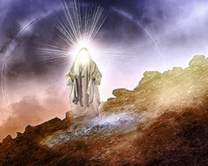
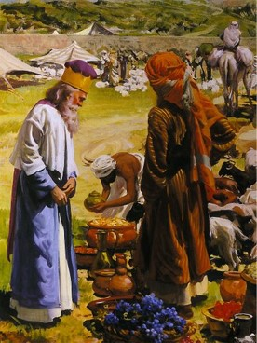
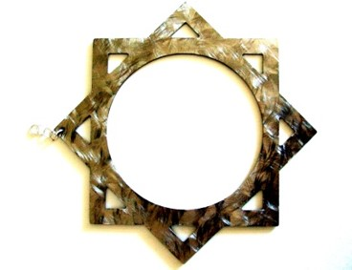
Melchisedec--Melchizedek
King of Salem
Priest of the most high God
Received tithes from Abraham
King of Peace
Hebrews 7:1-2

Slide 4
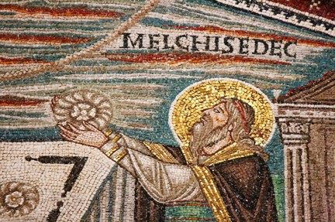
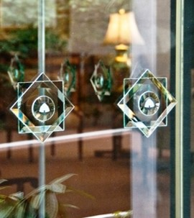
Priesthood by Authority
“Without father, without mother, without descent, having neither beginnings of day, nor end of life; but made like unto the Song of God; abideth a priest continually.”
Takes instruction from God
Hebrews 7:3

Slide 5
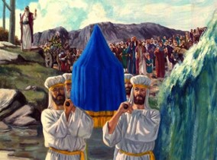
Sons of Levi—Tabernacle of Testimony
Levi was the third son of Jacob and Leah
His descendants ministered in the sanctuaries of Israel
Assisted the priests, (sons of Aaron)
Acted as musicians 1 Chronicles 15:16
They received no land inheritance in Cannaan
Numbers 1:47-54

Slide 6
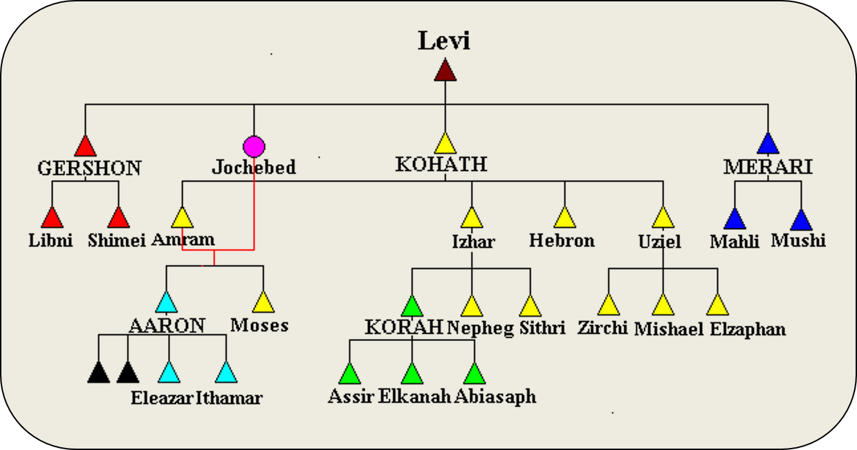

Slide 7
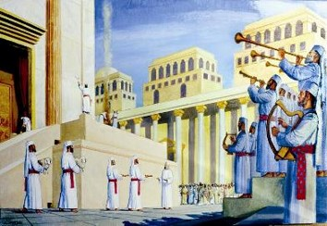
Levites Office of Priesthood
Jacob blessed Levi and his descendants. The Descendants of Levi ministered in the sanctuaries of Israel
“And verily they that are the sons of Levi, who receive the office of the priesthood, have a commandment to take tithes of the people according to the law…”
Hebrews 7:5

Slide 8
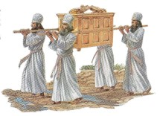
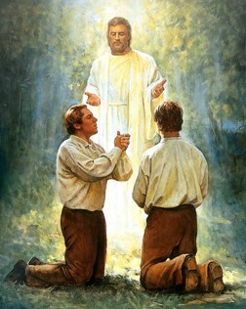
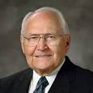
Priesthood of Aaron
Second priesthood
Conferred upon Aaron
An appendage to the greater, or Melchizedek Priesthood
Power to administer outward ordinances
(2)

Slide 9
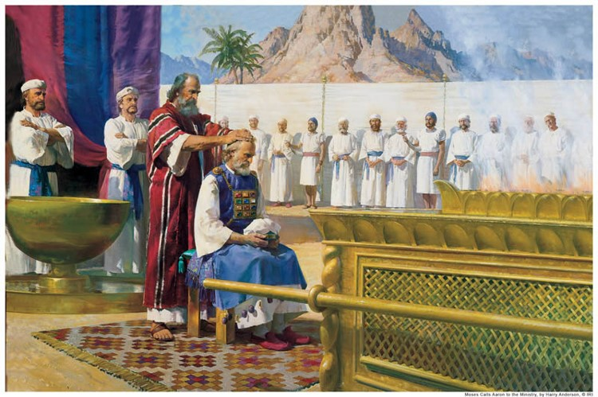
Priesthood of Aaron
The Aaronic Priesthood is a lesser authority, and it administers the preparatory gospel only.
Being the lesser order and thereby incapable of bringing men to perfection, was hereditary in nature, passing from father to son.
(2)

Slide 10
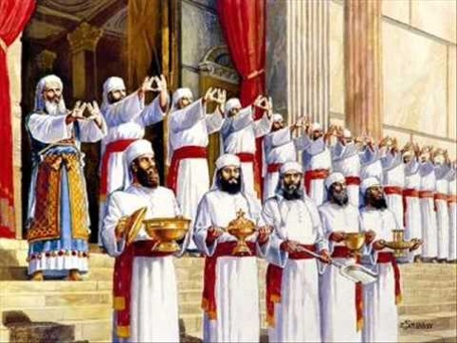
Not Without An Oath
“And inasmuch as not without an oath he was made priest:”
“(For those priests were made without an oath; but this with an oath by him that said unto him, The Lord sware and will not repent, Thou art a priest for ever after the order of Melchisedec)
Hebrews 7:20-21

Slide 11
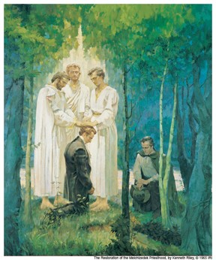
Receiving the Priesthood
“And this is according to the oath and covenant which belongeth to the priesthood.”
“Therefore, all those who receive the priesthood, receive this oath and covenant of my Father, which he cannot break, neither can it be moved.”
The Melchizedek Priesthood is received only by an oath and covenant.
D&C 84:39-40

Slide 12
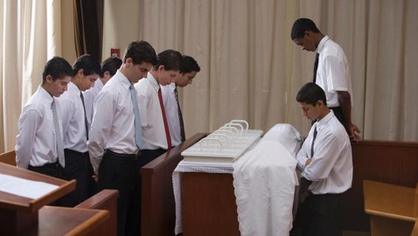
Covenant 1
Man on his part solemnly agrees to magnify his calling in the priesthood, to keep the commandments of God, to live by every word that proceedeth forth from the mouth of Deity, and to walk in paths of righteousness and virtue.
(3)

Slide 13
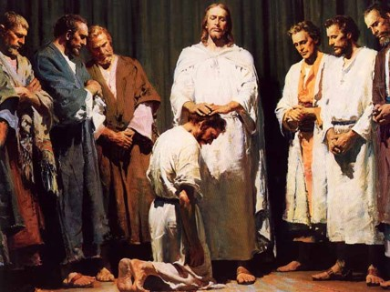
Covenant 2
God on his part agrees to give such persons an inheritance of exaltation and godhood in his everlasting presence. The oath is the solemn attestation of Deity, his sworn promise”
(3)

Slide 14
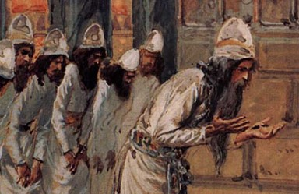
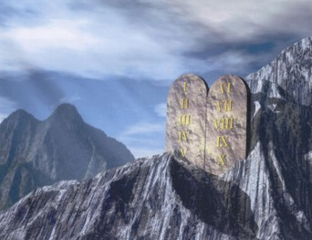
Change in Priesthood
“If therefore perfection were by the Levitical priesthood, (for under it the people received the law,) what further need was there that another priest should rise after the order of Melchisedec, and not be called after the order of Aaron?”
The mission and atonement of our Savior brought an end to the lesser law of Moses and instituted in its place the higher law of Jesus Christ.
Hebrews 7:11

Slide 15
I Am The Law
“For behold, the covenant which I have made with my people is not all fulfilled; but the law which was given unto Moses hath an end in me.
Behold, I am the law, and the light. Look unto me, and endure to the end…
3 Nephi 15:8-9

Slide 16
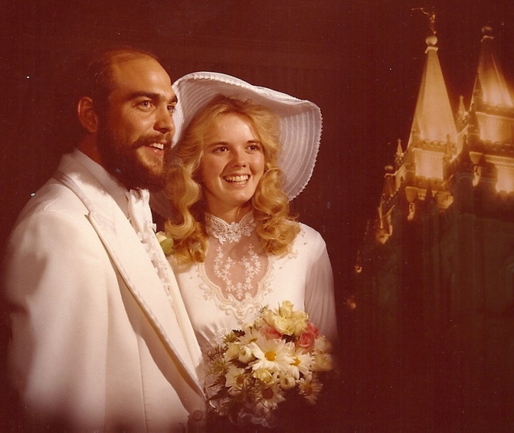
New and Everlasting Covenant
An order of the Priesthood
“Therefore, if a man marry him a wife in the world, and he marry her not by me nor by my word, and he covenant with her so long as he is in the world and she with him…
…their covenant and marriage are not of force when they are dead, and when they are out of the world…
D&C 132:15

Slide 17
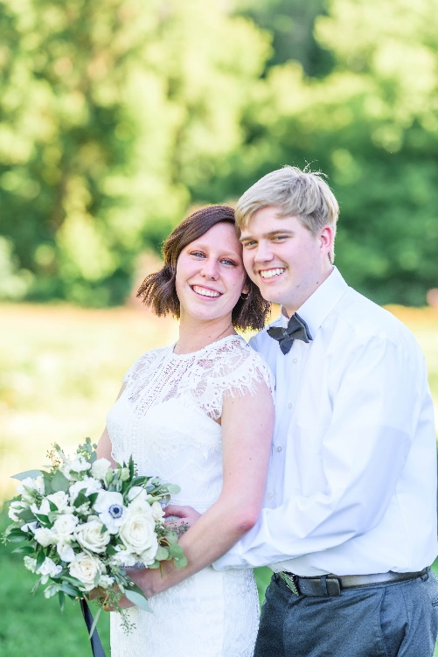
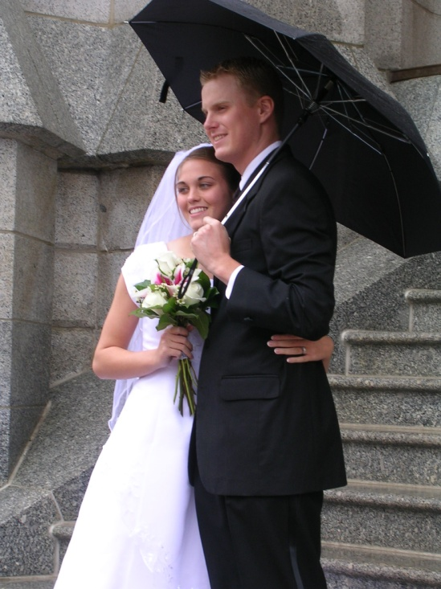
Marriage on Earth
…therefore, they are not bound by any law when they are out of the world.
Read D&C 132:16-18
“The blessings of the priesthood, such as baptism, receiving the Holy Ghost, the temple endowment, and eternal marriage, are available to men and women alike” (4)

Slide 18
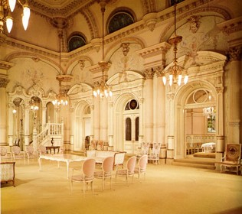
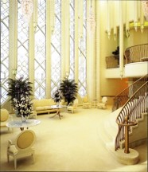
Celestial Glory
“And in order to obtain the highest, a man must enter into this order of the priesthood (meaning the new and everlasting covenant of marriage)
“He may enter into the other, but that is the end of his kingdom; he cannot have an increase.
D&C 131:1-2, 4

Slide 19
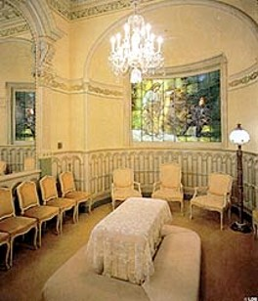
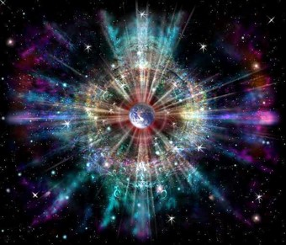
Sealed
A man who marries a wife in the new and everlasting covenant (sealed) will inherit thrones, kingdoms, etc.
…and a continuation of the seeds forever and ever.”
—D&C 132:19

Slide 20
“The Ten Blessings of the Priesthood” Hebrews 7-10

Slide 21
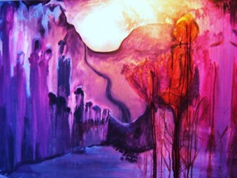
Blessing One
We are members of the only true and living Church upon the face of the whole earth, and we have received the fulness of the everlasting gospel.
(3)

Slide 22
Blessing Two
We have received the gift of the Holy Ghost, and we are entitled to receive the gifts of the Spirit—those wondrous spiritual endowments which set us apart from the world and raise us above carnal things.
(3)

Slide 23
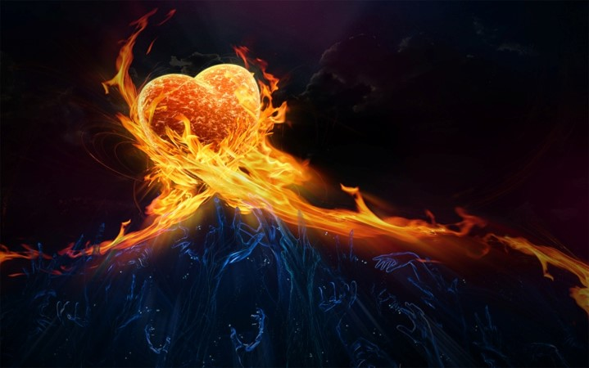
Blessing Three
We can be sanctified by the Spirit, have dross and evil burned out of us as though by fire, become clean and spotless, and be fit to dwell with gods and angels.
(3)

Slide 24
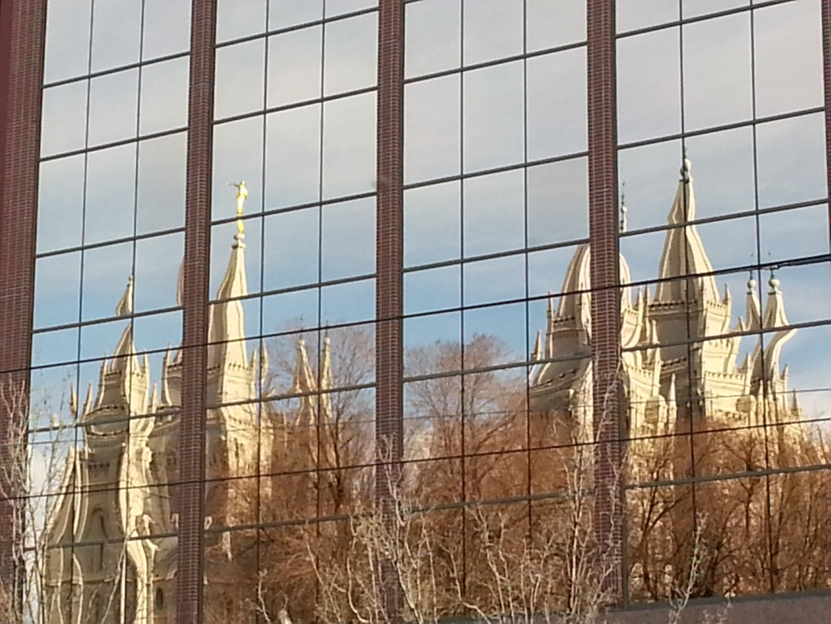
Blessing Four
We stand in the place and stead of the Lord Jesus Christ in administering salvation to the children of men.
(3)

Slide 25
Blessing Five
We have power to become the sons of God, to be adopted into the family of the Lord Jesus Christ, to have Him as our Father, to be one with Him as He is one with His Father.
(3)

Slide 26
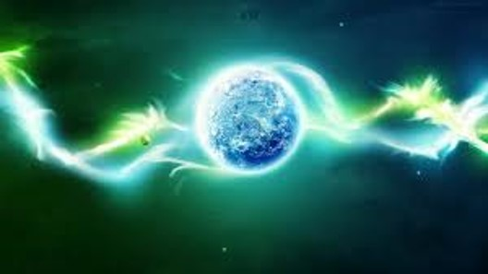
Blessing Six
We can enter into the patriarchal order, the order of eternal marriage, the order which enables the family unit to continue everlastingly in celestial glory.
(3)

Slide 27
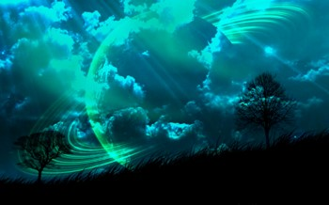
Blessing Seven
We have power to govern all things, both temporal and spiritual kingdoms of the world, and the elements and storms and powers of the earth.
(3)

Slide 28
Blessing Eight
We have power, through the priesthood, to gain eternal life, the greatest of all the gifts of God.
(3)

Slide 29
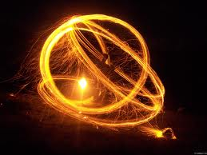
Blessing Nine
We have power to make our calling and election sure, so that while we yet dwell in mortality, having overcome the world and been true and faithful in all things, we shall be sealed up unto eternal life and have the unconditional promise of eternal life in the presence of Him whose we are.
(3)

Slide 30
Blessing Ten
We have the power—and it is our privilege—so to live, that becoming pure in heart, we shall see the face of God while we yet dwell as mortals in a world of sin and sorrow.
(3)

Slide 31
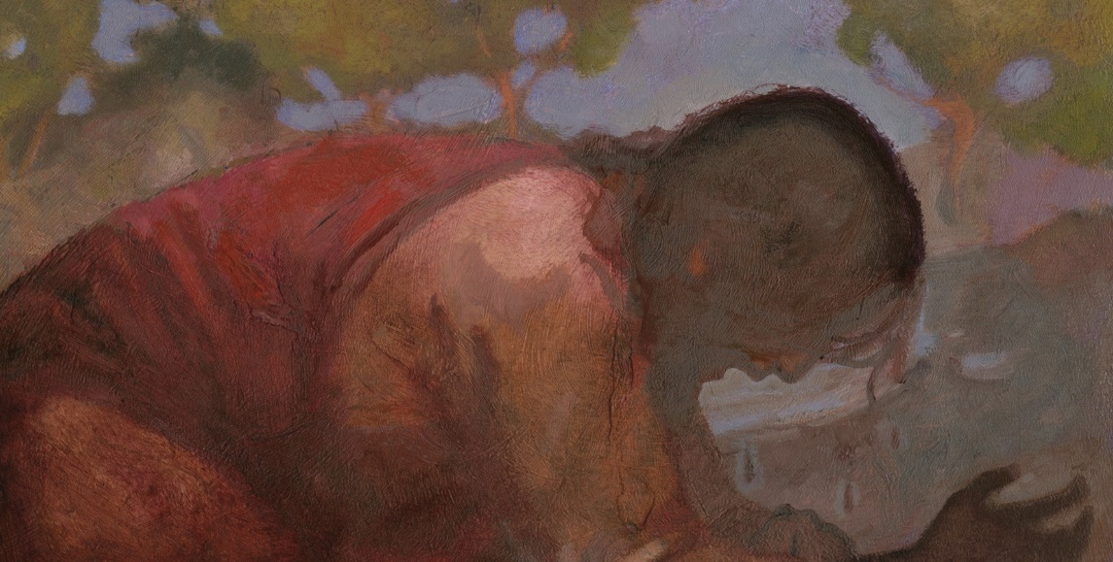
The Mediator of the Better Covenant
A third party who stands between two others to resolve their differences and to bring them together. (1)
Better Covenant = New Covenant
Read Jeremiah 31:31-34
“For every high priest is ordained to offer gifts and sacrifices: wherefore it is of necessity that this man have somewhat also to offer.”
Hebrews 8:1-13
J. Kirk Richards

Slide 32
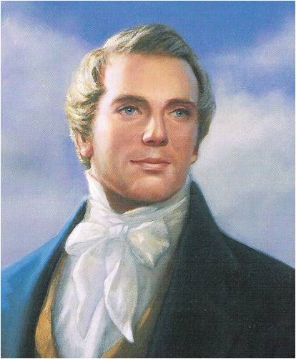
“Christ, in the days of His flesh, proposed to make a covenant with them, but they rejected Him and His proposals, and in consequence thereof, they were broken off, and no covenant was made with them at that time.
But their unbelief has not rendered the promise of God of none effect: no, for there was another day limited in David, which was the day of His power; and then His people, Israel, should be a willing people;—and He would write His law in their hearts, and print it in their thoughts; their sins and their iniquities He would remember no more.”
(5)

Slide 33
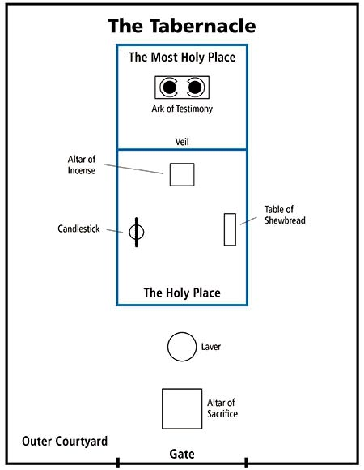
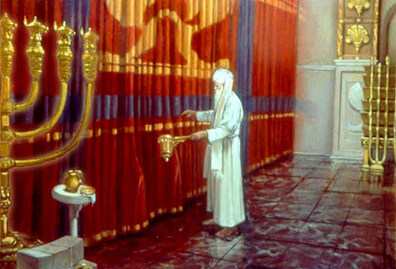
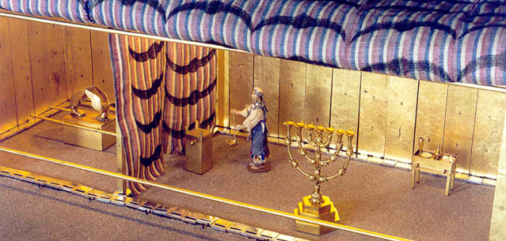
Blueprint
Ark of the testimony was the central feature of the tabernacle representing the presence of the Lord
Into this courtyard anyone of Israel could bring sacrifices, but only the priests could enter the tabernacle itself.
Most Holy Place is often called the Holy of Holies.
The Veil of the Tabernacle dividing two rooms
Basons underneath the Alter would catch the blood from the sacrifice
For the priests to clean and prepare to enter into Tabernacle
Hebrews 9-10; Exodus 26

Slide 34
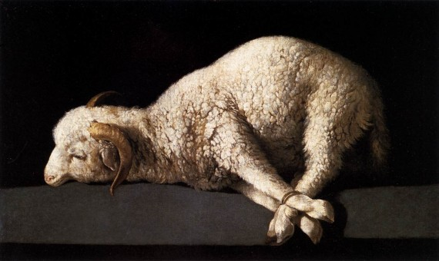
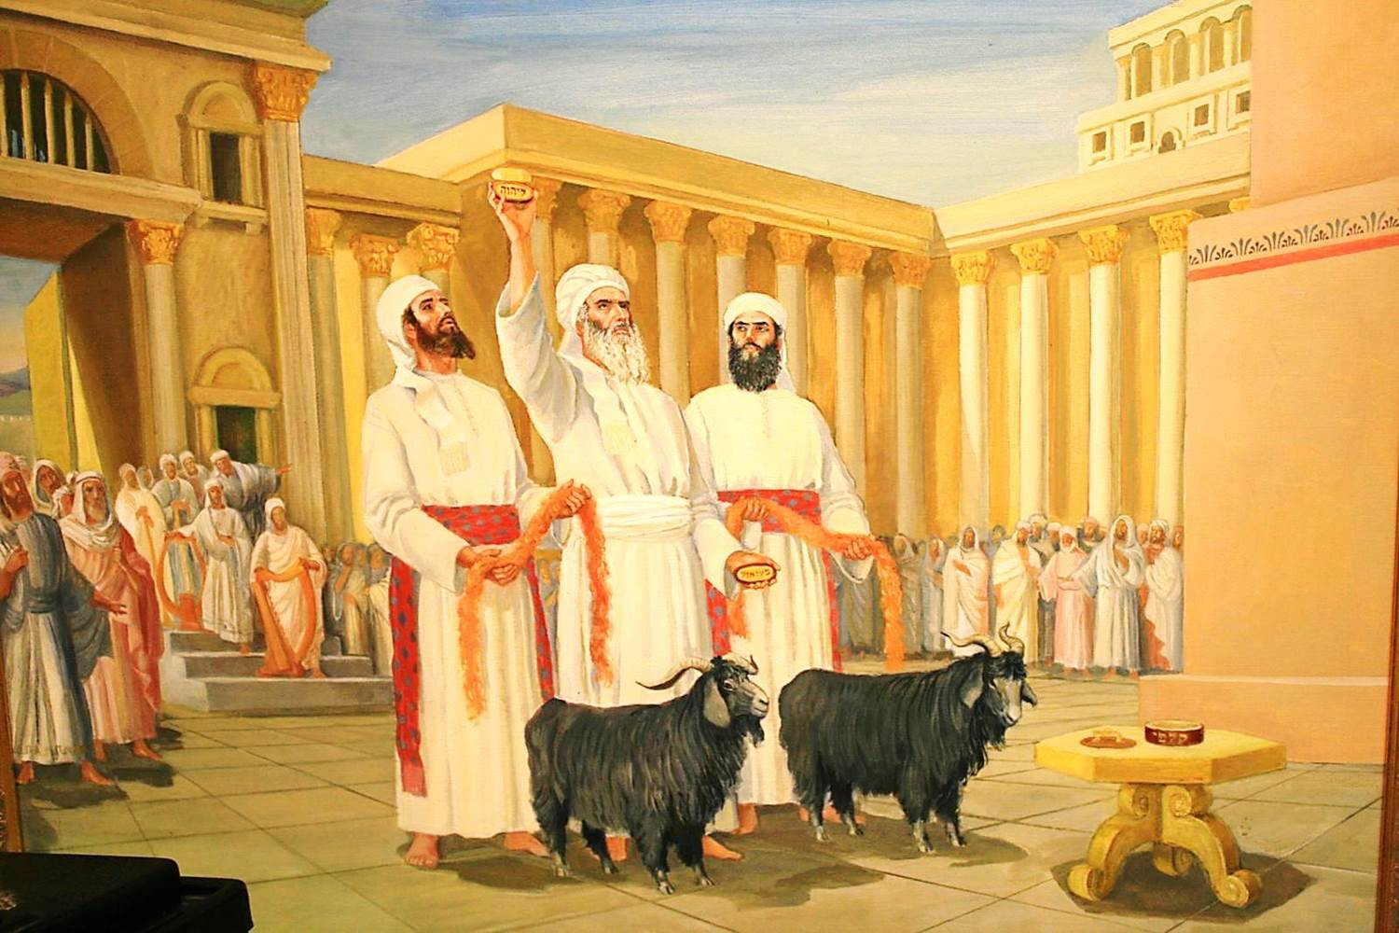
Day of Atonement
Once a year on the Jewish holy day called the Day of Atonement (also called Yom Kippur), the high priest was allowed to enter the Most Holy Place (also called the Holy of Holies) in the tabernacle or, later, the Jerusalem temple.
There, the high priest sacrificed a bullock and a he-goat. He sprinkled the animals’ blood in designated places in the Most Holy Place to symbolize Christ’s Atonement for the priest’s sins and for the people’s sins.
The high priest then symbolically transferred the people’s sins onto another he-goat (called the scapegoat), which was then driven into the wilderness, signifying the removal of the people’s sins.
He also sacrificed two rams as burnt offerings for himself and the people. (6)
Hebrews 9-10: Leviticus 16:22

Slide 35
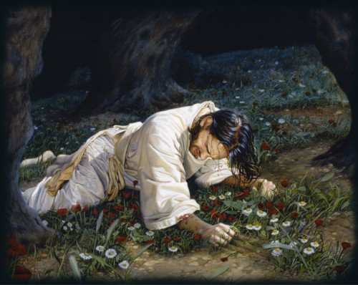
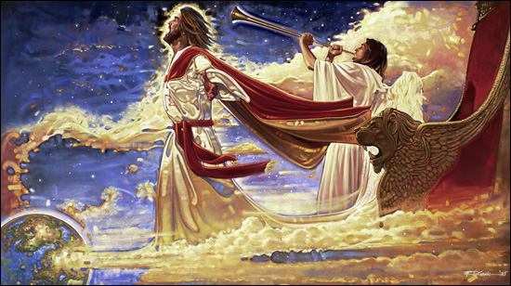
Day of Atonement
For then must he often have suffered since the foundation of the world: but now once in the end of the world hath he appeared to put away sin by the sacrifice of himself.
So Christ was once offered to bear the sins of many; and unto them that look for him shall he appear the second time without sin unto salvation.
Ron DiCianni
Hebrews 9:26, 28

Slide 36
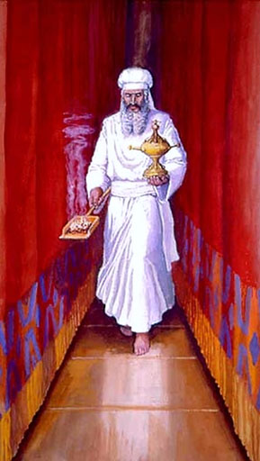
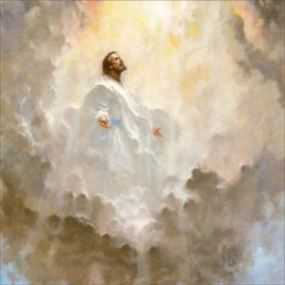
What is the importance of the Day of Atonement?
It was a rehearsal of things to come
Just as the high priests entered the Most Holy Place of the tabernacle on the Day of Atonement, what “holy place” could the Savior enter because of His Atonement?
Heavenly Father’s presence, or celestial glory.
Hebrews 9:12

Slide 37
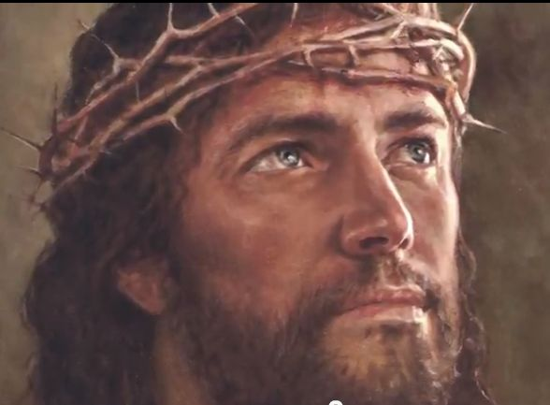
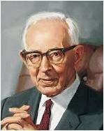
The Sacrifice
The Cleansing Power of Blood
What could Jesus Christ’s sacrifice do that the “blood of bulls and of goats” could not?
“The Latter-day Saints believe in the efficacy of the blood of Christ. They believe that through obedience to the laws and ordinances of the gospel they obtain a remission of sins; but this could not be if Christ had not died for them...” (6)
For it is expedient that there should be a great and last sacrifice; yea, not a sacrifice of man, neither of beast, neither of any manner of fowl; for it shall not be a human sacrifice; but it must be an infinite and eternal sacrifice.
Alma 34:10
Hebrews 10:4

Slide 38
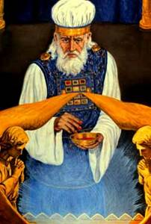
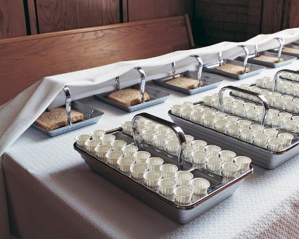
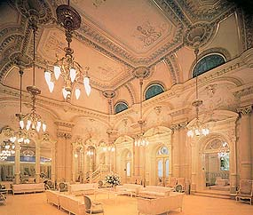
A Shadow of Good Things to Come
Why, then, did the high priests perform these sacrifices on the Day of Atonement?
To demonstrate “a shadow of the good things to come” or to point to the Savior’s Atonement.
We see the same shadowed symbolism in our day:
The sacrament is a shadow of the atoning sacrifice.
Baptism is a shadow of our entrance into the kingdom and our commitment to discipleship.
The celestial room is but a shadow of dwelling in the presence of God.
…someday, we will see the Light of the World-not through a glass darkly, not as a shadow cast by the gospel of Christ-but 'then face to face' (1 Cor. 13:12). (7)
Salt Lake Temple Celestial Room Liahona Nov. 1993
Hebrews 10:1

Slide 39
“[Jesus Christ’s] Atonement is infinite—without an end. It was also infinite in that all humankind would be saved from never-ending death. It was infinite in terms of His immense suffering. It was infinite in time, putting an end to the preceding prototype of animal sacrifice. It was infinite in scope—it was to be done once for all.”
Hebrews 10:10
(8)

Slide 40
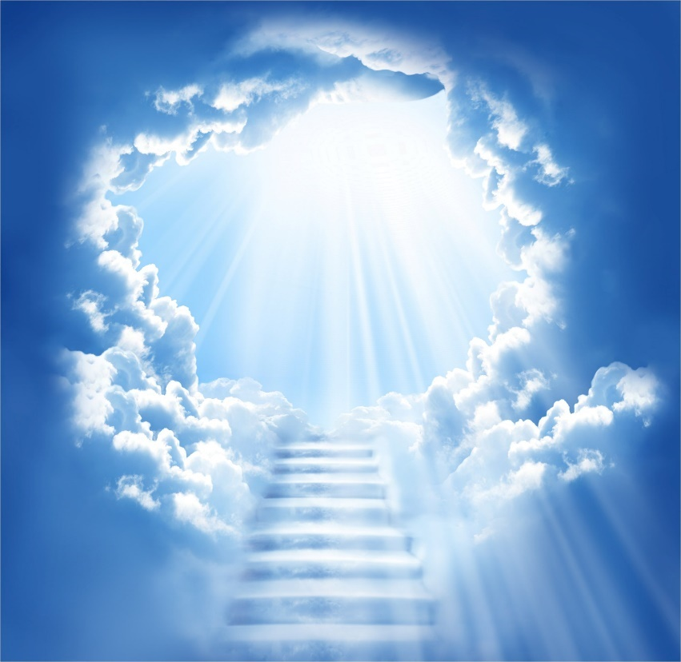
The Holiest Place
The “new and living way” refers to the gospel of Jesus Christ, or the plan by which we can be forgiven and sanctified through His Atonement and thereby become worthy to return to God’s presence.
Hebrews 10:19-20

Slide 41
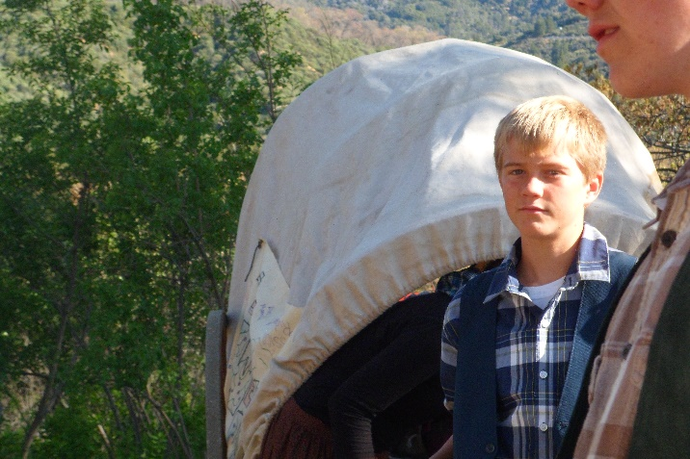
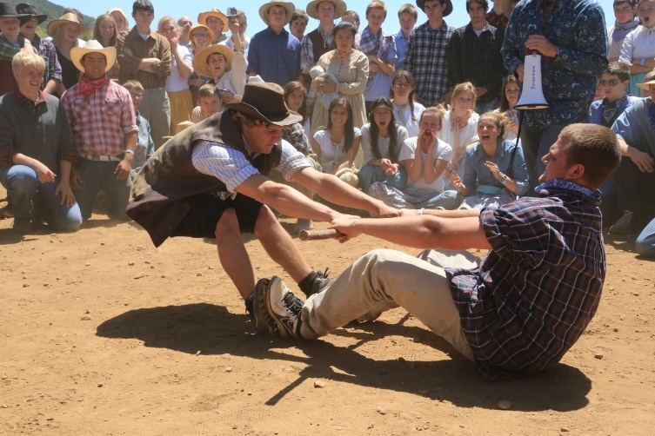
Caste Not Away Your Confidence
“In Latter-day Saint talk that is to say, “Sure it is tough”—before you join the Church, while you are trying to join, and after you have joined.
That is the way it has always been, Paul says, but don’t draw back. Don’t panic and retreat.
Don’t lose your confidence.
Don’t forget how you once felt.
Don’t distrust the experience you had.
That tenacity is what saved Moses and Joseph Smith when the adversary confronted them, and it is what will save you.” (9)
Hebrews 10:35
Poway Stake Trek for Youth 2013

Slide 42
Sources:
New Testament Institute Student Manual Chapter 48
Elder L. Tom Perry “The Priesthood of Aaron” 2010 Oct. General Conference
Bruce R. McConkie “Mormon Doctrine” page 480; “The Ten Blessings of the Priesthood” 1977 Oct. General Conference
Elder Dallin H. Oaks (“Priesthood Authority in the Family and the Church,” Ensign or Liahona, Nov. 2005, 26).
Joseph Smith in History of the Church, 1:313.
Joseph Fielding Smith Doctrines of Salvation, 3 vols., edited by Bruce R. McConkie [Salt Lake City: Bookcraft, 1954-1956], 1: 134-136
Gospeldoctrine.com
Elder Russell M. Nelson (“The Atonement,” Ensign, Nov. 1996, 35).
Elder Jeffrey R. Holland (“Cast Not Away Therefore Your Confidence,” Ensign, Mar. 2000, 8).
Presentation by ©http://fashionsbylynda.com/blog/

Slide 43
LETTER TO THE HEBREWS—BELIEVED WRITTEN BY PAUL, (HEBREWS)
Salvation Comes Through Christ’s Intercession | 7:23–28
Christ Offered Himself a Sacrifice for Sin | 8:1–5
A New Covenant with Israel | 8:6–13
Mosaic Ordinances Prefigure Christ’s Ministry | 9:1–14
Christ, the Mediator of the New Covenant | 9:15–28
“By the Blood Ye Are Sanctified” | 10:1–18
Those Who Fall From Grace Are Damned | 10:19–39
Salvation Comes Through Christ’s Intercession | 7:23–28
Day of Atonement Hebrews 9-10:
Once a year on the Jewish holy day called the Day of Atonement (also called Yom Kippur), the high priest was allowed to enter the Most Holy Place (also called the Holy of Holies) in the tabernacle or, later, the Jerusalem temple. There, the high priest sacrificed a bullock and a he-goat. He sprinkled the animals’ blood in designated places in the Most Holy Place to symbolize Christ’s Atonement for the priest’s sins and for the people’s sins. The high priest then symbolically transferred the people’s sins onto another he-goat (called the scapegoat), which was then driven into the wilderness, signifying the removal of the people’s sins. He also sacrificed two rams as burnt offerings for himself and the people. (See Bible Dictionary, “Fasts”; see also Leviticus 16:22.)
Good Things to Come Hebrews 9:11:
“Every one of us has times when we need to know things will get better. Moroni spoke of it in the Book of Mormon as ‘hope for a better world’ [Ether 12:4]. For emotional health and spiritual stamina, everyone needs to be able to look forward to some respite, to something pleasant and renewing and hopeful, whether that blessing be near at hand or still some distance ahead. It is enough just to know we can get there, that however measured or far away, there is the promise of ‘good things to come.’
“My declaration is that this is precisely what the gospel of Jesus Christ offers us, especially in times of need. There is help. There is happiness. There really is light at the end of the tunnel. It is the Light of the World, the Bright and Morning Star, the ‘light that is endless, that can never be darkened’ [Mosiah 16:9; see also John 8:12; Revelation 22:16]. … To any who may be struggling to see that light and find that hope, I say: Hold on. Keep trying. God loves you. Things will improve. Christ comes to you in His ‘more excellent ministry’ with a future of ‘better promises.’ He is your ‘high priest of good things to come’ [Hebrews 8:6; 9:11]” Elder Jeffrey R. Holland (“An High Priest of Good Things to Come,” Ensign, Nov. 1999, 36.
Life and Teachings of Jesus and His Apostles Chapter 47
‘Ordained into the Priesthood Hebrews 7:3; 11-19:
All those who are ordained unto this priesthood are made like unto the Son of God’ [Joseph Smith Translation, Hebrews 7:3; see also Moses 1:6]. This likeness is not only in ordination and ordinance but also in the perfecting of individual hearts, something that occurs ‘in process of time’ [Moses 7:21] as we ‘[yield] to the enticings of the Holy Spirit, and [put] off the natural man’ [Mosiah 3:19]. When a man is ordained to the Melchizedek Priesthood, he enters into an ‘order’ [Alma 13:2, 16 D&C 107:3] by which he may be refined through service to others” Elder Craig A. Cardon (“Moving Closer to Him,” Ensign or Liahona, Nov. 2006, 95).
Old and New Covenant Hebrews 9:22:
As Paul taught that both the old covenant and the new covenant required the blood of a sacrifice, he observed that “without shedding of blood is no remission” (Hebrews 9:22). Blood is symbolic of life. Sin offerings under the law of Moses required the shedding of an animal’s blood. In setting forth the laws respecting sacrificial ordinances in ancient Israel, the Lord explained: “For the life of the flesh is in the blood: and I have given it to you upon the altar to make an atonement for your souls: for it is the blood that maketh an atonement for the soul” (Leviticus 17:11). The blood of animals ratified the old covenant, foreshadowing the shedding of Jesus Christ’s blood that ratified the new covenant and made the remission of sins possible (see Hebrews 10:4; Mosiah 3:14–15). (1)

Slide 44
Hebrews 9:2-5 Holy artifacts of the Tabernacle
"Tabernacle: The tabernacle was a portable temple of the Lord, the place of the divine presence, and thus represents the kingdoms of heaven. The outer court represents the telestial order, the holy place the terrestrial order, and the Holy of Holies, the celestial world, the place where the throne of God is found.
"Candlestick: The seven-branched candelabrum of the tabernacle was part of the furniture of the holy place. It was not lighted by candles, but by pure olive oil in cup-shaped containers resting on the head of each of its branches. (Ex. 25:31-40.) Its light represents the light of the Holy Spirit. The seven branches or stems represent the fullness and perfection of the revelations of God and could be taken as affirmation that they would burn brightly in seven great gospel dispensations.
"Table: Paul's reference is to the table of shewbread that stood on the north or right side as one entered the holy place. It faced the candlestick and upon it were to be placed twelve loaves of bread made of fine (unleavened) flour. Paul does not identify its symbolism. Its equivalent in our day could be the sacrament table.
"Shewbread: Literally translated, the name shewbread means 'the bread of faces,' or 'the bread of the presence,' signifying that this bread was placed before the face of the Lord or in his presence. That there is a common symbolism between the Sabbath ritual in which the priests were to eat the shewbread and the ordinance of the sacrament, as introduced by Christ, seems apparent.
"Sanctuary: The sanctuary, in this text, refers to the holy place.
"Veil: Paul's reference is to the thick curtain separating the Holy of Holies from the holy place in the temple. The rending of the veil symbolizes the removal of the barrier between man and God, for man is thus enabled 'to enter into the holiest by the blood of Jesus.' ("Heb. 10:19Heb. 10:19.) Thus, the faithful and obedient can, in the fullest and most complete sense, enter into the rest of the Lord.
"Holiest of All: By holiest of all, Paul is referring to the Holy of Holies. This, the most sacred place in the temple, is the symbolic representation of the heavenly temple where the throne of God sits.
"Golden Censer: The vessel used for the burning of incense in the holy place was known as the golden censer. (Paul seems to indicate that this was housed in the Holy of Holies. There is nothing in the Old Testament that corroborates this.) The smoke rising from the vessel is a symbol of the prayers of Israel rising to God. (Ps. 141:2.)
"Ark of the Covenant: Housed within the Holy of Holies, the ark of the covenant signifies the divine presence and as such is the most sacred symbol in ancient Israel.
"Manna: Among the sacred relics found within the temple was a golden pot containing some of the manna sent down from heaven as food for Israel during their wilderness wanderings. This bread from heaven typifies the spiritual salvation that could be had only through Christ, who is the Bread of Life.
"Aaron's Rod: To affirm his call to Aaron and his tribe to labor in the priesthood in preference to the other tribes, the Lord instructed Moses to have each of the tribes bring a rod or branch with the name of their prince on it. These twelve rods were then placed before the Lord in the Holy of Holies. The following morning when Moses went to the sacred place, he found the rod of Aaron covered with buds, blossoms, and even mature almonds. The other rods remained as barren as before. (Num. 17.) As I have written elsewhere, 'The symbolism associated with this test was most deliberate: A rod, or branch, had been chosen to represent each of the twelve tribes or families of Israel; each had its name carefully placed upon it. By tradition, the rod, as a staff or sceptre, represented one's position and authority. Together, all were presented before the Lord. By making Aaron's rod bud, blossom, and put forth fruit, the Lord demonstrated once again that it was for him to choose those who will stand in his stead, be filled with his power, and bring forth his fruits.‘
"Tables of the Covenant: The tables of the covenant refers to the tablets upon which the Ten Commandments were written.
"Cherubim: The images of two cherubim were placed over the mercy seat of the ark in the Holy of Holies. Cherubim are angels, set to guard the way before the presence of the Lord. They are to see that no unclean thing enters the divine presence.
"Mercy Seat: The mercy seat is the golden lid to the ark of the covenant: This lid, which covers the ark, is a symbolic representation of the manner in which the Atonement overarches or covers all that is sacred. The name comes from the Hebrew kapporeth, which, in turn, comes from the root kaphar, meaning to cover or expiate. It implies the making of an atonement, a cleansing or forgiving.
"Though Paul did not detail the meaning of each of these items associated with the temple, his purpose was to emphasize that each was intended as a witness of Jesus as the Christ." (Joseph F. McConkie in Studies in Scripture, Vol. 6: Acts to Revelation, ed. By Robert L. Millet, [Salt Lake City: Deseret Book Co., 1987], 203.)

Slide 45
Faith
Hebrews 11
But without faith it is impossible to please him: for he that cometh to God must believe that he is, and that he is a rewarder of them that diligently seek him.
Hebrews 11:6

Slide 46
What is Faith?
(1) faith is the assurance of things hoped for that are true
(2) faith is the evidence of things not seen,
(3) faith is the principle of action in all intelligent beings.
These three elements of faith—assurance, evidence, and action—work together as we face the future, look to the past, and take action in the present.
(2)

Slide 47
“Truly understood and properly practiced, faith is one of the grand and glorious powers of eternity. It is a force powerful beyond our comprehension.
‘Through faith … the worlds were framed by the word of God’.
Through faith, waters are parted, the sick healed, the wicked silenced, and salvation made possible.
F
A
I
T
H
“Our faith is the foundation upon which all our spiritual lives rest. It should be the most important resource of our lives.”
Hebrews 11:3
(3)

Slide 48
Cain and Abel
“By faith in this atonement or plan of redemption, Abel offered to God a sacrifice that was accepted, which was the firstlings of the flock.”
“Cain offered of the fruit of the ground, and was not accepted, because he could not do it in faith; he could have no faith, or could not exercise faith contrary to the plan of heaven.
Hebrews 11:4
(4)

Slide 49
“It must be shedding the blood of the Only Begotten to atone for man, for this was the plan of redemption, and without the shedding of blood was no remission.
And as the sacrifice was instituted for a type by which man was to discern the great Sacrifice which God had prepared, to offer a sacrifice contrary to that, no faith could be exercised, because redemption was not purchased in that way, nor the power of atonement instituted after that order; consequently Cain could have no faith.”
Hebrews 11:4
(4)

Slide 50
Exercising Faith
God rewards those who exercise faith in Jesus Christ.
Hebrews 11:6
(4)

Slide 51
By Faith and Through Faith
Enoch
“moved with fear” means that Noah acted with hope and assurance based on God’s guidance
Hebrews 11:5-6
Noah
Hebrews 11:7
Abraham
Sara
Hebrews 11:8-10
Hebrews 11:11
Hebrews 11:6

Slide 52
By Faith and Through Faith
Moses chose “rather to suffer affliction with the people of God, than to enjoy the pleasures of sin for a season; esteeming the reproach of Christ greater riches than the treasures in Egypt” (1)
Isaac
Hebrews 11:20
Jacob
Hebrews 11:21
Joseph
Moses
Hebrews 11:22
Hebrews 11:23-25

Slide 53
By Faith and Through Faith
The traditional belief is that Isaiah was
“sawn asunder”
Egypt
Hebrews 11:26-29
Jericho
Hebrews 11:30
Daniel
Shadrach
Meshach
Abednego
The widow of Zarephath
Isaiah
Rahab
Hebrews 11:31
Scriptural People
Hebrews 11:33-37

Slide 54
“Faith precedes the miracle. It has ever been so and shall ever be. It was not raining when Noah was commanded to build an ark. There was no visible ram in the thicket when Abraham prepared to sacrifice his son Isaac. Two heavenly personages were not yet seen when Joseph knelt and prayed. First came the test of faith—and then the miracle.”
(5)

Slide 55
Everything good in life—every potential blessing of eternal significance—begins with faith.
Allowing God to prevail in our lives begins with faith that He is willing to guide us.
(6)

Slide 56
Miracles, signs, and wonders abound among followers of Jesus Christ today, in your lives and in mine. …
… They are not always what we ask for or what we expect, but when we trust in the Lord, He will be there, and He will be right. He will suit the miracle to the moment we need it. …
There are times we hope for a miracle to heal a loved one, to reverse an unjust act, or to soften the heart of a bitter or disillusioned soul.
Looking at things through mortal eyes, we want the Lord to intervene, to fix what is broken.
Through faith, the miracle will come, though not necessarily on our timetable or with the resolution we desired.
Does that mean we are less than faithful or do not merit His intervention? No. We are beloved of the Lord. He gave His life for us, and His Atonement continues to release us from burdens and sin as we repent and draw close to Him.
(7)

Slide 57
The Lord has reminded us, “Neither are your ways my ways”.
He offers, “Come unto me, all ye that labour and are heavy laden, and I will give you rest” —rest from worry, disappointment, fear, disobedience, concern for loved ones, for lost or broken dreams.
Peace amidst confusion or sorrow is a miracle. Remember the Lord’s words: “Did I not speak peace to your mind concerning the matter? What greater witness can you have than from God?”.
The miracle is that Jesus Christ, the Great Jehovah, the Son of the Highest, is responding with peace.
Isaiah 55:8; Matthew 11:28; Doctrine and Covenants 6:23
(7)

Slide 58
Sources:
New Testament Institute Student Manual Chapter 49
Elder David A. Bednar (“Seek Learning by Faith,” Ensign, Sept. 2007, 62).
Elder Joseph B. Wirthlin (“Shall He Find Faith on the Earth?” Ensign, Nov. 2002, 84).
Teachings of Presidents of the Church: Joseph Smith [2007], 48)
President Thomas S. Monson (“The Call to Serve,” Ensign, Nov. 2000, 48–49).
Russell M. Nelson, “Christ Is Risen; Faith in Him Will Move Mountains,” Liahona, May 2021, 102
Ronald A. Rasband, “Behold! I Am a God of Miracles,” Liahona, May 2021, 109, 111

Slide 59
LETTER TO THE HEBREWS—BELIEVED WRITTEN BY PAUL, (HEBREWS)
By Faith the Worlds Were Made | 11:1–3
Why Abel’s Sacrifice Was Acceptable | 11:4
The Doctrine of Translation | 11:5, 6
Faith Saved Noah | 11:7
Abraham Sought a Heavenly City | 11:8–16
Why Abraham Was Commanded to Sacrifice Isaac | 11:17–19
By Faith the Worlds Were Made | 11:1–3
Patriarchal Blessings Came by Faith | 11:20–22
Faith of Ancients Centered in Christ | 11:23–31
Faith and Miracles Are Inseparable | 11:32–35
Faith Enables Men to Endure Sufferings | 11:35–40
Faith:
“Important components of faith are patience, long-suffering, and enduring to the end. The Apostle Paul recounts the faith of … Abraham, and Sara, concluding that ‘these all died in faith, not having received the promises, but having seen them afar off, and were persuaded of them, and embraced them, and confessed that they were strangers and pilgrims on the earth’ (see Hebrews 11:4–13). These faithful Saints knew that this earth life was a journey, not their final destination” Elder Spencer J. Condie (“Claim the Exceeding Great and Precious Promises,” Ensign or Liahona, Nov. 2007, 17).
Abraham’s Test:
“Who can conceive of a more severe test of faith than the heaven-sent order to sacrifice the heir of promise, the heir whom God must then raise from the dead that his promises concerning Isaac might be fulfilled. (Gen. 21:12.) Is it any wonder that in all succeeding generations the seed of Abraham have looked back with awe and reverence upon a scene which tested mortal man almost beyond mortal power to obey?
“Why did Deity devise such a test? Certainly it was for Abraham’s blessing and benefit. There can be no question that the harder the test, the higher the reward for passing it. And here Abraham laid his all on the altar, thus proving himself worthy of that exaltation which he has now received. (D. & C. 132:29) And immediately following his conformity to the divine will, he received a heavenly manifestation of the glory and honor reserved for him and his seed. (Gen. 22:15–18.}
“Certainly, also, Abraham’s willingness to sacrifice Isaac was intended to be an example forever of that perfect obedience which the Lord expects of all the heirs of promise” (Elder Bruce R. McConkie Doctrinal New Testament Commentary, 3 vols. [1965–73], 3:206–7).
True Peace and Happiness: Hebrews 11:25:
“Those who yield to the enticing of Satan may, as the scripture says, ‘enjoy the pleasures of sin for a season’ (Heb. 11:25), but that kind of pleasure can never lead to lasting happiness or eternal joy. …
“Brothers and sisters, old and young, I plead with each of you to remember that wickedness never was happiness and that sin leads to misery [see Alma 41:10. Young people, do not seek happiness in the glittering but shallow things of the world. We cannot achieve lasting happiness by pursuing the wrong things” Elder Dallin H. Oaks (“Joy and Mercy” Ensign, Nov. 1991, 75).
Life and Teachings of Jesus and His Apostles Chapter 48

Slide 60
Run the Race With Faith
Hebrews 12-13

Slide 61
What can motivate a runner to keep running even when he or she faces fatigue or other difficulties?
In what ways is life as a disciple of Jesus Christ like an endurance race?
What difficulties might we face as disciples of Jesus Christ?
(2)

Slide 62
How would wearing a backpack filled with rocks affect a runner?
In what ways are our sins like a backpack filled with rocks?
What does it mean to run the race of discipleship with patience?
(2)

Slide 63
Lay Aside Sin
“author and finisher of our faith” = “the Leader and Perfecter of our faith”
Heinrich Hofmann
contradiction = opposition
“Remember that we do not run alone in this great race of life; we are entitled to the help of the Lord. (2)
As we look to the example of Jesus Christ, we can find strength to put aside our sins and patiently endure opposition.
Hebrews 12:2-4

Slide 64
Willing to suffer
“For His Atonement to be infinite and eternal, He had to feel what it was like to die not only physically but spiritually, to sense what it was like to have the divine Spirit withdraw, leaving one feeling totally, abjectly, hopelessly alone.
“But Jesus held on. He pressed on. The goodness in Him allowed faith to triumph even in a state of complete anguish. The trust He lived by told Him in spite of His feelings that divine compassion is never absent, that God is always faithful, that He never flees nor fails us.” (3)
Hebrews 12:2-4

Slide 65
"God truly is our Father, the Father of the spirits of all mankind. We are his literal offspring and are formed in his image.
We have inherited divine characteristics from him. Knowing our relationship to our Heavenly Father helps us understand the divine nature that is in us and our potential.
The doctrine of the fatherhood of God lays a solid foundation for self-esteem.“
(4)

Slide 66
Doctrinal Mastery
Furthermore we have had fathers of our flesh which corrected us, and we gave them reverence: shall we not much rather be in subjection unto the Father of spirits, and live?
Hebrews 12:9

Slide 67
God’s Character
Numbers 23:19
Psalm 103:8
Acts 10:34-35
Acts 17:28
Howard Lyon
James 1:17
1 Nephi 9:6
Moses 7:30-35

Slide 68
Having “a correct idea of [Heavenly Father’s] character, perfections, and attributes” is essential to exercising faith sufficient to obtain exaltation.
A correct understanding of Heavenly Father’s character can change how we see ourselves and others and help us to understand God’s tremendous love for His children and His great desire to help us become like Him.
An incorrect view of His nature can leave us feeling as if we are incapable of ever making it back to His presence.
(11)
Hebrews 12:9; Lectures on Faith (1985), 38

Slide 69
Be in Subjection
To be humble, teachable, and willing to make changes in our lives to align with His will.
If we submit to chastening from Heavenly Father, we will become more like Him and have the peace that comes from righteousness
Hebrews 12:9-10

Slide 70
Correction is vital if we would conform our lives “unto a perfect man, [that is,] unto the measure of the stature of the fulness of Christ”.
Paul said of divine correction or chastening, “For whom the Lord loveth he chasteneth”.
Though it is often difficult to endure, truly we ought to rejoice that God considers us worth the time and trouble to correct.
(10)
Correct
Ephesians 4:13; Hebrews 12:6

Slide 71
The Mount Might Be Touched
Paul compares the situation of the children of Israel in Moses’ day with the people of his own day.
In Moses’ time the children of Israel were forbidden by divine law to touch Mount Sinai on penalty of death; it was not so in Paul’s day, nor is it in our own.
“No longer is there a restraining barrier to keep the people from seeing and communing with their God. The mountain is no longer Sinai but Zion.” (5)
Hebrews 12:18; Ex. 19:9-25; 20:1-23.
(6)

Slide 72
Church of the Firstborn
Paul’s teaching that redeemed Saints join the “church of the firstborn” is the only biblical occurrence of this phrase.
In latter-day revelations, the Prophet Joseph Smith learned that the Church of the Firstborn refers to Christ’s heavenly Church, which comprises faithful, exalted Saints in the celestial kingdom .
That by keeping the commandments they might be washed and cleansed from all their sins, and receive the Holy Spirit by the laying on of the hands of him who is ordained and sealed unto this power;
And who overcome by faith, and are sealed by the Holy Spirit of promise, which the Father sheds forth upon all those who are just and true.
They are they who are the church of the Firstborn.
D&C 76:52-54
Hebrews 12:23
(7)

Slide 73
Paul’s Admonition
Brotherly Love = be mindful of those who suffer
Make marriage Honorable = Making sure your courtship is clean and virtuous
To not covet = to be content with all you have been given
Hebrews 13:1-9

Slide 74
The Altar
The altar Paul refers to is the sacramental table spread by the atonement of Jesus Christ, which may be partaken of by all who covenant with Christ.
Today’s Altar
'Those who serve the tabernacle' has reference to the Levitical Priesthood holders who performed the ordinances in the ancient tabernacle and temple."
Hebrews 13:10-12
(6)

Slide 75
Obedience To Spiritual Leaders
"Submitting to the leadership, counsel, and direction of those placed over us may test us, particularly in view of the imperfections leaders have. (8)
"I humbly and prayerfully hope that what I have to say will be received in the spirit that I would like to convey. We have just heard the prophet of God. He is a watchman on the tower. He has raised a warning voice. I would urge all to listen and follow his counsel. It is tremendously important always to be in harmony with those who, according to Paul, have 'watch for your souls, as they that must give account, that they may do it with joy, and not with grief‘. (9)
Hebrews 13:17-25

Slide 76
Sources:
New Testament Institute Student Manual Chapter 49
President Thomas S. Monson (“Great Expectations” [Brigham Young University devotional, Jan. 11, 2009], 6; speeches.byu.edu).
Elder Jeffery R. Holland (“None Were with Him,” Ensign or Liahona, May 2009, 88).
Elder Joseph B. Wirthlin ("Fruits of the Restored Gospel of Jesus Christ," Ensign, Nov. 1991, 15)
Elder Bruce R. McConkie DNTC, 3:229.)
Life and Teachings of Jesus and His Apostles Chapter 48
Guide to the scriptures
Elder Neal A. Maxwell (Not My Will, But Thine [Salt Lake City: Bookcraft, 1998], 104.)
President James E. Faust " ("Unwanted Messages," Ensign, Nov. 1986, 8)
D. Todd Christofferson, “As Many as I Love, I Rebuke and Chasten,” Ensign or Liahona, May 2011, 97–98
Brian K. Ashton, “The Father,” Ensign or Liahona, Nov. 2018, 93–94
Presentation by ©http://fashionsbylynda.com/blog/

Slide 77
LETTER TO THE HEBREWS—BELIEVED WRITTEN BY PAUL, (HEBREWS)
“Whom the Lord Loveth He Chasteneth” | 12:1–8
Premortality and Exaltation | 12:9, 10
Peace and Holiness Lead One to See God | 12:11–17
Exalted Saints Belong to the Church of the Firstborn | 12:18–24
“Our God Is a Consuming Fire” | 12:25–29
“Some Have Entertained Angels Unawares” | 13:1–3
Marriage Is Honorable | 13:4–7
Christ is Everlastingly the Same | 13:8
How Christians Offer Sacrifices | 13:9–25
The Father of Spirits 12:9: ‘Who am I?’ I am a child of God with a spirit lineage to heavenly parents. That parentage defines our eternal potential. That powerful idea is a potent antidepressant. It can strengthen each of us to make righteous choices and to seek the best that is within us. Establish in the mind of a young person the powerful idea that he or she is a child of God and you have given self-respect and motivation to move against the problems of life” (“Powerful Ideas” ) Elder Dallin H. Oaks Ensign, Nov. 1995, 25).
Mount Sinai Hebrews 12:18:
“No longer is there a restraining barrier to keep the people from seeing and communing with their God. The mountain is no longer Sinai but Zion. And all those who have cleansed and perfected their souls, shall be welcomed on the heavenly mountain, and in the heavenly city, the new Jerusalem, the city of exalted beings. And there, in that heavenly realm, where the saints shall see and know, as Moses alone did in Israel, shall be found such might, display, splendor and omnipotence, that the doings of Jehovah on Sinai, incomprehensibly glorious as they were, shall be but a blurred image in comparison.” Elder Bruce R. McConkie (McConkie, DNTC, 3:229.)
Firstborn Hebrews 12:23, 24:
“Members of The Church of Jesus Christ of Latter-day Saints who so devote themselves to righteousness that they receive the higher ordinances of exaltation become members of the Church of the Firstborn. …
“The Church of the Firstborn is made up of the sons of God, those who have been adopted into the family of the Lord, those who are destined to be joint-heirs with Christ in receiving all that the Father hath.” (McConkie, Mormon Doctrine, p. 139.)
The phrase “the Church of the Firstborn” has no reference to the apostate group of the same name. (Life and Teachings of Jesus and His Apostles Chapter 48
Life and Teachings of Jesus and His Apostles Chapter 48
Endure Hebrews 12:5-13:
“No pain that we suffer, no trial that we experience is wasted. It ministers to our education, to the development of such qualities as patience, faith, fortitude and humility. All that we suffer and all that we endure, especially when we endure it patiently, builds up our characters, purifies our hearts, expands our souls, and makes us more tender and charitable, more worthy to be called the children of God … and it is through sorrow and suffering, toil and tribulation, that we gain the education that we come here to acquire and which will make us more like our Father and Mother in heaven. …” (Orson F. Whitney, as cited in Kimball, Faith Precedes the Miracle, p. 98.)
Can Make You Perfect Hebrews 13:21:
"...you can't make yourself perfect. You can't make yourself sinless and worthy of the presence of God the Father. You can't make yourself celestial, no matter how hard you try, because you have already sinned, and sinlessness requires not only perfect performance in the future, but also perfect performance in the past. Otherwise, you are not sinless, you are just a sinner who hasn't sinned recently. Many an obsessive student has learned the sad truth that once he or she gets just one B, no number of A's thereafter will restore a perfect record, a 4.0 grade-point average. Innocence requires forgiveness and cleansing. It requires that the record be expunged and rewritten, that all the sinful former deeds and actions cease to be counted-and all these things come only through the atonement of Christ...only Christ can make you perfect and celestial." (Stephen E. Robinson, Believing Christ: The Parable of the Bicycle and Other Good News [Salt Lake City: Deseret Book Co., 1992], 27.)

Slide 78
Johann Michael Ferdinand Heinrich Hofmann (March 19, 1824 - June 23, 1911) was a German painter of the late 19th to early 20th century. He was the uncle of the German painter Ludwig von Hofmann. He was born in Darmstadt and died in Dresden. He is best known for his many paintings depicting the life of Jesus Christ.
Heinrich Hofmann grew up in a family that harbored a deep interest in art. His father, advocate Heinrich Karl Hofmann (1795–1845) painted in watercolors, his mother Sophie Hofmann, née Volhard (1798–1854) gave lessons in art before she married, and his four brothers all showed artistic talent. Heinrich, however, was the only one for whom art was not only a profession but the center of his life.
In 1853, Hofmann returned to Darmstadt, and in the beginning of 1854, his beloved mother died. He was deeply moved by her death and it inspired him to paint his first large religious work: Burial of Christ.
he married Elisabeth Werner. The couple had no children. He died 23 June 1911 (aged 87) Dresden
Self portrait

