Slide 1
James

Slide 2
Messages of Salvation
James 1
For all those who will not endure chastening, but deny me, cannot be sanctified.
D&C 101:5

Slide 3
James
He was the author of James and identifies himself as “James, a servant of God and of the Lord Jesus Christ”
James is probably the half brother of Jesus, not James, the brother of John
He was initially one of Jesus’ disciples but after Jesus’ resurrection James was one who was a special witness to whom Jesus appeared
He later became an Apostle and first Bishop in the Church in Jerusalem
(1)

Slide 4
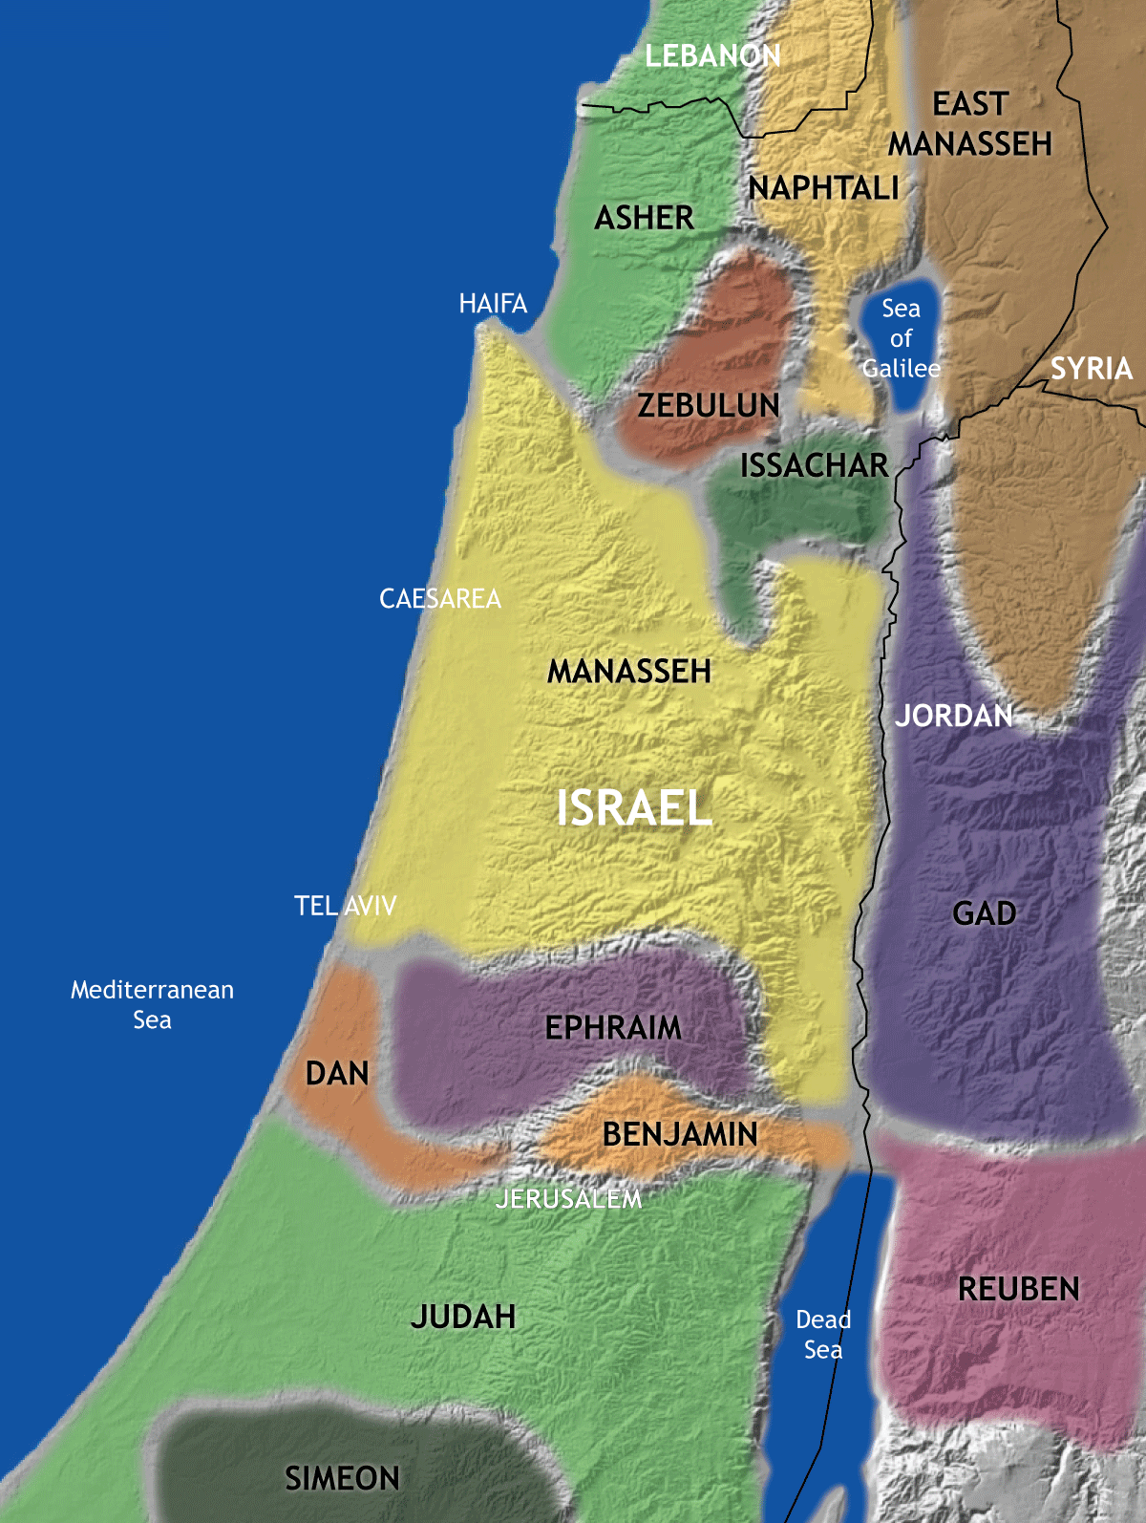
The Epistle of James
*James is the first of the seven “general Epistles” included in the New Testament—the others being 1 and 2 Peter; 1, 2, and 3 John; and Jude.
*James’ audience was to the scattered 12 Tribes, and we assume it was written in Jerusalem.
*Written probably before A.D 62. But maybe before A.D. 50. Which would mean that this letter was one of the earliest in the New Testament.
* In Josephus it is recorded that James and some others were taken before the Sanhedrin, sentenced to death, and delivered to be stoned.
(1)

Slide 5
Seeking Eternal Life
Faith Tested or Tried
Patience Produced
Sanctification and spiritual development
Patience
And again, be patient in tribulation until I come; and, behold, I come quickly, and my reward is with me, and they who have sought me early shall find rest to their souls. Even so. Amen.
D&C 54:10
James 1:2-4

Slide 6
Seeking Wisdom
My mind at times was greatly excited, the cry and tumult were so great and incessant. The Presbyterians were most decided against the Baptists and Methodists and used all the powers of both reason and sophistry to prove their errors, or, at least, to make the people think they were in error. On the other hand, the Baptists and Methodists in their turn were equally zealous in endeavoring to establish their own tenets and disprove all others.
In the midst of this war of words and tumult of opinions, I often said to myself: What is to be done? Who of all these parties are right; or, are they all wrong together? If any one of them be right, which is it, and how shall I know it?
Joseph Smith—History 1:9-10

Slide 7
Doctrinal Mastery
If any of you lack wisdom, let him ask of God, that giveth to all men liberally, and upbraideth not; and it shall be given him.
But let him ask in faith, nothing wavering. For he that wavereth is like a wave of the sea driven with the wind and tossed.
James 1:5-6

Slide 8
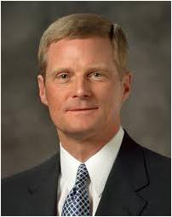
“Joseph’s questions focused not just on what he needed to know but also on what was to be done!
His prayer was not simply, ‘Which church is right?’ His question was, ‘Which church should I join?’ Joseph went to the grove to ask in faith, and he was determined to act.
“True faith is focused in and on the Lord Jesus Christ and always leads to righteous action. …
“… We press forward and persevere in the consecrated work of prayer, after we say ‘amen,’ by acting upon the things we have expressed to Heavenly Father.
“Asking in faith requires honesty, effort, commitment, and persistence.” (2)

Slide 9
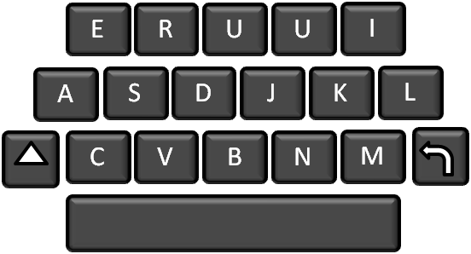
Four Steps to Obtain Personal Divine Communication
Study the scriptures daily, with an emphasis upon the Book of Mormon and the modern scriptures.
Be obedient to it
Pray Daily
Listen for the divine answer.
God will bless us with wisdom if we ask Him in Faith
(3)

Slide 10
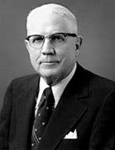
Double Minded
Wavering in loyalty and commitment to the Lord
"James pointed out that 'a double minded man is unstable in all his ways‘.
There are also some triple-minded and quadruple-minded individuals-people who have not tuned out enough of their distractions.
The secret of success is to limit the scope, narrow the vision, and concentrate the effort with a finer focus on a single objective.”
James 1:8
(4)

Slide 11
Resisting Temptations
While God is known to test the faith of His children He is not the source of temptation.
James taught that temptations do not come from God but from the devil, who attempts to draw us away from righteousness by enticing us to do evil.
The Greek verbs from which “drawn away” and “enticed” are translated refer to the traps and bait used when hunting and fishing
James 1:12-21
(1)

Slide 12
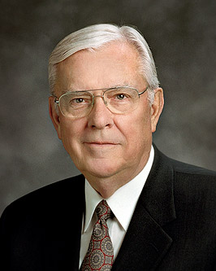
“The use of artificial lures to fool and catch a fish is an example of the way Lucifer often tempts, deceives, and tries to ensnare us.
“Like the fly fisherman who knows that trout are driven by hunger, Lucifer knows our ‘hunger,’ or weaknesses, and tempts us with counterfeit lures which, if taken, can cause us to be yanked from the stream of life into his unmerciful influence.”
James 1:12-21
(5)

Slide 13
Temptations Today
Inappropriate viewings on the internet
Illegal drug use
Immorality
Indecent Entertainment
We show our love for the Lord by resisting temptation, which is one of the requirements for receiving the crown of eternal life
James 1:12-21

Slide 14
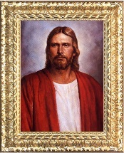
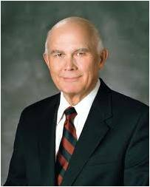
Hearers But Not Doers
James taught readers that it is not sufficient to hear the word of God; the Lord expects us to act upon gospel truths.
“It is not enough to know that God lives, that Jesus Christ is our Savior, and that the gospel is true. We must take the high road by acting upon that knowledge.”
(6)
James 1:23-24
(1)

Slide 15
How fully do I believe the truths I am learning in the scriptures, at home, at church, and at seminary?
How often do I set spiritual goals to act on the truths I am learning?
How often do I achieve them?
How often do I forget them?
What can I do better to be a doer of the word and not just a hearer?

Slide 16
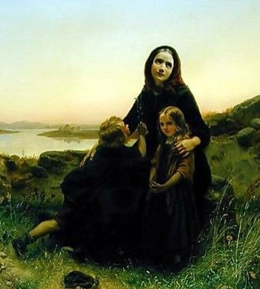
Pure Religion
James observed that caring for others, particularly widows and the fatherless, is a manifestation of “pure religion”
Carl Wilhelm Huebner
Anciently, widows and orphans were among the most underprivileged members of society and had few rights or opportunities; thus, the Lord repeatedly commanded His people to care for them and for others in great need.
James 1:26-27
(1)

Slide 17
Sources:
New Testament Institute Student Manual Chapter 50
Elder David A. Bednar (“Ask in Faith,” Ensign or Liahona, May 2008, 94–95).
President James E. Faust "He Restoreth My Soul," Ensign, Oct. 1997, 4
Elder Sterling W. Sill ("The Strait Gate," Ensign, July 1980, 6)
Elder M. Russell Ballard (“O That Cunning Plan of the Evil One,” Ensign or Liahona, Nov. 2010, 108).
Elder Dallin H. Oaks (“Be Not Deceived,” Ensign or Liahona, Nov. 2004, 46).
Presentation by ©http://fashionsbylynda.com/blog/

Slide 18
Ask in Faith James 1:5-6:
“This single verse of scripture has had a greater impact and a more far-reaching effect upon mankind than any other single sentence ever recorded by any prophet in any age. It might well be said that the crowning act of the ministry of James was not his martyrdom for the testimony of Jesus, but his recitation, as guided by the Holy Ghost, of these simple words which led to the opening of the heavens in modern times.
“And it might well be added that every investigator of revealed truth stands, at some time in the course of his search, in the place where Joseph Smith stood. He must turn to the Almighty and gain wisdom from God by revelation if he is to gain a place on that strait and narrow path which leads to eternal life” Elder Bruce R. McConkie (Doctrinal New Testament Commentary, 3:246–47).
Does God really want to speak to you? Yes! …
You don’t have to wonder about what is true [see Moroni 10:5]. You do not have to wonder whom you can safely trust. Through personal revelation, you can receive your own witness that the Book of Mormon is the word of God, that Joseph Smith is a prophet, and that this is the Lord’s Church. Regardless of what others may say or do, no one can ever take away a witness borne to your heart and mind about what is true. …
We are followers of Jesus Christ. The most important truth the Holy Ghost will ever witness to you is that Jesus is the Christ, the Son of the living God. He lives!
(Russell M. Nelson, “Revelation for the Church, Revelation for Our Lives,” Ensign or Liahona, May 2018, 95–96)
Temptation James 1:13:
"'God made me that way,' some say, as they rationalize and excuse themselves for their perversions. 'I can't help it,' they add. This is blasphemy. Is man not made in the image of God, and does he think God to be 'that way'? Man is responsible for his own sins. It is possible that he may rationalize and excuse himself until the groove is so deep that he cannot get out without great difficulty, but he can resist, he can change. Temptations come to all people. The difference between the reprobate and the worthy person is generally that one yielded and the other resisted. It is true that one's background may make the decision and accomplishment easier or more difficult, but if one is mentally alert, he can still control his future. That is the gospel message-personal responsibility." (President Kimball Speaks Out [Salt Lake City: Deseret Book Co., 1981], 12.)
To Ask In Faith:
Notice the requirement to ask in faith, which I understand to mean the necessity to not only express but to do, the dual obligation to both plead and to perform, the requirement to communicate and to act. …
Joseph’s questions focused not just on what he needed to know but also on what was to be done! His prayer was not simply, “Which church is right?” His question was, “Which church should I join?” Joseph went to the grove to ask in faith, and he was determined to act.
True faith is focused in and on the Lord Jesus Christ and always leads to righteous action. … We press forward and persevere in the consecrated work of prayer, after we say “amen,” by acting upon the things we have expressed to Heavenly Father.
Asking in faith requires honesty, effort, commitment, and persistence.
(David A. Bednar, “Ask in Faith,” Ensign or Liahona, May 2008, 94–95)
Drawn out James 1:14:
"As James describes man being influenced by his own lusts, he chooses two words that are vivid and descriptive of how Satan works upon men. The first word, translated as drawn out, was used in hunting and was the word which described what the hunter did when he lured wild game out of the safety of the thick brush into an area set with snares. And the word entice came from fishing and meant 'to bait, or to catch with bait.' How apt is the description, for the lusts of the flesh are designed to lure us out from the true safety of protective righteousness to become the victim of the evil hunter or fisherman." (Institute Manual, The Life and Teachings of Jesus & his Apostles, 2nd ed., p. 408)

Slide 19
Doers and Not Hearers Only James 1:23-24:
"Some tend to think that just because a few ordinances have been performed, or just because they have repented, they can relax and think they 'have it made.' This life is not one of arrival; rather it is a journey, where we are continually being given the opportunity to prove ourselves worthy of the rewards promised to those whose efforts have been characterized with steadfastness, hope, faith, and love throughout life to the very last moment of this existence." Robert E. Wells (The Mount and the Master [Salt Lake City: Deseret Book Co., 1991], 204.)
Caring for Others James 1:26-27:
This may be interpreted as meaning that a person who is religious is thoughtful to the unfortunate, and has an inner spirit that prompts to deeds of kindness and to the leading of a blameless life; who is just, truthful; who does not, as Paul says, think more highly of himself than he ought to think; who is affectionate, patient in tribulation, diligent, cheerful, fervent in spirit, hospitable, merciful; and who abhors evil and cleaves to that which is good. The possession of such a spirit and feeling is a true sign that a person is naturally religious.
The Church's outward ordinances and requirements are but necessary-yet they are necessary-aids to the inner spiritual life. The Church itself, the organization, meetings, ordinances, requirements, are only helps, but very necessary helps, to the practice of true religion." (Gospel Doctrine: Selections from the Sermons and Writings of Joseph F. Smith, compiled by John A. Widtsoe [Salt Lake City: Deseret Book Co., 1939], 121.)
“The term widows is used 34 times in the scriptures. In 23 of these passages, the term refers to widows and the fatherless. I believe the Lord has a tender feeling toward widows and the fatherless, or orphans. He knows that they may have to rely more completely on Him than on others. …
“To the family and friends of widows, God knows of your service and He may judge your works by how well you assist the widow. …
“… I know that the leaders of the Church are concerned about the welfare of widows. We members should care for and assist the widows within our family, home, ward, and neighborhood” Elder Earl C. Tingey (“The Widows of Zion,” Ensign, May 2000, 62–63).

Slide 20
For Richer and Poorer
James 2
Rob not the poor, because he is poor: neither oppress the afflicted in the gate:
Proverbs 22:22

Slide 21
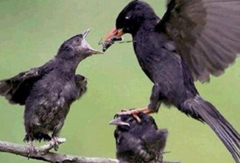
Have Respect To Persons
To show favoritism for one person or a group of people while mistreating others because of their circumstances or characteristics.
James condemned such biased treatment of others, specifically discrimination against the poor in favor of the rich.
James 2:1-4
(1)

Slide 22
Discrimination
Other scriptures teach that followers of Christ should not discriminate on the basis of skin color, social standing, gender, or nationality, education or economic standing, clothing or health, age or religious affiliation.
And thus, in their prosperous circumstances, they did not send away any who were naked, or that were hungry, or that were athirst, or that were sick, or that had not been nourished; and they did not set their hearts upon riches; therefore they were liberal to all, both old and young, both bond and free, both male and female, whether out of the church or in the church, having no respect to persons as to those who stood in need.
Alma 1:30
By living in this way, we become more like our Heavenly Father, who “is no respecter of persons.”
James 2:2-6
(1)

Slide 23
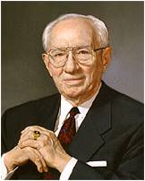
“We must never forget that we live in a world of great diversity.
The people of the earth are all our Father’s children and are of many and varied religious persuasions.
We must cultivate tolerance and appreciation and respect one another.
We have differences of doctrine.
This need not bring about animosity or any kind of holier-than-thou attitude.”
Thou shalt not avenge, nor bear any grudge against the children of thy people, but thou shalt love thy neighbour as thyself: I am the Lord.
Leviticus 19:18
James 2:2-6
(2)

Slide 24
To The Rich and To the Poor
Royal = belonging to a king
James wanted his readers to treat all people, both rich and poor, with charity.
To fulfill the “Royal Law”
Those who keep “the royal law” love everyone and avoid showing favoritism.
Faithful disciples of Jesus Christ love all people regardless of their circumstances
James 2:8
(1)

Slide 25
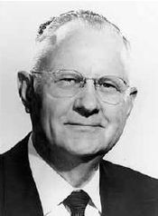
The Whole Law
First and second commandments:
Love the Lord Thy God.
Love thy neighbor as thyself.
“There needs to be full obedience to the whole gospel plan to obtain a fulness of eternal lives and glory,…
So often we are deceived by thinking that some divine laws are not too significant and to break them is no deterrent to a fulness of eternal joy.”
If we commit even one sin, we become guilty before God
'But no man is possessor of all things except he be purified and cleansed from all sin. And if ye are purified and cleansed from all sin, ye shall ask whatsoever you will in the name of Jesus and it shall be done.' (DC 50:28-29.)"
James 2:9-10
(3)

Slide 26
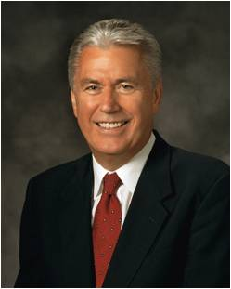
“All is not lost.
“The grace of God is our great and everlasting hope.
“Through the sacrifice of Jesus Christ, the plan of mercy appeases the demands of justice and [brings] about means unto men that they may have faith unto repentance’.
“Our sins, though they may be as scarlet, can become white as snow.
“Because our beloved Savior ‘gave himself a ransom for all,’ an entrance into His everlasting kingdom is provided unto us.”
James 2:9-10; Isaiah 1:18
(4)

Slide 27
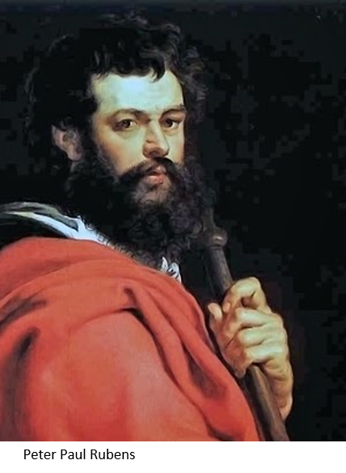
Faith Without Works Is Dead
Some people have misunderstood faith to be simply a verbal expression of belief.
James used the term works differently than the way the Apostle Paul had used it. When Paul used the term works, he referred to the works of the law of Moses.
When James used the term works, he referred to acts of devotion or works of righteousness.
James 2:14-26

Slide 28
Doctrinal Mastery
James
2:17-18
Even so faith, if it hath not works, is dead, being alone.
Yea, a man may say, Thou hast faith, and I have works: shew me thy faith without thy works, and I will shew thee my faith by my works.

Slide 29
“True faith is focused in and on the Lord Jesus Christ and always leads to righteous action. …
Action alone is not faith in the Savior, but acting in accordance with correct principles is a central component of faith.”
(5)

Slide 30
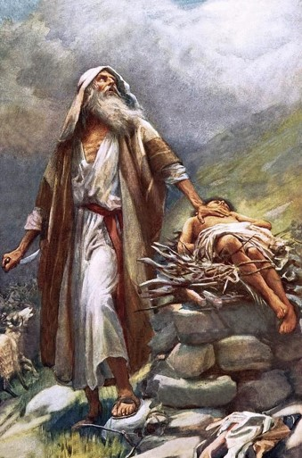
Abraham
Both James and Paul cited the Old Testament prophet Abraham as an important example of faith and good works Abraham’s willingness to carry out the command to offer up Isaac was a validation of his faith in God
James 2:21-25; Romans 4; Galatians-9
(1)

Slide 31
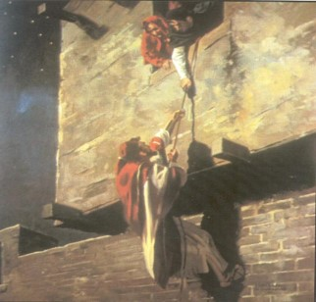
Rahab
The harlot Rahab also demonstrated her faith through her actions.
She was an inhabitant of Jericho at the time the armies of Israel, under Joshua’s leadership, approached the promised land.
Joshua sent two men into Jericho to spy out the strength of the city. Rahab took the spies in, even hiding them when the king sought for them. Then she helped them to escape safely from the city.
For her actions, she and her family were spared when the rest of Jericho was destroyed, and she dwelt in Israel for the remainder of her life.
James 2:21-25; Hebrews 11:31; Joshua 2: Joshua 6:22-25
(1)

Slide 32
Sources:
New Testament Institute Student Manual Chapter 50
President Gordon B. Hinckley (“The Work Moves Forward,” Ensign, May 1999, 5).
Delbert L. Stapley Conference Report, April 1961, Afternoon Meeting 65
President Dieter F. Uchtdorf (“The Gift of Grace,” Ensign or Liahona, May 2015, 108).
Elder David A. Bednar (“Ask in Faith,” Ensign or Liahona, May 2008, 95).
Presentation by ©http://fashionsbylynda.com/blog/

Slide 33
LETTER TO THE HEBREWS—BELIEVED WRITTEN BY PAUL, (HEBREWS)
Trials Are a Privilege—Ask God for Wisdom | 1:1–7
God Tempts No One to Do Wrong | 1:8–18
“Be Ye Doers of the Word” | 1:19–27
We Commit Sin If We Show Favoritism | 2:1–9
The Entire Law Must Be Kept | 2:10–13
“Faith Without Works Is Dead” | 2:14–26
Controlled Language Aids Perfection | 3:1–12
Envy and Strife Are of Evil | 3:13–18
The Source of War and Strife | 4:1–3
Identifying the Enemies of God | 4:4–6
Becoming a Friend of God | 4:7–12
What Is Sin? | 4:13–17
A Warning for the Wealthy | 5:1–6
Await the Lord’s Coming with Patience | 5:7–11
Elders Anoint and Heal the Sick | 5:12–20
The Royal Law James 2:8:
The 'royal law' has a brother called "the golden rule." These two concepts teach us how to treat our neighbor in every circumstance. Stephen E. Robinson noted, "there is...one particular principle that contains within it all the other principles. James ca:
lls this principle 'the royal law' (James 2:8), and Paul calls it 'a more excellent way' (1 Corinthians 12:31). To me it's the difference between trying to keep track of a thousand individual rules, like a thousand little marbles rolling around on a tabletop, and trying to follow one overriding principle, like putting all the marbles into a bag where they can be handled as a single object. In a bag all the marbles are still there, but you only have to keep track of one thing instead of a thousand. In the same way, one principle contains a thousand rules." (Stephen E. Robinson, Following Christ: The Parable of the Divers and More Good News [Salt Lake City: Deseret Book Co., 1995], 133 - 134.)
The Whole Law James 2:10:
"James did not mean that a man who stole was guilty of murder, or that one who lied was guilty of unchastity. He was endeavoring to impress upon the minds of the members that the kingdom of God is one. Its laws are perfect. No unclean person can enter there. Since it is a perfect kingdom, its laws must be obeyed. There can be no disunity, no opposition in that kingdom. Being an immortal kingdom with laws that have been proved through the eternities, they are perfect, therefore there is no room for varied opinions in relation to its government, such as we find in human man-made governments. These laws cannot be changed... They are based on justice and mercy with the perfect love of God. Therefore each who enters the kingdom must of his own free will accept all of the laws and be obedient to them, finding himself in complete accord with all. Anything short of this would cause confusion. Therefore the words of James are true. Unless a man can abide strictly in complete accord, he cannot enter there, and in the words of James, he is guilty of all." President Joseph Fielding Smith (Answers to Gospel Questions, 5 vols. [Salt Lake City: Deseret Book Co., 1957-1966], 3: 26.)
Breaking a commandment James 2:10:
When we are breaking or failing to keep one of God's commandments, we are in Satan's territory; and we become prey to impressions that spring from the other region." (The Teachings of Harold B. Lee, edited by Clyde J. Williams [Salt Lake City: Bookcraft, 1996], 108)
Life and Teachings of Jesus and His Apostles Chapter 49

Slide 34
Be careful with your words.
Once they are said, they can be only forgiven, not forgotten.
Watch Your Tongue
James 3

Slide 35
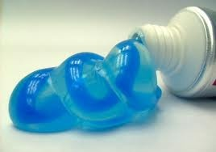
Words
How hard would it be to get the toothpaste back in the tube?
Wa Wa Wa Wa Wa
Imagine the toothpaste represents the words we say…
James 2:1-4

Slide 36
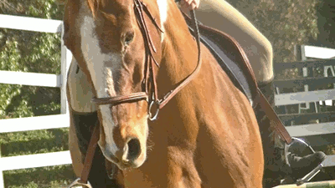
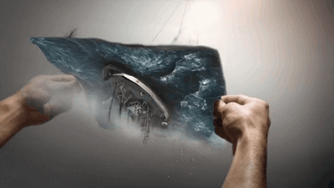
Symbolism
James 3:2
James 3:3
James 3:5-6
James 3:7-8
James 2:1-4

Slide 37
“Obviously James doesn’t mean our tongues are always iniquitous, nor that everything we say is ‘full of deadly poison.’ But he clearly means that at least some things we say can be destructive, even venomous—and that is a chilling indictment for a Latter-day Saint!
The voice that bears profound testimony, utters fervent prayer, and sings the hymns of Zion can be the same voice that berates and criticizes, embarrasses and demeans, inflicts pain and destroys the spirit of oneself and of others in the process. …
James 3:2-10
(2)
James 2:1-4

Slide 38
Husbands…
“Husbands, you have been entrusted with the most sacred gift God can give you—a wife, a daughter of God, the mother of your children who has voluntarily given herself to you for love and joyful companionship.
Think of the kind things you said when you were courting, think of the blessings you have given with hands placed lovingly upon her head, … and then reflect on other moments characterized by cold, caustic, unbridled words.
… A husband who would never dream of striking his wife physically can break, if not her bones, then certainly her heart by the brutality of thoughtless or unkind speech. …
James 3:2-10
(2)
James 2:1-4

Slide 39
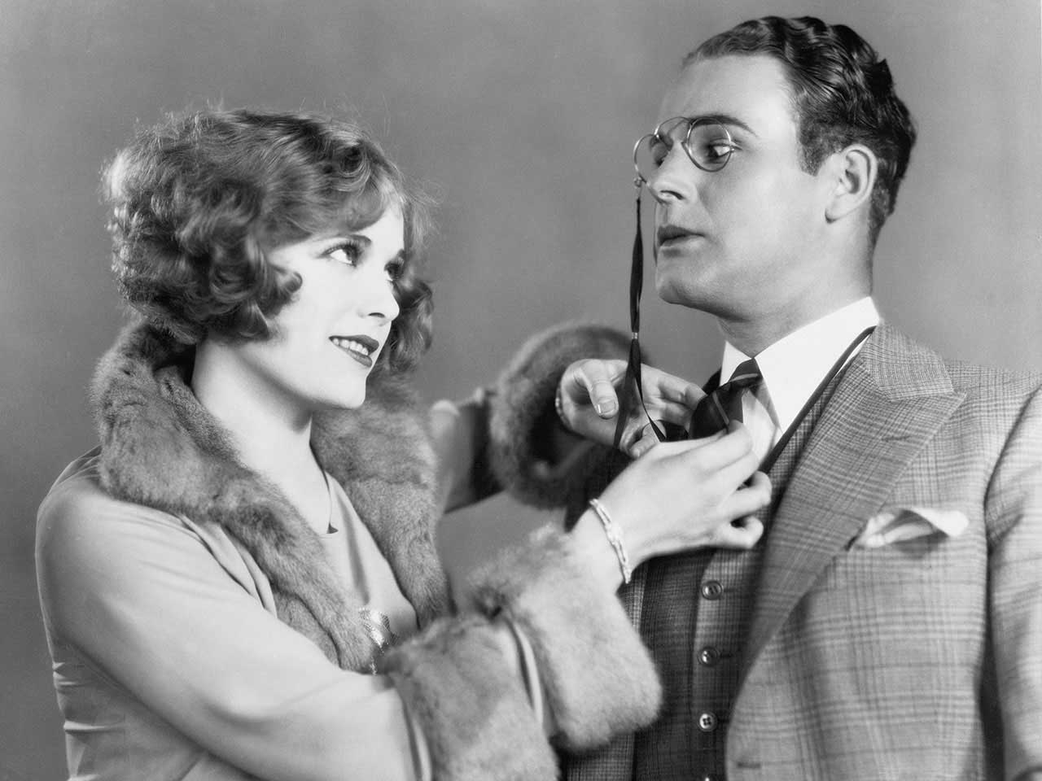
Wives…
“… Wives, what of the unbridled tongue in your mouth, of the power for good or ill in your words?
How is it that such a lovely voice … could ever in a turn be so shrill, so biting, so acrid and untamed?
A woman’s words can be more piercing than any dagger ever forged, and they can drive the people they love to retreat beyond a barrier more distant than anyone in the beginning of that exchange could ever have imagined.”
James 3:2-10
(2)
James 2:1-4

Slide 40
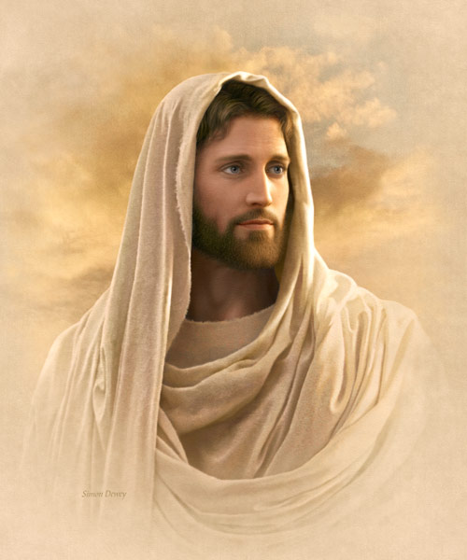
Communicating With Others
“How you communicate should reflect who you are as a son or daughter of God. Clean and intelligent language is evidence of a bright and wholesome mind. …
“Always use the names of God and Jesus Christ with reverence and respect. Misusing the names of Deity is a sin. …
James 3:2-10
Simon Dewey
(3)
James 2:1-4

Slide 41
Communicating With Others
“If you have developed the habit of using language that is not in keeping with these standards—such as swearing, mocking, gossiping, or speaking in anger to others—you can change.
Pray for help. Ask your family and friends to support you in your desire to use good language.”
Followers of God strive to use their language for righteous purposes, not to spread evil
James 3:2-10
(3)
James 2:1-4

Slide 42
Sources:
New Testament Institute Student Manual Chapter 50
Elder Jeffrey R. Holland (“The Tongue of Angels,” Ensign or Liahona, May 2007, 16–17)
For the Strength of Youth [booklet, 2011], 20–21).

Slide 43
Positive Speech James 3:2:
“I suppose it goes without saying that negative speaking so often flows from negative thinking, including negative thinking about ourselves. We see our own faults, we speak—or at least think—critically of ourselves, and before long that is how we see everyone and everything. No sunshine, no roses, no promise of hope or happiness. Before long we and everybody around us are miserable.
“… We should honor the Savior’s declaration to ‘be of good cheer’ [Matthew 14:27; Mark 6:50 John 16:33. (Indeed, it seems to me we may be more guilty of breaking that commandment than almost any other!) Speak hopefully. Speak encouragingly, including about yourself. Try not to complain and moan incessantly” (Elder Jeffrey R. Holland “The Tongue of Angels,” Ensign or Liahona, May 2007, 17–18).
“Our words and external expressions are not neutral, for they reflect both who we are and shape who we are becoming. …
“What we say and how we present ourselves not only betray our inner person but also mold that person, those around us, and finally our whole society. Every day each of us is implicated in obscuring the light or in chasing away the darkness. We have been called to invite the light and to be a light, to sanctify ourselves and edify others. …
“When we speak and act, we should ask whether our words and expressions are calculated to invite the powers of heaven into our lives and to invite all to come unto Christ. We must treat sacred things with reverence. We need to eliminate from our conversations the immodest and the lewd, the violent and the threatening, the demeaning and the false. As the Apostle Peter wrote, ‘But as he which hath called you is holy, so be ye holy in all manner of conversation’ (1 Pet. 1:15). The expression conversation refers here not only to speech but also to our entire comportment.” Elder Robert S. Woods (“The Tongue of Angels,” Ensign, Nov. 1999, 83, 84).

