Slide 1
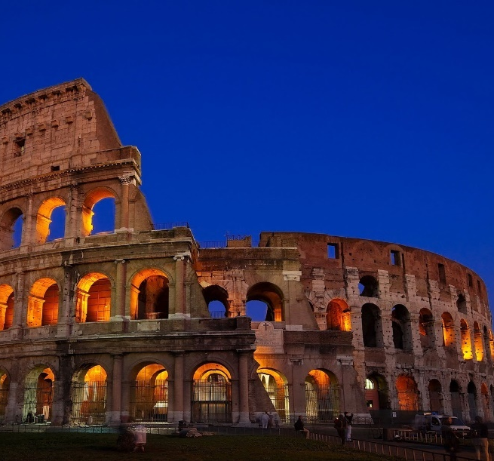
Philippians and Colossians

Slide 2
Working Out Our Salvation
Philippians 1-3

Slide 3
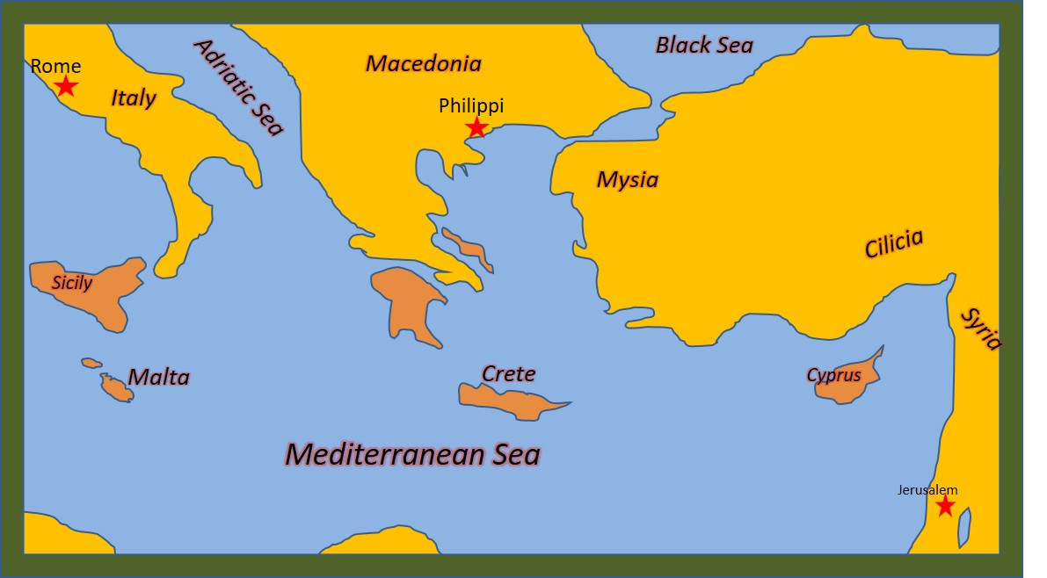
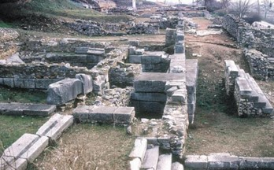
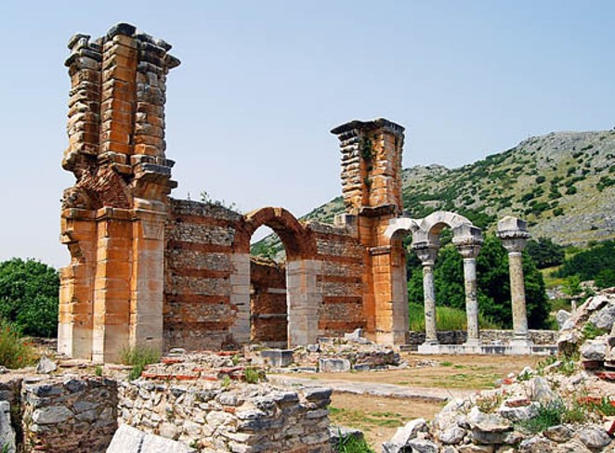
Philippi
This is Paul’s first imprisonment in Rome.
From there he preached for 10 years to the Philippians.
Philippians was the first city in Europe to receive the gospel.
A Woman named Lydia and her household were Paul’s first converts.
The Philippians sent Paul gifts while he was in prison. Epaphroditus, the gift bearer, got ill and had to return home. Paul sent a letter of thanksgiving.
Timothy may have acted as Paul’s scribe, writing the letter under Paul’s direction.
Philippians is often called a prison Epistle, along with Ephesians, Colossians, and Philemon

Slide 4
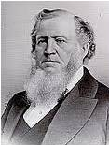
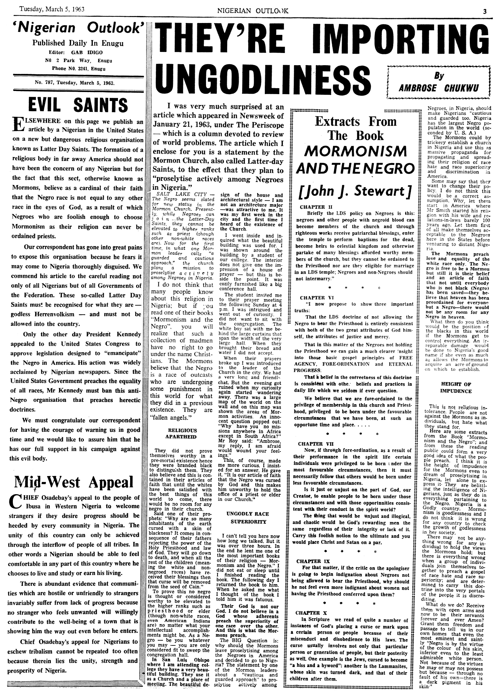
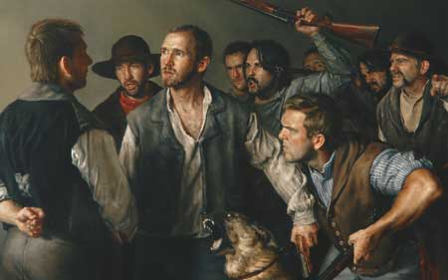
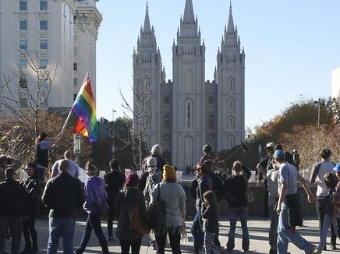
Opposition
“Every time you kick ‘Mormonism’ you kick it upstairs; you never kick it downstairs. The Lord Almighty so orders it.” (2)
What are some examples, either from history or from our day, of people kicking, or opposing, the Savior’s Church and His followers?

Slide 5
Selfishness VS Selfless
Paul taught that for the Philippian Saints to achieve unity, they must set aside selfishness and humbly consider the needs of others.
“There are those among us today who are completely selfless—as was [Jesus Christ].
A selfless person is one who is more concerned about the happiness and well-being of another than about his or her own convenience or comfort, one who is willing to serve another when it is neither sought for nor appreciated, or one who is willing to serve even those whom he or she dislikes.

Slide 6
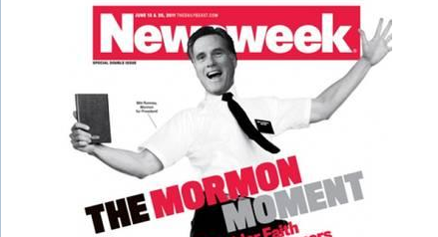
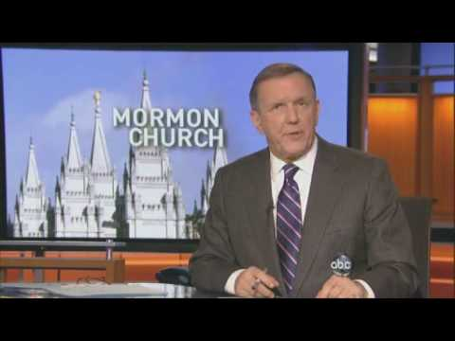
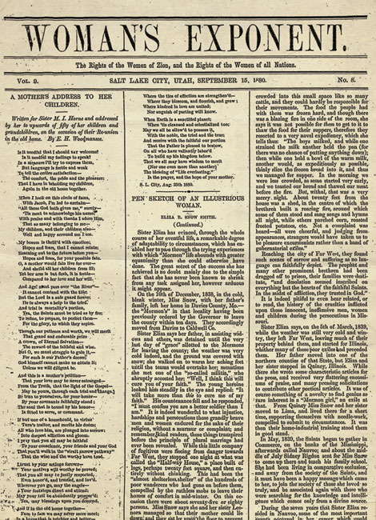
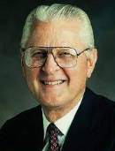
How Does This Further The Work?
From its beginnings, The Church of Jesus Christ of Latter-day Saints has used the power of the printed word to spread the message of the restored gospel throughout the world. The Lord, over the centuries, has had a hand in inspiring people to invent tools that facilitate the spreading of the gospel. The Church has adopted and embraced those tools, including print, broadcast media, and the Internet. (3)
Philippians 1:11-14

Slide 7
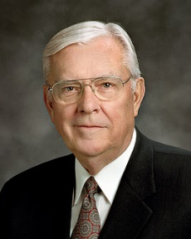
The Modern Printing Press
“Today we have a modern equivalent of the printing press in the Internet. The Internet allows everyone to be a publisher, to have his or her voice heard, and it is revolutionizing society. Before the Internet there were great barriers to printing. It took money, power, influence, and a great amount of time to publish. But today, because of the emergence of what some call “new media,” made possible by the Internet, many of those barriers have been removed.
“The emergence of new media is facilitating a worldwide conversation on almost every subject, including religion, and nearly everyone can participate.
“Now some of these tools—like any tool in an unpracticed or undisciplined hand—can be dangerous. The Internet can be used to proclaim the gospel of Jesus Christ and can just as easily be used to market the filth and sleaze of pornography.”
Philippians 1:11-14
(3)

Slide 8
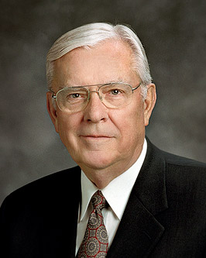
60 Minute Interview With A 6 Second Testimony
NBC television came to Salt Lake for an interview with me as part of a piece they were producing on the Church.
Reporter Ron Allen and I spent an hour together in the chapel in the Joseph Smith Memorial Building. We discussed the Church at length.
A few days later the story appeared, and in the four-minute segment that aired, there was one short quote of about six seconds from the one-hour interview.
That was just enough time for me to testify of our faith in Jesus Christ as the center of all we believe.
I repeat, just six seconds were used from a 60-minute interview. (3)
Elder M. Russell Ballard
Ron Allen

Slide 9
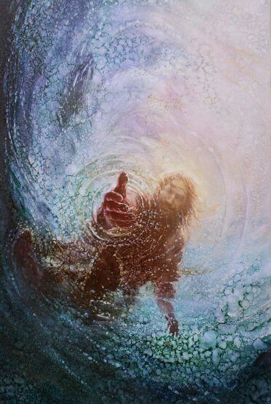
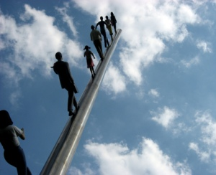
An Earned Salvation
Fear and Trembling = Awe and Reverence
“Work out your own salvation with fear and trembling”
Some people incorrectly use this verse to support the idea that we are saved by our own efforts and not by the grace of Jesus Christ.
However, Paul was not telling the Saints to work in order to earn salvation.
Instead, as Paul pointed out, the Saints should live the gospel so that the saving work God was already doing within them would be manifest in all they did.
Our efforts to work out our salvation are possible only because of the Lord’s grace within us. (1)
Yongsung Kim
God helps us desire and do what is required of us for salvation, which is made possible through the Atonement of Jesus Christ
Philippians 2:12

Slide 10
Sending A Messenger
Epaphroditus (Greek: Ἐπαφρόδιτος) is a New Testament figure appearing as an envoy of the Philippian and Colossian church to assist the Apostle Paul and also visited Paul in Prison.
Epaphroditus was the delegate of the Christian community at Philippi, sent with their gift to Paul during his first imprisonment at Rome or at Ephesus and taking back the Epistle to the Philippians.
Philippians 2:25-30

Slide 11
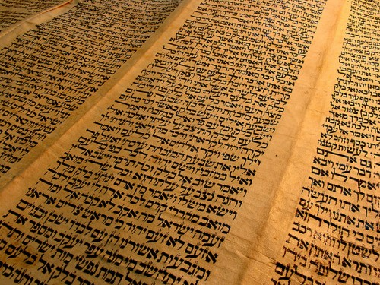
Dogs and Evil Workers
Paul was attacking the Judaizers—those Jewish Christians who demanded complete obedience to the Mosaic law as a condition for salvation.
He used the word dogs to imply that they were unclean and unholy.
His use of the words evil workers indicates those who thought they were righteous and in fact were not.
In sarcasm he used the word concision, which means “mutilation,” instead of circumcision, which is the normal adjective used to define Jews. (5)
Philippians 3:2-3

Slide 12
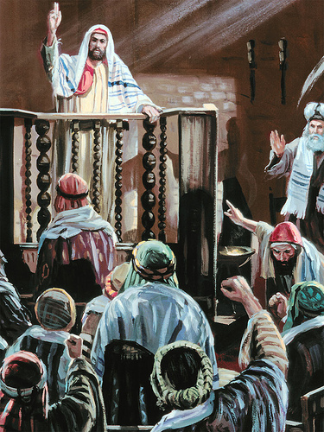
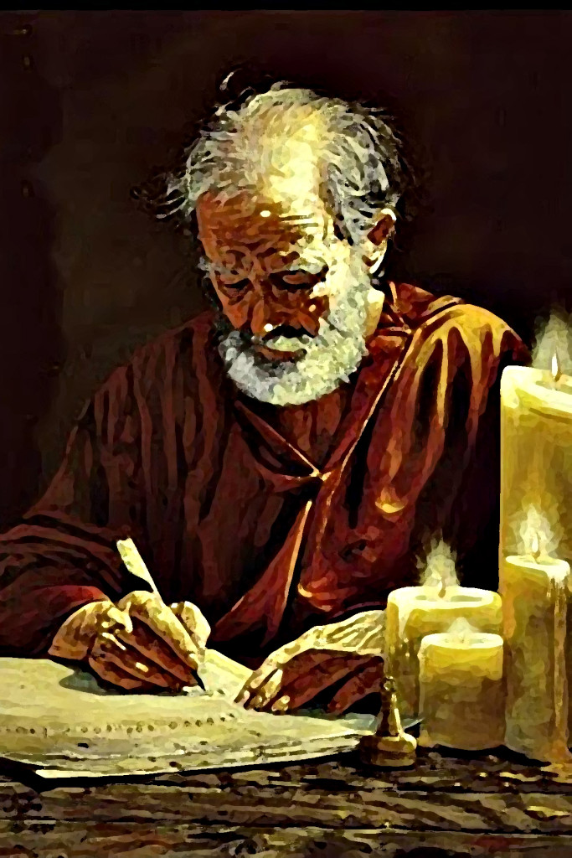
Willing to Sacrifice to Follow Jesus
Prior to Paul’s conversion to Jesus Christ on the road to Damascus, he was a Pharisee, a person of high religious and social standing among the Jews.
Because he chose to follow Jesus Christ and spend his life preaching the gospel, Paul experienced severe persecution, tribulation, physical pain, and emotional stress.
(10) That I may know him, and the power of his resurrection, and the fellowship of his sufferings, being made conformable unto his death;
Conformable=agreeable
(12) but I follow after=Press forward
The Apostle Paul gave up much when he chose to follow the Savior, including his influential standing in Jewish society as a Pharisee.
Philippians 3:5-14; Acts 9; 2 Corinthians 11:23-28

Slide 13
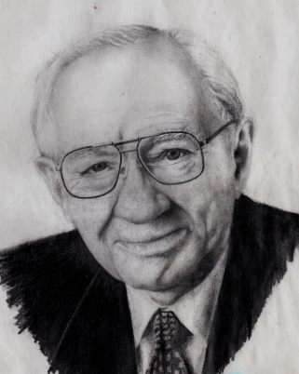
Many years ago this conference heard of a young man who found the restored gospel while he was studying in the United States.
As this man was about to return to his native land, President Gordon B. Hinckley asked him what would happen to him when he returned home as a Christian.
“My family will be disappointed,” the young man answered.
“They may cast me out and regard me as dead. As for my future and my career, all opportunity may be foreclosed against me.”
“Are you willing to pay so great a price for the gospel?” President Hinckley asked.
(8)

Slide 14
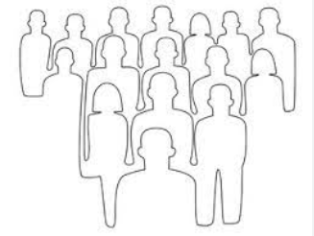
Tearfully the young man answered, “It’s true, isn’t it?”
When that was affirmed, he replied, “Then what else matters?”
That is the spirit of sacrifice among many of our new members.
(8)

Slide 15
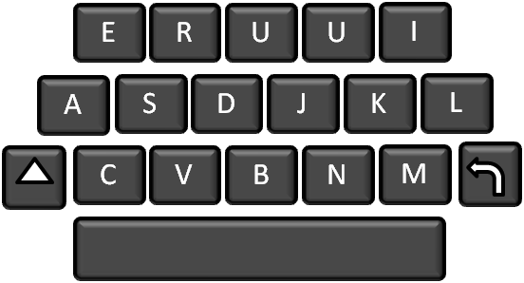
Things you may need to sacrifice in the next five years to come to know the Lord better and prepare for eternal life.
Philippians 3:14

Slide 16
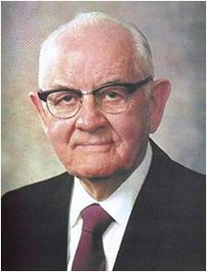
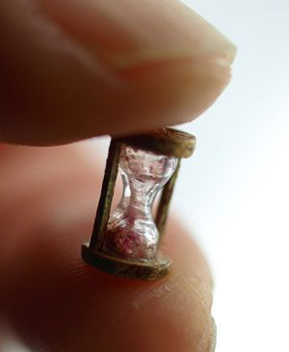
Blessings Come From Sacrifice
“We must lay on the altar and sacrifice whatever is required by the Lord. We begin by offering a ‘broken heart and a contrite spirit.’
We follow this by giving our best effort in our assigned fields of labor and callings.
We learn our duty and execute it fully.
Finally we consecrate our time, talents, and means as called upon by our file leaders and as prompted by the whisperings of the Spirit. …
And as we give, we find that ‘sacrifice brings forth the blessings of heaven!’ And in the end, we learn it was no sacrifice at all.”
Philippians 3:4-8
(6)

Slide 17
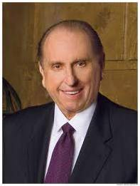
Toward the Mark
“reaching forth unto those things which are before”
Some of the imagery in these verses reflects the idea of a race, where runners continuously press on while always focusing on the finish line.
Paul declared that although he had not yet reached his final goal, he had left his past behind and was pressing forward toward the mark—the prize of salvation offered by Jesus Christ.
“There is no going back, but only forward. Rather than dwelling on the past, we should make the most of today, of the here and now, doing all we can.”
Philippians 3:12-14
(7)

Slide 18
Sources:
New Testament Institute Student Manual Chapter 45
Discourses of Brigham Young, sel. John A. Widtsoe [1954], 351
Elder H. Burke Peterson (“Selflessness: A Pattern for Happiness,” Ensign, May 1985, 66).
Elder M. Russell Ballard Sharing the Gospel Using the Internet July 2008 Ensign
Life and Teachings of Jesus and His Apostles Chapter 44
President Spencer W. Kimball (“Becoming the Pure in Heart,” Ensign, May 1978, 81).
President Thomas S. Monson (“Finding Joy in the Journey,” Ensign or Liahona, Nov. 2008, 85).
Dallin H. Oaks, “Sacrifice,” Ensign or Liahona, May 2012, 21
Presentation by ©http://fashionsbylynda.com/blog/

Slide 19
A LETTER FROM PAUL TO THE SAINTS IN PHILIPPI, MACEDONIA WRITTEN WHILE UNDER ARREST IN ROME, CA. A.D. 60-62 (PHILIPPIANS)
Paul’s Experiences in Teaching Christ | 1:1–26
Be of One Spirit and One Mind | 1:27–30; 2:1–4
The Equality of Father and Son | 2:5–8
All Men Shall Bow and Confess Christ | 2:9–11
“Work Out Your Own Salvation” | 2:12–18
The Mission of Timothy and Epaphroditus | 2:19–30
The Way of Salvation | 3:1–21
Working Out Salvation Philippians 2:12:
“An outstanding doctrine of the Church is that each individual carries the responsibility to work out his own salvation, and salvation is a process of gradual development. The Church does not accept the doctrine that a mere murmured belief in Jesus Christ is all that is necessary. A man may say he believes, but if he does nothing to make that belief or faith a moving power to do, to accomplish, to produce soul growth, his professing will avail him nothing. ‘Work out your salvation’ is an exhortation to demonstrate by activity, by thoughtful, obedient effort the reality of faith. But this must be done with a consciousness that absolute dependence upon self may produce pride and weakness that will bring failure. With ‘fear and trembling’ we should seek the strength and grace of God for inspiration to obtain the final victory.
“To work out one’s salvation is not to sit idly by dreaming and yearning for God miraculously to thrust bounteous blessings into our laps. It is to perform daily, hourly, momentarily, if necessary, the immediate task or duty at hand, and to continue happily in such performance as the years come and go, leaving the fruits of such labors either for self or for others to be bestowed as a just and beneficent Father may determine.” (David O. McKay in CR, Apr. 1957, p. 7.)
Life and Teachings of Jesus and His Apostles Chapter 44
First Corinthians reveals the problems, pressures, and struggles of a church called out of a pagan society.
The oldest recorded title of this epistle is Pros Korinthious A, in effect, the “First to the Corinthians.” The A was no doubt a later addition to distinguish this book from Second Corinthians.
In Paul’s day the population of Corinth was approximately 700,000, about 2/3 of whom were slaves.
Greek philosophy influenced any speculative thought that was there. “Talk Thru the Bible” by Bruce Wilkinson and Kenneth Boa pp. 382-383
Philippians 1:12-18:
Brigham Young once said-so I am informed-that you cannot hurt Mormonism it is like a rubber ball: every time you kick it the farther it goes. It is my experience, and is history, that where men persecute the church, or the principles of it, and those who preside in Israel, they often make friends for the Latter-day Saints. Samuel O. Bennion (Conference Report, April 1913, Second Day-Morning Session 31.)
When men open their lips against these truths they do not injure me, but injure themselves. (Teachings of the Prophet Joseph Smith, 373)

Slide 20
Admonition of Paul
Philippians 4
We believe in being honest, true, chaste, benevolent, virtuous, and in doing good to all men; indeed, we may say that we follow the admonition of Paul—We believe all things, we hope all things, we have endured many things, and hope to be able to endure all things. If there is anything virtuous, lovely, or of good report or praiseworthy, we seek after these things.
Articles of Faith 1:13

Slide 21
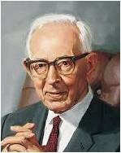
The Book of Life
“The book of life, or Lamb’s book of Life, is the record kept in heaven which contains the names of the faithful and an account of their righteous covenants and deeds.”
(2)
“We are not going to be saved in the kingdom of God just because our names are on the records of the Church. It will require more than that. We will have to have our names written in the Lamb’s Book of Life, and if they are written in the Lamb’s Book of Life then it is an evidence we have kept the commandments.
Every soul who will not keep those commandments shall have his name blotted out of that book” (3)
Philippians 4:3; Revelation 13:8

Slide 22
“Be Careful For Nothing”
I am worried about a family member who is sick…
I am worried about an upcoming test…
I am worried about standing up for my beliefs…
Throughout our lives, we will experience challenges or circumstances that may lead us to worry.
I am worried about whether I can be a successful missionary
Philippians 4:6-7

Slide 23
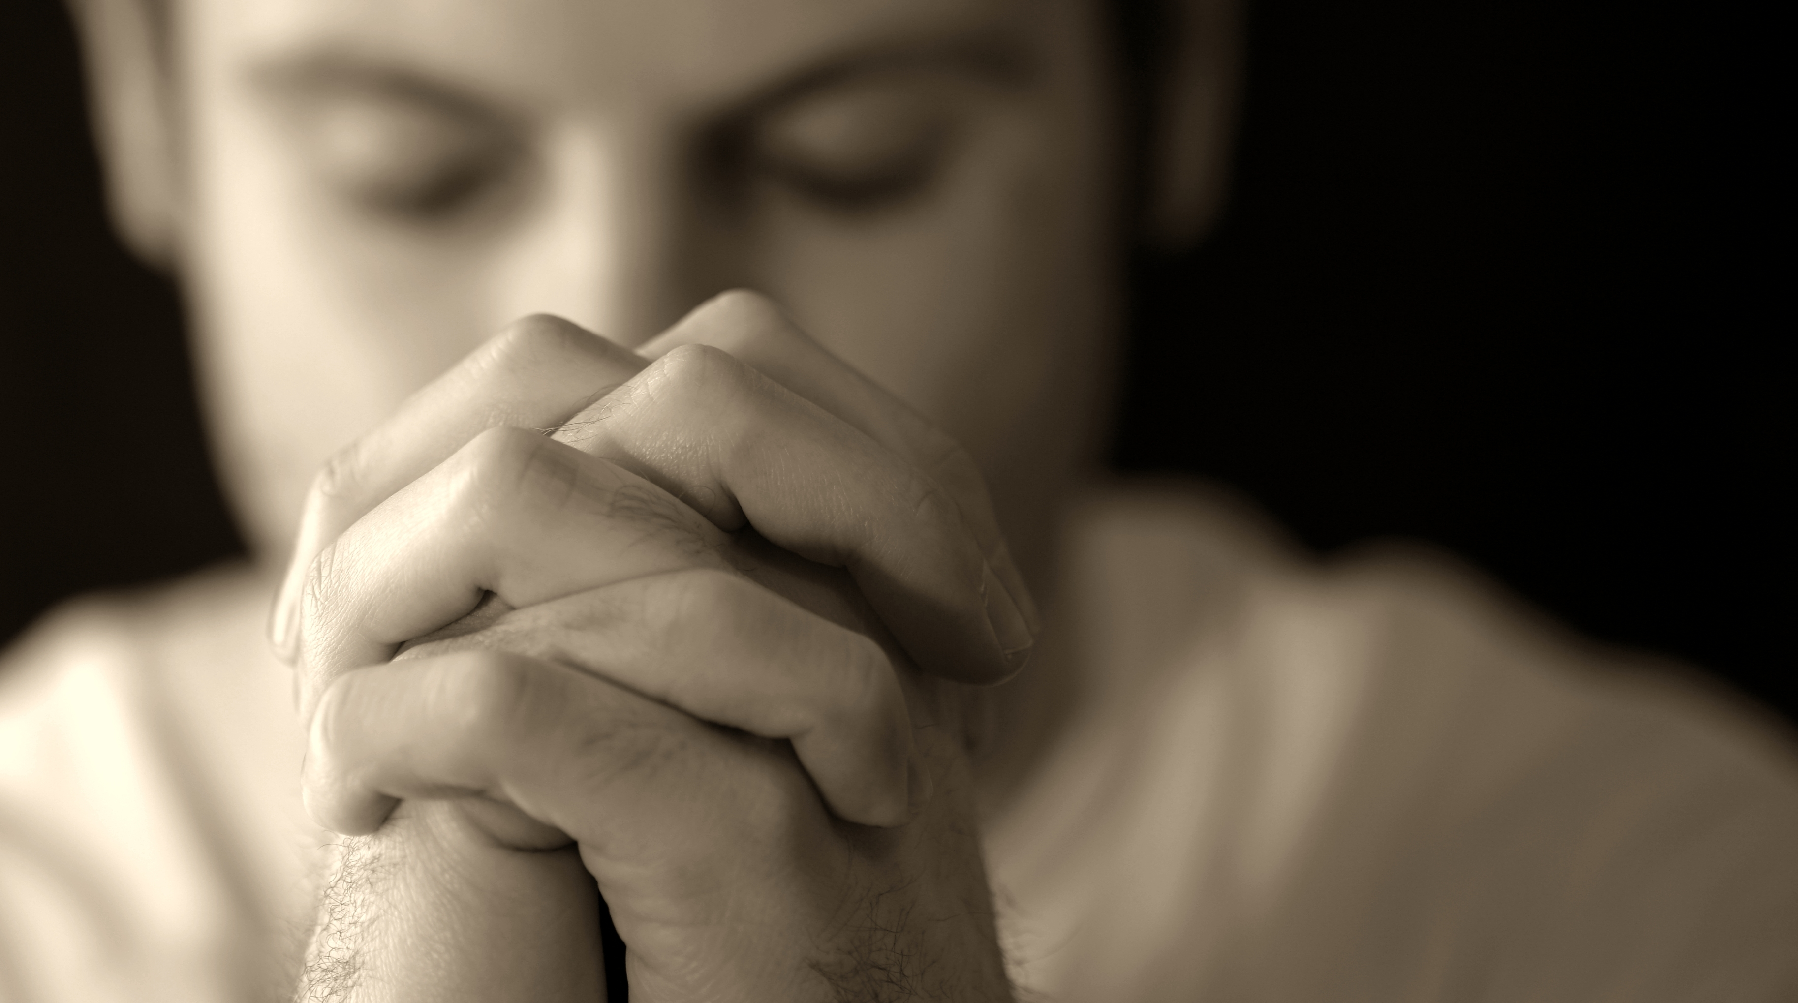
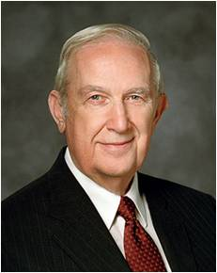
Prayer and Trust
Supplication = Humble, Ernest Request
Paul taught that the antidotes for anxiety were prayer and trust in the Lord. They bring “the peace of God, which passeth all understanding”
“Because He respects your agency, Father in Heaven will never force you to pray to Him.
But as you exercise that agency and include Him in every aspect of your daily life, your heart will begin to fill with peace, buoyant peace.
That peace will focus an eternal light on your struggles.
It will help you to manage those challenges from an eternal perspective.” (4)
Philippians 4:6-7

Slide 24
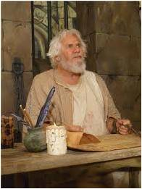
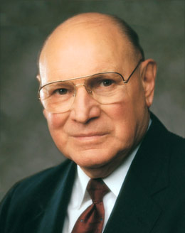
Admonition of Paul
“Finally, brethren, whatsoever things are true, whatsoever things are honest, whatsoever things are just, whatsoever things are pure, whatsoever things are lovely, whatsoever things are of good report; if there be any virtue, and if there be any praise, think on these things.”
Seek = to go in search of, try to discover, try to acquire. It requires an active, assertive approach to life. … It is the opposite of passively waiting for something good to come to us, with no effort on our part. (5)
Philippians 4:8

Slide 25
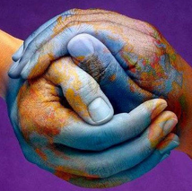
Peace In The Mists of Trials and Tribulations
“Our Savior declared to a modern prophet: ‘…he who doeth works of righteousness shall receive his reward, even peace in this world, and eternal life in the world to come.’”
—D&C 59:23
“Those things, which ye have both learned, and received, and heard, and seen in me, do: and the God of peace shall be with you.”
Philippians 4:9

Slide 26
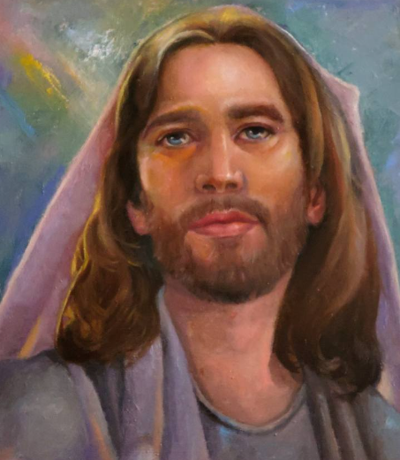
Finding Joy and Peace in Jesus Christ
How, then, can we claim that joy?
We can start by “looking unto Jesus the author and finisher of our faith in every thought”.
We can give thanks for Him in our prayers and by keeping covenants we’ve made with Him and our Heavenly Father.
As our Savior becomes more and more real to us and as we plead for His joy to be given to us, our joy will increase.
(14)
Philippians 4:6-9; Hebrews 12:2, D&C 6:36

Slide 27
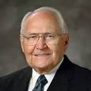
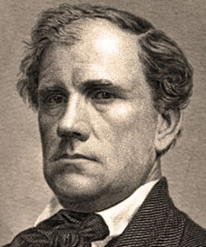
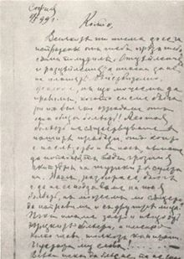
How the Articles of Faith Came to Be
“The Prophet was often asked to explain the teaching and practices of Mormonism.
“John Wentworth, editor of the Chicago Democrat, asked Joseph Smith to provide him with a sketch of ‘the rise, progress, persecution, and faith of the Latter-Day Saints.’”
(6)

Slide 28
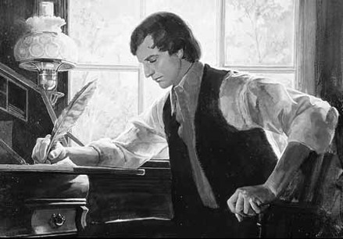
Joseph Compiles Documents
Accounts of many early events in the history of the Restoration…the First Vision, and the coming forth of the Book of Mormon
Thirteen statements outlining Latter-day Saints beliefs, which have come to be know as the Articles of Faith
The information was sent to Wentworth but not published. It was published in the Church newspaper, Times and Seasons, in March of 1842
(6)

Slide 29
Becoming Official Doctrine
1851 –Articles of Faith were included in the first edition of the Pearl of Great Price…published in the British Mission.
After the Pearl of Great Price was revised in 1878 and canonized in 1880, the Articles of Faith became official doctrine of the Church.
The 13th article provides a special insight into how we should conduct our lives and present ourselves before the peoples of the earth.
(6)

Slide 30
We Believe…
In being honest…
True…
Chaste…
Benevolent…
Virtuous…
free from fraud or deception
Steadfast, loyal
Innocent of unlawful sexual intercourse
Organized for the purpose of doing good
Conformity to a standard of right; morally excellent
13th Article of Faith

Slide 31
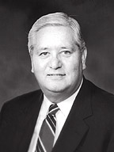
Integrity
Sincerity
Humility
Dependability
Christlike qualities:
Outward manifestation of the inner man
…ITY
Suffix=quality, state, or degree of being
Charity
Responsibility
Spirituality
Morality
Accountability
Generosity
Civility
Credibility
Fidelity
Confidentiality
(7)

Slide 32
Personal Conduct
And in doing good to all men;
“Most people will not commit desperate acts if they have been taught that dignity, honesty, and integrity are more important than revenge or rage; if they understand that respect and kindness ultimately give one a better chance at success.”
(8)

Slide 33
Ethics of Behavior
Indeed, we may say that we follow the Admonition of Paul:
Admonition = an act or action of admonishing; authoritative counsel or warning.
Paul writes to the Philippians on how to conduct their lives in harmony with the Gospel of Christ

Slide 34
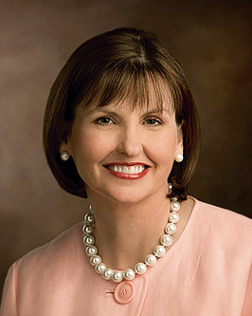
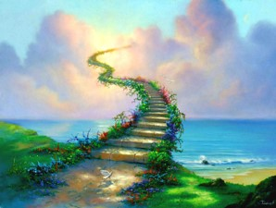
True to the Gospel of Christ
We Believe all things:
“Being true to our beliefs—even when doing so isn’t popular, easy, or fun—keeps us safely on the path that leads to eternal life with our Heavenly Father.”
(9)

Slide 35
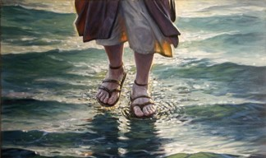
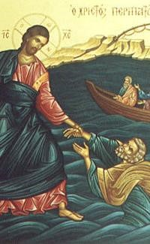
The Lord’s Side
We hope all things:
“…we have nothing to fear if we stay on the Lord’s side. If we will be prayerful, seeking wisdom from God…”
(10)

Slide 36
Endure
We have endured many things, and hope to be able to endure all things.
“Fear not, little flock; do good; let earth and hell combine against you, for if ye are built upon my rock, they cannot prevail….
“Look unto me in every thought; doubt not fear not.” D&C 6:33-34

Slide 37
Theology of Our Faith
If there is anything virtuous, lovely, or of good report or praiseworthy,
We seek after these things.
“For behold, the Spirit of Christ is given to every man, that he may know good from evil: wherefore, I show unto you the way to judge; for everything which inviteth to do good, and to persuade to believe in Christ, is sent forth by the power and gift of Christ; wherefore we may know with a perfect knowledge it is of God.”—Moroni 7:16

Slide 38
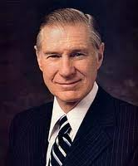
“The Spirit of Christ should permeate all we do, whether at work, at school or at home.”
(11)

Slide 39
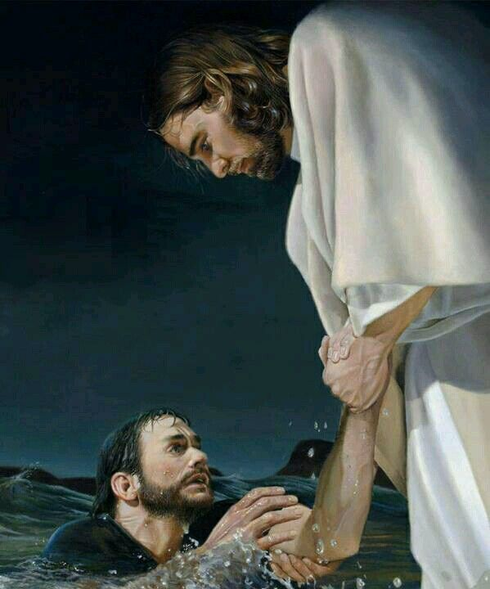
“God pours out blessings of power and strength, enabling us to achieve things that otherwise would be far beyond our reach.
It is by God’s amazing grace that His children can overcome the undercurrents and quicksands of the deceiver, rise above sin, and ‘be perfect[ed] in Christ.’”
Yea, come unto Christ, and be perfected in him, and deny yourselves of all ungodliness; and if ye shall deny yourselves of all ungodliness, and love God with all your might, mind and strength, then is his grace sufficient for you, that by his grace ye may be perfect in Christ; and if by the grace of God ye are perfect in Christ, ye can in nowise deny the power of God.
Moroni 10:32
(12)

Slide 40
I Can Do All Things
…And so we see that because of His Atonement, the Savior has the power to succor—to help—every mortal pain and affliction.
Sometimes His power heals an infirmity, but the scriptures and our experiences teach that sometimes He succors or helps by giving us the strength or patience to endure our infirmities.
(13)
Philippians 4:13

Slide 41
Sources:
New Testament Institute Student Manual Chapter 45
Elder Bruce R. McConkie Doctrinal New Testament Commentary, 3:455
President Joseph Fielding Smith (in Conference Report, Oct. 1950, 10)
Elder Richard G. Scott (“Make the Exercise of Faith Your First Priority,” Ensign or Liahona, Nov. 2014, 93).
Elder Joseph B. Wirthlin (“Seeking the Good,” Ensign, May 1992, 86).
Elder L. Tom Perry “The Articles of Faith” May 1998 Ensign
Elder H. David Burton “Let Virtue Garnish Your Thoughts” Oct. GC 2009
President Thomas S. Monson “Family Values in a Violent Society” Jan. 16, 1994 or “Finding Peace” Ensign, Mar. 2004
Ann M. Dibb “I Believe in Being Honest and True” May 2011 Ensign
President Gordon B. Hinckley “Fear Not to Do Good” 1983 April Gen. Conf.
11. Elder James E. Faust “We Seek After These Things” 1998 April GC
President Dieter F. Uchtdorf (“The Gift of Grace,” Ensign or Liahona, May 2015, 108).
Dallin H. Oaks, “Strengthened by the Atonement of Jesus Christ,” Ensign or Liahona, Nov. 2015, 62
Russell M. Nelson, “Joy and Spiritual Survival,” Ensign or Liahona, Nov. 2016, 82
Presentation by ©http://fashionsbylynda.com/blog/

Slide 42
A LETTER FROM PAUL TO THE SAINTS IN PHILIPPI, MACEDONIA WRITTEN WHILE UNDER ARREST IN ROME, CA. A.D. 60-62 (PHILIPPIANS)
“Stand Fast in the Lord” | 4:1–9
Paul’s Thanks for Aid | 4:10–23
Strengthen Me Philippians 4:13:
“We don’t seek out tests, trials, and tribulations. Our personal journey through life will provide just the right amount for our needs. Many trials are just a natural part of our mortal existence, but they play such an important role in our progress. …
“Sometimes we want to have growth without challenges and to develop strength without any struggle. But growth cannot come by taking the easy way. We clearly understand that an athlete who resists rigorous training will never become a world-class athlete. We must be careful that we don’t resent the very things that help us put on the divine nature.
“Not one of the trials and tribulations we face is beyond our limits, because we have access to help from the Lord. We can do all things through Christ, who strengthens us [see Philippians 4:13]” Elder Paul V. Johnson (“More Than Conquerors through Him That Loved Us,” Ensign or Liahona, May 2011, 79–80).
Life and Teachings of Jesus and His Apostles Chapter 43
Philippians 4:8:
Of all the admonitions of Paul, of all his inspired advice, of all his exhortations, Joseph Smith included this one as the thirteenth article of our faith. It is an admonition for the saints to search out all good. While the world accuses us of being closed-minded, the opposite should really be the case. We reject evil in all of its manifestations but accept every form of goodness and righteousness throughout the earth-in whatever form it may be. As Mormon taught, "Wherefore, all things, which are good cometh of God...that which is of God inviteth and enticeth to do good continually; wherefore, every thing which inviteth and enticeth to do good, and to love God, and to serve him is inspired of God." (Moro. 7:12-13) How broad and all encompassing is this doctrine? It acknowledges the good in all men of all religions, from all sources, from all cultures. It spans the best of literature, philosophy, and government as well as the best of fashion, entertainment, and music.
On March 1, 1842, Joseph Smith, at the request of Mr. John Wentworth, editor of a Chicago newspaper, composed thirteen brief statements known as the Articles of Faith, which summarize some of the basic doctrines of the Church. As the concluding statement, the Prophet wrote this inspired code of conduct: (quotes A of F 1:13).
What an inspiring description of good people, God-fearing people, people committed to deal justly with mankind! These would be the type of people who could raise up a nation and help it survive, and the kind of people to comprehend the true gospel of Jesus Christ with the needed faith to proclaim it to the inhabitants of the earth. Daivid B. Haight ("Ethics and Honesty," Ensign, Nov. 1987, 13-14)
In this article of their faith, the Latter-day Saints declare their acceptance of a practical religion; a religion that shall consist, not alone of professions in spiritual matters... but also, and more particularly, of present and every-day duties, in which proper respect for self, love for fellow men, and devotion to God are the guiding principles. Religion without morality, professions of godliness without charity, church-membership without adequate responsibility as to individual conduct in daily life, are but as sounding brass and tinkling cymbals-noise without music, the words without the spirit of prayer...
The comprehensiveness of our faith must appeal to every earnest investigator of the principles taught by the Church... Within the pale of the Church there is a place for all truth-for everything that is praiseworthy, virtuous, lovely, or of good report. Elder James E. Talmage (Articles of Faith [Salt Lake City: Deseret Book Co., 1981], 390.)

Slide 43
Rooted in the Gospel
We can be reconciled to God through the Atonement of Jesus Christ if we continue to be grounded and settled in our faith
Colossians 1-3

Slide 44
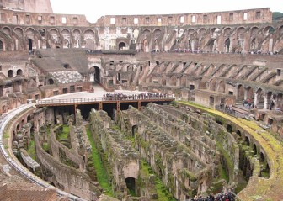
Colossians
This letter was written during his first Roman imprisonment to the saints in Colossae.
This letter was also to be read to the Saints in Laodicea
Macedonia
Black Sea
Rome
Italy
Adriatic Sea
Mysia
Colossae
Cilicia
Sicily
Laodicea
Antioch
Syria
Crete
Cyprus
Mediterranean Sea
Jerusalem
Colosse and larger neighboring cities of Hierapolis and Laodicea was a successful mercantile city in Asia Minor.

Slide 45
Epaphras
Known as “a faithful minister of Christ” was converted by Paul and spread the gospel throughout the region. However false religion was also accepted in Colosse.
Epaphras, unable to deal with the situation, went to Rome.
Paul wrote this letter sometime around A.D. 60-62.
The Epistles Include:
Correcting the false Greek and Jewish ideas by teaching that Christ is the very image of God.
* Christ is the Creator, the Head of the Church, and the first to be resurrected.
* Christ is a member of the Godhead, the Redeemer, and the “hope of the gospel, which ye have heard.”

Slide 46
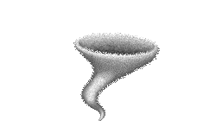
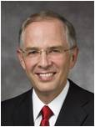
The Storm
If a storm came which of these trees might last the longest?
“More concerning than the prophesied earthquakes and wars [of the last days] are the spiritual whirlwinds that can uproot you from your spiritual foundations and land your spirit in places you never imagined possible, sometimes with your barely noticing that you have been moved.”
(2)

Slide 47
False Teachings Can Uproot
False beliefs and forms of worship in the area of Colossae minimized the eternal role and divinity of Jesus Christ.
It uprooted the Colossians from their faith.
“Because we need the Holy Ghost, we must be cautious and careful not to go beyond teaching true doctrine. The Holy Ghost is the Spirit of Truth. His confirmation is invited by our avoiding speculation or personal interpretation.
But we invite the Holy Ghost as our companion when we are careful to teach only true doctrine.
One of the surest ways to avoid even getting near false doctrine is to choose to be simple in our teaching. Safety is gained by that simplicity, and little is lost.”
Colossians 1:9
(3)

Slide 48
Blessings in Believing
Being fruitful in every good work
Paul acknowledged their faithfulness and explained that the gospel brings forth fruit, or blessings, in the lives of those who accept and live it.
“…true conversion is the fruit of faith, repentance, and consistent obedience. Faith comes by hearing the word of God and responding to it.
You will receive from the Holy Ghost a confirming witness of things you accept on faith by willingly doing them.
You will be led to repent of errors resulting from wrong things done or right things not done. As a consequence, your capacity to consistently obey will be strengthened.
…True conversion yields the fruit of enduring happiness that can be enjoyed even when the world is in turmoil and most are anything but happy.”
Colossians 1:1-11
(4)

Slide 49
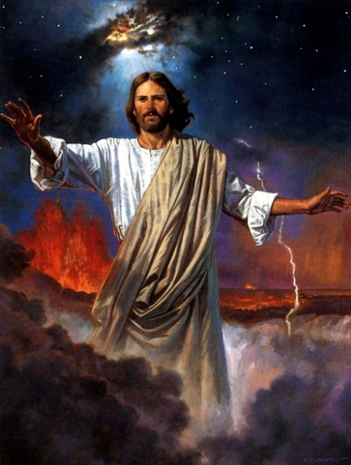
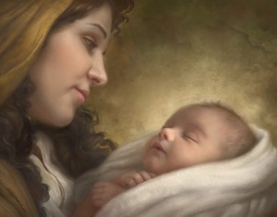
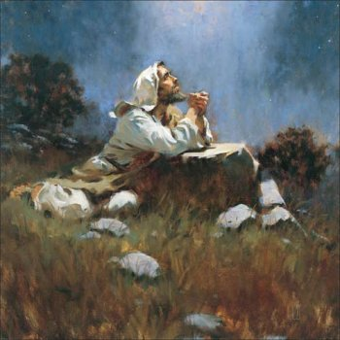
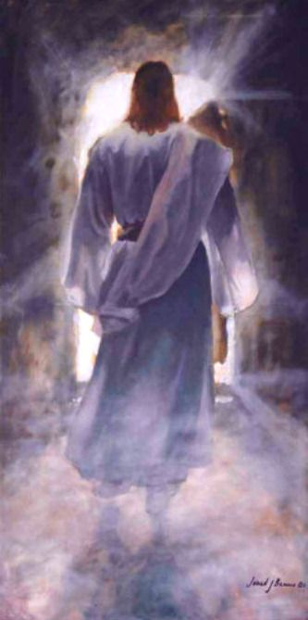
Who is Jesus Christ?
The Firstborn of Heavenly Father’s sprit children
The Creator of all things
Heavenly Father sent His Son so we can be delivered from darkness and forgiven of sin.
The Redeemer
Howard Lyon
The head of the church
The first to be resurrected
Brian Jekel
Colossians 1:12-19
Jared Barnes

Slide 50
Mysteries of God
Spiritual truths known only by revelation.
God reveals his mysteries to those who are obedient to the gospel. Some of God’s mysteries are yet to be revealed.
Colossians 1:26-28; 2:2; 4:3; Bible Dictionary

Slide 51
Treasures in Wisdom
“And inasmuch as our Heavenly Father is accessible to all, it is far better to store our minds with the treasures of wisdom and knowledge, by our own spiritual labours and toil, direct from the great Fountain of celestial light and love, than to trust wholly to the testimony and teachings of others.
Obtain the testimony of Jesus, which is the spirit of prophecy. Startle not at the idea of prophecy and prophets; for I would to God that all the Lord's people were prophets.”
Colossians 2:3
(7)

Slide 52
…so walk ye in him
“Rooted and built up in him, and stablished in the faith, as ye have been taught, abounding therein with thanksgiving.”
How often do we think of the Savior?
Are we grateful when we reflect on His life?
How central to our lives do we know him to be?
Colossians 2:6-7

Slide 53
Complete in Him
“Beware lest any man spoil you through philosophy and vain deceit, after the tradition of men, after the rudiments of the world, and not after Christ.
As the church expanded to outlying areas and encompassed the
Gentile population, the influence of Greek philosophy became profound.
Colossians 2:8

Slide 54
Making Christianity More Palatable
“From the time of Christ's heaven-heralded birth, heresies have crept into Christianity intended to dilute or undermine the pure doctrines of the gospel…
…These heresies are sponsored by the philosophies of men, in many instances, advocated by so-called Christian scholars.”
Colossians 2:8
(5)

Slide 55
Substitutes
“The Saints in Colosse were warned against seeking any person, philosophy, or traditions of men, however clever or sophisticated, as a substitute for the real thing.”
By being rooted and built up in Jesus Christ, we can avoid being led astray by worldly philosophies and traditions
“Because of the atonement, Jesus Christ is sufficient for all men in all things.”
Read Col. 1:18
Colossians 2:8
(6)

Slide 56
The world is not bashful in offering numerous new answers to every problem we face. People run from one new idea to the next, hoping to find something that will answer the burning questions of their souls. They attend seminars and buy books … and other products. They get caught up in the excitement of looking for something new.
But inevitably, the flame of each new theory fades, only to be replaced by another ‘new and improved’ solution that promises to do what the others before could not.
“It’s not that these worldly options don’t contain elements of truth—many of them do. Nevertheless, they all fall short of the lasting change we seek in our lives. After the excitement wears off, the hollowness remains as we look for the next new idea to unlock the secrets of happiness.
Colossians 2:6-8
(9)

Slide 57
“In contrast, the gospel of Jesus Christ has the answers to all of our problems.
The gospel is not a secret. It is not complicated or hidden.
“It can unlock the door to true happiness. It is not someone’s theory or proposition.
It does not come from man at all. It springs from the pure and everlasting waters of the Creator of the universe, who knows truths we cannot even begin to comprehend.”
Colossians 2:6-8
(9)

Slide 58
The Godhead
“Some have interpreted this passage to mean that the Godhead-Father, Son, and Holy Ghost-are the same person, or three persons in one.
Paul is anxious to combat the heretical notion that Christ was not a physical being and that his bodily suffering, death, and resurrection were only fictional.
In countering this false notion, and in order to emphasize the supremacy of the Savior above man and angels, Paul teaches that the fulness of the Godhead's glory, honor, and power is in Christ physically, or bodily-that is, nothing is lacking in the Savior that requires man to seek some other source or means of salvation."
(8)
Colossians 2:9

Slide 59
Let No Man Beguile You
“Let no man beguile you of your reward in a voluntary humility and worshipping of angel, intruding into those things which he hath not seen, vainly puffed up by his fleshly mind.”
Colossians 2:18

Slide 60
Paul’s warning
“Wherefore if ye be dead with Christ from the rudiments of the world, why, as though living in the world, are ye subject to ordinances…
“Touch not; taste not; handle not:
…Which all are to perish with the using; after the commandments and doctrines of men?”
Colossians 2:21-22, 23

Slide 61
Walk in Him
The saints were admonished to hold fast to Him, to set their affections on Him, and to “Walk…in Him
“Set your affection (mind) on things above, not on things on the earth.”
Colossians 3:2

Slide 62
Do Not Punish the Body
Paul denounced the doctrine of body-abasement or asceticism.
He declared that the saints were not to punish the body, rather to mortify (put to death) the evils of the flesh.
“Asceticism (from the Grek: ἄσκησις, áskēsis, "exercise" or "training") describes a lifestyle characterized by abstinence from various worldly pleasures, often with the aim of pursuing religious and spiritual goals.
Many religious traditions (e.g. Buddhism, Jainism, the Christian Desert Fathers) include practices that involve restraint with respect to actions of body, speech, and mind.
The founders and earliest practitioners of these religions lived extremely austere lifestyles, refraining from sensual pleasures and the accumulation of material wealth.
They practiced asceticism not as a rejection of the enjoyment of life, or because the practices themselves are virtuous, but as an aid in the pursuit of salvation or liberation. (10)
Colossians 3:5

Slide 63
Out with the Old in with the New
Lie not one to another, seeing that ye have put off the old man with his deeds;
And have put on the new man, which is renewed in knowledge after the image of him that created him:”
Colossians 3:9-10

Slide 64
Charity Above All
They are to “put on charity”---the pure love of Christ--, which is the bond of perfectness.
“And above all these things put on charity, which is the bond of perfectness.”
Perfection and charity go hand in hand for one begets the other-they cannot be separated-they are bound together by spiritual law. As we gain charity, we gain perfection; as we gain perfection, we gain charity. (11)
Colossians 3:14

Slide 65
A Thanksgiving
“Let the word of Christ dwell in you richly in all wisdom; teaching and admonishing one another in psalm and hymns and spiritual songs, singing with grace in your hearts to the Lord.”
“and whatsoever ye do in word or deed, do all in the name of the Lord Jesus, giving thanks to God and the Father by him.”
Colossians 3:16-17

Slide 66
Rooted-Grounded-Established
“That Christ may dwell in your hearts by faith; that ye, being rooted and grounded in love,”
“ if ye continue in the faith grounded and settled, and be not moved away from the hope of the gospel, which ye have heard, and which was preached to every creature which is under heaven; whereof I Paul am made a minister;”
Colossians 1:23; Ephesians 3:17

Slide 67
Seasoned With Salt
In ancient times, salt was used in the offering of temple offerings and thus became a symbol of gospel covenants.
Salt was also used as a purifying agent.
Therefore, Paul’s teachings about speech being seasoned with salt reminded Church members that all their communication, even with non-Christians, should be pure and in harmony with the covenants they had made with the Lord. (1)
Colossians 4:5-6; Leviticus 2:13

Slide 68
Gaining a Testimony
To walk ye in Him
To be rooted and built up in Him
To be established in the faith
To be complete in Him
Colossians 2:6-10

Slide 69
Sources:
New Testament Institute Student Manual Chapter 45
Elder Neil A. Anderson (“Spiritual Whirlwinds,” Ensign or Liahona, May 2014, 18).
President Henry B. Eyring The Power of Teaching Doctrine April 1999 Gen. Conf.
Elder Richard G. Scott Full Conversion Brings Happiness April 2002 Gen. Cong.
Tad R. Callister “The Inevitable Apostasy” p. 32
Edward J. Brandt “New Testament Backgrounds” March 1976 Ensign
Orson Hyde (Journal of Discourses, 26 vols. [London: Latter-day Saints' Book Depot, 1854-1886], 5: 71.)
J. Lewis Taylor, "New Testament Backgrounds: Colossians," Ensign, Mar. 1976, 39
President Dieter F. Uchtdorf (“The Way of the Disciple,” Ensign or Liahona, May 2009, 75).
Wikipedia
Gospeldoctrine.com

Slide 70
Written from His Imprisonment in Rome, ca. A.D. 61–63 (Acts 25–28; Colossians)
Gospel Brings Hope, Blessings, Salvation | 1:1–12
Christ Created All Things | 1:13–19
The Colossians Share in Salvation | 1:20–29
Paul Warns Against False Doctrines | 2:1–23
Rules of Christian Behavior | 3:1–17
Saints Should Be Wise in All Things | 3:18–25; 4:1–18
Jesus the Creator of All Things Colossians 1:16-17:
“Under the direction and according to the plan of God the Father, Jesus Christ is the Creator, the source of the light and life of all things. Through modern revelation we have the testimony of John, who bore record that Jesus Christ is ‘the light and the Redeemer of the world, the Spirit of truth, who came into the world, because the world was made by him, and in him was the life of men and the light of men.
“‘The worlds were made by him; men were made by him; all things were made by him, and through him, and of him’ (D&C 93:9–10” Elder Dallin H. Oaks (“The Light and Life of the World,” Ensign, Nov. 1987, 63;
Beguile and Worshipping of Angels Colossians 2:18:
"...Paul explains by building on his earlier testimony of Christ as the 'head of the body, the church' (Col. 1:18). But false teachers added the 'worshipping of angels,' inventing things they had 'not seen,' which took away their true 'head,' Jesus Christ (Col. 2:18-19). Medieval Christianity added angels to intercede for mortals, whose lowly condition did not allow them to approach God... some first-century Christians taught the more radical doctrine that the physical creation was an inferior act of a lower divinity. And they added angels or divinities above the Old Testament creator. Paul fought such heresies at Colossae, for Christ's authority as the true creator was being challenged as well as his physical reality. Paul raised the standard of revealed Christianity-of believing in Christ as the only head and mediator under the Father-of believing in the physicalness of Christ, having the form of the Father." (Richard Lloyd Anderson, Understanding Paul [Salt Lake City: Deseret Book Co., 1983], 254.)
Life and Teachings of Jesus and His Apostles Chapter 42
Spoil and Deceit Colossians 2:8:
"One problem Christian gnostics faced was that Christians believed Jesus Christ to have been both God and man. Because Jesus had a body of matter, his position in the heavenly hierarchies was problematic for gnostics. Paul responded forcefully to this ambivalence regarding the role of Jesus when he emphasized in Colossians 1:16-17 and 2:9-10 His preeminence over all. Note the power of his words as he defined Jesus' position:
'For by him were all things created, that are in heaven, and that are in earth, visible and invisible, whether they be thrones, or dominions, or principalities, or powers: all things were created by him, and for him.' (Col: 1:16.)
"Paul proclaimed the Savior to be 'the head of all principality and power.' (Col. 2:10.) He warned the Colossians to 'beware lest any man spoil you through philosophy and vain deceit, after the tradition of men, after the rudiments of the world, and not after Christ.' (Col. 2:8.) Gnosticism and related heresies were a serious problem for the Church. Such beliefs were so antithetical to the doctrines of Jesus and the Apostles that attempts to merge and reconcile them contributed to the corruption of the original faith. Extra-biblical sources tell us that gnosticism played an important role in the first centuries of Christian history. Whereas the religion of the Apostles did not continue, its gnosticized counterpart did. (Kent P. Jackson, "Early Signs of the Apostasy," Ensign, Dec. 1984, 12)
Avoiding Things of the World Colossians 3:2:
“We can spend a lifetime whirling about at a feverish pace, checking off list after list of things that in the end really don’t matter.
“That we do a lot may not be so important. That we focus the energy of our minds, our hearts, and our souls on those things of eternal significance—that is essential.
“As the clatter and clamor of life bustle about us, we hear shouting to ‘come here’ and to ‘go there.’ In the midst of the noise and seductive voices that compete for our time and interest, a solitary figure stands on the shores of the Sea of Galilee, calling quietly to us, ‘Follow me’” Elder Joseph B. Wirthling (“Follow Me,” Ensign, May 2002, 16).

Slide 71
Colossians 4:7, 9, 11
Onesimus, a faithful and beloved brother
Jesus, which is called Justus
Tychicus... is a beloved brother, and a faithful minister
"The epistle to Philemon is a special letter of intercession on behalf of the runaway slave Onesimus, who had earlier fled his master Philemon, and possibly taken with him some of the latter's money or property. Ordinarily, under contemporary law, a runaway slave could be subject to frightful penalties. However, while in Rome Onesimus was converted to the gospel by Paul and had proved himself 'profitable' (Philem. 1:10-11); therefore, when Tychicus went to Colosse (bearing the epistle to the Colossians), Paul sent Onesimus along, with an appeal to Philemon to receive him in the spirit of forgiveness as 'a faithful and beloved brother.' (See Col. 4:7-9.)
"Aside from the fact that it is a remarkable example of a tactful appeal, [the epistle to Philemon] shows that the gospel of Jesus Christ is an equalizing force in the lives of men regardless of differences in social status. Because Onesimus had come repentant into the gospel brotherhood, Philemon was asked to receive him, not as a servant, but as "a brother beloved, ... both in the flesh, and in the Lord." (Philem. 1:15, 16.)
"Because Paul has, in effect, delivered a slave back into servitude, some have interpreted this epistle as an endorsement of slavery as a practice. On the other hand, others have understood the request to receive Onesimus 'not ... as a servant' (Philem. 1:16) to be a disavowal of slavery. But Paul seems to have intended neither of these. He simply acknowledges slavery indirectly as a social reality, at the same time reminding Philemon of the obligations of brotherhood in the kingdom. (Lane Johnson, "New Testament Backgrounds: Philemon," Ensign, Apr. 1976, 58)
The name Jesus is the Greek rendition of the Hebrew name Joshua, which means "God is help" or "God saves." Because Joshua of Moses' day was such a great Jewish leader, his name would have been very common at the time, especially among the Jews, whom Paul refers to as being "of the circumcision." Perhaps the Jesus mentioned in this verse was referred to as Justus because the saints were beginning to think of the name of Jesus as a holy name instead of a common one.
There is symbolism in the Lord of the Universe taking upon himself a common name. The plan was for the Master to be born into the most humble of circumstances, to be raised in a common city, to live a life with no wealth or material distinction, and to be given a common name. This is part of the great condescension of God. When we think of all the scriptural names for the Son of God, we understand that the name Jesus is perhaps the most humble of them all. Consider when the Lord comes again. Will he be called Jesus? John says that he will be called "Faithful and True...and his name is called The Word of God...And he hath on his vesture and on his thigh a name written, KING OF KINGS, AND LORD OF LORDS." (Rev. 19:11-16)
"Tychicus had shown his reliability in accompanying Paul to Jerusalem with the welfare collection, and he had... carried the letters to Ephesus and Colossae. Much like Titus in experience, Tychicus was the kind of man whom Paul would consider as the new regional supervisor in Crete...
"Paul... sent Tychicus to Ephesus, and others named after Demas were probably away from Rome on assignment. No less than nine men seem to be fellow-laborers sent by Paul to different areas as his life closed. Tychicus must be typical; he was from Asia and was sent there to replace Timothy, who was now coming to Rome to be with Paul. Both 'beloved' and 'faithful' (Col. 4:7), Tychicus is obviously another regional representative, directing bishops in a major area. Forces of rebellion probably consumed the main attention of these leaders, for the Pastoral Letters mainly guide regional leaders to direct members and to keep them from deception. To accomplish this, area supervisors had to appoint leaders and train them, the real meaning of Paul's reminder to teach 'faithful men' (the bishops) so they could 'teach others' (their flocks). (2 Tim. 2:2)" (Richard Lloyd Anderson, Understanding Paul [Salt Lake City: Deseret Book Co., 1983], 344-345, 372.)

Slide 72
Colossians 4:12-14
Luke, the beloved physician
Epaphras, who is one of you... saluteth you
…them that are in Laodicea, and them in Hierapolis
"The epithet 'beloved' is uncommon in Paul's writings, and indicates an especially close bond between the apostle and his doctor... [Later] Paul recounts how many of his associates either had forsaken him or had gone on errands, and concludes with: 'Only Luke is with me.' (2 Tim. 4:11.) Alone and facing death, Paul doubtless found Luke's presence of more than medical comfort." (C. Wilfred Griggs, "Paul: The Long Road from Damascus," Ensign, Sept. 1975, 60)
"Who was Luke, that he should be called to write so much of the life of Jesus and of the acts of the apostles? What do we know of the man whom Paul called 'the beloved physician' (Col. 4:14) in his letter to the saints at Colossae?
"Though Luke tells us nothing of himself in his letters, still his writings reveal much about his values, priorities, personal testimony, and his tender charity toward mankind. Any sincere student of the scriptures must be moved by the humane selectivity of Luke's characterizations, descriptions, and phrasing.
"Luke was thought to have been born in Antioch of Syria, the 'City of Greek Kings.' With its 200,000 people it was one of the greatest cities of the Roman Empire and more than 33 times its present size. During Luke's lifetime, Jews in Antioch had the same status and privileges as Greeks. It was here that the first gentile branch of the church in that dispensation was formed; here, disciples were first called Christians. (See Acts 11:20-21, 26.)
"It appears that Paul started three missions from Antioch. Perhaps it was in his home city that Luke became involved with Paul, the 'apostle of the Gentiles.' (Rom. 11:13.) Or, Luke may have become acquainted with Paul at Troas.
"Luke did not identify which areas or to what extent he traveled with Paul on his missions. The fact that he first recorded many of the highlights of Paul's life and travels in the third person ('he' and 'they') and then abruptly changes to the first person plural ('we' and 'us') indicates that they served together from Troas to Philippi, and perhaps also in Achaia and Alexandria. (See Acts 16:10-17; Acts 20:5 through Acts 21:18; Acts 27:1 through Acts 28:16.) Later they traveled together to Miletus, Tyre, Caesarea, and Jerusalem.
"After Paul's arrest, Luke joined him in Caesarea, where Paul boldly declared his testimony before Festus and King Agrippa. When Paul went to Rome, Luke went with him.
)
"Certainly this close association with Paul would have qualified Luke to write the book of Acts. Another important qualification was his matchless access to key facts about the life of Jesus Christ. Over 100 quotations or facts from 32 events of major consequence in the life of the Savior are recorded only in Luke. Similarly, most of the events and testimonies in Acts are uniquely recorded by Luke. He alone recorded 18 of the descriptive titles for Jesus; there are 258 such titles or characterizations of Jesus in the entire Bible.
"Luke sought out the 'eyewitnesses' to the Lord's life and ministry, even those 'which from the beginning were eyewitnesses.' (See Luke 1:2.) Some scholars think that, during the years Paul was in prison in Caesarea, Luke contacted persons who remembered the event of Christ's life. Perhaps Luke contacted the eyewitnesses earlier than this. Certainly, his narrative contains details dealing with 'the beginning' (annunciation to Elisabeth and Mary, the birth and blessing, etc.) that suggest he did seek to obtain all that was known from as many witnesses as possible." (Robert T. Stout, "I Have a Question," Ensign, Sept. 1975, 38)
"Philemon's letter closes with a greeting from 'Epaphras, my fellowprisoner in Christ Jesus' (Philem. 1:23). This is probably a way of honoring this man who was well known at Colossae; he was assisting Paul in prison, just as the returning Onesimus had done. Colossians also names Epaphras, 'who is one of you, a servant of Christ' (Col. 4:12). The Colossians had 'learned' the gospel from 'Epaphras our dear fellowservant, who is for you a faithful minister of Christ' (Col. 1:7). Since he had 'declared unto us your love in the Spirit' (Col. 1:8), Paul's knowledge of the current problems of that area came through this missionary with their interest at heart. And Paul apparently wanted them to know that negative information was relayed for their benefit, since Epaphras has a 'great zeal for you, and them that are in Laodicea, and them in Hierapolis' ("Col. 4:13Col. 4:13)." (Richard Lloyd Anderson, Understanding Paul [Salt Lake City: Deseret Book Co., 1983], 245 - 246.)
"Hierapolis and these two cities (Laodicea and Colossae) formed a triangle with sides about ten miles long. In writing to Colossae, Paul also named 'them that are in Laodicea, and them in Hierapolis' (Col. 4:13). Substantial ruins of the latter city are spread out around its well-preserved stone theater. It was built adjacent to massive hot springs that attracted religious and recreational pilgrims. But Laodicea was the major city of the area in Paul's day. Just before Paul, Strabo wrote that Laodicea 'grew large in our time and in that of our fathers.' That geographer paid tribute to its 'fertile territory' and the private wealth of some of its citizens. Its ruins, including its theater, are badly deteriorated, but Laodicea's stone-strewn area is massive. Although Hierapolis is merely mentioned in Paul's Colossian letter, Laodicea is prominent, probably reflecting the size of the Church in that large city. Laodicea was possibly the regional center of Church administration. Three decades later John sent his letter to Laodicea as the most important branch of the Church in that area." (Richard Lloyd Anderson, Understanding Paul [Salt Lake City: Deseret Book Co., 1983], 245.)

