Slide 1
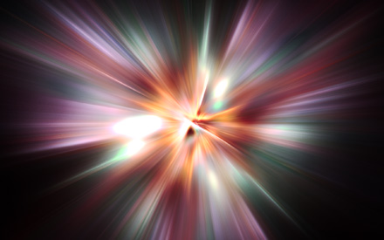
Revelation 15-22

Slide 2
“7 Angels with 7 Plagues”
Revelation 15-16

Slide 3
The Wrath of God
John gives another view of God’s wrath to be released before the kingdom of the devil comes to an end.
7= perfection, complete
Plagues= the last dregs of God’s wrath
Revelation 15:1

Slide 4
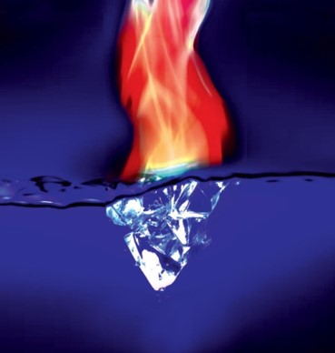
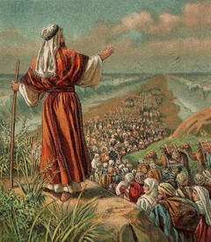
Sea of Glass
The Celestial earth mingled with fire—the saints will have come through great trials
Victory over the beast, image mark, and name—All done through the Atonement
Song of Moses—Israel sang when the Egyptian host was destroyed in the Red Sea, and they were free
Song of the Lamb—All Saints sing the song of victory
Revelation 15:2-4

Slide 5
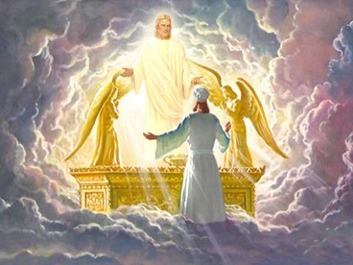
Temple of the Tabernacle
Covenant—Revelation 11:19
We saw the ark in the heavenly tabernacle.
Covenant VS Contract
Now the covenant and the law stand in the center. Mercy had its day. The time for execution of the law has come
Revelation 15:5

Slide 6
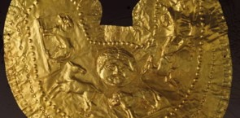
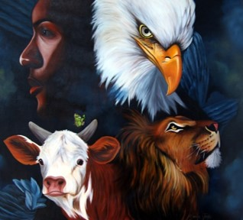
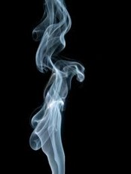
7 Angels and 7 Plagues
Pure and white linen—personal righteousness
(Rev 19:8)
4 beasts: (Rev. 4:7)
Lion
Calf
Man
Eagle
Breasts girded with golden girdles—angels of high rank. Pure—lasts forever
Smoke—signal of acceptance. God approves the mission of the 7 angels
Revelation 15:6-8

Slide 7
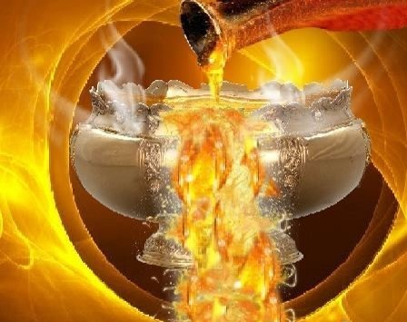
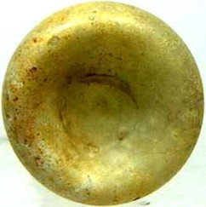
A Great Voice
Probably the voice of God
Vials—bowls for catching blood of the sacrificial animal.
The contents of the bowls is not blood but that which will shed blood.
Revelation 16:1

Slide 8
1st Angel
Pours vial on upon the earth—those with the mark of the beast
Noisome—evil and destructive nature of sores that plague the mind as well as the body.
Grievous sore—open abscesses or ulcers—representing the embodiment of all spiritual and physical suffering the wicked must endure themselves because they refused the Atonement (D&C 19:15-18)
Revelation 16:2

Slide 9
2nd Angel
Pours vial on the sea
Became as the blood of a dead man—the sea is a symbol of mankind. The first monster rose from the “Sea of mankind” (Rev. 13).
A spiritually dead society.
Dangers on the water: A curse.
D&C 61:4-5, 14-16
They have rejected the “Living Water”
Revelation 16:3

Slide 10
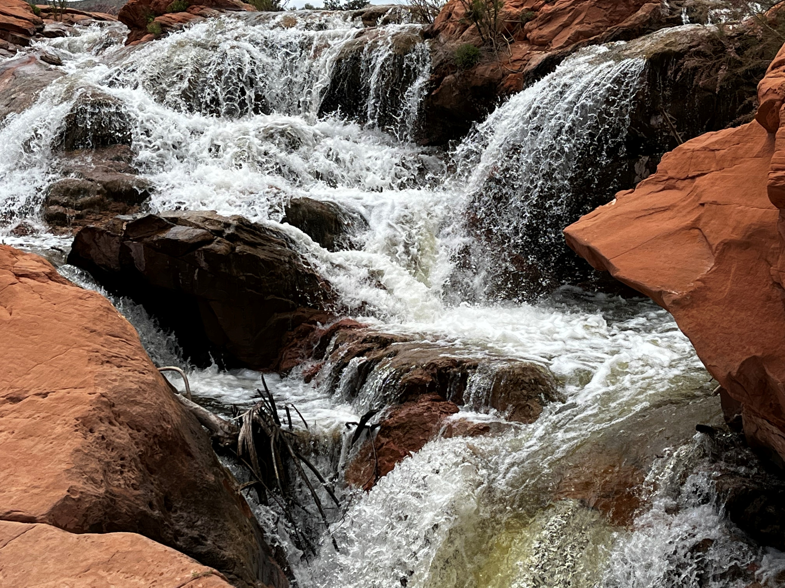
3rd Angel
Pours vial on the rivers and fountains—
The blood that was shed for the wicked
Joseph Smith—Carthage
D&C 87 and 88
Revelation and prophecy on war
Revelation 16:4

Slide 11
Angels of the waters
Which art, and wast, and shalt be—describes Truth and Christ
The angel is praising Christ for his wisdom in judgment
The Lord is making the wicked drink the cup they forced others to drink.
Revelation 16:5-7

Slide 12
4th Angel
Pours vial on the sun
Great heat is often associated with deserts and barren, unproductive land
This fire is cleansing, purifying the earth of all dross
This justice is a cosmic force that acts as a heavenly flame. When this consuming fire contacts something that is not itself just, it bursts into flame.
Revelation 16:8-9; D&C 64:23-24

Slide 13
5th Angel
Pours vial on the seat of the beast
Darkness—like plague of Egypt—thick, smothering
This darkness is of evil deeds and desires (Deut. 28:28-29)
The darkness is swallowing the kingdom of the first beast who is excluded from God’s light
(Isaiah 9:19-20)
Revelation 16:10-11

Slide 14
6th Angel
Prepares the world for war
Euphrates dries up—everything that held back the war is dried up and the war may go forth. (Red Sea and Jordan)
Frogs—unclean animals (Lev. 11:10)
3 frogs—Lies come out of the mouths of the unholy trinity in 3 forms:
1. Dragon—river of lies
2. Beast—blasphemies
3. False prophet—seductive propaganda
lie
lie
lie
Revelation 16:12-14

Slide 15
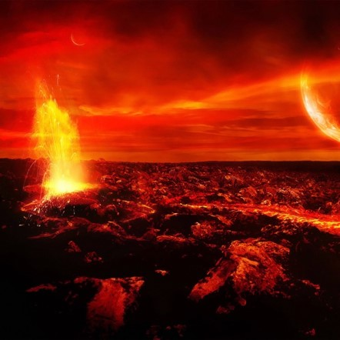
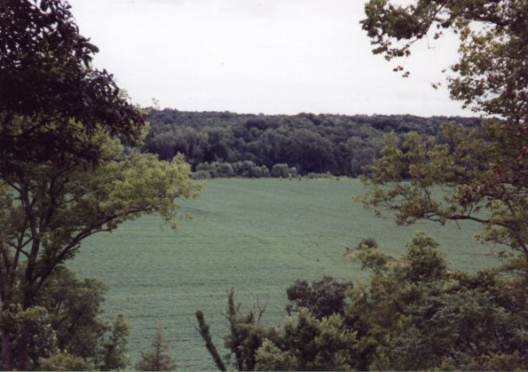
Armageddon
Place of rendezvous—all the forces of evil are gathering to battle.
Just as there is a gathering to the Gospel and Zion.
One ideology and theology against another
Revelation 16:15-16

Slide 16
7th Angel
Pours vial into air
“It is done”
Voices, Earthquakes, thunders, lightnings, hail
Babylon is divided into 3 parts
Cities of nations fell
Every island fled away, and mountains not found.
Chaotic Changes—beginning of earth for its paradisiacal state.
Hail—talent—
60-80 lbs
Revelation 16:17-19 and D&C 133:21-25

Slide 17
“It is a false idea that the Saints will escape all the judgments, whilst the wicked suffer; for all flesh is subject to suffer, and ‘the righteous shall hardly escape’ still many of the Saints will escape, for the just shall live by faith; yet many of the righteous shall fall a prey to disease, to pestilence, etc., by reason of the weakness of the flesh, and yet be save in the Kingdom of God. (2)
If we are watchful and spiritually ready, then we will be prepared for the Second Coming of Jesus Christ

Slide 18
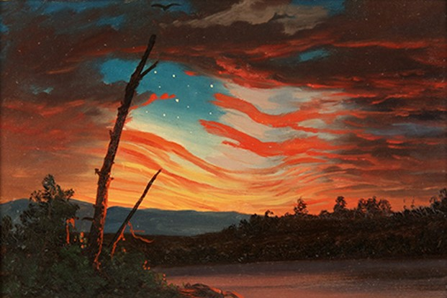
How do I Survive?
“Abide ye in the liberty wherewith ye are made free; entangle not yourselves in sin, but let your hands be clean, until the Lord come.”
D&C 88:86

Slide 19
Sources:
Notes from Lesley Meacham and Becky Davies Poway Institute
History of the Church 4:11
Presentation by ©http://fashionsbylynda.com/blog/

Slide 20
Angel Revelation 14:6:
““That angel has come. His name is Moroni” President Gordon B. Hinckley (“Stay the Course—Keep the Faith” Ensign, Nov. 1995, 70). The angel may also represent a composite of the many heavenly messengers, including Moroni, who have assisted in the latter-day Restoration of the gospel of Jesus Christ (see Bruce R. McConkie, Doctrinal New Testament Commentary, 3 vols. [1965–73], 3:529–31;
Armageddon Revelation 16: 14-21:
“The name Armageddon is derived from the Hebrew Har Megiddon, meaning the ‘mountain of Megiddo.’ The valley of Megiddo is in the western portion of the plain of Esdraelon, fifty miles (eighty kilometers) north of Jerusalem, and is the site of several crucial battles in Old Testament times. A great and final conflict that will take place near the time of the Second Coming of the Lord is called the battle of Armageddon because it will begin in the same locale. (See Ezek. 39:11; Zech. 12–14, especially 12:11; Rev. 16:14–21.)” (Guide to the Scriptures, “Armageddon,” scriptures.lds.org).
The battle that will begin at Har Megiddon will spread to Jerusalem.
Departed Spirits Revelation 14:11
The great misery of departed spirits in the world of spirits, where they go after death, is to know that they come short of the glory that others enjoy and that they might have enjoyed themselves, and they are their own accusers” (Teachings of Presidents of the Church: Joseph Smith[2007], 224).
“A man is his own tormentor and his own condemner. Hence the saying, They shall go into the lake that burns with fire and brimstone [see Revelation 21:8]. The torment of disappointment in the mind of man is as exquisite as a lake burning with fire and brimstone” (Teachings of Presidents of the Church: Joseph Smith, 224).
Babel Revelation 14:8:
“Babel was founded by Nimrod and was one of the oldest cities in the land of Mesopotamia, or Shinar (Gen. 10:8–10). The Lord confounded the languages at the time the people were building the Tower of Babel (Gen. 11:1–9 Ether 1:3–5, 33–35). Babylon later became Nebuchadnezzar’s capital. He built an enormous city of which the ruins still remain. Babylon became a very wicked city and has since come to symbolize the wickedness of the world” (Guide to the Scriptures, “Babel, Baby” scriptures.lds.org).
“The song of Moses” Revelation 15:1-19:
was sung by the children of Israel following their deliverance from Egyptian bondage (see Exodus 15:1–19). Revelation 15:3 tells us that the song of Moses will be sung again by those who inherit the celestial kingdom in celebration of the Lamb of God delivering them from the bondage of sin. New Testament Institute Manual Chapter 55
Mark on the Forehead / Mark on His name Revelation 14:11:
The practice common among Oriental nations of colouring the forehead or impressing on it some distinctive mark as a sign of devotion to some deity is alluded to in Revelation 13:16
Bible Study Tools

Slide 21
REVELATION 16 | DESCRIPTION OF THE PLAGUE
Verse 2 | First, “a noisome and grievous sore” comes upon the wicked. (Similar plagues are described in Exodus 9:8–12 and Zechariah 14:12.)
Verse 3 | Second, the waters of the sea turn to blood, and all creatures in the waters die (see also Exodus 7:19–21).
Verse 4 | Third, the rivers and fountains of water turn to blood (see also Exodus 7:19–21).
Verses 8–9 | Fourth, the sun scorches the wicked with fire and great heat.
Verses 10–11 | Fifth, darkness spreads across the kingdom of the devil, and the wicked suffer pains and sores.
Verses 12–16 | Sixth, the waters of the Euphrates River dry up to prepare for the gathering of the kings of the world at Armageddon (see also Zechariah 12:11).
Verses 17–21 | Seventh, there are voices, thunders, lightnings, and a great earthquake; the cities of the nations fall; Babylon receives the cup of God’s wrath; and great hail falls upon men.
New Testament Institute Manual Chapter 55

Slide 22
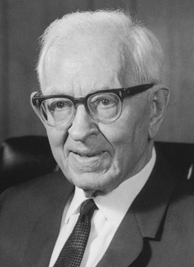
“We are informed that the Lord ‘shall command the great deep, and it shall be driven back into the north country, and the islands shall become one land; and the land of Jerusalem and the land of Zion shall be turned back into their own place, and the earth shall be like as it was in the days before it was divided.’ (Gen. 10:25.) The notion prevails quite generally that the dividing of the earth in the days of Peleg was a division politically among the people, but from this word of the Lord we gain the idea that the earth itself was divided and that when Christ comes it will again be brought back to the same conditions physically as prevailed before this division took place. The sea is to be driven back into the north. The land is to be brought back as it was originally and the lands of Zion (America) and Jerusalem (Palestine and all the land pertaining unto it) will be restored to their own place as they were in the beginning. The Savior will stand in the midst of his people and shall reign over all flesh. We have discovered in our study that the wicked, or all things that are corruptible [D&C 101:23–35], will be consumed and therefore will not be permitted to be on the earth when this time comes.”
Joseph Fielding Smith (Church History and Modern Revelation, 2 vols. [1953], 1:264; see Isaiah 40:4; 64:1; D&C 133:22–24, 40, 44).

Slide 23
Babylon, a Symbol of Satan’s Power
Revelation 17-19
It is easier to avoid temptation than it is to resist temptation” --Elder Lynn G. Robbins
Presentation by ©http://fashionsbylynda.com/blog/

Slide 24
“The titles church of the devil and great and abominable church are used to identify all churches or organizations of whatever name or nature—whether political, philosophical, educational, economic, social, fraternal, civic, or religious—which are designed to take men on a course that leads away from God and his laws and thus from salvation in the kingdom of god.” (2)

Slide 25
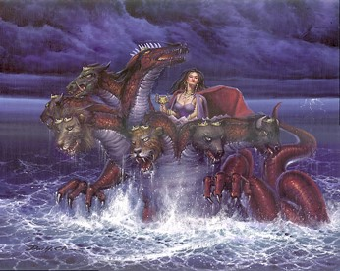
Great Whore
Those who left the Church
Those who broke the covenant
Those who committed fornication
Whenever people prove unfaithful to their covenants, they can be likened to a faithless woman who has sold herself to immorality and sin. (1)
Revelation 17:1-2

Slide 26
Sitteth Upon Waters
Jeremiah 51:13
“O thou that dwellest upon many waters, abundant in treasures, thine end is come, and the measure of thy covetousness.”
Waters: Representing peoples, and multitudes, and nations, and ‘tongues whom the harlot rules’
She has power and influence over the nations.
Wherefore, he that fighteth against Zion, both Jew and Gentile, both bond and free, both male and female, shall perish; for they are they who are the whore of all the earth; for they who are not for me are against me, saith our God.
2 Nephi 10:16
Revelation 17:1-2, 15; 1 Nephi 14:11

Slide 27
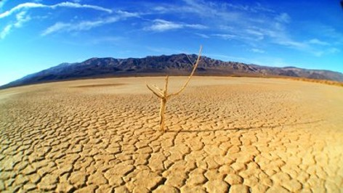
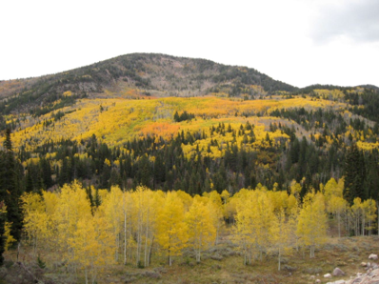
Wilderness
Apostasy—all the descriptions:
The whore of all the earth
The great and abominable church
The church of the devil
D&C 86:3 and 1 Nephi 13:5
Dualism
Those who are not His people will find themselves in the wilderness, full of wild beasts, desolation, etc.
(Zephaniah 2:13)
Denotes a place of discipline and protection, like the place the church with Zion was sent for safety. Psalms: 78:52
Revelation 17:3

Slide 28
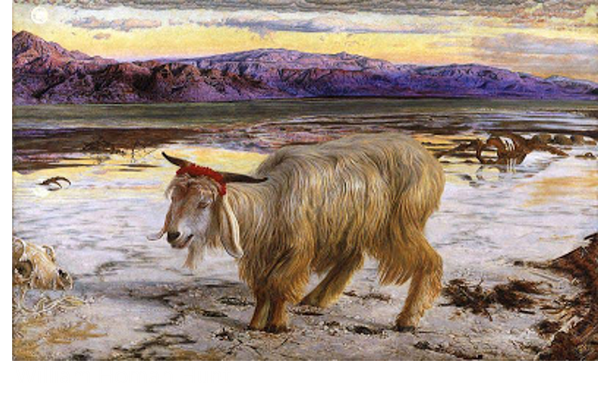
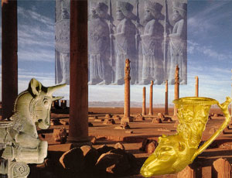
Scarlet Beast
A ribbon of this color was tied around the neck of the scapegoat on the Day of Atonement before it was driven into the wilderness to its death.
The Sins of Israel—associated with harlotry and the deep sins of ungodly conduct.
Beast—monster supporting the woman—associated with blasphemy—defiling name of God.
The beast may represent Rome in John’s day as well as corrupt kingdoms and nations in the last days.
Revelation 17:4

Slide 29
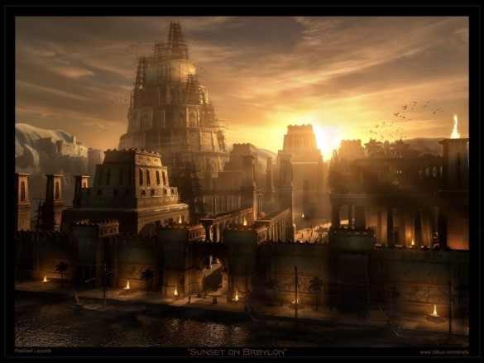
The Woman is Babylon
The ancient city had the reputation of being the first where men combined against god with the deliberate goal of frustration and wresting control from him.
Spiritual Babylon
All leagues which would be anti-Christ, one who perverts the right way of the Lord, and that promotes antichristian principle and life-styles.
Revelation 17:5

Slide 30
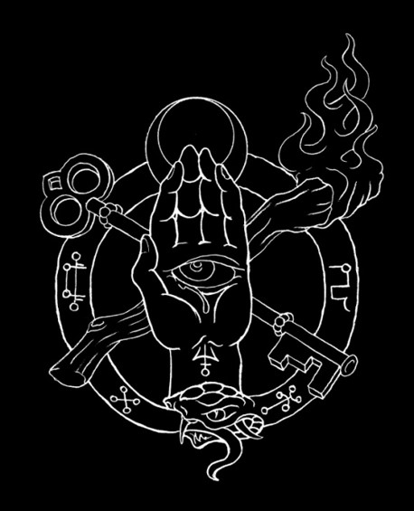
Mystery
Refers to the most holy teachings and doctrines of God kept from the profane world.
The apostles are stewards of the mysteries of God. Only the Holy Ghost reveals these mysteries.
The whore represents counterfeit ordinances with their secret oaths and biding covenant—secret works of darkness
Revelation 17:5

Slide 31
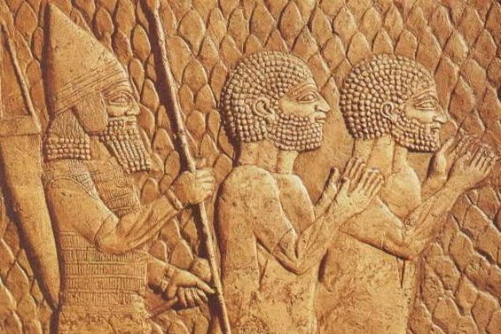
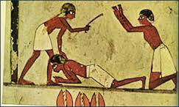
Being Drunk
Throughout the ages, many righteous people have been slain by the wicked, and the scriptural language suggests that slaying the righteous had an intoxicating effect on those who carried out the slaughter.
Throughout the ages, many righteous people have been slain by the wicked, and the scriptural language suggests that slaying the righteous had an intoxicating effect on those who carried out the slaughter.
Revelation 17:6

Slide 32
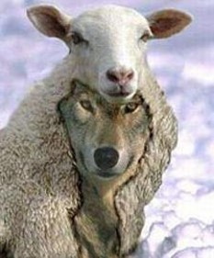
Admiration and Perdition
A negative connotation
Beast is the counterfeit of the Lamb of God.
The Lord is eternal
The beast is momentary
Revelation 17:6-8

Slide 33
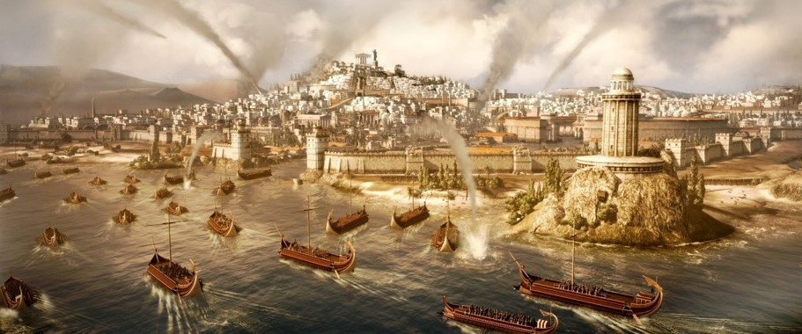
7 Heads are 7 Mountains
This fits Rome, which is called the city of 7 hills.
Rome itself stand as a symbol of the archetypal Babylon
This is a “type” of all wicked cities.
And there are seven kings: five are fallen, and one is, and the other is not yet come; and when he cometh, he must continue a short space.
Revelation 17:10

Slide 34
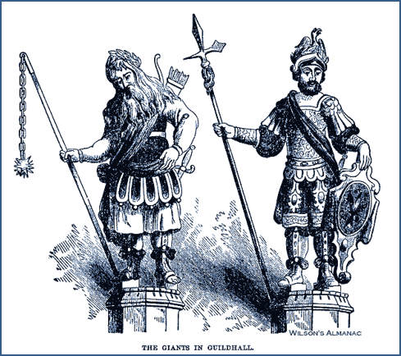
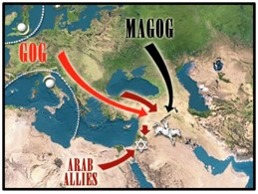
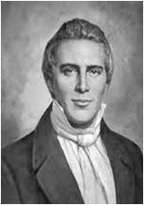
The Beast
Goeth into Perdition
Make war with the Lamb (with the faithful)
Shall be made desolate
Shall be burned by fire
Ezekiel 38:8-12, 39
Gog and Magog:
Before the coming of Christ, the great war, sometimes called Armageddon, will take place as spoken by Ezekiel
Another war of Gog and Magog will be after the millennium. (3)
Revelation 17:13-18

Slide 35
Things That Give Us the Greatest Problems:
Possessions
Do any possessions have a hold of me?
Power
Do I want to have all control?
Passion
Do I desire a physical need beyond the laws of God?
Popularity
Do I have a need for attention?
Pride
Do I have a high opinion of myself and regard myself superior to others?

Slide 36
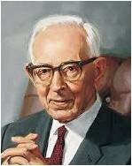
“Satan has control now. No matter where you look, he is in control, even in our own land. He is guiding the governments as far as the Lord will permit him.
That is why there is so much strife, turmoil, and confusion all over the earth. One master mind is governing the nations.
It is not the president of the United States; it is not Hitler; It is not Mussolini; it is not the king or government of England or any other land; it is Satan himself.”
(4)

Slide 37
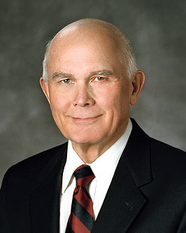
“The good, the true, and the beautiful are being replaced by the no-good, the “whatever,” and the valueless fodder of personal whim.
Not surprisingly, many of our youth and adults are caught up in pornography, pagan piercing of body parts, self-serving pleasure pursuits, dishonest behavior, revealing attire, foul language, and degrading sexual indulgence.” (5)

Slide 38
The Fall of Babylon
Revelation 18

Slide 39
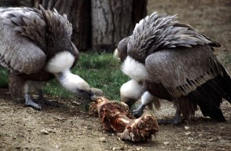
Angel Lightened in Glory
The Glory of the Lord returns to His temple and people.
A restoration
“Babylon has fallen”
Satan’s kingdom has come to an end via the Second Coming
Unclean birds—
1 Mosaic law=fowls (predators) that eat carrion (dead animals) were considered unclean.
2 Old Testament= associates fowls with the judgment of God upon the rebellious—something that feeds upon the souls of men
Revelation 18:1-2

Slide 40
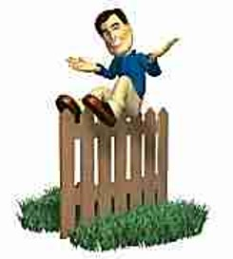
Fornication
Merchants—rich=Economic based on the finer things in life. Profit is the essential motive that drives Babylon.
“Come out of her”
“Lehk lekah” Get thee out (Gen 12:1) of the world. (D&C 133:7)
The price is the souls of men
There are no fence sitters. If we are not for the Lord and the truth we are fighting for the adversary.
Partakers of her sins—The righteous are warned not to participate in the evils of the last days
Revelation 18:3-4

Slide 41
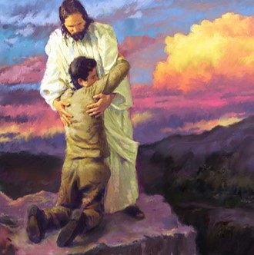
However:
“…Know the LORD: for they shall all know me, from the least of them unto the greatest of them, saith the LORD: for I will forgive their iniquity, and I will remember their sin no more.”
Jeremiah 31:34

Slide 42
Separating ourselves from the wickedness of the world can help us avoid sin and the judgments that will come upon the wicked in the last days

Slide 43
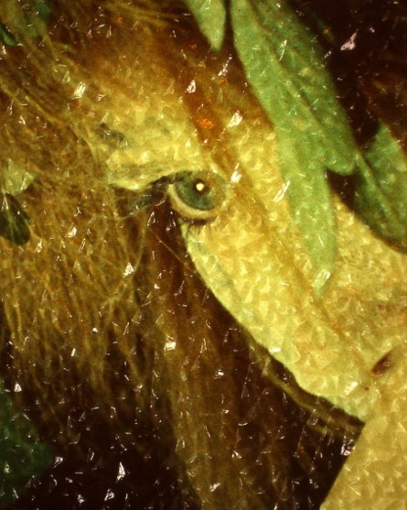
Payment
What does Babylon want?
The Souls of Men
She (Babylon) will give you what you want, only temporarily and at a price
Double=
Her payment to us is not 1 for 1, but 2 for 1
Revelation 18:5-6

Slide 44
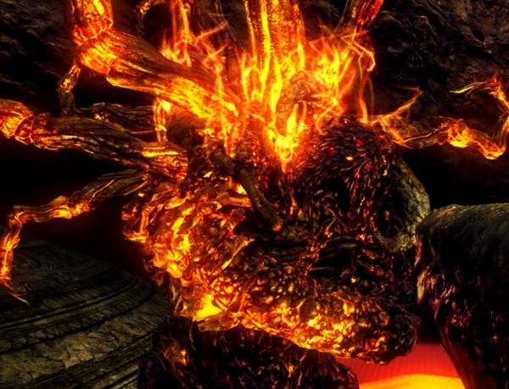
Plagues
Burned—
1. A purifying agent used in the last days. Only those things already pure and incorruptible will remain.
2. Fire of the Holy Ghost will purge those willing to have his companionship. They will cast Satan out.
Death and Mourning and Famine
And burned with fire
Representing the priestly class: Babylon, the whore.
Under the law, a woman found in adultery or harlotry, was stoned, but the daughter of a Levitical High Priest, was burned
Revelation 18:8

Slide 45
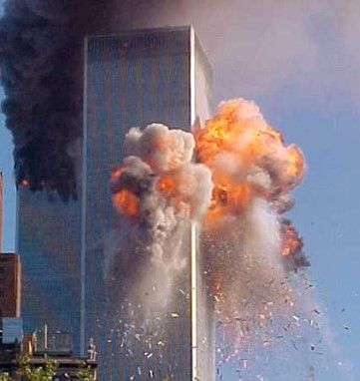
Kings Bewail
Powerful wicked Leaders
They will lament not because of guilt, but instead, they can’t continue living deliciously. They have lost their mistress (power) who provided great satisfaction.
People tend to put up with sin as long as the economy is good.
Standing afar off—fear of Babylon’s torment. Those who are in disbelief of the swiftness of the fall of their world. (9/11) Example
Merchants weep—their stores are full but no one is buying
No one buys because the whole economic structure has collapsed.
The spirit of consecration has humbled the power of possession.
Revelation 18:9-11

Slide 46
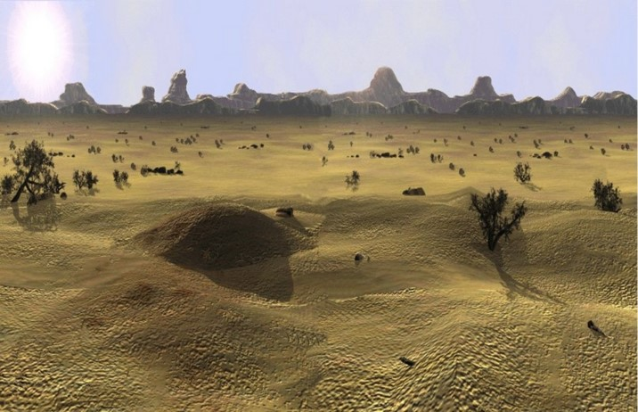
Departed From Thee
All is taken away
Mourning—of those who sold themselves to Babylon. It is suddenly gone. Not a cry of repentance but a grief that it can’t go on forever.
Is the Lord opposed to prosperity?
Read D&C 49:19-20
Revelation 18:12-19

Slide 47
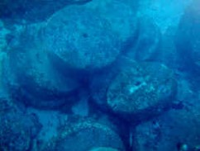
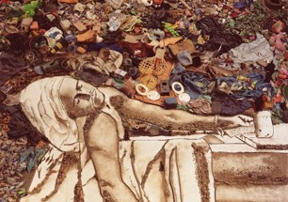
God’s Law
Law of bloodshed=Life of a man is required if he slays a fellow man
Law of a spiteful witness=if a witness is found guilty of perjury, he receives the punishment he desired for his fellow man.
As this millstone is thrown violently and sinks down into the abyss, Babylon is gone, never to rise again from the depths.
All the degrading music that was part of this city will cease
Revelation 18:20-24

Slide 48
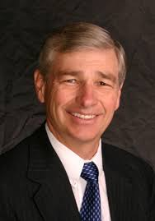
Don’t Look Back
“When we leave her (Babylon) we are not to depart, as did Israel out of Egypt, constantly looking back, longing for the “flesh pots” of their former bondage.
We must not itch and pine for the “good old days’ of worldliness. When we leave Babylon we are to go rejoicing, singing, and eager to tell the whole world the wonders of the Savior’s atonement that gave us a way out. “(6)

Slide 49
Preparing the Way for the Millennium Revelation 19

Slide 50
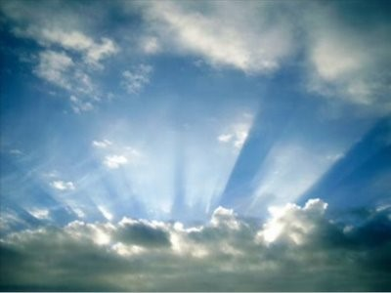
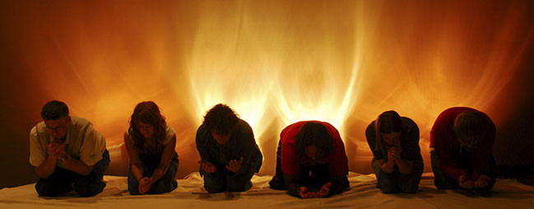
Alleluia—Praise ye the Lord
After all these things--After the destruction of Satan and the kingdom of Babylon
(D&C 29:21)
Hallehu-Jah=Praise ye Jehovah
The Righteous Rejoice—judgment has been made
Smoke rose up for ever and ever—Those who participated in the idolatries of Babylon shall go away into eternal burnings.
The prayers of the wicked are not heard anymore.
Revelation 19:1-3

Slide 51
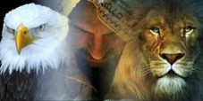
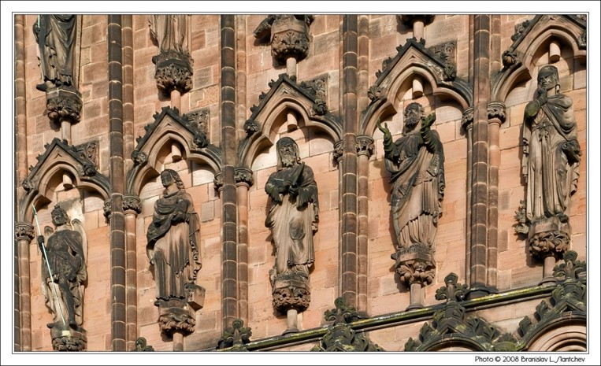
24 Elders and 4 Beasts
The Faithful elders during John’s day who belonged to the seven churches.
D&C 77:5
Beasts—the Highest of all God’s Creatures
Rev. 4:6-7 and D&C 77:2-3
Amen= Closure—Signifying agreement
Revelation 19:4

Slide 52
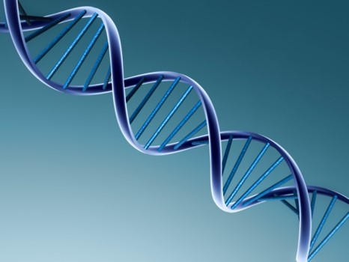
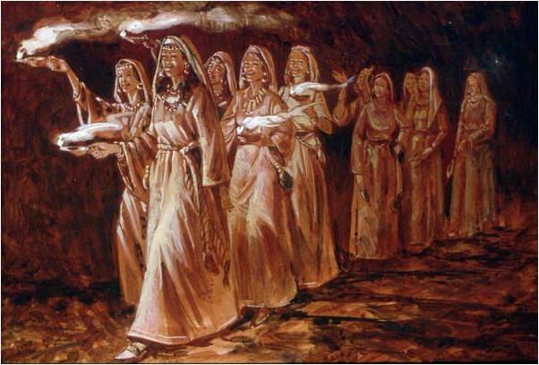
Made Themselves Ready
Voice of many waters—
All nature and all the righteous praise Christ
“Marriage of the Lamb”
See: Parable of the 10 virgins Matthew 25:4
Revelation 19:6-7

Slide 53
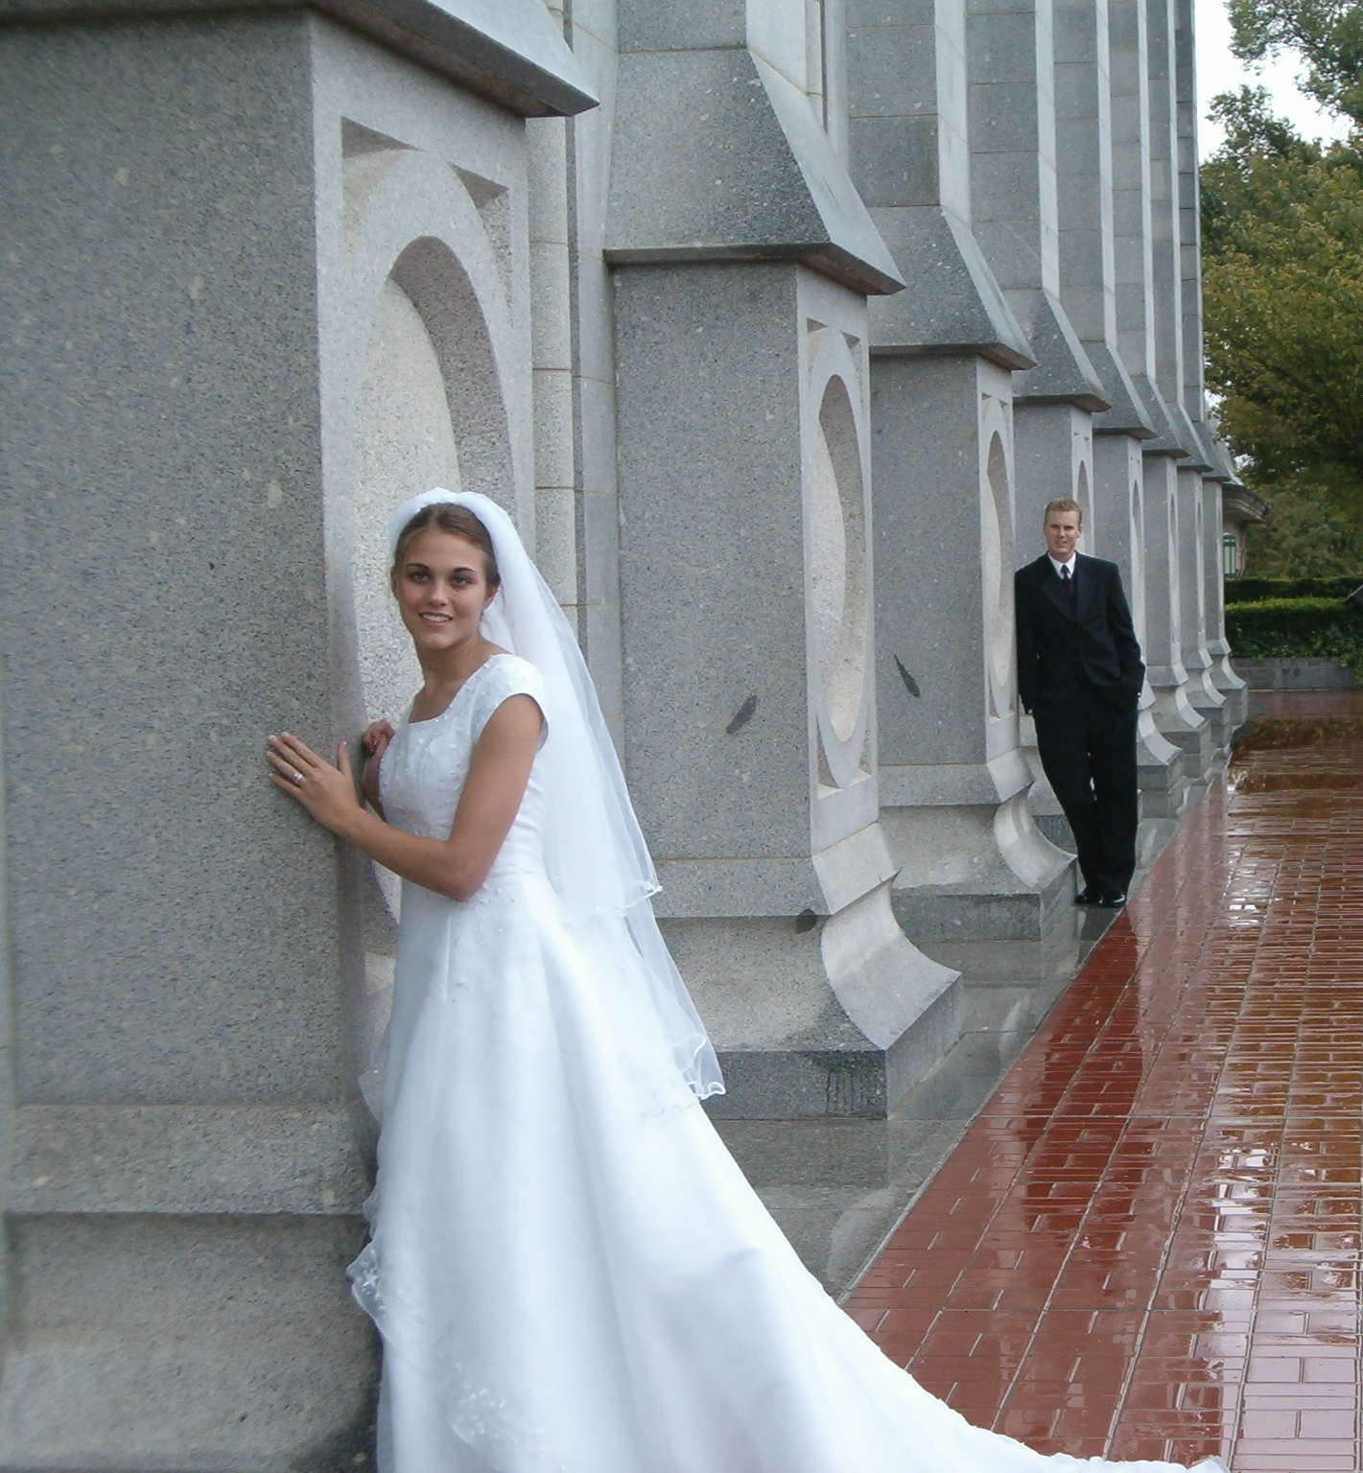
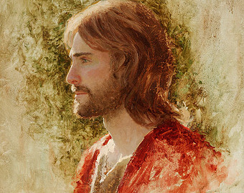
Marriage of the Lamb
Symbolic = The Savior’s Second coming
How does one prepare for marriage?
How does one prepare for The Savior’s second coming?
Blessed are they which are called unto the marriage supper of the Lamb.
Jared Barns
Revelation 19:7-9

Slide 54
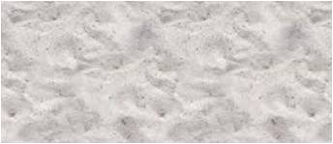
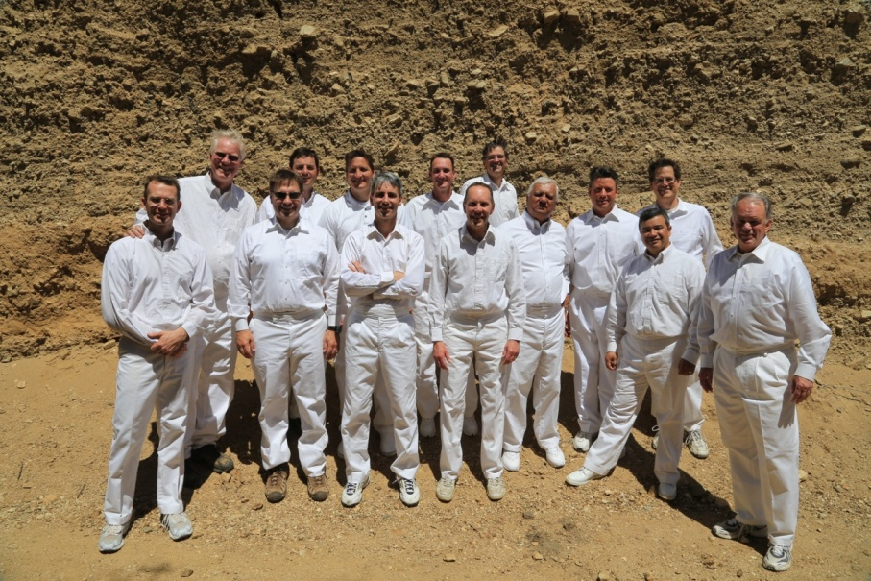
Fine Linen
Description of the clothing of the bride
Contrast to the whores clothing in Rev. 17:4
Clean and White=they are clothed with personal righteousness.
The Savior’s Atonement can do this for us, after all we can do.
Read 2 Nephi 9:14; 25:23
Revelation 19:8

Slide 55
Marriage Analogy
“marriage of the Lamb”
“On your wedding day the very best gift you can give your eternal companion is your very best self—clean and pure and worthy of such purity in return.” (7)
“In this dispensation the Bridegroom, who is the Lamb of God, shall come to claim his bride, which is the Church composed of the faithful saints who have watched for his return.” (2)
Revelation 19:7-9

Slide 56
Marriage Supper
The Angel in Rev. 1-- bearing a testimony -- asks John to Write
Those that are called (an invitation into God’s Kingdom)
If the Bride is the Church, Who are the guests?
Individual Saints
Read D&C 88:96
Revelation 19:9

Slide 57
Two Feasts
The condemned
Satan is the host
He entices us to sit at his feast
His is the meal of lies, betrayal, deception, and worldliness
Sanctified and justified
Savior is the Bridegroom and an honored patron of the ceremony, but he is also the server
He invites us to sit and brings the feast
A meal of truth
Which Feast would you desire to attend?

Slide 58
John Fell at His Feet
“I am your fellow servant”
Spirit of Prophecy—Spirit of Revelation
When we have a firm testimony of Jesus Christ, we will see things more clearly and can, in a sense, foretell future consequences.
Revelation 19:10

Slide 59
White Horse
Symbol of Victory—Christ’s return as King of Kings and a conqueror of evil
The Father turns all judgment over to Jesus
Jesus’ first ride was a donkey—symbol of peace
Revelation 19:11

Slide 60
Description of Jesus
Eye’s were as a flame of fire and many crowns—Christ rules over many kingdoms
Read D&C 88:50-61
New name—symbolic of Celestial glory—the key word
Read D&C 130:11
Revelation 19:12

Slide 61
Clothing
Dyed garments—
He will wear Red at His coming
Symbolic of the blood of the wicked as judgment falls upon them.
Read:
D&C 133:46-48
Isaiah 63:1-6
His Name = The Word of God
Revelation 19:12-13

Slide 62
Armies
An Army of Righteousness—
Those who fought in the war in Heaven
Revelation 19:14-15

Slide 63
Name Written
King of Kings and Lord of Lords—by birthright and son ship
Thigh—it is where the sword is kept.
Revelation 19:16

Slide 64
Angel in the Sun
Angel--Celestial Glory—power and authority
Fowls—Scavenge the souls of the wicked
Satan’s Banquet--Anarchy
Bodies of the rebellious supply the entrée.
D&C 29:14-21
Revelation 19:17-19

Slide 65
First to Fall
The Beast and the false prophets are the first to fall, under the power of Christ. False political entities and faithless institutions and philosophies will fail.
No longer supported by these philosophies, the armies of the world will succumb to
anarchy.
The only weapon the prophets need to
defeat the enemy and to establish peace
on the earth is the proclamation of the
gospel.
Revelation 19:20-21

Slide 66
Becoming Worthy
“Have ye walked, keeping yourselves blameless before God” Could ye say, if ye were called to die at this time, within yourselves, that ye have been sufficiently humble? That your garments have been cleansed and made white through the blood of Christ, who will come to redeem his people from their sins?
Behold, are ye stripped of pride? I say unto you, if ye are not ye are not prepared to meet God. Behold ye must prepare quickly; for the kingdom of heaven is soon at hand, and such an one hath not eternal life.”
Alma 5: 27-28

Slide 67
Sources:
“Life and Teachings of Jesus Christ and His Apostles” Page 464
Bruce R. McConkie “Mormon Doctrine” Pages 137-138; (Mormon Doctrine, 2nd ed. [1966], 469).
Joseph Smith (HC 5:298).
Joseph Fielding Smith “Doctrines of Salvation” 3:45; 3:315
Dallin H. Oaks Ensign, May 2004
6. Michael Wilcox “Who Shall Be Able to Stand” page 266
7. Elder Jeffrey R. Holland (“Personal Purity,” Ensign, Nov. 1998, 77).
David J. Ridges “The Book of Revelation Made Easier”
Notes from Lesley Meacham and Becky Davies from the Poway Institute Class
Presentation by ©http://fashionsbylynda.com/blog/

Slide 68
Babylon Revelation 17:1-6:
Because of the worldliness and corruption of ancient Babylon, and because it was a place where the children of Israel were captive, Babylon is often used figuratively in the scriptures to represent sin, worldliness, the influence of the devil on the earth, and spiritual captivity
Clothed with a Vesture Dipped in Blood Revelation 19:13:
“Having bled at every pore, how red His raiment must have been in Gethsemane, how crimson that cloak!
“No wonder, when Christ comes in power and glory, that He will come in reminding red attire (see D&C 133:48), signifying not only the winepress of wrath, but also to bring to our remembrance how He suffered for each of us in Gethsemane and on Calvary!” Elder Neal A. Maxwell (“Overcome … Even As I Also Overcame,” Ensign, May 1987, 72).
Come Out of Babylon Revelation 18:4
“Much of the world is being engulfed in a rising river of degenerate filth, with the abandonment of virtue, righteousness, personal integrity, traditional marriage, and family life. …
“… Despite pockets of evil, the world overall is majestically beautiful, filled with many good and sincere people. God has provided a way to live in this world and not be contaminated by the degrading pressures evil agents spread throughout it. You can live a virtuous, productive, righteous life by following the plan of protection created by your Father in Heaven: His plan of happiness” Elder Richard G. Scott (“How to Live Well amid Increasing Evil,” Ensign or Liahona, May 2004, 100).
The “marriage supper of the Lamb” (Revelation 19:9) is a symbolic reference to the Second Coming of Jesus Christ. The Prophet Joseph Smith taught:
“Those who keep the commandments of the Lord and walk in His statutes to the end, are the only individuals permitted to sit at this glorious feast. …
“Reflect for a moment, brethren [and sisters], and enquire, whether you would consider yourselves worthy [of] a seat at the marriage feast” (Teachings of Presidents of the Church: Joseph Smith [2007], 165–66).
Receive Not Her Plagues Revelation 18:4:
“It is a false idea that the Saints will escape all the judgments, whilst the wicked suffer; for all flesh is subject to suffer, and ‘the righteous shall hardly escape;’ … many of the righteous shall fall a prey to disease, to pestilence, etc., by reason of the weakness of the flesh, and yet be saved in the Kingdom of God” Joseph Smith (in History of the Church, 4:11).

Slide 69
Binding of Satan
Revelation 20

Slide 70
During Millennium
Satan is bound for a thousand years and no longer deceives the nations
Revelation 20:1-3
1 Nephi 22:26-28
The righteous rise in the First Resurrection
Revelation 20:4-6
Mosiah 15:21-23
D&C 88:96-98
“During that thousand years of peace the great work of the Lord shall be in the temples, and into those temples the people shall go to labor for those who have (died) and who are waiting to have these ordinances…preformed for them by those who still (live) upon the earth”
Joseph Fielding Smith
Doctrines of Salvation 3:58
Isaiah 2:2-5
D&C 128:15
If we are faithful to Jesus Christ, we will have part in the First Resurrection and reign with Christ during the Millennium

Slide 71
End of Millennium
Satan is loosed from his prison and once again deceives the nations. He gathers them to battle against God
Revelation 20:7-8
D&C 88:110-111
Satan’s armies surround the camp of the Saints. God sends fire that destroys Satan’s armies, Satan and others are cast into the lake of fire and brimstone.
Revelation 20:9-10
D&C 88:112-114
Those not in the First Resurrection are resurrected and judged. The wicked are sent away to suffer the second death.
Revelation 20:11-15
Helaman 14:17-19
D&C 63:17
At the end of the Millennium, the forces of God will defeat Satan and his followers.

Slide 72
After Millennium
The earth receives its celestial glory. God’s holy city is established upon the earth
Revelation 21:1-3; 22:1-2
The righteous Saints live with God in celestial splendor
Isaiah 60:19-21
Revelation 21:4-7; 22:3-5
Those who are exalted shall reign as gods
D&C 132:20
“Every man who reigns in celestial glory is a God to his dominions”
Joseph Smith “Teachings of the Prophet Joseph Smith” pg 374

Slide 73
The End—Or is it?
John is one of the few prophets to see the end of the earth whose writing the Lord has allowed to go forth to the world.
1 Nephi 14:24-27
“I testify that not many years hence the earth will be cleansed…Jesus the Christ will come again, this time in power and great glory to vanquish His foes (destroy His enemies) and to rule and reign on the Earth.”
Ezra T. Benson
1988 Conference Report or Ensign Nov. 1988

Slide 74
Key to Bottomless Pit
Michael will gather and lead the armies as he did in the War in Heaven
D&C 88:112
Dan 7:22
Key—Christ is the holder of the key
Chain—Satan’s Chain on us
The Key and the chain denote God’s supremacy over both Satan and his realm
Revelation 20:1

Slide 75
God is Magistrate of Pit, Not Satan
He who chained others is now chained.
He who loved to spread darkness over the earth is shut up in darkness
He who dragged others into the pit descends himself into it
He descends into the pit that he himself has dug
Isaiah 14:12-16, 19
(1)
D&C 88:32
Hell is described as your “own Place.”
Revelation 20:1

Slide 76
Binding for 1,000 Years
Dragon--Satan
“And in that day Satan shall not have power to tempt any man.”
D&C 101:28
Some suggest that it will only be “because of the righteousness of his people” that “Satan has no power” during the Millennium.
Revelation 20:2

Slide 77
“There are many among us who teach that the binding of Satan will be merely the binding which those dwelling on the earth will place upon him by their refusal to hear his enticings. This is not so. He will not have the privilege during that period of time to tempt any man.”
(3)
The Lord’s power binds Satan initially and the righteousness of the Saints Keeps him bound.
1 Nephi 22:26

Slide 78
Setting a Seal Upon Him
The purpose of Satan’s binding is precautionary.
The Savior and his people must have time to prepare the earth for the celestial glory.
Bottomless pit=Outer Darkness
The angel does the binding, not mankind.
People do not bring about the millennial condition through some kind of supreme righteous act.
Revelation 20:3

Slide 79
Loosed a Little Season
“There will be many within the nations who shall not know of the gospel law yet who shall live terrestrial live.
These will be spared destruction and enjoy the millennial period with the Saints of God through missionary work.”
(3)
After 1,000 years, Satan will be released to gather his army for the final battle where he will be cast into perdition forever.
Since only the power of God can loose him then his freedom must play an important part of God’s purposes.
Men will begin to
deny God.
Revelation 20:3 and 7

Slide 80
Paradisiacal Era
People who share in the Millennial reign
They worship God not Satan
They did not fall for Satan’s ideology
They actively fought for truth
All the martyrs who gave their lives in the service of the Lamb.
Christ had promised his apostles that they would be the judges of Israel.
D&C 29:12
Revelation 20:4

Slide 81
First Resurrection
D&C 88:96-101
“And the saints that are upon the earth, who are alive, shall be quickened and be caught up to meet him.”
Alma 13:11-12
“Therefore they were called after this holy order, and were sanctified, and their garments were washed white through the blood of the Lamb.”
“…they shall be priests (the priesthood) of God and of Christ, and shall reign with him a thousand years.”
Revelation 20:5-6

Slide 82
Second Resurrection
At the End of the Millennium
Hath no power (Alma 12:16-18)
Spiritual death
They are cast out of the presence of the Lord for 1,000 years
They are dead as pertaining to the things of righteousness (the things of the Spirit)
“These are the ones who have earned a telestial body, who were wicked and carnal in mortality, and who have suffered the wrath of God in hell “until the last resurrection” until Christ has finished His work...their final destiny is to inherit a telestial glory
(D&C 76:81-112)
(7)
Revelation 20:5-6

Slide 83
Sons of Perdition
Those who remain filthy still
Shall come forth out of their graves.
2 Nephi 9:14-16
“Then is the time when their torments shall be as a lake of fire and brimstone, whose flame ascendeth up forever and ever; and then is the time that they shall be chained down to an everlasting destruction, according to the power and captivity of Satan”
(Alma 12:17-18)
All except sons of perdition are save at least to some degree, by Christ, into the telestial, terrestrial, or celestial kingdoms
D&C 76:37-38, 81-87
Revelation 20:5-6

Slide 84
Gog and Magog
Symbolic of wicked nations and their leaders
“The battle of Gog and Magog will be after the millennium." (6)
King of Magog, a county or people near the Black Sea, and equivalent to Scythian, whose invasion of Israel was prophesied by Ezekiel (Ezek. 38-39)
The prophecy points to a time when the gentile nations of the north would set themselves against the people of God and would be defeated and led to recognize Jehovah as King. (5)
There will be a battle before the 2nd Coming and again after the Millennium, this time led by Michael—Those who will not answer Michael’s call will be those who rejected the doctrine of Christ. (1)
Revelation 20:8

Slide 85
Fire and Brimston
“A man is his own tormentor and his own condemner.
Hence the saying, They shall go into the lake that burns with fire and brimstone.
“The torment of disappointment in the mind of man is as exquisite as a lake burning with fire and brimstone.” (6)
Revelation 20:8

Slide 86
Beloved City
The Lord’s Kingdom
“compassed” the Saints and the city—protected
And cast the wicked out forever
Revelation 20:9-10

Slide 87
White Throne
Christ’s throne of purity and justice
Earth and Heaven fled away—
The end of the earth and of the atmospheric heaven which surround it.
—a new earth
D&C 29:24-25
Revelation 20:11

Slide 88
Book of Life
“and I saw the dead, small and great, stand before god; and the books were opened: and another book was opened, which is the book of life; and the dead were judged out of those things which were written in the books, according to their works…
The records of our acts are transcribed in our souls. The account of our obedience or disobedience is written in our bodies.
(7)
…And the sea gave up the dead which were in it; and death and hell delivered up the dead which were in them: and they were judged every man according to their works.”
Revelation 20:12-13; D&C 128:6-7

Slide 89
Doctrinal Mastery
And I saw the dead, small and great, stand before God; and the books were opened: and another book was opened, which is the book of life: and the dead were judged out of those things which were written in the books, according to their works.
Revelation 20:12

Slide 90
What Books?
The Standard Works of the Church, the holy scriptures wherein the law of the Lord is recorded and the instruction given as to how men should walk in this mortal probation;
also, the records of the Church wherein are recorded the faith and good works of the saints-the records of their baptism, celestial marriage, tithe paying, missionary service, and their acts of devotion and worship." (7)
God will judge us out of the books that have been written according to our works
Revelation 20:12

Slide 91
What about those who haven’t heard the Word of the Lord?
“…All who have died without a knowledge of this gospel, who thou have received it if they had been permitted to tarry, shall be heirs of the celestial kingdom of God.”
D&C 137:7

Slide 92
Note of Warning from John
Those who deny grace and reject Christ go to the eternal fire prepared for the devil and his angels, or Gehenna.
Gehenna, Valley of Hinnom, was an area in Israel used as a dump for trash and became synonymous with hell. (7)
Hell was not prepared for men, only for demons.
This is the Second Death.
It is visited only upon the most hardened, those who cannot find humility and acceptance and who remain “filthy still”
D&C 88:35
When they are resurrected, and all will be
resurrected, death—spiritual death—
immediately reclaims them.

Slide 93
2 Principles from John 20
The power of the first resurrection reaches only those of the past and present ages who are Christ’s at the time of His coming. That moment is critical.
Those who must seek a little time while they get their lives in order will find that the word, “I come quickly” indeed mean “I come suddenly, even before you are ready.”
The binding of Satan does more than merely give hope for the future.
The Power of evil, though deadly real now, has no place in the future.
It exists and operates at any time only by permission of God. When he
determines that
it will end, it will
end. (4)

Slide 94
Sources:
Michael Wilcox “Who Shall Be Able to Stand” page 284-285, 297
David J. Ridges “The Book of Revelation Made Easier”
Joseph Fielding Smith “Church History and Modern Revelation, 1:192 “Doctrine of Salvation” page 640, page 97
Richard D. Draper “Opening the Seven Seals” page 225-226
Bible Dictionary
Joseph Smith History of The Church of Jesus Christ of Latter-day Saints, 5: 298. Teachings of Joseph Smith, 224
Elder Bruce R. McConkie Doctrinal New Testament Commentary, 3 vols. [Salt Lake City: Bookcraft, 1965-1973], 3: 521, 579.)
Notes from Lesley Meacham and Becky Davis Poway Institute
Dragon artwork (iron) found in Borrego Springs California
Presentation by ©http://fashionsbylynda.com/blog/

Slide 95
Bottomless Pit Revelation 20:1
"The bottomless pit is the depths of hell. It is not a literal pit without a bottom, for such is a contradiction in terms. But it is a pit or prison where the inhabitants suffer, as mortals view suffering, to an infinite, unlimited, or bottomless extent. Referring to finite inability to comprehend the vastness of the suffering of those reaping the full measure of this status, the revelation says: 'The end, the width, the height, the depth, and the misery thereof, they understand not, neither any man except those who are ordained unto this condemnation.' (D. & C. 76:48.)" Elder Bruce R. McConkie (Mormon Doctrine, 2d ed. [Salt Lake City: Bookcraft, 1966], 101.)
After the Thousand Years Revelation 20:7
"Satan will be sealed up in the bottomless pit for a thousand years-but not forever. 'When the thousand years are expired, Satan shall be loosed' to once again do his work of deception and destruction on the earth. He will gather followers from all nations to a battle in which the warriors are as many 'as the sand of the sea.' Satan's mortal hosts will surround the Saints and their 'beloved city,' but the Lord will act in great glory and power to devour his enemy. Then the devil will be cast away forever, to be punished for his great sins for all eternity.
"The account in 4 Ne. 1 gives us a sobering preview of how the bright millennial era can be brought to a close. After the Savior's visit to the descendants of Lehi in the Americas, the people entered into a condition that was millennial in some important respects: 'There was no contention in the land, because of the love of God which did dwell in the hearts of the people...'
"The breakdown in this near-perfect society had tiny beginnings: 'a small part of the people . . . revolted from the church and [had] taken upon them the name of Lamanites' (vv. 20)...From that point, the society disintegrated rapidly. Within the next decade, 'there were many churches in the land; yea, there were many churches which professed to know the Christ, and yet they did deny the more parts of his gospel, insomuch that they did receive all manner of wickedness, and did administer that which was sacred unto him to whom it had been forbidden because of unworthiness. And this church did multiply exceedingly because of iniquity, and because of the power of Satan who did get hold upon their hearts' (vv. 27-28).
"Thus it was that in only a few years, Satan, who had essentially been bound, was loosed again in the land...The decline and fall of this blessed society makes for troubling reading, and the lessons for our day are clear. Satan ever lies in wait to deceive and destroy, and if he fails with one generation, he will try with redoubled efforts to harm the next." (Donald W. Parry and Jay A. Parry, Understanding the Book of Revelation [Salt Lake City: Deseret Book Co., 1998], 273-274.)
Judgment Revelation 20:3
"Under Christ, selected agents and representatives shall sit in judgment upon specified peoples and nations. Scriptural intimations indicate that there will be a great judicial hierarchy, each judge acting in his own sphere of appointment and in conformity with the eternal principles of judgment which are in Christ." Elder Bruce R. McConkie (Mormon Doctrine, 2d ed. [Salt Lake City: Bookcraft, 1966], 399.)
All those who have died in Christ Revelation 20:4:
"All those who have died in Christ shall come forth from the dead at his coming and shall dwell upon the earth as Christ shall be upon the earth during this millennium. They shall not remain here all the time during the thousand years, but they will mingle with those who are still here in mortal life. These resurrected saints and the Savior himself, shall come to give instruction and guidance; to reveal unto us [mortals] the things we ought to know; to give us information concerning the work in the temples of the Lord so we may do the work which is essential to the salvation of worthy men. Smith, Joseph Fielding" (Doctrines of Salvation, 3 vols., edited by Bruce R. McConkie [Salt Lake City: Bookcraft, 1954-1956], 3: 59.)
Book of Life Revelation 20:12:
“In one sense the book of life is the sum total of one’s thoughts and actions—the record of his life. However, the scriptures indicate that a heavenly record is kept of the faithful, whose names are recorded, as well as an account of their righteous deeds (D&C 88:2; 128:7)” (Bible Dictionary, “Book of life”).

Slide 96
“God judges men according to the use they make of the light which He gives them” (Teachings: Joseph Smith, 405). He also explained, “[The Lord] will award judgment or mercy to all nations according to their several deserts, their means of obtaining intelligence, the laws by which they are governed, the facilities afforded them of obtaining correct information, and His inscrutable designs” (Teachings: Joseph Smith, 404).
Revelation 20:14:
The second death, or spiritual death, is defined as being cut off from the presence of God. This means that you cannot see the face of God, you cannot withstand the presence of God, you will not enjoy the visitation of the Son, and you are not worthy of the smallest portion of the spirit of the Holy Ghost. It is a total and complete separation from God. As described in scripture, this state happens to those who suffer in hell. It also describes the state of the Sons of Perdition who are cast out after the last soul is resurrected. Therefore, the second death has power upon all those who suffer in hell until the resurrection of the wicked. At that point the second death applies only to the Sons of Perdition, 'These are they who shall go away into the lake of fire and brimstone, with the devil and his angels-And the only ones on whom the second death shall have any power' (DC 76:36-7).
One might be inclined to think that the "first death" must be the death of the mortal body. This is not the case. The Lord explains that the first death is also spiritual and occurs when we leave his presence and come to earth. This is symbolized by the fall of Adam, 'I, the Lord God, caused that he should be cast out from the Garden of Eden, from my presence, because of his transgression, wherein he became spiritually dead, which is the first death, even that same death which is the last death (or second death), which is spiritual, which shall be pronounced upon the wicked when I shall say: Depart, ye cursed' (DC 29:41).gospeldoctrine.com

Slide 97
Those Who Overcome
Revelation 21-22
John’s Last Words

Slide 98
New Heaven and New Earth
The earth passing through various stages:
It was created and pronounced good.
It partook of the decree of mortality coming through the fall.
It is now in the telestial condition, in which telestial beings predominate and rule.
It will then pass into the “renewed” or restored state, for a thousand years as a terrestrial earth and the abode of terrestrial inhabitants.
Then it comes to the end. The earth must die. It will then receive its resurrection and be celestialized in accordance to the Laws of Obedience
Revelation 21:1

Slide 99
Celestial
“The place where God resides is a great Urim and Thummin.”
…This earth, in its sanctified and immortal state, will be made like unto crystal and will be a Urim and Thummim to the inhabitants who dwell thereon…and this earth will be Christ’s”
D&C 130:8-9

Slide 100
In the celestial kingdom, God will dwell with and comfort His people, and they will no longer experience death, sorrow, or pain; and those who faithfully overcome the tests of mortal life will inherit eternal blessings in the celestial kingdom.

Slide 101
New Jerusalem
A city of the Celestial order
“…the same sociality (families, love within, marriage, eternal) which exists among us here will exist among us there, only it will be coupled with eternal glory we do not now enjoy.”
D&C 130:2
Revelation 21:2

Slide 102
The Lord is Here
1. Ancient Jerusalem, the city of much of our Lord’s personal ministry among men, shall be rebuilt in the last days and become one of the two great world capitals, a millennial city from which the word of the Lord shall go forth.
When this earth becomes a celestial sphere ‘that great city, the holy Jerusalem,’ shall again descend ‘out of heaven from God,’ as this earth becomes the abode of celestial beings forever—(2)
2. A new Jerusalem, a new Zion, a city of God shall be built on the American continent.
3. Enoch’s city, the original Zion, ‘the City of Holiness’ with its translated inhabitants now in their resurrected state, shall return, as a New Jerusalem, to join with the city of the same name which has been built upon the American continent.
Ezekiel 48:35—(1)
Revelation 21:2

Slide 103
The Tabernacle of God
Tent—God’s personal presence—
a covering—an atonement
Covenant Symbol=new and everlasting covenant
While on earth the Saints felt themselves as strangers seek a
“Better country, that is, an heavenly; Wherefore God is not ashamed to be called their God; for he hath prepared for them a city.” Hebrews 11:16
Revelation 21:3

Slide 104
All Things New
God begins to reveal himself
Christ bears testimony to John of the truthfulness of the things he is seeing and hearing.
God will dwell with and comfort His people, and they will no longer experience death, sorrow, or pain.
Revelation 21:5

Slide 105
Wipe Away All Tears
Sometimes our pains are so great we don’t believe any future joy can compensate for them
The wiping of tears is a gesture of deepest intimacy.
Only family or the closest of friends would do such a thing for another.
“All your losses will be made up to you in the resurrection provided you continue faithful.”
(9)
Isaiah 65:17-21
Revelation 21:4
Brent Borup

Slide 106
It is Done
Everything is fulfilled
His work is complete
Alpha and Omega
The beginning and end of the Greek alphabet.
What is Christ the end of?
The end of tears, of death, of sorrow, of crying, of pain.
What is Christ the beginning of?
The beginning of life, of peace, of happiness, of pleasure, of forgiveness.
Revelation 21:6

Slide 107
2nd Death
…a spiritual death, meaning they are cast out of the presence of the Lord and are dead as pertaining to the things of righteousness, which are the things of the spirit.”
“After the separation of the body and spirit, which is the natural death, the wicked and ungodly die a second death,…
Wherefore, I, the Lord, have said that the fearful, and the unbelieving, and all liars, and whosoever loveth and maketh a lie, and the whoremonger, and the sorcerer, shall have their part in that lake which burneth with fire and brimstone, which is the second death.
18 Verily I say, that they shall not have part in the first resurrection. D&C 63:17-18
Revelation 21:8
(2)

Slide 108
One of the 7 Angels
“…one of the seven angels which had the seven vials full of the seven last plagues…”
The Lamb’s Wife = The Church, the righteous, the City of Enoch, the celestial city, or the kingdom in Revelation 21:11-27
See Revelation 15
Jasper=represents the glory of the celestial kingdom. These don’t decay. The stones have no impurities. They reflect light and are symbols of beauty.
Revelation 21:9-11

Slide 109
12 Gates and 12 Angels
3 to each side= named after the 12 tribes of Israel—the pattern of the encampment around the tabernacle.
Angels =guarded by sentinels
Levites are assigned as porters
They have charge of the treasures, serve as officers and judges.
See: 1 Chronicles 26:1-19
possible divine government
Wall of the City—in the past just the temples had a wall around them to separate the holy from the profane.
This whole celestial city will have a wall, a sanctuary
Revelation 21:12-13

Slide 110
12 Foundation Stones
Name after the apostles of the Lord=Quorum
Golden reed to measure=this time not just the temple (like in Rev. 11) but the whole city and its inhabitants are measured.
1
2
3
Revelation 21:14-16

Slide 111
Cubic Shape
“Length, breadth, and height are equal= a celestial cube—a symbol of perfection and eternal stability, exactness, perfect and straight.
Hebrew tradition states that the universe is cubic in shape with the heavenly temple occupying a point exactly in the middle of the Cube.” (3)
Revelation 21:14-16

Slide 112
144,000 Cubits
Measurement of an angel
Rev. 11 signifies the area’s protection from judgment.
Golden Rod acts as a standard that demonstrates the city’s purity.
Wall of Jasper=The Light of the Urim and Thummim
12 stones=to beautify.
These however do not match the breastplates stones of the High Priests.
Revelation 21:17-20

Slide 113
Stones Garnish City Wall
Jasper
Sapphire
Chalcedony
Emerald
Sardonyx
Sardius
Chrysolite
Beryl
Topaz
Chrysoprasus
Jacinth
Amethyst
Revelation 21:19

Slide 114
12 Pearls
A perfect pearl in the Mediterranean world was worth more than gold
Parable of the Pearl of Great Price
Matthew 13:45-46
Revelation 21:21

Slide 115
No Temple Therein
The whole of the celestial kingdom is a Temple
There is no need for temples at this point, all the work has been done.
The Temples on earth are symbols and types of the Eternal Holy of Holies.
The Saints will live in the real heaven not just the heaven on earth (temple).
“No need of sun or moon”= We will live in the glory of God’s presence
Revelation 21:22-23

Slide 116
Gates Will Not Be Shut
There is no danger for the glory of God is there
No night= The eternal light is always on, no darkness
HOWEVER:
Anything that defileth= no unclean thing can enter into the kingdom
And no unclean thing can enter into his kingdom; therefore nothing entereth into his rest save it be those who have washed their garments in my blood, because of their faith, and the repentance of all their sins, and their faithfulness unto the end. 3 Nephi 27:19
Revelation 21:24-27

Slide 117
Frequently asked Questions
Do mortals actually die during the Millennium, after they’ve lived to be 100?
D&C 101:31
They actually die but are immediately resurrected.
What happens at the end of the Millennium?
D&C 88:111-115 and Revelation 20:8
Many mortals on earth at the time reject the Savior, whom they know, and turn to wickedness. The end of the war, which began with the war in heaven, takes place. Usually referred to the battle of God and Magog. Michael (Adam) will gather armies of righteousness and the devil will gather his armies and the devil and the ‘hosts of hell’ will be defeated and cast out forever.
3. Are all people separate and single, except those who attain exaltation?
D&C 131:1-4, 132:15-32
Yes, “In the terrestrial and telestial world there will be no marriages. Those who enter there will remain separately and singly forever. (7)
4. What about the righteous who wanted to marry but died without getting a fair chance at marriage during mortality?
D&C 131:1-4, 132:19-20
They will be given the opportunity to marry happily and be sealed during the Millennium. (10)

Slide 118
5. After final judgment, can a person progress from one kingdom to another?
D&C 76:112 and 29:29
No. “After a person has been assigned to his place in the kingdom….he will never advance from his assigned glory to another.” (10)
6. When we become gods, will we use the same plan of salvation for our own spirit children
D&C 132:20
Yes, we will, according to the first Presidency Statement –1916
7. Will there be differences between resurrected bodies of celestials, terrestrials, telestials, etc.?
D&C 88:28-32 and 1 Corinthians 15:39-42
Yes. Celestial bodies will shine like the sun. Terrestrial will not shine like the sun, but they will be more glorious that the bodies of those who received the telestial glory. In both the Terrestrial and Telestial bodies there will be limitations. They will have no power to increase (have children) neither power to live as husbands and wives. Celestial will live in families and have the ‘continuation of seeds forever’

Slide 119
8. Will there be any besides Latter-day Saints on earth during the Millennium?
D&C 43:30
“There will be millions of people, Catholics, Protestants, Agnostics, Mohammedans, people of all classes and all beliefs, still permitted to remain upon the face of the earth, but they will be those who have lived clean lives, those who have been free from wickedness and corruption. All who belong, by virtue of their good lives…(7)
*Not all Latter-day Saints will be on earth during the Millennium.
9. What will daily life be like during the Millennium?
D&C 29:11
Mortality as such will continue. Children will be born, grow up , marry, advance to old age, and die…Crops will be planted, harvested, and eaten; industries will be expanded, cities built, and education fostered. Men will continue to care for their own need, handle their own affairs, and enjoy the full endowment of free agency. Dwell in peace…(2)

Slide 120
10. How old will mortals live to be during the millennium?
Isaiah 65:20
100 years old
11. Will Righteous mothers get to raise their children who died young?
D&C 137:10
“…the mother who laid down her little child, being deprived of the privilege, the joy,…of bringing it up to manhood or womanhood in this world, would after the resurrection, have all the joy…and even more than it would have been possible to have had in mortality, in seeing her child grow to the full measure of the stature of its spirit.” (6)
12. What about stillborn children?
D&C 137:10
“Although temple ordinances are not performed for stillborn children, no loss of eternal blessings or family unity is implied. The family may record the name of a stillborn child on the family group record followed by the word stillborn in parentheses” (11)

Slide 121
13. When a baby dies, is it still a baby or is it an adult in the spirit world
D&C 137:10
“When a baby dies, it goes back into the spirit world, and the spirit assumes its natural form as an adult, for we were all adults before we were born.
“When a child is raised in the resurrection, that spirit will enter the body and the body will be the same size as it was when the child died. It will then grow after the resurrection to full maturity to conform to the size of the spirit.
“If parents are righteous, they will have their children after the resurrection. Little children who die, whose parents are not worthy of an exaltation, will be adopted into families of those who are worthy.” (7)

Slide 122
“Obedience is the First Law of Heaven”
--Joseph Fielding Smith
Revelation 22
לא יהיה לך אלוקים אחר על פני

Slide 123
The Throne of God
Therefore are they before the throne of God, and serve him day and night in his temple: and he that sitteth on the throne shall dwell among them.
They shall hunger no more, neither thirst any more; neither shall the sun light on them, nor any heat.
For the Lamb which is in the midst of the throne shall feed them, and shall lead them unto living fountains of waters: and God shall wipe away all tears from their eyes.
Revelation 22:1; Revelation 7:15-17

Slide 124
Pure River of Water
Living water—
The Love of God
1 Nephi 11:25
Joy—wells of salvation
Isaiah 12:3
“…if thou knewest the gift of God, and who it is that saith to thee, Give me to drink; thou wouldest have asked of him, and he would have given thee living water.”
John 4:10
Revelation 22:1

Slide 125
Tree of Life
The Love of God
1 Nephi 8:13
Fruit—the gospel--the benefits of the gospel are not seasonal rather continue constantly forever
1 Nephi 8:10
Midst of the street—the Celestial City—Celestial Glory
Revelation 20
Healing of nations=what the gospel can do for them
Revelation 22:2

Slide 126
No More Curse
On the Earth
Genesis 3:17-18
The Kingdom will be celestial—
This earth will be Christ’s
D&C 130:9; 88:25
“…the earth abideth the law of a celestial kingdom, for it filleth the measure of its creation, and transgresseth no the law—”
D&C 88:25
Revelation 22:3

Slide 127
See His Face
The righteous have taken His name upon them and kept their covenants
Revelation 3:12
Therefore they will be with Him in celestial glory
God Giveth Light
There is no need for light
They will be Gods
Revelation 22:4-5

Slide 128
Angel Bears Testimony
“…These sayings are faithful and true; and the Lord God of the holy prophets sent his angel to shew unto his servants the things which must shortly be done.”
Revelation 22:6

Slide 129
“I Come Quickly”
“Wherefore, stand ye in holy places, and be not moved, until the day of the Lord come; for behold, it cometh quickly, saith the Lord. Amen.”
D&C 87:8
Not “soon” but when the time is right. He will come suddenly upon the wicked as a thief in the night.
D&C 106:4-5
“Verily, I say unto you, I am Jesus Christ, who cometh quickly, in an hour you think not. Even so. Amen.”
D&C 51:20
Revelation 22:7

Slide 130
Thy Fellow Servant
“…there are no angels who minister to this earth but those who do belong or have belonged to it. Hence, when messengers are sent to minister to the inhabitants of this earth…
…they are not strangers, but from the ranks of our kindred, friends, and fellow-beings and fellow-servants.”
Revelation 22:9
(9)

Slide 131
Blessed Are They…
Those who have right to the tree of life
Revelation 22:14

Slide 132
Stay in the Boat
In Minnesota Elder Russell M. Nelson, wife, and daughter were rowing a small boat on a lake. “After rowing far from shore, we stopped to relax and enjoy the tranquil scene. Suddenly, our little toddler lifted one leg out of the boat and started to go overboard, exclaiming, ‘Time to get out, Daddy!’
”Quickly we caught her and explained, ‘No, dear, it’s not time to get out; we must stay in the boat until it brings us safely back to land.’ …
“Similarly, we as children of our Heavenly Father may foolishly want to get ‘out of the boat’ before we arrive at destinations He would like us to reach…
“We are first to get ‘on the boat’ with Him. Then we are to stay with Him. And if we don’t get ‘out of the boat’ before we should, we shall reach His kingdom, where we will be lifted up to eternal life.”
(8)

Slide 133
Jesus Sends Angel
To testify:
That He is the root and offspring of David
And He is the bright and morning Star=the Savior
Revelation 22:16

Slide 134
Come
And the Spirit (the Holy Ghost) and the bride (the righteous members of the Church):
Take of the living water freely
—an invitation for all to come
unto Christ
Revelation 22:17

Slide 135
Changing or Corrupting Revelation
“…If any man shall add unto these things, God shall add unto him the plagues that are written in this book:
“And if any man shall take away from the words of the book of this prophecy, god shall take away his part out of the book of life, and out of the holy city, and from the things which are written in this book.”
Revelation 22:18-19

Slide 136
John’s Warning
Do not intentionally twist the meanings, delete doctrines, etc., from the book of Revelation.
The same message was given to Moses:
Deuteronomy 4:2
“Ye shall not add unto the word which I command you, neither shall ye diminish ought from it, that ye may keep the commandments of the LORD you God which I command you.”
Revelation 22:18-19

Slide 137
John Testifies
John addresses his readers, including you and me, with a tender blessing upon us.
All of Paul’s epistles have such a statement or blessing upon his readers at or near the end of the last chapter.
All living prophets testify at the end of their talks.
We should do likewise.
Revelation 22:20

Slide 138
John Gives Us Hope
The great incentive to Repentance
The Savior will redeem them from our sins not in our sins.
Unto Salvation
It is a desire of faithful people to gain eternal salvation in the Kingdom of God.

Slide 139
What Should I Hope For?
To keep receiving the mark of the beast (Rev. 20:4)
To be called to the ‘marriage supper’ of the Lamb (Rev. 19:9)
To overcome all things (Rev. 21:7)
To be resurrected in the morning of the first resurrection (Rev. 20:6)
For the coming of Christ (Rev. 22:20)

Slide 140
“ This is good doctrine. It tastes good. I can taste the principle of eternal life, and so can you. …I know that when I tell you these words of eternal life…you taste them, and I know that you believe them. You say honey is sweet, and so do I. I can also taste the spirit of eternal life. I know it is good…and rejoice more and more.”
--Joseph Smith

Slide 141
Amen
“The grace of our Lord Jesus Christ be with you all. Amen.”
Revelation 22:21
“I testify that these things I have learned this school year are true. I testify of Jesus as my Savior and through His Atonement I know I can return to Him someday.”
I want to thank my husband for encouraging me to pursue this challenge…
…and all the many seminary teachers who have dedicated their time in spreading the true gospel.

Slide 142
Sources:
1. The Life and Teachings of Jesus Christ and his Apostles Page 469-470
2. Bruce R. McConkie “Doctrines of New Testament Commentary” 3:580-581Second death—3:583-584
During Millennium—”Mormon Doctrine” pp. 496-497
3. Matthew Brown “The Gate of Heaven” page 6
4. David J. Ridges “The Book of Revelation Made Easier”
5. First Presidency Message 1916 Improvement Era August 1916 page 942
6. Joseph F. Smith children raising “Gospel Doctrine” p. 453-454
Joseph Fielding Smith “Doctrines of Salvation” 2:56
Elder Russell M. Nelson conference Report April 1997 or Ensign May 1997
Joseph Smith “Teachings of Joseph Smith” page 355
President Spencer W. Kimball Ensign October 1979 The Importance of Celestial Marriage First Presidency Message
Church Handbook of Instructions
Notes from Lesley Meacham and Becky Davies Poway Institute
Presentation by ©http://fashionsbylynda.com/blog/

Slide 143
Statement #1
When Jesus Christ comes again and the Millennium begins, the earth will be changed to the condition it was in prior to the Fall of Adam and Eve. Before the Fall, the earth existed in a terrestrial, or paradisiacal, state (a state of paradise). After the Millennium, the earth will change again to a celestial state prepared for the presence of God. These changes may have been what John saw taking place when he “saw a new heaven and a new earth”
I Come Quickly Revelation 22:7:
The time is near-how near, no man knoweth: the day and the hour when the Son of Man shall come is a secret. In a revelation given to this Church, it is said that no man shall know until he comes; therefore we cannot expect to know the day nor the hour; but we know it is near at hand, and what a consolation it is. There may be men that will know within a year-that will have revelation to say within one or two years when the Lord shall appear. I do not know that there is anything against this.
But the great question is, brethren and sisters, Are we ready?-are we perfect enough for this day? Are we honest enough? and are we filled with integrity enough to be ready for the Saviour and his holy angels? Is there a sufficiency of union? Have we that firmness in our minds that we can stand in their presence-that we can look them in the eye and say that all is right? If we are pure, when we see a pure and holy being, clothed with all the glory of the heavens, surrounded with light that far outshines the sun at noonday, so much so that his eye discerns all things and pierces the inmost recesses of the heart,-when we can look him in the face, a thrill of joy will run through our bodies, and we shall be happy. Orson Pratt (Journal of Discourses, 26 vols. [London: Latter-day Saints' Book Depot, 1854-1886], 8: 49 - 50.)
Statement #2
The New Jerusalem that John saw coming down from heaven is the celestial city of God. This city will likely include the city of Enoch, which was translated and taken up to heaven. This “holy city” will descend and join the New Jerusalem, or Zion, that the Saints will have built on earth (see Moses 7:62–64).
Tree of Life Revelation 22:1-2:
"Note that the tree stands alone. It has no competition. The tree of good and evil has ceased to exist because the inhabitants of the city, knowing good from evil, have spurned all evil and eternally choose the good. In consequence the cherubim, placed to guard the tree of life, have been removed, allowing God's people to eat freely of the fruit. Jewish thought looked forward to the time when men would be free to partake of the wondrous tree.
"Following Ezekiel 47:12, the Seer notes that each month the tree produces a different type of fruit. John conveys the idea that the tree does not follow the normal course of budding, blossoming, fruit setting, and ripening, with one harvest a year. The crops grow continually. The entire image, as one scholar notes, 'expresses the absolute triumph of life over death.' The very leaves of the trees hold healing properties. Where it stands, not a single blade of sorrow or pain can be found. All nations are healed, that is, made whole and complete, through the power of the tree.
"But one must not overlook the meaning of the tree itself, for 'it is the love of God, which sheddeth itself abroad in the hearts of the children of men; . . . [which is] the most joyous to the soul' (1 Ne. 11:22-23). Thus, the tree and the water symbolize the same thing. The continuous flow of the water and the perpetual bearing of the tree emphasize the limitlessness of God's love. It flows from him forever and unconditionally. All who wish to partake may do so." (Richard D. Draper, Opening the Seven Seals: The Visions of John the Revelator [Salt Lake City: Deseret Book Co., 1991], 241-242.)
Alpha and Omega Revelation 22:13:
"Alpha is the first letter of the Greek alphabet, and omega is the last letter, thus verifying that Christ is the member of the Godhead who began the work of bringing 'to pass the immortality and eternal life' (Moses 1:39) of mankind upon this mortal earth and will be the one to conclude the events of this earth's plan of salvation. The Lord used the same Greek word designations in modern revelation (see D&C 19:1; D&C 38:1; D&C 45:7)." (Monte S. Nyman, "I Am Jesus Christ the Son of God," Ensign, Dec. 1999, 9)
Adding or Taking Away from the Scriptures Revelation 22:18:
A careful reading of each of these admonitions makes it clear that man is not to make changes in the revelations of the Lord: man is not to add to or take from the words of God. There is no indication or intimation that God could not, or would not, add to or take from; nor would any reasonable person with a belief in the divine powers of God consciously believe that God would be so restricted. Without question he would have the right and power to give additional revelation for the guidance of his children in any age and to add additional scripture. Howard W. Hunter ("No Man Shall Add to or Take Away," Ensign, May 1981, 64-65)

Slide 144
Stones Garnish City Wall
Jasper
Sapphire
Chalcedony
Emerald
Sardonyx
Sardius
Chrysolite
Beryl
Topaz
Chrysoprasus
Jacinth
Amethyst
Stones on the High Priest Breastplate
While the list of stones isn't completely clear due to differences in translations over the years, a common modern translation reads: "They fashioned the breastplate -- the work of a skilled craftsman. They made it like the ephod: of gold, and of blue, purple and scarlet yarn, and of finely twisted linen. It was square -- a span long and a span wide -- and folded double. Then they mounted four rows of precious stones on it.
First Row: Ruby Chrysolite Beryl
Second Row: Turquoise Sapphire Emerald
Third Row: Jacinth Agate Amethyst
Fourth Row: Topaz Onyx Jasper.
They were mounted in gold filigree settings. There were twelve stones, one for each of the names of the sons of Israel, each engraved like a seal with the name of one of the twelve tribes." (Exodus 39:8-14).

