Slide 1
Salvation For Everyone
Romans 1-6
Look unto me in every thought; doubt not, fear not.
D&C 6:36

Slide 2
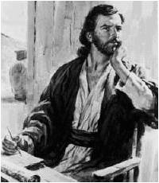
Pauline Epistles
His writings are properly called “Letters”
Under the inspiration of the Holy Spirit, Paul was able to address specific problems and issues of his time.
“The Epistles have an abundance of doctrine, but it is designed for practical application, not theoretical speculation.” (2)
Some letters are lost:
1 Corinthians 5:9
2 Corinthians 10:9-10
Colossians 4:16
2 Thessalonians 3:17
The New Testament contains 9 Pauline letters to the churches and 4 letters to individuals.

Slide 3
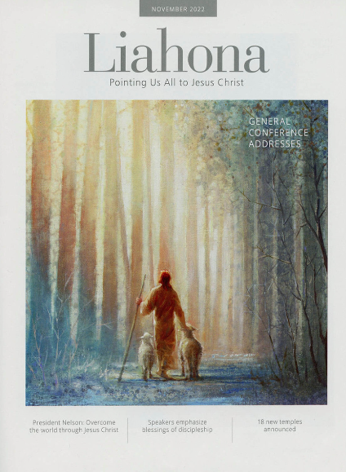
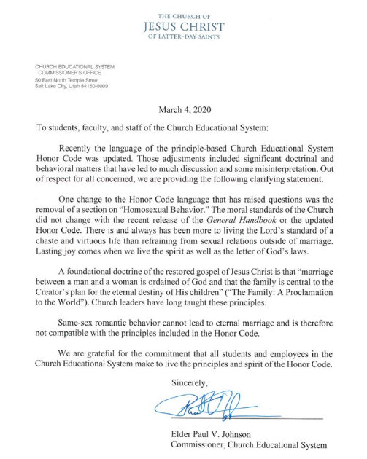
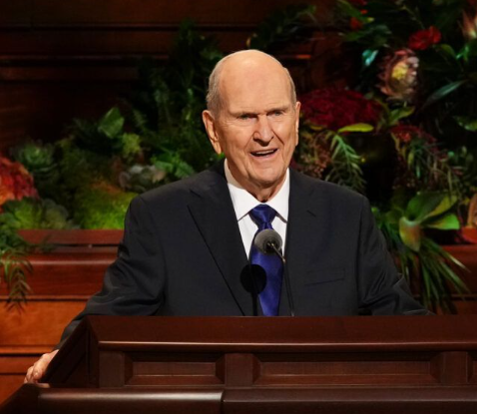
What Are Epistles?
Talks given by Church leaders that have been collected over the years
Various letters written by Church leaders to the Saints
Official Church announcements made by the prophet

Slide 4
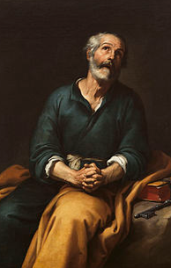
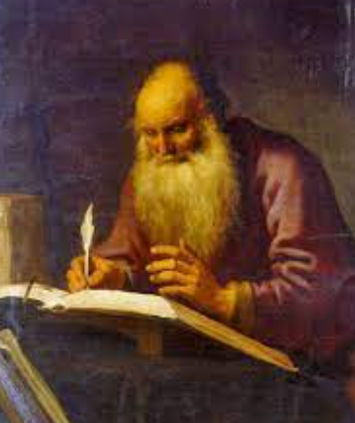
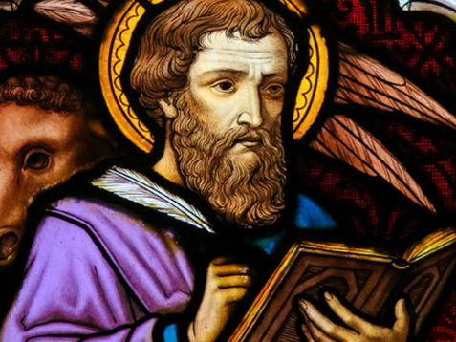
Who is credited for writing 14 of the 21 epistles included in the New Testament?
Peter
Paul
Luke

Slide 5
How were the first 13 of the Epistles organized?
Chronologically by when they were written
By Importance
By length

Slide 6
Other Authors of the Epistles
James, Peter, John, and Jude
James, Peter, John, and Stephen
James, Peter, John, and Timothy

Slide 7
Main Form of “Letters”
During Paul’s time:
Form | Scripture Example | Scripture
The sender’s name and office | Paul, a servant of Jesus Christ, called to be an apostle, separated unto the gospel of God | Romans 1:1
The name of the recipient | To all that be in Rome, beloved of God, called to be saints: | Romans 1:7
A greeting or wish for prosperity | Grace to you and peace from God our Father, and the Lord Jesus Christ…For I long to see you that I may impart unto you some spiritual gift… | Romans 1:7, 11
The main body of the letter | The wrath of God rets on those guilty of sin; The deeds of men; the judgements, both Jew and Gentiles; justification; faith, works and grace; being saved through atonement; baptism a similitude; Christ brings eternal life; law of Moses fulfilled in Christ; the inward man; the law of Christ; adopted children of God; the elect; foreordination; salvation; How to live as a saint; How to treat others; fellowshipping and preaching gospel | Romans 1-16
A farewell with closing greetings and good wishes | The grace of our Lord Jesus Christ be with you all. Amen To God only wise, be glory through Jesus Christ for ever. Amen | Romans 16:24,27
The signature of the writer | “I Tertius [the scribe] who wrote this epistle, salute you in the Lord | Romans 16:22
Paul’s testimony is given throughout the letters:
Example: “For I am not ashamed of the gospel of Christ: for it is the power of God unto salvation to every one that believeth…(Romans 1:16)

Slide 8
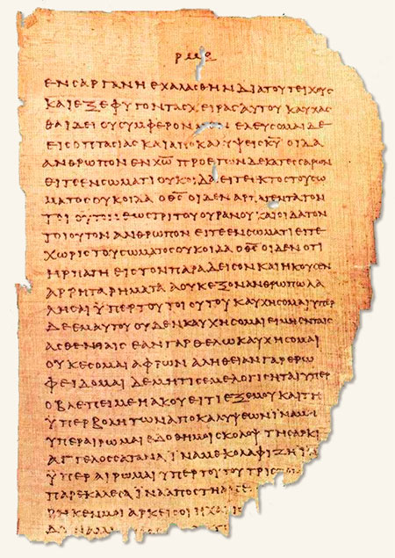
Paul’s Scribe
“Paul followed the usual procedure of using a scribe or amanuensis for the final form of his letters, but he wrote the concluding lines and signature with his own hand to guarantee authenticity.
Paul’s signature found in:
Romans 16:25-27
1 Corinthians 16:21
Galatians 6:11
Colossian 4:8
2 Thessalonians 3:17
Philemon 19
Tertuis wrote his own greeting to the Roman Saints near the conclusion of the epistle
A partially deteriorated page of Papyrus 46, one of the oldest surviving Greek manuscripts of the New Testament. Dating to about A.D. 200, the papyrus contains copies of most of the epistles of Paul, first among them the Epistle to the Romans.

Slide 9
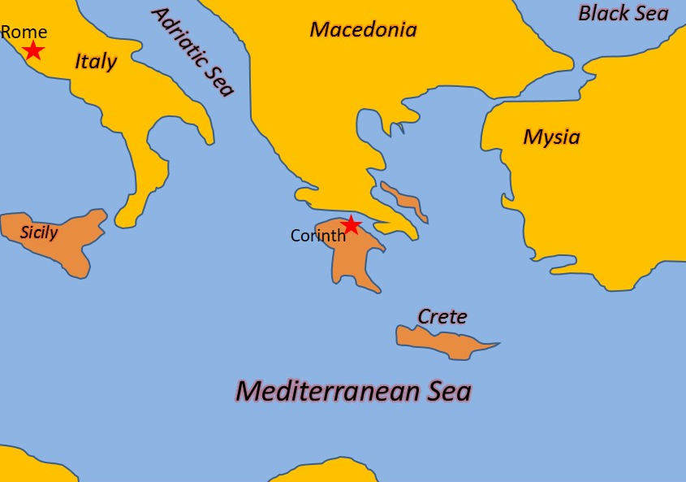
Written to the Romans
Paul writes to the Romans from Corinth near the end of his missionary journeys
around 55-56 AD
3 Reasons why Paul wrote to the Romans:
1. To prepare for his future arrival in Rome
2. To clarify and defend his teachings
3. To promote unity between Jewish and Gentile members of the Church
Phebe (Phoebe) = A notable woman in the church of Cenchreae, was trusted by Paul to deliver his letter to the Romans.
“Paul wrote it to the saints, to members of the Church, to those who already had the gift of the Holy Ghost, to those who had been born again, to those who held the priesthood and enjoyed the gifts of the Spirit.” (3)

Slide 10
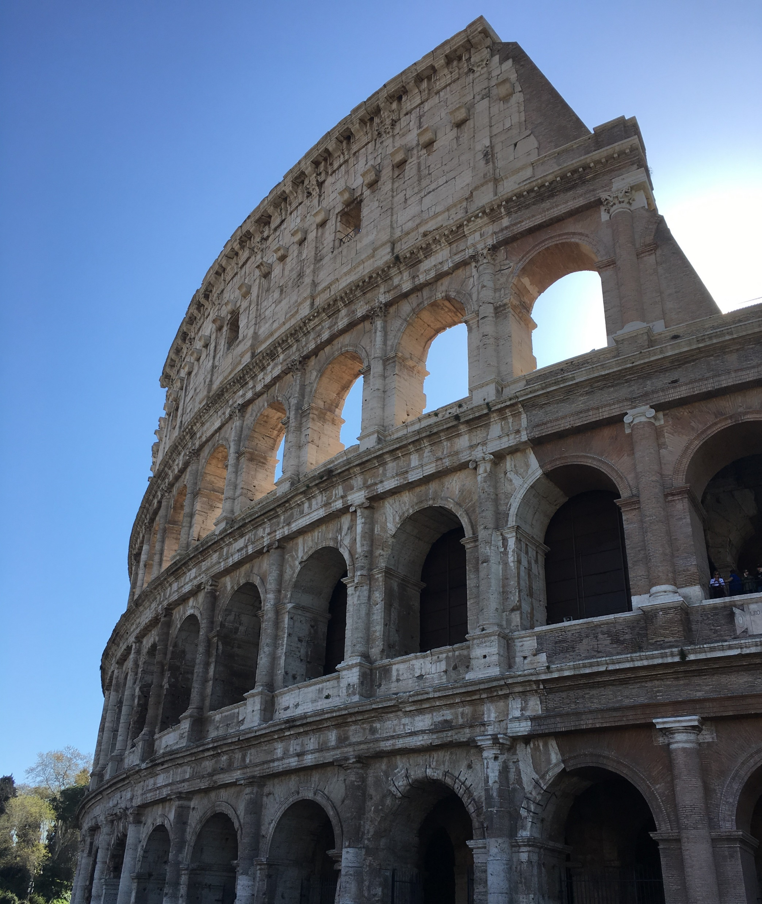
Rome—the capital of the Roman Empire—was saturated with worldly philosophies and was a difficult place to preach and live the gospel of Jesus Christ.
Stand Up For What You Believe
Paul knew that Rome was a difficult place to live and preach the gospel. He also faced opposition from those who misunderstood or rejected his teachings. Nevertheless, Paul was eager to go to Rome and preach there to bring others to Christ
Romans 1:15

Slide 11
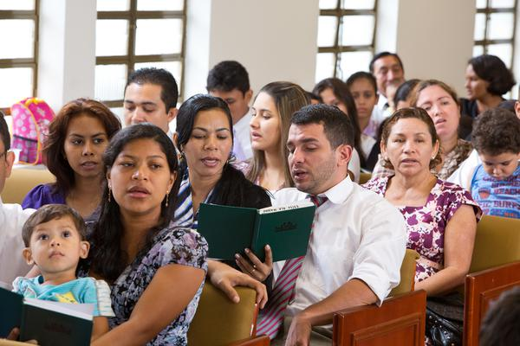
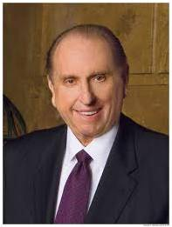
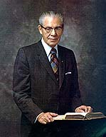
Be Not Ashamed
“If we are not ashamed of the gospel of Christ, then we should not be ashamed to live it. And if we are not ashamed to live it, then we should not be ashamed to share it." (4)
“People expect a great deal from the members of this Church because we profess much.
"Let each of us every day live an exemplary life, that our influence may be felt for good and that others, seeing our good works, may be led to glorify God.
"We are members of the church of Jesus
Christ. May we always live worthy of this." (5)
Romans 1:16

Slide 12
Inviting Others
Come and See
Come and Help
Come and Stay
Romans 1:16

Slide 13
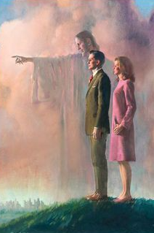
Overcoming…
Draw close to God. …
Fill your heart with love for others. …
Strive to walk the path of discipleship. …
Share what is in your heart. …
Trust the Lord to work His miracles.
(12)

Slide 14
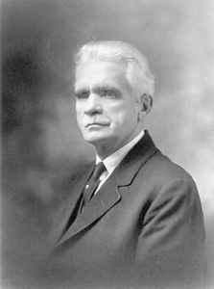
The Power of Salvation
…the righteousness of God revealed from faith to faith
'Power', as related to the gospel is that which produces whatever is the objective of the gospel.
In this case the objective is 'the power...unto salvation'; or that which produces salvation." (6)
Power = to produce movement which causes effects
Romans 1:15-17

Slide 15
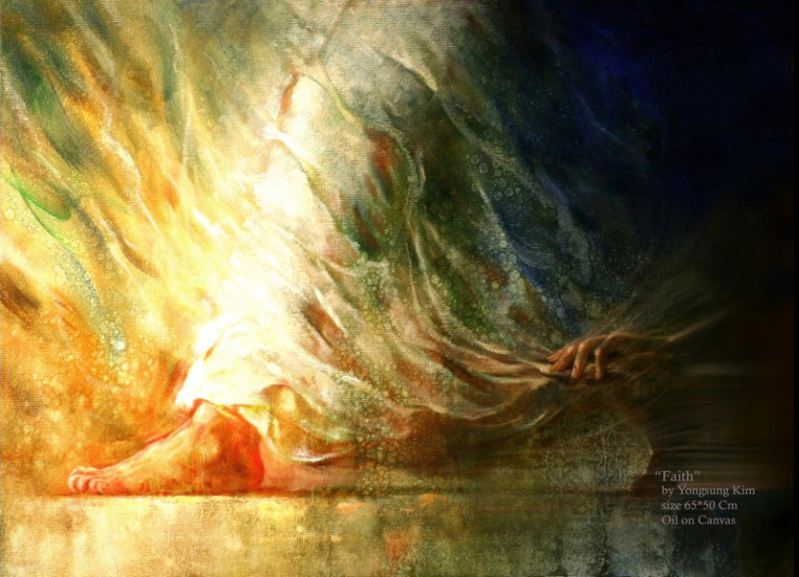
Belief and Faith
“Faith in Jesus Christ … is manifested in a life of obedience to the laws and ordinances of the gospel and service to Christ”
Wholehearted acceptance of and trust in Him as the One who offered Himself in Atonement for our sins.
This deep trust leads to a life of faithfulness, manifested by repenting of sins, being baptized, and trying to live as Jesus Christ taught.
Yongsung Kim
Romans 1:17; Acts 16:30-33; Romans 6:1-11; 1 Corinthians 6:9-11

Slide 16
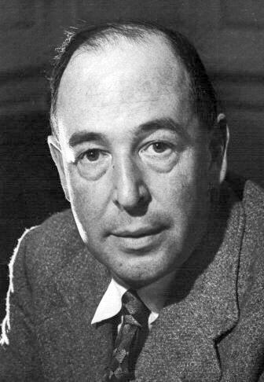
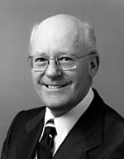
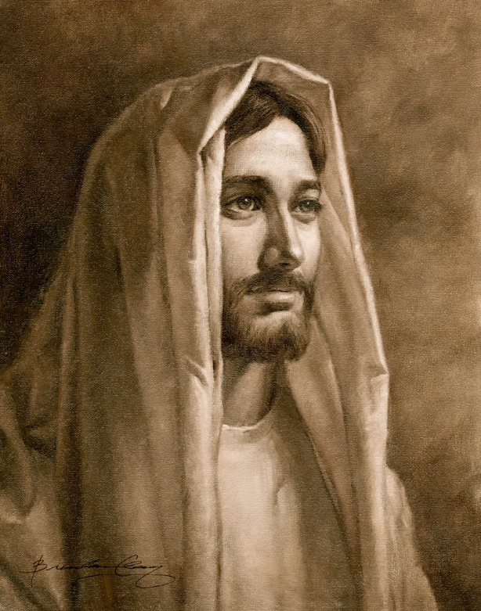
“What Christ desires from each of us is surrender, complete and total—a voluntary gift of trust, faith, and love.”
“Christ says, ‘Give me All. I don’t want so much of your time and so much of your money and so much of your work: I want You.
“…No half-measures are any good. I don’t want to cut off a branch here and a branch there, I want to have the whole tree down. … Hand over the whole natural self, all the desires which you think innocent as well as the ones you think wicked—the whole outfit. I will give you a new self instead. In fact, I will give you Myself: my own will shall become yours.’” (7)
A little girl, misquoting the twenty-third Psalm, put everything in perspective. She said, “The Lord is my shepherd. That’s all I want!”
What more could anyone want? What could be more desirable than to “look unto [Jesus] in every thought”?
(6)

Slide 17
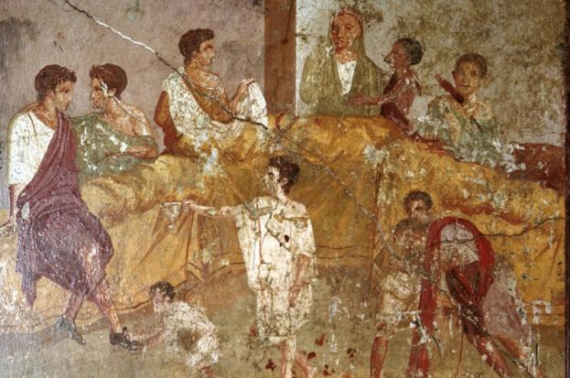
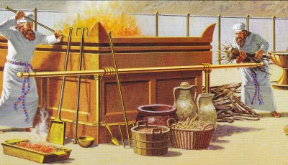
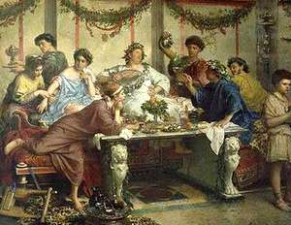
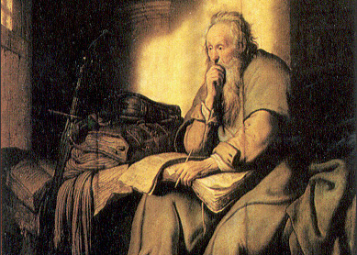
Facing Immoral Behavior
In Paul’s day, some Gentile Christians sought to excuse immoral or sinful behavior by emphasizing God’s mercy and ignoring His perfect justice.
Also, some Jewish Christians believed that observance of the law of Moses was necessary for their salvation.
Paul sought to correct both misconceptions.
Romans 1:18

Slide 18
Offensive to God
For I the Lord cannot look upon sin with the least degree of allowance;
D&C 1;31
The “wrath” of God is not hostility toward mankind; rather, it is rejection of sin.
Immorality
It is impossible to sin without the law.
Sin is defined as violation of God's law.
Idolatry
Romans 1:18-32

Slide 19
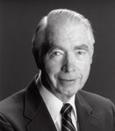
Judgments of God
Those in the Law and Those out of the Law
Paul taught that all people will be judged according to their works, and he showed that the Jews’ unrighteousness came from their living the law of Moses outwardly but not inwardly.
“Paul is explaining that the Jews who violate the law will be worse off than the Gentiles who were never given the law. Again, we turn to the teachings of Jacob, 'but wo unto him that has the law given, yea, that has all the commandments of God, like unto us, and that transgresseth them...for awful is his state!'
"Paul argues that the Jew who
violated this moral law was inferior
to the Gentile who kept his
covenant of conscience by his
righteous actions." (9)
Romans 2:5-13

Slide 20
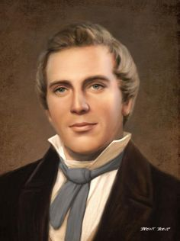
The Prophet Joseph Smith taught:
“God judges men according to the use they make of the light which He gives them.”
Romans 2:12
(10)

Slide 21
"Does salvation come, then, by works?
No, not by the works of the law of Moses, and for that matter, not even by the more perfect works of the gospel itself.
Salvation comes through Christ's atonement, through the ransom he paid, the propitiation he made; without this no good works on the part of men could redeem them from temporal death, which redemption is resurrection, or redeem them from spiritual death, which redemption is eternal life."
Romans 2:20
(10)

Slide 22
What actions or thoughts cause a person to draw away from the Lord?
What happens spiritually when we draw away?
What effect does sin have in our lives?
How does it feel to lose the Lord’s spirit?
Why is darkness a good representation for being void of the spirit?
Why do you think some People seem to prefer the darkness to Light?
Righteousness
Sin

Slide 23
What actions or thoughts cause a person to draw toward the Lord?
What happens spiritually when we draw closer to the Lord?
What effect does righteousness have in our lives?
How does it feel when we feel the Lord’s spirit?
Why is light a good representation of the spirit?
Why do you think people prefer the Light of Christ?
Sin
Righteousness

Slide 24
Overcome
The Barrier
God’s presence
Imagine you are on a path to a highly desirable destination.
As you move along the path, however, you find a barrier or wall blocking the way.
The barrier blocks any further progress and is impossible to get past on your own.
Romans 3:10-12, 20-23

Slide 25
Justification
For All Has Sinned = God cannot accept sin and that every accountable person commits sin.
Being “pardoned from punishment for sin and declared guiltless”
Help or strength, given through the bounteous mercy and love of Jesus Christ”
Justification
Grace
propitiation
Atoning sacrifice and source of mercy
Romans 3:24-31

Slide 26
Because we have all “sinned, and come short of the glory of God” and because “there cannot any unclean thing enter into the kingdom of God”, every one of us is unworthy to return to God’s presence.
Even if we were to serve God with our whole souls, it is not enough, for we would still be “unprofitable servants”.
We cannot earn our way into heaven; the demands of justice stand as a barrier, which we are powerless to overcome on our own.
(12)
Through faithful acceptance of Jesus Christ, all mankind may be justified through His grace.
Romans 3:23-24; 1 Nephi 15:34; Mosiah 2:21

Slide 27
Sources:
New Testament Institute Student Manual Chapter
Talk thru the Bible by Bruce Wilkinson and Kenneth Boa pp.367
Elder Bruce R. McConkie (DNTC, 2:216.)
Thomas S. Monson, "That All May Hear," Ensign, May 1995, 49.
N. Eldon Tanner ("Never Be Ashamed of the Gospel of Christ," Ensign, Feb. 1980, 5)
B.H. Roberts (The Falling Away, [Salt Lake City: Deseret Book Co., 1931], 204)
Elder Robert L. Backman Jesus is the Christ Oct. 1991 Gen. Conf.
C. S. Lewis (Mere Christianity, New York: Collier Books, 1960, p. 167.)
Richard Lloyd Anderson, Understanding Paul [Salt Lake City: Deseret Book Co., 1983], 175.)
(Teachings of Presidents of the Church: Joseph Smith [2007], 405).
Elder Bruce R. McConkie (Doctrinal New Testament Commentary, 3 vols. [Salt Lake City: Bookcraft, 1965-1973], 2: 231.)
(Dieter F. Uchtdorf, “Sharing the Gospel in Normal and Natural Ways,” ChurchofJesusChrist.org); “The Gift of Grace,” Ensign or Liahona, May 2015, 108
Presentation by ©http://fashionsbylynda.com/blog/

Slide 28
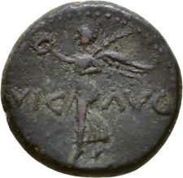
PAUL’S Letter to the Romans (55-56 AD)
The Power of God unto Salvation | 1:1–17
God’s Anger Against the Unrepentant Depraved | 1:18–32
All Men Are Judged by Gospel Standards | 2:1–11
Man Is Not Justified by the Law of Moses | 2:12–29; 3:1–20
Man Is Justified by Faith | 3:21–31
Romans:
“Romans defines the gospel and summarizes the laws by obedience to which full salvation comes. It speaks plainly of Adam’s fall, which brought death, and Christ’s atoning sacrifice, which brought life. It tells how the law of justification works, how men are justified by faith and works, through the blood of Christ. In it are some of the most explicit Biblical teachings on the election of grace, the status of the chosen race, on why salvation cannot come by the law of Moses alone, on why circumcision was done away in Christ, and on how and why salvation was taken to the Gentiles. And it is a chief source of the glorious doctrine of joint-heirship with Christ, that marvelous principle under which men, through celestial marriage and the continuation of the family unit in eternity, can gain exaltation in the highest celestial heaven. …
“In its very nature Romans is an epistle capable of differing interpretations. Those without prior and full knowledge of the doctrines involved find it exceedingly difficult to place Paul’s comments about these doctrines into their true perspective.
For instance, it is on a misunderstanding of the Apostle’s statement about justification by faith alone that the whole sectarian world is led to believe that men are not required to work out their own salvation; and it was this very passage that enabled Martin Luther to justify in his own mind his break with Catholicism, an eventuality of vital importance to the furtherance of the Lord’s work on earth.” Elder Bruce R. McConkie (McConkie, DNTC, 2:212–13.)
Life and Teachings of Jesus and His Apostles Chapter 39
When did Paul Write the Letters to Rome? Acts 20:2-3:
Luke tells us that during Paul’s third missionary journey the apostle spent three months in Corinth. He was probably waiting for good sailing conditions before departing for Jerusalem. From these clues it can be said with some certainty that the letter to Rome was written from Corinth near the end of the third journey, most likely during the winter months of A.D. 57–58.
Life and Teachings of Jesus and His Apostles Chapter 39
"Background: The City
"Perhaps a million people were interlocked in Rome, city of the emperor, the aristocracy, and the masses. Augustus could claim that he found a city of brick and changed it to marble. This boast had merit, for he left behind an astounding list of temples and public buildings that he built and repaired. Political and geographical center of the empire, Rome had long attracted Paul as a culminating missionary opportunity. He wrote to the Saints that he had desired 'these many years to come unto you' (Rom. 15:23)...Rome is wicked but on the move with projects and ideas-an international city and a melting pot...And the Jews? They are also unwelcome realities in Roman satire." (Richard Lloyd Anderson, Understanding Paul [Salt Lake City: Deseret Book Co., 1983], 169.)
"The church at Rome was composed of a mixture of Jewish and gentile converts. The Apostle Paul is aware that the different backgrounds of these two groups, prior to church membership, brought about conflicting views among them. His chief concern is with the claimed necessity and benefits of the law of Moses. Preoccupation with the centuries-old, legalistically annotated law had left a deep imprint in the lives of the Jewish converts to the church. The gentile converts were influenced by the Hellenistic philosophical system and concepts of learning. Their accompanying paganistic worship of idols was an additional deterrent to the proper understanding of gospel truths about which they were cautioned. (Rom. 1:20-25.)" (Edward J. Brandt, "New Testament Backgrounds: Romans," Ensign, Jan. 1976, 82)
Nero Ancient Coins
Rome 41-68 AD

Slide 29
Jew and Greek (Gentile).
The Jews were the surviving members of God’s covenant people, Israel, to whom He had revealed the law of Moses over one thousand years before Christ. Paul used both the terms Greek and Gentile to refer to people who were not born into the house of Israel. (1)
Inward and Outward Acts 2:15-30:
Paul reminded the Roman Saints that circumcision, which had been required by the law of Moses, was no longer required of God’s people, for the Savior’s earthly mission and atoning sacrifice had fulfilled the law of Moses. Any outward ordinance—whether circumcision in the Abrahamic covenant or baptism and the sacrament in the gospel covenant—has meaning only if it is done with sincerity and real intent
Idolatry Romans 1:21-23:
Paul wrote that when people refused to worship the Creator, they often turned to the worship of images of men and beasts. In the Greco-Roman world in which Paul ministered, idol worship and its accompanying mythologies formed an integral part of ancient religion and culture. (1)
Atoning Sacrifice Acts 3:
"So Paul taught these people-who thought that they could be saved by some power that was within them, or by observing the law of Moses-he pointed out to them the fact that if it were not for the mission of Jesus Christ, if it were not for this great atoning sacrifice, they could not be redeemed. And therefore it was by the grace of God that they are saved, not by any work on their part, for they were absolutely helpless. Paul was absolutely right." President Joseph Fielding Smith (Doctrines of Salvation, 3 vols., edited by Bruce R. McConkie [Salt Lake City: Bookcraft, 1954-1956], 2: 310.)
“In the second chapter of Romans, the Apostle Paul teaches that God will ‘judge the secrets of men’ (Romans 2:16). His judgment will be ‘according to truth’ (Romans 2:2). In describing that judgment, Paul contrasted the position of those Jews who preached the law and then did not practice it with Gentiles who did not have the law but whose actions ‘shew the work of the law written in their hearts’ (Romans 2:15). He concluded his example with this teaching:
“‘For he is not a Jew, which is one outwardly; neither is that circumcision, which is outward in the flesh:
“‘But he is a Jew, which is one inwardly; and circumcision is that of the heart, in the spirit, and not in the letter; whose praise is not of men, but of God.’ (Romans 2:28–29.)
“To paraphrase, a person is a true Latter-day Saint if he (or she) is so inwardly, if his conversion is that of the heart, in the spirit, whose praise is not from men for outward acts but from God for the inward desires of his heart.
“… The issue is not what we have done but what we have become. And what we have become is the result of more than our actions. It is also the result of our attitudes, our motives, and our desires” Elder Dallin H. Oaks (Pure in Heart[1988], 138–39).
Immorality Romans 1:24-28:
Paul identified various sexual sins that were common among Gentiles in the ancient Greco-Roman world—sins Paul termed “not convenient,” meaning not fitting or correct. Paul taught that because of people’s immorality, “God gave them up [abandoned or delivered them] unto vile affections” and “to a reprobate mind [depraved thinking]”. They then “[received] in themselves that recompence of their error which was meet”. When people commit sexual sins, they separate themselves from God, and God allows them to experience the consequences of their sins. This does not show a lack of love on God’s part; rather, He is allowing the natural consequences of sinful behavior to occur (see John 15:10; D&C 95:12). (1)
Rome may have been the cultural and political capital at the time, but it was also the capital of sexual sin and homosexuality. Paul could not afford to avoid this subject as it was so prevalent among the Romans of the day. So prevalent in fact that it contributed to the very fall of Rome. "The grandeur of ancient Greece, the majesty of Rome, once the proud rulers of the world, have disappeared; and the verdict of history specifies the prevalence of sexual immorality as among the chief of the destructive agencies by which the fall of those mighty peoples was effected." (Editors' Table, Improvement Era, 1917, Vol. Xx. June, 1917. No. 8)
First Presidency Statement on Same-Gender Marriage:
“Homosexual and lesbian behavior is a serious sin. If you find yourself struggling with same-gender attraction or you are being persuaded to participate in inappropriate behavior, seek counsel from your parents and bishop. They will help you” (For the Strength of Youth [booklet, 2011], 36).
“The Church’s doctrinal position is clear: Sexual activity should only occur between a man and a woman who are married. However, that should never be used as justification for unkindness. Jesus Christ, whom we follow, was clear in His condemnation of sexual immorality, but never cruel. His interest was always to lift the individual, never to tear down. …
“The Church distinguishes between same-sex attraction and behavior. While maintaining that feelings and inclinations toward the same sex are not inherently sinful, engaging in homosexual behavior is in conflict with the ‘doctrinal principle, based on sacred scripture … that marriage between a man and a woman is essential to the Creator’s plan for the eternal destiny of His children’ [“First Presidency Statement on Same-Gender Marriage,” mormonnewsroom.org]” (“Same-Sex Attraction,” Gospel Topics, lds.org/topics).

Slide 30
Structure of Letters During Paul’s Time--Example
Form | Scripture Example | Scripture
The sender’s name and office | Paul, a servant of Jesus Christ, called to be an apostle, separated unto the gospel of God | Romans 1:1
The name of the recipient | To all that be in Rome, beloved of God, called to be saints: | Romans 1:7
A greeting or wish for prosperity | Grace to you and peace from God our Father, and the Lord Jesus Christ…For I long to see you that I may impart unto you some spiritual gift… | Romans 1:7, 11
The main body of the letter | The wrath of God rets on those guilty of sin; The deeds of men; the judgements, both Jew and Gentiles; justification; faith, works and grace; being saved through atonement; baptism a similitude; Christ brings eternal life; law of Moses fulfilled in Christ; the inward man; the law of Christ; adopted children of God; the elect; foreordination; salvation; How to live as a saint; How to treat others; fellowshipping and preaching gospel | Romans 1-16
A farewell with closing greetings and good wishes | The grace of our Lord Jesus Christ be with you all. Amen To God only wise, be glory through Jesus Christ for ever. Amen | Romans 16:24,27
The signature of the writer | “I Tertius [the scribe] who wrote this epistle, salute you in the Lord | Romans 16:22

Slide 31
Spiritual Saving and Justification
Romans 4-7
And I, John, bear record that I beheld his glory, as the glory of the Only Begotten of the Father, full of grace and truth, even the Spirit of truth, which came and dwelt in the flesh, and dwelt among us.
D&C 93:11

Slide 32
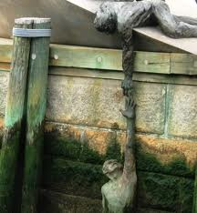
Previously…
Salvation comes to those who accept Jesus as their Redeemer
“For I the Lord cannot look upon sin with the least degree of allowance…
…Nevertheless, he that repents and does the commandments of the Lord shall be forgiven.”
D&C 1:31-32

Slide 33
Which of the Following Will Save You?
(a) your belief that the water can save you,
(b) your effort to get to the water and drink it, or
(c) the water itself?
How do these words relate?
faith, works, and grace

Slide 34
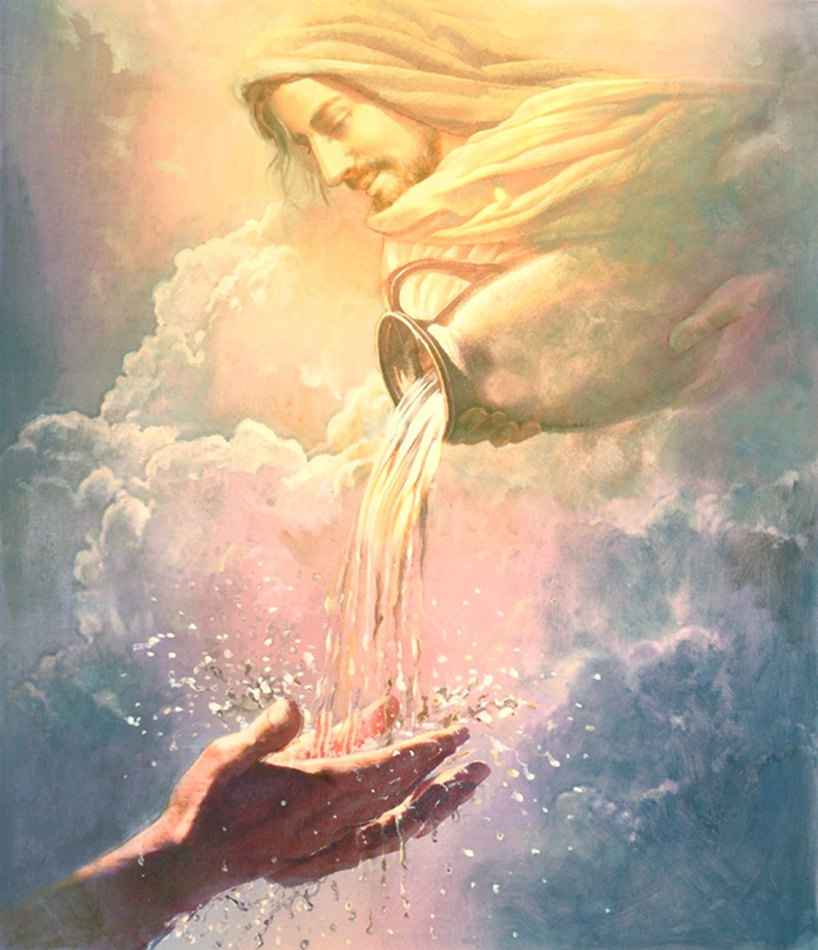
The Power of Water
The water has power to save our lives.
But we must have confidence that the water will
save us so that we will make the effort to climb the hill.
We must climb the hill to get the water
and we must drink the water to save us.
But whosoever drinketh of the water that I shall give him shall never thirst; but the water that I shall give him shall be in him a well of water springing up into everlasting life.
John 4:14

Slide 35
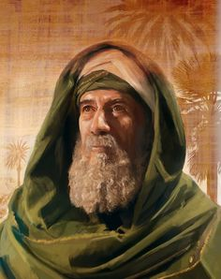
Abraham-Righteous
Since Abraham lived centuries before the law of Moses was given, he was an ideal example of someone who was justified through faith in Jesus Christ and not through the law of Moses.
Abraham believed God, and it was counted unto him for righteousness.
Abraham received this assurance before he was circumcised
Under the law of Moses, circumcision was the rite by which male Israelites “accepted the responsibilities of the covenant”
Thus, Paul was able to show from scripture that individuals were not justified through obedience to the law of Moses—
they were justified through faith in God’s promises.
(1)
Romans 4:2-5

Slide 36
We are justified by faith and works through the grace of Jesus Christ
“Salvation cannot be bought with the currency of obedience; it is purchased by the blood of the Son of God.
“Grace is a gift of God, and our desire to be obedient to each of God’s commandments is the reaching out of our mortal hand to receive this sacred gift from our Heavenly Father.”
(2)

Slide 37
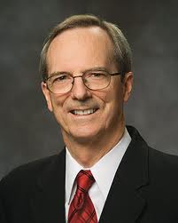
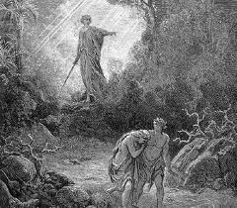
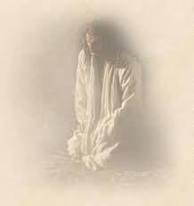
The Gift -- Unconditional
Original Sin—caused by our first Parents
Outcome--A separation from God
First spiritual death
“The Atonement corrects the first spiritual death for all men without any effort on their own.”
“For as in Adam all die, even so in Christ shall all be made alive”
(1 Cor. 15:22)
“…for all man kind, by the fall of Adam being cut off from the presence of the Lord, are considered as dead, both as to things temporal and to things spiritual.”
(Helaman 14:16)
“Jesus Christ has redeemed all mankind from all the consequences of the fall of Adam.” (3)

Slide 38
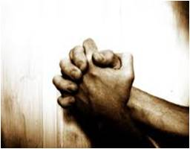
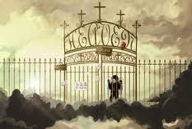
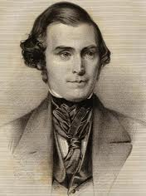
The Gift of Grace -- Conditional
A separation from God caused by our own sins
Repentance—offered to all but not received by all
Second Spiritual Death
“…its benefits can be obtained only through faith, repentance, baptism, the laying on of hands, and obedience to all other requirements of the gospel.”
(4)
“…and there cometh upon them again a spiritual death, yea, a second death for they are cut off again as to things pertaining to righteousness.”
(Helaman 14:18)

Slide 39
“Neither the unconditional nor the conditional blessings of the Atonement are available except through the grace of Christ.
Obviously the unconditional blessings of the Atonement are unearned, but the conditional ones are not fully merited either.
By living faithfully and keeping the commandments of God, one can receive additional privileges; but they are still given freely, not technically earned.”
(5)

Slide 40
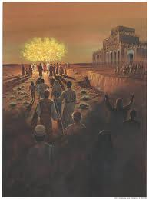
A Temporary Reunion
“Every saint or sinner, will return to the presence of God after the resurrection for Judgment.
“…No unclean thing can dwell with God.”
(1 Nephi 10:21)
“For I the Lord cannot look upon sin with the least degree of allowance;
Nevertheless, he that repents and does the commandments of the Lord shall be forgiven.” (D&C 1:31-32)
(3)

Slide 41
We Are Free to Choose
“Wherefore, men are free according to the flesh; and all things are given them which are expedient unto man…
2 Nephi 2:27
…And they are free to choose liberty and eternal life, through the great Mediator of all men, or to choose captivity and death, according to the captivity and power of the devil.”
2 Nephi 2:27

Slide 42
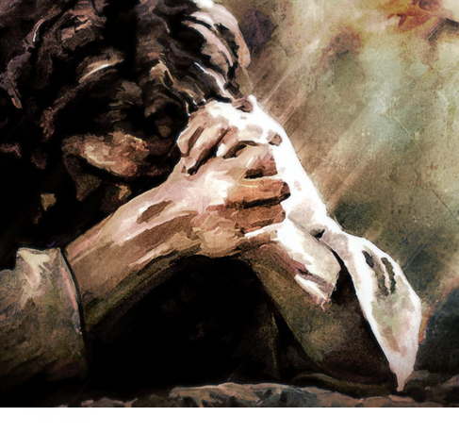
Grace – The Free Gift
Grace = charis and charisma (Greek) = free gift
Blessings, mercy, help, and strength available to us because of Jesus Christ’s Atonement.
“The power of the Atonement makes repentance possible and … strengthens us to see, do, and become good in ways that we could never recognize or accomplish with our limited mortal capacity.” (6)
Read Doctrine and Covenants 93:11-14
Romans 4:4, 16; 5:2, 15–21; 6:1–2, 14–15.

Slide 43
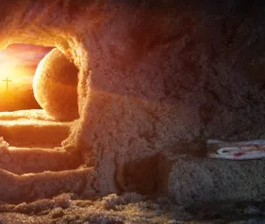
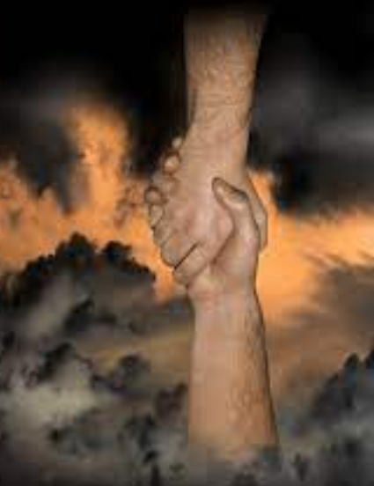
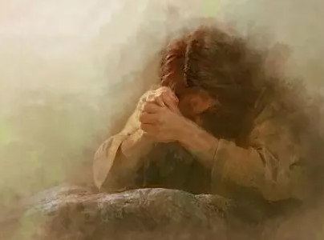
Grace In the Book of Mormon
2 Nephi 2:8
2 Nephi 25:23
Ether 12:41
Ether 12:27
Moroni 10:32–33
2 Nephi 10:24–25

Slide 44
Spiritual Saving
But for His Atonement to be of full effect in our lives we must:
Have Faith in the Lord---have faith the water will save us
Do what He requires of us ---Climb to the top
Partake of the Atonement ---Drink
“It is grace that we are saved, after all we can do.”
(2 Nephi 25:23)
Romans 5:12-14

Slide 45
The Natural Man
When we sin, we estrange ourselves from God:
We cut off the relationship we had with him.
When we sin, we become “the natural man”.
The “natural man” is an enemy to God.
“For the natural man is an enemy to God, and has been from the fall of Adam and will be forever and ever, unless…
Mosiah 3:19

Slide 46
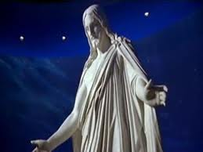
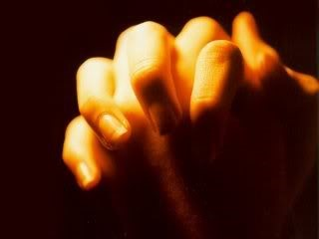
Can You Save Yourself?
Jesus Christ was the only person who was justified by his works.
The rest of us must be justified, or made righteous, or be put back into the proper relationship with God, by faith in Jesus Christ.
(7)

Slide 47
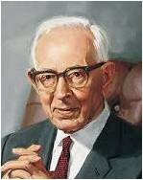
“Baptism cannot be by any other means than immersion of the entire body in water, for the following reasons:
Baptism by immersion can symbolize our death to sin and newness of spiritual life
“1. It is in the similitude of the death, burial, and resurrection of Jesus Christ, and of all others who have received the resurrection.
“2. Baptism is also a birth and is performed in the similitude of the birth of a child into this world.
“3. Baptism is not only a figure of the resurrection, but also is literally a transplanting or resurrection from one life to another. …” (11)

Slide 48
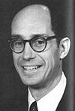
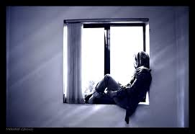
“All of us can remember times in our lives when we felt a pull to be better than we were, to rise higher.”
Sometimes we have these feelings:
Is there something better than this?
Maybe I’ll just give up
Maybe this feeling of being miserable is what life is like
Maybe I need to learn to live with it
I don’t deserve to be where I am
I am the only one who feels like this
No one else knows what I’m going through
Could I live with the way things are?
No one can help me, I have to do it alone
Why can’t I be happy like everyone else?
(8)

Slide 49
“But some time in their lives, maybe just once that they can remember, they felt that upward pull, that thought that there just had to be something better and higher.”
(8)

Slide 50
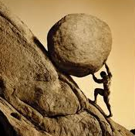
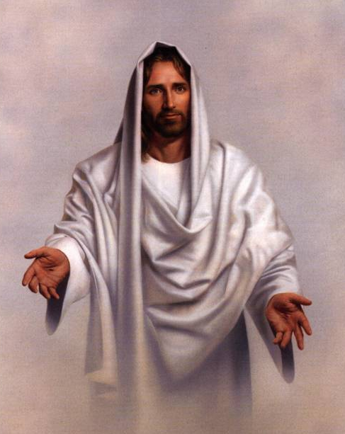
Comfort And Hope Scripture #1
Moroni 10:32-33
Come unto Christ
Be perfected in Him
Deny yourselves of all ungodliness
Love God with all your might, mind, and strength
Then you can nowise deny the power of God
Ye are sanctified in Christ through His shedding of blood
Receive a remission of sins through the covenant of the Father
His grace is sufficient for you
His grace may be perfect in Christ
That you become holy without spot

Slide 51
Comfort and Hope Scripture #2
Isaiah 40:30-31
Even the youths shall faint and be weary
And the young men shall utterly fall
Wait upon the Lord
Hebrew word “wait” is hope or anticipation
Renew their strength
Mount up with wings as eagles
They shall run and not be weary
They shall walk and not faint

Slide 52
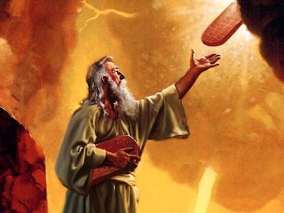
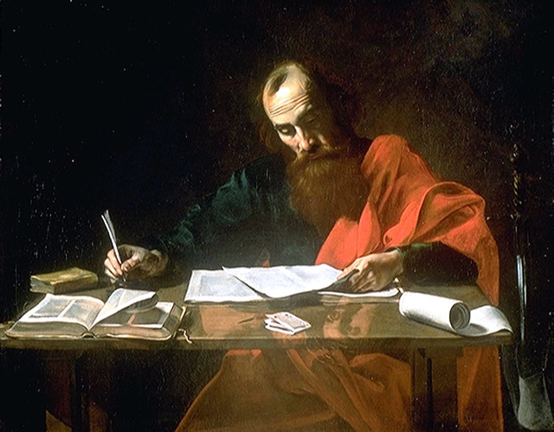
Many people Paul was writing to were still committed to the law of Moses and did not understand that the Atonement had fulfilled it.
They needed someone to teach them that they could overcome sin through Jesus Christ, not through the law.
Romans 6:8-23

Slide 53
“Heavenly Father does more than allow you to feel that upward pull…
…He has provided a way to rise higher—almost beyond our limits of imagination…
(8)

Slide 54
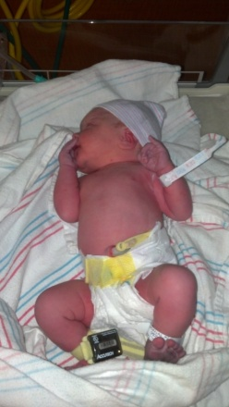
What Has He taught?
The purpose of Life
The Plan of Salvation
Live by the commandments
Through Prophets and scriptures
Provides covenants
With covenants come ordinances
“If I do this for Him”
Between God and myself
“He will do this for me”
A two way Promise
(8)

Slide 55
Paul teaches the Romans how to turn away from sin
Romans 3-7
Buried with Him by baptism into death
Burying our sins
Baptism into death
Through the Atonement
Our sins are “covered”
In the likeness of His death
Just as He died and was resurrected
Our old self is destroyed and our new self is without sin
Walking in a newness of life
Being resurrected
Making and Keeping covenants

Slide 56
I Have a Question
Does baptism wash away sin?
Is baptism a time to commit to become clean?
Is baptism a time to walk in a newness of life?
Are sins remitted in the waters of baptism?
Do you receive a newness of life after baptism?
Is baptism a time to prepare to receive the gift of the Holy Ghost?
Is the Holy Ghost the power in which we are actually cleansed?
Yes No
Yes No
Yes No
Yes No
Yes No
Yes No
Yes No

Slide 57
Through Jesus Christ, we can be changed and “walk in newness of life.”
CHANGE
AHEAD
Therefore we are buried with him by baptism into death: that like as Christ was raised up from the dead by the glory of the Father, even so we also should walk in newness of life.
What types of changes do you think are easy to make?
Which ones are difficult?
Romans 6:4
(9)

Slide 58
“Sins are remitted not in the waters of baptism, as we say in speaking figuratively, but when we receive the Holy Ghost…
…It is the Holy Spirit of God that erases carnality and brings us into a state of righteousness…
(9)

Slide 59
…We become clean when we actually receive the fellowship and companionship of the Holy Ghost.
…It is then that sin and dross and evil are burned out of our souls as though by fire.”
(9)

Slide 60
“…For the gate by which ye should enter is repentance and baptism by water; and then cometh a remission of your sins by fire and by the Holy Ghost.”
(2 Nephi 31:17)
“And after they had been received unto baptism, and were wrought upon and cleansed by the power of the Holy Ghost,…”
(Moroni 6:4)

Slide 61
“And the remission of sins bringeth meekness, and lowliness of heart; and because of meekness and lowliness of heart cometh the visitation of the Holy Ghost…
…which Comforter filleth with hope and perfect love, which love endureth by diligence unto prayer, until the end shall come, when all the saints shall dwell with God.”
Moroni 8:26

Slide 62
Died Unto Our Sins
We are baptized only once for a remission of our sins.
However, each week, by partaking of the sacrament, we can renew our commitment to “walk in newness of life.”
Romans 6:4, 10

Slide 63
Reckon Ye Also
“reckon ye also yourselves to be dead indeed unto sin, but alive unto God through Jesus Christ”?
Paul has described Jesus' death on the cross for the sins of humanity as a one-time, once-for-all event.
He submitted to death in that moment, but once He was resurrected, death was defeated.
It no longer had any hold over Him. Jesus was free from death forever.
Those who trust in Christ for their salvation and die, be buried, and then resurrected to a new spiritual life, is on the same path as Jesus.
Romans 6:11

Slide 64
Baptism and Resurrection
“Baptism is not only a figure of resurrection, but also is literally a transplanting or resurrection from one life to another…”
(10)

Slide 65
Sin Should Not Overpower You
We must remember, our rewards for righteous living are only partially enjoyed in this mortal life. Likewise, our miseries for breaking the commandments of God will not all be realized fully as we live here on the earth. Eternity is a long, long time.
“The secret to cleansing our spirit of whatever the impurity is not very complicated. It begins with [sincere, heartfelt] prayer every morning and ends with prayer every night. This is the most important step I know in the cleansing process. It may simply be a prayer for strength to turn from bad habits,” or a prayer that sin will be distasteful to you.”
Romans 6:12-14 Paintings by Ron DiCianni
(12)

Slide 66
Sources:
New Testament Institute Student Manual Chapter 36
President Dieter F. Uchtdorf(“The Gift of Grace,” Ensign or Liahona, May 2015, 109, 110).
Tad R. Callister “Infinite Atonement” page 45-46
Orson Pratt “Doctrines of Salvation” 2:9-10
Elder Jeffrey R. Holland (“The Atonement of Jesus Christ,” Ensign or Liahona, Mar. 2008, 36).
Elder David A. Bednar (“Therefore They Hushed Their Fears,” Ensign or Liahona, May 2015, 47).
Bruce R. McConkie “Life and Teachings of Christ” pg. 319
Elder Henry B. Eyring Upward Pull CES fireside Sept. 1996
Bruce R. McConkie—A New Witness for the Articles of Faith 290
Joseph Smith—Doctrines of Salvation 2:323-24
President Joseph Fielding Smith Doctrines of Salvation, 2:323–24.)
Elder H. Burke Peterson “Touch Not the Evil Gift, nor the Unclean Thing” Ensign, Nov. 1980, p. 39).
Presentation by ©http://fashionsbylynda.com/blog/

Slide 67
PAUL’S Letters to the Romans
Abraham Was Justified by Faith, Works, and Grace | 4:1–25
Man Is Justified Through the Blood of Christ | 5:1–11
Adam Fell, Christ Atoned, Man Saved | 5:12–21
A New Life Begins with Baptism | 6:1–11
Holiness, Not Sin, Should Be One’s Master | 6:12–14
The Christian Is Freed from the Slavery of Sin | 6:15–19
The Reward of Sin and the Reward of Holiness | 6:20–23
A New Life Begins with Baptism | 6:1–11
The Law of Moses Is Fulfilled in Christ | 7:1–6
The Law of Christ Replaces the Law of Moses | 7:7–25
Justification:
…he yields to the enticings of the Holy Spirit, and putteth off the natural man and becometh a saint through the atonement of Christ the Lord…
“…all covenants, contracts, bonds, obligations, oaths, vows, performances, connections, associations or expectations in which men must abide to be saved and exalted, must be entered into and performed in righteousness so that the holy spirit can justify the candidate for salvation in what has been done.” (7)
Atonement Romans 5:11:
This verse is the only verse in the King James Version of the New Testament that uses the word atonement; however, a related term, reconciliation, is found in other New Testament passages (see Romans 5:10; 11:15; 2 Corinthians 5:18–20; Ephesians 2:16; Colossians 1:20–21). Both of these words denote a change from hostile to friendly terms, the reestablishment of an interrupted or broken relationship, and the restoration of harmony between two parties. (1)
Elder Bruce R. McConkie (1915–85) of the Quorum of the Twelve Apostles defined reconciliation as “the process of ransoming man from his state of sin and spiritual darkness and of restoring him to a state of harmony and unity with Deity” (Doctrinal New Testament Commentary, 3 vols. [1965–73], 2:422).
New Testament authors also used other terms, translated as redemption or ransom, to refer to the Atonement of Jesus Christ.
“Ponder the deep meaning of the word atonement. In the English language, the components are at-one-ment, suggesting that a person is at one with another. Other languages employ words that connote either expiationor reconciliation. Expiation means ‘to atone for.’ Reconciliation comes from Latin roots re, meaning ‘again’; con, meaning ‘with’; and sella, meaning ‘seat.’ Reconciliation, therefore, literally means ‘to sit again with.’
“Rich meaning is found in study of the word atonementin the Semitic languages of Old Testament times. In Hebrew, the basic word for atonement is kaphar, a verb that means ‘to cover’ or ‘to forgive.’ Closely related is the Aramaic and Arabic word kafat, meaning ‘a close embrace.’ …
“I weep for joy when I contemplate the significance of it all. To be redeemed is to be atoned—received in the close embrace of God, with an expression not only of His forgiveness, but of our oneness of heart and mind” Elder Russell M. Nelson (“The Atonement,” Ensign, Nov. 1996, 34).
Life and Teachings of Jesus and His Apostles Chapter 39-40
Losing the Gift of Grace Romans 4:2, 4-5:
“The Redemption of the one is compulsory; the reception of the other is voluntary.
Man cannot, by any possible act, prevent his redemption from the fall; but he can utterly refuse and prevent his redemption from the penalty of his own sins.” (4)
Divine Grace:
Allows all men and women to lay hold on eternal life and exaltation after they have expended their own best efforts. Bible Dictionary

Slide 68
SOME TEACHINGS ABOUT GRACE IN ROMANS
SCRIPTURE | EXPLANATION
Joseph Smith Translation, Romans 3:24. “Therefore being justified only by his grace through the redemption that is in Christ Jesus” (in Romans 3:24, footnote a). | It is only by the grace of God—made available to everyone through the Atonement of Jesus Christ—that we may be forgiven of sin. (See the commentary for Romans 3:23–2.)
Joseph Smith Translation, Romans 4:4, 16. “To him that worketh is the reward not reckoned of grace, but of debt. … Therefore ye are justified of faith and works, through grace” (in Romans 4:16, footnote a). | Salvation from sin is not something that God owes us, like a debt, nor is it something we earn solely by our actions (see Romans 3:23; 5:8). Like the promise God gave Abraham, salvation is something that God has graciously offered us. We receive this gift by placing our faith in Jesus Christ. But even after all we do to receive this gift of salvation, it remains a gift from God (see 2 Nephi 25:23).
Romans 5:1–2. “By [Jesus Christ] also we have access by faith into this grace wherein we stand.” | To “stand” can mean to be in a condition or state (our standing) and to remain firm or upright. Thus, when we have placed our faith in Jesus Christ by entering the gospel covenant, we then (1) stand in a state of favor with God and (2) receive strength from God to remain faithful.
Romans 5:20–21. “Where sin abounded, grace did much more abound.” | The Atonement of Jesus Christ, which is the supreme manifestation of God’s grace, completely overcame the effects of the Fall (see Romans 5:14–21) and is more than ample in its power to enable us to overcome sin and be forgiven. The Lord’s grace is “sufficient” for us (see 2 Corinthians 9:8; Ether 12:26–27; Moroni 10:32; D&C 17:8).
Romans 6:1–2, 14–15. “Shall we continue in sin, that grace may abound? God forbid. … Sin shall not have dominion over you: for ye are not under the law, but under grace. What then? shall we sin, because we are not under the law, but under grace? God forbid.” | God’s grace does not condone sin; it is empowering. It enables us to become “dead to sin” (Romans 6:2).
New Testament Institute Manual chapter 36

Slide 69
Content of the Law
The content of the Law is spread among the books of Exodus, Leviticus, and Numbers, and then reiterated and added to in Deuteronomy (deutero-nomy is Latinised Greek for "Second reading of the Law").
This includes the Ten Commandments:
Moral laws - on murder, theft, honesty, adultery, etc.
Social laws - on property, inheritance, marriage and divorce.
Food laws - on what is clean and unclean, on cooking and storing food.
Purity laws - on menstruation, seminal emissions, skin disease and mildew, etc.
Feasts - the Day of Atonement, Passover, Feast of Tabernacles, Feast of Unleavened Bread, Feast of Weeks etc.
Sacrifices and offerings - the sin offering, burnt offering, whole offering, heave offering, Passover sacrifice, meal offering, wave offering, peace offering, drink offering, thank offering, dough offering, incense offering, red heifer, scapegoat, first fruits, etc.
Instructions for the priesthood and the high priest including tithes.
Instructions regarding the Tabernacle, and which were later applied to the Temple in Jerusalem, including those concerning the Holy of Holies containing the Ark of the Covenant (in which were the tablets of the law, Aaron's rod, the manna). Instructions and for the construction of various altars.
Forward looking instructions for time when Israel would demand a king.
Instructions for Proselytes and the Noahide Laws.
The law as given through Moses was a good law, although adapted to a lower spiritual capacity than is required for obedience to the gospel in its fulness. However, the Jewish leaders had added many unauthorized provisions, ceremonies, and prohibitions to the original law, until it became extremely burdensome. These innovations were known as the “traditions of the elders.” By New Testament times among the Jews the law had become so altered it had lost much of its spiritual meaning. It is this form of the law that is so harshly spoken against by Jesus and by Paul (see Matt. 15:1–9; Mark 7:1–13; Gal. 2:16–21). There is no evidence that the law of Moses had become as altered among the Nephites as among the Jews, and this may partially explain why the Nephites had less trouble in giving it up when the Savior came.
One of the major questions the early Church in Palestine had to decide was about the obligation of Christians to the ceremonial law of Moses. The matter was partially solved by the conference held in Jerusalem, as recorded in Acts 15 and Gal. 2. The Jewish Christians in particular had difficulty giving up the ritual of the law of Moses. The Nephites, on the other hand, seemed to have had much less of a problem doing so (see 3 Ne. 15:1–5). Bible Dictionary
What the Law Could Not Do:
Some devout Jews had accused Paul of speaking blasphemously against the law of Moses (see Acts 21:28). In Romans 7–8, Paul clarified his position by explaining that the law of Moses was good, but it had limitations. The law taught what sin was—“for by the law is the knowledge of sin”—and therefore the law was holy (see Romans 3:20; 7:7, 12–13). But the law could not overcome the effects of the Fall, which makes mankind “carnal, sold under sin” (Romans 7:14), and the law alone could not correct the problem of human weakness or provide means for people to be transformed by the Spirit (see Romans 8:3–4; Galatians 3:21). For that, we need the grace made available through the Atonement of Jesus Christ. (1)

