Slide 1
Romans 7-16

Slide 2
Romans 7:
The Law of Moses VS the Law of Christ
Presentation by ©http://fashionsbylynda.com/blog/

Slide 3
The Law of Moses VS the Law of Christ
Wife and Husband
As long as her husband lives she is bound to her husband.
She is required to obey his (husband’s) law.
If she be with another,
Israel and the law
As long as the law lived, and was therefore in force,
Israel was married to it and required to obey its provision.
If she (Israel) went with other gods, or follow other religions,

Slide 4
She is an adulteress.
But when the husband dies,
He can no longer direct her actions
And she is free to marry another;
She can no longer be subject to him that is dead.
It was as adultery.
But now the law is fulfilled; it no longer lives;
It has become dead in Christ;
And Israel is married to another; even to Christ
Whose gospel law must now be obeyed.
Bruce R. McConkie—New Testament Commentary 2:253-54

Slide 5
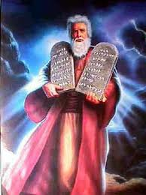
Why Did God Give Israel the Law of Moses?
“…it is expedient that there should be a law given to the Children of Israel, ye, even a very strict law; for they were a stiffnecked people, quick to do iniquity, and slow to remember the Lord their God.”
Mosiah 13:29

Slide 6
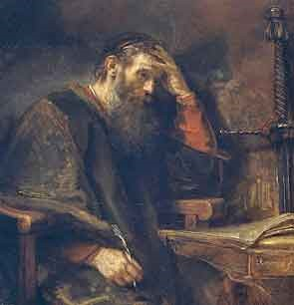
Romans 7:7-25
Romans 7 letters explains the difficultly in which Paul, himself had in explaining, and keeping the new Higher Law of Christ; let alone to the New Christians and Gentiles in Rome.

Slide 7
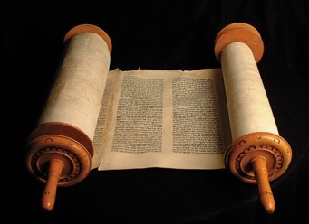
JST---JST---JST---JST---JST---JST---JST---JST---JST
New Testament
Joseph Smith Translation
5. which were by the law,
6. that being dead wherein we were held;
9. For I was alive without the law once; but when the commandment came,
5. which were not according to the law,
6. Being dead to the law,
9. For once I was alive without transgression of the law, but when the commandments of Christ came,
Compare: 2 Nephi 9:39 ; Mosiah 3:19

Slide 8
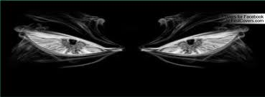
JST---JST---JST---JST---JST---JST---JST---JST---JST
10. And the commandment, which was ordained to life, I found to be unto death
11. For sin, taking occasion by the commandment, deceived me, and by it slew me.
10. And when I believed not the commandment of Christ which came, which was ordained to life, I found it condemn me unto death.
11. For sin, taking occasion, denied the commandment, and deceived me; and by it I was slain.

Slide 9
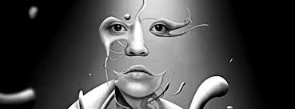
JST---JST---JST---JST---JST---JST---JST---JST---JST
12. Wherefore the law is holy, and the commandment holy, and just , and good.
13. that which is good;
14. For we know that the law is spiritual: but I am carnal, sold under sin.
12. Nevertheless, I found that the law to be holy, and the commandment to be holy, and just , and good.
13. that which is good working death in me;
14. For we know that the commandment is spiritual; but when I was under the law, I was yet carnal, sold under sin.

Slide 10
JST---JST---JST---JST---JST---JST---JST---JST---JST
15. For that which I do I allow not; for what I would, that do I not; but what I hate, that do I.
16. If then I do that which I would not, I consent unto the law that it is good.
15. But now I am spiritual; for that which I am commanded to do, I do; and that which I am commanded not to allow, I allow not.
16. For what I know is not right I would not do; for that which is sin, I hate.

Slide 11
JST---JST---JST---JST---JST---JST---JST---JST---JST
17. Now then it is no more I that do it, but sin that dwelleth in me.
18. For I know that in me (that is, in my flesh,) dwelleth no good thing: for to will is present with me; but how to perform that which is good I find not.
17. If then I do not that which I would not allow, I consent unto the law, that it is good; and I am not condemned.
18. No, then it is no more I that do sin; but I seek to subdue that sin which dwelleth in me.

Slide 12
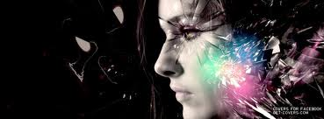
JST---JST---JST---JST---JST---JST---JST---JST---JST
19. For the good that I would I do not: but the evil which I would not, that I do.
20. Now if I do that I would not, it is no more I that do it, but sin that swelleth in me.
19. For I know that in me, that is, in my flesh, dwelleth no good thing; for to will is present with me, but to perform that which is good I find not, only in Christ.
20. For the good that I would have done when under the law, I find not to be good; therefore, I do it not.

Slide 13
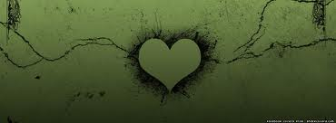
JST---JST---JST---JST---JST---JST---JST---JST---JST
21. I find then a law, that, when I would do good, evil is present with me.
22. For I delight in the law of God after the inward man:
21. But the evil which I would not do under the law, I find to be good; that, I do.
22. …through the assistance of Christ, I would not do under the law, I am not under the law; and it is no more that I seek to do wrong, but to subdue sin that dwelleth in me.

Slide 14
JST---JST---JST---JST---JST---JST---JST---JST---JST
23. But I see another law in my member, warring against the law of my mind, and bringing me into captivity to the law of sin which is in my members.
23. I find then that under the law, that when I would do good evil was present with me; for I delight in the law of God after the inward man.
24.And now I see another law, even the commandment of Christ, and it is imprinted in my mind.
25. But my members are warring against the law of my mind, and bringing me into captivity to the law of which is in my members.

Slide 15
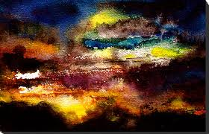
JST---JST---JST---JST---JST---JST---JST---JST---JST
24. Oh wretched man that I am! who shall deliver me from the body of this death?
25. I thank God through Jesus Christ our Lord. So then with the mind I myself serve the law of God; but with the flesh the law of sin.
26. And if I subdue no the sin which is in me, but with the flesh serve the law of sin; O wretched…
27. I than God through Jesus Christ our Lord, then, that so with the mind I myself serve the law of God.
Jesus Christ can deliver us from the captivity of sin

Slide 16
Many people feel discouraged because they constantly fall short. They know firsthand that “the spirit indeed is willing, but the flesh is weak”
They raise their voices with Nephi in proclaiming, “My soul grieveth because of mine iniquities” …
When I think of what the Savior did for us leading up to that first Easter Sunday, I want to lift up my voice and shout praises to the Most High God and His Son, Jesus Christ!
The gates of heaven are unlocked!
The windows of heaven are opened!
Today and forevermore God’s grace is available to all whose hearts are broken and whose spirits are contrite. Jesus Christ has cleared the way for us to ascend to heights incomprehensible to mortal minds.
(12)
Matthew 26:41; 2 Nephi 4:17; 3 Nephi 9:19-20; 1 Corinthians 2:9

Slide 17
Sources:
New Testament Institute Student Manual Chapter 36
President Dieter F. Uchtdorf(“The Gift of Grace,” Ensign or Liahona, May 2015, 109, 110).
Tad R. Callister “Infinite Atonement” page 45-46
Orson Pratt “Doctrines of Salvation” 2:9-10
Elder Jeffrey R. Holland (“The Atonement of Jesus Christ,” Ensign or Liahona, Mar. 2008, 36).
Elder David A. Bednar (“Therefore They Hushed Their Fears,” Ensign or Liahona, May 2015, 47).
Bruce R. McConkie “Life and Teachings of Christ” pg. 319
Elder Henry B. Eyring Upward Pull CES fireside Sept. 1996
Bruce R. McConkie—A New Witness for the Articles of Faith 290
Joseph Smith—Doctrines of Salvation 2:323-24
President Joseph Fielding Smith Doctrines of Salvation, 2:323–24.
Dieter F. Uchtdorf, “The Gift of Grace,” Ensign or Liahona, May 2015, 110.
Presentation by ©http://fashionsbylynda.com/blog/

Slide 18
Content of the Law
The content of the Law is spread among the books of Exodus, Leviticus, and Numbers, and then reiterated and added to in Deuteronomy (deutero-nomy is Latinised Greek for "Second reading of the Law").
This includes the Ten Commandments:
Moral laws - on murder, theft, honesty, adultery, etc.
Social laws - on property, inheritance, marriage and divorce.
Food laws - on what is clean and unclean, on cooking and storing food.
Purity laws - on menstruation, seminal emissions, skin disease and mildew, etc.
Feasts - the Day of Atonement, Passover, Feast of Tabernacles, Feast of Unleavened Bread, Feast of Weeks etc.
Sacrifices and offerings - the sin offering, burnt offering, whole offering, heave offering, Passover sacrifice, meal offering, wave offering, peace offering, drink offering, thank offering, dough offering, incense offering, red heifer, scapegoat, first fruits, etc.
Instructions for the priesthood and the high priest including tithes.
Instructions regarding the Tabernacle, and which were later applied to the Temple in Jerusalem, including those concerning the Holy of Holies containing the Ark of the Covenant (in which were the tablets of the law, Aaron's rod, the manna). Instructions and for the construction of various altars.
Forward looking instructions for time when Israel would demand a king.
Instructions for Proselytes and the Noahide Laws.
The law as given through Moses was a good law, although adapted to a lower spiritual capacity than is required for obedience to the gospel in its fulness. However, the Jewish leaders had added many unauthorized provisions, ceremonies, and prohibitions to the original law, until it became extremely burdensome. These innovations were known as the “traditions of the elders.” By New Testament times among the Jews the law had become so altered it had lost much of its spiritual meaning. It is this form of the law that is so harshly spoken against by Jesus and by Paul (see Matt. 15:1–9; Mark 7:1–13; Gal. 2:16–21). There is no evidence that the law of Moses had become as altered among the Nephites as among the Jews, and this may partially explain why the Nephites had less trouble in giving it up when the Savior came.
One of the major questions the early Church in Palestine had to decide was about the obligation of Christians to the ceremonial law of Moses. The matter was partially solved by the conference held in Jerusalem, as recorded in Acts 15 and Gal. 2. The Jewish Christians in particular had difficulty giving up the ritual of the law of Moses. The Nephites, on the other hand, seemed to have had much less of a problem doing so (see 3 Ne. 15:1–5). Bible Dictionary
What the Law Could Not Do:
Some devout Jews had accused Paul of speaking blasphemously against the law of Moses (see Acts 21:28). In Romans 7–8, Paul clarified his position by explaining that the law of Moses was good, but it had limitations. The law taught what sin was—“for by the law is the knowledge of sin”—and therefore the law was holy (see Romans 3:20; 7:7, 12–13). But the law could not overcome the effects of the Fall, which makes mankind “carnal, sold under sin” (Romans 7:14), and the law alone could not correct the problem of human weakness or provide means for people to be transformed by the Spirit (see Romans 8:3–4; Galatians 3:21). For that, we need the grace made available through the Atonement of Jesus Christ. (1)

Slide 19
Spiritually Reborn
Romans 8-11
Brethren, my heart’s desire and prayer to God for Israel is, that they might be saved.
Romans 10:1

Slide 20
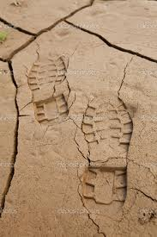
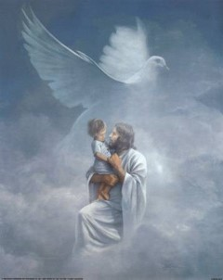
The Law of the Spirit
“There is therefore now no condemnation to them which are in Christ Jesus, who walk not after the flesh, but after the Spirit.”
The “Spirit” and to the “flesh” = “The law of the Spirit of life in Christ Jesus”
“For the law of the Spirit of life in Christ Jesus hath made me free from the law of sin and death.”
The atoning sacrifice of Jesus Christ and the gospel established after the law of Moses
Romans 8:1-2

Slide 21
Weak through the Flesh
The Law of Moses
“Life and peace come, not through the law of Moses, but through Christ and his saving grace.
The Mosaic performances deal with carnal things, the things of the flesh, the things of death.
There is not power in them to atone, to ransom, to save, to bring joy and peace here and eternal life hereafter.
But Christ deals with spiritual things, the things of the Spirit, the things that bring life.
Because of him, ‘he who doeth the works of righteousness shall receive his reward, even peace in this world, and eternal life in the world to come.’ (D. & C. 59:23.)”
Romans 8:3
(2)

Slide 22
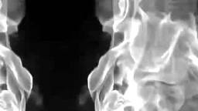
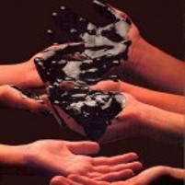
To be Carnally minded
“For to be carnally minded is death; but to be spiritually minded is life and peace.”
Satan deals only with the physical temptations of the mind and body.
The needs of our body often become the vulnerable base of operations.
Romans 8:13

Slide 23
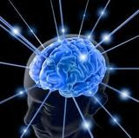
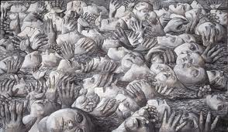
Satan’s Snare
How many souls have been won by Satan as they surrendered to bodily appetites?
How many eternal life’s have been lost because they were not spiritually minded but rather were dominated by “the mind of the flesh” ?
Some groups in Christianity and other religious traditions have believed that the only way to overcome desires of the flesh is to abstain completely from physical pleasures. However, many physical pleasures are not sinful, but are good. (1)
(3)

Slide 24
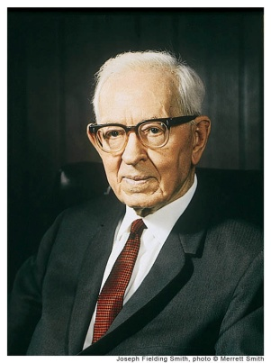
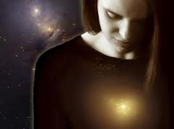
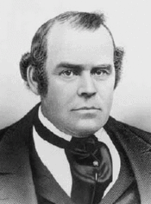
Influence on Mortal Life
“The spirit influences the body to a great extent, just as the body in its desires and cravings has an influence on the spirit.” (4)
“The gift of the Holy Ghost … purifies all the natural passions and affections, and adapts them, by the gift of wisdom, to their lawful use” (5)

Slide 25
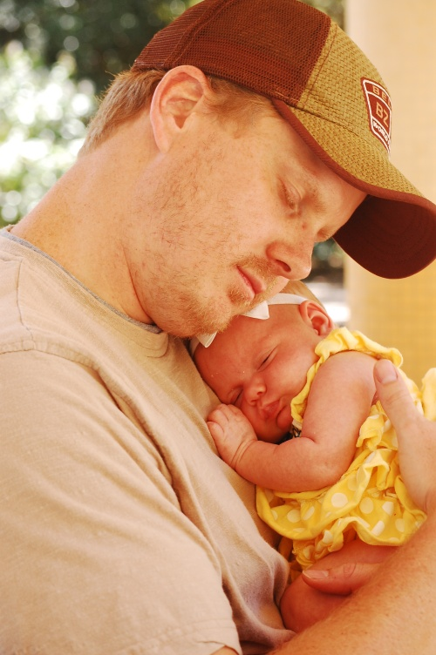
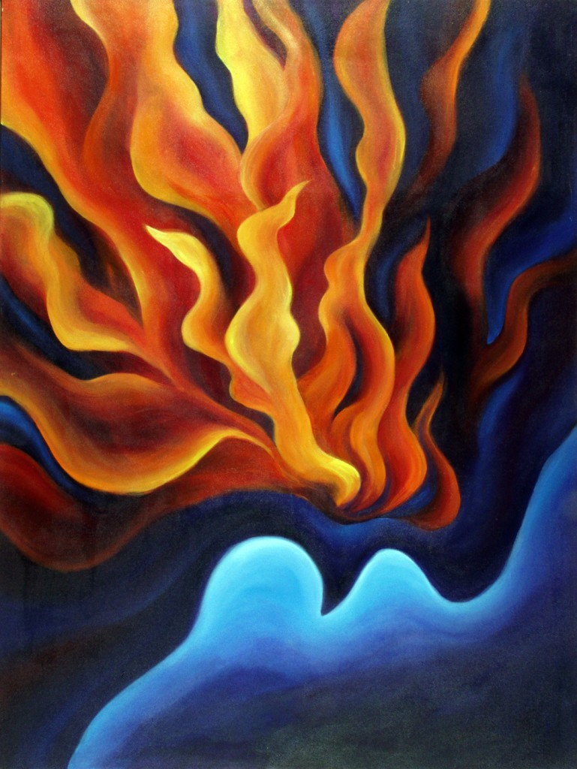
Spirit of Adoption
Every human being is literally a beloved spirit child of Heavenly Father
“For as many as are led by the Spirit of God, they are the sons of God.”
We are “reborn” as children of God through a covenantal relationship when we manifest faith in Jesus Christ, repent, are baptized,
and receive the Holy Ghost (1)
Romans 8:14-15

Slide 26
Free Agency
“God gave his children free agency, even in the spirit world…
...by which the individuals spirits had the privilege, just as men have here, of choosing the good and rejecting the evil, or partaking of the evil to suffer the consequences of their sins.”
Romans 8:15

Slide 27
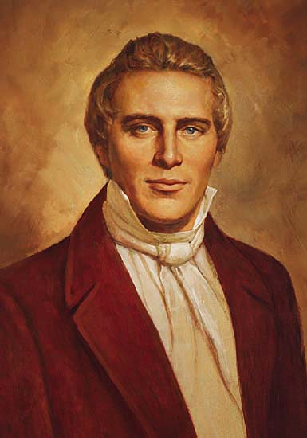
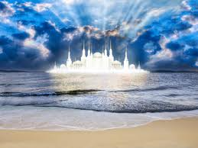
Joint-heirship
“To inherit the same power, the same glory and the same exaltation, until you arrive at the station of God, and ascend the throne of eternal power, the same as those who have gone before.”—Joseph Smith

Slide 28
What does it mean to you that we can receive all that Heavenly Father and Jesus Christ have?
What have Heavenly Father and Jesus Christ done to make it possible for us to receive these blessings?
Heavenly Father desires to bless us with all that He has

Slide 29
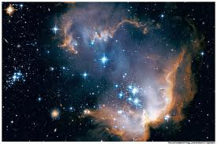
Inheritance
“A joint-heir is one who inherits equally with all other heirs including the Chief Heir who is the son.”
“Each joint-heir has an equal and an undivided portion of the whole of everything.”
“If one knows all things, so do all others. If one has all power, so do all those who inherit jointly with him.”
“If the universe belongs to one, so it does equally to the total of all upon whom the joint inheritances are bestowed.”
(2)

Slide 30
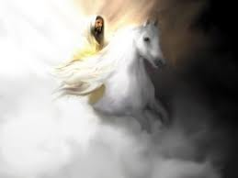
Glorified Together
(D&C 88:107)
“For ye are all the children of God by faith in Christ Jesus…
…for ye are all one in Christ Jesus.”
(Galatians 3:26,28)
…And the saints shall be filled with his glory, and receive their inheritance and be made equal with him.”
“And thn shall the angels be crowned with the glory of his might,…

Slide 31
Suffer With Him
Paul did not mean that we would suffer what the Savior did as part of His atoning sacrifice,
…but rather that we would go through our own suffering with Him.
Romans 8:17
(1)

Slide 32
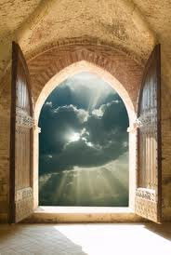
Qualifying for Inheritance
“…those who walk not after the flesh, but after the Spirit.”
Choosing God’s ways not the world’s ways
“…if so be that the Spirit of God dwell in you.”
To have the spirit with you at all times
“…is so be that we suffer with him…”
To repent of our sins no matter how difficult
“…waiting for the adoption, to wit, the redemption of our body.”
Being patient for spiritual things do not come instantly
Romans 8:1,9,17,23

Slide 33
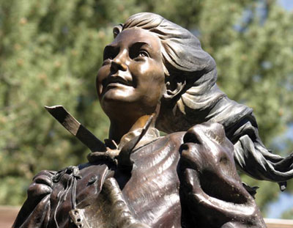
Providing Hope
While your testimony does not minimize the reality, painfulness, or difficulty of trials that you and your loved ones experience, it can provide hope, comfort, and an eternal perspective during those trials.
Romans 8:18-24

Slide 34
What might a doctor prescribe for the following conditions?
Stomach flu
Broken toe
Migraine headache
A cold
What specific advice might be given for each of those conditions?
What general advice might help treat all of those conditions?
Romans 8:18

Slide 35
Saved by Hope
Satan’s way is an instance gratification
The Lord’s way takes time and effort.
In Satan’s grasp you will find your freedoms taken away and severe consequences to follow
If we are spiritually minded you will find freedom and peace in your life
Romans 8:24-25

Slide 36
If we love God, all things will work together for our good. Through Jesus Christ we can overcome all the challenges and tribulations of mortality. Nothing can separate us from God’s love, which is manifest in the Atonement of Jesus Christ.
Romans 8:26-28

Slide 37
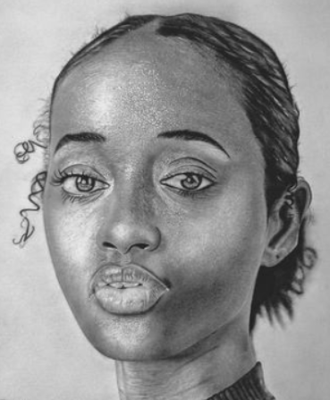
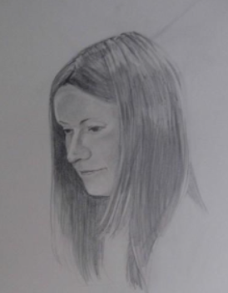
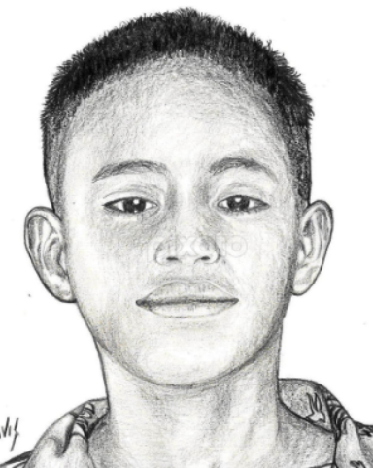
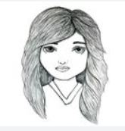
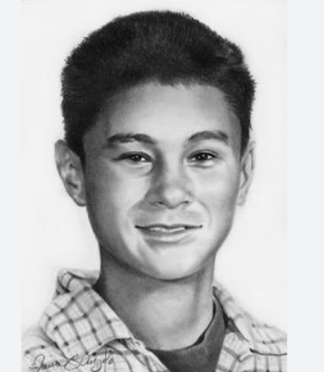
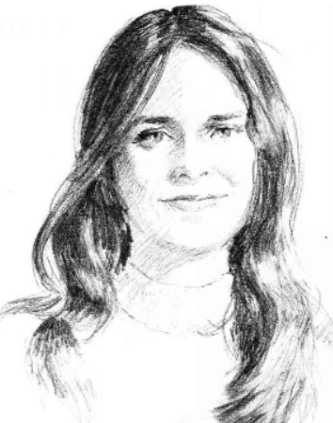
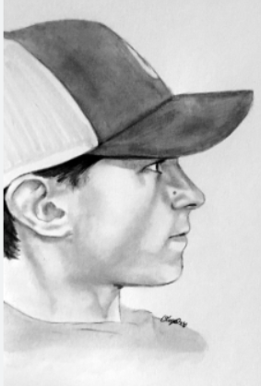
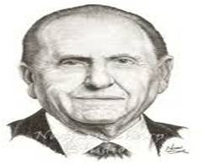
Your Heavenly Father loves you—each of you. That love never changes.
It is not influenced by your appearance, by your possessions, or by the amount of money you have in your bank account.
It is not changed by your talents and abilities. It is simply there.
It is there for you when you are sad or happy, discouraged or hopeful. God’s love is there for you whether or not you feel you deserve love.
It is simply always there.
(8)
Romans 8:39

Slide 38
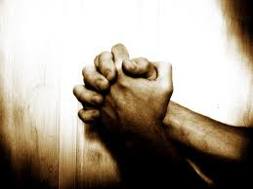
Intersession
To intercede is to plead or act on behalf of another person
“And we know that all things work together for good to them that love God, to them who are the called according to his purpose.”
Romans 8:26-28

Slide 39
Foreordination
“Predestinate”—determining beforehand one’s state, condition, and actions in life by divine decree.
Predestination is the Divine foreordaining or foreknowledge of all that will happen; with regard to the salvation of some and not others. It has been particularly associated with the teachings of John Calvin.
Romans 8:29
(6)

Slide 40
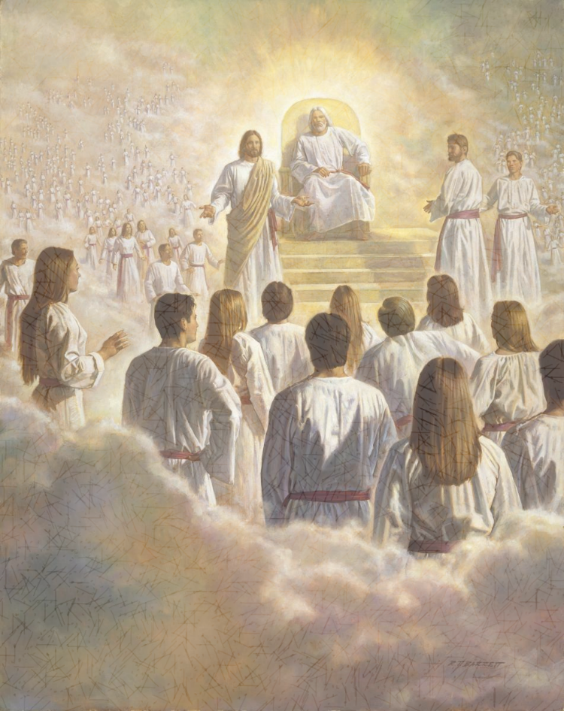
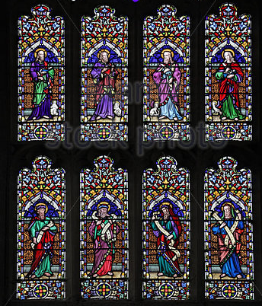
Premortal life
“We once had an estate before we came here, and were obedient, more or less, to the laws that were given us there.”
Robert Barrett
“Those who were faithful in all things there received greater blessings here, and those who were not faithful received less.”
(4)

Slide 41
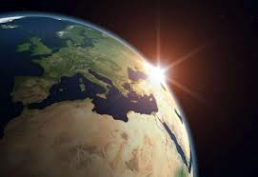
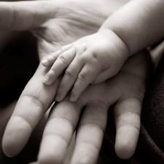
Called for His purpose
“Every soul coming into this world came here with the promise that through obedience he would receive the blessings of salvation.”
“ No person was foreordained or appointed to sin or to perform a mission of evil.”
Because of Free Agency
(4)

Slide 42
Before the World was Created and Adoption into the Kingdom of God
Romans 9-11

Slide 43
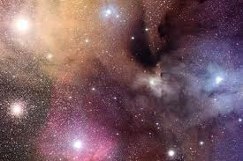
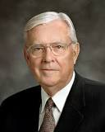
Before the world was created
Lived with Heavenly Father as spirit children
Some of what our Eternal Father is, we have inherited.
Members of the House of Israel
Inheritance—embryo traits and attributes
Foreordained to receive blessing
What He has become --
we may become
Chosen before birth
Talents of spirituality
(2,7)

Slide 44
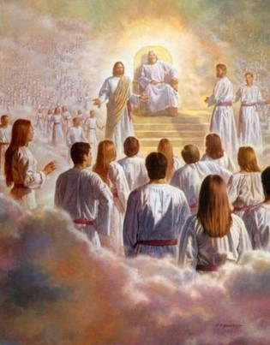
“And God saw these souls that they were good, and he stood in the midst of them, and he said: These I will make my rulers; for he stood among those that were spirits, and he saw that they were good; and he said unto me: Abraham, thou art one of them; thou wast chosen before thou wast born.”
Abraham 3:23

Slide 45
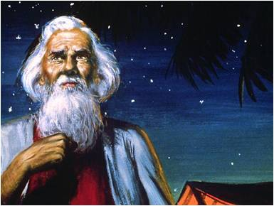
Acceptance in Heaven and on Earth
Law of election
saved by obedience—accept and follow Christ
Obedience to the gospel
Promises, blessings, and responsibilities
Through the acceptance of Jesus Christ
If Israel rejects Christ-- looses promises
Inherit all of Israel’s blessings
Grafting—partaking fully of blessings and promises of the gospel
Romans 9: 1-5

Slide 46
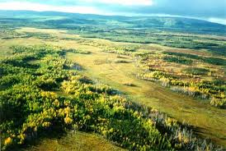
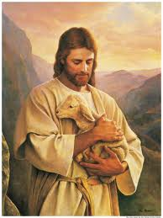
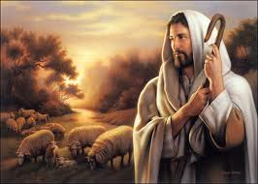
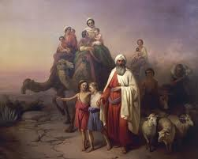
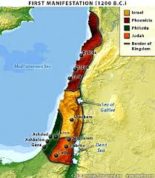
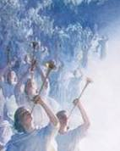
Promises and Blessings
Heavenly Father will honor them by:
Nourishing them
Watching over them
Giving Land to them
Making them a great nation
Multiplying their posterity
Receiving eternal life

Slide 47
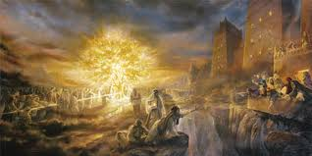
However:
Premortal faithfulness, foreordained promises or being born into a certain lineage do not guarantee salvation.
D&C 64:35-36

Slide 48
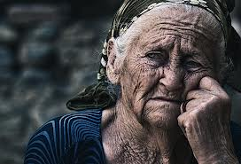
Rejection and Rebellious
Heavenly Father removes His Spirit by:
Long suffering and curses
Destruction
Taking away their land
Cutting them off from the land of Zion
Scattering
Eternal Damnation

Slide 49
.
Confess Jesus’ name to be saved
Confess = Covenant = Call Upon
These words could refer to entering into covenants and taking upon ourselves the name of Christ.
Romans 10:1–13 is often quoted to defend the position that we only need to confess the name of Jesus Christ to be saved.
However, the Savior specifically spoke against this doctrine when He said, “Not every one that saith unto me, Lord, Lord, shall enter into the kingdom of heaven; but he that doeth the will of my Father which is in heaven”.
Paul emphasizes the importance of the ordinance of baptism.
For as many of you as have been baptized into Christ have put on Christ.
Galatians 3:27
Not every one that saith unto me, Lord, Lord, shall enter into the kingdom of heaven; but he that doeth the will of my Father which is in heaven.
Romans 10:1–13

Slide 50
Branches and Roots
“For if the firstfruit be holy, the lump is also holy; and if the root be holy, so are the branches.” ---Israel
“And if some of the branches be broken off, and thou, being a wild olive tree, wert graffed in among them, and with them partakest of the root and fatness of the olive tree.”
Romans 11:16-17

Slide 51
Israel Rejects Christ
“Well; because of unbelief they were broken off…
“For if God spared not the natural branches, take heed lest he also spare not thee.”
Romans 11:20

Slide 52
Israel Rejects Christ—Gentiles Receive Him
“…if they abide not still in unbelief, shall be graffed in: for God is able to graff them in again.”
“…lest ye should be wise in your own conceits; that blindness in part is happened to Israel, until the fulness of the Gentiles be come in.”
Romans 11:16-25

Slide 53
“There was a period or time appointed for the Jews to hear the word, and then a period of time for the Gentiles to take precedence.
The times of the Gentiles is the period during which the gospel goes to them on a preferential basis, and this will continue until they have had a full opportunity to accept the truth, or in other words until the fulness of the Gentiles.
Then the message will go again to the Jews, meaning to the Jews as a nation and as a people.”
Romans 11:25
(2)

Slide 54
Will the grafted branch ever become part of the tree just as the original branches are?
If an original branch gets its nourishment from the roots, where does the grafted branch gets its nourishment?
When and why might a gardener use grafting?
What benefits come to a tree through grafting?
What benefits come to a branch that has been grated?
Yes
Also from the roots
Open for discussion
It increases in size and may produce more or better fruit
It becomes part of the tree
Romans 11:16-25

Slide 55
What spiritual process does Paul compare to grafting?
How will the Gentiles who are adopted into the house of Israel benefit?
How does this grafting process show the great love that the Lord has for all His Children?
Who is the Root?
The adoption of Gentiles into the house of Israel.
Gentile converts who join the Church are counted as part of the house of Israel, fulfilling the scripture
Roger Loveless
Romans 11:25

Slide 56
“I Jesus have sent mine angel to testify unto you these things in the churches. I am the root and the offspring of David, and the bright and morning star.”
Revelations 22:16

Slide 57
Sources:
New Testament Institute Student Manual Chapter 36-37
Bruce R. McConkie Mormon Doctrine p. 395
Doctrinal New Testament Commentary, 2:259–60; 2:290.
A New Witness for the Articles of Faith, 512-13
Life and Teachings of Jesus Christ page 324
Joseph Fielding Smith “Doctrine of Salvation” page 58-61
Elder Parley P. Pratt (Key to the Science of Theology [1978], 61).
Wikipedia
M. Russell Ballard Our Search for Happiness: An Invitation to Understand The Chruch of Jesus Christ of latter-day Saints [1993] ,70
Thomas S. Monson, “We Never Walk Alone,” Ensign or Liahona, Nov. 2013, 123–24
Presentation by ©http://fashionsbylynda.com/blog/

Slide 58
PAUL’S Letters to the Romans
The Law of Christ Brings Life and Peace | 8:1–13
The Sons of God Are Joint-Heirs with Christ | 8:14–19
Faithful Men Receive the Hope of Eternal Life | 8:20–25
How the Spirit Intercedes for Man | 8:26, 27
God’s Elect Are Foreordained to Eternal Life | 8:28–34
Christ Intercedes for Men | 8:34–39
How the Law of Election Operates | 9:1–33
How Faith and Salvation Come | 10:1–18
Israel Is Chosen According to the Election of Grace | 10:19–21; 11:1–10
Gentile Converts Are Adopted into Israel | 11:11–24
The Fulness of the Gentiles to Precede the Conversion of the Jews | 11:25–36
Adoption During Christ’s Time:
Caesar Augustus (see Luke 2:1), who was the ruler of Rome at the time of Christ’s birth, was adopted by his predecessor, Julius Caesar. Adoption was common in the Roman world and would have been a familiar concept to Paul’s readers.
A person who legally adopted someone conferred on that person all the rights and privileges that a natural-born child would have. Therefore, when we receive “the Spirit of adoption” (Romans 8:15) through entering the gospel covenant, we become the children of God and “joint-heirs with Christ” (Romans 8:17). (1)
Joint-Heirs Romans 16-17:
“In the theology of the restored church of Jesus Christ, the purpose of mortal life is to prepare us to realize our destiny as sons and daughters of God—to become like Him. … The Bible describes mortals as ‘the children of God’ and as ‘heirs of God, and joint-heirs with Christ’ (Rom. 8:16–17). It also declares that ‘we suffer with him, that we may be also glorified together’ (Rom. 8:17) and that ‘when he shall appear, we shall be like him’ (1 Jn. 3:2). We take these Bible teachings literally. We believe that the purpose of mortal life is to acquire a physical body and, through the atonement of Jesus Christ and by obedience to the laws and ordinances of the gospel, to qualify for the glorified, resurrected celestial state that is called exaltation or eternal life.” Elder Dallin H. Oaks (“Apostasy and Restoration,” Ensign, May 1995, 86).
Life and Teachings of Jesus and His Apostles Chapter 40-41
Suffer With Him Romans 8:17:
“We can learn spiritual lessons if we can approach suffering, sorrow, or grief with a focus on Christ. Anciently Paul wrote that our suffering may give us an opportunity to know the Savior better. Paul wrote to the Romans:
“‘The Spirit itself beareth witness with our spirit, that we are the children of God:
“‘And if children, then heirs; heirs of God, and joint-heirs with Christ; if so be that we suffer with him, that we may be also glorified together.’ [Romans 8:16–17.]
“Now, lest anyone go looking for hardship and suffering, that is not what is taught. Rather, it is the attitude with which we approach our hardships and trials that allows us to know the Savior better. …
“As we are called upon to endure suffering, sometimes inflicted upon us intentionally or negligently, we are put in a unique position—if we choose, we may be allowed to have new awareness of the suffering of the Son of God. …
“… We can have a greater appreciation for that which He did, and we can feel His spirit succoring us, and we can know the Savior in a very real sense.” Elder Keith R. Edwards (“That They Might Know Thee,” Ensign or Liahona, Nov. 2006, 99–101).
“We are the children of God.” Romans 14-17:
The children of God that Paul spoke of were those who, by virtue of their covenant relationship with Christ, were “led by the Spirit of God”. The companionship of the Holy Ghost is God’s assurance that we are His covenant children and that if we are faithful we will one day be “glorified together” with Jesus Christ. The blessings Paul discussed in Romans 8—blessings such as being “heirs of God”, the Spirit’s intercession on our behalf, and the full manifestations of God’s enduring love—are enjoyed by God’s covenant children, but not necessarily by all of His spirit children. (1)
Spirit of Adoption Romans 8:15-16:
“our spirit”, meaning our spirit bodies, was created by Heavenly Father, making every person literally a spirit child of Heavenly Father. However, it is by making covenants with God through ordinances and then keeping those covenants that people are spiritually reborn, or adopted, as His sons and daughters in the gospel covenant. The companionship of the Holy Ghost indicates that such people are not only God’s spirit children by virtue of creation, but they are also His covenant children.

Slide 59
All Things Work Together Romans 8:28:
Our Heavenly Father, who loves us completely and perfectly, permits us to have experiences that will allow us to develop the traits and attributes we need to become more and more Christlike. Our trials come in many forms, but each will allow us to become more like the Savior as we learn to recognize the good that comes from each experience. As we understand this doctrine, we gain greater assurance of our Father’s love. We may never know in this life why we face what we do, but we can feel confident that we can grow from the experience.” Elder James B. Martino(“All Things Work Together for Good” Ensign or Liahona, May 2010, 101).
The Bible Dictionary explains that election is “a theological term primarily denoting God’s choice of the house of Israel to be the covenant people with privileges and responsibilities, that they might become a means of blessing to the whole world. …
“The elect are chosen even ‘before the foundation of the world,’ yet no one is unconditionally elected to eternal life. Each must, for himself, hearken to the gospel and receive its ordinances and covenants from the hands of the servants of the Lord in order to obtain salvation. If one is elected but does not serve, his election could be said to have been in vain, as Paul expressed in 2 Cor. 6:1.
“… An ‘election of grace’ spoken of in … Rom. 11:1–5 has reference to one’s situation in mortality; that is, being born at a time, at a place, and in circumstances where one will come in favorable contact with the gospel. This election took place in the premortal existence. Those who are faithful and diligent in the gospel in mortality receive an even more desirable election in this life and become the elect of God. These receive the promise of a fulness of God’s glory in eternity (D&C 84:33–41)” (Bible Dictionary, “Election”; see also Alma 13:3–4).
The Prophet Joseph Smith explained that “unconditional election of individuals to eternal life [predestination] was not taught by the Apostles. God did elect or predestinate, that all those who would be saved, should be saved in Christ Jesus, and through obedience to the Gospel” (in History of the Church, 4:360). That is, all people who will be saved will receive salvation through the Atonement of Jesus Christ and in no other way.
Firstborn Among Many Others Romans 8:29:
Some Latter-day Saints have tended to focus on Christ’s Sonship as opposed to His Godhood. As members of earthly families, we can relate to Him as a child, as a Son, and as a Brother because we know how that feels. We can personalize that relationship because we ourselves are children, sons and daughters, brothers and sisters. For some it may be more difficult to relate to Him as a God. And so in an attempt to draw closer to Christ and to cultivate warm and personal feelings toward Him, some tend to humanize Him, sometimes at the expense of acknowledging His Divinity. So let us be very clear on this point: it is true that Jesus was our Elder Brother in the premortal life, but we believe that in this life it is crucial that we become ‘born again’ as His sons and daughters in the gospel covenant” M. Russell Ballard (“Building Bridges of Understanding,” Ensign, June 1998, 67).
Foreordination Romans 8:28-29:
the Greek term translated as predestinate means ‘to appoint or determine beforehand’ and refers to the foreordination some people receive, based on God’s foreknowledge, to follow Jesus Christ and become like Him (see also Ephesians 1:3–4; 1 Peter 1:2). ‘Foreordination does not guarantee that individuals will receive certain callings or responsibilities. Such opportunities come in this life as a result of the righteous exercise of agency, just as foreordination came as a result of righteousness in the premortal existence’ (‘Foreordination’ True to the Faith: A Gospel Reference [2004], 69; see also Alma 13:3–4)” (New Testament Student Manual [Church Educational System manual, 2014], 350).

Slide 60
Understanding Paul’s words
“Accursed from Christ”
“To Whom Pertaineth the Adoption”
For they stumbled at that stumbling block”
JST indicates that Paul actually wrote, “For once I could have wished that myself were accursed from Christ” He probably was referring to the time when he persecuted the Church of Jesus Christ
Using imagery, he refers to those not of the house of Israel who accepted the gospel and lived its teaching. They were adopted into the family of Abraham and literally became Israelites.
Jesus Christ is the rock or stone upon which the Jews stumbled. He fulfilled the law of Moses and restored the gospel in its fulness, but the Jews rejected Him and continued to believe that they could be saved by the “works of the law” without His help.

Slide 61
“The Fulness of the Gentiles”
“Election of Grace”
“Graffed in among Them”
Peter opened the door to preaching the gospel to the Gentiles, and Paul became their chief apostolic advocate and teacher. There was a period of time for the Jews to hear the gospel and one for the Gentiles. This will continue throughout time until they have all had the opportunity to hear the message.
Heavenly Father’s plan requires that all of His children have an opportunity to accept or reject the gospel. The “election of grace” gives members of the Church the assignment to fulfil this assignment in our day.
When branches on fruit trees begin to die, a gardener can cut them off and graft in new branches from a healthy tree. If done correctly, the new branches will grow and become part of the old tree. Paul taught that converted Gentiles are new branches “graffed…”

Slide 62
Ellen (called Nellie) Pucell Unthank. When 9-year-old Nellie left her home in Tintwhistle, England, she could not have imagined the journey that would follow. As depicted by sculptor Jerry Anderson, childhood for Nellie was bright and filled with opportunity. What she would survive of her expedition at such a young age would secure her place in the pages of pioneer history. And of her later life in Cedar City, Utah, a tale equally as admirable.
With parents Margaret and William Pucell, Nellie and her sister Maggie, age 14, set sail at Liverpool, England in 1856 on a ship named Horizon. Leaving life and possessions behind, the Pucells looked forward to a bright future and plans for establishing a home with fellow Latter-day Saints in the new Rocky Mountain Zion.
Six weeks later, they arrived at Boston where they met up with other members of the Mormon migration in traveling by train to Iowa. At Iowa City, the group joined the Martin Handcart Company for what would become the ill-fated final stretch of their transcontinental journey.
As the group of just over 500 made their way pulling handcarts to Utah, they were beset by early winter snowstorms and cold temperatures as they reached Wyoming. On Oct. 19, snow and frigid temperatures hit the region, and as conditions only grew worse, some began suffering frostbite, hunger, exhaustion and hypothermia. Nellie’s father slipped into a bitterly cold stream while the company was attempting to cross, and died from exposure on Oct. 22, 1856. Her mother died five days later. Nellie’s parents were among an estimated 150 members of the handcart company who did not survive the journey from Iowa to Utah.
When news of the company’s tragedy reached Salt Lake City, rescue teams were sent to aid and recover survivors. Those who remained of the Martin Company were found nearly covered in snow. Orphaned and maimed from frostbite, Nellie and Maggie were among survivors delivered by wagon to Salt Lake City Nov. 30, 1856. With frozen limbs through, Nellie’s injuries required amputation of both legs just below the knee.
Maggie and Nellie later joined with fellow survivors of their handcart company and traveled south to settle at Cedar City, Utah. Nellie was 24, and though wooden legs and shoes were crafted to assist her, her pain was severe and prosthetics only exacerbated her condition. Instead, she moved about by crawling on her knees.
Statue: story of trials of young pioneer
https://www.suu.edu/news/2017/07/nellie-unthank-pioneer-settler.html

Slide 63
Armour of Light
Romans 12-16
Let your light so shine before men, that they may see your good works, and glorify your Father which is in heaven.
Matthew 5:16

Slide 64
The Shape of Water
If you pour the water into this container, how will the shape of the water change?
It will conform to the shape of the container.
If you pour that water into another container how will it change the shape of the water?
It will conform to the shape of that container.
The water represents people and the containers represent different worldly beliefs and practices.
What dangers can come from continually conforming to worldly beliefs and practices?

Slide 65
The REAL Meaning: Romans 12: 1-3
“Present your bodies”
“Conformed to this world”
3. “Transformed”
4. “Think soberly”
Change
Sacrifice all you enjoy
Wicked
Copying worldly ways
Living a life of service
Improved
Don’t have pride
Avoid humor

Slide 66
A Living Sacrifice
Old Testament practice of sacrificing animals = These animals were dedicated offerings to God.
Mosaic Law
Lust
lust
Church members are to dedicate themselves completely to God by giving up sinful desires.
God expects us to dedicate our lives to Him and refrain from conforming to the world

Slide 67
A Living Sacrifice
Romans 12:9-16
Romans 12:17-21
Romans 13:8-13
Love should be shown without hypocrisy
Be honest in all things
Do not barrow and not return
Live peaceably
Love one another
Be kind to all
Do not seek revenge
Do not commit adultery, steal, bear false witness, covet, or kill
Learn the value of hard work
Take care of the poor and the needy
Live with hope
Overcome evil thoughts and intentions
Cast off darkness and put on the ‘armour of light’
Be hospitable and generous
Be of one mind

Slide 68
Armour of Light
“put on the whole armour of God.”
“I came to understand that I am not the light or the source of light. But light—the light of truth, understanding, and knowledge—is there, and that light will only shine in many dark places if I reflect it.
“… I can reflect light into the dark places of this world … and change some things in some people. Perhaps others may see and do likewise. This is what I am about. This is the meaning of my life.”
When we encounter people who are struggling, can we reflect the Savior’s light to encourage them?
The Apostle Paul taught the Romans, “Let us therefore cast off the works of darkness, and let us put on the armour of light”. How do we do this? (2)
Doc Christensen
Doc Christensen
Romans 13:12

Slide 69
Paul has written the conditions that are required in order to qualify for salvation
for now is our salvation nearer than when we believed
Romans 13:11

Slide 70
Salvation
“…for we know that it is by grace that we are saved, after all we can do.”
What does it mean to be saved?
“…if thou shalt confess with thy mouth the lord Jesus, and shalt believe in thin heart that God hath raised him from the dead, thou shalt be saved.”
2 Nephi 25:23 Romans 10:9

Slide 71
Have you been saved?
“There are 6 different meanings of the words saved and salvation…
“…Some of these, our salvation is assure---we are already saved.
Some salvation is spoken as a future event or as conditioned upon the future.”
(3)

Slide 72
Meaning #1
We are all saved from physical death
(Alma 11:43-44)
First, all mortals have been saved from the permanence of death through the Resurrection of Jesus Christ.
“For as in Adam all die, even so in Christ shall all be made alive”
1 Corinthians 15:22.
(3)

Slide 73
Meaning #2
“We can be saved from sin through
obedience to the law and ordinances of
the gospel if we endure to the end.
(D&C 14:7) and Article of Faith 3
Saved with conditions
“Believers may not be saved until they completed their mortal probation, having faith, repentance, baptism and receiving the gift of the Holy Ghost.”
(3)

Slide 74
Meaning #3
“We can be saved by being “born again”
(John 3:3-5 and Mosiah 27:24-26)
Born again---enter into a covenant relationship
Born of Water, and of the spirit and by taking upon us the name of Jesus Christ.
Renewal---Rebirth---Sacrament
(3)

Slide 75
Meaning #4
“We can be saved from ignorance
through the light of the gospel.
(John 8:12)
Being saved from the darkness of ignorance of God, and His son
“I am the light of the world, he that followeth me shall not walk in darkness, but shall have the light of life”
(John 12:46)
(3)

Slide 76
Meaning #5
“We can be saved from the second death.”
( 1 Corinthians 15:40-42 and Revelation 2:11)
The final spiritual death---assurance of the kingdom of glory
“Resurrection—every person who ever lived upon the face of the earth—except for a very few—is assured of salvation.
(D&C 76:52-60)
(3)

Slide 77
Meaning #6
“We can be saved by receiving exaltation.”
( D&C 76:52-60)
Exaltation = Eternal Life = The fulness of salvation
Requires more than repentance and baptism by priesthood authority
Requires making sacred covenants, including eternal marriage in the temple of the Lord
(3)

Slide 78
“But in all meanings, or kinds of salvation, salvation is in and through Jesus Christ.”
(3)

Slide 79
“If we use the word salvation to mean ‘exaltation,’ it is premature for any of us to say that we have been ‘saved’ in mortality. That glorious status can only follow the final judgment.”
(4)

Slide 80
Conflict In Rome
Handling matters of personal preference
Paul pointed out that some Church members chose to “eat all things” while others chose to eat only “herbs,” or in other words, vegetables .
Those who ate only vegetables were likely Jewish converts, while those who ate other foods were probably Gentile converts.
Luis Meléndez
Sue Zimmermann
These differences in personal practices led to divisions among Saints in Rome and other locations.
Albert Benaroya
Some Church members chose to follow Jewish customs, practices, and holidays.
Romans 14:1-15
(1)

Slide 81
Avoiding Conflict
Paul taught that many personal choices concerning diet and other practices were not addressed by any specific commandment.
Therefore, these were matters to be decided between the individual and the Lord .
Paul taught Church members to refrain from judging others in this matter of personal preference.
Although we all have differences, members of the Church can strive to be united through the teachings of Jesus Christ.
Romans 14:1-15
(1)

Slide 82
Consider the Effects
Why is it a problem when Church members look down on or condemn other Church members who make different choices in matters where no commandment requires or forbids a certain behavior?
Paul counseled the Saints to be considerate of the effect of their personal practices on others and be willing to forgo actions that could influence others to stumble spiritually
Paul taught that we should not impose our private interpretations on fellow Church members or pass judgment on those who live differently.
Romans 14:1-15
(1)

Slide 83
Consider This…
Is an alcoholic beverage or tobacco unclean?
Is it the alcohol or tobacco which tarnishes our souls?
The answer is no, for 'there is nothing unclean of itself' and it is 'not that which goeth into the mouth [that] defileth a man; but that which cometh out of the mouth, this defileth a man' (Matt. 15:11).
A man who has not been taught the Word of Wisdom is not made unclean by a cigarette or a glass of beer.
His choice may be unwise, but it is not sinful. Nevertheless, he may find some Church Members looking down on him.
Like the judgmental Romans, we sometimes fall prey to judgmental attitudes about those who smoke and drink.
But how can we hold him accountable for violating a law he has never covenanted to keep?
'why dost thou judge thy brother?
Romans 14:1-15
(1)

Slide 84
Breaking the Work of Wisdom
When a member of the church breaks the Word of Wisdom, he is unclean, not because the substance itself is unclean, but because he has broken his covenants to be obedient to God's law.
Faith, hope, charity, peace and joy are the fruits of the Spirit and are much more important than our latter-day dietary code.
Word of Wisdom "faddists," as Elder McConkie calls them, sometimes forget to place this law in its proper perspective.
If we liken the scriptures to ourselves, we might correctly declare, 'For the kingdom of God is not abstinence from tobacco and alcohol; but righteousness, and peace, and joy in the Holy Ghost' (v. 17).
However:
We are not to Judge
Romans 14:1-15
(4, 5)

Slide 85
Bear the Infirmities of the Weak
“Remember, we are not alone. We belong to a great body of friends, thousands upon thousands who are striving to follow the teachings of the Lord. …
“I remember interviewing a discouraged missionary. He was having trouble with a language which was not his own. He had lost the spirit of his work and wanted to go home. He was one of 180 missionaries in that mission.
“I told him that if he were to go home he would break faith with his 179 companions. Every one of them was his friend. Every one of them would pray for him, fast for him, and do almost anything else to help him. They would work with him. They would teach him. They would get on their knees with him. They would help him to learn the language and be successful because they loved him.
Romans 15:1
(6)

Slide 86
“I am happy to report that he accepted my assurance that all of the other missionaries were his friends. They rallied around him, not to embarrass him, but to strengthen him.
The terrible feeling of loneliness left him. He came to realize that he was part of a winning team. He became successful, a leader, and he has been a leader ever since.
“That’s what each of us must do for one another.”
Romans 15:1
(6)

Slide 87
The Scriptures Are For Us
“for our learning” and to provide comfort and hope
Therefore will I give thanks unto thee, O Lord, among the heathen, and sing praises unto thy name.
(Psalm 18:49)
Rejoice, O ye nations, with his people: for he will avenge the blood of his servants, and will render vengeance to his adversaries, and will be merciful unto his land, and to his people.
(Deuteronomy 32:43)
O praise the Lord, all ye nations: praise him, all ye people. (Psalm 117:1)
And in that day there shall be a root of Jesse, which shall stand for an ensign of the people; to it shall the Gentiles seek: and his rest shall be glorious. (Isaiah 11:10)
Paul quoted several Old Testament scriptures to reassure the Saints that missionary work to the Gentiles was in accordance with God’s plan, and he encouraged all Church members to accept one another
Romans 15:4; 9-12
(1)

Slide 88
The End of the Epistle
Paul concluded his epistle by describing his efforts to preach the gospel. He also warned about those who cause divisions, teach false doctrines, and seek to deceive others.
A warning about the dangers of allowing individual amplifications of gospel principles to become expectations for others:
“Sometimes, well-meaning amplifications of divine principles—many coming from uninspired sources—complicate matters further, diluting the purity of divine truth with man-made addenda. One person’s good idea—something that may work for him or her—takes root and becomes an expectation. And gradually, eternal principles can get lost within the labyrinth of ‘good ideas.’” (7)
Romans 15-16

Slide 89
Testimony of Paul to the Romans:
“For I am not ashamed of the gospel of Christ: for it is the power of God unto salvation to every one that believeth; to the Jew first, and also to the Greek.
For therein is the righteousness of God revealed from faith to faith: as it is written, The just shall live by faith.”
Romans 1:16-17

Slide 90
Our Church culture comes from the gospel of Jesus Christ. The Epistle of the Apostle Paul to the Romans is profound. …
… Paul admonishes the Jews and the Gentiles to keep the commandments and love one another and affirms that righteousness leads to salvation.
The culture of the gospel of Jesus Christ is not a Gentile culture or a Judaic culture. It is not determined by the color of one’s skin or where one lives.
While we rejoice in distinctive cultures, we should leave behind aspects of those cultures that conflict with the gospel of Jesus Christ.
(8)

Slide 91
Sources:
New Testament Institute Student Manual Chapter 37
Robert Fulghum, What on Earth Have I Done? (2007), 290–91
Dallin H. Oaks April 1998 Conf. or May Ensign 1998
Bruce R. McConkie “The Mortal Messiah” vol. 4 (1979-81), 1:242
Word of Wisdom “Food Faddists” (Doctrinal New Testament Commentary, Vol.2, p.313)
gospeldoctrine.com
President Gordon B. Hinckley (“Strengthening Each Other,” Ensign, Feb. 1985, 3).
President Dieter F. Uchtdorf (“The Love of God,” Ensign or Liahona, Nov. 2009, 21).
Quentin L. Cook, “Hearts Knit in Righteousness and Unity,” Ensign or Liahona, Nov. 2020, 20–21
Presentation by ©http://fashionsbylynda.com/blog/

Slide 92
PAUL’S Letters to the Romans
Be A Living Sacrifice Through Obedience to God | 12:1–3
Talents Are Given Saints for Service | 12:4–8
Resist Evil with Charity | 12:9–21
Submission to Church Authorities | 13:1–7
“Love Is the Fulfilling of the Law” | 13:8–10
Righteousness Leads to Salvation | 13:11–14
What are Matters of True Religion? | 14:1–23
True Saints Fellowship Each Other | 15:1–7
Gospel Gifts Poured Out upon Gentiles | 15:8–33
Paul Salutes the Saints | 16:1–27
Ordained Power Romans 13:1:
"Governments are instituted of God, sometimes by His direct interposition, sometimes by His permission. When the Jews had been brought into subjection by Nebuchadnezzar, king of Babylon, the Lord commanded through the prophet Jeremiah (27:4-8) that the people render obedience to their conqueror, whom He called His servant; for verily the Lord had used the pagan king to chastise the recreant and unfaithful children of the covenant. The obedience so enjoined included the payment of taxes and extended to complete submission. After the death of Christ the apostles taught obedience to the powers that be, which powers, Paul declared 'are ordained of God.' See Rom. 13:1-7; Titus 3:1; 1 Tim. 2:1-3; see also 1 Pet. 2:13, 14. Through the medium of modern revelation, the Lord has required of His people in the present dispensation, obedience to and loyal support of the duly established and existing governments in all lands. See D&C 58:21-22; 98:4-6; and section 134 throughout. The restored Church proclaims as an essential part of its belief and practice: 'We believe in being subject to kings, presidents, rulers, and magistrates, in obeying, honoring, and sustaining the law.'" James E. Talmage (Jesus the Christ: A Study of the Messiah and His Mission According to Holy Scriptures Both Ancient and Modern [Salt Lake City: Deseret Book Co., 1983], 522, footnote 2.)
JST There is no power in the church but of God Romans 13:1:
The Joseph Smith Translation is helpful for two reasons. First, it reminds the leaders in the church that they are powerless without God, for the 'powers of heaven cannot be controlled nor handled only upon the principles of righteousness' (DC 121:36).
Secondly, it preempts misinterpretation. Paul's phrase, 'there is no power but of God,' could be misinterpreted to justify the wicked rule of kings, tyrants, and despots. Hereby, the wicked could lay claim to their unjust rule, saying that their power is 'ordained of God.' Certainly, we are to understand that Paul was not justifying all forms of government. Furthermore, we know that Satan often uses kings and queens, "false priests who oppress" in order to "reign with blood and horror." God doesn't ordain wicked governments, but he does permit them in order to preserve the free exercise of man's agency. Hence, the Joseph Smith Translation arms us against false interpretation by allowing an alternative to those who wrest the scriptures unto their own destruction. As with many inspired alterations by the Prophet, the change is not so much intended to restore Paul's original intent as it is to defuse Satan's powers of doctrinal distortion.
Gospeldoctrine.com
Life and Teachings of Jesus and His Apostles Chapter 41
The Higher Power Romans 13:1-7 "The Church believes that 'Governments were instituted of God for the benefit of man; and that He holds men accountable for their acts in relation to them, both in making laws and administering them, for the good and safety of society.' (D. & C. 134:1.)
"Governments must be righteous to receive the support of the Church. They must be in harmony with the principles of justice acknowledged by believers in God. This includes the full and unqualified right of the free exercise of individual liberty whenever it does not infringe upon the rights and liberties of others. Moreover, governments must be organized and maintained for the good and safety of society, that is for the governed, rather than for those who govern. This implies a constitutional form of Government, a form of Government in which the people participate.
"The Church believes 'that all governments necessarily require civil officers and magistrates to enforce the law of the same; and that such as will administer the law in equity and justice should be sought for and upheld by the voice of the people if a republic, or the will of the sovereign.' (D. & C. 134:3.)" (John A. Widtsoe, Program of The Church of Jesus Christ of Latter-day Saints [Salt Lake City: The Church of Jesus Christ of Latter-day Saints, 1937], 100.)

Slide 93
The Full Story of Light:
A story is told by Robert Fulghum, a Unitarian minister, about a seminar he once attended in Greece.
On the last day of the conference, the discussion leader walked over to the bright light of an open window and looked out. Then he asked if there were any questions.
Fulghum laughingly asked him what was the meaning of life. Everyone in attendance laughed and stirred to leave. However, the leader held up his hand to ask for silence and then responded “I will answer your question.”
He took his wallet out of his pocket and removed a small round mirror about the size of a quarter. Then he explained:
When I was a small child during World War II, we were very poor and we lived in a remote village. One day on the road, I found the broken pieces of a mirror. A German motorcycle had been wrecked in that place. I tried to find all the pieces and put them together, but it was not possible, so I kept the largest piece. This one. And by scratching it on a stone, I made it round.
I began to play with it as a toy and became fascinated by the fact that I could reflect light into dark places where the sun could never shine. It became a game for me to get light into the most inaccessible places that I could find. I kept the little mirror, and as I grew up, I would take it out at idle moments and continue the challenge of the game.
As I became a man, I grew to understand that this was not just a child’s game, but a metaphor of what I could do with my life. I came to understand that I am not the light or the source of the light. But light – be it truth or understanding or knowledge – is there, and it will only shine in many dark places if I reflect it.
I am a fragment of a mirror whose whole design and shape I do not know. Nevertheless, with what I have, I can reflect light into the dark places of this world – into the dark places of human hearts – and change some things in some people. Perhaps others seeing it happen will do likewise. This is what I am about. This is the meaning of my life.
Found in “Put on the Armour of Light” by Elder S. Gifford Nielsen of the Seventy March 2015 Ensign
Artist: Albert Benaroya is a unique artist who specializes in oil paintings. One of Albert’s most burning passions in life is to create original and quality works of art such as oil paintings, portraits and Jewish painting.
Albert's jewish paintings are created under the strictest standards of quality. In addition to that, every time he paints he uses only the best quality oil paints in order to make sure he will be able to breathe life in the most sincere manner into his creative and imaginative thoughts, out of which he creates amazing and wonderful paintings. Albert Benaroya is a popular jewish painter in Israel and all over the world.
http://www.albertbenaroya.com/Jewish-Paintings
Maintaining personal preferences Romans 14:13-15, 19; 15:1-3:
Church members should consider the effect of their personal practices on others and be willing to forgo some actions if they might cause another to stumble spiritually Promoting peace and edification in the Church is a higher priority than maintaining personal preferences Some actions and priorities simply matter more than others. (1)
Unity within the Church
Unity within the Church and among the saints is the goal of the gospel. There is no place in the Church of God for division, for disagreement on doctrine, for cults and cliques, for liberal views as contrasted with conservative concepts. Among the faithful saints there is only one mind and one judgment and these are the Lord's; those with the full enjoyment of the Spirit learn the Lord's views on all things and conform their minds and hearts to his, becoming one with him. "Be one; and if ye are not one ye are not mine," is his everlasting decree to his saints. (D. & C. 38:27.) Elder Bruce R. McConkie Commentary I, pp. 426- 427; 765-767.

