Slide 1


Galatians

Slide 2

Only One Gospel
Galatians 1-4
“ Knowing that a man is not justified by the works of the law, but by the faith of Jesus Christ…” (Galatians 2:16)

Slide 3
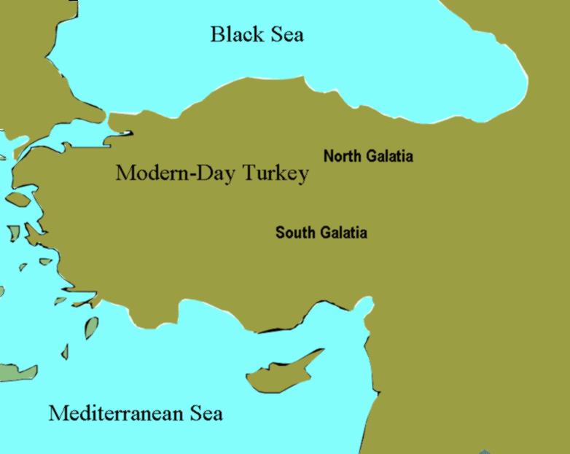
Galatians
Paul is the author of Galatians
Paul had baptized the Saints in the southern region during his 1st missionary journey, and the northern Saints during his 2nd missionary journey.
It is unclear as to which region these letters were to.
Paul likely wrote his Epistle to the Galatians while traveling through Macedonia during his third missionary journey, about AD 57; but the letter also may have been written as early as A.D. 48

Slide 4
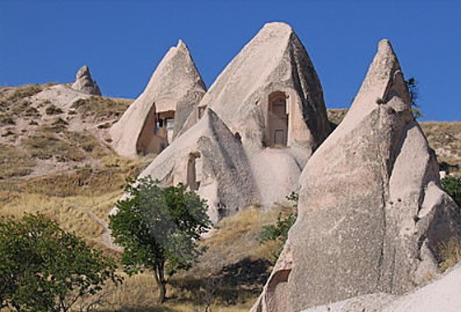
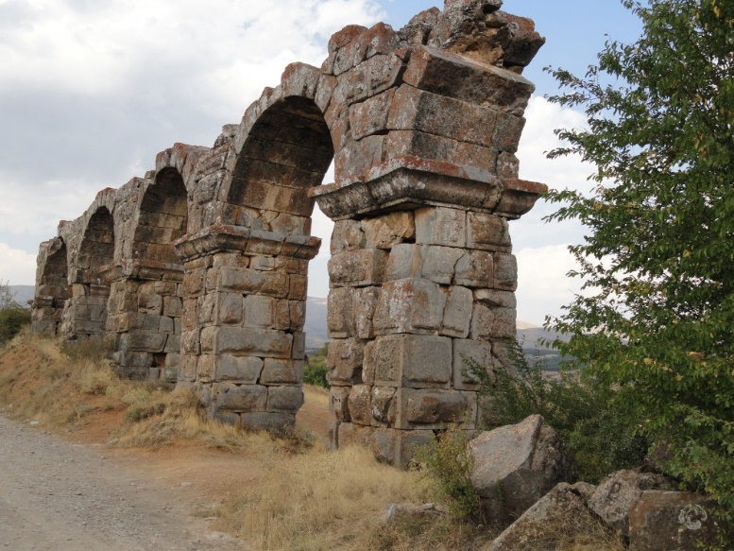
Galatia
Galatian Hoodoo Houses
“build their houses on the sand”- Matthew 7:26
Galatia was a region in north-central Asia Minor, whose population had immigrated from western Europe (modern France), where they had been known as Gauls.
Ruins in Antioch in Pisidia
Paul visited the Galatian churches on his second and third missionary journeys (see Acts 16:6; 18:23).

Slide 5
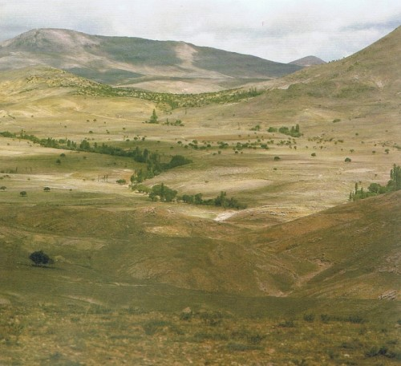
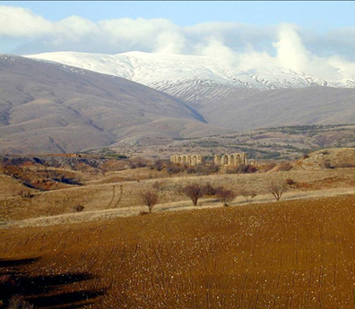
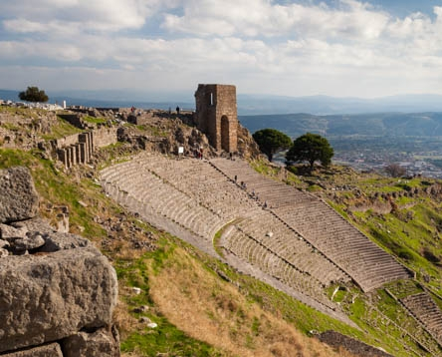

Paul’s main purposes in writing the Epistle to the Galatians included:
(1) defending himself against the accusations of the false teachers who opposed him;
(2) teaching that all people, whether Jew or Gentile, are saved by the Atonement of Jesus Christ by placing their faith in Jesus Christ, not by performing the works of the law of Moses;
(3) clarifying the role of the law of Moses in God’s plan;
(4) distinguishing between the old covenant God made through Moses and the new covenant in Christ; and
(5) calling upon the Saints to live by the Spirit.
(1)

Slide 6
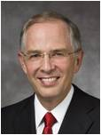
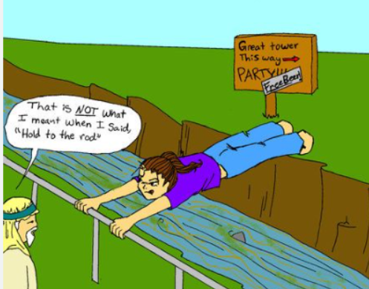
Perverting the Gospel
Some Jewish Christians were corrupting gospel teachings and raising doubts about Paul’s teaching that salvation comes only through Jesus Christ.
The iron rod is the word of God. I like to think of it in this way: The word of God contains three very strong elements that intertwine and sustain one another to form an immovable rod.
These three elements include, first, the scriptures, or the words of the ancient prophets. …
The second element of the word of God is the personal revelation and inspiration that comes to us through the Holy Ghost. …
… The third element, a critical addition intertwining with the other two[,] … represents the words of the living prophets.
(7)
Galatians 1:7

Slide 7
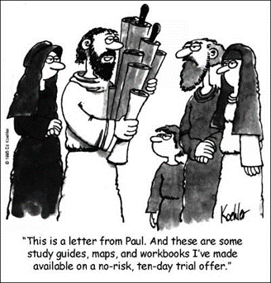
Preaching Another Gospel
“But though we, or an angel from heaven, preach any other gospel unto you than that which we have preached unto you, let him be accursed.”
These false teachers were Jewish Christians who claimed that the Galatian Saints had to be circumcised
“…if any man preach any other gospel unto you than that ye have received, let him be accursed.”
Galatians 1:8-9

Slide 8
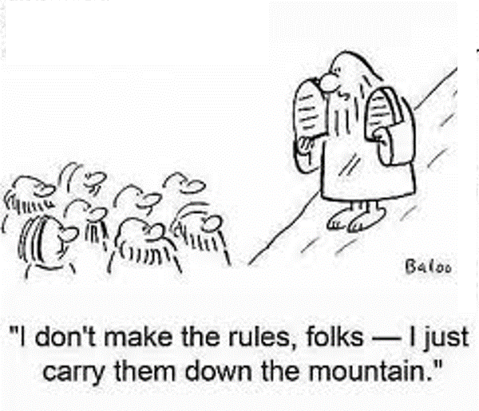
Revealing the True Gospel
Followers of Jesus Christ, both Jews and Gentiles, are justified not by the works and rituals of the law of Moses “but by the faith of Jesus Christ”
Galatians 1:10-12

Slide 9

What do God’s efforts to provide us with these sources teach us about Him?
How can hearkening to the words of Christ from both ancient and modern prophets help you avoid being deceived?
How can personal revelation help you avoid being deceived?
Galatians 1:6-9

Slide 10
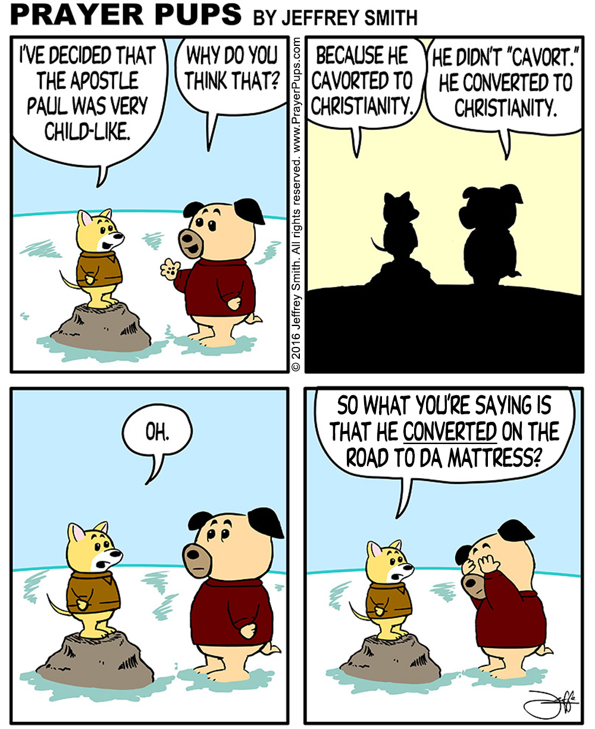
Reviewing Paul’s Conversion
Galatians 1:11-2:10

Slide 11
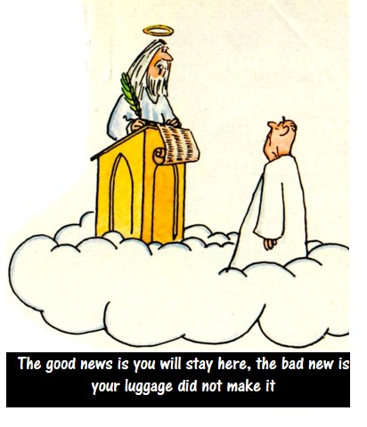
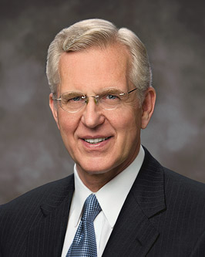
Justified, Pardoned, And Sanctified
Paul identified the essential truth that made clear why the Gentile Saints should not be excluded from dining with Jewish Saints. Both groups were justified (pardoned from punishment for sin) by placing their faith in Jesus Christ, not by performing the works of the law of Moses.
“We may appropriately speak of one who is justified as pardoned, without sin, or guiltless.
“To be sanctified through the blood of Christ is to become clean, pure, and holy. If justification removes the punishment for past sin, then sanctification removes the stain or effects of sin.” (2)
Galatians 2:15-16

Slide 12
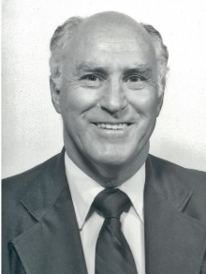
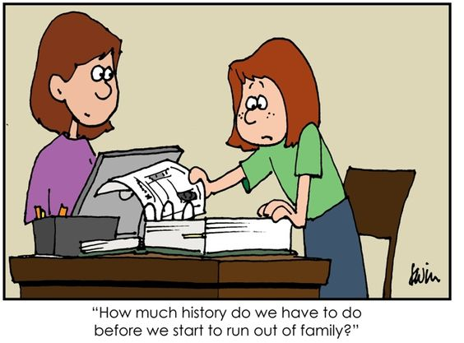
Who is the Seed of Abraham?
“blessed with faithful Abraham” refers to being a beneficiary of the covenant God made with Abraham that through him all people could enjoy the blessings of the gospel.
-- Abraham 2:11
"A major part of the covenant with Abraham is the promise that through Abraham and his seed all the families of the earth would be blessed.
Paul explains that the Lord Jesus Christ was born into the world through Abraham's lineage, and since Jesus is the Savior for all mankind, all are thus blessed through Abraham's seed.
This is one application of the promise. Another way in which all people are or will be blessed is that the descendants of Abraham, Isaac, and Jacob are mixed and intermingled with all nations; thus today the descendants of these patriarchs are found more or less among all nations and among all people, making them heirs to the promise that the gospel would be offered to them.
Furthermore, the descendants of Abraham bear the holy priesthood and minister the gospel to all nations."
Galatians 3:8-10
(3)

Slide 13
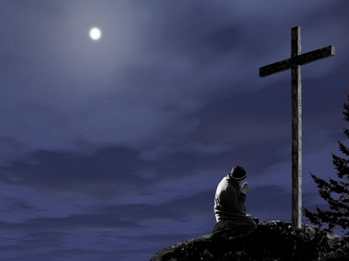
A Curse For Us
Some Jews believed that Jesus could not be the Messiah because he had been crucified or, in other words, hung on a tree.
They referred to a passage in Deuteronomy stating that a criminal who was put to death by being hung on a tree was “accursed of God.”
According to this way of thinking, Jesus had to be regarded as cursed by God. But Paul showed another way of looking at the concept of being “cursed” as applied to the Savior.
He explained that Jesus willingly took our sins upon Himself in order to perform the work of redemption, thus becoming “cursed” in our place: “Christ hath redeemed us from the curse of the law, being made a curse for us: for it is written, Cursed is every one that hangeth on a tree” (1)
Galatians 3:13; Acts 5:30; 10:39; 1 Peter 2:24; Deuteronomy 21:22-23

Slide 14
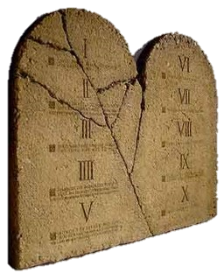
Paul explains the Purpose of the
Law of Moses to the Galatians
“Wherefore then serveth the law?”
What is the purpose of the Law of Moses?
Galatians 3:19

Slide 15
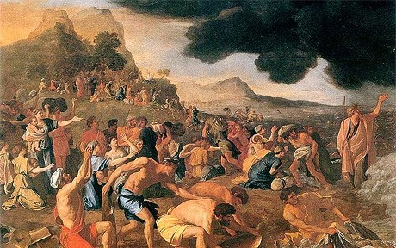
Adding to the Commandments
“It was added because of transgressions,
Because the people were not keeping the commandments
Galatians 3:19

Slide 16
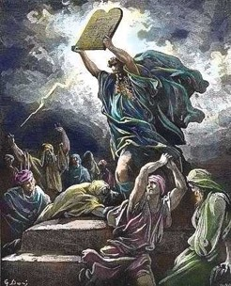
Not Understanding the Law
And now, did they understand the Law? I say unto you, Nay, they did not all understand the law…
…and this because of the hardness of their hearts; for they understood not that there could not any man be saved except it were through the redemption of God.”
Mosiah 13:32

Slide 17
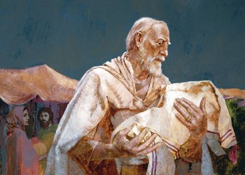
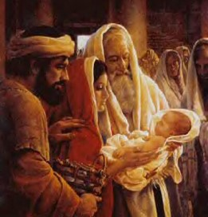
How long shall they be under the Law of Moses?
“till the seed should come to whom the promise was made;”
Till Christ comes and brings in the full gospel
Galatians 3:19

Slide 18
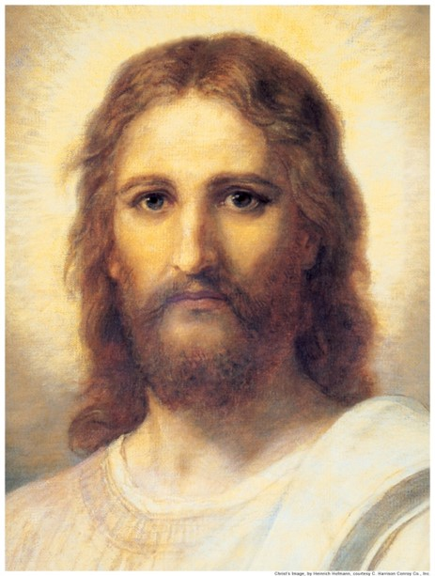
Who is the mediator?
“Now a mediator is not a mediator of one, but God is one.”
Jesus Christ is the mediator
Galatians 3:20

Slide 19
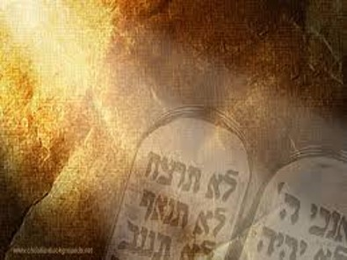
Promises of God
“Is the law then against the promises of God?”
The Law of Moses was a divine institution and was not opposed to God’s promises.
However…
Galatians 3:21

Slide 20
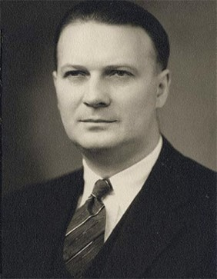
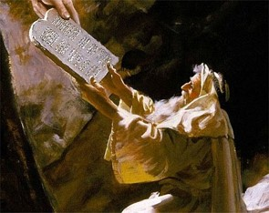

A Guidance—A Beginning
“The Law was given as a protection to the Jews as a moral guide to make them sin-and-guilt-conscious.”
Each one of us has started out with guidance since we were born.
(5)

Slide 21
Temporary Wheels
A bike with training wheels
“Yet the Lord God saw that his people were a stiffnecked people, and he appointed unto them a law, even the law of Moses.”
Mosiah 3:14

Slide 22
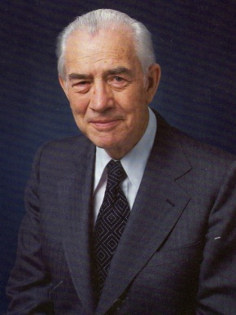
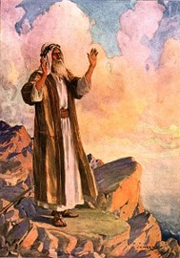
The Law of Training
Moses testified of Christ and other prophets, yet the people did not believe Moses therefore they were not prepared to receive Christ.”
Lower Law= The Law of Moses
Higher Law=Yet to come in the event of Jesus Christ
(6)

Slide 23
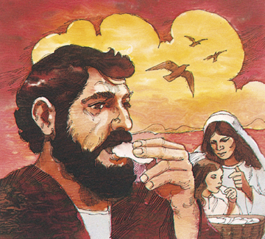
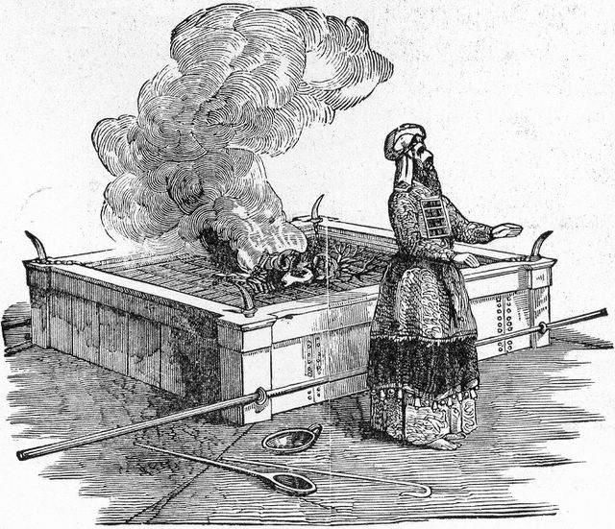
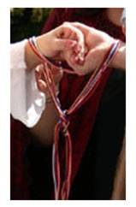
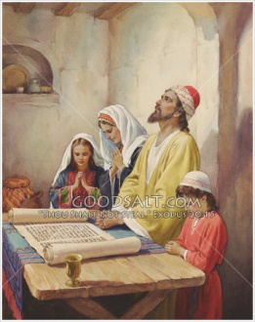
Types of Laws
How to eat
How to celebrate an occasion
Rituals such as sacrifices
How to Pray
“Behold, I am he that gave the law, and I am he who covenanted with my people Israel…

Slide 24
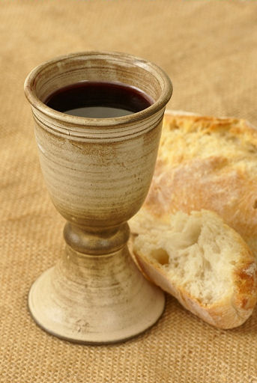
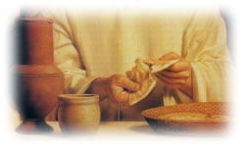
Law Fulfilled
“Behold, I am he that gave the law, and I am he who covenanted with my people Israel…
…therefore, the law in me is fulfilled, for I have come to fulfil the law; therefore it hath an end.”
3 Nephi 15:5

Slide 25
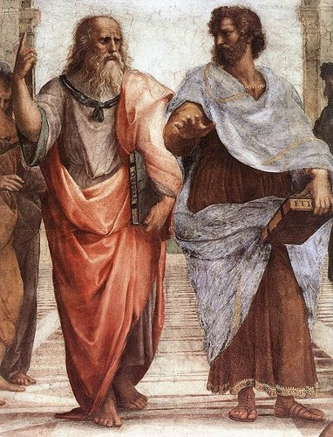
Schoolmaster
“When Christ came there was no need for a tutor (law) for it had filled its purpose”
“Wherefore the law was our schoolmaster to bring us unto Christ, that we might be justified by faith.”
Galatians 3:24

Slide 26
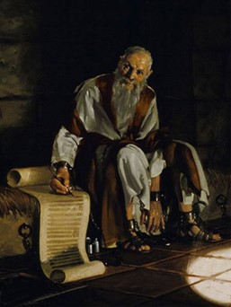
Superior Law
Paul wanted the Galatian Saints to understand that the blessings of the gospel are superior to what the law Moses offered.

Slide 27
Higher Gospel Law
The Bike
“But after that faith is come, we are no longer under a schoolmaster.
Galatians 3:25

Slide 28
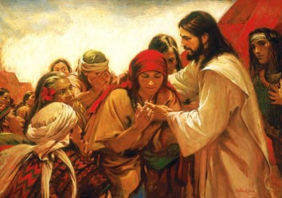
Nephites look for the law to be fulfilled
“And, notwithstanding we believe in Christ, we keep the law of Moses, and look forward with steadfastness unto Christ, until the law shall be fulfilled.”
“For, for this end was the law given; wherefore the law hath become dead unto us, and we are made alive in Christ because of our faith; yet we keep the law because of the commandments.”
2 Nephi 25:24-25

Slide 29
The Law of Moses was given to a righteous people (Galatians 3:19)
The law of Moses was intended to last forever (Galatians 3:19)
Abraham knew that Jesus Christ would come. (JST Galatians 3:20)
The law of Moses removed the need for the promised Savior. (Galatians 3:21)
Everyone sins; everyone needs Jesus Christ and His Atonement.
The law of Moses, by itself, limited spiritual growth (Galatians 3:23)
Yes No
Yes No
Yes No
Yes No
Yes No
Yes No

Slide 30


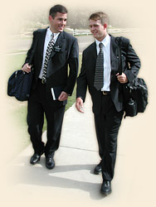
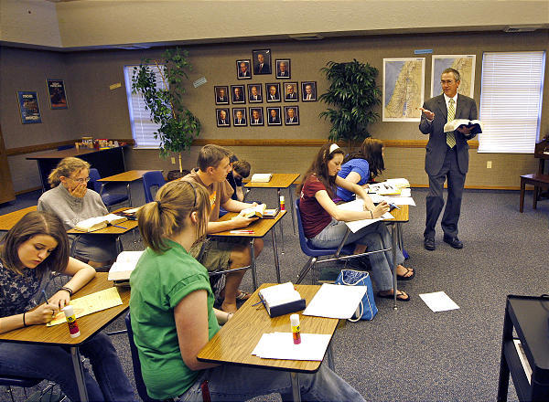
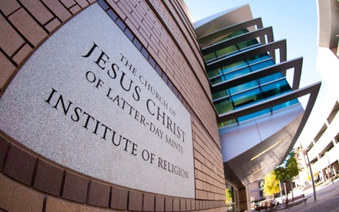
Spiritual Training Wheels of Today
Parents
Primary
Seminary
Institute
Mission

Slide 31
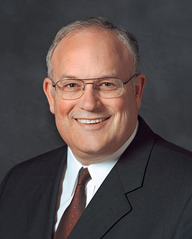
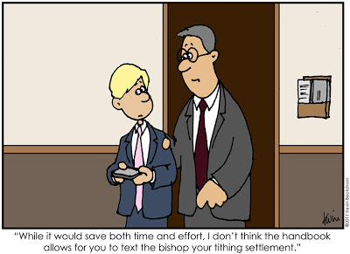
No Longer Under a Schoolmaster
“Our willingness to accept change in the kingdom helps the Lord hasten His work.
In the last half of the New Testament a major challenge the Church faced was the issue of gentile converts being assimilated as Christians.
The problem stemmed from the fact that many Jewish Christians felt that gentile converts should be required to adhere to the ceremonial law of Moses.
Even after a special council in Jerusalem decided that the gentile converts need not be subject to the law and an epistle was written explaining this decision, the issue remained a source of contention and division.
This was a major change for the Church, and many members struggled with it. (4)
Galatians 3:24-25; Acts 15

Slide 32
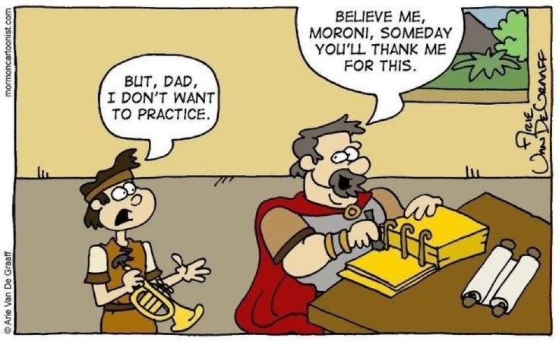
Exercising Faith in Jesus Christ
An Heir
Paul taught the Galatians that our relationship with God is better understood as that of a child to a father
He declared to the Galatians that being a “son” in the gospel covenant was far better than being a servant to the false gods they had worshipped before they accepted the truth.
Galatians 4:1-9

Slide 33
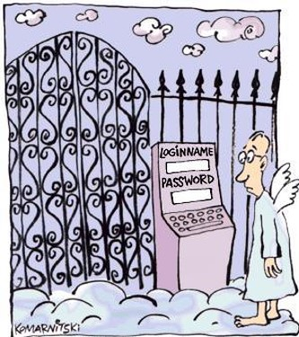
Only One True Gospel
There is only one true gospel on the earth that has all the teachings, ordinances, and covenants we need to return to Heavenly Father and live like Him in His kingdom.
NT Resource manual

Slide 34
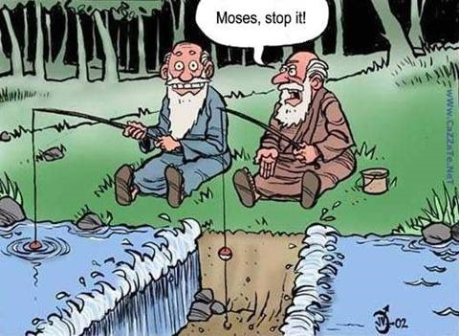
Sources:
New Testament Institute Student Manual Chapter 43 and 31 (Chart on Paul’s Life and Events)
Elder D. Todd Christofferson (“Justification and Sanctification,” Ensign, June 2001, 20, 22; see also Moses 6:59–60).
Robert J. Matthews, "Our Covenants with the Lord," Ensign, Dec. 1980, 37
Elder Paul V. Johnson (“Responding Appropriately to Change” [address to CES religious educators, Feb. 8, 2013], 1; si.lds.org).
Dr. Sidney B. Sperry “Paul’s Life and Letters” page 163, 169
Mark E. Peterson “The Way of the Master” Page 75
Neil L. Andersen, “Hold Fast to the Words of the Prophets” [Brigham Young University devotional, Mar. 4, 2007], speeches.byu.edu
Presentation by ©http://fashionsbylynda.com/blog/

Slide 35
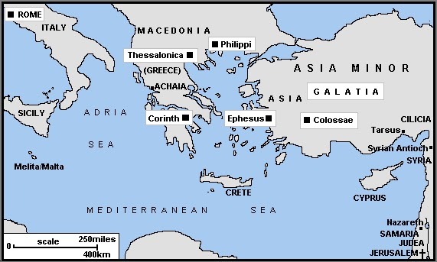
Letter from Paul during his second and third mission Written most likely from Macedonia about AD 48-AD 57
A Warning Against False Preachers | 1:1–10
Paul’s Call to the Ministry | 1:11–24
The Meeting at Jerusalem | 2:1–10
Peter and Paul of Antioch | 2:11–14
Salvation Comes Through Christ | 2:15–21
The Spirit Comes by Faith | 3:1–5
How the Mission of Abraham Is Extended to the Gentiles | 3:6–18
The Purpose of the Law | 3:19–22
Saints Are God’s Children by Faith | 3:23–29
How Saints Become Sons of God | 4:1–8
Galatians Called Back to Assist | 4:9–20
The Two Covenants: Hagar and Sarah | 4:21–31
Paul’s Confrontation with Peter in Jerusalem Galatians 2:11-14:
In order to emphasize to the Gentile converts in Galatia that they did not need to be circumcised, Paul recounted a confrontation with Peter, the chief Apostle. After a meeting in Jerusalem (see Galatians 2:1), Peter visited the Saints in Antioch (in Pisidia), where Paul was staying. While there, Peter began to dine with the Gentile Saints, but he stopped doing so when a group of Jewish Christians arrived from Jerusalem. He feared that the visitors would find his association with the Gentile Saints offensive (see Galatians 2:12). In many cultures of the ancient world, including the Jewish culture, dining with others affirmed a bond of fellowship and loyalty (see Mark 2:15–16; Acts 10:28). To some Jewish Christians, the cultural tradition of maintaining separation from Gentiles was more important than the Christian bond they shared with Gentile Saints. This was unacceptable to Paul. He taught that among the followers of Christ, there was to be “neither Jew nor Greek, … for ye are all one in Christ Jesus” (Galatians 3:28). Paul felt that Peter’s withdrawal from the Gentile Saints implied that they could not enjoy fellowship with Church members like Peter unless they lived “as do the Jews” (Galatians 2:14).
It is important to remember that we have only Paul’s account of this confrontation and that Paul acknowledged that Peter’s ministry was primarily to the Jews (see Galatians 2:7–8).
“In defense of the chief Apostle, however, one should recall that Peter was the leader of a relatively small church that was composed of two emotionally fragile factions; the situation was delicate. The Jewish Christians, on the one hand, did not appreciate the reluctance of some Gentiles to submit to the regulations of the Mosaic law, especially circumcision. Paul and his followers, on the other hand, were not worried about offending the feelings of the Jewish Christians who still held fast to the traditions of the law of Moses. Peter the prophet, naturally, loved and was concerned about both Jewish and Gentile members of the Church.
“It was a no-win situation for Peter. If he continued eating with the Gentiles, he would offend the visiting group of Jewish Christians. If he departed, he would offend Paul and the Gentile Christians in Antioch. No compromise was possible. Either way, he was going to hurt some feelings. Maybe Peter felt that an offended Paul would still remain true, while an offended group of Jewish Christians would potentially influence many others to dissent or leave the young church” (Frank F. Judd Jr., “The Jerusalem Conference: The First Council of the Christian Church,” Religious Educator, vol. 12, no. 1 [2011], 67; rsc.byu.edu).
Conspicuously absent from Galatians 2 is any reference to the Jerusalem conference held in A.D. 49 (see Acts 15). Paul was a participant in that conference, and he later shared the decision of that conference with those to whom he ministered (see Acts 15:30; 16:4). Since Paul made no mention of the conference or the letters describing the decision to take the gospel to the Gentiles, some experts believe that the experience described in Galatians 2:11–21 occurred prior to the Jerusalem conference. (1)
Life and Teachings of Jesus and His Apostles Chapter 38

Slide 36
CHRONOLOGY OF EVENTS IN PAUL’S LIFE AND MINISTRY
About A.D. 1–3 | Born in Tarsus of the tribe of Benjamin—a Pharisee and a Roman citizen by birth | Acts 9:11; 22:3, 27–28; Philippians 3:5
About A.D. 19–29 | Taught by Gamaliel in Jerusalem | Acts 22:3
A.D. 33 | Witnessed the martyrdom of Stephen and persecuted Christians in the Jerusalem area | Acts 7:54–8:4; Philippians 3:6
A.D. 33 | On the road to Damascus, saw a vision of Jesus Christ, was converted, and preached of Christ in Damascus | Acts 9:1–25
A.D. 33–35 | Fled Damascus to Arabia | Galatians 1:17
A.D. 35 | Returned to Damascus and briefly preached the gospel | Galatians 1:17
A.D. 35 | After three years visited Jerusalem and spoke with Peter and James, the Lord’s brother | Acts 9:26–29; Galatians 1:18–19
A.D. 35–49 | Spent 14 years in Syria-Cilicia (part of that time on his mission with Barnabas). Tarsus, Paul’s hometown, was located in Cilicia. | Acts 9:30; 11:19–26; Galatians 2:1, 21
A.D. 46–49 | First missionary journey (with Barnabas) | Acts 13:1–14:28
A.D. 49 | Attended the Jerusalem Conference | Acts 15:12; Galatians 2:1–2
A.D. 49–53 | Second missionary journey | Acts 15:36–18:20
A.D. 53 | Visited Jerusalem | Acts 18:21–22
About A.D. 54–58 | Third and final mission | Acts 18:23; 19:1–20:38
About A.D. 58 | Farewell visit to Greece; traveled to Jerusalem to deliver offerings for the poor | Acts 21:1–16
Spring A.D. 58 | Reported to presiding Brethren in Jerusalem, had misunderstandings at the temple, and was arrested | Acts 21:17–23:22
Spring A.D. 58–60 | Imprisoned in Caesarea | Acts 23:23–26:32
(1)

Slide 37

Freedom From the Yoke of Bondage
Galatians 5-6
O that ye would awake; awake from a deep sleep . . . and shake off the awful chains by which ye are bound, which are the chains which bind the children of men, that they are carried away captive down to the eternal gulf of misery and woe.
2 Ne. 1:13

Slide 38


Tug of War
How do you win at tug of war?
In what ways are our lives similar to a tug-of-war?
Porn
Unchaste and immoral behavior
Our struggle against temptation

Slide 39
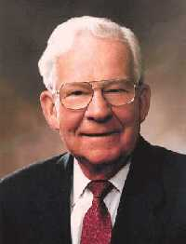

Burdens of the Law of Moses
'Stand fast therefore in the liberty wherewith Christ hath made us free, and be not entangled again with the yoke of bondage.'
Some Jewish Christians had misled the Saints in Galatia by teaching them that they needed to live the law of Moses and be circumcised in order to be saved.
Too often we are inclined to be impressed with the loud, noisy, and dramatic.
Students and members in general are sometimes led away from the paths of success because they are swayed by the sensational and artificial light.
Very often in today’s busy world we ignore the quiet promptings of our leaders and those who guide with soft words. (2)
To be easily swayed
Galatians 5:1

Slide 40
Free From Bondage?
Paul chastened the Galatian Saints for being so easily swayed away from the liberty of the gospel of Jesus Christ and returning instead to the bondage of the law of Moses.
He then clarified that even though followers of Christ had been freed from the bondage of the law of Moses, that did not mean they had the freedom to indulge freely in sin.
But when the righteous turneth away from his righteousness, and committeth iniquity, and doeth according to all the abominations that the wicked man doeth, shall he live? All his righteousness that he hath done shall not be mentioned: in his trespass that he hath trespassed, and in his sin that he hath sinned, in them shall he die.
Ezekiel 18:24
Galatians 5:2-15

Slide 41
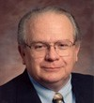
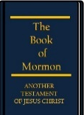
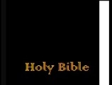
"As Paul points out, trying to keep the commandments is a long way from actually keeping them.
According to him, anyone stupid enough to trust his own ability to keep all the rules makes the atonement of Christ ineffectual in his own life.
Moreover, anyone who wants to trust entirely in his own righteousness needs to be reminded that righteousness through law requires perfect performance...
Paul points out that any claim to righteousness based on one's own efforts to keep the commandments requires a perfect record.
One slip and you are no longer perfect, you have become a sinner-and in this sense we are all sinners."
Galatians 5:4
(3)

Slide 42
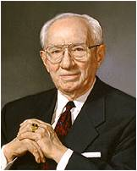
To Be Free
Paul taught that the liberty of Christ meant that disciples were free to be led by the Spirit and were not constrained by the law. (1)
Obedience
“True freedom lies in obedience to the counsels of God. …
The gospel is not a philosophy of repression, as so many regard it.
It is a plan of freedom that gives discipline to appetite and direction to behavior. Its fruits are sweet and its rewards are liberal.” (4)
Galatians 5:16-17

Slide 43

4 Categories of Sin
(1) Sexual sins. “Fornication” refers to any immoral sexual relationship; “lasciviousness” refers to unbridled or excessive lust.
(2) Sins from the religious realm, such as idolatry and witchcraft.
(3) Sins against other persons. “Variance” can be interpreted as discord and is an outgrowth of “hatred”; “emulations” are actions carried out in order to equal or be superior to another, often out of jealousy.
(4) Sins associated with alcohol: “drunkenness” and “revellings.” Paul warned that those who habitually participate in these sins “shall not inherit the kingdom of God” (1)
Unchaste and immoral behavior
Galatians 5:19-21

Slide 44
Competing Forces
Walk in the Spirit
Fulfill the lust of the flesh
To live worthy of and follow the Holy Ghost
Temptations to sin
As we walk in the Spirit, we will overcome the temptations of the flesh
Galatians 5:16-25

Slide 45






Fruit of the Spirit
Joy and Peace
Gentleness Goodness Meekness
Faith
Love
Long Suffering and temperance
Galatians 5:2-15
Jeremy Winborg artist

Slide 46
When We Walk in the Spirit
Unchaste and immoral behavior
They cease to be a part of our lives
"You recognize the promptings of the Spirit by the fruits of the Spirit-that which enlighteneth, that which buildeth up, that which is positive and affirmative and uplifting and leads us to better thoughts and better words and better deeds is of the Spirit of God. That which tears us down, which leads us into forbidden paths-that is of the adversary. I think it is just that plain, just that simple." (4)
"'If we live in the Spirit, let us also walk in the Spirit'
Galatians 5:24-25

Slide 47



It is not expected that you go through life without making mistakes, but you will not make a major mistake without first being warned by the promptings of the Spirit.
This promise applies to all members of the Church. …
If you are slipping into things that you should not slip into or if you are associating with people who are pulling you away in the wrong direction, that is the time to assert your independence, your agency.
Listen to the voice of the Spirit, and you will not be led astray.
I say again that youth today are being raised in enemy territory with a declining standard of morality.
But as a servant of the Lord, I promise that you will be protected and shielded from the attacks of the adversary if you will heed the
promptings that come from the Holy Spirit.
(7)

Slide 48

Bearing One’s Burden
How should members of the Church respond to someone who has sinned?
“Restore” the person, or help him or her return to the gospel path.
'The law of Christ, which it is our duty to fulfil, is the bearing of the cross. My brother's burden which I must bear is not only his outward lot [and circumstance], ... but quite literally his sin.
And the only way to bear that sin is by forgiving it in the power of the cross of Christ in which [we] now share.
Thus the call to follow Christ always means a call to share [in] the work of forgiving men their sins. Forgiveness is the Christlike suffering which it is the Christian's duty to bear.‘ (5)
Galatians 6:2-5

Slide 49




Eternal Goals
I recently met a fine teenage young man. His goals were to go on a mission, obtain an education, marry in the temple, and have a faithful happy family. I was very pleased with his goals.
But during further conversation, it became evident that his conduct and the choices he was making were not consistent with his goals.
I felt he genuinely wanted to go on a mission and was avoiding serious transgressions that would prohibit a mission, but his day-to-day conduct was not preparing him for the physical, emotional, social, intellectual, and spiritual challenges he would face.
Galatians 6:8
()

Slide 50

Obtaining Eternal Goals
He had not learned to work hard. He was not serious about school or seminary.
He attended church, but he had not read the Book of Mormon.
He was spending a large amount of time on video games and social media.
He seemed to think that showing up for his mission would be sufficient.
(8)
.
Galatians 6:8
()

Slide 51
Sowing and Reaping
What you sow, or plant, is what you reap, or harvest.
This is called the law of the harvest.
Paul taught that God cannot be mocked, for the law of the harvest applies to spiritual things as well as physical.
He admonished that we “not be weary in well doing” for we will reap the blessings of our righteous actions, as well as the spiritually destructive results of sinful choices. (1)
Whatever a person sows is what they will also reap
Galatians 6:7-9

Slide 52


To sow in the Spirit means that all our thoughts, words, and actions must elevate us to the level of the divinity of our heavenly parents.
However, the scriptures refer to the flesh as the physical or carnal nature of the natural man, which allows people to be influenced by passion, desires, appetites, and drives of the flesh instead of looking for inspiration from the Holy Ghost.
If we are not careful, those influences together with the pressure of the evil in the world may conduct us to adopt vulgar and reckless behavior which may become part of our character. In order to avoid those bad influences, we have to follow what the Lord instructed the Prophet Joseph Smith about continuously sowing in the Spirit: “Wherefore, be not weary in well-doing, for ye are laying the foundation of a great work.
And out of small things proceedeth that which is great” (9)
Doctrine and Covenants 64:33).9

Slide 53
Sources:
New Testament Institute Student Manual Chapter 44
Elder Marvin J. Ashton A Still Voice of Perfect Mildness February 20, 1990 BYU Speeches
(Stephen E. Robinson, Believing Christ: The Parable of the Bicycle and Other Good News [Salt Lake City: Deseret Book Co., 1992], 40.)
President Gordon B. Hinckley (in Conference Report, Apr. 1965, 78). Teachings of Gordon B. Hinckley [Salt Lake City: Deseret Book Co., 1997], 261
Elder Jeffrey R. Holland (Dietrich Bonhoeffer, The Cost of Discipleship, 2d ed., New York: Macmillan, 1959, p. 100.)" ("I Stand All Amazed," Ensign, Aug. 1986, 72)
Elder Dallin H. Oaks (“Be Not Deceived,” Ensign or Liahona, Nov. 2004, 45).
Boyd K. Packer, “Counsel to Youth,” Ensign or Liahona, Nov. 2011, 18
Quentin L. Cook, “Choose Wisely,” Ensign or Liahona, Nov. 2014, 47
Ulisses Soares, “Abide in the Lord’s Territory!,” Ensign or Liahona, May 2012, 39
Presentation by ©http://fashionsbylynda.com/blog/

Slide 54
Letter from Paul during his second and third mission Written most likely from Macedonia about AD 48-AD 57
Christian Liberty | 5:1–12
Liberty and Charity | 5:13–15
Walk in the Spirit | 5:16–26
Bear One Another’s Burdens | 6:1–6
“As Ye Sow, So Shall Ye Reap” | 6:7–18
Freedom Galatians 5:13:
"Occasionally, I hear of some young people who rejoice when they leave home for the first time and who feel inclined to experiment with worldly influences once they are beyond the sight of parents or other authority figures. They regard their 'freedom' as license to stretch the commandments, test the waters of sin, and engage in questionable practices. Usually, those who use 'liberty for an occasion to the flesh' do so thinking, I will only do it once or twice, and I can repent later. Such misled people, however, fail to recognize the binding nature of drugs, other stimulants, and undesirable habits. They forget that fire from any source burns or destroys and leaves ugly and sometimes irreparable scars.“ Carlos E. Asay (In the Lord's Service: A Guide to Spiritual Development [Salt Lake City: Deseret Book Co., 1990], 51.)
Sin is Sin Galatians 5:13:
"You must be honest with yourself and remain true to the covenants you have made with God. Do not fall into the trap of thinking you can sin a little and it will not matter. Remember, 'the Lord cannot look upon sin with the least degree of allowance.' (D&C 1:31.) Some young men and women in the Church talk openly about sexual transgression. They seem to forget that the Lord forbids all sexual relations before marriage, including petting, sex perversion of any kind, or preoccupation with sex in thought, speech, or action. Some youth foolishly rationalize that it is 'no big deal' to sin now because they can always repent later when they want to go to the temple or on a mission. Anyone who does that is breaking promises made to God both in the premortal life and in the waters of baptism. The idea of sinning a little is self-deception. Sin is sin! Sin weakens you spiritually, and it always places the sinner at eternal risk. Choosing to sin, even with the intent to repent, is simply turning away from God and violating covenants." ("Keeping Covenants," Ensign, May 1993, 7) Elder M. Russell Ballard
Life and Teachings of Jesus and His Apostles Chapter 38
"President Gordon B. Hinckley has counseled against surrendering to sin:
'Today there are persons numbered in the millions, who, in a search for freedom from moral restraint and peace from submerged conscience, have opened a floodgate of practices that enslave and debauch. These practices, if left unchecked, will not only destroy these individuals but also the nations of which they are a part. . . . Nations and civilizations have flowered, then died, poisoned by their own moral sickness. As one commentator has remarked, Rome perished before the Goths poured over its walls. But it was not that the walls were low. It was that Rome itself was low.' (Teachings of Gordon B. Hinckley, pp 380-382.)
"If we yield to sin, we are, in effect condemning not just ourselves but our communities and our countries. We may think we are merely 'exercising our agency' when we choose not to follow the Lord's commandments, but in reality we are worshiping the devil and giving him veto power over our souls." (The Spirit of Freedom, LDS Church News, 1998, 07/04/98)
Sin of Today Galatians 5:19:
"Today the dealers of pornography, sex, alcohol, tobacco, narcotics, and other forms of vice hate the souls of youth but love their money and resources. Such despisers of youth would make slaves of the young by drowning them in the addictive works of the flesh. So they raise their voices high and seek to entice young people to get lost down strange roads with dead ends. Their contempt for you is evidenced in the trail of broken hearts, broken promises, and broken health (physical and spiritual) they leave behind." (The Road to Somewhere: A Guide for Young Men and Women [Salt Lake City: Bookcraft, 1994], 127.)
Our Yoke Galatians 5:2-15:
“In our day, our yoke, our law of Moses, is anything that prevents or impedes our total commitment to Christ and His gospel.” (Gaye Strathearn, “Law and Liberty in Galatians 5–6” in Go Ye into All the World: Messages of the New Testament Apostles [2002], 70–71; rsc.byu.edu).

Slide 55
Enlightens the Mind | D&C 6:15
Leadeth to do good--…to do justly, to walk humbly, to judge righteously | D&C 11:12
Fills the soul with joy | D&C 11:13: Mosiah 4:20
Reveals the ‘truth of all things’ | Moroni 10:5
Bears record of Father and Son | D&C 20:27
Knows all things | D&C 42:17
Convinces | D&C 100:8
Gives Knowledge | D&C 121:26
Speaks in a ‘still small voice’ | 1 Nephi 17:45
Teaches a man to pray | 2 Nephi 32:8
Brings about mighty change | Mosiah 5:2
Gives assurances | Alma 58:11
Fills with ‘hope and perfect love’ | Moroni 8:26
Gives liberty | 2 Corinthians 3:17
Comforts | John 14:16
Speaks peace | Alma 58:11
Is available to all | D&C 6:14
Examples of the
“fruit of the Spirit”
Elder Dennis E. Simmons
(“His Peace,” Ensign, May 1997, 32).

