Slide 1
Revelation 1-5

Slide 2
Symbolism-colors
White---purity, righteousness,
exaltation
Black---evil; famine; darkness
Red---sins, bloodshed
Blue---heaven, godliness,
remembering and keeping
God’s commandments
Green---life; nature
Amber---sun, light, divine glory
Scarlet---royalty
Silver---of worth, but less than gold
Gold---the best, exaltation

Slide 3
Symbolism---body parts
Eye---perception, light and knowledge
Head---governing
Ears---obedience, hearing
Mouth---speaking
Hair---modesty, coverage
Members---offices and callings
Heart---inner man, courage
Hands----actions, acting
Right hand---covenant hand, making covenants
Bowels---center of emotion, whole being
Loins---posterity, preparing for action (gird up your loins)
Liver---center of feeling

Slide 4
Symbolism---body parts
Reins---kidneys; center of desires, thoughts
Arm---power
Foot---mobility, foundation
Toe---associated with cleansing rites
Nose---anger
Tongue---speaking
Blood---life of the body
Knee---humility, submission
Shoulder---strength, effort
Forehead---total dedication, loyalty

Slide 5
Symbolism---Numbers
1---Unity, God
3---God, Godhead, a word repeated three time means superlative, “the most”, or the “the best”
4---mankind, earth, (four angels over four parts of the earth)
7---Completeness, perfection. (When man lets God help, it leads to perfection. 4+3=7
Man+God= perfection
10---numerical perfection, well-organized (tithing, Ten Commandments)
12---divine government, God’s organization
40 days---literal, sometimes means “a long time”
Forever---endless, can sometimes be a specific period or age, not endless

Slide 6
Symbolism---Other
Horse---victory, power to conquer
Donkey---peace
Palms---joy, triumph, victory
Wings---power to move, act
Crown---power, dominion, exaltation
Robes---royalty, kings, queens, exaltation

Slide 7
Graphic Symbols
Horizontal temporal
Vertical Spiritual
Together, the square, Exactness, precision, integrity
Circle Eternity
Equilateral triangle man looking heavenward
Equilateral triangle God looking earthward
Star of David Man’s covenant relationship with Deity

Slide 8
Apostle of the Lamb
Revelation 1
I am the light of the world: he that followeth me shall not walk in darkness, but shall have the light of life.
John 8:12

Slide 9
Prophecies fulfilled:
Christ would be born of a virgin
He would be born in Bethlehem
He would flee to Egypt with His family

Slide 10
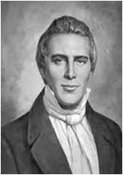
Apocalypse in Greek means revelation, uncovering, or unveiling.
In Revelation John records the events Jesus Christ showed him in a vision “which must shortly come to pass”.
Purpose of Revelation: to bless those who hear the words of this prophecy and keep those things which are written therein.
Prophet Joseph Smith said, “the Book of Revelation is one of the plainest books God ever caused to be written.”

Slide 11
The Book of Revelation
John the Beloved is the ancient author of Revelation.
Revelation is a book of holy scripture. It came by revelation from the Lord.
Revelation deals with those things that interest people who have received the gift of the Holy Ghost, and those who have hope of eternal life.
Before John was born Nephi saw John in a vision and angels identified him as “One of the 12 apostles of the Lamb.”
Nephi also saw that John was appointed and foreordained to write the very visions now found in the book.
(1)

Slide 12
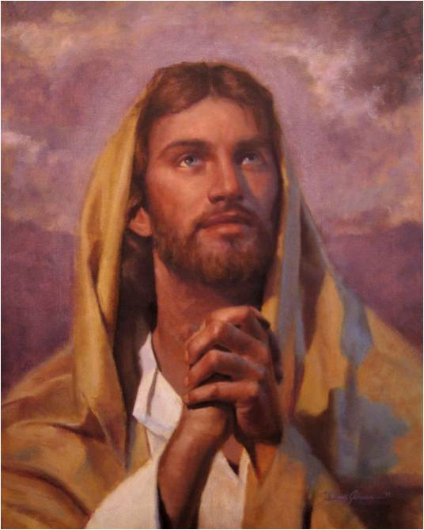
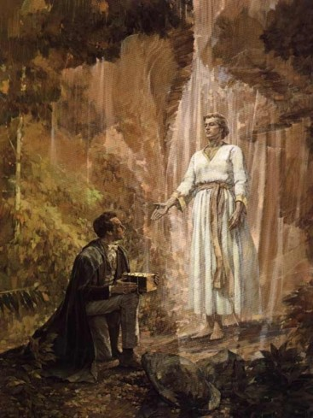
Divine Investiture
The Savior speaks for the Father (D&C 29:1, 42, 46)
The Holy Ghost speaks for the Savior(Moses 5:9)
An angel speaks for the Savior (Rev. 1:1)
And so forth….

Slide 13
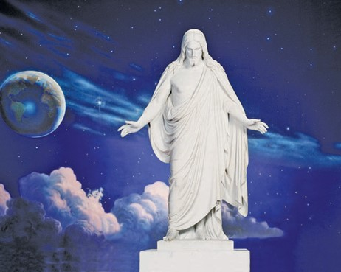
Jesus In Speaking For The Father
“In giving revelations our Savior speaks at times for Himself; at other times for the Father, and in the Father’s name, as though He were the Father, and yet it is Jesus Christ, our Redeemer who gives the message.”
Read D&C 29:1
(2)

Slide 14
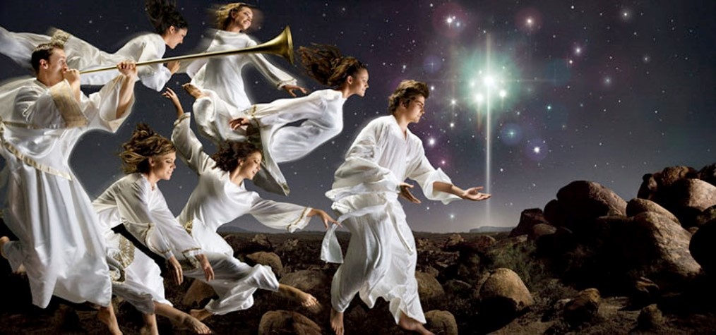
John Address Us In Our Day
JST
Blessed are they who hear and understand the words of the prophecy.
The Lord draweth nigh
Revelation 1:2-3

Slide 15
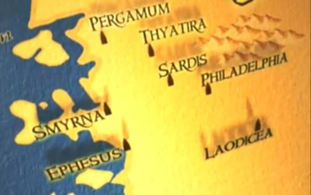
John’s Testimony Over the Churches
To the 7 leaders of the 7 branches of the Church in Asia
Now western Turkey
Sends blessings and peace from Jesus Christ
Being cleansed by Atonement
---washed us---blood cells constantly cleans out toxins and give us newness of life to each cell.
Revelation 1:4-5

Slide 16
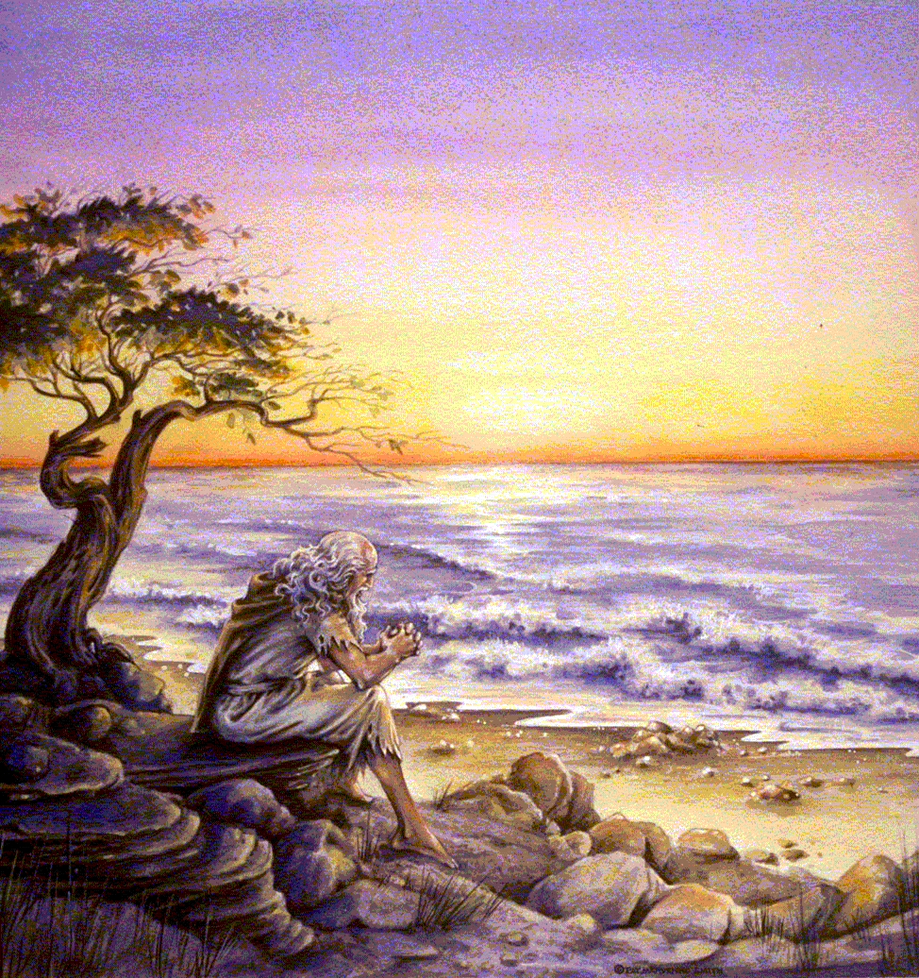
Addressed to the seven branches of the Church in Asia Minor. However, it is not exclusively for them.
Background: Severe persecution against the Saints. Most likely administered by Rome either during the reign of Nero ad 54-68 or Domitian ad 81-96. Domitian persecuted those who did not worship gods approved by the state and many refused and were executed or exiled.
John wrote from a penal colony on the Island of Patmos, where he had been exiled because of his word of God and testimony of Jesus Christ.
The early Church suffered from internal apostasy , a warning from Paul the apostle.

Slide 17
About Revelation:
Same as all scriptures, there will be an eventual triumph on this earth of God over the devil. A permanent victory of good over evil, of the saints over their persecutors, of the kingdom of God over the kingdoms of men and of Satan.
2 sections: a vision of John’s day chapters 1-3, and a vision of the future Chapters 4-22.
Lord reveals to the seven churches their strengths and weaknesses and invites them to prepare for the future by repenting and learning to overcome the world.

Slide 18
Heaven’s Open
John was on the Island of Patmos. It was Sunday. The heavens opened, angelic ministrants attended, voices were heard, and visions were seen.
John was overshadowed by the power of the Holy Ghost.
Prophecy, visions, and revelations come by the power of the Holy Ghost and can only be understood in their fullness and perfection by the power of that same Spirit

Slide 19
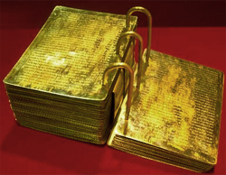
Searching Through Revelation
The Lord expects us to seek wisdom, to ponder his reveled truths, and to gain a knowledge of them by the power of his Spirit.
He has sealed a portion of the Book of Mormon from us because it is beyond our present ability to comprehend.
He has not withheld Revelations because it is not beyond our capacity to comprehend.

Slide 20
Beasts and Plagues
“ I make this broad declaration, that whenever God gives a vision of an image, or beast, or figure of any kind, He always holds Himself responsible to give a revelation or interpretation of the meaning thereof, otherwise we are not responsible or accountable for our belief in it.
Don’t be afraid of being damned for not knowing the meaning of a vision or figure, if God has not given a revelation or interpretation of the subject.”
As we read, seek to understand, and obey the Lord’s words, we will be blessed
(3)

Slide 21
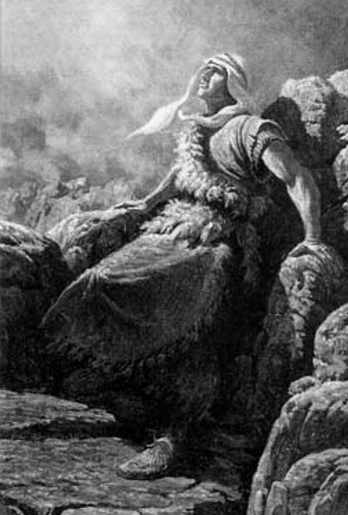
Nephi’s Vision
“And I looked and beheld a man, and he was dressed in a white robe…
…and the angel said unto me: Behold one of the twelve apostles of the Lamb.”
1 Nephi 14:19-20

Slide 22
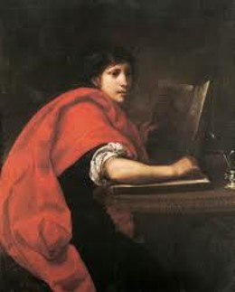
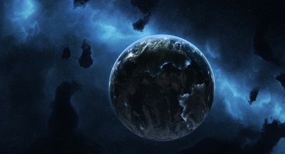
The Prophecy
“Behold, he shall see and write the remainder of these things; yea, and also many things which have been.”
…and he shall also write concerning the end of the world.”
1 Nephi 14:21-22

Slide 23
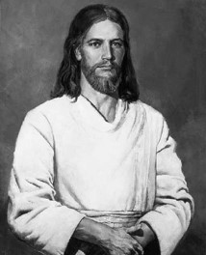
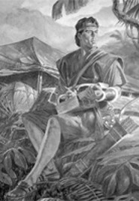
Bearing Record—writing record
“And I, Nephi, heard and bear record, that the name of the apostle of the lamb was John, according to the word of the angel.”
John is commanded by Jesus to “write in a book, and send it unto the seven churches…”
1 Nephi 14:27; Revelation 1:11

Slide 24
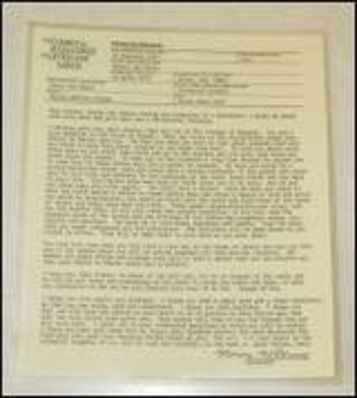
Your Record--Future
Patriarchal blessings are given to worthy members of the Church by ordained patriarchs.
Patriarchal blessings include a declaration of a person's lineage in the house of Israel and contain personal counsel from the Lord.
As a person studies his or her patriarchal blessing and follow the counsel it contains, it will provide guidance, comfort, and protection.

Slide 25
Angel to John
“The Revelation of Jesus Christ, which God gave unto him, to shew unto his servants things which must shortly come to pass; and he sent and signified it by his angel unto his servant John:”
Signified = representing by a sign, mark, or token.
“Blessed is he that readeth, and they that hear the words of this prophecy…
hear the words = study and understand and keep
Revelation 1:1-3

Slide 26
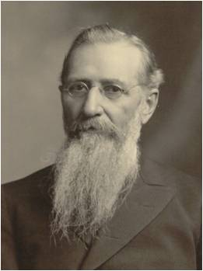
Make You Kings and Priests
The object of our earthly existence is that we may have a fulness of joy, and that we may become the sons and daughters of God, in the fullest sense of the word, being heirs of God and joint heirs with Jesus Christ, to be kings and priests unto God, to inherit glory, dominion, exaltation, thrones and every power and attribute developed and possessed by our Heavenly Father.
This is the object of our being on this earth. In order to attain unto this exalted position, it is necessary that we go through this mortal experience, or probation, by which we may prove ourselves worthy, through the aid of our elder brother Jesus.
(8)
Revelation 1:6; Romans 8:14-17

Slide 27
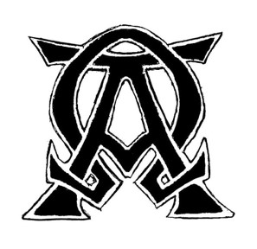
Jesus Christ
“…Grace be unto you, and peace, from him which is, and which was, and which is to come;”
Which is, which was, and which is to come = “I Am”
Read D&C 93
“I am Alpha and Omega, the beginning and the ending…”
“…what thou seest, write in a book, and send it unto the seven churches…”
Revelation 1:4-8, 11

Slide 28
Almighty
“Almighty” is the English translation of the Greek word Pantokrator, which suggests one who rules and regulates all things.
One theme of the book of Revelation is that even though God’s people in all ages face persecution and trouble, God does indeed govern all things and will one day put an end to all evil.
Alpha and Omega
These words, the first and last letters of the Greek alphabet, are used figuratively to teach the timelessness and eternal nature of our Lord’s existence, that is that “from eternity to eternity he is the same, and his years never fail”
(5)
Revelation 1:8; D&C 76:4

Slide 29
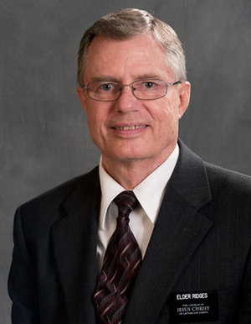
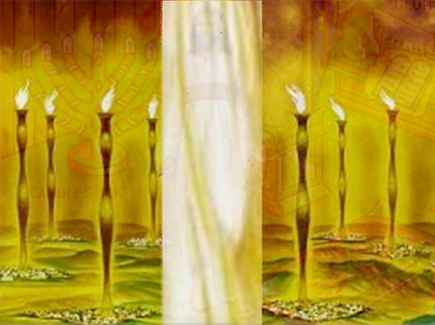
Vision of John
“And I turned to see the voice that spake with me, and being turned, I saw seven gold candlesticks.”
Gold = the best, or true gospel
Candlesticks do not give light, rather, they carry the source of light, which is Christ and His gospel, to the world.
(4)
Revelation 1:12

Slide 30
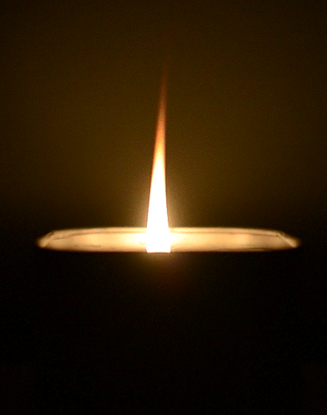
Christ is the Light of the World
“Candlesticks carry light; they do not create it. Their function is to make it available, not to bring it into being.
So by using seven candlesticks to portray the seven churches to whom John is now to give counsel, the Lord is showing that his congregations on earth are to carry his light to the world…
‘Hold up your light that it may shine unto the world. Behold I am the light which ye shall hold up—that which ye have seen me do.’
Revelation 1:12; John 8:12; 3 Nephi 18:24; Matthew 5:14-16
(5)

Slide 31
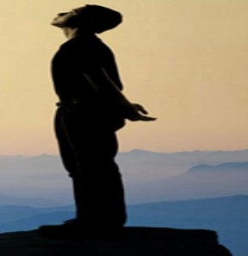
The Savior’s Right Hand
Fear thou not; for I am with thee: be not dismayed; for I am thy God: I will strengthen thee; yea, I will help thee; yea, I will uphold thee with the right hand of my righteousness.
Isaiah 41:10
In Hebrew, one word commonly rendered “south” means literally “right” or “right hand.”
Another word frequently translated as “south” means to face east—or in other words to face God.
In both cases the connotation derives from the fact that when we face east, south is at our right (or covenant) hand. (6)
Revelation 1:16

Slide 32
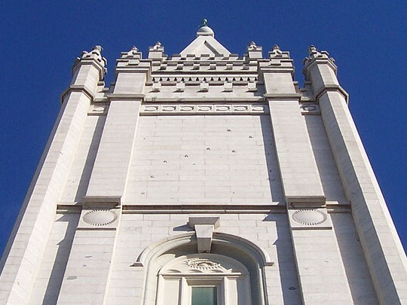
Seven Stars
Stars are the leaders, bishops, of the seven churches
“In the ancient world people used the stars for navigation. People looked to them for direction because they were constant and unchanging.
On the central west tower of the Salt lake Temple, about halfway up, you can see the Big dipper carved into the granite. These stone stars represent the priesthood, who will show us the way, just as we use the Big Dipper to find the North Star.” (7)
Revelation 1:16

Slide 33
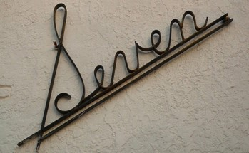
Seven = Completeness, Perfection
Seven Churches
The Seven Seals
The Seven Judgments on Harlots
The Seven Persons
The Seven Vials
The Seven Trumpets

Slide 34
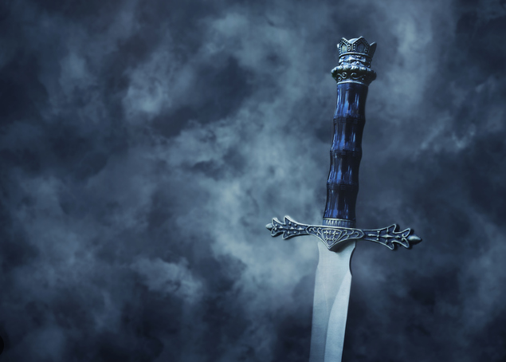
Sharp Two-Edged Sword
One edge is for righteousness—penetrates the soul and moves one into action, testimony, and faithfulness.
Another edge is for the wicked and rebellious.
Revelation 1:16
(7)

Slide 35
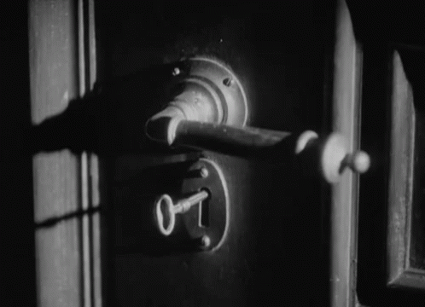
The Keys of Death and Hell
The Key of David
Isaiah used the event as a foreshadowing of the resurrecting power of the coming Messiah, who would hold a key that would open the door to a much higher majesty than the court of David’s descendants.
Death: Death of the body
Hell: Death of the Spirit
The fall of Adam resulted in two deaths.
The resurrection overcomes the first of these two deaths; the atoning blood of Christ's mercy overcomes the second.
Revelation 1:16
(7)

Slide 36
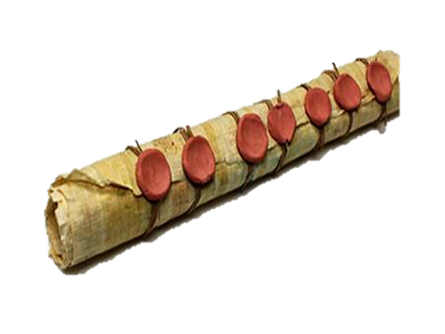
“The message of Revelation is the same as that of all scripture: there will be an eventual triumph on this earth of God over the devil; a permanent victory of good over evil, of the Saints over their persecutors, of the kingdom of God over the kingdoms of men and of Satan” (1)

Slide 37
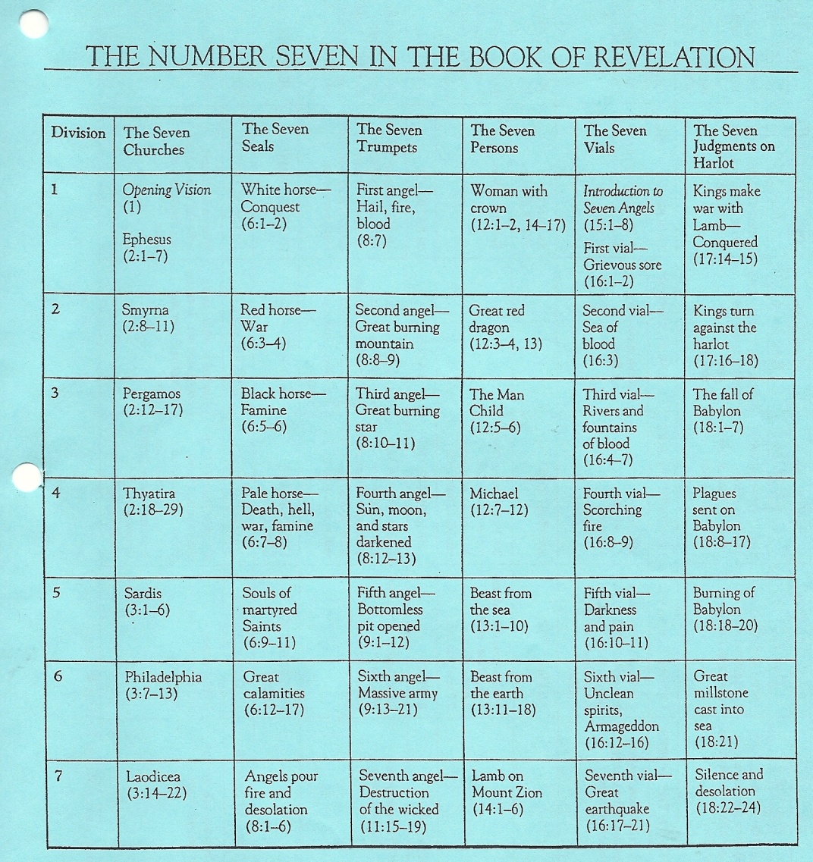
David J. Ridges “The Book of Revelation Made Easier” pg. 12

Slide 38
Sources:
Bible Dictionary
Joseph Fielding Smith---Doc. Of Salvation 1:27
Teachings of the Prophet Joseph Smith p 291
David J. Ridges “The Book of Revelation Made Easier” pg. 12
Elder Bruce R. McConkie Doctrinal New Testament Commentary, 3 vols. [1965–73], 3:442. Alpha and Omega Doctrinal New Testament Commentary [1973], 3:439
Alonzo L. Gaskill, The Lost Language of Symbolism pg. 157--Drinkard, “South” 6:171; Unger, Bible Dictionary, 1041; Myers, Eerdmans Dictionary, 965, Dahood, Psalms III; 288
S. Milchael Wilcox, Who Shall Be Able to Stand? Finding personal Meaning in the Book of Revelation, pg. 23-27
Teachings of Presidents of the Church: Joseph F. Smith [1998], 150
Presentation by ©http://fashionsbylynda.com/blog/

Slide 39
Understanding Revelation:
Book of Revelation deals with things that are to occur after New Testament times, particularly in the last days.
Knowledge of the plan of salvation and of the nature of God’s dealing with men on earth.
Use various latter-day revelations which expand upon the same subjects in similar language. Example: D&C 45 Latter-day plagues and the Second Coming. D&C 76 expands upon the doctrines relative to salvation and exaltation.
Study the sermons of Joseph Smith relative to the book of Revelation.
Use the Inspired Version of the Bible.
Reserve judgment on those things for which no interpretation is given. Avoid being entangled in the specious speculation of an uninspired world.
Seek the Spirit.
Chief Message: That Jesus is Lord of all, that He descended from his Father’s throne to dwell among men, that He worked out the infinite and eternal atonement and has now returned in glory to that throne from whence he came, and that He will raise all men to a kindred glory and a like dominion if they will overcome the world and walk as He walked.
Elder Bruce R. McConkie Sept. 1975 Ensign

Slide 40
Symbols in Revelation 1
SYMBOL | POSSIBLE MEANING
Revelation 1:12—Seven golden candlesticks | Revelation 1:20; 3 Nephi 18:24—
Revelation 1:16–17—The right hand | Mark 16:19—
Revelation 1:16—Seven stars | Joseph Smith Translation, Revelation 1:20 (in Revelation 1:20, footnote b)—
Revelation 1:16—A sharp two-edged sword | Hebrews 4:12—
Revelation 1:18—The keys of hell and death | 2 Nephi 9:10–13—

Slide 41
Symbolism-color
White---purity, righteousness,
exaltation
Black---evil; famine; darkness
Red---sins, bloodshed
Blue---heaven, godliness,
remembering and keeping
God’s commandments
Green---life; nature
Amber---sun, light, divine glory
Scarlet---royalty
Silver---of worth, but less than gold
Gold---the best, exaltation

Slide 42
Symbolism---body parts
Eye---perception, light and knowledge
Head---governing
Ears---obedience, hearing
Mouth---speaking
Hair---modesty, coverage
Members---offices and callings
Heart---inner man, courage
Hands----actions, acting
Right hand---covenant hand, making covenants
Bowels---center of emotion, whole being
Loins---posterity, preparing for action (gird up your loins)
Liver---center of feeling

Slide 43
Symbolism---body parts
Reins---kidneys; center of desires, thoughts
Arm---power
Foot---mobility, foundation
Toe---associated with cleansing rites
Nose---anger
Tongue---speaking
Blood---life of the body
Knee---humility, submission
Shoulder---strength, effort
Forehead---total dedication, loyalty

Slide 44
Symbolism---Numbers
1---Unity, God
3---God, Godhead, a word repeated three time means superlative, “the most”, or the “the best”
4---mankind, earth, (four angels over four parts of the earth)
7---Completeness, perfection. (When man lets God help, it leads to perfection. 4+3=7
Man+God= perfection
10---numerical perfection, well-organized (tithing, Ten Commandments)
12---divine government, God’s organization
40 days---literal, sometimes means “a long time”
Forever---endless, can sometimes be a specific period or age, not endless

Slide 45
Symbolism---Other
Horse---victory, power to conquer
Donkey---peace
Palms---joy, triumph, victory
Wings---power to move, act
Crown---power, dominion, exaltation
Robes---royalty, kings, queens, exaltation

Slide 46
Graphic Symbols
Horizontal Temporal
Vertical Spiritual
Together, the square, Exactness, precision, integrity
Circle Eternity
Equilateral triangle Man looking heavenward
Equilateral triangle God looking earthward
Star of David Man’s covenant relationship with Deity

Slide 47
The Seven Churches
Revelation 2-3
Because Heavenly Father and Jesus Christ know each of us, They can acknowledge our good works and warn us of needed changes

Slide 48
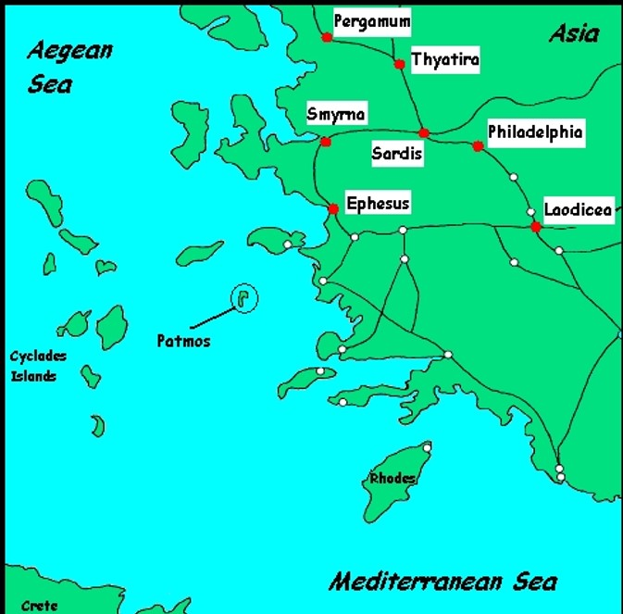

Slide 50
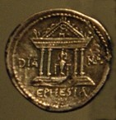
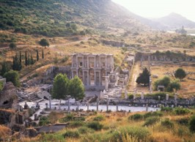
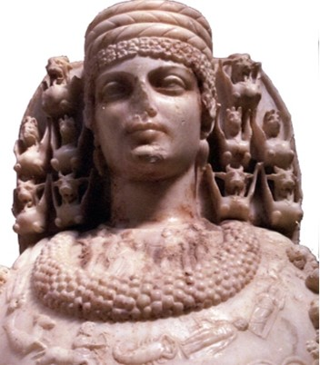
Ephesus: Revelation 2:1-7
The largest city in Asia Minor. It was an import and harbor
and junction for important highways and trade routes. It
was famous throughout the world for its magnificent temple
of Diana, one of the seven wonders of the ancient world.
The temple was the center of the riot in Ephesus involving the apostle Paul. His preaching threatened to destroy the business of the local artisans who made silver models of the temple to sell to tourists and worshippers (Acts 19:23). At the time of Paul, the port was filling with silt from the river Cayster, and, while still a major city, Ephesus was in a state of gradual decline. Ephesus was the center of the Christian church for many years until the center gradually shifted to Rome. The Nicolaitans were a religious group who claimed they could commit sexual sin without punishment because the grace of God would save them.

Slide 51
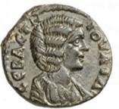
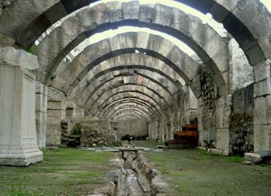
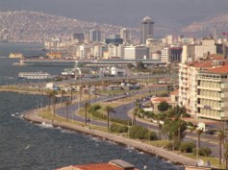
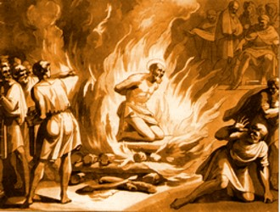
Smyrna Revelation 2:8-10
Called the “Jewel of Asia.” Situated on an excellent harbor
that is still one of the major ports of Turkey (present day
Izmir). Smyrna was an important trade center. It was
destroyed by an earthquake in 627 BC and was rebuilt,
one of the few “planned” cities of the ancient world. Smyrna built a temple to the goddess of Rome and was one of the first and foremost cities to heartily embrace the Imperial Cult or emperor worship. The Saints of Smyrna faced intense persecution and struggled under the burden of poverty. Special encouragement to the servants in Smyrna. It is interesting to note that Polycarp, the Bishop of Smyrna, was martyred when he refused to deny Christ. He was burned at the stake and smitten with a sword as the flames encircled him.

Slide 52
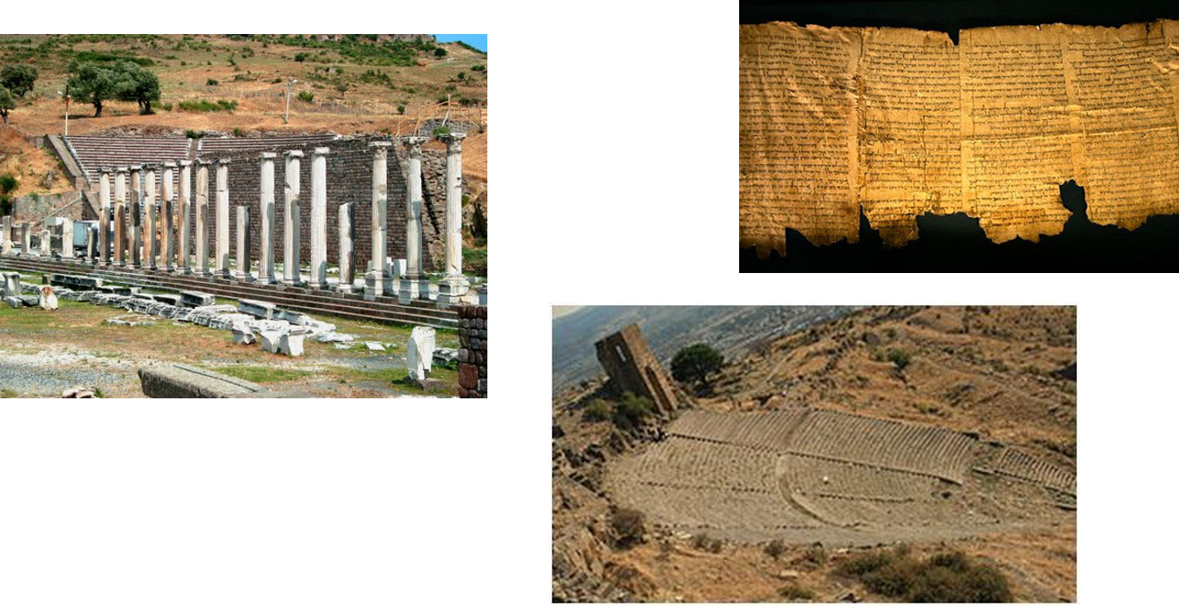
Pergamos Revelation 2:12-17
This city was the provincial capital of Asia, the seat of the proconsul of Rome. Pergamos became a major center for emperor worship and was most famous for its library which housed over 200,000 scrolls. It was also a major center for the worship of the serpent god, whose 3 temples stood in the city. The city was a place of much wickedness. The doctrine of Balaam refers to breaking God’s commandments to satisfy worldly desires or to seek the honors of men.

Slide 53
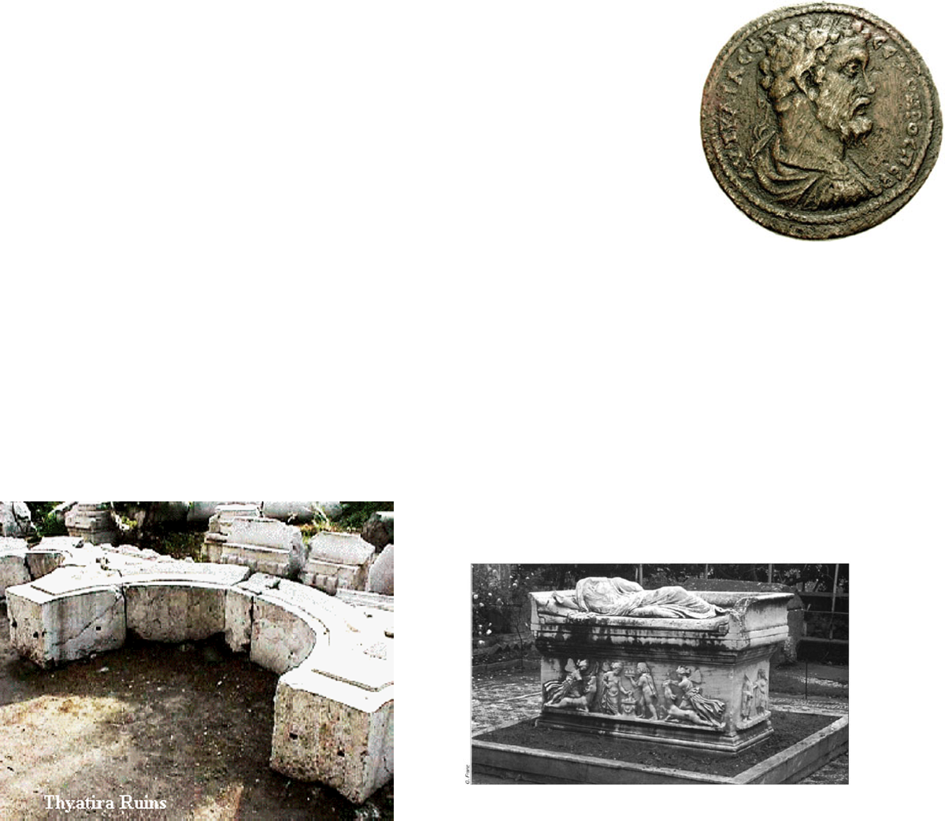
Thyatira Revelation 2:18-29
Even though Thyatira was the smallest of the seven cities,
they received the longest letter. The city was best known as
a center for many craft guilds, including dyeing of wool.
To be a member of one of the many trade guilds, you were
required to participate in the guild banquets. In these banquets, all meat and wine were sacrificed to the particular god associated with that guild. All those in attendance had to eat and drink—honoring their patron---and they were also expected to participate in the other “festivities”, which were often public and sexual in nature. The city was a garrison city. The military spirit was stressed highly and its chief deity, a son-god, was portrayed in attitudes of military prowess.

Slide 54
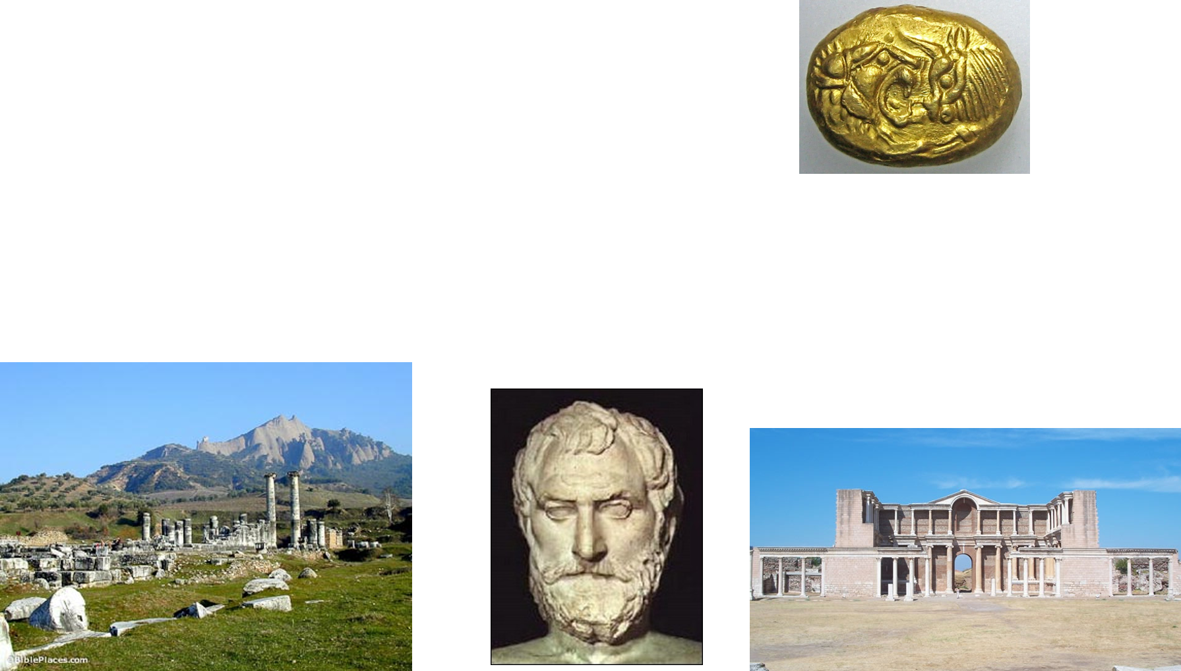
Sardis Revelation 3:1-6
Sardis was located at the crossroads of five major land
routes and was an important inland trade center.
Thales, the first Greek philosopher, was from there.
Built on an impregnable cliff, made Sardis virtually impenetrable to attack.
The river which flowed through the town carried gold dust. It was renowned for its great wealth, and resulting inner softness and corruption. “I know thy works, that thou has a name (a reputation) that thou livest and art (spiritually) dead”

Slide 55
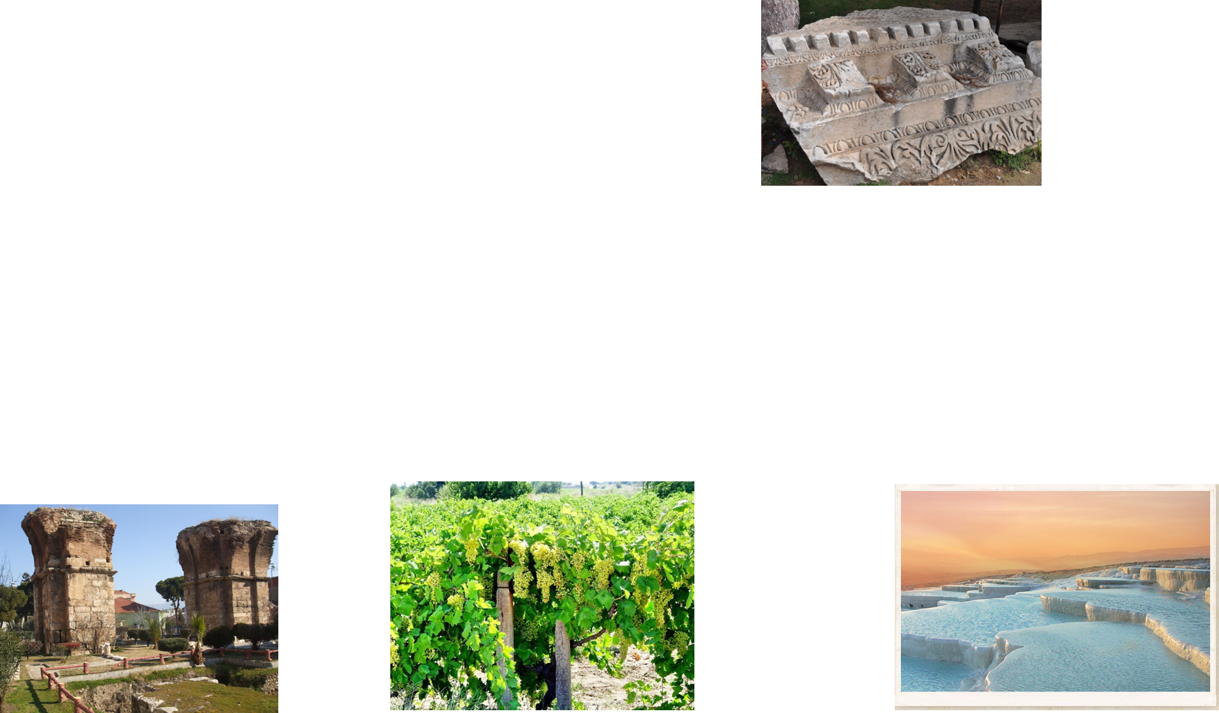
Philadelphia Revelation 3:7-13
Philadelphia was called the “Gateway to the East”
because of its location. Its name means city of brotherly
love. It was in the midst of an active volcanic region and
had several hot springs in the area. It was a city of great
idolatry Bacchus, the god of wine, was the primary god worshiped there, since Philadelphia lay in a rich area of vineyards. The city of Philadelphia was subject to frequent and sever earthquakes. Because of this situation, the people often fled to the open country living in tents or booths. The city was often shattered and the migrations from its ruins were frequent. The citizens lived in constant terror. Christ encouraged His people with the promise that if they were faithful, they would one day enter the New Jerusalem---the city of god, where they could dwell safely and “go no more out.” The message only acknowledges good works.

Slide 56
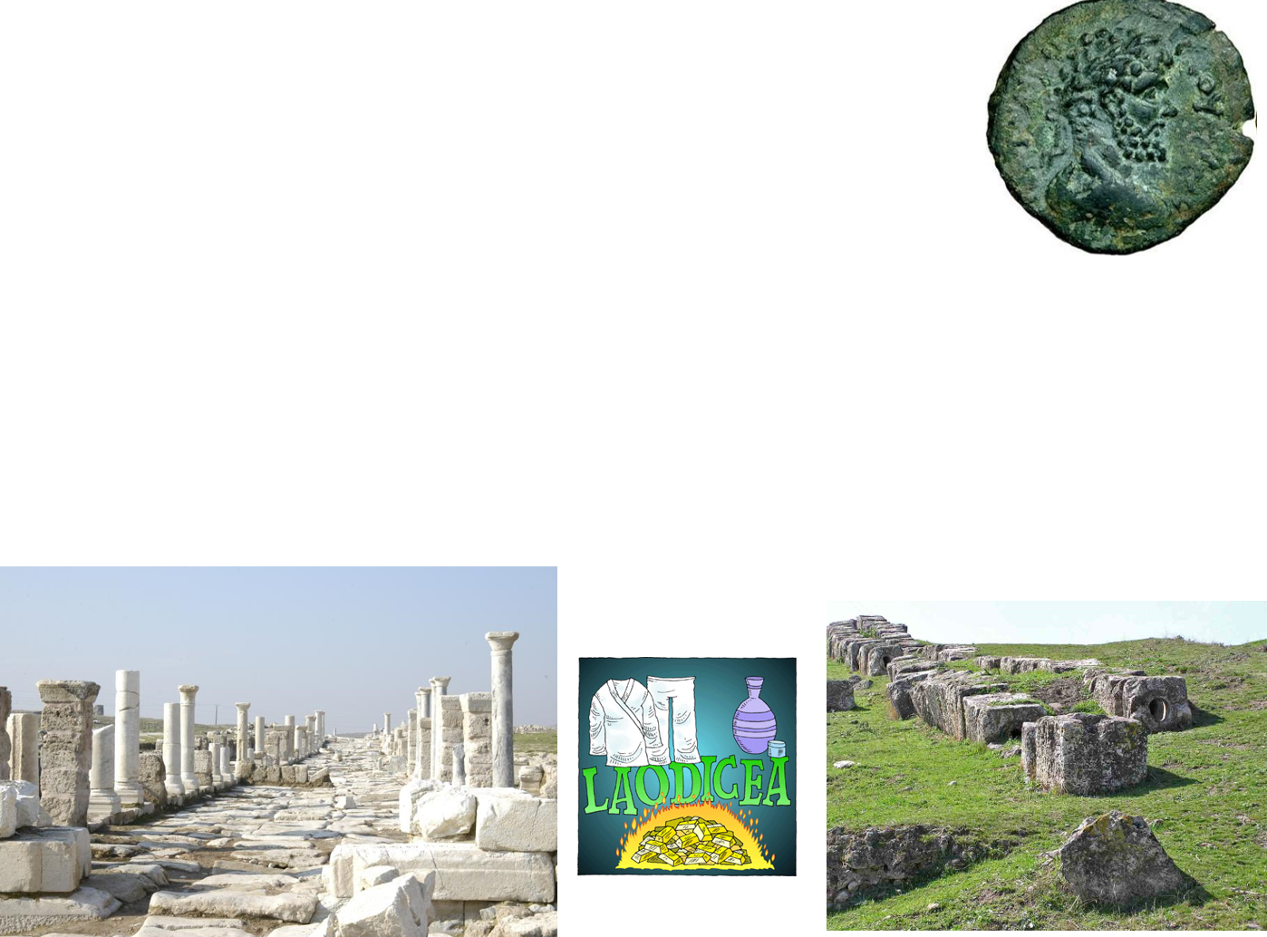
Laodicea Revelation 3:14-21
Laodicea was located at the junction of two important valleys
and three major roads. Is was one of the richest commercial
centers in the ancient world. Laodicea was a center of learning,
art and culture. It was especially noted for its banking, its
manufacture of a unique black wool, and for a medical school that was famous for an eye salve made from Phyrgian stone (3:18). Hot springs, a short distance to the north, and a place of healing, sent steaming waters into the ice-cold streams from nearby mountains. By the time the water mixed and reached the city it was lukewarm. It had a reputation for accommodating itself to all peoples---a melting pot of diversity---a City of Compromise. The message only corrects imperfect works. Lukewarm means to not be fully committed to the gospel of Jesus Christ.

Slide 57
Promises to the Seven Branches of the Church
Eternal life and exaltation in the Celestial Kingdom
Revelation 2-3

Slide 58
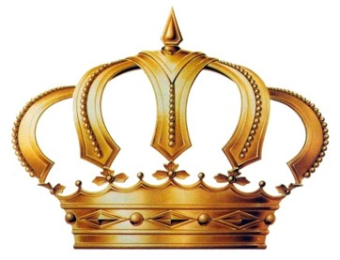
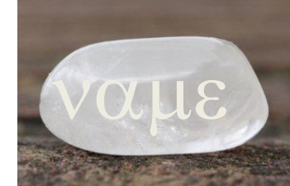
Tree of Life
Revelation 2:7
Crown of Life and promise of ruling
Revelation 2:10
Revelation 2:27
White Stone with a new name
Revelation 2:17
Eternal Life
Revelation 22:2
Blessings in the celestial kingdom of ruling as kings and priests forever
D&C 76:56
Only given to those who obtain the celestial kingdom
D&C 130:10-11

Slide 59
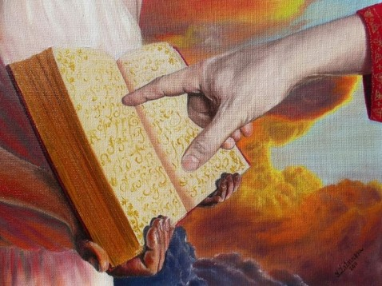
Clothed in white and whose names are written in book of life
Revelation 3:4-5
Name of God written on them are gods themselves
Revelation 3:12
Those who are sanctified and inherit the celestial kingdom
D&C 88:2
The promised blessing of those who are exalted
D&C 76:58

Slide 60
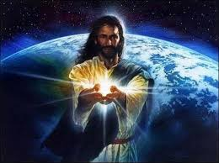
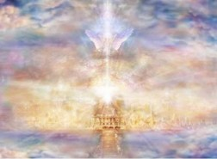
The Morning Star
Revelation 3:14
Sit with Christ on His throne is to be as He is
Revelation 3:21
A Symbol of Jesus Christ
Only given to those who inherit exaltation in the highest degree of the celestial kingdom
D&C 132:20

Slide 61
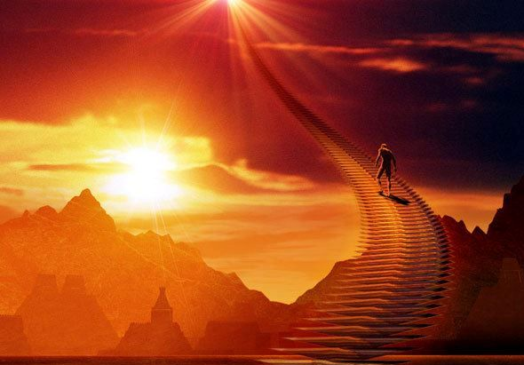
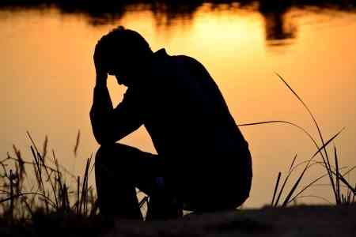
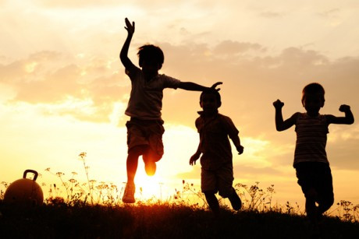
If we overcome, then we can receive the blessings of exaltation
Because the Lord loves us, He corrects us so we will repent
The Lord is merciful, and those who have sinned can obtain eternal life if they will repent

Slide 62
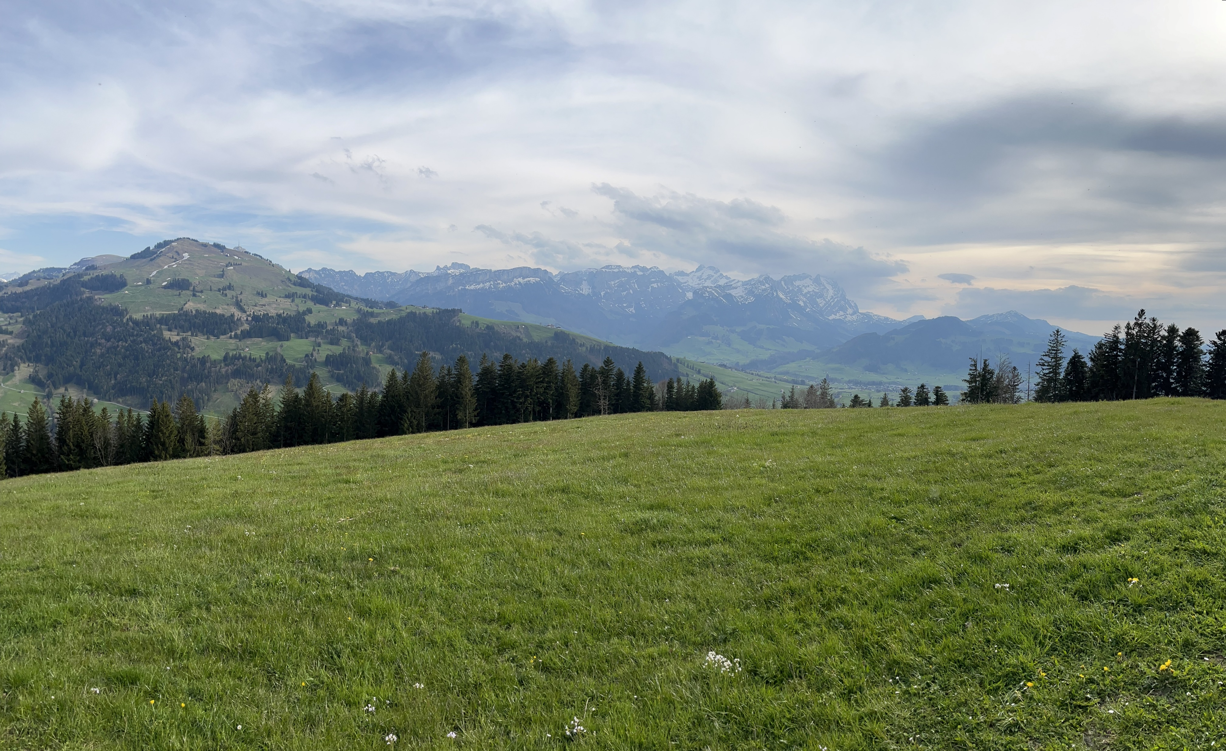
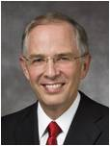
Overcome the World
Is it possible to overcome the world and receive these blessings?
Yes, it is.
Those who overcome the world develop an all-encompassing love for our Lord and Savior, Jesus Christ. …
Overcoming the world is not one defining moment in a lifetime, but a lifetime of moments that define an eternity.
(4)
(2)

Slide 63
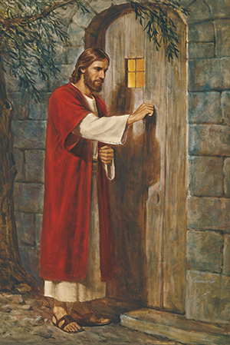
“One day [an artist named Holman Hunt] was showing his picture of ‘Christ Knocking at the Door’ to a friend when the friend suddenly exclaimed: ‘There is one thing wrong about your picture.’
“‘What is it?’ inquired the artist.
“‘The door on which Jesus knocks has no handle,’ replied his friend.
“‘Ah,’ responded Mr. Hunt, ‘that is not a mistake. You see, this is the door to the human heart. It can only be opened from the inside.’
“And thus it is. Jesus may stand and knock, but each of us decides whether to open.”
As we open the door to the Savior, He will come into us and sup with us
Revelation 3:20
(2)

Slide 64
Counsel For Your Own Life
With all the strength of my soul I testify that our Heavenly Father loves each one of us. He hears the prayers of humble hearts; He hears our cries for help. …
His Son, our Savior and Redeemer, speaks to each of us today: “Behold, I stand at the door, and knock: if any man hear my voice, and open the door, I will come in to him”.
Will we listen for that knock? Will we hear that voice? Will we open that door to the Lord, that we may receive the help He is so ready to provide? I pray that we will.
(3)
Revelation 3:20

Slide 65
Sources:
Taken from Poway Institute Handouts by Lesly Meachum and Becky Davies
President Spencer W. Kimball (The Miracle of Forgiveness [1969], 212).
Thomas S. Monson, “Mrs. Patton—the Story Continues,” Ensign or Liahona, Nov. 2007, 24)
Neil L. Andersen, “Overcoming the World,” Ensign or Liahona, May 2017, 59
See Article Jay M. Todd, "The Seven Cities of Revelation ," Ensign, August 1976
Presentation by ©http://fashionsbylynda.com/blog/

Slide 66
“First Love” Revelation 2:4
The Saints in Ephesus were being chastened for neglecting the commandment to love God
Hidden Manna and White Stone Revelation 2:17:
“The Lord provided life-sustaining manna for the children of Israel to eat during their 40-year sojourn in the wilderness (see Exodus 16:15, 35). Just as the manna sustained physical life, Jesus Christ is the ‘bread of life’ that sustains spiritual life (John 6:35, 48). The ‘hidden manna’ mentioned in Revelation 2:17 refers to Jesus Christ. Jesus is ‘hidden’ from the wicked. But, as He taught in John 6, those who symbolically partake of His flesh will receive everlasting life (see John 6:47–58). …
“… For revealed insight into the meaning of the white stone, see Doctrine and Covenants 130:8–11” (New Testament Student Manual [Church Educational System manual, 2014], 535).
Poverty and Riches Revelation 2:9
The Savior was acknowledging the faith of the Saints in Smyrna and reassuring them of the eternal riches promised to those who keep His commandments
“Revelation 2:11 teaches that the faithful ‘shall not be hurt of the second death.’ The wicked, however, ‘shall have their part in the lake which burneth with fire and brimstone: which is the second death’ (Revelation 21:8). While serving in the Presidency of the Seventy, Elder Earl C. Tingey explained that ‘the second death is spiritual. It is separation from God’s presence’” (‘The Great Plan of Happiness,’ Ensign or Liahona, May 2006, 73).
“In one sense, we all experienced a spiritual death when we left God’s presence to come to earth. This initial separation, however, is not the ‘second death’ mentioned in Revelation 2:11. Through the Atonement of Jesus Christ, all of God’s children will overcome this initial spiritual death and be brought back to God’s presence to be judged (see Helaman 14:16–17), after which most people will inherit a kingdom of glory. A second spiritual death will be pronounced at the Day of Judgment upon those who refuse to repent of their sins and who willfully rebel against the light and truth of the gospel, as Satan did [see D&C 29:44–45; Guide to the Scriptures, ‘Death, Spiritual,’ scriptures.lds.org]. They will be forever separated from God and will be sons of perdition (see D&C 76:30–37, 44)” (New Testament Student Manual [Church Educational System manual, 2014], 534)
The Morning Star Revelation 2:28:
“‘The morning star’ is a symbol of Jesus Christ (Revelation 2:28; 22:16). The promise of ‘the morning star’ is given to him ‘that overcometh, and keepeth my works unto the end’ (Revelation 2:26)” (New Testament Student Manual [Church Educational System manual, 2014], 535).
Amen Revelation 3:14:
“In Hebrew and Greek the word ‘amen’ means truly, certainly, or faithfully. In Revelation 3:14, Christ’s faithfulness and truthfulness as the great ‘Amen’ are presented as a contrast to the lukewarm attitudes of the Laodiceans. When uttered at the conclusion of a prayer or a discourse, ‘amen’ is a way of solemnly affirming what has been said or expressing agreement with it. Elder Bruce R. McConkie taught that the Savior’s title ‘Amen’ also shows ‘that it is in and through him that the seal of divine affirmation is placed on all the promises of the Father’ (Mormon Doctrine, 2nd ed. [1966], 32)” (New Testament Student Manual [Church Educational System manual, 2014], 536).
Balaam Revelation 2:14:
“Balaam was an Old Testament prophet, whose actions are recorded in Numbers 22–24; 31:16. He appeared at first to be true to the Lord and His people, repeatedly refusing Balak’s request to curse Israel. Nevertheless, Balaam eventually succumbed to Balak’s offer of riches and taught Balak how to cause the army of Israel to weaken themselves through sexual sin and idolatry (see Numbers 25:1–5; 31:13–16). The plan included having Moabite women seduce the men of Israel and persuade them to offer sacrifices to heathen gods, thus destroying them spiritually” (New Testament Student Manual[Church Educational System manual, 2014], 534).

Slide 67
A Vision of the Future
Revelation 4-5

Slide 68
Come Up Hither
John sees a door open in heaven and is invited to “Come up Hither”
(JST: open into Heaven)
Revelation 4:1

Slide 69
The Throne of God
Jasper and sardine stone=hard, deep orange-red—look on with awe
Rainbow=glory and beauty, mercy and Covenant
See Book of Abraham Facsimile 2, fig. 3
Revelation 4:3

Slide 70
Heavenly Images Described by Ezekiel
A throne, as the appearance of a sapphire stone: and upon the likeness of the throne was the likeness as the appearance of a man above upon it.
And I saw as the colour of amber, as the appearance of fire round about within it, from the appearance of his loins even upward, and from the appearance of his loins even downward, I saw as it were the appearance of fire, and it had brightness round about.
As the appearance of the bow that is in the cloud in the day of rain, so was the appearance of the brightness round about. This was the appearance of the likeness of the glory of the Lord. And when I saw it, I fell upon my face, and I heard a voice of one that spake.
Revelation 4:3; Ezekiel 1:26-28

Slide 71
A Rainbow
A Rainbow is a result of sunlight passing through raindrops. Each raindrop acts as a prism to bend the light which produces the colors. They always appear in this order: red, orange, yellow, green, blue, purple and violet.
Light and water are scriptural symbols of revelation.
God’s mercy and covenants come through revelation to man, not to be taken from the earth until Christ comes.
(2)

Slide 72
Four and twenty Seats = thrones, symbolic of royalty—twenty four elders
Multiple of 12 suggests fullness
12 Patriarchs of the 12 tribes of Israel and 12 Apostles
Revelation 4:4; D&C 77

Slide 73
Lightnings and Thunderings and Voices
7 lamps of burning fire=
7 Spirits of God=
7 leaders of
7 wards
Revelation 4:5

Slide 74
Sea of Glass
Crystal=beauty, purity, clarity=transparent, nothing hidden
(Urim and Thummin)
The earth in its celestial glory
Revelation 4:6 and D&C 77:1

Slide 75
4 beasts—all the energy emulating from God
Lion—King, predator, wild, strength=Mark
Eagle---dignified, birds, might=John
Calf—docile, friendly, domestic, heart=Luke
Man—Thought, highest order, mind=Matthew
(3)
D&C 77:2

Slide 76
Beasts have Spirits and will dwell in eternal felicity
Power to Move and Act
6 wings—movement and power
Full of eyes within---full of light and knowledge
Revelation 4:8 and D&C 77:4

Slide 77
Wings
The Prophet Jeremiah uses wings as an image of power swooping down upon Moab and Bozrah (Jeremiah 48:40)
In Isaiah there is a similar image regarding Judah (Isaiah 8:8)
“More often than not, ancient and modern iconography depicts heavenly beings as possessing wings. This image is purely symbolic, however, for “an angel of God never has wings.”
(Joseph Smith)
(4)
Revelation 4:8

Slide 78
Six
Heavenly creatures have 6 wings:
Six = symbol of incomplete
“It may be a representation of their (the beasts) interim state as celestial heirs awaiting resurrection, which may explain the sense in which they are “incomplete”
Revelation 4:8
(4)

Slide 79
The Power of Wings
“Upon the wings of his Spirit hath my body been carried away upon exceedingly high mountains.”
(2 Nephi 4:25)
The power of the Holy Ghost
“…healing in his wings…” Malachi 4:2
2 Nephi 25:13
3 Nephi 25:2
An image of His power over death and the blessing that awaits all people because of that power.
Revelation 4:8
(4)

Slide 80
Praises To God and The Lamb
“Thou art worthy, O Lord, to receive glory and honour and power: for thou hast created all things, and for thy pleasure according to thy will they are and were created.”
God’s Work
Begets children
Creates worlds
Exalts them
As we recognize Heavenly Father’s greatness, we desire to worship and praise Him
Revelation 4:9

Slide 81
Casting Their Crowns
24 elders show their humility, submission, and respect to the Father and His authority
Before the throne—
Consecrating their stewardship
Revelation 4:10
(5)

Slide 82
Temporal existence of earth
Revelation 5

Slide 83
Revelation 5
What was contained in the book described in Revelation 5:1?
How long is the earth’s temporal existence?
Who was the only one who could open and read the book in Revelation 5:5?
What number did Joseph Smith change in Revelation 5:6?
Who did the spirits of God in Revelation 5:6 represent?
Were the 4 beasts in Revelation 5:8 actual animals? See also Revelation 4:8
The “will, mysteries, and the works of God” concerning the earth during its temporal existence (D&C 77:6)
7,000 years (D&C 77:6)
Jesus Christ (Revelation 22:16)
The number 7 to 12 (JST Revelation 5:6)
The Twelve Apostles (JST Revelation 5:6)
Yes, though John describes them figuratively (D&C 77:2-4)

Slide 84
Why was Jesus Christ able to open the sealed book?
How many angels did John see shouting praises to the Lamb? See Revelation 5:11
Who else praised Him?
Because of His atoning sacrifice (Revelation 5:9)
“Ten thousand times ten thousand, and thousands of thousands” (Revelation 5:11)

Slide 85
The Right Hand = Covenant hand
Revelation 5:1

Slide 86
Seven Seals
In ancient times, important documents were sealed with clay or wax seals. Only the owner of the document and those whom the owner authorized were allowed to break the seals and read the text
“And when I looked, behold, an hand was sent unto me; and , lo, a roll of a book was therein;
And he spread it before me; and it was written within and without…”
"The document is sealed with seven seals. The use of seals was common during ancient times to prevent adulteration of important papers and, more importantly, to prove their authenticity.
The verb sphragiz, to provide with a seal, carried the idea of assured content and authenticity. But the idea of ownership was important because the owner protected the document. In John's day, seals carried the mark of the owner who guaranteed the contents and was responsible for carrying out the agreements, if any, contained therein." (6)
Revelation 5:1-4; Ezekiel 2:9-10

Slide 87
Weep Not
Christ is the Lion of the tribe of Juda
The root of David- providing lifesaving water and nourishment.
A Lamb---Christ
Who is worthy to open the book?—no man
When Father Jacob gave Judah his patriarchal blessing, Judah was likened both to a lion's whelp and to an old lion and was promised that the sceptre should not depart from his descendants until the coming of Christ.
Accordingly, to denominate our Lord as the Lion of the Tribe of Judah is to point to his position as a descendant of Judah, to his membership in that tribe from which kings were chosen to reign, and also to show his status as the most pre-eminent of all that house. (7)
Revelation 5:5-6; Genesis 49:8-12

Slide 88
12 Eyes and Horns
The twelve servants are the apostles of the Lamb. Their eyes are a representation of light and knowledge.
Their horns are likely a representation of their strength in fighting the dragon as they are "sent forth into all the earth."
The Number 12 symbolizes complete
Revelation 5:6; D&C 77:4

Slide 89
“vials full of odours” = wide cups or bowls full of incense.
In the tabernacle of Moses and the temple of Solomon, there was an altar of incense made of gold. Upon it sat the candlestick (candelabra) and an altar for offering incense.
Every morning, when the candlestick was dressed and every evening when the lamps were lit, sweet incense was burned to the Lord.
The smoke of the incense rising up to heaven was symbolic of the prayers of his people ascending to God. King David's petition was, "Let my prayer be set forth before thee as incense."
Similarly, the golden vials full of sweet odors are a similitude of the prayers of the saints of God. It would seem that the prayers of the righteous are the perfume of heaven.
Jesus Christ is the only one who is worthy and able to redeem us
Revelation 5:8; Exodus 30:7-8; 40:4-6; Psalms 141:2

Slide 90
Praising in Song
“And they sung a new song, saying, Thou art worth to take the book, and open the seals thereof: for thou wast slain, and hast redeemed us to God by the blood out of every Kindred, and tongue, and people, and nation;”
Revelation 5:9

Slide 91
Gratitude Unto the Lamb
“And every creature which is in heaven, and on the earth, and under the earth, and such as are in the sea, and all that are in them, heard I saying, Blessing, and honour, and glory, and power, be unto him that sitteth upon the throne, and unto the lamb for ever and ever.
As we recognize and feel gratitude for what Heavenly Father and Jesus Christ have done for us, we desire to worship and praise Them
Revelation 5:13

Slide 92
When we worship God, we approach Him with reverent love, humility, and adoration.
We acknowledge and accept Him as our sovereign King, the Creator of the universe, our beloved and infinitely loving Father.
We respect and revere Him.
We submit ourselves to Him.
We lift our hearts in mighty prayer, cherish His word, rejoice in His grace, and commit to follow Him with dedicated loyalty. …
When we worship, our hearts are drawn out in praise to our blessed God morning, noon, and night.
We hallow and honor Him continually—in our meetinghouses, homes, temples, and all our labors.
When we worship, we open our hearts to the healing power of the Atonement of Jesus Christ.
Our lives become the token and expression of our worship.
(8)

Slide 93
“True and perfect worship consists in following in the steps of the Son of God; it consists in keeping the commandments and obeying the will of the Father to that degree that we advance from grace to grace until we are glorified in Christ as he is in his Father.
It is far more than prayer and sermon and song. It is living and doing and obeying. It is emulating the life of the great Exemplar.”
(7)

Slide 94
Sources:
Taken from Poway Institute Handouts by Lesly Meacham and Becky Davies
Words of Joseph Smith page 211---rainbow
Smith, Hyrum M. Smith and Janne M. Sjodahl D&C Commentary pg. 473
“The Lost Language of Symbolism” Alonzo L. Gaskill
“The Book of Revelation Made Easier” David J. Ridges
Richard D. Draper, Opening the Seven Seals: The Visions of John the Revelator [Salt Lake City: Deseret Book Co., 1991], 53.
Elder Bruce R. McConkie (Mormon Doctrine, 2d ed. [Salt Lake City: Bookcraft, 1966], 449.); How to Worship,” Ensign, Dec. 1971, 130
Dean M. Davies, “The Blessings of Worship,” Ensign or Liahona, Nov. 2016, 94–95
Presentation by ©http://fashionsbylynda.com/blog/

Slide 95
Vision of Heaven Revelation 4:1:
Now, I make this declaration, that those things which John saw in heaven had no allusion to anything that had been on the earth previous to that time, because they were the representation of "things which must shortly come to pass," and not of what has already transpired. John saw beasts that had to do with things on the earth, but not in past ages... The revelations do not give us to understand anything of the past in relation to the kingdom of God. What John saw and speaks of were things which he saw in heaven; those which Daniel saw were on and pertaining to the earth. (Discourses of the Prophet Joseph Smith, compiled by Alma P. Burton [Salt Lake City: Deseret Book Co., 1977], 248.)
Beast of Beast Rev. 4:6-8: The prophets do not declare that they saw a beast or beasts, but that they saw the image or figure of a beast. Daniel did not see an actual bear or a lion, but the images or figures of those beasts. The translation should have been rendered "image" instead of "beast," in every instance where beasts are mentioned by the prophets. But John saw the actual beast in heaven, showing to John that beasts did actually exist there, and not to represent figures of things on the earth. When the prophets speak of seeing beasts in their visions, they mean that they saw the images, they being types to represent certain things. At the same time, they received the interpretation as to what those images or types were designed to represent.
I make this broad declaration, that whenever God gives a vision of an image, or beast, or figure of any kind, He always holds Himself responsible to give a revelation or interpretation of the meaning thereof, otherwise we are not responsible or accountable for our belief in it. Don't be afraid of being damned for not knowing the meaning of a vision or figure, if God has not given a revelation or interpretation of the subject.
John saw curious looking beasts in heaven; he saw every creature that was in heaven,-all the beasts, fowls and fish in heaven,-actually there, giving glory to God. How do you prove it? (See Rev. 5:13.) "And every creature which is in heaven, and on the earth, and under the earth, and such as are in the sea, and all that are in them, heard I saying, Blessing, and honor, and glory, and power, be unto Him that sitteth upon the throne, and unto the Lamb for ever and ever.“
I suppose John saw beings there of a thousand forms, that had been saved from ten thousand times ten thousand earths like this,-strange beasts of which we have no conception: all might be seen in heaven. The grand secret was to show John what there was in heaven. John learned that God glorified Himself by saving all that His hands had made, whether beasts, fowls, fishes or men; and He will glorify Himself with them.
Says one, "I cannot believe in the salvation of beasts." Any man who would tell you that this could not be, would tell you that the revelations are not true. John heard the words of the beasts giving glory to God and understood them. God who made the beasts could understand every language spoken by them. The four beasts were four of the most noble animals that had filled the measure of their creation, and had been saved from other worlds, because they were perfect: they were like angels in their sphere. We are not told where they came from, and I do not know; but they were seen and heard by John praising and glorifying God...
Again, there is no revelation to prove that things do not exist in heaven as I have set forth, nor yet to show that the beasts meant anything but beasts; and we never can comprehend the things of God and of heaven, but by revelation. We may spiritualize and express opinions to all eternity; but that is no authority. (Teachings of the Prophet Joseph Smith, selected and arranged by Joseph Fielding Smith [Salt Lake City: Deseret Book Co., 1976], 291-292)
The Gems Revelation 4:3:
John described glory of the Lord as jasper green and the deep orange-red color of sardine stone. Ezekiel saw the glory of the Lord as the "colour of amber" and the "appearance of fire" sitting upon a sapphire blue throne. Ezekiel said the glory emanating from the throne was in the shape of a rainbow; John tells us the rainbow was emerald green in color. "John does not give us a prismatic bow; it shimmers of but one hue, green, suggesting that life overarches all God is and all He does." (Richard D. Draper, Opening the Seven Seals: The Visions of John the Revelator [Salt Lake City: Deseret Book Co., 1991], 45.)
All four precious gems mentioned by these prophets were contained in the breastplate which the High Priest wore in ancient days. Sardius, emerald, sapphire, and jasper were four of the twelve precious gems inset into the breastplate (Ex. 28:17-20). Anciently, the breastplate was to be used with the Urim and Thummim. The heavenly representation of the Urim and Thummim is the "sea of glass like unto crystal" which was before the throne (Rev. 4:6, D&C 130:7-9). Thus, anciently, when a seer wore the breastplate and used the Urim and Thummim, the colors of God's throne sat upon his breast as he looked into the Urim and Thummim, like the sea of glass before the throne, "where all things...are manifest, past, present, and future." (D&C 130:7)
24 Elders Revelation 4:4
It is worthy of note that these [righteous] persons who are sitting with God on his throne are elders: not seventies, not high priests, not patriarchs, not apostles, but elders-than which there is no more important priesthood in God's earthly kingdom. Indeed, every elder who magnifies his calling as an elder has the immutable promise of the Father, guaranteed by his personal oath, that he shall gain all that the Father hath, which is eternal life, which is godhood, which is to sit with him on his throne. Elder Bruce R. McConkie (Doctrinal New Testament Commentary, 3 vols. [Salt Lake City: Bookcraft, 1965-1973], 3: 466.)

Slide 96
Joseph Smith – D&C 77:2-3
Paul understood that in the resurrection, there would be different classes of creatures to be resurrected. He said, "All flesh is not the same flesh: but there is one kind of flesh of men, another flesh of beasts, another of fishes, and another of birds." (1 Cor. 15:39) The same principle is here taught by John. He sees four individual beasts each representing their class of beings. The lion, the eagle, etc. are the most noble and glorious of their class of beings and are therefore representative.
Description of Beast (Rev. 4:7) | Representative class (D&C 77:3)
The first beast was like a lion | Beasts, primarily mammals
The second beast [was] like a calf | Creeping things
The third beast had a face as a man | Man
The fourth beast was like a flying eagle | Fowls of the air
Immediately, we see the incongruity of a calf being used to represent creeping things. The lion rules among the beasts of the forest, the eagle soars above the fowls of the air, man is given dominion over all the animals, and the calf is out of place among the creeping things. The term calf usually refers to a young cow. Occasionally, it may refer to the young of other animals but not to any class of animals which creep upon the ground. Probably, it is a mistranslation. More consistent would be the most powerful and noble of all reptiles and snakes. However, the student should be aware that Ezekiel also described four beasts. Each had faces of different creatures: man, lion, ox, and eagle (Ezek. 1:10). Neither Ezekiel's ox nor John's calf make sense as representing a class of creatures which creep upon the ground, but the principle is still instructive.
John saw curious looking beasts in heaven; he saw every creature that was in heaven,-all the beasts, fowls and fish in heaven,-actually there, giving glory to God. How do you prove it? (See Rev. 5:13.) "And every creature which is in heaven, and on the earth, and under the earth, and such as are in the sea, and all that are in them, heard I saying, Blessing, and honor, and glory, and power, be unto Him that sitteth upon the throne, and unto the Lamb for ever and ever."
John learned that God glorified Himself by saving all that His hands had made, whether beasts, fowls, fishes or men; and He will glorify Himself with them.
...John heard the words of the beasts giving glory to God, and understood them. God who made the beasts could understand every language spoken by them. The four beasts were four of the most noble animals that had filled the measure of their creation, and had been saved from other worlds, because they were perfect: they were like angels in their sphere. We are not told where they came from, and I do not know; but they were seen and heard by John praising and glorifying God. (Teachings of the Prophet Joseph Smith, selected and arranged by Joseph Fielding Smith [Salt Lake City: Deseret Book Co., 1976], 291-292)

Slide 97
Revelation 4
WHAT JOHN SAW | CROSS-REFERENCE | ADDITIONAL INFORMATION
Throne (Revelation 4:2–3) | Doctrine and Covenants 137:1–4
Twenty-four elders with crowns (Revelation 4:4) | Doctrine and Covenants 77:5
Seven Spirits of God (Revelation 4:5) | Joseph Smith Translation, Revelation 4:5 (in Revelation 4:5, footnote a)
Sea of glass (Revelation 4:6) | Doctrine and Covenants 77:1; 130:6–9
Four beasts (Revelation 4:6–7) | Doctrine and Covenants 77:2–3
Beasts’ many eyes and six wings (Revelation 4:8) | Doctrine and Covenants 77:4
Revelation 4
WHAT JOHN SAW | CROSS-REFERENCE | ADDITIONAL INFORMATION
Throne (Revelation 4:2–3) | Doctrine and Covenants 137:1–4
Twenty-four elders with crowns (Revelation 4:4) | Doctrine and Covenants 77:5
Seven Spirits of God (Revelation 4:5) | Joseph Smith Translation, Revelation 4:5 (in Revelation 4:5, footnote a)
Sea of glass (Revelation 4:6) | Doctrine and Covenants 77:1; 130:6–9
Four beasts (Revelation 4:6–7) | Doctrine and Covenants 77:2–3
Beasts’ many eyes and six wings (Revelation 4:8) | Doctrine and Covenants 77:4

