Slide 2
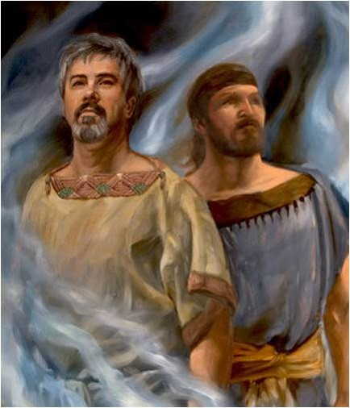
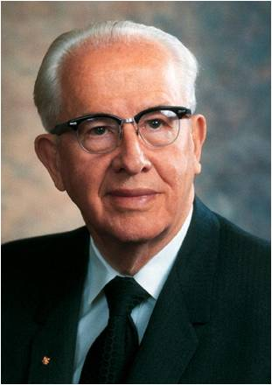
Hardness of the Heart
Laman and Lemuel dispute over the words their father had said about his dream
Dispute
Noun --A disagreement, argument, or debate.
Verb --Argue about (something); discuss heatedly:
“One of Satan’s greatest tools is pride: to cause a man or a woman to center so much attention on self that he or she becomes insensitive to his Creator or fellow beings. It is a case for discontent, divorce, teenage rebellion, family indebtedness, and most other problems we face.”
Ezra Taft Benson
If we harden our hearts and do not look to the Lord, then we will struggle to understand spiritual truth
1 Nephi 15:2

Slide 3
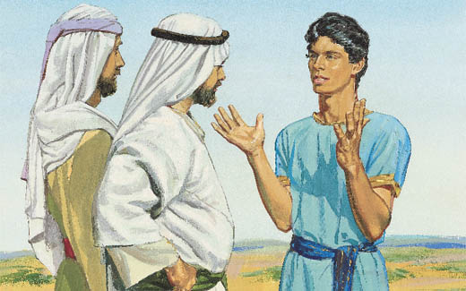
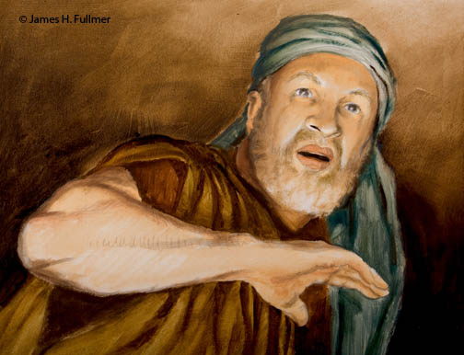
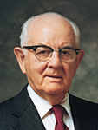
Inquired of the Lord
Nephi asks his brother if they had prayed.
Brother of Jared (Ether 2:14)
“…and chastened him because he remembered not to call upon the name of the Lord.”
“…The effectual fervent prayer of a righteous man availeth much.”
(James 5:16)
“…Prayer is an armor of protection against temptation and I promise you that if you will teach your children to pray, fervently and full of faith, many of your problems are solved before they begin.”
Spencer W. Kimball
1 Nephi 15:8

Slide 4
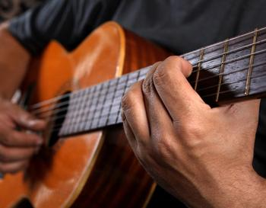
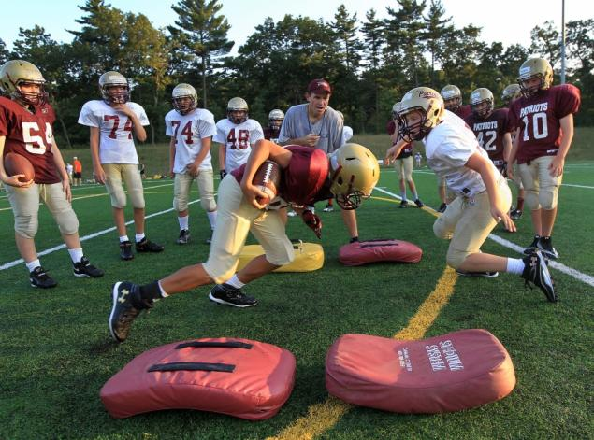
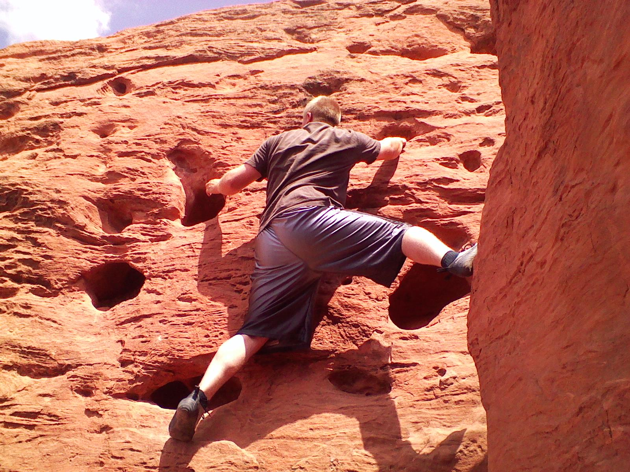
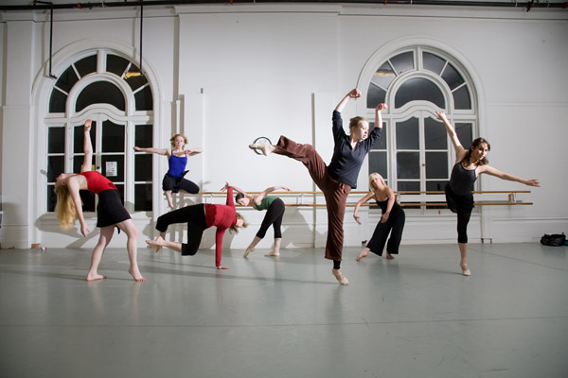
Effort and Results
In order to get the results of something you want to do you must put forth the effort
In order to receive revelation you must put forth the effort through prayer
“…they had given themselves to much prayer, and fasting; therefore they had the spirit of prophecy, and the spirit of revelation…”
Alma 17:3

Slide 5
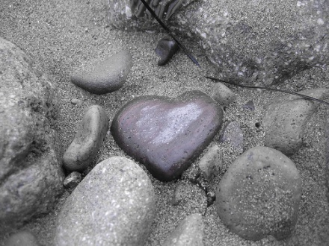
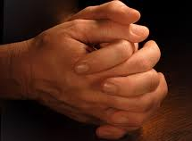
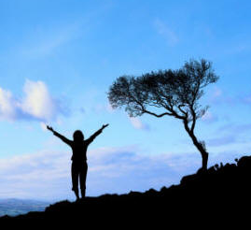
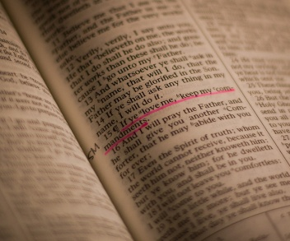
Understanding and Counsel
Because Laman and Lemuel had not asked of these things they did not understand. They had not put forth the effort.
Counsel Nephi gave his brothers:
not harden their hearts
to ask in faith
to believe that they would receive an answer
to be diligent in keeping the commandments
If we do not harden our hearts and we ask the Lord in faith and keep His commandments, then we will receive answers and understanding from Him
1 Nephi 15:9-11

Slide 6
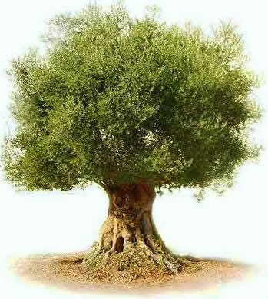
The Olive Tree
Olive Tree---Emblem of peace and purity—used in ancient Israel representing Israel or the Church and Kingdom of God
READ
Jacob 5:3
1 Nephi 15:12

Slide 7
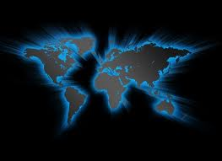
Cutting Off and Grafting
Lehi and Ishmael were of the house of Israel. They left and cut themselves off of that branch, taking what they knew with them and also the plates of Laban. Later their branch will be grafted in when the Gentiles (Joseph Smith and the restoration) will bring the truth of the gospel to the remnants of Lehi’s seed.
Grafting in of natural branches—After this branch is planted in the Americas it will grow wild for many generations.
Even after Christ’s visit to the Nephites they would dwindle in unbelief and the gospel taken from them.
--TSM
1 Nephi 15:13

Slide 8
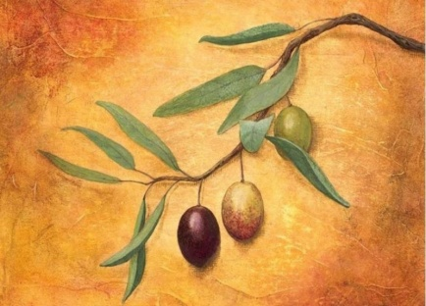
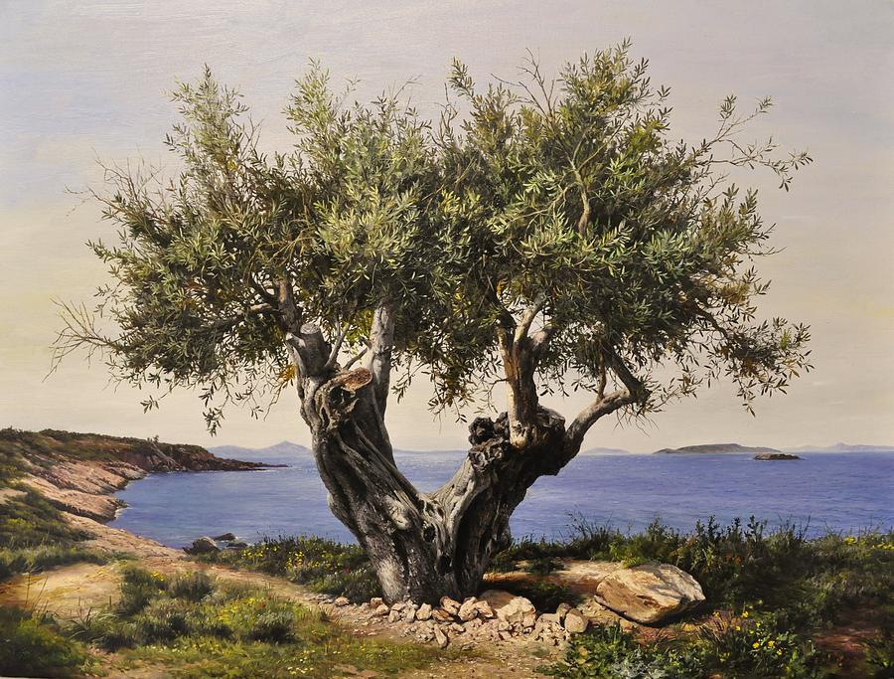
The True Vine
The true fold of God
References to Christ, and through Christ.
Since Israel is scattered and lost primarily in a spiritual sense.
They will, in the last days, be reunited again with the Church—The gospel will be restored and bring the remnant of Lehi’s and Ishmael’s seed back to their rightful heirs of the promises made to the fathers.
1 Nephi 15:15

Slide 9
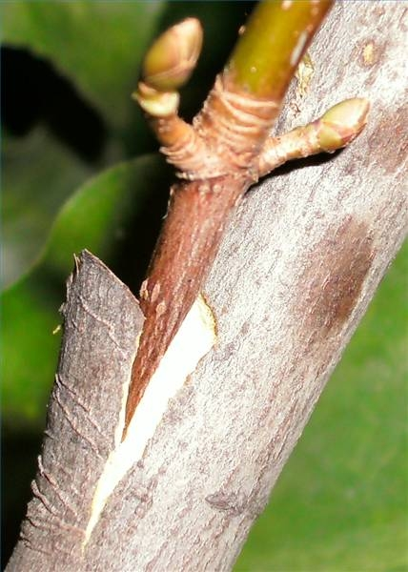
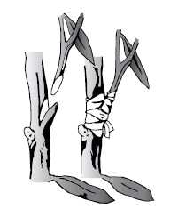
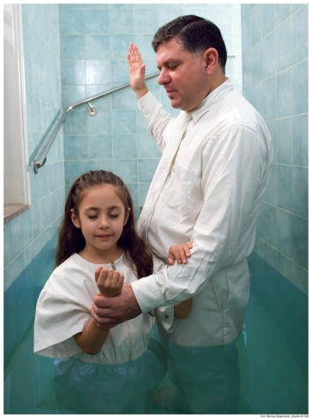
Grafting In
To graft a tree branch is to insert a branch of one tree into another tree. The grafted branch receives nourishment from the tree and becomes a permanent part of the tree
Through the waters of baptism these descendants of ancient Israel became again a covenant people. Having come to the
knowledge of the Messiah
and took upon themselves
His name.
1 Nephi 15:13-14

Slide 10
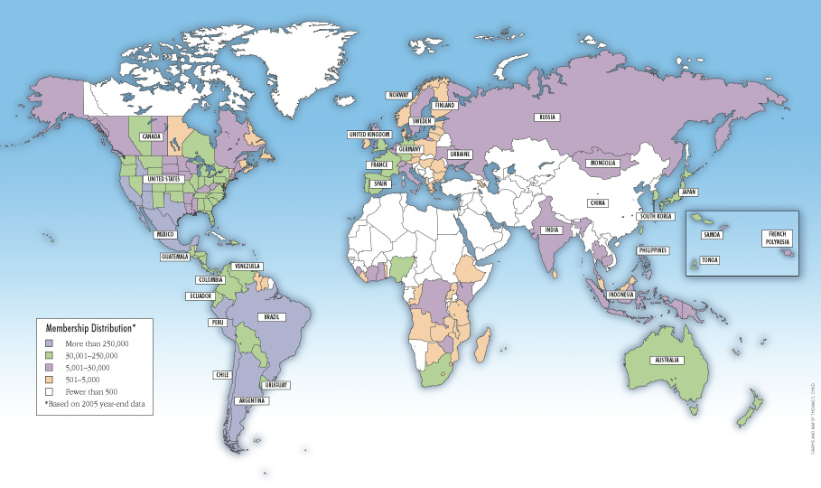
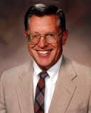
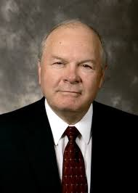
The True Olive Tree
The Restored Church
“In the last days there would be many vines, many folds, and many trees, yet there would be only one true olive-tree.”
“On both hemispheres the chosen seed, having broken their covenants, would be scattered by Gentiles before the day of their restoration to those covenants. In the last days the gospel would go preferential first to the Gentiles and then to the Jews.”
--Joseph Fielding McConkie and Robert L. Millet
1 Nephi 15:16-17

Slide 11
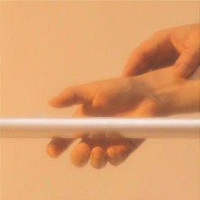
Fill in Blanks
1. “In the __________ … we can find the power to resist temptation.”
2. “The __________ … has the power to fortify the Saints and arm them with the Spirit.”
3. “His __________ is one of the most valuable gifts He has given us.”
Word of God
Word of God
Word
1 Nephi 23-24

Slide 12
Heed
To Hearken--To Hold fast= To Mind; to regard with care; to take notice of; to attend to;
What can I do to Give Heed to the Lord?
Daily Scripture Study
Listening to counsel of Church leaders
Seek and follow personal revelation through prayer
“It is understood that as you continue to heed the Lord, you will not waver, vacillate, or complain, but rather, you will weather the storm and persevere no matter what you may be called upon to endure”
--K. Douglas Bassett
Studying and following the word of God daily strengthens us against Satan’s temptations.
1 Nephi 15:25

Slide 13
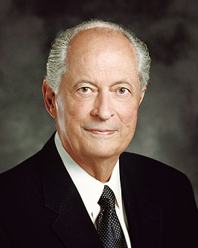
“So essential are these truths that Heavenly Father gave both Lehi and Nephi visions vividly representing the word of God as a rod of iron. Both father and son learned that holding to this strong, unbending, utterly reliable guide is the only way to stay on that strait and narrow path that leads to our Savior”
--Robert D. Hales

Slide 14
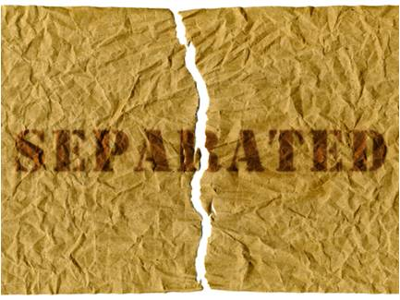
Wicked Separated from Righteous
Why will the wicked be separated from the righteous?
“…and if their works have been filthiness they must needs be filthy; and if they be filthy it must needs be that they cannot dwell in the kingdom of God…”
“But behold, I say unto you, the kingdom of God is not filthy, and there cannot any unclean thing enter into the kingdom of God:…”
1 Nephi 15:33-36

Slide 15
Sources:
Video: The Olive Tree (2:33) can be used for Jacob 5-11
Ezra Taft Benson Ensign May 1979
Spencer W. Kimball Teachings of Spencer W. Kimball Pg 117
K. Douglas Bassett “Latter-Day Commentary on the Book of Mormon” pg. 45
Elder Robert D. Hales (“Holy Scriptures: The Power of God unto Our Salvation,” Ensign or Liahona, Nov. 2006, 25).
TSM- Seminary manual 2013-14 Lesson 15
Presentation by ©http://fashionsbylynda.com/blog/

