Slide 2
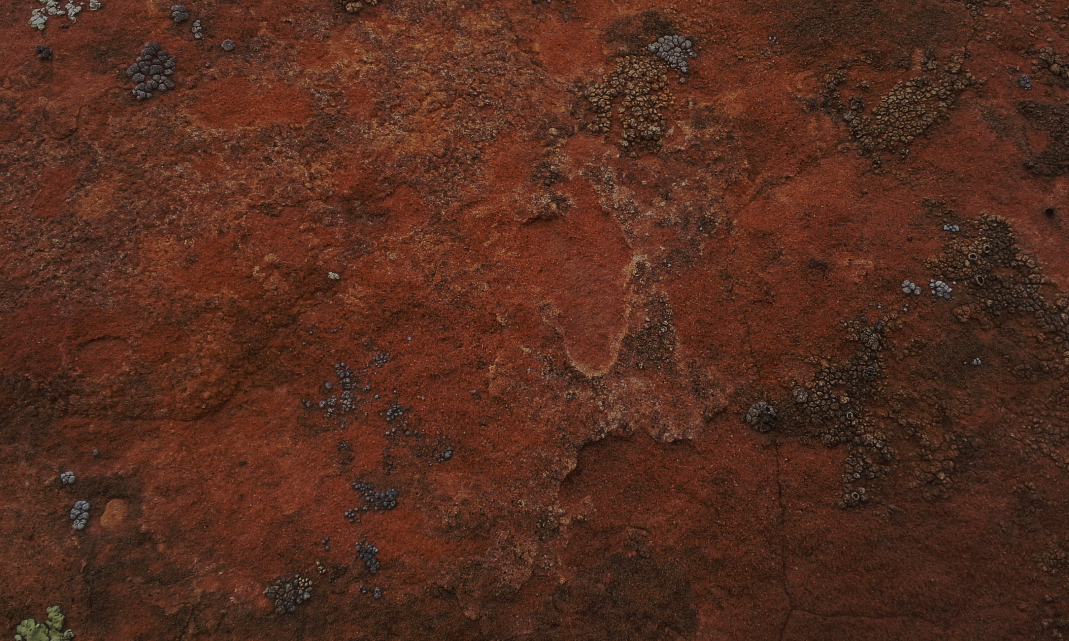
This Book
Serves as a bridge between the small plates of Nephi (1 Nephi–Omni) and Mormon’s abridgment of the large plates of Nephi (Mosiah–4 Nephi).
An understanding of which records Mormon abridged as he compiled the Book of Mormon.
This Book also introduces the faith and accomplishments of King Benjamin.
Who wrote this book?
Mormon
He was a prophet, a record keeper, and the abridger and compiler of the Book of Mormon.
He was also a righteous father and a military
leader among the Nephites.
The prophet Moroni was his son.

Slide 3
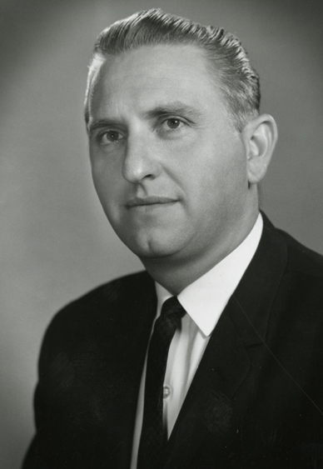
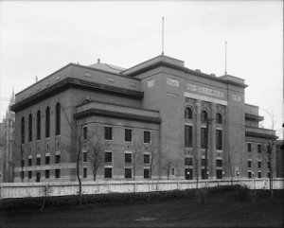
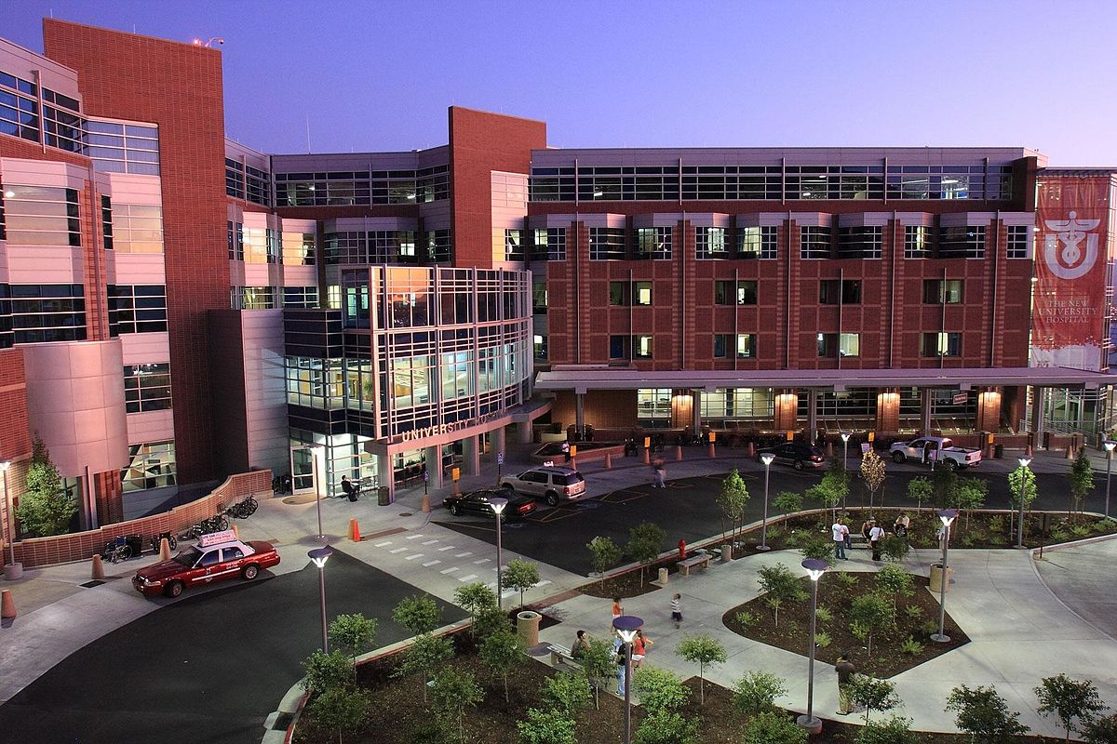
A Prompting
“On one occasion many years ago, I was swimming laps at the old Deseret Gym in Salt Lake City when I felt the inspiration to go to the University Hospital to visit a good friend of mine who had lost the use of his lower limbs because of a malignancy and the surgery which followed.
I immediately left the pool, dressed, and was soon on my way to see this good man…” Thomas S. Monson

Slide 4
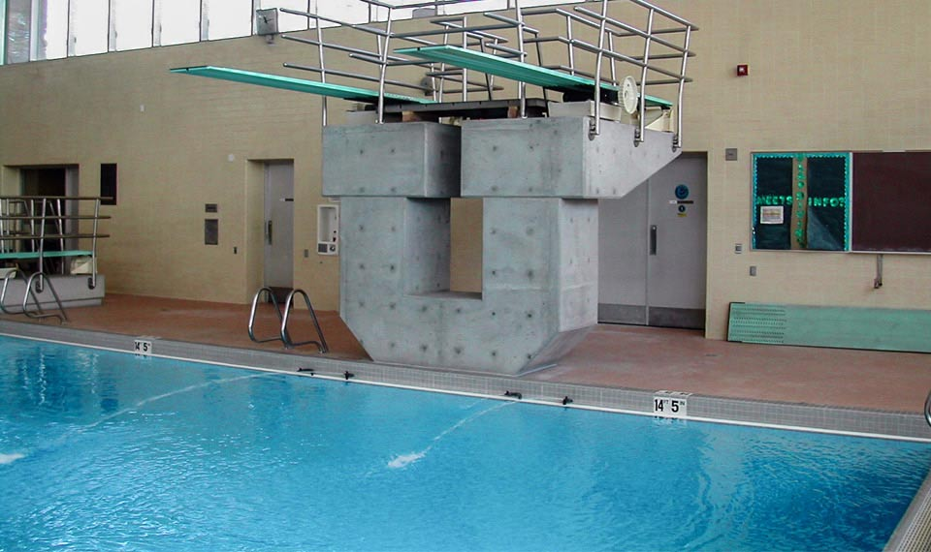
“When I arrived at his room, I found that it was empty. Upon inquiry I learned that I would probably find him in the swimming pool area of the hospital, an area which was used for physical therapy.
Such turned out to be the case. He had guided himself there in his wheelchair and was the only occupant of the room. He was on the far side of the pool, near the deep end. I called to him, and he maneuvered his wheelchair over to greet me. We had an enjoyable visit, and I accompanied him back to his hospital room, where I gave him a blessing.
“I learned later from my friend that he had been utterly despondent that day and had been contemplating taking his own life. He had prayed for relief but began to feel that his prayers had gone unanswered. He went to the pool with the thought that this would be a way to end his misery—by guiding his wheelchair into the deep end of the pool. I had arrived at a critical moment, in response to what I know was inspiration from on high.
“… How pleased I am to have been an instrument in the Lord’s hands on that critical day at the swimming pool.”
Thomas S. Monson

Slide 5
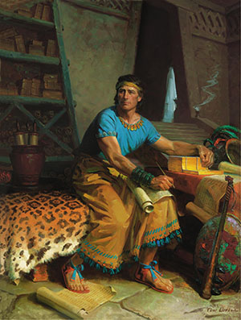
Spiritual promptings are often quiet feelings or thoughts and that it may sometimes be difficult to know whether thoughts that we have come from us or from the Holy Ghost. Either way, if we have a thought or feeling to do something good, we should do it.
Mormon followed a prompting from the Spirit even though he did not understand all the reasons why he needed to do it.

Slide 6
Future Audience
Mormon addressed a future audience, with hope that his writings and the writings of his son Moroni “may profit them” (Words of Mormon 1:2).
Specifically, he wrote for the benefit of the Lamanites.
“My prayer to God is concerning my brethren, that they may once again come to the knowledge of God, yea, the redemption of Christ; that they may once again be a delightsome people”
Mormon wrote this book in about AD 385, after having “witnessed almost all the destruction of [his] people, the Nephites”
Mormon did not record where he was when he wrote this book.
Words of Mormon
Words of Mormon 1:1-2, 8

Slide 7
500 Years After Amaleki
This short book interrupts the chronological order of books at the beginning of the Book of Mormon.
In this book, Mormon briefly explains his compilation and abridgment of the records of his people.
Remember that the Lord commanded Nephi to make two sets of plates for a “special” and “wise” purpose (see 1 Nephi 9:3, 5). One set of plates, often called the large plates, contained the secular history of the Nephites, while the other set, often called the small plates, contained a sacred record of the Nephites’ preaching, revelations, and prophecies (see 1 Nephi 9:2–4; Jacob 1:3–4).
Mormon discovered the small plates of Nephi after he had already made an abridgment of part of the large plates (see Words of Mormon 1:3).
Guided by the Spirit of the Lord, Mormon included the small plates with his abridgment of the large plates. He did this “for a wise purpose,” according to the Lord’s will (see Words of Mormon 1:4–7).
The Small Plates of Nephi
The Large Plates of Nephi

Slide 8
Joseph Smith Translated
Joseph Smith started with Mormon’s abridgment of the large plates of Nephi—the secular history.
Martin Harris, who was the Prophet’s scribe for this portion of the translation, lost 116 pages of the manuscript.
The Lord revealed to Joseph Smith that wicked men had obtained those pages and changed the words (see D&C 10:8–10).
If Joseph had translated the same material again, those men would have claimed that he was not a prophet because he could not translate the book the same way twice (see D&C 10:11–19).
The Lord told Joseph not to translate that part again but to translate the small plates of Nephi that Mormon had included with his abridgment of the large plates (see D&C 10:30–45).
Thus, Words of Mormon helps us see how the Lord prepared a way to frustrate the
plan of wicked men and to include scripture that not only covered the same time
period as the lost manuscript but provided “greater views upon
[the Lord’s] gospel” (D&C 10:45).
The Large Plates of Nephi

Slide 9
Mormon
He was born around AD 310
At 10 years of age he was visited by Ammaron (the Prophet who had the responsibility of the records) and gave Mormon the records (Mormon 1:2)
The following year Mormon was taken to Zarahemla by his father, also called Mormon
At age 15 he was visited by Jesus (Mormon 1:15)
He commanded the Nephite forces from the time he was sixteen until the final battle at Cumorah (Mormon 2:1-2)
At age 24 he went and got the plates and started to abridge the Nephite records
He was chosen to finalize the ultimate structure and content of the Book of Mormon, with the help of his son, Moroni
He witnessed the destruction of nearly a half million of his people
(Mormon 6)
Mormon was killed by the Lamanites around AD 385 (Mormon 8:3,5) leaving Moroni to finish the work of the Lord
Who’s Who

Slide 10
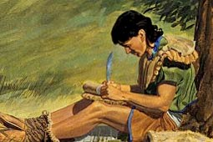
From Lehi to Benjamin
Two Assignments
Continue to record his own days on the large plates
He was to abridge the large plates themselves, writing this abridged record on what we now call the plates of Mormon
Words of Mormon 1:1-3

Slide 11
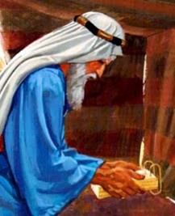
Intent and Choice
These things--Small Plates
To persuade men and women to come unto the God of their fathers and be saved.
The details of the story of the Nephites from the days of Amaleki to the end of Benjamin’s reign (and the coronation of his son, Mosiah) are on the large plates
100th part
Choosing those principles which are most important
When someone writes in their journal and records how they felt, they usually write what is most important to them.
Words of Mormon 1:4-5

Slide 12
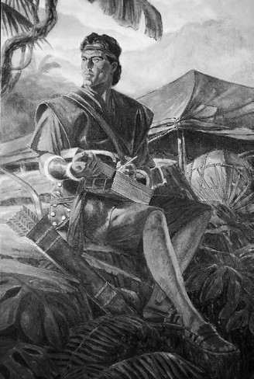
A Wise Purpose--Influence of the Holy Ghost
Mormon included prophecies and revelations with his collection for “a wise purpose” in the Lord
The Lord knows all things
The Lord can work through us to accomplish His will.
Book of Lehi
The Lord instructed Nephi to begin the small plates and Mormon to include the small plates, this because He knew that through the machinations of the ungodly the 116 pages of manuscript would be lost to the Prophets Joseph Smith.
Mormon had perfect confidence in the power of the Book of Mormon to turn men to Christ; to touch the hearts of sincere reader; to make all men “a delightsome people”
Words of Mormon 1:6-8

Slide 13
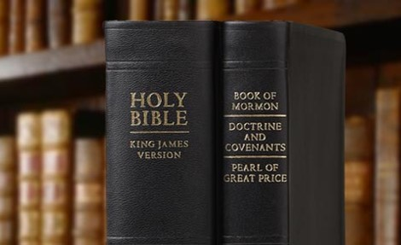
Records Preserved--Men Judged
Mormon knew that records had been preserved and that they would be preserved in the future
Mormon testifies that his brethren will be judged in the last days
“Men are judged according to the light and knowledge they have received”
D&C 20:13-14
Members of the Church
In the dispensation of the fulness of times will be judged by the doctrines and standards set forth in the Bible, the Book of Mormon, The Doctrine and Covenants, the Pearl of Great Price, and words of the living oracles
JMF and RLM
Words of Mormon 1:11

Slide 14
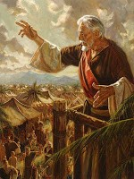
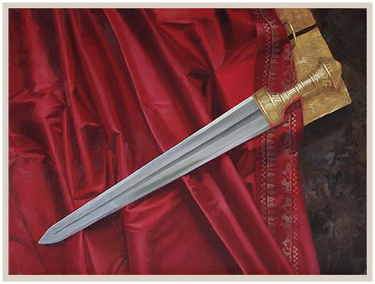
King Benjamin
Mormon said a few things about King Benjamin:
The contentions with his own people
The contentions with the Lamanities
King Benjamin is best remembered as a powerful spiritual figure and also a courageous defender of the liberties of his people.
The Sword of Laban
King Benjamin led armies to battle against the Lamanites and wielded the sword with his own arm in their defense.
Words of Mormon 1:12-14

Slide 15
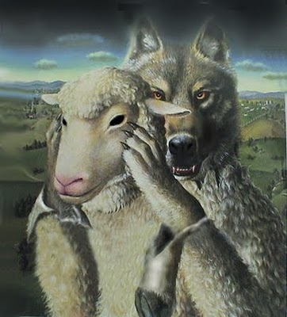
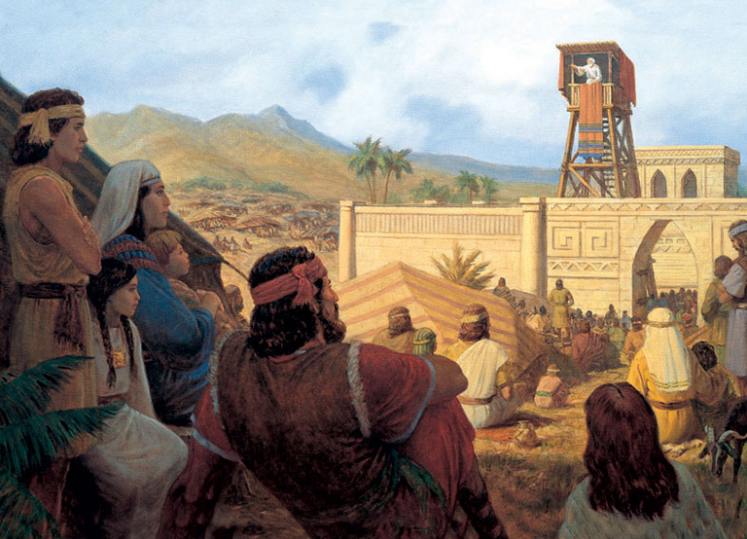
False Christs
“A false Christ is not a person. It is a false system of worship; a false church…”
Bruce R. McConkie
The Savior warns us against false Christs:
“…there shall arise false Christs, and false prophets, and shall shew great signs and wonders; insomuch that, if it were possible, they shall deceive the very elect.”
Matthew 24:24
Mormon recognizes that through all of King Benjamin’s labors the people did once again establish peace in the land
Words of Mormon 1:15-18

Slide 16
Sources:
Video: Presentation of Thomas S. Monson: Always Follow the Promptings of the Spirit (2:40)
Thomas S. Monson, “Consider the Blessings,” Ensign or Liahona, Nov. 2012, 87
Joseph Fielding McConkie and Robert L. Millet Doctrinal Commentary on the Book of Mormon Vol. 2 pg. 123
Bruce R. McConkie Millennial Messiah pg 47-48
Who’s Who (Book of Mormon) Ed J. Pinegar and Richard J. Allen pg 122-123
Presentation by ©http://fashionsbylynda.com/blog/

