Slide 2
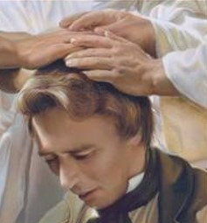
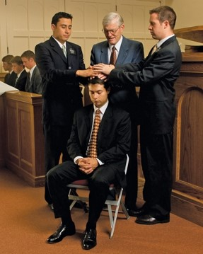
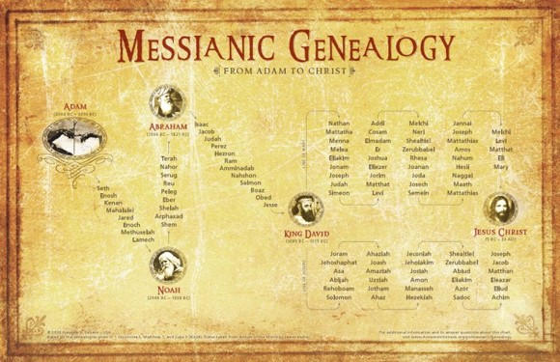
The Order of Heaven
Ordination
A formal ritual by which the priesthood, offices and rights of the presidency are conferred upon
Alma ordains priests and elders
Can only be done by the laying on of hands
Laying on of hands is a symbolic representation of the Lord’s hands.
Authority can be traced back to the Lord whence it comes.
JFM and RLM
Alma 6:1

Slide 3
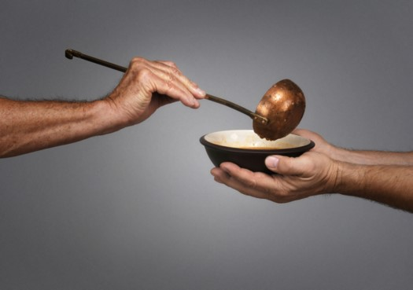
Establishing An Order of God
Those who repented were baptized
Those who did not repent—names blotted out..not to be numbered among the righteous
In teaching the gospel there should be not distinction between the rich and the poor
“For if there come unto your assembly a man with a gold ring, in goodly apparel, and there come in also a poor man in vile raiment;
And ye have respect to him that weareth the gay clothing, and say unto him, Sit thou here in a good place; and say to the poor, Stand thou there, or sit here under my footstool:
Are ye not then partial in yourselves, and are become judges of evil thoughts?”
James 2:2-4
Alma 6:1-5

Slide 4
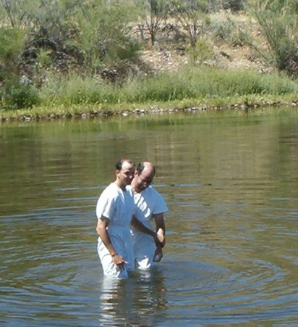
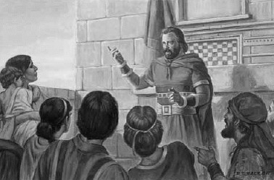
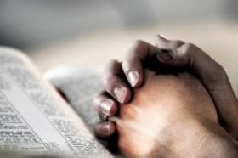
Children of God
The Baptismal Covenant
“And now, because of the covenant which ye have made ye shall be called the children of Christ, his sons, and his daughters; for behold, this day he hath spiritually begotten you; for ye say that your hearts are changed through faith on his name; therefore, ye are born of him and have become his sons and his daughters.”
Mosiah 5:7
Gather oft:
Prayer and fasting
“Also, I give unto you a commandment that ye shall continue in prayer and fasting from this time forth.” D&C 88:76
Alma 6:6

Slide 5
“Everyone prays for the missionaries. May it ever be so. In that same spirit, we should also pray for those who are (or who need to be) meeting the missionaries. In Zarahemla, members were commanded to ‘join in fasting and mighty prayer’ [Alma 6:6] for those who had not yet joined the Church of God. We can do the same.
“We can also pray daily for our own personal missionary experiences. Pray that under the divine management of such things, the missionary opportunity you want is already being prepared in the heart of someone who longs for and looks for what you have. ‘There are many yet on the earth … who are only kept from the truth because they know not where to find it.’ [D&C 123:12.]
Pray that they will find you! And then be alert, because there are multitudes in your world who feel a famine in their lives”
Elder Jeffrey R. Holland

Slide 6
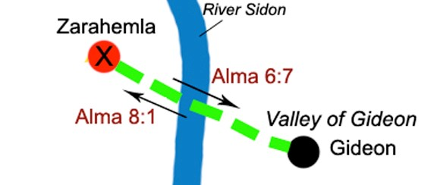
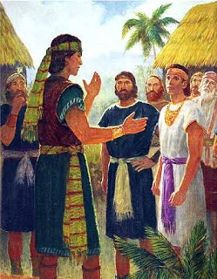
Alma’s Departure
Alma goes to the Valley of Gideon…called after Gideon whom Nehor slew.
Alma’s desire was for those that lived in the Valley of Gideon maintain their trust in the mercy and grace of their Lord
Alma discerns by the power of the Holy Spirit that the people of this valley are more righteous than those in Zarahemla.
Alma 7:1-5

Slide 7
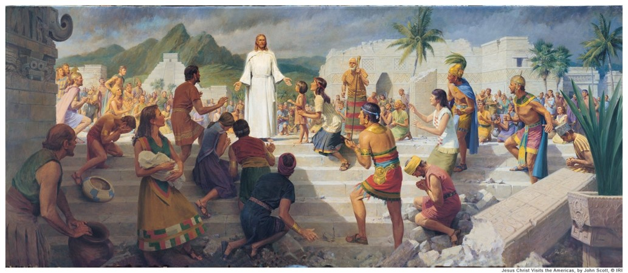
Jesus Would Come
Alma knows of the testimony of Nephi
“And after Christ shall have risen from the dead he shall show himself unto you, my children, and my beloved brethren; and the words which he shall speak unto you shall be the law which ye shall do.”
2 Nephi 26:1
Alma 7:7-10; 1 Nephi 12:4-6

Slide 8
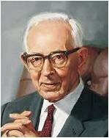
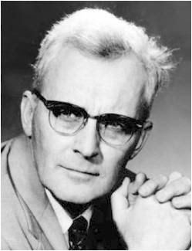
“There is no conflict or contradiction in the Book of Mormon with any truth recorded in the Bible. A careful reading of what Alma said will show that he had no intention of declaring that Jesus would be born in Jerusalem. Alma knew better. So did Joseph Smith and those who were associated with him in the bringing forth of the Book of Mormon. Had Alma said, ‘born in Jerusalem, the city of our fathers,’ it would have made all the difference in the world. Then we would have said he made an error. Alma made no mistake, and what he said is true.
Joseph Fielding Smith
“… One of the favorite points of attack on the Book of Mormon has been the statement in Alma 7:10 that the Savior would be born “at Jerusalem which is the land of our forefathers.” Here Jerusalem is not the city “in the land of our forefathers,” it is the land. Christ was born in a village some six miles from the city of Jerusalem; it was not in the city, but it was in what we now know the ancients themselves designated as “the land of Jerusalem”
Dr. Hugh Nibley

Slide 9
Challenges--Temptations
Jesus Christ suffered to save us from sin and death and to help us through the challenges of mortality.
“Are you battling a demon of addiction—tobacco or drugs or gambling, or the pernicious contemporary plague of pornography? … Are you confused with gender identity or searching for self-esteem? Do you—or someone you love—face disease or depression or death? Whatever other steps you may need to take to resolve these concerns, come first to the gospel of Jesus Christ. Trust in heaven’s promises. …
“This reliance upon the merciful nature of God is at the very center of the gospel Christ taught. I testify that the Savior’s Atonement lifts from us not only the burden of our sins but also the burden of our disappointments and sorrows, our heartaches and our despair. [See Alma 7:11–12.] From the beginning, trust in such help was to give us both a reason and a way to improve, an incentive to lay down our burdens and take up our salvation”
Elder Jeffrey R. Holland
Alma 7:11-13

Slide 10
Doctrinal Mastery
11. “And he shall go forth, suffering pains and afflictions and temptations of every kind; and this that the word might be fulfilled which saith he will take upon him the pains and the sicknesses of his people.
12. And he will take upon him death, that he may loose the bands of death which bind his people; and he will take upon him their infirmities, that his bowels may be filled with mercy, according to the flesh, that he may know according to the flesh how to succor his people according to their infirmities.
13. Now the Spirit knoweth all things; nevertheless the Son of God suffereth according to the flesh that he might take upon him the sins of his people, that he might blot out their transgressions according to the power of his deliverance; and now behold, this is the testimony which is in me.”
Alma 7:11-13

Slide 11
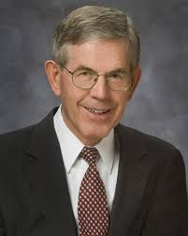
The Atonement is not just for sinners
“The Spirit of the Lord … hath anointed me to preach good tidings unto the meek; … to bind up the brokenhearted, to proclaim liberty to the captives, … to appoint unto them that mourn in Zion … beauty for ashes.” (Isa. 61:1, 3; italics added.)
The Savior’s atonement is thus portrayed as the healing power not only for sin, but also for carelessness, inadequacy, and all mortal bitterness. The Atonement is not just for sinners…
The Savior desires to save us from our inadequacies as well as from our sins. Inadequacy is not the same as sinfulness…
The Lord will not save us in our sins, but from them. However, he can save us in our inadequacies as well as from them. A sense of falling short or falling down is not only natural, but essential to the mortal experience. But, after all we can do, the Atonement can fill that which is empty, straighten our bent parts, and make strong that which is weak.”
Bruce C. Hafen
Alma 7:11-13

Slide 12
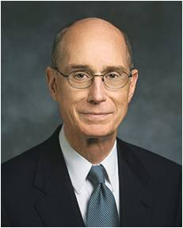
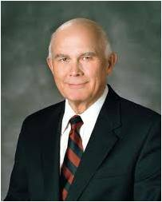
The comfort we can receive because of the Savior’s Atonement:
“It will comfort us when we must wait in distress for the Savior’s promised relief that He knows, from experience, how to heal and help us. The Book of Mormon gives us the certain assurance of His power to comfort. And faith in that power will give us patience as we pray and work and wait for help. He could have known how to succor us simply by revelation, but He chose to
learn by His own personal
Experience.”
President Henry B. Eyring
The Challenges We Face:
“Many carry heavy burdens. Some have lost a loved one to death or care for one who is disabled. Some have been wounded by divorce. Others yearn for an eternal marriage. Some are caught in the grip of addictive substances or practices like alcohol, tobacco, drugs, or pornography. Others have crippling physical or mental impairments. Some are challenged by same-gender attraction. Some have terrible feelings of depression or inadequacy. …
“The healing power of the Lord Jesus Christ—whether it removes our burdens or strengthens us to endure and live with them …
—is available for every affliction
in mortality.”
Elder Dallin H. Oaks
Christ’s Empathy and Ability to help us:
“Christ walked the path every mortal is called to walk so that he would know how to succor and strengthen us in our most difficult times. He knows the deepest and most personal burdens we carry. He knows the most public and poignant pains we bear. He descended below all such grief in order that he might lift us above it. There is no anguish or sorrow or sadness in life that he has not suffered in our behalf and borne away upon his own valiant and compassionate shoulders.”
Elder Jeffrey R. Holland

Slide 13
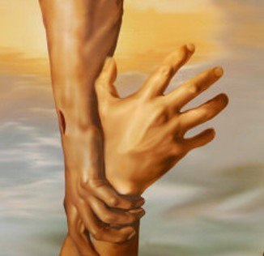
Lay Aside Every Sin
Demons of addition:
Tobacco or drugs
Gambling
Pornography
Confusion with:
Gender identity
Self esteem
Depression or suicide
Whatever other steps you may need to take to resolve these concerns, come first to the gospel of Jesus Christ. Trust in heaven’s promises. …”
The merciful nature of God:
Lifting us not only the burden of our sins but also the burden of our disappointments and sorrow
Our heartaches and despair
Elder Jeffrey R. Holland (Broken Things…)

Slide 14
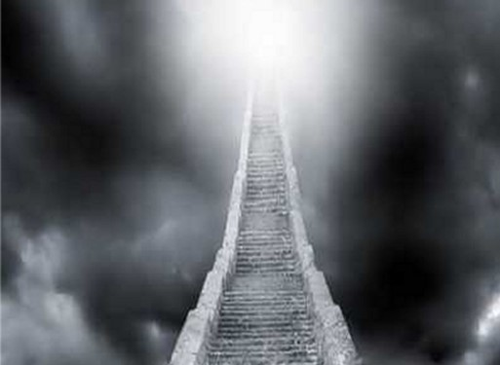
On the Path of Righteousness
Alma sees that the people of Gideon are not perfect…but they are striving through their allegiance to and trust in Christ
Like the people of Paul:
“And that, knowing the time, that now it is high time to awake out of sleep: for now is our salvation nearer than when we believed.” (Roman 13:11)
By living the principles of the gospel, we follow the path to the kingdom of God
They are on the right track, their course is approved by God
Righteousness prepares the way for the Lord
Alma 7:17-20

Slide 15
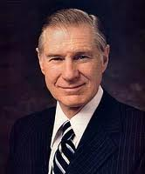
Unholy Places
The Spirit can not abide in those who have not kept their covenants or broken the commandments and remain unrepentant
Those who die in their sins shall remain in their sins
“We unavoidably stand in so many unholy places and are subjected to so much that is vulgar, profane, and destructive of the Spirit of the Lord that I encourage our Saints all over the world, wherever possible, to strive to stand more often in holy places. Our most holy places are our sacred temples. Within them is a feeling of sacred comfort. We should seek to be worthy to take our families to the temple to be sealed together for eternity. We should also search for the records of our kindred dead so that they too can be sealed to us in one of the
temples. We must strive for holiness by being
“an example of the believers, in word, in
conversation, in charity, in spirit, in faith,
in purity.
” In this way we can maintain and
Strengthen our own individual relationship
with our God.”
James E. Faust
Alma 7:21

Slide 16
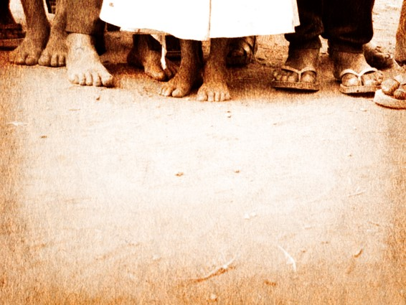
Walk Blameless
Alma counsels the people of Gideon to live worthy of the companionship of the Holy Spirit
Be humble
Be submissive and gentle
Easy to be entreated
Full of patience and long-suffering
Temperate in all things
Diligent in keeping commandments at all times
Prayer for things of need spiritual and temporal
Giving thanks unto God
Faith, hope and charity, and abound in good works
Alma 7:22-24

Slide 17
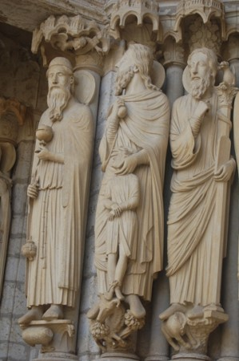
Sit Down With The Patriarchs
Abraham—the Father of Faith
“Go ye, therefore, and do the works of Abraham; enter ye into my law and ye shall be saved.”
D&C 132:32
“Thus I, Abraham, talked with the Lord, face to face, as one man talketh with another; and he told me of the works which his hands had made;”
Abraham 3:11
Isaac did not become an Abraham or a Jacob. He did not reach the heights of Abraham, called the “father of the faithful.” Nor was he as impressive as his son Israel, father of the twelve tribes. Yet Isaac is loved and revered. He worshiped God, cared for his home, and pursued his work. He is remembered simply as a man of peace. The eloquent simplicity of his life and his unique ability to lend importance to the commonplace made him great.
A. Theodore Tuttle
It was through Jacob that the covenant of Abraham continued; it was then passed on to Joseph and Ephraim.
He is today exalted upon a throne in heaven, in company with Abraham and Isaac
Bible Dictionary
To be qualified in their presence
Alma 7:25; Genesis 28:1-4, 12-22; D&C 132:37

Slide 18
A Farewell of Peace
“And now, may the peace of God rest upon you, and upon your houses and lands, and upon your flocks and herds, and all that you possess, your women and your children, according to your faith and good works, from this time forth and forever. And thus I have spoken. Amen.”
“Peace I leave with you, my peace I give unto you: not as the world giveth, give I unto you. Let not your heart be troubled, neither let it be afraid.”
John 14:27
“And the peace of God, which passeth all understanding, shall keep your hearts and minds through Christ Jesus.”
Philippians 4:7
“And let the peace of God rule in your hearts, to the which also ye are called in one body; and be ye thankful.”
Colossians 3:5
Alma 7:25

Slide 19
Sources:
Videos:
Like a Broken Vessel (11:36)
Are We Christians? (3:22)
The Healing Power of the Atonement (1:10)
None Were With Him (4:23)
Joseph Fielding McConkie and Robert L. Millet Doctrinal Commentary on the Book of Mormon Vol. 3 pg. 47-49
Elder Jeffrey R. Holland (“Witnesses unto Me,” Ensign, May 2001, 15).
(Answers to Gospel Questions, comp. Joseph Fielding Smith Jr., 5 vols. [1957–66], 1:174).
Dr. Hugh Nibley, in his course of study for the priesthood for 1957,An Approach to the Book of Mormon, in Lesson 8, page 85,
Joseph Smith Teachings pg. 121
President Henry B. Eyring (“Adversity,” Ensign or Liahona, May 2009, 24).
Elder Dallin H. Oaks (“He Heals the Heavy Laden,” Ensign or Liahona, Nov. 2006, 6, 8).
Elder Jeffrey R. Holland (Christ and the New Covenant: The Messianic Message of the Book of Mormon [1997], 223–24).
Elder Jeffrey R. Holland (“Broken Things to Mend,” Ensign orL iahona, May 2006, 70–71).
Elder Bruce C. Hafen “The Atonement is not just for sinners” (“Beauty for Ashes: The Atonement of Jesus Christ,” Ensign, Apr. 1990, 7).
James E. Faust Standing in Holy Places April Conf. 2005
A. Theodore Tuttle Altar, Tent, Well Oct. 1972 General Conf
Presentation by ©http://fashionsbylynda.com/blog/

Slide 20
