Slide 2
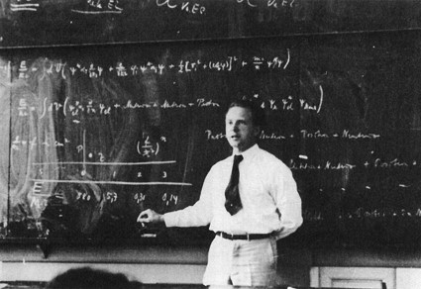
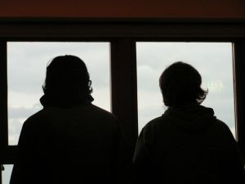
A Surprise Test
A teacher announces that there is a surprise test
Student A has been in class everyday
Student B has been absent the last two weeks
Which Student will do better on the test?
Why?
How well did the people of Ammonihah understand the gospel and the power of God?
Alma 9

Slide 3
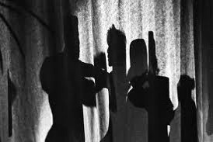
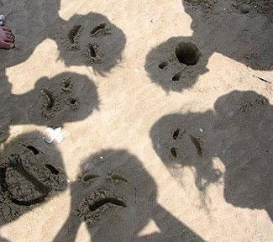
What They Did Not Understand:
The prophecy that the Lord would destroy the city one day--‘knew not that the earth should pass away’
They had forgotten ‘the tradition of their fathers’
They had forgotten the commandments of God
They had forgotten how they had been delivered out of the hands of their enemies
What are some reasons you forget what you have learned?
Too young
Not paying attention…focused on other things
Struggling with you testimony and faith
Not being patient with yourself, others, and Heavenly Father
Not praying for the Holy Spirit
Alma 9:1-10

Slide 4
The difference between the Lamanites and the People of Ammonihah in their dealings with the Lord
The Spiritual Background of the People
What the Lord Expected of the People
What the Lord Promised the People
Lamanites
Alma 9:14-17
Cut off from Lord
They will learn of their incorrect traditions and repent
The Lord will be more merciful and prolong their existence
People of Ammonihah
Alma 9:18-24
They knew of the commandments but did not keep them
To not live in their iniquities, and repent
He would send the Lamanites upon them if they did not repent
Alma 9:14-24

Slide 5
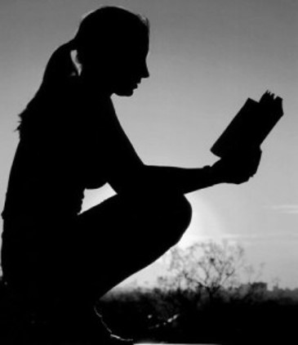
Higher Expectations
For Those Who: sin against the light
For Those Who: walk in paths of wickedness when one has been enlightened by the spirit, has enjoyed its gifts, and has been heir to the promises of the Almighty—is to place oneself in a precarious position.
The Lord expects greater obedience from those who have received the knowledge and blessings of the gospel
“For of him unto whom much is given much is required; and he who sins against the greater light shall receive the greater condemnation.”
D&C 82:3
The more you know, the more you will be held accountable for
Alma 9:19-24

Slide 6
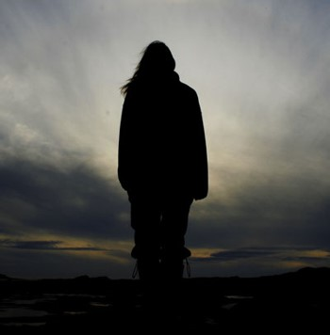
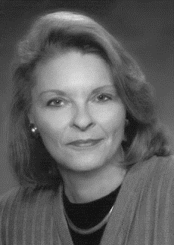
We are unique. We are unique because of our covenants, our spiritual privileges, and the responsibilities attached to both. We are endowed with power and gifted with the Holy Ghost. We have a living prophet to guide us, ordinances that bind us to the Lord and to each other, and the power of the priesthood in our midst.
We understand where we stand in the great plan of happiness. And we know that God is our Father and that His Son is our unfailing Advocate.
“With these privileges comes great responsibility, for ‘unto whom much is given much is required’”
Sheri L.Dew

Slide 7
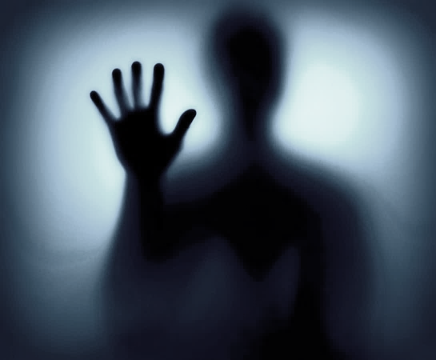
Highly Favored People
They were visited by the Spirit of God
They conversed with angels
They were spoken unto by the voice of the Lord
They had the spirit of prophecy
They had the spirit of revelation
They had the gift of speaking with tongues
They had the gift of preaching
They had the gift of the Holy Ghost
They had the gift of translation
Alma 9:20-21

Slide 8
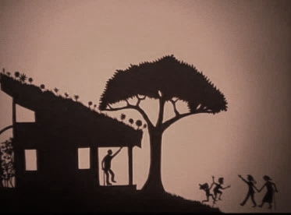
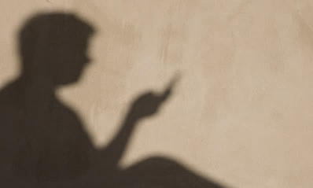
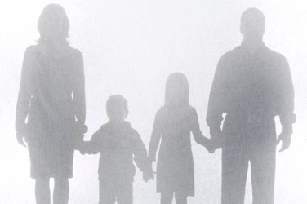
Gifts and Blessings of Today
What Gifts have you been given because you are a member of the Church of Jesus Christ of Latter-day Saints?
When have you felt that you were blessed because you obeyed a call from the Lord?
How have you seen blessings come to others because you or someone else responded to the Lord’s call?
How do these experiences influence your desire to listen for and obey calls from the Lord?

Slide 9
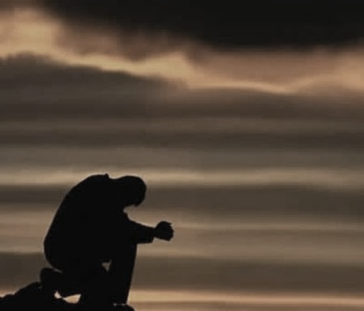
Quick to Hear
Alma:
“And not many days hence the Son of God shall come in his glory; and his glory shall be the glory of the Only Begotten of the Father, full of grace, equity, and truth, full of patience, mercy, and long-suffering, quick to hear the cries of his people and to answer their prayers.”
“Proper prayers are made to the Father, in the name of the Son, by the power of the Holy Ghost. The Father answers prayers, but he does it through the Son, into whose hands he has committed all things.”
Bruce R. McConkie
Alma 9:26

Slide 10
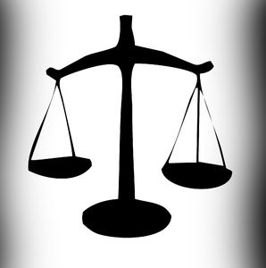
To Redeem—A Reward
“…that ye are willing to repent of your sins and enter into a covenant with him to keep his commandments, and witness it unto him this day by going into the waters of baptism.”
Alma 7:15
Those who have been baptized…to take upon themselves the name of Christ..to accept and apply their lives to His atoning sacrifice
A Law of Justice:
“Each individual would be judged by his individual acts. If he did well, then he would receive the reward of exaltation, and those who were faithful and true would become the sons and daughters of God and dwell eternally with him as his hears entitled to the fulness of his kingdom.”
Joseph Fielding Smith
Alma 9:27-28; Romans 8:12-18

Slide 11
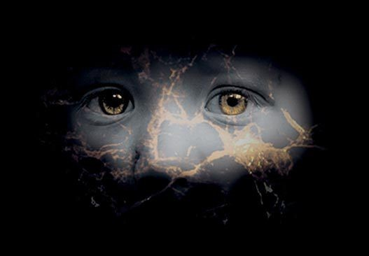
Lost and Fallen
Angel’s voice:
“And now, my beloved brethren, for ye are my brethren, and ye ought to be beloved, and ye ought to bring forth works which are meet for repentance, seeing that your hearts have been grossly hardened against the word of God, and seeing that ye are a lost and a fallen people.”
Lehi:
“Wherefore, all mankind were in a lost and in a fallen state, and ever would be save they should rely on this Redeemer.”
1 Nephi 10:6
Alma 9:29-30

Slide 12
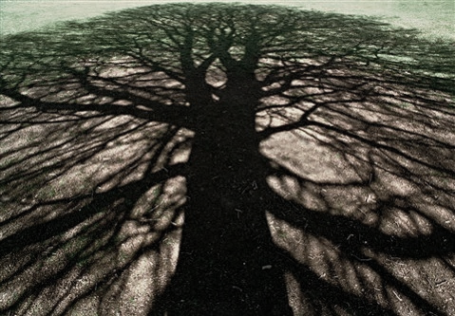
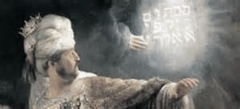
Amulek’s Witness
Amulek gives an account of his genealogy and reminds them of who he is…his reputation
Amulek mentions his ancestor Aminadi who interpreted the writing which was upon the wall of the temple, which was written by the finger of God
Aminadi was a descendant of Nephi, Lehi, Manasseh who was son of Joseph (the one sold into Egypt)
Alma 10:2-4

Slide 13
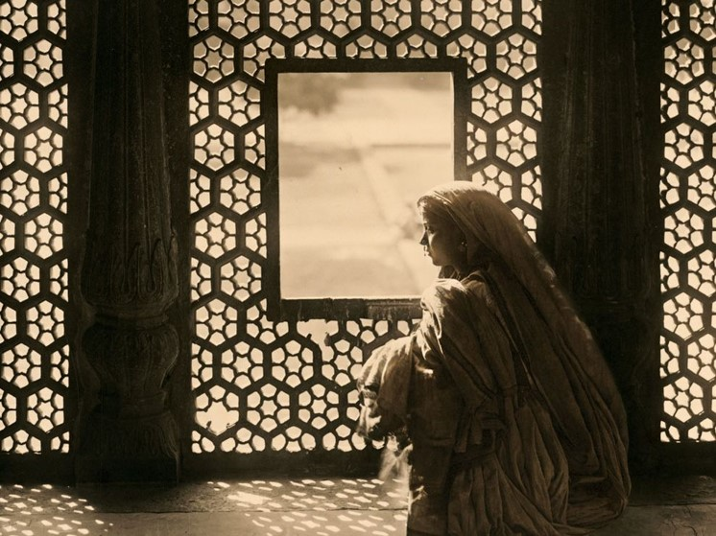
An Influence
Would it be helpful in a community to be well known and have a good reputation?
“I prefer not to think of reputation as a superficial facade, attempting to indicate depth where there is only shallowness, honesty where there is deceit, or virtue where there is unrighteousness. Rather, I like to think of reputation as a window, clearly exhibiting the integrity of one’s soul. It is through this integrity of thought and integrity of conduct that we become pure and holy before the Lord. It is in this state that we can be most effective in serving our fellowmen.”
O. Lesley Stone
Alma 10:2-4

Slide 14
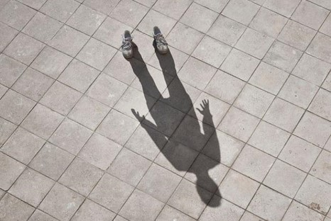
Wake-Up Calls
I would not hear and I would not know?
“The voice of the Lord calls to us regularly. It is not wickedness which keep us from feeling and hearing the word; it is preoccupation.”
JFM and RLM
Keeping focused on the things of the Lord will help us in our daily endeavors.
Sometimes we need an alarm to remind us of who we are and what we represent
Alma 10:5-6

Slide 15
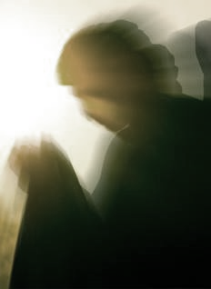
Amulek’s Angel
“As I was journeying to see a very near kindred, behold an angel of the Lord appeared unto me and said: Amulek, return to thine own house, for thou shalt feed a prophet of the Lord; yea, a holy man, who is a chosen man of God; for he has fasted many days because of the sins of this people, and he is an hungered, and thou shalt receive him into thy house and feed him, and he shall bless thee and thy house; and the blessing of the Lord shall rest upon thee and thy house.”
Alma was the Holy Man the angel had spoken of
Alma had blessed Amulek’s household…”the Lord hath rested upon us according to the words which he spake…”
Alma 10:7-11

Slide 16
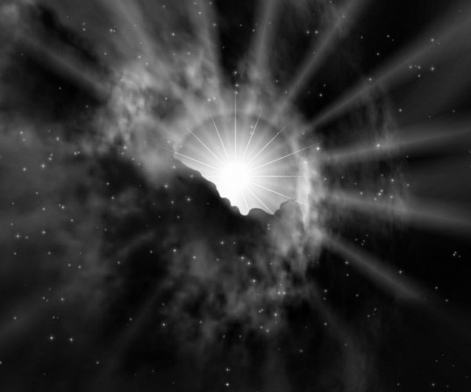
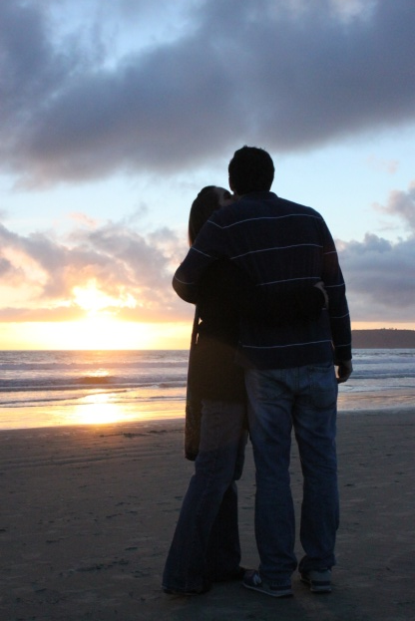
When the Spirit Dwells With Us
You have felt the quiet confirmation in your heart and mind that something was true. And you knew that it was inspiration from God. …
The Holy Ghost is the Spirit of Truth. You feel peace, hope, and joy when it speaks to your heart and mind that something is true. Almost always I have also felt a sensation of light.
Any feeling I may have had of darkness is dispelled. And the desire to do right grows.
Henry B. Eyring
“The key to strengthening our families is having the Spirit of the Lord come into our homes. The goal of our families is to be on the strait and narrow path.”
Robert D. Hales

Slide 17
When we hear and obey the Lord’s call, blessings come to us and to others.
Alma 10:11-12

Slide 18
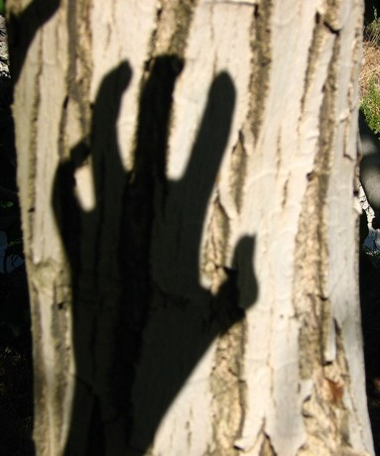
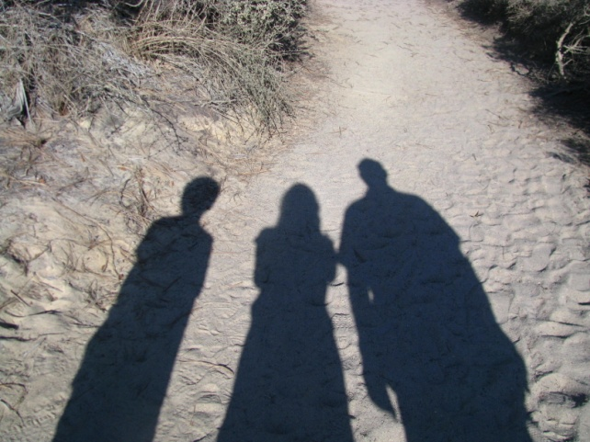
Those Who Oppose
1. Become angry and defensive
2. Doubt the importance of the counsel
3. Criticize the person who gave the counsel
4. Question or debate the counsel
How do you respond to being corrected by a:
Parent?
Teacher?
Church Leader?
Alma 10:7-11

Slide 19
Responding to the Messages
Alma 9:2-3
Alma 9:4-5
Alma 10:13
Alma 10:16-17
Alma 10:24
Alma 10:28-30
They did not believe in the testimony of one man and they did not understand the words
They did not believe their city could be destroyed…they did not believe God would do this ‘marvelous’ thing
They thought they could catch their words by trickery…that they might find false against them…to slay them or put them in prison
That they might find their words contradictory
They said that they reviled against their laws
They called Amulek a ‘child of the devil’ and that he lied to them

Slide 20
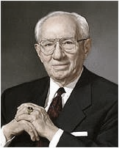
“There is so much of evil everywhere. Temptation, with all its titillating influences, is about us everywhere. We lose some to these destructive forces, unfortunately. We sorrow over every one that is lost.
We reach out to help them, to save them, but in too many cases our entreaties are spurned. Tragic is the course they are following. It is the way which leads down to destruction.”
Gordon B. Hinckley

Slide 21
An Introduction to Zeezrom
Zeezrom comes into the picture as a lawyer
But this will have to wait until another lesson
Alma 10:31-32

Slide 22
Sources:
Video:
The Eternal Principle of Law and Justice
Sheri L. Dew (D&C 82:3)” (“We Are Women of God,” Ensign, Nov. 1999, 98)
Joseph Fielding Smith Answers to Gospel Questions Vol 2 pg. 194
O. Leslie Stone The Importance of Reputation Oct. 1975 General Conf.
Joseph Fielding McConkie and Robert L. Millet Doctrinal Commentary on the Book of Mormon Vol. 3 pg. 68
Robert D. Hales Strengthening Families: Our Sacred Duty April 1999 Gen. Conf
Henry B. Eyring Sep. 10, 2006 • Devotional Gifts of the Spirit for Hard Times
Gordon B. Hinckley (“My Testimony,” Ensign, May 2000, 69).
Presentation by ©http://fashionsbylynda.com/blog/

Slide 23
 | The Spiritual Background of the People | What the Lord Expected of the People | What the Lord promised the People
Lamanites Alma 9:14-17
People of Ammonihah Alma 9:18-24

