Slide 1
Into the Wilderness
1 Nephi 1-5

Slide 2
Another Record
1 Nephi 1

Slide 3
The Daily News
Page 1
570 BC
Lehi and Family Flee into the Wilderness
A Visionary Man
Seeking guidance from God, Lehi receives dreams and visions. Lehi, his wife Sariah and their children, Laban, Lemuel, Nephi, and Sam flee the land of Jerusalem into the wilderness. With the guidance of a peculiar round object call “the Liahona” and the Holy Ghost, they are directed to their destination called “The Land of Promise”.
Nephi, a Fugitive?
Nephi, son of Lehi of Jerusalem, secretly obtains the “Brass Plates” from Laban, a man of great wealth and possessions. The Brass Plates contained the genealogy of his father, Lehi. Under the command of God, Nephi obeys his father and while in a drunken state, Laban dies by his own sword. With the plates Nephi returns to his father.
It is sited that Nephi returns to Jerusalem and leaves with Ishmael and his daughters.
Ancient Records are Found
Nephi, a son of Lehi of Jerusalem, records the history of his people in the Americas on what is called the “Brass Plates”. This history includes the Nephites (called after Nephi) and the Lamanites (call after Laman), which divided their people because of religious differences. This history of this people is now found in “The Book Of Mormon”. The plates were hidden for many thousand of years by a man named Moroni, and a young man named Joseph Smith obtained the plates on September 22, 1827.

Slide 4
Page 2
Nephi to Record Accounts
Nephi Chosen To Be Leader
Nephi quotes:
After Lehi’s family reached the land of promise, Lehi chooses Nephi to be the leader of the people. Lehi dies about 588 to 570 B.C.
Nephi writes while he is in the Land of Nephi. About 570 B.C.
1 Nephi contains several accounts of heavenly manifestations in dreams, visions, and direct revelation. These manifestation show that God instructs, guides, and protects those who seek after Him:
Examples:
Lehi prays a pillar of fire Sees and Hears
1 Nephi 1:6-7
Lehi receives a vision the destruction of Jerusalem
1 Nephi 1:8-14
The Lord commands Lehi to depart
1 Nephi 2:1-2
The Lord directs Lehi to send his sons back to Jerusalem
1 Nephi 3:2-4
An angel intervenes
1 Nephi 3:29
The Lord commands them to return to Jerusalem
1 Nephi 7:1-2
Lehi and Nephi vision tree of life
1 Nephi 8:11-14
Nephi builds a ship
1 Nephi 18:1
“And it came to pass that the Lord God said unto me: Make other plates; and thou shalt engraven many things upon them which are good in my sight, for the profit of they people.”
--2 Nephi 5:30
“But I, Nephi, have written what I have written, and I esteem it as of great worth, and especially unto my people. For I pray continually for them by day, and mine eyes water my pillow by night, because of them; and I cry unto my God in faith, and I know that he will hear my cry.”
--1 Nephi 33:3
Other People Found in the Land of Promise
According to the Book of Mormon two other groups are found:
The Mulekites
--Omni 1:14-17
And the Jaredites
--Ether 6:4-12
Items Also Found With The Gold Plates
Along with the Book found, two significant items are discovered: The sword of Laban that was handed down through the generations until the end of the Nephite civilization. And the “Liahona” which was the compass that the guided them through the wilderness.

Slide 5
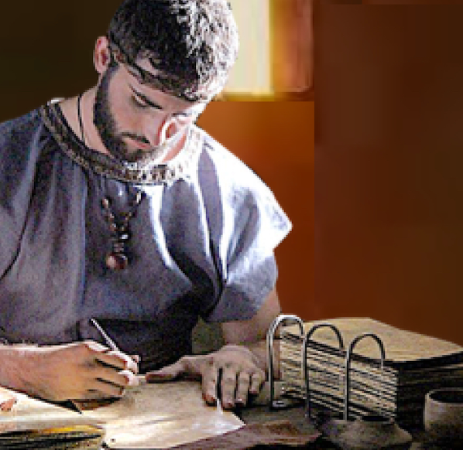
The Small Plates of Nephi
Nephi wrote the record that we know as the First Book of Nephi on the small plates of Nephi about 30 years after leaving Jerusalem

Slide 6
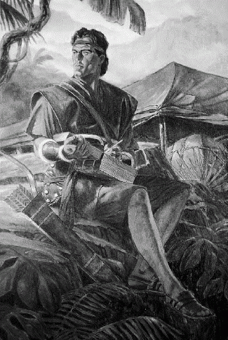
30 Years Later
30 Years Later
It had been thirty years since Nephi left Jerusalem with his family. He was now in the land of promise. He had kept an accurate record of the experiences of his family on what came to be known as the large plates of Nephi.
But now a new commandment came from the Lord instructing him to make another record.
This record would be things of spiritual value to those who would read them.
1 Nephi 9:1-5
The Large Plates of Nephi
The Small Plates of Nephi

Slide 7
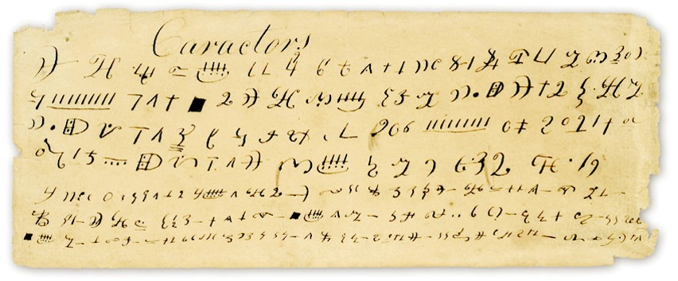
The Language Written
Moroni indicates the plates were written in reformed Egyptian that had been altered by the Nephites after their manner of speech.
Mormon 9:32-33
The Small Plates of Nephi
A type of shorthand
Moroni stated that if the plates had been larger, they would have been written in Hebrew—therefore the record would have been without imperfections.

Slide 8
The Language
Mosiah 1:2,4
About 470 years later, king Benjamin taught his sons in all the language of his father, which was likely the same language of the Egyptians that Lehi taught to his children
1 Nephi 1:2
Nephi made his record in the language of the Egyptians
Mormon 9:32
Moroni indicated that by his day, approximately 1,000 years from the time of Lehi and Nephi, he and other record keepers had written “in the characters which are called among us the reformed Egyptian, being handed down and altered by us, according to our manner of speech”

Slide 9
A Warning
Many Prophets came to warn the people
Jeremiah 35:15
Zephaniah
1:2
Ezekiel
3:17-19
Habakkuk
2:8
Prophets do not always share messages that are popular with the world, but their teachings and warnings demonstrate the Lord’s love for His people.
Lehi was called by God to preach repentance to the people of Jerusalem. Despite his pleas and warnings, they rejected his words and sought to kill him.
Lehi also sees a vision and warns the people of Jerusalem that their great city will be destroyed unless they repent.
1 Nephi 1:4
Nahum
2:13

Slide 10
Zedekiah—King of Judah
608-605 B.C.
Necho—Pharaoh of Egypt—sends army against Assyria through Palestine
Josiah—King of Judah—resist army—battle (Hebrews beaten)—King Josiah slain
Jews choose Jehoahaz (Josiah’s son) to be King—only 3 months—Egypt replaces him
Jehoiakim (another Josiah’s son)—3 years Pharaoh has control of Judah
Babylonians come against Pharaoh's cohorts—takes Jewish nation (2 Kings 23-25)
Jewish people still not free—Babylonians rule—Southern Palestine—vassal state
Revolt against Jehoiakim (Egyptian appointee)—King Nebuchadnezzar army—Jehoiakim dies.
Jehoiachin (Jehoiakim’s son) surrenders to Babylonians—Uncle—Zedekiah—appointed to throne by Nebuchadnezzar—21 years old—seeks alliance with Egypt— Prophet Jeremiah —warnings of Jerusalem destruction. (Book of Mormon Student Manual)

Slide 11
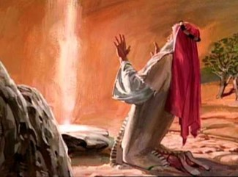
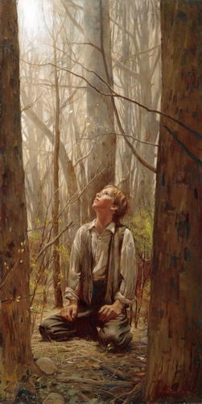
Lehi’s and Joseph’s Spiritual Experience
Lehi prays for the people
Pillar of fire (v.6)
Lehi sees and hears much that he trembles
Lehi is overcome by the spirit
Lehi sees a vision of Heaven including God the Father, Jesus Christ, the Twelve Apostles and angels.
Lehi is shown the future
Lehi praises God and rejoices
Lehi is mocked
Joseph prays for truth
Pillar of Light overhead(v. 16)
Joseph was ready to sink into despair.
The light rested upon him
Joseph sees two Personages
Moroni and Apostles also appears to Joseph
Joseph received revelation
Joseph gives thanks (v. 75)
Joseph is persecuted
1 Nephi 1:5-15
Joseph Smith History

Slide 12
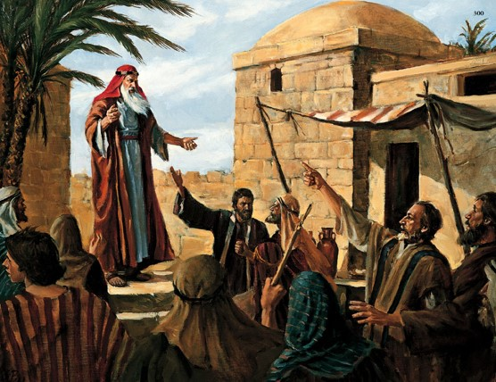
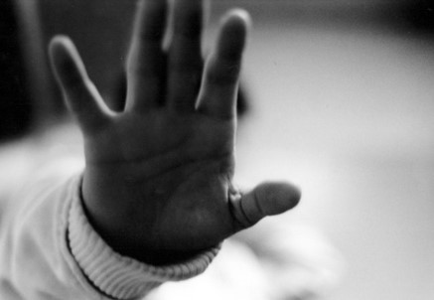
Prophet’s Warnings
The people responded by mocking him, then they were angry, and sought to take his life.
Lehi teaches the people of Jerusalem concerning the things which he had both seen and heard
God calls prophets to denounce sin, warn of its consequences, and testify of Jesus Christ
Why do some people reject the Prophet’s messages?
A Prophet warns against sin and teaches salvation through Jesus Christ
1 Nephi 1:19-20

Slide 13
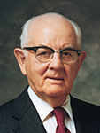
“Those prophets I have known are the most loving of men. It is because of their love and integrity that they cannot modify the Lord’s message merely to make people feel comfortable. They are too kind to be so cruel” (3)

Slide 14
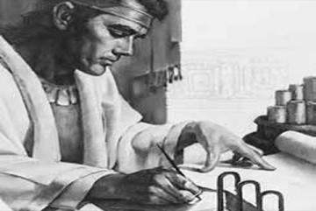
Tender Mercies of the Lord
But behold, I, Nephi, will show unto you that the tender mercies of the Lord are over all those whom he hath chosen, because of their faith, to make them mighty even unto the power of deliverance.
Because God is merciful, He will not allow those who come unto Him to perish
1 Nephi 1:20

Slide 15
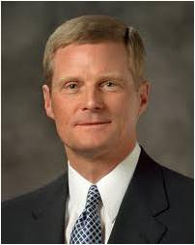
“The Lord’s tender mercies are the very personal and individualized blessings, strength, protection, assurances, guidance, loving-kindnesses, consolation, support, and spiritual gifts which we receive from and because of and through the Lord Jesus Christ. …
“… The Lord’s tender mercies do not occur randomly or merely by coincidence. Faithfulness and obedience enable us to receive these important gifts and, frequently, the Lord’s timing helps us to recognize them.
“We should not underestimate or overlook the power of the Lord’s tender mercies” (2)

Slide 16
Sources:
1. The Book of Mormon Student Manual Religion 121-122 page 15
2. Elder David A. Bednar “The Tender Mercies of the Lord,” Ensign or Liahona, May 2005
3. Spencer W. Kimball, “Listen to the Prophets,” Ensign, May 1978, 77).
Presentation by ©http://fashionsbylynda.com/blog/

Slide 17
Don’t Look Back
1 Nephi 2

Slide 18
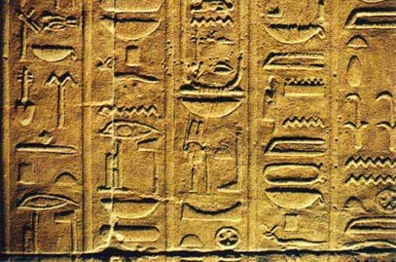
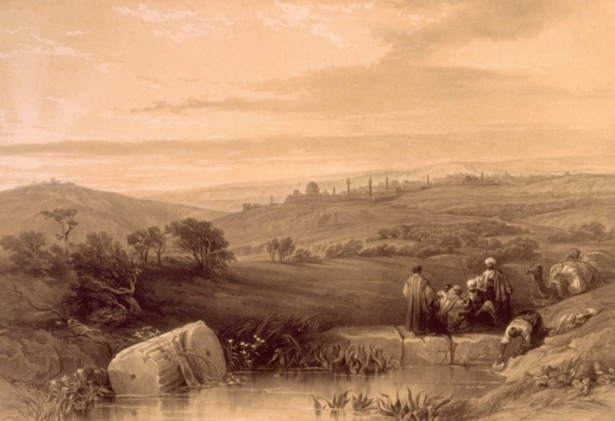
Lehi
Lehi lived somewhere in the country, not directly in the city of Jerusalem
1 Nephi 3:16, 1 Nephi 3:23
Lehi was a rich Jew. 1 Nephi 2:4
He had an Egyptian education.
He wrote and spoke Egyptian. Mosiah 1:4, Mormon 9:32-33
And he insisted his sons learn the language 1 Nephi 1:2
Living outside of the walls of Jerusalem he probably was an expert in the vineyard, cultivating olives, figs, and honey.
Hugh Nibley

Slide 19
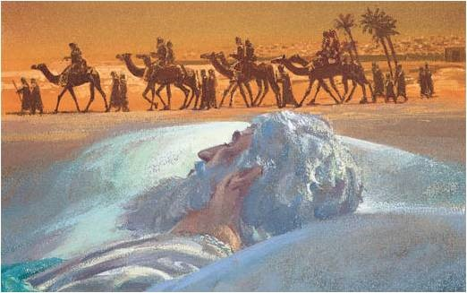
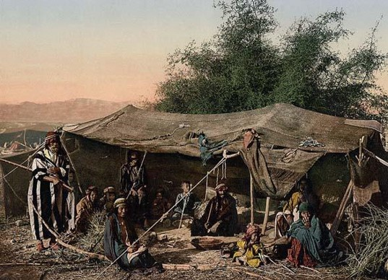
Lehi’s Dream
Obedience to the Lord’s commandments can require sacrifice
Commanded of the Lord to leave
Why do you think Lehi was so prompt and ready to leave?
Wilderness travel—Bedouin—land of the desert people
Hugh Nibley

Slide 20
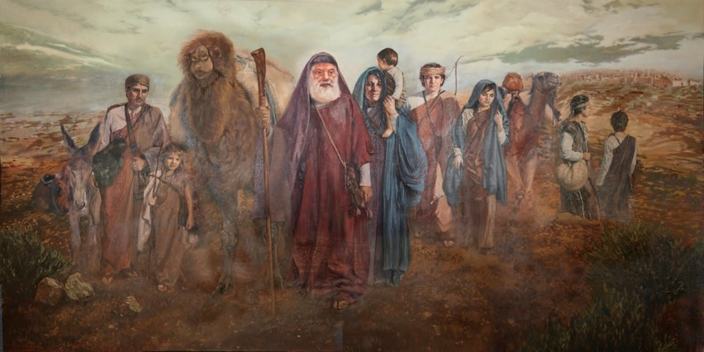
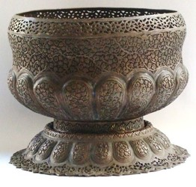
Take Only What you Need To Survive
Transportation
Belongings
Food and shelter

Slide 21
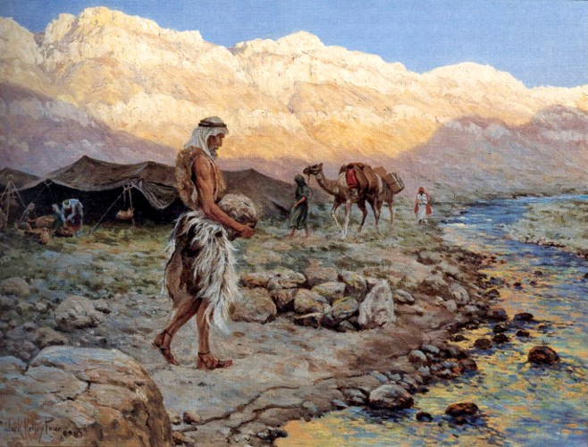
Offering Thanks
“…pitched his tent in a valley by the side of a river of water.”
Building an alter—3 Days Journey
Altar---Raised structure or place used for sacrifice, worship, or prayer. Altars probably originated with the belief that objects or places (e.g., a tree or spring) were inhabited by spirits or deities worthy of prayers or gifts.
--Merriam-Webster Dictionary
1 Nephi 2:6-7

Slide 22
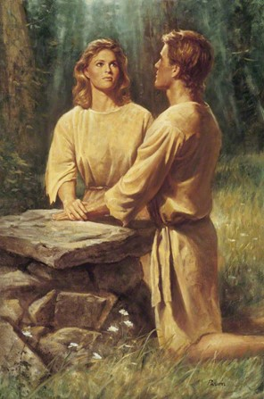
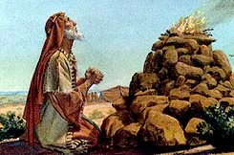
Altar of Stones
We know that Adam had an alter. (Moses 5:5)
“And there shalt thou build an altar unto the LORD thy God, an altar of stones: thou shalt not lift up any iron tool upon them.”
“Thou shalt build the altar of the LORD thy God of whole stones; and thou shalt offer burnt offerings thereon unto the LORD thy God:”
Deuteronomy 27: 5-6

Slide 23
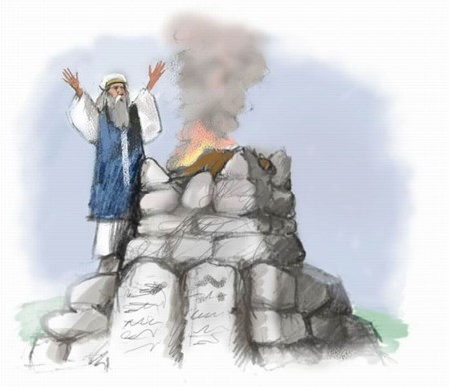
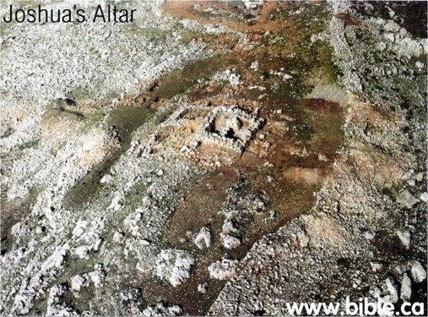
Altar of Testimony
“…Let us now prepare to build us an altar, not for burnt offering, nor for sacrifice:…
…but that it may be a witness between us, and you, and our generations after us, that we might do a service of the LORD before him with our burnt offerings, and with our sacrifices, and with our peace offerings…”
Joshua 22:26-27

Slide 24
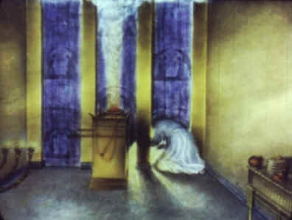
Altar of Prayers
“And another angel came and stood at the altar, having a golden censer; and there was given unto him much incense, that he should offer it with the prayers of all the saints upon the golden altar which was before the throne.”
Revelation 8:3-5

Slide 25
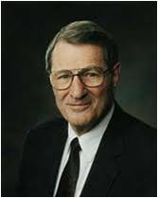
Altar and Repentance
All burnt offerings were performed on the altar of sacrifice (Exodus 27:1-8). Sacrifice was the first thing an individual did when entering the tabernacle if he desired to progress any further.
“The real act of Personal sacrifice is not now nor ever has been placing an animal on the altar. Instead, it is a willingness to put the animal that is in us upon the altar—then willingly watching it be consumed: Such is the ‘sacrifice unto (the Lord of) a broken heart and a contrite spirit’”
--Neal a Maxwell
3 Nephi 9:20

Slide 26
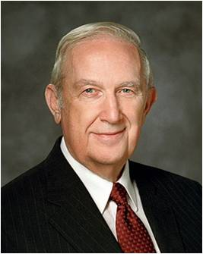
Temple Altars
“I know the exquisite joy that comes from an eternal marriage sealed at a temple altar through the holy sealing power. When there is righteousness, a commitment to give of self, obedience to the commandments of God, and the resolve to seek His will in all things together, that joy is unspeakable.”
--Richard G. Scott

Slide 27
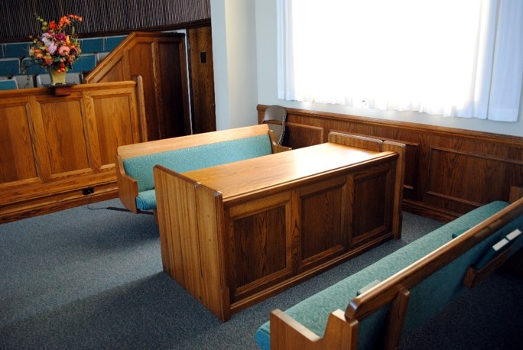
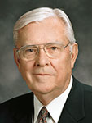
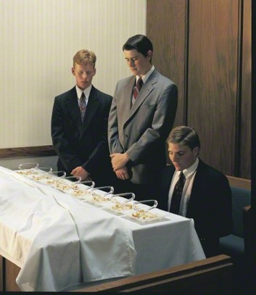
Today’s Altars
“How is it we show the Lord that we have symbolically put ourselves upon today’s sacrificial altar? … When we overcome our own selfish desires and put God first in our lives and covenant to serve Him regardless of the cost, we are then living the law of sacrifice.”
--Elder M. Russell Ballard

Slide 28
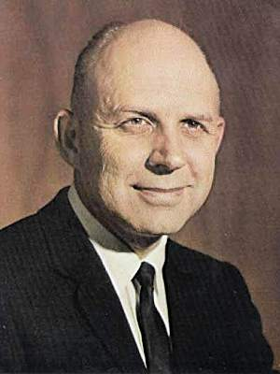
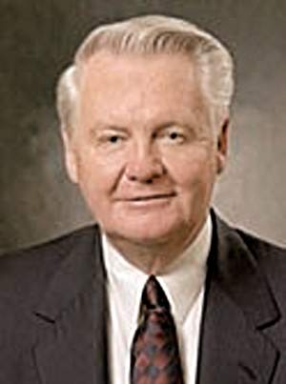
My Father Dwelt in a Tent
Altar, tent, and well: his worship, his home, his work. These basic things of life signified his relationship to God, his family, and his fellowmen. Every person on earth is touched by these three.
To know the word and works of God, Isaac knelt in his day at his altar. His tent, a home for himself and family, was sacred to him, as our homes are to us.
To Latter-day Saints, the home is a holy place, patterned after the celestial home whence we came. The priesthood-led home is the loftiest spiritual unit we know.
Genesis 26:25
A. Theodore Tuttle
Bedouin tent
Isaiah talks about the tent which represents the gospel of Christ.
He states that in the last days the cords of the tent would be stretched across the earth and stakes would be planted in every land.
Isaiah 54:1-2 –Merrill J. Bateman
Where do you dwell?

Slide 29
Laman and Lemuel Murmur
River---Laman
“…O that thou mightest be like unto this river, continually running into the fountain of all righteousness!”
Valley---Lemuel
“… O that thou mightest be like unto this valley, firm and steadfast, and immovable in keeping the commandments of the Lord!”
Murmur—
complain
frustrated
irritated
find excuses
slothful
uncommitted
question whether commandments
are applicable to you
deception of the adversary
1 Nephi 2:8-12

Slide 30
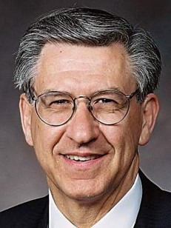
“Murmuring consists of three steps, each leading to the next in a descending path to disobedience.”
First, people begin to question. They question “first in their own minds,” and then they plant questions “in the minds of others.”
Second, those who murmur begin to “rationalize and excuse themselves from doing what they [have] been instructed to do. … Thus, they [make] an excuse for disobedience.” Their excuses lead to the third step: “Slothfulness in following the commandment of the Master. …
--Elder H. Ross Workman
Not knowing the dealings of the Lord and disbelieving His prophets can cause us to murmur

Slide 31
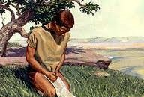
Thou Hast Sought Me Diligently
Prayer—to know mysteries of God
Nephi comes to know by revelation that what his father had been teaching was true.
Sam (his brother) was touched by the power of Nephi’s testimony
“To some it is given by the Holy Ghost to know that Jesus Christ is the son of God…To others it is given to believe on their words…”
D&C 46:13-14
1 Nephi 2:16-17

Slide 32
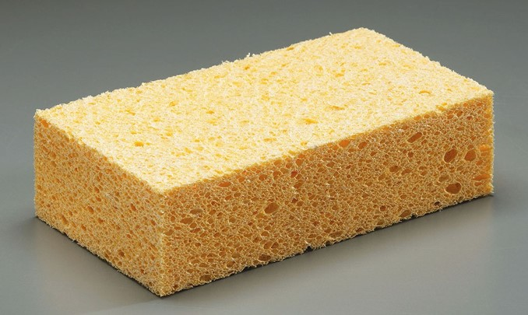
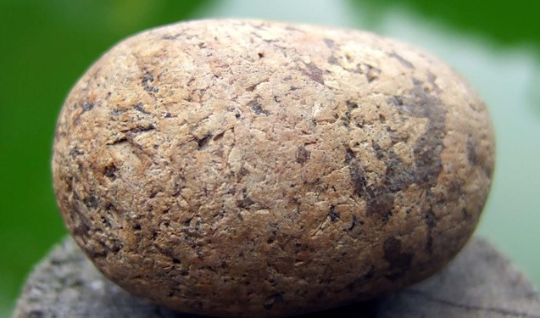
Softening Our Hearts
Softened Hearts:
Nephi sought the Lord early
Nephi could view things from an elevated perspective.
Hardened Hearts:
Laman and Lemuel did not seek earnestly
Laman and Lemuel continued to refuse the vantage point of the higher ground.
When we diligently seek to understand the Lord’s commandments, He can soften our hearts to help us to believe and obey.
1 Nephi 2:16, 18

Slide 33
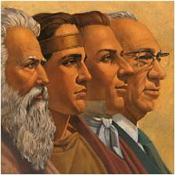
Chosen People and Chosen Lands
“As there are chosen people, so there are chosen lands. Promised lands are given to covenant people, people of the promise.”
--Joseph Fielding McConkie, and Robert L. Millet
Rulers and Teachers—
God blesses those who are obedient and faithful.
1 Nephi 2:20-22

Slide 34
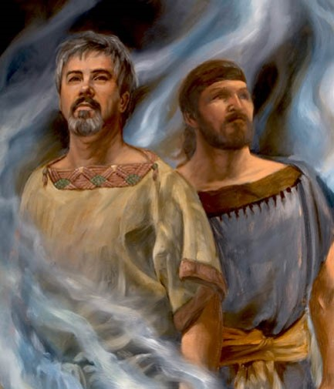
Spiritual Rebellion
“The Lamanites demonstrated clearly the depths to which a nation could sink through spiritual rebellion”
A scourge unto thy seed—A curse
The removal of the Lord's spirit
1 Nephi 2:23-24

Slide 35
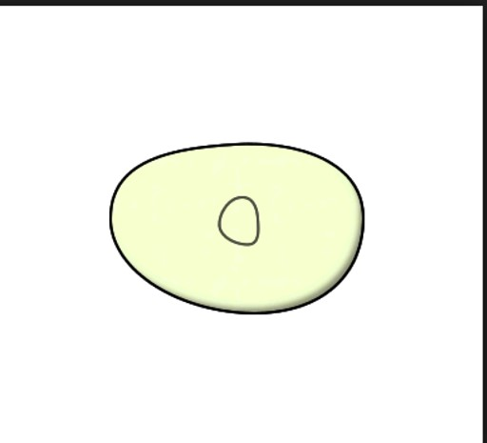
If we keep the Lord’s commandments,
He will prosper us and bless us.
If we rebel against the Lord and His servants, we will be separated from His influence.

Slide 36
“Obedience is the first law of heaven. All progression, all perfection, all salvation, all godliness, all that is right and just and true, all good things come to those who live the laws of Him who is Eternal. There is nothing in all eternity more important than to keep the commandments of God”
---Bruce R. McConkie

Slide 37
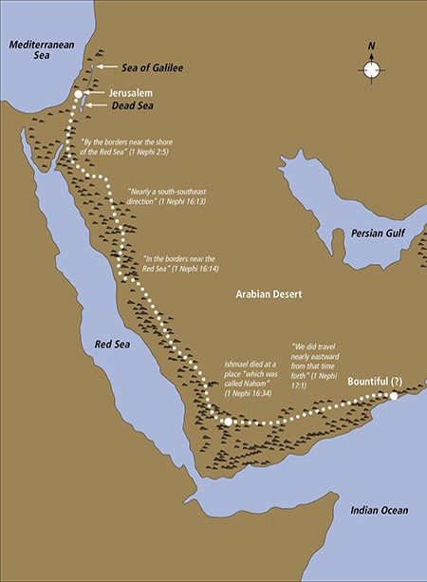
Possible route taken by Lehi’s family

Slide 38
Chiasmus 1 Nephi 1-9
1. Nephi discusses his record (1 Nephi 1: 1-3)
2. Lehi’s early visions are reported, followed by by his preaching and prophesying to the Jews (1 Nephi 1: 6-15, 18-20)
3.Lehi takes his family into the wilderness (1 Nephi 2:15)
4. The Lord speaks prophecies to Nephi about Lehi’s seed (1 Nephi 2:19-24)
5. Lehi’s sons obtain the brass plates, and Nephi records the most striking example of murmuring of his faithless brothers
(1 Nephi 3:2-5, 16)
4. Lehi, filled with the spirit, prophesies about his seed (1 Nephi 5:17-19, 7:1)
3. Ishmael takes his family into the wilderness (1 Nephi 7:2-22)
2. Lehi’s tree of life vision is reported, followed by his prophecies and preaching to Laman and Lemuel (1 Nephi 8:2-35)
1. Nephi again discusses his record, and he records his testimony. (1 Nephi 9:1-6)

Slide 39
Sources:
Hugh Nibley “Lehi in the Wilderness”
Neal A. Maxwell “Meek and Lowly” pg. 94
Richard G. Scott “Receive the Temple Blessings” 1999 April General Conference
Elder H. Ross Workman of the Seventy “Beware of Murmuring” Ensign Nov. 2001
Elder M. Russell Ballard of the Quorum of the Twelve Apostles, “The Law of Sacrifice,” Ensign, Oct. 1998, 10.
Joseph Fielding McConkie, Robert L. Millet “Doctrinal commentary on the Book of Mormon” vol. 1 pg. 34-36
Bruce R. McConkie (The Promised Messiah: The First Coming of Christ [1978], 126).
A. Theodore Tuttle “Altar, Tent, Well” Oct. Conference 1972
Merrill J. Bateman “Stretching the Cords of a Tent” April Conference 1994
You may want to highlight the repeating words on the next page for a handout
Presentation by ©http://fashionsbylynda.com/blog/

Slide 40
Chiasmus 1 Nephi 1-9
1. Nephi discusses his record (1 Nephi 1: 1-3)
2. Lehi’s early visions are reported, followed by by his preaching and prophesying to the Jews (1 Nephi 1: 6-15, 18-20)
3.Lehi takes his family into the wilderness (1 Nephi 2:15)
4. The Lord speaks prophecies to Nephi about Lehi’s seed (1 Nephi 2:19-24)
5. Lehi’s sons obtain the brass plates, and Nephi records the most striking example of murmuring of his faithless brothers
(1 Nephi 3:2-5, 16)
4. Lehi, filled with the spirit, prophesies about his seed (1 Nephi 5:17-19, 7:1)
3. Ishmael takes his family into the wilderness (1 Nephi 7:2-22)
2. Lehi’s tree of life vision is reported, followed by his prophecies and preaching to Laman and Lemuel (1 Nephi 8:2-35)
1. Nephi again discusses his record, and he records his testimony. (1 Nephi 9:1-6)

Slide 41
1 Nephi 2:16 Do you agree or disagree with the prophets?
Don’t be surprised if at times your personal views are not initially in harmony with the teachings of the Lord’s prophet. These are moments of learning, of humility, when we go to our knees in prayer. We walk forward in faith, trusting in God, knowing that with time we will receive more spiritual clarity from our Heavenly Father. One prophet described the incomparable gift of the Savior as “the will of the Son being swallowed up in the will of the Father” [Mosiah 15:7]. The surrender of our will to God’s will is, in fact, not surrender at all but the beginning of a glorious victory. (Neil L. Andersen, “The Prophet of God,” Ensign or Liahona, May 2018, 26)
Long-term impact of decisions from lesson manual
Laman and Lemuel | Nephi
Lehi’s sons are commanded to retrieve the brass plates | 1 Nephi 3:5 | 1 Nephi 3:6–7
An angel assures Lehi’s sons that the Lord will deliver Laban into their hands | 1 Nephi 3:31 | 1 Nephi 4:1–3
Lehi shares his vision of the tree of life | 1 Nephi 15:2–3, 8–9 | 1 Nephi 10:17; 11:1
Nephi breaks his bow | 1 Nephi 16:18–20 | 1 Nephi 16:23, 30–32
Nephi is commanded to build a ship | 1 Nephi 17:17–18 | 1 Nephi 17:8–9, 50-51
Lehi’s sons respond to new leadership following Lehi’s death | 2 Nephi 5:1–3, 20 | 2 Nephi 5:5–11
Gratitude:
Could I suggest that we see gratitude as a disposition, a way of life that stands independent of our current situation? In other words, I’m suggesting that instead of being thankful for things, we focus on being thankful in our circumstances—whatever they may be. (Dieter F. Uchtdorf, “Grateful in Any Circumstances,” Ensign or Liahona, May 2014, 75)

Slide 42
God Prepares A Way
1 Nephi 3-4

Slide 43
Another Dream
What do the Brass Plates of Laban Contain?
The Five Books of Moses (the Jewish Torah)
A history of the Jewish people, down to the reign of [then current] King Zedekiah
The prophecies of the Israelite prophets down to Jeremiah, seen in the Book of Mormon as a contemporary of Lehi
A genealogy of Lehi's own ancestors, revealing him to be a descendant of Joseph, son of the patriarch Jacob
After reading the contents of the brass plates, Lehi prophesied that they would "never be dimmed any more by time,” and that they would ultimately "go forth unto all nations, kindreds, tongues, and people who were of his seed
--Wikipedia

Slide 44
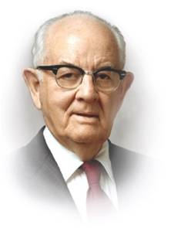
Record Keepers
Nephi declared that the people needed the records in order to keep the commandments of God; without them, they would “dwindle and perish in unbelief.”
“…those who keep a book of remembrance are more likely to keep the Lord in remembrance in their daily lives.”
--Spencer W. Kimball
1 Nephi 4:13

Slide 45
The Lord Provides a Way
When you strive to fulfill a command or a difficult task from the Lord, He will: (Choose one of the following)
a. Change the command so it will be simple and easy for you to accomplish.
b. Bless your efforts by providing a way for you to fulfill the command, even though it may still be difficult.
c. Intervene and do all the work for you.
d. Require you to do it entirely on your own without any help.

Slide 46
Doctrinal Mastery
“And it came to pass that I, Nephi, said unto my father: I will go and do the things which the Lord hath commanded, for I know that the Lord giveth no commandments unto the children of men, save he shall prepare a way for them that they may accomplish the thing which he commandeth them.”
1 Nephi 3:7

Slide 47
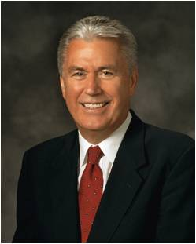
Gospel Principles
The Lord will bless us if we obey His commands without murmuring
God prepares a way for us to accomplish whatever He asks us to do
Following the Savior will not remove all of your trials. However, it will remove the barriers between you and the help your Heavenly Father wants to give you. God will be with you.
Dieter F. Uchtdorf

Slide 48
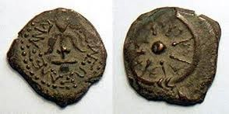
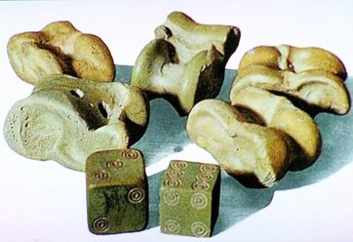
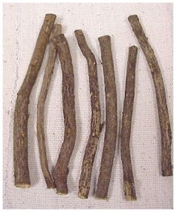
Attempt #1
Question: "What was the practice of casting lots?" Answer: The practice of casting lots is mentioned 70 times in the Old Testament and seven times in the New Testament. (Only 1 time in the Book of Mormon) In spite of the many references to casting lots in the Old Testament, nothing is known about the actual lots themselves. They could have been sticks of various lengths, flat stones like coins, or some kind of dice; but their exact nature is unknown. The closest modern practice to casting lots is likely flipping a coin.
Lot is cast to Laman
Got questions.com
1 Nephi 3:11

Slide 49
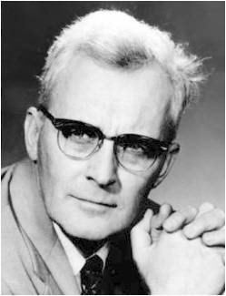
Laban
He commanded a garrison of fifty, that he met in full ceremonial armor with the ‘the elders of the Jews’ for secret consultations by night.
He had control of a treasury.
He was of the old aristocracy, being a distant relative to Lehi himself, that he probably held his job because of his ancestors.
His house was the storing place of very old records.
He was a large man.
He was short-tempered.
He was crafty, dangerous, and to the bargain cruel, greedy, unscrupulous, and weak.
He was “given to drink.”
--Hugh Nibley
1 Nephi 3:7

Slide 50
Attempt #2
Keeping an Oath
“Nephi and his brethren were seeking to obtain the brass plates from Laban. Their lives were in peril. Yet Nephi swore this oath: “As the Lord liveth, and as we live, we will not go down unto our father in the wilderness until we have accomplished the thing which the Lord hath commanded us.”
Thus Nephi made God his partner. If he failed to get the plates, it meant God had failed. And because God does not fail, it was incumbent upon Nephi to get the plates or lay down his life in the attempt.”
--Bruce R. McConkie
1 Nephi 3:15

Slide 51
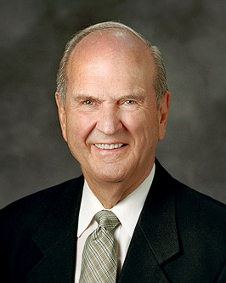
We can pray to our Heavenly Father and receive guidance and direction, be warned about dangers and distractions, and be enabled to accomplish things we simply could not do on our own. If we will truly receive the Holy Ghost and learn to discern and understand His promptings, we will be guided in matters large and small.
Russell M. Nelson
I actively seek Heavenly Father’s guidance and direction to help me with my challenges, questions, and decisions.
Often
Sometimes
Rarely
I trust in Heavenly Father’s ability and desire to guide my life by the Spirit.
Often
Sometimes
Rarely
I go forth with faith and act upon the promptings of the Holy Ghost, even when my path is unclear.
Often
Sometimes
Rarely
Choose the word that best fits your feelings

Slide 52
Trading Possessions
Gold, silver and precious things in trade for the Brass Plates
1 Nephi 3:22-26

Slide 53
Divine Intervention
Why were Laman and Lemuel angry with Nephi?
Who intervened Nephi’s persecution?
Why did they continue to murmur?
SEE: Parable of the Rich Man and Lazarus (Luke 16:19-30)
1 Nephi 3:27-31

Slide 54
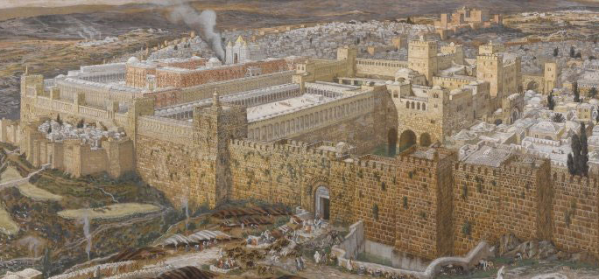
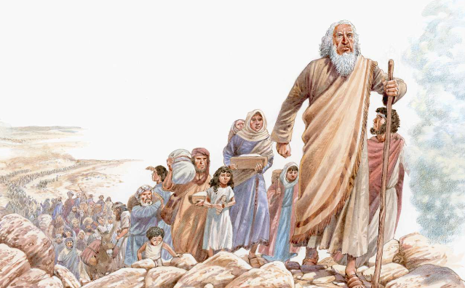
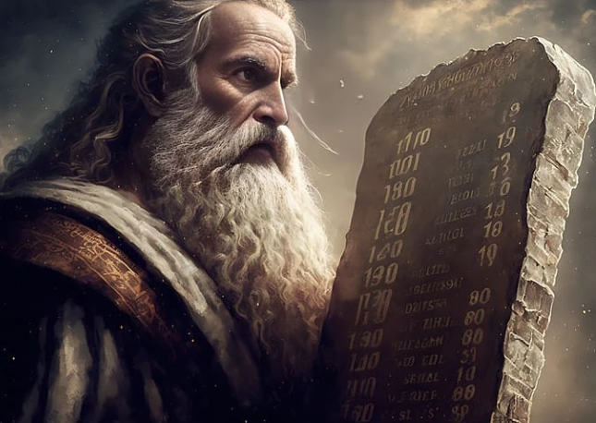
3rd Attempt: Let Us Go Up
Let us go up again unto Jerusalem
Let us go up; the Lord is able to deliver us
let us be strong like unto Moses;
1 Nephi 4:1-3

Slide 55
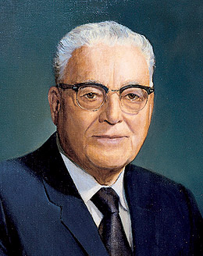
Faithfully Persist
“And I was led by the Spirit, not knowing beforehand the things which I should do.”
The Lord may inspire us to do something without immediately revealing how, when, or why we should do it.
Nephi learned how, when, and why the Lord would help him only after he allowed the Holy Ghost to direct him and after he decided to go forward in faith.
“You must learn to walk to the edge of the light, and perhaps a few steps into the darkness [the unknown], and you will find that the light will appear and move ahead of you”
--Harold B. Lee
1 Nephi 4:6

Slide 56
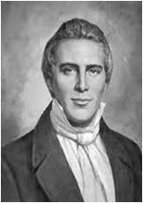
Exercising Faith
When we exercise faith in God and seek to do what He asks, even when we cannot see the outcome, He will lead us by the influence of the Holy Ghost.
What justification is there for a righteous man like Nephi to take the life of another person?
“God said, ‘Thou shalt not kill;’ at another time He said ‘Thou shalt utterly destroy.’ This is the principle on which the government of heaven is conducted—by revelation adapted to the circumstances in which the children of the kingdom are placed. Whatever God requires is right, no matter what it is, although we may not see the reason thereof till long after the events transpire.” –Joseph Smith
1 Nephi 4:7-19

Slide 57
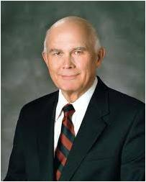
In my study of the scriptures I have noted that most revelation to the children of God comes when they are on the move, not when they are sitting back in their habitations waiting for the Lord to tell them the first step to take. …
So we do all we can.
Then we wait upon the Lord for His revelation.
Dallin H. Oaks
In times of uncertainty, we can receive guidance from Heavenly Father through the Spirit as we go forth with faith.

Slide 58
Laban’s Fate
To better understand the Lord’s command to slay Laban, it may help to remember the following:
The Lord gave Laban at least two chances to part with the brass plates before requiring his life. Laban was a liar and a robber, and he had at least twice sought to murder.
Under the law of Moses, stealing and attempted murder could both be punishable by death.
Exodus 21:14; 22:2 and Deuteronomy 24:7
2. The Lord wanted Lehi and his descendants to have the scriptural record contained in the brass plates, even if “one man should perish” for it to happen. The brass plates not only blessed the Nephite and Mulekite nations, they also provided some of the content of the gold plates (such as the quotations from Isaiah and from Zenos’ allegory of the tame and wild olive trees).
The Book of Mormon has blessed millions of people and will bless millions more. Ultimately, all of this was at stake when Nephi stood over Laban and followed the Spirit’s direction.
1 Nephi 4:14

Slide 59
Spiritual Impressions
“1. What do the standard works have to say about it? ‘To the law and to the testimony: if they speak not according to this word, it is because there is no light in them,’ said Isaiah. Isaiah 8:20 …
“We must diligently study the scriptures. Of special importance to us are the Book of Mormon and the Doctrine and Covenants …
“2. The second guide is: what do the latter-day Presidents of the Church have to say on the subject—particularly the living President? …
“There is only one man on the earth today who speaks for the Church. (See D&C 132:7; 21:4). That man is [the] President [of the Church]. Because he gives the word of the Lord for us today, his words have an even more immediate importance than those of the dead prophets. When speaking under the influence of the Holy Ghost his words are scripture. (See D&C 68:4) …
“3. The third and final test is the Holy Ghost—the test of the Spirit. By that Spirit we ‘… may know the truth of all things.’ (Moroni 10:5) This test can only be fully effective if one’s channels of communication with God are clean and virtuous and uncluttered with sin.”
--Ezra Taft Benson

Slide 60
Zoram the Servant
How to get away with the Brass Plates
Dressed like Laban
Disguised voice like Laban’s
Pretended to be Laban
Swore an oath to Zoram
An oath is the one thing that is most sacred and inviolable among the desert people and their descendants. “As the Lord liveth, and as I live.” 1 Nephi 4:32
1 Nephi 19-37

Slide 61
Sources:
Spencer W. Kimball Ensign May 1978
Brass plates http://en.wikipedia.org/wiki/Laban_(Book_of_Mormon)
Casting lots http://www.gotquestions.org/casting-lots.html#ixzz2VvE3sc3q
Hugh Nibley “Lehi in the Desert and the World of the Jaredites” page 111
Bruce R. McConkie Conference Report April 1982
Harold B. Lee (in Lucile C. Tate, Boyd K. Packer: A Watchman on the Tower [1995], 137–38).
Ezra Taft Benson Conference Report, Oct. 1963, 16–17).
Joseph Smith History of the Church, 5:135
Dieter F. Uchtdorf, “A Yearning for Home,” Ensign or Liahona, Nov. 2017, 22
Russell M. Nelson, “Revelation for the Church, Revelation for Our Lives,” Ensign or Liahona, May 2018, 94
Dallin H. Oaks, “In His Own Time, in His Own Way,” Ensign, Aug. 2013, 22–24
Presentation by ©http://fashionsbylynda.com/blog/

Slide 62
“J. W. Jack noted in 1938 that „excavations have shown a closer connection with the land of the Pharaohs that was suspected‟….Recently found ivories, seals, inscriptions, and the preliminary study of mounds throughout the land all tell the same story: over-whelming and unexpected preponderance of Egyptian influence, to the equally surprising exclusion of influences from Babylonia and Assyria...Elephantine papyri tell us an-other thing that scholars never dreamed of and which they were at first most reluctant to believe, namely, that the colonies of Jewish soldiers and merchants were entirely at home in upper Egypt, where they enjoyed free practice of their religion. The ties between Palestine and Egypt were, moreover, of a very long standing, centuries of „a common Hebrew-Egyptian environment‟ being necessary to produce the permeation of Egyptian modes of thought and expression into Hebrew…[A] near contemporary of Lehi can boast, „behold, are not the Ethiopian, the Syrian, and all foreigners alike instructed in the language of Egypt?‟ For centuries it was the custom of the princes of Syria to send their sons to Egypt to be educated.” (Hugh Nibley, Lehi in the Desert, 9-11)
Insight to Lehi’s Time by Hugh Nibley
“The discovery of the Elephantine documents in 1925 showed that colonies of Jews actually did flee into the desert in the manner of Lehi, during his lifetime, and for the same reasons; arriving in their new home far up the Nile, they proceeded to build a replica of Solomon's Temple, exactly as Lehi did upon landing in the New World. Both of these oddities, especially the latter, were once considered damning refutations of the Book of Mormon.” (Hugh Nibley, The Prophetic Book of Mormon, 388)
“The first three verses of 1 Nephi, sharply set off from the rest of the text, are a typical colophon, a literary device that is highly characteristic of Egyptian compositions. Typical is the famous Bremer-Rhind Papyrus, which opens with a colophon containing (1) the date, (2) the titles of Nasim, the author, (3) the names of his parents and a word in praise of their virtues, with special mention of his father’s prophetic calling, (4) a curse against anyone who might “take the book away,”….Compare this with Nephi’s colophon: (1) his name, (2) the merits of his parents, …(3) a solemn avowal (corresponding to Nasim’s curse) that the record is true, and the assertion, “I make it with mine own hand‟—an indispensable condition of every true colophon, since the purpose of a colophon is to establish the identity of the actual writer-down...of the text. Egyptian literary writings regularly close with the formula and thus it is,‟ and so it is.‟ Nephi ends the main sections of his book with the phrase, And thus it is, Amen‟”. (Hugh Nibley, Lehi in the Desert, 17)

Slide 63
Of Great Worth
1 nephi 5

Slide 64
Safe Return
Sariah’s complaints:
Lehi was a visionary man
Lehi had led the family away from the land of their inheritance
Lehi had made decisions that may have led to the loss of their sons and that could lead to their own deaths in the wilderness.
Are they just?
1 Nephi 5:1-3

Slide 65
Complaining
Did you know all the information?

Slide 66
Lehi’s response
A Testimony:
Lehi knew he is a visionary man
Lehi had seen God
Lehi knew the goodness of God
Lehi knew of the imminent destruction of Jerusalem
Lehi knew there was a better place (a land of promise) in which his family was to enjoy
Lehi knew that his sons would be safe
Lehi comforted his wife
1 Nephi 5:4-9

Slide 67
“... A successful union is the result of mature commitment, personal selflessness, unity, and loving understanding. Such a marriage includes the ability and willingness to share spiritual feelings, show love and affection, support and encourage each other, resolve normal and natural differences, and communicate effectively.”
--Spencer W. Kimball

Slide 68
Learning by Example
When we receive blessings from God, we can choose to pause and give Him thanks
And it came to pass that they did rejoice exceedingly and did offer sacrifice and burnt offerings unto the Lord; and they gave thanks unto the God of Israel.
Giving thanks always for all things unto God and the Father in the name of our Lord Jesus Christ;
Ephesians 5:20
1 Nephi 5:9

Slide 69
What Are These Worth To You?
One way to determine an object’s worth is by determining what people are willing to pay or exchange for the object.
In addition to their financial value, what are other ways these items could have worth?
1 Nephi 5:10-22

Slide 70
What Was the Sacrifice?
Nephi and his brothers risked their lives, sacrificed their riches, and traveled a long distance.
1 Nephi 5:10-22

Slide 71
Reading VS Searching
Quantity
Skimming
Can’t wait to finish
Skipping over mundane paragraphs
Setting the book aside after reading
Forgetting what was read
Putting the book out of mind
Quality
Stopping and pondering
Thirsting for more
Reading over and over again for understanding
Praying for spiritual impressions and writing down thoughts
Remembering what you felt when you read and the message that God had intended for you
Relating what you read to your life and how to make it better

Slide 72
As we search the scriptures, we can be filled with the Spirit and receive revelation
“When we want to speak to God, we pray. And when we want Him to speak to us, we search the scriptures; for His words are spoken through His prophets. He will then teach us as we listen to the promptings of the Holy Spirit.”
Robert D. Hales
1 Nephi 5:7-9

Slide 73
Enlarge my Soul
“When I say ‘study,’ I mean something more than reading. It is a good thing sometimes to read a book of scripture within a set period of time to get an overall sense of its message, but for conversion, you should care more about the amount of time you spend in the scriptures than about the amount you read in that time.
I see you sometimes reading a few verses, stopping to ponder them, carefully reading the verses again, and as you think about what they mean, praying for understanding, asking questions in your mind, waiting for spiritual impressions, and writing down the impressions and insights that come so you can remember and learn more.
Studying in this way, you may not read a lot of chapters or verses in a half hour, but you will be giving place in your heart for the word of God, and He will be speaking to you.
Remember Alma’s description of what it feels like:
‘It beginneth to enlarge my soul; yea, it beginneth to enlighten my understanding, yea, it beginneth to be delicious to me’ [Alma 32:28]”
D. Todd Christofferson

Slide 74
Of Great Worth
As we search the scriptures, we can discover their great worth for us.
“If you have not heard His voice speaking to you lately, return with new eyes and new ears to the scriptures. They are our spiritual lifeline.”
Robert D. Hales
1 Nephi 5:20-21

Slide 75
Concerning His Seed
Lehi was filled with the Holy Spirit and received revelation “concerning his seed” (his posterity).
We can be filled with the Holy Spirit and receive revelation.
Likewise, when we sacrifice our time and energy to search the scriptures as Lehi did, we can receive strength to keep God’s commandments.

Slide 76
What we can Learn
By Studying the Scriptures?
Who we are
What we can become
Prophecies for us and for our posterity
The commandments, laws, ordinances, and covenants we must live to obtain eternal life
How we must live in order to endure to the end and return to our Heavenly Father with honor
Robert D. Hales

Slide 77
Value of the Brass Plates
“The value of the Brass Plates to the Nephites cannot be overestimated. By means of them they were able to preserve the language (1 Nephi 3:19), most of the civilization, and the religious knowledge of the people from whence they came.
(1 Nephi 22:30.) By way of contrast, the Mulekites, who were led out of Jerusalem some 11 years after Lehi’s departure, and who had no record equivalent to the Brass Plates, soon dwindled in apostasy and unbelief and lost their language, civilization, and religion. (Omni 14-18.)
“From prophet to prophet and generation to generation the Brass Plates were handed down and preserved by the Nephites. (Mosiah 1:16; 28:20; 3 Nephi 1:2.) At some future date the Lord has promised to bring them forth, undimmed by time and retaining their original brightness, and the scriptural accounts recorded on them are to ‘go forth unto every nation, kindred, tongue, and people.’ (Alma 27:3-5; 1 Nephi 5:18-19.)”
--Bruce R. McConkie

Slide 78
Contents of Brass Plates
The first five books of the Old Testament (see 1 Nephi 5:11) |  | A. The book of Jeremiah
2. A valuable gift from the holy prophets (see 1 Nephi 5:13) |  | B. To help Lehi’s family and posterity keep God’s commandments
3. Writings of a prophet who lived in Jerusalem at the same time as Lehi (see 1 Nephi 5:13) |  | C. The books of Moses
4. A record of Lehi’s fathers (see 1 Nephi 5:14-16) |  | D. Will go forth to every nation, kindred, tongue, and people
5. The future of the plates of brass (see 1 Nephi 5:18) |  | E. Genealogy
6. Why Lehi’s family needed the plates of brass (see 1 Nephi 4:13-15) |  | F. Prophecies

Slide 79
Sources:
Spencer W. Kimball “For Husbands and Wives” September 1981 Ensign
Douglas Brinley “What Happily Married Couples Do” Jan. 2012 Ensign
D. Todd Christofferson “When Thou Art Converted,” Ensign or Liahona, May 2004
Robert D. Hales “Holy Scriptures: The Power of God unto Our Salvation,” Ensign or Liahona, Nov. 2006
Elder Bruce R. McConkie “Mormon Doctrine”, 2nd ed. [1966], pg. 103
Presentation by ©http://fashionsbylynda.com/blog/

Slide 80
Marriage 1 Nephi 5:4-7:
“A happy marriage is not so much a matter of romance as it is an anxious concern for the comfort and well-being of one’s companion.” If you want a happy marriage, do what happily married couples do. Pres. Gordon B. Hinckley “What God Hath Joined Together,” Ensign, May 1991, 73.
The description of Nephi 1 Nephi 5:11-13:
The brass plates of Laban contained the history of the Jews from the creation down to Lehi's day. It included the Old Testament prophecies written prior to Lehi's day. Even the prophecies of Lehi's contemporary, Jeremiah, were contained on the plates (see 1 Ne 5:13). Almost all the major Old Testament prophets' prophecies were recorded. The Nephite record would not have included prophecies from Daniel, Ezekiel, Micah, or Malachi. This is hinted at by the ministry of the Savior among the Nephites. At that time, the Lord made sure that the most important scriptures were a part of the Nephite record. This required Him to rehearse some of the Old Testament prophecies which were either of great doctrinal importance or which the Nephites did not have. A careful study of 3 Nephi demonstrates that he mostly quoted Isaiah, Micah, and Malachi.
The plates of brass represented a larger body of literature than our current Old Testament. This is apparent from the statement of Nephi, it (today's Bible) is a record like unto the engravings which are upon the plates of brass, save there are not so many (1 Ne 13:23). The plates of brass obviously contained a considerable body of literature no longer extant in our Old Testament. It contained the words of many prophets whose message, without the Book of Mormon, would have otherwise been lost to the world. These were men who clearly taught of a Messiah who would come in the flesh to redeem his people. These prophets include Zenock, Zenos, and Neum (see the Book of Mormon Index). Gospeldoctrine.com
Quick to Forgive 5 Nephi 4-7:
“Marriage partners must be quick to forgive. If we will sue for peace, taking the initiative in settling differences—if we forgive and forget with all our hearts … if we forgive all real or fancied offenses before we ask forgiveness for our own sins—if we pay our own debts, large or small, before we press our debtors—if we manage to clear our own eyes of the blinding beams before we magnify the motes in the eyes of others—what a glorious world this would be! Divorce would be reduced to a minimum; courts would be freed from disgusting routines; family life would be heavenly; the building of the kingdom would go forward at an accelerated pace; and the peace which passeth understanding would bring to us all a joy and happiness which has hardly ‘entered into the heart of man.’”
The Teachings of Spencer W. Kimball, ed. Edward L. Kimball (1982), 242.
"These plates of brass, contained the prophecies of all the holy Prophets from the beginning-from the days of Adam; hence they must have contained the prophecies of Enoch, Adam, Noah, Abraham, Isaac, Jacob, and Joseph in Egypt. The prophecies of Isaiah and many others of the holy Prophets were contained upon these plates of brass.
"Notwithstanding brass is a metallic substance capable of being dissolved and crumbling back, in a few years to the elements, yet there was a miracle wrought upon these plates of brass. The Prophet said that these plates of brass should not be dimmed by time, that God would preserve them to the latest generations. What for? In order that they might come forth and their contents be translated by the Urim and Thummim, that these contents might be declared to all nations, and kindreds, and tongues, and people, who were the descendants of Lehi upon the face of all this continent, from the frozen regions of the north to the very utmost extremities of South America. That all these nations should come to a knowledge of the things contained on those plates of brass." Orson Pratt (Journal of Discourses,16: 55)
1 Nephi 5:11 The five books of Moses are referred to as the "Pentateuch." The Bible dictionary states:
"A Greek word meaning the fivefold book; a name given to the five books that stand at the beginning of our Bible, and that contain the Torah or law of Israel. The Pentateuch was written by Moses, although it is evident that he used several documentary sources from which he compiled the book of Genesis, beside a divine revelation to him. It is also evident that scribes and copyists have left their traces upon the Pentateuch as we have it today; for example, the explanation of Moses' supposed death (Deut. 34:5-12) was surely added by a later hand. But latter-day revelation confirms that Moses was the author of the first five books of the Bible."
The first five books of Moses represent the most important of all Jewish canon. The Torah is the Jewish bible and contains nothing more than the first five books of Moses. The Talmud contains many other Old Testament writings, but these are considered to be less important - doctrinally and historically.

