Slide 1
Title Page, Introduction, and Testimonies of the Three and Eight Witnesses
The
Book
of
Mormon
ANOTHER TESTAMENT
OF JESUS CHRIST

Slide 2

What is the purpose of this tool?
How might this relate to understanding the purpose and value of the Book of Mormon?
Why does it help to know and understand the purpose of this tool?
The
Book
of
Mormon
How can I share this understanding with others?
ANOTHER TESTAMENT
OF JESUS CHRIST

Slide 3
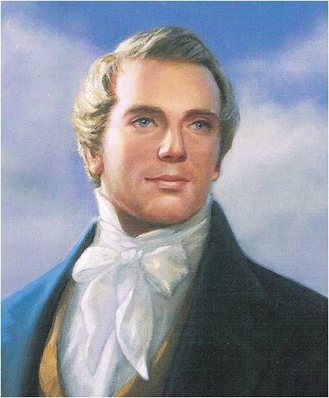
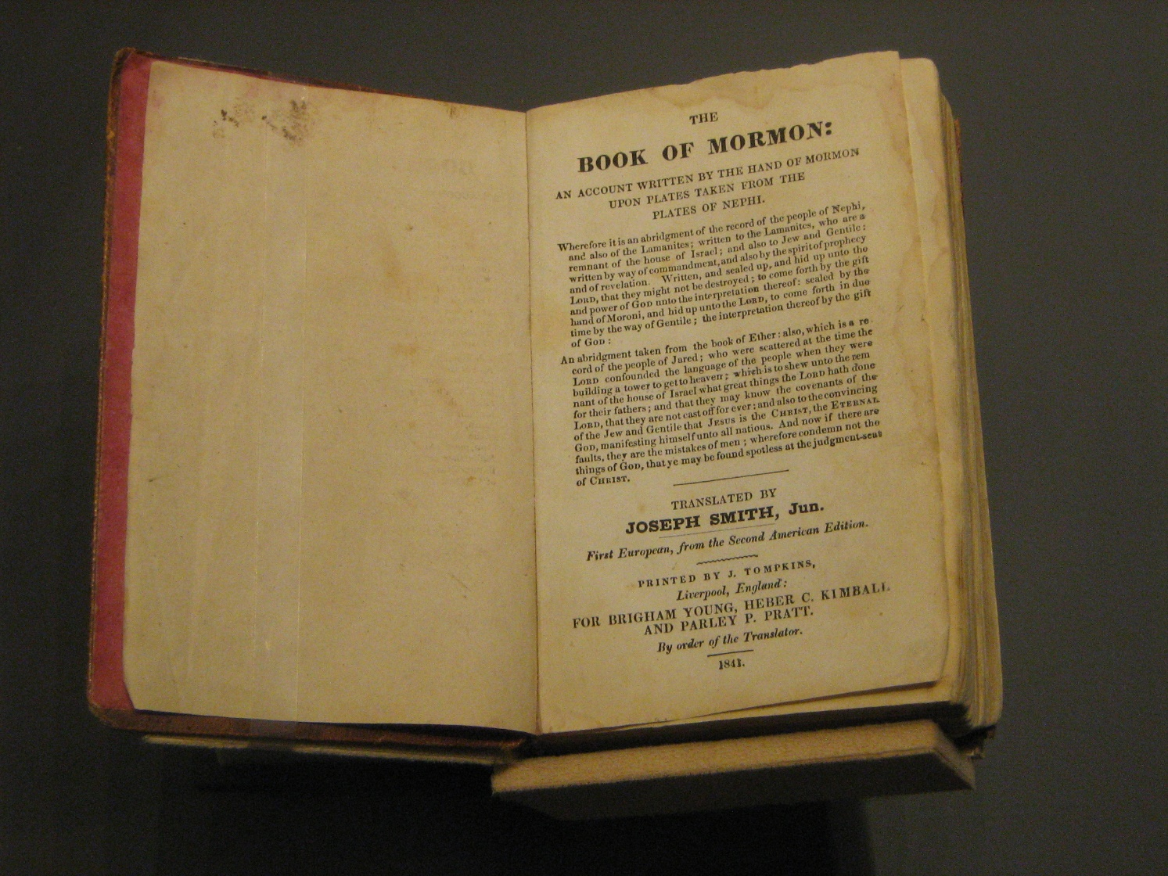
The Title Page
The Prophet Joseph Smith explained that this page is a literal translation of the words Moroni wrote on the final leaf of the golden plates. (1)
The Book of Mormon was written to convince all people that Jesus is the Christ.

Slide 4
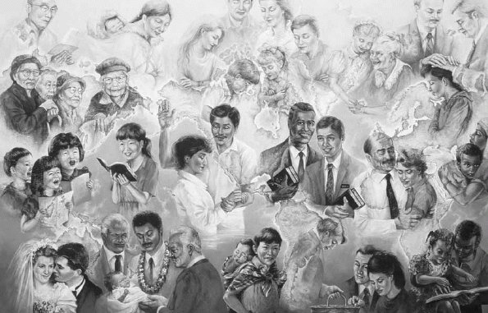

Who was the Book of Mormon written to?
Who is the Book of Mormon about?
Why was the Book of Mormon written?
The Book of Mormon was written to help gather Israel and convince all people that Jesus is the Christ.

Slide 5
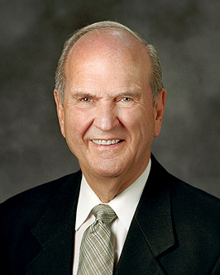
Gathering Israel
The Book of Mormon refers often to the covenant that the Lord has made to gather Israel.
[In] the Book of Mormon, you will learn the doctrine of the gathering, truths about Jesus Christ, His Atonement, and the fulness of His gospel not found in the Bible. The Book of Mormon is central to the gathering of Israel. In fact, if there were no Book of Mormon, the promised gathering of Israel would not occur. (4)

Slide 6
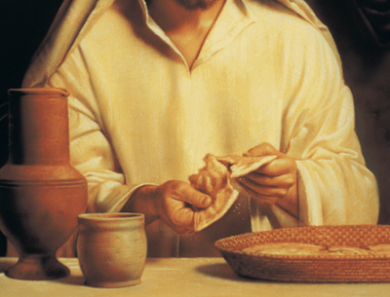
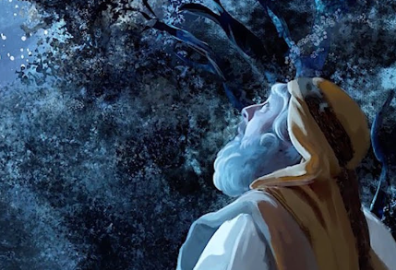
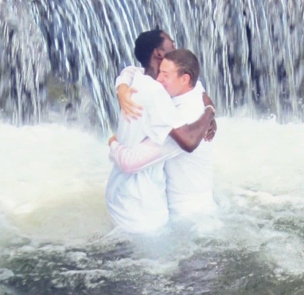
The Book of Mormon and Gathering Israel
Covenant with the Lord
1 Nephi 15:14–18
1 Nephi 22:11–12
2 Nephi 29:14
Mormon 9:36–37
Moroni 10:31
How would your life be different without the Book of Mormon?

Slide 7
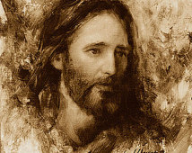
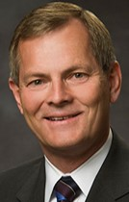
Understanding Jesus Christ
A title and is the Greek equivalent of the word Messiah, which means “the anointed.”
In the premortal existence, Jesus was anointed or chosen by Heavenly Father to be our Savior. (2)
Jared Barnes
You will pore through the passages of this precious book and encounter your beloved Savior, the Lord Jesus Christ, on nearly every page. It is estimated that some form of His name is used an average of once every 1.7 verses. (5}
How often does the Book of Mormon mention Jesus Christ?

Slide 8
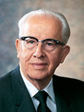
“The honest seeker after truth can gain the testimony that Jesus is the Christ as he prayerfully ponders the inspired words of the Book of Mormon.
J
E
S
U
S
“Over one-half of all the verses in the Book of Mormon refer to our Lord. Some form of Christ’s name is mentioned more frequently per verse in the Book of Mormon than even in the New Testament.
“He is given over one hundred different names in the Book of Mormon. Those names have a particular significance in describing His divine nature.”

Slide 9
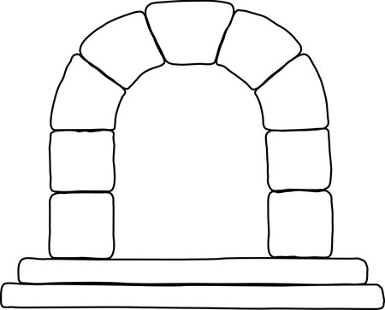
The Keystone
When an arch is constructed, the two sides are built up with external supports to hold them upright.
The space at the top of the arch is carefully measured, and the keystone is cut to fit it exactly.
When the keystone is put in place, the arch can stand without supports.

Slide 10
“I told the brethren that the Book of Mormon was the most correct of any book on earth, and the keystone of our religion, and a man would get nearer to God by abiding by its precepts, than by any other book.”

Slide 11

“There are three ways in which the Book of Mormon is the keystone of our religion. It is the keystone in our witness of Christ. It is the keystone of our doctrine. It is the keystone of testimony. …
Religion
Doctrine
“… Just as the arch crumbles if the keystone is removed, so does all the Church stand or fall with the truthfulness of the Book of Mormon.
The enemies of the Church understand this clearly. This is why they go to such great lengths to try to disprove the Book of Mormon, for if it can be discredited, the Prophet Joseph Smith goes with it.
Testimony
So does our claim to priesthood keys, and revelation, and the restored Church. But in like manner, if the Book of Mormon be true … then one must accept the claims of the Restoration and all that accompanies it.”
Accept

Slide 12
The Book of Mormon
Eternal Families
Knowledge of the Plan of Salvation
Priesthood Ordinances
The Restored Church of Jesus Christ
Keystone
Priesthood Keys
The Prophet Joseph Smith
Continuing Revelation
The Divinity of Jesus Christ

Slide 13
I trust others who have received their own personal testimony and have assured me that the Book of Mormon is true.
I am not sure if I know the Book of Mormon is true.
I have received a witness from the Holy ghost that the Book of Mormon is true.
Moroni 10:3-5

Slide 14
If we know the Book of Mormon is true, then we will also know that Jesus is the Christ, that Joseph Smith was a prophet of God, and that The Church of Jesus Christ of Latter-day Saints is the Lord’s kingdom on the earth today.

Slide 15
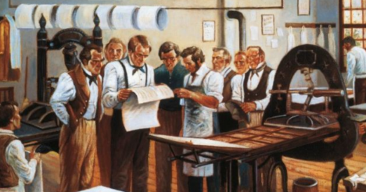
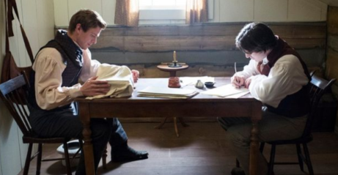
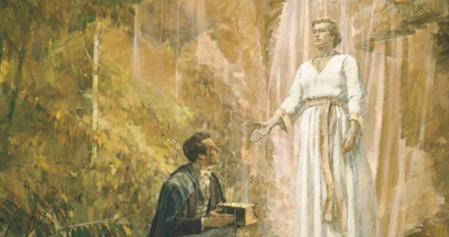
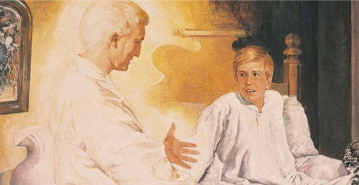
How do you think Joseph Smith might have felt during each of these events?

Slide 16
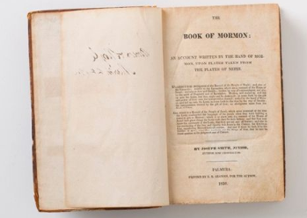
Joseph Smith brought forth the Book of Mormon by the gift and power of God

Slide 17
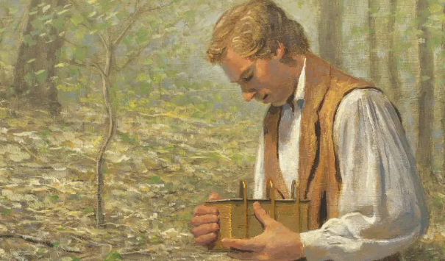
For a time, Joseph Smith was not allowed to show the gold plates to anyone. In fulfillment of prophecy, the Lord eventually revealed to Joseph that additional witnesses would be allowed to see the plates and testify of their reality.
READ
2 Nephi 27:12-14
However: the Lord provided multiple witnesses of the plates of the Book of Mormon.

Slide 18
Oliver Cowdery
David Witmer
Martin Harris
Testimony of Three Witnesses
They saw an angel holding the plates and heard the voice of God

Slide 19
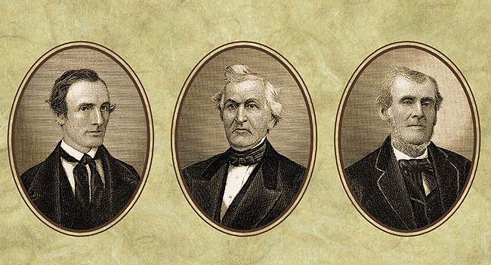
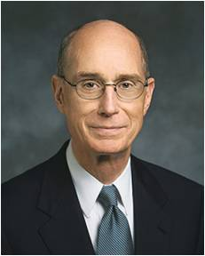
The Three Witnesses never denied their testimony of the Book of Mormon.
They could not because they knew it was true.
They made sacrifices and faced difficulties beyond what most people ever know.
Oliver Cowdery gave the same testimony about the divine origin of the Book of Mormon as he lay dying.
But in the times of trial, they wavered in their faith that Joseph was still God’s prophet and that the only way to come unto the Savior was through His restored Church.
That they continued to affirm what they saw and heard in that marvelous experience, during long periods of estrangement from the Church and from Joseph, makes their testimony more powerful. (6)

Slide 20
Testimony of Eight Witnesses
Christian Whitmer
Hyrum Page
Jacob Whitmer
Joseph Smith Sen.
Peter Whitmer Jun
Hyrum Smith
John Whitmer
Samuel H. Smith
They saw and handled the plates in an ordinary manner.

Slide 21
A Testimony of Your Own
As we read, ponder, and pray about the Book of Mormon, the Holy Ghost will witness that it is true
The
Book
of
Mormon
ANOTHER TESTAMENT
OF JESUS CHRIST

Slide 22
Sources:
Joseph Smith History of the Church,1:71.
Guide to the Scriptures “Messiah”.
Ezra Taft Benson, “Come unto Christ,” Ensign, Nov. 1987, 83; The Book of Mormon—Keystone of Our Religion,” Ensign or Liahona, Oct. 2011, 54, 55).
Russell M. Nelson and Wendy W. Nelson, “Hope of Israel [worldwide youth devotional, June 3, 2018],” supplement to the New Era and Ensign, 13, ChurchofJesusChrist.org.
Gary E. Stevenson, “Look to the Book, Look to the Lord,” Ensign or Liahona, Nov. 2016, 47.
Henry B. Eyring, “An Enduring Testimony of the Mission of the Prophet Joseph,” Ensign or Liahona, Nov. 2003, 90.

Slide 23
House of Israel refers to descendants of Abraham, Isaac, and Jacob. In addition, the house of Israel includes those who are not actual descendants of Abraham, Isaac, and Jacob but have accepted the message of the restored gospel and come into the restored Church through the necessary covenants and ordinances.
Jews originally referred to anyone from the tribe of Judah (one of the twelve tribes of Israel). Writers in the Book of Mormon, however, often used this term to refer to all those who lived in the Southern Kingdom of Judah in Old Testament times (2 Nephi 30:4; 33:8), even though they may have been descendants of other tribes of Israel (Alma 10:3). It also refers to “people who practice the religion, lifestyles, and traditions of Judaism but may or may not be Jewish by birth” (Guide to the Scriptures, “Jews,” scriptures.ChurchofJesusChrist.org).
Gentiles means “the nations” (Bible Dictionary, “Gentile”). “Sometimes it designates people of non-Israelite lineage, sometimes people of non-Jewish lineage, and sometimes nations that are without the gospel, even though there may be some Israelite blood among the people. This latter usage is especially characteristic of the word as used in the Book of Mormon and Doctrine and Covenants” (Guide to the Scriptures, “Gentiles,” scriptures.ChurchofJesusChrist.org).
An abridgment is a shortened version of something.
A remnant is a remaining part.

Slide 24
Daily Study:
I promise that as you prayerfully study the Book of Mormon every day, you will make better decisions—every day. I promise that as you ponder what you study, the windows of heaven will open, and you will receive answers to your own questions and direction for your own life. I promise that as you daily immerse yourself in the Book of Mormon, you can be immunized against the evils of the day, even the gripping plague of pornography and other mind-numbing addictions.
Whenever I hear anyone, including myself, say, “I know the Book of Mormon is true,” I want to exclaim, “That’s nice, but it is not enough!” We need to feel, deep in “the inmost part” of our hearts [Alma 13:27], that the Book of Mormon is unequivocally the word of God. We must feel it so deeply that we would never want to live even one day without it. (Russell M. Nelson, “The Book of Mormon: What Would Your Life Be Like without It?,” Ensign or Liahona, Nov. 2017, 62–63)
A Challenge:
In order to help the Book of Mormon become the keystone of your testimony, I offer you a challenge. I recently learned that many young people spend an average of seven hours a day looking at TV, computer, and smartphone screens. With this in mind, would you make a small change? Will you replace some of that daily screen time—particularly that devoted to social media, the internet, gaming, or television—with reading the Book of Mormon? If the studies I referred to are accurate, you could easily find time for daily study of the Book of Mormon even if for only 10 minutes a day. And you can study in a way that allows you to enjoy it and understand it—either on your device or in book form. (Gary E. Stevenson, “Look to the Book, Look to the Lord,” Ensign or Liahona, Nov. 2016, 46)
Historical Events:
After Joseph Smith had completed translating the Book of Mormon, he still had to find a publisher. This was not easy. The complexity of this lengthy manuscript and the cost of printing and binding thousands of copies were intimidating. Joseph first approached E. B. Grandin, a Palmyra printer, who refused. He then sought another printer in Palmyra, who also turned him down. He traveled to Rochester, 25 miles (40 km) away, and approached the most prominent publisher in western New York, who also turned him down. Another Rochester publisher was willing, but circumstances made this alternative unacceptable.
Weeks had passed, and Joseph must have been bewildered at the opposition to accomplishing his divine mandate. The Lord did not make it easy, but He did make it possible. Joseph’s fifth attempt, a second approach to the Palmyra publisher Grandin, was successful. (Dallin H. Oaks, “Opposition in All Things,” Ensign or Liahona, May 2016, 116)
Blessings of Studying the Book of Mormon:
It is not just that the Book of Mormon teaches us truth, though it indeed does that. It is not just that the Book of Mormon bears testimony of Christ, though it indeed does that, too. But there is something more. There is a power in the book which will begin to flow into your lives the moment you begin a serious study of the book. You will find greater power to resist temptation. You will find the power to avoid deception. You will find the power to stay on the strait and narrow path. The scriptures are called “the words of life” [Doctrine and Covenants 84:85], and nowhere is that more true than it is of the Book of Mormon. When you begin to hunger and thirst after those words, you will find life in greater and greater abundance. (Ezra Taft Benson, “The Book of Mormon—Keystone of Our Religion,” Ensign, Nov. 1986, 7)
Translation:
The translation process of the Book of Mormon was also a miracle. This sacred ancient record was not “translated” in the traditional way that scholars would translate ancient texts by learning an ancient language. We ought to look at the process more like a “revelation” with the aid of physical instruments provided by the Lord, as opposed to a “translation” by one with knowledge of languages. Joseph Smith declared that through God’s power he “translated the Book of Mormon from [hieroglyphs], the knowledge of which was lost to the world, in which wonderful event [he] stood alone, an unlearned youth, to combat the worldly wisdom and multiplied ignorance of eighteen centuries, with a new revelation.” The Lord’s help in the translation of the plates—or revelation, so to speak—is also evident when considering the miraculously short time Joseph Smith took to translate them. (Ulisses Soares, “The Coming Forth of the Book of Mormon,” Ensign or Liahona, May 2020, 33)

Slide 25
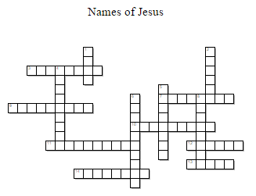
Across
3. One who leads
7. One who negotiates
9. One who comes to save
10. One who guides
11. One who comes
12. One who saves
13. Name of Christ
14. One who forgives
Down
Glory of God
Anointed One
One who protects
Meaning “God is with us”
6. One who makes peace
8. One who supports
Across
3. One who leads
7. One who negotiates
9. One who comes to save
10. One who guides
11. One who comes
12. One who saves
13. Name of Christ
14. One who forgives
Down
Glory of God
Anointed One
One who protects
Meaning “God is with us”
6. One who makes peace
8. One who supports
Word Bank:
Shepherd, Savior, Redeemer, Protector, Peacemaker, Mediator, Lord, Jesus, Emmanuel, Deliverer, Counselor, Christ, Bridegroom, Advocate
Word Bank:
Shepherd, Savior, Redeemer, Protector, Peacemaker, Mediator, Lord, Jesus, Emmanuel, Deliverer, Counselor, Christ, Bridegroom, Advocate

Slide 26
Acquiring Spiritual Knowledge
To examine doctrinal concepts, questions, and social issues with an eternal perspective, we consider them in the context of the plan of salvation and the teachings of the Savior.

Slide 27
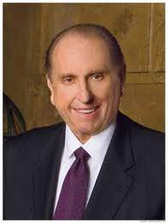
“The goal of gospel teaching… is not to ‘pour information’ into the minds of class members. … The aim is to inspire the individual to think about, feel about, and then do something about living gospel principles.”
*Pres. Thomas S. Monson

Slide 28
To enlarge our memory
Why Do We Read the Scriptures?
To convince us of error
To bring us knowledge of Christ
To bring us to repentance

Slide 29
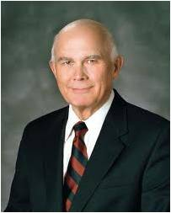
Because of our knowledge of this plan and other truths that God has revealed, we start with different assumptions than those who do not share our knowledge.
As a result, we reach different conclusions on many important subjects that others judge only in terms of their opinions about mortal life. (4)

Slide 30
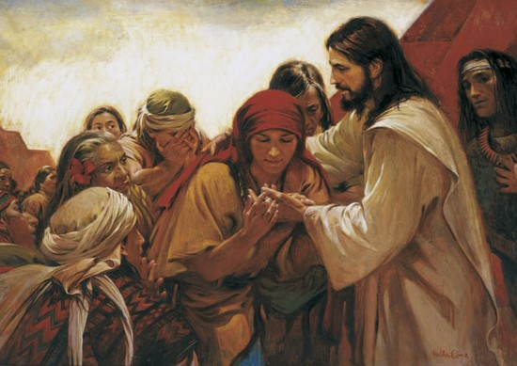
Understanding background and setting of the scriptures
“Become acquainted with the lessons the scriptures teach. Learn the background and setting of the Master’s parables and the prophets’ admonition. Study them as though they were speaking to you, for such is the truth.”
Pres. Thomas S. Monson

Slide 31
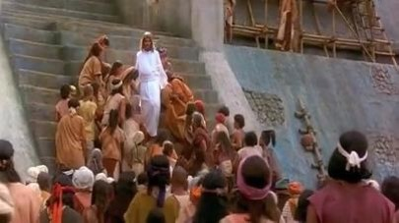
Questions to ask yourself while reading the Scriptures
Who is speaking in these verses?
To whom is he or she speaking?
What is happening in this account?

Slide 32
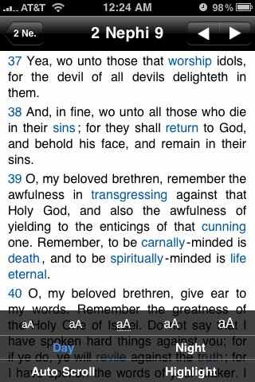
What do you do to gain a better understanding of the scriptures?
Looking up the meaning of difficult words
Using the footnotes and cross references
Examining the surrounding text
Reading the summaries at the beginnings of the chapter

Slide 33
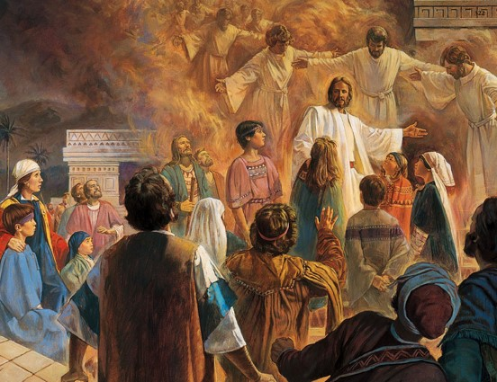
Who is narrating this account?
Who is speaking?
Who is receiving the message?
What has happened before this event?
What miracles occurred after He said that He would stay?
3 Nephi 17:1-10
3 Nephi 8-16
(prior information)

Slide 34
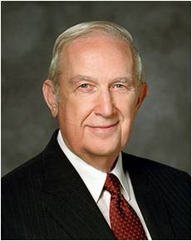
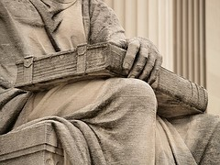
“Principles are concentrated truth, packaged for application to a wide variety of circumstances.”
Elder Richard G. Scott
*Doctrines and principles are eternal, unchanging truths of the gospel of Jesus Christ that provide direction for our lives.
Identifying and understanding doctrines and principles
Direct doctrine in phrases as
“thus we see”
Or
“therefore”
(Helaman 3:27-29 and Alma 32:16)

Slide 35

Other important questions to ask yourself while reading
What is the message of this story?
What did the writer intend for us to learn from this story?
What truths are taught in this passage of scripture?
Read again
3 Nephi 17:1-10 and ask these questions

Slide 36
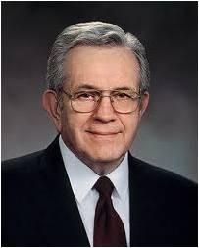
Applying doctrines and principles
“True doctrine, understood, changes attitudes and behavior. The study of the doctrines of the gospel will improve behavior quicker than a study of behavior will improve behavior. …that is why we stress so forcefully the study of the doctrines of the gospel”
Pres. Boyd K. Packer

Slide 37
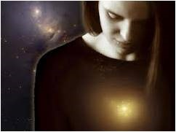
Application takes place when we do something about the principles we have learned.
A Greater Opportunity to Feel the Holy Spirit
“For behold, again I say unto you that if ye will enter in by the way, and receive the Holy Ghost, it will show unto you all things what ye should do.” (2 Nephi 32:5)
“And by the power of the Holy Ghost ye may know the truth of all things.” (Moroni 10:5)

Slide 38
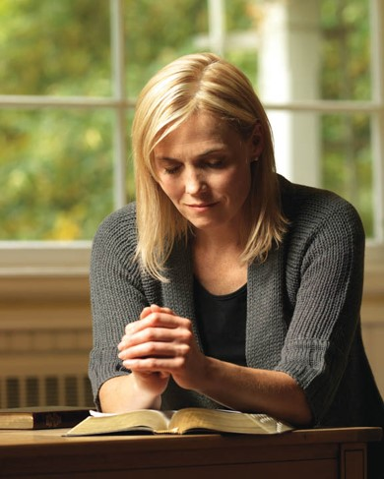
What does the Lord want me to do with this knowledge?
What difference can this make in my life?
What can I start or stop doing now to live my life a little better?
How will my life be better if I do this?
The Importance of Prayer before, during, and after personal scripture study

Slide 39
Sources
1.President Thomas S. Monson “Be Your Best Self” Ensign May 2009
2. Elder Richard G. Scott “Acquiring Spiritual Knowledge” Ensign Nov. 1993
3. President Boyd K. Packer “Little Children” Ensign Nov. 1986
4. Dallin H. Oaks, “As He Thinketh in His Heart” [evening with a General Authority, Feb. 8, 2013], broadcasts.ChurchofJesusChrist.org
Presentation by ©http://fashionsbylynda.com/blog/

Slide 40
Overview of the Book of Mormon
The
Book
of
Mormon
ANOTHER TESTAMENT
OF JESUS CHRIST

Slide 41
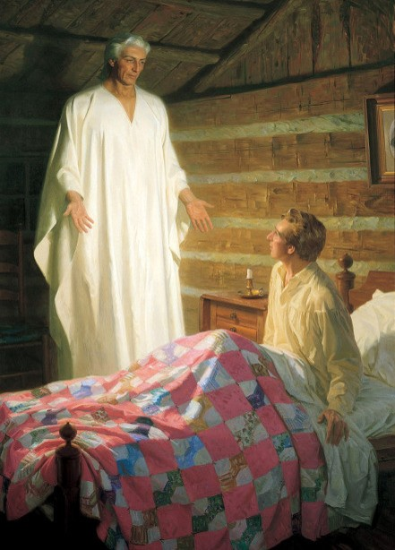
A Visit From Angel Moroni
Read:
Joseph Smith History 1:30, 32-35, 42
Read:
Joseph Smith History 1:51-54, 59-60
Joseph Smith was tutored 4 years by Moroni

Slide 42
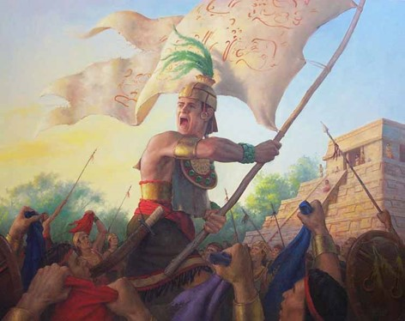
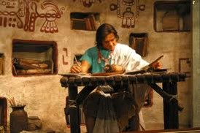
Introduction
A record of God’s dealing with ancient inhabitants of the Americas and contains the fulness of the everlasting gospel.
Written by many ancient prophets by the spirit of prophecy and revelation.

Slide 43
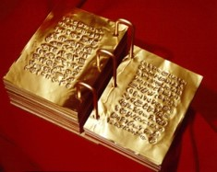
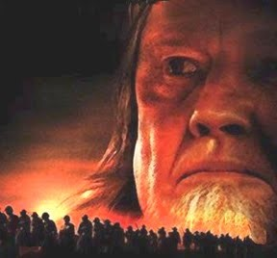
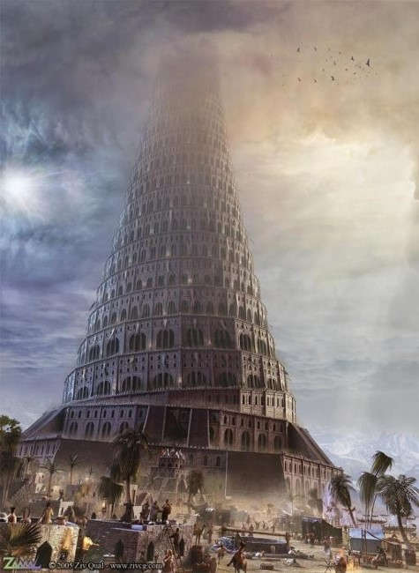
The Record-Written on Gold Plates
An account of two great civilizations.
One from Jerusalem in 600 B.C.—Nephites and Lamanites
Another account of when the Lord confounded the tongues at the Tower of Babel.
Jaradites

Slide 44
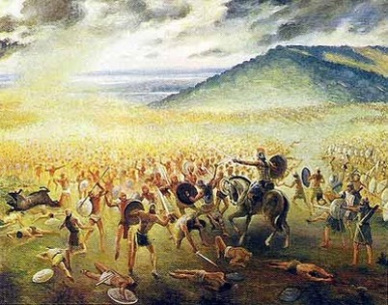
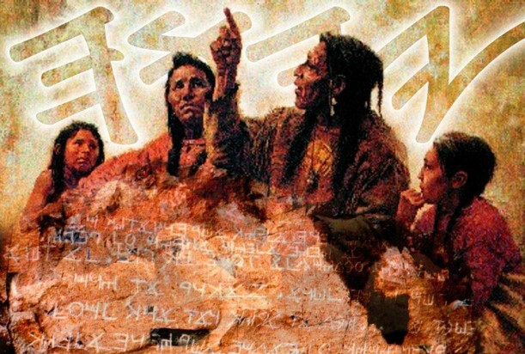
After Thousands of Years
All were destroyed except the Lamanites
They are among the ancestors of the American Indians

Slide 45
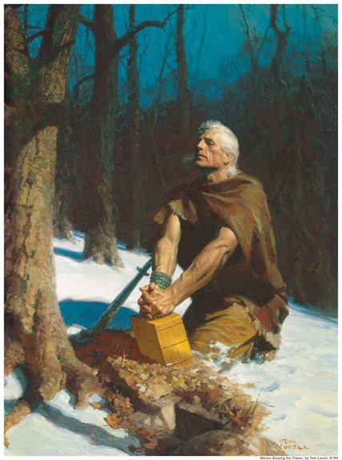
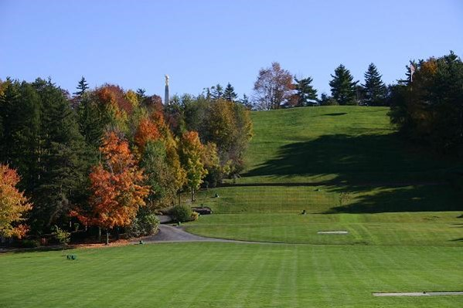
Delivering
Mormon completes his writing and delivered his account to his son Moroni
Moroni hid the plates in the Hill Cumorah.

Slide 46
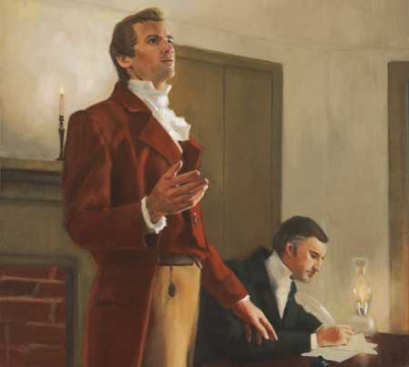
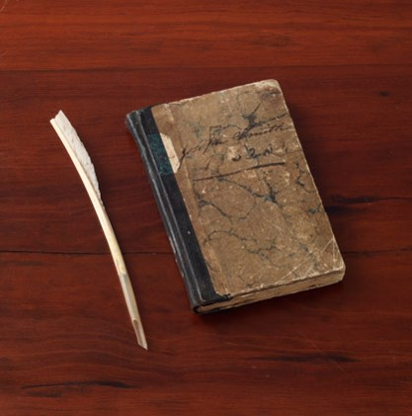
Most Correct
“I told the brethren that the Book of Mormon was the most correct of any book on earth, and the keystone of our religion, and a man would get nearer to God by aiding by its precepts, than by any other book.”
The Book of Mormon contains the fulness of the gospel of Jesus Christ
(1)

Slide 47
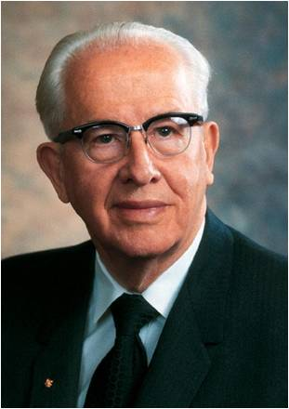
“The Lord Himself has stated that the Book of Mormon contains the ‘fulness of the gospel of Jesus Christ’ (D&C 20:9).
That does not mean it contains every teaching, every doctrine ever revealed.
Rather, it means that in the Book of Mormon we will find the fulness of those doctrines required for our salvation.
And they are taught plainly and simply so that even children can learn the ways of salvation and exaltation.”
(2)

Slide 48
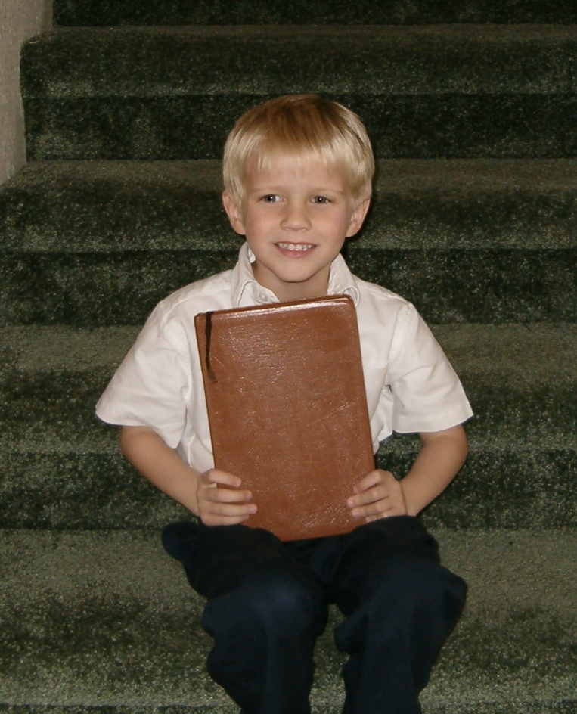
An Invitation To Read
the Book of Mormon
Read: Moroni 10:3-5

Slide 49
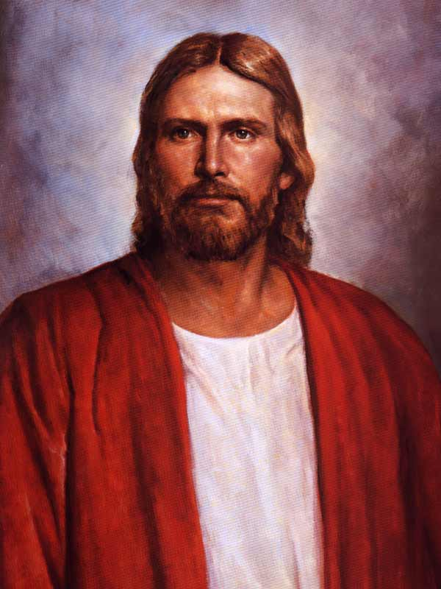
The Lord’s Kingdom
“Those who gain this divine witness from the Holy Spirit will also come to know by the same power that Jesus Christ is the Savior of the World, that Joseph Smith is His revelator and prophet in these last days, and that The Church of Jesus Christ of Latter-day Saints is the Lord’s kingdom once again established on the earth, preparatory to the Second Coming of the Messiah.”
(3)

Slide 50
The Record Keepers
1 Nephi 6:4–6
2 Nephi 25:23, 26
Words of Mormon 1:4–8
Mormon 8:1, 34–35
“Each of the major writers of the Book of Mormon testified that he wrote for future generations. … (2)

Slide 51
“If they saw our day, and chose those things which would be of greatest worth to us, is not that how we should study the Book of Mormon?
We should constantly ask ourselves, ‘Why did the Lord inspire Mormon (or Moroni or Alma) to include that in his record?
What lesson can I learn from that to help me live in this day and age?’”
(2)

Slide 52
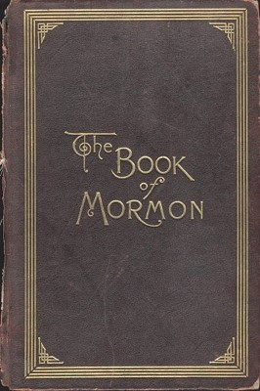
Sources:
Joseph Smith History of the Church, 4:461
Ezra T. Benson (“The Book of Mormon—Keystone of Our Religion,” Ensign, Nov. 1986, 6).
Introduction to the Book of Mormon
Presentation by ©http://fashionsbylynda.com/blog/

Slide 53
The Book of Mormon contains answers to life’s most meaningful questions.
Is there a God? | Alma 30:37-44
Can I know God? | Alma 22:18
Does God care about me? | 3 Nephi 13:26-32
How can I resist temptation and sin? | Helaman 5:12
What is the purpose of life? | Alma 34:32-34
Is there life after death? | Alma 40:11-12, 21-23
How can I find peace and joy and be happy? | Mosiah 2:41; 4:2-3; Alma 41:10
How can my family be happier and more united? | Mosiah 4:14-15
How can I judge between right and wrong? | Moroni 7:16-17
Why does God allow evil and suffering to occur? | 2 Nephi 2:1-2, 11-16, 22-27; Alma 14:9-11; 60:13

Slide 54
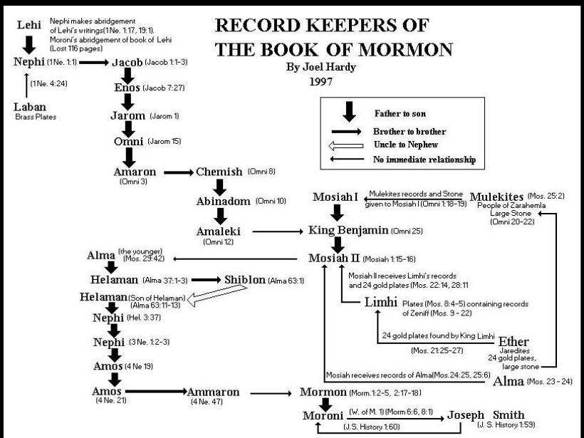

Slide 55
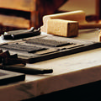
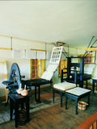
Printing of the book, An Introduction:
The Book of Mormon was first printed and sold in the Grandin Building located in downtown Palmyra, New York. After translating the golden plates, Joseph Smith "agreed with Mr. Egbert B. Grandin to print five thousand copies"1 of the Book of Mormon. Publication of the book was financed by Martin Harris, a family friend who mortgaged part of his farm to guarantee the $3,000 printing cost.
In mid-August 1829, the Prophet Joseph, with Martin Harris, Oliver Cowdery, Hyrum Smith, Joseph Smith Sr., and several others gathered around Grandin's press to print and inspect a proof sheet. Joseph declared the work was "excellent," and printing of the book began.2 The Book of Mormon was first offered for sale in Grandin's bookstore on March 26, 1830, as another witness of the divinity and mission of Jesus Christ. It also provides tangible evidence of the prophetic calling of Joseph Smith.
The Church purchased the Grandin Building in 1978 and opened it as a historic site several years later. At the conclusion of extensive restoration in 1998, the building was dedicated as the Book of Mormon Historic Publication Site.
https://history.lds.org/article/historic-sites/new-york/book-of-mormon-publication-site-palmyra?lang=eng

