Slide 2
Your Own Future
In what ways could Satan interfere with these goals?

Slide 3
Background
The Zoramites dissented from the Nephites
Alma feared the dissenters would join with the Lamanites, so he endeavored to preach the word of God to them
Those who believed in Alma’s preaching were cast out by the unbelieving Zoramites, who feared the loss of their wealth and power if conversion were widespread
These castaways were given asylum by the “People of Ammon” and lived in the land of Jershon
The wicked Zoramites protested this action and threatened the people of Ammon
The dissenting Zoramites mixed with the Lamanites in an attempt to stir them up to war against the people of Ammon
The Ammonites and the converted Zoramites were evacuated to the land of Melek, and the Nephite armies occupied the land of Jershon
There was a possibility of war
Student Manual

Slide 4
Teaching and Preparation
A Review
Alma sent his sons among the Nephites to call them to repentance
The apostate Zoramites became Lamanites
The Lamanites moved into the land of Antionum in preparation for an attack upon the Nephites
The Lamanite leader was Zerahemnah
18th Year of the Reign of the Judges
Alma 43:1-6

Slide 5
Zerahemnah
He was a Lamanite general around 74 BC
He was offered an ultimatum to surrender his weapons and enter into a covenant to desist from warfare, or be killed
He wanted to deliver up their weapons but not take the oath to never come and war again
Moroni, a Nephite Captain, would not save them unless he would surrender his weapons and take the oath of covenant
One of Moroni’s men scalped Zerahemnah with the sword
The protector raised the scalp of Zerahemnah with the point of the sword and demanded peace
Many Lamanites surrendered their weapons and made a covenant of peace and retreated to the wilderness
Later he retracted his claim and swore an oath of peace and Moroni disarmed the enemy and sent them into the wilderness
Who’s Who

Slide 6
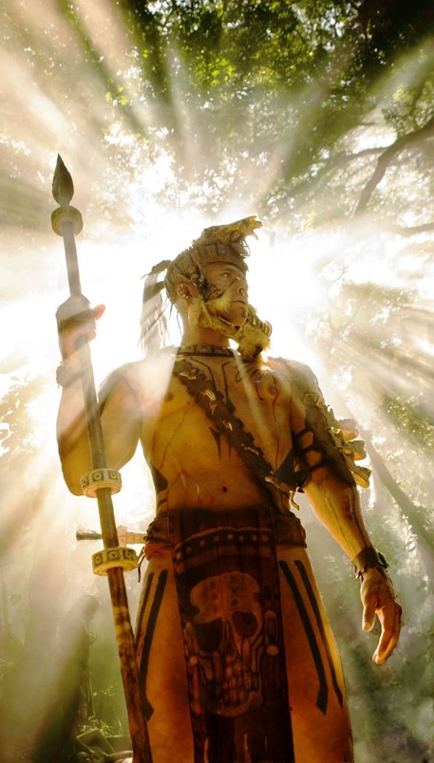
Zerahemnah’s Army
The army was made up of Lamanites, Zoramites, and Amalekites
Because the Amalekites were more wicked than the Lamanites Zerahemnah made them chief captains over the Lamanites, even the Zoramites
They fought for their hatred toward the Nephites in hopes of bringing them into subjection--bondage
Alma 43:6-8

Slide 7
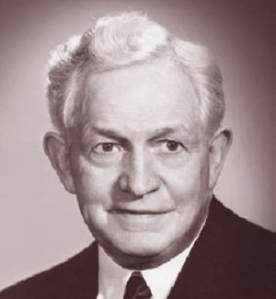
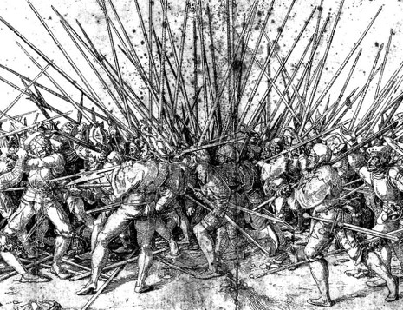
War
Nearly 1/3 of the Book of Mormon is about war
“There are, however, two conditions which may justify a truly Christian man to enter—mind you, I say enter, not begin—a war.
An attempt to dominate and to deprive another of his free agency;
Loyalty to his country.
Possibly there is a third, viz, Defense of a weak nation that is being unjustly crushed by a strong, ruthless one.”
David O. McKay
Mormon knew that we would live in a day of “wars and rumors of wars.” D&C 45:26
“War is an ugly thing…It causes men to do things they might not normally do. It breaks up families and causes hatred, immorality, and cheating. Those who have been involved in war are usually reluctant to recall or even to speak of what they have witnessed.”
Student Manual

Slide 8
Captain Moroni
He was chief commander of the Nephite armies from around 74 BC until his retirement, not long before his death in 56 BC
He was a strong and mighty man with a ‘perfect understanding’
He was 25 years old when he was appointed chief captain
He did not ‘delight in bloodshed’
He believed in liberty and freedom of his country
He is known in connection with the “title of liberty”
Because of his leadership the people were able to take an effective stand against the Lamanites
He planned many years of action and sought the guidance and blessings of God
Eventually there was a peace for the Nephites for about 18 years
In about 56 BC he yielded up the command of his armies to his son, Moronihah, and spent his remaining years in peace
Who’s Who

Slide 9
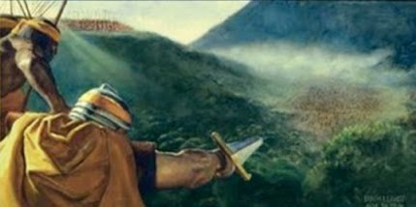
Nephite Army
The army was made up of Nephites, yet the “People of Ammon” did not join the army
Moroni was appointed to be chief captain over the Nephites
They fought for their land, houses, wives, and children…they were fighting for liberty
Alma 43:9-12, 16

Slide 10
Attitudes of War
War is basically selfish
War impels you to hate your enemies
War originates in the hearts of men
War is rebellious and seeks to destroy morality
War is Incompatible with Christ’s teachings
David O. McKay

Slide 11
Justifying War
I fight for my land
I fight for my home
I fight for my wife and children
I fight for my freedom
It is our duty to defend our families, our religion, and our liberties
“Without freedom of thought, freedom of choice, freedom of action within lawful bounds, man cannot progress.” --David O. Mckay
Alma 43:9

Slide 12
Preparations
The Nephites had:
Breastplates, arm-shields, shields for their heads, and thick clothing
The Lamanites:
Swords, cimeters, bows and arrows, stones for their slings.
They were naked save a ‘skin girded about their loins’
Amalekites and Zoramites:
Did not have breastplates, or shields
Alma 43:18-21

Slide 13
Defending Ourselves
Having Faith in Jesus Christ
Seeking guidance of our Prophets
Pray continually
Repenting of wrongdoing
Applying the scriptures in our lives
Living righteously
Having Peace in our hearts
Living the Gospel to the fullest
Alma 43:18-21

Slide 14
Prayer For Inspiration
Moroni sent spies to the camp of the Lamanites
Moroni sent a messenger to Alma to inquire of the Lord whether to defend themselves or not
The message of the Lord was to go into battle with the Lamanites
As we pray for help in accomplishing our righteous plans and desires, God will help us accomplish them
Alma 43:23-24

Slide 15
Moroni’s Strategy
Moroni left part of the army in the Land of Jershon and took the remaining army to Manti
Land Bountiful
West Sea
East Sea
Jershon
Moroni placed spies near the bank of the river Sidon
Hill Riplah
Zarahemla
Manti
Then he divided the army and placed them on the southeast side of Hill Riplah
Jerusalem
Land of Nephi
Alma 43:25-35

Slide 16
Lehi— A Nephite General
He was an excellent field general around 74 BC
As Moroni crossed the River Sidon…Lehi and his army came up behind the Lamanites
There was a severe battle between the Nephites and the Lamanites. Lehi held his army firm on the east of the River Sidon’s shore
In around 72 BC Lehi was appointed captain over the city of Noah
The Lamanites attacked the city of Noah…however they were driven back
Lehi assisted in the defeat of the Lamanites near Bountiful (Alma 52:27-40)
He was placed in charge of the city of Mulek…one of the chief cities of the Lamanites in the land of Nephi
After the insurrection in Zarahemla…Moroni left Lehi and Teancum in charge of the forces in the field in about 61 DC and returned to claim the capital
He was also victorious in the battle in the land of Moroni and peace was restored in around 60 BC
He later assisted in defeating the Lamanite armies in Zarahemla (Helaman 1:28-30)
Who’s Who

Slide 17
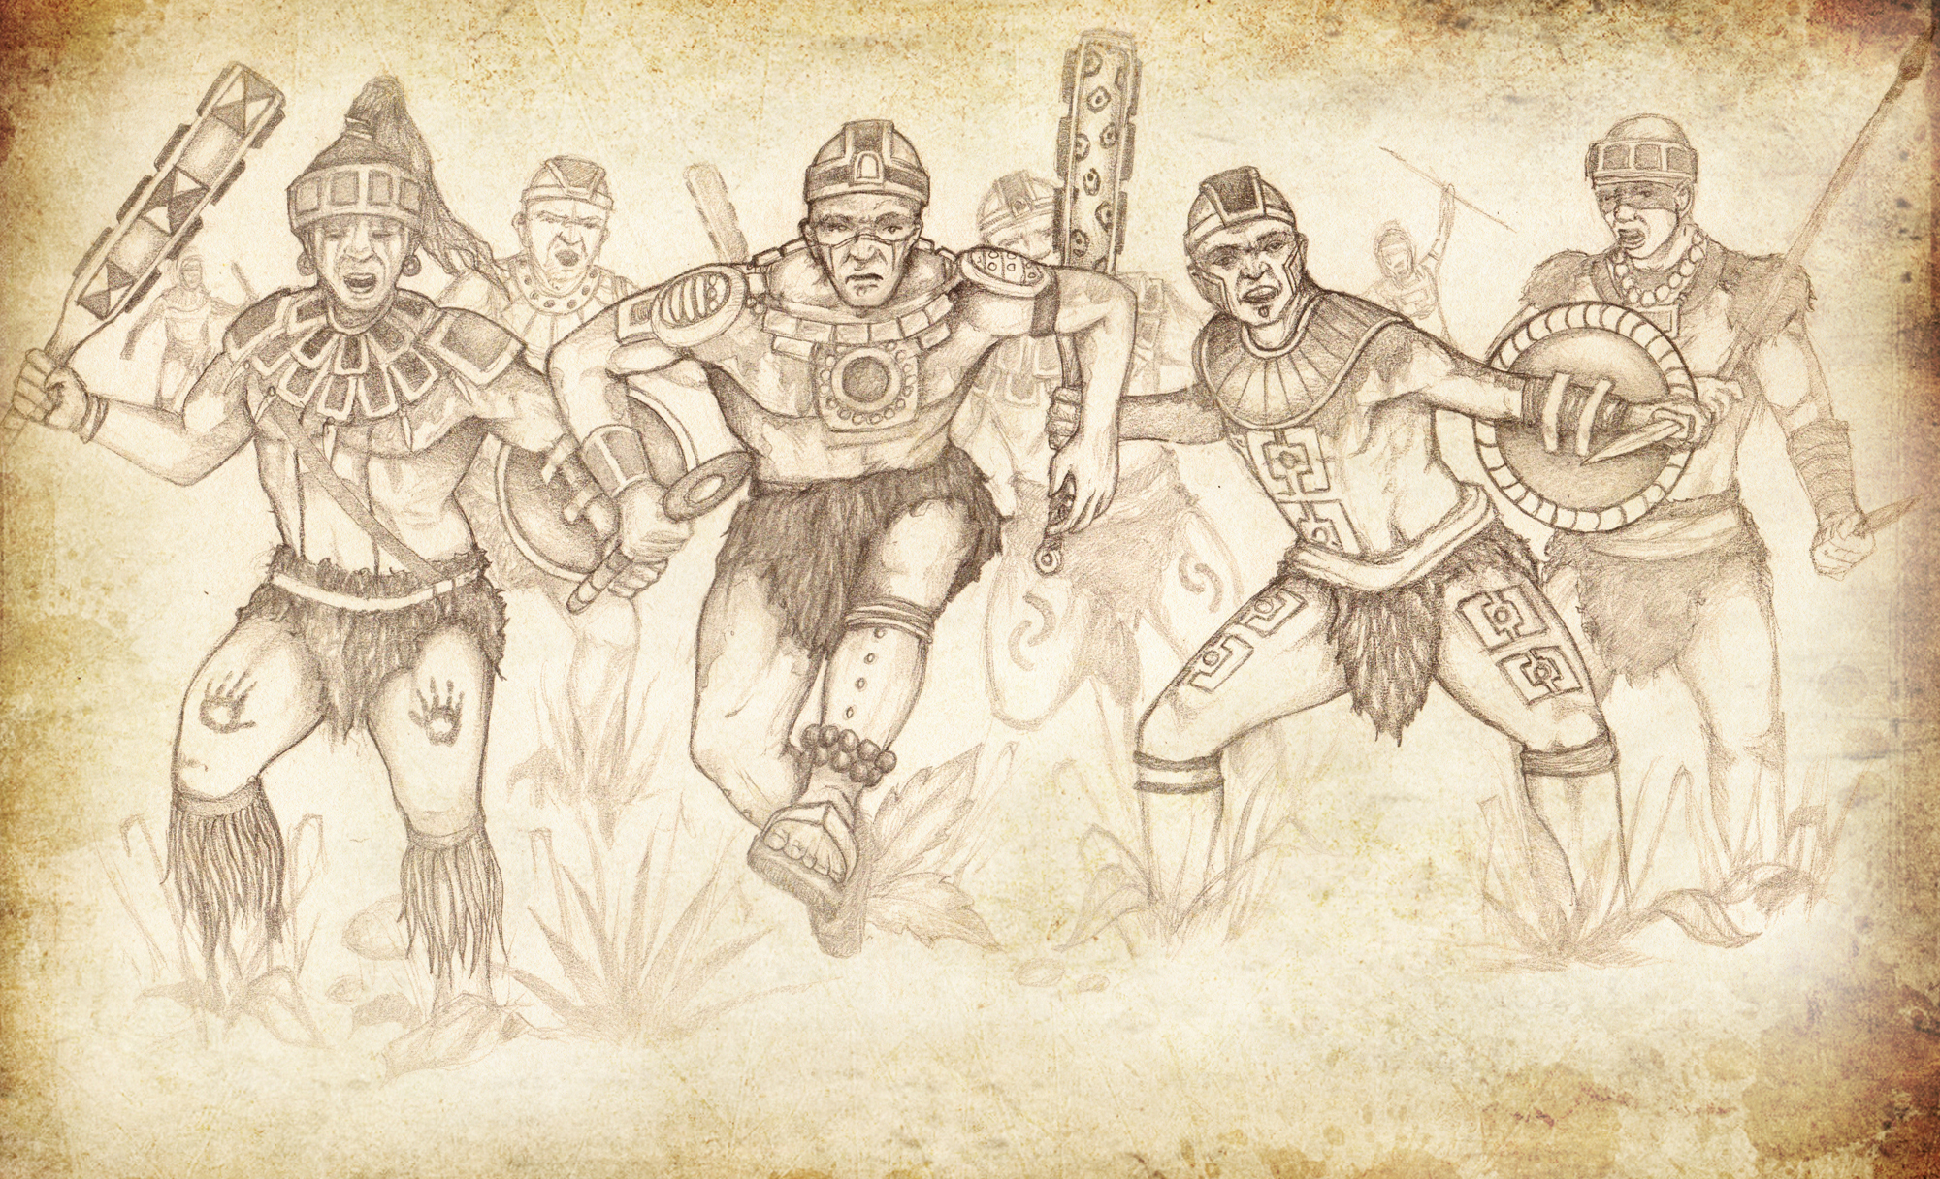
The Fate of the Lamanites
The forces of the Nephite army came from the front of them and behind them
Death was brought to them in almost every stroke (vs. 37)
Loss of Blood
They tried to shield themselves better
There was great destruction and they began to flee towards the River Sidon
They were pursued by Lehi’s army and they wouldn’t let the Lamanites cross the river
They tried to flee towards the land of Manti and met with Moroni’s army
They fought like dragons
Jody Livingston
Alma 43:35-43

Slide 18
The Fate of the Nephites
There was a great many lost
They were inspired by a better cause
They fought for their freedom
“Ye shall defend your families even unto bloodshed.”
They began to stand against the Lamanites with power
They encircled them about at the river Sidon
When Moroni saw the terror of the Lamanites he caused his men to stop shedding their blood
The Lord will help us fulfill our duty to defend our families, our liberty, and our religion
Alma 43:45-54

Slide 19
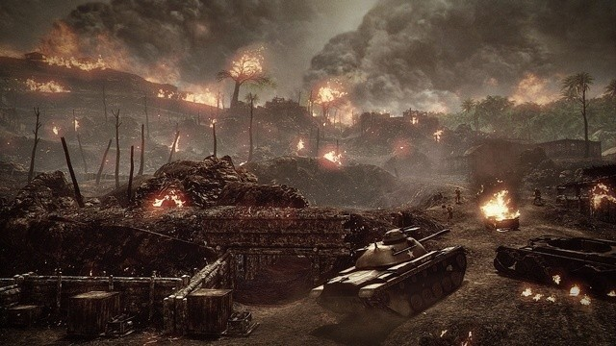
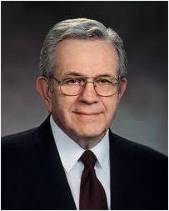
What About Today?
“Youth today are being raised in enemy territory with a declining standard of morality. But as a servant of the Lord, I promise that you will be protected and shielded from the attacks of the adversary if you will heed the promptings that come from the Holy Spirit.
“Dress modestly; talk reverently; listen to uplifting music. Avoid all immorality and personally degrading practices.
Take hold of your life and order yourself to be valiant. Because we depend so much on you, you will be remarkably blessed. You are never far from the sight of your loving Heavenly Father”
Boyd K. Packer

Slide 20
Making a Covenant—Laying down swords
Moroni knows the Lamanites are angry with them because of their religion and faith in Christ
Moroni desires not to fight
They also don’t want to be overpowered and ‘come into bondage’
Zerahemnah knows his army is surrounded
Zerahemnah is willing to give up their weapons but will not take the oath and they would not believe in their God
Moroni commands that Zerahemnah make a covenant and deliver up their weapons, to not fight anymore and leave and never come back
Zerahemnah knows the Lamanites would break the oath and come back and fight
Moroni returns the weapons that Zerahemnah gave to him and said, “Behold, we will end the conflict.”
Alma 44:1-11

Slide 21
The Lord Delivers —The Lord Takes away
One of Moroni’s soldiers “smote it even to the earth, and it broke by the hilt”
Zerahemnah was angry with Moroni and rushed forward that he might slay Moroni
Zerahemnah withdrew from before them into the midst of his soldiers
“…and he also smote Zerahemnah that he took off his scalp and it fell to the earth”
The Lamanites had been warned that they would die unless they give up their weapons and make a covenant of peace
Many were ‘struck with fear’ and threw down their weapons and entered into a covenant of peace…then departed into the wilderness
Alma 44:12-15

Slide 22
Making a Covenant— Laying down swords
Moroni commands his army to slay the Lamanites that had remained
Zerahemnah continues to fight
They fight with all their might, but to no avail
When Zerahemnah saw that they were about to be destroyed he did promise he would make the covenant and never come to war against them again
Moroni caused the work of death to be ceased and he took their weapons
They departed into the wilderness
Alma 44:19-20

Slide 23
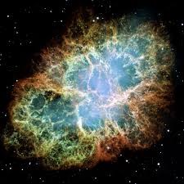
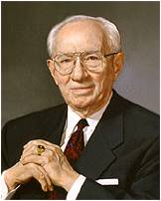
The War Goes On
“There is [a] war that has gone on since before the world was created and which is likely to continue for a long time yet to come. …
“That war … is the war between truth and error, between agency and compulsion, between the followers of Christ and those who have denied Him. His enemies have used every stratagem in that conflict. …
“… It is as it was in the beginning. … The victims who fall are as precious as those who have fallen in the past. It is an ongoing battle. …
“The war goes on. … It is waged in our own lives, day in and day out, in our homes, in our work, in our school associations; it is waged over questions of love and respect, of loyalty and fidelity, of obedience and integrity. We are all involved in it.
… We are winning, and the future never looked brighter” --Gordon B. Hinckley

Slide 24
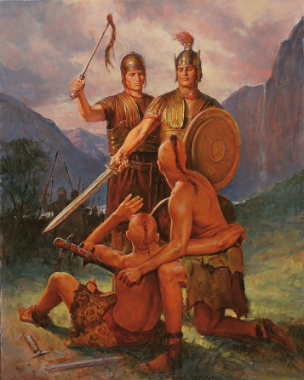
Sources:
Videos:
Fight For Families (1:43)
Captain Moroni: Firm in the Faith (time codes 2:48-11:04
What is Religious Freedom
David O. McKay Conference Report, April 1942 pg 72
Book of Mormon Who’s Who Ed J. Pinegar and Richard J. Allen pg. 124-125, 197-198
"Lamanite" Warrior from Apocolypto [source: Icon Distribution]
Boyd K. Packer (“Counsel to Youth,” Ensign or Liahona, Nov. 2011, 18).
Gordon B. Hinckley (“The War We Are Winning," Ensign, Nov. 1986, 42, 44–45).
Presentation by ©http://fashionsbylynda.com/blog/

Slide 25
Nephite Plans
Lamanite Plans

