Slide 1
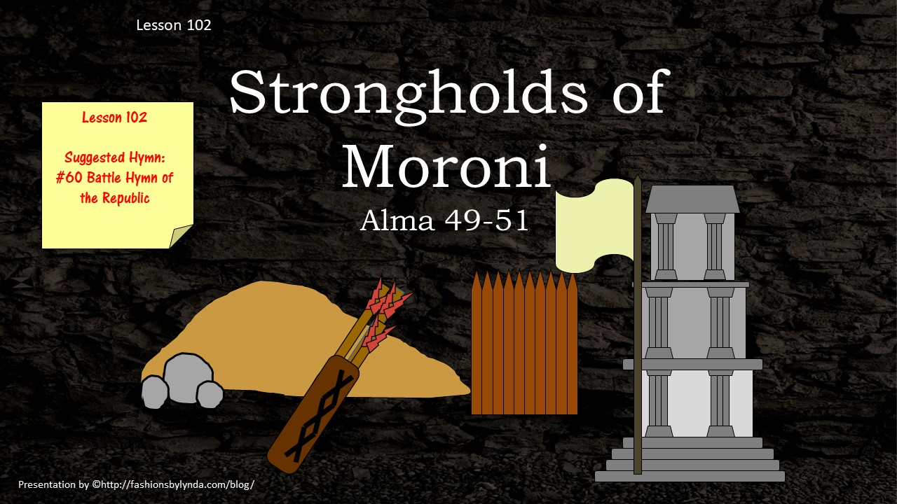

Slide 2

Ammonihah
The Lamanites were seen approaching towards the land of Ammonihah
The city had been rebuilt and Moroni had stationed an army by the borders of the city
Ammonihah
Zarahemla
North
Nephi
Alma 49:1-4

Slide 3
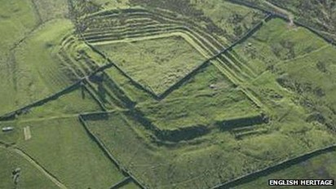
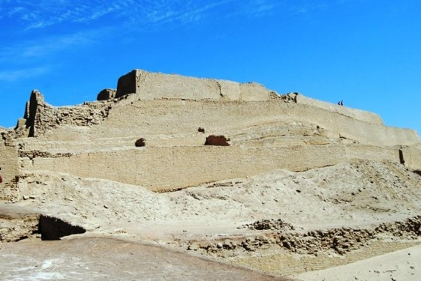
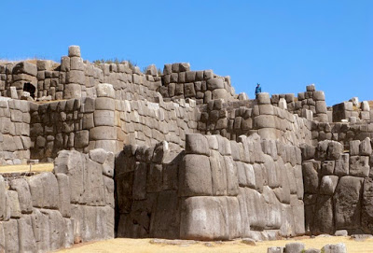
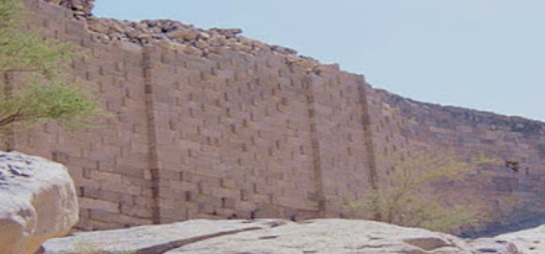
A Ridge of Earth
The Nephites had dug up a ridge of earth
They dug around their city so high that the Lamanites could not throw stones or arrows beyond the earth
Alma 49:4

Slide 4
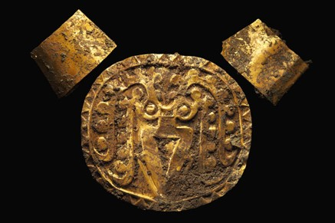
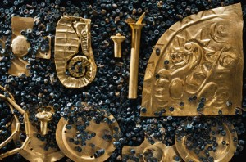
Frustration
The Lamanites had prepared themselves with shields, breastplates and covered themselves with ‘garments of skin’
They thought with their numbers they could overpower the Nephites
Amalickiah did not come down from the city of Nephi himself to battle—if he would have he would have attacked the Nephites in Ammonihah
The Lamanites retreated
Alma 49:5-12

Slide 5
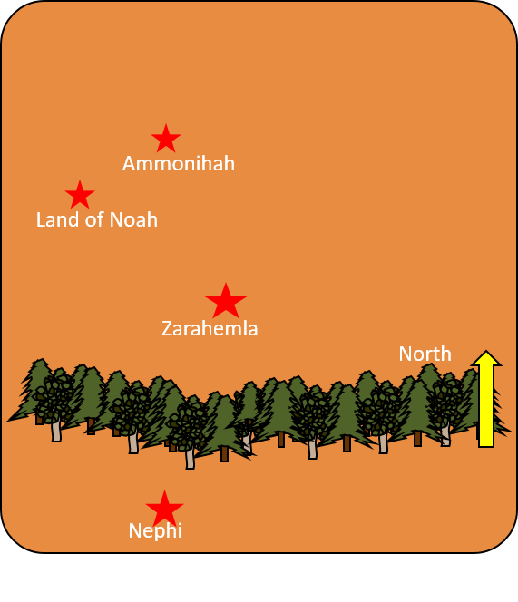
Marching to the Land of Noah
The Lamanites marched to the land of Noah…hoping for more action
They took an oath that they would destroy that city
However…Moroni had also fortified the city of Noah
Moroni sent Lehi to be chief captain over the men in that city
Again the Lamanites were disappointed—nevertheless they ‘sworn an oath’ to attack the city
Alma 49:16-17

Slide 6
The Place of Entrance
The only way anyone could get into the cities that Moroni had fortified was through an entrance that was heavily guarded by the strongest men to defend that city
The Nephites would destroy anyone trying to climb the walls by casting stones and arrows at them
The Lamanites brought armies to the place of entrance…but they were driven back
Alma 49:18-22

Slide 7
The Great Loss
The Lamanites:
The chief captains were all slain
The rest fled into the wilderness and returned to the land of Nephi to tell the king, Amalickiah about their great loss
The Nephites:
Not a single soul was slain
50 were wounded
Alma 49:23-25

Slide 8
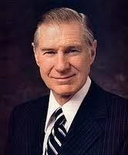
Amalickiah—Satan’s Advocate
If we prepare ourselves, we can withstand attacks (temptations) from the adversary
“Satan is our greatest enemy and works night and day to destroy us. But we need not become paralyzed with fear of Satan’s power.
He can have no power over us unless we permit it. He is really a coward, and if we stand firm he will retreat.” James E. Faust

Slide 9
A Cursing and Gratitude
Amalickiah:
Was angry with his people
Was ‘wroth’ with God and cursed Him
Was ‘wroth’ with Moroni swearing an oath that he would ‘drink his blood’
The People of Nephi:
Thanked the Lord their God because of his ‘matchless power’ in delivering them from the hands of their enemies.
“Yea, and there was continual peace among them, and exceedingly great prosperity in the church because of their heed and diligence which they gave unto the word of God, which was declared unto them by Helaman, and Shiblon, and Corianton, and Ammon and his brethren, yea, and by all those who had been ordained by the holy order of God, being baptized unto repentance, and sent forth to preach among the people.”
Alma 49:26-30

Slide 10
Moroni’s Stronghold
Ridges of earth
Timbers built up
Towers to be erected
Stones and arrows made and collected
Alma 50: 1-6

Slide 11

Strengthening Your Spiritual Walls of Protection
Honoring and obeying your parents
Listening and heeding to the prophets of today
Sincere repentance and forgiving others
Being honest in all things
Attending Church regularly
Maintaining the standards of the Church
Giving Service
Renewing your covenants by partaking of the sacrament
Reading and Studying the scriptures
Praying with real intent and sincerity

Slide 12
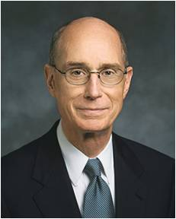
“As the forces around us increase in intensity, whatever spiritual strength was once sufficient will not be enough.
And whatever growth in spiritual strength we once thought was possible, greater growth will be made available to us.
Both the need for spiritual strength and the opportunity to acquire it will increase at rates which we underestimate at our peril.”
President Henry B. Eyring
Because the adversary will continually attack us, we must continually improve our spiritual fortifications

Slide 13
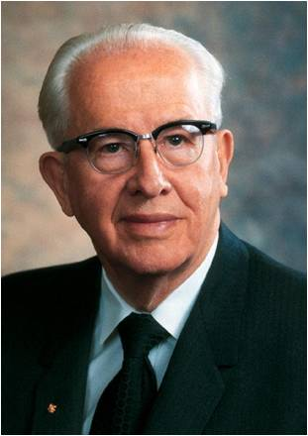
I will prepare to withstand temptation by…
I will stand firm when…
“It is better to prepare and prevent than it is to repair and repent”
Ezra Taft Benson

Slide 14
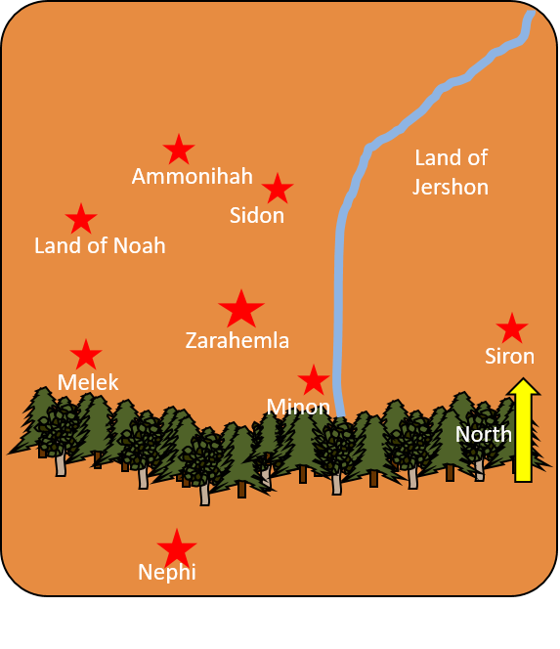
Driving the Enemy Away
Moroni caused that his armies go forth to the east wilderness and drive all the Lamanites back to their own lands
Moroni also caused that the inhabitants go to that east wilderness and by the borders of the seashore and posses that land and fortify those lands, cutting off all stronghold of the Lamanites between the land of Zarahemla and the land of Nephi
Alma 50:11-12

Slide 15
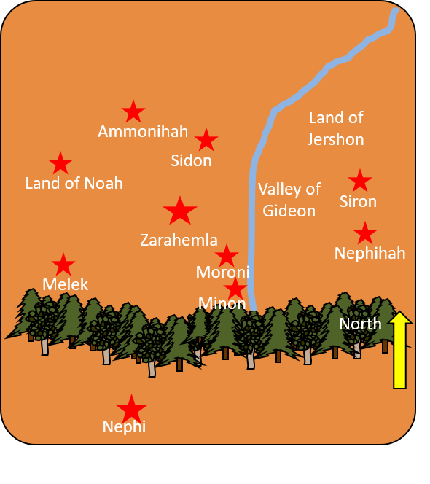
New Cities Built
Nephites begin a new foundation and called it “Moroni”
They also began a foundation for a city between the city of Moroni and the city of Aaron called “Nephihah”
Mormon
Many other cities did they build and that ended the 20th year of the reign of the judges—about 72 to 67 BC
Alma 50:13-16

Slide 16
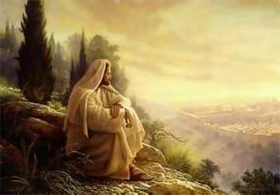
Destruction or Prosperity
“And we see that these promises have been verified to the people of Nephi; for it has been their quarrelings and their contentions, yea, their murderings, and their plunderings, their idolatry, their whoredoms, and their abominations, which were among themselves, which brought upon them their wars and their destructions.”
“And those who were faithful in keeping the commandments of the Lord were delivered at all times, whilst thousands of their wicked brethren have been consigned to bondage, or to perish by the sword, or to dwindle in unbelief, and mingle with the Lamanites.”
“But behold there never was a happier time among the people of Nephi, since the days of Nephi, than in the days of Moroni, yea, even at this time, in the twenty and first year of the reign of the judges.”
Alma 50:21-23

Slide 17
What Causes Division?
Ammonihah
Land of Jershon
Two joining borders of the land of Morianton and the land of Lehi began to have contention
Sidon
Land of Noah
Morianton and Land of Lehi
Morianton and Land of Lehi
Zarahemla
Melek
Minon
North
Nephi
Alma 50:25-29

Slide 18
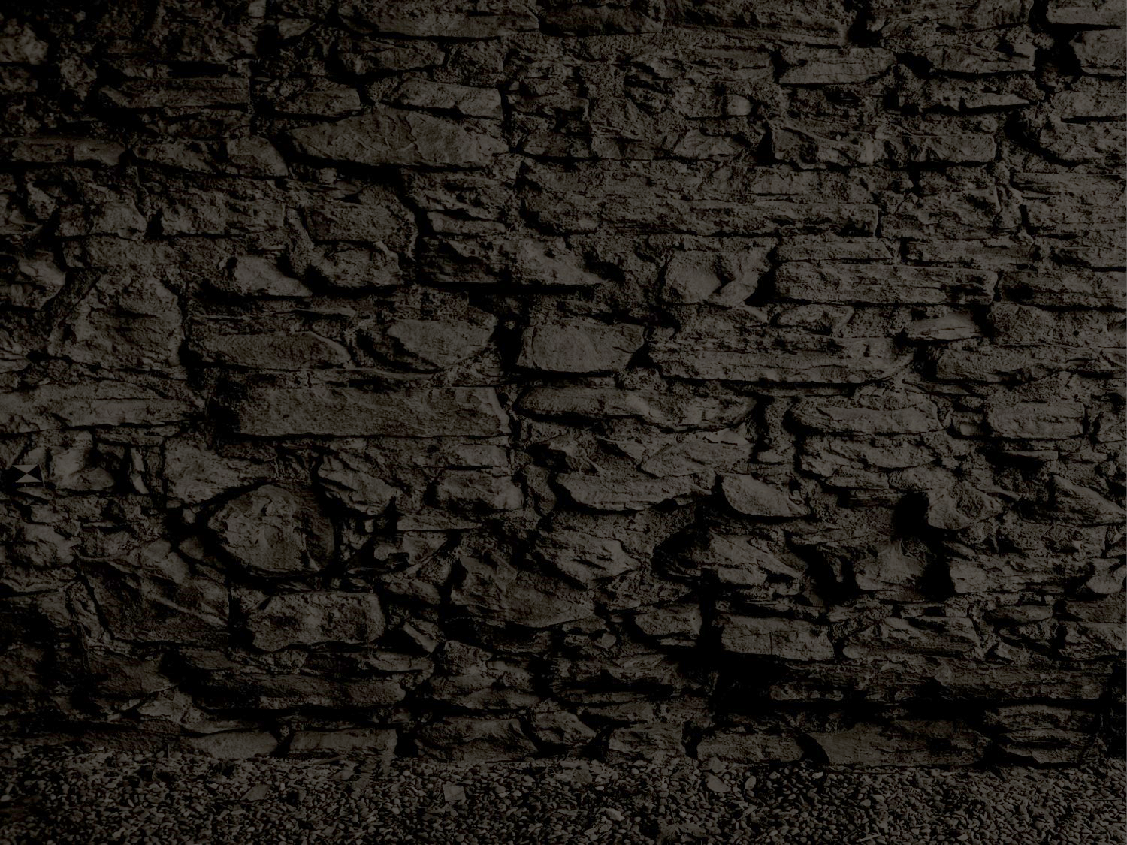
Morianton
He was a Nephite introduced in about 68 BC
He caused a rebellion among the people living in Morianton and the city of Lehi
He claimed that part of the property of city of Lehi belonged to the people living in Morianton
Because the problem was presented to Moroni, Morianton and his followers went into the land northward (Land of Desolation)
He beat one of his maid servants who went and told Moroni’s camp about the incident
Moroni sent Teanchum and his army to head off the forces of Morianton
He was killed during this battle
The people of Morianton covenanted to maintain peace with their neighbors and was sent back to their land
Who’s Who

Slide 19
Teancum
He was a commander of the Nephite forces from around 74 BC until 56 BC
Moroni place him in charge of a quelling rebellion between two Nephite groups (one led by Morianton)
He engaged in forces of the Lamanite army under Amalickiah, a Nephite dissenter
He killed Amalickiah one night in Amalickiah’s battle tent by putting a javelin in Amalickiah’s heart
Toward the end of Moroni’s career Teancum and Lehi were placed in charge of the Nephite forces in battle
He also thrust a javelin in the heart of Amalickiah’s brother, Ammoron
The king, during this time, alerted the guards and killed Teancum in about 56 BC
Who’s Who

Slide 20
Nephihah
He was the second chief judge in Zarahemla
He succeeded Alma the Younger around 83 BC
He was selected as a wise man among the elders of the church and gave him power according to the voice of the people
He declined Alma’s invitation to manage the sacred records of the people
His son Pahoran succeeded him as chief judge and governor of the land
He served in his public leadership capacity until his death around 67 BC
His tenure included:
The destruction of Ammonihah by the Lamanites
Establishment of Jershon and protector
The dissention of the Zoramites
The insurrection of Amalickiah
Who’s Who

Slide 21
Pahoran I
He was the Son of Nephihah
He succeeded his father as chief judge and governor in Zarahemla around 67 BC for 17 years..he was the 3rd chief following the reign of Mosiah
He took an oath to keep the peace and freedoms of the people
He worked with Captain Moroni to restore peace to the land in the wake of rebellion by the “king-men”
He is best known for his correspondence with Moroni
He was accused by Moroni, at one point, of disloyalty and misuse of funds for not sending vitally needed men and supplies for the war effort
However, Moroni didn’t know that Pahoran had to flee for his life and that he was doing all in his power to send forces
Moroni and Pahoran then collaborated in a campaign lasting 2 years to rid the capital of “king-men”
After Pahoran’s death in about 52 BC his son Pahoran succeeded him
Who’s Who

Slide 22
King-men and Freemen
The 25th year of the Reign of the Judges—about 67-66 BC
King-men
Wanted Pahoran to be dethroned from the judgment-seat
Wanted the law changed to overthrow the free government and establish a king over the land
Those of ‘high birth’
Those who sought power and authority over the people
Freemen
Wanted Pahoran to remain as chief judge
Wanted their right and privileges to their religion
Opposing groups—they are people who seek to overthrow the government of the land in favor of a kingdom
Division and contention destroy our peace
The voice of the people went in favor of the freemen
Alma 51:5-8

Slide 23
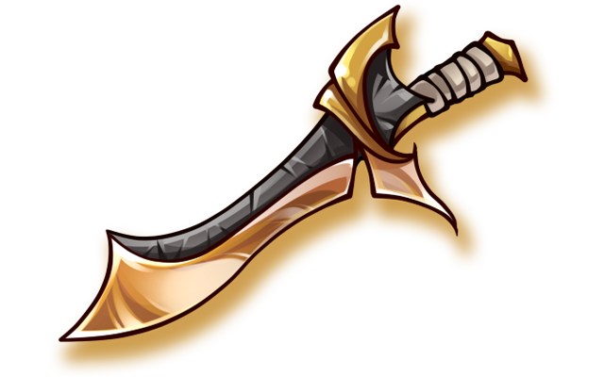
Refusing to Defend Their Country
“And it came to pass that he sent a petition, with the voice of the people, unto the governor of the land, desiring that he should read it, and give him (Moroni) power to compel those dissenters to defend their country or to put them to death.”
Amalickiah again gathers up his army
When the king-men heard the Lamanites coming to battle they refused to take up arms to defend their country.
4,000 dissenters were hewn down by the sword, those who were not slain were put in prison
Alma 51:9-20

Slide 24
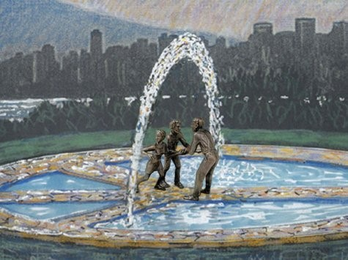
Refusing to Defend Our Country
Draft evasion is an intentional decision not to comply with the military conscription policies of one's nation.
Such practices that do not involve law breaking or which are based on conscientious objection are sometimes referred to as "draft avoidance." Refusing to submit, the draft is considered a criminal offense in most countries where conscription is in effect.
Those who practice draft evasion are sometimes pejoratively referred to as "draft dodgers," a term which was made popular during the Vietnam War.
Draft evasion is distinct from desertion in that only
an active member of a military service can become a
deserter by absenting himself from military service
without receiving a valid leave of absence or
discharge and without any intention of returning to
the service.

Slide 25
Taking Possession
While Moroni was taking care of the dissenters
Amalickiah was taking possession of many cities (See Alma 51:26)
Mulek
Ammonihah
Land of Jershon
Sidon
Land of Noah
Morianton and Land of Lehi
Zarahemla
Nephihah
Melek
Moroni
Minon
Moroni
North
Nephi
Alma 51:23-30

Slide 26
Don’t Mess With Teancum
Alma 51:29-37

Slide 27
Sources:
Breastplate--Radiocarbon tests would date the burials to about A.D. 900—the era when the Maya civilization, some 800 miles to the northwest.
James E. Faust (“Be Not Afraid,” Ensign, Oct. 2002, 4).
Henry B. Eyring (“Always,” Ensign, Oct. 1999, 9).
(The Teachings of Ezra Taft Benson [1988], 285).
Book of Mormon Who’s Who by Ed J. Pinegar and Richard J. Allen p. 121-122, 145, 153-154, 178-179
Draft Evasion--http://en.wikipedia.org/wiki/Draft_evasion
More interesting information from the lands in
South America on the next 3 slides
Presentation by ©http://fashionsbylynda.com/blog/

Slide 28
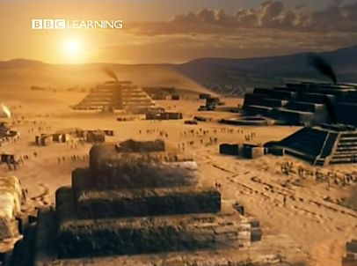
Last December (2012), Haas and Creamer again made headlines with a paper in Nature that presented carbon datings for 13 sites with platform mounds and residential complexes in river valleys near Caral.
Some appeared to be even older than Caral, with dates as early as 3200 B.C. “It is now clear,” the couple wrote, that Caral and other Supe Valley sites “were parts of a much more extensive cultural system that reached across at least three valleys and an area of 1,800 square kilometers.” They called the region the Norte Chico, a colloquial term for the north-central coast of Peru. And they mentioned Shady only in their footnotes.
http://www.abovetopsecret.com/forum/thread495572/pg

Slide 29
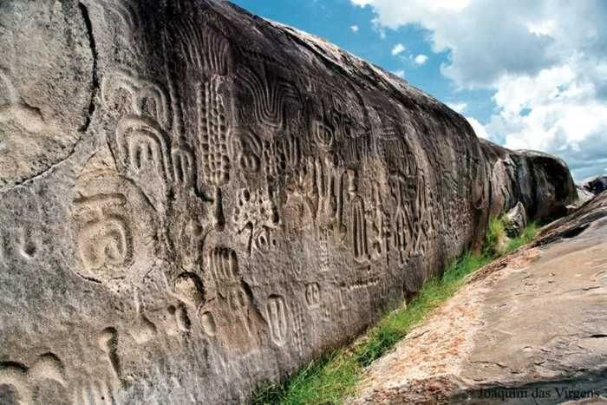
The Ingá Stone (Pedra do Ingá in Portuguese) is located in near the small city of Ingá in the Paraíba State in the northeast of Brazil. The Ingá Stone is also called Itacoatiara do Ingá. The word Itacoatiara means stone in the Tupi language of the natives that lived in that area. It is composed of some basalt stones covered with symbols and glyphs undeciphered until now.
Most scholars think its origin is related to the natives that lived around until the 18th century, but there are also some people that defended an extraterrestrial origin. Most glyphs represents animals, fruits, humans, constellations (including the Milk Way), and other unrecognizable images.
http://www.abovetopsecret.com/forum/thread495572/pg

Slide 30
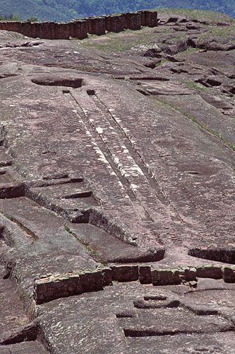
Not far away from Samaipata, one of the most important archeological monuments of pre-Columbian time in Bolivia can be found: El Fuerte (The Fortress). This archeological place has been declared Cultural Patrimony of Humanity by UNESCO. This mysterious place has been given many hypothetical explanations for its origins. It is supposed that El Fuerte is the work of the Amazonian pre-Incan 'Chané' culture, and later on was used as an advanced city by the Incas and finally by the Spanish colonists that turned El Fuerte into a fortress.
El Fuerte near Samaipata from aside village near el fuerte El Fuerte is the largest carved stone in the world. This archaeological monument reaches a height of 1.949 metres above sea level and is on the ridge of a hill of a sandy rock where ancient cultures sculptured figures but emphasized snakes and pumas, as well as waterways and wells, triangular and rectangular seats, vaulted niches, among other details.
http://www.abovetopsecret.com/forum/thread495572/pg

Slide 31
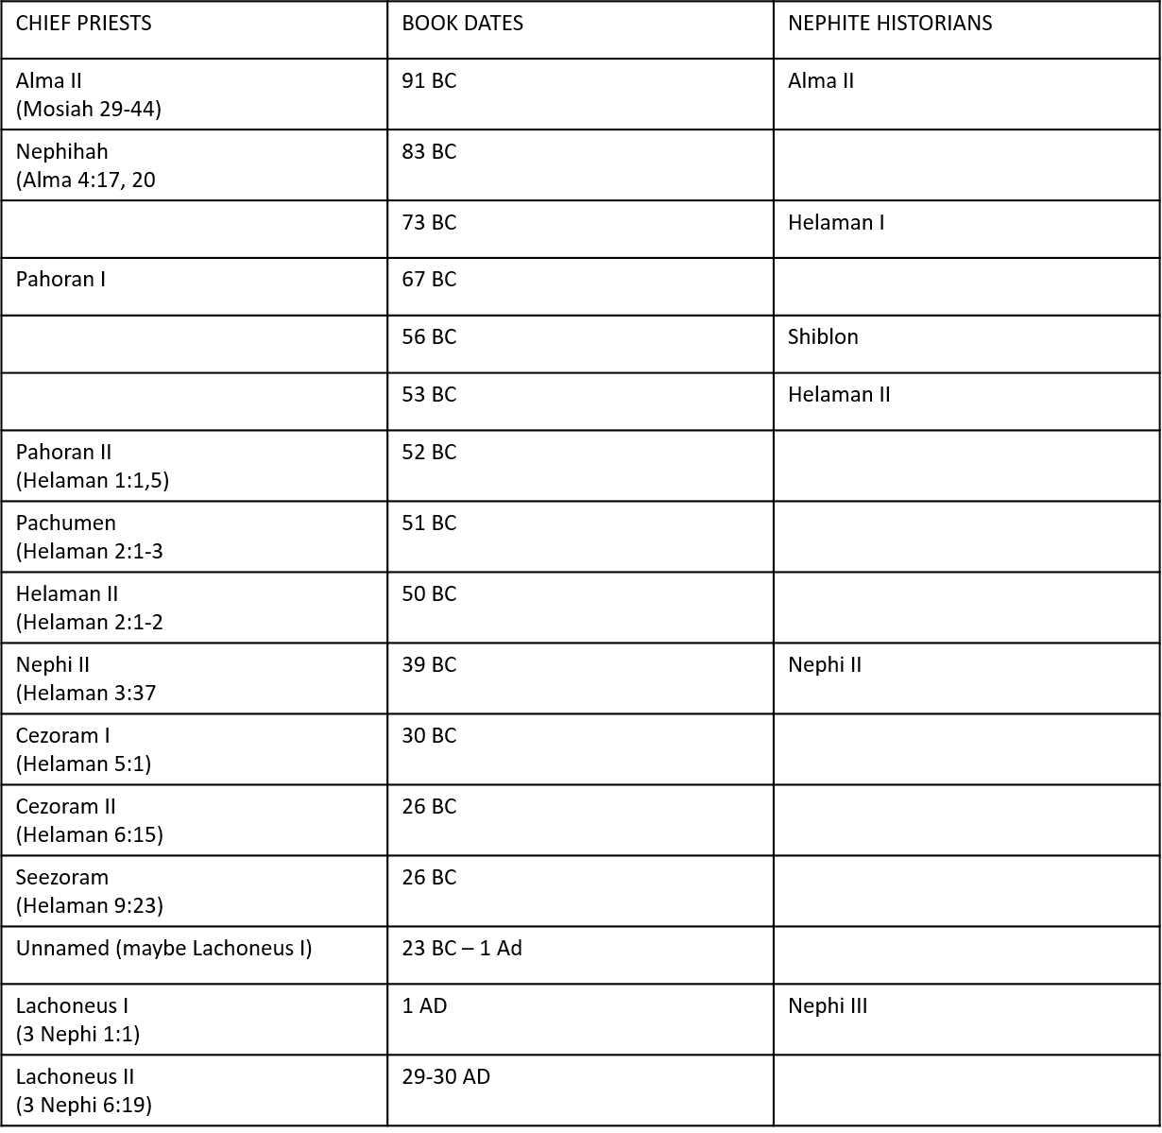

Slide 32
