Slide 2
The Loss of a City
Mulek
“And now, when Moroni saw that the city of Nephihah was lost he was exceedingly sorrowful, and began to doubt, because of the wickedness of the people, whether they should not fall into the hands of their brethren.”
Gid
Ammonihah
Valley of Gideon
Zarahemla
Nephihah
Moroni
Antionum
It was easier to keep the city from falling into the hands of the Lamanites than to retake it from them
Manti
North
Nephi
Alma 59:11-13

Slide 3
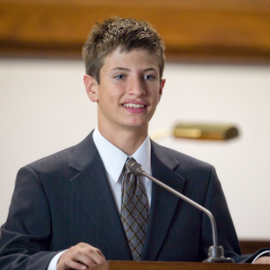
Keeping Your Faith
It is easier and better to remain faithful than it is to return to the faith after going astray
Why is staying faithful in the Church easier than returning to the Church after a period of being less active?
Why is it easier to maintain a testimony than it is to regain a testimony after falling away?

Slide 4
Trials of Miscommunication
Captain Moroni rejoiced in Helaman’s success in regaining some of the Nephite cities that had been lost to the Lamanites.
However, when he learned that the city of Nephihah had been captured by the Lamanites, he was angry at the government for neglecting to send reinforcements.
I am very, very disappointed
In a letter to Pahoran, the chief judge, he lamented the suffering of the righteous and rebuked Pahoran for not supporting the cause of freedom.
Alma 59-60

Slide 5
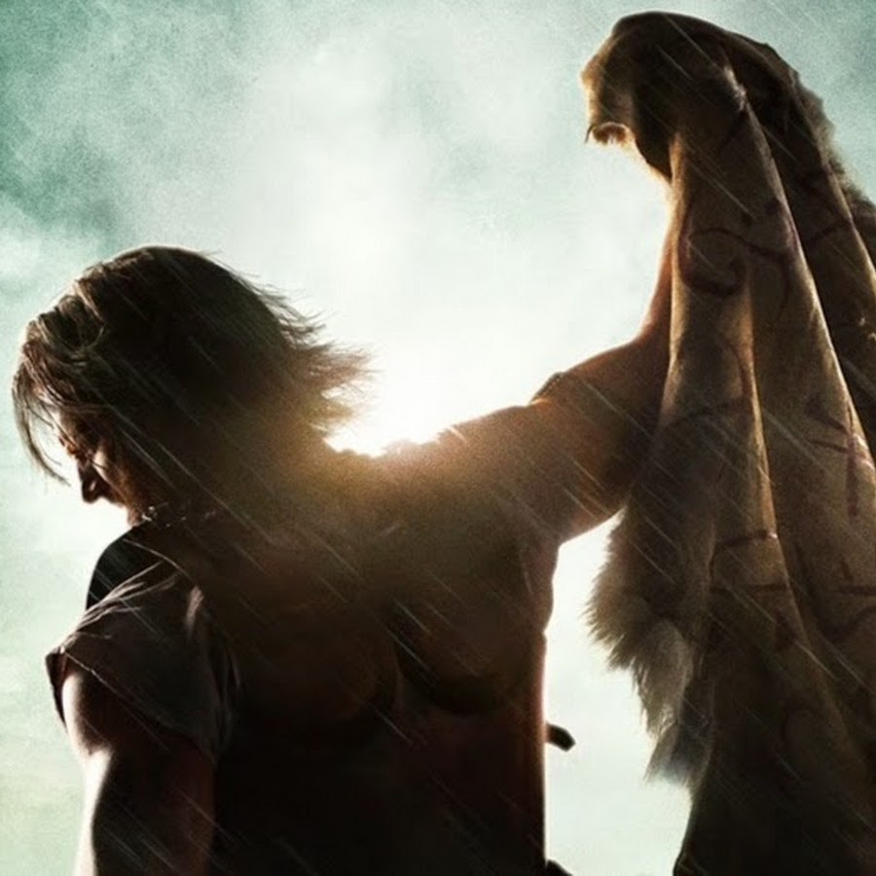
Moroni’s Passionate Complaints
We have suffered:
Hunger, thirst, fatigue, and all manner of afflictions
Our people have been slaughtered
The Lamanites are upon us
The king-men fight among us
We have looked to your government for protection:
But you are slothful and idle
You are “traitors to your country”
We ask you to send help:
Provisions
Men
We ask you to defend your freedoms
Alma 59-60

Slide 6
Understanding
Unknown to Moroni, Pahoran had fled to the land of Gideon because of the rebellion of the Nephite king-men.
Mulek
Gid
Ammonihah
Valley of Gideon
Zarahemla
Nephihah
Moroni
Manti
Antionum
North
Pahoran did not take offense at Moroni’s chastisement; rather, he rejoiced in Moroni’s love of liberty.
Nephi
Alma 61

Slide 7
We can choose to not be offended by the words and actions of others.
We should avoid making unkind judgments about others
When we unite in righteousness with others, we are stronger in our battles against evil.
How can we choose not to be offended?

Slide 8
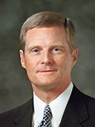
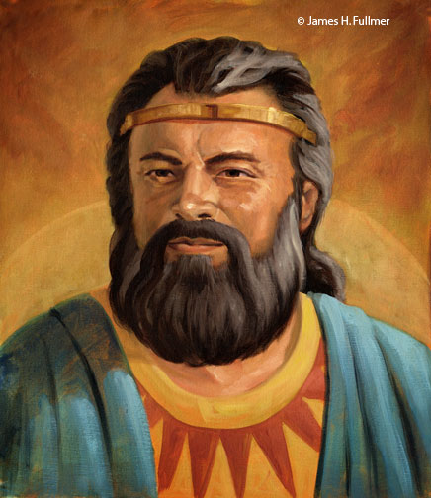
“Pahoran might easily have resented Moroni and his message, but he chose not to take offense. …
“One of the greatest indicators of our own spiritual maturity is revealed in how we respond to the weaknesses, the inexperience, and the potentially offensive actions of others. A thing, an event, or an expression may be offensive, but you and I can choose not to be offended—and to say with Pahoran, ‘it mattereth not.’ …
James H. Fullmer
“… If a person says or does something that we consider offensive, our first obligation is to refuse to take offense and then communicate privately, honestly, and directly with that individual.
Such an approach invites inspiration from the Holy Ghost and permits misperceptions to be clarified and true intent to be understood.”
David A. Bednar

Slide 9
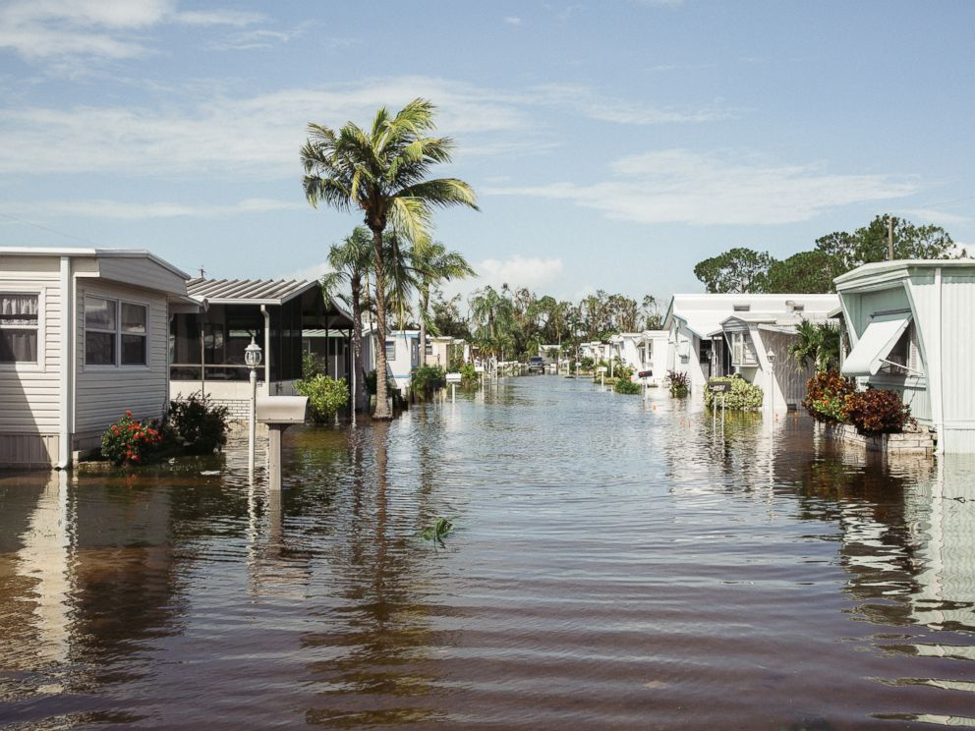
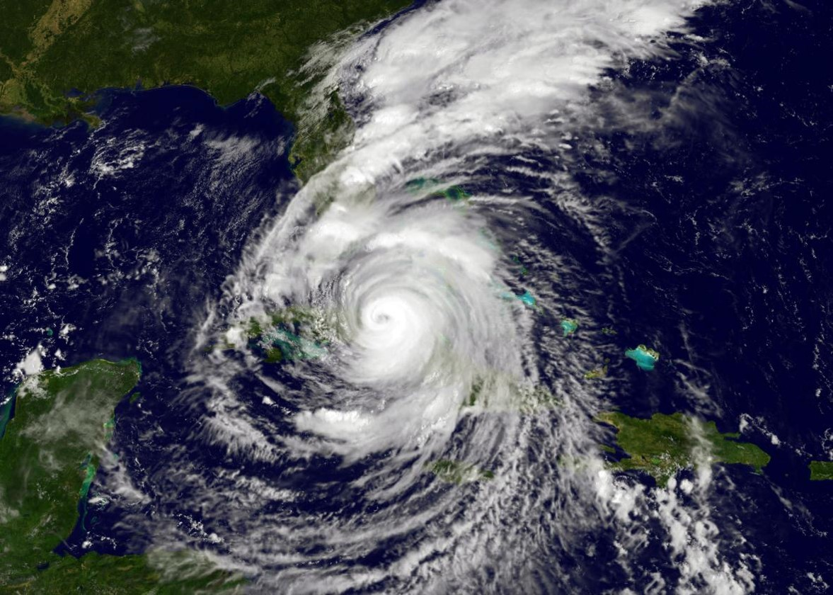
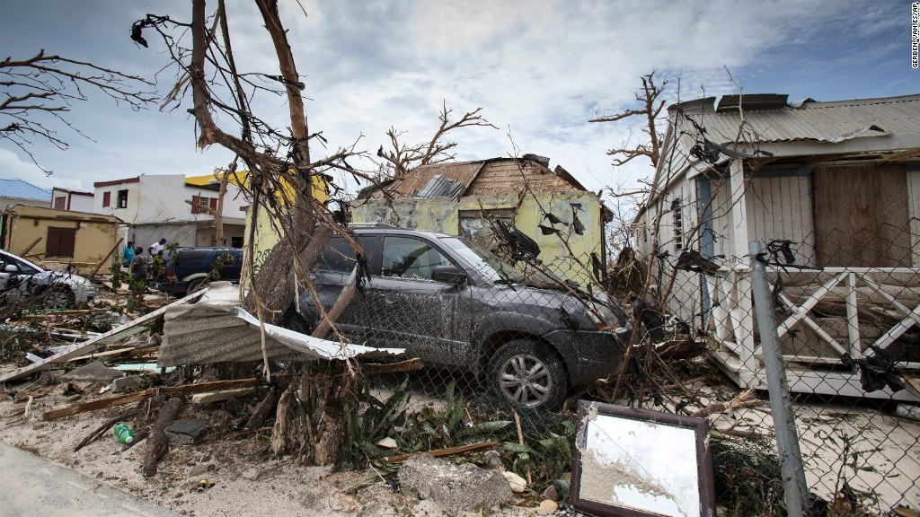
In times of adversity, some people humble themselves before God while others become hardened
“A news account quoted two different persons who had suffered the same tragedy and received the same blessing: each of their homes had been totally destroyed, but each of their family members had been spared death or injury.
One said that this tragedy had destroyed his faith; how, he asked, could God allow this to happen? The other said that the experience had strengthened his faith. God had been good to him, he said. Though the family’s home and possessions were lost, their lives were spared and they could rebuild the home. … The gift of moral agency empowers each of us to choose how we will act when we suffer adversity”
Dallin H. Oaks

Slide 10
Pahoran’s Epistle
I do not ‘joy’ in your afflictions
The king-men have risen against me and driven the freemen out
They have sought to take the judgment seat and have a king—Tyranny--Pachus
The king wants to ally with the Lamanites—which eventually we would lose our lands and come into bondage
I have been driven out of Zarahemla and fled to Gideon
I am not angry with your words
“God made us free”
We need to resist evil with our swords
Alma 61

Slide 11
The Need to Take Possession of Zarahemla
Pahoran asks Moroni to leave Lehi and Teancum in charge and come to aid him
“And we will take possession of the city of Zarahemla, that we may obtain more food to send forth unto Lehi and Teancum; yea, we will go forth against them in the strength of the Lord, and we will put an end to this great iniquity.”
“See that ye strengthen Lehi and Teancum in the Lord; tell them to fear not, for God will deliver them, yea, and also all those who stand fast in that liberty wherewith God hath made them free. And now I close mine epistle to my beloved brother, Moroni.”
Alma 61:15-21

Slide 12
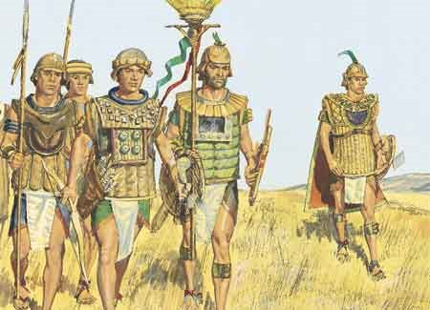
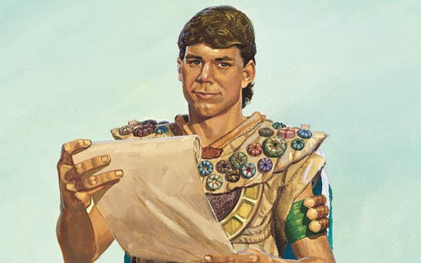
Renewed Vigor
Captain Moroni brought a portion of his army to help Pahoran overthrow the king-men in Zarahemla.
Then, with their united army and the help of other Nephite forces, Moroni and Pahoran retook the remaining cities that had been lost to the Lamanites.
They drove the Lamanites from the land and established peace among the people.
“And it came to pass that Moroni and Pahoran went down with their armies into the land of Zarahemla, and went forth against the city, and did meet the men of Pachus, insomuch that they did come to battle.
And behold, Pachus was slain and his men were taken prisoners, and Pahoran was restored to his judgment-seat.”
Alma 62:3-8

Slide 13
Pachus
He was the lead of the Nephite dissenters who revolted against Pahoran—king for a time
He drove the “freemen” from Zarahemla
Moroni and Pahoran combined their forces and invaded Zarahemla and killed Pachas and placed his followers under arrest
Those dissenters who denied having freedom were executed according to the law (Alma 62:9-10)
Who’s Who

Slide 14
The Law
“And the men of Pachus received their trial, according to the law, and also those king-men who had been taken and cast into prison; and they were executed according to the law; yea, those men of Pachus and those king-men, whosoever would not take up arms in the defense of their country, but would fight against it, were put to death.
And thus it became expedient that this law should be strictly observed for the safety of their country; yea, and whosoever was found denying their freedom was speedily executed according to the law.”
The end of the 30th Year of the Reign of the Judges
Alma 62:9-10

Slide 15
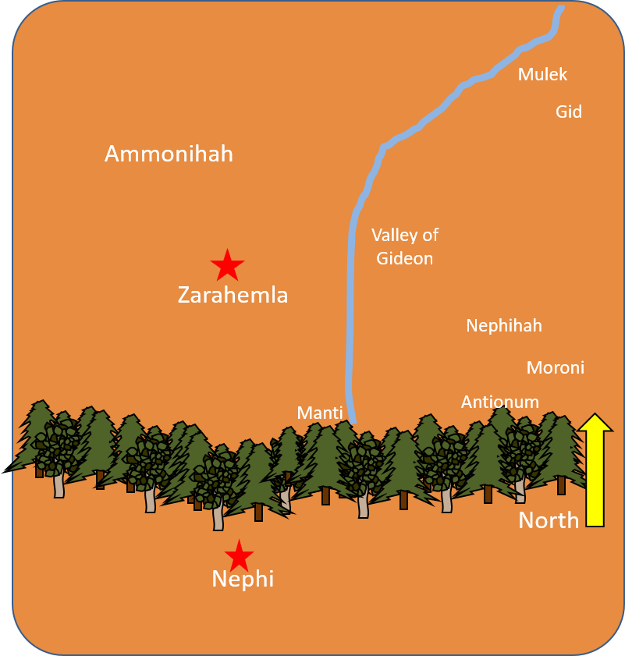
Combined Forces
Then, with their united army and the help of other Nephite forces, Moroni and Pahoran retook the remaining cities that had been lost to the Lamanites.
Some Lamanites joined with the People of Ammon.
They went to the land of Moroni and camped around the borders.
The Fate of Teancum
“…he did cast a javelin at him (Ammoron), which did pierce him near the heart. But behold, the king did awaken his servants before he died, insomuch that they did pursue Teancum, and slew him.”
They drove the Lamanites from the land and established peace among the people
Alma 62:14-42

Slide 16
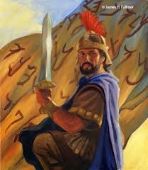
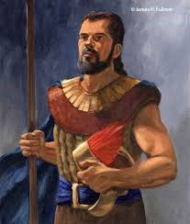
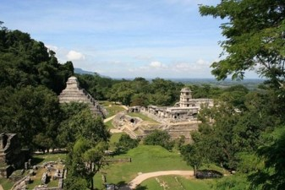
What Happened To…
And Pahoran did return to his judgment-seat; and Helaman did take upon him again to preach unto the people the word of God; for because of so many wars and contentions it had become expedient that a regulation should be made again in the church.
And Moroni yielded up the command of his armies into the hands of his son, whose name was Moronihah; and he retired to his own house that he might spend the remainder of his days in peace.
Therefore, Helaman and his brethren went forth, and did declare the word of God with much power unto the convincing of many people of their wickedness, which did cause them to repent of their sins and to be baptized unto the Lord their God.
He died in the 35th year of the Reign of the Judges
And it came to pass that they did establish again the church of God, throughout all the land.
Alma 62:43-46
James H. Fullmer

Slide 17
Prosper in the Land
Alma 62:48-51

Slide 18
Alma to Helaman then to Shiblon
Helaman son of King Benjamin
Mosiah 1-2
Alma 63:1

Slide 19
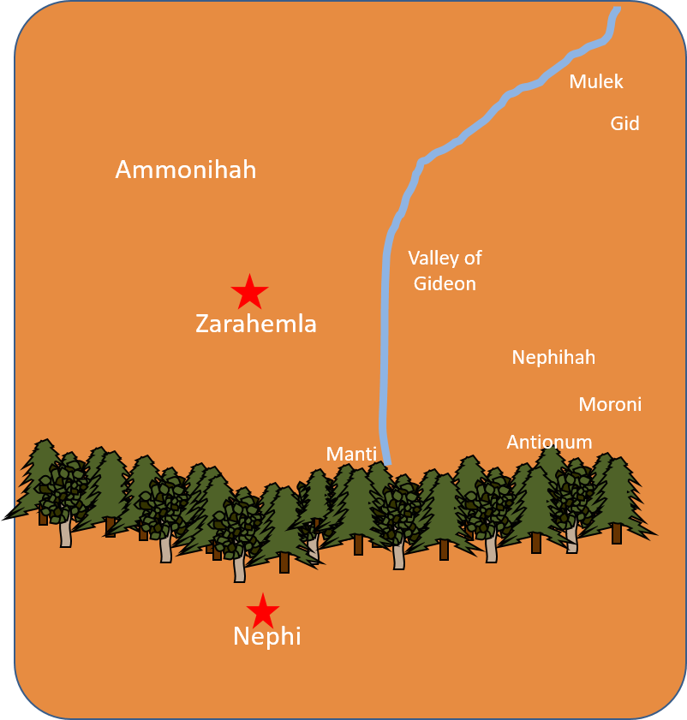
Migrating Northward
Many Nephites started to migrate northward, by land and by sea.
Shiblon conferred the sacred records to Helaman.
Captain Moroni died, and his son Moronihah led an army that drove back another Lamanite attack.
North
Alma 63

Slide 20
Moronihah
He was the son of Captain Moroni
He succeeded his father as commander of the Nephite armed forces around 60 BC
He received superior training from his father—in strategy, leadership, and love of God and liberty.
His initial battle came when the Lamanites under the Nephite dissenter Coriantum succeeded in overpowering the capital city of Zarahemla in the year 51 BC
He and Lehi were able to repel the Lamanites and expel them from the land, Coriantum was killed during this time
In 34 BC , again the dissenters and the Lamanites started to battle and forced Moronihah upward toward Bountiful
The Nephites were able to regain half of their cities
He and the sons of Helaman, Nephi and Lehi preached repentance to the people---there was a decline of spirituality and faith among the Nephites
Who’s Who

Slide 21
Hagoth
He was a Nephite who migrated with 4,400 men women and children north around 56 BC
He built a large ship on the borders of the land Bountiful by the land Desolation and launched it forth into the west sea
Many Nephites set sail northward on this ship, carrying abundant provisions.
1 year later he built other ships and carried many more people northward but was not heard from again.
It is not clear that he was among the passengers of the ships he built
Who’s Who

Slide 22
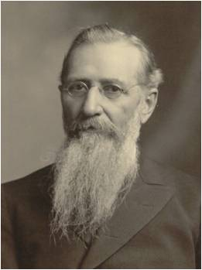
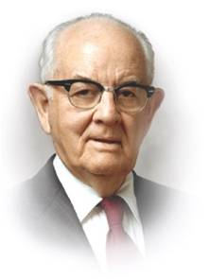
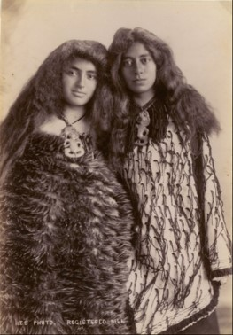
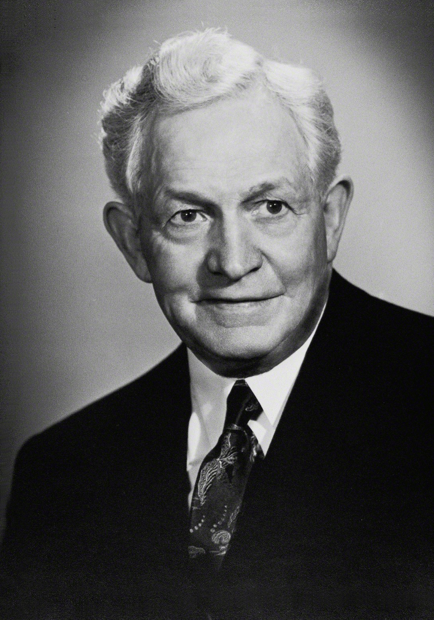
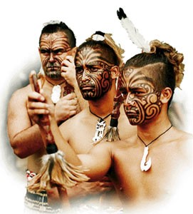
Hagoth and His Descendant
Latter-day prophets have said that Hagoth’s people settled on the islands that are now known as New Zealand.
To Saints in New Zealand:
“You brothers and sisters from New Zealand, I want you to know that you are from the people of Hagoth”
Joseph F. Smith
In the dedicatory prayer for the Hamilton New Zealand Temple: “We express gratitude that to these fertile Islands Thou didst guide descendants of Father Lehi, and hast enabled them to prosper”
President David O. McKay
“It is reasonable to conclude that Hagoth and his associates were about nineteen centuries on the islands, from about 55 B.C. to 1854 before the gospel began to reach them. They had lost all the plain and precious things which the Savior brought to the earth, for they were likely on the islands when the Christ was born in Jerusalem.”
President Spencer W. Kimball
Alma 63:4-10

Slide 23
The End of the Account of Alma
39th Year of the Reign of the Judges
Many people went forth into the land northward.
Shiblon died
Corianton had gone northward also in a ship carrying provisions
There were numerous wars against the people of Moronihah
“And thus ended the account of Alma, and Helaman his son, and also Shiblon, who was his son.”
Alma 63:9-17

Slide 24
Sources:
Choose Not to Be Offended (2:31)
Our Own Storehouse of Faith (2:09)
Book of Mormon Who’s Who by Ed J. Pinegar and Richard J. Allen pg. 61, 129-130, 152-153
David A. Bednar, “And Nothing Shall Offend Them,” Ensign or Liahona, Nov. 2006, 91, 92
Dallin H. Oaks, “Adversity,” Ensign, July 1998, 8.
Artist: James H. Fullmer
Joseph F. Smith about New Zealand (quoted by Spencer W. Kimball in Joseph Fielding McConkie and Robert L. Millet, Doctrinal Commentary on the Book of Mormon, vol. 3 [1991], 329).
David O. McKay (“Dedicatory Prayer Delivered by Pres. McKay at New Zealand Temple,” Church News, May 10, 1958, 2).
President Spencer W. Kimball (Temple View Area Conference Report, February 1976, 3; quoted in Joseph Fielding McConkie and Robert L. Millet, Doctrinal Commentary on the Book of Mormon, vol. 3, 329).
Presentation by ©http://fashionsbylynda.com/blog/

Slide 26
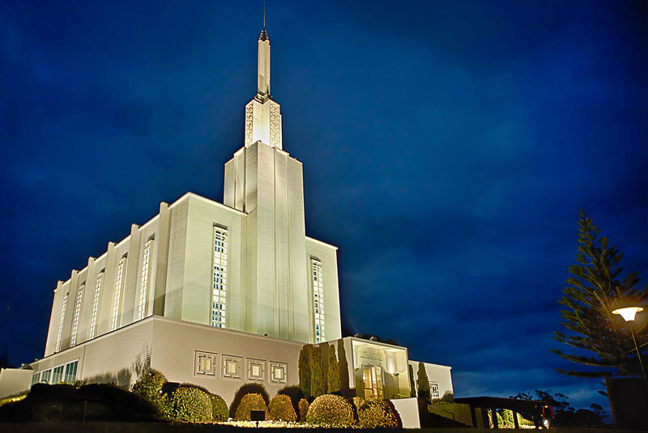
Referring to Alma 62:39–41, President Boyd K. Packer of the Quorum of the Twelve Apostles taught:
“The same testing in troubled times can have quite opposite effects on individuals. …
“Surely you know some whose lives have been filled with adversity who have been mellowed and strengthened and refined by it, while others have come away from the same test bitter and blistered and unhappy” (“The Mystery of Life,” Ensign, Nov. 1983, 18).
Elder Dallin H. Oaks of the Quorum of the Twelve Apostles explained that we choose how we will respond to adversity:
“Surely these great adversities are not without some eternal purpose or effect. They can turn our hearts to God. … Even as adversities inflict mortal hardships, they can also be the means of leading men and women to eternal blessings.
“Such large-scale adversities as natural disasters and wars seem to be inherent in the mortal experience. We cannot entirely prevent them, but we can determine how we will react to them. For example, the adversities of war and military service, which have been the spiritual destruction of some, have been the spiritual awakening of others. The Book of Mormon describes the contrast:
“‘But behold, because of the exceedingly great length of the war between the Nephites and the Lamanites many had become hardened, because of the exceedingly great length of the war; and many were softened because of their afflictions, insomuch that they did humble themselves before God, even in the depth of humility’ (Alma 62:41).
“I read of a similar contrast after the devastating hurricane that destroyed thousands of homes in Florida some years ago. A news account quoted two different persons who had suffered the same tragedy and received the same blessing: each of their homes had been totally destroyed, but each of their family members had been spared death or injury. One said that this tragedy had destroyed his faith; how, he asked, could God allow this to happen? The other said that the experience had strengthened his faith. God had been good to him, he said. Though the family’s home and possessions were lost, their lives were spared and they could rebuild the home. For one, the glass was half empty. For the other, the glass was half full. The gift of moral agency empowers each of us to choose how we will act when we suffer adversity” (“Adversity,” Ensign, July 1998, 7–8).
Dedication of Hamilton New Zealand Temple:
“We express gratitude that to these fertile Islands Thou didst guide descendants of Father Lehi, and hast enabled them to prosper” (David O. McKay, “Dedicatory Prayer Delivered by Pres. McKay at New Zealand Temple,” Church News, May 10, 1958, 2).

