Slide 1
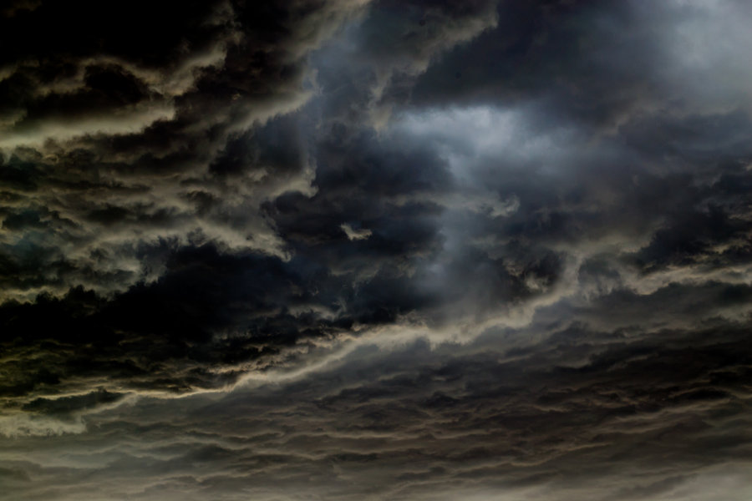
The Coming of the savior
3 Nephi 8-10
Lesson 119
Suggested Hymn
#134 I Believe in Christ

Slide 2
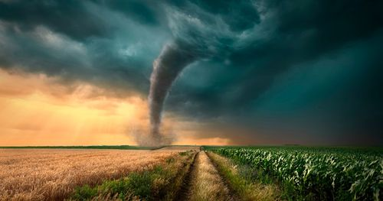
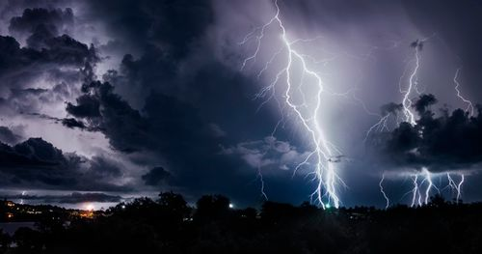
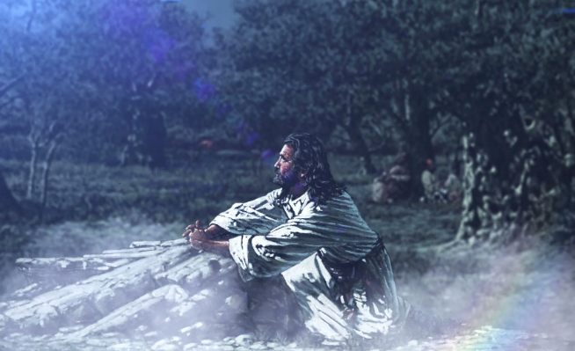
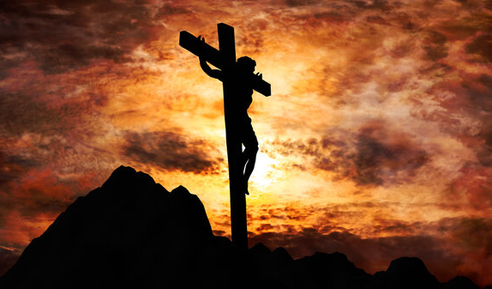
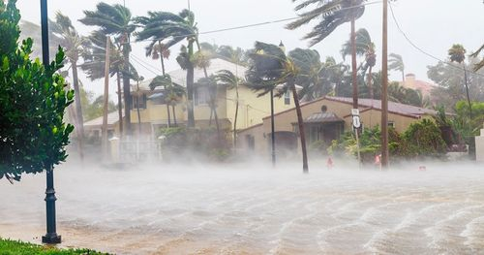
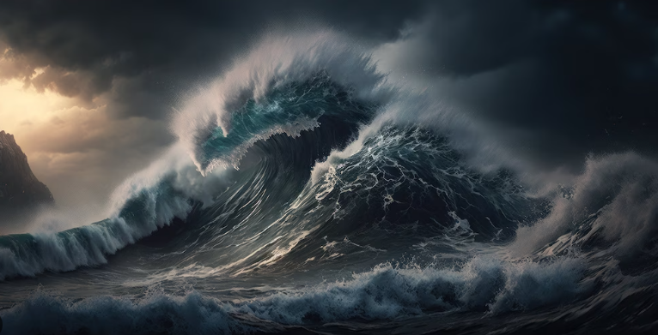
A Great Storm
When Jesus Christ was crucified in Jerusalem, a terrible storm and earthquake in the Americas caused great destruction. These events fulfilled Samuel the Lamanite’s prophecies about the signs of the Savior’s death.
Helaman 14:20-27

Slide 3
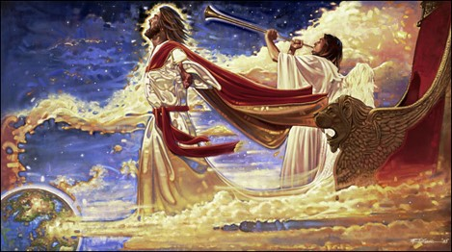
Looking for Signs
He who is righteous may know of the signs of heaven.
Those who were righteous began to look for the signs told of by Samuel
Those who did not believe had doubts
“But no man is possessor of all things except he be purified and cleansed from all sin.”
D&C 50:28
What are the signs of today for the Savior’s Second Coming?
Many prophecies, such as the Restoration of the gospel, the coming of the prophet Elijah, and the gospel being preached throughout the world, have been fulfilled or are being fulfilled.
3 Nephi 8:1-4

Slide 4
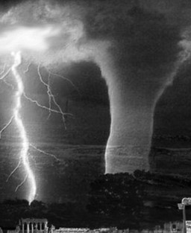
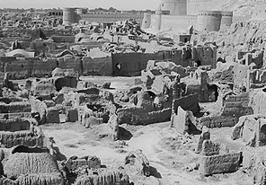
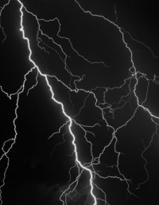
The Times
3 Nephi 8:1-10
Page 1
1/4/0034
Prophecy of Samuel, the Lamanite To Come True
Destruction Leaves Many Dead
The Great Storm lasting 3 hours
Man on a Wall
39 years ago, Samuel, who was a Lamanite and the first Lamanite prophet to speak on repentance, stood on the wall in Zarahemla and preached to the Nephites and the Lamanites.
His speech included a prophecy of a day without a night.
He also prophesied of days of terrible destruction.
33 years ago after seeing the sign of the Savior’s birth the Nephites now begin to look for signs that Samuel had said about the Savior’s death.
Terrible tempest crossed over the land today. Lasting three hours.
Reports of thunders, lightnings, earthquakes, and whirlwinds have destroyed much of the land southward and more so in the north.
Many people of both the Nephite and Lamanite nations have died. Many people have gone missing.
Major Cities Destroyed
Zarahemla, the capital, has caught on fire. The City of Moroni, reporters say, have sunk into the depths of the sea and there are no survivors. The City of Moronihah has had its earth carried up and has risen into a mountain. There have been reports throughout the land that the land has changed its formation, many cities have sunken and buildings have fallen and the people have been ‘slain’. There have been cases of some individuals who were carried away in the whirlwind. There has been no sign of the people carried away.

Slide 5
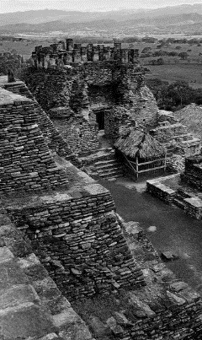
Page 2
Across the World
The Day in Which the Light Did Shine
The Voice From Above
Jesus, son of Mary, was born 34 years ago. When there was no darkness for a night. Many prophets of the Old Testament prophesied of His birth and many prophets testified of His upcoming birth in the Book of Mormon, including Lehi, Nephi, King Benjamin, Samuel, the Lamanite, and many more.
The crucifixion of Jesus occurred during the 1st century AD. Jesus, whom Christians believe to be the Son of God as well as the Messiah, was arrested, tried, and sentenced by Pontius Pilate to be scourged, and finally crucified.
Once at Golgotha, Jesus was offered wine mixed with gall to drink. Matthew's and Mark's Gospels record that he refused this. He was then crucified and hung between two convicted thieves. According to Mark's Gospel, he endured the torment of crucifixion for some six hours from the third hour, at approximately 9 am, until his death at the ninth hour, corresponding to about 3 pm.[The soldiers affixed a sign above his head stating "Jesus of Nazareth, King of the Jews" in three languages, divided his garments and cast lots for his seamless robe. The Roman soldiers did not break Jesus' legs, as they did to the other two men crucified (breaking the legs hastened the crucifixion process), as Jesus was dead already. Each gospel has its own account of Jesus' last words, seven statements altogether. In the Synoptic Gospels, various supernatural events accompany the crucifixion, including darkness, an earthquake, and (in Matthew) the resurrection of saints. Following Jesus' death, his body was removed from the cross by Joseph of Arimathea and buried in a rock-hewn tomb, with Nicodemus assisting. According to the Gospels, Jesus then rose from the dead two days later ("the third day").
--Wikipedia
According to author Moroni, of the Book of Mormon, after Christ ascended from the earth, leaving his apostles behind, he visited the Lamanites and the Nephites, descendant of the Israelite Nation.
“Wo, wo, wo” is heard from a voice. The voice is asking the people to repent.
The voice announces He has destroyed Zarahemla by fire, caused the city of Moroni to be sunk in the sea, and the death of those that lived there, the city of Moronihah He has covered with earth, and other cities that have been destroyed, including:
Gilgal
Onihah
Mocum
Jerusalem
Gadiandi
Gadiomnah
Jacob
Gimgimno
Jacobugath
Laman
Josh
Gad
and Kishkumen.
The Voice announces that He is Jesus Christ, the Son of God, the creator of all things on earth and heaven.
Darkness Upon the Face of the Land
According to the Book of Mormon author, darkness covered the whole earth. For three days Jesus hung on the cross. This was one of the signs spoken of by Samuel, the Lamanite. Torches, candles, or fire could be kindled, nor stars in the sky would shine. The people who survived the devastation mourned for their salvation and their loss in darkness.
Those Who Survived
“O all ye that are spared because ye were more righteous that they, will ye not now return unto me, and repent of your sins, and be converted, that I may heal you?” These are the words of the Lord, Jesus Christ
3 Nephi 9:13

Slide 6
Cities that were destroyed | How destroyed | The reason for them being destroyed
Zarahemla | By fire | Slaying of fair sons and daughters, iniquity and abominations
Moroni | Caused to be sunk in the sea | Slaying of fair sons and daughter, iniquity and abominations
Moronihah | Covered with earth | Wickedness and abominations
Gilgal | Sunken and buried | Not mentioned…but probably wickedness
Onihah Mocum Jerusalem | Tsunami—waters | Wickedness and abominations, slaying of the prophets and saints
Gadiandi Gadiomnah Jacob Gimgimno | Sunken, and made hills and valley..buried in the earth | Wickedness and abominations, slaying of the prophets and saints
Jacobugath, inhabitated by the people of king Jacob | Burned with fire | Wickedness, secret murders and combinations…they had destroyed the people and government
Laman Josh Gad Kishkumen | Burned with fire | Wickedness, casting out prophets, Stoning of prophets
The Cities Destroyed
3 Nephi 8:5
3 Nephi 9:1-12

Slide 7
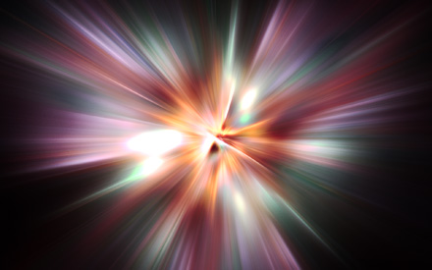
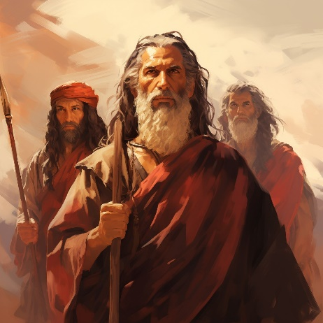
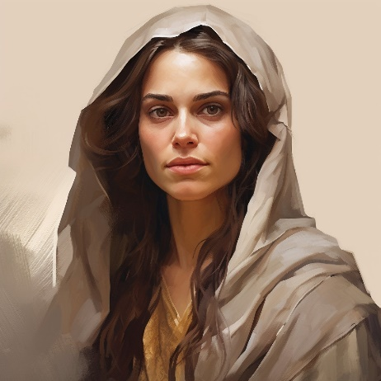
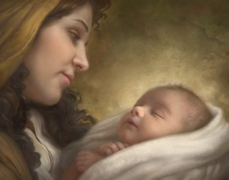
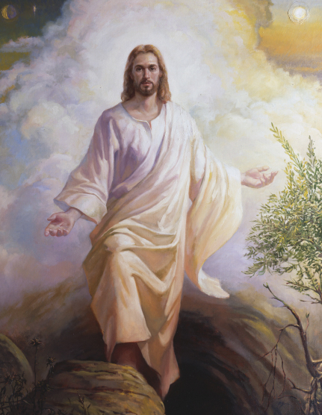
I Am
“And God said unto Moses, I AM THAT I AM: and he said, Thus shalt thou say unto the children of Israel, I AM that sent me unto you.” (Exodus 3:13-14)
Nephi: “And he said unto me: Behold, the virgin whom thou seest is the mother of the Son of God, after the manner of the flesh.”
1 Nephi 11:18
“And because he dwelleth in flesh he shall be called the Son of God, and having subjected the flesh to the will of the Father, being the Father and the Son—
The Father, because he was conceived by the power of God; and the Son, because of the flesh; thus becoming the Father and Son—”
Mosiah 15:2-3
To Know…To Do…To Be
“If I am to become Christlike, I must be lifted to fully accept Christ’s name, “I Am.”
3 Nephi 9:15

Slide 8
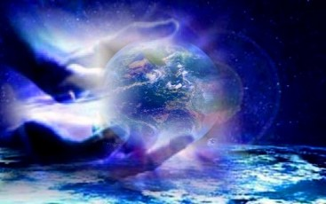
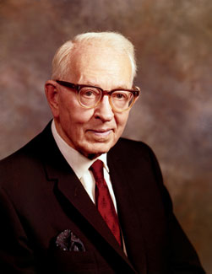
I Created the Heavens and the Earth
And all things that in them are…
“Under the direction of his Father, Jesus Christ created this earth. No doubt others helped him, but it was Jesus Christ, our Redeemer, who, under the direction of his Father, came down and organized matter and made this planet, so that it might be inhabited by the children of God.”
Joseph Fielding Smith
3 Nephi 9:15

Slide 9
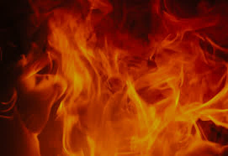
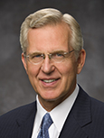
Baptized With Fire
If we come unto Christ with a broken heart and contrite spirit, He will bless us with the companionship of the Holy Ghost.
“You can offer the Lord the gift of your broken, or repentant, heart and your contrite, or obedient, spirit. In reality, it is the gift of yourself—what you are and what you are becoming.
“Is there something in you or in your life that is impure or unworthy?
When you get rid of it, that is a gift to the Savior. Is there a good habit or quality that is lacking in your life?
When you adopt it and make it part of your character, you are giving a gift to the Lord.” D. Todd Christofferson
3 Nephi 9:20

Slide 10
The Law of Moses Fulfilled—His divine Role
He came unto my own
Those who receive Him
Those who believe in Him
He is the light and life of the world
He is Alpha and Omega
There is to be no more shedding of blood for sacrifices
He will accept the broken hearted and contrite spirit for the sins of all
He comes to bring redemption to the
world
He will accept those who become “as a little child unto repentance”
His own received me not
He has given to men to become the sons of God
Redemption comes through Him
He is the source of truth
The beginning and the end— eternal
He has shed his blood for all mankind
There will be a baptism of fire (The Holy Spirit)
To save the world from sin
Being innocent and humble…To be teachable
3 Nephi 9:16-22

Slide 11
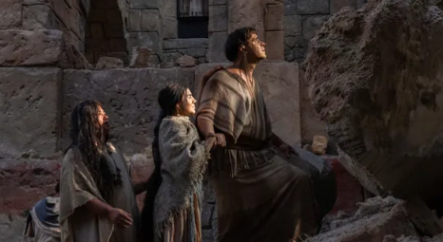
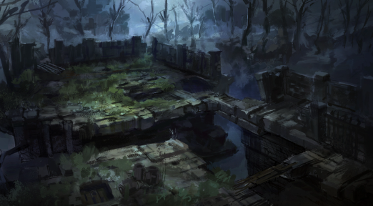
Silence
For the space of many hours
“…so great was the astonishment of the people that they did cease lamenting and howling for the loss of their kindred which had been slain; therefore there was silence in all the land for the space of many hours.”
3 days did pass away
3 Nephi 10:1-2,9

Slide 12
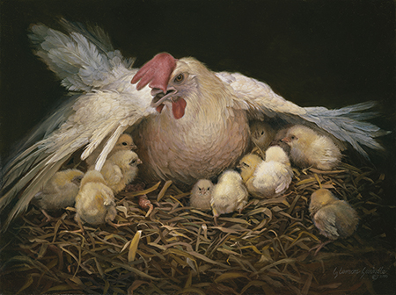
Jesus Reminds Them and Us
How oft have I gathered you as a hen gathereth her chickens under her wings, and nourished you?
“Jesus’ reminder that he had gathered and sheltered them in the past (vs. 4) as well as of his many efforts to gather them that had been rebuffed is not unique to the Nephites and Lamanite. He used similar language in Jerusalem as he lamented the impending destruction of the Jews.
In our day he has again used this phrase as a beckoning call to repentance and as a warning of the consequences of rejecting his invitation.”
JFM and RLM
He will continue to seek to gather us home…through our faith, repentance, submission to gospel ordinances, and continually obedience.
If we repent and return to the Savior, He will gather and protect us.
3 Nephi 10:5-6

Slide 13
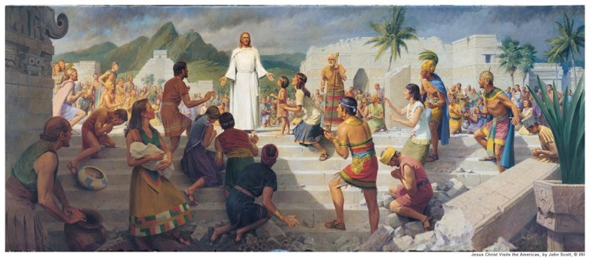
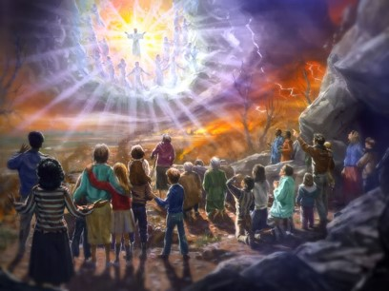
Darkness did Cease
All the noises and trembling did cease
Their mourning was turned to joy
Their lamentations into praise and thanksgiving unto the Lord, Jesus Christ, their Redeemer
They knew the scriptures had been fulfilled
Isaiah declares about our future:
“He will swallow up death in victory; and the Lord God will wipe away tears from off all faces; and the rebuke of his people shall he take away from off all the earth;: for the lord hath spoken it. And it shall be said in that day (our day), Lo, this is our god; we have waited for him, we will be glad and rejoice in his salvation.”
Isaiah 25:8-9 See also: Revelation 7:14-17
3 Nephi 10:9-11

Slide 14
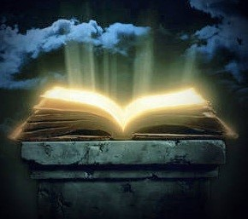
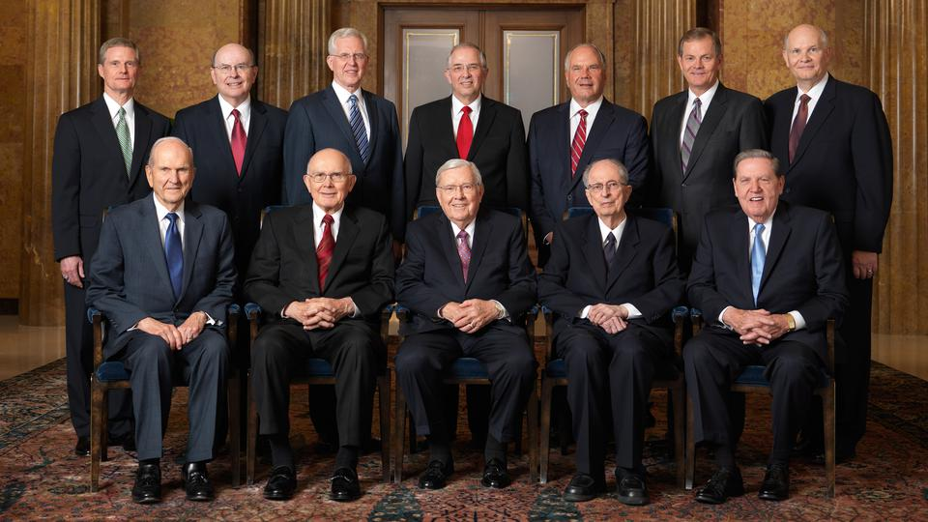
Written in the Lamb’s Book
They had received the prophets
Their names are added to the Book of Life
“In our day, the Lord declared that the righteous—…are those who hear and heed the Lord’s chosen servants
“For he that receiveth my servants receiveth me;
And he that receiveth me receiveth my Father;
And he that receiveth my Father receiveth my Father’s kingdom; therefore all that my Father hath shall be given unto him.”
D&C 84:36-38
3 Nephi 10:12-19

Slide 15
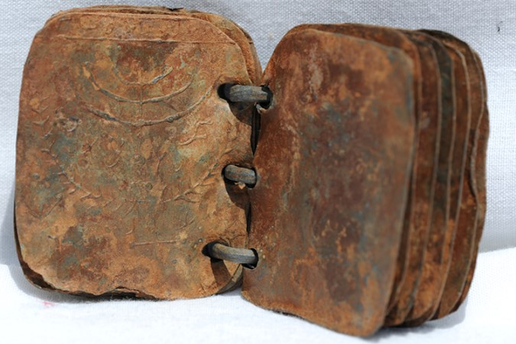
The council to the people
Read the scriptures
Those who readeth, let him understand
Search them…understand the prophecies that have taken place
Remember the testimony of Zeno, Zenock, Jacob (the seed of Joseph) written on the brass plates
Remember those who were slain because they had testified of Christ
What are we counseled to do today concerning the gospel?
3 Nephi 10:14-

Slide 16
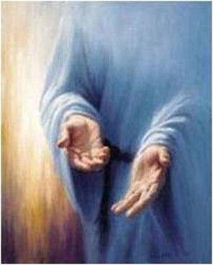
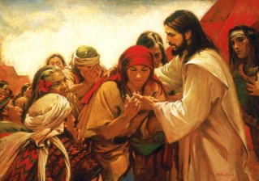
Mormon’s Commentary
“And it came to pass that in the ending of the thirty and fourth year, behold, I will show unto you that the people of Nephi who were spared, and also those who had been called Lamanites, who had been spared, did have great favors shown unto them, and great blessings poured out upon their heads, insomuch that soon after the ascension of Christ into heaven he did truly manifest himself unto them—
Showing his body unto them, and ministering unto them; and an account of his ministry shall be given hereafter. Therefore for this time I make an end of my sayings.”
3 Nephi 10:18-19

Slide 17
Sources:
Christ Brings Light Where There Is Darkness (0:37)
Signs of the Times Handouts—Lesley Meachum and Becky Davies Poway Institute (Ridges)
http://en.wikipedia.org/wiki/Crucifixion_of_Jesus
Joseph Fielding Smith Doctrines of Salvation 1:74
D. Todd Christofferson, “When Thou Art Converted,” Ensign or Liahona, May 2004, 12).
Joseph Fielding McConkie and Robert L. Millet Doctrinal Commentary on the Book of Mormon Vol. 4 pg 47
Presentation by ©http://fashionsbylynda.com/blog/

Slide 18
Spirit to be poured out on all flesh. (Joel 2:28-32)
Discovery and use of printing.
Protestant Reformation and age of Renaissance.
Discovery and colonization of America (Ne. 13:1-19
Establishment of the American nation. (3 Ne. 21:4 and 2 Ne. 10:9-19)
Translation and printing of Bible.
Establishment of the U. S. Constitution (D&C 98:4-10;134) (D&C 101:76,80)
Latter Day revelation.
Coming forth of the Book of Mormon (Isaiah, 29; Ezek. 37)
Opposition to the Book of Mormon.
Restoration of keys and priesthood (D&C 13:27; 128)
Restoration of the gospel. (Rev. 14:6-8) (Isaiah, 2; 4; 5; 10; 11; 13)
Messenger to precede Second Coming. (Mal. 3: 1-6) (D & C 45:9)
Church and kingdom set up again. (Dan. 2:31-45) (D&C 20)
Growth of the church. (Dan. 2:44) (D&C 65)
Gathering of Israel. (Acts 1: 6-11) (D&C 110:11)
Ten tribes to return. (D&C 133:26-34)
Times of Gentiles being fulfilled. (1 Ne. 13:42) (Luke 21 :24)
Return of Judah to Jerusalem. (D&C 133:13)
Jews to begin to believe in Christ. (D&C 45: 51-52) (Zech. 12: 8-14)
Building of latter-day temples. (Isa, 2: 1-5) (Ezekiel 37)
Lord to come suddenly to temple (Mal. 3:1) (D&C 110: 1-10)
Spirit of Elijah and genealogical research.
Persecution of the Saints.
Persecution of the Jews (Luke 21:20-24)
True gospel to be preached in all the world (D&C 113:37)
Worldly knowledge to increase (2 Tim. 3: 1-7)
Scientific and inventive progress. (Rev. 9: 5-10)
Disease, plague, pestilence to sweep earth(Luke 21:26)
Elements in commotion. (Joseph Smith 1 :29)
Disasters and calamities to abound. (D&C 61: 4-5)
Strikes, anarchy, violence, to increase. (D&C 45:26)
Latter-day wickedness (Joseph Smith 1 :30) (Luke 23:29)
Spirit ceasing to strive with wicked. (D&C 63:32)
Peace taken from the earth (to resume at Second Coming).
Angels now reaping the earth. (D&C 38:12)
Wars and rumors of wars. (D&C 63:33 and 97:22-24)
Famines, depressions and economic turmoil.
Apostate darkness covers earth. (2 Tim. 3: 1 -5)
Many false churches in latter days. (Rev. 13:13~14)
Refusal of men to believe signs of time (Matt. 16: 1-4)
Signs on Earth and in heavens. (D&C 45:39-42).
Lamanites to blossom as the rose. (D&C 49: 24-25)
Gathering at Adam-Ondi-Ahman. (2 Thess. 1 :8) (Dan 10) (D&C 115)
Final great war to attend Second Coming, (Zech 12; 13; 14) (Ezek. 38; 39)
Sorrow and fear precede and accompany the Second Coming. (D&C 29:15)
Fall of the great and abominable church. (D&.C 88:94)
Special mission in Jerusalem of two latter-day prophets. (D&C 77:15)
Wicked to be burned as stubble. (D&C 29: 9 & 10)
Final restitution of all things to be completed (new earth, heaven) (D&C 100:23-31)
Christ to reign personally upon the earth. (Rev. 11) (D&C 29:11)
Signs of the Times

Slide 19
Sign | State of Fulfillment | Notes
Apostate darkness covers the earth | Fulfilled | The Great Apostasy before the Restoration
2 Pet.2:1-2, 2 Thess.2:1-12, Mor. 8:28-31
Many false churches D&C 112:23, 2 Ne | Fulfilled | 41,000 Christian denominations worldwide
26:20-29
Spirit to be poured out on all flesh | Fulfilled | Science, discoveries, explorations, progression
Dan. 12:4, D&C 88:73
Discovery and use of printing | Fulfilled | Gutenberg press 1439 | Gutenberg Bible 1455
The invention of printing is credited to |  | Freedom of press 1789
Johannes Gutenberg in 1450
Discovery of America 1 Ne 13:12-16 | Fulfilled | Columbus
Protestant Reformation & Age | Fulfilled | Martin Luther
of Renaissance |  | Art, Science, Religion
Translation of Bible | Fulfilled | Wycliffe
Colonization of America 1 Ne 13: 16-19 |  | Pilgrims, Puritans
Establishment of US Constitution | Fulfilled | Founding Fathers
adopted on September 17, 1787 |  | Agency & Inalienable Rights
Latter-day Revelation | Fulfilled | The First Vision & Moroni
 |  | Holy Ghost poured out
Coming forth of the Book of Mormon | Fulfilled | The Plates, the printing of the Book
Ezek 37:15-19,3 N 21:1-2
Opposition to the Book of Mormon | Fulfilled | Prof Anthon
 |  | Clergy & Mobs
Restoration of keys and priesthood | Fulfilled | John the Baptist
D&C 20: 73, 138: 30 |  | Peter James & John
Spirit of Elijah and genealogical | Fulfilled | Elijah restored keys
research Sealing keys, D&C 110: 13-16, | & in Progress | Kirtland Temple April 3,1836
Mal 4:5-6
Restoration of the Gospel, Church to be | Fulfilled | April 6, 1830 - Incorporation
established, Isa 2: 2-3
Messenger to precede second coming | Fulfilled | Joseph Smith
Lord to come suddenly | Fulfilled | Christ appeared Kirtland Temple April 3, 1836
to His temple | & Yet Future | Dual: New Jerusalem Temple
Kingdom set up | Fulfilled | 1830 = 6 | 1852 = 60,000
Growth of the church. Church will fill |  | 1950 = 1 + mil 2000 = 14+mil
the whole earth, Dan 2: 35, 44-45
Gathering of Israel Return: Elder | Fulfilled | Spiritual Gathering
Morris, CR, April 1960, p. 100 -101, |  | Ephraim & Manasseh
D&C 133: 13,45:24-25
Times of the Gentiles Luke 21:24, D&C | Fulfilled | Gentiles receive the Gospel before the Jews
45:22-28
Building of latter-day temples Marv | Fulfilled | 140 Operating
Work and a Wonder, p. 33, Isa 2:2, | & in Progress | 14 under construction & 14 announced
D&C 133:13 |  | ZO\~

Slide 20
Persecution of the Saints | Fulfilled | Mobbed from place to place
Persecution of the Jews | Fulfilled | Pogroms & Holocaust
 | & in Progress | Middle East attacks
True gospel to be preached to all the | Fulfilled | Missionary work
world | & in Progress | Every member a missionary
Worldly & Scientific knowledge | Fulfilled | Science, Technology, Space age
increases Dan 121:4 | & in Progress | Explosion of inventions
Ten tribes to return D&C 133:26-33, | Fulfilled | Spiritual return
Talmage, A of F, p. 308 | & in Progress | Patriarchal blessings from every tribe
Lamanites to blossom as the rose D&C | Fulfilled | Conversion of American Indians,
49:24 | & in Progress | Central & South Americans
 |  | Spanish # 1 language in Church
Jews to begin to believe in Christ and | Fulfilled | Jews for Jesus
accept the gospeL 2 N 30:7, Zech 12: 7-10 | & in Progress | Some Jews join LDS Church
Pouring out of the Spirit JSM 1:39 | Fulfilled | Dreams and visions by "Servants" & "handmaids."
 | & in Progress | Gifts of the Spirit
Latter-day wickedness | Fulfilled | Crime, juvenile delinquency
 | & in Progress | Dissolution of the Family
Withdrawal of the Spirit from wicked | Fulfilled | God's organizing spirit is withdrawing
D&C 63:32, 95:4, Joel 2:28-29, Rom 1: 29-32 | & in Progress | from mankind
Elements in commotion D&C 45:323, | Fulfilled | Tsunamis, earthquakes, volcanoes, tornadoes
88:88-91, | & in Progress
Calamities to abound D&C 109:30,84: | Fulfilled | Man-made disasters
97, 2N 6:14-15, D&C 45:31 | & in Progress | Increase of murder, rape, abuse
Social unrest, corruption, violence | Fulfilled | Labor troubles, Political movements
Isa 3:5, 2 Tim 3:1-4, HeI4:21-23 | & in Progress | Terrorism, oppression
 |  | Drug & sex trafficking, Violence
Peace taken from the earth D&C 1 :35- | Fulfilled | Love of many waxes cold
36, 115:6 | & in Progress | Contention in homes and society
Wars and rumors of wars Matt 24:6, | Fulfilled | Frequency of wars has doubled since WWII
JSM 23, D&C 45:26; D&C 87 | & in Progress
Famines, depressions, & | Fulfilled | Govt instability, corruption & spending
economic turmoil | & in Progress | Entitlement, deficits, loss of incomes
Apostate darkness | Fulfilled | Sifting of members of Church
 | & in Progress | Deception by the philosophies of men
 |  | Even the very elect are deceived
Many False churches JSM 1:22, Rev | Fulfilled | Anti-Christs and false prophets
13:13-15 | & in Progress | Priestcraft increasing
Angels now reaping the earth | Fulfilled | Wilford Woodruff 1894 -
 | & in Progress | Angels were at the portals. | Now are reaping.
Constitution Hanging by a Thread | In Progress | US Constitution in danger of destruction
JSPapers Mar 10, 1844 |  | Will be saved by righteous citizens
Dangers upon the waters | Fulfilled | The Destroyer, toxins, pollution, storms,
D&C 61:4-6, 13-19,22 | & in Progress | acid rain, warships, tsunamis

Slide 21
Baptize with Fire 3 Nephi 9:20:
“We were baptized by immersion in water for the remission of sins. We must also be baptized by and immersed in the Spirit of the Lord, ‘and then cometh a remission of your sins by fire and by the Holy Ghost’ (2 Nephi 31:17).
“As we gain experience with the Holy Ghost, we learn that the intensity with which we feel the Spirit’s influence is not always the same. Strong, dramatic spiritual impressions do not come to us frequently. Even as we strive to be faithful and obedient, there simply are times when the direction, assurance, and peace of the Spirit are not readily recognizable in our lives. In fact, the Book of Mormon describes faithful Lamanites who ‘were baptized with fire and with the Holy Ghost, and they knew it not’ (3 Nephi 9:20).
“The influence of the Holy Ghost is described in the scriptures as ‘a still small voice’ (1 Kings 19:12; see also 3 Nephi 11:3) and a ‘voice of perfect mildness’ (Helaman 5:30). Thus, the Spirit of the Lord usually communicates with us in ways that are quiet, delicate, and subtle” (David A. Bednar, “That We May Always Have His Spirit to Be with Us,” Ensign or Liahona, May 2006, 29).
Broken Heart and Contrite Spirit 3 Nephi 9:19-20:
“Real, personal sacrifice never was placing an animal on the altar. Instead, it is a willingness to put the animal in us upon the altar and letting it be consumed! Such is the ‘sacrifice unto the Lord … of a broken heart and a contrite spirit’ (D&C 59:8)” (Neal A. Maxwell, “Deny Yourselves of All Ungodliness,” Ensign, May 1995, 68).

