Slide 2
Malachi—Meaning My Messenger
He was the last of the Old Testament prophets
The Book of Malachi was written around 430 BC
He lived in the Holy Land about 170 years after Lehi and his family left Jerusalem
His purpose was to call the people to repentance and to prepare for the Second Coming and judgments of the Lord
Because his words were not written in the Brass plates Jesus had the Nephites write Malachi’s words in their records
His words included the truths about the law of tithing and the sealing commission of Elijah
He prophesied of “a messenger” speaking of John the Baptist, to prepare the way for the Savior
Moroni also cited the words of Malachi to Joseph Smith concerning the prophet Elijah
He is included among the elect whom President Joseph F. Smith beheld during his vision of the work of salvation going on in the spirit world (D&C 138:46)
Who’s Who

Slide 3
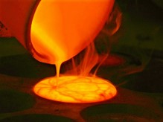
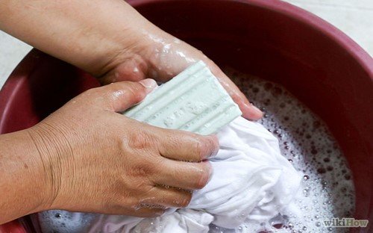
Cleansing Agents
At Christ’s Second Coming He will purify the world
A refiner uses fire to heat a metal like silver or gold until it reaches a liquid state. The heating process allows dross, or impurities, to rise to the surface of the liquid metal, where the refiner can remove them, thus purging the metal of its impurities.
A fuller is someone who cleans or whitens fabrics using soap.
3 Nephi 24:1-3

Slide 4
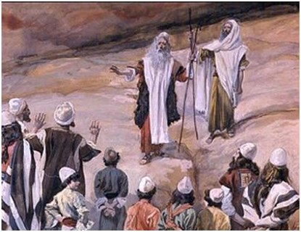
Priesthood Holders
The “sons of Levi” were priesthood holders in ancient Israel.
They will participate in the “restoration of all things” by once again offering sacrifice D&C 13; 84:31
Today the phrase can refer to modern-day priesthood holders
“For whoso is faithful unto the obtaining these two priesthoods of which I have spoken, and the magnifying their calling, are sanctified by the Spirit unto the renewing of their bodies.
They become the sons of Moses and of Aaron and the seed of Abraham, and the church and kingdom, and the elect of God.”
D&C 84:33-34
3 Nephi 24:5-6

Slide 5
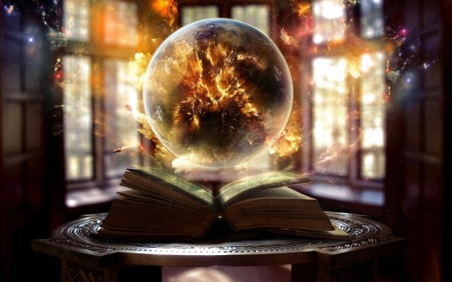
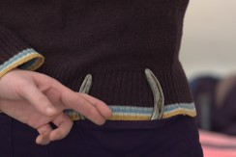
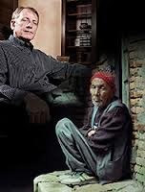
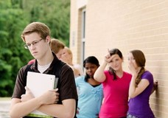
Cleansing the Earth by Fire
Jesus will be against the:
Sorcerers
Adulterers
False swearers
Those who oppress
Those who turn aside the stranger
Those who fear not me
“Yea, I tell thee, that thou mayest know that there is none else save God that knowest thy thoughts and the intents of thy heart.”
D&C 6:16
“…therefore ye sons of Jacob are not consumed.”
3 Nephi 24:5-6

Slide 6
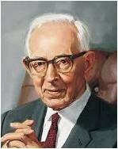
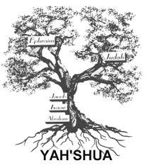
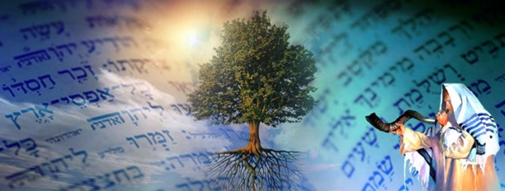
Sons of Jacob
“Every person who embraces the gospel becomes of the house of Israel. In other words, they become members of the chosen lineage, or Abraham’s children through Isaac and Jacob unto whom the promises were made.
The great majority of those who become members of the Church are literal descendants of Abraham through Ephraim, son of Joseph.
Those who are not literal descendants of Abraham and Israel must become such, and when they are baptized and confirmed they are grafted into the tree and are entitled to all the rights and privileges as heirs.”
Joseph Fielding Smith
“That all the ends of the earth may know that we, thy servants, have heard thy voice, and that thou hast sent us; that from among all these, thy servants, the sons of Jacob, may gather out the righteous. … Now these words, O Lord, we have spoken before thee, concerning the revelations and commandments which thou hast given unto us, who are identified with the Gentiles. … And may all the scattered remnants of Israel, who have been driven to the ends of the earth, come to a knowledge of the truth, believe in the Messiah, and be redeemed from oppression, and rejoice before thee.”
Doctrine and Covenants 109:57–58, 60, 67:
3 Nephi 24:6

Slide 7
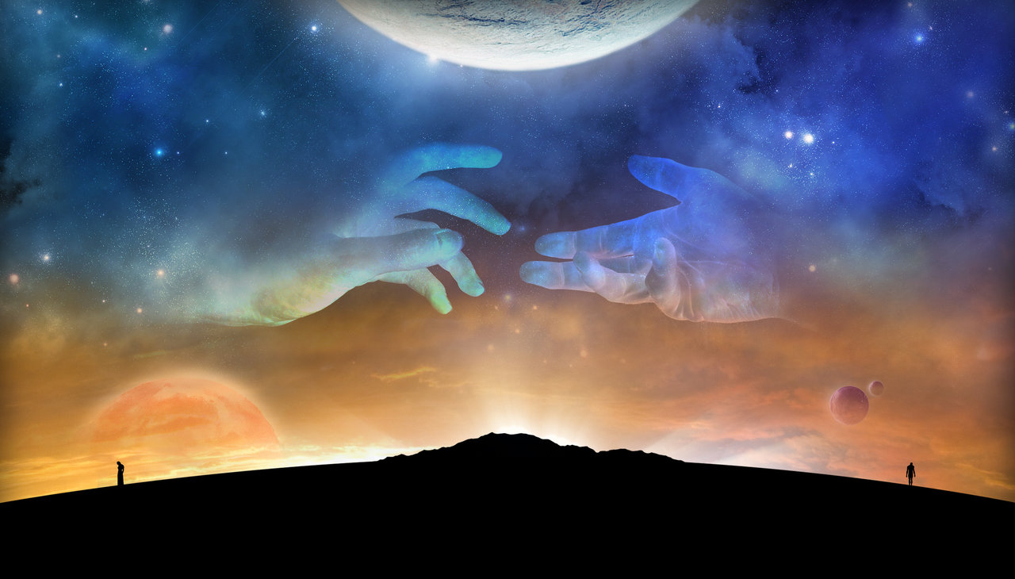
Gone Away
No Longer Keeping Covenants
Those who drift away from the teachings of Christ = They were no longer keeping the covenants and ordinances of the gospel.
Robin Reith Mayr
3 Nephi 24:7

Slide 8
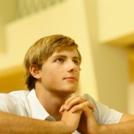
“Return Unto Me”
What promise did the Lord give to those who were not keeping their covenants?
“Return unto me and I will return unto you.”
“Malachi warns the wicked who continue to blatantly disregard the Lord’s commands and who physically or spiritually stone the prophets, and pleads with them to return unto the Lord.”
JFM and RLM
If we will return unto the Lord, He will return unto us
3 Nephi 24:7

Slide 9
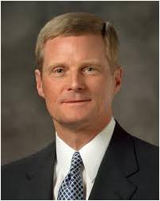
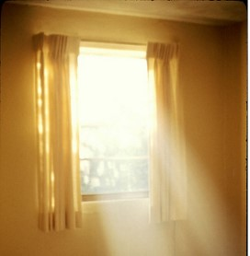
Law of Tithing
“Bring ye all the tithes into the storehouse, that there may be meat in my house; and prove me now herewith, saith the Lord of Hosts, if I will not open you the windows of heaven, and pour you out a blessing that there shall not be room enough to receive it.”
“The imagery of the “windows” of heaven used by Malachi is most instructive. Windows allow natural light to enter into a building. In like manner, spiritual illumination and perspective are poured out through the windows of heaven and into our lives as we honor the law of tithing.”
Elder David A. Bednar
3 Nephi 24:8-12

Slide 10
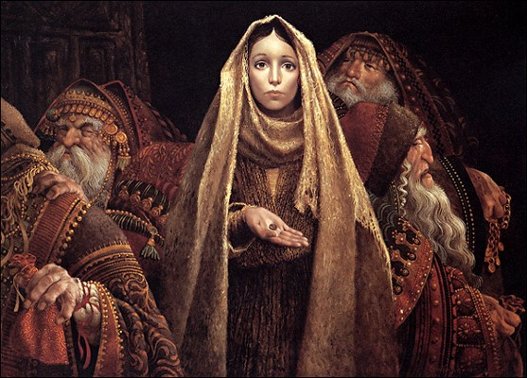
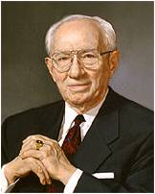
Can I Afford to Pay My Tithing?
“And there came a certain poor widow, and she threw in two mites, which make a farthing.
“And he called unto him his disciples, and saith unto them, Verily I say unto you, That this poor widow hath cast more in, than all they which have cast into the treasury:
“For all they did cast in of their abundance; but she of her want did cast in all that she had, even all her living”
(Mark 12:41–44).
“We can pay our tithing. This is not so much a matter of money as it is a matter of faith”
President Gordon B. Hinckley
3 Nephi 24:8-12

Slide 11
Where Does My Tithing Go?
“These sacred funds are used in a rapidly growing church to spiritually bless individuals and families by constructing and maintaining temples and houses of worship, supporting missionary work, translating and publishing scriptures, fostering family history research, funding schools and religious education, and accomplishing many other Church purposes as directed by the Lord’s ordained servants.”
Elder David A. Bednar
3 Nephi 24:8-12

Slide 12
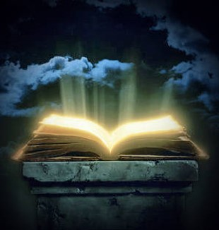
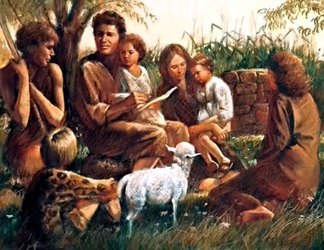
Book of Remembrance
Recorded from Revelations 20:12:
“…which was the book of life; but the dead were judged out of those things which were written in the books, according to their works; consequently, the books spoken of must be the books which contained the record of their works, and refer to the records which are kept on the earth.
And the book which was the book of life is the record which is kept in heaven; the principle agreeing precisely with the doctrine which is commanded you in the revelation contained in the letter which I wrote to you previous to my leaving my place—that in all your recordings it may be recorded in heaven.”
D&C 128:7
“And a book of remembrance was kept, in the which was recorded, in the language of Adam, for it was given unto as many as called upon God to write by the spirit of inspiration;…”
Moses 6:5
3 Nephi 24:13-16

Slide 13
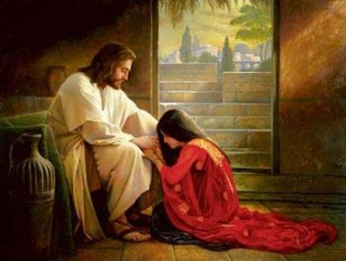
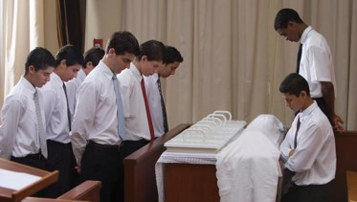
Fear Him
fear = reverence or respect
“…Fear God, and give glory to him who sitteth upon the throne, forever and ever; for the hour of his judgment is come.”
D&C 88:104
Interpretation:“…Give reverence to God, and give glory to him who sitteth upon the throne, forever and ever; for the hour of his judgment is come.”
“Serve the Lord with fear, and rejoice with trembling.”
Psalm 2:11
Interpretation: “Serve the LORD with reverence and respect.”
3 Nephi 24:16

Slide 14
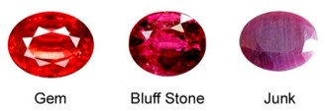
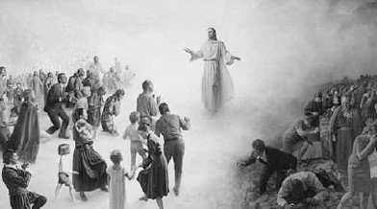
Jewels
The Lord then indicated that when He comes again, He will preserve the faithful and reserve them to Himself as a treasure, or “make up [His] jewels.”
“A jewel is a precious stone measured by its intrinsic and extrinsic value in the marketplace of men. God's jewels, as indicated here, are those who keep his ordinances and do not speak against their Lord. This, he says, is the way to "discern between the righteous and the wicked, between him that serveth God and him that serveth him not”
Student Manual
3 Nephi 24:17

Slide 15
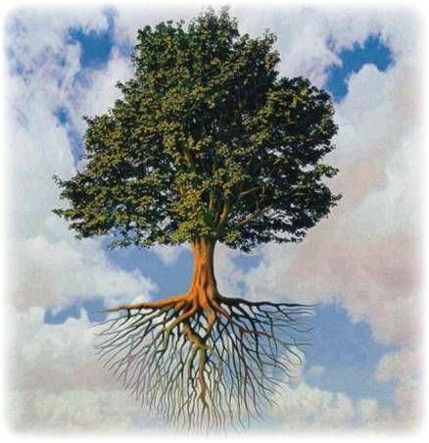
Tree = Symbolic = People
What would happen to a tree if we eliminated one of its vital parts?
Branches
Branch = Posterity
Trunk = You
Trunk
Roots = Ancestors
Roots
How can your actions affect your family tree in the eternities?
3 Nephi 25

Slide 16
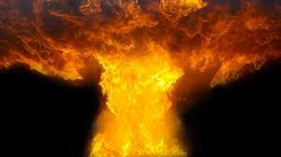
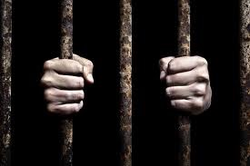
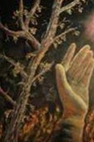
All Wickedness Removed
“it shall leave them neither root nor branch” means for the wicked?
“For the hour is nigh and the day soon at hand when the earth is ripe; and all the proud and they that do wickedly shall be as stubble; and I will burn them up, saith the Lord of Hosts, that wickedness shall not be upon the earth;”
D&C 29:9
“…and I will not spare any that remain in Babylon.”
D&C 64:24
“Go ye out from among the nations, even from Babylon, from the midst of wickedness, which is spiritual Babylon.”
D&C 133:14
The word root likely refers to ancestors and the word branch to posterity. Thus, in the next life, the wicked will not enjoy the blessings of being sealed to their ancestors and posterity
3 Nephi 25:1

Slide 17
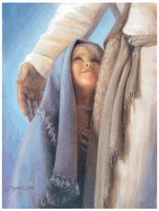
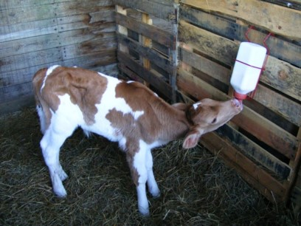
Healing in His Wings
The Nephites had just witnessed the wicked being destroyed (3 Nephi 9:3-12)
The preservation of the more ‘righteous part’ and healing with wings—the protection they had received during this destruction and the protection through His Atonement
Wings—Power
The Son of Righteousness came with the power of the Atonement
Calves in the stall—they are safe, well fed, and cared for. The Lord promises that He will similarly protect and care for those who “fear [His] name. (Reverence His name)
They will gather the people of the Lord to Christ into the lands of their inheritance during the restoration of Israel in the Millennium
3 Nephi 25:2-3

Slide 18
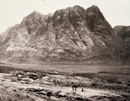
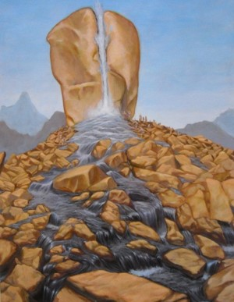
The Higher Law Given to Moses
Christ is referring to Moses and the law given even though He had fulfilled that law…Why?
Perhaps “…the Lord (and Malachi) were not referring to the Mosaic code and carnal commandments but rather to a different law that was given to Moses in Horeb—a higher law, even the fulness of the gospel that, because of Israel’s rebelliousness and stiffneckedness, they never were able to fully receive (see JST, Exodus 34:1-2)
Read: D&C 84:23-24
“Therefore, he took Moses out of their midst, and the Holy Priesthood also;
And the lesser priesthood continued, which priesthood holdeth the key of the ministering of angels and the preparatory gospel;”
D&C 84:25-26
Horeb, is the mountain at which the book of Deuteronomy in the Hebrew Bible states that the Ten Commandments were given to Moses by God. It is described in two places (Exodus 3:1, 1 Kings 19:8) as the "Mountain of God". The mountain is also called the Mountain of YHWH (one of the names of the God of Israel).
3 Nephi 25:4

Slide 19
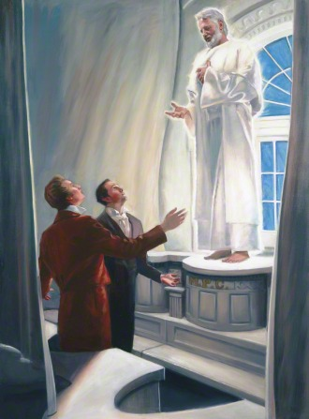
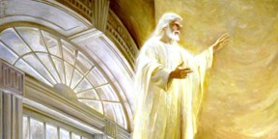
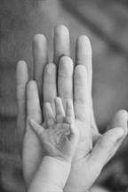
Elijah, the Prophet
Elijah’s return to the earth as part of the Restoration of the gospel.
On April 3, 1836, Elijah appeared to Joseph Smith and Oliver Cowdery in the newly dedicated Kirtland Temple (see D&C 110:13–16).
At that time, Elijah restored the priesthood keys necessary to seal families for eternity in the Lord’s holy temples. Through family history research, we identify family members for whom temple ordinances can be performed.
What do you think it means that Elijah would “turn the heart of the fathers to the children, and the heart of the children to their fathers”?
As our hearts turn to our fathers through family history and temple work, we are helping to prepare the earth for the Second Coming of Jesus Christ
3 Nephi 25:5-6

Slide 20
Elijah
Meaning: Jehovah is my God
He was a Tishbite in a long line of extraordinary prophets
He commenced his ministry around 926 BC among the northern tribes of Israel
Peter, James, and John witnessed Elijah (Elias) and Moses at the Mount of Transfiguration (Matthew 17:1-11)
He restored the keys of sealing power of the priesthood to Joseph Smith (D&C 110:13-16) in the Kirtland Temple on April 3, 1836
He taught the Doctrines of Salvation
He fasted 40 days and his successor Elisha received the priesthood power from him
He held the “keys of the power of turning the hearts of the fathers to the children, and the hearts of the children to the fathers…(D&C 27:9)
Who’s Who

Slide 21
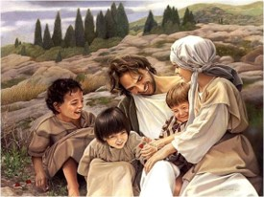
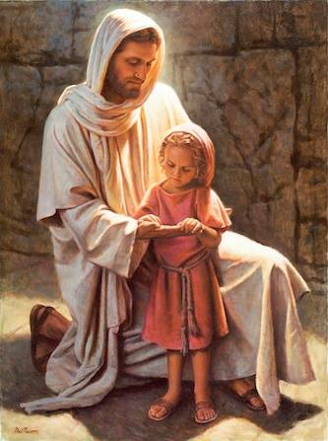
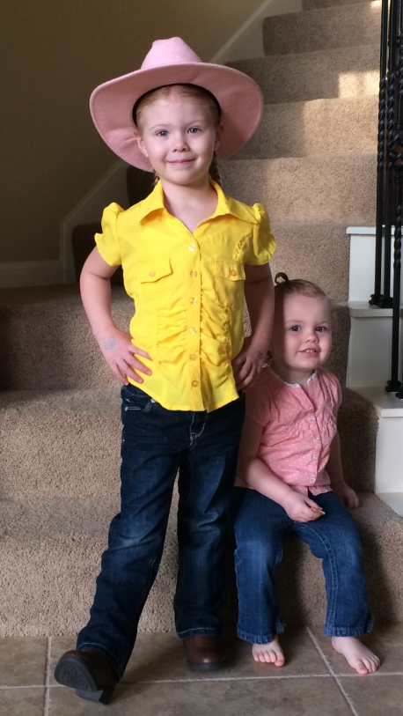
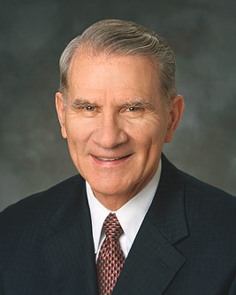
Through the Mouths of Children
¶And it shall come to pass afterward, that I will pour out my spirit upon all flesh; and your sons and your daughters shall prophesy, your old men shall dream dreams, your young men shall see visions:”
Joel 2:8
“And now, he imparteth his word by angels unto men, yea, not only men but women also. Now this is not all; little children do have words given unto them many times, which confound the wise and the learned.”
Alma 32:23
“Children come into this world whole, innocent, and pure (see Moses 6:54). “They cannot sin, for power is not given unto Satan to tempt little children, until they begin to become accountable before me” (D&C 29:47).
We are commanded to become like them:
“And Jesus called a little child unto him, and set him in the midst of them,
“And said, Verily I say unto you, Except ye be converted, and become as little children, ye shall not enter into the kingdom of heaven.
“Whosoever therefore shall humble himself as this little child, the same is greatest in the kingdom of heaven” (Matt. 18:2–4.)”
Elder Jay E. Jensen
Del Parson
3 Nephi 25:14-16

Slide 22
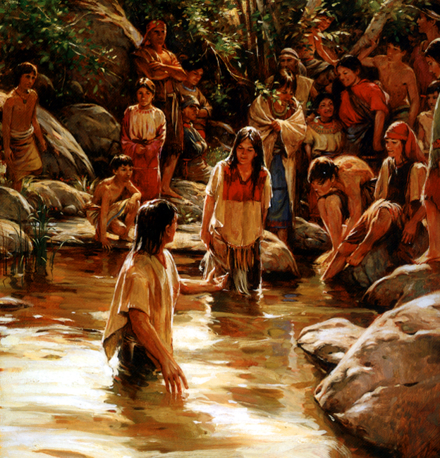
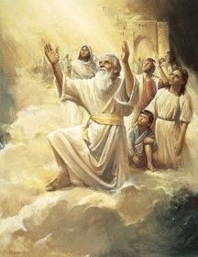
All Things in Common
“And they taught, and did minister one to another; and they had all things common among them, every man dealing justly, one with another.
And it came to pass that they did do all things even as Jesus had commanded them.
And they who were baptized in the name of Jesus were called the church of Christ.”
They were united—as the city of Enoch, in the bonds of consecration and stewardship
They were called the Church of Christ—Taking on the name of Christ
A membership of an Earthly Church
“They are they who are the church of the Firstborn.”
D&C 76:54
3 Nephi 25:19-21

Slide 23
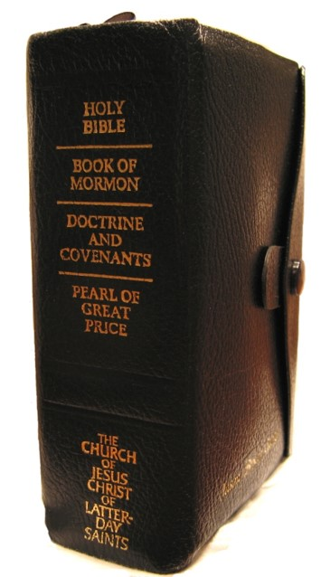
For the Future Generations
The Prophecies of Malachi can be found in all the standard works:
Old Testament– Malachi 1-4
New Testament– Luke 1:17
Book of Mormon– 3 Nephi 24, 25
Doctrine and Covenants– 2:1-3
Pearl of Great Price– Joseph Smith—History 1:37-39
Jesus was given to expound ‘all things’ to the Nephite people
From the beginning to the end
3 Nephi 26:1-5

Slide 24
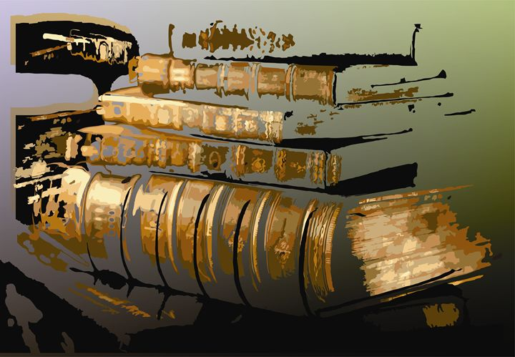
To Be Revealed
“The Lord has promised us greater knowledge, greater understanding than we find in the Book of Mormon, when we are prepared to receive it.” Joseph Fielding Smith
As we believe and act on what God has revealed, we prepare ourselves to receive greater revelation
Stojanovska Emilija
3 Nephi 26:9

Slide 25
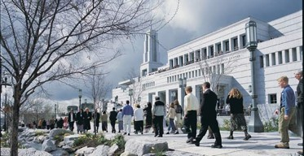
Much Has Been Held Back
"Now the Lord has placed us on probation as members of the Church. He has given us the Book of Mormon, which is the lesser part, to build up our faith through our obedience to the counsels which it contains, and when we ourselves, members of the Church, are willing to keep the commandments as they have been given to us and show our faith as the Nephites did for a short period of time, then the Lord is ready to bring forth the other record and give it to us, but we are not ready now to receive it.
Why? Because we have not lived up to the requirements in this probationary state in the reading of the record which had been given to us and in following its counsels."
Joseph Fielding Smith
3 Nephi 26:6-12

Slide 26
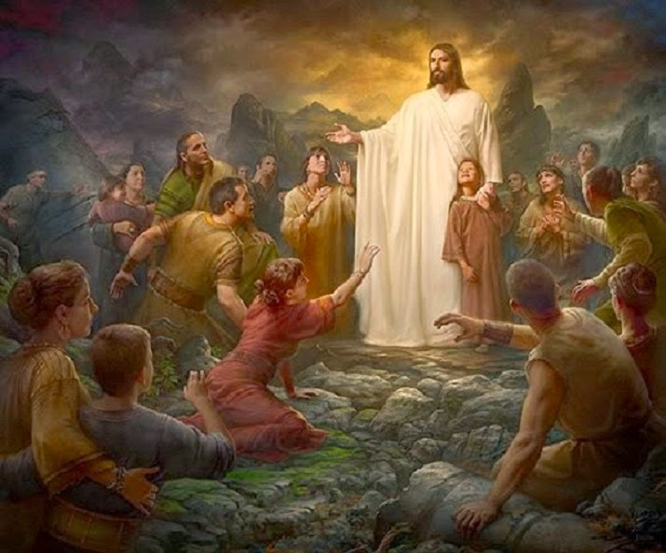
Ascended a 2nd Time
“And it came to pass that after he had ascended into heaven—the second time that he showed himself unto them, and had gone unto the Father, after having healed all their sick, and their lame, and opened the eyes of their blind and unstopped the ears of the deaf, and even had done all manner of cures among them, and raised a man from the dead, and had shown forth his power unto them, and had ascended unto the Father—”
3 Nephi 26:15

Slide 27
Sources:
Video: Too Sacred to Discuss (1:34)
The Book of Mormon Who’s Who by Ed J. Pinegar and Richard J. Allen pgs. 116-117
The Old Testament Who’s Who by Ed. J. Pinegar and Richard J. Allen pgs. 47=48,121-122
Daniel H. Ludlow Of the House of Israel Jan. 1991 Ensign
Joseph Fielding Smith (Doctrines of Salvation, 3 vols., Salt Lake City: Bookcraft, 1954–56, 3:246.)
Joseph Fielding McConkie and Robert L. Millet Doctrinal Commentary on the Book of Mormon Vol. 4 pgs. 163-164
Elder David A. Bednar The Windows of Heaven Oct. 2013 Gen. Conf.
President Gordon B. Hinckley (“Let Us Move This Work Forward,” Ensign, Nov. 1985, 85)
Student Manual of Religion Book of Mormon 121-122 pgs. 435-436
Rock of Horeb by Mariano David Otero artwork
Joseph Fielding Smith in CR, Oct. 1961, p. 20.
Elder Jay E. Jensen Little Children and the Gospel Jan. 1999 Ensign
Presentation by ©http://fashionsbylynda.com/blog/

Slide 28
3 Nephi 24: 3-7 What Is the Offering That the Levites Are to Make?
"It is generally supposed that sacrifice [blood sacrifice] was entirely done away when the Great Sacrifice [i.e.,] the sacrifice of the Lord Jesus was offered up, and that there will be no necessity for the ordinance of sacrifice in future; but those who assert this are certainly not acquainted with the duties, privileges and authority of the Priesthood, or with the Prophets.
"The offering of sacrifice has ever been connected and forms a part of the duties of the Priesthood ....
"These sacrifices, as well as every ordinance belonging to the Priesthood, will, when the Temple of the Lord shall be built, and the sons of Levi be purified, be fully restored and attended to in all their powers, ramifications, and blessings." (Joseph Smith, Teachings of the Prophet Joseph Smith, pp. 172-73.)
3 Nephi 24:8-12. What Blessings Are Promised to Those Who Pay Tithing?
"I bear my testimony ... that if the people will pay their tithes and offerings, they will not only be blessed in their material affairs, but they will be abundantly blessed with increased outpouring of the Spirit of the Lord." (Heber J. Grant, Gospel Standards, p. 106.)
Such is the promise which the Lord makes through his servant Malachi: He will not only open the windows of heaven and pour down spiritual blessings, but he will also preserve our fruits and vegetables (that is, the labor of our hands) from destruction as well. (See Malachi 3:8-12.)
"One of the important things the Lord has told us to do is to be liberal in our payment of fast offerings. I would like you to know that there are great rewards for so doing-both spiritual and temporal rewards. The Lord says that the efficacy of our prayers depends upon our liberality to the poor." (Marion G. Romney, "Fundamental Welfare Services," Ensign, May 1979, p. 95.)
3 Nephi 24:2. What Is "Fuller's Soap"?
"The art of fulling, cleansing, and bleaching cloth was of importance because of the high cost of clothing and the need to cleanse the fibres of their natural oil or gums before dyeing. In some places the fuller was also the dyer.
"It was customary for a fuller to work outside a town within reach of water in which clothes could be cleaned by treading them on a submerged stone. Hence the fuller was characteristically called a 'trampler' (Heb. kabas). At Jerusalem the locality outside the east wall where garments were spread to dry in the sun was called the 'fuller's field' (2 Ki. xviii, 17; Is. vii, 3, xxxvi. 2).
Christ's garments at the transfiguration were described as brighter than it was possible for any fuller (Gk. gnapheus, 'cloth dresser') to whiten them (Mk. ix, 3).
"For cleansing natron (nitre) was sometimes imported from Egypt, where, mixed with white clay, it was used as soap (Pr. xxv. 20; [e. ii. 22). Alkali was plentifully available in plant ash, and 'soap' (Heb. borit, kali) was obtained by burning the soda plant (Salsola kali). The 'fullers' sope' of Mal. iii. 2 was probably' cinders of borit,' since potassium and sodium nitrate do not seem to have been known in Syria or Palestine, though found in Babylonia." (J. D. Douglas, ed., New Bible Dictionary, s.v. "Arts and Crafts.")
Excerpts from Student Manual page 436—Religion 121-122 Book of Mormon

