Slide 2
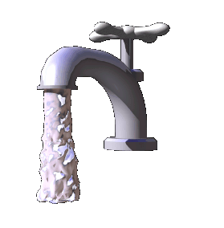
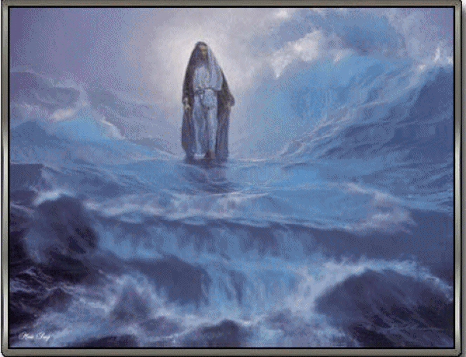
Imagine Life Without
What do you imagine life would be like without this object?
How would life be different without the Atonement of Jesus Christ?
What would life be like without this?
aiaiaiaiaiaiaiaia
aiaiaiaiaiaiaiaia
The Zoramites believed there would “be no Christ”.
Alma encouraged them to try an experiment by choosing to believe in Jesus Christ.
Alma 31:16; Alma 32-33

Slide 3
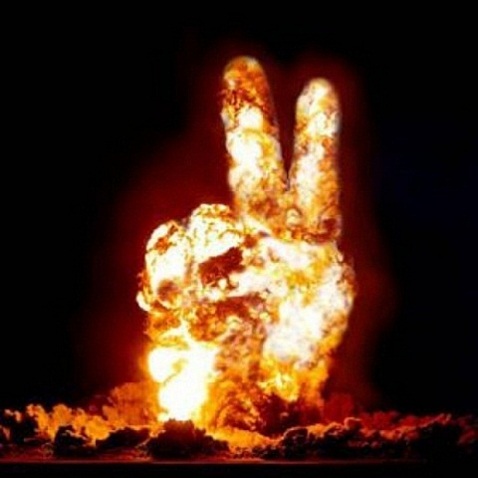
A The Mouths of Two
“At the mouth of two witnesses, or three witnesses, shall he that is worthy of death be put to death; but at the mouth of one witness he shall not be put to death.”—referring to the binding of two or more witnesses has more validity than one.”
Deuteronomy 17:6
The Lord has said that in the mouths of two or three witnesses shall his every word be established
aiaiaiaiaiaiaiaia
aiaiaiaiaiaiaiaia
The Lord always sends his words through witnesses who testify of Him and His word
Two or more witnesses give a binding voice in the testimony of truth

Slide 4
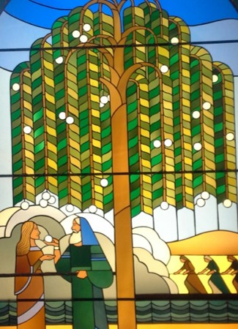
Amulek—the 2nd Witness
Amulek affirms that the Word is in Christ to the Zoramites
Alma sets the terms of faith in Alma 32 while
Amulek focuses “upon how one who is lacking in faith may, through the divine experiment, grow from desire to belief, through a hope that there is and shall be a Christ…and eventually partake of the fruit of the tree of life.”
aiaiaiaiaiaiaiaia
aiaiaiaiaiaiaiaia
Alma 34:3

Slide 5
True or False?
1. When Jesus Christ atoned for the sins of mankind, He suffered only for righteous people.
2. All people need the Atonement in order to be saved.
3. Any person can atone or pay for the sins of another.
True False
True False
aiaiaiaiaiaiaiaia
aiaiaiaiaiaiaiaia
True False
Alma 34:3-11

Slide 6
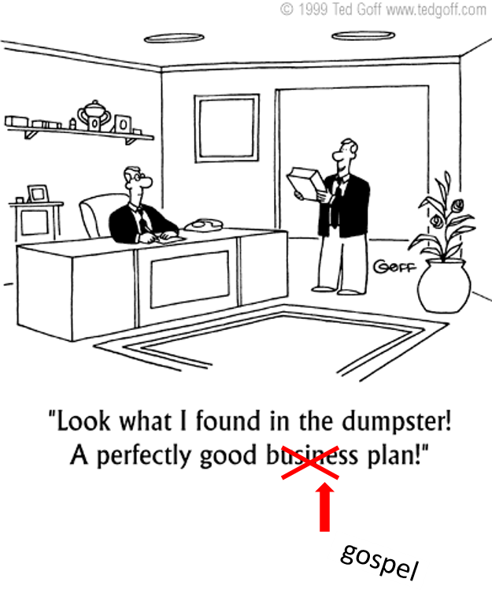
The Plan of God
aiaiaiaiaiaiaiaia
aiaiaiaiaiaiaiaia
Alma 34:8-39

Slide 7
An atonement will be made for the multitudinous sins of men
Alma 34:8
2. The sacrifice of Christ is to be infinite and eternal
Alma 34:10,12
aiaiaiaiaiaiaiaia
aiaiaiaiaiaiaiaia

Slide 8
For it is expedient that an atonement should be made; for according to the great plan of the Eternal God there must be an atonement made, or else all mankind must unavoidably perish; yea, all are hardened; yea, all are fallen and are lost, and must perish except it be through the atonement which it is expedient should be made.
For it is expedient that there should be a great and last sacrifice; yea, not a sacrifice of man, neither of beast, neither of any manner of fowl; for it shall not be a human sacrifice; but it must be an infinite and eternal sacrifice.
Alma 34:9-10
aiaiaiaiaiaiaiaia
aiaiaiaiaiaiaiaia

Slide 9
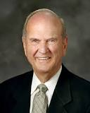
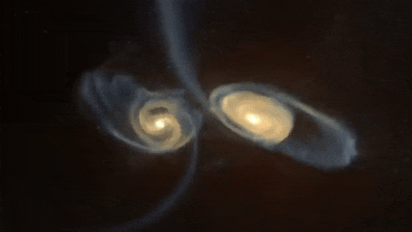
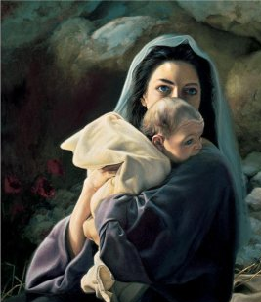
“His Atonement is infinite—without an end. It was also infinite in that all humankind would be saved from never-ending death. It was infinite in terms of His immense suffering. … It was infinite in scope—it was to be done once for all. And the mercy of the Atonement extends not only to an infinite number of people, but also to an infinite number of worlds created by Him. It was infinite beyond any human scale of measurement or mortal comprehension.
aiaiaiaiaiaiaiaia
aiaiaiaiaiaiaiaia
“Jesus was the only one who could offer such an infinite atonement, since He was born of a mortal mother and an immortal Father.
Because of that unique birthright,
Jesus was an infinite Being.”
Liz Lemon Swindle
Elder Russell M. Nelson

Slide 10
3. Each man must bear responsibility for his own sins, and one man cannot atone for the sins of someone else
Alma 34:11-12
4. The fulfillment of the law of Moses is to be through a “great and last sacrifice” by the “the Son of God, yea, infinite and eternal”
Alma 34: 13-14
aiaiaiaiaiaiaiaia
aiaiaiaiaiaiaiaia
Without the infinite and eternal Atonement of Jesus Christ, all mankind would be lost forever

Slide 11
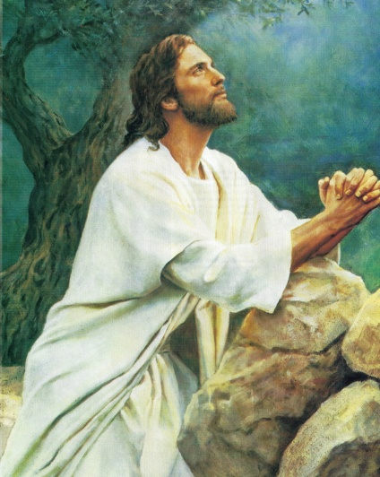
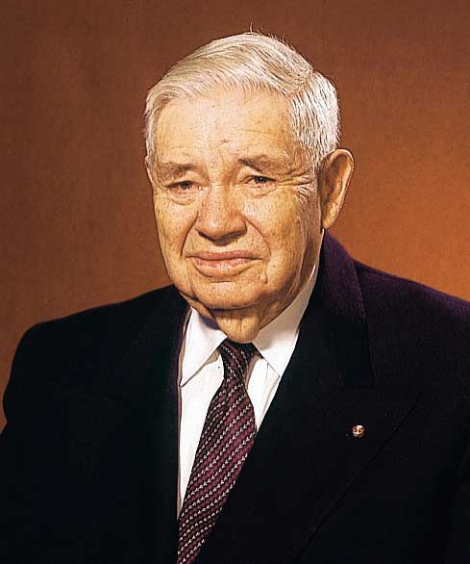
“According to eternal law, that atonement required a personal sacrifice by an immortal being not subject to death.
Yet He must die and take up His own body again. The Savior was the only one who could accomplish this. From His mother He inherited power to die. From His Father He obtained power over death.”
Elder Russell M. Nelson
aiaiaiaiaiaiaiaia
aiaiaiaiaiaiaiaia
“Under the new covenant that came in with Christ, the sinner must offer the sacrifice out of his own life, not by offering the blood of some other creature…”
Reuben Clark, Jr.

Slide 12
5. This sacrifice brings about mercy, which “overpowereth justice, and bringeth about means unto men that they may have faith unto repentance”
Alma 34:15
6. He who exercises “faith unto repentance” is encircled in the arms of mercy, while he who does not repent “is exposed to the whole law of the demands of justice”
Alma 34:16
aiaiaiaiaiaiaiaia
aiaiaiaiaiaiaiaia

Slide 13
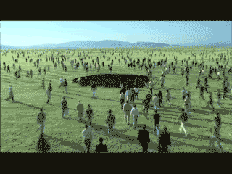
Justice may be satisfied in two ways:
Keeping the law perfectly; or
Suffering the effects of a broken law.
Christ satisfied the demands of justice in both of these ways; he kept the law perfectly for himself and suffered in the Garden of Gethsemane and on the cross for and in behalf of those of us who repent.
aiaiaiaiaiaiaiaia
aiaiaiaiaiaiaiaia
Those who refuse to repent are
exposed to the “whole law of the
demands of justice.”
JFM and RLM

Slide 14
7. Men may call upon God in all places and under all conditions, both for themselves and for others
Alma 34:17-29
8. Men must repent when the opportunity is presented, for “now is the time and the day of your salvation” and “this life is the time for men to prepare to meet God” by performing all their labors
Alma 34:31-32
aiaiaiaiaiaiaiaia
aiaiaiaiaiaiaiaia

Slide 15
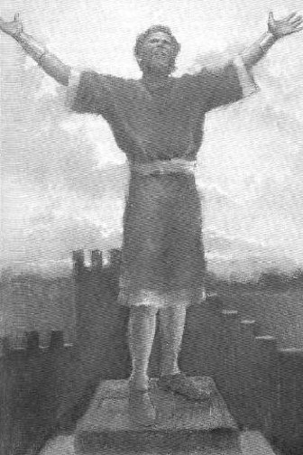
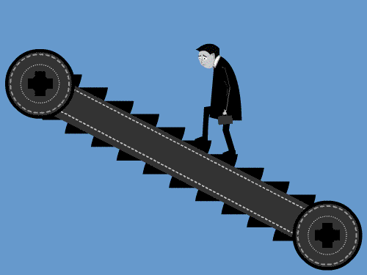
When one’s prayers seem repetitive maybe it is a time to examine your testimony of Christ
aiaiaiaiaiaiaiaia
aiaiaiaiaiaiaiaia

Slide 16
9. If men procrastinate their repentance and fail to “prepare for eternity,” the “night of darkness wherein there can be no labor performed” overtake them
Alma 34:33
10. Men cannot repent when “brought to that awful crisis” (death? judgment?) and return to God, because the “same spirit” that possesses a man’s body at the time he goes out of this life has power to possess his body in that eternal world
Alma 34:34
aiaiaiaiaiaiaiaia
aiaiaiaiaiaiaiaia

Slide 17
Procrastination is the thief of eternal life.
One may find that putting off repentance until later strengthens a poor habit and lessens the ability to change
“If we do not improve ourselves during this period of time, then it will be too late.”
This life is the time for us to prepare to meet God. If we procrastinate the day of our repentance, we will become subject to the spirit of the devil.
aiaiaiaiaiaiaiaia
aiaiaiaiaiaiaiaia
“But behold, your days of probation are past; ye have procrastinated the day of your salvation until it is everlastingly too late, and your destruction is made sure; yea, for ye have sought all the days of your lives for that which ye could not obtain; and ye have sought for happiness in doing iniquity, which thing is contrary to the nature of that righteousness which is in our great and Eternal Head.”
Helaman 13:38

Slide 18
11. Procrastination of one’s repentance until death is evidence that one has subjected himself to the devil and that the spirit of the Lord has withdrawn from him
Alma 34:35-36
12. Men should work out their salvation with fear before God, take upon themselves the name of Christ, humble themselves in worship before god, “live in thanksgiving daily” and “be watchful unto prayer continually” as a defense against the devil
Alma 34:38-39
aiaiaiaiaiaiaiaia
aiaiaiaiaiaiaiaia
Student Manual

Slide 19
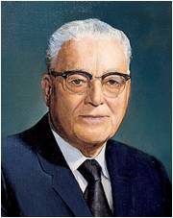
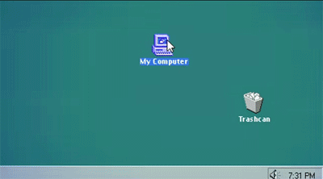
“Now, if you have made mistakes, make today the beginning of a change of your lives. Turn from the thing that you have been doing that is wrong. The most important of all the commandments of God is that one that you are having the most difficulty keeping today.
aiaiaiaiaiaiaiaia
aiaiaiaiaiaiaiaia
If it is one of dishonesty, if it is one of unchastity, if it is one of falsifying, not telling the truth, today is the day for you to work on that until you have been able to conquer that weakness. … Put that aright and then you start on the next one that is most difficult for you to keep.”
Harold B. Lee
mistake

Slide 20
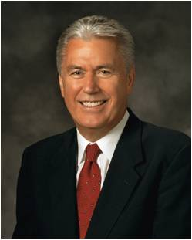
Jesus Christ brings salvation to all who believe on His name and exercise faith unto repentance
“We need a strong faith in Christ
to be able to repent. …
Faith in Christ will change our thoughts, beliefs, and behaviors that are not in harmony with God’s will. …
Repentance means a change of mind and heart—we stop doing things that are wrong, and we start doing things that are right”
President F. Uchtodorf
aiaiaiaiaiaiaiaia
aiaiaiaiaiaiaiaia

Slide 21
The Zoramites Were Told To:
Worship God wherever they were
Receive the Holy Ghost and take upon themselves the name of Christ
Humble themselves
aiaiaiaiaiaiaiaia
aiaiaiaiaiaiaiaia
Bear their afflictions with patience
Live in thanksgiving daily
Pray continually
Alma 34:8-38-40

Slide 22
The True Spirit of Christianity
The Zoramites who embraced the words of Amulek and Alma and were converted were cast out by the wicked rulers and priests and teachers
aiaiaiaiaiaiaiaia
aiaiaiaiaiaiaiaia
The people of Ammon who lived in the land of Jershon took them into their land, fed and clothed them, and gave them land
Alma 35

Slide 23
Making Preparations For War
The Zoramites were angry with the people of Ammon and began to ally with the Lamanites
The Zoramites and Lamanites began to make preparations of war
The end of the 17th year of the reign of the judges
aiaiaiaiaiaiaiaia
Alma, Ammon, and their brethren and Shiblon and Corianton returned to the land of Zarahemla
aiaiaiaiaiaiaiaia
The righteous Zoramites in the land of Jershon began to take up arms for battle
The battle commenced in the 18th year of the reign of the judges
Alma 35

Slide 24
Sources:
Student Manual Religion 121-122 Book of Mormon pg. 301-302
Reuben Clark Jr. Church News, 24 Dec 1960 pg. 15
Bruce R. McConkie Mormon Doctrine pg. 64
Joseph Fielding McConkie and Robert L. Millet Doctrinal Commentary on the Book of Mormon Vol. 3 pg. 251
Elder Russell M. Nelson ” (“The Atonement,” Ensign, Nov. 1996, 35) and (“Constancy amid Change,” Ensign, Nov. 1993, 34).
(Teachings of Presidents of the Church: Harold B. Lee[2000], 30).
President F. Uchtodorf (“Point of Safe Return,” Ensign or Liahona, May 2007, 100).
aiaiaiaiaiaiaiaia
aiaiaiaiaiaiaiaia

