Slide 2
The Sacred Records
Alma’s successor in the judgment seat refused to assume responsibility for the sacred records
(Alma 50:37-38)
Nephihah
Helaman
Alma 37:1

Slide 3
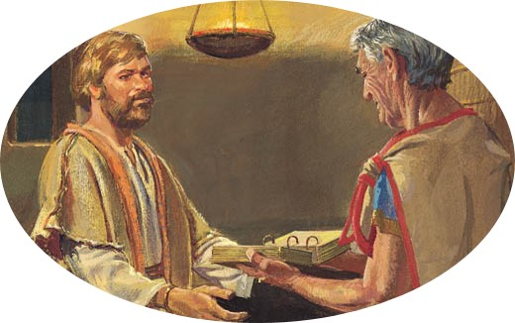
Instructions to Helaman
For a wise purpose
Keep them (scriptures) according to as I have done
Records of Holy scriptures
Genealogy of the forefathers—even the beginning
They must retain their brightness
Containing the mysteries of God
Prophecies of the forefathers
Kept and preserved until they go forth to every nation, kindred, tongue, and people
Handed down from generation to generation
Alma 37:1-5

Slide 4
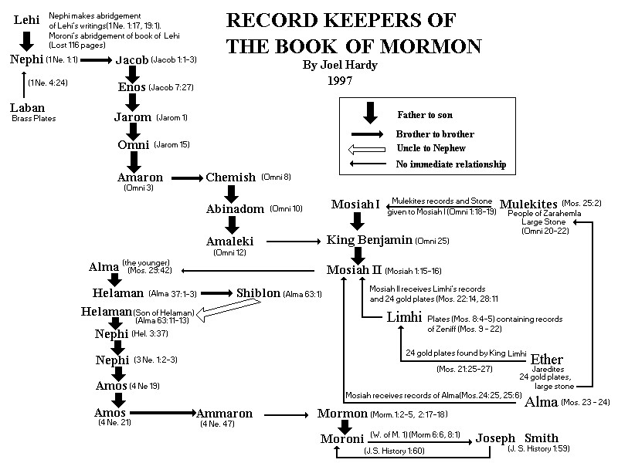
Joel Hardy
Alma 37:1-5

Slide 5
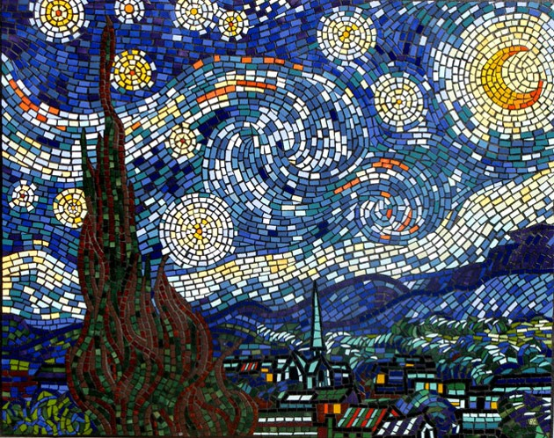
Small and Simple Things
“…our purposes of the Lord in our personal lives generally are fulfilled through the small and simple things, and not the momentous and spectacular.”
M. Russell Ballard
“Wherefore, be not weary in well-doing, for ye are laying the foundation of a great work. And out of small things proceedeth that which is great.”
D&C 63:33
By small and simple things are great things brought to pass. The Lord works by very small means to bring about the salvation of many souls
Alma 37:6-7

Slide 6
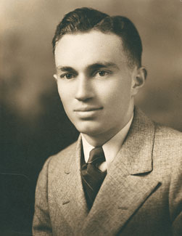
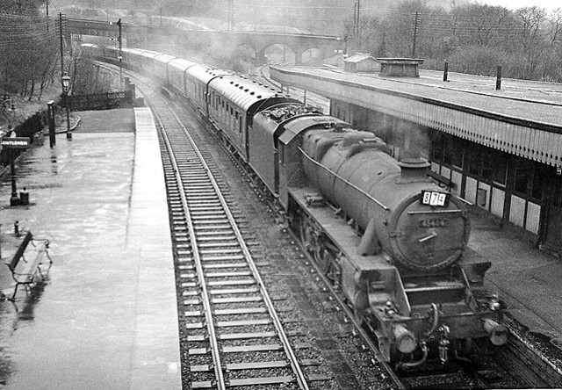
“Many years ago I worked for a railroad in the central offices in Denver. I was in charge of what is called head-end traffic.
That was in the days when nearly everyone rode passenger trains.
One morning I received a call from my counterpart in Newark, New Jersey. He said, ‘Train number such-and-such has arrived, but it has no baggage car. Somewhere, 300 passengers have lost their baggage, and they are mad.’
Gordon B. Hinckley

Slide 7
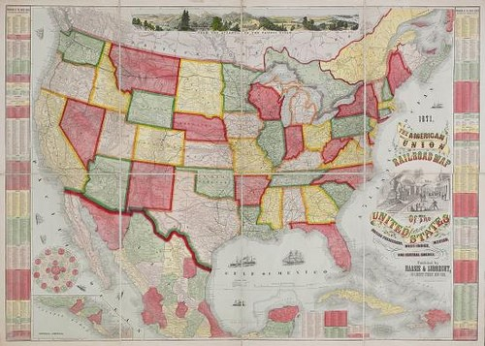
“I went immediately to work to find out where it may have gone. I found it had been properly loaded and properly trained in Oakland, California. It had been moved to our railroad in Salt Lake City, been carried to Denver, down to Pueblo, put on another line, and moved to St. Louis.
Gordon B. Hinckley

Slide 8
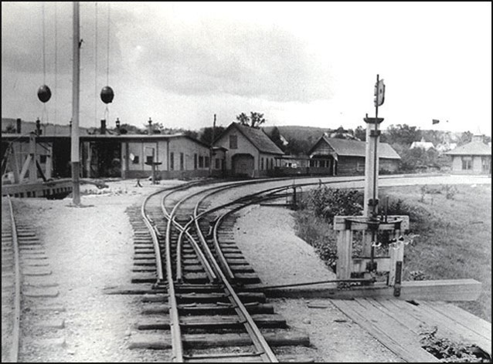
There it was to be handled by another railroad which would take it to Newark, New Jersey.
But some thoughtless switchman in the St. Louis yards moved a small piece of steel just three inches, a switch point, then pulled the lever to uncouple the car.
We discovered that a baggage car that belonged in Newark, New Jersey, was in fact in New Orleans, Louisiana—1,500 miles from its destination.
Just the three-inch movement of the switch in the St. Louis yard by a careless employee had started it on the wrong track, and the distance from its true destination increased dramatically.”
Gordon B. Hinckley

Slide 9
“That is the way it is with our lives. Instead of following a steady course, we are pulled by some mistaken idea in another direction.
The movement away from our original destination may be ever so small, but, if continued, that very small movement becomes a great gap and we find ourselves far from where we intended to go.”
Gordon B. Hinckley

Slide 10
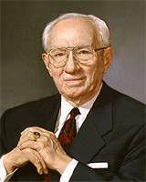
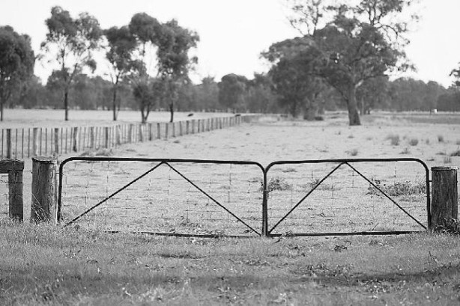
“Have you ever looked at one of those 16-foot farm gates?
When it is opened, it swings very wide. The end at the hinges moves ever so slightly, while out at the perimeter the movement is great.
It is the little things upon which life turns that make the big difference in our lives, my dear young friends.”
Gordon B. Hinckley

Slide 11
The Big Impact
Enlarging your memory—scripture reading reminds us of:
Our duty to God
The obligation of doing good
Remembering our covenants
Holding true to our standards
“All scripture given by inspiration of god is profitable for doctrine, for reproof, for correction, for instruction in righteousness: that the man of God may be perfect, thoroughly furnished unto all good works.”
(JST 2 Timothy 316-17)
“Ammon and his brethren taught from the scriptures. They bore witness of the truth and sustained their testimonies through the power of holy writ.”
JFM and RLM
Alma 37:8-9

Slide 12
The Mysteries
“Alma has not been granted a specific vision of the future so as to tell the impact of the brass plates, the scriptures, on generation upon generation of his people”
JFM and RLM
Council in His wisdom—Heavenly Father knows what is to come and what is best for us in order to bring about His eternal purposes.
“The works, and the designs, and the purposes of God cannot be frustrated, neither can they come to naught.
For God doth not walk in crooked paths, neither doth he turn to the right hand nor to the left, neither doth he vary from that which he hath said, therefore his paths are straight, and his course is one eternal round.”
D&C 3:1-2
Alma 37:10-12

Slide 13
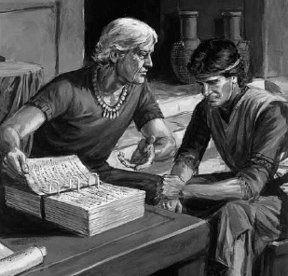
Strict Obedience
Alma entrusts the scriptures to Helaman
He is to remember that God has entrusted him also with the scriptures
He is to remember to keep a strict obedience to the commandments
If he breaks the commandments the sacred records will be taken away
Satan’s sift---The spirit will no longer be with Helaman
Alma 37:13-15

Slide 14
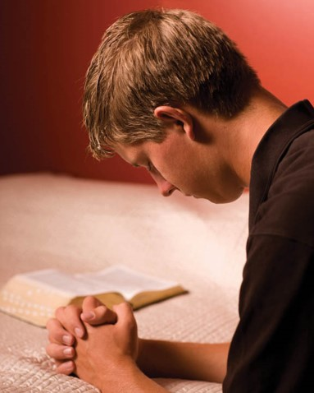
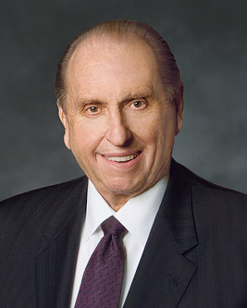
Must Appeal All Things
“The power of fervent prayer—if he will petition the heavens for direction and deliverance from evil, there is no power—whether men or demons—that can remove them from his hands. God has all power.”
JFM and RLM
“We learn to pray by praying. One can devote countless hours to examining the experiences of others, but nothing penetrates the human heart as does a personal, fervent prayer and its heaven-sent response.”
Thomas S. Monson
Alma 37:16

Slide 15
Lessons of the Jaradites
Alma teaches Helaman about the 24 plates from the Jaradite records from the land of Desolation…discovered by the people of Limhi who were searching for Zarahemla.
Limhi
There were certain things Alma wanted to expose of this group and some he did not want to be made known.
The things he didn’t want to be made know were the secret combinations.
The 24 plates
Prepared by Ether
Translated by Mosiah
Alma 37:21

Slide 16
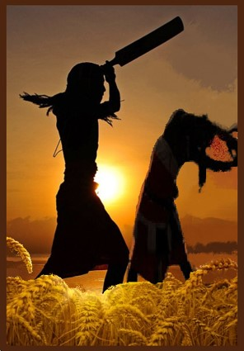
Secret Combinations
Secret Oaths– Gadianton Robbers--An organization of people bound together by oaths to carry out the evil purposes of the group.
Their plunderings
Their wicked dealings
Their secret murders
Their secret oaths
The first secret combination was between Cain and the Devil
Moses 5:51
Alma 37:21-22

Slide 17
Gazelem
name given to servant of God
the Lord will prepare unto his servant Gazelem a stone
“He is a seer or a servant God commissioned to apply the sacred interpreters so as to expose the wickedness of past societies and nations, thus providing a warning to future generations to live according to the principles of the gospel.”
“And now, my son, these interpreters were prepared that the word of God might be fulfilled, …” (Alma 37:24)
Index study helps and Who’s Who

Slide 18
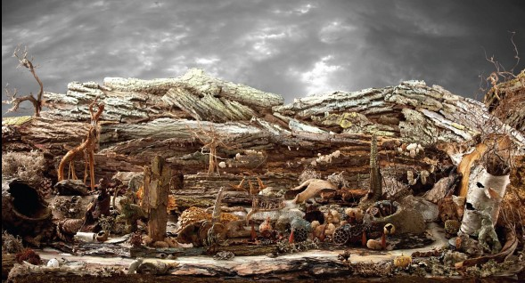
Instructions
Do not let the people know about:
The secret combinations of the Jaradite people
There is a curse upon the land of Desolation
Why would Alma want these things kept secret from the people?
Alma 37:26-31

Slide 19
Giving Ideas
Why is it that we teach our children and ourselves to not watch inappropriate or evil movies…or read inappropriate books or magazines…or listen to inappropriate music?
There is a lesson that Alma was teaching his son, that if they read and talked about these wicked things it might give others ideas to experiment with wickedness.
Alma 37:26-31

Slide 20
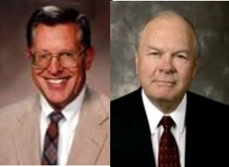
Teach Them
Alma instructs Helaman to teach the people a hatred against sin
“It is not enough to teach the people of God about the gift of repentance; we must teach the awful consequences of transgression and must, to be sure, teach them to hate sin.”
JFM and RLM
“Each one of us has the Light of Christ, or a conscience. It constantly prompts us to choose good. Good choices yield good consequences. On the other hand, delaying repentance and continuing to commit sin is like continuing to kick the skunk. The stench will become stronger with each sin, alienating us further and further from God and those we love.”
JFM and RLM
Alma 37:32-34

Slide 21
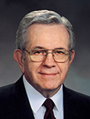
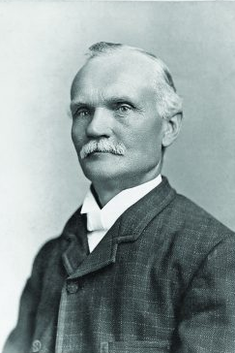
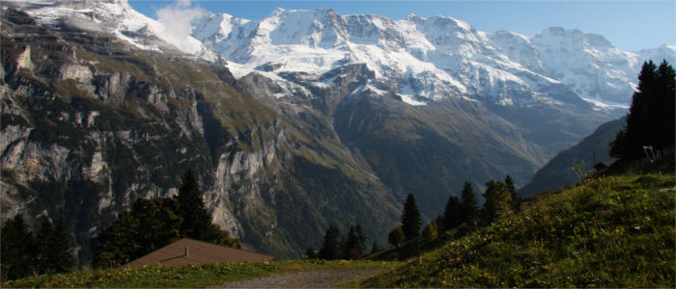
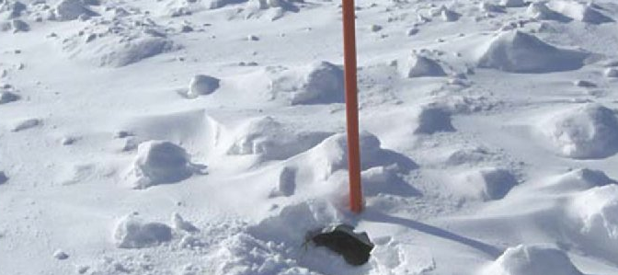
Sticks in the Snow
“[A Church member named Karl G. Maeser] was going with a group of young missionaries across the alps. They were crossing a high mountain pass on foot. There were long sticks stuck into the snow of the glacier to mark the path so that travelers could find their way safely across the glacier and down the mountain on the other side.
Jura Alps
“When they reached the summit, Brother Maeser … pointed to those sticks that they had followed [and compared them to priesthood leaders in the Church, saying,] ‘They are just common old sticks, but it’s the position that counts. Follow them and you will surely be safe. Stray from them and you will surely be lost.’”
Boyd K. Packer

Slide 22
Learn Wisdom in thy youth
Pray for support
Learn to keep the commandments
Let the affections of thy heart be placed upon the Lord forever
Let thy thoughts be always directed of the Lord
By following the teachings of Church leaders, we can find rest to our souls
When thou liest down at night lie down unto the Lord, that he may watch over you in your sleep:
Counsel with the Lord
Alma 37:32-37

Slide 23
When thou risest in the morning let thy heart be full of thanks unto God…
Alma 37:37

Slide 24
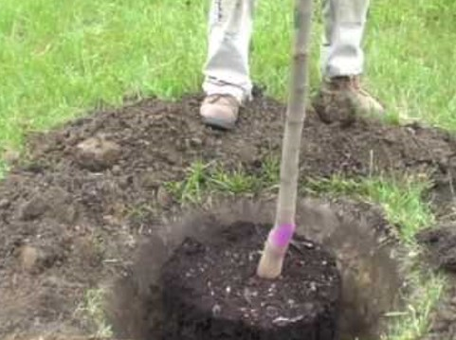
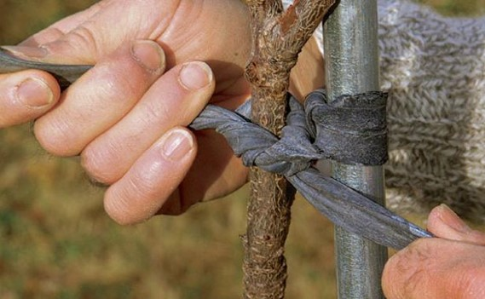
The Tree
President Gordon B. Hinckley planted a young tree near his home soon after he was married. He “paid little attention to it as the years passed.” One day he noticed the tree was misshapen and leaning to the west. He tried to push it upright, but the trunk was too thick. He tried using a rope and pulleys to straighten it, but it would not bend. Finally, he took his saw and cut off the heavy branch on the west side, leaving an ugly scar. He later said of the tree:
“The other day I looked again at the tree. It is large. Its shape is better. It is a great asset to the home. But how serious was the trauma of its youth and how brutal the treatment I used to straighten it.
“When it was first planted, a piece of string would have held it in place against the forces of the wind. I could have and should have supplied that string with ever so little effort. But I did not, and it bent to the forces that came against it.”
Gordon B. Hinckley

Slide 25
We should learn in our youth to keep the commandments of God
What difference do you think it makes in a person’s life to learn to keep the commandments of God while still young?
What are some ways you feel you have been or will be blessed because of your efforts to obey the commandments while you are young?

Slide 26
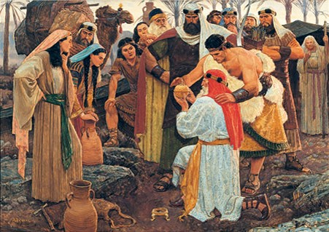
The Ball—or Director
Liahona—worked according to their faith
A symbol of their faithfulness—a visible evidence of their standing before God
If we follow the words of Jesus Christ, they will direct us to receive eternal life.
Alma 37:38-41

Slide 27
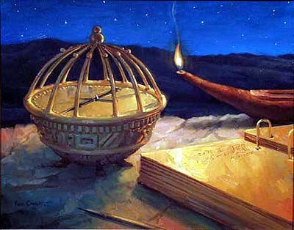
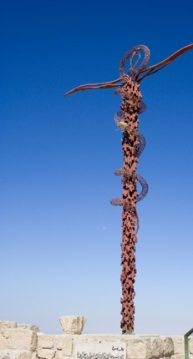
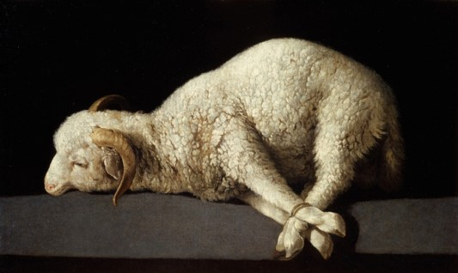
Not without Shadow
Types or shadows—like animal sacrifice, the brazen serpent, or the Liahona are not Christ himself, but a reflection of Christ, a representation of the Redeemer.
A shadow is not the object itself but rather a reflection, an evidence of the nearness of the object.
Alma 37:43-45

Slide 28
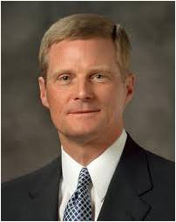
“As we each press forward along the pathway of life, we receive direction from the Holy Ghost just as Lehi was directed through the Liahona. …
“The Holy Ghost operates in our lives precisely as the Liahona did for Lehi and his family, according to our faith and diligence and heed. …
“And the Holy Ghost provides for us today the means whereby we can receive, ‘by small and simple things’ (Alma 37:6), increased understanding about the ways of the Lord. …
“The Spirit of the Lord can be our guide and will bless us with direction, instruction, and spiritual protection during our mortal journey. We invite the Holy Ghost into our lives through meaningful personal and family prayer, feasting upon the words of Christ, diligent and exacting obedience, faithfulness and honoring of covenants, and through virtue, humility, and service.
And we steadfastly should avoid things that are immodest, coarse, crude, sinful, or evil that cause us to withdraw ourselves from the Holy Ghost.
“We also invite the ongoing companionship of the Holy Ghost as we
worthily partake of the sacrament each Sabbath day.”
Elder David A. Bednar

Slide 29
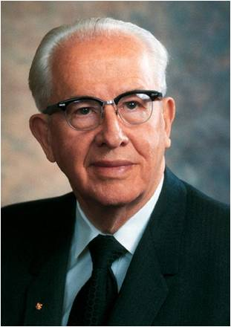
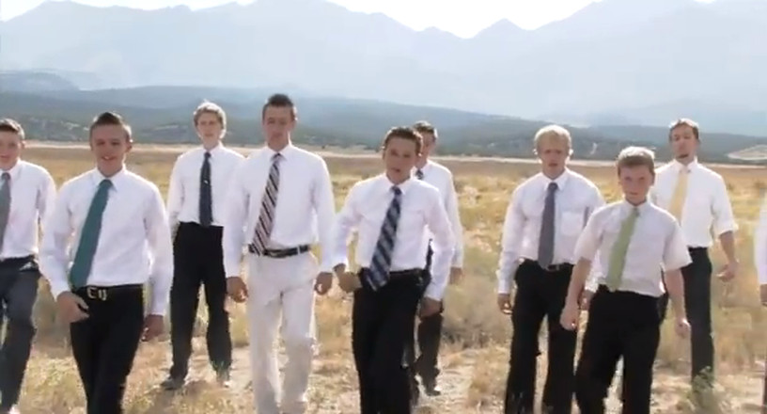
Lesson 92
“Give me a young man who has kept himself morally clean and has faithfully attended his Church meeting.
Give me a young man who has magnified his priesthood and has earned hi duty to God Award and is an Eagle Scout.
Give me a young man who is a seminary graduate and has a burning testimony of the Book of Mormon.
Give me such a young man and I will give you a young man who can perform miracles for the Lord in the mission field and throughout his life.”
Ezra Taft Benson

Slide 30
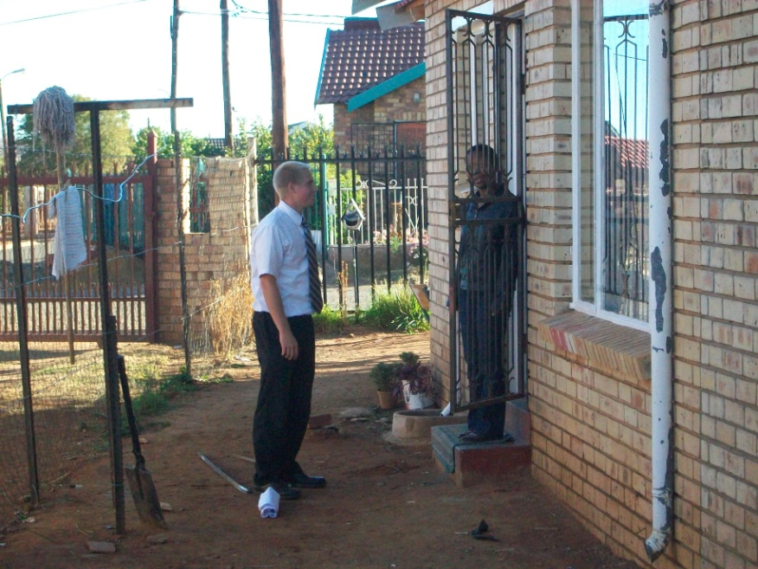
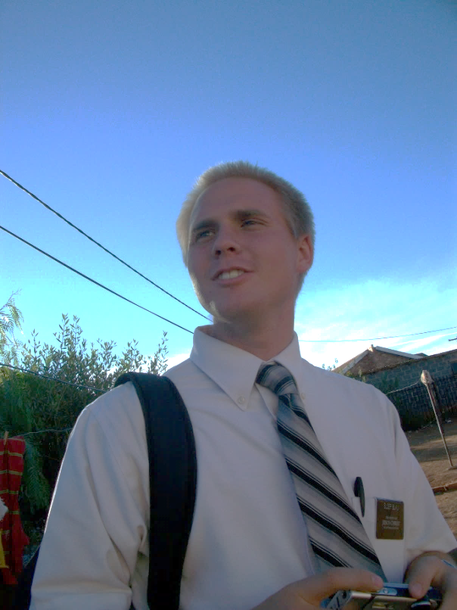
Go and Declare
The gospel message is a voice of gladness, a declaration of good news, a proclamation of peace.
Alma 37:47

Slide 31
Sources:
Videos:
Learn in Thy Youth (3:02)
Fulfilling Your Duty to God (4:55)
M. Russell Ballard Ensign May 1990 p. 6
Gordon B. Hinckley (“A Prophet’s Counsel and Prayer for Youth,” Ensign, Jan. 2001, 5–7); “Bring Up a Child in the Way He Should Go,” Ensign, Nov. 1993, 59
Joseph Fielding McConkie and Robert L. Millet Doctrinal Commentary on the Book of Mormon Vol. 3 pg. 274, 279
Thomas S. Monson Teach the Children Oct. 1997 Gen. Conf
Who’s Who of the Book of Mormon Ed J. Pinegar and Richard J. Allen p. 56
Boyd K. Packer, “It Is the Position That Counts,” New Era, June 1977, 51
Spencer V. Jones Overcoming the Stench of Sin April 2003 Gen. Conf
Elder David A. Bednar (“That We May Always Have His Spirit to Be with Us,” Ensign or Liahona, May 2006, 30–31).
Teachings of Ezra Taft Benson p. 197
https://rsc.byu.edu/archived/called-teach-legacy-karl-g-maeser/mission-fatherland-1867-70
Presentation by ©http://fashionsbylynda.com/blog/

Slide 32
Interesting thought:
Gazelem—”this may well be a play on words. Is Gazelem the seer stone or the servant It is difficult to tell from the passage and depends very much on the placement of a comma in the sentence. Perhaps it could refer to both. Though this name or title of Gazelem may be used in regard to any seer who utilizes seer stones, it seems in this instance to be a direct reference to Joseph Smith the Prophet.” by Joseph Fielding McConkie and Robert L. Millet…see (JST John 1:42)
“You can put it down in your little black book…That if you will not be loyal in the small things you will not be loyal in the large things. If you will not respond to the so-called insignificant or menial tasks which need to be performed in the Church and Kingdom, there will be no opportunity for service in the so-called greater challenges.”
Boyd K. Packer- Follow the Brethren BYU Speeches of the Year 1965 PP. 4-5
Liahona…This interesting word is Hebrew with an Egyptian ending. It is the name which Lehi gave to the ball or director he found outside his tent…L is a Hebrew preposition meaning ‘to,’ and sometimes used to express the possessive case. Iah is a Hebrew abbreviated form of ‘Jehovah,’ common in Hebrew names. On is the Hebrew name of the Egyptian ‘City of the Sun.”…L-iah-on means, therefore, literally, ‘To God is Light’; or, ‘of God is Light.’ That is to say God gives light, as does the Sun. The final a reminds us that the Egyptian form of the Hebrew name On is Annu, and this seems to be the form Lehi used.”
G. Renynolds and J. Sjodahl (Commentary on the Book of Mormon, 4:162, 178)
“It is not necessary that our young people should know of the wickedness carried on in anyplace. Such knowledge is not elevating and it is quite likely that more than one young man (or woman) can trace the first step of his downfall to a curiosity which led him (her) into questionable places”
Joseph F. Smith (Gospel Doctrine pp. 373-374)

Slide 34
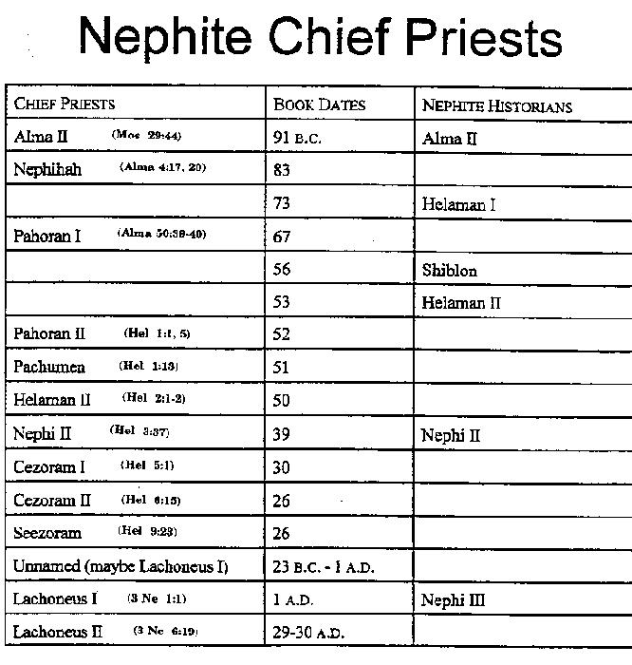

Slide 37
Something of Interest--Gazelam
Gazelam is a name mentioned in the scriptures and appears only once in a reference found in Alma 37:23 of the Book of Mormon. Some writings and scholars have rendered the spelling "Gazalem" and “Gazelam”. As with most semetic words vowels are often not written and thus when translated into English can take on different spellings and pronunciations. The Scripture reads, "And the Lord said: I will prepare unto my servant Gazelem, a stone, which shall shine forth in darkness unto light, that I may discover unto my people who serve me, that I may discover unto them the works of their brethren, yea, their secret works, their works of darkness, and their wickedness and abominations." Alma 37:23. Here in Alma the name "Gazalem" refers to a "servant" or a prophet who would have the use a "stone" whose function is bring to light the covert events and happenings of the people of Ether, a group who inhabited the Americas at the time of the tower of Babel. (see Alma 37:21, Ether 1:1-43) The person Gazelem referred to here is the Prophet, Joseph Smith. From March of 1832 to sometime after April of 1834 certain revelations given through the Joseph Smith used pseudonyms or code names to refer to individuals as a way of protecting their identity. During that time of perseuction Joseph was identified in sections 78, 82, and 104 of the D&C as "Gazelem" rather than by his given name. Elder Bruce R. McConkie said, "Strange and unusual names were placed by the Prophet in some of the early revelations so that the individuals whom the Lord was then addressing would not be known to the world. The purpose for keeping these identities secret from their enemies having long since passed, the true names are now found in the Doctrine and Covenants. Two of the names, which identified the Prophet himself, were Gazelam and Enoch. (D. & C. 78:9; 82:11; 104:26, 43, 45, 46.) Presumptively these and other names used at the same time have particular meanings, which are not now known to us. With reference to the name Gazelam, it is interesting to note that Alma in directing Helaman to preserve both the Urim and Thummim and the plates containing the Book of Ether, says that such record will be brought to light by the Lord's servant Gazelem, who will use "a stone" in his translation work. (Alma 37:21-23.) It may be that Gazelem is a variant spelling of Gazelam and that Alma's reference is to the Prophet Joseph Smith who did in fact bring forth part at least of the Ether record. Or it could be that the name Gazelem (Gazelam) is a title having to do with power to translate ancient records and that Alma's reference was to some Nephite prophet who brought the Book of Ether to light in the golden era of Nephite history." Bruce R. McConkie Mormon Doctrine, p.307 Hugh Nibley teaches that the name, while having a connection to the term 'stone' is the name of a person not the name of the stone as some have surmised. He says quoting the verse, "That's a person he [Alma] is talking about; Gazelem is not the stone. His servant Gazelem has the stone; he is preparing it for him. Incidentally, that word Gazelem is a very interesting one. It's an Aramaic word, and it has definitely to do with the shining stone. "…yea, their secret works, their works of darkness, and their wickedness and abominations." Now that's what the story is going to be. That's not very nice. These interpreters were prepared for that reason, the whole idea being this horrible story I'm telling you that "except they repent I will destroy them from off the face of the earth; and I will bring to light all their secrets [just as I did of the Jaredites] and abominations, unto every nation that shall hereafter possess the land." George Reynolds in his book "The Story of the Book of Mormon", p.293 says that the word "Gazelem appears to have its roots in Gaz--a stone, and Aleim, a name of God as a revelator or interposer in the affairs of men. If this suggestion be correct, its roots admirably agree with its apparent meaning--a seer. The text reads: And the Lord said. I will prepare unto my servant Gazelem, a stone, which shall shine forth in darkness unto light, that I may discover unto my people who serve me, that I may discover unto them the works of their brethren: yea, their secret works, their works of darkness, and their wickedness and abominations." Reynolds explanation would indicate that the name Gazelem has been applied to Joseph Smith as a sort of nickname indicating an attribute the prophet posesses much the same as we might use a nickname like "Blondie" or "Slim" when applied to a person having those attributes. B. H. Roberts in the book New Witnesses for God, Vol.3, p.145 also says the word is from the Nephite vocabulary. "The word "Gazelem" is also a Nephite word, meaning "a stone," that is, a seer stone, since it is spoken of as a means of ascertaining knowledge through it by revelation." In a semon delivered in 1873 Orson Hyde said Joseph was called Gazelam, "being a person to whom the Lord had given the Urim and Thummim" and so was known to many by that name in the early days of the Church. (Discourse by Orson Pratt, 16 August 1873, Journal of Discourses, 16:156.) Published 2/10/06 http://www.contractorsales.biz/ces/Gazelem.html

