Slide 1

1 Nephi 11-15

Slide 2
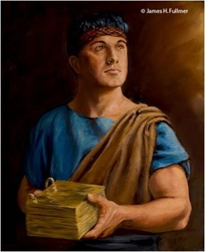
Principles in Nephi’s Experiences
Desire
What did Nephi desire to see, hear, and know?
How do our desires affect our ability to receive revelation?
What do I desire to know from the Lord?
Belief
What beliefs did Nephi express as he sought revelation?
How might these beliefs influence our ability to receive revelation?
How can I increase my testimony of and belief in Jesus Christ?
James Fuller
Pondering
What happened when Nephi sat pondering?
Why can pondering lead to revelation?
What can I do to more diligently ponder the words of the prophets?
1 Nephi 11:1-6

Slide 3
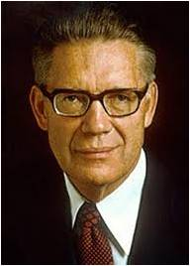
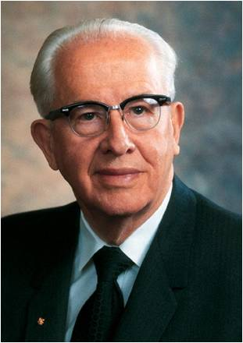
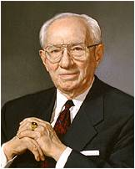
Condescension of God the Father
And of Jesus Christ
“It means to descend or come down from an exalted position to a place of inferior station.' "
Before being born of Mary, he was the God of Abraham, Isaac, and Jacob.
After the virgin birth, he was seen as the carpenter's son.”
--President Ezra Taft Benson
“The condescension of God lies in the fact that he, an exalted Being, steps down from his eternal throne to become the Father of a mortal Son”
--Bruce R. McConkie
"'Knowest thou the condescension of God?'
I suppose none of us can fully understand that-how the great Jehovah should come among men, born in a manger in a vassal state, among a people who would hate him."
--President Gordon B. Hinckley
1 Nephi 11:16
The condescension of God demonstrates His love for us.

Slide 4
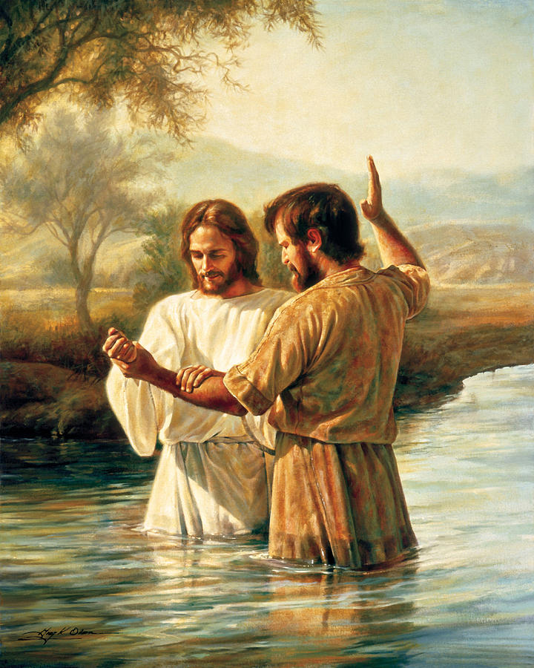
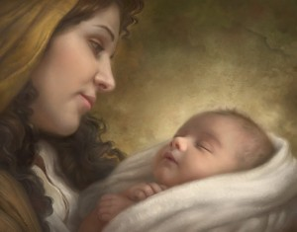
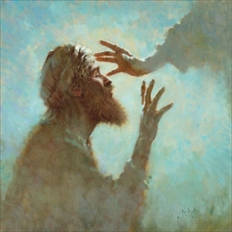
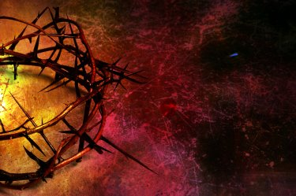
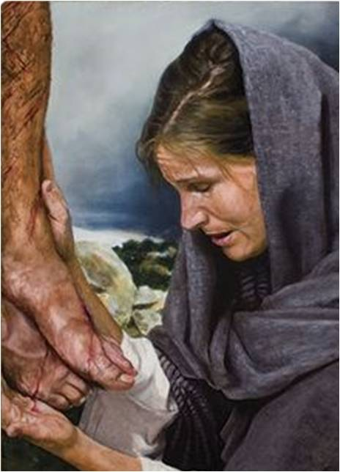
He descended to be born of a mortal woman, even though He was glorified and exalted.
He descended to minister to the humblest of the humble, even though He was exalted.
Greg Olsen
He descended to be baptized of man, even though He was perfect and sinless.
Howard Lyon
He descended to subject Himself to the will of the Father, suffering Himself to be tempted, mocked, scourged, cast out, and disowned, even though He was all-powerful.
He descended to be lifted on the cross and slain for the sins of the world, even though no man could take away His life.
He descended to be judged of the world, even though He was the Judge of the world.
1 Nephi 11:16
President Ezra Taft Benson

Slide 5
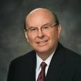
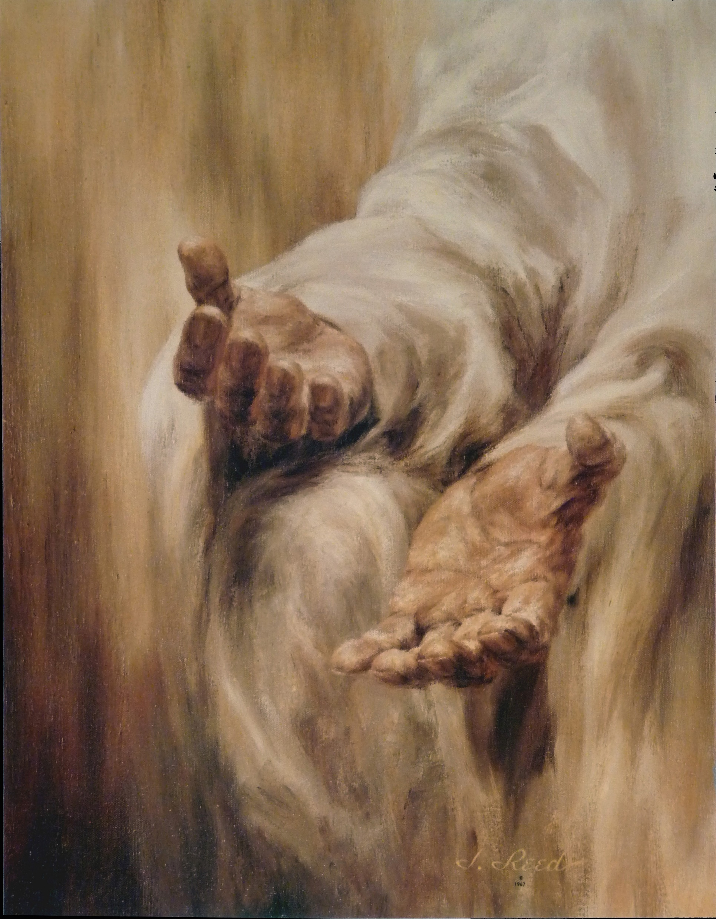
The Savior’s example of humility and sacrifice for all mankind is the most profound event in history.
The Savior, even as a member of the Godhead, was willing to come to earth as a lowly infant and begin an existence that included teaching and healing His brothers and sisters and ultimately suffering indescribable pain in Gethsemane and on the cross in order to perfect His Atonement.
This act of love and humility on the part of Christ is known as His condescension. He did this for every man and woman God has created or will create.
Quentin L. Cook

Slide 6
Nephi’s Desire
Nephi seeks to see, hear, and know the truths his father taught
God shall give unto you knowledge by his Holy Spirit, yea, by the unspeakable gift of the Holy Ghost,…
D&C 121:26
1 Nephi 10:17-19

Slide 7
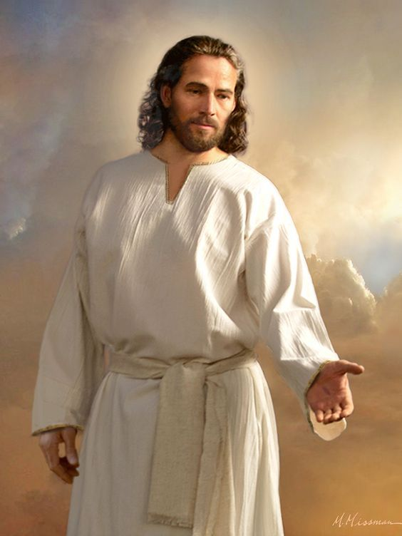
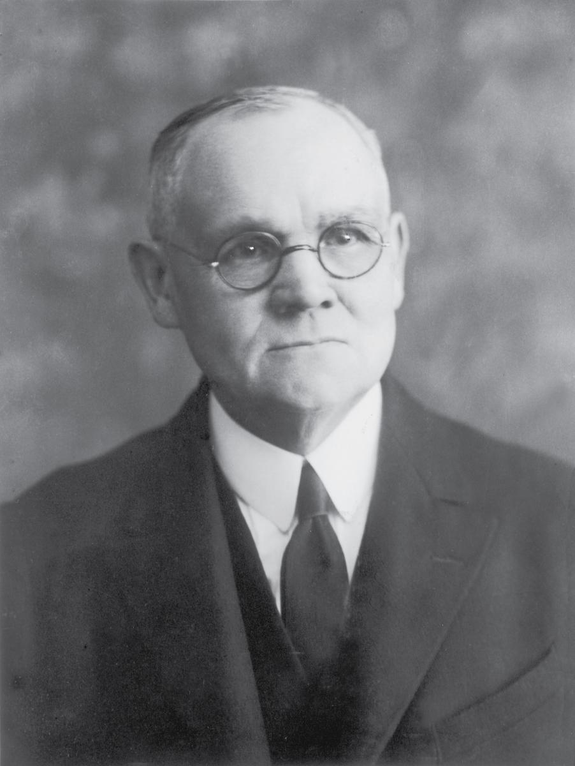
… the Spirit of the Lord is capable of manifesting Himself in the form and figure of a man, is indicated by the wonderful interview between the Spirit and Nephi, in which He revealed Himself to the prophet, questioned him concerning his desires and belief, instructed him in the things of God, speaking face to face with the man.”
James E. Talmage

Slide 8
Same Tree-White as Snow
And I saw heaven opened, and behold a white horse; and he that sat upon him was called Faithful and True,…
Revelation 19:11
…and they shall walk with me in white: for they are worthy.
Revelation 3:4
…And, behold, they are righteous forever; for because of their faith in the Lamb of God their garments are made white in his blood.
1 Nephi 12:10
1 Nephi 11:8

Slide 9
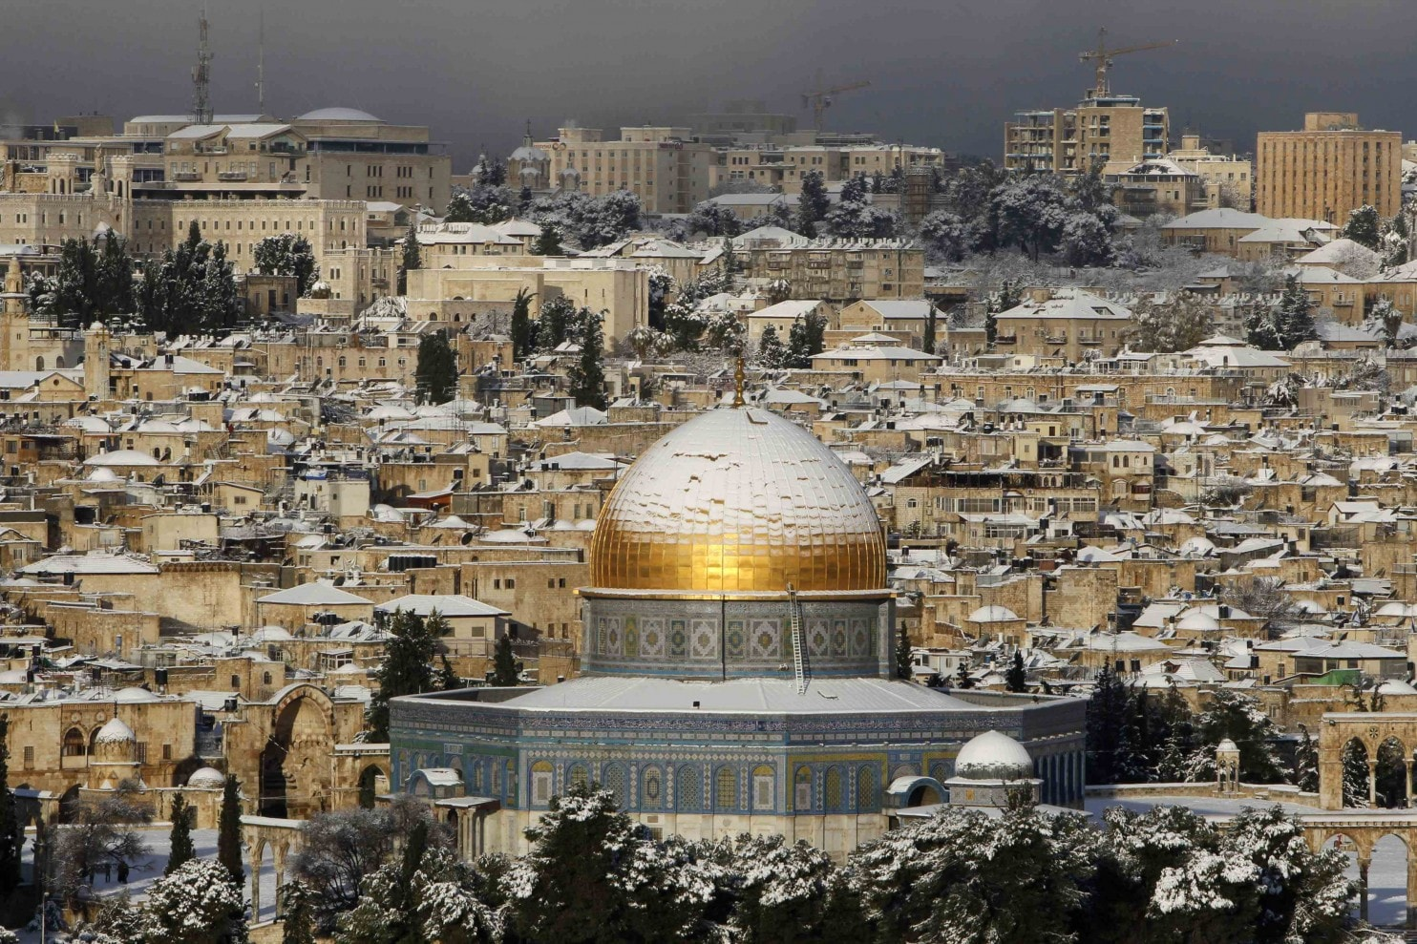
How Did They Know What Snow Looked Like?
Lehi:
And it came to pass that I did go forth and partake of the fruit thereof; and I beheld that it was most sweet, above all that I ever before tasted. Yea, and I beheld that the fruit thereof was white, to exceed all the whiteness that I had ever seen.
1 Nephi 8
Nephi:
And it came to pass that the Spirit said unto me: Look! And I looked and beheld a tree; and it was like unto the tree which my father had seen; and the beauty thereof was far beyond, yea, exceeding of all beauty; and the whiteness thereof did exceed the whiteness of the driven snow.
Yes, it does snow in Jerusalem
1 Nephi 11:8

Slide 10
The Great City of Jerusalem
And many nations shall come, and say, Come, and let us go up to the mountain of the Lord, and to the house of the God of Jacob; and he will teach us of his ways, and we will walk in his paths: for the law shall go forth of Zion, and the word of the Lord from Jerusalem.
Micah 4:2
And he spake also concerning the house of Israel, and the Jerusalem from whence Lehi should come—after it should be destroyed it should be built up again, a holy city unto the Lord; wherefore, it could not be a new Jerusalem for it had been in a time of old; but it should be built up again, and become a holy city of the Lord; and it should be built unto the house of Israel—
Ether 13:5
1 Nephi 11:13

Slide 11
An Angel From the Heavens
For God so loved the world, that he gave his only begotten Son, that whosoever believeth in him should not perish, but have everlasting life.
John 3:16
1 Nephi 11:14

Slide 12
A Beautiful Virgin Carrying the Lamb of God
Therefore the Lord himself shall give you a sign; Behold, a virgin shall conceive, and bear a son, and shall call his name Immanuel.
Isaiah 7:14
1 Nephi 11:15 and 20

Slide 13
Many People Bowed to Worship Him
And saw the holy angels, and them who are sanctified before his throne, worshiping God, and the Lamb, who worship him forever and ever.
D&C 76:21
1 Nephi 11:24

Slide 14
Iron Rod—Word of God
And it came to pass that I beheld that the rod of iron, which my father had seen, was the word of God, which led to the fountain of living waters, or to the tree of life; which waters are a representation of the love of God; and I also beheld that the tree of life was a representation of the love of God.
1 Nephi 11:25

Slide 15
A Prophet Prepares a Way and Baptizes
And John went down into the water and baptized him.
JST Matthew 3:44
1 Nephi 11:27

Slide 16
Savior preaches…some listen…some do not
Listen to the voice of the Lord your God, even Alpha and Omega, the beginning and the end, whose course is one eternal round, the same today as yesterday, and forever.
D&C 35:1
Hearken and listen to the voice of him who is from all eternity to all eternity, the Great I Am, even Jesus Christ—
D&C 39:1
1 Nephi 11:28

Slide 17
12 Others Follow Jesus
And I also saw and bear record that the Holy Ghost fell upon twelve others; and they were ordained of God, and chosen.
1 Nephi 12:7
And he ordained twelve, that they should be with him, and that he might send them forth to preach,
And to have power to heal sicknesses, and to cast out devils:
Mark 3:14-15
1 Nephi 11:29

Slide 18
Angels Administer to the Children of men “LOOK”
And as they looked to behold they cast their eyes towards heaven, and they saw the heavens open, and they saw angels descending out of heaven as it were in the midst of fire; and they came down and encircled those little ones about, and they were encircled about with fire; and the angels did minister unto them.
3 Nephi 17:24
And they brought young children to him, that he should touch them: and his disciples rebuked those that brought them.
Mark 10:13
1 Nephi 11:30

Slide 19
Savior Administers to the Sick
…all the multitude, with one accord, did go forth with their sick and their afflicted, and their lame, and with their blind, and with their dumb, and with all them that were afflicted in any manner; and he did heal them every one as they were brought forth unto him.
3 Nephi 17:9
But so much the more went there a fame abroad of him: and great multitudes came together to hear, and to be healed by him of their infirmities.
Luke 5:15
1 Nephi 11:31

Slide 20
Jesus is Put on the Cross and Slain
And he bearing his cross went forth into a place called the place of a skull, which is called in the Hebrew Golgotha:
Where they crucified him, and two other with him, on either side one, and Jesus in the midst.
John 19:17-18
And the Lord said unto Enoch: Look, and he looked and beheld the Son of Man lifted up on the cross, after the manner of men;
Moses 7:55
1 Nephi 11:32-33

Slide 21
Gathered Together to Fight Against Righteousness
And the rebellious shall be pierced with much sorrow; for their iniquities shall be spoken upon the housetops, and their secret acts shall be revealed.
D&C 1:3
1 Nephi 11:34-35

Slide 22
The Building Destroyed and Falls Down
It came to pass that I saw and bear record, that the great and spacious building was the pride of the world; and it fell, and the fall thereof was exceedingly great. And the angel of the Lord spake unto me again, saying: Thus shall be the destruction of all nations, kindreds, tongues, and people, that shall fight against the twelve apostles of the Lamb.
"The gigantic, global collapse that is yet to come will not be that of a failing stock market, but the fall of hardened mind-sets and collective pride when it all finally tumbles.”
--Elder Neal A. Maxwell
1 Nephi 11:36

Slide 23
Nephi writes all he sees and hears
The
Book
Of
Mormon
1 Nephi 11:36

Slide 24
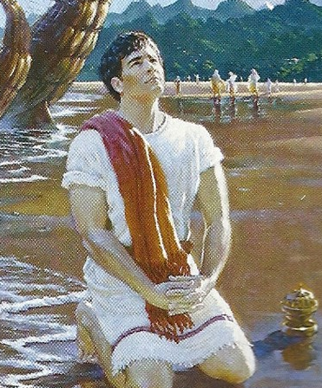
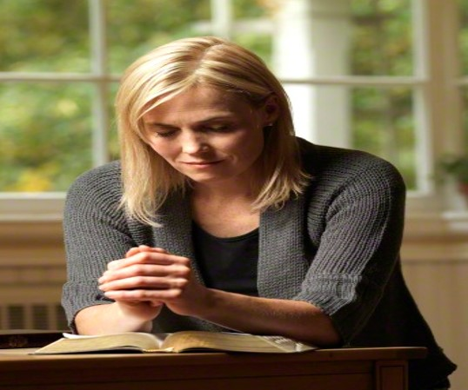
God reveals truth to those who diligently seek Him

Slide 25

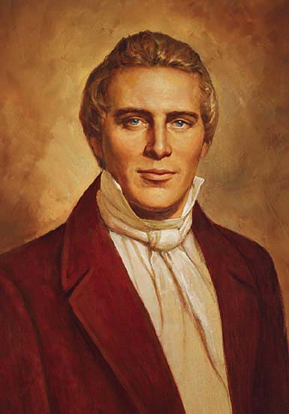
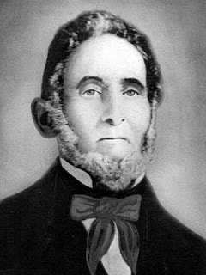
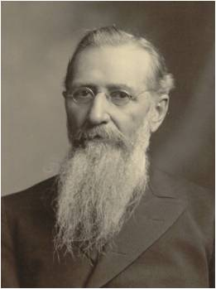
“Take time to ponder and reflect. Get away from the bustle of life. Find a quiet place and take time to simply sit and think, to listen to your thoughts and feelings, to open yourself to the promptings of the Spirit. Note what the following prophets said they were doing prior to receiving important revelations.
--Elder Gerald N. Lund
Nephi: ‘I sat pondering in my heart’ (1 Nephi 11:1).
Joseph Smith and Sidney Rigdon: ‘While we meditated upon these things’ (D&C 76:19).
Joseph F. Smith: ‘I sat in my room pondering over the scriptures; and reflecting’ (D&C 138:1–2).
Joseph Smith: ‘My mind was called up to serious reflection. … I reflected … again and again [upon the words of James]’ (JS—H 1:8, 12).

Slide 26
Sources:
President Ezra Taft Benson Ensign, Dec. 2001, 18
Quentin L. Cook, “The Eternal Everyday,” Ensign or Liahona, Nov. 2017, 52
James E. Talmage, The Articles of Faith [1968], 159–60; see also Marion G. Romney, “The Holy Ghost,” Ensign, May 1974, 90–92
Bruce R. McConkie, The Mortal Messiah [1979], 1:314
President Gordon B. Hinckley Teachings of Gordon B. Hinckley, p. 285 – 286
Elder Neal A. Maxwell Meek and Lowly p. 54

Slide 27
“No man can receive the Holy Ghost without receiving revelations. The Holy Ghost is a revelator” (in History of the Church, 6:58).
“Having a knowledge of God, we begin to know how to approach Him, and how to ask so as to receive an answer.
“When we understand the character of God, and know how to come to Him, he begins to unfold the heavens to us, and to tell us all about it. When we are ready to come to him, he is ready to come to us” (in History of the Church, 6:308).
Condescension 1 Nephi 11:16, 26:
“Here was Jesus—a member of the Godhead, the Firstborn of the Father, the Creator, Jehovah of the Old Testament—now leaving His divine and holy station; divesting Himself of all that glory and majesty and entering the body of a tiny infant; helpless, completely dependent on His mother and earthly father. That He should not come to the finest of earthly palaces and be … showered with jewels but should come to a lowly stable is astonishing. Little wonder that the angel should say to Nephi, ‘Behold the condescension of God!’ (1 Ne. 11:26.)” (Gerald N. Lund, Jesus Christ, Key to the Plan of Salvation [1991], 16).
Branches of the Olive Tree or Remnants of the House of Israel 1 Nephi 10:14:
"A detailed discussion of the destiny of the house of Israel (as depicted through the allegory of the olive-tree) will be undertaken in Jacob 5-6. For the moment let us make some simple observations. The Lord chose an olive tree to dramatize the destiny of his chosen people. An olive tree almost never dies. It may be pruned and worked with over numerous generations before the fruit is such as to satisfy the owner of the vineyard; this is often after many and varied cuttings and trimmings and replantings. So, it is with the house of Israel. That house is stubborn and often requires constant and enduring care. It frequently requires chastening and pruning, actions painful at the time but ultimately accepted as a blessing and perhaps the only means of preservation. As it is with the dedicated gardener, so it is with the Lord-his mercies and tender regard will simply not allow him to let his chosen people go: he pleads with his people Israel to cleave unto him as he cleaves unto them. (Jacob 6:5.)
"Whose branches should be broken off? The Lord chooses periodically to 'break off' or separate certain branches or groups of the house of Israel from the main body; through this means-that of scattering-the blood and influence of' the chosen people may be spread throughout the earth. The Nephite and Mulekite branches are illustrative of this principle." (McConkie, Millet, Doctrinal Commentary on the Book of Mormon, vol. 1, p.69)
Those Against the Apostles of the Lord 1 Nephi 11:35:
"The world is still fighting the apostles of the Lamb because they represent the truth, and the world rejects the truth. Even those of the house of Israel at times will gather to fight against the twelve: 'And the angel of the Lord spake unto me again saying: Behold the world and the wisdom thereof; yea, behold the house of Israel hath gathered together to fight against the twelve apostles of the Lamb' (v 35). This verse describes the apostasy following Christ's ministry in Jerusalem. The Apostasy was caused by the pride and wisdom of the world, but it will not stand forever: 'And it came to pass that I saw and bear record, that the great and spacious building was the pride of the world; and it fell, and the fall thereof was exceedingly great. And the angel of the Lord spake unto me again, saying: Thus shall be the destruction of all nations, kindreds, tongues, and people, that shall fight against the twelve apostles of the Lamb' (v 36). The world still fights the Twelve Apostles and their teaching with its own wisdom, but it will eventually fall, and the pride that motivates the fight will be the cause of that fall." (Monte S. Nyman and Charles D. Tate, Jr., eds., Fourth Nephi through Moroni: From Zion to Destruction [Provo: BYU Religious Studies Center, 1995], 210.)
The Form of a Man 1 Nephi 11:11:
"That the Spirit of the Lord is capable of manifesting Himself in the form and figure of man, is indicated by the wonderful interview between the Spirit and Nephi, in which He revealed Himself to the prophet, questioned him concerning his desires and belief, instructed him in the things of God, speaking face to face with the man [1 Ne 11:11]. However, the Holy Ghost does not possess a body of flesh and bones, as do both the Father and the Son, but is a personage of spirit. Much of the confusion existing in human conceptions concerning the nature of the Holy Ghost arises from the common failure to segregate His person and powers. Plainly, such expressions as being filled with the Holy Ghost, and His falling upon persons, have reference to the powers and influences that emanate from God, and which are characteristic of Him; for the Holy Ghost may in this way operate simultaneously upon many persons even though they be widely separated, whereas the actual person of the Holy Ghost cannot be in more than one place at a time." Elder James E. Talmage (Articles of Faith, p. 42, as taken from Latter-day Commentary on the Book of Mormon compiled by K. Douglas Bassett, p. 36)

Slide 28
Historical events Nephi was shown after each portion of Lehi's dream was given.
Vision of the Tree of Life | Vision of the History of the World­­­­
Tree=love of God (v. 8) | The birth of the Lamb of God to a virgin from Nazareth (v. 13-21)
 | The Savior going forth among the children of men (v. 24)
Rod of iron=word of God (v. 25) | The Lamb of God was baptized (v. 27)
 | He ministers in power and great glory (v. 28)
 | 12 apostles and the ministering of angels (v. 29-30)
 | The Lamb of God heals the sick and afflicted (v. 31)
 | He is judged of the world and crucified (v. 32-33)
Large and spacious building=pride of the world (v. 35) | The multitudes of the earth gather to fight against the apostles of the Lamb (v. 34-35)
Mist of darkness=temptations of the devil (1 Ne 12:4,17) | Vapor of darkness covers the Americas for 3 days (1 Ne 12:5)
 | Christ appears to the Nephites (12:6)
 | They are righteous up to the fourth generation (12:12)
 | They fall prey to the temptations of the devil and are destroyed (12:17-20)
Filthy water=depths of hell (12:16) | Wickedness and destruction of the Nephites (12:19-20)
Terrible gulf=justice of God (12:18) | Nephites destroyed for their wickedness (12:19-20)
Source: gospeldoctrine.com

Slide 29

Symbols of Vision
1 Nephi 12-13

Slide 30
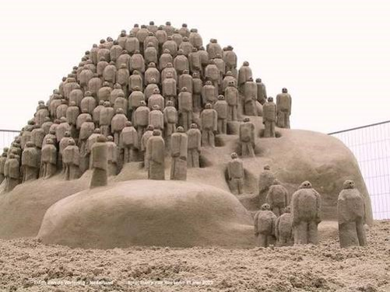
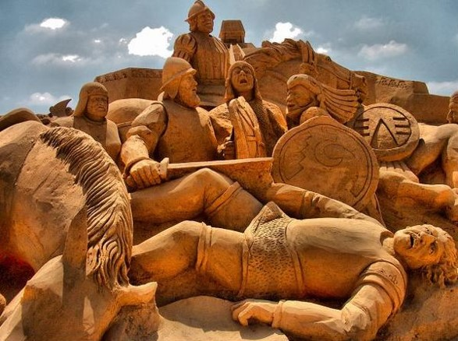
Symbols of Vision
Nephi’s Posterity---as many as the sand of the sea—become a great nation
Wars between Lamanites and Nephites before the coming of the Lord
1 Nephi 12:1-3

Slide 31
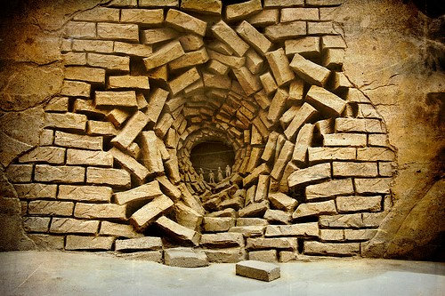
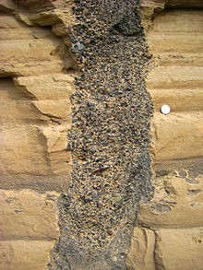

Destruction
Great destructions--Lightnings and Thunders and earthquakes and tumultuous noises
And it was about the sixth hour, and there was a darkness over all the earth until the ninth hour.
Luke 23:44
Vapor of darkness
And the sun was darkened, and the veil of the temple was rent in the midst. Luke 23:45
Read 3 Nephi 8:19-21
1 Nephi 12:4-5

Slide 32
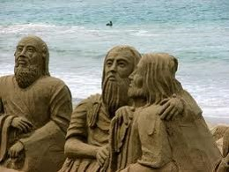
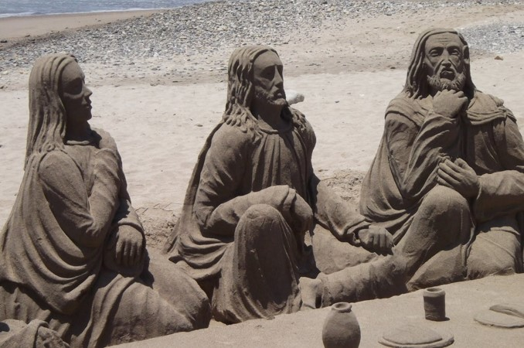
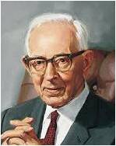
Twelve Others Chosen to Minister
The Savior visited the Americas and ordained twelve disciples who would preside over His Church among the Nephites.
Holy Ghost fell upon them
Ordained of God
The twelve men chosen by our Savior among the Nephites are called disciples in the Book of Mormon...
…The Nephite twelve became apostles, as special witnesses, just as did Joseph Smith and Oliver Cowdery in the Dispensation of the Fulness of Times.“ --Joseph Fielding Smith
1 Nephi 12:6-8

Slide 33
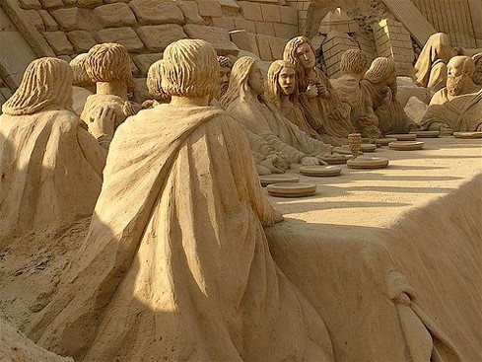
The Judges
"Under Christ a great hierarchy of judges will operate, each functioning in his assigned sphere. John saw many judges sitting upon thrones. (Rev. 20:4.)
Paul said the saints would judge both the world and angels. (1 Cor. 6:2-3.)
The elders are to sit in judgment on those who reject them. (D. & C. 75:21-22; Matt. 10:14-15.)
Daniel saw that judgment would be given to the saints. (Dan. 7:22.)
The Nephite Twelve will be judged by the Twelve from Jerusalem and then in turn will judge the Nephite nation. (1 Nephi 12:9-10; 3 Nephi 27:27; Morm. 3:19.) And the Twelve who served with our Lord in his ministry shall judge the whole house of Israel. (D. & C. 29:12.)
No doubt there will be many others of many dispensations who will sit in judgment upon the peoples of their days and generations-all judging according to the judgment which Christ shall give them, 'which shall be just.‘”
Read 3 Nephi 27:27
1 Nephi 12:9

Slide 34
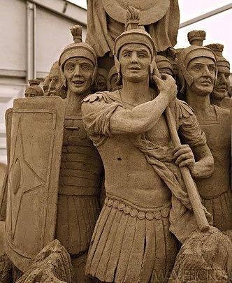
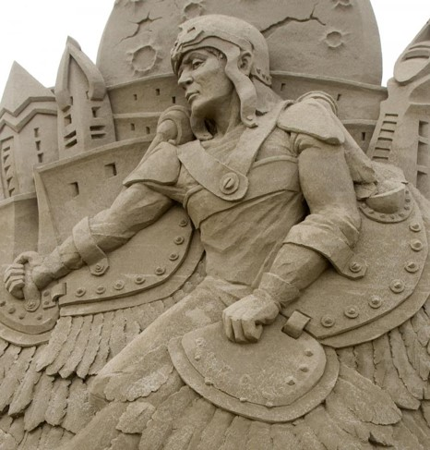
After 4 Generations
Nephites become proud and wicked
Nephites are destroyed by the Lamanites
1 Nephi 12:11-19

Slide 35
Come Unto Christ Liberty
Depths of Humility
Seek help from God
Blessings
Prosperity
Humility Cycle
Misery/Endless Wo
We come to ourselves
Selfishness
Self-Indulgence
Become “Lifted Up”
Inequality
Class divisions
Hatred
War
Pride Cycle
Persecution of Others
Seek Control over others
Use others
Insensitivity
Past Feeling
Personal Apostasy
Sin and Bondage
Becky Davies

Slide 36
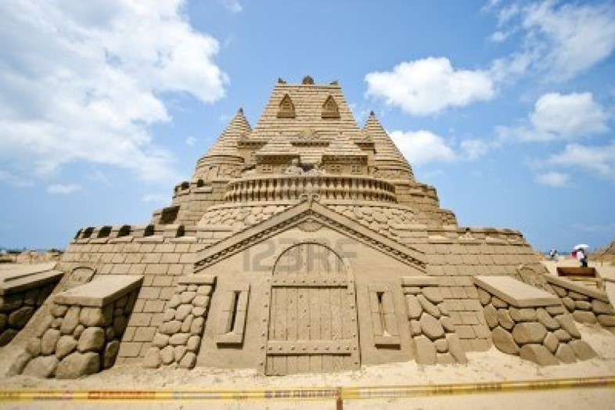
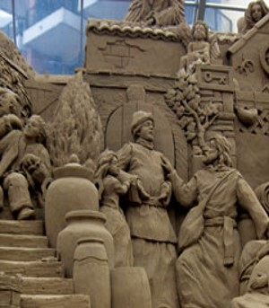
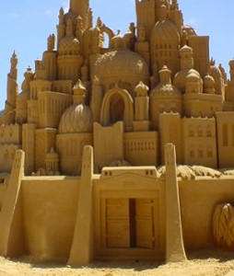
Great and Abominable Church
The “great and abominable church” does not refer to a particular denomination or church.
It refers to any and all organizations that are designed to lead people away from God and His laws.
Designed to lead people away from God and His laws.
Satan and his followers want to destroy the Saints of God and bring them into captivity
1 Nephi 13:1-9

Slide 37
“The titles church of the devil and great and abominable church are used to identify all … organizations of whatever name or nature—whether political, philosophical, educational, economic, social, fraternal, civic, or religious—which are designed to take men on a course that leads away from God and his laws and thus from salvation in the kingdom of God”
--Bruce R. McConkie

Slide 38
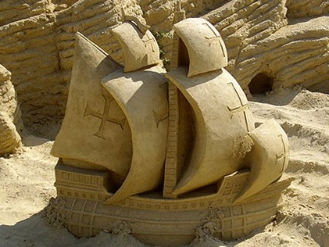
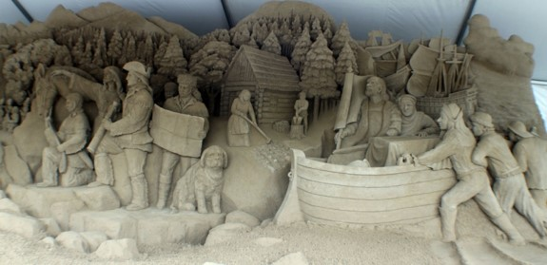
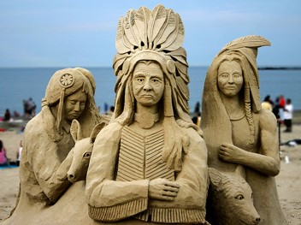
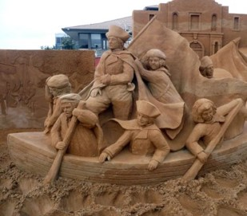
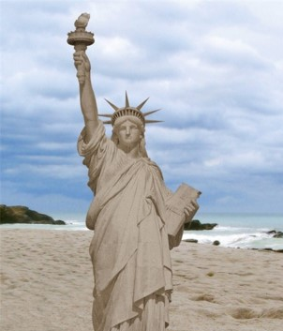
Preparation: A Free Land Where The Gospel Can Be Restored
Columbus sails to the Americas
Pilgrims sail to the Americas, seeking religious freedom
Gentiles prosper in the Americas
Native Americans are driven from their lands
Although outnumbered, American revolutionary armies are victorious
1 Nephi 13:12-19

Slide 39
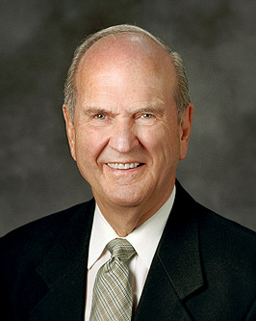
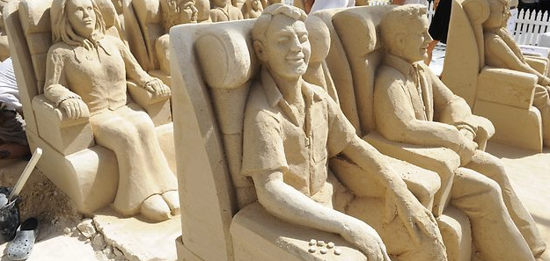
We have front-row seats to witness live what the prophet Nephi saw only in vision. …
You, my brothers and sisters, are among those men, women, and children whom Nephi saw. Think of that!
Russell M. Nelson

Slide 40
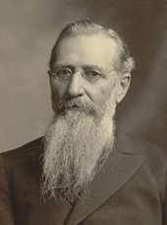
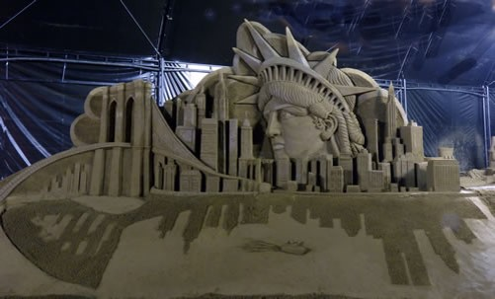
“This great American nation the Almighty raised up by the power of his omnipotent hand, that it might be possible in the latter days for the kingdom of God to be established in the earth.
If the Lord had not prepared the way by laying the foundations of this glorious nation, it would have been impossible (under the stringent laws and bigotry of the monarchical governments of the world) to have laid the foundations for the coming of his great kingdom. The Lord has done this”
Joseph F. Smith (Gospel Doctrine, 5th ed.
[1939], 409).

Slide 41
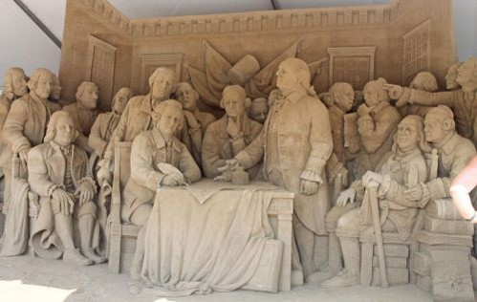
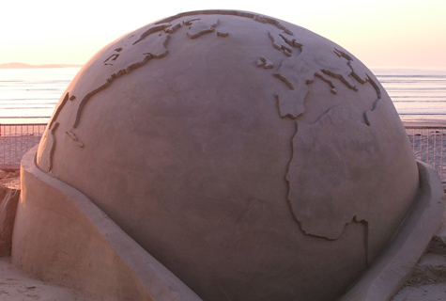
The Lord Prepares a Way
The Lord prepared the way for the Restoration by establishing a country with freedom of religion where He could restore His Church.
The Lord has prepared, and will continue to prepare, a way for His restored gospel to enter every nation.
1 Nephi 13:10-19

Slide 42
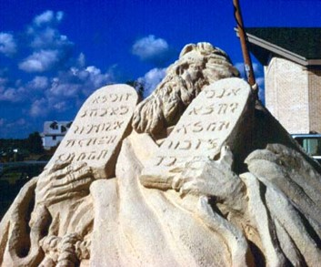

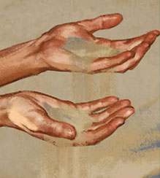
The Bible, the Book of Mormon, and Latter Day Scriptures
The Bible--Of Great Worth– When the revelation in the Bible were originally recorded, they “contained the fulness of the gospel of the Lord”
Plain and Precious Truths—Removed
The Book of Mormon and latter-day scriptures restore plain and precious truths that help us know that Jesus Christ is the Son of God and help us know how to come unto Him.
1 Nephi 13:20-42

Slide 43
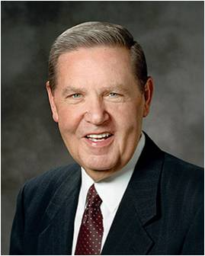
“Elements … missing from the Bible were both ‘plain and most precious.’ They were plain in their simplicity and clarity, being easy to ‘the understanding of … men’; they were precious in their purity and profound worth, their saving significance and eternal importance to the children of God”
--Jeffrey R. Holland
“Many important points touching the salvation of man had been taken from the Bible, or lost before it was compiled.
The Bible “as it read when it came from the pen of the original writers,” and that “ignorant translators, careless transcribers, or designing and corrupt priests have committed many errors”.
--Joseph Smith

Slide 44
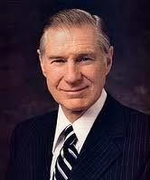
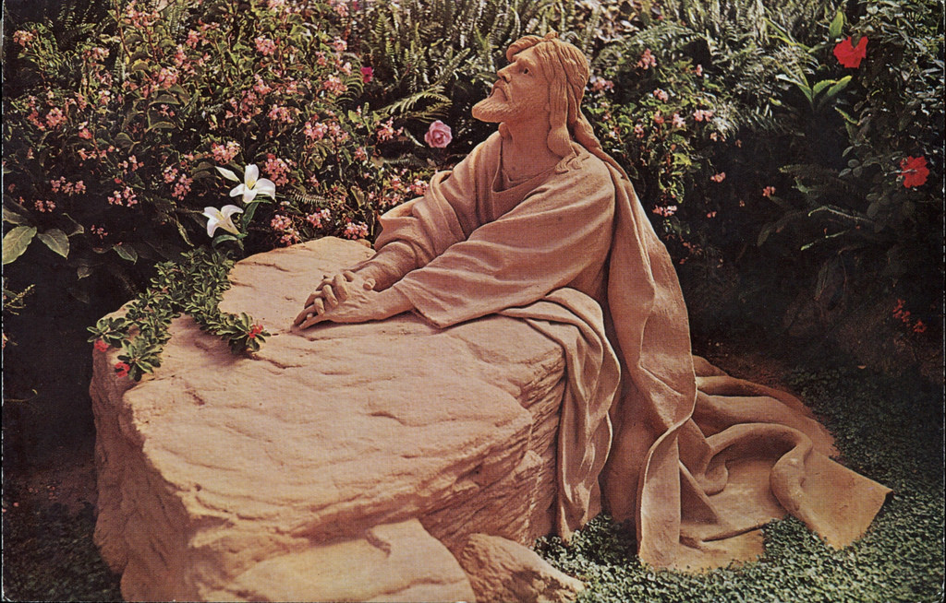
“Prior to the Restoration, the heavens had been closed for centuries. But with prophets and apostles upon the earth once more, the heavens were opened once again with visions and revelations.
Many of the revelations that came to the Prophet Joseph Smith were written down in a book that came to be known as the Doctrine and Covenants.
This contains further insights about principles and ordinances and is a valuable source concerning the structure of the priesthood. In addition, we have another canon of scripture called the Pearl of Great Price.
It contains the book of Moses, which came by revelation to the Prophet Joseph Smith, and the book of Abraham, which he translated from a purchased Egyptian scroll. From these we learn not only a great deal more about Moses, Abraham, Enoch, and other prophets but also many more details about the Creation. We learn that the gospel of Jesus Christ was taught to all of the prophets from the beginning—even from the time of Adam”
-- President James E. Faust
“The Book of Mormon is another testament of Christ. It restored precious
truths concerning the Fall, the Atonement, the Resurrection, and life after
death.
Ted Conibear

Slide 45
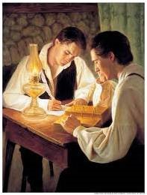
The Joseph Smith Translation of the Bible also helps restore many plain and precious truths.
The Joseph Smith Translation is “a revision or translation of the King James Version of the Bible in English, which the Prophet Joseph Smith began in June 1830.
He was commanded by God to make the translation and regarded it as part of his calling as a prophet.
The Book of Mormon and other latter-day scriptures restore plain and precious truths that help us know that Jesus Christ is the Son of God and that we must come unto Him to be saved

Slide 46
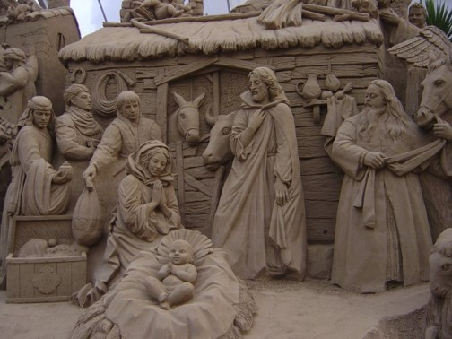


Coming Closer
How has the Book of Mormon influenced your testimony of Jesus Christ and helped you come closer to Him?

Slide 47

Sources:
Joseph Fielding Smith Answers to Gospel Questions, 5 vols. [Salt Lake City: Deseret Book Co., 1957-1966], 1: 120-122.)
Elder Bruce R. McConkie (Doctrinal New Testament Commentary, 1:558.); (Mormon Doctrine, 2nd ed. [1966], 137–38).
Joseph F. Smith (Gospel Doctrine, 5th ed. [1939], 409).
Jeffrey R. Holland (Christ and the New Covenant: The Messianic Message of the Book of Mormon [1997], 5).
Joseph Smith (Teachings of Presidents of the Church: Joseph Smith [2007], 207,217
James E. Faust (“The Restoration of All Things,” Ensign or Liahona, May 2006, 67–68).
Becky Davies “Pride Cycle” Chart -- Poway Institute
Russell M. Nelson, “Hear Him,” Ensign or Liahona, May 2020, 88
Photos are sand sculptures
Presentation by ©http://fashionsbylynda.com/blog/

Slide 48
Come Unto Christ Liberty
Depths of Humility
Seek help from God
Blessings
Prosperity
Humility Cycle
Misery/Endless Wo
We come to ourselves
Selfishness
Self-Indulgence
Become “Lifted Up”
Inequality
Class divisions
Hatred
War
Pride Cycle
Persecution of Others
Seek Control over others
Use others
Insensitivity
Past Feeling
Personal Apostasy
Sin and Bondage
Becky Davies

Slide 49
As Many As the Sand of the Sea 1 Nephi 12:1:
Many experts have tried to figure out how large the population was in Book of Mormon times. Nephi describes it as "in number as the sand of the sea." Expert predictions may underestimate the number of people who lived on this continent. Evidence suggests that near the time of Christ, the settlements were not great in number, and the geography was confined to a relatively small area. However, latter-day attempts to shrink the geography populations of the Book of Mormon have at times gone too far. Nothing can be determined about the number of people who lived in the Jaredite era or during the many generations which passed between Nephi and king Benjamin. We must accept the fact that the Book of Mormon was not written as a census or an almanac. But the population seemed to Nephi 'as the sand of the sea' for multitude.
Man Among the Gentiles 1 Nephi 13:12:
"During seven long years Columbus importuned King Ferdinand for a hearing. But he was generally regarded as a visionary. Even the children in the streets knew him as one mentally unsound. When, at last, the learned council condescended to make a report, it was to the effect that the plan was too foolish to merit attention. 'It is absurd," they said, "to believe that there are people on the other side of the world, walking with their heels upward, and their heads hanging down. And then, how can a ship get there? The torrid zone through which they must pass, is a region of fire, where the very waves boil. And even if a ship could perchance get around there safely, how could it ever get back? Can a ship sail uphill?'
"With such arguments the wise men of Spain were about to drive Columbus out of the country. In fact, he decided to go to France. But, fortunately, the queen, Isabella, had as much to say in such matters as her royal consort. And she listened to friends of Columbus. She was even willing to raise money on her jewels to defray the expenses of a voyage. But this was not required of her. Luis de Santangel, who held the keys to the treasury of Aragon, looked after the finances. The agreement between the regents and Columbus was signed on April 17, 1492. Columbus shed tears of joy. He had reached the goal, after eighteen long years of labor, disappointments and heartache.
"Columbus is described as a man of commanding presence, tall and powerful, fair, ruddy complexion, and blue-grey eyes. By the time he sailed for the new world, his hair had turned white. His bearing was courteous and his conversation was captivating. Notwithstanding all discouragement, he never lost faith in his divine calling and mission.
"It was on August 3, 1492, that Columbus with three vessels-the Santa Maria, the Pinta, and the Niña, with 90 souls on board-set out from Palos, Spain. It was on October 12, the same year that Columbus with a retinue of officers and men set foot on the beach of an island which he named San Salvador." (Reynolds and Sjodahl, Commentary on the Book of Mormon, vol. 1, p. 119
Difference Between Disciple and Apostle 1 Nephi 12:8:
"Discipleship is general; any follower of a man or devotee to a principle may be called a disciple, The Holy Apostleship is an office and calling belonging to the Higher or Melchizedek Priesthood, at once exalted and specific, comprising as a distinguishing function that of personal and special witness to the divinity of Jesus Christ as the one and only Redeemer and Savior of mankind. The apostleship is an individual bestowal, and as such is conferred only through ordination. That the Twelve did constitute a council or 'quorum' having authority in the Church established by Jesus Christ is shown by their ministrations after the Lord's resurrection and ascension.
"....The word 'apostle' is an Anglicized form derived from the Greek apostolos, meaning literally 'one who is sent,' and connoting an envoy or official messenger, who speaks and acts by the authority of one superior to himself." James E. Talmage (Jesus the Christ, p. 227-8)
Disciples or Apostles? 1 Nephi 12:8:
"In fulfilment of this prophecy when the Savior came to the Nephites, he chose twelve men and gave them authority to minister in his name among the Nephites on this American continent in all the ordinances essential to their salvation. These twelve went forth healing the sick and performing many miracles and administering the ordinances as they had been commanded to do. The fulness of the gospel with the power and the authority of the Melchizedek Priesthood were given to the Nephites the same as they were to the Church on the Eastern Hemisphere
"While in every instance the Nephite twelve are spoken of as disciples, the fact remains that they had been endowed with divine authority to be special witnesses for Christ among their own people. Therefore, they were virtually apostles to the Nephite race, although their jurisdiction was, as revealed to Nephi, eventually to be subject to the authority and jurisdiction of Peter and the twelve chosen in Palestine. According to the definition prevailing in the world an apostle is a witness for Christ, or one who evangelizes a certain nation or people. 'A zealous advocate of a doctrine or cause.' Therefore the Nephite twelve became apostles, as special witnesses, just as did Joseph Smith and Oliver Cowdery in the Dispensation of the Fulness of Times." Joseph Fielding Smith (Answers to Gospel Questions, 5 vols. [Salt Lake City: Deseret Book Co., 1957-1966], 1: 120-122.)

Slide 50
Draw a line to the correct statement
1 Nephi 13:14
1 Nephi 13:16-19
1 Nephi 13:12
1 Nephi 13:15
1 Nephi 13:12
Columbus Sails to the Americas
Pilgrim's sail to the Americas, seeking religious freedom
Native Americans are driven from their lands
Gentiles prosper in the Americas
Although outnumbered, American revolutionary armies are victorious

Slide 51

Triumph Over Evil
1 Nephi 14

Slide 52
If… A Choice
If
Then
If I follow the Lord, then …
If I refuse to follow the Lord, then …
Depending on what we choose, we experience different outcomes.
Nephi saw future generations and noted that if they would be righteous, they would be blessed; or if they would choose wickedness, they would be cursed.

Slide 53
Choice and Blessings
If they hearken unto the Lamb of God
And do not harden their hearts
Then they shall:
Be numbered of the house of Israel
Be a blessed people forever
Not be brought down into captivity
“stumbling blocks” = obstacles that keep people from following the Lord.
“numbered among the house of Israel” = counted among the Lord’s covenant people
1 Nephi 14:1-2

Slide 54


Covenants
Why is it important to be among the Lord’s covenant people?
(To receive the blessings of the Abrahamic covenant [see D&C 132:30–31].)
What does it mean to “hearken unto the Lamb of God”?
To hear the words of God
“…Hearken, O ye nations of the earth, and hear the words of that God who made you.”
(D&C 43:23)
1 Nephi 14:1-2

Slide 55


If… A Choice
Repent
If
Hardened Heart
If we repent and do not harden our hearts against the Lord and His work, then we will receive peace and eternal life
Blessings come to those who repent
Negative consequences come to those who harden their hearts.
1 Nephi 14:5-7

Slide 56


If… A Choice
If the people repent…
Then they shall…
“it shall be well with them”
They shall receive “Peace and life eternal”
If the people harden
their hearts…
Then they shall…
Perish and “be brought down into captivity” and “destruction”
If we do not repent but harden our hearts against the Lord and His work, we will eventually be brought down into captivity and destruction.
1 Nephi 14:5-7

Slide 57

A Great and Marvelous Work
A Restoration of the priesthood, the gospel, and the Lord’s Church in the latter days.
How is The Church of Jesus Christ of Latter-day Saints “great and marvelous” to you?
How does it bring you peace?
How does it bring you hope for eternal life?
Repenting of our sins leads to great blessings.
Hardening our hearts against the Lord and His Church leads to spiritual captivity and destruction.
1 Nephi 14:7

Slide 58


Apostasy Comes to a Close
“Therefore, I will proceed to do a marvelous work among this people yea, a marvelous work and a wonder, for the wisdom of their wise and learned shall perish, and the understanding of their prudent shall be hid.”
2 Nephi 27:25-26
Isaiah 29:13-14
The beginning of times of restitution (Acts 3:21)…an age initiated by the call of Joseph Smith
1 Nephi 14:7

Slide 59


Everlasting Work
“A new and everlasting covenant is the fulness of the gospel, the aggregate of all covenants and obligations which lead to salvation.”
(D&C 1:22; 39:11; 45:9; 49:9; 66:2; 133:57)
“The angel instructed Nephi that one accepts or rejects the message of the Restoration at the peril of his own salvation.”
--Joseph Fielding McConkie and Robert L. Millet
1 Nephi 14:7

Slide 60


The Battle—Two Churches
Takes place in the Latter Days
The Lamb of God- authorized Church of Jesus Christ
Accepting of the Lord’s commandments
Harkens to the word of God
Members are few
Great and Abominable Church
Founder—Devil
Mother of abomination
Whore of the earth
Those who are not of the Church of the Lamb belong to that Great and Abominable Church
1 Nephi 14:8-17

Slide 61

“As this work progresses in its onward course, and becomes more and more an object of political and religious interest and excitement, no king, ruler, or subject, no community or individual, will stand neutral.
All will at length be influenced by one spirit or the other; and will take sides either for or against the kingdom of God”
–First Presidency Message
Quorum of the Twelve Apostles on April 6, 1845
1 Nephi 14:10

Slide 62



...“All churches may be false, but only one can be true, simply because religion comes from God, and God is not the author of confusion.”
--Joseph Smith
“The Lord is not condemning all who are not members of the church. Nor is he ensuring an exaltation to all those who have received the fulness of the gospel.
The Lord has said that he is pleased with the Church collectively and not necessarily individually, we are neither baptized nor judged as congregations.”
--Joseph Fielding McConkie and Robert L. Millet

Slide 63

“There is only light and darkness; there is no dusky twilight zone (in regard to the fulness of salvation). Either men walk in the light or they cannot be saved.”
--Bruce R. McConkie

Slide 64

Armed with Righteousness
Build up the Kingdom of God
Serving Jesus Christ by serving others
Baptismal
Covenants
Sustain truth and righteousness
Taking upon the name of Jesus Christ
Stand as witnesses of God
Keeping all the commandments
1 Nephi 14:14

Slide 65



Armed with Righteousness
If we keep our covenants, we will be armed with righteousness and with the power of God.
… I testify that the covenant people of the Lord today indeed are armed with righteousness and with the power of God in great glory. I have witnessed faith, courage, perspective, persistence, and joy that extend far beyond mortal capacity—and that only God could provide.
David A. Bednar,
1 Nephi 14:14

Slide 66


“We [members of the Church] are a tiny fraction when compared to the billions of people on earth. But we are who we are, and we know what we know, and we are to go forth and preach the gospel.
“The Book of Mormon makes it clear that we never will dominate by numbers. But we have the power of the priesthood …
“We can and in due time certainly will influence all of humanity. It will be known who we are and why we are. It might seem hopeless; it is monumentally difficult; but it is not only possible but certain that we will win the battle against Satan”
--Boyd K. Packer
1 Nephi 14:14

Slide 67

What do your daily actions tell you about how important the covenants are that you have made?
Why do you need the power that comes from covenants with Heavenly Father?
How could you more fully invite into your life the blessings of making and honoring covenants with Heavenly Father?

Slide 68

John the Revelator
The major theme in John’s writing is in the Book of Revelation. This then includes that God will triumph over the forces of the devil.
Nephi also saw a vision of the end of the world, but he was commanded not to record it because John had been given the responsibility to do so.
1 Nephi 14:18-27

Slide 69

“The Book of Revelation is one of the plainest books God ever caused to be written.”
--Joseph Smith

Slide 70
Sources:
Joseph Fielding McConkie and Robert L. Millet “Doctrinal Commentary on the Book of Mormon” pg. 108 and pg. 110
Proclamation: James R. Clark, comp., Messages of the First Presidency of The Church of Jesus Christ of Latter-day Saints [1965], 1:257).
Joseph Smith Doctrinal New Testament Commentary 2:506-7
Bruce R. McConkie “The Millennial Messiah” pg. 54
Boyd K. Packer “The Power of the Priesthood,” Ensign or Liahona, May 2010, 7.
Joseph Smith (Teachings p 290)
David A. Bednar, “With the Power of God in Great Glory,” Liahona, Nov. 2021, 29–30
Presentation by ©http://fashionsbylynda.com/blog/

Slide 71
1 Nephi 14:7:
"Joseph Smith, or any other man, could not have obtained all this information by reading the Bible or studying all the books that have ever been written. It came from God. It is exactly what Isaiah promised the Lord would do when conditions upon the earth should become as Joseph Smith found them when he went into the woods to pray for light as to which of all the churches he should join....
"It truly is a marvelous work and a wonder. Can you conceive of anything that could be more marvelous or more wonderful?
"In the face of it all, the wisdom of wise men does perish. The world has no satisfactory explanation. In the Church Historian's Office in Salt Lake City are more than 20,000 volumes, large and small, each of which says something about the Prophet Joseph Smith. There are also some 2,000 pamphlets on the subject. Many of these publications represent attempts on the part of non-Mormon writers to explain the conundrum of Joseph Smith and the work he established, but all without avail. All these writings have been accumulated since the birth of Joseph Smith in 1805. In contrast, in the more than two centuries that have elapsed since the birth of George Washington, it is reported, there are only some 3,000 volumes written about him on file in the Library of Congress....
"We emphasized a statement published in the New York Herald, which we quoted in this chapter; 'Joseph Smith is creating a spiritual system, combined with morals and industry that may change the destiny of the race.' This statement was made in 1842, and at this writing, more than a century and a half later, it is evident, from the present accomplishments of the Church founded under his leadership, that this prognostication is sure to achieve a complete fulfillment.
"It is equally sure that the prediction of Josiah Quincy, previously quoted, will find its fulfillment:
"'It is by no mans improbable that some future textbook, for the use of generations yet unborn, will contain a question something like this: What historical American of the nineteenth century has exerted the most powerful influence upon the destinies of his countrymen? And it is by no means impossible that the answer to that interrogatory may be thus written: 'Joseph Smith, the Mormon prophet.'" LeGrand Richards (A Marvelous Work and a Wonder, pp. 411-2)
1 Nephi 14:14:
On January 19, 1841, Joseph Smith received a revelation from the Lord commanding him to “make a solemn proclamation of my gospel … to all the kings of the world” (see D&C 124:1-14). Before he could fulfill this commandment, the Prophet Joseph suffered martyrdom in June 1844. Nine months later, on April 6, 1845, the Quorum of the Twelve Apostles—the highest governing body in the Church at the time—published a proclamation addressed:
“To all the Kings of the World;
To the President of the United States of America;
To the Governors of the several States;
And to the Rulers and People of all Nations”.
The proclamation of 1845 is considered “one of the great prophetic utterances of the last dispensation” and “covers some of the preparations that are expected to be made throughout the world as a preface to the Second Coming of the Lord Jesus Christ to reign on the earth.” A major purpose of the proclamation is to present a bold call-to-action to the kings of the earth to assist the Latter-day Saints with their divine mission. Particularly striking is the clear timeline it presents, “outlining as it does future developments of the Kingdom of God in both the Eastern and Western Hemispheres,” including a detailed description of the Battle of Armageddon and the glorious destiny of the indigenous peoples of North and South America (James R. Clark, Messages of the First Presidency, 1:252).

Slide 72
Something of Interest
Latter Day Chiasmus 1845 (Proclamation)
#1: This chiasm clearly defines the “kingdom of God” that has been “prayed for in all ages” and announces its establishment “in these last days.” It also explains how the Lord, through “open visions” and “the great and eternal High Priesthood,” speaks “from the heavens” and “communes with man upon the earth.”
A: Know ye:—That the kingdom of God has come: as has been predicted by ancient prophets, and prayed for in all ages; even that kingdom which shall fill the whole earth, and shall stand for ever.
B: The great Eloheem [sic] Jehovah has been pleased once more to speak from the heavens; and also to commune with man upon the earth,
C: by means of open visions, and by the ministration of HOLY MESSENGERS.
C: By this means
B:the great and eternal High Priesthood, after the Order of his Son, even the Apostleship, has been restored; or, returned to the earth.
A: This High Priesthood, or Apostleship, holds the keys of the kingdom of God, and power to bind on earth that which shall be bound in heaven; and to loose on earth that which shall be loosed in heaven. And, in fine, to do, and to administer in all things pertaining to the ordinances, organization, government and direction of the kingdom of God. Being established in these last days for the restoration of all things spoken by the prophets since the world began; and in order to prepare the way for the coming of the Son of Man.

Slide 73
#2: This chiasm describes the preparation needed for the Second Coming of Christ, which is “near at hand.” This preparation centers around the first principles and ordinances of the Gospel—faith in Jesus Christ, repentance, baptism, and the gift of the Holy Ghost. The central focus of this chiasm is a description of the blessings that come as a result of having the gift of the Holy Ghost.
A: And we now bear witness that his coming is near at hand; and not many years hence, the nations and their kings shall see him coming in the clouds of heaven with power and great glory.
B: In order to meet this great event there must needs be a preparation.
C: Therefore we send unto you with authority from on high, and command you all to repent and humble yourselves as little children, before the majesty of the Holy One ; and come unto Jesus with a broken heart and a contrite spirit, and be baptized in his name, for the remission of sins (that is, be buried in the water in the likeness of his burial and rise again to newness of life, in the likeness of his resurrection), and you shall receive the gift of the Holy Spirit, through the laying on of the hands of the Apostles and elders, of this great and last dispensation of mercy to man.
D: This Spirit shall bear witness to you, of the truth of our testimony; and shall enlighten your minds, and be in you as the spirit of prophecy and revelation. It shall bring things past to your understanding and remembrance; and shall show you things to come.
D: It shall also impart unto you many great and glorious gifts; such as the gift of healing the sick, and of being healed, by the laying on of hands in the name of Jesus; and of expelling Demons; and even of seeing visions, and conversing with Angels and spirits from the unseen world.
C: By the light of this Spirit, received through the ministration of the ordinances—by the power and authority of the Holy Apostleship and Priesthood, you will be enabled to understand, and to be the children of light;
B: and thus be prepared to escape all the things that are coming on the earth,
A: and so stand before the Son of Man.

Slide 74
#3: This parallelism describes the Lord’s twin capitals that are to be built on the earth—Jerusalem on the eastern hemisphere and the New Jerusalem on the western hemisphere.
A: And we further testify that the Lord has appointed a holy city and temple to be built on this continent for the endowment and ordinances pertaining to the priesthood; and for the Gentiles, and the remnant of Israel to resort unto,
B: in order to worship the Lord; and to be taught in his ways and walk in his paths:
C: in short, to finish their preparations for the coming of the Lord.
A: And we further testify, that the Jews among all nations are hereby commanded, in the name of the Messiah, to prepare, to return to Jerusalem in Palestine; and to rebuild that city and temple unto the Lord:
B: And also to organize and establish their own political government, under their own rulers, judges, and governors in that country.
C: For be it known unto them that we now hold the keys of the priesthood and kingdom which is soon to be restored unto them. Therefore let them also repent and prepare to obey the ordinances of God.

Slide 75
#4: This chiasm describes additional requirements placed upon the “kings, rulers, and people of the Gentiles.” They are to use their temporal riches and resources in furthering the work of the Lord, to lighten the load carried by the Latter-day Saints.
A: And now, O ye kings, rulers, and people of the Gentiles: hear ye the word of the Lord; for this commandment is for you. You are not only required to repent and obey the gospel in its fulness, and thus become members or citizens of the kingdom of God,
B: but you are also hereby commanded, in the name of Jesus Christ, to put your silver and your gold, your ships and steam-vessels, your railroad trains and your horses, chariots, camels, mules, and litters, into active use, for the fulfilment of these purposes. For be it known unto you, that the only salvation which remains for the Gentiles, is for them to be identified in the same covenant, and to worship at the same altar with Israel. In short, they must come to the same standard. For, there shall be one Lord, and his name one, and He shall be king over all the earth.
C: The Latter-day Saints, since their first organization in the year 1830, have been a poor, persecuted, abused, and afflicted people. They have sacrificed their time and property freely, for the sake of laying the foundation of the kingdom of God, and enlarging its dominion, by the ministry of the gospel. They have suffered privation, hunger, imprisonment, and the loss of houses, lands, home, and political rights, for their testimony.
C: And this is not all ; but their first founder, Mr. Joseph Smith, whom God raised up as a Prophet and Apostle, mighty in word and in deed, and his brother Hiram, who was also a prophet, together with many others, have suffered a cruel martyrdom in the cause of truth; and have sealed their testimony with their blood. And still the work has, as it were, but just begun.
B: A great, a glorious, and a mighty work is yet to be achieved, in spreading the truth and kingdom among the Gentiles—in restoring, organizing, instructing and establishing the Jews—in gathering, instructing, relieving, civilizing, educating and administering salvation to the remnant of Israel on this continent; in building Jerusalem in Palestine; and the cities, stakes, temples, and sanctuaries of Zion in America; and in gathering the Gentiles into the same covenant and organization— instructing them in all things for their sanctification and preparation; that the whole Church of the Saints, both Gentile, Jew and Israel, may be prepared as a bride, for the coming of the Lord.
A: And now, O ye kings, rulers, presidents, governors, judges, legislators, nobles, lords, and rich men of the earth; will you leave us, to struggle alone, and to toil unaided in so great a work? Or will you share in the labors, toils, sacrifices, honors and blessings of the same?

Slide 76
#5: This chiasm proclaims that the latter day effort to “usher in the great millennium” is “the greatest of all revolutions.”
A: Have you not the same interest in it that we have? Is it not sent forth to renovate the world—to enlighten the nations—to cover the earth with light, knowledge, truth, union, peace and love? And thus usher in the great millennium, or sabbath of rest, so long expected and sought for by all good men?
B: We bear testimony that it is.
B: And the fulfilment of our words will establish their truth, to millions yet unborn: while there are those now living upon the earth who will live to see the consummation.
A: Come, then, to the help of the Lord; and let us have your aid and protection—and your willing and hearty co-operation, in this, the greatest of all revolutions.
#6: This chiasm provides a remarkable prophetic warning to the people and nations of the earth. Although the Saints were a tiny minority at the time of this proclamation, they would become “more and more an object of political and religious interest and excitement.” As a result, every individual and community would no longer have the option of standing “as idle and disinterested spectators,” but would reach a point where they would either choose to “aid and bless the people of God” or “fight against God, and seek to destroy his people.” chiasm clearly defines the “kingdom of God” that has been “prayed for in all ages” and announces its establishment “in these last days.” It also explains how the Lord, through “open visions” and “the great and eternal High Priesthood,” speaks “from the heavens” and “communes with man upon the earth.”
A: There is also another consideration of vast importance to all the rulers and people of the world, in regard to this matter. It is this: As this work progresses in its onward course, and becomes more and more an object of political and religious interest and excitement, no king, ruler, or subject, no community or individual, will stand neutral. All will at length be influenced by one spirit or the other; and will take sides either for or against the kingdom of God, and the fulfilment of the prophets, in the great restoration and return of his long dispersed covenant people.
B: Some will act the part of the venerable Jethro, the father-in-law of Moses; or the noble Cyrus; and will aid and bless the people of God; or like Ruth, the Moabitess, will forsake their people and their kindred and country, and will say to the Saints, or to Israel: “This people shall be my people, and their God my God.”
B: While others will walk in the footsteps of a Pharaoh, or a Balak, and will harden their hearts, and fight against God, and seek to destroy his people. These will commune with priests and prophets who love the wages of unrighteousness; and who, like Balaam, will seek to curse, or to find enchantments against Israel.
A: You cannot therefore stand as idle and disinterested spectators of the scenes and events which are calculated in their very nature to reduce all nations and creeds to one political and religious standard, and thus put an end to Babel forms and names, and to strife and war. You will, therefore, either be led by the good Spirit to cast in your lot, and to take a lively interest with the Saints of the Most High, and the covenant people of the Lord, or on the other hand, you will become their inveterate enemy, and oppose them by every means in your power.

Slide 77
#7: In this chiasm, the remarkable prophecy continues with a vivid description of armed conflict and a dramatic change in “the whole order of things in Europe and Asia, in regard to political and religious organization, and government.” The “great division” of the people of the world will eventually lead “the nations of the old world” to besiege and attack Jerusalem. In the midst of battle, the Messiah (Christ) will appear as the “defender of the Jews” and “complete their victory.” As a result of this “signal victory,” Jerusalem will become the “capital of the old world,” where the nations of the eastern hemisphere will be required to annually keep the Feast of Tabernacles.
A: To such an extreme will this great division finally extend, that the nations of the old world will combine to oppose these things by military force. They will send a great army to Palestine, against the Jews; and they will besiege their city and will reduce the inhabitants of Jerusalem to the greatest extreme of distress and misery.
B: Then will commence a struggle in which the fate of nations and empires will be suspended on a single battle.
C: In this battle the governors and people of Judah distinguish themselves for their bravery and warlike achievements. The weak among them will be like David, and the strong among them will be like God: or like the angel of the Lord.
D: In that day the Lord will pour upon the inhabitants of Jerusalem the spirit of grace and supplication, and they shall look upon the Messiah whom they have pierced.
D: For lo he will descend from heaven, as the defender of the Jews: and to complete their victory. His feet will stand in that day upon the Mount of Olives, which shall cleave in sunder at his presence, and remove one half to the north, and the other to the south; thus forming a great valley where the mountain now stands.
C: The earth will quake around him, while storm and tempest, hail and plague, are mingled with the clash of arms, the roar of artillery, the shouts of victory, and the groans of the wounded and dying. In that day all who are in the siege, both against Judea and against Jerusalem, shall be cut in pieces; though all the people of the earth should be gathered together against it.
B: This signal victory on the part of the Jews, so unlooked for by the nations, and attended with the personal advent of Messiah, and the accompanying events, will change the whole order of things in Europe and Asia, in regard to political and religious organization, and government. The Jews as a nation become holy from that day forward; and their city and sanctuary becomes holy. There also the Messiah establishes his throne, and seat of government. Jerusalem then becomes the seat of empire, and the great centre and capital of the old world.
A: All the families of the land shall then go up to Jerusalem once a year, to worship the King, the Lord of Hosts, and to keep the feast of Tabernacles. Those who refuse to go up, shall have no rain, but shall be smitten with dearth and famine. And if the family of Egypt go not up (as it never rains there) they shall be smitten with the plague. And thus all things shall be fulfilled according to the words of the holy prophets of old, and the word of the Lord which is now revealed, to confirm and fulfil them.

Slide 78
#8: This chiasm provides more detail about the dramatic power shift described in the previous chiasm.
A: In short the kings, rulers, priests and people of Europe, and of the old world, shall know this once that there is a God in Israel, who, as in days of old, can utter his voice, and it shall be obeyed.
B: The courts of Rome, London, Paris, Constantinople, Petersburgh, and all others, will then have to yield the point, and do homage, and all pay tribute to one Great Centre, and to one mighty Sovereign,
C: or, THRONES WILL BE CAST DOWN,
C: AND KINGDOMS WILL CEASE TO BE.
B: Priests, bishops, and clergy, whether Catholic, Protestant, or Mahomedan, will then have to yield their pretended claims to the priesthood, together with titles, honors, creeds and names; and reverence and obey the true and royal priesthood of the order of Melchisedech, and of Aaron; restored to the rightful heirs, the nobility of Israel;
A: or, the dearth and famine will consume them, and the plague sweep them quickly down to the pit, as in the case of Korah, Dathan and Abiram, who pretended to the priesthood, and rebelled against God’s chosen priests and prophets, in the days of Moses.

Slide 79
#9: In this parallelism, the scene shifts in this remarkable prophecy “a scene of grandeur, greatness, and glory, far surpassing the scene just described,” which will take place in the western hemisphere. The indigenous peoples of North and South America will “stand forth in manly dignity” and claim their inheritance as descendants of Joseph. They will build the city of Zion, claim their temple blessings, enjoy a personal visit from the Lord, and become a “standard” for the nations of the western hemisphere.
A: While these great events are rolling on the wheels of time, and being fulfilled in the old world, the Western Continent will present a scene of grandeur, greatness, and glory, far surpassing the scene just described. The Lord will make her that halted a remnant; and gather her that was driven out and afflicted; and make her who was cast afar off, a strong nation; and will reign over them in Mount Zion from that time forth and for ever (sic). Or, in other words, He will assemble the Natives, the remnants of Joseph in America; and make of them a great, and strong, and powerful nation: and he will civilize and enlighten them, and will establish a holy city, and temple, and seat of government among them, which shall be called Zion.
B: And there shall be his tabernacle, his sanctuary, his throne, and seat of government for the whole continent of North and South America for ever. In short, it will be to the western hemisphere what Jerusalem will be to the eastern.
C: And there the Messiah will visit them in person; and the old Saints, who will then have been raised from the dead, will be with him. And he will establish his kingdom and laws over all the land.
D: To this city, and to its several branches or stakes, shall the Gentiles seek, as to a standard
E: of light and knowledge. Yea, the nations, and their kings and nobles, shall say. Come, and let us go up to the Mount Zion, and to the temple of the Lord; where his holy priesthood stand to minister continually before the Lord; and where we may be instructed more fully, and receive the ordinances of remission, and of sanctification, and redemption; and thus, be adopted into the family of Israel and identified in the same covenants of promise.
A: The despised and degraded son of the forest, who has wandered in dejection and sorrow, and suffered reproach, shall then drop his disguise, and stand forth in manly dignity, and exclaim to the Gentiles who have envied and sold him: “I am Joseph: does my father yet live?” Or, in other words: I am a descendant of that Joseph who was sold into Egypt. You have hated me, and sold me, and thought I was dead. But lo! I live, and am heir to the inheritance, titles, honors, priesthood, sceptre, crown, throne, and eternal life and dignity of my fathers, who live for evermore.
B: He shall then be ordained, washed, anointed with holy oil, and arrayed in fine linen, even in the glorious and beautiful garments and royal robes of the high priesthood, which is after the order of the Son of God; and shall enter into the congregation of the Lord, even into the Holy of Holies, there to be crowned with authority and power which shall never end. The Spirit of the Lord shall then descend upon him, like the dew upon the mountains of Hermon, and like refreshing showers of rain upon the flowers of Paradise. His heart shall expand with knowledge, wide as eternity; and his mind shall comprehend the vast creations of his God, and His eternal purpose of redemption, glory, and exaltation, which was devised in heaven before the worlds were organized; but made manifest in these last days, for the fulness of the Gentiles, and for the exaltation of Israel.
C: He shall also behold his Redeemer, and be filled with his presence, while the cloud of his glory shall be seen in his temple.
D: The city of Zion, with its sanctuary and priesthood, and the glorious fulness of the gospel, will constitute a standard which will put an end to jarring creeds and political wranglings, by uniting the republics, states, provinces, territories, nations, tribes, kindred, tongues, people, and sects of North and South America in one great and common bond of brotherhood.
E: While truth and knowledge shall make them free, and love cement their union. The Lord also shall be their king and their lawgiver; while wars shall cease, and peace prevail for a thousand years. Thus, shall American rulers, statesmen, citizens, and savages know, “this once,” that there is a God in Israel, who can utter his voice, and it shall be fulfilled.

Slide 80
#10: The following structure consists of two chiasms sandwiched between two corresponding introductory elements (labeled I and II). The two chiasms describe the work of the Lord that “must roll on in fulfillment” and two major contributions the people of the Americas can make to the work of the latter days. In the first chiasm, they are instructed to “protect the Saints” by extending “the broad banner of the Constitution and laws over” them, including punishing their “offenders” and helping them reclaim “the millions they have lost.” In the second chiasm, the people of the Americas are encouraged to continue their efforts to “civilize” the indigenous peoples and to educate them about “their Israelitish origin.”
I: Americans! This mighty and strange work has been commenced in your midst, and must roll on in fulfillment.
A: You are now invited, and earnestly intreated, to investigate it thoroughly, and to aid and
participate in its accomplishment.
B: You ask, What can be done?
C: We answer: Protect the Saints; give them their rights; extend the broad banner of the Constitution and laws over their homes, cities, fire- sides, wives, and children;
D: that they may CEASE to be BUTCHERED, MARTYRED, ROBBED, PLUNDERED, AND DRIVEN, and may peaceably proceed in the work assigned them by their God.
D: Execute the Law upon the offenders, and thus rid your garments of INNOCENT BLOOD.
C: Pass acts, also, to indemnify them in the millions they have lost, by your cruel and criminal neglect.
B: Contribute liberally of your substance
A: for their aid, and for the fulfillment of their mission.
A: Let the Government of the United States also continue to gather together, and to colonize the tribes and remnants of Israel (the Indians), and also to feed, clothe, succor, and protect them, and endeavor to civilize and unite;
B: and also to bring them to the knowledge of their Israelitish origin, and of the fulness of the gospel which was revealed to, and written by, their forefathers on this land;
C: the record of which has now come to light.
C: It is these records,
B: together with the other scriptures, and the priesthood and authority now conferred upon the Saints,
A: that will effect their final conversion and salvation; while the creeds of man, and the powerless forms and dogmas of sectarianism will still remain powerless and inefficient.
II: The Lord has spoken, and who can disannul it? He has uttered his voice, and who can gainsay it? He has stretched out his arm, and who can turn it back?

Slide 81
#11: This parallelism contrasts the blessings and cursings that will follow either supporting or rejecting the Latter-day Saints. Ultimately, they will either “be prepared to receive their king, Messiah, and to dwell for ever under his peaceful government in this happy country,” or they will lose their inheritance when the Messiah comes and executes “judgement for the Saints, and give[s] them the dominion.”
A: If the rulers and people will now inform themselves on these momentous subjects, and fulfill the duties we have just pointed out to them,
B: they will then be entitled to a continuation of the great national blessings and favors they have heretofore enjoyed; yea, and to more abundant favors from His bountiful hand, who first raised them to national greatness. They will in that case be prospered and enlarged, and spread their dominions wide and more wide over this vast country, till not only Texas and Oregon, but the whole vast dominion from sea to sea, will be joined with them, and come under their protection as one great, powerful and peaceful empire of Liberty and Union. Millions of people would also come from all nations, their silver and their gold with them, and would take protection under our banner, till in less than half a century from the present time we would have upwards of a hundred millions of population, all united and free, while civilization, arts, cultivation and improvement would extend to the most wild regions of our continent, making our “wilderness like Eden and our deserts like the garden of the Lord.” Or, if they will go still further, and obey the fulness of the gospel, they would then be entitled, not only to temporal blessings, but to the gifts of the Holy Spirit,
C: and thus be prepared to receive their king, Messiah, and to dwell for ever under his peaceful government in this happy country.
A: But, so long as they remain indifferent and ignorant on these subjects, and so long as they continue to breathe out slanders, lies, hatred and murder against the Saints and against the remnants of Israel, and to speak evil of and oppose the things which they understand not,
B: so long the blood of the Saints and of the martyrs of Jesus must continue to flow, and souls to cry from under the altar for vengeance on a guilty land,
C: till the great Messiah shall execute judgment for the Saints, and give them the dominion.
#12: This chiasm boldly declares that the “faith, hope or knowledge” possessed by the Saints gives them power to endure “death and war in their most horrid forms.”
A: It is in vain to suppose that the sword, the musket, the thunder of cannon, or the grating and rattle of chains, bolts and bars, will take away the faith, hope or knowledge of a Latter-day Saint.
B: They know some facts—
B: and these will continue to be known facts
A: when death and war in their most horrid forms are raging around them. They cannot shut their eyes upon these facts to please either governors, rulers, or the raging multitude.

Slide 82
#13: This chiasm acknowledges the danger of declaring the words of this proclamation, that they may be considered “treason[ous]” by some. The apostles boldly accept this fate by restating and summarizing much of what has previously been presented in this proclamation.
A: We would now make a solemn appeal to our rulers and other fellow-citizens, whether it is treason to know? or even to publish what we know? If it is, then strike the murderous blow, but listen to what we say.
B: We say, then, in life or in death, in bonds or free, that the great God has spoken in this age.—And we know it.
C: He has given us the Holy Priesthood and Apostleship, and the keys of the kingdom of God, to bring about the restoration of all things as promised by the holy prophets of old.—And we know it.
D: He has revealed the origin and the Records of the aboriginal tribes of America, and their future destiny.—And we know it. He has revealed the fulness of the gospel, with its gifts, blessings, and ordinances.—And we know it. He has commanded us to bear witness of it, first to the Gentiles and then to the remnants of Israel and the Jews.—And we know it.
E: He has commanded us to gather together his Saints on this Continent, and build up holy cities and sanctuaries.—And we know it.
F: He has said, that the Gentiles should come into the same gospel and covenant; and be numbered with the house of Israel and be a blessed people upon this good land for ever,
G: if they would repent and embrace it.—And we know it.
G: He has also said that, if they do not repent, and come to the knowledge of the truth,
F: and cease to fight against Zion, and also put away all murder, lying, pride, priestcraft, whoredom, and secret abomination, they shall soon perish from the earth, and be cast down to hell.—And we know it.
E: He has said, that the time is at hand for the Jews to be gathered to Jerusalem.—And we know it.
D: He has said, that the Ten Tribes of Israel should also be revealed in the North country, together with their oracles and records, preparatory to their return, and to their union with Judah, no more to be separated.—And we know it. He has said, that when these preparations were made, both in this country and in Jerusalem and the gospel in all its fulness preached to all nations for a witness and testimony,
C: He will come, and all the Saints with him, to reign on the earth one thousand years.—And we know it.
B: He has said that he will not come in his glory and destroy the wicked, till these warnings were given and these preparations were made for his reception.—And we know it.
A: Now, fellow-citizens, if this knowledge, or the publishing of it is treason or crime we refuse not to die. But be ye sure of this,

Slide 83

#14: This concluding chiasm continues the apostles’ bold acceptance of death for the testimony contained in this proclamation. They renew their invitation to the people of the earth to assist the Saints with their “silver and gold” and testify of the great blessings that will accompany “the great restoration of all things.”
A: that whether we live or die the words of the testimony of this proclamation which we now send unto you, shall all be fulfilled. Heaven and earth shall pass away, but not one jot or tittle of his revealed word shall fail to be fulfilled. Therefore, again we say to all people, Repent, and be baptized in the name of Jesus Christ, for remission of sins; and you shall receive the Holy Spirit, and shall know the truth, and be numbered with the house of Israel.
B: And we once more invite all the kings, presidents, governors, rulers, judges, and people of the earth, to aid us, the Latter-day Saints; and also, the Jews, and all the
remnants of Israel, by your influence and protection, and by your silver and gold, that we may build the cities of Zion and Jerusalem, and the temples and sanctuaries of our God; and may accomplish the great restoration of all things, and bring in the latter-day glory.
C: That knowledge, truth, light, love, peace, union, honor, glory, and power, may fill the earth with eternal life and joy.
C: That death, bondage, oppression, wars, mourning, sorrow, and pain, may be done away for ever, and all tears be wiped from every eye.
B: In fulfillment of the work assigned them, let the Saints throughout the world, and all others who feel an interest in the work of God, forward their gifts, tithes, and offerings, for the building of the temple of the Lord, which is now in progress in the city of Nauvoo, in the State of Illinois. Let them also come with their gold and silver, and goods, and workmen, to establish
manufactories and business of all kinds, for the building up of the city; and for the employmentand support of the poor, and thus strengthen the hands of those who have borne the burden and heat of the day, and who have made great sacrifices in laying the foundation of the kingdom of God, and moving on the work thus far.
A: We also make a solemn and an earnest request of all Editors of newspapers, both in this country and other countries to publish this proclamation. It certainly contains news, such as is not met with at all times, and in every place, and cannot fail to interest the reading public, especially those who have prayed every day of their lives for the Lord’s kingdom to to come; and for his will to be done on the earth, as it is done in heaven.
Chiasmus in the 1845 Proclamation of the Twelve Apostles strengthens an already bold statement of the divinely commissioned mission of the Latter-day Saints. It makes clear what is expected of the kings of the earth, leaving them accountable and “without excuse.” It provides a clear definition of the prophesied kingdom of God that has been established in our time. It stresses the importance and blessings associated with the ordinances of the Gospel—in particular, the gift of the Holy Ghost. Chiasmus also provides greater detail to the remarkable prophecy concerning the social and political divisions of the people leading to the battle of Armageddon in the eastern hemisphere and the building up of Zion on the western hemisphere. Most importantly, perhaps, it strengthens the faith of the Latter-day Saints by illuminating their understanding of the events of the latter days and the role the Lord expects them to play.
https://latterdaychiasmus.com/2016/10/31/to-all-the-kings-of-the-world-chiasmus-1845-proclamation-twelve-apostles/

Slide 84

Prayer Leads to Revelation
1 Nephi 15

Slide 85

Hardness of the Heart
Laman and Lemuel dispute over the words their father had said about his dream
Dispute
Noun --A disagreement, argument, or debate.
Verb --Argue about (something); discuss heatedly:
“One of Satan’s greatest tools is pride: to cause a man or a woman to center so much attention on self that he or she becomes insensitive to his Creator or fellow beings. It is a case for discontent, divorce, teenage rebellion, family indebtedness, and most other problems we face.”
Ezra Taft Benson
If we harden our hearts and do not look to the Lord, then we will struggle to understand spiritual truth
1 Nephi 15:2

Slide 86



Inquired of the Lord
Nephi asks his brother if they had prayed.
Brother of Jared (Ether 2:14)
“…and chastened him because he remembered not to call upon the name of the Lord.”
“…The effectual fervent prayer of a righteous man availeth much.”
(James 5:16)
“…Prayer is an armor of protection against temptation and I promise you that if you will teach your children to pray, fervently and full of faith, many of your problems are solved before they begin.”
Spencer W. Kimball
1 Nephi 15:8

Slide 87




Effort and Results
In order to get the results of something you want to do you must put forth the effort
In order to receive revelation you must put forth the effort through prayer
“…they had given themselves to much prayer, and fasting; therefore they had the spirit of prophecy, and the spirit of revelation…”
Alma 17:3

Slide 88




Understanding and Counsel
Because Laman and Lemuel had not asked of these things they did not understand. They had not put forth the effort.
Counsel Nephi gave his brothers:
not harden their hearts
to ask in faith
to believe that they would receive an answer
to be diligent in keeping the commandments
If we do not harden our hearts and we ask the Lord in faith and keep His commandments, then we will receive answers and understanding from Him
1 Nephi 15:9-11

Slide 89

The Olive Tree
Olive Tree---Emblem of peace and purity—used in ancient Israel representing Israel or the Church and Kingdom of God
READ
Jacob 5:3
1 Nephi 15:12

Slide 90

Cutting Off and Grafting
Lehi and Ishmael were of the house of Israel. They left and cut themselves off of that branch, taking what they knew with them and also the plates of Laban. Later their branch will be grafted in when the Gentiles (Joseph Smith and the restoration) will bring the truth of the gospel to the remnants of Lehi’s seed.
Grafting in of natural branches—After this branch is planted in the Americas it will grow wild for many generations.
Even after Christ’s visit to the Nephites they would dwindle in unbelief and the gospel taken from them.
--TSM
1 Nephi 15:13

Slide 91


The True Vine
The true fold of God
References to Christ, and through Christ.
Since Israel is scattered and lost primarily in a spiritual sense.
They will, in the last days, be reunited again with the Church—The gospel will be restored and bring the remnant of Lehi’s and Ishmael’s seed back to their rightful heirs of the promises made to the fathers.
1 Nephi 15:15

Slide 92



Grafting In
To graft a tree branch is to insert a branch of one tree into another tree. The grafted branch receives nourishment from the tree and becomes a permanent part of the tree
Through the waters of baptism these descendants of ancient Israel became again a covenant people. Having come to the
knowledge of the Messiah
and took upon themselves
His name.
1 Nephi 15:13-14

Slide 93



The True Olive Tree
The Restored Church
“In the last days there would be many vines, many folds, and many trees, yet there would be only one true olive-tree.”
“On both hemispheres the chosen seed, having broken their covenants, would be scattered by Gentiles before the day of their restoration to those covenants. In the last days the gospel would go preferential first to the Gentiles and then to the Jews.”
--Joseph Fielding McConkie and Robert L. Millet
1 Nephi 15:16-17

Slide 94

Fill in Blanks
1. “In the __________ … we can find the power to resist temptation.”
2. “The __________ … has the power to fortify the Saints and arm them with the Spirit.”
3. “His __________ is one of the most valuable gifts He has given us.”
Word of God
Word of God
Word
1 Nephi 23-24

Slide 95

Heed
To Hearken--To Hold fast= To Mind; to regard with care; to take notice of; to attend to;
What can I do to Give Heed to the Lord?
Daily Scripture Study
Listening to counsel of Church leaders
Seek and follow personal revelation through prayer
“It is understood that as you continue to heed the Lord, you will not waver, vacillate, or complain, but rather, you will weather the storm and persevere no matter what you may be called upon to endure”
--K. Douglas Bassett
Studying and following the word of God daily strengthens us against Satan’s temptations.
1 Nephi 15:25

Slide 96

“So essential are these truths that Heavenly Father gave both Lehi and Nephi visions vividly representing the word of God as a rod of iron. Both father and son learned that holding to this strong, unbending, utterly reliable guide is the only way to stay on that strait and narrow path that leads to our Savior”
--Robert D. Hales

Slide 97

Wicked Separated from Righteous
Why will the wicked be separated from the righteous?
“…and if their works have been filthiness they must needs be filthy; and if they be filthy it must needs be that they cannot dwell in the kingdom of God…”
“But behold, I say unto you, the kingdom of God is not filthy, and there cannot any unclean thing enter into the kingdom of God:…”
1 Nephi 15:33-36

Slide 98
Sources:
Ezra Taft Benson Ensign May 1979
Spencer W. Kimball Teachings of Spencer W. Kimball Pg 117
K. Douglas Bassett “Latter-Day Commentary on the Book of Mormon” pg. 45
Elder Robert D. Hales (“Holy Scriptures: The Power of God unto Our Salvation,” Ensign or Liahona, Nov. 2006, 25).
TSM- Seminary manual 2013-14 Lesson 15
Presentation by ©http://fashionsbylynda.com/blog/

