Slide 1
1 Nephi 16-22

Slide 2
A Guide in the Wilderness
1 Nephi 16
N
W
E
S
לא יהיה לך אלוקים אחר על פני

Slide 3
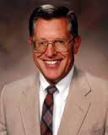
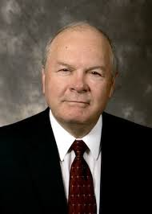
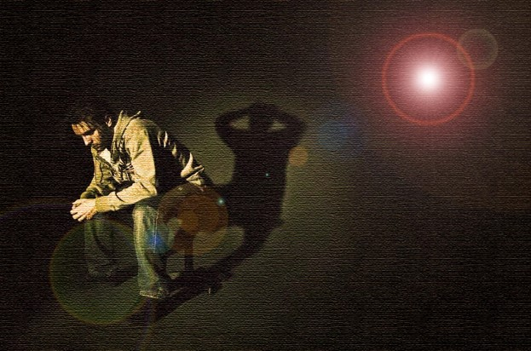
Truth Offends the Wicked
“The guilty taketh the truth to be hard, for it cutteth them to the very center”
“…the righteous rejoice in the word of God, while the wicked are offended with it…
Those who leave the Church, clothed in deeds of darkness, find it difficult to leave the Church alone.
All to often they are found attempting to expose the Church or demean its doctrines…for they realize that if the Church is true they are servants of darkness and must needs repent.”
--Joseph Fielding McConkie and Robert L. Millet
1 Nephi 16:1-3

Slide 4
“The prophet tells us what we need to know, not always what we want to know…How we respond to the words of a living prophet when he tells what we need to know, but would rather not hear, is a test of our faithfulness.”
Ezra Taft Benson
1 Nephi 16:1-3

Slide 5
Nephi’s Advise to His Brothers
Nephi’s brothers would not murmur if they would:
Hearken to the truth
Give heed unto the truth
Walk uprightly before God
Nephi exhorts his brothers to:
Keep the commandments
לא יהיה לך אלוקים אחר על פני
Nephi has great hopes that they would:
Walk in the paths of righteousness
1 Nephi 16:4-5

Slide 6
Zorum
He was employed by Laban and held the keys of the treasury
He was a descendant of Joseph who was the keeper of the records in Jerusalem
He was recruited by Nephi to join Lehi in the wilderness and Nephi promised to spare his life and grant him freedom
He married the eldest daughter of Ishmael
When the aging Lehi gave his blessings to his sons, he also gave Zorum a blessing of prosperity to him and his children if he would keep all the commandments
When Nephi separated from Laman and Lemuel in the Promised Land Zorum went with Nephi
Through the years some of the generations of Zorum detached themselves spiritually and sought worldly pursuits and went with the Lamanites
It is not clear if the name Zoramites belonged to the descendants of Zorum
Who’s Who in the Book of Mormon

Slide 7
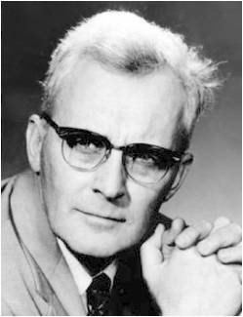
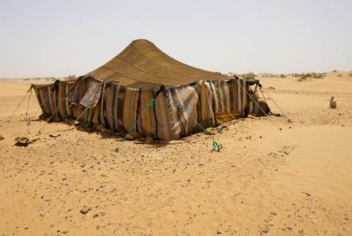
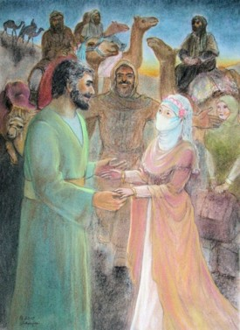
In the Valley of Lemuel
My father dwelt in a tent:
“…since Nephi himself finds the fact very significant and refers constantly to his father's tent as the center of his universe…
“Nephi serves notice that he had assumed the desert way of life...
“Nephi seems to think of his father's tent as the hub of everything, he is simply expressing the view of any normal Bedouin, to whom the tent of the sheikh is the sheet anchor of existence.
"It is most significant how Nephi speaks of his father's tent; it is the official center of all administration and authority. ”
Hugh W. Nibley
The family may have spent an entire season in this valley making preparations to continue their journey
Nephi records (30 years after his marriage) that he and his brothers took Ishmael’s daughters for their wives and also Zoram took the eldest daughter.
1 Nephi 16:6-12

Slide 8
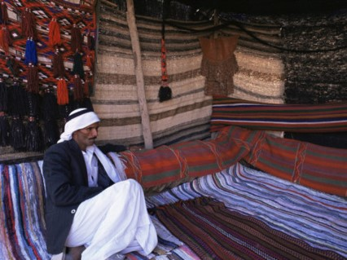
Councils in the Tent
The main activity in the sheikh's tent is always the same. It is talk. In every Arab tribe the sheikh's tent is before all the place where the councils of the tribe are held; says Musil, "the tent of tryst.”
To make up for the long silence on the march—necessary to avoid undue thirstiness, "when they assemble under their tents, a very animated conversation is kept up among them without interruption.”
So it is the most natural thing in the world for Nephi after being out alone to return to the tent of his father and find his brothers there, "and they were disputing one with another concerning the things which my father had spoken unto them“ (1 Nephi 15:1—2).
And it was perfectly natural for him to join the discussion and win the day with a long and eloquent speech.
Interior of Bodouin tent
Hugh W. Nibley

Slide 9
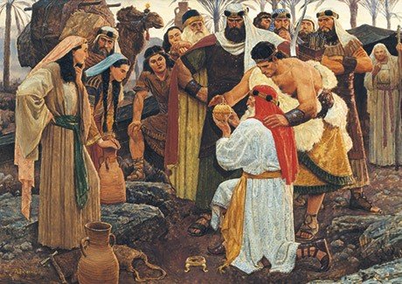
Our Mortal Journey and Trials
Why do you think righteous people, such as Lehi and Nephi, sometimes have to face trials?
Many trials we face are not necessarily consequences for wrong choices.
Rather, they are chances to learn and grow as part of our mortal journey.
What was given, from our Lord, to help Lehi and his family through their trials and to continue on their journey?
1 Nephi 16:9-10

Slide 10
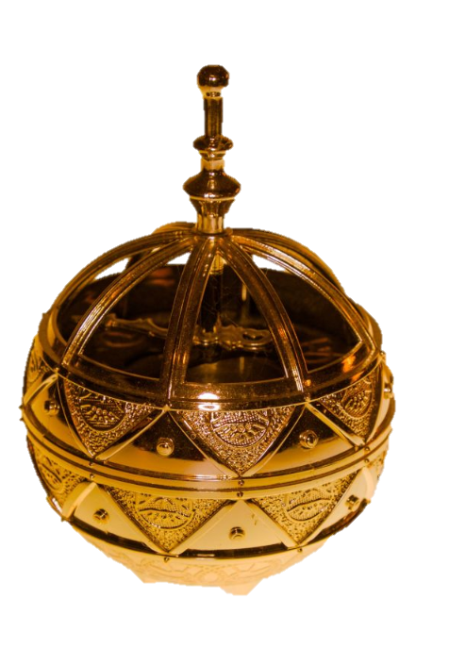
Ball of Curious Workmanship
“Curious”= skillful
Lehi and his family's compass to the Land of Promise
This compass is later identified by Alma 37:38
“And now, my son, I have somewhat to say concerning the thing which our fathers call a ball, or director--or our fathers called it Liahona, which is being interpreted, a compass; and the Lord prepared it.”
“Rather then identifying magnetic north, if pointed the direction that they should travel; at times writing would appear, giving directions or appropriate reproval for sin.”
Joseph Fielding McConkie and Robert L. Millet
1 Nephi 16:9-10

Slide 11
Liahona = Holy Ghost
1 Nephi 16:10
1 Nephi 16:15–16
1 Nephi 16:18–20, 25–27
1 Nephi 16:28
1 Nephi 16:29
1 Nephi 18:8–13, 21–22
Alma 37:38–42
One pointed the way whither we should go
We did follow the direction of the ball
Look upon the ball and behold which things are written
They did work accoding to the faith and diligence
By small things the Lord can bring about great things
After they had loosed me, behold, I took the compass, and it did work whither I desired it.
It did work for them according to their faith in God

Slide 12
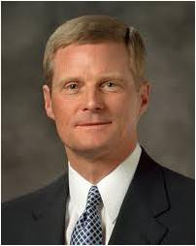
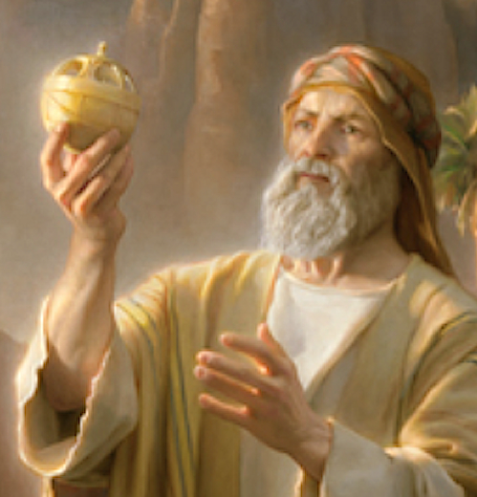
Just as Lehi was blessed in ancient times, each of us in this day has been given a spiritual compass that can direct and instruct us during our mortal journey. …
As we each press forward along the pathway of life, we receive direction from the Holy Ghost just as Lehi was directed through the Liahona. …
The Holy Ghost operates in our lives precisely as the Liahona did for Lehi and his family, according to our faith and diligence and heed.
David A. Bednar

Slide 13
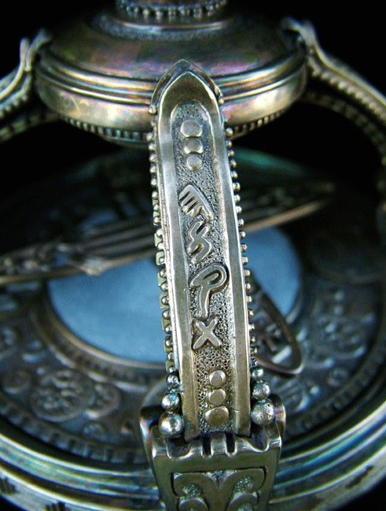
A Reflection of Their Faith
The Liahona provide direction only as they were faithful and obedient
“And it did work for them according to their faith in God; therefore , if they had faith to believe that God could cause that those spindles should point the way they should go, behold, it was done: therefore they had this miracle…” (Alma 37:40)
As we listen to the promptings of the Holy Ghost, the Lord can guide us in our journey through life; the Holy Ghost works in our lives according to the faith, diligence, and heed we give it; and the Holy Ghost gives us understanding concerning the ways of the Lord.
1 Nephi 16:9-10

Slide 14
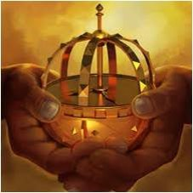
Our Own Liahona
The Lord gave to every person, a conscience which tells him every time he starts to go on the wrong path.
He is always told, if he is listening: but people can, of course, become so used to hearing the messages that they ignore them until finally they do not register anymore.

Slide 15
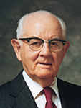
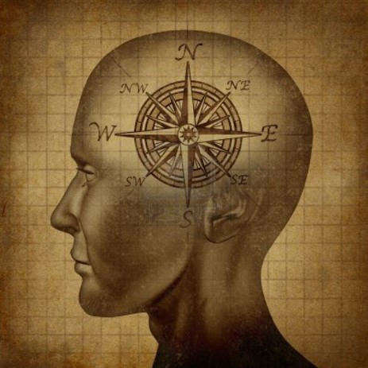
Knowing Good From Evil
“You have something like the Liahona in your own system.
Every child is given this consciences. When he is 8 years of age, he knows good from evil, if his parents have been teaching him well.
If he ignores the Liahona that he has in his own makeup, he eventually may not have it whispering to him.
But if we will remember that everyone of us has the thing that will direct him aright, our ship will not get on the wrong course…if we listen to the dictates of our own Liahona, which we call the conscience.”
Spencer W. Kimball

Slide 16
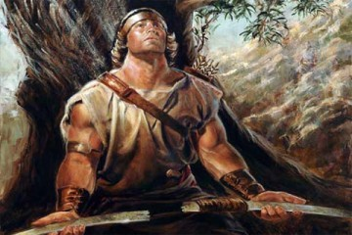
The Broken Bow
How did Lehi’s family react to Nephi’s broken bow?
Read: 1 Nephi 16:20–22
What was Nephi’s response to this trial and how his response affected his family?
Read 1 Nephi 16:23–25, 30–32

Slide 17
If We Do All We Can Do
The Lord will help us through our difficulties
Do we casually follow the Lord’s direction?
Or Do we follow the Lord’s direction with faith and obedience?
Showing the way By Small Means
Read: 1 Nephi 16:29 (bring about great things)
Alma 37:6–7 (brought about His great and eternal purposes)
Alma 37:38–41 (showed marvelous works)

Slide 18
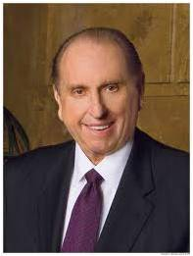
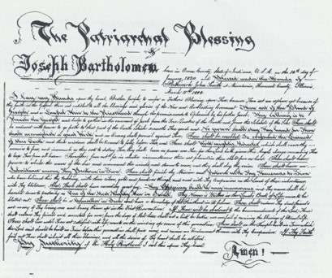
The Patriarchal Blessing
“The same Lord who provided a Liahona for Lehi provides for you and for me today a rare and valuable gift to give direction to our lives, to mark the hazards to our safety, and to chart the way, even safe passage—not to a promised land, but to our heavenly home. The gift to which I refer is known as your patriarchal blessing. …
“… Your blessing is not to be folded neatly and tucked away. It is not to be framed or published. Rather, it is to be read. It is to be loved. It is to be followed. Your patriarchal blessing will see you through the darkest night. It will guide you through life’s dangers. … Your patriarchal blessing is to you a personal Liahona to chart your course and guide your way.”
Thomas S. Monson

Slide 19
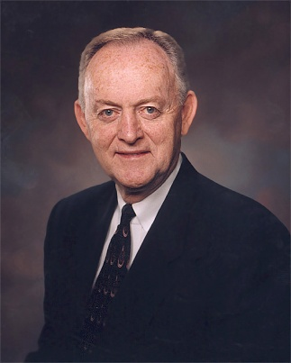
“The words of Christ can be a personal Liahona for each of us, showing us the way. Let us not be slothful because of the easiness of the way. Let us in faith take the words of Christ into our minds and into our hearts as they are recorded in sacred scripture and as they are uttered by living prophets, seers, and revelators.
Let us with faith and diligence feast upon the words of Christ, for the words of Christ will be our spiritual Liahona telling us all things what we should do.”
Elder W. Rolfe Kerr

Slide 20
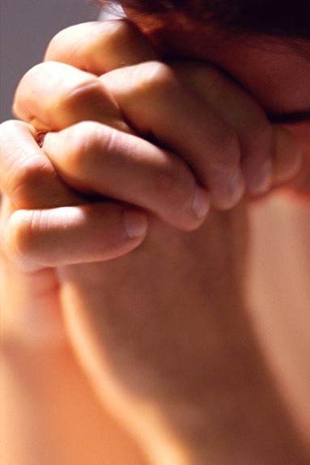
The Holy Ghost
“As we strive to align our attitudes and actions with righteousness, then the Holy Ghost becomes for us today what the Liahona was for Lehi and his family in their day.
The very factors that caused the Liahona to work for Lehi will likewise invite the Holy Ghost into our lives.
And the very factors that caused the Liahona not to work anciently will likewise cause us to withdraw ourselves from the Holy Ghost today.”
Elder David A. Bednar

Slide 21
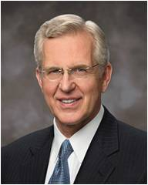
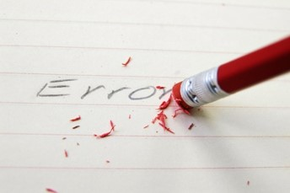
Is it Worth the Time?
“Though it is often difficult to endure, truly we ought to rejoice that God considers us worth the time and trouble to correct. …
“… If we are open to it, needed correction will come in many forms and from many sources. It may come in the course of our prayers as God speaks to our mind and heart through the Holy Ghost .
It may come in the form of prayers that are answered no or differently than we had expected. Chastening may come as we study the scriptures and are reminded of deficiencies, disobedience, or simply matters neglected.
“Correction can come through others, especially those who are God-inspired to promote our happiness.”
“Yea, behold, I will tell you in your mind and in your heart, by the Holy ghost, which shall come upon you and which shall dwell in your heart. “ (D&C 8:2)
Elder D. Todd Christofferson

Slide 22
Sources:
Who’s Who in the Book of Mormon by Ed J. Pinegar and Richard J. Allen p. 200
Joseph Fielding McConkie and Robert L. Millet “Doctrinal Commentary on the Book of Mormon” pg 122. Liahona pg 124
Ezra Taft Benson (BYU Speeches of the Year. Pg 26-30)
Hugh W. Nibley Appendix: Echoes and Evidences from the Writings of Hugh Nibley and Man Versus Man Provo, Utah: Maxwell Institute
Spencer W. Kimball Conference Report Oct. 1976
Thomas S. Monson “Your Patriarchal Blessing:
A Liahona of Light,” Ensign, Nov. 1986
Elder W. Rolfe Kerr (“The Words of Christ—Our Spiritual Liahona,”
Ensign or Liahona, May 2004
Elder David A. Bednar, “That We May Always Have His Spirit to Be with Us,” Ensign or Liahona, May 2006, 30–31
Be with Us,” Ensign or Liahona, May 2006
Elder D. Todd Christofferson (“As Many as I Love, I Rebuke and Chasten,” Ensign or Liahona, May 2011
Presentation by ©http://fashionsbylynda.com/blog/

Slide 23
Abraham 1 Nephi 16:6:
"Nephi...refers constantly to his father's tent as the center of his universe. To an Arab, 'My father dwelt in a tent' says everything....
"So with the announcement that his father dwelt in a tent, Nephi serves notice that he had assumed the desert way of life, as perforce he must for his journey: any easterner would appreciate the significance and importance of the statement, which to us seems almost trivial. If Nephi seems to think of his father's tent as the hub of everything, he is simply expressing the view of any normal Bedouin (Arabian tent dweller)." Hugh Nibley (Lehi in the Desert and The World of the Jaredites, pp. 57-8)
The Space of Four Days 1 Nephi 16:13:
"As to the direction taken by Lehi's party the Book of Mormon is clear and specific. He took what we now know to have been the only possible way out, what with immediate danger threatening from the north, and the eastern and western lands held by opposing powers on the verge of war. Only the south desert, the one land where Israel's traders and merchants had felt at home through the centuries, remained open--even after Jerusalem fell this was so. And the one route into that desert was the great trade-road down the burning trough of the Arabah. For a long time the party traveled south-southeast and then struck out almost due east over a particularly terrible desert and reached the sea at a point to be considered later. Nephi is careful to keep us informed of the main bearing of every stage of the journey, and never once does he mention a westerly or a northerly trend. The party traveled for eight years in but two main directions, without retracing their steps or doubling back, and many of their marches were long forced marches."
"All this entirely excludes the Sinaitic Peninsula as the scene of their wanderings, and fits perfectly with a journey through the Arabian Peninsula. The slowest possible march "in a south-southeasterly direction" in Sinai would reach the sea and have to turn north within ten days; yet Lehi's people traveled "for many days," nay, months, in a south-southeasterly direction, keeping near the coast of the Red Sea all the while. Ten days take a foot traveler the entire length of that coast of Sinai which runs in a south-southeasterly direction--and what of the rest of the eight years?" (Lehi in the Desert and The World of the Jaredites, pp. 54-5)
Daughters of Ishmael 1 Nephi 16:7:
"Marriages in the Valley of Lemuel. Ishmael and his family were brought down from Jerusalem by Nephi and his brothers, according to a divine command. (1 Ne. 7:2) Marriage for the purpose of raising up posterity 'unto the Lord' was enjoined upon them as a sacred duty.
"Ishmael had five daughters and two sons. During the journey from Jerusalem to the Valley of Lemuel, Laman and Lemuel opposed Nephi. They even bound him and plotted his death. Two of the daughters of Ishmael sided with Laman and his supporters. One daughter of Ishmael stood up valiantly for Nephi, and plead so sincerely for his righteous cause that he was set free. (1 Nephi 7:19) Thus a line of cleavage was already drawn. In all probability, the two girls who had sided with Laman and Lemuel became their wives, while the valiant little girl, possibly the youngest of them, joined her hero in the sacred relationship contemplated. There were two girls left. Zoram, the servant of Laban, married the oldest daughter, and Sam presumably the remaining girl." (Reynolds and Sjodahl, Commentary on the Book of Mormon, vol. 1, p. 165)
The Steel Bow 1 Nephi 16:17:
"Through the years critics of the Book of Mormon have constantly called attention to the mention of steel in that book as a gross anachronism. But now we are being reminded that one cannot be dogmatic in dating the appearance of steel since there is more than one kind of steel with 'a whole series of variants in the combination of iron and steel components' in ancient times; and when a particularly fine combination was hit upon it would be kept secret in 'individual workshops' and 'passed on from father to son for many generations.' Hence it is not too surprising to learn that 'even in early European times' there is evidence for the production of steel 'of very high quality' and extreme hardness. Further east steel is attested even earlier." (Since Cumorah, p. 254)

Slide 24
Easy VS Difficult
1 Nephi 17

Slide 25
Do you find your life easy or difficult?
1 Nephi 17:2, 3, 5
1 Nephi 17:1, 4, 6
Means were provided, raw meat
Women had plenty of suck (milk for their babies)
Children were strong and kept commandments
No murmurings
Much fruit and honey prepared by the Lord
Wade through much affliction
8 years in the wilderness
Suffered many afflictions and much difficulty
If we keep the commandments, then the Lord will strengthen us and provide means for us to accomplish that which He has commanded

Slide 26
The Land Bountiful
Pitch their tents
Nephi is commanded to go into the Mountains
Nephi is commanded to build a ship
Brothers mock Nephi and complain and refuse to help
Nephi rebukes them for wickedness then exhorts them to repent
Nephi teaches them
1 Nephi 17:6-7

Slide 27
Mountains
The instruction for Nephi was to go into the mountain so the Lord could speak to him.
Mountains are nature’s temples and frequently used as such by prophets and righteous men when a temple is not available.
Nephi went seeking the Lord
Many people are willing to respond to the commandments of the Lord, but few actively inquire as to how they might serve.
1 Nephi 17:7

Slide 28
“Nephi was not a sailor. He had been reared in Jerusalem, an inland city, rather than along the borders of the Mediterranean Sea.
It seems unlikely that he knew much about or had experience with the tools and skills necessary to build a ship.
He may not have ever previously seen an oceangoing vessel.
In essence, then, Nephi was commanded and instructed to build something he had never built before in order to go someplace he had never been before.”
David A. Bednar

Slide 29
The Lord Makes Things Easier
“For the Lord had not hitherto suffered that we should make much fire, as we journeyed in the wilderness; for he said: I will make thy food become sweet, that ye cook it not;
When we are close to Jesus Christ, we can feel love and gratitude for Him even during difficult times.
…And I will also be your light in the wilderness; and I will prepare the way before you, if it so be that ye shall keep my commandments; wherefore, inasmuch as ye shall keep my commandments ye shall be led towards the promised land; and ye shall know that it is by me that ye are led.”
1 Nephi 17:12-13

Slide 30
Doing Tasks For Ourselves
Nephi was given a revealed blueprint for the construction of his ship.
Moses was given a pattern in Sinai to be followed in making the tabernacle that Israel was to take with them into the wilderness (Exodus 25:40)
Joseph Smith was given a pattern for the laying out of the city Zion, for the building of various building, and for the building of the temple (D&C 94:2)
The Lord will not do for us that which we can do for ourselves.
Blueprint
1 Nephi 17: 8-16

Slide 31
Strengthen Us
If we keep the commandments, then the Lord will strengthen us and provide means for us to accomplish that which He has commanded.
If we keep the commandments, then the Lord will strengthen us and provide means for us to accomplish that which He has commanded.
1. What did the Lord command Nephi to do? (1 Nephi 17:7−8)
How did Nephi respond? (1 Nephi 17:9−11, 15−16)
How did his brothers respond? (1 Nephi 17:17−21)
2. How did the Lord help Moses accomplish the task he was commanded to do? (1 Nephi 17:23−29)
3. How were Nephi’s brothers like the children of Israel? (1 Nephi 17:30, 42)
4. What has the Lord commanded that may be difficult for me?
5. How can I respond like Nephi and Moses? How can I avoid the mistakes of Nephi’s brothers and the children of Israel?

Slide 32
Difficult Tasks
Although God has not asked us to accomplish tasks like building a ship or parting the Red Sea, He has given commandments and asked us to accomplish things that some people find difficult.
Examples:
He has commanded us to maintain virtuous thoughts
Keep the Sabbath day holy
Expects us to fulfill Church callings
Expects us to serve others
Expects us to keep our covenants
Expects us to stay active in the Church even in the face of challenges

Slide 33
Rebuke
shock = “to cause to shake or tremble.”)
The shock the Lord gave Laman and Lemuel was just one of many ways the Lord had communicated with them.
Other Communications from the Lord:
Visited by an angel and spoken to
Hearing a voice from time to time
Spoken in a still small voice
Spoken to them in the voice of thunder
Caused the earth to shake
When we choose to sin, it becomes more difficult to feel and recognize the voice of the Lord
1 Nephi 17:45

Slide 34
Strengthen Us
The Holy Ghost speaks with a still, small voice that we feel more than we hear.
If we keep the commandments, then the Lord will strengthen us and provide means for us to accomplish that which He has commanded.
“The Holy Ghost speaks with a voice that you feel more than you hear. It is described as a ‘still small voice’ [D&C 85:6].
And while we speak of ‘listening’ to the whisperings of the Spirit, most often one describes a spiritual prompting by saying, ‘I had a feeling …’”
Boyd K. Packer

Slide 35
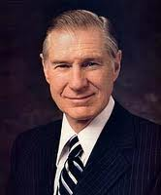
Past Feeling
“Cellular phones are used for much of the communication in our time.
Occasionally, however, we find dead spots where the signal coming to a cell phone fails. This can happen when the cell phone user is in a tunnel or a canyon or when there is other interference.
“So it is with divine communication. …
We often put ourselves in spiritual dead spots—places and situations that block out divine messages. Some of these dead spots include anger, pornography, transgression, selfishness, and other situations that offend the Spirit.”
1
2
3
4
5
6
7
8
9
0
Spiritual Dead Spots are preventing you from receiving such communications
James E. Faust

Slide 36
A Need for Repentance
“A … requirement for frequent companionship and direction from the Holy Ghost is to be clean. The Spirit must withdraw from those who are not clean. …
“… If you have difficulty in feeling the Holy Ghost, you might wisely ponder whether there is anything for which you need to repent and receive forgiveness.
“If you have felt the influence of the Holy Ghost today, you may take it as evidence that the Atonement is working in your life. For that reason and many others, you would do well to put yourself in places and in tasks that invite the promptings of the Holy Ghost.
Feeling the influence of the Holy Ghost works both ways: the Holy Ghost only dwells in a clean temple, and the reception of the Holy Ghost cleanses us through the Atonement of Jesus Christ.
You can pray with faith to know what to do to be cleansed and thus qualified for the companionship of the Holy Ghost and the service of the Lord. And with that companionship you will be strengthened against temptation and empowered to detect deception.”
1 Nephi 17:45
Henry B. Eyring

Slide 37
Sources:
David A. Bednar (“Learning to Love Learning” [Brigham Young University commencement address, Apr. 24, 2008], 4, speeches.byu.edu).
Boyd K. Packer (“Personal Revelation: The Gift, the Test, and the Promise,” --Ensign, Nov. 1994, 60).
James E. Faust(“Did You Get the Right Message?” Ensign or Liahona, May 2004, 67).
Henry B. Eyring (“Gifts of the Spirit for Hard Times,” Ensign, June 2007, 23).
Dallin H. Oaks, “Opposition in All Things,” Ensign or Liahona, May 2016, 117.
Presentation by ©http://fashionsbylynda.com/blog/

Slide 38
1 Nephi 18

Slide 39
An Act of Faith
If we pray often unto the Lord, we can receive the specific guidance we need
In order to accomplish what the Lord commands, we need to seek His help and put forth our own effort
“Not at any time have I given unto you a law which was temporal; neither any man, nor the children of men; neither Adam your father, whom I created.” D&C 1:28
1 Nephi 18:1-8

Slide 40
Preparation and Guidance
Preparation:
Work timbers
The Lord’s assistance:
Show from time to time
“They could not trust their temporal salvation to a ship made after the worldly manner, neither can we find our way to eternity through the world. Our trust cannot be in the ‘arm of flesh.’” D&C 1:19
“…and blessed from on high, and receive knowledge from time to time.”(D&C 1:28)
1 Nephi 18:1-2

Slide 41
Pray Often
“Pray always…not to perform any thing unto the Lord save in the first place ye shall pray unto the Father in the name of Christ:
(2 Nephi 32:9)
The mount…A place of prayer and revelation.
“And upon the wings of his Spirit hath my body been carried away upon exceedingly high mountain…” (2 Nephi 4:25)
1 Nephi 18:3

Slide 42
Humble For A Moment
Once more Nephi’s brother humbled themselves and assumed the spirit of unity, yet only for a moment
1 Nephi 18:4

Slide 43
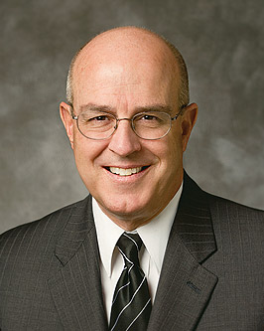
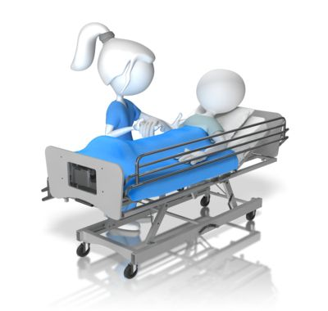
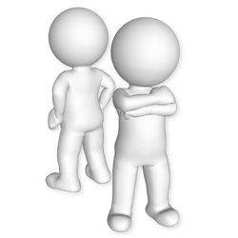
Rebellion Because of Burdens
“Some burdens are the natural product of the conditions of the world in which we live. Illness, physical disability, hurricanes, and earthquakes come from time to time through no fault of our own. …
Other burdens are imposed on us by the misconduct of others. Abuse and addictions can make home anything but a heaven on earth for innocent family members. Sin, incorrect traditions, repression, and crime scatter burdened victims along the pathways of life. …
Our own mistakes and shortcomings produce many of our problems and can place heavy burdens on our own shoulders. The most onerous burden we impose upon ourselves is the burden of sin.”
1 Nephi 18:9-12
Elder L. Whitney Clayton

Slide 44
Burdens
Conditions of the World
Our own mistakes and shortcomings
Misconduct of others
During the voyage, Laman, Lemuel and others made poor choices that resulted in hardship for everyone on the ship.
What poor choices do we make to cause hardship in our own families and at home?

Slide 45
Why would God allow Laman and Lemuel to cause such suffering?
God rarely infringes on the agency of any of His children by intervening against some for the relief of others. But He does ease the burdens of our afflictions and strengthen us to bear them. …
He does not prevent all disasters, but He does answer our prayers to turn them aside … or blunt their effects. …
Through all mortal opposition, we have God’s assurance that He will “consecrate [our] afflictions for [our] gain”. Dallin H. Oaks
In no way should this be interpreted to mean that Heavenly Father is indifferent toward our suffering, especially when it comes to abuse.
1 Nephi 18:17-19; 2 Nephi 2:2

Slide 46
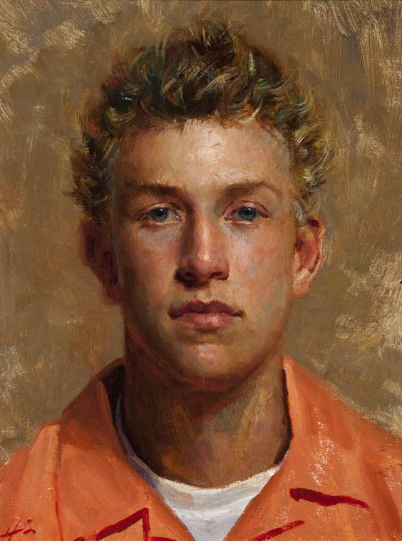
The Lord expects us to do everything we can to prevent abuse and to protect and help victims.
No one is expected to endure abusive behavior.
Reports of abuse should never be dismissed.
Everyone should respond with compassion and sensitivity toward victims and their families.
Those affected by abuse need to be heard and supported.
Jeff Hein
Elspeth C. Young
1 Nephi 18:17-19; 2 Nephi 2:2

Slide 47
Nephi Fears
“Nephi properly feared that the protective blessings of heaven would be withdrawn because of the vulgar and ribald (vulgar) behavior of Laman, Lemuel, Ishmael’s sons, and their wives.
Coarse behavior is not attractive to the spirit, and when the Spirit withdraws it is natural to expect the protective blessings of heaven to withdraw also.”
Joseph Fielding McConkie and
Robert L Millet
1 Nephi 18:9-10

Slide 48
Music — Good or Bad?
What would you do if a family member or Church leader asked you to change the music you listen to, the way you dance, or the way you speak?
What are you willing to change?
“…Music can, by its tempo, by its beat, by its intensity, dull the spiritual sensitivity of people…Be selective in what you consume and what you produce. It becomes a part of you.
…Young people, you cannot afford to fill your mind with the unworthy hard music of our day…”
Boyd K. Packer
1 Nephi 18:9 “They began to dance, and to sing, and to speak with much rudeness”
Rudeness = being vulgar or coarse. Vulgar and course dancing, music, and speech are offensive to the Lord and result in losing the companionship of the Holy Ghost.

Slide 49
“How you communicate should reflect who you are as a son or daughter of God. Clean and intelligent language is evidence of a bright and wholesome mind. Good language that uplifts, encourages, and compliments others invites the Spirit to be with you. Our words, like our deeds, should be filled with faith, hope, and charity. …
“Choose carefully the music you listen to.
Pay attention to how you feel when you are listening. Some music can carry evil and destructive messages.
Do not listen to music that encourages immorality or glorifies violence through its lyrics, beat, or intensity.
Do not listen to music that uses vulgar or offensive language or promotes evil practices. Such music can dull your spiritual sensitivity. …
“Attend only those dances where dress, grooming, lighting, lyrics, music, and entertainment contribute to a wholesome atmosphere where the Spirit may be present.”
For the Strength of the Youth Booklet

Slide 50
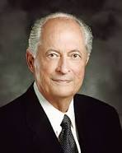
When we fear the Lord’s judgments more than the judgments of others, we can have the courage to confront unrighteous behavior
Courage
“To respond in a Christlike way cannot be scripted or based on a formula. The Savior responded differently in every situation. When He was confronted by wicked King Herod, He remained silent. When He stood before Pilate, He bore a simple and powerful testimony of His divinity and purpose.
Facing the moneychangers who were defiling the temple, He exercised His divine responsibility to preserve and protect that which was sacred. Lifted up upon a cross, He uttered the incomparable Christian response:
‘Father, forgive them; for they know not what they do’ (Luke 23:34). …
“As we respond to others, each circumstance will be different. … As true disciples seek guidance from the Spirit, they receive inspiration tailored to each encounter. And in every encounter, true disciples respond in ways that invite the Spirit of the Lord.”
Robert D. Hales

Slide 51
Rebellious Acts Effects All
Sin leads to suffering for ourselves and sometimes for others as well.
“No redeeming qualities were evident in the repentance of Laman and Lemuel. The pleading of their parents was of no avail, the sorrow of their younger brothers did not affect them, nor did the tears of Nephi’s wife soften their hearts.
Only the threat of death or personal suffering could get them to free Nephi and desist from their course of wickedness.”
Joseph Fielding McConkie and
Robert L. Millet
1 Nephi 18:11-21

Slide 52
When We Face Trials
“No matter the burdens we face in life as a consequence of natural conditions, the misconduct of others, or our own mistakes and shortcomings, we are all children of a loving Heavenly Father, who sent us to earth as part of His eternal plan for our growth and progress. Our unique individual experiences can help us prepare to return to Him. … We must do everything we can to bear our burdens ‘well’ [see D&C 121:7–8]. …
“… I know that as we keep the commandments of God and our covenants, He helps us with our burdens. He strengthens us. When we repent, He forgives us and blesses us with peace of conscience and joy.”
We can choose to look to God and remain faithful during our trials
L. Whiney Clayton

Slide 53
Sources:
Elder L. Whitney Clayton (“That Your Burdens May Be Light,” Ensign or Liahona, Nov. 2009, 12–13).
Joseph Fielding McConkie and Robert L Millet Doctrinal Commentary on the book of Mormon Vol. 1 p 142-143
Boyd K. Packer (Inspiring Music—Worthy Thoughts) Ensign Jan. 1974
(For the Strength of Youth [booklet, 2011], 20, 22, 23).
Robert D. Hales, “Christian Courage: The Price of Discipleship,” Ensign or Liahona, Nov. 2008, 72–73).
Dallin H. Oaks, “Opposition in All Things,” Ensign or Liahona, May 2016, 117
Gospel Topics, “Abuse,” topics.ChurchofJesusChrist.org
Presentation by ©http://fashionsbylynda.com/blog/

Slide 54
Faith means trusting God in good times and bad, even if that includes some suffering until we see His arm revealed in our behalf. That can be difficult in our modern world when many have come to believe that the highest good in life is to avoid all suffering, that no one should ever anguish over anything. But that belief will never lead us to “the measure of the stature of the fulness of Christ” [Ephesians 4:13]. (Jeffrey R. Holland, “Waiting on the Lord,” Ensign or Liahona, Nov. 2020, 116)
Similarities | Nephi | Jesus Christ
Favored son | 1 Nephi 3:6, 8 | Matthew 3:17
Hated and rejected by his brothers | 1 Nephi 18:10 | John 7:5; 15:24–25
Bound by the wicked | 1 Nephi 18:11 | Matthew 27:2
Rejected as the rightful ruler | 1 Nephi 18:10 | John 19:15
Willingly suffered | 1 Nephi 18:11, 16 | Luke 22:42
Glorified God in his suffering | 1 Nephi 18:16 | Doctrine and Covenants 19:19
Family dependent upon him overcoming | 1 Nephi 18:20–22 | 2 Nephi 9:6–9
Saved all from death | 1 Nephi 18:22–23 | 1 Corinthians 15:22
My dear brothers and sisters, the joy we feel has little to do with the circumstances of our lives and everything to do with the focus of our lives.
When the focus of our lives is on God’s plan of salvation … and Jesus Christ and His gospel, we can feel joy regardless of what is happening—or not happening—in our lives. (Russell M. Nelson, “Joy and Spiritual Survival,” Ensign or Liahona, Nov. 2016, 82)

Slide 55
The Large Plates of Nephi
The Small Plates of Nephi
The Prophets of Old
1 Nephi 17

Slide 56
A Historical Record—The Other Plates
The Record of Nephi’s People
Record of His Father
and their journey into the wilderness (1 Nephi 19:2)
Genealogies of Lehi’s fathers (1 Nephi 19:2)
To be handed down from one generation to another, or from one prophet to another (1 Nephi 19:4)
Reign of kings, and wars, contentions, and destruction (1 Nephi 9:4)
Kept by kings to be handed down
Secular History--Abridged by Mormon
Books of Mosiah, Alma, Helaman, 3 Nephi, and 4 Nephi
The Large Plates of Nephi
1 Nephi 19:1-6

Slide 57
Keeping A Sacred Record—These Plates
Plain and Precious parts. Also Instructs Jacob to engrave most precious, sacred things (Jacob 1:1-2,4) kept for the knowledge of Nephi’s people
Instructions for Nephi’s people--an account of ministry for the profit of his people (2 Nephi 5:30-32)
Other wise purposes-- known unto the Lord (1 Nephi 19:3)
Nephi abridges record of his father, their journey in the wilderness, his father’s prophecies
Nephi’s own prophecies (1 Nephi 19:1)
Upon these plates Nephi writes things of his soul and scriptures engraven on brass plates (2 Nephi 4:15)
Spiritual history of the Nephites
Books of 1 Nephi, 2 Nephi, Jacob, Enos, Jarom, and Omni
The Small Plates of Nephi
1 Nephi 19:1-6

Slide 58
Records Passed Down Through Generations
Nephi
Jacob
Brother of Nephi
Enos
Jacob’s Son
Jarom
Enos’s Son
The Small Plates of Nephi
Omni
Jarom’s Son
Amaron
Omni’s Son
Chemish
Amaron’s brother
Abinadom
Chemish’s Son
Amaleki
Abinadom’s Son
Boyd K. Packer

Slide 59
What Happened to the Small Plates?
Amaleki was the last to write on the small plates. “Having no seed, and knowing King Benjamin to be a just man before the Lord, wherefore, I shall deliver up these plates unto him” (Omni 1:25, 30)
“These plates are full.”
The Large Plates of Nephi
The Small Plates of Nephi
Benjamin, who was both prophet and king, “took (the small plates) and put them with the other (large plates), which contained records which had been handed down by the kings.” (Words of Mormon 1:10)
Boyd K. Packer

Slide 60
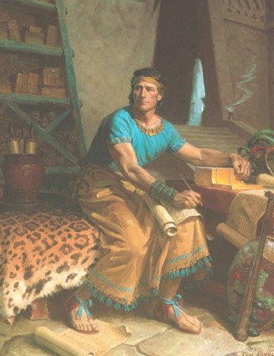
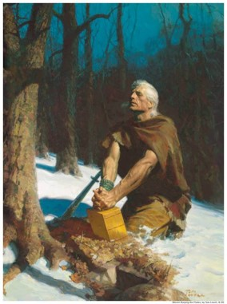
The Story Continues
“Mormon then found the small and large plates 400 years later.
When Mormon was a boy of ten, Ammaron (who had received the records from his brother Amos II) told him where they were hidden.
He instructed the boy: “When ye are about twenty and four years old…ye shall take the (large) plates of Nephi…and the remainder shall ye leave in the place where they are.” (Mormon 1:3-4)
“Mormon began to abridge the large plates. Being able to choose but a hundredth part. Mormon chose the better part of the small plates.
Mormon finished the abridgment and wrote of his last days. (Mormon 1-7)
“Mormon’s son, Moroni, finished his father’s record, then abridged the plates of the Jaredites. Then added his own book of Moroni.”
Boyd K. Packer

Slide 61
Naught and Trample
Naught—Nothing
To set someone at naught is to treat that person as if he or she is worthless.
The world is to reject Jesus by those in Jerusalem.
“His rejection as ‘a thing of naught’ by the world has been ongoing throughout all generations and is still widespread today.
Yet in spite of them, because He loves us Jesus is willing to atone for the sins of the very men who esteem Him, ‘to be a thing of naught.’
Jesus Christ allowed Himself to suffer and be crucified because of His loving-kindness and long-suffering for the children of men
REJECTED
Full atonement comes only for those who accept Him with full purpose of heart.”
1 Nephi 19:8
Student Manual 121-122

Slide 62
Prophets of The Old Testament
Zenock…Neum…Zenos
Nephi’s source for his remarkably detailed messianic prophecy include three prophets of the Old World whose words may have been among the “plain and precious things” excluded from the Old Testament record. Without the Book of Mormon, we would know nothing about these three prophets or their witnesses of Jesus Christ.
1 Nephi 19:8

Slide 63
Zenock
Hebrew prophet
His writings were included in the brass plates and were accessible to the Book of Mormon prophets.
He bore solemn witness of the mission of the Son of God (Alma 33:15)—that the Messiah would yield himself into the hands of wicked men to be crucified and would be the source of redemption for mankind (Alma 34:7)
He was of the lineage of Joseph
Prior to 600 BC when Lehi left Jerusalem.
The Zoramites describe Zenock as a martyr (Alma 33:17)
Stoned to death.
1 Nephi 19:10
Book of Mormon Who’s Who

Slide 64
Neum
Hebrew prophet
Quoted by Nephi in connection with the coming Atonement of the Savior
Nephi found reference to Neum (and other prophets) in the plates of brass
Predicted that all of them (the other prophets) predated the exodus of Lehi and his family from Jerusalem in 600 BC
Neum’s name is only in 1 Nephi 19:10
1 Nephi 19:10
Book of Mormon Who’s Who

Slide 65
Zenos
Hebrew prophet
He was of the lineage of Joseph
His writings were included in the brass plates and were accessible to the Book of Mormon prophets.
He prophesied that the Redeemer would be buried in a sepulchre after His crucifixion, and that three days of darkness would be experienced by those “who should inhabit the isles of the sea, more especially given unto those who are of the house of Israel”
He prophesied of widespread natural calamities that would occur at the time, with the result that “many of the kings of the isles of the sea shall be wrought upon by the spirit of God” (1 Nephi:19:12) While those in Jerusalem will be scourged and scattered for rejecting the Holy One of Israel
1 Nephi 19:10
Book of Mormon Who’s Who

Slide 66
Zenos
He prophesied when the House of Israel would turn their hearts again to the Savior, He would remember the covenants He had made with their fathers and “All the earth shall see the salvation of the Lord…” (1 Nephi 19:17)
Gave the Allegory of the Tame and Wild Olive Trees
(Jacob 5)
Alma quotes Zenos while teaching the Zoramites about the doctrine of prayer (Alma 33:3-11)
Amulek witnesses that Zenos taught “redemption cometh through the Son of God” (Alma 34:7)
Nephi, son of Helaman bearing witness about the mission of the Savior (Helaman 8:19)
Samuel cited Zenos in prophesying to the people that the Lamanites would one day be restored to a knowledge of the truths of the gospel (Helaman 15:11)
Next to Isaiah, the prophet Zenos is quoted in the Book of Mormon more extensively than any other of the ancient Hebrew prophets.
--Who’s Who
1 Nephi 19:10

Slide 67
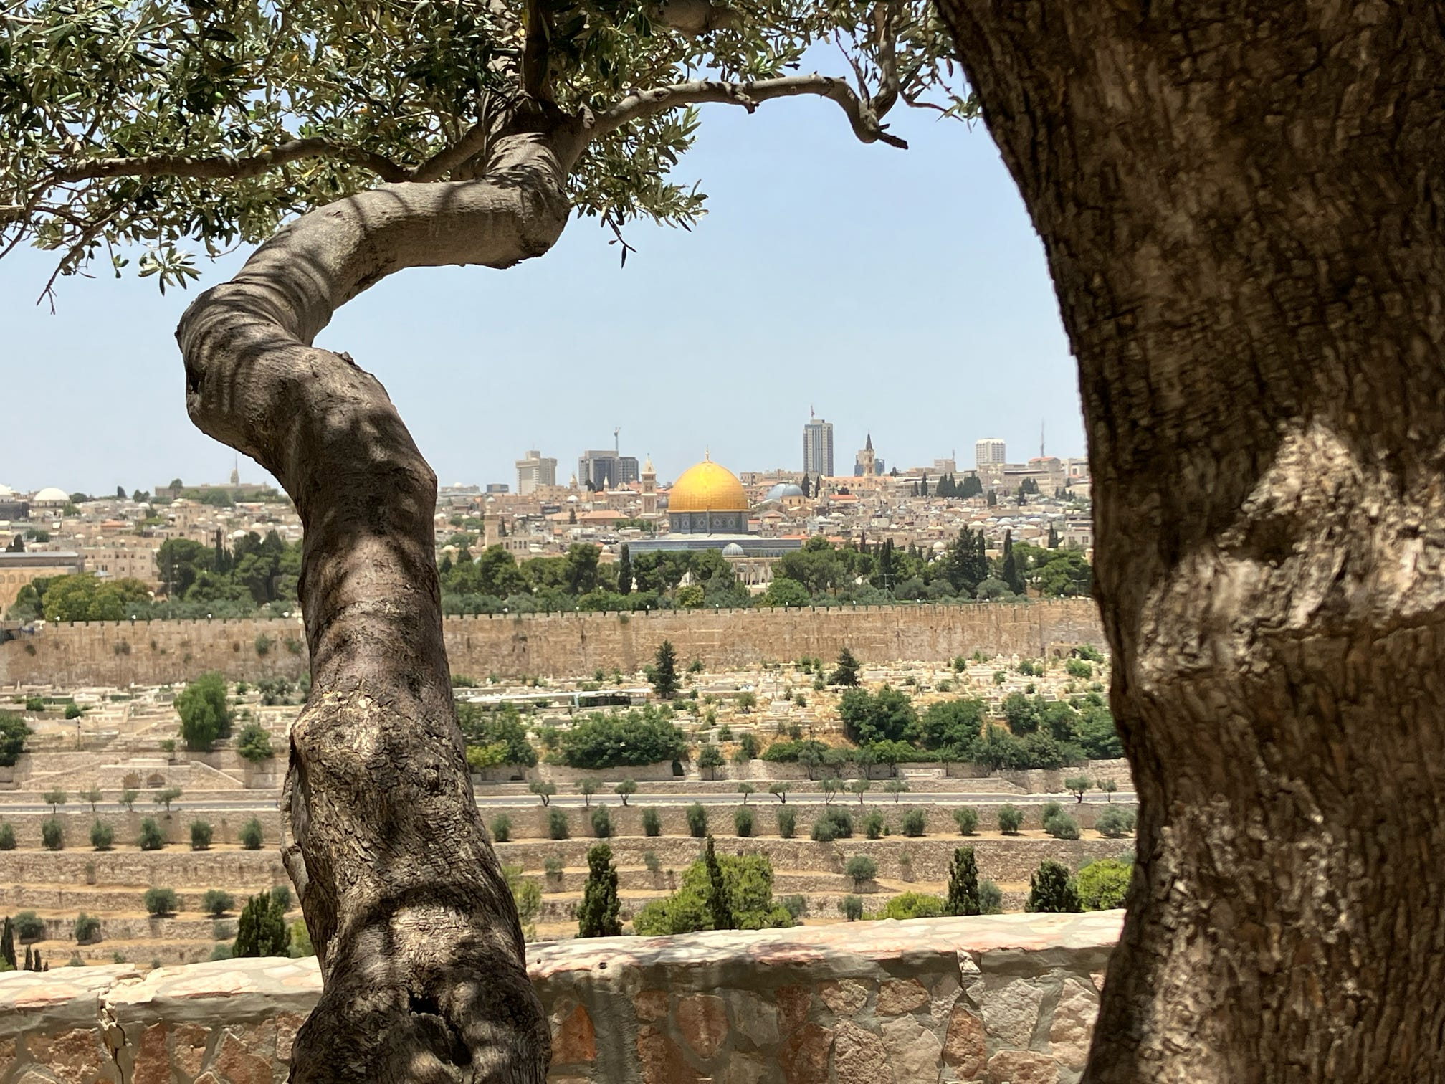
Turn Their Hearts Aside
What would be the consequences of someone turning their heart aside from the Lord?
What reason would the people crucify the Savior?
Why would their descendants be “scourged by all people”?
Example:
If you stop studying the scriptures, you diminish the ability to receive revelation
“Wander in the flesh”—Israel was scattered because they rejected the land of inheritance is a symbolic representation of eternal promises or everlasting inheritances that will yet be enjoyed by those who are true and faithful—those who keep their covenants.
To break those covenants is to forfeit the right or claim to their earthly counterpart. None have claim to such possessions, save it be in righteousness (Abraham 2:6)
What are the promises to those who turn their hearts back to Him?
1 Nephi 19:14

Slide 68
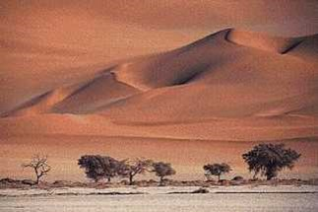
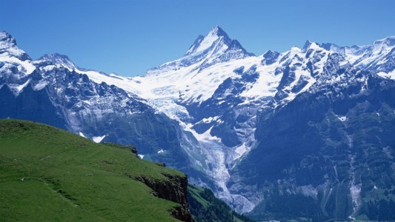
From the Four Quarters of the Earth
Zenos—
Foreshadow the future day when Israel, now scattered among every nation, kindred, tongue, and people, will embrace the faith of their righteous progenitors and thus have claim again to the promises made to them.
Prophecy
In that day when Israel remembers their God—that is accepts Jesus as the Christ—then He will remember them and the covenants which He made with their father. This spiritual gather must precede the temporal gathering.
--Joseph Fielding McConkie
and Robert L. Millet
1 Nephi 19:14

Slide 69
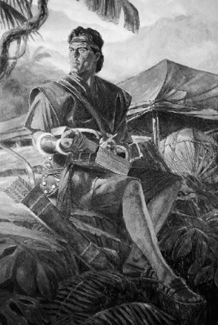
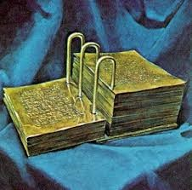
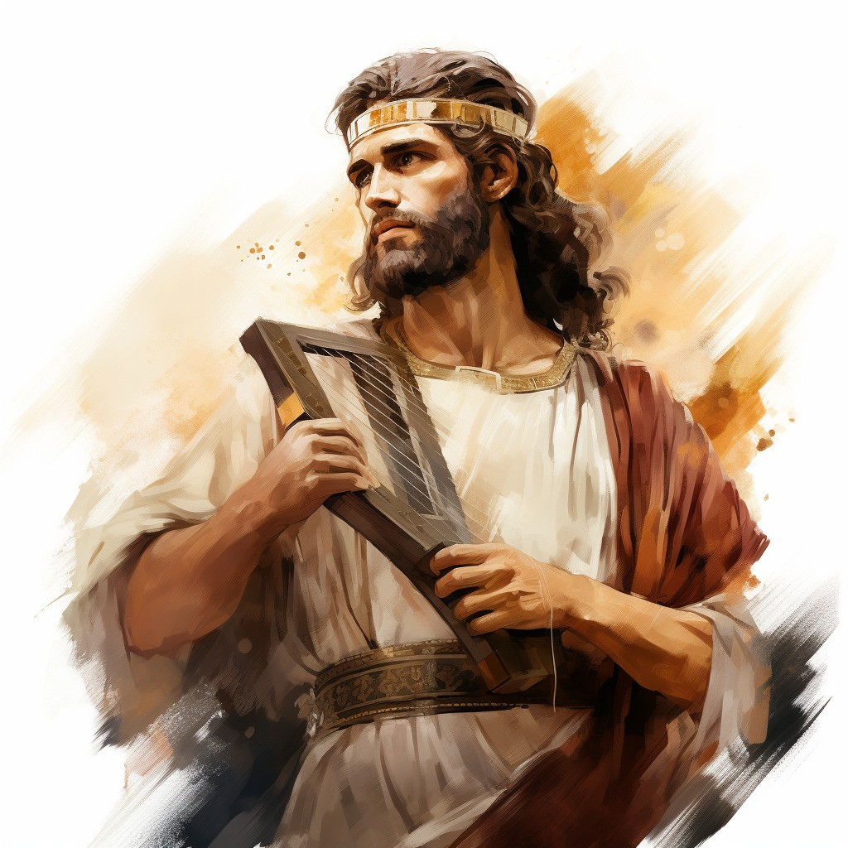
The Records For Our Day
Nephi intended his record for all members of the house of Israel
Including Us
“I write unto all the ends of the earth; yea unto you, twelve tribes of Israel”
(Mormon 3:18)
“All my joints are week”
The workings of the spirit
Alma becomes weak (Mosiah 27:17)
David said, “I am poured out like water, and all my bones are out of joint…”(Psalm 22:14)
Nephi knew in the depths of his soul that the Jews in Jerusalem had suffered the fate his father said they would.
1 Nephi 19:18-22

Slide 70
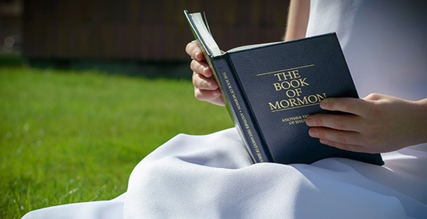
“I will make you this promise about reading the Book of Mormon: You will be drawn to it as you understand that the Lord has embedded in it His message to you. Nephi, Mormon, and Moroni knew that, and those who put it together put in messages for you. I hope you have confidence that the book was written for your students.
There are simple, direct messages for them that will tell them how to change.
That is what the book is about.
It is a testimony of the Lord Jesus Christ and the Atonement and how it may work in their lives. You will have an experience this year feeling the change that comes by the power of the Atonement because of studying this book.”
One reason the Book of Mormon was written was to persuade us to remember the Lord our Redeemer
Henry B. Eyring

Slide 71
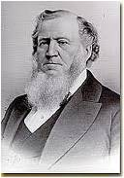
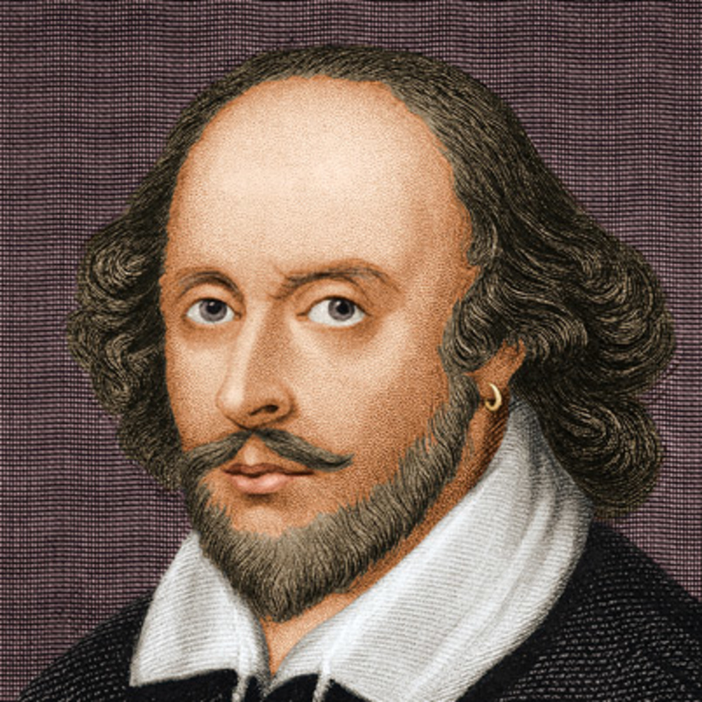
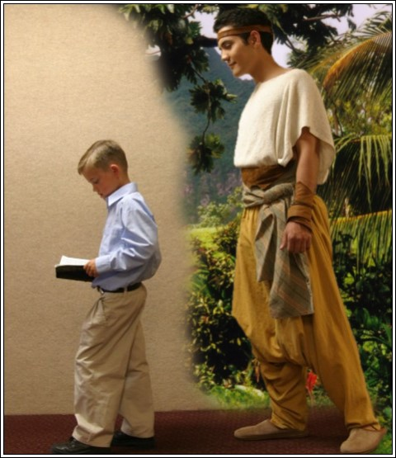
Liken the Scriptures
Repeating bad history:
“Those who fail to learn the lessons of history are doomed to repeat them”
--Shakespeare: “The past is prologue.”
“Do you read the Scriptures, my brethren and sisters, as though you were writing them?...do you read them as though you stood in the place of the men who wrote them? If you do not feel thus, it is your privilege to do so, that you may be as familiar with the spirit and meaning of the written word of God as you are with your daily walk and conversation, or as you are with your workmen or with your households.”
Brigham Young
As we liken the scriptures to ourselves, we will learn and profit from them
1 Nephi 19:21-24

Slide 72
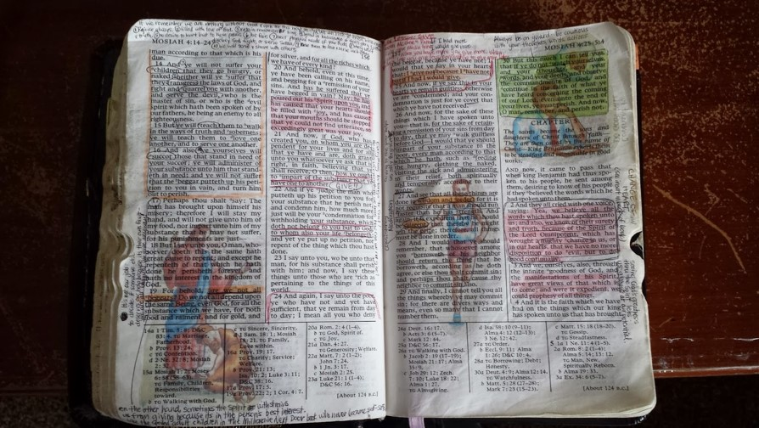
“The Book of Mormon was written for us today. God is the author of the book. It is a record of a fallen people, compiled by inspired men for our blessing. Those people never had the book—it was meant for us. Mormon, the ancient prophet after whom the book is named, abridged centuries of records. God, who knows the end from the beginning, told him what to include in his abridgment that we would need for our day.”
“If they saw our day, and chose those things which would be of greatest worth to us, is not that how we should study the Book of Mormon? We should constantly ask ourselves, ‘Why did the Lord inspire Mormon (or Moroni or Alma) to include that in his record? What lesson can I learn from that to help me live in this day and age?’”
Ezra Taft Benson

Slide 73
Sources:
Boyd K. Packer “Let Not Your Heart Be Troubled” pg. 271-276
Student Manual 121-122 Book of Mormon pg 52
Book of Mormon Who’s Who by E. J. Pinegar and Richard J. Allen pg 196-197
Joseph Fielding McConkie and Robert L. Millet Doctrinal Commentary of Book of Mormon Vol. 1 pg. 147-148
Brigham Young “Discourse of Brigham Young” pg 128
Henry B. Eyring “The Book of Mormon Will Change Your Life,” Ensign, Feb. 2004
Ezra Taft Benson (“The Book of Mormon Is the Word of God,” Ensign, Jan. 1988, 3). (“The Book of Mormon—Keystone of Our Religion,” Ensign, Nov. 1986, 6).
Presentation by ©http://fashionsbylynda.com/blog/

Slide 74
What Have You Learned?
Who is narrating this account?
Who is speaking?
Who is receiving the message?
What is happening in this account?
What has happened before this event?
What is the message of this story?
What did the writer intend for us to learn from this story? (Doctrine or Principle)
Other Ideas or Thoughts
Another Way to Study the Scriptures

Slide 75
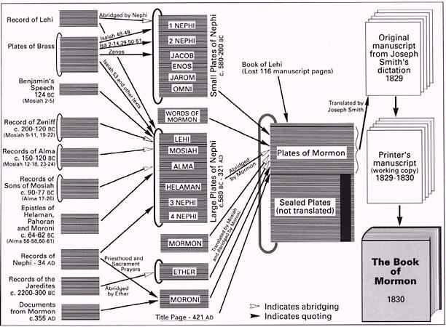

Slide 76
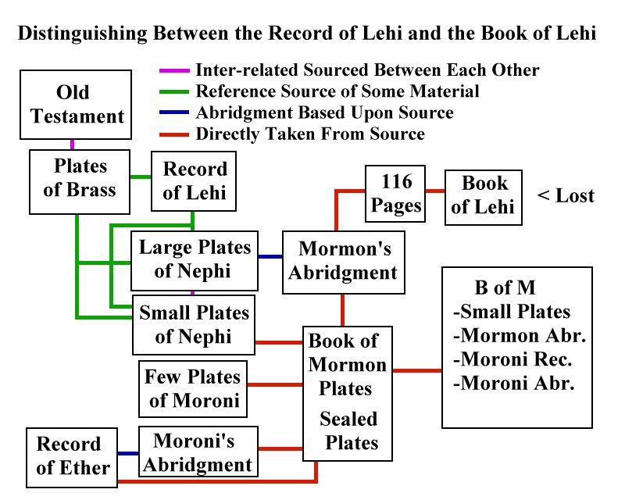

Slide 77
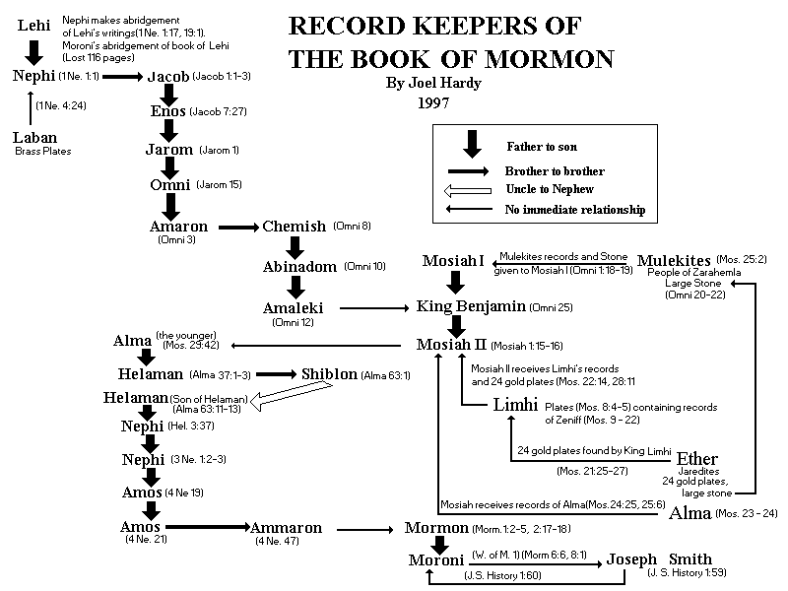

Slide 78
Reading from the Brass Plates
1 Nephi 20-22
Isaiah 48-49
The Brass Plates of Laban

Slide 79
Isaiah
Isaiah played a profound role in the Book of Mormon. His words were upon the plates of brass obtained from Laban.
Isaiah lived in Jerusalem and wrote in the period 740 BC to 701 BC at a time when Israel had incurred the anger of the Lord through pride and idolatry.
Isaiah’s language includes much symbolism, although he uses references of his own time with those of future times.
The message from Isaiah is one of the mission of the Redeemer and the atoning power of the Father’s plan of salvation.
Isaiah’s words are the bridge that unites the Old Testament, the New Testament, and the Book of Mormon.
Isaiah is quoted in the Book of Mormon more than any other prophet
—Who’s Who

Slide 80
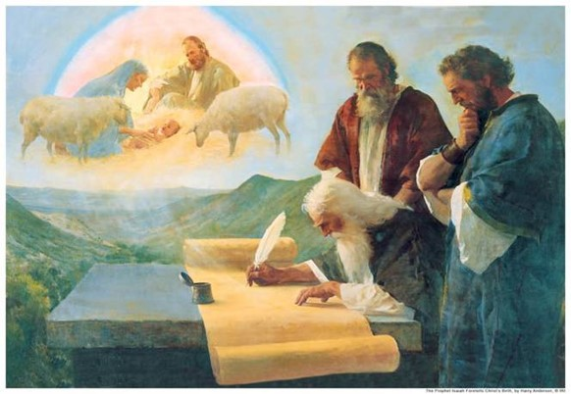
Receiving Blessings from Isaiah’s words
Nephi taught his family and read some of the words of Isaiah that had been included in the brass plates
As we study Isaiah’s words and seek to understand them we will be blessed.
He did this so that he “might more fully persuade them to believe in the Lord their Redeemer” (1 Nephi 19:23; see also verse 24).

Slide 81
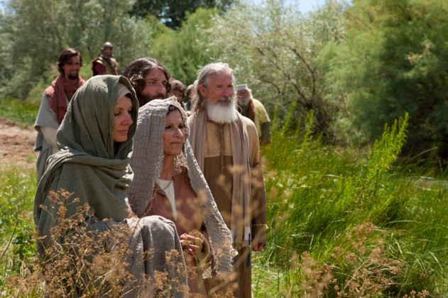
Baptized individuals who are unfaithful to their covenants
The Old Testament contains the history of Jacob, who was Isaac’s son and Abraham’s grandson.
The Lord gave Jacob the name Israel.
The term “the house of Israel” refers to Jacob’s descendants and to the covenant people of the Lord.
And he said, Thy name shall be called no more Jacob, but Israel: for as a prince hast thou power with God and with men, and hast prevailed. Genesis 32:28
1 Nephi 20:1-2
Bible Dictionary

Slide 82
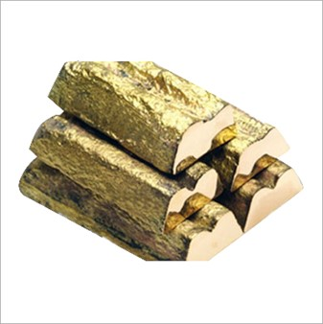
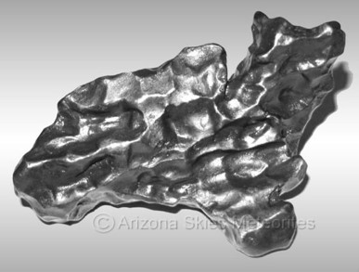
Why had not Israel been Faithful?
Iron Sinew: stiff necked
A sinew is a tendon. Just as iron does not bend easily, a prideful person will not bow his or her neck in humility. The phrase “iron sinew” indicates that many people in the house of Israel were filled with pride.
Brow brass: hardheaded
Is generally taken to represent judgment, also of evil content.
"I know that thou art obstinate, and thy neck is an iron sinew, and thy brow brass" (Isa. 48:4).
Pride
1 Nephi 20:3-4

Slide 83
Why do The Wicked have no peace?
“Christ is the Prince of Peace, and the citizens of his kingdom—those obedient to his laws—come to know that peace, even in a world of turmoil of which they must often be a part.”
Joseph Fielding McConkie and Robert L. Millet
Thy peace been as a river—constant flow
Thy righteousness as the waves of the sea—strong and powerful
The seed as the sand—promised to faithful through the covenant of eternal marriage
The offspring of thy bowels like the gravel— “…his name should not have been cut off nor destroyed from before me.”
1 Nephi 20:18-19, 22

Slide 84
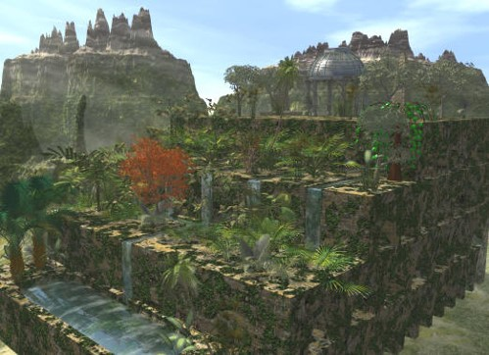
Babylon and Chaldeans
Babylon or Babel
The capital of Babylonia. According to Gen. 10:8–10 it was founded by Nimrod and was one of the oldest cities of the land of Shinar; in 11:1–9 we have the record of the Tower of Babel and the “Confusion of Tongues.” (See Ether 1:3–5, 34–35)
During the Assyrian supremacy it became part of that empire and was destroyed by Sennacherib.
After the downfall of Assyria, Babylon became Nebuchadnezzar’s capital. He built an enormous city of which the ruins still remain. The city was square, and the Euphrates ran through the middle of it.
Bible Dictionary
Chaldeans—people of Chaldea
The portion of Babylonia that lay south and east of Babylon, though the name was sometimes used after the days of Jeremiah to denote the whole district lying between and adjoining the rivers Tigris and Euphrates. In Dan. 2:2, 10 the name is applied to a learned class in Babylon who made a special study of astrology.
Leaving Babylon and the Chaldeans is symbolic of leaving worldliness behind and coming unto the Lord.
“Go ye out from among the nations, even from Babylon, from the midst of wickedness, which is spiritual Babylon.” (D&C 133:14)
1 Nephi 20:20

Slide 85
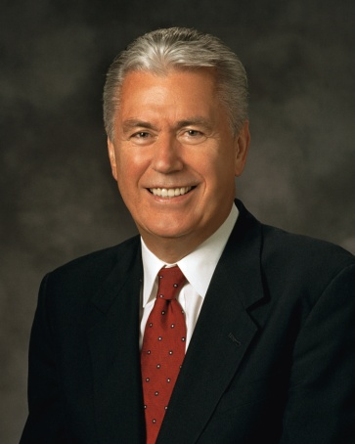
An Invitation For Repentance
“Satan … wants us to feel that we are beyond forgiveness (see Revelation 12:10). Satan wants us to think that when we have sinned, we have gone past a ‘point of no return’—that it is too late to change our course. …
“… The Atonement of Jesus Christ is the gift of God to His children to correct and overcome the consequences of sin. God loves all of His children, and He will never cease to love and to hope for us. …
“Christ came to save us. If we have taken a wrong course, the Atonement of Jesus Christ can give us the assurance that sin is not a point of no return. A safe return is possible if we will follow God’s plan for our salvation. …
“… There is always a point of safe return; there is always hope.”
--Dieter F. Uchtdorf
1 Nephi 20:20

Slide 86
He will Not Forget
“Messiah shall be a light to the Gentiles and shall free the prisoners” and “Israel shall be gathered with power in the last days.”
The Lord’s words reveal His love for His people—even for those who have gone astray and have forgotten Him.
“But, behold, Zion hath said; The Lord hath forsaken me, and my Lord hath forgotten me—but he will show that he hath not.”
The Lord loves us, and He will never forget us
1 Nephi 21:1-13, 14

Slide 87
Only that part of Israel who hear the voice of the Lord’s prophets will be a part of the latter-day gathering.
“…for mine elect hear my voice and harden not their hearts.” (D&C 29:7)
To Joseph Smith the Lord said, “This generation shall have my word through you” (D&C 5:10)
Harken, o ye house of Israel
All Ye that are broken off
Isaiah is addressing all the house of Israel, his message is more especially for that part of Israel that had been scattered, not through their own wickedness, but because of the corruption of the Church in the Old World. It was this corruption of the Church and the temple priesthood that caused Lehi and his family to flee.
Joseph Fielding McConkie and
Robert L. Millet
1 Nephi 21:1

Slide 88
Listen, O isles
“Wherefore as it says isles, there must needs be more than this (meaning the Americas), and they are inhabited also by our brethren.” (2 Nephi 10:21)
Wickedness in the house of Israel caused the Lord to transplant various branches throughout the world.
The bowels of my mother
All scattered Israel are now invited to listen to the voice of a servant of the Lord, one called from “the womb.” not one “self-ordained” but rather one “foreordained” and known by name even before his birth.
Joseph Fielding McConkie and
Robert L. Millet
1 Nephi 21:1

Slide 89
What does Isaiah teach by comparing the Savior to a mother of an infant?
What does the word graven imply?
What does it mean to you to be graven “upon the palms of [the Savior’s] hands”?
What experiences have helped you know that the Lord has not forgotten you?
1 Nephi 21:15-16 Isaiah 49:16

Slide 90
Compassion
“For can a woman forget her sucking child, that she should not have compassion on the son of her womb? Yea, they may forget, yet will I not forget thee, O house of Israel.”
As a righteous and loving mother could never forget the child of her womb, so the God of Israel cannot forget the children of his covenant.
Graven
“Behold, I have graven thee upon the palms of my hands; thy walls are continually before me.”
The clause is an allusion to the ancient practice of tattooing the palm with a symbol of the temple or some other sacred emblem to show devotion so that it might serve as a reminder of one’s commitment.
“That they were graven with an iron pen and lead in the rock for ever!”
(Job 19:24)
1 Nephi 21:15-16 Isaiah 49:16

Slide 91
The Scattering
The people of ancient Israel were scattered whenever they stopped worshipping Jehovah and broke their covenants and the commandments of God.
The people of Israel are gathered when they come unto Christ, accept His gospel through baptism, and keep His commandments.
The Savior promised scattered Israel that He would not forget them and that He would gather them to Him in the last days.
Teacher Manual
1 Nephi 21:1-5; 2 Nephi 6:10-11; 10:3-6; 1 Nephi 15:13-14

Slide 92
“Why was Israel scattered? The answer is clear; it is plain; of it there is no doubt. Our Israelite forebears were scattered because they rejected the gospel, defiled the priesthood, forsook the church, and departed from the kingdom. …
“What, then, is involved in the gathering of Israel? The gathering of Israel consists in believing and accepting and living in harmony with all that the Lord once offered his ancient chosen people. … It consists of believing the gospel, joining the Church, and coming into the kingdom. … It may also consist of assembling to an appointed place or land of worship.”
Bruce R. McConkie
Through the Restoration of the gospel, all of God’s children everywhere may be blessed
1 Nephi 21:1-5

Slide 93
The Gathering
“Zion shall flourish upon the hills and rejoice upon the mountains and shall be assembled together unto the place which I have appointed.” (D&C 49:25)
The place of gathering has been established, and there is “none other place appointed, “we are told”, “until the day cometh when there is found no more room for them; and then I have other places which I will appoint unto them, and they shall be called stakes, for the curtains or the strength of Zion”
(D&C 101:20-21: Isaiah 54:2-3: 3 Nephi 22:2-3)
The stakes of Zion are the gathering places for letter-day Israel
(D&C 115:5-6)
In the Millennial day the earth will be renewed and its barren deserts blossom in paradisiacal splendor. Metaphorically Israel gathers to the waters of everlasting life as they unite themselves once again in covenant with the God of their fathers.
1 Nephi 21:19-20 and 1 Nephi 22:25-26

Slide 94
Blessings To Those Who Are Gathered
His sheep– These are they whose names are written in the Lamb’s book of life.
“be one-fold”
A fold is a place where a flock of sheep is protected. Israel are of one-fold and have one shepherd only when their faith and actions are in perfect unity with that of their Master.
Satan has no power—Satan will be bound during the Millennial reign and cannot be loosed for many years (D&C 29:22)
The Holy One of Israel reigneth:--
“Christ and the resurrected Saints will reign over the earth during the thousand years. They will not probably dwell upon the earth, but will visit it when they please, or when it is necessary to govern it.”
--Joseph Smith
1 Nephi 22:25-26

Slide 95
A Mighty Nation Among the Gentiles
United States of America
A marvelous work among the Gentiles in the latter days. This great work includes the Restoration of the gospel of Jesus Christ and the priesthood keys necessary to bring the covenants of God to “all the kindreds of the earth”
The events described in 1 Nephi 22:7 had to precede those described in 1 Nephi 22:8–9. In the early 1800s, most countries in the world had forced state religions. The gospel could be restored only in a country where freedom of religion was established by law and freely practiced.
The First Amendment to the Constitution of the United States includes a proclamation of freedom of religion. This amendment and others were ratified on December 15, 1791, allowing freedom of religion to take root in the modern world.
Joseph Smith was born in December 1805, just 14 years after the ratification of these amendments to the United States Constitution.
--Mark E. Peterson
1 Nephi 22:7-9

Slide 96
The Lord promised to restore the gospel and gather Israel
in the latter days
Where do we gather today?
In our stakes, wards, districts, and branches.
Why do we gather?
We gather to partake of the sacrament, to fellowship one another, to serve together, and to learn and teach the gospel.
How do we help other people gather?
Through missionary work.
How are people gathered into
the Church?
They are baptized and confirmed
members of the Church.
1 Nephi 22:25

Slide 97
Sources:
Book of Mormon Who’s Who Ed J. Pinegar and Richard J. Allen pg. 69-71
Bible Dictionary, “Israel,” and “Israel, Kingdom of”
Joseph Fielding McConkie and Robert L. Millet Doctrinal Commentary of Book of Mormon Vol. 1 Pg 156, 158
Dieter F. Uchtdorf (“Point of Safe Return,” Ensign or Liahona, May 2007, 99, 101).
Bruce R. McConkie (A New Witness for the Articles of Faith [1985], 515).
Joseph Smith “Teachings” p 268
Elder Mark E. Petersen “The Great Prologue” [address given at Brigham Young University, Sept. 29, 1974], 4, speeches.byu.edu.
Presentation by ©http://fashionsbylynda.com/blog/

Slide 98
1 Nephi: 15-16:
Jehovah asked, “For can a woman forget her sucking child, that she should not have compassion on the son of her womb?” As unlikely as it is that a loving mother would forget her infant child, Jehovah declared that His devotion was even more steadfast. He affirmed: “Yea, they may forget, yet will I not forget thee. … Behold, I have graven thee upon the palms of my hands; thy walls are continually before me” [1 Nephi 21:15–16]. Because Jesus Christ endured the infinite atoning sacrifice, He empathizes perfectly with us [see Alma 7:11–13]. He is always aware of us and our circumstances. (Dale G. Renlund, “Infuriating Unfairness,” Liahona, May 2021, 43)
Worthy of God’s Love:
Remember change is possible, repentance is a process, and worthiness is not flawlessness. Most important, remember that God and Christ are willing to help us right here and now. …
So many have been hurt by broken and strained relationships that it is difficult for them to believe in God’s compassion and long-suffering. They struggle to see God as He is—a loving Father who meets us in our need and knows how to “give good things to them that ask him” [3 Nephi 14:11]. His grace is not just a prize for the worthy. It is the “divine assistance” He gives that helps us become worthy. It is not just a reward for the righteous. It is the “endowment of strength” He gives that helps us become righteous [Dieter F. Uchtdorf, “The Gift of Grace,” Ensign or Liahona, May 2015, 107]. We are not just walking toward God and Christ. We are walking with Them. (Bradley R. Wilcox, “Worthiness Is Not Flawlessness,” Liahona, Nov. 2021, 62, 67)
God’s love is not found in the circumstances of our lives but in His presence in our lives. We know of His love when we receive strength beyond our own and when His Spirit brings peace, comfort, and direction. At times it may be difficult to feel His love. We can pray to have our eyes opened to see His hand in our lives and to see His love in the beauty of His creations. (Susan H. Porter, “God’s Love: The Most Joyous to the Soul,” Liahona, Nov. 2021, 35)

Slide 99
A. 1 Nephi 20: 1-9
Listen to the Lord, Israel
You claim to be of God’s people but refuse to serve him.
He has revealed things to you in a particular way because of your hardness.
From the beginning you have been unfaithful.
But the Lord has not forsaken you.
B. 1 Nephi 20:10-22
He will still accomplish His work with you
This is for His own purposes.
All His works will be fulfilled.
Flee Babylon and Chaldea (symbolic of the world), and He will redeem you.
C. 1 Nephi 21:1-26
Israel will be gathered
He knows where they have been scattered.
Through the Messiah (the servant, the Holy One). Israel and the gentiles shall be blessed.
Israel will be gathered in the last days.
This is because the Lord has not forgotten his people even though they are constantly forsaking Him.
They shall inherit their former lands in great glory.
The gentiles shall assist in this gathering.
Those who once persecuted and oppressed Israel shall be punished.
Nephi quotes these particular chapters of Isaiah (handout)
Book of Mormon Institute Manual 121-122 pg. 54

