Slide 1
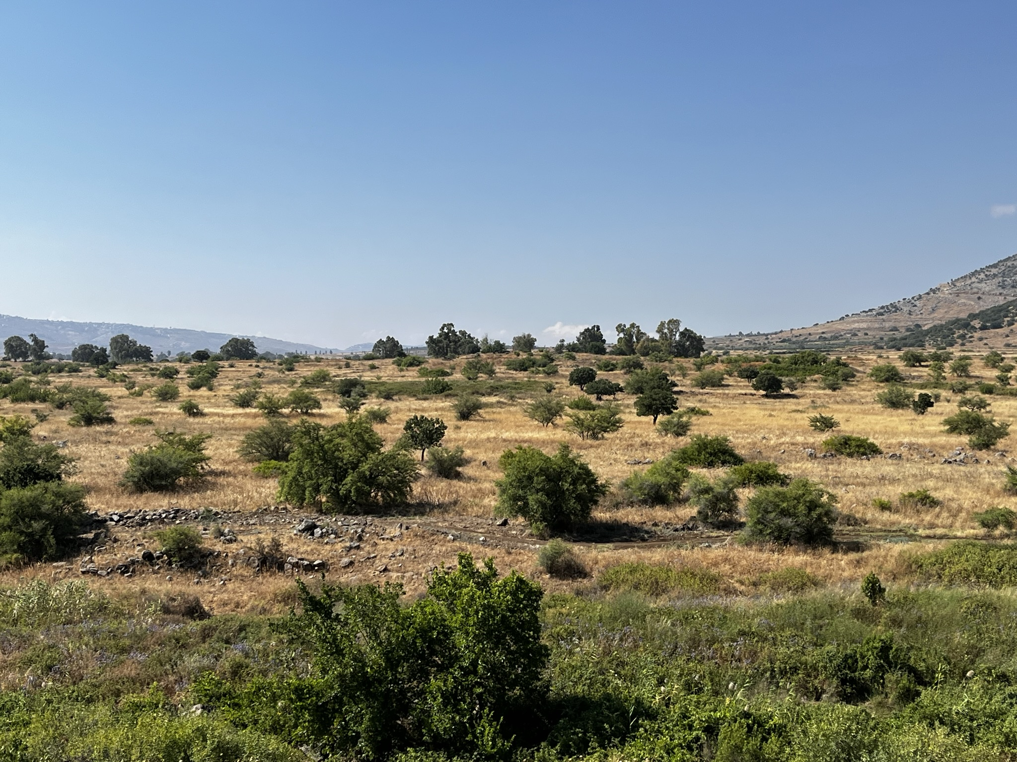
1 Nephi 6-10

Slide 2
A Wise Purpose
1 Nephi 6 and 9
The Small Plates of Nephi
The Large Plates of Nephi

Slide 3
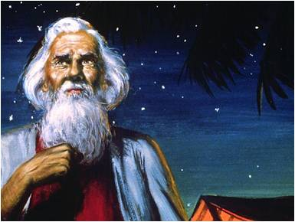
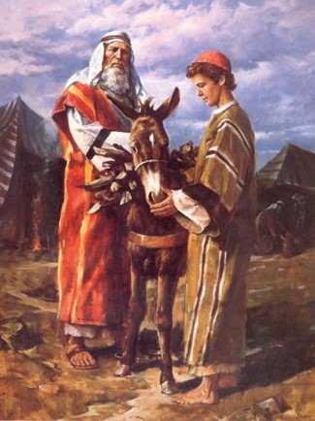
The Purpose
God of Abraham
Jesus Christ
Jehovah
God of Jacob
God of Isaac
1 Nephi 6:4

Slide 4
“We must keep in mind who Jesus was before He was born. He was the Creator of all things, the great Jehovah, the Lamb slain before the foundation of the world, the God of Abraham, Isaac, and Jacob. He was and is the Holy One of Israel”
--Ezra Taft Benson

Slide 5
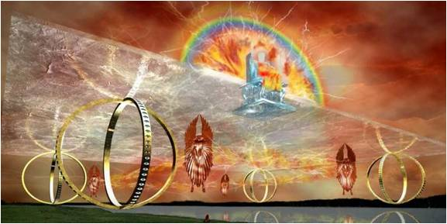
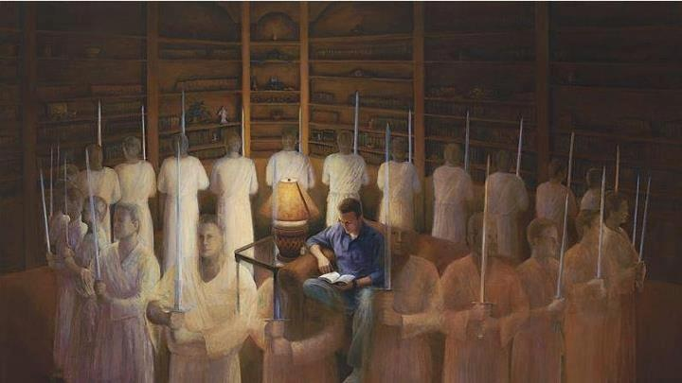
The Intent
Persuade---To Come unto Jesus Christ
“…which are pleasing unto God”
“…and not things which are pleasing unto the world.”
1 Nephi 6:4-5

Slide 6
An Invitation
By the time Nephi finishes his record of the things of God, the Spirit prompts him to hold the reader responsible for how they receive his writings.
'And if ye shall believe in Christ ye will believe in these words, for they are the words of Christ, and he hath given them unto me; and they teach all men that they should do good. And if they are not the words of Christ, judge ye--for Christ will show unto you, with power and great glory, that they are his words, at the last day; and you and I shall stand face to face before his bar; and ye shall know that I have been commanded of him to write these things, notwithstanding my weakness....for these words shall condemn you at the last day.' (2 Ne 33:10-11,14)
The messages contained in the Book of Mormon are pleasing to God and are of great worth to His children

Slide 7
Not Pleasing to the World
"No wonder these scriptures fail to please or to impress the world. There are those who prefer details on ancient agriculture to the 'bread of life,' who prefer information on the rising of dynasties to insights on the rising of Jesus from the tomb.
Perhaps this is so because the former type of data is very interesting without being very demanding.
The second type demands both faith and, thereafter, a certain behavior."
--Elder Neal A. Maxwell
1 Nephi 6:5

Slide 8
The Plates
The Small Plates of Nephi
The Large Plates of Nephi
Small Plates
“these plates”
--Nephi starts to write things of God (about 20 years after Lehi left Jerusalem)
--ministry and revelations
--an abridgement of Lehi’s account
--Mormon includes in compilation of Book of Mormon
--Nephi’s record found in 1 and 2 Nephi
Large Plates
“the other plates”
--Nephi starts to write from memory of Lehi’s words (about 10 years after Lehi left Jerusalem)
--history—reign of kings, wars, contentions.
However, the first record of Nephi is not included in the Book of Mormon— lost 116 pages
1 Nephi 9:1-5

Slide 9
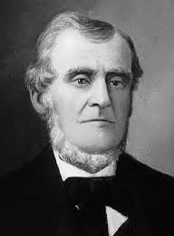
A Loss
Martin Harris, who had been helping Joseph, wanted to show the translation to his wife and family. Reluctantly, the Prophet allowed Martin to borrow the 116 pages of manuscript that had been completed up to that time.
The 116 pages were stolen from Martin, and, as a consequence, the plates, the Urim and Thummim, and the gift to translate were temporarily taken from Joseph Smith.
D&C 3:14

Slide 10
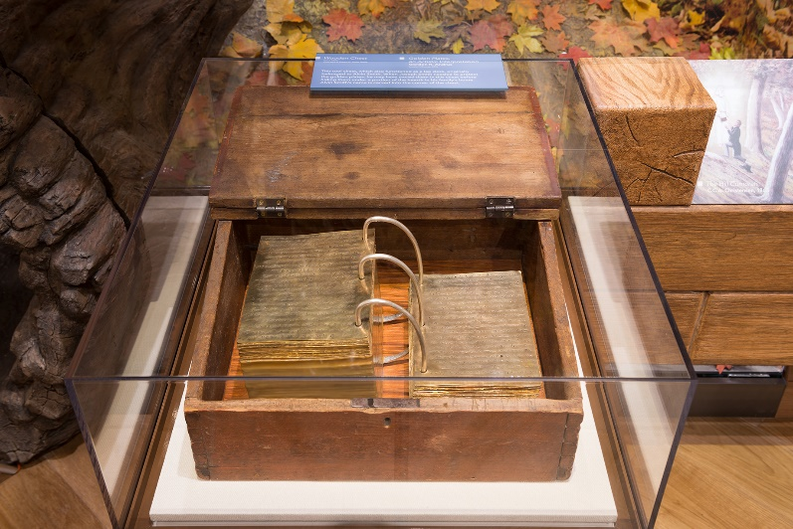
A Wiser Purpose
“It strikes me that there is a wiser purpose than that [compensating for the loss of the 116 pages], or, more accurately, a wiser purpose in that.
The key to such a suggestion of a wiser purpose is in verse 45 of Doctrine and Covenants section 10.
As the Lord instructs Joseph on the procedure for translating and inserting the material from the small plates into what had been begun as the translation of the abridged large plates.
‘Behold, there are many things engraven upon the [small] plates of Nephi which do throw greater views upon my gospel’
“… We got back more than we lost. And it was known from the beginning that it would be so. It was for a wiser purpose. …

Slide 11
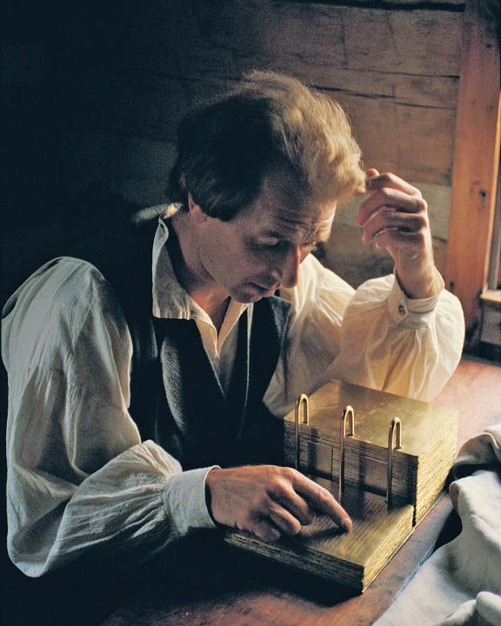
Repentance Period
After Joseph Smith went through a period of repentance , the Lord told him not to retranslate the lost portion.
Instead, He commanded him to translate the small plates of Nephi, which covered the same period of time.
He informed Joseph that those who had taken the 116 pages had changed them and planned to use them to discredit the work.
The Lord had foreseen these events many hundreds of years earlier and had provided the second record to thwart Satan’s plan.
Read Mormon 10

Slide 12
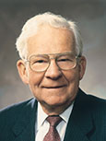
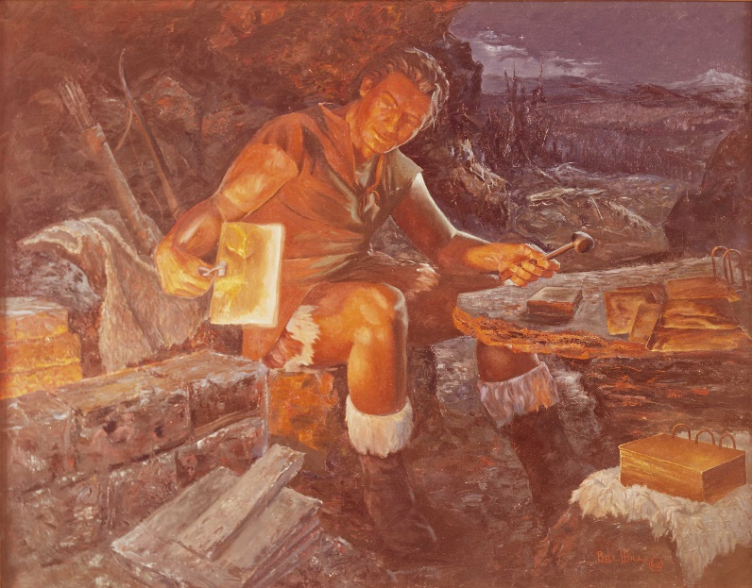
Trust
Trusting and obeying the Lord, even when we do not fully understand the reason for a commandment, can lead to great blessings.
“Sometimes when we are asked to be obedient, we do not know why, except the Lord has commanded. … Nephi followed instructions even though he didn’t fully understand the wise purpose.
His obedience resulted in blessings to mankind all over the world.”
--Marvin J. Ashton
Read Mormon 1:3-7
The Final Battle
A.D. 385
Bill L. Hill

Slide 13
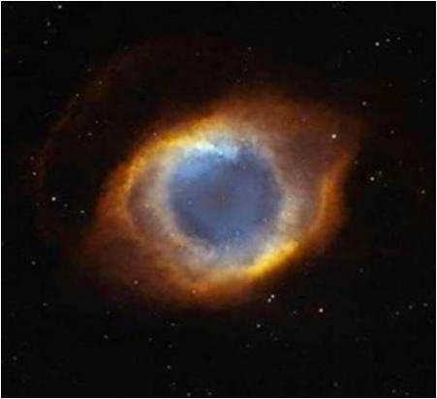
God Knows All Things
1 Nephi 9:6
“Without the knowledge of all things God would not be able to save any portion of his creatures; for it is by reason of the knowledge which he has of all things, from the beginning to the end, that enables him to give that understanding to his creatures by which they are made
partakers of eternal life; and if it
were not for the idea existing in
the minds of men that God had
all knowledge it would be
impossible for them to exercise
faith in him”
(Lectures on Faith [1985], 51–52).

Slide 14
Sources:
Marvin J. Ashton “Who Will Forfeit the Harvest?” Ensign Nov. 1978
Ezra T. Benson “Five Marks of the Divinity of Jesus Christ,” Ensign, Dec. 2001
Elder Neal A. Maxwell (But for a Small Moment, p. 38)
Jeffrey R. Holland, “A Standard unto My People” [address given at the Church Educational System Symposium, Aug. 9, 1994], 7–8, 9).
Presentation by ©http://fashionsbylynda.com/blog/

Slide 15
1 Nephi 9:5:
"The ancient preparation of the Book of Mormon, its preservation, and its publication verify Nephi's words that 'the Lord knoweth all things from the beginning; wherefore, he prepareth a way to accomplish all his works among the children of men; for behold, he hath all power unto the fulfilling of all his words' (1 Nephi 9:6). We are not required to prove that the Book of Mormon is true or is an authentic record through external evidences-though there are many. It never has been the case, nor is it so now, that the studies of the learned will prove the Book of Mormon true or false. The origin, preparation, translation, and verification of the truth of the Book of Mormon have all been retained in the hands of the Lord, and the Lord makes no mistakes. You can be assured of that." (The Teachings of Ezra Taft Benson, p. 65.)

Slide 16
A Family is Forever
1 Nephi 7
Marriage and family are central to God’s plan; if we exercise faith in the Lord, He is able to do all things for us according to His will; and forgiving others brings peace.

Slide 17
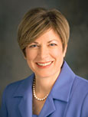
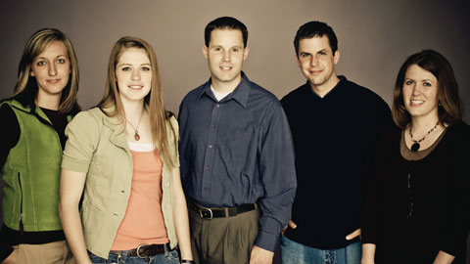
“As I meet with young single adults around the world, I ask them, ‘Why does the First Presidency care so much about you and provide so many resources for you?’”
“These are some of the answers I get:
‘We are future Church leaders.’ ‘We need training so we can stay strong.’ ‘Our testimonies are strengthened in our seminary and institute classes.’ ‘We need to meet other great Latter-day Saint youth.’ ‘We are the hope of the future.’ I have rarely heard, ‘So I will someday be a better father or a better mother.’ …
Julie B. Beck

Slide 18
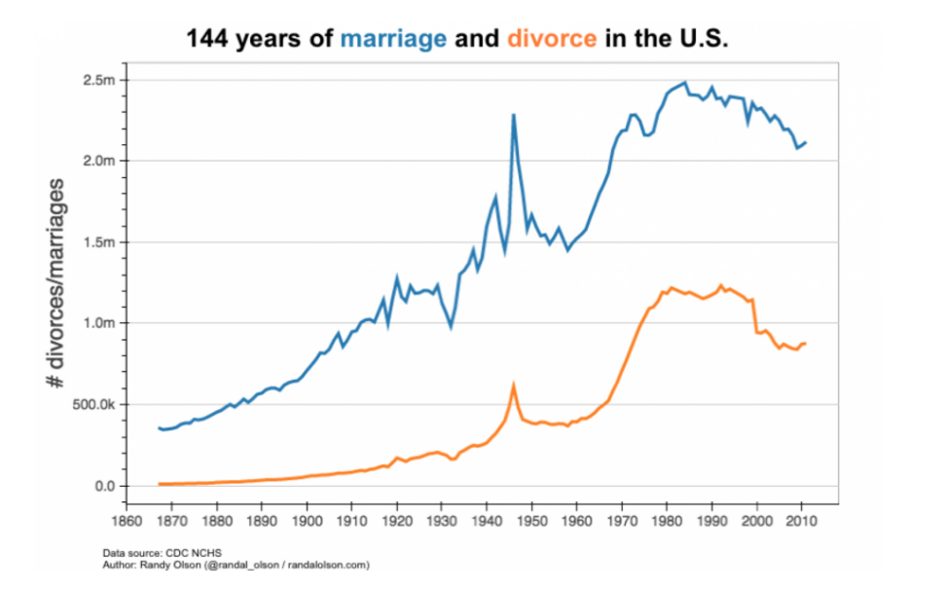
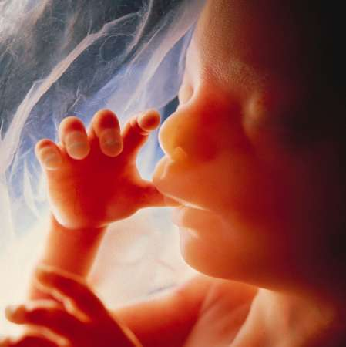
“… Evidence is all around us that the family is becoming less important. Marriage rates are declining, the age of marriage is rising, and divorce rates are rising. Out-of-wedlock births are growing.
Abortion is rising and becoming increasingly legal. We see lower birth rates. We see unequal relationships between men and women, and we see cultures that still practice abuse within family relationships.
Many times a career gains importance over the family.
Julie B. Beck

Slide 19
“Many of our youth are losing confidence in the institution of families.
They’re placing more and more value on education and less and less importance on forming an eternal family. Many don’t see forming families as a faith-based work. …
“This generation will be called upon to defend the doctrine of the family as never before. If they don’t know it, they can’t defend it”
Julie B. Beck

Slide 20
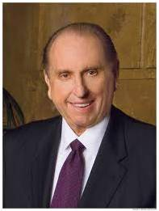
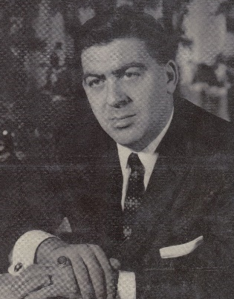
Perhaps most significant of all classrooms is the classroom of the home. It is in the home that we form our attitudes, our deeply held beliefs. It is in the home that hope is fostered or destroyed. Our homes are the laboratories of our lives. What we do there determines the course of our lives when we leave home.
Dr. Stuart E. Rosenberg wrote in his book The Road to Confidence, “Despite all new inventions and modern designs, fads and fetishes, no one has yet invented, or will ever invent, a satisfying substitute for one’s own family.”
President Thomas S. Monson

Slide 21
The Lord Commands Us To Marry and Raise Children
Sons should take “daughters to wife”
Raise up seed unto the Lord
1 Nephi 7:1-2

Slide 22
The Family: A Proclamation to the World
“We, the First Presidency and the Council of the Twelve Apostles of The Church of Jesus Christ of Latter-day Saints, solemnly proclaim that marriage between a man and a woman is ordained of God and that the family is central to the Creator’s plan for the eternal destiny of His children.”

Slide 23
Importance of Marriage
1. Bringing children into the world
2. Raise up children “unto the Lord”
“We declare that God’s commandment for His children to multiply and replenish the earth remains in force. …
“… Parents have a sacred duty to rear their children in love and righteousness, to provide for their physical and spiritual needs, to teach them to love and serve one another, observe the commandments of God, and be law-abiding citizens wherever they live. Husbands and wives—mothers and fathers—will be held accountable before God for the discharge of these obligations.”
1 Nephi 7:1-2
Family Proclamation

Slide 24
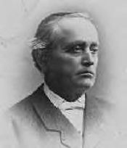
The House of Ishmael
Three days journey back to Jerusalem
The Book of Mormon is sometimes referred to as “the stick of Joseph” Ezekiel 37:19 or “the stick of Ephraim” D&C27:5. Lehi was a descendant of Manasseh (see Alma 10:3) and Ishmael was a descendant of Ephraim. The prophecies of Jacob (see Genesis 48:16; 49:22) were fulfilled as Ishmael (of Ephraim) came to the American continent with Lehi (of Manasseh).
The sons did gain favor in the site of Ishmael
Related Already?
“…which is the record of Nephi individually, he himself being of the lineage of Manasseh; but that Ishmael was of the lineage of Ephraim, and that his sons married into Lehi’s family, and Lehi’s sons married Ishmael’s daughter.”—Erastus Snow
1 Nephi 7:3-4

Slide 25
Ishmael and His Wife
He was the father and leader of a family of 7 children from Jerusalem.
The Lord softened his heart so he would agree to take his family and follow Lehi’s sons into the wilderness.
He sided with Nephi in a dispute over returning to Jerusalem.
He died during the wildness journey and was buried in a place called Nahom.
His death cased many to murmur against Lehi and Nephi.
She traveled with her husband into the wilderness.
She didn’t rebel against Nephi, and she begged for Nephi’s life when Laman and Lemuel threatened to kill him.
1 Nephi 7:4-6; 1 Nephi 16:34-35; 1 Nephi 7:6, 19
Lehi’s Family Tree

Slide 26
Sons of Ishmael
They joined in the wilderness rebellion and remained unrepentant.
They supported the conspiracy to murder Lehi and Nephi.
Lehi treated them like a sons, but they appear to have always sided with the complainers.
They rebelled against Nephi at first but changed their mind and pled for Nephi’s life.
They later became very angry with Lehi and Nephi.
After their father died Lehi became their “father.”
During the voyage to the Promised Land, they got caught up in rude dancing and singing.
They followed Laman and Lemuel when the family separated.
1 Nephi 7:6, 19; 1 Nephi 16:37; 1 Nephi 18:9; 2 Nephi 1:28
Lehi’s Family Tree

Slide 27
Daughter of Ishmael and Wife of Zorum
She was the oldest of five daughters.
She married Zoram, and they had a family.
She and her husband followed Nephi when the family separated.
Zorum was a servant of Laban in Jerusalem, he held the keys of the treasury.
He agreed to travel into the wilderness with Nephi and his family and later married the eldest daughter of Ishmael.
He was faithful to the Lord and a trusted friend to Nephi.
1 Nephi 16:7; 2 Nephi 5:6; 1 Nephi 4:20, 30-37; 2 Nephi 1:30-32;
Lehi’s Family Tree

Slide 28
Rebellion In The Wilderness
Nephi’s questions to his brothers and their wives:
9. How is it that ye have not hearkened unto the word of the Lord?
10. How is it that ye have forgotten that ye have seen an angel of the Lord?
11. How is it that ye have forgotten what great things the Lord hath done for us…delivering us out of the hands of Laban?
12. How is it that ye have forgotten that the Lord is able to do all things according to his will for the children of men, if it so be that they exercise faith in him?
1 Nephi 7:9-12

Slide 29
Nephi’s Promises
13. If we are faithful to him, we shall obtain the land of promise
15. If the brothers return to Jerusalem they will perish
If we exercise faith in the Lord, He is able to do all things for us according to His will
1 Nephi 7:13-15

Slide 30
The Warning
Nephi warned his brothers and members of Ishmael’s family that they would perish if they returned to Jerusalem.
A number of years after Lehi and Ishmael’s families left Jerusalem, the Babylonians surrounded the city. According to the Bible, an approximately 18-month siege left the people of Jerusalem without food, the city “broken up,” and King Zedekiah’s army scattered (2 Kings 25:1–7).
The Babylonians then destroyed the temple and carried many of the people away as captives to Babylon. If Laman, Lemuel, and the others had returned to Jerusalem, they would have suffered captivity or death.
But because they chose to follow Lehi and Nephi, they instead enjoyed the fruit and honey of the land of Bountiful and obtained a land of inheritance. In addition, the Lord has been merciful to Laman and Lemuel’s latter-day posterity, blessing them with the gospel.
1 Nephi 7:13-15; 2 Nephi 1:4-5; 1 Nephi 17:3-6; 2 Nephi 4:7-9

Slide 31
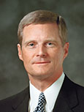
Cords That Bind
Brothers sought to take Nephi’s life
“Nephi is an example of one who knew and understood and relied upon the enabling power of the Savior. … Please note Nephi’s prayer in verse 17: ‘O Lord, according to my faith which is in thee, wilt thou deliver me from the hands of my brethren; yea, even give me strength that I may burst these bands with which I am bound’..
“… It is especially interesting to me that Nephi did not pray … to have his circumstances changed. Rather, he prayed for the strength to change his circumstances. And may I suggest that he prayed in this manner precisely because he knew and understood and had experienced the enabling power of the Atonement of the Savior” (“In the Strength of the Lord.”
The Lord’s deliverance
1 Nephi 7:16-19
David A. Bednar

Slide 32
Nephi Forgives
Seeking forgiveness and forgiving others brings unity and peace.
Frankly = honestly and directly
Choosing to frankly forgive others can bring peace
1 Nephi 7:20-21

Slide 33
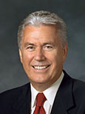
“I have discovered one thing that most [happy families] have in common: they have a way of forgiving and forgetting the imperfections of others and of looking for the good.
“Those in unhappy families, on the other hand, often find fault, hold grudges, and can’t seem to let go of past offenses. …
“… As we accept [our Savior’s] ways and overcome our pride by softening our hearts, we can bring reconciliation and forgiveness into our families and our personal lives. God will help us to be more forgiving,
… to be first to apologize even if something wasn’t our fault, to lay aside old grudges and nurture them no more.”
1 Nephi 7:20-21
Dieter F. Uchtdorf

Slide 34
Sources:
Julie B. Beck “Teaching the Doctrine of the Family,” Ensign, Mar. 2011, 12.
President Thomas S. Monson (“Precious Children—A Gift from God,” Ensign, Nov 1991, 67)
Elder Estrus Snow Sermon delivered in May 1882…quoting Joseph Smith
Elder David A. Bednar Brigham Young University devotional address, Oct. 23, 2001
Dieter F. Uchtdorf, “One Key to a Happy Family,” Ensign, Oct. 2012, 5, 6).
Lehi’s Family Tree January 2004 New Era
Presentation by ©http://fashionsbylynda.com/blog/

Slide 35
Education is an important part of Heavenly Father’s plan to help you become more like Him. He wants you to educate your mind and to develop your skills and talents, your power to act well in your responsibilities, and your capacity to appreciate life. The education you gain will be valuable to you during mortality and in the life to come.
Education will prepare you for greater service in the world and in the Church. It will help you better provide for yourself, your family, and those in need. It will also help you be a wise counselor and companion to your future spouse and an informed and effective teacher of your future children.
Education is an investment that brings great rewards and will open the doors of opportunity that may otherwise be closed to you. Plan now to obtain an education. Be willing to work diligently and make sacrifices if necessary. Share your educational goals with your family, friends, and leaders so they can support and encourage you. Strength of the Youth Pamphlet
Worldly Education:
I am restless over the possibility, ever present, that education may fail to achieve a righteous purpose and be perversely used. We have many examples in the world where the misuse of this power has degraded men rather than exalted them... The voice of atheism, of corruption, of faithlessness, of dissention resounds from a thousand platforms. It is subsidized from public funds. It is invited to the forum in public institutions, tolerated by most, and encouraged by many. The voice of faith, on the other hand, is fading. Few places are left where it might speak. (BYU Speeches of the Year, 29 April 1969, p.3)
In a review of what a student has gained at school, or in a class, he should give attention to things he may have lost. If he knew the value of some things he may have discarded, he would dig frantically through the wastebasket and trash can to rescue them before they are hauled away permanently. He came to school basically to learn an occupation, and likely he has. But as always, there was a price to pay, and occasionally students pay an exorbitant price... Did they come with patriotism and replace it with cynicism? Did they come free from any binding habits and now leave with an addiction? Did they arrive aspiring for marriage, a home, and a family and now have abandoned those aspirations? And critically important, did they come with virtue and moral purity and now must admit to themselves that while they were here they have lost it?" (Teach Ye Diligently p. 184-185, 1979.)
Each year, many fall victim in the colleges and universities. There, as captive audiences, their faith, their patriotism, and their morality are lined up against a wall and riddled by words shot down from the mouths of irreverent professors. (That All May be Edified, p. 165)
President Boyd K. Packer
Forgiveness
“Forgive, and ye shall be forgiven” [Luke 6:37], Christ taught in New Testament times. And in our day: “I, the Lord, will forgive whom I will forgive, but of you it is required to forgive all men” [Doctrine and Covenants 64:10]. It is, however, important for some of you living in real anguish to note what He did not say. He did not say, “You are not allowed to feel true pain or real sorrow from the shattering experiences you have had at the hand of another.” Nor did He say, “In order to forgive fully, you have to reenter a toxic relationship or return to an abusive, destructive circumstance.” But notwithstanding even the most terrible offenses that might come to us, we can rise above our pain only when we put our feet onto the path of true healing. That path is the forgiving one walked by Jesus of Nazareth, who calls out to each of us, “Come, follow me” [Luke 18:22]. (Jeffrey R. Holland, “The Ministry of Reconciliation,” Ensign or Liahona, Nov. 2018, 78–79)
Education:
Prophets and apostles teach that education is an eternal principle, following the Savior’s counsel that “the glory of God is intelligence, or, in other words, light and truth” (D&C 93:36) and that “whatever principle of intelligence we attain unto in this life, it will rise with us in the resurrection” (D&C 130:18).
“For members of the Church, education is not merely a good idea—it’s a commandment,” says President Dieter F. Uchtdorf, Second Counselor in the First Presidency. Members of the Church are instructed to learn “of things both in heaven and in the earth, and under the earth; things which have been, things which are, things which must shortly come to pass; things which are at home, things which are abroad” (D&C 88:79).
https://www.lds.org/prophets-and-apostles/unto-all-the-world/education-is-a-commandment?lang=eng
Brothers and sisters, are there people in our lives who have hurt us? Do we harbor what seem like fully justified feelings of resentment and anger? Are we letting pride keep us from forgiving and letting go? I invite all of us to forgive completely and let healing occur from within. And even if forgiveness doesn’t come today, know that as we desire it and work for it, it will come—just as it eventually did for me. (Larry J. Echo Hawk, “Even as Christ Forgives You, So Also Do Ye,” Ensign or Liahona, May 2018, 16)

Slide 36
Partakers of the Tree of Life
1 Nephi 8
You may think that Lehi’s dream or vision has no special meaning for you, but it does. You are in it; all of us are in it.
Boyd K. Packer

Slide 37
What are some reasons why people turn away from the gospel of Jesus Christ even if they know it is true and have received great blessings from it?
How can I remain faithful to the Lord and His gospel when I am surrounded by temptations and individuals who try to persuade me to make poor choices?

Slide 38
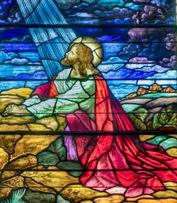
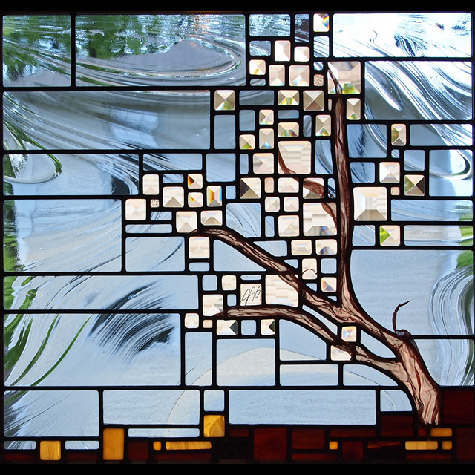
“The greatest manifestation of God’s love for His children is the mortal ministry, atoning sacrifice, and Resurrection of the Lord Jesus Christ.
As we partake of the blessings of the Savior’s Atonement, we are filled with joy and a desire to help others come unto Him
The fruit on the tree can be considered a symbol for the blessings of the Savior’s Atonement”
--David A. Bednar

Slide 39
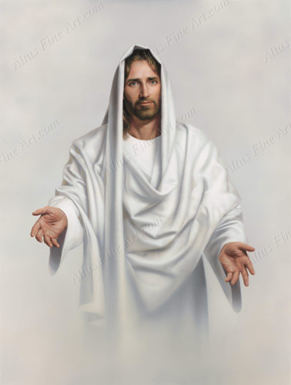
The Man
Wearing a White Robe
Follow Him
Simon Dewey
1 Nephi 8:5-6

Slide 40
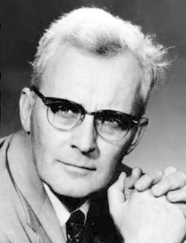
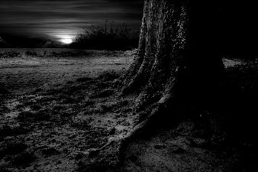
The Dark and Dreary
Many Hours
“Invariably darkness is given as the main source of terror (the heat and glare of the day, though nearly always mentioned, are given second place), and the culminating horror is almost always a 'mist of darkness,' a depressing mixture of dust, and clammy fog, which, added to the night, completes the confusion of any who wander in the waste.” –Hugh Nibley
Prayer for mercy
1 Nephi 8:7-8

Slide 41
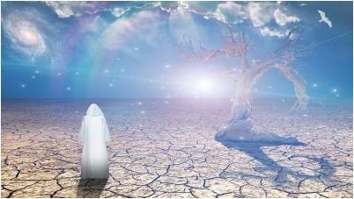
Spacious Field
“The tree of life … is the love of God (see 1 Nephi 11:25). The love of God for His children is most profoundly expressed in His gift of Jesus as our Redeemer: ‘God so loved the world, that he gave his only begotten Son’ (John 3:16). To partake of the love of God is to partake of Jesus’ Atonement and the emancipations and joys which it can bring” –Elder Neal A. Maxwell
1 Nephi 8:9

Slide 42
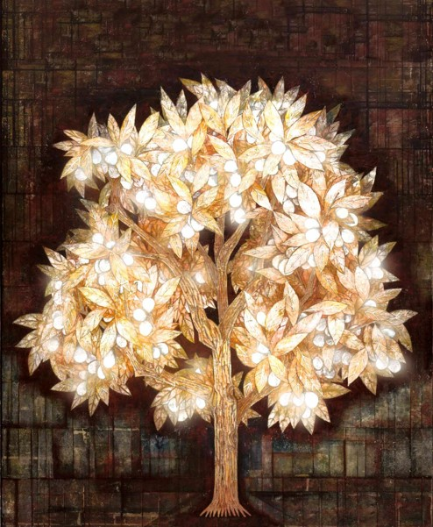
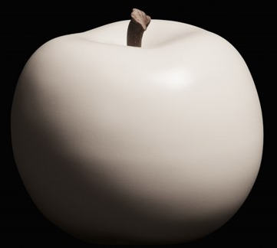
The Fruit
1 Nephi 8:10-12
1 Nephi 11:21-24
Desirous to make one happy
The Love of God
Blessings received through the Atonement Jesus Christ

Slide 43
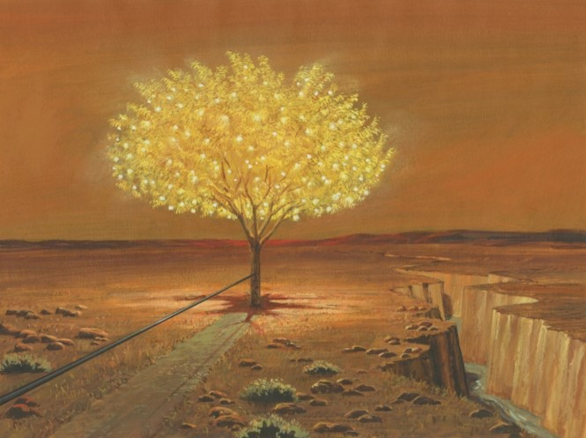
The Rod of Iron
1 Nephi 8:19
The Word of God
1 Nephi 11:25
Nephi later describes a terrible gulf that this river runs through. The depths of the river represent the depths of hell. Therefore, the depths of hell are not far from the rod of iron; it doesn't take many steps off the strait and narrow path before one falls into the terrible gulf and the river.
And thus we can plainly discern, that after a people have been once enlightened by the Spirit of God, and have had great knowledge of things pertaining to righteousness, and then have fallen away into sin and transgression, they become more hardened, and thus their state becomes worse than though they had never known these things. (Alma 24:30)

Slide 44
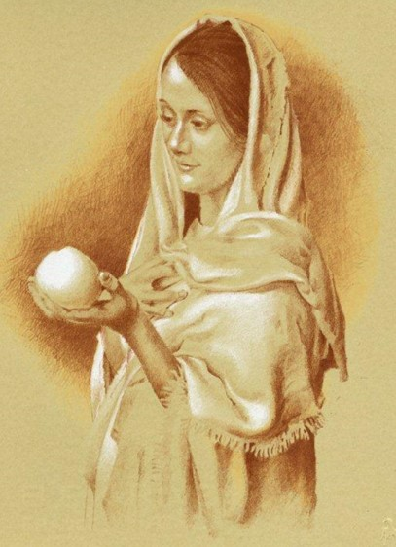
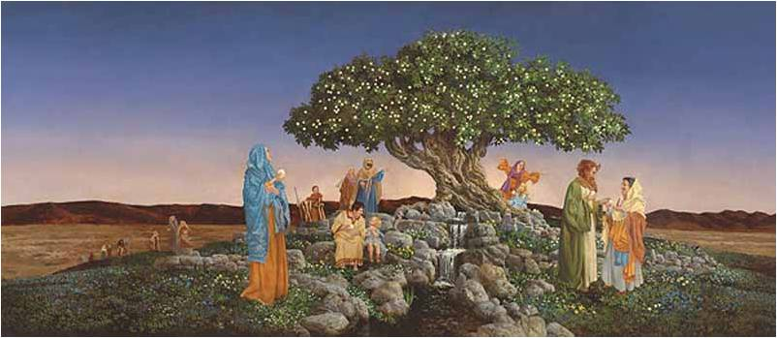
Sharing the Joy
Partaking the fruit
Come unto me and ye shall partake of the fruit of the tree of life; yea, ye shall eat and drink of the bread and the waters of life freely.
Alma 5:34
1 Nephi 8:12-16

Slide 45
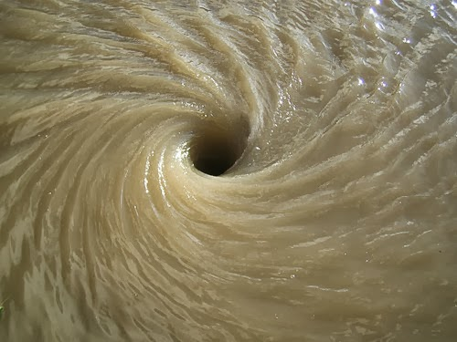
The Filthy Water
1 Nephi 8:13
1 Nephi 12:16; 15:26-29
Filthiness; the depths of hell
…that they who are righteous shall be righteous still, and they who are filthy shall be filthy still; wherefore, they who are filthy are the devil and his angels;
2 Nephi 9:16

Slide 46
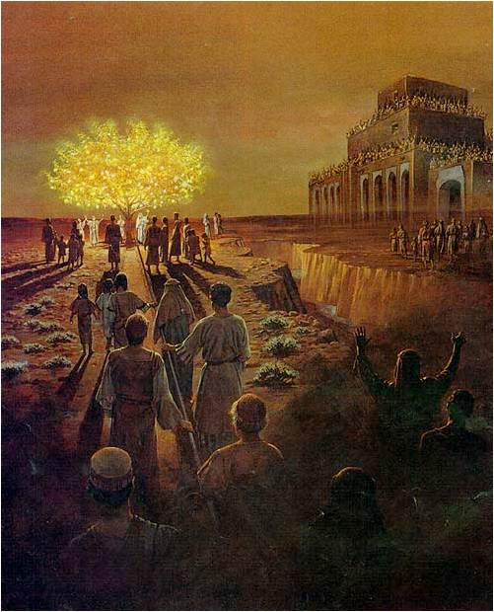
Leading to the Tree
Numberless concourses of people pressing forward
1 Nephi 8:19-22

Slide 47
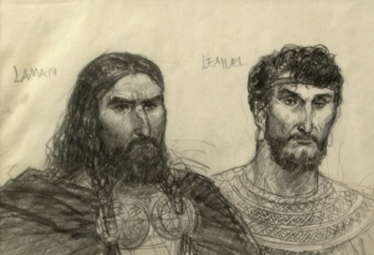
The Mists of Darkness
1 Nephi 8:23
Temptations of the Devil
1 Nephi 12:17
Those who do not partake
If we yield to the temptations of the devil, we will be led away from the path of righteousness and from the blessings of the Savior’s Atonement

Slide 48
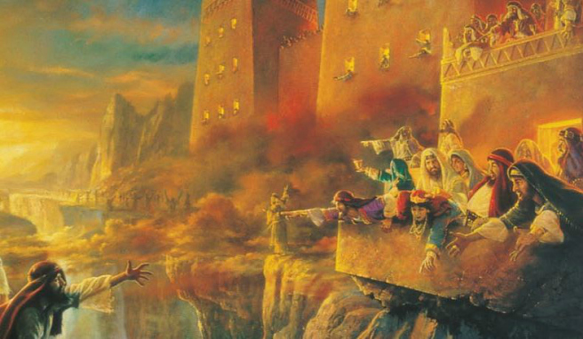
The Ashamed
Barely clinging to the rod
Questioning the fruit
If we are ashamed of Jesus Christ and His gospel, we can fall away into forbidden paths and become lost
Looking to other side of the river
1 Nephi 8:24-28

Slide 49
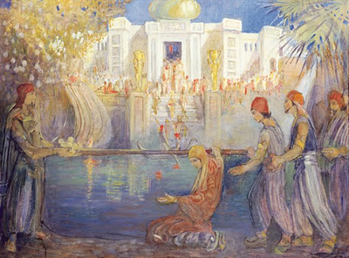
The Great and Spacious Building
The pride and vain imaginations of the world
1 Nephi 11:35-36; 12:18
1 Nephi 8:26

Slide 50
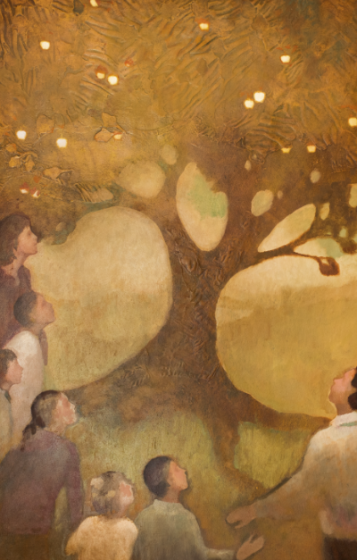
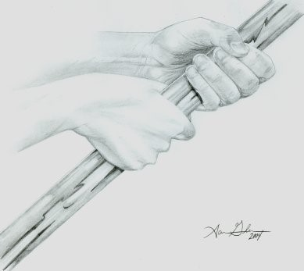
The Holders
Iron Rod
If we hearken and hold fast to the word of the Lord, the adversary’s temptations will not overpower us.
Holding fast
'However diligent we may be in other areas, certain blessings are to be found only in the scriptures, only in coming to the word of the Lord and holding fast to it as we make our way through the mists of darkness to the tree of life.'"
–President Ezra Taft Benson
1 Nephi 8:30

Slide 51
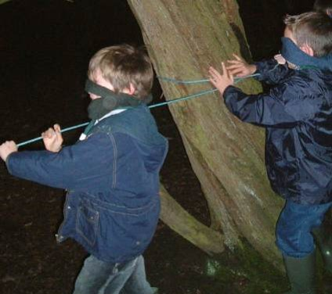
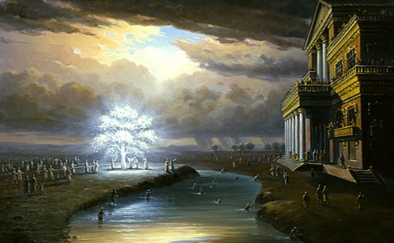
The Non-Partakers
Feeling their way
We can remain faithful by choosing not to heed those who mock us as we partake of the blessings of the gospel.
Many drowned and lost and wandering on strange roads
1 Nephi 8:31-33

Slide 52
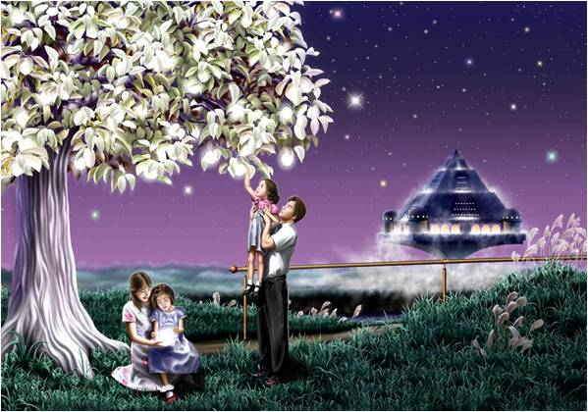
The Test of Life
•What obstacles did the people in Lehi’s vision face?
•What do those obstacles represent?
•What form do those obstacles take today?
•What helped the people reach the tree and partake of the fruit?
•In what ways is an iron rod like the word of God?
•How does the word of God help us overcome obstacles on the path to eternal life?
Holding fast to the word of God helps us grow closer to the Lord and receive the blessings of the Atonement.
If we hold fast to the word of God, it will help us overcome temptation and worldly influences.

Slide 53
“The images of Christ and the tree [are] inextricably linked. … At the very outset of the Book of Mormon…
Christ is portrayed as the source of eternal life and joy, the living evidence of divine love, and the means whereby God will fulfill his covenant with the house of Israel and indeed the entire family of man, returning them to all their eternal promises”
–Jeffrey R. Holland

Slide 54
Parable of the Sower
(planting the seed)
Lehi’s Dream
(reactions to the tree of life)
Some seeds fell by the way side
(Luke 8-5) (Matthew 13:4,19)
Some went directly to the great and spacious building
(1 Nephi 8:31:32)
Some seeds grew, then withered in the sun
(Matthew 13:5-6, 20-21)
Some partook of the fruit, then fell away
(1 Nephi 8:25)
Some grew among thorns and choked
(Luke 8:7) (Matthew 13:7, 22)
Some started on the path, then wandered off
(1 Nephi 8:23)
Some grew in good soil and brought forth fruit
(Luke 8:8) (Matthew 13:8, 23)
Some partook of the fruit and stayed by the tree
(1 Nephi 8:30)

Slide 55
Sources:
David A. Bednar, “Come and See,” Ensign or Liahona, Nov. 2014, 109; Lehi’s Dream: Holding Fast to the Rod Ensign, Oct. 2011, 34
Hugh Nibley (Lehi in the Desert and The World of the Jaredites, p. 47-8).
President Ezra T. Benson 1986 Gen. Conf.
Neal A. Maxwell (“Lessons from Laman and Lemuel,” Ensign Nov. 1999
Jeffrey R. Holland (Christ and the New Covenant [1997], 160, 162).
Boyd K. Packer, “Finding Ourselves in Lehi’s Dream,” Ensign or Liahona, Aug. 2010, 22
Presentation by ©http://fashionsbylynda.com/blog/

Slide 56
What Lehi Saw | Meaning
Large and spacious field (v.9) | the world (v. 20)
Tree (v.10) | the love of God (1 Ne 11:22)
Fruit (v.10) | the love of God or eternal life (1 Ne 15:36)
River of water (v.13) | depths of the river=depths of hell (1 Ne 12:16)
Rod of iron (v.19) | the word of God (1 Ne 11:25)
Strait and narrow path (v.20) | the way to eternal life (2 Ne 31:18)
Mist of Darkness (v.23) | the temptations of the devil (1 Ne 12:17)
Great and spacious building | the vain imaginations and pride of the world (1 Ne 11:36, 12:18)
What Nephi Saw | Meaning
Fountain of living waters (1 Ne 11:25) | the love of God (1 Ne 11:25)
Terrible gulf (1 Ne 12:18) | the justice of the Eternal God (1 Ne 12:18)

Slide 57
Joseph Smith’s Dream:
According to Lucy Mack Smith, Joseph Smith, Senior, the father of the Prophet, had the following dream in 1811 when the family was living in Lebanon, New Hampshire. Joseph Smith, Junior, would have been 5 years old at the time.
I thought...I was traveling in an open, desolate field, which appeared to be very barren. As I was thus traveling, the thought suddenly came into my mind that I had better stop and reflect upon what I was doing, before I went any further. So I asked myself, "What motive can I have in traveling here, and what place can this be?" My guide, who was by my side, as before, said, "This is the desolate world; but travel on." The road was so broad and barren that I wondered why I should travel in it; for, said I to myself, "Broad is the road, and wide is the gate that leads to death, and many there be that walk therein; but narrow is the way, and straight is the gate that leads to everlasting' life, and few there be that go in there at."
Traveling a short distance farther, I came to a narrow path. This path I entered, and, when I had traveled a little way in it, I beheld a beautiful stream of water, which ran from the east to the west. Of this stream I could see neither the source nor yet the termination; but as far as my eyes could extend I could see a rope running along the bank of it, about as high as a man could reach, and beyond me was a low, but very pleasant valley, in which stood a tree such as I had never seen before. It was exceedingly handsome, insomuch that I looked upon it with wonder and admiration. Its beautiful branches spread themselves somewhat like an umbrella, and it bore a kind of fruit, in shape much like a chestnut bur, and as white as snow, or, if possible whiter. I gazed upon the same with considerable interest, and as I was doing so the burs or shells commenced opening and shedding their particles, or the fruit which they contained, which was of dazzling whiteness. I drew near and began to eat of it, and I found it delicious beyond description. As I was eating, I said in my heart, "I can not eat this alone, I must bring my wife and children, that they may partake with me." Accordingly, I went and brought my family, which consisted of a wife and seven children, and we all commenced eating, and praising God for this blessing. We were exceedingly happy, insomuch that our joy could not easily be expressed.
While thus engaged, I beheld a spacious building standing opposite the valley which we were in, and it appeared to reach to the very heavens. It was full of doors and windows, and they were filled with people, who were very finely dressed. When these people observed us in the low valley, under the tree, they pointed the finger of scorn at us, and treated us with all manner of disrespect and contempt. But their contumely we utterly disregarded.
I presently turned to my guide, and inquired of him the meaning of the fruit that was so delicious. He told me it was the pure love of God, shed abroad in the hearts of all those who love him, and keep his commandments. He then commanded me to go and bring the rest of my children. I told him that we were all there. "No," he replied, "look yonder, you have two more, and you must bring them also." Upon raising my eyes, I saw two small children, standing some distance off. I immediately went to them, and brought them to the tree; upon which they commenced eating with the rest, and we all rejoiced together. The more we ate, the more we seemed to desire, until we even got down upon our knees, and scooped it up, eating it by double handfuls.
After feasting in this manner a short time, I asked my guide what was the meaning of the spacious building which I saw. He replied, "It is Babylon, it is Babylon, and it must fall. The people in the doors and windows are the inhabitants thereof, who scorn and despise the Saints of God because of their humility."
I soon awoke, clapping my hands together for joy.
Lucy Mack Smith, Joseph Smith, The Prophet And His Progenitors For Many Generations, chapter 14
Taste the Fruit of the Gospel 1 Nephi 8:12:
"There are those whom you love and when anything that is really important happens to you, you want to share it with the people you love. That is the way Lehi was when he tasted the fruit of the gospel. This is the motivation behind the whole missionary, the proselyting, the sharing program of the Church. It is a simple thing, yes, but the longer I live the more impressive it becomes to me that no real Latter-day Saint with convictions can ever retire to a chimney corner, a kind of spiritual isolation, and clasp to his bosom the blessings of the gospel and thank God he has it, and, grieve that others are without it. Rather, if he really tastes the fruit he will not be able to refrain from desiring to share it with those he loves best and with all his brothers and sisters-the children of God. I say this sentiment is as normal and natural as it can be." Marion D. Hanks (BYU Speeches of the Year, May 4, 1960, p. 5.)
The Iron Rod 1 Nephi 8:19
The fact that the rod of iron is so close to this river is significant. Remember that Nephi later describes a terrible gulf that this river runs through. The depths of the river represent the depths of hell. Therefore, the depths of hell are not far from the rod of iron; it doesn't take many steps off the strait and narrow path before one falls into the terrible gulf and the river. Mormon wrote, thus we can plainly see that after a people have been once enlightened by the Spirit of God, and have had great knowledge of things pertaining to righteousness, and then have fallen away into sin and transgression, they become more hardened, and thus their state becomes worse than though they had never known these things. (Alma 24:30) Gospeldoctrine.com

Slide 58
Something of Interest
The Fruit of the Tree
Lehi’s famous vision of the tree of life includes this memorable feature: “And it came to pass that I did go forth and partake of the fruit [of the tree]; and I beheld that it was most sweet, above all that I ever before tasted. Yea, and I beheld that the fruit thereof was white, to exceed all the whiteness that I had ever seen” (1 Nephi 8:11, italics added).
This detail about the fruit of the Tree of Life, that it was “white, to exceed all the whiteness” finds an interesting parallel in ancient Judeo-Christian belief. In a 2005 presentation, Margaret Barker, a non-Mormon biblical scholar, asked the question, “Do the revelations to Joseph Smith fit in that context, the reign of King Zedekiah . . . [who] was installed as king in Jerusalem in 597 [BC]?” She then offered a number of examples that, in her mind, affirm “the revelation of history [in the Book of Mormon] to Joseph Smith is not out of character” with the world of the ancient Near East.
One example offered by Barker is the depiction of the white fruit in Lehi’s vision, which finds parallels in ancient Jewish and Christian beliefs. The early Christian (Gnostic) treatise titled On the Origin of the World includes a description of paradise (the Garden of Eden) and the Tree of Life.
“The tree of life looks like the sun, and its branches are lovely,” the text reads. “Its leaves are like the leaves of cypress, its fruit is like a cluster of white grapes, and its height reaches the sky.”
This finds a parallel in the non-canonical Jewish text 1 Enoch, which describes the fragrant “tree of wisdom” as containing clusters of grapes (1 Enoch 32:4–6).
Along similar lines, C. Wilfred Griggs has drawn attention to the tree of paradise being a white (or possibly shining) cypress tree in ancient Greek religion.
Barker mentions that she was unaware of other ancient sources describing the fruit as being white until she encountered the Book of Mormon. “Imagine my surprise,” Barker exclaimed, “when I read the account of Lehi’s vision of the tree whose white fruit made one happy (1 Nephi 11:4–23).” Barker concluded, “This revelation to Joseph Smith was the ancient Wisdom symbolism, intact, and almost certainly as it was known in 600 BCE.”
Scholars in and outside of the Mormon faith are starting to recognize the fact that the Book of Mormon contains many teachings and symbols in harmony with early Judeo-Christian and other ancient Mediterranean beliefs. These teachings can be found embedded in the text’s narrative and theology. One such religious idea linked the color white to holiness and sacredness.
The Israelite High Priest, for instance, was clothed in white linen as a sign of his holy calling (Leviticus 16:4, 32), and white linen was worn by heavenly beings (angels and the redeemed saints) in John’s revelation (Revelation 3:5, 18; 4:4; 6:11; 7:9, 13; 15:6; 19:8). The Book of Mormon’s description of white fruit adorning the Tree of Life may therefore be seen as a symbol of something holy and sacred that should be freely picked and gladly eaten by all people who seek righteousness and eternal life.
https://knowhy.bookofmormoncentral.org/content/what-fruit-white

Slide 59
A Desire to Know
1 Nephi 10

Slide 60
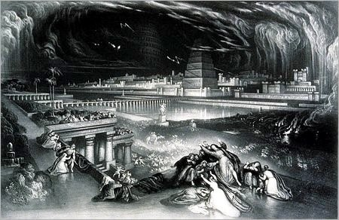
Prophesies From Lehi
The Jews would be destroyed, and many taken captive into Babylon
Return (according to the own due time of the Lord) again
The Jews would possess again the land of their inheritance
A Prophet--A Messiah would be raised
—the Redeemer of the world (Det. 18:15)
Mankind were in a “lost and fallen state”
and rely on this Redeemer (Romans 5:12)
A Prophet to come to prepare the way
of the Messiah and to baptize Him
with water
1 Nephi 10:1-11

Slide 61
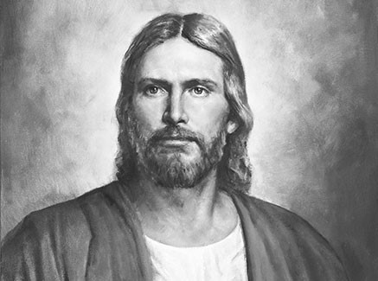
Messiah
Messiah is “a form of an Aramaic and Hebrew word meaning ‘the anointed.’
In the New Testament Jesus is called the Christ, which is the Greek equivalent of Messiah.
It means the anointed Prophet, Priest, King, and Deliverer whose coming the Jews were eagerly expecting”
--Bible Dictionary
1 Nephi 10:4

Slide 62
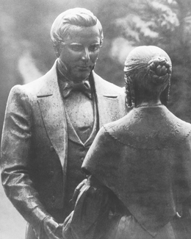
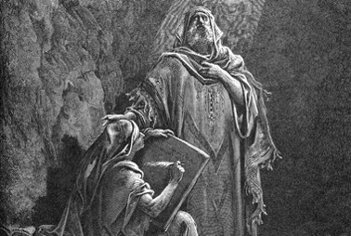
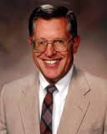
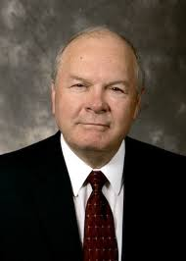
Prophets Testify
“…and of thy brethren that have the testimony of Jesus: worship God: for the testimony of Jesus is the spirit of prophecy” (Revelation 19:10)
“By definition, any man or woman who has the testimony of Jesus is a prophet, for the testimony of Jesus is the spirit of prophecy.”
-- Joseph Fielding McConkie and Robert L. Millet
“…Behold I say unto you that none of the prophets have written, nor prophesied, save they have spoken concerning this Christ.” (Jacob 7:11)
1 Nephi 10:5

Slide 63
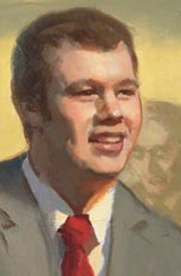
Differences
Three young men attend the same Church meeting.
After returning home:
One young man feels that the meeting was boring and a waste of
his time.
Another thinks the meeting was nice but is unaffected by it.
The third returns home uplifted by the Holy Ghost and receives inspiration and direction for his life, even beyond what was taught in the meeting.
How is it possible that the three young men could attend the same meeting but have such different experiences? (1 Nephi 15:2)
1 Nephi 10:17

Slide 64
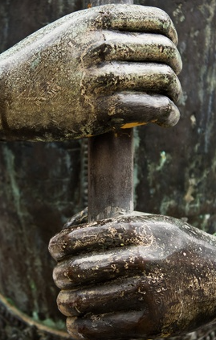
Personal Revelation
If we hearken and hold fast to the word of the Lord, the adversary’s temptations will not overpower us.

Slide 65
Sources:
Joseph Fielding McConkie and Robert L. Millet “Doctrinal Commentary of the Book of Mormon” Volume 1 page 65
Bible Dictionary “Messiah”

Slide 66
“No man can receive the Holy Ghost without receiving revelations. The Holy Ghost is a revelator” (in History of the Church, 6:58).
“Having a knowledge of God, we begin to know how to approach Him, and how to ask so as to receive an answer.
“When we understand the character of God, and know how to come to Him, he begins to unfold the heavens to us, and to tell us all about it. When we are ready to come to him, he is ready to come to us” (in History of the Church, 6:308).
Condescension 1 Nephi 11:16, 26:
“Here was Jesus—a member of the Godhead, the Firstborn of the Father, the Creator, Jehovah of the Old Testament—now leaving His divine and holy station; divesting Himself of all that glory and majesty and entering the body of a tiny infant; helpless, completely dependent on His mother and earthly father. That He should not come to the finest of earthly palaces and be … showered with jewels but should come to a lowly stable is astonishing. Little wonder that the angel should say to Nephi, ‘Behold the condescension of God!’ (1 Ne. 11:26.)” (Gerald N. Lund, Jesus Christ, Key to the Plan of Salvation [1991], 16).
Branches of the Olive Tree or Remnants of the House of Israel 1 Nephi 10:14:
"A detailed discussion of the destiny of the house of Israel (as depicted through the allegory of the olive-tree) will be undertaken in Jacob 5-6. For the moment let us make some simple observations. The Lord chose an olive tree to dramatize the destiny of his chosen people. An olive tree almost never dies. It may be pruned and worked with over numerous generations before the fruit is such as to satisfy the owner of the vineyard; this is often after many and varied cuttings and trimmings and replantings. So it is with the house of Israel. That house is stubborn and often requires constant and enduring care. It frequently requires chastening and pruning, actions painful at the time but ultimately accepted as a blessing and perhaps the only means of preservation. As it is with the dedicated gardener, so it is with the Lord-his mercies and tender regard will simply not allow him to let his chosen people go: he pleads with his people Israel to cleave unto him as he cleaves unto them. (Jacob 6:5.)
"Whose branches should be broken off? The Lord chooses periodically to 'break off' or separate certain branches or groups of the house of Israel from the main body; through this means-that of scattering-the blood and influence of' the chosen people may be spread throughout the earth. The Nephite and Mulekite branches are illustrative of this principle." (McConkie, Millet, Doctrinal Commentary on the Book of Mormon, vol. 1, p.69)
Those Against the Apostles of the Lord 1 Nephi 11:35:
"The world is still fighting the apostles of the Lamb because they represent the truth and the world rejects the truth. Even those of the house of Israel at times will gather to fight against the twelve: 'And the angel of the Lord spake unto me again saying: Behold the world and the wisdom thereof; yea, behold the house of Israel hath gathered together to fight against the twelve apostles of the Lamb' (v 35). This verse describes the apostasy following Christ's ministry in Jerusalem. The Apostasy was caused by the pride and wisdom of the world, but it will not stand forever: 'And it came to pass that I saw and bear record, that the great and spacious building was the pride of the world; and it fell, and the fall thereof was exceedingly great. And the angel of the Lord spake unto me again, saying: Thus shall be the destruction of all nations, kindreds, tongues, and people, that shall fight against the twelve apostles of the Lamb' (v 36). The world still fights the Twelve Apostles and their teaching with its own wisdom, but it will eventually fall, and the pride that motivates the fight will be the cause of that fall." (Monte S. Nyman and Charles D. Tate, Jr., eds., Fourth Nephi through Moroni: From Zion to Destruction [Provo: BYU Religious Studies Center, 1995], 210.)
The Form of a Man 1 Nephi 11:11:
"That the Spirit of the Lord is capable of manifesting Himself in the form and figure of man, is indicated by the wonderful interview between the Spirit and Nephi, in which He revealed Himself to the prophet, questioned him concerning his desires and belief, instructed him in the things of God, speaking face to face with the man [1 Ne 11:11]. However, the Holy Ghost does not possess a body of flesh and bones, as do both the Father and the Son, but is a personage of spirit. Much of the confusion existing in human conceptions concerning the nature of the Holy Ghost arises from the common failure to segregate His person and powers. Plainly, such expressions as being filled with the Holy Ghost, and His falling upon persons, have reference to the powers and influences that emanate from God, and which are characteristic of Him; for the Holy Ghost may in this way operate simultaneously upon many persons even though they be widely separated, whereas the actual person of the Holy Ghost cannot be in more than one place at a time." Elder James E. Talmage (Articles of Faith, p. 42, as taken from Latter-day Commentary on the Book of Mormon compiled by K. Douglas Bassett, p. 36)

Slide 67
Historical events Nephi was shown after each portion of Lehi's dream was given.
Vision of the Tree of Life | Vision of the History of the World­­­­
Tree=love of God (v. 8) | The birth of the Lamb of God to a virgin from Nazareth (v. 13-21)
 | The Savior going forth among the children of men (v. 24)
Rod of iron=word of God (v. 25) | The Lamb of God was baptized (v. 27)
 | He ministers in power and great glory (v. 28)
 | 12 apostles and the ministering of angels (v. 29-30)
 | The Lamb of God heals the sick and afflicted (v. 31)
 | He is judged of the world and crucified (v. 32-33)
Large and spacious building=pride of the world (v. 35) | The multitudes of the earth gather to fight against the apostles of the Lamb (v. 34-35)
Mist of darkness=temptations of the devil (1 Ne 12:4,17) | Vapor of darkness covers the Americas for 3 days (1 Ne 12:5)
 | Christ appears to the Nephites (12:6)
 | They are righteous up to the fourth generation (12:12)
 | They fall prey to the temptations of the devil and are destroyed (12:17-20)
Filthy water=depths of hell (12:16) | Wickedness and destruction of the Nephites (12:19-20)
Terrible gulf=justice of God (12:18) | Nephites destroyed for their wickedness (12:19-20)
Source: gospeldoctrine.com

