Slide 1
2 Nephi 11-19
Isaiah 2-10

Slide 2
Likening Isaiah to Ourselves
2 Nephi 11 and 16
Isaiah 6

Slide 3
Where Were You Last Night?
How could you verify what you were doing at that time?
Are there any witnesses who could verify where you were?
Why are witnesses important when we are searching for truth?
Nevertheless, God sendeth more witnesses, and he proveth all his words.

Slide 4
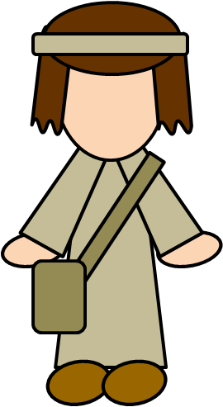
Multiple Witnesses
Three witness of the reality of the Redeemer
Nephi—Jacob--Isaiah
The Lord calls prophets to be His witnesses to the world
By studying prophets’ testimonies of Jesus Christ, we can strengthen our faith in Jesus Christ and rejoice in Him.
“God has said through his prophet, ‘In the mouth of two or three witnesses shall every word be established.’ (2 Corinthians 13:1)
2 Nephi 2-3

Slide 5
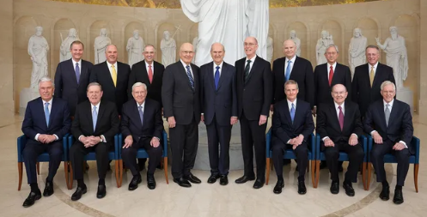
Modern Witnesses of Christ
Read:
“The Living Christ: The Testimony of the Apostles”

Slide 6
We receive this testimony when the Holy Spirit speaks to the spirit within us.
We will receive a calm and unwavering certainty that will be the source of our testimony and conviction irrespective of our culture, race, language, or socioeconomic background.
These promptings of the Spirit, rather than human logic alone, will be the true foundation upon which our testimony will be built.
The core of this testimony will always be the faith in and the knowledge of Jesus Christ and His divine mission, who in the scriptures says of Himself, “I am the way, the truth, and the life” (John 14:6).
So how do we receive a personal testimony rooted in the witness of the Holy Ghost? …
First: Desire to believe. …
Second: Search the scriptures. …
Third: Do the will of God; keep the commandments. …
Fourth: Ponder, fast, and pray.
Dieter F. Uchtdorf

Slide 7
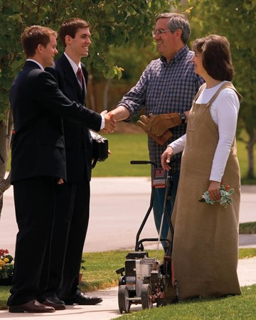
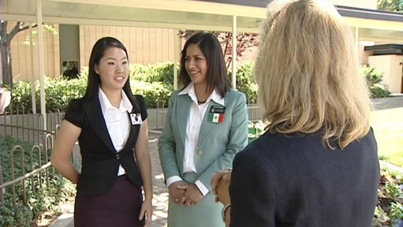
Delight
There is a spirit associated with teaching and testifying of Christ
A feeling that is deeper than just liking or being interested in something. It implies an experience of joy and satisfaction.
Nephi reasoned that if there were no Christ, no Savior to redeem mankind from their lost and fallen state, then there could be no God, for there would be no justice; and if there were no God, there could be no creation.
Heavenly Father sends witnesses to testify of the reality of His Son.
2 Nephi 4-7

Slide 8
Including Isaiah’s Writings
1. Isaiah had seen the Savior, as Nephi and Jacob had
Including Isaiah’s description of a vision in which he saw the Savior
2. Nephi delighted in testifying of Christ, and Isaiah also testified of Christ
An example of Isaiah’s prophecy of the Savior.
3. Nephi delighted in the covenants of the Lord
Isaiah’s prophecies related to the covenants of the Lord.
Isaiah prophesied of latter-day temple work
“…for he verily saw my Redeemer, even as I have seen him.” 2 Nephi 11:2–3
“…for mine eyes have seen the King, the Lord of hosts.” Isaiah 6:5
“Behold, my soul delighteth in proving unto my people the truth of the coming of Christ…” 2 Nephi 11:4
“…Behold, a virgin shall conceive, and bear a son, and shall call his name Immanuel.” Isaiah 7:14
“…my soul delighteth in the covenants of the Lord which he hath made to our fathers…” 2 Nephi 11:5
“…he will teach us of his ways, and we will walk in his paths…” Isaiah 2:3
2 Nephi 4-7

Slide 9
Nephi’s Hope
What did Nephi hope his people and future readers of the Book of Mormon would experience when they read the words of Isaiah?
“…proving unto my people the truth of the coming of Christ…”
2 Nephi 11:4

Slide 10
Understanding Isaiah
“Do not stop reading! Move forward through those difficult-to-understand chapters … even if you understand very little of it. Move on, if all you do is skim and merely glean an impression here and there”
Elder Boyd K. Packer
However:
“If our eternal salvation depends upon our ability to understand the writing of Isaiah as fully and truly as Nephi understood them—and who shall say such is not the case!—how shall we fare in that great day when with Nephi we shall stand before the pleasing bar of him who said: ‘Great are the words of Isaiah’?
(3 Nephi 23:1)
…It just may be that my salvation (and yours also!) does in fact depend upon our ability to understand the writing of Isaiah as fully and truly as Nephi understood them.”
Elder Bruce R. McConkie

Slide 11
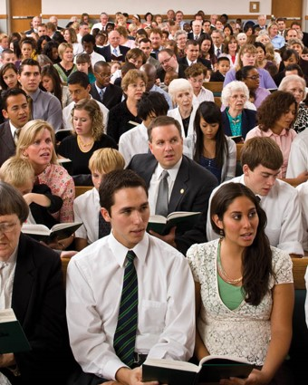
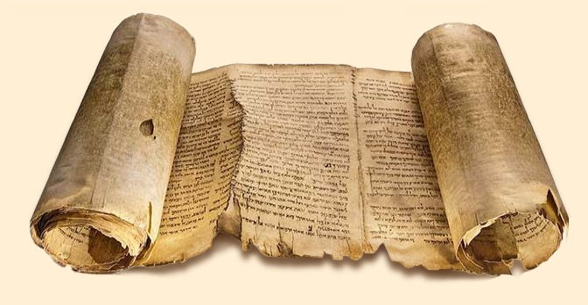
Revealed Truth
“Truth is knowledge of things as they are, and as they were, and as they are to come.” (D&C 93:24)
Nephi understood the message to be vital to all, but especially to those who live in the latter days, for they will through the fulfillment of his words. (2 Nephi 25:7)

Slide 12
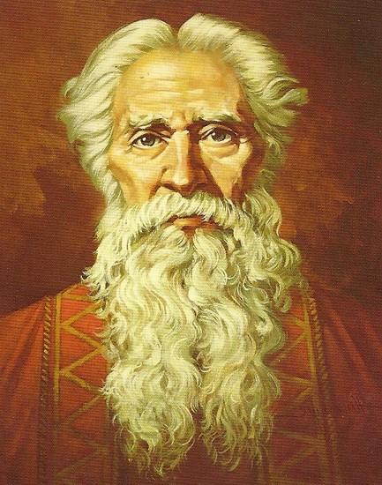
Isaiah’s Name
“Jehovah has saved”
“The Lord is salvation”
Isaiah’s central message:
The life and mission, and glorious atonement of him who is Jehovah—Jesus Christ
Ted Henninger
Student Manual

Slide 13
Who is Isaiah?
He was the son of Amoz
The Book of Isaiah is one of the major prophetic books of the Old Testament, along with Jeremiah, Lamentations (by Jeremiah), Ezekiel, and Daniel.
He was the chief advisor to Hezekiah, King of Judah
Other names "Isaias" and "Esaias"
The first verse of the Book of Isaiah states that he prophesied during the reigns of Uzziah (or Azariah), Jotham, Ahaz, and Hezekiah, the kings of Judah (Isaiah 1:1).
He may have prophesied for as long as 64 years.
He had two sons, naming one Shear-Jashub, meaning "A remnant shall return" (Isaiah 7:3) and the younger, Maher-Shalal-Hash-Baz, meaning, "Spoil quickly, plunder speedily." (Isaiah 8:3)
Who’s Who

Slide 14
More About Isaiah
He played a role in the Book of Mormon
His words are written in the Brass Plates
Nephi and Jacob give an exposition on his words
He is the most quoted prophet in scripture. Jesus said, “Great are the words of Isaiah” (3 Nephi 23:1)
He wrote in the period of 740 BC to 701 BC at a time when Israel had incurred the anger of the Lord through wanton behavior pride, and idolatry.
His language includes much symbolism
He mingles references to events of his own day with those of future time.
His famous message is “wickedness never was happiness”
Who’s Who

Slide 15
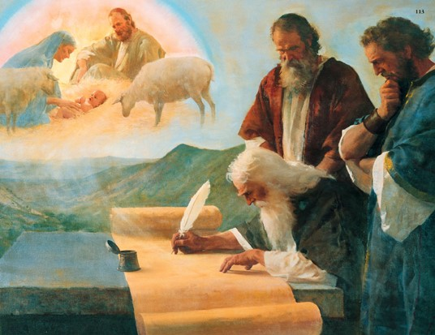
Liken
For I will liken his words unto my people, and I will send them forth unto all my children, for he verily saw my Redeemer, even as I have seen him… (2 Nephi 11:2)
And now I write some of the words of Isaiah, that whoso of my people shall see these words may lift up their hearts and rejoice for all men. Now these are the words, and ye may liken them unto you and unto all men.
(2 Nephi 11:8)
And now, behold, I say unto you,
that ye ought to search these things.
Yea, a commandment I give unto you
that ye search these things diligently;
for great are the words of Isaiah.
(3 Nephi 23:1)

Slide 16
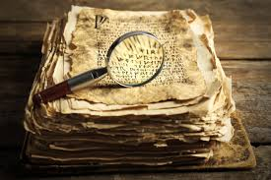
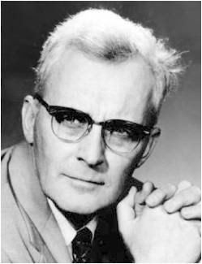
Why Isaiah?
“The Book of Isaiah is a tract for our own times; our very aversion to it testifies to its relevance…Isaiah’s message has not been popular and he tells us why.
The wicked do not like to be told about their faults.
But says Isaiah, the people of Israel (and our day) want to hear smooth things “Prophesy not unto us right things, speak unto us smooth things.”
(Isaiah 30:10)
Hugh Nibley

Slide 17
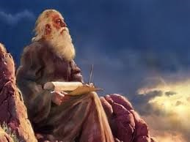
Isaiah is Called
Isaiah is called to serve as a prophet—the vision Isaiah 6
Read 2 Nephi 16
“All things which have been given of God from the beginning of the world, unto man, are the typifying of [Jesus Christ]” 2 Nephi 11:4

Slide 18
Symbolic Language
Symbolic Language, types, and figurative expressions:
Train
Sepaphim (angels)
6 wings each
Smoke
Unclean lips
Live coal
hem or skirts of a robe.
Cherubims-- angels who reside in the presence of God
The image of wings is symbolic of power to move and act.)
The presence, power, and glory of the Lord
Undone was translated from a Hebrew word that means “cut off,” and the phrase unclean lips refers to Isaiah’s consciousness of his sins and the sins of his people. Isaiah was expressing that he felt unworthy to be in the presence of the Lord.
a symbol of cleansing.
2 Nephi 16

Slide 19
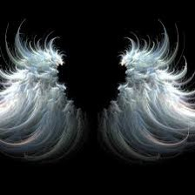
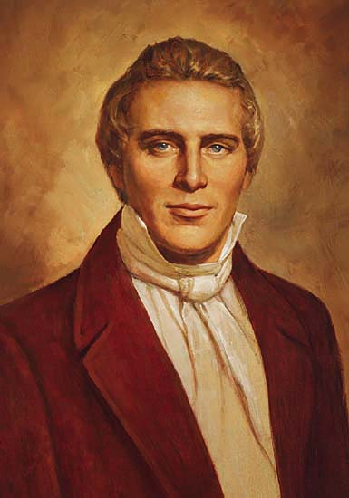
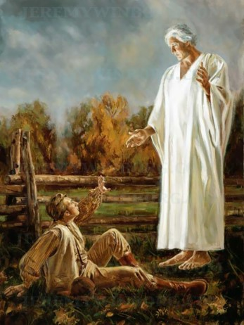
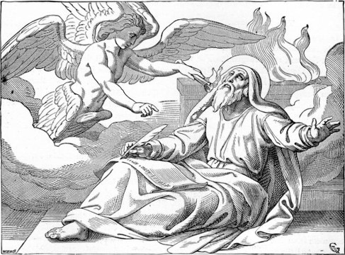
Do Angels Have Wings?
“An angel of God never has wings” Joseph Smith
Then why did Isaiah describe angels as having wings?
“The fact that these holy beings were shown to him as having wings was simply to symbolize their ‘power, to move, to act, etc.’ as was the case also in visions others had received. (D & C 77:4.)” Bruce R. McConkie
2 Nephi 16:2-3

Slide 20
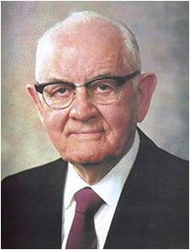
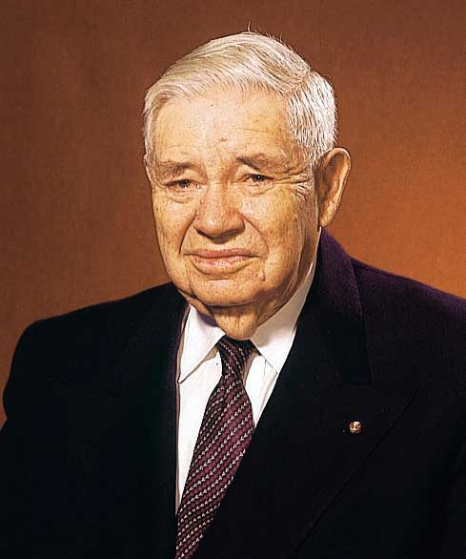
The Telephone Call
President Spencer W. Kimball described the telephone call in
which President J. Reuben Clark Jr. of the First Presidency
informed him that he had been called to the Quorum of the Twelve:
“‘Oh, Brother Clark! Not me? You don’t mean me? There must be some mistake. I surely couldn’t have heard you right.’ This as I sank past the chair to the floor. …
“‘Oh, Brother Clark! It seems so impossible. I am so weak and small and limited and incapable’”
Isaiah, a righteous man, felt “undone” and “unclean” in the presence of the Lord.
Who among us would not feel unworthy standing before God?

Slide 21
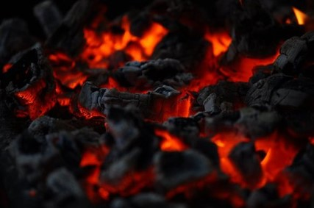
Symbolically Cleansed
What did it mean when the angel
symbolically touched Isaiah’s lips with
a hot coal?
When the angel in Isaiah’s vision touched his lips with the coal, it represented the Lord cleansing Isaiah of his unworthiness and forgiving him of his sins.
As we are forgiven of our sins, we become more willing to do what God asks of us.
2 Nephi 16:7

Slide 22
Sources:
Bruce R. McConkie Ensign Oct. 1973 pg 78
Joseph Fielding McConkie and Robert L. Millet Doctrinal Commentary of the Book of Mormon vol. 1
Student Manual Book of Mormon Religion 121-122 pg 89
Who’s Who in the Book of Mormon by Ed J. Pinegar and Richard J. Allen pg. 69-71
Boyd K. Packer(“The Things of My Soul,” Ensign, May 1986, 61).
Spencer W. Kimball (Edward L. Kimball and Andrew E. Kimball Jr., Spencer W. Kimball: Twelfth President of The Church of Jesus Christ of Latter-day Saints [1977], 189).
Joseph Smith, in History of the Church, 3:392).
Elder Bruce R. McConkie (Mormon Doctrine, 2nd ed. [1966], 703).
Dieter F. Uchtdorf, “The Power of a Personal Testimony,” Ensign or Liahona, Nov. 2006, 38–39
Presentation by ©http://fashionsbylynda.com/blog/

Slide 23
Why Nephi included the writings of Isaiah in his record:
Why Nephi included the writings of Isaiah in his record:
Isaiah had seen the Savior, as Nephi and Jacob had… | 2 Nephi 11:2-3; 2 Nephi 16:1-5 | which includes Isaiah’s description of a vision in which he saw the Savior).
Nephi delighted in testifying of Christ, and Isaiah also testified of Christ… | 2 Nephi 11:4,6; 2 Nephi 17:14; 19:6-7 | two examples of Isaiah’s prophecies of the Savior.
Nephi delighted in the covenants of the Lord | 2 Nephi 11:5; 2 Nephi 12:1-3 | Isaiah’s prophecies were related to the covenants of the Lord. For example, he prophesied of latter-day temple work
Isaiah had seen the Savior, as Nephi and Jacob had… | 2 Nephi 11:2-3; 2 Nephi 16:1-5 | which includes Isaiah’s description of a vision in which he saw the Savior).
Nephi delighted in testifying of Christ, and Isaiah also testified of Christ… | 2 Nephi 11:4,6; 2 Nephi 17:14; 19:6-7 | two examples of Isaiah’s prophecies of the Savior.
Nephi delighted in the covenants of the Lord | 2 Nephi 11:5; 2 Nephi 12:1-3 | Isaiah’s prophecies were related to the covenants of the Lord. For example, he prophesied of latter-day temple work

Slide 24
Ensign to the Nations
2 Nephi 12-14
Isaiah 2-4

Slide 25
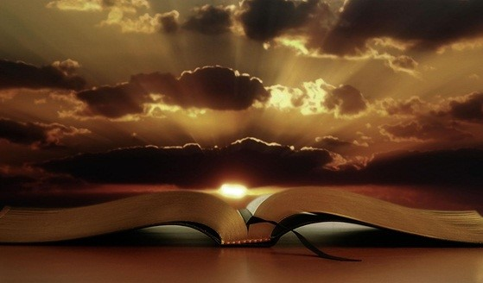
2 Nephi 12-15
“The book of Isaiah contains numerous prophecies that seem to have multiple fulfillments. …
The fact that many of these prophecies can have multiple meanings underscores the importance of our seeking revelation from the Holy Ghost to help us interpret them.”
Elder Dallin H. Oaks

Slide 26
Those Who Live Contrary To Their Covenants
Attitudes
Consequences
What attitudes and practices reflect the sins of these people?
2 NEPHI 12:5–12
2 Nephi 17–19
2 Nephi 13:8–9
What will happen to these people as a consequence of their sins?
2 NEPHI 13:16–26

Slide 27
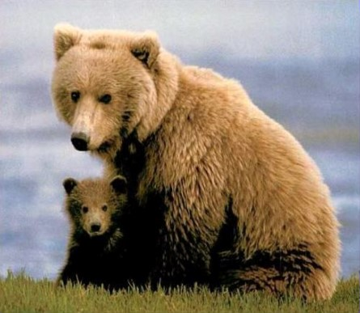
God’s People Present and Future
The Future Millennial Condition
Warnings of Judgment
Kanah-- The Lord’s Kanah
For thou shalt worship no other god: for the Lord,
whose name is Jehovah, is a jealous God.
Exodus 34:14
Jealousy = (Heb) Kanah. The word in ancient times did not convey the negative emotion we attach to it today. In our language today it would convey the emotion we feel when a cherished object is threatened and we may lose it. The “mother bear” response to a threat made toward one of our children.
Kanah means filled up with this deep emotion.
Kanah means to be filled up with strong ardor, a fervent zeal, and an intense emotion toward someone or something important to us.
God’s Kanah has two edges:
To cherish or protect His children, even to bloodshed.
A demand for the repentance of His children or retribution when He is offended by them. (see handout)
He rebukes them for:
Pride
Passions
Popularity
Power
2 Nephi 12:1-4
Becky Davies and Lesley Meacham

Slide 28
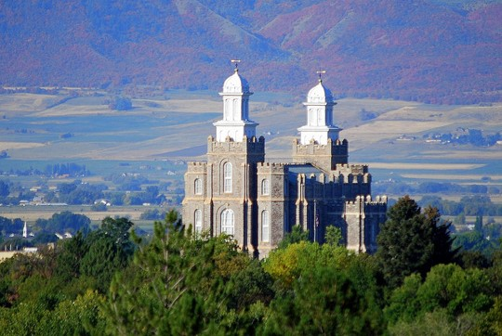
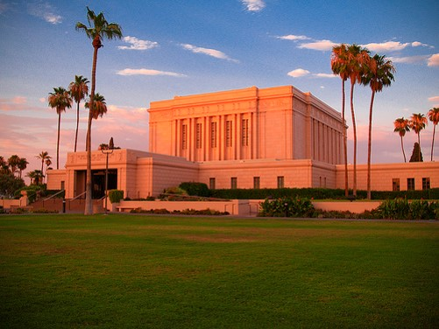
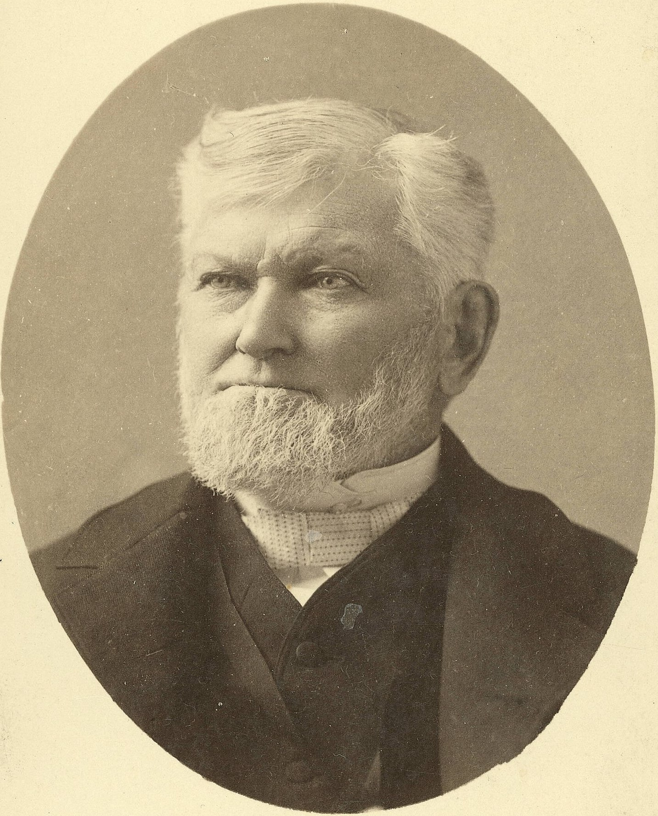
Mountain—High Place of God
A Place of Revelation
“All the Holy temple of our God in the latter days shall be built in the mountains of the Lord, for his mountains—whether the land itself is a hill, a valley or a plain—are the places where he comes, personally and by the power of his Spirit, to commune with his people.”
Elder Bruce R. McConkie
Dedicatory Prayer
“…when the mountain of the Lord’s house should be established in the tops of the mountains, and should be exalted above the hills. We than Thee that we have had the glorious opportunity of contributing to the fulfillment of these visions of Thine ancient seers…”
Wilford Woodruff
2 Nephi 12:1-4

Slide 29
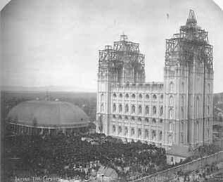
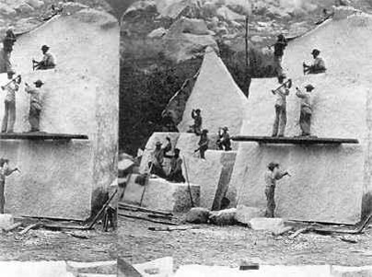
“Ever since the Salt Lake Temple was dedicated, we have interpreted that scripture from Isaiah (2 Nephi: 2-5) … as applying to this sacred house of the Lord. And of this place, since the day of its dedication, an ever-increasing number from across the world have said in effect, ‘Come ye, and let us go up to the mountain of the Lord, to the house of the God of Jacob, that He might teach us of His ways, that we might walk in His paths.’”
President Gordon B. Hinckley

Slide 30
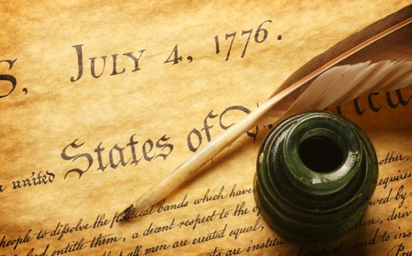
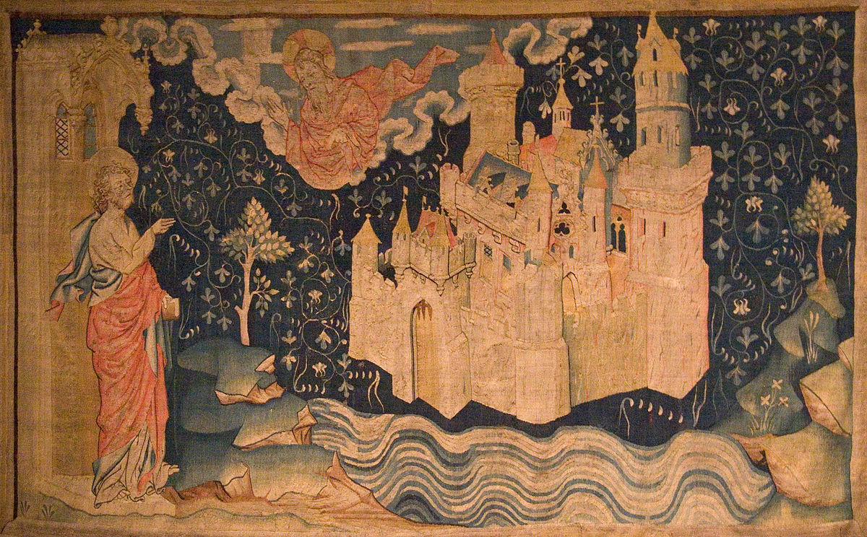
The Law From Zion—The Word from Jerusalem
A Great Nation
“He (God) will assemble the native, the remnants of Joseph in America, and make of them a great, and strong, and powerful nation; and he will civilize and enlighten them, and will establish a holy city, and temple, and seat of government among them, which shall be called Zion. …”
Jerusalem
“…And there shall be his tabernacle, his sanctuary, his throne, and seat of government for the whole continent of North and South America forever.
In short, it will be to the western hemisphere what Jerusalem will be to the eastern.”
2 Nephi 12:3 Message of the 1st Presidency

Slide 31
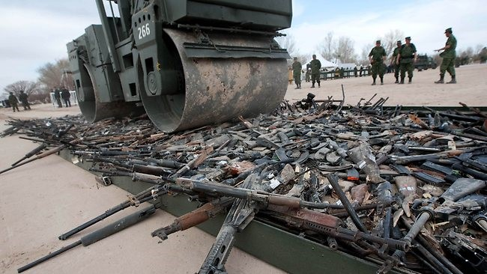
Neither Shall They Learn War
“Obviously Isaiah is describing a condition in the world that shall come at or after the Second Advent of the Lord.”
Sidney Sperry
During the Millennium
Nations will not lift the sword against nations, nor will they learn warfare anymore.
2 Nephi 12:4

Slide 32
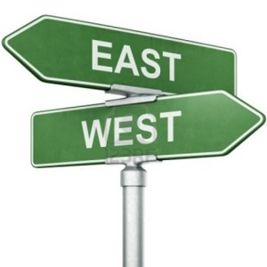
An Invitation
“Come ye, and let us walk in the light of the Lord”
Ye have all gone astray/wicked ways
Lord has abandoned the people
Influences from the East
Please themselves w/children of strangers
He talks of where we are today. He wants us to see what it will take to move us from our present-day Reality to the Ideal
God never abandons but relies on our agency. He withdraws his Spirit only when He is rejected.
Which way do we go back into the presence of God? West. The East was always a symbol of the world. Moroni beacons to the East (world) to come unto Christ and to herald His coming from the East. Isaiah means that we are looking to the world for our inspiration and direction instead of the prophets and the Gospel.
They are marrying out of the Covenant.
2 Nephi 12:5-6

Slide 33
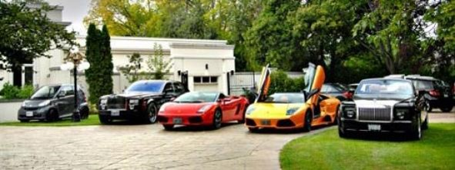
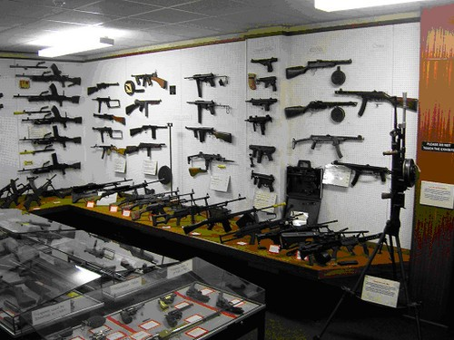
The Worldly Way
“Their land also is full of:
Land/treasure
Horses/chariots
Materialism, they are focused on accumulation of wealth for security
Warfare. Can you imagine living in a world where the people are obsessed with the accumulation of wealth and building up of military weapons? Where do we look for safety and security?
2 Nephi 12:7

Slide 34
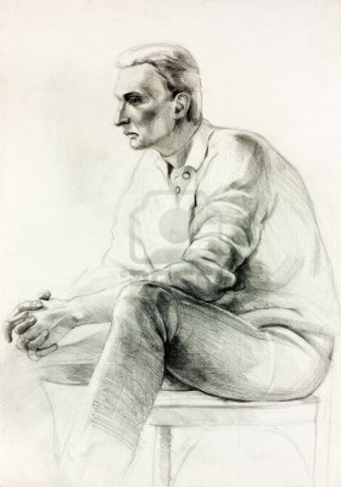
Man
“Their land also is full of:
The average and common man
The common and great men refuse to bow to God but humble themselves before what they themselves have made.
Mean man
Boweth not down and great man humbleth himself not
Ask Yourselves: Are we valuing:
Intellectualism or popular ideology more than prophets and scriptures?
Materialism and militarism more than simplicity of living within our means and the protection virtue gives us?
The things we produce ourselves? Or do we acknowledge all comes from God?
2 Nephi 12:8

Slide 35
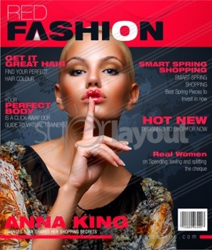
Full of Idols
“Their land also is full of:
Idols
Worshipping what we make with our own hands
Secular humanism
What is an idol? Anything we put before the Lord
We worship the creation more than the creator. Idolatry and adultery have the same root. Idol worship was attractive because it was connected to perverted sexual practices. How are much of our material creation marketed today?
Through sexual advertisement.
Only believe in physical world and proof. We perceive God through of recognizing truth by the Spirit not our physical senses only.
God speaks to us through our spirits…
Satan speaks to us through our bodies
2 Nephi 12:9

Slide 36
“Modern idols or false gods can take such forms as clothes, homes, businesses, machines, automobiles, pleasure boats, and numerous other material deflectors from the path to godhood. …
Many young men decide to attend college when they should be on missions first. The degree, and the wealth and the security which come through it, appear so desirable that the mission takes second place. …
Many worship the hunt, the fishing trip, the vacation, the weekend picnics and outings. Others have as their idols the games of sport, baseball, football, the bullfight, or golf. …
Still another image men worship is that of power and prestige”
Spencer W. Kimball
Isaiah prophesied of people who would show their pride and worldliness by the way they dressed.
How can we guard against worldly attitudes and trends?
2 NEPHI 12:5–12, 17–19;13:8–9
2 NEPHI 13:16–26
What attitudes and practices reflect the sins of these people?
What will happen to these people as a consequence of their sins?
Insert Video:
A Day When

Slide 37
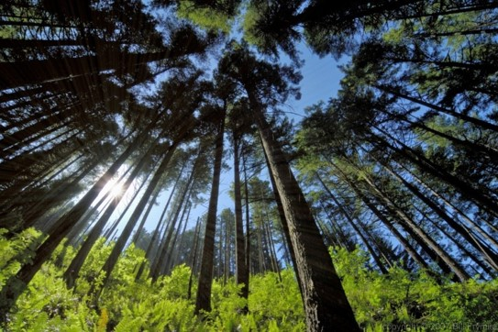
Consequences
What will happen to those who persist in these maladies?
Wicked/hide
Lofty/haughty/cedars/oaks/mountain/hills/tower/wall
Isaiah says if they don’t repent they will hide to avoid God’s wrath. Isaiah describes panic, fear and shame that they will feel when the Messiah comes.
All these images are of things that stand tall (high)
…They are symbolic of the way prideful men think of themselves…all are brought low. No man is worthy of our high esteem…only the Lord.
2 Nephi 12:9-15

Slide 38
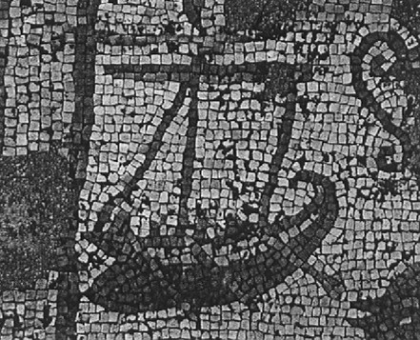
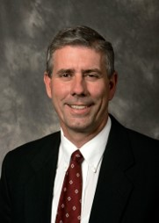
2 Ancient Versions
What will happen to those who persist in these maladies?
“And upon all the ships of the sea, and upon all the ships of Tarshish, and upon all pleasant pictures.”
“And upon all the ships of Tarshish, and upon all pleasant pictures”
Isaiah 2:16
Masoretic(Hebrew---text) 1000 AD and Septuagint (300 BC Greek)
Each say just one—either “ships of Tarshish” or “ships of the sea.”
With both showing Nephi may have had an earlier copy of Isaiah.
Fabrication?
“As Joseph Smith was fabricating the Book of Mormon and speaking Greek, he went to the local library and checked out both books.” Terry Ball
2 Nephi 12:16

Slide 39
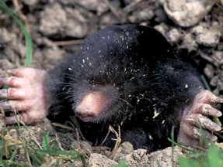
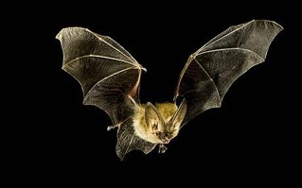
The Caves of the Earth
Hiding?
Into holes of rocks
Terror of the Lord
In that day
Cast gold/silver to moles/bats
In order to go/caverns/rock/clefts
Stop regarding man
How would we hide the evidence of idols we have?
Lord’s Kanah or jealous judgment.
He has withdrawn His Spirit and if we are not willing to come back into the light we will suffer the eternal consequences
Our day
The people will throw their god/silver idols to animals who are blind from living so long in the darkness.
Those who were blinded by idols will live like moles/bats rather than face God
Isaiah warns us that we must cease placing confidence in man and his status symbols and idols
2 Nephi 12:19-20

Slide 40
Wo---Actions and Attitude Bringing Sorrow
Wo unto them that call evil good, and good evil, that put darkness for light, and light for darkness, that put bitter for sweet, and sweet for bitter!
In what ways have you seen people calling “evil good, and good evil” in our day?
Matthew 12:35
“ A good man out of the good treasure of the heart bringeth forth good things: and an evil man out of the evil treasure bringeth forth evil things.”
2 Nephi 12:20

Slide 41
“Evil that used to be localized and covered like a boil is now legalized and paraded like a banner. The most fundamental roots and bulwarks of civilization are questioned or attacked. Nations disavow their religious heritage. Marriage and family responsibilities are discarded as impediments to personal indulgence. The movies and magazines and television that shape our attitudes are filled with stories or images that portray the children of God as predatory beasts or, at best, as trivial creations pursuing little more than personal pleasure. And too many of us accept this as entertainment…
An increasing number of opinion leaders and followers deny the existence of the God of Abraham, Isaac, and Jacob and revere only the gods of secularism. Many in positions of power and influence deny the right and wrong defined by divine decree. Even among those who profess to believe in right and wrong, there are “them that call evil good, and good evil” (Isa. 5:20; 2 Ne. 15:20). Many also deny individual responsibility and practice dependence on others, seeking, like the foolish virgins, to live on borrowed substance and borrowed light.”
Elder Dallin H. Oaks

Slide 42
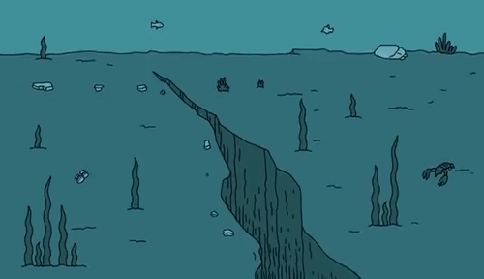
The Wicked and Unrepentant
Run Away
Cleft/ragged rocks
Shake terribly the earth
Cease ye from man
Whose breath is in his nostrils
The wicked will run away as if they were “safe” from God
All forms of manmade security will fail as in an earthquake as the justice of God’s Kanah arises.
Stop putting your trust in mankind
Man is weak and fragile.
Man has no control over his life. His next breath could be his last.
2 Nephi 12:21-22

Slide 43
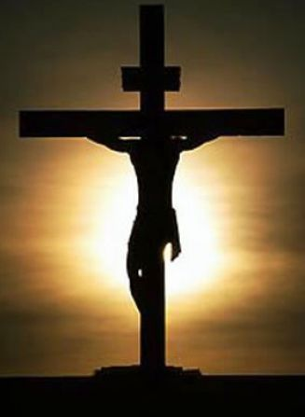
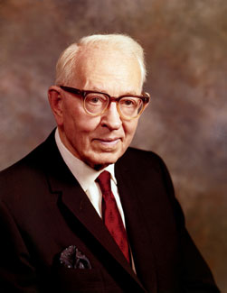
Ensign
Ensign refers to a standard, flag, or banner that is used as a rallying point or as a signal to assemble, especially in battle.
“That ensign [is] the Church of Jesus Christ of Latter-day Saints, which was established for the last time, never again to be destroyed or given to other people. It was the greatest event the world has seen since the day that the Redeemer was lifted upon the cross and worked out the infinite and eternal atonement. It meant more to mankind than anything else that has occurred since that day.”
Joseph Fielding Smith

Slide 44
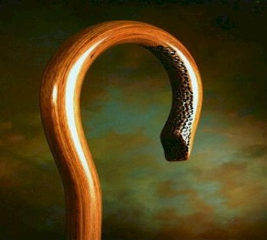
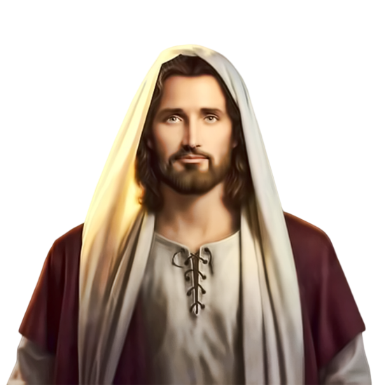
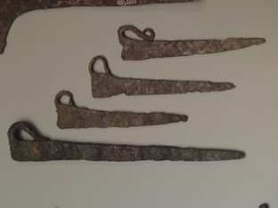
Judah and Jerusalem
Roman Stay/Staff=
Hebrew supply/support
Bread/Water
When a stay, or tent prop or stakes are removed the tent collapses. A shepherd’s staff is a symbol of mercy and rescue.
When God removes His supply and support chaos happens.
3 times Jerusalem would be taken over (captive) and destroyed:
Babylon, Rome, Armageddon
---a physical starvation, cannibalism and eventual desolation by their enemies.
God’s withdrawal also brings spiritual death and destruction.
He is the “bread of life” and the “living water”.
Sacrament Image—Christ and His atonement—His presence covers and protects us from evil.
2 Nephi 13:1

Slide 45
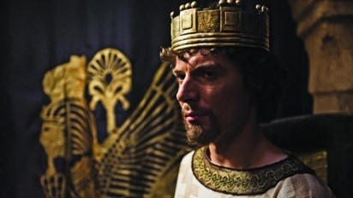
Disobedient=Chaos
Mighty man
No prophet
Children/adolescents
Babes rule
People oppressed
People to represent all who have achieved community status and who will be made puppets of false ideology or taken into captivity, leaving the masses who are easy to control.
There will be men and soldiers, magistrates and false prophets but no one to lead with true authority.
When there are no prophets who is there to warn the people and call them to repentance? (Matthew 15:14)
Gentiles, or those with childish understanding will lead
The inexperience rule. From Manasseh to Zedekiah the kings were between the ages of 8 to 25 years old and all but one fell to evil leadership and were incapable of bringing order.
A breakdown of society=oppressed by each other=Youth rule and elderly are discarded.
Isaiah repeatedly warned the people not to put confidence in man because of the vanity and weakness of human powers.
2 Nephi 13:2-5

Slide 46
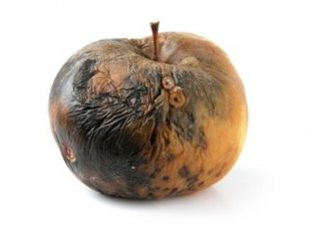
Culture, Wealth, and Status
Thou hast clothing/be thou our ruler
I will not be a healer
Jerusalem ruined, Judah is fallen
Provoke the eyes of his glory
Leaders are chosen for their material goods
Full of sores and no one to heal. Israel is decaying and there is no one who is willing or capable to really lead them
1. Social breakdown---patriarchal (family and priesthood)
2. The extreme physical poverty of the state
What is God’s glory? To bring to pass the immortality and eternal life or man.
These people have rebelled against God’s work that would have saved them.
2 Nephi 13:6-8

Slide 47
Chiasmus-- (from the Greek: χιάζω, chiázō,) “is the figure of speech in which two or more clauses are related to each other through a reversal of structures in order to make a larger point
Jerusalem and Judah are addressed (v.1)
B. Bread and water are taken away (v.2)
C. Society’s leaders are listed (v. 2-3)
D. Children rule over princes (v. 4)
E. People oppress each other (v. 5a)
D. Youth rebel against the elders (v. 5b)
C. Family leaders are called upon (v. 6)
B. Lack of bread and leadership (v. 7)
A. Jerusalem and Judah are ruined (v. 8)
The middle is the most important message:
E. The whole society suffers
2 Nephi 13:1-8

Slide 48
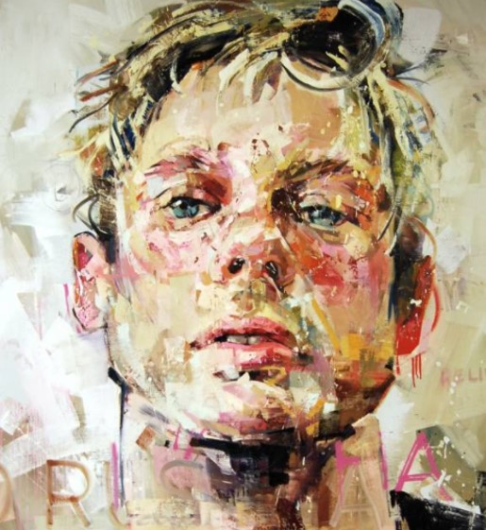
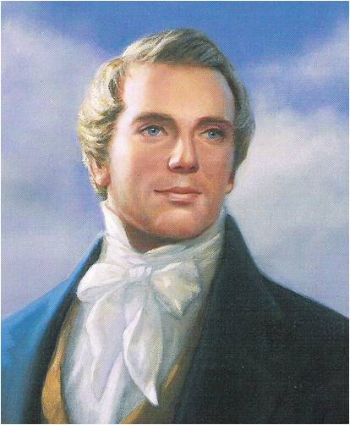
Show of Their Countenances
“You will always discover in the first glance of a man, in the outlines of his features something of his mind.”
Joseph Smith
“Who we are inside will eventually show up in our paces. Israel’s faces revealed perverted sexuality and hatred of god and mankind.
“Nothing happened in Sodom and Gomorrah which exceeds the wickedness and depravity which surrounds us now....”
Israel was distracted.
Sin used to be hidden and now it is open and flagrantly flaunted.
Andrew Salgado
Elder Boyd K. Packer
2 Nephi 13:9

Slide 49
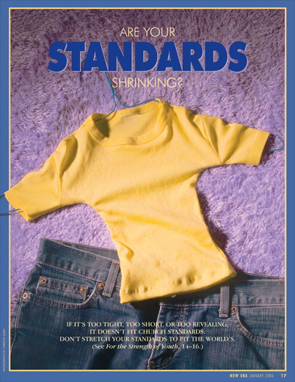
Hide It Not
“Your body is sacred. Respect it and do not defile it in any way.
Through your dress and appearance, you can show that you know how precious your body is. You can show that you are a disciple of Jesus Christ and that you love Him.
Prophets of God have continually counseled His children to dress modestly. When you are well groomed and modestly dressed, you invite the companionship of the Spirit and you can be a good influence on others. Your dress and grooming influence the way you and others act.
Never lower your standards of dress. Do not use a special occasion as an excuse to be immodest.
When you dress immodestly, you send a message that is contrary to your identity as a son or daughter of God. You also send the message that you are using your body to get attention and approval.”
For the Strength of Youth” Booklet
2 Nephi 13:9

Slide 50
Wo Unto the Wicked
Righteous shall eat of the fruit of their doings
The reward shall be upon them (wicked)
Children
Women rule over them
Those who are righteous shall have joy in their posterity
What they labor for is what their reward will
Book of Mormon=they shall perish
Isaiah= it shall be ill with them
They shall be paid back for the deeds they have done!
Gentiles are the oppressors. Can also be the rebellion of the youth.
Leaders will be as weak as or will actually be women. This is an insult in ancient Israelite culture. Leadership was a Priesthood function only. This would be a disbanding of the traditional patriarchal social structure. Example: The Relief Society taking over the leadership
Priesthood= the framework and order
Relief Society= Internal Creation
2 Nephi 13:10-12

Slide 51
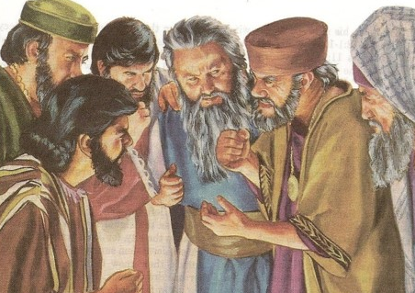
Unjust to the Poor
Lord standeth up to plead/judge
Judgment with the ancients
Grinding the faces of the poor
Haughty/wanton
Jesus has two roles in the heavenly courts:
Advocate and Judge
The Lord will be harsh against the apostate elders of the people who have combined with the political rulers to exploit the poor by taxes or fraud. Social injustice is a common theme in Isaiah
How can they justify the crime of crushing and humiliating the people of God?
God likens the disobedient covenant people to the “Daughters of Zion”
2 Nephi 13:13-16

Slide 52
Daughters of Zion
see Handout
Why “Daughters” of Zion?
Throughout all Isaiah the relationship of covenant people to God is like husband and wife. The ‘daughters’ of Zion are those espoused to the bridegroom Jesus Christ. They should be keeping themselves lovely and pure. The is literal and figurative
What are they doing?
They are playing the harlot trying to attract other lovers instead of patiently waiting and preparing for the bridegroom Joseph Fielding Smith interpreted this in part to the dress styles of our modern day.
Who are the lovers?
Anything we are attracted to outside of the Truth and Heavenly Father’s plan.
Looking for happiness in the wrong places.

Slide 53
Decay
Lord will smite with a scab the crown
In the hour of judgment the “beauty” of these harlots would be replace by decay.
Literally may refer to the humiliating Babylonian punishment of shaving the head when enslaved.
The Old Testament law forbade priests from shaving their heads or beards (Leviticus 21:5). In the ancient Hebrew culture, men usually had long beards. In fact, it was considered a disgrace for an adult man not to have a beard (2 Samuel 10:4-5).
Men taking the Nazarite vow were not to cut their hair until the vow was completed, at which time they were to shave their heads.
Regarding women shaving, Scripture says that it is disgraceful for a woman to shave her head (1 Corinthians 11:5-6) and that her hair “is a glory to her” (v. 15 KJV).
Spiritually an uncovered head means lost privileges of the Atonement.
Charles Zacharie Landelle
Charles Zacharie Landelle
2 Nephi 13:17

Slide 54
Rebellion Against God
Discover their secret parts
There shall be stink
Instead of girdle a rent
A girding of sackcloth
Burning
War
Her entrance
To be stripped naked and held up to the leering gaze of their captors.
Use of perfume has always been important to women, but in judgment there would only be the odor of death and decay of those slain by the enemy.
No stylish clothing but rags
A sign of mourning
Guilt---literal---branding, tattoos, shaving, sackcloth and branding traditionally mark those taken into captivity.
A result of rebelling against God and the withdrawal of His protection
No gates are open. Jerusalem is desolate
2 Nephi 13:17, 24-26

Slide 55
Chapter 14
…we read of the glorious spring
of restoration with its
heaven-sent cleansing rains,
followed in turn by the pleasant
summer of millennial splendor.”
“In the preceding chapter we read of the bitter winter seasons of apostate darkness. Now we read of darkness and wickedness giving way to light and righteousness…
“It is day when Zion’s daughters have abandoned worldly fashions and have adorned themselves with robes of righteousness, while Jacob's faithful sons have in the language of Isaiah, put on their beautiful garments—the authority and power of the holy priesthood.”
2 Nephi 14; Isaiah 52:1; D&C 113:7-8
JFM and RLM

Slide 56
Seven Women
In their humiliated state, women have abandoned coquettish, alluring tactics for a direct and desperate approach.
Eat our own bread
“Because war has claimed the lives of many men of Jerusalem many women will take hold of one man. In times of unrighteousness some women want to avoid motherhood. Economic problems will be such that these women will be willing to provide their own food and clothing, contrary to the usual marriage customs.
(Isaiah 3:25-26)
Barrenness for an ancient women would have been a curse. Bearing children was their only means of honor.” (Genesis 30:22-24, Luke 1:24-25)
Victor L. Ludlow
7= perfect, complete, whole…symbolically
In the Hebrew culture men were to provide for his wife. These women will provide for themselves. (Exodus 21:10)
Charles Zacharie Landelle
2 Nephi 14:1

Slide 57
Branch of the Lord
In that day---our day
Righteous Branch
Offshoot of the House of Israel
Branch
Jesus is called the branch—bring spiritual and physical sustenance to His righteous followers when He returns.
Servant poem Isaiah 11—Rod– representing a great servant of the Lord, perhaps depicting a latter-day leader who will prepare the world for the Lord’s second coming.
Joseph’s patriarchal blessing:
“…a fruitful vine by a well whose branches would run over the wall.” (Genesis 49:22)
“… out of the fruit of his loins the Lord God would raise up a righteous branch unto the house of Israel; not the Messiah, but a branch which was to be broken off, ” (2 Nephi 3:5)
Fruit of the earth—is the blessings of the restored gospel.
Blessed because of:
Temples---associated with abundance and prosperity of any people.
2 Nephi 14:2

Slide 58
Spiritual Fruit of Escape
Them that escaped
They that have not been caught up or led astray by the adversary.
Escaped from pride and materialism
They are free because they are not taken captive by sin.
The Lord will be the spiritual “Fruit” for the escaped, who are the scattered remnants of the house of Israel (Isaiah 11)
2 Nephi 14:2
Ludlow

Slide 59
Left in Zion
Those in America after latter-day judgment
Remaineth in Jerusalem—
Those in Israel who survive the judgments
Holy= Pure, sanctified
Those who are temporarily transfigured so they can be caught up during the great destruction of the wicked
(D&C 88:96-98)
Hebrew root word “Holy” = translated “Temple”
Those caught up will, in Zion or Jerusalem, be called a “temple people”
Parable of 10 Virgins (Matthew 25:1-13) an example of “not all members of the church will be worthy to be saved.” The inward vessel must be cleansed first
(Alma 60:23)
2 Nephi 14:3

Slide 60
Wash Away the Filth
A Chosen people of the Old World (in Jerusalem) and the people of the New world, living in Zion (the New Jerusalem)
As members of the stakes of Zion, we are included in the Lord’s assurance of protection (D&C 68:26; 107:36; 109:59)
Cleansing = Water ==washes away
Burning = Fire = by the spirit of burning
“The filth of the children of Israel” will be washed away symbolically by the ordinance of baptism—this does not mean children are filthy.
Through the gift of the Atonement, the Savior cleanses those who come unto Him and purges those worthy of His grace.
Symbolic washing and cleansing from the blood and sins of this telestial life are also experienced in our temples as we prepare to enter God’s celestial realms.
2 Nephi 14:3-4
Ludlow

Slide 61
A Place of Refuge
“And the Lord will create upon every dwelling-place of mount Zion, and upon her assemblies, a cloud and smoke by day and the shining of a flaming fire by night; for upon all the glory of Zion shall be a defense.”
What is our greatest defense?
Our individual homes are our holy places
Assemblies—our churches and Stake centers
Flame of fire by night—God’s spiritual presence to light the way
Defense—Canopy or protective covering
2 Nephi 14:5

Slide 62
Cloud and Fire
“And there shall be a tabernacle for a shadow in the daytime from the heat, and for a place of refuge, and a covert from storm and from rain.”
Tent
Temple
We will be protected from spiritual harm in these 3 sanctuaries just as we are protected physically by seeking shelter/refuge/covert
Refuge/covert—Zion is called a “city of refuge” and “a place of safety.”
Zion homes
Stakes
Temples
Our Covering—Through Jesus Christ--Atonement
Heat/ storm/ rain= Our trials. Satan’s attacks. Symbols of God’s judgment on the wicked
(D&C 87:6-8) Ask any Young Woman or Young Man what this scripture is…They should know it by heart.
2 Nephi 14:5-6

Slide 63
Isaiah is Giving Us a Choice of:
A vision of who we are and our hope for the future
A view of where we are now
Where we will end up if we don’t change

Slide 64
Sources:
Elder Dallin H. Oaks (“Scripture Reading and Revelation,” Ensign, Jan. 1995, 8).; April 2004 General Conference Preparation For the Second Coming.
Bruce R. McConkie Millennial Messiah pg 275
Gordon B. Hinckley (“An Ensign to the Nations, a Light to the World,” Ensign, Nov. 2003, 82).
Wilford Woodruff Discourse Of pg. 337 (Dedicatory prayer of the Salt lake Temple April 6, 1893)
April 6 1845 Message of the 1st Presidency 1:259-261
Sidney Sperry Book of Mormon Compendium pg 175
Spencer W. Kimball(The Miracle of Forgiveness [1969], 40–41).
Joseph Fielding Smith (Doctrines of Salvation, 3 vols. [1954–56], 3:254–55).
Notes from Lesley Meacham and Becky Davies Poway Institute
Elder Boyd K. Packer, Source: Talk to J. Reuben Clark Law Society, February 2004
Victor L. Ludlow Isaiah, Prophet, Seer, and Poet pg 109 and Unlocking Isaiah in the Book of Mormon pg 99
Joseph Fielding McConkie and Robert L. Millet Doctrinal Commentary on the Book of Mormon 1:279
Presentation by ©http://fashionsbylynda.com/blog/

Slide 65
Those Who Live Contrary To Their Covenants
Attitudes
Consequences
What attitudes and practices reflect the sins of these people?
2 NEPHI 12:5–12
2 Nephi 17–19
2 Nephi 13:8–9
What will happen to these people as a consequence of their sins?
2 NEPHI 13:16–26
Lesson 32

Slide 66
The Lord’s Kanah
For thou shalt worship no other god: for the Lord,
whose name is Jehovah, is a jealous God.
Exodus 34:14
Jealousy = (Heb) Kanah. The word in ancient times did not convey the negative emotion we attach to it today. In our language today it would convey the emotion we feel when a cherished object is threatened and we may lose it. The “mother bear” response to a threat made toward one of our children.
Kanah means filled up with this deep emotion. It is used in the same sense of fabric put in a dye which has reached its maximum point of saturation and can take on no other dye. A common experience would be dying Easter eggs. Little children will dye pastel eggs because they get so excited and take the eggs out before the egg has fully pulled in the dye. Older children or adults will let the eggs sit in the dye until the color is rich and full. Kanah means to be filled up with strong ardor, a fervent zeal, and an intense emotion toward someone or something important to us.
God’s Kanah has two edges:
To cherish or protect His children, even to bloodshed
A demand for the repentance of His children or retribution when He is offended by them.
When Israel was about to enter the Promised Land and inherit the land and cities and farms and livestock they had not developed and earned themselves, the Lord tells them of His Kanah and what to do with this wealth they were inheriting. He told them they had better not forget Him and seek other means to success and security. He told them there would be temptation to seek other gods, but that they were to be faithful to Him and his jealousy or Kanah would be as a guardian and champion for them.
The Israelites knew what being a champion meant. When petty kings, whose realm consisted of only a few cities each, wanted to fight their enemy they would agree to each choose a champion to fight to the death. They could not afford to lose many men because they had so few. If you’re an emperor – who cares how many men you lose? You can always round up more from all the provinces. In this fight of the champions, whichever side wins – they become the rulers and enslave the kingdom of the other petty king. This was the story of David and Goliath.
God told the Israelites that if they would remain righteous it would move His Kanah (the full extent of the emotion to be their protector) to be their champion so that Israel would not longer need to fear in battle. God would be their champion and He would always win their battles for them. In essence He was saying, “You are my treasure and if anyone bothers my treasure, I will fight them.” But, on the other hand, if the Israelites were to rebel against God they would provoke his jealousy or Kanah to a fullness of wrath against them.
--Richard Draper

Slide 67
“He (God) will assemble the native, the remnants of Joseph in America, and make of them a great, and strong, and powerful nation; and he will civilize and enlighten them, and will establish a holy city, and temple, and seat of government among them, which shall be called Zion. And there shall be his tabernacle, his sanctuary, his throne, and seat of government for the whole continent of North and South America forever. In short, it will be to the western hemisphere what Jerusalem will be to the eastern. And there the Messiah will visit them in person; and the old Saints, who will then have been raised from the dead will be with him, And he will establish his kingdom and laws over all the land. …The city of Zion, with its sanctuary and priesthood, and the glorious fulness of the gospel, will constitute a standard which will put an end to jarring creeds and political wranglings, by uniting the republics, states, provinces, territories, nations, tribes, kindred, tongues, people, and sects of North and South America in one great and common bond of brotherhood. …Americans! This might and strange work has been commenced in your midst, and must roil on in fulfillment.”
(Originally published Apr. 6, 1845 Messages of the 1st Presidency 1:259-261)

Slide 68
Daughters of Zion Successive Excessive Accessories Isaiah 3:16-24 and 2 Nephi 13:16-24
Think figuratively of covenant men and women of the Church
Stretched forth necks
Wanton Eyes
Walking and mincing
Tinkling with their feet
Smite with a scab
Discover their secret parts
Caws
Round tires like the moon
Chains
Mufflers
Bonnets
Ornaments of the legs
Tablets
Earrings, rings, Nose jewels
Changeable suits of apparel
Hoods
Mantles
Wimples
Crisping pins
Glasses
Stomacher
Stretched forth necks
Haughtiness (2 N e 13: 16)
Seductive eyes that focus on things of the flesh
Short rapid steps that draw attention
Ornaments and bells on their ankles
Itchy rash or perhaps a sign of slavery
Or "uncover," put to shame, humiliate
Hair nets or veils covering all but eyes
Crescent-shaped ornaments
Pendants, necklaces, earrings
Veils that shimmer with movement
Decorative headdresses, tiaras or turbans
Ankle chains to make their steps equal
"Smelling boxes" or "bottles," perfumes/fragrant odors
Charms or amulets,
Rings hung from cartilage between nostrils Various costly outfits of robes and garments
Women's turbans
Tunic with sleeves or loose robe
Cloaks or shawls
Large money bags that were highly ornamented
Polished mirrors or transparent clothing
Nice robe
Haughtiness (2 Ne 13:16)

Slide 69
Chiasmus-- (from the Greek: χιάζω, chiázō,) “is the figure of speech in which two or more clauses are related to each other through a reversal of structures in order to make a larger point
Jerusalem and Judah are addressed (v.1)
B. Bread and water are taken away (v.2)
C. Society’s leaders are listed (v. 2-3)
D. Children rule over princes (v. 4)
E. People oppress each other (v. 5a)
D. Youth rebel against the elders (v. 5b)
C. Family leaders are called upon (v. 6)
B. Lack of bread and leadership (v. 7)
A. Jerusalem and Judah are ruined (v. 8)
The middle is the most important message:
E. The whole society suffers
2 Nephi 13:1-8

Slide 70
Parable of the Vineyard
2 Nephi 15
Isaiah 5

Slide 71
The Vineyard—
The Covenant People--Israel
Well Beloved--Savior
Towers—Temples
Watchmen--Prophets
Fence and Stones--preparation
Fruitful Hill—The Lord places us where we will have the best harvest
Grapes
wild—sour—worthless.
Symbol of decaying and evil people
Winepress—Christ’s atonement
2 Nephi 15:1-2

Slide 72
What Should the Lord Do?
“What could have been done more to my vineyard, that I have not done in it? wherefore, when I looked that it should bring forth grapes, brought it forth wild grapes?” (Isaiah 5:4)
Even though they had been raised in sweet conditions, they had become wicked—they unknowingly pronounce judgment on themselves
2 Nephi 15:4

Slide 73
God’s Protection is Taken Away
The wall, hedge and tower =
Gods Protection
He simply leaves the sinner alone to face life’s adversities and Satan’s buffeting without the comfort and protection of His Spirit.
What happens when we reject God?
If we are prideful and turn away from the Lord, we will lose His protection
2 Nephi 15:5-6

Slide 74
Form of Tough Love
I will lay it waste
The land (and the individual) becomes a wasteland without care and protection
No Rain—No Revelation, No Word of God
Briars and thorns--
Consequences that come
Designed to help us turn back to God
Apostasy
2 Nephi 15:5-6

Slide 75
Woe--Condemning the Rich
During Isaiah’s time each family received an inheritance.
They were to maintain it and pass it down to posterity
Greedy men were buying up all the real estate in hopes of enriching themselves
Judah was forfeiting her individual freedoms to a central government which was controlling the property.
Losing Personal Ownership
2 Nephi 15:8-9

Slide 76
Woe—Habitual Evil
Drink early in the morning
Musical instruments
Gone into Captivity
Hell hath enlarged herself
Mean/mighty man
Strangers eat in the waste places
Definition of an alcoholic.
The need for constant entertainment. Some music is associated with alcohol and that lifestyle makes them not even aware of God.
The popular culture drives away the Spirit and leads the people into captivity, and they don’t even know…they are past feeling.
Where does Satan get his power?
From us. Hell’s mouth is a metaphor—using the symbolism of feasting—all those that “swallow” wickedness will get swallowed by hell.
The commoner/masses and the leaders will be humbled. This lifestyle is no respecter of persons and will bring everyone down.
Foreigners will take Israel over and move in.
2 Nephi 15:11-17

Slide 77
Woe—Vanity
Draw iniquity with cords of vanity
Cart Rope
Honor is given to men in unscrupulous business deals calling it “good business” Money buys the façade of respectability, but it is vanity
These sheep have huge tails and in order for them to move around they need to have their tail put on a cart
SIN
The wicked pulls his sins around in a cart. Metaphor for Pride/Vanity
We accommodate our sins, and the body suffers as our life’s best goes into the fat in the tail. If we cut it off, we could be free—but instead we protect it and carry he burden.
2 Nephi 15:18

Slide 78
Woe—Evil Good and Good Evil
So called ‘New Morality’
A reversal of values
What used to be a known standard is now its opposite
“Political Correctness”
“Many modern professors of human behavior advocate as a cure to an afflicted conscience that we simply ignore the unwanted messages.
They suggest that we change the standard to fit the circumstances so that there is no longer a conflict, thus easing the conscience.
The followers of the divine Christ cannot subscribe to this evil and perverse philosophy with impunity. For the troubled conscience in conflict with right and wrong, the only permanent help is to change the behavior and follow a repentant path.”
James E. Faust
Update
Now
2 Nephi 15:20

Slide 79
Woe—Corruptible Knowledge
Reminding us that the world’s transient and corruptible knowledge pales in comparison to the Lord’s everlasting truth and wisdom
Wise in their own eyes
People who rely solely on their own wisdom and what “feels” good
Supreme arrogance-- to think we know more than God and can save ourselves
Being learned is good if we hearken to the councils of God.
“If we accept our Father's method of teaching us through our trials and service, we are able to gain eternal wisdom.” Victor L. Ludlow
2 Nephi 15:21

Slide 80
Woe—Drinkers of Strong Drinks
“The use of liquor has brought much sorrow, pain, suffering, death to innocent bystanders. Some social drinkers claim they will never become alcoholic, but how sure can they be?
…We hope our people will eliminate from their lives all kinds of drugs so far as possible. Too many depend upon drugs as tranquilizers and sleep helps, which is not always necessary.
Certainly numerous young people have been damaged or destroyed by the use of marijuana and other deadly drugs.”
Spencer W. Kimball
2 Nephi 15:22

Slide 81
Woe—The Unrepentant Wicked
Justify the wicked for reward
Fire devoureth the stubble
Root/blossoms
Anger of the Lord
Those willing to do evil as a means to an end such as:
False advertising--Popular culture
Those who mislead/seduce people into sinning. You can get out of judgment if you have enough money or status.
The wicked have no weight or substance that righteousness gives. They are shallow, empty like chaff and stubble--Only good to burn or cast away
Stubble burns hot and fast. They burn themselves up
The parent and the offspring
The unrepentant wicked will not enjoy family ties in the eternities.
God removes His protective mantle (Kanah) and man is left to himself.
However:
His hand is stretched out still
2 Nephi 15:23-25

Slide 82
Ensign to Nations
Hiss-
Whistle (King James Version)
A signal to gather to Zion
Narnia---Saying “Aslan is on the move!”
A Standard
At a time when everything goes the Lord puts up His standard through the lives of His people as a light to rally all…this is the unstoppable nature of the Church.
2 Nephi 15:26

Slide 83
“That ensign [is] the Church of Jesus Christ of Latter-day Saints, which was established for the last time, never again to be destroyed or given to other people.
It was the greatest event the world has seen since the day that the Redeemer was lifted upon the cross and worked out the infinite and eternal atonement.
It meant more to mankind than anything else that has occurred since that day.”
2 Nephi 15:26
Joseph Fielding Smith

Slide 84
None Shall Be Weary
Those who are immersed in the Atonement and doing God’s work will not be weary
They don’t carry burdens
The Spirit provides the energy
Girdle/latchet
Those who come to Zion will be those in constant state of preparedness.
Prey
Lions don’t carry prey off—they eat them.
These lions are mighty missionaries and members assisting in the gathering, bringing souls to Christ.
2 Nephi 15:27-29

Slide 85
Latter Day Transportation ?
Just a Thought:
“In fixing the time of the great gathering, Isaiah seemed to indicate that it would take place in the day of the railroad train and the airplane : (Isaiah 5:26-29)
Since there were neither trains nor airplanes in that day, Isaiah could hardly have mentioned them by name. However, he seems
to have described them in unmistakable words. How better could ‘their horses’ hoofs be counted like flint, and ‘their wheels like a whirlwind’ than in the modern train? How better could ‘their roaring…be like a lion’ than in the roar of the airplanes?
Trains and airplanes do not stop for night. Therefore, was not Isaiah justified in saying: ‘none shall slumber nor sleep; neither shall the girdle of their loins be loosed, nor the latchet of their shoes be broken’?
With this manner of transportation the Lord can really ‘hiss unto them from the ends of the earth,’ that ‘they shall come with speed swiftly.’ Indicating that Isaiah must have foreseen the airplane, he stated ‘Who are these that fly as a cloud, and as the doves to their windows?” (Isaiah 60:8)
LeGrand Richards
2 Nephi 15:26-29

Slide 86
In That Day—The Last Days
Roar against them
The children of Zion, armed with the Spirit and His gifts and the priesthood are mightier than the great roaring of the earth’s oceans.
Darkness and sorrow
Contrast to Zion and God’s protection
The spiritual light will be on Zion and the wicked will be only darkness and sorrow.
2 Nephi 15:30

Slide 87
Sources:
James E. Faust Unwanted Messages November Ensign 1986
Victor L. Ludlow Unlocking Isaiah in the Book of Mormon p 108
Spencer W. Kimball God Will Not Be Mocked October Conference 1974
Lesley Meacham and Becky Davies Poway Institute Notes
LeGrand Richards Israel! Do You Know? p 182
Joseph Fielding Smith, Doctrines of Salvation, comp. Bruce R. McConkie [1956], 3:254–55
Presentation by ©http://fashionsbylynda.com/blog/

Slide 88
“That ensign [is] the Church of Jesus Christ of Latter-day Saints, which was established for the last time, never again to be destroyed or given to other people. It was the greatest event the world has seen since the day that the Redeemer was lifted upon the cross and worked out the infinite and eternal atonement. It meant more to mankind than anything else that has occurred since that day” (Joseph Fielding Smith, Doctrines of Salvation, comp. Bruce R. McConkie [1956], 3:254–55).

Slide 89
A Sign:
The Future Messiah
2 Nephi 17-18
Isaiah 7-8

Slide 90
Immanuel-- God with us
“Behold, a virgin shall be with child, and shall bring forth a son, and they shall call his name Emmanuel, which being interpreted is, God with us.”
Most Well-Known Verses from Isaiah
“For unto us a child is born, unto us a son is given; and the government shall be upon his shoulder; and his name shall be called, Wonderful, Counselor, The Mighty God, The Everlasting Father, The Prince of Peace.
Of the increase of government and peace there is no end, upon the throne of David, and upon his kingdom to order it, and to establish it with judgment and with justice from henceforth, even forever. The zeal of the Lord of Hosts will perform this.”
2 Nephi 19:6-7
Matthew 1:18-25

Slide 91
Judah, Israel, and Syria
Assyrian Empire sought to conquer the three smaller nations.
Country | Judah | Syria | Israel
Capital City | Jerusalem | Damascus | Samaria
Territory or principal tribe | Judah | Aram | Ephraim
Leader | Ahaz (King) of the house of David | Rezin (King) | Pekah (King) son of Remaliah
Maps 1,3 and 5
Victor L. Ludlow

Slide 92
Alliance
association, union, treaty, or pact
What are some reasons a nation might seek an alliance with other nations?
During the prophet Isaiah’s ministry in the kingdom of Judah, the kings of Israel and Syria wanted King Ahaz of Judah to join them in an alliance against the powerful empire of Assyria.
When King Ahaz refused, Israel and Syria attacked Judah in an effort to force the alliance and place another ruler on Judah’s throne.
2 Nephi 17–18 describes the counsel that the prophet Isaiah gave King Ahaz as the king tried to determine how to defend Judah against the threats posed by Israel, Syria, and Assyria.
2 Nephi 17:1,6

Slide 93
Ahaz
His Name means: possessor
Son and successor of Jotham, King of Judah…Grandson of Uzziah (King of Leprosy)
He was about 20 or 23 years of age and King of Judah 730s and 720s BC
He ruled in wickedness, and made an alliance with the King of Assyria against Isaiah’s counsel
He conquered the temple rites and offered his own son in heathen sacrifice (2 Kings 16 and 2 Chronicles 28)
Isaiah had a Messianic prophecy during this time and gave it to Ahaz
Ahaz is mentioned by Nephi in the Book of Mormon 5 times; 4 times while citing Isaiah 7 (2 Nephi 17) and once in citing Isaiah 14 (2 Nephi 24)
Who’s Who

Slide 94
Put Faith in the Lord
Trees = people
What do you think it means that Ahaz’s “heart was moved, and the heart of his people, as the trees of the wood are moved with the wind”?
Ahaz and his people were fearful and unsure about what to do after Israel and Syria attacked them
Because Ahaz feared Israel and Syria, he considered forming an alliance with Assyria to protect his kingdom (see 2 Kings 16:7).
Isaiah told Ahaz that if he (Ahaz) would put
his faith in the Lord instead of making political
alliances, the Lord would protect the kingdom
of Judah..
2 Nephi 17:1-2

Slide 95
Be Not Afraid
“The United States and much of the world have been plunged into a state of fear by the terrorist attacks of 11 September 2001. But this is nothing new in the history of the world.
The roles of terror and killing were integral parts of the Gadianton strategy in the history of the Nephites. This terror perpetrated in this new millennium has been skillfully designed to frighten us, but fear need not control us.
The subsequent anthrax scare is perceived as being more psychologically damaging because it is less obvious than a plane crash. Yet we deal with far more prevalent risks such as staph infections, which happen every day. We are more ready to accept risks that we are familiar with, such as riding in an automobile or even crossing the street.
Satan is our greatest enemy and works night and day to destroy us. But we need not become paralyzed with fear of Satan’s power. He can have no power over us unless we permit it. He is really a coward, and if we stand firm he will retreat.”
James E. Faust

Slide 96
Smoking Firebrands
burned-out torch “Don’t be alarmed by the attack. Those two kings have little fire left.”
Israel and Syria had spent their strength.
They would soon be crushed by Assyria and would no longer be a threat to Judah.
What would happen to the people of Judah if they relied on political alliances instead of trusting in the Lord?
What would happen if Ahaz would not trust in the Lord?
Judah would be destroyed
2 Nephi 17:3-8 and 2 Nephi 17:9, 17-25

Slide 97
Refusing Help from the Lord
When Isaiah directed Ahaz to ask for a sign, he was actually urging Ahaz to seek the Lord’s counsel regarding his problem.
When Ahaz refused, he was saying that he did not need God’s help and that he intended to rely on his own judgment.
“It is the glory of God to conceal a thing: but the honour of kings is to search out a matter.
The heaven for height, and the earth for depth, and the heart of kings is unsearchable.”
(Proverbs 25:2-3)
2 Nephi 17:10-12

Slide 98
A Sign
Isaiah is offering Ahaz a sign
Signs are not usually given to the wicked.
“Each one of us has been given the power to change his or her life. As part of the Lord’s great plan of happiness, we have individual agency to make decisions. We can decide to do better and to be better. In some ways all of us need to change; that is, some of us need to be more kind at home, less selfish, better listeners, and more considerate in the way we treat others. Some of us have habits that need to be changed, habits that harm us and others around us. Sometimes we may need a jolt to propel us into changing.”
James E. Faust
Isaiah is giving Ahaz the opportunity to change
2 Nephi 17:10-12

Slide 99
Going Back on an unwise decision
Ahaz knew from history the consequences of asking for a sign. but this sign was offered by a prophet.
Ahaz didn’t want proof because he would be under obligation to believe.
Ahaz was not a believer. He considered himself to be a practical politician who did not want Isaiah for his spiritual advisor. He had his own soothsayers.
He was depending on Assyria’s help to fight these two nations. Ahaz had already gone to Assyrian king giving treasures of the temple and made a deal with him for protection. So he didn’t need God
Ahaz chose to instruct the Lord to do things his way
Do we sometimes know the answers to our own problems but refuse to take counsel from the prophets knowing we would have to change?
2 Nephi 17:13-14

Slide 100
Prophecy of the Savior—the sign
A virgin shall conceive—A young woman who is physically untouched and one who is pure and undefiled by the world.
(1 Nephi 11:13-16)
“almah” Hebrew “virgin”
The Virgin names the child Immanuel
(Matthew 1:21-23)
“There are plural or parallel elements to this prophecy, as with so much of Isaiah’s writing. The most immediate meaning was probably focused on Isaiah’s wife, a pure and good woman who brought forth a son about this time, the child becoming a type and shadow of the greater, later fulfillment of the prophecy that would be realized in the birth of Jesus Christ.
The symbolism in the dual prophecy acquires additional importance when we realize that Isaiah’s wife may have been of royal blood, and therefore he son would have been royalty of the line of David. Here again is a type, a prefiguration of the greater Immanuel, Jesus Christ, the ultimate son of David, the royal King who would be born of a literal virgin. Indeed, his title Immanuel would be carried forward to the latter days, being applied to the Savior in D&C 128:22.”
Elder Jeffrey R. Holland
2 Nephi 17:13-14

Slide 101
The Child
Butter and Honey—Curd and honey. The food of the poor man. This child was to live like us, learn as we do, and how to refuse evil and choose good.
Before the child shall know– Before this child was at the age of accountability—age 8—Israel and Syria would no longer be kingdoms during that time.
The Lord will use Assyria to punish Ahaz, and his family and Judah who have rejects him
Judah had not had days so severe since Israel and Judah split
2 Nephi 17:15-17

Slide 102
Hiss--Whistle
The Lord will signal the Egyptian and Assyrians armies. This symbol came from an actual ancient practice of beekeepers who whistled to bees to get them to return to their hives.
Fly/bee—fighting soldiers. The Nile brought swarms of flies and Assyria was well know for its bees.
They shall come—Invading armies would infest the land like insects do and there would be no place for the people to hide.
2 Nephi 17:18-19

Slide 103
Lord’s Hired Razor
The Lord will use the Assyrian army. The symbol of the razor is used because Assyria was know for capturing an enemy and shaving them head to toe to humiliate and put under subjection as slaves.
Taking away their Pride
In that day—a message from Isaiah to us.
Nourish a cow/sheep—talking of those who will be left in Judah---they will be poor—instead of possessing great herds and flocks, they will have only enough to exist.
Abundance of Milk—Israel used to be called a land flowing with milk and honey, symbolizing the fertile and productive land. Fresh milk in abundance is gone and only butter and wild honey exists—food for the poor man
2 Nephi 17:20-22

Slide 104
1,000 Vines at 1,000 Silverlings
The great vineyards that were once worth 1,000 coins of silver, are now thorns
Apostasy
With bows and arrows shall men come– agriculture will be replaced by hunters seeking their prey. Survival of the fittest. They’ll need to be armed in order to live and protect themselves.
Oxen/sheep—Cultivated farmland will become range for cattle and sheep
2 Nephi 17:23-25

Slide 105
The Promise of Immanuel
Isaiah message is one of importance that assures us that “God is with us.”
What are the dangers in pursuing foolish alliances instead of a relationship with the greatest Ally of all?
Isaiah was trying to tell Ahaz that it doesn’t matter if Syria is “with you” or Israel is “with you.” What matters is that God is with you.
Any other alliance is meaningless, or worse, a distraction from the only alliance that matters.
2 Nephi 17:23-25

Slide 106
Who is Your Alliance With?
“If God be for us, who can be against us?” Romans 8:31
“In our day, we are tempted to form alliances—perhaps not with neighboring kingdoms, but in our quest for wealth, our physical appearance, our image, or notoriety (popularity). When we seek security in the things of the world, the world eventually turns on us. Just as the Assyrians turned on Ahaz. ..
Someone once said, “Unless you have chosen the kingdom of God first, it will in the end make no difference what you have chosen instead.”
John Bytheway
2 Nephi 17:23-25

Slide 107
Maher-Shalal-Hash-Baz
Son of Isaiah
Longest word in the Bible
Name means “destruction is imminent” or “the spoil speeds, the prey hastens.” or
interpretation by Terry B. Ball “Here Comes Trouble”
Isaiah’s wife conceives a son
“And I went unto the prophetess; and she conceived and bare a son. Then said the Lord to me: Call his name, Maher-shalal-hash-baz.
For behold, the child shall not have knowledge to cry, My father, and my mother, before the riches of Damascus and the spoil of Samaria shall be taken away before the king of Assyria.”
Before the child is old enough to speak the riches of Damascus and the goods of Samaria would be taken by the King
2 Nephi 18:3-4

Slide 108
Waters of Shiloah
Part of the ancient water supply of Jerusalem
Isaiah prophesied that the Assyrians would advance to the walls of Jerusalem—in other words, the neck of the city.
This prophecy was fulfilled when 185,000 Assyrian soldiers came to attack Jerusalem, stopping at the walls of the city.
The Lord defended His people by sending an angel to destroy the attacking army.
Waters go softly-- a living Christ imagery, however Judah was headed for the waters to bring death—in the form of armies
2 Nephi 18: 5-8 and 2 Kings 19:32-35

Slide 109
Who’s Who
Remaliah—father of Pekah
Rezin—King of Syria
who entered into an
alliance with Pekah,
King of Israel
They besieged Jerusalem during the reign of Ahaz, King of Judah
With the alliance Ahaz induced the Assyrians to advance on Damascus causing Rezin to return to his own domain where he was slain (2 Kings 16:9)
Pekah was the son
of Remaliah, a captain in
the army of Pekahiah,
king of Israel. Aided by
a band of Gileadites,
Pekah slew the king and
took his place on the
throne (2 Kings 15:25)
He ruled in wickedness until he was slain by Hoshea
Hoshea—was the last king of Israel
(9 years) prior to the Assyrian
deportation of the ten tribes of
Israel beyond the Euphrates River
around 721 BC (2 Kings 15:30)
He also ruled in wickedness.
2 Nephi 18: 6

Slide 110
The Warning
What would be the consequences for those who would fight against Judah?
Why would these nations be destroyed?
What did the Lord say concerning whether Judah should form a confederacy (join Assyria)?
In whom did Isaiah tell the people to put their trust?
Based on fear, what situations might tempt you to make a wrong choice?
If you have turned to God for strength and you have been tempted, how has God helped you?
God will be with us when we trust in Him, even during times of difficulty and fear.
2 Nephi 18: 9-13

Slide 111
Fear the Lord
”Sanctify the Lord of Hosts himself, and let him be your fear, and let him be your dread.”
“Fearing the Lord means to be reverent and to love Him and to keep His commandments.
We show that we serve the Lord by the way in which we live the commandments received from Him, by the work we do to help establish the kingdom of God on earth, and by the way we act towards our neighbor.
Putting away worldly gods means keeping impure thoughts out of our minds, shedding all hateful feelings from our hearts, and ridding our lives of everything which may prevent the Holy Ghost from being always with us.”
Adhemar Damiani
2 Nephi 18:13

Slide 112
Broken in Pieces
Stone and stumbling block and for a Rock of offense--misplaced allegiances
“A Standard of Truth has been erected; no unhallowed hand can stop the work from progressing; persecutions may rage, mobs may combine, armies may assemble, calamity may defame, but the truth of God will go forth boldly, nobly, and independent, till it has penetrated every continent, visited every clime, swept every country, and sounded in every ear, till the purposes of God shall be accomplished and the Great Jehovah shall say the work is done.” Joseph Smith
2 Nephi 18:14

Slide 113
Testimony
Isaiah “binds” up his testimony and leaves it for the disciples to be the witnesses
Does the Lord Hide?
Hideth his face (3 Nephi 22:8)
“In a little wrath I hid my face from thee for a moment, but with everlasting kindness will I have mercy on thee, saith the Lord thy Redeemer.”
Isaiah 54:8
“In a little wrath I hid my face from thee for a moment; but with everlasting kindness will I have mercy on thee, saith the Lord thy Redeemer.”
2 Nephi 18:17

Slide 114
For Signs and Wonders
Isaiah and his sons are “for signs and wonders”
“Behold, I and the children whom the Lord hath given me are for signs and for wonders in Israel from the Lord of Hosts, which dwelleth in Mount Zion.”
Name meanings:
Isaiah = Jehovah is salvation
Maher-shalal-hash-baz =
destruction is imminent
Shearjashub = a remnant shall return
2 Nephi 18:18

Slide 115
What is the Truth?
Those who seek truth through Medium will find darkness
Isaiah warns of the dangers of:
Counterfeit revelation
Spiritual mediums,
Fortune tellers
Astrologers
Spirit of Divination
She foretold of “These men” being servants of the most high God. She told a truth. She brought her masters much “gain by soothsaying”
Paul recognized that she had a truth but it came from the wrong source.
Read story in Acts 16:17
The missionaries encounter a “certain damsel possessed”
“…But Paul, being grieved, turned and said to the spirit, I command thee in the name of Jesus Christ to come out of her.”
2 Nephi 18:19

Slide 116
Why Cast Out Her Gift?
It is important for us to understand why this woman's actions grieved Paul so.
This spirit claimed to know certain truths of God and to "prophecy" about them, but it was the wrong spirit.
Someone can say something that is true, but still be demonically inspired.
Paul was able to discern the spirit operating behind those words. This is why God tells us to test the spirits (I John 4:1).
Even truths spoken in the wrong spirit is not the “Way of the Lord”
1 John 4:1
“Beloved, believe not every spirit, but try the spirits whether they are of God: because many false prophets are gone out into the world.”
Spirit of divination

Slide 117
The Law and the Prophets
The Law
Genesis
Exodus
Leviticus
Numbers
Deuteronomy
The Prophets
Isaiah
Jeremiah
Ezekiel
Daniel
Etc.
The Writings
Joshua
Judges
Samuel
Kings
Etc.
The Poetic Books
Psalms
Proverbs
Isaiah testifies that spiritual light comes from the Lord through the Law (the first five books of the Old Testament) and the testimony of the prophets—(whose words are also contained in books of the Old Testament) the New Testament often refers to certain Old Testament writing as “the law and the prophets” (Matthew 22:40)
2 Nephi 18:20—Book of Mormon Student Handbook 121-122

Slide 118
Pass Through it
They—
“And they shall pass through it, hardly bestead and hungry: and it shall come to pass, that when they shall be hungry, they shall fret themselves, and curse their king and their God, and look upward.
And they shall look unto the earth; and behold trouble and darkness, dimness of anguish; and they shall be driven to darkness.”
Another Translation
“My people will be led away captive, stumbling, weary and hungry. And because they are hungry they will rave and shake their fists at heaven and curse their King and their God. Wherever they look there will be trouble and anguish and dark despair. And they will be thrust out into darkness.”
John Bytheway
2 Nephi 18:21-22

Slide 119
Pass Through it
We can either accept the living waters that “go softly” or be overcome with the current:
Current concerns
Current fashions
Current fads
Current preoccupations that come upon us
Current politics
Current philosophies
We can either build on the rock, or stumble over it, but either way, the rock is right in front of us and we must decide what we’re going to do with it.
What think ye of Christ?
(Matthew 22:42)
Shall we stumble or stand?
John Bytheway

Slide 120
Sources:
Victor L. Ludlow, Isaiah: Prophet, Seer, and Poet [1982], 140
Who’s Who of the Book of Mormon and Old Testament by Ed J. Penigar and Richard J. Allen page 8 and 12
President James E. Faust Be Not Afraid Oct Ensign 2002 The Power to Change Oct Ensign 2007
Elder Jeffrey R. Holland Christ and the New Covenant pg. 79
John Bytheway Isaiah for Airheads pg 112, 115, 118-119
Terry B. Ball Isaiah and the Book of Mormon audiotape #4
Joseph Smith History of the Church 4:540
Adhemar Damiani Serving the Lord Oct. 1999 General Conference
Lesley Meacham and Becky Davies Poway Institute Notes
Presentation by ©http://fashionsbylynda.com/blog/

Slide 121
Judah, Israel, and Syria
Assyrian Empire sought to conquer the three smaller nations.
Country | Judah | Syria | Israel
Capital City | Jerusalem | Damascus | Samaria
Territory or principal tribe | Judah | Aram | Ephraim
Leader | Ahaz (King) of the house of David | Rezin (King) | Pekah (King) son of Remaliah
Maps 1,3 and 5 and 2 Nephi 17-18
Victor L. Ludlow

Slide 122
THE SIGN TO AHAZ: THE IMMANUEL PHOPHECY
Themes | Isaiah 7: 14-17 | Isaiah 8: 3- 7
Mother | Virgin (14) | Prophetess (3) ,
Conception | Shall conceive (14) | She conceived (3)
Child is a son | Bear a son (14) | Bare a son (3)
Naming of son | Call his name Immanuel (14) | Call his name
 |  | Maher-shalal-hash-baz
Child shall have | Before the child shall know (16) | Before the child shall have
knowledge |  | knowledge (4)
Child before | To refuse the evil and choose the | To cry, My father, and my
eight years | good (16) | mother (4)
Land | Land ... shall be forsaken (16) | Damascus and ... Samaria shall
 |  | be taken away (4)
Kings | Both her kings (16) | King of Assyria (4)
Role of the Lord | Lord shall bring upon thee (17) | Lordbringeth up upon them (7)
Assyrian king | King of Assyria (17) | King of Assyria (7)
The Lord extended a sign to Ahaz to give him courage to trust in the Lord’s message to him through his prophet, Isaiah. The sign pertained to a specific virgin who would conceive and bring forth a son whose name would be called Immanuel. The prophecy has a dual application. First, the greater fulfillment is in Christ, who was Immanuel, the son of the virgin Mary. (Matthew 1 :21-23) Second, because the sign was given to strengthen Ahaz it would have to have some fulfillment during his lifetime. The lesser fulfillment was that Isaiah's wife, the prophetess, would bring forth a son, and all the conditions of his birth would be a type for Christ. (Jeffrey R. Holland Christ and the New Covenant pg. 79)
Themes | Isaiah 7 :14-17 | , | Isaiah 8: 3-7 | Matthew 1:21
Mother | Virgin (14) |  | Prophetess (3) | She (Mary)
Conception | Shall conceive (14) |  | Conceived (3) | Bring forth
Child is a son | Bear a son (14) |  | Bare a son (3) | A son
Naming of son | Call his name |  | Call his name Maher- | Call his name Jesus | I
 | Immanuel (14) |  | shalal-hash-baz
Matthew's account of the fulfillment of this prophecy in the meridian of time

Slide 123
Yesterday’s Assyria
And
Us Today
2 Nephi 19-20
Isaiah 9-10

Slide 124
Paying Tribute to Assyria
Ahaz rejected Isaiah’s counsel and chose to make an alliance with Assyria (see 2 Kings 16:7–20).
Judah became a vassal state, paying tribute to Assyria for protection against the threat of Syria and Israel.
As Isaiah prophesied, Assyria eventually conquered these smaller kingdoms—Damascus (Syria) in 732 B.C. and Samaria (Israel) in 722 B.C.
Assyria had also overrun all of Judah, except for Jerusalem, by 701 BC.
Rejected
2 Nephi 19-20

Slide 125
Lord Defends the City of Jerusalem
When Assyria conquered Syria and Israel and laid siege to Judah’s capital city, Jerusalem, Ahaz was no longer the king of Judah.
A righteous king, Hezekiah, was then on the throne. Because Hezekiah placed his trust in the Lord, the Lord defended the city of Jerusalem against the siege of the Assyrian army.
In the night, an angel of the Lord smote the camp of the Assyrians.
In the morning, 185,000 soldiers in the Assyrian army were found dead.
2 Nephi 19-20; 2 Kings 19:34–35;2 Chronicles 32:21; Isaiah 37:36)

Slide 126
Hezekiah
Meaning; whom Jehovah has strengthen
Son of Ahaz
Great reformer in a long tradition of kings who were wicked and unrighteous
Reigned around 726 to 697 BC (2 Kings 18-2 and Chronicles 29-33 and Isaiah 36-39)
Concurrent with the ministry of the prophet Isaiah around 740-701 BC
Isaiah served him as a religious and political counselor
Went to the Lord to plead on behalf of the people for deliverance (which the enemy was thwarted)
Became ill…however the Lord blessed him for 15 more years
2 Nephi 19-20

Slide 127
Nevertheless
Adding more information to the previous message:
This is a continuation of 2 Nephi 18
The last chapter ends in darkness and dimness and that their problems will be more severe the next time around.
The lands of Zebulun and Naphtali:
Sons of Jacob changed to Israel
Land of their posterity after they were led out of Egyptian bondage.
These lands were often “afflicted” and “vexed” as the first to be attacked in time of war.
2 Nephi 19:1

Slide 128
Prestigious Property But Spiritually Dark
Major Highways:
The Way of the Sea
The Patriarch’s way
The King’s Way
People that walk in Darkness
Emotionally dark because of the horrible battles fought…resulting in sadness and death
These lands are where Jesus spent much of his ministry.
(Matthew 4:13-16)
John Bytheway
Galilean landscape: black basalt rock—homes built with rock—actually dark landscape
Spiritually dark--Apostasy
2 Nephi 19:1-2

Slide 129
Increased the Joy
Abraham was promised that he would be the father of many nations
The Abrahamic covenant includes:
Priesthood
Prosperity
Posterity
“Men are that they might have joy, and the Messiah “increases the joy” by his mercy and his offer to free us from spiritual bondage.”
The Joy:
Compared to the joy at the time of harvest and the joy of soldiers returning victorious from battles.
John Bytheway
2 Nephi 19:3

Slide 130
Yoke, Rod, and Staff--Bloodshed
Symbols of slavery and oppression.
The Messiah delivers us from spiritual bondage, which gives us a cause to rejoice.
Jews---a physical bondage
Jesus---a spiritual bondage of sin and death
Noise and Blood, or burning and fire?
Future battles will be different
from conventional wars with the
confusion of battle and bloodshed.
This battle will be fuel and fire.
Burning---cleansing of the earth by
fire prior or the setting up of the Messianic Kingdom.
John Bytheway
Another suggestion:
The burning and fire of the Holy Ghost involved in conversion
Terry Ball
2 Nephi 19:4-5

Slide 131
A Child is Born
Famous Handel’s Messiah.
This verse starts with allusions to Jesus’ mortal ministry, using words such as “son” and “child”, and concludes with titles describing His millennial power.
While we accept this prophecy as referring to Christ, some scholars suggest it may also have partial fulfillment in King Hezekiah, a righteous son of King Ahaz
Wonderful
Counselor
The Mighty God
The Everlasting Father
The Prince of Peace= the wisdom, power, glory and love of our Lord
Increase of government…no end--
A prophecy of the Savior’s dominion in the Millennium, when he will reign personally upon the earth over all nations
2 Nephi 19:6-7
Victor L. Ludlow and John Bytheway

Slide 132
“…Christ did proclaim a peace—the peace of everlasting righteousness, which is the eternal and mortal enemy of sin. Between righteousness and sin, in whatever form, there can only be unceasing war…This war cannot end until sin is crushed and Christ brings all flesh under his dominion. Righteousness is peace wherever it abides; sin in itself is war wherever it is found.”
J. Reuben Clark
Atonement image
2 Nephi 19:6-7

Slide 133
Pride and Stoutness of Heart
In Isaiah’s own day:
Warning to tribes of Jacob
Foreshadow to:
Assyrians destruction and the
scattering of the northern 10 tribes
Israel says they will build new structure, more beautiful…Hewn stone
Overly proud the Lord sends Assyrians against them
Thus
The northern 10 tribes are scattered and taken captive
2 Nephi 19:8-12
Victor L. Ludlow and John Bytheway

Slide 134
Leaders Cause Them to Err
Head = the king and other leaders
is leading into wickedness
Tail Branch= False prophets = apostate priests and teachers
Isaiah was the last prophet to address all of covenant Israel before the northern kingdom was capture and scattered.
“Many of our political and business leaders set poor examples of moral behavior and integrity. Also, numerous religious and social leaders try to turn us away from the truth. By the power of the Holy Spirit, we can determine if we are being led astray. As we follow the words of God’s prophets, we will stay on the path to truth.”
Anger is not turned away,
but his hand is stretched out still
2 Nephi 19:17
2 Nephi 19:13-17
Victor L. Ludlow and John Bytheway

Slide 135
Devour
Syrians from the east and the Philistines from the west will attack kingdom of Israel
Combined fury of the tribes of Joseph (Ephraim and Manasseh) against Judah
The final burning and destruction
Refers both to Isaiah’s time and our own
Isaiah explains that this destruction will be so devastating that people will not help each other.
2 Nephi 19:18-21
Victor L. Ludlow

Slide 136
“I am well aware that the world in which the youth of today live will be vastly different from the one I have known…A moral blackness is settling in. You young people are in many ways the hope of the future, and I remind you that valuable diamonds shine better against a dark background.”
James E. Faust

Slide 137
“To all of you who think you are lost or without hope, or who think you have done too much that was too wrong for too long, to every one of you who worry that you are stranded somewhere on the wintry plains of life and have wrecked your handcart in the process, this conference calls out Jehovah’s unrelenting refrain, ‘[My] hand is stretched out still’
‘I shall lengthen out mine arm unto them,’ He said, ‘[and even if they] deny me; nevertheless, I will be merciful unto them, … if they will repent and come unto me; for mine arm is lengthened out all the day long, saith the Lord God of Hosts’.
His mercy endureth forever, and His hand is
stretched out still.
His is the pure love of Christ, the charity that never faileth, that compassion which endures even when all other strength disappears.”
Jeffrey R. Holland
Isaiah 5:25; 9:17, 21 and 2 Nephi 28:32 and see Moroni 7:46–47

Slide 138
Decree
A warning to those who make laws which are unjust and which hurt the poor
Turn away—judgment—justice—the needy are not receiving justice in their dealings with their fellowmen
Day of visitation—another “day of the Lord”—any day judgment is set—Second Coming
Fleeing—Where do the oppressed and poor go for help?
Since they have forsaken their Lord-
Nowhere
“The devil will not support his children at the last day but doth speedily drag them down to hell.” (Alma 30:60)
2 Nephi 20:1-3
John Bytheway

Slide 139
To The Poor
“If there be among you a poor man of one of thy brethren within any of thy gates in thy land which the Lord thy God giveth thee, thou shalt not harden thine heart, nor shut thine hand from thy poor brother:
…For the poor shall never cease out of the land: therefore I command thee, saying, Thou shalt open thine hand wide unto thy brother, to thy poor, and to thy needy, in thy land.”
The Israelite unashamedly hardened their hearts against the poor and helpless, blatantly disobeying the Lord’s command.
Deuteronomy 15:7,11
John Bytheway

Slide 140
Where is Your Glory?
All that glitters is gold
Living in the material world
Diamonds are a girl’s best friend
Popular, I know about popular
We don't care, we're driving Cadillacs in our dreams
Cause I am a champion and You're gonna hear me ROAR!
I am titanium
And I will try to fix you
“And what will ye do in the day of visitation, and in the desolation which shall come from far? To whom will ye flee for help? And where will ye leave your glory?”
2 Nephi 20:3
John Bytheway

Slide 141
A Rod = A Wake-Up Call
Dual meaning---to punish or to save
In God’s hand to punish the Covenant Israel
The Lord used the Assyrians as a tool or “rod to strike covenant Israel when they were disobedient.
Just as the Lord often used the Lamanites to stir up the Nephites.
The Shepherds rod is like a policeman’s club. It is often made of oak wood and has a knob on the end of it. Into this knob nails are sometimes driven so as to make a better weapon. It is very useful for protection, and no shepherd would be without it. It was no doubt the rod that David used in protecting his sheep from wild
animals)
1 Samuel 17:34-36).
He mentions both
the rod and the
staff in his Shepherd
Psalm (PS 23:4)
Fred H. Wight
2 Nephi 20:5
John Bytheway

Slide 142
Recognition and Princes
He meaneth not so…
The king of the Assyria doesn’t recognize that he is being used as a tool in the Lord’s hands to punish the wicked.
“It is by the wicked that the wicked are punished.” (Mormon 4:5)
Princes = Commanders
The Assyrians boosts of the cities they have conquered over which his commanders would likely be appointed as rulers or kings.
If the Israelite Samaria and her idols fall, would the Judean city of Jerusalem and the God of the Jews also fall?
Each city had idols and gods that were supposed to protect them, but all were overcome and rendered powerless.
2 Nephi 20:7-9
John Bytheway

Slide 143
Kindle a Burning--fire
The fire that will come against Assyria is revealed as “the light of Israel,: or the “Holy One”
Leveling of a forest—the army will be so completely demolished that a child will be able to count the number of soldiers left.
Decades later the prophecy of the Babylonian and Persians destroy the Assyrian empire and the Assyrians ceased to be a nation.
Wicked Israel in 700 BC compared to Nephites in 500 BC:
Nephi uses this historical reference to remind his people about their ancestors and their wickedness
2 Nephi 20:16-19
Victor L. Ludlow

Slide 144
Shall Return
Future:
Isaiah assures covenant Israel will return.
So more again stay upon him—Rely. Israel will not have to rely on their new captors or ruler but can rely on the Lord.
Consumption decreed = destruction of the wicked in the last days (D&C 87:6)
Emergency of Temples:
“The Saints have not too much time to save and redeem their dead, and gather together their living relatives, that they may be saved also, before the earth will be smitten, and the consumption decreed falls upon the world”
Joseph Smith
2 Nephi 20:20-22
Victor L. Ludlow

Slide 145
A Witness and a Promise
Isaiah testifies of God’s eternal power compared to man’s transitory might.
“…yoke is easy, and (His) burden is light”
Matthew 11:30
“And it shall come to pass in that day that his burden shall be taken away from off thy shoulder, and his yoke from off thy neck, and the yoke shall be destroyed because of the anointing.”
Isaiah records the Lord’s promise that He will bring back a numerous remnant of righteous Israel.
Side Note:
2 Nephi 20:26
Midian –(one of the six sons of Abraham and Keturah)
was slaughtered at rock of Oreb
Gideon, a righteous leader, defeated a great army of Midianites and allied warriors with a small but faithful band of 300 men (Judges 7:25)
2 Nephi 20:13-27
Victor L. Ludlow

Slide 146
Shake Hand Against…
Hill of Jerusalem
Almighty One—even the Lord of Hosts
The rescue did occur in 701 BC when the Assyrians came against the city of Jerusalem. Before the armies were able to attack the walls of the city, however, the Lord sent a debilitating plague throughout the army camps, essentially wiping out the Assyrian forces (Isaiah 37:36)
In the latter days the armies of the wicked will make a similar advance against the holy city of Jerusalem just before the Millennium. They too will be destroyed before they complete their conquest.
This time it will not be sickness that stops them but the Lord Himself.
He will appear on the Mount of Olives
and will utterly destroy the two
armies of armies that have gathered
against Jerusalem.
(Rev. 11:1-13; Zechariah 14:2-5)
2 Nephi 20:28-34
Victor L. Ludlow

Slide 147
To Sum It Up
The Assyrians were obsessed with land, power, and wealth.
The Lord burned and consumed the Assyrians as a type of burning that will take place at His Second Coming
Modern covenant Israel need not live in fear, even when these trials are at their doors because, “at the last minute,” the Lord will intervene and redeem covenant Israel.
Many of us have reached the limits of our faith and been forced to our knees before the Lord has intervened. Some have waited and currently waiting for the Lord’s blessings.
2 Nephi 20:28-34
John Bytheway

Slide 148
“One of the trials of life is that we do not usually receive immediately the full blessing for righteousness or the full cursing for wickedness. That it will come is certain, but oft times there is a waiting period that occurs, as was the case with Job and Joseph.
During this testing time the righteous must continue to love God, trust in His promises, be patient, and be assured…”
Ezra T. Benson
Isaiah teaches us to wait upon the Lord with faith and never give up, but to “stand still, with the utmost assurances, to see the salvation of god, and for his arm to be reveled.”
(D&C 123:17)
John Bytheway
2 Nephi 20:28-34

Slide 149
Sources:
John Bytheway Isaiah for Airheads Pg. 122-137
Terry Ball Isaiah and the Book of Mormon audiotape #4
Victor Ludlow Isaiah: Prophet, Seer, and Poet Pg 151-154
J. Reuben Clark Conference Report April 1939, 104-5
James E. Faust Finding Light in a Dark World pg 97
Jeffrey R. Holland Prophets in the Land Again Ensign, Nov. 2006, 106–7
Fred H. Wight Manners and Customs of Bible Lands pg 149
Joseph Smith Teachings of the Prophet pg 330
Ezra T. Benson The Great Commandment—Love the Lord Ensign May 1988
Presentation by ©http://fashionsbylynda.com/blog/

Slide 150
The wicked will bow down (vs. 1-4)
B. Assyria raised by the Lord (5)
C. The Assyrian king speaks against Jerusalem (6-11)
D. The Lord will punish proud Assyria (12-14)
E. An ax is used as a tool (15)
F. The Lord is a burning fire in the land (16-17)
G. Out of all the (multitudes)—only a remnant returns (18-19)
H. A remnant of Israel shall return to the Lord (20-21)
G. Out of the ‘sand of the sea’—only a remnant returns (22)
F. A divine consumption is in the land (23)
E. A rod is used as an instrument (24-26)
D. Assyria’s yoke will be lifted (27)
C. Assyrian army approaches Jerusalem (28-32)
B. Assyria humbled by the Lord (33)
A. The haughty will be cut down (34)
Chiasmus
2 Nephi 20
-Victor Ludlow
“Yea, and he has also brought our fathers out of the land of Jerusalem; and he has also, by his everlasting power, delivered them out of bondage and captivity, from time to time even down to the present day; and I have always retained in remembrance their captivity; yea, and ye also ought to retain in remembrance, as I have done, their captivity.” (Alma 36:29)

Slide 151
2 Nephi 19:6: Savior’s Title:
The fact that the government would eventually be upon [Jesus Christ’s] shoulders affirms what all the world will one day acknowledge—that he is Lord of lords and King of kings and will one day rule over the earth and his Church in person. …
As “Wonderful Counselor,” he will be our mediator, our intercessor, defending our cause in the courts of heaven. …
“Mighty God” conveys something of the power of God, his strength, omnipotence, and unconquerable influence. …
“Everlasting Father” underscores the fundamental doctrine that Christ is a Father—Creator of worlds without number, the Father of restored physical life through the Resurrection, the Father of eternal life for his spiritually begotten sons and daughters, and the One acting for the Father (Elohim) through divine investiture of authority. (Jeffrey R. Holland, Christ and the New Covenant [1997], 80–81)

Slide 152
Assyria
Assyria
Israel (King Pekah)
Syria (King Rezin)
Israel (King Pekah)
Syria (King Rezin)
Judah (King Ahaz)
In the days of King Ahaz, the nations of Israel, Syria, and Judah were being threatened by the much stronger Assyrian Empire. The kings of Israel and Syria wanted King Ahaz of Judah to join them in an alliance against the powerful empire of Assyria
Judah (King Ahaz)
When King Ahaz refused to join the alliance against Assyria, Israel and Syria attacked Judah in order to place another ruler on Judah’s throne who would support the alliance against Assyria (see 2 Nephi 17:1, 6

Slide 153
Assyria
Assyria
In the days of King Hezekiah—the son of Ahaz—Isaiah compared the Assyrian army to a river that would symbolically flood the land of Judah and “reach even to the neck”—meaning the walls of Jerusalem (2 Nephi 18:8).
This prophecy was fulfilled when 185,000 Assyrian soldiers came to attack Jerusalem, stopping at the walls of the city.
King Hezekiah, unlike his father, Ahaz, chose to trust in the Lord and follow Isaiah’s counsel. As a result, the Lord defended the people in Jerusalem by sending an angel to destroy the attacking army (See 2 Kings 19:32–35).
Israel (King Pekah)
Syria (King Rezin)
Judah (King Ahaz)
Judah (King Hezekiah)
Rather than trusting in the Lord’s protection, Ahaz plundered the temple treasury in Jerusalem and offered those resources to the Assyrians in an attempt to buy their protection and favor. However, the Assyrians attacked Judah anyway (See 2 Kings 16:8; 2 Chronicles 28:21).

