Slide 1
The Millenium
2 Nephi 21-25
Isaiah 11-14

Slide 2
The Stem of Jesse
2 Nephi 21
Isaiah 11

Slide 3
Jesse pronounced yee-shaw-ee, which meant to hold out, as in to extend
He was of the line of Judah’s son, (son of Leah and Jacob) Pharez, the elder of the twin sons of Judah with his former daughter-in-law Tamar (Genesis 29:32-35)
Grandson of Ruth (Ruth 4:18-22)
Son of Obed
From Bethlehem (1 Samuel 17:58)
Father of David, the boy who would slay Goliath and become King of Israel
Jesse became renowned throughout the land because of David’s heroic act
His direct line of descents leads to Christ (Matthew 1:5-6)

Slide 4
A New Branch
After the Lord has cut down the wicked new branches begin to grow
D&C 113:1-4
Who is the Stem of Jesse spoken of in the 1st, 2d, 3d, 4th, and 5th verses of the 11th chapter of Isaiah?
Verily thus saith the Lord: It is Christ.
What is the rod spoken of in the first verse of the 11th chapter of Isaiah, that should come of the Stem of Jesse?
Behold, thus saith the Lord: It is a servant in the hands of Christ, who is partly a descendant of Jesse as well as of Ephraim, or of the house of Joseph, on whom there is laid much power.
Stem of Jesse—Hebrew word for stump (Root word—geza)
Rod = shoot = A servant
2 Nephi 21:1

Slide 5
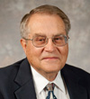
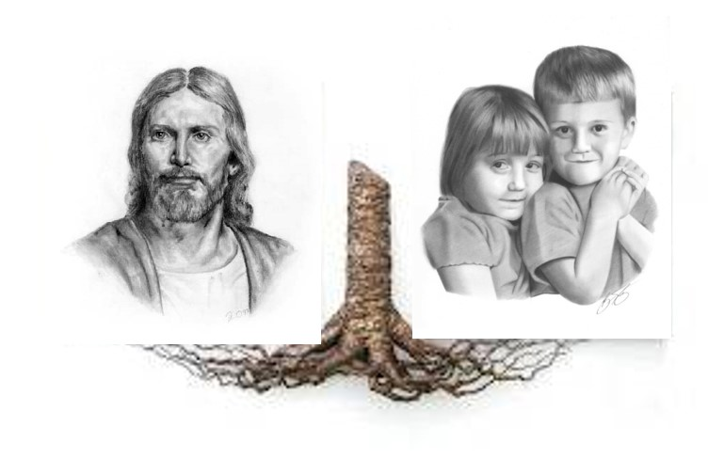
The Stem--Stump
(Root word—geza) Most powerful part of tree providing support for the network of branches and twigs
Branches and twigs symbolize His faithful followers that have developed from His care. We can be part of this network of branches if we choose to be grafted in through the ordinance of baptism and obedience to the commandments of God.
Victor L. Ludlow
2 Nephi 21:1

Slide 6
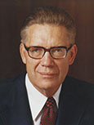
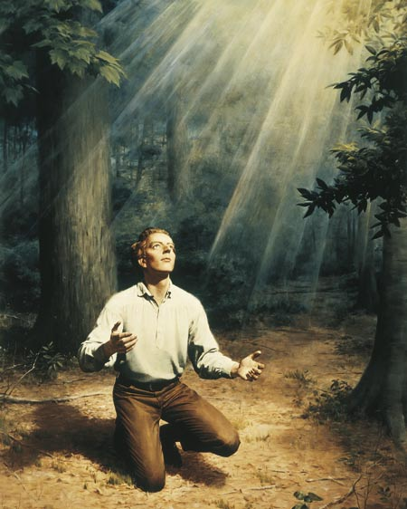
A Servant
“Are we amiss in saying that the prophet here mentioned is Joseph Smith, to whom the priesthood came, who received the keys of the kingdom, and who raised the ensign for the gathering of the Lord’s people in our dispensation? And is he not also the ‘servant in the hands of Christ, who is partly a descendant of Jesse as well as of Ephraim, or of the house of Joseph, on whom there is laid much power’?”
Bruce R. McConkie
2 Nephi 21:1

Slide 7
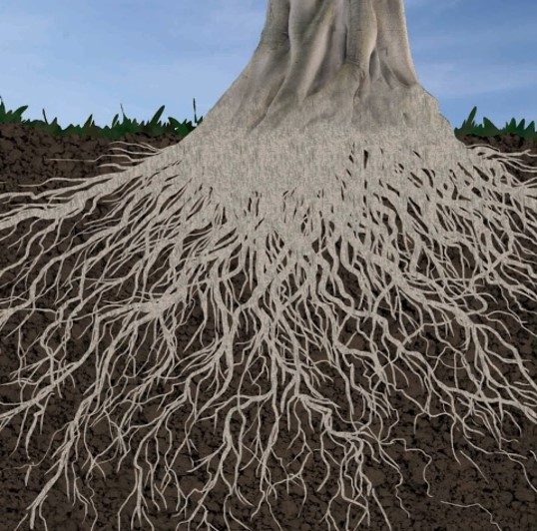
The Root
D&C 113:5-6
What is the root of Jesse spoken of in the 10th verse of the 11th chapter?
Behold, thus saith the Lord, it is a descendant of Jesse, as well as of Joseph, unto whom rightly belongs the priesthood, and the keys of the kingdom, for an ensign, and for the gathering of my people in the last days.
Root of Jesse = Joseph Smith
Stand for an ensign of the people
2 Nephi 21:1 and Isaiah 11:10

Slide 8
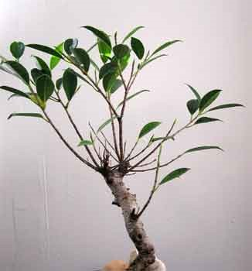
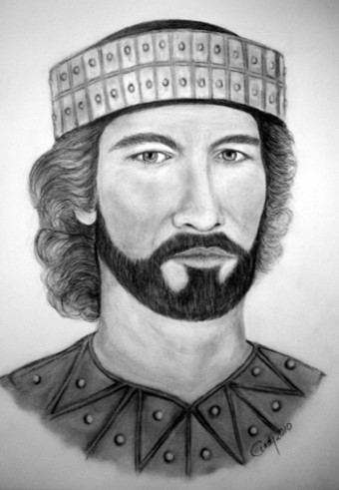
The Branch
Branch = A great leader among the Jews
Branch—Hebrew—natzar—a word found in:
Daniel 11:7
Jeremiah 23:5-6
Hosea 3:5
“Although David was a king, he never did obtain the spirit and power of Elijah and the fullness of the Priesthood…the throne and kingdom of David is to be taken from him and given to another by the name of David in the last days.”
Joseph Smith
2 Nephi 21:1 and Isaiah 11:1

Slide 9
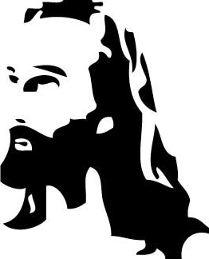
The Preparation
“Verse 1 provides a revealing look into the identity and life of two pivotal individuals in the last days: Jesus Christ, the Savior of mankind, and a powerful servant of the Lord who will come from the lineage of Jesse to rule in righteousness and play a key role in the preparation for the Lord’s millennial reign.”
Victor L. Ludlow
In the last days, the Lord has restored His Church through the Prophet Joseph Smith and is gathering His people.
2 Nephi 21:1 and Isaiah 11:1

Slide 10
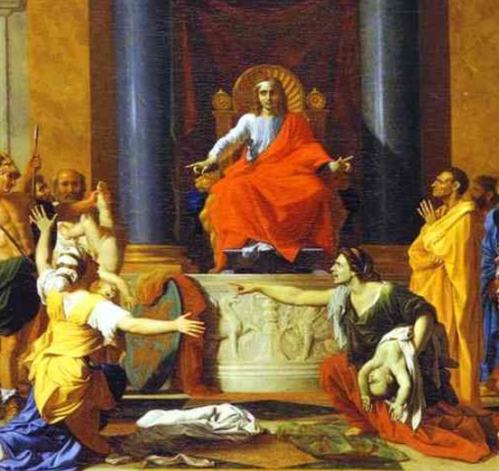
The Spirit of Him
”And the Spirit of the Lord shall rest upon him,” -- “The servant, a future ruler of Israel, will do many great things to prepare the world for the Second Coming. However, he will not become powerful on his own. Instead… his power will come through the Spirit of the Lord…he will gain access to heavenly gifts, such as wisdom, understanding, sensitivity, might, knowledge, and fear (a reverence) of the Lord.”
“…quick understanding” – which will allow him to judge others as God does, by looking on a person’s heart and not his or her dress, appearance, speech, or actions; and he shall not judge after the sight of his eyes, neither reprove after the hearing of his ears.”
Example: Solomon and the complaining mothers
(1 Kings 3:16-28)
2 Nephi 21:2-3
Victor L. Ludlow

Slide 11
Christ Repairs Injustices
Isaiah reveals that the servant will judge the poor with righteousness and will “reprove with equity for the meek.”
Christ will not judge by outward appearance or testimony but because
He knows the intent of our hearts.
“smite with rod” – He will destroy the wicked by truth
Girdle—endowed in righteousness
Girding the loins—ready to work, loins symbolize creative powers.
Reins—Center of faithfulness. Ready to do the Lord’s work
2 Nephi 21:4-5 and Isaiah 11:4-5
Victor L. Ludlow and Poway Institute

Slide 12
The Future is the Millenium
What are some important events in the future you look forward to? Why?
What feelings do you have when you think about these events?
What are you doing to prepare?

Slide 13
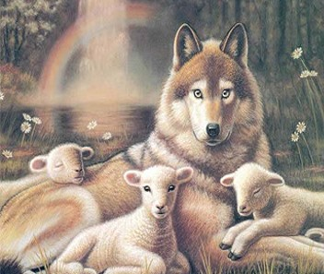
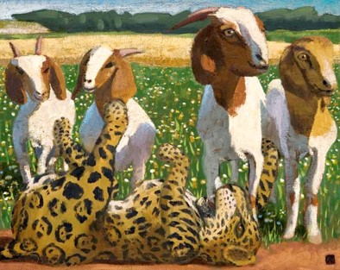
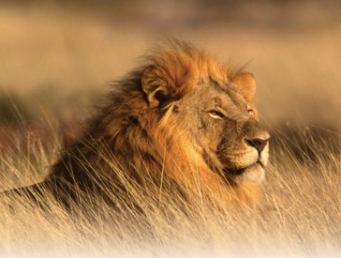
The Wolf and The Lamb
What will it be like during the Millennium?
No longer will the prey have to flee from the predator
Symbolism—the pure in heart and innocent will be the leaders of the converted wild ones
The leopard shall lie down with the kid
The Lion shall eat straw
“All animals shall mingle together in peace, and the appetites of the carnivores, beast shall be changed so that the grass of the field becomes the common diet of the animal world.”
Bruce R. McConkie
2 Nephi 21:6-9 and Isaiah 11:6-9
Victor L. Ludlow and Poway Institute

Slide 14
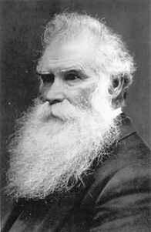
“There will be no place of ignorance, no place of darkness, no place for those that will not serve God, Why?
Because Jesus…will be himself on the earth,
and His holy angels will be on the earth,
and all the resurrected Saints that have died in former dispensations…will be on the earth.
What a happy earth this creation will be, when this purifying process shall come, and the earth be filled with the knowledge of God as the waters cover the great deep! What a change!
Orson Pratt
See also: 2 Nephi 30:12-15

Slide 15
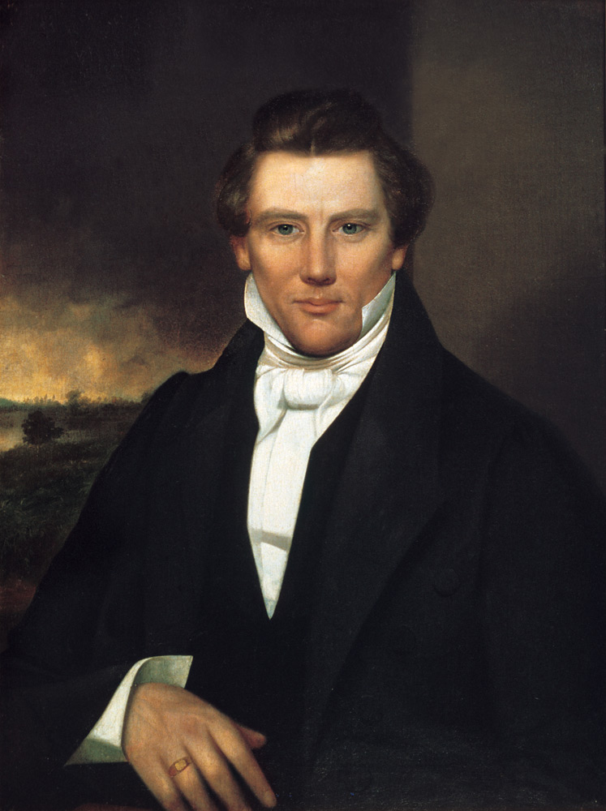
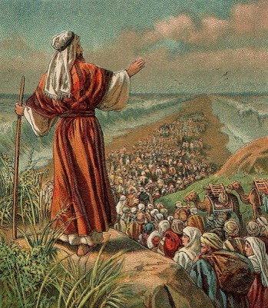
Set up an Ensign
The first-time covenant Israel was gathered—Moses
Second time—restoration of the gospel
Moses personally restored the keys of the gathering of Israel when he appeared in the Kirtland Temple on April 3, 1836
D&C 110:11
“A root of Jesse—This root is generally understood to be the Prophet Joseph Smith. D&C 113:6
Verse 11: the whole world that Isaiah knew at that time
Four Corners of the earth—Recovered Remnant
Judah will be gathered from all over. Tribes will be returning. 1 Nephi 22:3-5
Ensign = The Gospel of Jesus Christ
So that all will see
2 Nephi 21:10-12 and Isaiah 11:10-12
Victor L. Ludlow and Poway Institute

Slide 16
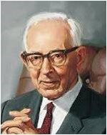
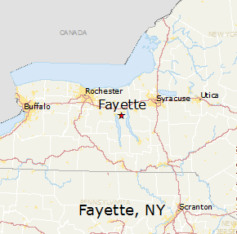
“In the little town of Fayette, Seneca County, New York, the Lord set up an ensign to the nations. It was the fulfillment of the prediction made by the Prophet Isaiah…that ensign was the Church of Jesus Christ of Latter-day Saints, which was established for the last time, never again to be destroyed or given to other people.
It was the greatest event the world has seen since the day that the Redeemer was lifted upon the cross and worked out the infinite and eternal atonement. It meant more to mankind than anything else that has occurred since that day.”
Joseph Fielding Smith

Slide 17
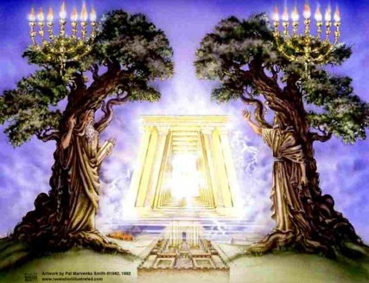
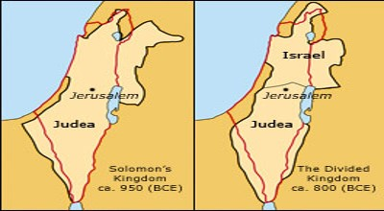
United in Victory
Kingdom of Judah
Ephraim
After the death of Solomon the nation was disrupted by a revolt.
The Tribe of Judah…part of tribe of Benjamin, and small remnants of a few other tribes remained true to royal succession and accepted Rehoboam, son of Solomon, as their king.
The rest…broke their allegiance to the house of David, and made Jeroboam, an Ephraimite, their king. The 10 Tribes retained the title Kingdom of Israel though also know as Ephraim.
The hostility between these two tribes will reunite…because of the principles of peace the Gospel teaches.
The Gentiles will assist in this union
Balfour Declaration 1917—allowed Jews to return to Palestine
2 Nephi 21:13-14 and Isaiah 11:13-14
Victor L. Ludlow and Poway Institute

Slide 18
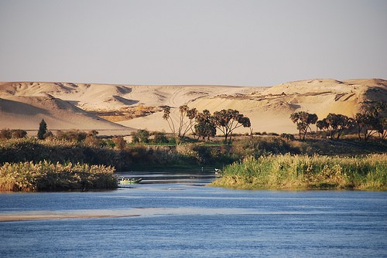
The River
Tongue of the Egyptian sea—gulf—Red Sea.
The unstoppable children of Israel that were able to flee powerful Egypt….in the same way no nation will stop the future promised events.
Mighty wind…hand over the river--
a remembrance of the Red Sea and Jordan River.
Same power will help Israel return
Seven streams---the dividing of the mighty Euphrates might mean smaller rivers that are easier to cross. river … men go over dry-shod
“The Nile will be so diminished that its various branches and canals will dry up. Or it could mean that the Nile waters will be dispersed into so many small diversions that multiple roads and bridges will permit people to cross over the waters by foot.”
2 Nephi 21:15 and Isaiah 11:15
Victor L. Ludlow and Poway Institute

Slide 19
The Highway— He will be the way
The gathering back to the Promised Land
To complete the gathering of all Israel, the remnants of Ephraim and Judah must work together. Great inroads have been made in removing the enmity between Ephraim and Judah, but more must be done.
The members of the Church can play an essential role in building bridges of understanding between the two tribes—LeGrand Richards
Moving Forward: world harmony and love can be fostered among all God’s children on the earth
2 Nephi 21:16 and Isaiah 11:16
Victor L. Ludlow and Poway Institute

Slide 20
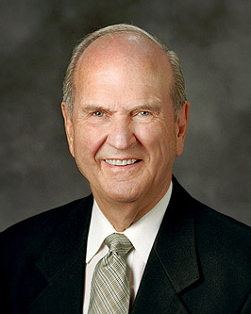
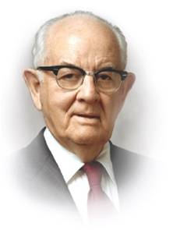
Will The Church of Jesus Christ of Latter-day Saints exist in the Millennium?
This Church will not be moved from its place, even through the Millennium. Russell M. Nelson
In 2 Nephi 22:66 how can Satan have no power?
When Satan is bound in a single home—when Satan is bound in a single life—the Millennium has already begun in that home, in that life.
Teachings of Spencer W. Kimball

Slide 21
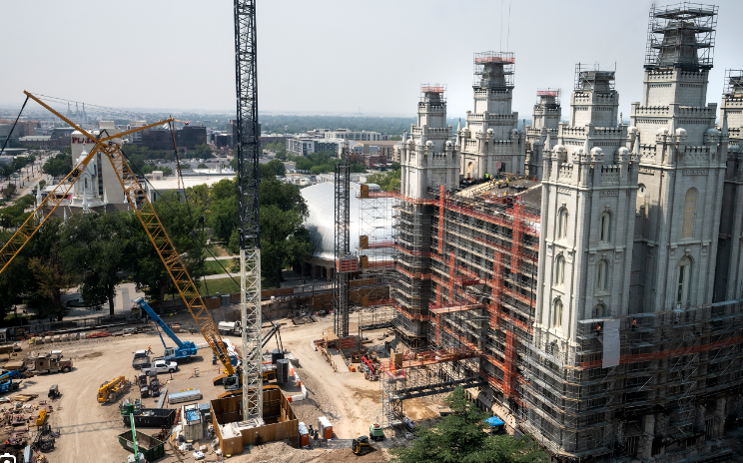
It is the sincere hope of Church leaders that the significant renovations to the Salt Lake Temple will contribute to the fulfillment of Brigham Young’s desire to see “the temple built in a manner that it will endure through the millennium.”
During the coming years, may we allow these improvements made to the Salt Lake Temple to move and inspire us, as individuals and families, so that we too—metaphorically—will “be built in a manner that will endure through the millennium.”
Gary E. Stevenson

Slide 22
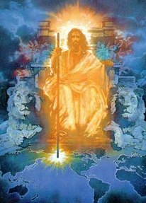
Jesus Christ will reign on the earth in righteousness and peace during the Millennium.

Slide 23
Sources:
Lesley Meacham and Becky Davies Poway Institute Notes
Bruce R. McConkie (The Millennial Messiah: The Second Coming of the Son of Man [1982], 339–40).
Victor L. Ludlow Unlocking Isaiah in the Book of Mormon pg 168-178
Joseph Smith Church History 6:253
Bruce R. McConkie Mormon Doctrine 496
Orson Pratt Journal Discourses 21:325
Joseph Fielding Smith Doctrines of Salvation 3:254-55
Gary E. Stevenson, “A Good Foundation against the Time to Come,” Ensign or Liahona, May 2020, 51–52
Russell M. Nelson, “How Firm Our Foundation,” Ensign or Liahona, May 2002, 76
Teachings of Spencer W. Kimball, ed. Edward L. Kimball [1982], 172
Presentation by ©http://fashionsbylynda.com/blog/

Slide 24
Blessings of the Millennium:
Singleness, childlessness, death, and divorce frustrate ideals and postpone the fulfillment of promised blessings. … The Lord has promised that in the eternities no blessing will be denied his sons and daughters who keep the commandments, are true to their covenants, and desire what is right.
Many of the most important deprivations of mortality will be set right in the Millennium, which is the time for fulfilling all that is incomplete in the great plan of happiness for all of our Father’s worthy children. We know that will be true of temple ordinances. I believe it will also be true of family relationships and experiences. (President Dallin H. Oaks, “The Great Plan of Happiness,” Ensign, Nov. 1993, 75)
What will life be like during the Millennium?
The Millennium consists in this—every heart in the Church and Kingdom of God being united in one; the Kingdom increasing to the overcoming of everything opposed to the economy of heaven, and Satan being bound, and having a seal set upon him. All things else will be as they are now, we shall eat, drink, and wear clothing. …
In the Millennium, when the Kingdom of God is established on the earth in power, glory, and perfection, and the reign of wickedness that has so long prevailed is subdued, the Saints of God will have the privilege of building their temples, and of entering into them, becoming, as it were, pillars in the temples of God [see Revelation 3:12], and they will officiate for their dead. Then we will see our friends come up, and perhaps some that we have been acquainted with here. … And we will have revelations to know our forefathers clear back to Father Adam and Mother Eve, and we will enter into the temples of God and officiate for them. Then [children] will be sealed to [parents] until the chain is made perfect back to Adam, so that there will be a perfect chain of Priesthood from Adam to the winding-up scene.
This will be the work of the Latter-day Saints in the Millennium. (Teachings of the Presidents of the Church: Brigham Young [2007], 333–4)
During the Millennium:
Some members of the Church have an erroneous idea that when the millennium comes all of the people are going to be swept off the earth except righteous members of the Church. That is not so. There will be millions of people … of all classes, and of all beliefs, still permitted to remain upon the face of the earth, but they will be those who have lived clean lives, those who have been free from wickedness and corruption. …
Eventually, however, the knowledge of the Lord will cover the earth as the waters do the sea. But there will be need for the preaching of the gospel, after the millennium is brought in, until all men are either converted or pass away. (Joseph Fielding Smith, Doctrines of Salvation, 1:86–87)

Slide 25
Joyful Psalms of Thanks and Praise
2 Nephi 22
Isaiah 12
HYMNS

Slide 26
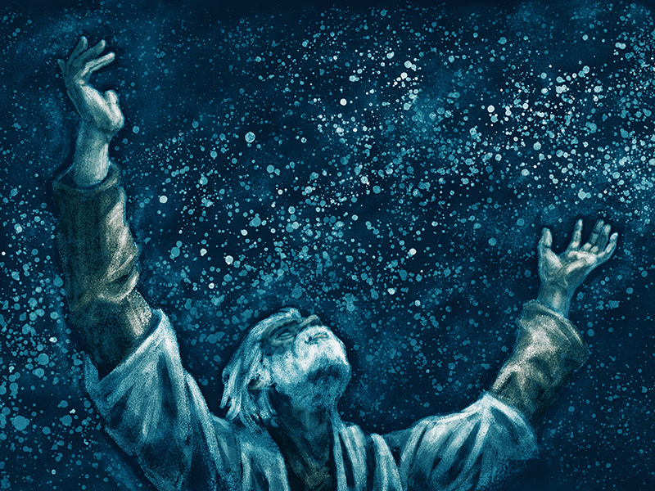
Expressions of Worship
Praise
Recognizes God for what He is
Thanks
Recognizes God for what He does
Thou comfortedst me
I will trust, and not be afraid—have faith
Draw water out of the wells of salvation
He hath done excellent things that is known unto the earth—He created all things
He is my strength and my song
Become my salvation—he saves all
Call upon his name
Declare his doings-Preach His gospel
His name is exalted—He is the Savior
Sing unto the Lord
Cry out and shout
“thou inhabitant of Zion”
Great is the Holy One of Israel who is here
Isaiah describes the spirit of worship that people will have during the Millennium.
2 Nephi 22: 1-6

Slide 27
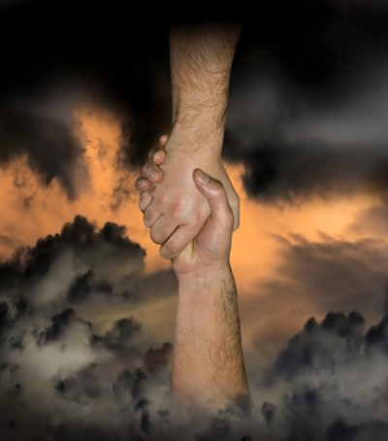
Salvation
Salvation
Comes only through the Savior called Jehovah
Jehovah = The proper name of the God of Israel in the Hebrew Bible, which has also been transcribed as "Yehowah" or "Yahweh".
Isaiah reminds us that our Heavenly Father has provided the divine plan of Happiness and Jesus Christ has fulfilled it.
Through the Atonement Christ becomes our salvation.
2 Nephi 22: 1-6

Slide 28
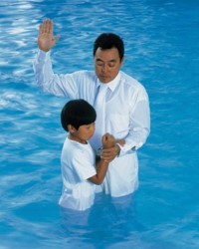
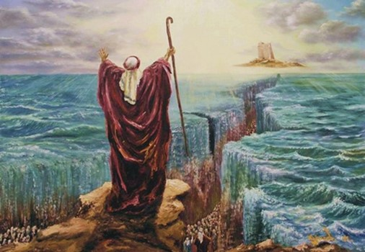
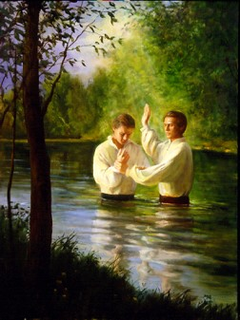
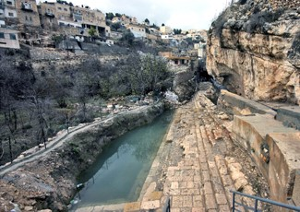
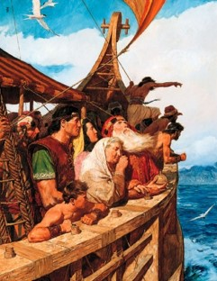
Water
Images of Water Connecting
5 generations
Ancient Israelites delivered from Egypt
(13th century BC)
Israelites during Isaiah’s time
(8th-7th century BC)
waters of Shiloah
Go softly
Latter-day Saints (now)
Early-day Saints
(1st century AD)
Nephites
(6th century BC)
2 Nephi 22: 1-6

Slide 29
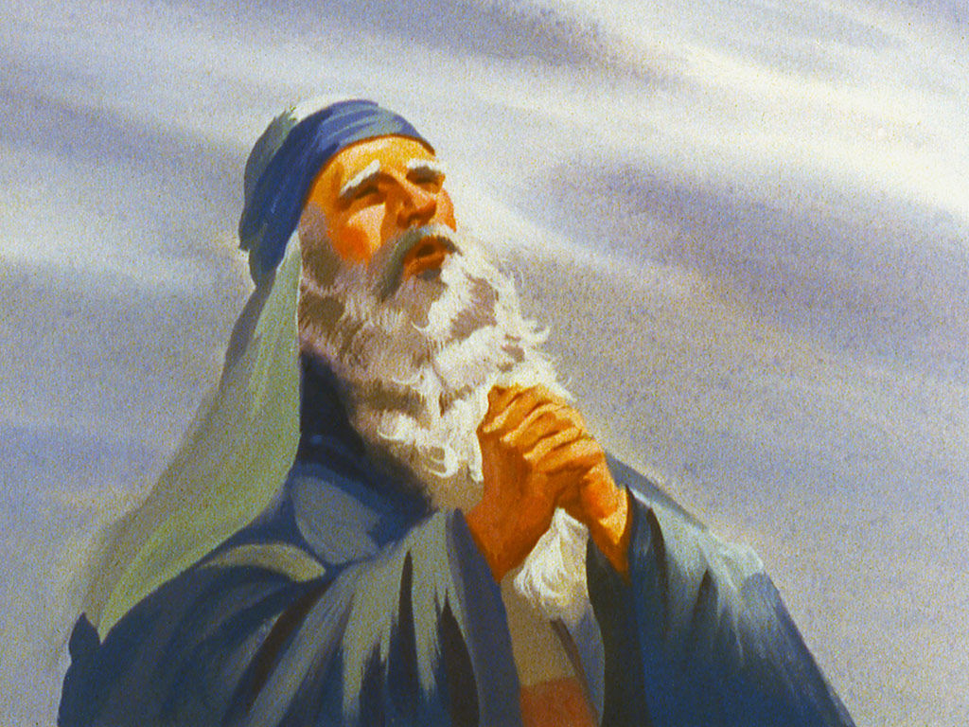
Praise Psalm
Moses’ people sang a song following their deliverance:
Exodus 15:2
“The Lord is my strength and song, and he is become my salvation: he is my God, and I will prepare him an habitation; my father’s God, and I will exalt him.”
And they sing the song of Moses the servant of God, and the song of the Lamb, saying, Great and marvellous are thy works, Lord God Almighty; just and true are thy ways, thou King of saints.
Revelation 15:3
In the Future
“And they sung as it were a new song before the throne, and before the four beasts, and the elders: and no man could learn that song but the hundred and forty and four thousand, which were redeemed from the earth.” Revelations 14:3
2 Nephi 22: 1-6

Slide 30
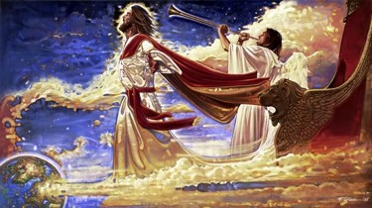
People of the Millennial Era glorify the Lord as They Sing Praises to Him and His Doing.
New Song—a victory sung by the above host before God’s throne
99 The Lord hath brought again Zion; The Lord hath redeemed his people, Israel, According to the election of grace, Which was brought to pass by the faith And covenant of their fathers.
100 The Lord hath redeemed his people; And Satan is bound and time is no longer. The Lord hath gathered all things in one. The Lord hath brought down Zion from above. The Lord hath brought up Zion from beneath.
101 The earth hath travailed and brought forth her strength; And
truth is established in her bowels; And the heavens have smiled upon
her; And she is clothed with the glory of her God; For he stands in the
midst of his people.
102 Glory, and honor, and power, and might, Be ascribed to our God;
for he is full of mercy, Justice, grace and truth, and peace,
Forever and ever, Amen.
D&C 84:98-102

Slide 31
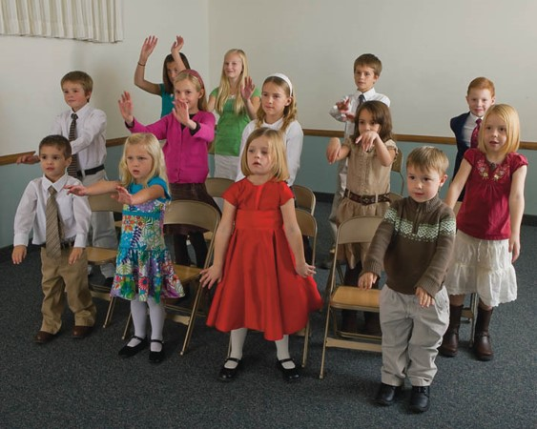
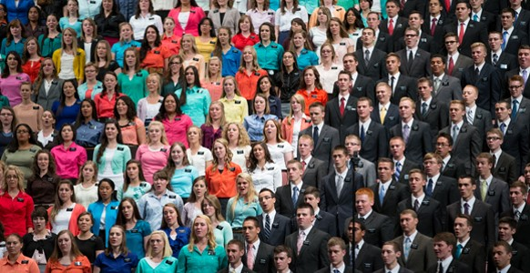
Developing Our Psalm
How can we develop this same attitude in praise and psalm?
2 Nephi 22: 1-6

Slide 32
Sources:
Victor L. Ludlow Unlocking Isaiah in the Book of Mormon pg. 179-184
D&C 25:12
“For my soul delighteth in the song of the heart; yea, the song of the righteous is a prayer unto me, and it shall be answered with a blessing upon their heads.”
Presentation by ©http://fashionsbylynda.com/blog/

Slide 34
Why Babylon?
Isaiah’s words about Babylon and her king were applicable to the wicked living during Book of Mormon times as well as the unrighteous today.
History, we know, is apt to repeat itself, and to foist very old incidents upon us with only a slight change of costume.
GEORGE ELIOT
Isaiah teaches: the wicked will perish and the Lord will have mercy on His people

Slide 35
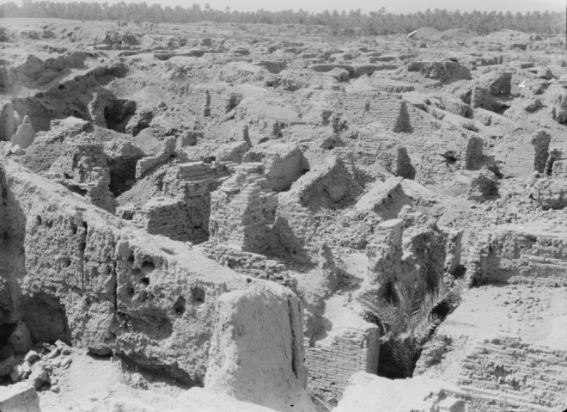
Nephi knew of Babylon as a Boy
A century after Isaiah delivered his Babylon prophecy, people would have “known he was completely wrong in his prediction. Before Nephi was born, Babylon had overthrown the Assyrian yoke and regained her independence, and the New Babylonian Empire would be the greatest empire the Near East had ever see.
When Nephi was a youth, Daniel, his three friends, and many other gifted Jews were taken to Babylon to help build her into a magnificent city (Daniel 1).
…Babylon was not decreasing but increasing in wealth and power. This was the Babylon that Nephi knew when he and his family left Jerusalem about 600 BC
“Shortly after Babylonian armies destroyed Jerusalem and the temple in 586 BC, the Babylonian Empire began a steady decline.
Persian conquest in 539 BC
Babylonian culture and language gradually died out, the last know tablets dating AD 75.
The city of Babylon was deserted by AD 200

Slide 36
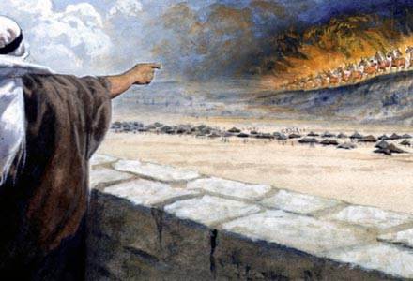
Comparing
The destruction of Babylon to the destruction of the wicked at the Savior’s Second Coming.
Babylon refers generally to the wickedness of the world.
Isaiah prophesied that ‘great destruction’ would come upon the wicked in Babylon and in the last days.
The Burden of Babylon—The message of doom
Lift ye up a banner—standard around which armies gather
Gates of the Nobles—Often represent the entire city—or the proud
My sanctified ones—Saints
I’ll be your host---”Lord of Hosts” = “Lord of Sabaoth” = title of Jehovah = hosts were armies of Israel…also angelic armies of heaven
2 Nephi 23:1-4

Slide 37
Lord’s Power Against Spiritual Babylon
The day of the Lord—Judgment day
Hearts shall melt—failing them in the last days
Faces shall be as flames—faces flushed with shame and guilt…or faces
witnessing the burning at the Second Coming.
Wrath and fierce anger— justice doing His work, but the Lord’s judgment comes only after repeated invitation to repent are ignored
The sun shall be darkened—strange signs and wonders as a signal that the Second Coming is near (D&C 45:42)
More precious than fine gold—Rare and scarce…Many people will be destroyed in the event preceding Jesus’ Second Coming.
2 Nephi 23:6-12

Slide 38
Shake the Heavens
The Earth will be moved out of its place and flee toward Kolob at amazing speed (D&C 88:87)– The Renewal of the Earth
The Chased roe—a hunted deer—famous for tremendous speed
No man taketh up—without a shepherd to take care for and protect
The Medes—This nation at one time formed an alliance with Babylon, but eventually attack and conquer about (538 BC). God uses the Medes as a weapon against physical Babylon—a description of the killing of Satan’s mortal army
Not regard silver and gold—The Medes will be more interested in killing than in gathering the spoils of the conquered land
Persians, Cyrus and the armies swept into Babylon. Isaiah not only identifies their destruction but the nation that will do it. They will spare no one.
2 Nephi 23:13-17

Slide 39
One of The Great Cities
The glory of kingdoms--Babylon was one of the great cities.
How could it be destroyed?
Chaldees—often synonymous with Babylonians
Just like: Sodom and Gomorrah—this city is a wasteland
No one will live there—it will be leveled to dust
Wild beast of the desert shall lie there—Wild beasts and doleful creatures will occupy what was once a mighty Babylon
Satyrs—he-goats
Dragons—wild dogs or jackals
2 Nephi 23:18-22

Slide 40
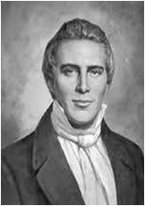
“As, therefore, the tares are gathered and burned in the fire, so shall it be in the end of the world; that is, as the servants of God go forth warning the nations…and as they (the people) harden their hearts and reject the light of truth, (they are) delivered over to the buffeting of Satan, and…they are left in darkness, and delivered over unto the day of burning.”
Joseph Smith

Slide 41
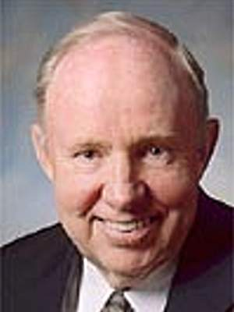
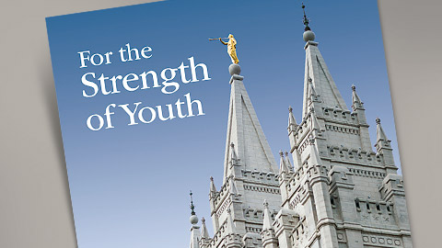
“Seduced by our culture, we often hardly recognize our idolatry, as our stings are pulled by that which is popular, in the Babylonian world…
We do not need to adopt the standards, the mores, and the morals of Babylon. We can create Zion in the midst of Babylon. We can have our own standards for music and literature and dance and film and language. We can have our own standards for dress and deportment, for politeness and respect. We can live in accordance with the Lord’s moral laws. We can limit how much of Babylon we allow into our homes by the media of communication.
We do not need to become as puppets in the hands of the culture of the place and time.
We can be courageous and, walk in the
Lord’s paths and follow His footsteps.”
David R. Stone

Slide 42
Merciful
The only ray of hope in a rather dismal prophecy
2 Nephi 23:22

Slide 43
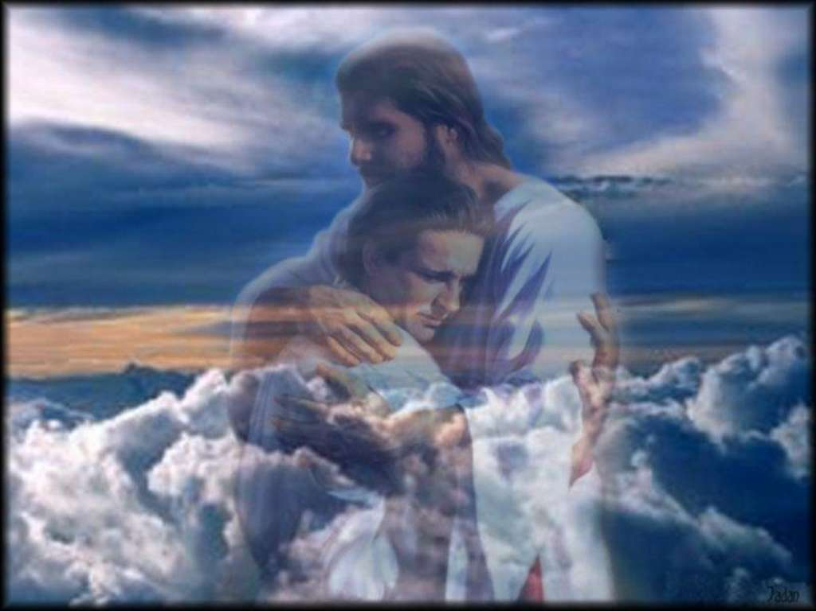
Restoring Covenant Israel
Dual Prophecy
King Cyrus of Persia will allow the Jews to return from Babylonian captivity to Judah in 537 BC
Also: it may refer to the latter-day gathering of Israel, in which modern covenant Israel will receive help from the Gentiles—”Strangers shall be joined with them…” (Isaiah 14:1)
When we turn away from worldliness and rely on the Lord’s mercy, He gives us rest and peace.
“The Lord shall give thee rest, from thy sorrow, and from thy fear, and from the hard bondage wherein thou wast made to serve.”
2 Nephi 24:1-3

Slide 44
Taunt song verses 4-20
A Rest Hymn = Peace for a 1,000 years = Millennium
About the Fallen King of Babylon—Satan
Israel sings against its king.
The song is written using a common Hebrew poetic form.
Ancient kings of Babylon were not only powerful, but they were also notorious for their arrogance and persecution against others.
The Kingdom has fallen.
Note: verses 19-20
Thou art cast out of thy grave
The body of the king of Babylon (Nebuchadnezzar) was never found.
Similarly, Lucifer has no body and will occupy no grave
“It has always been considered a great calamity not to obtain an honorable burial: and one of the greatest curses the ancient prophets could put on any man, was that he should go without a burial.”
Joseph Smith
2 Nephi 24:4-20

Slide 45
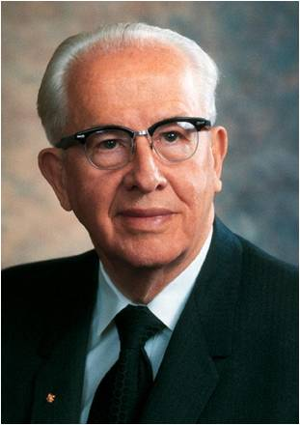
The Fall of Lucifer
How would we feel about Satan if we could see him for what he is?
“In the premortal council, it was pride that felled Lucifer, ‘a son of the morning.’ …
In the pre-earthly council, Lucifer placed his proposal in competition with the Father’s plan as advocated by Jesus Christ.
He wished to be honored above all others.
In short, his prideful desire was to dethrone God.”
Ezra Taft Benson
2 Nephi 24:12-16; D&C 76:25-27; Moses 4:1-3; D&C 29:36; 76:28

Slide 46
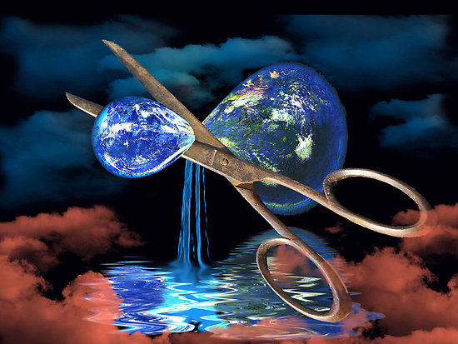
Fate of Follows of Satan
His children—the children of Lucifer
“Let not another evil generation arise and resume an evil regime”
Cut off
We all hope our families will enjoy the Lord’s promised blessing. Being “cut off” is synonymous with being excommunicated or denied eternal increase (1 Nephi 22:20; D&C 1:14: D&C 132:19)
Possession for the bittern
Instead of beautiful cities, it will be inhabited by the bittern, which has also been translated as “owl,” “hedgehog,” and “porcupine.”
The “pools of water’ -- marshes or swamps.
A “besom” – broom– swept away
2 Nephi 24:21-23

Slide 47
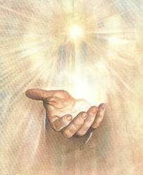
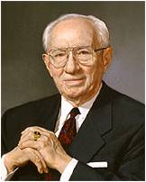
Fall of Assyria
Probably refers to the Assyrian attack on the kingdom of Israel (721 BC)
Yoke depart—Assyrian’s yoke will be removed from Israel
His hand is stretched out still
“The God who fathered the spirit of every person on this earth will always remember His faithful children.”
Victor L. Ludlow
“You and I may fail as individuals and miss the blessing. But (the Lord’s) work cannot fail. There will always be those he will raise up to accomplish it.”
Gordon B. Hinckley
2 Nephi 24:24-27

Slide 48
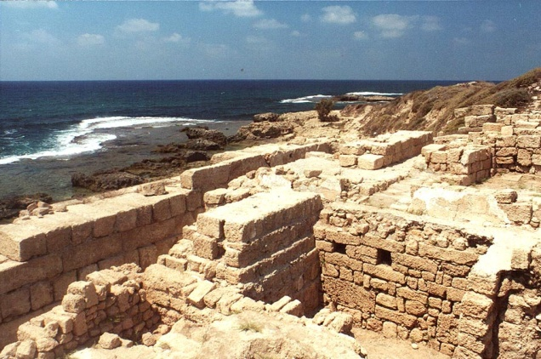
The Burden
Those Philistine peoples that bordered Judah to the west.
Since the days of King David, the Philistines were subject to the military and economic power of Judah. Although they might rejoice that Judah was being attacked by Assyria and “the rod of him (Judah) that smote thee is broken:, (v. 29), even worse catastrophes were awaiting Palestine.
Assyria later attacked the Philistines and conquered their nation.
“The only kingdom that will stand the test of time is the one founded by the Lord of Hosts. Zion, where the “first-born of the poor shall feed, and the needy shall lie down in safety” is the stronghold where the righteous dwell.
Nephi understood the weakness of worldly powers such as Babylon
2 Nephi 24:28-32
Victor L. Ludlow

Slide 49
Sources:
GEORGE ELIOT, Janet's Repentance
John Bytheway Isaiah for Airheads pg 147-152
Joseph Smith Teachings Pg 101 and pg 295 (burial)
David R. Stone Zion in the Midst of Babylon Ensign May 2006
Ezra Taft Benson “Beware of Pride” Ensign, May 1989, 4–5
Victor L. Ludlow Unlocking Isaiah in the Book of Mormon pg 198
Gordon B. Hinckley He Slumbers Not, Nor Sleeps Ensign May 1987
Presentation by ©http://fashionsbylynda.com/blog/

Slide 50
The Key to Unlocking Isaiah
2 Nephi 25

Slide 51
“Manner” of Prophesying
Why did Nephi’s people find Isaiah’s prophecies hard to understand?
(2 Nephi 1)
They did not know “concerning the manner of prophesying among the Jews.”
What are some characteristics of the ancient Jews’ prophecies?
Isaiah and other prophets used symbolism and poetic language.
Would it be helpful to understand this
“manner” of writing?
2 Nephi 25:1

Slide 52
How and Where Can I Find It?
By:
Examining the literary mode of communication, Isaiah’s poetic parallelisms and patterns.
Searching special names, titles, history, and descriptions of visual objects. Example: Trees often refer to people
Using footnotes in scriptures, Topical Guide and Bible Dictionary entries, and viewing reverent insights from the latter-day prophets and apostles. Example: The New Era, Ensign, and Conference Talks
2 Nephi 24:1
Isaiah 14:1
Don’t forget to pray for understanding
The
Holy Bible
2 Nephi 25:1

Slide 53
The Key
“Nephi helps us understand what Isaiah says and he also teaches us why Isaiah is difficult yet understandable.
From Nephi’s words we can also learn how to study and understand Isaiah’s teaching and prophecies.”
Victor L. Ludlow
What is the key to unlocking Isaiah’s words?
(2 Nephi 25:4)
The spirit of prophecy.
“A prophecy consists of divinely inspired words or writings, which a person receives through revelation from the Holy Ghost. The testimony of Jesus is the spirit of prophecy (Rev. 19:10). A prophecy may pertain to the past, present, or future.
When a person prophesies, he speaks or writes that which God wants him to know, for his own good or the good of others. Individuals may receive prophecy or revelation for their own lives”
-- Guide to the Scriptures
“…for because the words of Isaiah are not plain unto you, nevertheless they are plain unto all those that are filled with the spirit of prophecy…”
2 Nephi 25:4

Slide 54
Increasing in Isaiah’s Words
By:
Seeking the guidance of the Holy Ghost
And
Having a testimony of Jesus Christ and a desire to learn of Him.
Approaching Isaiah’s Words:
Always look for ways his prophecy testifies of the Savior.
You will be able to learn what God wants you to know, for your own good or for the good of others.
2 Nephi 25:4

Slide 55
Beheld the Things of the Jews
And:
“know concerning the regions round about” Nephi and his family understood the Hebrew literary techniques of Isaiah…
However, since Nephi’s brothers were spiritually insensitive, they may have missed the correct interpretation.
What can we do to gain some knowledge of these things?
By studying the culture, history, and geography of ancient Israel.
2 Nephi 25:5-6

Slide 56
Lock It Up
When people want to keep valuable possessions safe, they often lock them up.
They might keep the only key to the lock, or they might give a copy of the key to a trusted friend or family member.
Nephi knew that the prophecies of Isaiah were “of great worth”
However, he did not keep them secret.
“…they are of worth unto the children of men, and he that supposeth that they are not, unto them will I speak particularly, and confine the words unto mine own people; for I know that they shall be of great worth unto them in the last days; for in that day shall they understand them; wherefore, for their good have I written them.”
2 Nephi 25:8

Slide 57
How and Where Can I Find It?
What prophecies have we studied that have already been fulfilled?
The prophecies about the Salt Lake Temple [see 2 Nephi 12:2–3]
The birth of Jesus Christ [see2 Nephi 19:6]
Joseph Smith [see 2 Nephi 21:1, 10]
Because these Prophecies have been fulfilled, what does that do for your testimony?
Remember: You can grow in their understanding of Isaiah’s words as they seek the spirit of prophecy. You can enhance your understanding through a study of the ancient Jews’ manner of prophesying and the culture, history, and geography of ancient Israel.
2 Nephi 25:7-8

Slide 58
Nephi Prophesied About the Jews
The Jews who had been taken captive to Babylon after the destruction of Jerusalem would return to “the land of their inheritance” v 9-11
Jesus Christ, the Messiah, would live among them, but many would reject Him and crucify Him v 12-13
After the Savior’s death and Resurrection, Jerusalem would again be destroyed, and the Jews would be scattered and scourged by other nations v 14-15
They would eventually believe in Jesus Christ and His Atonement, and the Lord would restore them “from their lost and fallen state” v 16-19
2 Nephi 25:9-19

Slide 59
Salvation Comes Through Jesus
Do latter-day saints believe in Jesus Christ? Have you ever been told that you do not believe in Christ?
“And, notwithstanding we believe in Christ, we keep the law of Moses, and look forward with steadfastness unto Christ, until the law shall be fulfilled.” 2 Nephi 25:24
The “right way” is to believe in Christ and not deny him.
Believing in Jesus Christ is the right way, why?
Salvation comes only through Jesus Christ.
Because of Jesus Christ, we can be saved by grace after all we can do.
Through the Savior’s Atonement, we can receive a remission of our sins.
2 Nephi 25:20-30

Slide 60
Messiah
The anointed Prophet, Priest, King, and Deliverer”
“Many Jews were looking only for a deliverer from the Roman power and for a greater national prosperity; thus, when the Messiah came, the leaders and many others rejected him.”
Jesus Christ is the only name whereby we can be saved
The word name can be used to represent a person or to represent his or her power or authority.
Thus, another way of saying that “Jesus Christ is the only name whereby we can be saved” is “Jesus Christ is the only person with the power to save us,” or “Jesus Christ is the only person who can save us.”
2 Nephi 25:16, 20
(Guide to the Scriptures)

Slide 61
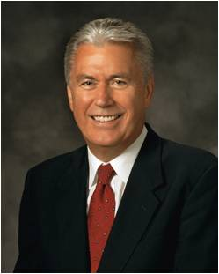
To Feel Discouraged
“Many people feel discouraged because they constantly fall short. They know firsthand that ‘the spirit indeed is willing, but the flesh is weak’.
They raise their voices with Nephi in proclaiming, ‘My soul grieveth because of mine iniquities’.
Dieter F. Uchtdorf
Why is it easy to feel discouraged at times because of our weaknesses or sins?
We are saved by the grace of Jesus Christ, after all we can do.
2 Nephi 25:21-30; Matthew 26:41; Romans 7:19; 2 Nephi 4:17

Slide 62
The Word Grace
“The main idea of the word [grace] is divine means of help or strength, given through the bounteous mercy and love of Jesus Christ.
“It is through the grace of the Lord Jesus, made possible by his atoning sacrifice, that mankind will be raised in immortality, every person receiving his body from the grave in a condition of everlasting life.
It is likewise through the grace of the Lord that individuals, through faith in the atonement of Jesus Christ and repentance of their sins, receive strength and assistance to do good works that they otherwise would not be able to maintain if left to their own means.
This grace is an enabling power that allows men and women to lay hold on eternal life and exaltation after they have expended their own best efforts.
“Divine grace is needed by every soul in consequence of the fall of Adam and also because of man’s weaknesses and shortcomings. However, grace cannot suffice without total effort on the part of the recipient. Hence the explanation, ‘It is by grace that we are saved, after all we can do’ (2 Ne. 25:23). It is truly the grace of Jesus Christ that makes salvation possible.” (Bible Dictionary, “Grace”).
2 Nephi 25:23

Slide 63
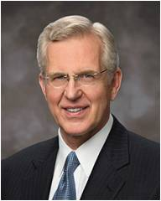
After All We Can Do—Saved by Grace
“I wonder if sometimes we misinterpret the phrase ‘after all we can do.’ We must understand that ‘after’ does not equal ‘because.’
“We are not saved ‘because’ of all that we can do. Have any of us done all that we can do? Does God wait until we’ve expended every effort before He will intervene in our lives with His saving grace?”
Dieter F. Uchtdorf
“We do not need to achieve some minimum level of capacity or goodness before God will help—divine aid can be ours every hour of every day, no matter where we are in the path of obedience. But I know that beyond desiring His help, we must exert ourselves, repent, and choose God for Him to be able to act in our lives consistent with justice and moral agency.”
D. Todd Christofferson
2 Nephi 25:23

Slide 64
Grace is the divine help or strength extended to us through the Atonement of the Lord Jesus Christ. …
Grace is a gift from Heavenly Father given through His Son, Jesus Christ.
The word grace, as used in the scriptures, refers primarily to enabling power and spiritual healing offered through the mercy and love of Jesus Christ.
Gospel Topics
President Dieter F. Uchtdorf
2 Nephi 25:23

Slide 65
Moses and the Brass Serpent
And as Moses lifted up the serpent in the wilderness, even so must the Son of man be lifted up:
That whosoever believeth in him should not perish, but have eternal life.
John 3:14-15
God gave laws through Moses when the children of Israel failed to obey the higher law they had been given.
This became known as the law of Moses.
It consisted of many rules, ceremonies, and sacrifices that were intended to remind them of God and their duty toward Him.
Much of the ceremonial law was fulfilled at the death and Resurrection of Jesus Christ.
One reason the law was considered dead was because it could not bring salvation to God’s children. Only Jesus Christ could do so.
2 Nephi 25:24-25; Exodus 32;34; Joseph Smith Translation, Exodus 34:1-2; Mosiah 13:30; Alma 34:13-14, Guide to Scriptures

Slide 66
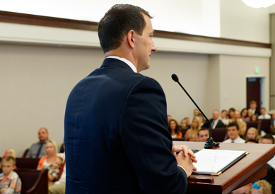
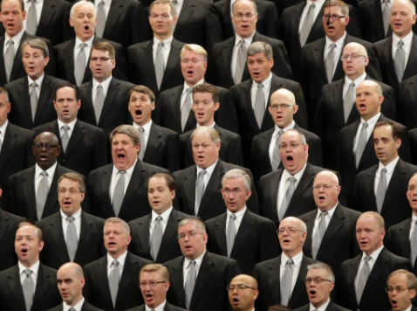
Rejoice in Christ
And we talk of Christ, we rejoice in Christ, we preach of Christ, we prophesy of Christ, and we write according to our prophecies, that our children may know to what source they may look for a remission of their sins.
Talk
Rejoice
Preach
Prophesy
Write
2 Nephi 25:26

Slide 67
Are Mormons Christian?
“Members of The Church of Jesus Christ of Latter-day Saints unequivocally affirm themselves to be Christians. They worship God the Eternal Father in the name of Jesus Christ. When asked what the Latter-day Saints believe, Joseph Smith put Christ at the center:
‘The fundamental principles of our religion is the testimony of the apostles and prophets concerning Jesus Christ, “that he died, was buried, and rose again the third day, and ascended up into heaven;” and all other things are only appendages to these, which pertain to our religion’.
Gospel Topics

Slide 68
Sources:
Victor L. Ludlow Unlocking Isaiah in the Book of Mormon pg 199
Guide to the Scriptures, “Prophecy, Prophesy,” scriptures.lds.org.
President Dieter F. Uchtdorf, “The Gift of Grace,” Ensign or Liahona, May 2015, 110
D. Todd Christofferson, “Free Forever, to Act for Themselves,” Ensign or Liahona, Nov. 2014, 19
Elder M. Russell Ballard Ensign, June 2001, 74).
Elders’ Journal 1 (July 1838): 44, available at josephsmithpapers.org; republished with punctuation changes in Teachings of Presidents of the Church: Joseph Smith (2007), 49]” (“Are Mormons Christian?” Gospel Topics, topics.lds.org).
Gospel Topics, “Grace,” topics.ChurchofJesusChrist.org)
President Dieter F. Uchtdorf, then of the First Presidency,
See Guide to the Scriptures, “Law of Moses,” scriptures.ChurchofJesusChrist.org
Presentation by ©http://fashionsbylynda.com/blog/

Slide 69
The Name 2 Nephi 25:19:
"One of the marvelous contributions of modern revelation (including the Book of Mormon) is an insight into the nature of Christ's eternal gospel, the revelation to the Church and to the world that Christian prophets have taught Christian doctrine and administered Christian ordinances since the days of Adam. The name of the Messiah--revealed to us as Jesus Christ, meaning literally 'Jehovah is salvation, the anointed one'--was known from the very beginning of earth's history. God spoke to Adam as follows: 'I made the world, and men before they were in the flesh. And [God] also said unto him: If thou wilt turn unto me, and hearken unto my voice, and believe, and repent of all thy transgressions, and be baptized, even in water in the name of mine Only Begotten Son, who is full of grace and truth, which is Jesus Christ, ... ye shall receive the gift of the Holy Ghost.' (Moses 6:51-52.) Enoch, whose name and city are associated with transcendent righteousness, pleaded in behalf of the people of the earth: 'I ask thee, O Lord, in the name of thine Only Begotten, even Jesus Christ, that thou wilt have mercy upon Noah and his seed, that the earth might never more be covered by the floods' (Moses 7:50). Noah called upon a wicked generation: 'Believe and repent of your sins and be baptized in the name of Jesus Christ, the Son of God, even as our Fathers, and ye shall receive the Holy Ghost' (Moses 8:24). Likewise, the brother of Jared, the spiritual leader among that colony which left the eastern hemisphere at the time of the confusion of tongues at the Tower of Babel was told: 'Behold, I am he who was prepared from the foundation of the world to redeem my people. Behold, I am Jesus Christ.' (Ether 3:14.)" (McConkie and Millet, Doctrinal Commentary on the Book of Mormon, vol. 1, p. 292)
Written Always in Their Heart 2 Nephi 25:26:
"Those who are committed to Christ 'stand as witnesses of God at all times and in all things, and in all places' that they may be in 'even until death' (Mosiah 18:9). They 'retain the name' of Christ 'written always' in their hearts (Mosiah 5:12). They take upon themselves 'the name of Christ, having a determination to serve him to the end' (Moroni 6:3).
"When we live a Christ-centered life, 'we talk of Christ, we rejoice in Christ, we preach of Christ' (2 Nephi 25:26). We 'receive the pleasing word of God, and feast upon his love' (Jacob 3:2). Even when Nephi's soul was grieved because of his iniquities, he said, 'I know in whom I have trusted. My God hath been my support.' (2 Nephi 4:19-20.)
"We remember Alma's counsel: 'Let all thy doings be unto the Lord, and whithersoever thou goest let it be in the Lord; yea, let all thy thoughts be directed unto the Lord; yea, let the affections of thy heart be placed upon the Lord forever. Counsel with the Lord in all thy doings.' (Alma 37:36-37.)" (The Teachings of Ezra Taft Benson, p. 11)
Faith
“As a Church we have critics, many of them. They say we do not believe in the traditional Christ of Christianity. There is some substance to what they say.
Our faith, our knowledge is not based on ancient tradition, the creeds which came of a finite understanding and out of the almost infinite discussions of men trying to arrive at a definition of the risen Christ.
Our faith, our knowledge comes of the witness of a prophet in this dispensation who saw before him the great God of the universe and His Beloved Son, the resurrected Lord Jesus Christ.
They spoke to him. He spoke with Them. He testified openly, unequivocally, and unabashedly of that great vision.
It was a vision of the Almighty and of the Redeemer of the world, glorious beyond our understanding but certain and unequivocating in the knowledge which it brought.
It is out of that knowledge, rooted deep in the soil of modern revelation, that we, in the words of Nephi, ‘talk of Christ, we rejoice in Christ, we preach of Christ, we prophesy of Christ, and we write according to our prophecies, that [we and] our children may know to what source [we] may look for a remission of [our] sins.’”
Gordon B. Hinckley
“We Look to Christ,” Ensign, May 2002, 90–91).
Grace…After All We Can Do 2 Nephi 25:23:
“My testimony to you is that the safety, peace, joy, and security we seek are found only in accepting and sincerely believing in the life and mission of Jesus Christ, the Son of Almighty God. As we embrace His teachings, we give up all of our sins, we repent, and we do all that is in our power to come unto Him in a true spirit of discipleship, knowing perfectly well that it is through His grace that we are saved, even after all that we can do. And as we give ourselves to Christ, fully and completely, we find safety, peace, joy, and security in Him” (in “Latter-day Counsel,”).
M. Russell Ballard

Slide 70
The Law of Moses | The Gospel of Jesus Christ
1. The Law: the 10 Commandments, etc. focusing on one's actions & the outward ordinances | 1. The Law: the higher law, focusing on one's actions, thoughts, and desires and requiring the exercise of faith.
2. The Covenant: If the Israelites keep the commandments, they are promised, I will walk among you, and will be your God, and ye shall be my people (Leviticus 26:12). | 2. The Covenant: the new and everlasting covenant. See also Hebrews 10:16-20
3. Blessings: see Deuteronomy 28:1-14 | 3. Blessings: all the blessings of the covenant of Abraham and eternal life (DC 132)
4. Cursings: see Deuteronomy 28:15-68 | 4. Cursings: to be turned over to the buffetings of Satan (DC 104:9). See also DC 84:41-42.
5. Priesthood: Aaronic | 5. Priesthood: Melchizedek
6. Temple: Tabernacle of Moses, and the Temple of Solomon | 6. Temple: Latter-day Temples with saving ordinances for the living and the dead
7. Sacrifice: of the firstborn shall make an atonement for...his sin, and it shall be forgiven him (Leviticus 4:26) | 7. Sacrifice: The offering of Christ's perfect sacrifice requires of us a broken heart and a contrite spirit (3 Nephi 9:19-20)
In spite of the Nephite obedience to the Law of Moses, they understood the reason the law was given-as a symbol for the mission of Jesus Christ. Hence the explanation by Nephi, the law hath become dead unto us, and we are made alive in Christ because of our faith.

