Slide 1
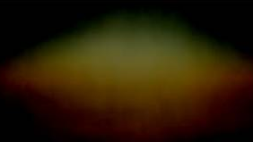
2 Nephi 26-30
The
Book
of
Mormon
ANOTHER TESTAMENT
OF JESUS CHRIST

Slide 2
Future Destruction of the Nephites
2 Nephi 26

Slide 3
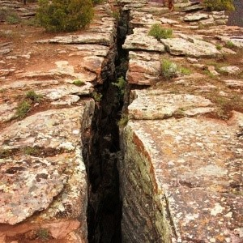
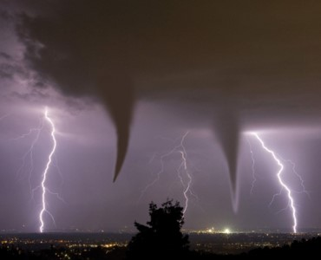
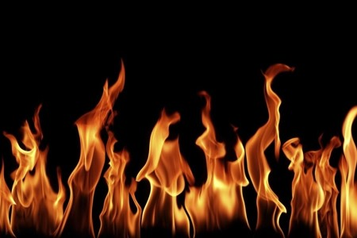
Nephi Foresees Destruction
After the Messiah comes:
Signs- of His birth, death and resurrection
The wicked will perish because they cast out prophets and saints, stoned and slay them.
The saints will be resurrected and cry against the wicked
Those who were proud
shall be “burned as a
stubble”
Earthquakes--The depths of the earth—swallow-- mountains cover them—buildings fall
Tornados—whirlwinds
Thunder and lightning
Fire of the Lord—anger—stubble and consume them
2 Nephi 26:1-5

Slide 4
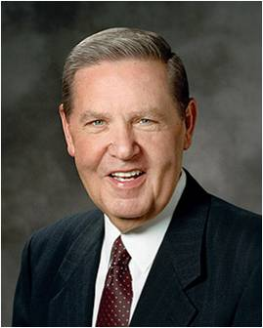
Thy Ways Are Just
Someone who is just will always treat people fairly.
“There is a law, irrevocably decreed in heaven before the foundations of this world, upon which all blessings are predicated—
And when we obtain any blessing from God, it is by obedience to that law upon which it is predicated.”
D&C 130:20-21
“A basic principle of Latter-day Saint doctrine is that we have to know that God is just in order to go forward.
One of God’s attributes is justice, and we would not have the faith—because of fear—to live righteously or to love better or to repent more readily if somehow we didn’t think that justice would count for us, if somehow we thought God would change His mind and decide there was another set of rules.
Because we know that God is just and would cease to be God if He weren’t so, we have the faith to go forward, knowing that we will not be the victims of whimsy or caprice or a bad day or a bad joke. That assurance is very encouraging.”
Jeffrey R. Holland
2 Nephi 26:7

Slide 5
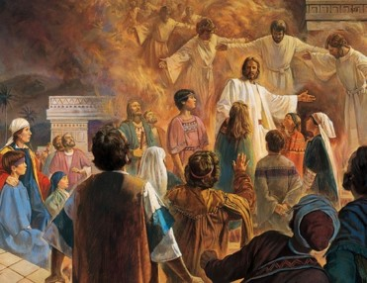
Those Who Are Righteous
“But behold, the righteous that hearken unto the words of the prophets, and destroy them not, but look forward unto Christ with steadfastness for the signs which are given, notwithstanding all persecution—behold, they are they which shall not perish.”
They will be healed
They shall have peace with the Savior—for 3 generations and many for 4 generations
(roughly 300-400 years of peace)
As we exercise faith in Jesus Christ, He manifests Himself to us by the power of the Holy Ghost.
Nephi has seen the destruction and it “greaveth his soul”:
For their pride and foolishness
They choose the devil and the works of the devil
They choose darkness (spiritually) rather than light (Christ)
When the spirit ceases, then there is a quick destruction.
2 Nephi 26:8-11

Slide 6
Gospel Principles
Those who are prideful and choose works of darkness rather than light will lose the Spirit and be destroyed.
Those who reject the prophets and persecute the Savior’s followers will perish.
2 Nephi 26:11

Slide 7

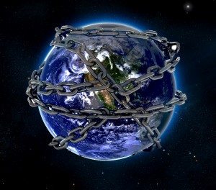
Stumbling Blocks
Nephi prophesied that the Book of Mormon would come forth in the last days during a time when many people would be prideful and unbelieving.
Obstacles:
What are some obstacles that Nephi saw that would cause the Gentiles to stumble?
What are some other examples of obstacles that Satan uses to lead people to stumble?
Placing “stumbling blocks” in our path to direct us away from God, Satan seeks to bind us.
“…yea, and he leadeth them by the neck with a flaxen cord, until he bindeth them with his strong cords forever.”
Enoch sees Satan with a great chain in his hand, and it veiled the whole earth with darkness (Moses 7:26)
2 Nephi 26:20-22

Slide 8
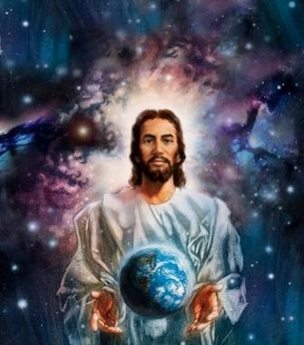
That All Mankind May Be Saved
What is the purpose of everything the Lord does?
Everything the Lord does is for the benefit of the world
The Lord does not work in darkness
He does all things to the benefit of the world
He asks us to come:
“Buy milk and honey, without money and without price”—the most desirable foods symbolize that life’s most desirable gifts are freely given
He asks us to worship Him, in your homes, at church and in the temple
Salvation is free to everyone
He has commanded us to repent and then partake of His goodness
He loves us-- He laid down His own life for us
2 Nephi 26:23-28

Slide 9

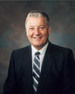
“God’s love fills the immensity of space; therefore, there is no shortage of love in the universe, only in our willingness to do what is needed to feel it. To do this, Jesus explained we must “love the Lord thy God with all thy heart, … soul, … strength, and … mind; and thy neighbour as thyself”.
When filled with God’s love, we can do and see and understand things that we could not otherwise do or see or understand.
Filled with His love, we can endure pain, quell fear, forgive freely, avoid contention, renew strength, and bless and help others in ways surprising even to us.”
John H. Groberg
2 Nephi 26:23-28; Luke 10:27

Slide 10
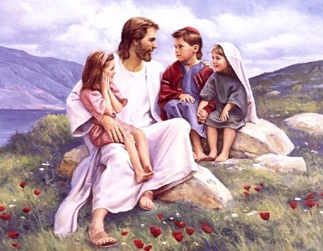
An Invitation
How does the Lord’s love apply in our lives?
All
Any
None
“Behold, hath the Lord commanded any that they should not partake of his goodness? Behold I say unto you, Nay; but all men are privileged the one like unto the other, and none are forbidden.”
The Lord invites all people to come unto Him and partake of His salvation
“He loves all of his children and his love is not unconditional in the sense of treating all of his children alike; men and women are rewarded or punished according to their works” (Romans 2:11).
JFM and RLM
2 Nephi 26: 28, 33

Slide 11
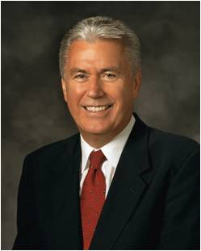
“I hope that we welcome and love all of God’s children, including those who might dress, look, speak, or just do things differently. It is not good to make others feel as though they are deficient. Let us lift those around us. Let us extend a welcoming hand.
Let us bestow upon our brothers and sisters in the Church a special measure of humanity, compassion, and charity so that they feel, at long last, they have finally found home. …
“It seems only right and proper that we extend to others that which we so earnestly desire for ourselves.
“I am not suggesting that we accept sin or overlook evil, in our personal life or in the world. Nevertheless, in our zeal, we sometimes confuse sin with sinner, and we condemn too quickly and with too little compassion. …
“… Let our hearts and hands be stretched out in compassion toward others, for everyone is walking his or her own difficult path”
Dieter F. Uchtdorf

Slide 12
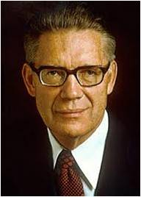
Priesthood VS Priestcraft
The Priesthood is of God
Priestcraft is of Satan
“Priesthood and priestcraft are two opposite. One is of God, the other of the devil.
When ministers claim but do not possess the priesthood;
when they set themselves up as lights to their congregations, but do not preach the pure and full gospel;
when their interest is in gaining personal popularity and financial gain, rather than in caring for the poor and ministering to the wants and needs of their fellow men—
they are engaged, in a greater or lesser degree, in the practice of priestcrafts”
Bruce R. McConkie
“He that speaketh of himself seeketh his own glory: but he that seeketh his glory that sent him, the same is true, and no unrighteousness is in him.” (John 7:18)
“Those who serve with charity do so with a pure heart, having no desire but to build up the kingdom of God and establish his righteousness.”
JFM and RLM
2 Nephi 26: 29-30

Slide 13
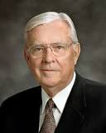
A caution that priestcraft can occur in the Church.
“Let us beware of false prophets and false teachers, both men and women, who are self-appointed declarers of the doctrines of the Church and who seek to spread their false gospel and attract followers by sponsoring symposia, books, and journals whose contents challenge fundamental doctrines of the Church.
Beware of those who speak and publish in opposition to God’s true prophets and who actively proselyte others with reckless disregard for the eternal well-being of those whom they seduce.
Like Nehor and Korihor in the Book of Mormon, they rely on sophistry to deceive and entice others to their views. They ‘set themselves up for a light unto the world, that they may get gain and praise of the world; but they seek not the welfare of Zion’ (2 Ne. 26:29)”
M. Russell Ballard
Caution

Slide 14
He Will Remember
Those who will perish:
Those who labor in Zion for money shall perish
Those who murder
Those who lie
Those who steal
Those who take the Lord's name in vain
Those who have envy or malice in the hearts
Those who contend one with another
Those who commit “whoredoms”
These characters do not come from the Lord
Nevertheless:
He doeth “that which is good among the children of men.”
He invites all to come and partake of His goodness.
He denies no one that come unto him, black and white, bond and free, male and female
He will remember the “heathen” (those that have been wicked) Gentile or Jew
2 Nephi 26:31-33

Slide 15
Sources:
Handout-- Victor L. Ludlow Unlocking Isaiah of the Book of Mormon pg 205
Jeffrey R. Holland The Justice and Mercy of God Ensign Sept 2013. From a fireside address, “Borne Upon Eagles’ Wings,” delivered on June 2, 1974, at Brigham Young University.
John H. Groberg The Power of God’s Love October 2004 General Conference
Joseph Fielding McConkie and Robert L. Millet Doctrinal Commentary on the Book of Mormon pg 309-310
Bruce R. McConkie Mormon Doctrine p 593
Dieter F. Uchtdorf You Are My Hands Ensign, May 2010, 68–69).
M. Russell Ballard Beware of False Prophets and False Teachers Ensign, Nov. 1999, 63).
Presentation by ©http://fashionsbylynda.com/blog/

Slide 16
 |  | . |  |  |  | .
1. | 29:1-2 | 29:1-2 |  |  | Isaiah's introduction
2. |  |  |  | 26:14-15a | Nephi's first introduction
3. | 29:~3-4 | 29:~3-4 |  | 26:15b-16 | Warfare and "speech out of
 |  |  |  |  | the dust"
4. |  |  |  | 26:17 | Sealed records hidden from
 |  |  |  |  | unbelievers
5. | 29:5 | 29:5 |  | 26:18 | Multitudes disappear as chaff
6. |  |  |  | 26:19-33 | Nephi's commentary; God's
 |  |  |  |  | open invitations
7. |  |  |  | 27:1 | Nephi's second introduction
8. | 29:6-10 | 29:6-10 |  | 27:2-5 | God's signs; man's empty
 |  |  |  |  | dreams, closed eyes
9. | 29:11a | 29: 11-12a |  | 27:6-7 | Vision and words of a sealed
 |  |  |  |  | book
10. |  | 29: 12b-20b |  | 27:8-15b | Book delivered to a man;
 |  |  |  |  | shown to witnesses
II. | 29:11b | 29:20c |  | 27:15c | Words of book shown to a
 |  |  |  |  | learned man
12. |  | 29:21a-c |  | 27:15d-17 | Learned man wants to see
 |  |  |  |  | sealed book
13. | 29:11c | 29:21d |  | 27:18 | Learned man says he cannot
 |  |  |  |  | read sealed book
14. | 29:12 | 29:22a-b |  | 27:19 | Unlearned man cannot read
 |  |  |  |  | words of the book
15. |  | 29:22c-26a |  | 27:20-23 | God instructs man with the
 |  |  |  |  | sealed book
16. | 29:13-24 | 29:26-32 |  | 27:24-35 | God's marvelous works and
 |  |  |  |  | wonders
Victor L. Ludlow pg 205
2 Nephi
26-27
Isaiah 29
KJV
Isaiah 29
JST
Isaiah 29
Description or Contents
--
--
--
--
--
--
--
--
Comparing 3 different versions
--
--

Slide 17
2 Nephi 26:33
“I hope that we welcome and love all of God’s children, including those who might dress, look, speak, or just do things differently. It is not good to make others feel as though they are deficient. Let us lift those around us. Let us extend a welcoming hand. Let us bestow upon our brothers and sisters in the Church a special measure of humanity, compassion, and charity so that they feel, at long last, they have finally found home. …
“It seems only right and proper that we extend to others that which we so earnestly desire for ourselves.
“I am not suggesting that we accept sin or overlook evil, in our personal life or in the world. Nevertheless, in our zeal, we sometimes confuse sin with sinner, and we condemn too quickly and with too little compassion. …
“… Let our hearts and hands be stretched out in compassion toward others, for everyone is walking his or her own difficult path” (Dieter F. Uchtdorf, “You Are My Hands,” Ensign or Liahona, May 2010, 68–69).

Slide 18
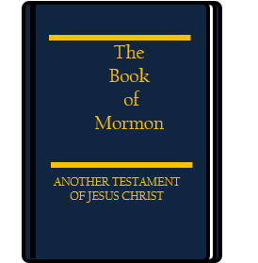
A Marvelous Work and a Wonder
2 Nephi 27
Isaiah 29

Slide 19
Each item has a solution to a problem
What might be the problem?
What is the solution?
Nephi’s prophecy tells us of problems that would exist in our day. He taught that people would stumble spiritually because of their iniquity,
that they would suffer from spiritual blindness, and that they would
reject the prophets. Nephi also prophesied about what God would do to solve these problems.
2 Nephi 27

Slide 20
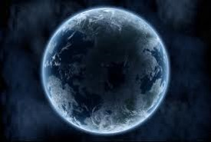
Days of the Gentiles
Jesus foretells the doom of Jerusalem and the destruction of the temple—Great calamities will precede His Second Coming…Matthew 24
Jesus tells of the calamities and signs preceding the Second Coming—There will be false Christs and false prophets…Mark 13:1-37
He tells of the signs to precede His Second Coming …Luke 21:5-36
Christ revealed signs of His coming as given on the Mount of Olives; 24–38,
The gospel will be restored, the times of the Gentiles will be fulfilled, and a desolating sickness will cover the land; 39–47,
Signs, wonders, and the Resurrection are to attend the Second Coming; 48–53,
Christ will stand on the Mount of Olives, and the Jews will see the wounds in His hands and feet; D&C 54–59,
The Lord will reign during the Millennium; 60–62…D&C 45:16-59
“But, behold, in the last days, or in the days of the Gentiles—yea, behold all the nations of the Gentiles and also the Jews, both those who shall come upon this land and those who shall be upon other lands, yea, even upon all the lands of the earth, behold, they will be drunken with iniquity and all manner of abominations—”
2 Nephi 27:1

Slide 21
How Oft Have I Called On You?
By:
The mouth of my servants
The voice of judgment
Ministering angels?
The great sound of a trump
Mine own voice
“And would have saved you with an everlasting salvation, but ye would not.”
The voice of thunderings
Famines and pestilences of every kind
The voice of lightnings
Great hailstones
The voice of voice of tempests
The voice of earthquakes
…But ye would not…
2 Nephi 27:2 and D&C 43:25

Slide 22
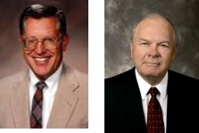

Nations Fight Against Zion
The Great and Abominable Church--Any organization that fights against the Church of the Lamb, or opposes its practices or beliefs
(2 Nephi:10:16)
Ariel- another name for Jerusalem
The wicked who fight will be punished
In terms of a “nightmare” in which they are starving and thirsting yet can not be filled. (Isaiah 29:7-8)
The Soul is empty
Drunken Men--
“ …in a spiritual sense drunkenness means apostasy”
Bruce R. McConkie
They stumble through life, unsure of their spiritual desires or heavenly origin and destiny
They have “closed their eyes” to truths of the gospel and rejected the prophets and rulers—spiritual blindness (Isaiah 29:10)
2 Nephi 27:3-5
JFM and RLM

Slide 23
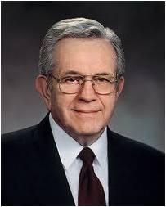

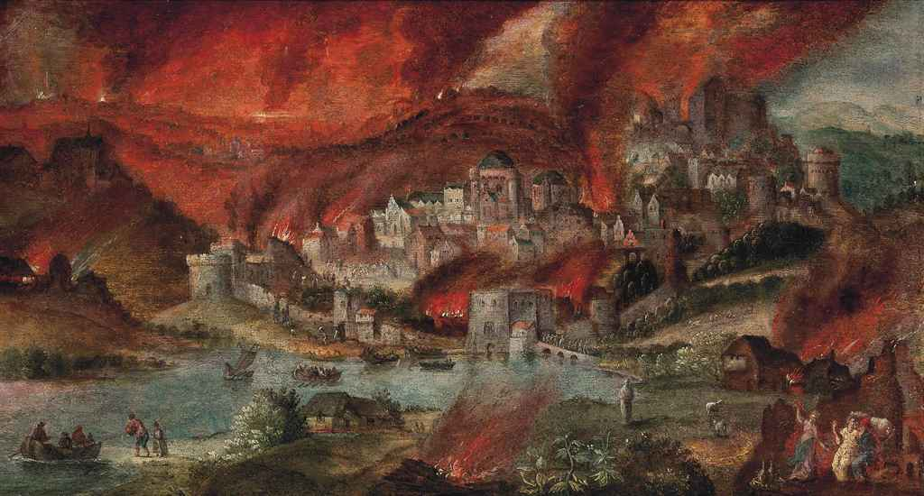
In the last days, many people will be full of iniquity and will reject the prophets
“I know of nothing in the history of the Church or in the history of the world to compare with our present circumstances. Nothing happened in Sodom and Gomorrah which exceeds in wickedness and depravity that which surrounds us now.
“Words of profanity, vulgarity, and blasphemy are heard everywhere. Unspeakable wickedness and perversion were once hidden in dark places; now they are in the open, even accorded legal protection.
“At Sodom and Gomorrah these things were localized. Now they are spread across the world, and they are among us.”
Boyd K. Packer
2 Nephi 27:5

Slide 24
Prophecy of the Book of Mormon
A Sealed Religious Record:
“And it shall come to pass that the Lord God shall bring forth unto you the words of a book, and they shall be the words of them which have slumbered.
And behold the book shall be sealed; and in the book shall be a revelation from God, from the beginning of the world to the ending thereof.”
”And the vision of all is become unto you as the words of a book that is sealed, which men deliver to one that is learned, saying, Read this, I pray thee: and he saith, I cannot; for it is sealed:” (Isaiah 29:11)
2 Nephi 27:6
JFM and RLM

Slide 25
Shall Be Sealed
Brother of Jared had seen a vision of things from premortality to the end of the Millennium (Ether 3:22-28; 4:4-7)
“And behold, when ye shall come unto me, ye shall write them and shall seal them up, that no one can interpret them; for ye shall write them in a language that they cannot be read.” (Ether 2:22)
“Wherefore the Lord hath commanded me to write them; and I have written them. And he commanded me that I should seal them up; and he also hath commanded that I should seal up the interpretation thereof; wherefore I have sealed up the interpreters, according to the commandment of the Lord.”
(Ether 4:5)
2 Nephi 27:7

Slide 26
A Record
Enoch
“…and he beheld also things which were not visible to the natural eye; and from thenceforth came the saying abroad in the land: A seer hath the Lord raised up unto his people.” (Moses:6:36)
For a book of remembrance we have written among us, according to the pattern given by the finger of God; and it is given in our own language.”
(Moses 6:46)
“But the records of the fathers, even the patriarchs, concerning the right of Priesthood, the Lord my God preserved in mine own hands; therefore a knowledge of the beginning of the creation, and also of the planets, and of the stars, as they were made known unto the fathers, have I kept even unto this day, and I shall endeavor to write some of these things upon this record, for the benefit of my posterity that shall come after me.”
(Abraham 1:31)
2 Nephi 27:7

Slide 27
Others Have Seen and Heard
“And he saw God face to face, and he talked with him, and the glory of God was upon Moses; therefore Moses could endure his presence.” (Moses 1:1)
“But now mine own eyes have beheld God; but not my natural, but my spiritual eyes, for my natural eyes could not have beheld; for I should have withered and died in his presence; but his glory was upon me; and I beheld his face, for I was transfigured before him.” (Moses 1:11)
“ And in a day when the children of men shall esteem my words as naught and take many of them from the book which thou shalt write, behold, I will raise up another like unto thee; and they shall be had again among the children of men—among as many as shall believe.” (Moses 1:41)
2 Nephi 27:7

Slide 28
Opening the Book
John
“And I saw in the right hand of him that sat on the throne a book written within and on the backside, sealed with seven seals.” (Revelation 5:1)
“And I wept much, because no man was found worthy to open and to read the book, neither to look thereon.” (Revelation 5:4)
“And one of the elders saith unto me, Weep not: behold, the Lion of the tribe of Juda, the Root of David, hath prevailed to open the book, and to loose the seven seals thereof.” (Revelation 5:5)
2 Nephi 27:7

Slide 29
Carrying a Book
“And it came to pass that I, Nephi, beheld that they did prosper in the land; and I beheld a book, and it was carried forth among them.”
(1 Nephi 13:20)
2 Nephi 27:7

Slide 30
Translating the Book
Joseph Smith
“And again, what do we hear? Glad tidings from Cumorah! Moroni, an angel from heaven, declaring the fulfilment of the prophets—the book to be revealed.”(D&C 128:20)
And he has translated the book, even that part which I have commanded him, and as your Lord and your God liveth it is true. (D&C 17:6)
By the gift and power of God, Joseph Smith translated the Book of Mormon
2 Nephi 27:7

Slide 31
Translating the Book
The Lord brought forth this book to help correct problems in the last days and to bring light to a darkened world.
The Lord revealed to ancient prophets details concerning the coming forth of the Book of Mormon.
Why does the Bible not mention the name “Book of Mormon”?
The
Book
of
Mormon
ANOTHER TESTAMENT
OF JESUS CHRIST
Him
“And the book is delivered to him that is not learned, saying, Read this, I pray thee: and he saith, I am not learned.”
(Isaiah 29:12)
At length the time arrived for obtaining the plates, the Urim and Thummim, and the breastplate. On the twenty-second day of September, one thousand eight hundred and twenty-seven, having gone as usual at the end of another year to the place where they were deposited, the same heavenly messenger delivered them up to me with this charge: that I should be responsible for them; that if I should let them go carelessly, or through any neglect of mine, I should be cut off; but that if I would use all my endeavors to preserve them, until he, the messenger, should call for them, they should be protected. JS—H 1:59.
2 Nephi 27:9

Slide 32
Divine Assistance of the Book
“Joseph Smith could neither write nor dictate a coherent and well-worded letter; let alone dictat[e] a book like the Book of Mormon. …
“My belief is that the Book of Mormon is of divine authenticity—I have not the slightest doubt of it. I am satisfied that no man could have dictated the writing of the manuscripts unless he was inspired; for, when acting as his scribe, [he] would dictate to me hour after hour; and when returning after meals, or after interruptions, he would at once begin where he had left off, without either seeing the manuscript or having any portion of it read to him. This was a usual thing for him to do. It would have been improbable that a learned man could do this; and, for one so ignorant and unlearned as he was, it was simply impossible”
Emma Smith

Slide 33
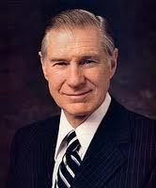
Read on the Housetops
“And the day cometh that the words of the book which were sealed shall be read upon the house tops; and they shall be read by the power of Christ; and all things shall be revealed unto the children of men which ever have been among the children of men, and which ever will be even unto the end of the earth.”
Advances in travel and communication have helped the institutional Church move forward at a rapid pace in proclaiming the gospel. Media referrals are introducing our missionaries to more investigators. Church-produced videos help the missionaries explain the gospel message and the mission of the Church. But are we as individuals doing our part to move this holy work forward? Today the information highway, with all of its means of communication, affords an opportunity for us to carry the mission with a thousand fold greater speed…. Thousands of messengers, their feet shod with the gospel of peace, now go forth with the message of God.”
James E. Faust
2 Nephi 27:11

Slide 34
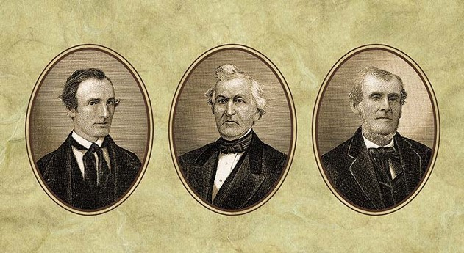
Chosen Witnesses—Burden of Proof
Who Shall View The Book?
“In the mouth of two or three witnesses shall every word be established.” (2 Corinthians 13:1)
“And behold, ye may be privileged that ye may show the plates unto those who shall assist to bring forth this work;
And unto three shall they be shown by the power of God; wherefore they shall know of a surety that these things are true.
And in the mouth of three witnesses shall these things be established; and the testimony of three, and this work, in the which shall be shown forth the power of God and also his word, of which the Father, and the Son, and the Holy Ghost bear record—and all this shall stand as a testimony against the world at the last day.”
(Ether 5:2-4)
Read D&C 17
Oliver Cowdery, David Whitmer, and Martin Harris were moved upon by an inspired desire to be the three special witnesses. Heading to D&C 17
2 Nephi 27:12

Slide 35
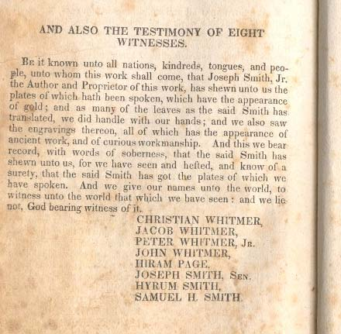
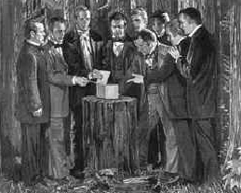
None Shall View Save a Few
“…they (the witnesses) repaired to a place in the woods where members of the Smith family were wont to hold secret prayer, and there the plates were shown to these eight witnesses by the prophet himself.”
(HC 1:58, note)
“By the words of three (specially, Isaiah, Nephi and Jacob). God hath said, I will establish my word. Nevertheless, God sendeth more witnesses, and he proveth all his words.”
2 Nephi 27:13

Slide 36
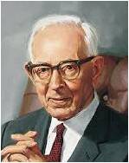
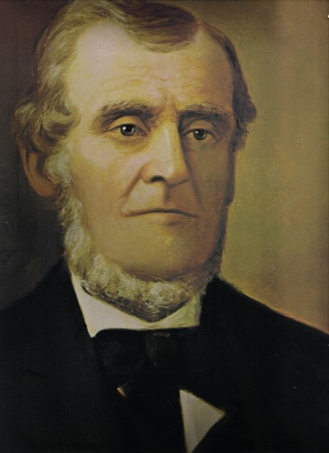
Take These to the Learned
Read 2 Nephi 15-20
Martin Harris took copies of the engravings of the plates of the Book of Mormon to professor Anthon in New York.
Mr. Anthon answered Martin in almost the language of Isaiah, when he was informed that the book from which the characters were taken was sealed.
Said he: “I cannot read a sealed book.”
“How remarkable it is that Isaiah said that the words of the book were delivered to one who was learned and that the book was delivered to the one who was not learned. How perfectly this harmonizes with the history of the case respecting Mr. Anthon and Joseph Smith.”
Joseph Fielding Smith
2 Nephi 27:15-20

Slide 37
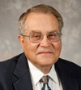
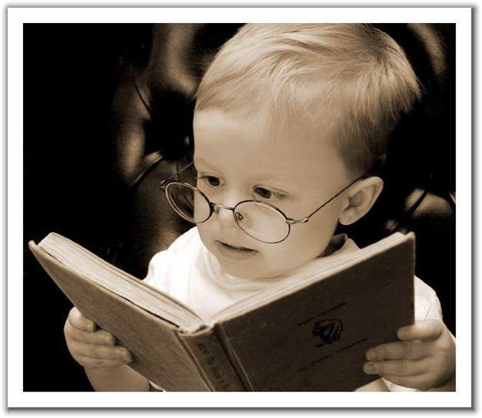
More Than Just a Book
“Granted, when one talks of the ancient texts themselves, the unlearned cannot read the ancient languages in which the texts are written. And the scholars, who can read the ancient texts, often lack gospel insights and the prophetic perspectives recorded in the scriptures outside the bible. Thus, they may be able to read the text, but they do not really understand the spiritual message of the writing.” Victor L. Ludlow
“Therefore, whoso readeth it, let him understand, for the Spirit manifesteth truth;
And whoso is enlightened by the Spirit shall obtain benefit therefrom;
And whoso receiveth not by the Spirit, cannot be benefited. Therefore it is not needful that it should be translated. Amen.”
D&C 91:4-6
2 Nephi 27:15-20

Slide 38
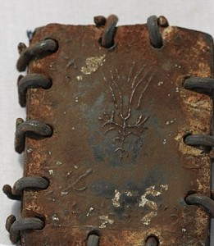
Touch Not—A Sealed Portion
“Touch not the things which are sealed, for I will bring them forth in mine own due time; for I will show unto the children of men that I am able to do mine own work.”
What is the “sealed portion” of the Book of Mormon, and will we ever know what’s in it?
When Moroni was finishing the Book of Mormon record, he was commanded to seal up some of the plates, and Joseph Smith was later commanded not to translate them. This sealed portion contains the complete record of the vision of the brother of Jared (see Ether 4:4–5). This vision included “all things from the foundation of the world unto the end thereof” (2 Nephi 27:10–11; see also Ether 3:25). So basically the Lord revealed to the brother of Jared the history of mankind, and the sealed portion of the plates was Moroni’s translated copy of it.
According to Joseph Smith’s associates
who saw the golden plates, anywhere
from half to two-thirds of all the plates
were in the sealed portion.
Oct. 2011
“And now I, Moroni, have written the words which were commanded me, according to my memory; and I have told you the things which I have sealed up; therefore touch them not in order that ye may translate; for that thing is forbidden you, except by and by it shall be wisdom in God.”
(Ether 5:1)
2 Nephi 27:21-22

Slide 39
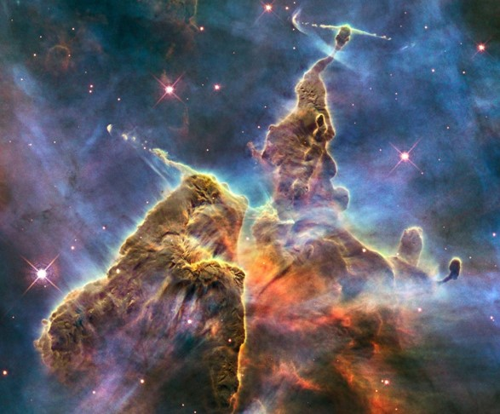
God of Miracles
“God has the power to reveal truth to man, the power to make known all things from the beginning to the end, even those mysteries contained on the record of the brother of Jared.
God is the Omnipotent One, being a miracles who is able to convey verities and perform acts which are beyond the power of mortal man to comprehend. But he is also the Omniscient One and, knowing perfectly the thoughts and intents of all his creation, is able to discern who is ready to receive what.”
JFM and RLM
“…it is by faith that miracles are wrought…”
(Moroni 7:17)
Hubble Space Image
2 Nephi 27:23

Slide 40
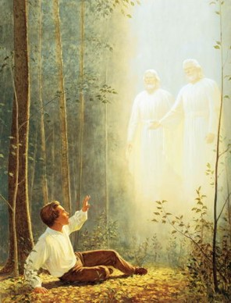

Our Day
Nephi quoting Isaiah 29:13-24
“These words evidence that Isaiah saw our day, witnessed the erection of the glorious gospel standard—the ensign to the nations—among the latter-day Saints, and acknowledged that such a restoration was indeed a marvelous work and a wonder.”
JFM and RLM
Drew near unto me with their mouth— “In speaking of the churches of the ninetieth century, the risen Lord said to the boy prophet Joseph Smith that “they were all wrong” and that “all their creeds were an abomination in his sight; that those professors were all corrupt; that: “they draw near to me with their lips, but their hearts are far from me, they teach for doctrines the commandments of men, having a form of godliness, but they deny the power thereof’ ”
Joseph Smith
Precepts of man—Philosophies of men
2 Nephi 27:24-25

Slide 41

A Marvelous Work
The work of the Restoration is both marvelous and wonderful. In our day, in our final dispensation of grace, “shall the Father work a work,”
Jesus taught the Nephites. “which shall be a great and a marvelous work, among them; and there shall be among them those who will not believe it, although a man shall declare it unto them.”
(3 Nephi 21:9)
Wisdom of their wise and learned shall perish—
“A library containing the wisdom of man is not of equal worth to a single sentence uttered by the power of the Holy Ghost.”
JFM and RLM
Seek deep to hide their counsel from the Lord—Hebrew word sod, usually translated as counsel in KJV, may also be secret (Amos 3:7)
Those who try desperately to hide their secrets, their secret acts from him who sees and knows all things. –works of darkness
2 Nephi 27:25-27

Slide 42
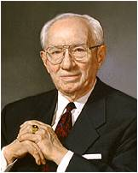
The Lord performed a marvelous work and a wonder through the coming forth of the Book of Mormon and the Restoration of His gospel.
“That glorious day dawned in the year 1820, when a boy, earnest and with faith, walked into a grove of trees and lifted his voice in prayer, seeking that wisdom which he felt he so much needed.
“There came in response a glorious manifestation. God the Eternal Father and the risen Lord Jesus Christ appeared and spoke with him. The curtains which had been closed for much of two millennia were parted to usher in the dispensation of the fulness of times. There followed the restoration of the holy priesthood, first the Aaronic, and then the Melchizedek, under the hands of those who had held it anciently. Another testament, speaking as a voice from the dust, came forth as a second witness to the reality and the divinity of the Son of God, the great Redeemer of the world.
“Keys of divine authority were restored, including those keys which were necessary to bind together families for time and eternity in a covenant which death could not destroy.
“The stone was small in the beginning. It was hardly noticeable. But it has grown steadily and is rolling forth to fill the earth”
Gordon B. Hinckley

Slide 43
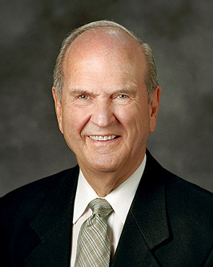
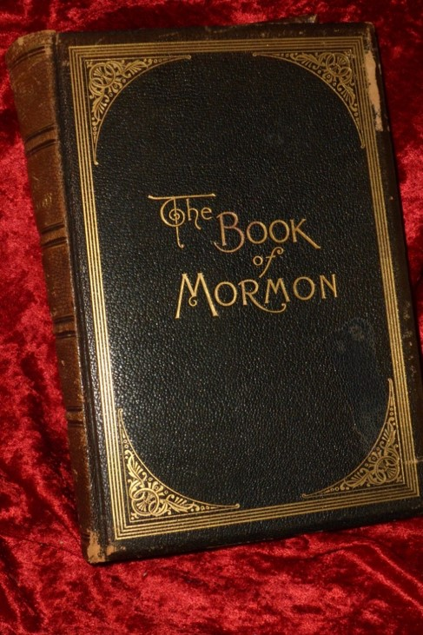
Think of the short time Joseph took to translate the Book of Mormon. Working from April to June of 1828, Joseph translated the 116 pages that Martin Harris later lost. Joseph began translating again on Tuesday, April 7, 1829, with Oliver Cowdery as scribe.
The manuscript was completed eighty-five days later, on June 30 of that year.
Of course, not all of that time was spent working on the translation. The Prophet and his scribes also took time to eat, to sleep, to seek employment, to receive the Aaronic and Melchizedek priesthoods, to make at least one (and possibly two) trips to Colesville thirty miles away, to receive and record thirteen revelations that are now sections of the Doctrine and Covenants, to move from Harmony to Fayette, to acquire the Book of Mormon copyright, and to begin making arrangements for the publication of the Book of Mormon.
Conservatively estimated, this left sixty-five or fewer working days on which the prophet and his scribes translated this book, which contains 531 pages in its current edition.
Russell M. Nelson

Slide 44


Things Upside Down
Stirring up the hearts and minds of people
The Meek– the Poor—Rejoice
“Those unencumbered by the vanities of men, those who are eager and earnest in their quest for eternal life—these are they in the latter days who shall glory in the message of the Restoration, who shall rejoice in the testimony of the Holy One of Israel set forth by the Book of Mormon.”
JFM and RLM
The plainness of the Book of Mormon brings hearing to those who have not yet heard, sight to those who have not yet seen; the pages of this ancient volume are filled with solemn and sacred sounds, with bright and brilliant rays of light.
Watching with Iniquity--
Those who are ever alert for the opportunity to do evil
2 Nephi 27:27-31

Slide 45
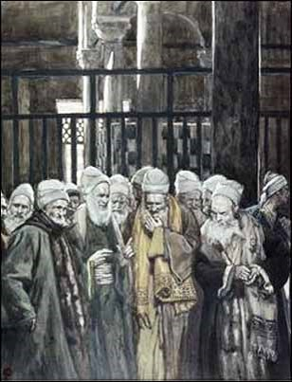
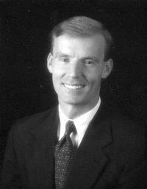

Lay a Snare for Him
Reprove in the Gate--Princes and judges would sit at the gate to discharge their official duties.
“And they that make a man an offender for a word, and lay a snare for him that reproveth in the gate, and turn aside the just for a thing of naught.”
“Those who make themselves judges of others, who are eagerly looking for their neighbors or Church leaders to make mistakes so they can criticize them.”
see (D&C 45:50) John Bytheway
The Lord condemns those seeking to misuse or abuse his words, and those whom he has sent, making the innocent an “offender for a word.”
Those who cry transgression do it because they are the servants of sin, and are the children of disobedience themselves. (D&C 121:16-17)
2 Nephi 27:32-35

Slide 46

Jacob Shall Not Be Ashamed
Jacob---The people of Israel
Wax pale—be ashamed—embarrased
No longer will the people of Israel hang down their heads in sorrow.
The beginning of the Father's work in the last days—the work of gathering.
Sanctify the Holy One—to reverence the God of heaven through true and proper worship—serve God in righteousness
Erred in Spirit—The Restoration shall sweep away theological cobwebs, the abomination of man-made creeds, and mistaken notions concerning God, man, and the purpose of existence.
Shall learn doctrine—People murmur when they know not the dealings of that God who created them (1 Nephi 2:12).
However: Those that seek the light of Christ can participate in the ordinances of salvation and learn of the doctrine of Christ.
2 Nephi 27:33-35

Slide 47
What Does It All Mean?
Isaiah teaches us of the preeminence of the Book of Mormon in our Heavenly Father’s plan, the importance of the mission of the Prophet Joseph Smith, and of our own place as part of the marvelous work and a wonder so long foretold.
John Bytheway
“More than seven hundred years before the birth of Jesus Christ the Lord spoke through Isaiah of the coming forth of the Book of Mormon and the restoration of the Gospel. Isaiah, by prophecy, spoke of the restoration of the new and everlasting covenant, and the Lord performing a ‘marvelous work and a wonder,’ which should cause ‘the wisdoms of their wise men’ to be hid….this marvelous work is the restoration of the Church and the Gospel with all the power and authority, keys and blessings which pertain to their great work for the salvation of the children of men.”
Joseph Fielding Smith
2 Nephi 27:33-35

Slide 48
Sources:
Bruce R. McConkie Mormon Doctrine pg. 209
Victor L. Ludlow Unlocking Isaiah in the Book of Mormon pg 207-215
Joseph Fielding McConkie and Robert L. Millet Doctrinal Commentary on the Book of Mormon pg. 312-327
Boyd K. Packer, “The One Pure Defense” [evening with a General Authority, Feb. 6, 2004], 4).
James E. Faust This is Our Day April Conf. 1999
Joseph Fielding Smith Doctrines of Salvation 3:213-214
Oct. 2011 Ensign Common Questions… (see Kirk B. Henrichsen, “What Did the Golden Plates Look Like?”New Era, July 2007, 31).
Joseph Smith History 1:19
Emma Smith “Last Testimony of Sister Emma,” The Saints’ Herald, vol. 26, no. 19 [Oct. 1, 1879], 290).
Gordon B. Hinckley(“At the Summit of the Ages,” Ensign, Nov. 1999, 74).
John Bytheway Isaiah for Airheads pg. 164
Joseph Fielding Smith quoted in Isaiah Plain and Simple Brewster pg 168(
Russell M. Nelson, “A Treasured Testament,” Ensign, July 1993, 61–62)
See John W. Welch, Ensign, Jan. 1988, pp. 46–47.) That calculates to an average of eight pages per day. Consider this when you translate a book, or as you schedule your own reading of the Book of Mormon.
Presentation by ©http://fashionsbylynda.com/blog/

Slide 49
 | NEPHI’S PROPHECY OF WHAT THE MAN WOULD DO | THE MAN’S NAME | THE FULFILLMENT OF THE PROPHECY JOSEPH SMITH HISTORY 1:63-65
1st Man (“not learned”) 2 Nephi 27:9; 15,19
2nd Man (“another”) 2 Nephi 27:15,17
3rd Man (“learned”) 2 Nephi 27:15-18

Slide 50
The Sealed Book 2 Nephi 27:10:
The book being “sealed” can refer to the Book of Mormon, in general, being protected against unauthorized possession or use. It can also refer to a specific portion of the golden plates that were physically sealed off (“the revelation which was sealed” [2 Nephi 27:10]). This sealed portion contains a vision revealing “all things from the foundation of the world unto the end thereof” (2 Nephi 27:10), given to the brother of Jared (see Ether 3:25–27; 4:4–5; see also the chart titled “The Plates and Their Relationship to the Published Book of Mormon,” located in the appendix of this manual). Nephi prophesied that the sealed portion of the Book of Mormon would be brought forth in the “due time of the Lord” (2 Nephi 27:10).
More Scriptures? 2 Nephi 27:11
“Many more scriptural writings will yet come to us, including those of Enoch (see D&C 107:57), all of the writings of the Apostle John (see Ether 4:16), the records of the lost tribes of Israel (see 2 Nephi 29:13), and the approximately two-thirds of the Book of Mormon plates that were sealed: ‘And the day cometh that the words of the book which were sealed shall be read upon the house tops; and they shall be read by the power of Christ; and all things shall be revealed unto the children of men which ever have been among the children of men, and which ever will be even unto the end of the earth’ (2 Nephi 27:11)” (Neal A. Maxwell, A Wonderful Flood of Light [1990], 18).
By the Gift and Power of God 2 Nephi 27:20-21:
In writing the title page of the Book of Mormon, the prophet Moroni said that the interpretation of the record would “come forth by the gift and power of God.” At the time Joseph Smith received the golden plates, he also received the Urim and Thummim, which the Lord had prepared for translating the plates (see Joseph Smith—History 1:33–35, 59, 62). Joseph Smith also used a small oval stone referred to as a seer stone, which he had obtained years before. Several scribes and others who observed the translation described how “Joseph placed either the interpreters or the seer stone in a hat, pressed his face into the hat to block out extraneous light, and read aloud the English words that appeared on the instrument” (“Book of Mormon Translation,” Gospel Topics, topics.lds.org). When asked about the process of translation, Joseph Smith responded that it had been done “by the gift and power of God.” (For more information, see “Book of Mormon Translation,” Gospel Topics, topics.lds.org; Richard E. Turley Jr., Robin S. Jensen, and Mark Ashurst-McGee, “Joseph the Seer,” Ensign, Oct. 2015, 49–54.)

Slide 51
Beware-a warning of false churches and doctrines
2 Nephi 28
WARNING

Slide 52
Warning Signs
ONE WAY

Slide 53
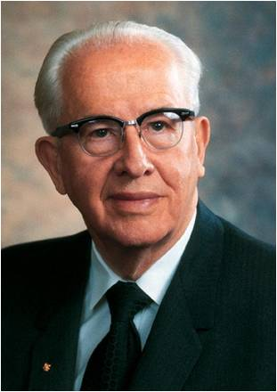
“The Book of Mormon exposes the enemies of Christ. It confounds false doctrines. … It fortifies the humble followers of Christ against the evil designs, strategies, and doctrines of the devil in our day. The type of apostates in the Book of Mormon are similar to the type we have today”
Ezra Taft Benson

Slide 54
Nephi Has Spoken
Constrained me— to compel, to urge to action (Webster’s Dictionary 1828)
Surely come to pass—The word of the Lord is sure and certain—Whether the word is spoken by the Lord himself or by one of his servants—It is all the same (D&C 1:38-39)
The Book— Of Great Worth—Those who open their minds in the last days to the truth—a familiar spirit--Restoration
BEWARE OF THE LAST DAYS
2 Nephi 28:1-2

Slide 55
Churches Built
How does the Book of Mormon expose the enemies of Christ?
It includes accounts of people who tried to lead others away from faith in Christ. It allows us to see their errors and false ideas.
How does the Book of Mormon fortify us against the adversary?
The Book of Mormon exposes the false ideas of the devil and strengthens us against his evil designs.
“Whether established for noble or ignoble causes,
any church initiated by man rather than by the
revelation of God is without the power of salvation.
Such organizations cannot fully satisfy man’s innate
yearning to worship and serve the true and living God.”
JFM and RLM
BEWARE OF FALSE IDEAS
2 Nephi 28:3

Slide 56
All Roads Lead to Rome
Do all churches teach the truth?
Joseph Fielding Smith states that there were many corrections in the Hebrew scriptures in their purity and went to the Gentiles. Many changes were made (to the Bible), and “many parts which are plain and most precious; and also many covenants of the Lord have they taken away.” (1 Nephi 13:23-32)
The Church of Jesus Christ, as it was established in the days of the apostles, was governed by apostles, prophets, evangelist, high priest, seventies and other officers, who are not found in the churches of the world today.
BEWARE OF FALSE CHURCHES
Matthew 12:30
“He that is not with me is against me; and he that gathereth not with me scattereth abroad.”
2 Nephi 28:1-2

Slide 57
Merciful
If God is merciful to everyone, will everyone inherit heaven’s blessings (salvation)?
“Salvation is in Christ, is reveled by him from age to age, and is available only to those who keep his commandments and obey his ordinances. These commandments are taught in, and these ordinances are administered by, his Church….
BEWARE OF FALSE DOCTRINES
…Any church or organization of any kind whatever which satisfies the innate religious longings of man and keeps him from coming to the saving truths of Christ and his gospel is therefore not of God.”
Bruce R. McConkie
2 Nephi 28:1-2

Slide 58
For tomorrow we die
“Yea, and there shall be many which shall say: Eat, drink, and be merry, for tomorrow we die; and it shall be well with us.
And there shall also be many which shall say: Eat drink, and be merry; nevertheless, fear God—he will justify in committing a little sin; yea, lie a little, take the advantage of one because of his words, dig a pit for thy neighbor; there is no harm in this; and do all these things, for tomorrow we die; and if it so be that we are guilty, God will beat us with a few strips, and at last we shall be saved in the kingdom of God.”
2 Nephi 28:7-9

Slide 59
Eat, Drink, and Be Merry
“Yea, and there shall be many which shall say: Eat, drink, and be merry, for tomorrow we die; and it shall be well with us.
This is a focus on the present, what people want now, what is pleasurable now with :
No consequences in the future.
No goals and rewards for the future.
No hope in a future of eternal life.
BEWARE OF PEER PRESSURE
2 Nephi 28:7-9

Slide 60
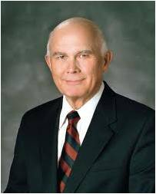
“The idea that one is better off after one has sinned and repented is a devilish lie of the adversary. Does anyone here think that it is better to learn firsthand that a certain blow will break a bone or a certain mixture of chemicals will explode and sear off our skin?
Are we better off after we have sustained and then healed such injuries?
I believe we all can see that it is better to heed the warnings of wise persons who know the effects on our bodies.”
Dallin H. Oaks
2 Nephi 28:7-9

Slide 61
God Fearing
And there shall also be many which shall say: Eat drink, and be merry; nevertheless, fear God—
BEWARE OF EVIL MEN
God fearing has a negative connotation…the punishments of God
Fear can have two meanings: (1) to fear God is to feel reverence and awe for him and to obey his commandments; (2) to fear man, mortal dangers, pain, and evil is to be afraid of such things and to dread them. Guide to Scriptures
2 Nephi 28:7-9

Slide 62
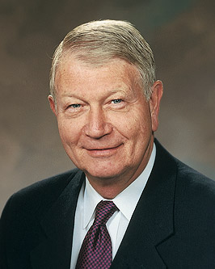
A Little sin
….will justify in committing a little sin; yea, lie a little, take the advantage of one because of his words, dig a pit for thy neighbor; there is no harm in this; and do all these things, for tomorrow we die; and if it so be that we are guilty, God will beat us with a few strips, and at last we shall be saved in the kingdom of God.
BEWARE OF LITTLE LIES
“Every transgression, regardless of how minor, makes us more susceptible to Satan’s influence the next time he tempts us. Satan takes us an inch at a time, deceiving us as to the consequences of so-called minor sins until he captures us in major transgression…”
Richard C. Edgley
1
2
3
2 Nephi 28:7-9

Slide 63
“Nephi so describes the people of his day, as he also describes so many of our day. How easy it is for us to say, ‘We believe in being honest, true, chaste, benevolent.’
But how difficult for so many to resist the temptation to lie a little, cheat a little, steal a little, bear false witness in speaking in gossipy words about others. Rise above it. … Be strong in the simple virtue of honesty.”
Gordon B. Hinckley
2 Nephi 28:7-9; Article of Faith 1:13

Slide 64
Hiding from the Lord
Yea, and there shall be many which shall teach after this manner, false and vain and foolish doctrines, and shall be puffed up in their hearts, and shall seek deep to hide their counsels from the Lord; and their works shall be in the dark.”
BEWARE OF PRIDE
“That they may be conferred upon us, it is true; but when we undertake to cover our sins, or to gratify our pride, our vain ambition, or to exercise control or dominion or compulsion upon the souls of the children of men, in any degree of unrighteousness, behold, the heavens withdraw themselves; the Spirit of the Lord is grieved; and when it is withdrawn, Amen to the priesthood or the authority of that man.”
(D&C 121:37)
2 Nephi 28:7-9

Slide 65
“…The central feature of pride is enmity—opposition or hostility toward God and our fellowmen. The proud man wants to do things on his own and does not want God or anyone else telling him what to do. He is lifted up in the pride of his heart, rather than being meek and lowly in heart.
In such a state he cannot be helped because he is not open to the influence of the Spirit. He hardens his heart and resists the enticings of the Spirit. Instead of learning from his weaknesses and mistakes, he becomes blind to the truth about himself. Rather than facing himself and growing, he chooses to fight and blame others or to take flight and escape.
It is frightening to discover how much the world thrusts pride upon us. We are taught to be the best, be number one, dress for success, and so forth. Much of this world functions on competition—and comparisons and competition lead many to be filled with pride. The proud make every man their adversary by pitting their intellects, opinions, works, wealth, talents, or any other worldly measuring device against others.
We have all learned to be proud; anyone who doesn’t think he is proud is very proud indeed. This spiritual cancer manifests itself in many ways, such as faultfinding, gossiping, backbiting, murmuring, living beyond our means, envying, coveting, withholding gratitude and praise that might lift another, and being unforgiving and jealous. It leads to selfishness, self-pity, contention, worldly self-fulfillment, grudge-holding, defensiveness, a refusal to forgive, and an unwillingness to confess and forsake sin.”
Ezra T. Benson
2 Nephi 28:7-9

Slide 66
Saints Cry from the ground
“Too many noble and great ones have lived and preached and taught; too many have sacrificed their comforts, their homes, their families, and there own lives; to many have laid their all on the altar—too many have given their lives to the kingdom of god for the wicked and unbelieving to defile the earth.”
The cry of all the prophets and saints can be heard for justice to be rendered. For evil to be abolished.
JFM and RLM
“…but my people will I preserve.”
(Moses 7:48, 60-61)
BEWARE OF PERSECUTION
2 Nephi 28:10

Slide 67
Gone out of the way
Those who have strayed from the Lord himself. Gone off the path of straight and narrow.
“For strait is the gate, and narrow the way that leadeth unto the exaltation and continuation of the lives, and few there be that find it, because ye receive me not in the world neither do ye know me.”
(D&C 132:22)
BEWARE OF CROOKED PATHS
2 Nephi 28:11

Slide 68
Because of Pride and False Doctrines
Nephi warns what will happen to many churches and people in the last days because of pride and false doctrines.
In what ways do pride and false teachings influence people?
Churches become corrupt
It robs the poor because of fine sanctuaries and fine clothing (A person becoming more concerned with manner of dress)
It persecutes the meek and poor in heart
It listens only to the precepts of “man”
How can we avoid being deceived by “the precepts of men”?
“precepts of men”—teachings of people instead of teachings of the Lord
BEWARE OF FALSE TEACHINGS
Why are “humble followers of Christ” not led astray by pride and wickedness?
“…and there are none save a few only who do not lift themselves up in the pride of their hearts,…”
(Mormon 8:36)
2 Nephi 28:12-14

Slide 69
Consequences of Pride
They all shall be thrust down to hell
The Lord will speedily visit the inhabitants of the earth, and they shall perish
If they repent, they will not be destroyed
The Abominable Church must tumble to the earth…fall
The kingdom of the devil will shake and the devil will grasp them with his “everlasting chains”
BEWARE OF THE DEVIL’S CHAINS
2 Nephi 28:15-19

Slide 70

The Everlasting Chains
Satan seeks to grasp us with his everlasting chains by … ?
Stirring people up to anger against that which is good
Pacifying and lulling away individuals into carnal security
Telling people that there is no hell and no devil.

Slide 71
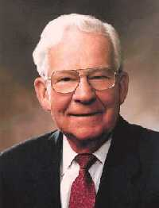
“It should come as no surprise that one of the adversary’s tactics in the latter days is stirring up hatred among the children of men. He loves to see us criticize each other, make fun or take advantage of our neighbor’s known flaws, and generally pick on each other.
The Book of Mormon is clear from where all anger, malice, greed, and hate come. By the looks of what we constantly see depicted in the news media, it appears that Satan is doing a pretty good job. In the name of reporting the news, we are besieged with sometimes graphic depictions—to often in living color—of greed, extortion, violent sexual crimes, and insults between business, athletic, or political opponents.”
Marvin J. Ashton
2 Nephi 28:20

Slide 72
“Those ahead of you in life have probed about the water holes a bit and raise a voice of warning about crocodiles. Not just the big, gray lizards that can bite you to pieces, but spiritual crocodiles, infinitely more dangerous, and more deceptive and less visible, even, than those well-camouflaged reptiles of Africa.
“These spiritual crocodiles can kill or mutilate your souls. They can destroy your peace of mind and the peace of mind of those who love you. Those are the ones to be warned against, and there is hardly a watering place in all of mortality now that is not infested with them”
Boyd K. Packer

Slide 73
Why do you think it is dangerous for people to be “at ease in Zion,” thinking that no improvement is needed?
What are some examples of Satan trying to “stir [people] up to anger against that which is good”?
Why do you think Satan is able to lead such people “carefully down to hell”?
How can we guard against flattery?
What does it mean to flatter someone?
What are some things we can do to guard against anger?
Why would Satan try to convince people that he does not exist?
Why do you think flattery can lead some people away from the Lord?
2 Nephi 28:20-29

Slide 74
Everyone does it
Some of the devils most appealing lines
If it doesn’t hurt anybody else, it’s all right
It is just a little thing
If I feel all right about it, it’s OK
It’s the “in” thing to do it
2 Nephi 28:20-29
James E. Faust

Slide 75
“It is not good practice to become intrigued by Satan and his mysteries. No good can come from getting close to evil. Like playing with fire, it is too easy to get burned…The only safe course is to keep well distanced from him and any of his wicked activities or nefarious practices…”
James E. Faust

Slide 76
Line upon Line
The Lord honors our agency and our efforts to learn of Him.
A testimony is not thrust upon you; a testimony grows. We become taller in testimony like we grow taller in physical stature; we hardly know it happens because it comes by growth…
... You cannot force spiritual things... You can no more force the Spirit to respond than you can force a bean to sprout, or an egg to hatch before it’s time. You can create a climate to foster growth, nourish, and protect; but you cannot force or compel: you must await the growth.
Do not be impatient to gain great spiritual knowledge. Let it grow, help it grow, but do not force it or you will open the way to be misled.
Boyd K. Packer
2 Nephi 28:30

Slide 77
Doctrinal Mastery
For behold, thus saith the Lord God: I will give unto the children of men line upon line, precept upon precept, here a little and there a little; and blessed are those who hearken unto my precepts, and lend an ear unto my counsel, for they shall learn wisdom; for unto him that receiveth I will give more; and from them that shall say, We have enough, from them shall be taken away even that which they have.
2 Nephi 28:30

Slide 78
Gospel Principles
If we believe that we do not need more of God’s words, we will lose those we already have
If we receive God’s words, He will give us more
God reveals truth line upon line, precept upon precept. If we hearken to God’s precepts and counsel, we will learn wisdom.

Slide 79
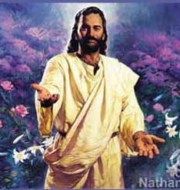
We Have Enough?
The Lord speaks to people who have denied Him.
“I shall lengthen out mine arm unto them from day to day”--
The Lord tells of His mercy and His willingness to help us each day as we seek to follow His will, even if we have rejected Him in the past.
The Lord will be merciful to all people who repent and come to Him.
2 Nephi 28:32

Slide 80
“And how merciful is our God unto us, for he remembereth the house of Israel, both roots and branches; and he stretches forth his hands unto them all the day long; and they are a stiffnecked and a gainsaying people; but as many as will not harden their hearts shall be saved in the kingdom of God.
Wherefore, my beloved brethren, I beseech of you in words of soberness that ye would repent, and come with full purpose of heart, and cleave unto God as he cleaveth unto you. And while his arm of mercy is extended towards you in the light of the day, harden not your hearts.”
Jacob 6:4-5

Slide 81
Sources:
Ezra Taft Benson The Book of Mormon Is the Word of God, Ensign, Jan. 1988, 3; quote from 1992 Nov. No Place For Pride C. Richard Chidester
Joseph Fielding McConkie and Robert L. Millet Doctrinal Commentary on the Book of Mormon pg. 328-346
Joseph Fielding Smith Plan of Salvation Vol. 3 pg 190-191 and Vol. 1 pg 239
Bruce R. McConkie Mormon Doctrine pg. 138
Dallin H. Oaks Sin and Suffering [Brigham Young University fireside address, Aug. 5, 1990], 6, speeches.byu.edu
Gordon B. Hinckley Building Your Tabernacle Ensign, Nov. 1992, 52.
Richard C. Edgley Ensign, Nov. 1994
Marvin J. Aston Ensign, May 1992
Boyd K. Packer Spiritual Crocodiles Ensign, May 1976, 30–31; The Candle of the Lord Jan. 1983 Ensign
James E. Faust The Great Imitator Nov. 1987 Ensign
Presentation by ©http://fashionsbylynda.com/blog/

Slide 82
Rejection of the Book of Mormon
2 Nephi 29-30
Holy Bible
The
Book
of
Mormon
ANOTHER TESTAMENT
OF JESUS CHRIST

Slide 83
Nephi Prophesies
Come One, come all for there will be a great and marvelous work that will come to pass.
There will be a restoration of the gospel that was foretold by Isaiah the prophet.
Hear ye, oh my people…
Remember the promises made by our father’s; Abraham’s seed, which we are descendants of, and to the remnants of my seed.
These words shall be a standard that will go forth unto the ends of the earth
2 Nephi 29:1-2

Slide 84
We Already Have a Bible.
We don’t need any thing else
2 Nephi 29: 3

Slide 85
The spirit of Apostasy denies the spirit of revelation; therefore it seeks to seal the heavens
Nephi was prophetic in his description of people’s reaction to the Book of Mormon.
People today often express doubts about the Book of Mormon because they already have the Bible.
The Holy Bible
2 Nephi 29:3

Slide 86
Additional Scriptures
What is the Lord’s purposes for giving scripture in addition to the Bible?
The Lord remembers all people and sends His word to all nations (see verse 7)
The Lord speaks the same message to all nations, and the Book of Mormon is a second witness to the truths in the Bible (see verse 8)
The Lord is always the same, and He speaks according to His pleasure (see verse 9)
God’s work is not finished, and He will continue to speak to accomplish His work (see verse 9)
People should not assume that the Bible contains all of the Lord’s words or that the Lord has not caused more words to be written (see verse 10)
The Lord commands people in all nations to record His words (see verse 11).
2 Nephi 29:7-10

Slide 87
“Does God love us less than those led by the ancient prophets? Do we need his guidance and instruction less? Reason suggests that this cannot be. Does he not care? Has he lost his voice? Has he gone on a permanent vacation? Does he sleep? The unreasonableness of each of these proposals is self-evident.”
James E. Faust
2 Nephi 29:3-11

Slide 88
Yesterday, Today, and Forever
The whole system of salvation depends upon the constancy of God.
My Work is not finished:
As the Lord told Moses:
“As one earth shall pass away and the heavens thereof even so shall another come; and there is no end to my works, neither to my words.” (Moses 1:18)
2 Nephi 29:9

Slide 89
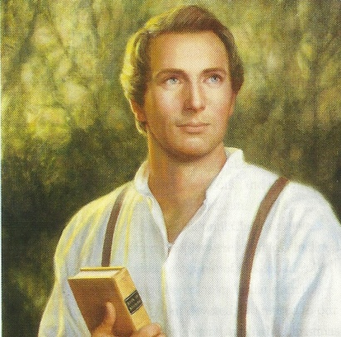
Does the Bible Contain All God’s Words?
“Wherefore, because that ye have a Bible ye need not suppose that it contains all my words; neither need ye suppose that I have not caused more to be written.”
“Much instruction has been given to man since the beginning which we do not possess now…some of our friends…are bold to say that we have everything written in the bible which god ever spoke to man since the world began…Does it remain for a people who never had faith enough to call down one scrap of revelation from heaven, and for all they have now are indebted to the faith of another people who lived hundreds and thousands of years before them, does it remain for them to say how much God
has spoken and how much he has not spoken?...
It is nowhere said that volume by the mouth of
god, that He would not, after giving what is there
contained, speak again.”
Joseph Smith
2 Nephi 30:10

Slide 90
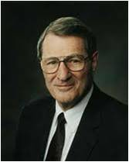
“Lost books are among the treasures yet to come forth. Over twenty of these are mentioned in the existing scriptures. Perhaps most startling and voluminous will be the records of the lost tribes of Israel (see 2 Nephi 29:13). We would not even know of the impending third witness for Christ except through the precious Book of Mormon, the second witness for Christ! This third set of sacred records will thus complete a triad of truth. Then, just as the Perfect Shepherd has said, ‘My word also shall be gathered in one’ (v. 14). There will be ‘one fold and one shepherd’ (1 Nephi 22:25) in a welding together of all the Christian dispensations of human history (see D&C 128:18)”
Neal A. Maxwell

Slide 91
“The Lord will eventually cause the inspired teachings He has given to His children in various nations to be brought forth for the benefit of all people. This will include accounts of the visit of the resurrected Lord to what we call the lost tribes of Israel and His revelations to all the seed of Abraham. …
When new writings come forth—and according to prophecy they will—we hope they will not be treated with the rejection some applied to the Book of Mormon because they already had a Bible.”
Dallin H. Oaks

Slide 92
Keeping Sacred Records
Did other people keep sacred records?
“In any and all ages the Lord’s people have had scripture of their own writing…the Jews had their own scriptural record…the Nephites kept their own…other families were led away from time to time by the hand of the Lord to various places throughout the earth. They would have kept scriptural records which will someday be restored to us…
…the Lord announces a future day when he will speak unto all nations of the earth and they also will write it…
As long as there are righteous people upon the earth, new scriptural records will be written.”
JFM and RLM
The gathering will not only be of people but of sacred records that have been kept
2 Nephi 29:11-14

Slide 93
No Salvation in Sin
We become part of God’s covenant people when we repent and believe in Jesus Christ.
Christ came to save men “from their sins,” not in them
Matthew 1:21
“no unclean thing can inherit the kingdom of God”
Alma 40:26
2 Nephi 30:1-2

Slide 94
The Lord’s Promises
The covenant people—
Abraham and his descendants
Those who recognize Christ as their Savior
“…For after the book of which I have spoken shall come forth, and be written unto the Gentiles, and sealed up again unto the Lord, there shall be many which shall believe the words which are written; and they shall carry them forth unto the remnant of our seed.”
2 Nephi 30:2-3

Slide 95
Descendants of the Jews
Nephi’s forefathers were citizens of the kingdom of Judah (not that they were of that tribe) 2 Nephi 33:8
Lehi was a descendant of Manasseh (Alma 10:3)
Ishmael of Ephraim (JD 23:184
The Book of Mormon is the record of Joseph or the ‘stick of Ephraim”
(D&C 27:5 and 2 Nephi 3:12)
2 Nephi 30:4

Slide 96
Doing Our Part To Share
The Book of Mormon can help all people come to know Jesus Christ and live His gospel
The
Book
of
Mormon
ANOTHER TESTAMENT
OF JESUS CHRIST
What can we do to help others come to know Jesus Christ through the Book of Mormon?
The work of gathering that will commence in the Millennium will be of such magnitude (missionary work).
How has the Book of Mormon helped you come to know the Savior?
2 Nephi 30:4-8

Slide 97
Conditions Prior to Millennium
The fulness and blessings have been promised to the poor
Each person and nation is to hear the gospel…either in mortality or the spirit world.
God will go first to the nations of wealth and education and those righteous can reach out to those that are poor, lame, blind—meaning the underprivileged nations. (D&C 58:7-12)
There will be authority and chastisement—the rod of his mouth (D&C 19:15)
Breath of his lips--The wicked shall be destroyed by the brightness and glory of the Second Coming. God has no need of armies or armaments to carry out his decrees. (Moses 1:32)
Eventually all must choose; all must either accept the Christ or reject Him.
2 Nephi 30:9-10 JFM and RLM

Slide 98
“I testify that as the forces of evil increase under Lucifer’s leadership and as the forces of good increase under the leadership of Jesus Christ, there will be growing battles between the two until the final confrontation. As the issues become clearer and more obvious, all mankind will eventually be required to align themselves either for the kingdom of God or for the kingdom of the devil. As these conflicts rage, either secretly or openly, the righteous will be tested. God’s wrath will soon shake the nations of the earth and will be poured out on the wicked without measure.”
President Ezra Taft Benson
2 Nephi 30:4-8; JS—1:45; D&C 1:9

Slide 99
The Daily News
Page 1
2013
The Return of Jesus Christ is Soon at Hand
The Gospel Message
Throughout all the nations, the gospel message of Jesus Christ shall move forward. Missionaries are sent forth all over the world to preach the gospel of Jesus Christ.
Each nation will have the opportunity to hear about the Savior of the world.
For those unable to hear the word during their mortality, the message will be given to them in the spirit world. There will be hope for all to return to Heavenly Father through Jesus Christ our Savior.
A Great Division
People will have to eventually choose to either accept Jesus Christ as their Savior, and those that have testified of Him through the Book of Mormon, or reject Him.
Those rejecting the Savior will be “cut off” from among the Lord’s people at the Lord’s return (3 Nephi 21:11)
There will be a division between the righteous and the wicked. And Satan will not have power over the people during the Millennium and the righteous will have peace.
Savior Helps the Underprivileged
God will go first to the nations of wealth and education.
The righteous people who accept Him will be able to reach out to those that are poor, lame, blind—meaning the underprivileged nations. (D&C 58:7-12)

Slide 100
Page 2
Quote from George Q. Cannon
Quote by Robert D. Hales of the Quorum of the Twelve Apostles
Elder Larry W. Gibbons of the Seventy said:
“In this day of moral relativism we must be prepared to take a stand and say, ‘This is right, and this is wrong.’ We cannot follow the crowd! Now, I am not suggesting, of course, that we move to the wilderness and lock our doors. We can be in the world, go to school, go to work, join worthwhile community organizations, and so forth. But we must hold to the Lord’s standards. …
“Brothers and sisters, stay on the straight and narrow path. No, stay in the middle of the straight and narrow path. Don’t drift; don’t wander; don’t dabble; be careful.
“Remember, do not flirt with evil. Stay out of the devil’s territory. Do not give Satan any home-field advantage. Living the commandments will bring you the happiness that too many look for in other places”
Ensign or Liahona, Nov. 2006, 103–4).
“We talk about Satan being bound. Satan will be bound by the power of God; but he will be bound also by the determination of the people of God not to listen to him, not to be governed by him. The Lord will not bind him and take his power from the earth while there are men and women willing to be governed by him. That is contrary to the plan of salvation. To deprive men of their agency is contrary to the purposes of our God. There was a time on this continent, of which we have an account, when the people were so righteous that Satan did not have power among them. Nearly four generations passed away in righteousness. They lived in purity, and died without sin. That was through their refusal to yield to Satan. It is not recorded that Satan had no power in other parts of the earth during that period. According to all history that we have in our possession, Satan had the same power over men who were willing to listen to him. But in this land he did not have power, and he was literally bound. I believe that this will be the case in the millennium; and I reason upon it as I do upon that happy condition that is described in the record of which I speak. I expect that before Satan is fully bound the wicked will be destroyed” Conf. Report, Oct. 1897
“As Latter-day Saints we need not look like the world. We need not entertain like the world. Our personal habits should be different. Our recreation should be different” (“Gifts of the Spirit,”
Ensign, Feb. 2002, 17).
Temple Work
Members of the Church will also participate in temple work during the Millennium. The Saints will continue to build temples and receive ordinances in behalf of their kindred dead. Guided by revelation, they will prepare records of their ancestors all the way back to Adam and Eve.
Peace Among the People
Complete righteousness and peace will continue until the end of the 1,000 years, when Satan ‘shall be loosed for a little season, that he may gather together his armies.’ The armies of Satan will fight against the hosts of heaven, who will be led by Michael, or Adam. Satan and his followers will be defeated and cast out forever. D&C 88:111-115

Slide 101
Sources:
James E. Faust Conference Report April 1980
Joseph Smith History of the Church 2:18
Joseph Fielding McConkie and Robert L. Millet Doctrinal Commentary on the Book of Mormon Vol. 1 pg 352-353
Neal A. Maxwell (“God Will Yet Reveal,” Ensign, Nov. 1986, 52).
George Q. Cannon Conference Report, Oct. 1897, 65)..
Temple Work--True to the Faith Gospel Reference 2004
Ezra Taft Benson, “I Testify,” Ensign, Nov. 1988, 87.
Dallin H. Oaks, “All Men Everywhere,” Ensign or Liahona, May 2006, 80)
Presentation by ©http://fashionsbylynda.com/blog/

Slide 102
What is the Millennium?
“A millennium is a period of 1,000 years. When we speak of ‘the Millennium,’ we refer to the 1,000 years following the Savior’s Second Coming (see Revelation 20:4; D&C 29:11). During the Millennium, ‘Christ will reign personally upon the earth’ (Articles of Faith 1:10).
“The Millennium will be a time of righteousness and peace on the earth. The Lord has revealed that ‘in that day the enmity of man, and the enmity of beasts, yea, the enmity of all flesh, shall cease’ (D&C 101:26; see also Isaiah 11:6–9). Satan will be ‘bound, that he shall have no place in the hearts of the children of men’ (D&C 45:55; see also Revelation 20:1–3).
“During the Millennium, all people on the earth will be good and just, but many will not have received the fulness of the gospel. Consequently, members of the Church will participate in missionary work.
“Members of the Church will also participate in temple work during the Millennium. The Saints will continue to build temples and receive ordinances in behalf of their kindred dead. Guided by revelation, they will prepare records of their ancestors all the way back to Adam and Eve.
“Complete righteousness and peace will continue until the end of the 1,000 years, when Satan ‘shall be loosed for a little season, that he may gather together his armies.’ The armies of Satan will fight against the hosts of heaven, who will be led by Michael, or Adam. Satan and his followers will be defeated and cast out forever. (See D&C 88:111–115.)” (True to the Faith: A Gospel Reference [2004], 103–4).
2 Nephi 30:9-10:
“As Latter-day Saints, we need not look like the world. We need not entertain like the world. Our personal habits should be different. Our recreation should be different” (Robert D. Hales, “Gifts of the Spirit,” Ensign, Feb. 2002, 17).
2 Nephi 20:9-10:
“In this day of moral relativism we must be prepared to take a stand and say, ‘This is right, and this is wrong.’ We cannot follow the crowd! Now, I am not suggesting, of course, that we move to the wilderness and lock our doors. We can be in the world, go to school, go to work, join worthwhile community organizations, and so forth. But we must hold to the Lord’s standards. …
“Brothers and sisters, stay on the straight and narrow path. No, stay in the middle of the straight and narrow path. Don’t drift; don’t wander; don’t dabble; be careful.
“Remember, do not flirt with evil. Stay out of the devil’s territory. Do not give Satan any home-field advantage. Living the commandments will bring you the happiness that too many look for in other places” (Larry W. Gibbons, “Wherefore, Settle This in Your Hearts,” Ensign or Liahona, Nov. 2006, 103, 104).
2 Nephi 29:2:
“We, the members of the Church, and particularly the missionaries, have to be the ‘hissers,’ or the tellers and testifiers, of the Book of Mormon unto the ends of the earth” (Ezra Taft Benson, “The Book of Mormon Is the Word of God,” Ensign, May 1975, 65).
2 Nephi 30:9-10:
“The distance between the Church and a world set on a course which we cannot follow will steadily increase” (Boyd K. Packer, “The Father and the Family,” Ensign, May 1994, 21).

