Slide 1
2 Nephi 3-5

Slide 2
The Bucket List
Part 2
2 Nephi 3

Slide 3
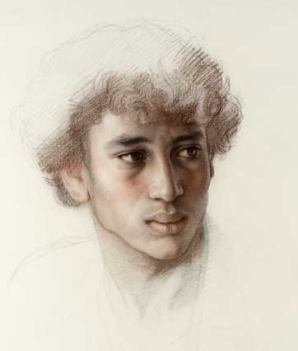
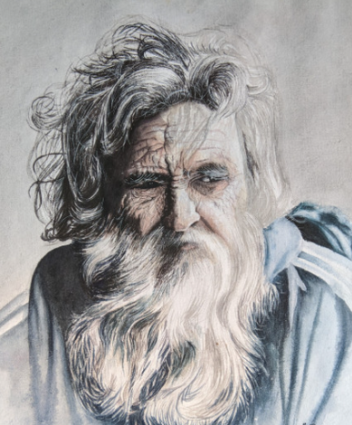
Lehi’s dying words to his youngest son, Joseph.
Lehi quoted a prophecy made by Joseph of Egypt roughly 1,700 years before the birth of Christ.

Slide 4
2 Nephi 3:3
2 Nephi 3:4
2 Nephi 3:14
2 Nephi 3:15
The Four Josephs

Slide 5
Lehi Blesses and Counsels
Joseph
He was the youngest son also born in the wilderness not long after Lehi and his family fled Jerusalem in 600 BC (1 Nephi 18:7)
He also felt the affects of his brothers’ wickedness
Lehi gave him a father’s blessing and referred to the promises of the ancient patriarch, Joseph of Egypt and the prophecies of the Restoration
“And Jacob and Joseph also being young, having need of much nourishment, were grieved because of the afflictions of their mother;…”
(1 Nephi 18:19)
2 Nephi 3:3-4

Slide 6
Joseph of Egypt
A visionary prophet.
He was promised that he would be a “fruitful bough”—Vineyard of the Lord
His descendants represents the tribes of Ephraim and Manasseh
He had spoken of the branch was to be broken off and “carried into a far country.” and that this knowledge would be hidden from the Old World (Genesis 50 JST)
He saw in a vision of the work and labors of the Prophet Joseph Smith and his role as a great prophet in the Restoration
He foretold of the last days—a promise which was found in the Book of Mormon
“Joseph is a fruitful bough, even a fruitful bough by a well; whose branches run over the wall:”
(Genesis 49:22)
2 Nephi 3:4-11

Slide 7
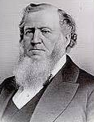
Joseph Smith Jr.
Referred to as a “Choice Seer” by Joseph of Egypt
Through him we have received a spiritual history of the ancient inhabitants of the Americas
He has brought forth the histories of the dispensations of Adam, Enoch, Noah, Abraham, Moses, and restored texts from John the Baptist and John the Revelator
(Book of Moses and Abraham also D&C 7; 93:6-18)
Read D&C 135:3
Seer—the ability to see and know the past
“It was decreed in the counsels of eternity, long before the foundations of the earth were laid, that he, Joseph Smith, should be the man, in the last dispensation of this world, to bring forth the word of God to the people, and receive the fulness of the keys and power of the Priesthood of the Son of God. The Lord had his eyes upon him, and upon his father, and upon his father’s father, and upon their progenitor's clear back … to Adam. He has watched that family and that blood as it has circulated from its fountain to the birth of that man. He was fore-ordained in eternity to preside over this last dispensation” Brigham Young
2 Nephi 3:6-15

Slide 8
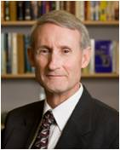
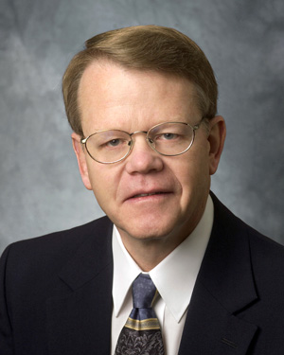
Joseph Smith Sr.
He was the father of Joseph Smith Jr.
He pursued farming and teaching as a profession
He had faith in his son’s reports of the events of the Restoration
One of the 8 Witnesses of the Book of Mormon
He was baptized April 6, 1830, the day the Church was organized
Inherited a place in the eternal realm
(D&C 124:19)
Who’s Who
“Interestingly, the common practice in early America was for the first son to be named after the father, but the first two sons born to Joseph Sr. and Lucy Mack Smith were Alvin and Hyrum, reserving the name Joseph for the third son, thus unknowingly fulfilling an ancient prophecy.”
D. Kelly Ogden and Andrew Skinner
Read: A Memorable Honor
D&C 4:1-7
“In a December 1834 blessing, Father Smith confirmed to his son that ancient Joseph in Egypt ‘Looked after his posterity in the last days… (and) sought diligently to know…who should bring forth the word of the Lord (to them) and his eyes beheld thee, my son (Joseph Smith Jr.); (and) his heart rejoiced and his should was satisfied.”
Neal A. Maxwell
2 Nephi 3:15

Slide 9
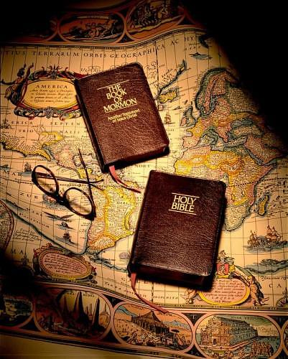
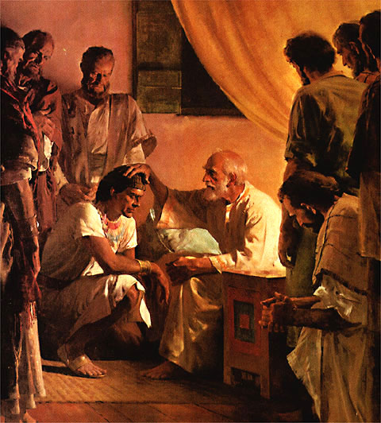
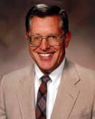
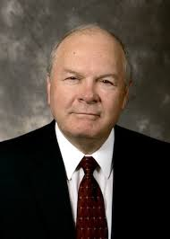
Joseph of Egypt Prophesies
2 Books
Written by the descendants of Joseph of Egypt was the Book of Mormon
Written by the descendants of Judah was the Bible
“…shall grow together, unto the confounding of false doctrines and laying down of
contentions, and
Establishing
peace among the
fruit of thy loins, and
bring them to the
knowledge of
their fathers…”
“It is only when the Bible and the Book of Mormon are used as one that we gain the power to confound false doctrines, bring an end to contentions, and establish the pure peace of the gospel.”
Joseph Fielding McConkie and Robert L. Millet
2 Nephi 3:12

Slide 10
“The Old Testament and the New Testament … and … the Book of Mormon … are now woven together in such a way that as you pore over one you are drawn to the other; as you learn from one you are enlightened by the other. They are indeed one in our hands”
Boyd K. Packer
The Book of Mormon and the Bible work together to confound false doctrines, establish peace, and bring people to the knowledge of the Lord’s covenants

Slide 11
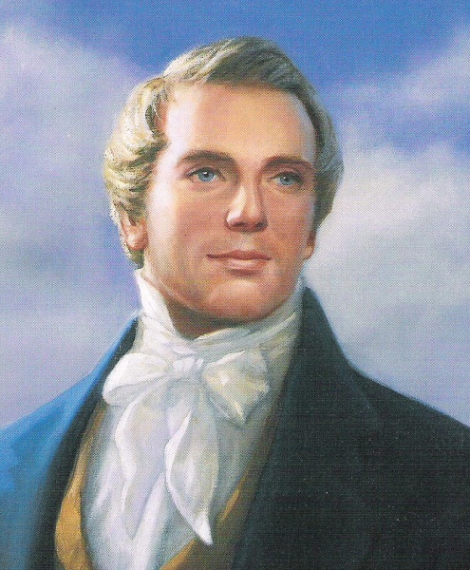
Bring About Restoration
The Lord raise up the prophet Joseph Smith to help bring about the Restoration of the gospel:
Bring forth My Word (Convincing)
Out of weaknesses he shall be made strong
They that seek to destroy him shall be confounded
His name shall be called after me
Called after name of father
Likened unto me
Power to bring forth My word through:
Book of Mormon
Doctrine and Covenants
Pearl of Great price
Joseph Smith Translation
Prophet’s Sermons
The Lord raised up the Prophet Joseph Smith to help bring about the Restoration of the gospel
2 Nephi 3:11-15

Slide 12
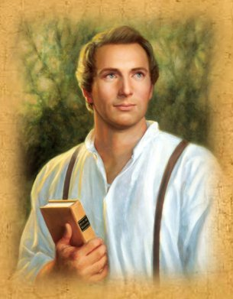
Joseph Smith, the Prophet and Seer of the Lord, has done more, save Jesus only, for the salvation of men in this world, than any other man that ever lived in it.
In the short space of twenty years, he has brought forth the Book of Mormon, which he translated by the gift and power of God, and has been the means of publishing it on two continents; has sent the fulness of the everlasting gospel, which it contained, to the four quarters of the earth;
has brought forth the revelations and commandments which compose this book of Doctrine and Covenants, and many other wise documents and instructions for the benefit of the children of men;
gathered many thousands of the Latter-day Saints, founded a great city, and left a fame and name that cannot be slain.
He lived great, and he died great in the eyes of God and his people; and like most of the Lord’s anointed in ancient times,
has sealed his mission and his works with his own blood; and so has his brother Hyrum.
In life they were not divided, and in death they were not separated!
D&C 135:3

Slide 13
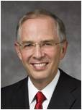
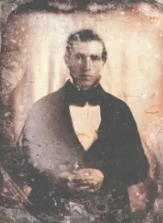
The negative commentary about the Prophet Joseph Smith will increase as we move toward the Second Coming of the Savior.
The half-truths and subtle deceptions will not diminish.
There will be family members and friends who will need your help. …
To the youth … I give a specific challenge: Gain a personal witness of the Prophet Joseph Smith.
Gaining A Testimony of Your Own
A testimony of the Prophet Joseph Smith can come differently to each of us. It may come as you kneel in prayer, asking God to confirm that he was a true prophet.
It may come as you read the Prophet’s account of the First Vision.
A testimony may distill upon your soul as you read the Book of Mormon again and again.
It may come as you bear your own testimony of the Prophet or as you stand in the temple and realize that through Joseph Smith the holy sealing power was restored to the earth. With faith and real intent, your testimony of the Prophet Joseph Smith will strengthen.
Neil L. Andersen

Slide 14
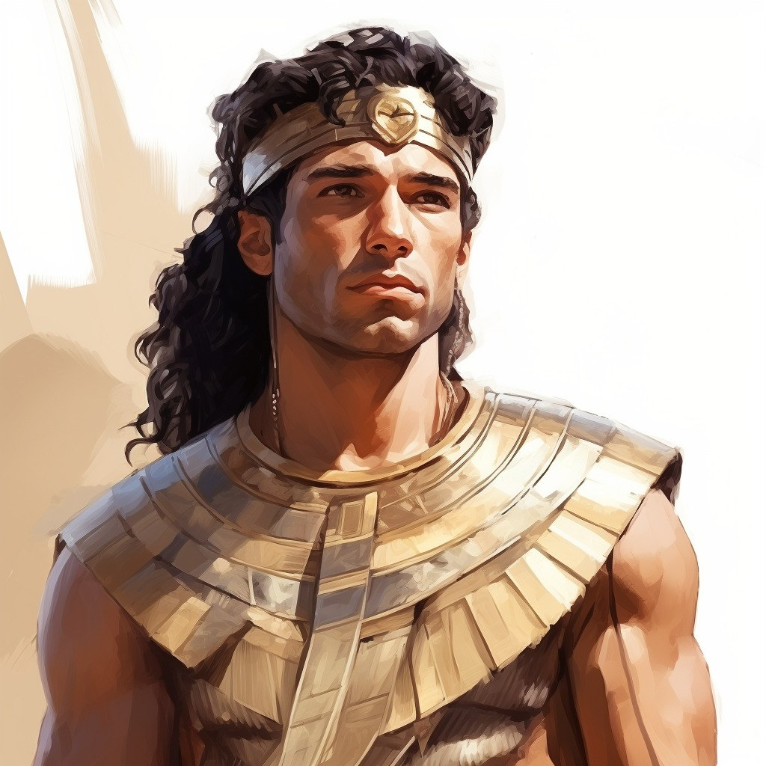
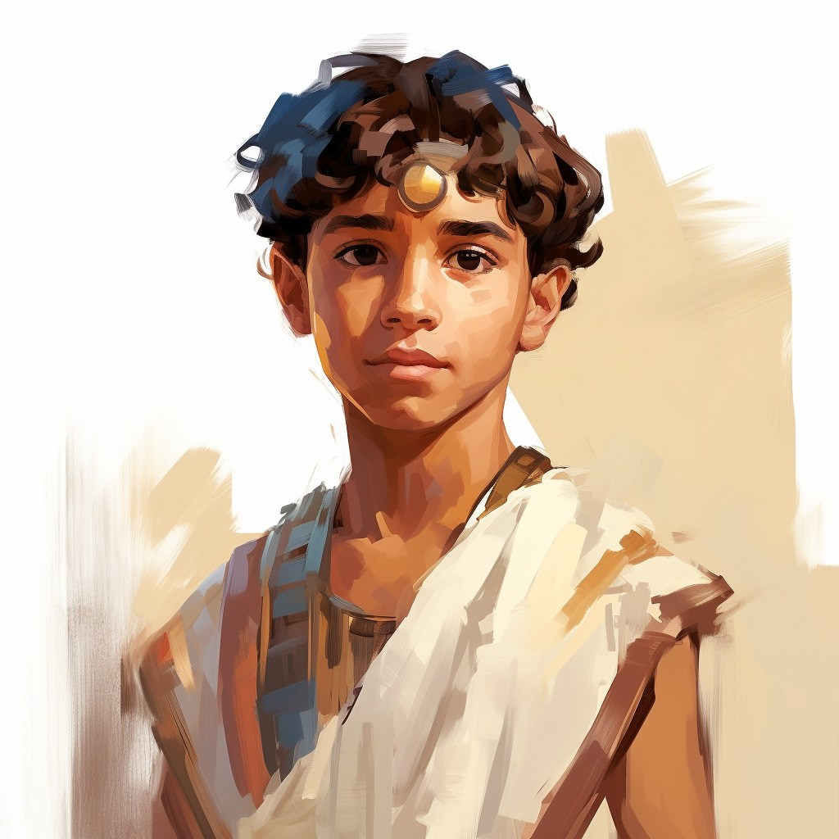
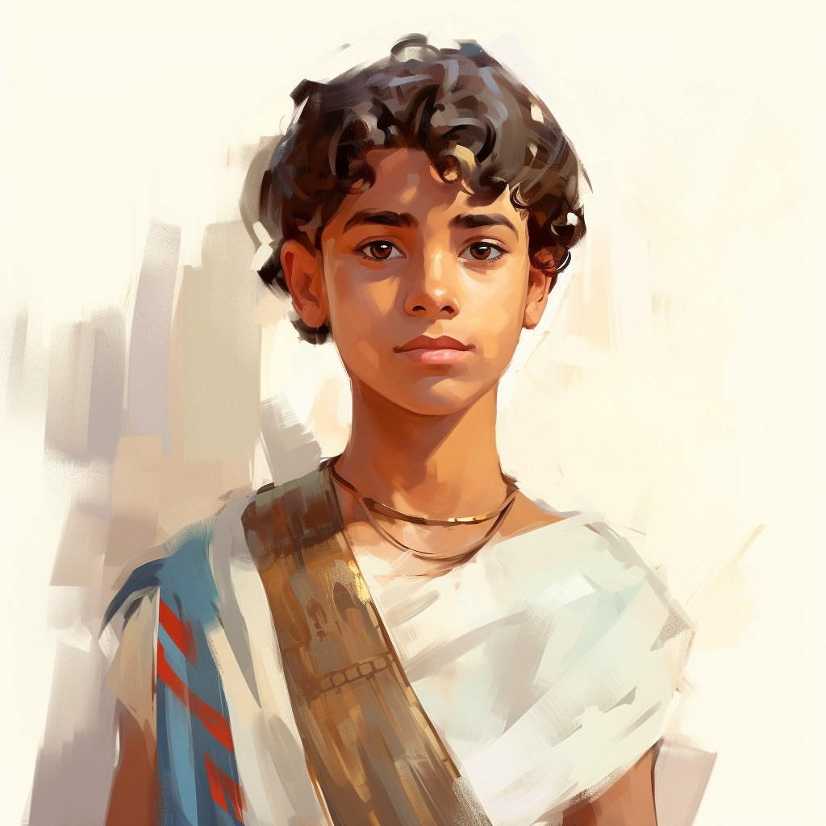
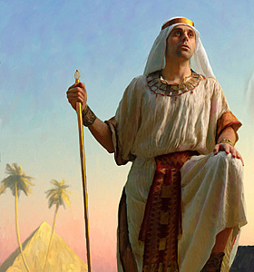
God’s Covenant with Joseph
“ Yea, thus prophesied Joseph: I am sure of this thing, even as I am sure of the promise of Moses; for the Lord hath said unto me, I will preserve thy seed forever.”
“Lord sware unto Joseph that he would preserve his seed forever:”
Genesis 50:34, 36
2 Nephi 3:16

Slide 15
“Permit me to name a few of many doctrines and practices which distinguish us from all other churches, and all of which have come of revelation to the youthful Prophet [Joseph Smith]. …
“[The] knowledge of Deity. …
“The Book of Mormon. …
“… The restored priesthood. …
“… The plan for the eternal life of the family. …
“The innocence of little children. …
“… The great doctrine of salvation for the dead. …
“The eternal nature of man. …
“… The principle of modern revelation. …
“… During the brief 38 and one-half years of his life, there came through him an incomparable outpouring of knowledge, gifts, and doctrine.”
Gordon B. Hinckley

Slide 16
Prophets and Spokesmen
“Note these words of the Lord: ‘And I, behold, I will give unto him [Mormon] that he shall write the writing of the fruit of thy loins [the Nephites], unto the fruit of thy loins [the Lamanites]; and the spokesman of thy loins [Joseph Smith] shall declare it.’ That is, Mormon wrote the Book of Mormon, but what he wrote was taken from the writings of the Nephite prophets; and these writings, compiled into one book, were translated by Joseph Smith and sent forth by him unto the Lamanites”
Comments of Bruce R. McConkie
2 Nephi 3:17-18

Slide 17
Fruit of Thy Loins
Something of Interest
The phrase “fruit of thy loins” is mentioned 19 times in 2 Nephi 3
Rachel, Joseph’s mother dies around 1900 BC
Zedekiah dies around 600 BC
1900
-600
1300
Assuming a person lives about 72 years
1300
72
18.6 (19)
19 generations from Joseph to Zedekiah
About 588 to 572 BC that Lehi speaks to his son Joseph
Hummm!
2 Nephi 3:17-18

Slide 18
Sources:
Discourses of Brigham Young, sel. John A. Widtsoe [1954], 108.
Neal A. Maxwell (Ensign May 1992 p. 39 quoting from Patriarchal Blessing, 1:3); Neil L. Andersen, “Joseph Smith,” Ensign or Liahona, Nov. 2014, 30
Doctrine and Covenants Who’s Who by Ed J. Pinegar and Richard J. Allen
D. Kelly Ogden and Andrew Skinner, Verse by Verse, The Book of Mormon, pg 130
Gordon B. Hinckley (“The Great Things Which God Has Revealed,” Ensign or Liahona, May 2005, 80–83).
Joseph Fielding McConkie and Robert L. Millet Doctrinal Commentary of Book of Mormon pg. 207
Boyd K. Packer (“Scriptures,” Ensign, Nov. 1982, 53).
Comments of Bruce R. McConkie (A New Witness for the Articles of Faith [1985], 426).
Presentation by ©http://fashionsbylynda.com/blog/

Slide 19
Do we worship Joseph? We worship God the Eternal Father and His Son, Jesus Christ, not the Prophet Joseph nor any mortal man or woman. (Gerrit W. Gong, “All Nations, Kindreds, and Tongues,” Ensign or Liahona, Nov. 2020, 39)
Foreordained: I know that Joseph Smith is the foreordained prophet whom the Lord chose to open this last dispensation. Through him the Lord’s Church was restored to the earth. Joseph sealed his testimony with his blood. How I love and honor him! (Russell M. Nelson, “Hear Him,” Ensign or Liahona, May 2020, 92)
Testimony: Like other faithful Latter-day Saints, I have built my life on the testimony and mission of the Prophet Joseph Smith. In all of my reading and original research, I have never been dissuaded from my testimony of his prophetic calling and of the gospel and priesthood restoration the Lord initiated through him. (Dallin H. Oaks, “Joseph, the Man and the Prophet,” Ensign, May 1996, 73)

Slide 20
The Bucket List
Part 3
2 Nephi 4

Slide 21
A Sacred Duty
“Parents have a sacred duty to rear their children in love and righteousness, to provide for their physical and spiritual needs, and to teach them to love and serve one another, observe the commandments of God, and be law-abiding citizens wherever they live. Husbands and wives—mothers and
fathers—will be held accountable
before God for the discharge of these obligations. … Extended families
should lend support when needed.”
The Family: A Proclamation to the World

Slide 22
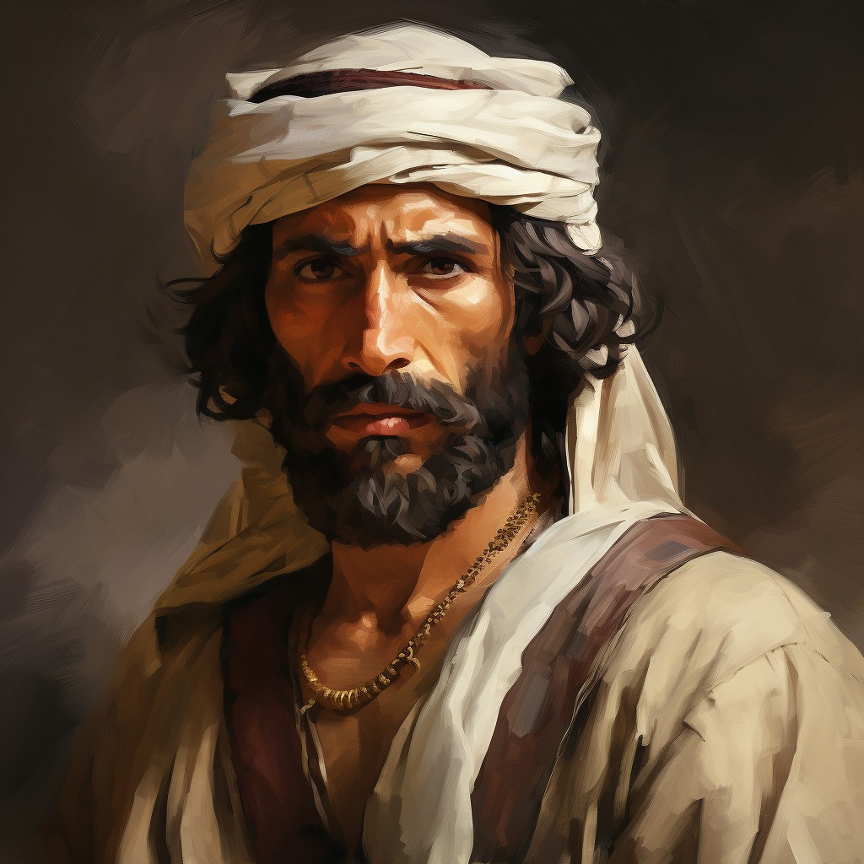
Lehi’s Last Blessings
Laman
“…ye shall keep my commandments ye shall prosper in the land; and inasmuch as ye will not keep my commandments ye shall be cut off from my presence.”
“…for behold, I know that if ye are brought up in the way ye should go ye will not depart from it.
“Wherefore, if ye are cursed, behold, I leave my blessing upon you, that the cursing may be taken from you and be answered upon the heads of your parents.”
“Wherefore, because of my blessing the Lord God will not suffer that ye shall perish; wherefore, he will be merciful unto you and unto your seed forever.”
2 Nephi 4:4-7
The oldest son of Lehi
Was the cause of murmur and deception
“cast off from the presence of the Lord”
(1 Nephi 8:36)
Joined with Lemuel, accusing their father of being a “visionary man”
Had a preference for the earthly treasures
Jealous of the leadership of brother Nephi
Was rebuked many times by the Lord
Constant persistent and hardness of the heart

Slide 23
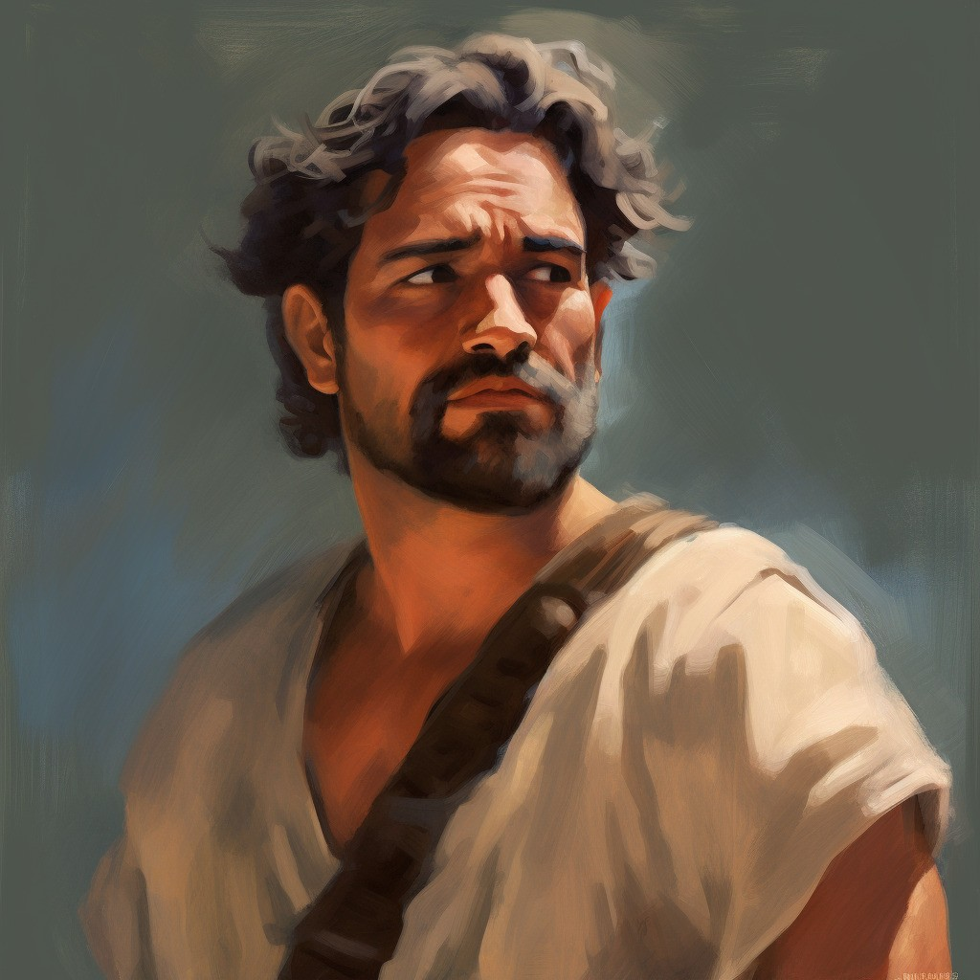
Lehi’s Last Blessings
Lemuel
“And he spake unto them, saying: Behold, my sons and my daughters, who are the sons and the daughters of my second son; behold
I leave unto you the same blessing which I left unto the sons and daughters of Laman; wherefore, thou shalt not utterly be destroyed;
but in the end thy seed shall be blessed.”
2 Nephi 4:9
The second son of Lehi
A mirror image of his brother Laman
Was rebellious of the ways of the Lord
“cast off from the presence of the Lord”
(1 Nephi 8:36)
Joined with Laman, accusing their father of being a “visionary man”
Was a murderer and plotted murders
Jealous of the leadership of brother Nephi
Was rebuked many times by the Lord
Constant persistent and hardness of the heart

Slide 24
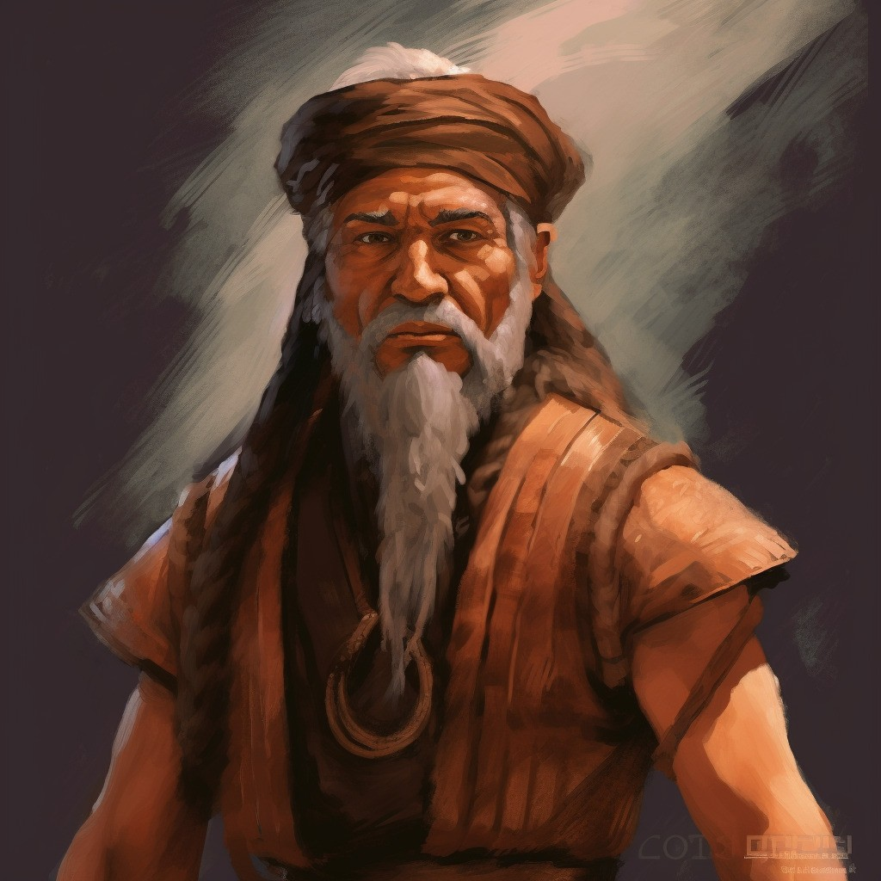
Lehi’s Last Blessings
Ishmael
A descendant of Ephraim—a lineage of Joseph
Had 5 daughters that married into Lehi’s family
Had 2 sons that also joined with Lehi’s family
Was supportive of the exodus, but his children reflected a division between the rebellious children of Lehi and the righteous
Oldest daughter marries Zorum
Did not complete the journey to the land of promise and dies in the wilderness
“And it came to pass that when my father had made an end of speaking unto them, behold, he spake unto the sons of Ishmael, yea, and even all his household.”
2 Nephi 4:10

Slide 25
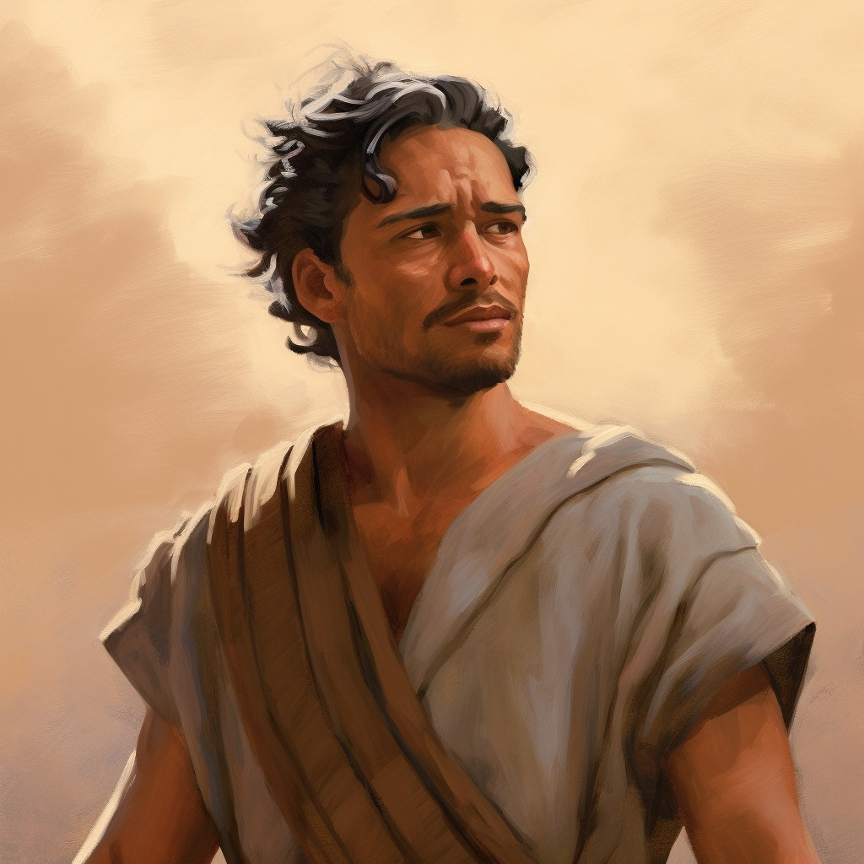
Lehi’s Last Blessings
Sam
Nephi’s next older brother
Was with his brothers to obtain the brass plates
Partook of the “Tree of Life” in his father’s vision
Sided with Nephi in the ways of the Lord
Sam’s posterity remained united with the posterity of Nephi
They lived after the “manner of happiness” (2 Nephi 5:27)
Was part of the righteous branch along with Nephi, Jacob, Joseph who were just and holy men (Alma 3:6)
”And after he had made an end of speaking unto them, he spake unto Sam, saying:
Blessed art thou, and thy seed; for thou shalt inherit the land like unto thy brother Nephi.
And thy seed shall be numbered with his seed; and thou shalt be even like unto thy brother, and thy seed like unto his seed;
and thou shalt be blessed in all thy days.”
2 Nephi 4:11

Slide 26
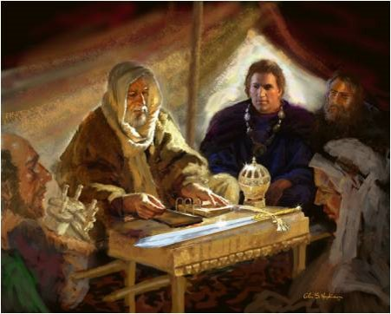
The Responsibility
A righteous father has the responsibility to bless and instruct his children.
The nature of the blessings granted to each was predicated upon their worthiness,
We know , like his fellow patriarchs in the Old World, blessed all his children—worthy and the unworthy alike.
Laman and Lemuel were promised that their seed in the distant future would enjoy the fulness of gospel blessings.
The power of the righteous man to bless his family and to labor in their behalf is not limited to mortality, nor is it limited to the generation in which the man lived.
Joseph Fielding McConkie and Robert L. Millet
“The effectual fervent prayer of a righteous man availeth much” (James 5:16)

Slide 27
Lehi Dies
And it came to pass after my father, Lehi, had spoken unto all his household, according to the feelings of his heart and the Spirit of the Lord which was in him, he waxed old. And it came to pass that he died, and was buried.

Slide 28
Sources:
“The Family: A Proclamation to the World,” Ensign, Nov. 2010, 129
Joseph Fielding McConkie and Robert L. Millet Doctrinal Commentary of the Book of Mormon Vol. 1 pg 214-215
Continued

Slide 29
Scriptures are written for our learning and profit
In My Weaknesses
2 Nephi 4:12-35

Slide 30
Anger
Anger is an emotion related to one's psychological interpretation of having been offended, wronged, or denied and a tendency to react through retaliation.
What causes anger?
Frustration
Irritations
Easily provoked
Being threatened
A resentment
Knowing what you are doing or thinking may be wrong
2 Nephi 4:13-14

Slide 31
What Does Anger do?
• It distorts reality (it is a misinterpretation of the reality) or it involves some illogical ways of evaluating yourself, others, and the world around you
• It prevents you from achieving your goals and purposes
• It creates extreme emotions which persist, cause distress, and immobilize
• It leads to behaviors that may harm yourself, others, and your life in general.

Slide 32
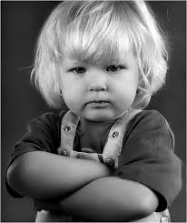
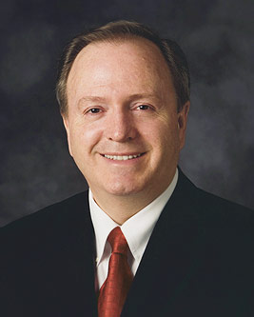
Does someone else control
how we feel?
No one makes us mad.
Others don’t make us angry.
There is no force involved.
Becoming angry is a conscious choice, a decision;
Therefore, we can make the choice not to become angry.
We choose!.
LYNN G. ROBBINS

Slide 33
Is Anger a Sin?
“In the Joseph Smith Translation of Ephesians 4:26 [Eph. 4:26], Paul asks the question, “Can ye be angry, and not sin?” The Lord is very clear on this issue: “He that hath the spirit of contention is not of me, but is of the devil, who is the father of contention, and he stirreth up the hearts of men to contend with anger, one with another.”
LYNN G. ROBBINS

Slide 34
So, what is Anger?
“Anger is a yielding to Satan’s influence by surrendering our self-control.
It is the thought-sin that leads to hostile feelings or behavior.
It is the detonator of road rage on the freeway, flare-ups in the sports arena, and domestic violence in homes.”
LYNN G. ROBBINS

Slide 35
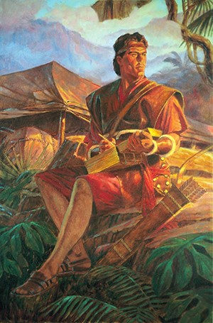
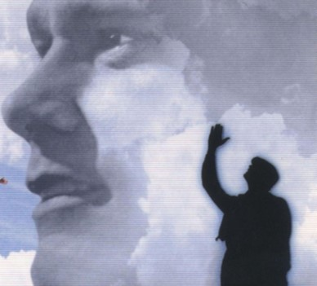
My Soul Delighteth
Delight in the things of the Lord
Nephi writes his thoughts and feelings
Nephi ponders the things which the Lord has taught him
Nephi is in the midst of a growth in his testimony
The Union of heart and mind is necessary to an understanding of the word of the Lord.
Eternal truths—revelations—to the mind and heart through the Holy Ghost
2 Nephi 4:15

Slide 36
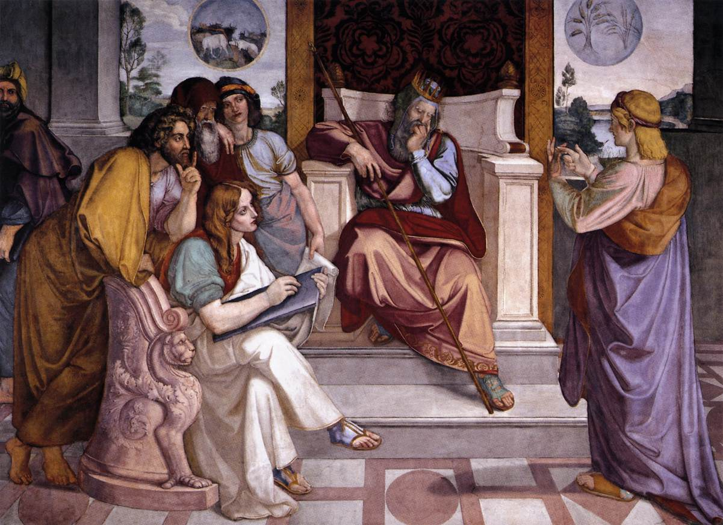
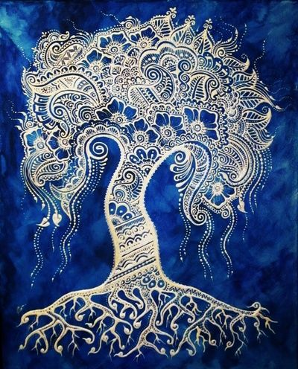
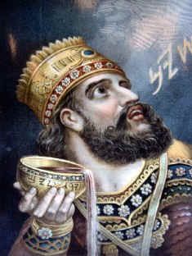
Pondering
Pharaoh dreams a dream but can’t interpret it (Genesis 41:1-32)
It is one thing to have a revelation and quite another to understand it.
Belshazzar saw the hand of the Lord write a message upon a wall but could not translate it
(Daniel 5: 1-3)
The world is full of people who have the Bible but understand little of it.
Nephi saw a marvelous vision in his youth and spent a lifetime growing in his understanding of it.
(1 Nephi 11-14)
How often do we ponder to understand?
2 Nephi 4:16

Slide 37
Trials of Nephi
“O wretched man that I am! Yea, my heart sorroweth because of my flesh; my soul grieveth because of mine iniquities.
I am encompassed about, because of the temptations and the sins which do so easily beset me.”
Wretched
Flesh
Beset
Miserable
Weak
Surround or to press from all sides
Examples:
Troubles at home
Peer pressure
Difficulty with schoolwork
Temptations
2 Nephi 4:17

Slide 38
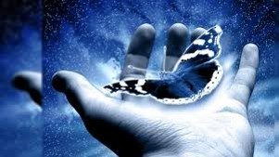
From Sadness to Hope
“And when I desire to rejoice, my heart groaneth because of my sins;
Nevertheless
I know in whom I have trusted.
In times of discouragement remember the Lord and His goodness
2 Nephi 4:19

Slide 39
“Nephi’s references to personal sins should not be taken to imply any serious moral transgression on his part. No man could have seen and known God as did who was not pure in heart.
Rather, he is almost surely alluding to the negative emotions of anger, impatience, and frustration he must have felt at times in dealing with his enemies, his own family, and others who lacked his singleness of purpose….”
Rodney Turner

Slide 40
Our Own Trials
You said
“It’s impossible”
“Nobody really loves me”
“I’m too tired”
“I can’t go on”
“I am not able”
“I can’t do it”
“It’s not worth it”
“I can’t forgive myself”
“I feel alone”
The Lord said
“All things are possible…”
“I love you”
“I will give you rest”
“My grace is sufficient”
“I am able”
“You can do all things”
“It will be worth it”
“I forgive you”
“I will never leave or forsake you”
Bible
Luke 18:27
1 John 3:1
Matthew 11:28
2 Corinthians 12:9
2 Corinthians 9:8
Philippians 4:13
Romans 8:28
1 John 1:9
Hebrews 13:5

Slide 41
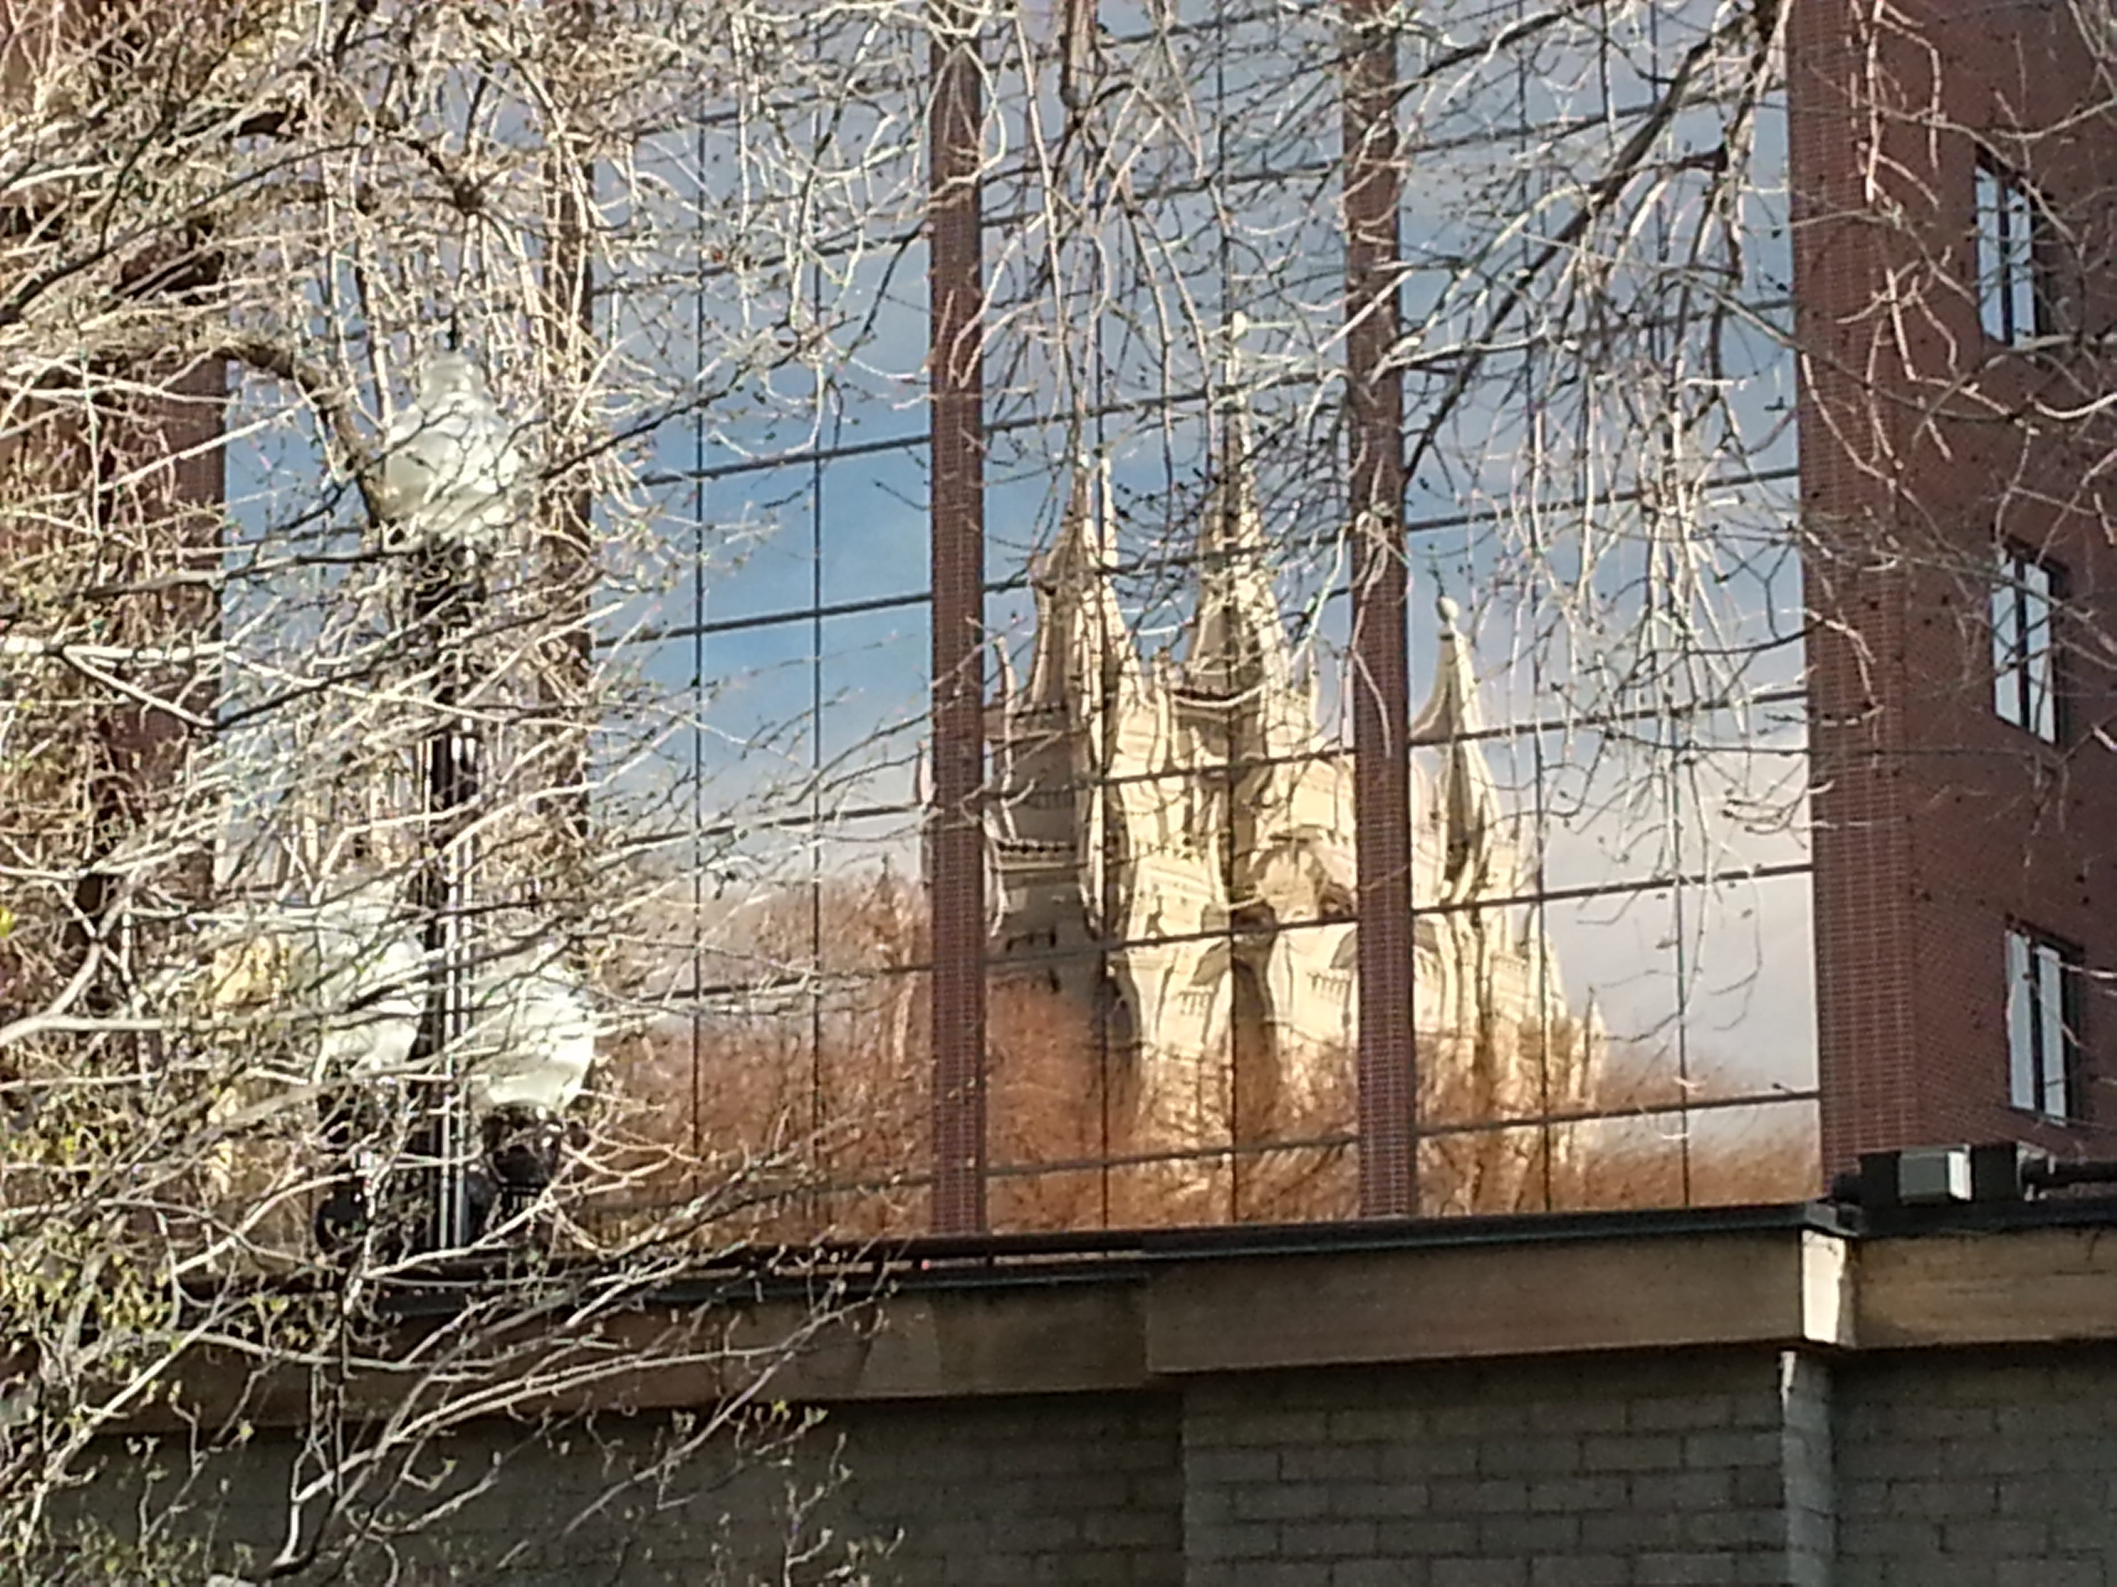
Nephi’s Psalm
Praise and Thanksgiving (2 Nephi 4:20-25)
Carried on a
high mountain
Moses—exceedingly high mountain
(Moses 1:1-2)
Ezekiel--upon a very high mountain—future of the temple
(Ezekiel 40:2)
Jesus was in the Spirit—exceeding high mountain
(JST Matthew 4:8)
Other prophets—carried by the Spirit to the heavenly temple
(Isaiah 6:1) (Lehi in 1 Nephi 1:8)
(John the Revelator in Revelation 4:1-4)
Temple experiences: We are forbidden to write such sacred things. (D&C 76:115-116)
2 Nephi 4:17-35

Slide 42
Salvation Experiences Does Not Assure Salvation
“Salvation is not the promised end of some spiritual experience, no matter how marvelous it may have been.
None in our dispensation, and few who have walked the earth, have been the recipient of more spiritual experiences, more heavenly manifestation that the Prophet Joseph Smith.”
“…although a man may have many revelations, and have power to do many mighty works, yet if he boasts in his own strength, and sets at naught the counsels of God, and follows after the dictates of his own will and carnal desires, he must fall and incur the vengeance of a just God upon him” (D&C 3:4)
2 Nephi 4:26-31
Joseph Fielding McConkie and Robert L. Millet

Slide 43
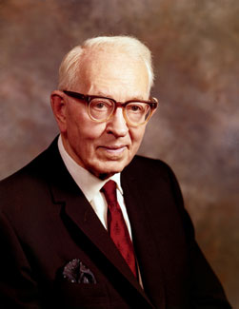
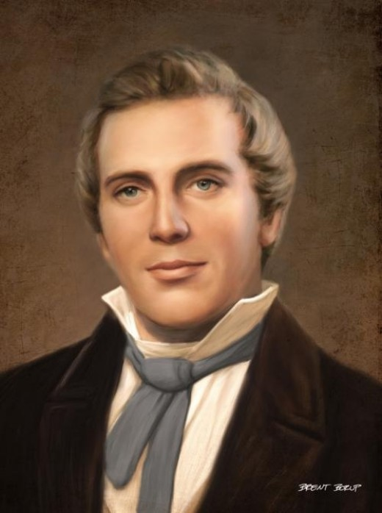
Redeem My Soul
Noble souls— faithful to the end
“I pray that I may be true and faithful to the end.”—Joseph Fielding Smith
Redeemed—free from the power of the adversary---those made clean by the suffering of the Lamb and their obedience to the laws and ordinances of the gospel—those who have overcome the world by faith and worthy to enter into the presence of the Lord.
Deliver out of hands of enemies– “Salvation is nothing more nor less than to triumph over all our enemies and put them under our feet…to triumph over all evil spirits in the world to come, then we are saved…” Teachings of Joseph Smith
Broken Heart and Contrite Spirit—Godly Sorrow
2 Nephi 4:26-31

Slide 44
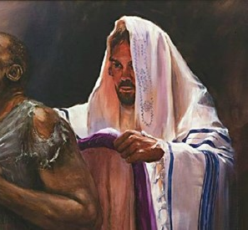
Low Valleys and Plain Roads
Gospel covenants are to be lived with exactness and honor.
Man should not dictate the terms of salvation
“Too many have been too willing to rewrite the terms of eternal covenants into which they have entered. It has been observed that to almost live the commandments is to almost receive the promised blessings.”
Robes of Righteousness:
“Wherefore, we shall have a perfect knowledge of all our guilt, and our uncleanness, and our nakedness; and the righteous shall have a perfect knowledge of their enjoyment, and their righteousness, being clothed with purity, yea, even with the robe of righteousness.” (2 Nephi 9:14)
2 Nephi 4:32
JFM and RLM

Slide 45
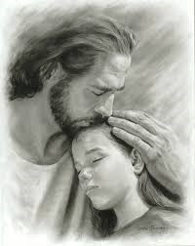
Support from the Lord
Trust in him—in times of discouragement remember the Lord and His goodness
“Draw near unto me and I will draw near unto you; seek me diligently and ye shall find me; ask, and ye shall receive; knock, and it shall be opened unto you.
Whatsoever ye ask the Father in my name it shall be given unto you, that is expedient for you;
And if ye ask anything that is not expedient for you it shall turn unto your condemnation.”
(D&C 88:63-65)
Trusting in the Lord and remembering past spiritual experiences can help us overcome temptations and discouragement.
2 Nephi 4:35

Slide 46
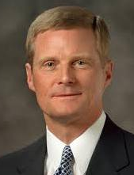
Sincere prayer can strengthen our commitment to overcome sin and discouragement
“There may be things in our character, in our behavior, or concerning our spiritual growth about which we need to counsel with Heavenly Father in morning prayer. After expressing appropriate thanks for blessings received, we plead for understanding, direction, and help to do the things we cannot do in our own strength alone. For example, as we pray, we might:
“• Reflect on those occasions when we have spoken harshly or inappropriately to those we love the most.
“• Recognize that we know better than this, but we do not always act in accordance with what we know.
“• Express remorse for our weaknesses and for not putting off the natural man more earnestly.
“• Determine to pattern our life after the Savior more completely.
“• Plead for greater strength to do and to become better”
David A. Bednar

Slide 47
Sources:
Agency and Anger– Lynn G. Robbins April Conf. 1998
Joseph Fielding McConkie and Robert L. Millet Doctrinal Commentary of Book of Mormon pg. 219, 220
Teaching of Joseph Smith pg 297
Rodney Turner (First Nephi, The Doctrinal Foundation, BYU Religious Studies Center pg. 93)
David A. Bednar (“Pray Always” Ensign or Liahona, Nov. 2008, 41).
Presentation by ©http://fashionsbylynda.com/blog/

Slide 48
Along with the peaceful direction we receive from the Holy Ghost, from time to time, God powerfully and very personally assures each of us that He knows us and loves us and that He is blessing us specifically and openly. Then, in our moments of difficulty, the Savior brings these experiences back into our mind. …
You might think of your spiritual memories this way. With constant prayer, a determination to keep our covenants, and the gift of the Holy Ghost, we navigate our way through life. When personal difficulty, doubt, or discouragement darken our path, or when world conditions beyond our control lead us to wonder about the future, the spiritually defining memories from our book of life are like luminous stones that help brighten the road ahead, assuring us that God knows us, loves us, and has sent His Son, Jesus Christ, to help us return home. (Neil L. Andersen, “Spiritually Defining Memories,” Ensign or Liahona, May 2020, 19, 21)
Brothers and sisters, if you feel discouraged or wonder if you can ever get out of the spiritual hole that you have dug, please remember who stands “betwixt [us] and justice,” who is “filled with compassion towards the children of men,” and who has taken upon Himself our iniquities and transgressions and “satisfied the demands of justice” [Mosiah 15:9]. In other words, as Nephi did in his moment of self-doubt, simply remember “in whom [you] have trusted” [2 Nephi 4:19], even Jesus Christ, and then repent and experience yet again “a perfect brightness of hope” [2 Nephi 31:20]. (Allen D. Haynie, “Remembering in Whom We Have Trusted,” Ensign or Liahona, Nov. 2015, 123)
I encourage you now, to recall, especially in times of crisis, when you felt the Spirit and your testimony was strong; remember the spiritual foundations you have built. (Ronald A. Rasband, “Lest Thou Forget,” Ensign or Liahona, Nov. 2016, 114)
When we face … temptations in our time, we must declare, as young Nephi did in his, “[I will] give place no more for the enemy of my soul” [2 Nephi 4:28]. We can reject the evil one. If we want it dearly and deeply enough, that enemy can and will be rebuked by the redeeming power of the Lord Jesus Christ. (Jeffrey R. Holland, “Place No More for the Enemy of My Soul,” Ensign or Liahona, May 2010, 46)

Slide 49
Our Own Trials
You said
“It’s impossible”
“Nobody really loves me”
“I’m too tired”
“I can’t go on”
“I am not able”
“I can’t do it”
“It’s not worth it”
“I can’t forgive myself”
“I feel alone”
The Lord said
“All things are possible…”
“I love you”
“I will give you rest”
“My grace is sufficient”
“I am able”
“You can do all things”
“It will be worth it”
“I forgive you”
“I will never leave or forsake you”
Bible
Luke 18:27
1 John 3:1
Matthew 11:28
2 Corinthians 12:9
2 Corinthians 9:8
Philippians 4:13
Romans 8:28
1 John 1:9
Hebrews 13:5

Slide 50
Separation
2 Nephi 5
Whom Shall I Follow?
God can lead us away from danger.

Slide 51
Spiritual Leader
Nephi—
Prophet and Leader
Laman and Lemuel seek to take Nephi’s life
One cannot do the Lord’s work without offending the devil
The hateful spirit forever thirsts for blood of the Lord’s anointed
Wickedness is always a great divider
2 Nephi 5:2

Slide 52
Because of Him
Laman and Lemuel blamed Nephi for their difficulties
All souls are agents unto themselves (D&C 58:28)
It is easy to blame others for our own mistakes
Most of our problems are of our own making
2 Nephi 5:3

Slide 53
The Lord’s Warning
Warnings are given to protect the faithful
Warning
Nephi should depart from his brothers
“We cannot set off on a wrong course without first overruling a warning”
Boyd K Packer
The bounds are set for those who are true and faithful D&C 122:9
2 Nephi 5:5

Slide 54
The Language of the Spirit
The Lord will help those who follow Him
There is guidance from the Lord who faithfully seek him in prayer
Why is it important to continue to be faithful when our prayers are not answered immediately or in the way we desire?
Our prayers may not always be answered immediately or in the way we desire.
2 Nephi 5:5

Slide 55
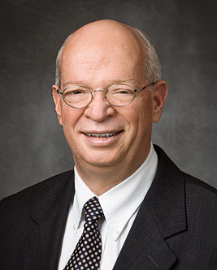
Sometimes we seem to get no answer to our sincere and striving prayers. It takes faith to remember that the Lord answers in His time and in His way so as to best bless us.
Or, on further reflection, we will often realize that we already know full well what we should do.
Please do not be discouraged if this does not work for you all at once. Like learning a foreign language, it takes practice and effort.
Please know, though, that you can learn the language of the Spirit, and when you do, it will give you great faith and power in righteousness.—J. Devn Cornish

Slide 56
The Separation
Nephites from the Lamanites was the result of Laman and Lemuel’s hatred for Nephi. This separation continued for centuries, with the descendants of Laman and Lemuel teaching their children to hate the descendants of Nephi.
Read
Mosiah 10:12–17
2013 Manual
2 Nephi 5:1-8

Slide 57
Remove
There are times when it is necessary to physically flee from evil, as Nephi and his followers did. However, we may not always be able to physically remove ourselves from wickedness.
If we choose to believe in the revelations of God and to hearken to His prophets, we can be led away from danger
2 Nephi 5:6

Slide 58
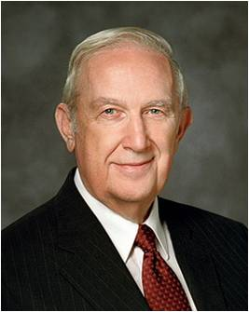
“God has provided a way to live in this world and not be contaminated by the degrading pressures evil agents spread throughout it. You can live a virtuous, productive, righteous life by following the plan of protection created by your Father in Heaven: His plan of happiness. It is contained in the scriptures and in the inspired declarations of His prophets. …
“Avoid worldly wickedness.
Know that God is in control. In time, Satan will completely fail and be punished for his perverse evil. God has a specific plan for your life. He will reveal parts of that plan to you as you look for it with faith and consistent obedience.
His Son has made you free—not from the consequences of your acts, but free to make choices. God’s eternal purpose is for you to be successful in this mortal life.
No matter how wicked the world becomes, you can earn that blessing.
Seek and be attentive to the personal guidance given to you through the Holy Spirit.
Continue to be worthy to receive it. Reach out to others who stumble
and are perplexed, not certain of what path to follow”
Richard G. Scott

Slide 59
Elements of Happiness
2 Nephi
5:10-18
2 Nephi 5:26
2 Nephi 5:6
They followed righteous leaders
They obeyed the Lord
They worked hard to support themselves
They took scriptures with them
They built a temple
Nephi and his followers went with their families
We can live after the manner of happiness by applying the teachings of the gospel of Jesus Christ.

Slide 60
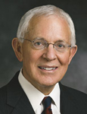
“Certain unchanging principles and truths bring happiness to our lives. This subject has been of interest to me for many years because although I am richly blessed and have every reason to be happy, I sometimes struggle and do not always have the natural inclination toward happiness and a cheerful disposition that some people seem to enjoy.
“For that reason, several years ago a Book of Mormon passage caught my attention. … Nephi established a society founded on gospel truths; and of that society he says, ‘And it came to pass that we lived after the manner of happiness’ (2 Ne. 5:27). The passage deeply impressed me. … I wondered … what the individual elements of a truly happy society and life might be, and I began to search Nephi’s writings for clues. I … invite you to conduct your own personal search. It could be a lifelong and worthwhile pursuit. …
“… The same patterns and elements of daily life that enabled Nephi and his people to be happy 560 years before Christ work equally well today.”
Elder Marlin K. Jensen

Slide 61
Our way of life, our happiness
What blessings did the people receive because they kept the Lord’s commandments?
When have you felt that the Lord has been with you?
How has the Lord’s influence in your life contributed to your happiness?
How might the temple have helped the people “live after the manner of happiness”?
How has the temple brought greater happiness to you or
someone you know?
In what ways does hard work contribute to happiness?
2 Nephi 5:10–11, 16,

Slide 62
A holy Sanctuary to the Lord
The Lord’s people have always been a temple- building people.
The temple has always been the focal point of true religion
Temple
Sacred Ground
A place to receive Revelation
A place to receive eternal covenants
2 great temples of the future:
one in Jerusalem and another in New Jerusalem
(Ether 13:3-12, D&C 133:13)
2 Nephi 5:16

Slide 63
A Curse
The changing of their skin was only a mark or sign of the curse.
A separation from God
“The dark skin was placed upon the Lamanites so that they could be distinguished from the Nephites and to keep the two peoples from mixing. The dark skin was the sign of the curse. The curse was the withdrawal of the Spirit of the Lord. …
“The dark skin of those who have come into the Church is no longer to be considered a sign of the curse. Many of these converts are delightsome and have the Spirit of the Lord.”
Joseph Fielding Smith Jr.
2 Nephi 5:19-25

Slide 64
Results of the curse
“…become an idle people, full of mischief and subtlety”
This curse lasted only as long as the people were wicked.
When the Lamanites repented and chose to live the gospel, “the curse of God did no more follow them” (Alma 23:18).
The book of Helaman tells of a time when the Lamanites were more righteous than the Nephites (see Helaman 13:1).
2 Nephi 5:24

Slide 65
Like Flint
A hard stone—a hardening of the heart
Marriage Warning: verse 23
Why is it important to avoid dating and marrying those who do not hearken to the Lord?
How do you think the people you date and eventually marry will influence your efforts to live the gospel?
“Choose to date only those who have high moral standards and in whose company you can maintain your standards” Strength of Youth
2 Nephi 5:21,23

Slide 66
Separation
When people harden their hearts against the Lord, they separate themselves from Him.
However
Save they shall repent of their iniquities…they will be saved.
No blessings are denied if they repent
Example:
Later in the Book of Mormon we read about faithful Lamanites upon whom the hand of the Lord rests with great power
God
Satan
2 Nephi 5:22

Slide 67
What warnings did you find that you think the world most needs today?
What do you think the consequences are for obeying or disregarding these warnings?
How are these warnings a sign of God’s love?
How will obeying the warnings you found help you become more like Jesus Christ?
How can ignoring His warnings distance us from Him?

Slide 68
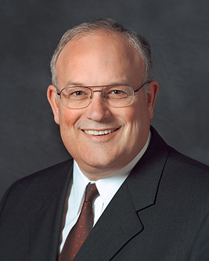
“There is so much [inspired] guidance and direction available that you won’t make major mistakes in your life unless you consciously ignore the guidance you receive.”
Paul V. Johnson
What are some dangers that we can avoid when we heed warnings that come from prophets and other Church leaders?
Oops!
2 Nephi 5:16

Slide 69
Sources:
Boyd K Packer (quoted in Kenneth Johnson, “Yielding to the Enticings of the Holy Spirit,” Ensign, Nov. 2002, 90).
J. Devn Cornish The Privilege of Prayer Oct. Conf. 2011
Richard G. Scott (“How to Live Well amid Increasing Evil,” Ensign or Liahona, May 2004, 100, 102).
Elder Marlin K. Jensen (“Living after the Manner of Happiness,” Ensign, Dec. 2002, 56, 61).
(Answers to Gospel Questions, comp. Joseph Fielding Smith Jr., 5 vols. [1957–66], 3:122–23).
[For the Strength of Youth (booklet, 2011), 4].)
Paul V. Johnson (“The Blessings of General Conference,” Ensign or Liahona, Nov. 2005, 51).
2013 Seminary Manual Book of Mormon
Presentation by ©http://fashionsbylynda.com/blog/

Slide 70
Prosperity 2 Nephi 5:11,13:
“When I say prosperity I am not thinking of it in terms of dollars and cents alone. … But what I count as real prosperity, as the one thing of all others that is of great value to every man and woman living, is the growth in a knowledge of God, and in a testimony, and in the power to live the gospel and to inspire our families to do the same. That is prosperity of the truest kind” (Heber J. Grant, Teachings of Presidents of the Church: Heber J. Grant[2002], 124).
The Curse 2 Nephi 5:20:
1. What was the curse?
The curse is clearly defined in 2 Nephi 5:20 as being “cut off from the presence of the Lord.” The dark skin of the Lamanites was not the curse.
2. What caused the curse?
According to 2 Nephi 5:21, the curse came to the Lamanites “because of their iniquity” and because “they had hardened their hearts against [the Lord].” Since the Fall of Adam, wickedness has always resulted in being cut off from the presence of the Lord (see 1 Nephi 2:21; 2 Nephi 4:4; 9:6; Alma 9:13; Ether 10:11).
3. Why was the mark of dark skin set upon the Lamanites?
This was a specific mark or sign for a specific set of circumstances. Nephi explained, “That they [the Lamanites] might not be enticing unto my people the Lord God did cause a skin of blackness to come upon them” (2 Nephi 5:21). Alma gave a similar explanation: “The skins of the Lamanites were dark … that thereby the Lord God might preserve his people, that they might not mix and believe in incorrect traditions” (Alma 3:6, 8). These explanations are consistent with other scriptural warnings that the people of the Lord should not marry unbelievers because the result of doing so was often that the righteous would turn away from the Lord (see Deuteronomy 7:2–4; 1 Kings 11:4; 2 Corinthians 6:14; D&C 74:5).
4. What was the result of the curse?
As a result of the curse—being cut off from the presence of the Lord—the Lamanites “did become an idle people, full of mischief and subtlety” (2 Nephi 5:24).
This curse lasted only as long as the people were wicked. When the Lamanites repented and chose to live the gospel, “the curse of God did no more follow them” (Alma 23:18). The Book of Mormon includes many examples of Lamanites who repented and received the guidance of the Spirit of the Lord. The book of Helaman tells of a time when the Lamanites were more righteous than the Nephites (see Helaman 13:1). Seminary 2017 Book of Mormon Manual Lesson 27
Happiness 2 Nephi 5:10-18; 26-27:
“Happiness comes of righteousness. ‘Wickedness never was happiness.’ (Alma 41:10.) Sin never was happiness. Selfishness never was happiness. Greed never was happiness. Happiness lies in living the principles of the gospel of Jesus Christ” (Gordon B. Hinckley, in “Fast-Paced Schedule for the Prophet: Meets with Young Adults, Youth in Three Meetings in Colorado,” Church News ,Apr. 20, 1996, 3).
Building a Temple 2 Nephi 5:16:
“Nephi’s temple may have differed in some ways from our latter-day temples, but its central purpose was likely the same: to teach and orient God’s children concerning His plan for their happiness and to provide the ordinances and covenants essential to the attainment of that happiness.
“After living on this good earth for over five decades, I can honestly say that the most spiritually mature and happy people I know are ardent temple goers. There is good reason for that. It is in the temple that the full sweep of God’s program for us is told and retold, each telling bringing greater understanding and commitment to living life His way. …
“A good test of how well we are doing in our quest to come unto Christ may be how we feel about the temple and our experiences there. Temple can be synonymous with happiness and joy. It was for Nephi and his people” (Marlin K. Jensen, “Living after the Manner of Happiness,” Ensign, Dec. 2002, 60).

