Slide 1
2 Nephi 31-33

Slide 2
Doctrine of Christ
2 Nephi 31

Slide 3
In order to receive eternal life, we must exercise faith in Jesus Christ, repent of our sins, be baptized, receive the Holy Ghost, and endure to the end.

Slide 4
Plainness and Understanding
For my soul delighteth in plainness
God and his angels speak according to the language and understanding of those they have chosen to address.
To Joseph Smith He spoke in English
To Adam He spoke in Adamic
To the Nephites He spoke the language of their day
To each He would speak also according to their understanding
Phrases of the Doctrine of Christ includes:
“I must speak concerning”
“none other way”
“the only and true doctrine”
2 Nephi 31:1-3

Slide 5
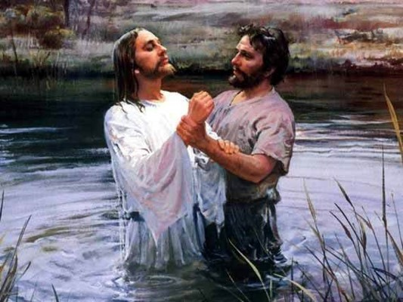
The Pattern of Baptism
Prophecies of Christ’s Baptism
“Prepare ye the way of the LORD– Isaiah prophesies of John the Baptist (Isaiah 40:3)
Esaias; and these are the words, saying, The voice of one crying in the wilderness, Prepare ye the way of the Lord, and make his paths straight.
JST Luke 3:4
“Behold, I will send my messenger, and he shall prepare the way before me: and the Lord, whom ye seek, shall suddenly come to his temple, even the messenger of the covenant.”—Malachi 3:1
“…and I also beheld the prophet who should prepare the way before him. And the Lamb of God went forth and was baptized of him.”
1 Nephi 11:27
The Savior had to be baptized to “fulfill all righteousness” There is no righteousness without willing submission to all the ordinances of salvation.
2 Nephi 31:5

Slide 6
Christ Had to Be Baptized
To be considered righteous—sinless, pure, or merely good—There was a perfect example of Christ being baptized
Righteousness is not simply the absence of evil …it is the active seeking of the mind and will of the Father and compliance with that will once it has been obtained.
In order for John and Jesus to be considered righteous they needed to fulfill this covenant of Baptism. Matthew 3:15
Son of Righteousness—title for deity—keeping covenants
Legal requirements to return to Heavenly Father was to be baptized…righteousness is an obligation to fulfilling that requirement.
Salvation
Righteousness
2 Nephi 31:5

Slide 7
Jesus Christ, though sinless, was baptized to fulfill all righteousness
Jesus Christ set the perfect example of obedience for us to follow
If we sincerely repent and follow the Savior by being baptized, then we will receive the Holy Ghost

Slide 8
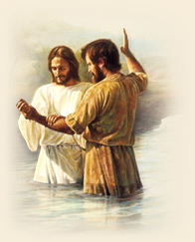
Christ Fulfilled All Righteousness
He humbled Himself before the Father through His baptism
He entered a covenant relationship with the Father, promising obedience in keeping the commandments
He opened to Himself the gate to the celestial kingdom
He set a perfect example for all to follow
None but the righteous can be saved—only those who are willing to enter into and honor the covenants of salvation.
Christ is the Example—A Pattern to follow after.
“As baptism was required of Christ so that he might be an heir of salvation, so it is required of all who seek that blessing.”
JFM and RLM
2 Nephi 31:7,9

Slide 9
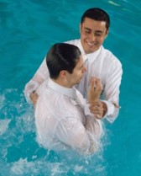
Baptism is a Commandment
A Requirement:
In order to receive the gift of the Holy Ghost
Which is:
Necessary in our efforts to follow Jesus Christ
How can we be an example of obedience?
Jesus Christ set the perfect example of obedience for us to follow.
We must follow Jesus Christ, be baptized, and receive the Holy Ghost.
Jesus Christ, though sinless, was baptized to fulfill all righteousness.
2 Nephi 31:5-9

Slide 10
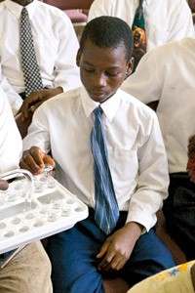
Christ Fulfilled All Righteousness
How to follow the Savior:
With full purpose of heart
Acting no hypocrisy and no deception before God, but with real intent
Repenting of your sins, witnessing unto the Father that ye are willing to take upon you the name of Christ, by baptism—
By following your Lord and your Savior down into the water, according to his word, behold, then shall ye receive the Holy Ghost
Full purpose of Heart:
—applying activities such as daily scripture study and Church attendance
-- “saying a prayer” and praying “with full purpose of heart”
--saying that you are sorry about something you have done and repenting “with full purpose of heart”
With Real Intent:
--The difference between eating the sacrament bread and partaking of the sacrament bread
2 Nephi 31:13

Slide 11
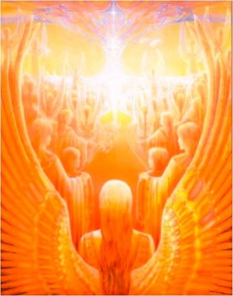
Another Baptism
Of Fire and of the Holy Ghost--
“Fire is an agent of purification. When a person is baptized by fire the dross of sin is burned from his soul and he thus becomes a fit abiding place for the Holy Ghost. Fire is also a metaphor used to describe the witness of the Spirit that is associated with the receipt of the Holy Ghost (Jeremiah 20:9)”
JFM and RLM
The Tongue of angels--
“…Angels speak by the power of the Holy Ghost; wherefore, they speak the words of Christ…” (2 Nephi 32:3)
2 Nephi 31:13

Slide 12
The Greater Sin
After you have repented, been baptized, received the Holy Ghost then deny Him. “… it would have been better for you that ye had not known me.”
To refuse obedience to the gospel standard is obviously a greater sin for those who have received the witness of the Spirit than it is for those who never knew it.
“For if after they have escaped the pollutions of the world through the knowledge of the Lord and Saviour Jesus Christ, they are again entangled therein, and overcome, the latter end is worse with them than the beginning.
For it had been better for them not to have known the way of righteousness, than, after they have known it, to turn from the holy commandment delivered unto them.”
2 Peter 2:20-21
“The worst enemies of the Church are among those who were once members of it. Such leave the Church but find it impossible to leave it alone.” JFM and RLM
2 Nephi 31:14

Slide 13
A Journey of a Lifetime
Enduring to the end consists of keeping the commandments after baptism Alma 7:16
“… enduring to the end is not just a matter of passively tolerating life’s difficult circumstances or “hanging in there.” Ours is an active religion, ... Viewed from this perspective, enduring to the end is exalting and glorious, not grim and gloomy.
This is a joyful religion, one of hope, strength, and deliverance. “Adam fell that men might be; and men are, that they might have joy.”
Enduring to the end is a process filling every minute of our life, every hour, every day, from sunrise to sunrise. It is accomplished through personal discipline following the commandments of God…
Enduring to the end implies “patient continuance in well doing”, striving to keep the commandments, and doing the works of righteousness…”
Dieter F. Uchtdorf
Christ’s Life Is Our Example
2 Nephi 31:15; 2 Nephi 2:25; Romans 2:7; D&C 59:23

Slide 14
The Gate
Presence of God—Eternal Life—Celestial Kingdom
How are repentance and baptism like a gate?
What does the path lead to?
What does the Holy Ghost do for us?
The Holy Ghost witnesses of the Father and the Son and brings a remission of sins.
What do we need to do after baptism in order to stay on the path to eternal life?
Continue following the Savior’s example, press forward with a steadfastness in Christ, have faith and hope, love God and all people, feast upon the word of Christ, endure to the end
Repentance and Baptism
The beginning point for the journey back to Heavenly Father
2 Nephi 31:16-18

Slide 15
Straight and Narrow Path
What do we need to do after baptism in order to stay on the path to eternal life?
Repentance and Baptism
Receive the Gift of the Holy Ghost
If we live according to the doctrine of Christ, we will receive eternal life.
Endure to the end
2 Nephi 31:19-20

Slide 16
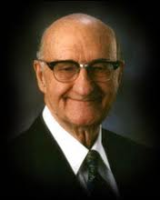
“We need to feast upon the words of Christ in the scriptures and as these words come to us from living prophets. Just nibbling occasionally will not do. Feasting means partaking with relish and delight and savoring—not gorging episodically in heedless hunger, but partaking gratefully, dining with delight, at a sumptuous spread carefully and lovingly prepared…, over the centuries.”
Neal A. Maxwell
Feast Upon the Word of Christ
“In the beginning this may not be easy. Reading scripture with eagerness usually comes after one has cultivated a familiarity with the teaching of Christ and learns how to attract the spirit of the Lord in order to gain a thrilling depth of understanding concerning the vast and profound concepts which lie behind each Gospel principle. Then one can feast indeed upon the teaching of Christ. And the longer one participates, the greater the feast becomes.”
Cleon Skousen
2 Nephi 31:19-20

Slide 17
“The ‘doctrine of Christ’ as taught by Nephi in his grand, summational discourse focuses on faith in the Lord Jesus Christ, repentance, baptism by immersion, receiving the gift of the Holy Ghost, and enduring to the end.
It does not, in this declaration, attempt to cover the entire plan of salvation, all the virtues of a Christian life, or the rewards that await us in differing degrees of heavenly glory.
It does not, in this declaration, deal with the offices of the priesthood, the ordinances of the temple, or many other true doctrines. All these are important, but as used in the Book of Mormon, ‘the doctrine of Christ’ is simple and direct.
It focuses on the first principles of the gospel exclusively, including an expression of encouragement to endure, to persist, to press on. Indeed, it is in the clarity and simplicity of ‘the doctrine of Christ’ that its impact is found. Nephi knew it would be so. He wrote, ‘I shall speak unto you plainly, according to the plainness of my prophesying’ [2 Nephi 31:2]”
Jeffrey R. Holland
2 Nephi 31:21

Slide 18
As we follow the example of the Savior and endure to the end, we will receive eternal life with our Heavenly Father.

Slide 19
Just Keep Going
Heaven is cheering you on today, tomorrow, and forever.
…So keep loving. Keep trying. Keep trusting. Keep believing. Keep growing.
Jeffrey R. Holland

Slide 20
Sources:
Joseph Fielding McConkie and Robert L. Millet Doctrinal Commentary on the Book of Mormon pg 360-368
Jeffrey R. Holland (Christ and the New Covenant: The Messianic Message of the Book of Mormon [1997], 49–50). Jeffrey R. Holland, “Tomorrow the Lord Will Do Wonders among You,” Ensign or Liahona, May 2016, 127
Dieter F. Uchtdorf Have We Not Reason to Rejoice? Conference Report Oct. 2007
Neal A. Maxwell Wherefore Ye Must Press Forward pg 28
Cleon Skousen Treasures from the Book of Mormon Vol. 1 pg. 291
Jeffrey R. Holland (Christ and the New Covenant: The Messianic Message of the Book of Mormon [1997], 49–50).
Presentation by ©http://fashionsbylynda.com/blog/

Slide 21
Importance of Baptism 2 Nephi 31:12
At baptism we make a covenant with our Heavenly Father that we are willing to come into His kingdom and keep His commandments from that time forward, even though we still live in the world. …
When we understand our baptismal covenant and the gift of the Holy Ghost, it will change our lives and will establish our total allegiance to the kingdom of God. When temptations come our way, if we will listen, the Holy Ghost will remind us that we have promised to remember our Savior and obey the commandments of God. (Robert D. Hales, “The Covenant of Baptism: To Be in the Kingdom and of the Kingdom,” Ensign, Nov. 2000, 7)
Enduring to the End 2 Nephi 31:15-16:
“Enduring to the end is the doctrine of continuing on the path leading to eternal life after one has entered into the path through faith, repentance, baptism, and receiving the Holy Ghost. Enduring to the end requires our whole heart or, as the Book of Mormon prophet Amaleki teaches, we must ‘come unto him, and offer [our] whole souls as an offering unto him, and continue in fasting and praying, and endure to the end; and as the Lord liveth [we] will be saved’ [Omni 1:26].
“Enduring to the end means that we have planted our lives firmly on gospel soil, staying in the mainstream of the Church, humbly serving our fellow men, living Christlike lives, and keeping our covenants. Those who endure are balanced, consistent, humble, constantly improving, and without guile. Their testimony is not based on worldly reasons—it is based on truth, knowledge, experience, and the Spirit” (Joseph B. Wirthlin, “Press On,” Ensign or Liahona, Nov. 2004, 101).
Receiving the Holy Ghost 2 Nephi 31:13, 17-18:
“The ordinance of confirming a new member of the Church and bestowing the gift of the Holy Ghost is both simple and profound. Worthy Melchizedek Priesthood holders place their hands upon the head of an individual and call him or her by name. Then, by the authority of the holy priesthood and in the name of the Savior, the individual is confirmed a member of The Church of Jesus Christ of Latter-day Saints, and this important phrase is uttered: ‘Receive the Holy Ghost.’
“The simplicity of this ordinance may cause us to overlook its significance. These four words—‘Receive the Holy Ghost’—are not a passive pronouncement; rather, they constitute a priesthood injunction—an authoritative admonition to act and not simply to be acted upon (see 2 Nephi 2:26). The Holy Ghost does not become operative in our lives merely because hands are placed upon our heads and those four important words are spoken. As we receive this ordinance, each of us accepts a sacred and ongoing responsibility to desire, to seek, to work, and to so live that we indeed ‘receive the Holy Ghost’ and its attendant spiritual gifts. …
“Praying, studying, gathering, worshipping, serving, and obeying are not isolated and independent items on a lengthy gospel checklist of things to do. Rather, each of these righteous practices is an important element in an overarching spiritual quest to fulfill the mandate to receive the Holy Ghost. The commandments from God we obey and the inspired counsel from Church leaders we follow principally focus upon obtaining the companionship of the Spirit. Fundamentally, all gospel teachings and activities are centered on coming unto Christ by receiving the Holy Ghost in our lives” (David A. Bednar, “Receive the Holy Ghost,” Ensign or Liahona, Nov. 2010, 95, 97).
Sins Remitted 2 Nephi 17-18:
“Sins are remitted not in the waters of baptism, as we say in speaking figuratively, but when we receive the Holy Ghost. … We become clean when we actually receive the fellowship and companionship of the Holy Ghost. It is then that sin and dross and evil are burned out of our souls as though by fire. The baptism of the Holy Ghost is the baptism of fire” (Bruce R. McConkie, A New Witness for the Articles of Faith [1985], 290).
The pure doctrine of Christ is powerful. It changes the life of everyone who understands it and seeks to implement it in his or her life. The doctrine of Christ helps us find and stay on the covenant path. Staying on that narrow but well-defined path will ultimately qualify us to receive all that God has. Nothing could be worth more than all our Father has! (Russell M. Nelson, “Pure Truth, Pure Doctrine, and Pure Revelation,” Liahona, Nov. 2021, 6)
The Holy Ghost 2 Nephi 17-18:
“When [the Holy Ghost] is your companion, you can have confidence that the Atonement is working in your life. …
“Not only is your feeling the influence of the Holy Ghost a sign that the Atonement, the cure for sin, is working in your life, but you will also know that a preventative against sin is working” (Henry B. Eyring, “Come unto Christ” President Henry B. Eyring [Brigham Young University devotional, Oct. 29, 1989], speeches.byu.edu).

Slide 22
Chiasmus in 2 Nephi 31 (The Doctrine of Christ)
2 …a few words which I must speak concerning the doctrine of Christ;
9 And again, it showeth unto the children of men the straitness of the path, and the narrowness of the gate, by which they should enter, he having set the example before them.
11 And the Father said: Repent ye, repent ye, and be baptized in the name of my Beloved Son.
13 Wherefore, my beloved brethren, I know that if ye shall follow the Son, with full purpose of heart, acting no hypocrisy and no deception before God, but with real intent, repenting of your sins, witnessing unto the Father that ye are willing to take upon you the name of Christ, by baptism—yea, by following your Lord and your Savior down into the water, according to his word, behold, then shall ye receive the Holy Ghost; yea, then cometh the baptism of fire and of the Holy Ghost;
14 After ye have repented of your sins, and witnessed unto the Father that ye are willing to keep my commandments, by the baptism of water,
18 And then are ye in this strait and narrow path which leads to eternal life;
21 And now, behold, this is the doctrine of Christ, and the only and true doctrine of the Father, and of the Son, and of the Holy Ghost, which is one God, without end. Amen.
Chiasmus in 2 Nephi 31 (The Doctrine of Christ)
2 …a few words which I must speak concerning the doctrine of Christ;
9 And again, it showeth unto the children of men the straitness of the path, and the narrowness of the gate, by which they should enter, he having set the example before them.
11 And the Father said: Repent ye, repent ye, and be baptized in the name of my Beloved Son.
13 Wherefore, my beloved brethren, I know that if ye shall follow the Son, with full purpose of heart, acting no hypocrisy and no deception before God, but with real intent, repenting of your sins, witnessing unto the Father that ye are willing to take upon you the name of Christ, by baptism—yea, by following your Lord and your Savior down into the water, according to his word, behold, then shall ye receive the Holy Ghost; yea, then cometh the baptism of fire and of the Holy Ghost;
14 After ye have repented of your sins, and witnessed unto the Father that ye are willing to keep my commandments, by the baptism of water,
18 And then are ye in this strait and narrow path which leads to eternal life;
21 And now, behold, this is the doctrine of Christ, and the only and true doctrine of the Father, and of the Son, and of the Holy Ghost, which is one God, without end. Amen.

Slide 23
Seeking Divine Direction
2 Nephi 32
The
Book
of
Mormon
ANOTHER TESTAMENT
OF JESUS CHRIST

Slide 24
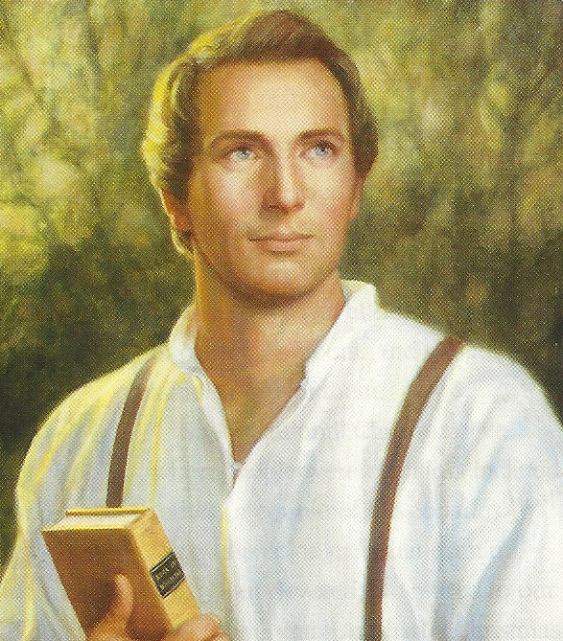
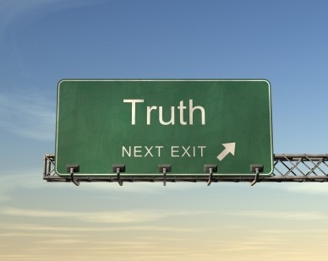
Revelation
“No man can receive the Holy Ghost without receiving revelation. The Holy Ghost is the Revelator.”
Joseph Smith
We are told that should a gospel truth be taught independent of that spirit “it is not of God.”
D&C 50:13-18
All true religion is revealed religion and its truth must be taught by the spirit of revelation.
Nephi counsels us to seek divine direction through the words of Jesus Christ and the promptings of the Holy Ghost
2 Nephi 32:1-7

Slide 25
Doctrinal Mastery
Angels speak by the power of the Holy Ghost; wherefore, they speak the words of Christ. Wherefore, I said unto you, feast upon the words of Christ; for behold, the words of Christ will tell you all things what ye should do.
2 Nephi 32:3

Slide 26
Words of Christ
What words in describe how we should receive the words of Christ?
Feast
What do you think it means to feast on the words of Christ?
To study and ponder the words of Christ
What did Nephi say will be the outcome when we feast on the words of Christ?
The words will tell you all things you should know
What are some places where we can find the words of Jesus Christ?
The scriptures, the words of modern prophets, and inspiration from the Holy Ghost
2 Nephi 32:3

Slide 27
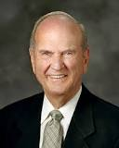
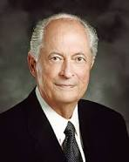
Feasting
“To feast means more than to taste. To feast means to savor. We savor the scriptures by studying them in a spirit of delightful discovery and faithful obedience. When we feast upon the words of Christ, they are embedded ‘in fleshy tables of the heart.’
They become an integral part of our nature”
Russell M. Nelson
“If you and I are to feast upon the words of Christ, we must study the scriptures and absorb His words through pondering them and making them a part of every thought and action”
Elder Robert D. Hales
2 Corinthians 3:3

Slide 28
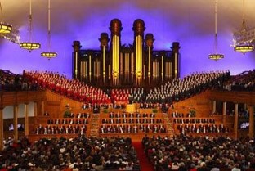
Where Can I find the Words of Christ?
1. Personal scripture study
3. General Conference
4. Family scripture study
2. Sacrament meeting
5. Seminary
7. Aaronic Priesthood quorum meeting or Young Women class
6. Family home evening
8. Personal prayer
2 Nephi 32:3

Slide 29
To Understand is to Ask
Knock
In eternal life
Ask in Faith
If we pray always, God will consecrate our performance for the welfare of our souls.
Receive Revelation and knowledge
Find peaceable joy
Through the Holy Ghost
2 Nephi 32:4

Slide 30
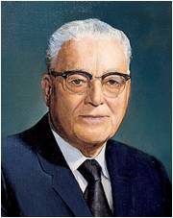
“We are commanded to pray always to the Father in the name of the Son.
We are promised that if we pray sincerely for that which is right and good and in accordance with God’s will, we can be blessed, protected, and directed.
Revelation is communication from Heavenly Father to His children on earth.
As we ask in faith, we can receive revelation upon revelation and knowledge upon knowledge and come to know the mysteries and peaceable things that bring joy and eternal life.
The mysteries are those matters that can only be known and understood by the power of the Holy Ghost.
Harold B. Lee
2 Nephi 32:4; 3 Nephi 18:19-20; D&C 19:38: 42:61

Slide 31
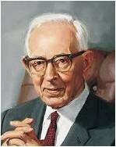
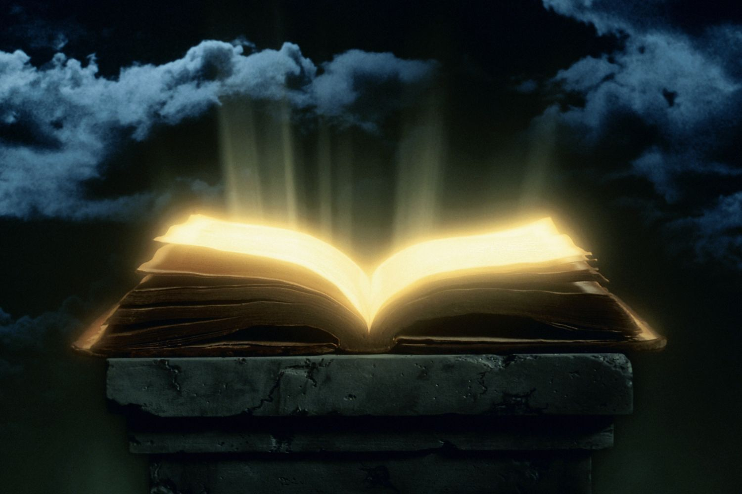
Withholding Revelation
“The Lord withholds much that he would otherwise reveal if the members of the Church were prepared to receive it.
When they will not live in accordance with the revelations he has given, how are they entitled to receive more?
The people in the church are not living in full accord with the commandments the Lord has already required of them.”
Joseph Fielding Smith
And when they shall have received this, which is expedient that they should have first, to try their faith, and if it shall so be that they shall believe these things then shall the greater things be made manifest unto them.
And if it so be that they will not believe these things, then shall the greater things be withheld from them, unto their condemnation. (3 Nephi 26:9-10)
“We have little occasion to clamor for more revelation when we refuse to heed what the Lord has revealed for our salvation.”
2 Nephi 32:7

Slide 32
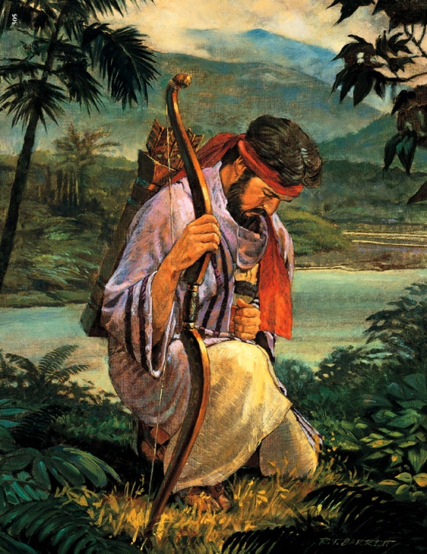
Key to Prayer
“Pray always, that you may come off conqueror; yea, that you may conquer Satan, and that you may escape the hands of the servants of Satan that do uphold his work.”
D&C 10:5
Earnest
Pleading
Yearning
Hungering
Living as you pray
Enos 1:4
And my soul hungered; and I kneeled down before my Maker, and I cried unto him in mighty prayer and supplication for mine own soul; and all the day long did I cry unto him; yea, and when the night came I did still raise my voice high that it reached the heavens.
2 Nephi 32:8-9

Slide 33
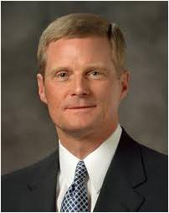
“There may be things in our character, in our behavior, or concerning our spiritual growth about which we need to counsel with Heavenly Father in morning prayer. …
“During the course of the day, we keep a prayer in our heart for continued assistance and guidance. …
“We notice during this particular day that there are occasions where normally we would have a tendency to speak harshly, and we do not; or we might be inclined to anger, but we are not.
We discern heavenly help and strength and humbly recognize answers to our prayer. Even in that moment of recognition, we offer a silent prayer of gratitude.
“At the end of our day, we kneel again and report back to our Father. We review the events of the day and express heartfelt thanks for the blessings and the help we received. We repent and, with the assistance of the Spirit of the Lord, identify ways we can do and become better tomorrow. Thus our evening prayer builds upon and is a continuation of our morning prayer. And our evening prayer also is a preparation for meaningful morning prayer.
“Morning and evening prayers—and all of the prayers in between—are not unrelated, discrete events; rather, they are linked together each day and across days, weeks, months, and even years. This is in part how we fulfill the scriptural admonition to ‘pray always’. Such meaningful prayers are instrumental in obtaining the highest blessings God holds in store for His faithful children.”
David B. Bednar
Luke 21:36; 3 Nephi 18:15, 18;D&C 31:12

Slide 34
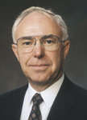
For the Welfare of our Souls
Mission
“You may be facing decisions regarding a mission, your future career, and, eventually, marriage. As you read the scriptures and pray for direction, you may not actually see the answer in the form of printed words on the page, but as you read you will receive distinct impressions, and promptings, and, as promised, the Holy Ghost ‘will show unto you all things what ye should do.’”
Spencer J. Condie
Education
Career
Marriage
2 Nephi 32:5

Slide 35
Sources:
Joseph Smith Teachings pg 328
Russell M. Nelson (“Living by Scriptural Guidance,” Ensign, Nov. 2000, 17).
Robert D. Hales (“Healing Soul and Body,” Ensign, Nov. 1998, 15).
Harold B. Lee, Ye Are the Light of the World [1974], 211).
Joseph Fielding Smith Doctrine of Salvation Vol. 1 Pg 283
David A. Bednar Pray Always Ensign or Liahona, Nov. 2008, 41–42).
Spencer J. Condie Becoming a Great Benefit to Our Fellow Beings Ensign, May 2002, 45.
Presentation by ©http://fashionsbylynda.com/blog/

Slide 36
Witness Through the Holy Ghost
2 Nephi 33
The
Book
of
Mormon
ANOTHER TESTAMENT
OF JESUS CHRIST

Slide 37
“Success in righteousness, the power to avoid deception and resist temptations, guidance in our daily lives, healing of the soul—these are but a few of the promises the Lord has given to those who will come to His word.”
Ezra T. Benson

Slide 38
Nephi Laments
Not mighty in writing—
Nephi realizes that the messages he is speaking is difficult to write, because when he speaks he speaks by the power of the Holy Ghost.
into
unto
The Holy Ghost carries truth to our hearts
What is the difference between a message going unto someone’s heart and a message going into someone’s heart?
Why do you think it is significant that the Holy Ghost carries the truth unto our hearts but not into our hearts?
2 Nephi 33:1

Slide 39
Pride
Rebellion
When we open our hearts, messages from the Holy Ghost can enter our hearts
Envy
Faithlessness
Behaviors of Hardened Hearts
Loss of the Spirit
By testifying of the truth, the Holy Ghost provides an opportunity for us to receive a spiritual witness and testimony of the truth that is taught.
If we harden our hearts against the Holy Spirit, we will not understand the value of the word of God.
2 Nephi 33:2

Slide 40
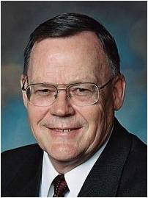
“Please notice how the power of the Spirit carries the message unto but not necessarily into the heart. A teacher can explain, demonstrate, persuade, and testify, and do so with great spiritual power and effectiveness. Ultimately, however, the content of a message and the witness of the Holy Ghost penetrate into the heart only if a receiver allows them to enter.”
David A. Bednar
“Why just unto the heart? Individual agency is so sacred that Heavenly Father will never force the human heart, even with all His infinite power. … God allows us to be the guardians, or the gatekeepers, of our own hearts. We must, of our own free will, open our hearts to the Spirit.”
Gerald N. Lund
2 Nephi 33:1-3

Slide 41
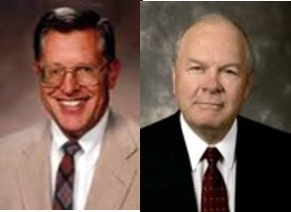
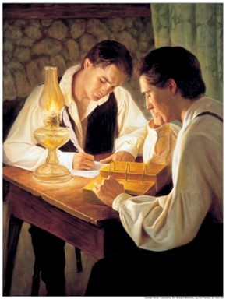
Words Written in Weakness
“If you receive not the Spirit ye shall not teach”
D&C 42:14
If a message is from God, the Spirit will bear witness of it, whether it is delivered orally or in writing.
Any doctrine that opposes the principle of revelation is rooted in the kingdom of darkness. Those who argue for a closed canon, declaring the Bible to be the final or last word that God will speak, have at the same time closed the door to any possibility of understanding the true meaning of the Bible. Revelation can be understood only by the spirit of revelation.
Nephi knew that the record in which he was making would be rejected by those who deny the spirit of revelation. He also knew that those who rejected the testimony of the Book of Mormon would do so in the name of loyalty to the Bible.
2 Nephi 33:4 and JFM and RLM

Slide 42
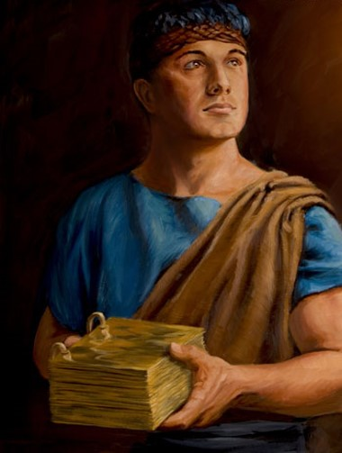
The Purpose of Nephi’s Record
A hope that his readers will believe in Christ
For I pray continually for them by day, and mine eyes water my pillow by night, because of them; and I cry unto my God in faith, and I know that he will hear my cry.
2 Nephi 33:3
I pray continually for …
I know …
I glory …
I have …
The Book of Mormon persuades people to do good, to believe in Jesus Christ, and to endure to the end.
I know that the Lord God will consecrate my prayers for the gain of my people.
2 Nephi 33:4
I glory in plainness; I glory in truth; I glory in my Jesus, for he hath redeemed my soul from hell.
2 Nephi 33:6
I have charity for my people, and great faith in Christ that I shall meet many souls spotless at his judgment-seat.
2 Nephi 33:7
James H. Fullmer
How can we strengthen our personal testimonies of Jesus Christ and His Atonement?
2 Nephi 33-3-7

Slide 43
President Joseph Fielding Smith said: “It seems to me that any member of this Church would never be satisfied until he or she had read the Book of Mormon time and time again, and thoroughly considered it so that he or she could bear witness that it is in very deed a record with the inspiration of the Almighty upon it, and that its history is true.”
Joseph Fielding Smith
“There will come into [their] lives and into [their] homes an added measure of the Spirit of the Lord, a strengthened resolution to walk in obedience to His commandments, and a stronger testimony of the living reality of the Son of God.”
Gordon B. Hinckley

Slide 44
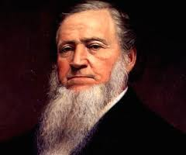
Nephi’s Farewell
“The Book of Mormon is the most Christ centered scriptural record ever published. Every doctrine within its covers is but an appendage to its central theme—the testimony that Jesus is the Christ. All who believe in Christ will believe the words of this book. One cannot truly believe in the Bible and at the same time not believe in the Book of Mormon.”
JFM and RLM
“There is not that person on the face of the earth who has had the privilege of learning the gospel of Jesus Christ from these two books (the Bible and the Book of Mormon), that can say that one is true, and the other is false. No Latter-day Saint, no man or woman, can say the Book of Mormon is true, and at the same time say that the Bible is untrue. If one be true, both are; and if one be false, both are false.”
Brigham Young
2 Nephi 33:10

Slide 45
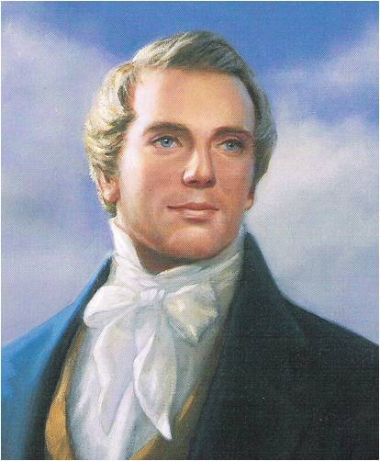
A Rejection
Christ was rejected by a nation professing loyalty to the Law of Moses
“Do not think that I will accuse you to the Father: there is one that accuseth you, even Moses, in whom ye trust.
For had ye believed Moses, ye would have believed me: for he wrote of me.
But if ye believe not his writings, how shall ye believe my words?”
John 5:45-47
Joseph Smith was rejected by many who profess loyalty to the Bible…
Even though he is mentioned in the Bible by Moses, Ezekiel, and Isaiah
If we do not respect the words of the Lord and His servants, then their words will condemn us at the last day
“Nephi, as with all the holy prophets since the world began, will stand at the judgment bar of god as a witness against those who rejected his testimony.”
JFM and RLM
2 Nephi 33:11

Slide 46
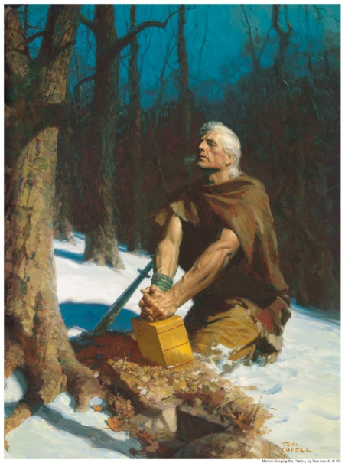
Crying From the Dust
Nephi understood the destiny of the record he was keeping
He knew:
The record would spring forth out of the earth –Psalm 85:11
Isaiah 45:8
Carrying:
The testimony of those whose bodies had long since returned to the dust
Isaiah 29:4
1 Nephi 27:13
All would be judged:
By the manner in which they accepted or rejected the voice of prophecy as it was available to them, either in scriptural writ or by the voice of living oracles (Prophets)
2 Nephi 33:13-14

Slide 47
Sealed On Earth
A Pattern in which the prophets of all ages seal their teaching with a testimony that what they have taught is dive truth. (D&C 1:8-10)
Nephi sealed his testimony
“For what I seal on earth, shall be brought against you at the judgment bar; for thus hath the Lord commanded me, and I must obey. Amen.”
2 Nephi 33:15

Slide 48
Sources:
Ezra T Benson The Power of the Word Ensign May 1986
David A Bednar (“Seek Learning by Faith” [address to CES religious educators, Feb. 3, 2006], 1, si.lds.org).
Gerald N. Lund (“Opening Our Hearts,” Ensign or Liahona, May 2008, 33).
Joseph Fielding McConkie and Robert L. Millet Doctrinal Commentary Vol 1 pg 172-174
Brigham Young Journal of Discourses 1:38
Joseph Fielding Smith (in Conference Report, Oct. 1961, 18).
Gordon B. Hinckley (“A Testimony Vibrant and
True,” Ensign, Aug. 2005, 6).
Presentation by ©http://fashionsbylynda.com/blog/

Slide 49
The Heart 2 Nephi 33:2:
“The heart is a tender place. It is sensitive to many influences, both positive and negative. It can be hurt by others. It can be deadened by sin. It can be softened by love. Early in our lives, we learn to guard our hearts. It is like we erect a fence around our hearts with a gate in it. No one can enter that gate unless we allow him or her to.
“In some cases the fence we erect around our hearts could be likened to a small picket fence with a Welcome sign on the gate. Other hearts have been so hurt or so deadened by sin that they have an eight-foot (2.5-m) chain-link fence topped with razor wire around them. The gate is padlocked and has a large No Trespassing sign on it. …
“… The condition of our hearts directly affects our sensitivity to spiritual things. Let us make it a part of our everyday striving to open our hearts to the Spirit. Since we are the guardians of our hearts, we can choose to do so” (Gerald N. Lund, “Opening Our Hearts,” Ensign or Liahona, May 2008, 33, 34).

