Slide 2
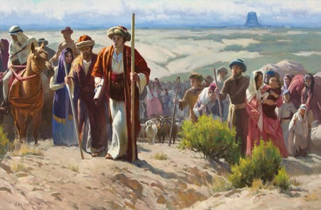
Who Were the Jaredites?
The descendants of Jared.
They were led away from the Tower of Babel by the Lord.
A group of people who traveled to the Western Hemisphere and lived there for many centuries before the arrival of the people of Lehi.

Slide 3
The Book of Ether
Moroni abridged this book from 24 gold plates called the plates of Ether.
The book is named for the prophet Ether, who was the last prophet of the Jaredites and who created a record of their history (see Ether 15:33–34).
About 500 years before Moroni made his abridgment of the sacred records, some of the people of Limhi discovered the plates of Ether as they were searching for the land of Zarahemla (see Mosiah 8:7–11; Ether 1:2).
Nephite prophets and record keepers passed the plates of Ether down until they came into Moroni’s possession. Moroni stated that he did not include even “the hundredth part” of the record in his abridgment (Ether 15:33).
The Book of Ether

Slide 4
To Whom Was This Book Written?
Because Moroni abridged the plates of Ether after the Jaredites and his own people had been destroyed, he intended this book for the people of our day.
Moroni admonished latter-day Gentiles to repent, serve God, and do away with secret combinations (see Ether 2:11–12; 8:23).
He also recorded the words of Jesus Christ, inviting “all ye ends of the earth” to repent, come unto Him, be baptized, and receive the knowledge that is withheld from the world because of unbelief (see Ether 4:13–18).

Slide 5
Where and When Was The Record Written?
Ether completed the record of his people during and after the final great battle that killed all but two of the Jaredites—himself and Coriantumr
(see Ether 13:13–14; 15:32–33).
He then hid his writings “in a manner that the people of Limhi did find them”
(Ether 15:33; see also Mosiah 8:7–9).
Moroni abridged the record of Ether between A.D. 400 and A.D. 421
(see Mormon 8:3–6; Moroni 10:1).
Moroni wrote that the Jaredites were destroyed in “this north country” (Ether 1:1), indicating he may have been in the land where they were destroyed when he abridged their record.

Slide 6
The Book of Ether
Unlike other books in the Book of Mormon, the book of Ether does not relate the history of the descendants of Lehi.
The book recounts how the Jaredites came forth from the Tower of Babel and traveled to the land of promise, where eventually they were destroyed.
The book of Ether is a second witness to the record of the Nephites illustrating that “whatsoever nation shall possess [the promised land] shall serve God, or they shall be swept off … when they are ripened in iniquity” (Ether 2:9).
Jesus Christ’s premortal appearance to the brother of Jared “ranks among the greatest moments in recorded history.”
This event “established the brother of Jared among the greatest of God’s prophets forever”
Jeffrey R. Holland
The Book of Ether

Slide 7
Ether
He was the last of the Jaredite prophets
He was a descendant of Coriantor
His ministry was in the Northern part of the land
The people rejected Ether’s words
He had to hide himself in the cavity of a rock by day and venture forth to make his observations only at night
He witnessed the fate of the Jaredite nation
He hid the records he kept and later would be discovered by Limhi
The records were of the 24 plates found by the people of Limhi in the days of King Mosiah in about 120-121 BC

Slide 8
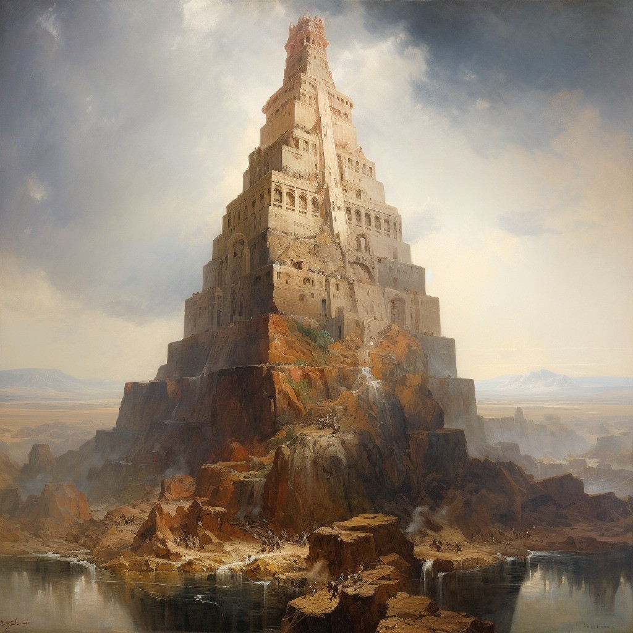
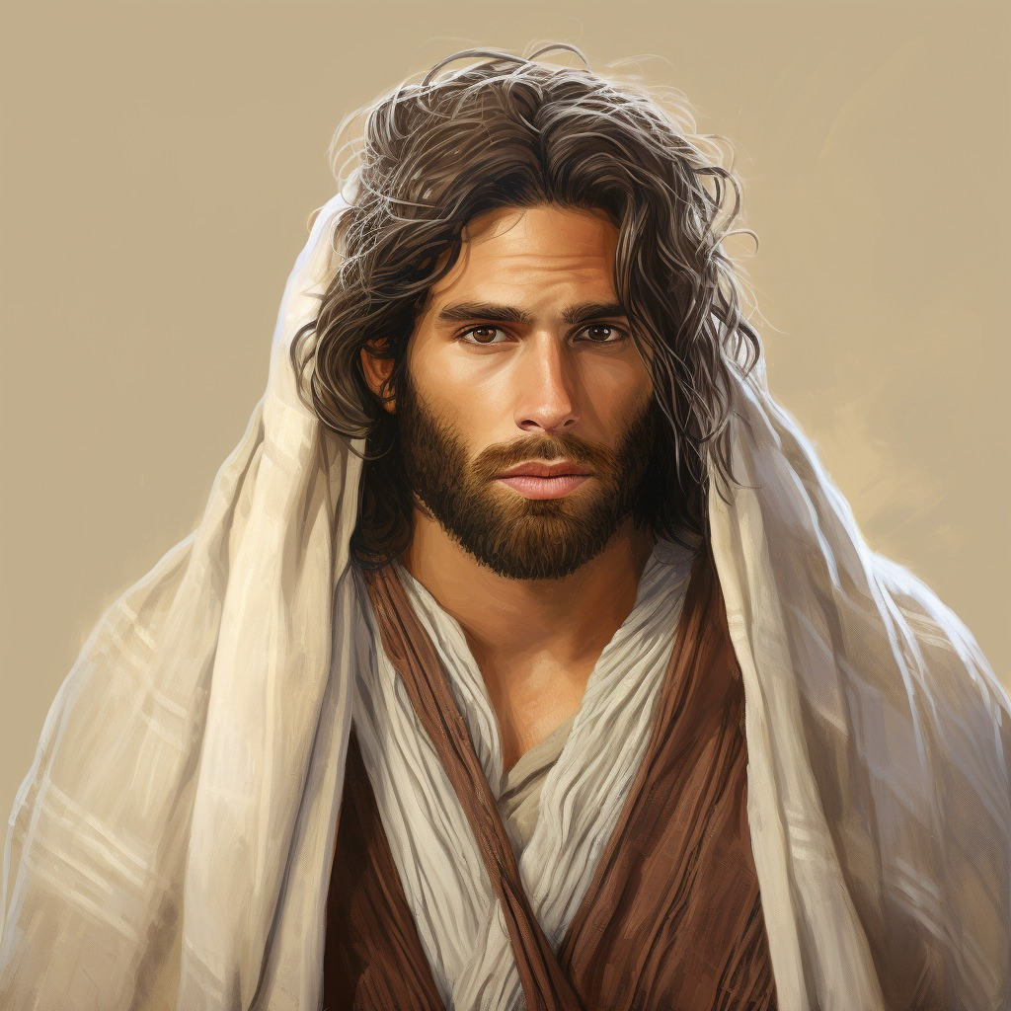
Nimrod and the Great Tower
Nimrod was the son of Cush, grandson of Ham, and great-grandson of Noah; and as "a mighty one in the earth" and "a mighty hunter before the Lord

Slide 9
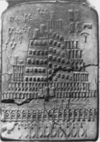
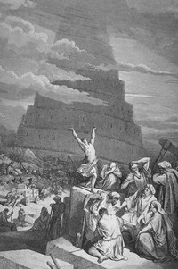
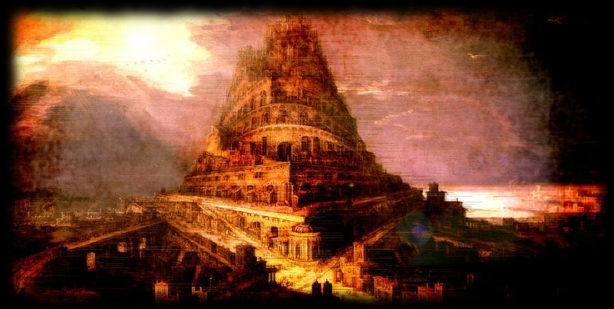
The Tower of Babel
“But behold, I give not the full account, but a part of the account I give, from the tower down until they were destroyed.”
Babel was founded by Nimrod and was one of the oldest cities in the land of Mesopotamia, or Shinar (Gen. 10:8–10). The Lord confounded the languages at the time the people were building the Tower of Babel (Gen. 11:1–9; Ether 1:3–5, 33–35). Babylon later became Nebuchadnezzar’s capital. He built an enormous city of which the ruins still remain. Babylon became a very wicked city and has since come to symbolize the wickedness of the world.
Bible Dictionary
Jared and his family lived during this time
Somewhere around 2000 years before the birth of the Savior

Slide 10
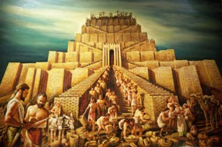
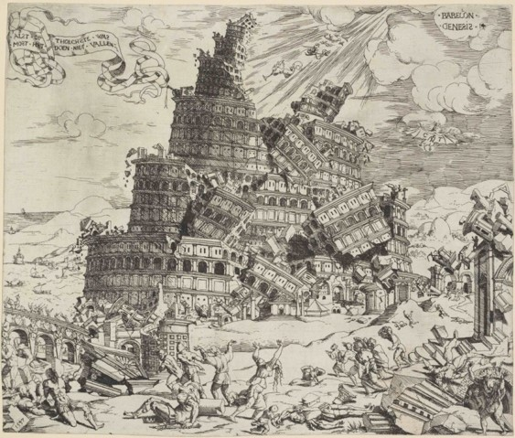
Scattered and Confounding the Language
“And they said, Go to, let us build us a city and a tower, whose top may reach unto heaven; and let us make us a name, lest we be scattered abroad upon the face of the whole earth.
And the Lord came down to see the city and the tower, which the children of men builded.
And the Lord said, Behold, the people is one, and they have all one language; and this they begin to do: and now nothing will be restrained from them, which they have imagined to do.
Go to, let us go down, and there confound their language, that they may not understand one another’s speech.
So the Lord scattered them abroad from thence upon the face of all the earth: and they left off to build the city.
Therefore is the name of it called Babel; because the Lord did there confound the language of all the earth: and from thence did the Lord scatter them abroad upon the face of all the earth.”
Genesis 11:4-9

Slide 11
Jared
Orihah
Kib
Sule
Omer
Emer
Coriantum
Com
Heth
Shez
Riplakish
Morianton (descendant of)
Kim
Levi
Corom
Kish
Lib
Hearthom
Heth
Aaron (descendant of)
Amnigaddah
Coriantum
Com
Shiblon
Ether’s Genealogy
Ether 1:6-32
Seth
Ahah
Ethem
Moron
Coriantor
Ether

Slide 12
Brother of Jared
He was a large and mighty man and highly favored of the Lord
He petitioned the Lord as to where his family and friends should go after the confounding of the languages during the time of the ‘Tower of Babel’
The Lord gave a promise to him that his seed and his brother’s seed will go to a great nation and build it up
He was chastened by the Lord for not preparing for their journey across the sea
He sought help in preparing the 8 barges that would carry them to another land
He spoke with the Lord for three hours (for me, that is just not enough time
He gathered stones for the barges and the Lord extended his finger to impart radiance to the stones
The Lord showed him a vision of the divine plan for the immortality and eternal life of mankind, from the beginning to the end
He was commanded to keep a record and seal them up with 2 interpreting stones to come forth at a later time
Who’s Who

Slide 13
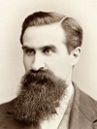
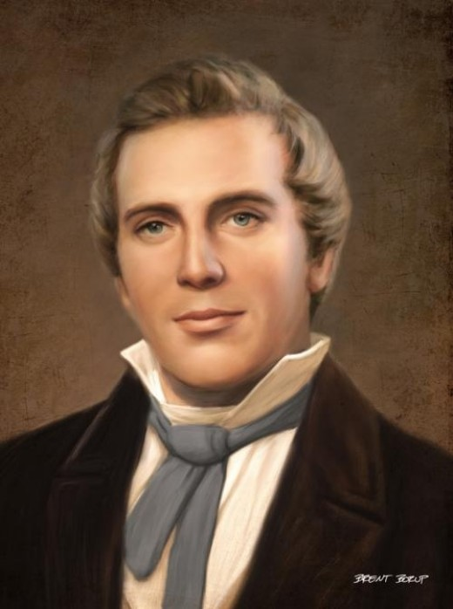
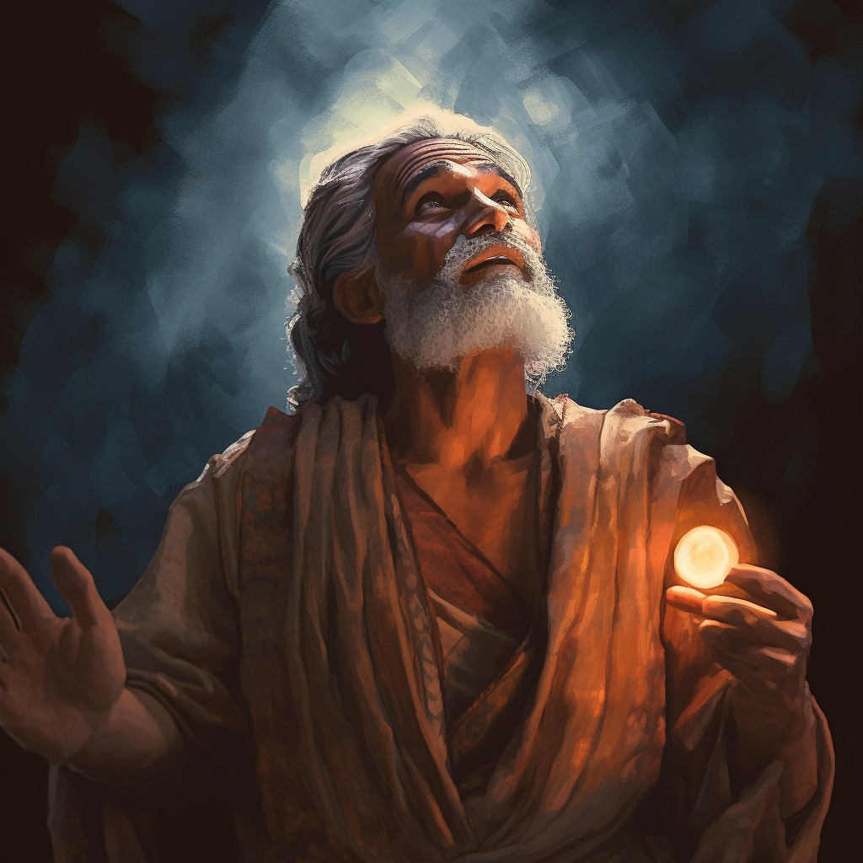
Mahonri Moriancumer
Although the brother of Jared is not identified by proper name in the Book of Mormon:
“While residing in Kirtland Elder Reynolds Cahoon had a son born to him. One day when President Joseph Smith was passing his door, he called the Prophet in and asked him to bless and name the baby. Joseph did so and gave the boy the name of Mahonri Moriancumer.
When he had finished the blessing he laid the child on the bed, and turning to Elder Cahoon he said, ‘The name I have given your son is the name of the brother of Jared; the Lord has just shown [or revealed] it to me.’ Elder William F. Cahoon … heard the Prophet make this statement to his father; and this was the first time the name of the brother of Jared was known in the Church in this dispensation.”
George Reynolds

Slide 14
Jared
He was the first leader associated with the civilization known as the “Jaradites”
He came forth with his brother and their families and others from the great tower at the time the Lord confounded the language of the people
Jared asked his brother to appeal to the Lord to spare their families and friends from the confounding of the languages
Jared asked his brother to petition the Lord in guidance concerning their journey and destination which they took provisions to a valley northward to wait for instructions
They were led by the Lord 344 days on the water until they reached the shores of the New World
Jared had four sons: Jacom, Gilgah, Maha, and Orihah
Jared, in his old age, and his brother’s warning, he advised against having a king
Who’s Who

Slide 15
Jacom, Gilgah, Maha, and Orihah
The Son’s of Jared
Jacom, Gilgah, and Maha declined the invitation of the people to become their king.
They heeded the prophetic warning of the brother of Jared against a monarchy “Surely this thing leadeth into captivity.” Ether 6:23
Orihah was chosen to be the Jaradite King
He was humble and righteous
Who’s Who

Slide 16
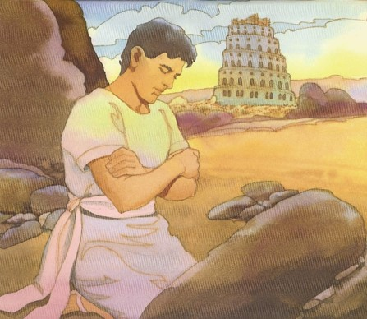
Cry Unto the Lord
A mighty prayer—in faith and sincerity
As we consistently cry unto God in faith, He will have compassion on us
Jared and his brother’s concern:
They would not be able to speak to each other and their friends in the same language
Where should they go?
When have you felt Heavenly Father’s compassion in answer to prayer?
When have family members or friends told you of Heavenly Father’s compassion in answer to prayer?
What do God’s answers to our prayers teach us about His feelings for us?
What can you do to make your prayers more meaningful?
Ether 1:34-37

Slide 17
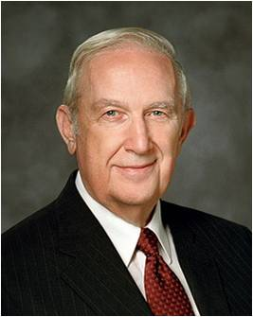
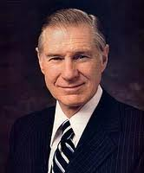
Improving Our Prayers
“A fervent, sincere prayer is a two-way communication which will do much to bring [the Savior’s] Spirit flowing like healing water to help with the trials, hardships, aches, and pains we all face.
What is the quality of our secret prayers when only He listens?
As we pray, we should think of Him as being close by, full of knowledge, understanding, love, and compassion, the essence of power, and as having great expectations of each of us.”
President James E. Faust
“Let your Father in Heaven know of your feelings, your needs, your concerns, your hopes and aspirations. Speak to Him with total confidence, knowing that He will hear and respond. Then patiently go forth in your life doing those things you know are correct, walking with confidence born of faith and righteousness, patiently waiting for the response that will come in the manner and at the time the Lord considers most appropriate.” Elder Richard G. Scott
Ether 1:34-43

Slide 18
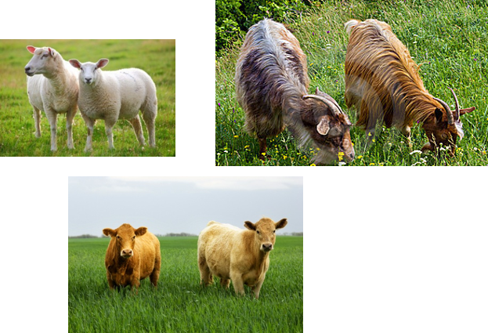
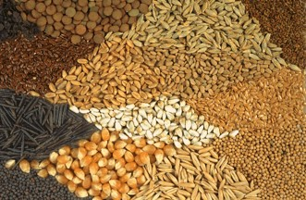
Preparations to Leave
Gathering flocks—male and female of every kind
Seeds of every kind
Family and friends
Ether 1:41

Slide 19
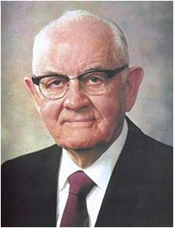
“This long time ye have cried unto me”
“Do you get answers to your prayers? If not, perhaps you did not pay the price. Do you offer a few trite words and worn-out phrases, or do you talk intimately to the Lord? Do you pray occasionally when you should be praying regularly, often, constantly? Do you offer pennies to pay heavy debts when you should give dollars to erase that obligation?
“When you pray, do you just speak, or do you also listen? Your Savior said, ‘Behold, I stand at the door, and knock: if any man hear my voice, and open the door, I will come in to him, and will sup with him, and he with me.’ ”
President Spencer W. Kimball
If we pray regularly to God with faith, we can receive blessings beyond those we request.
Ether 1:43; Rev. 3:20

Slide 20
Sources:
Jeffrey R. Holland, Christ and the New Covenant: The Messianic Message of the Book of Mormon [1997], 17.
Who’s Who in the Book of Mormon by Ed J. Pinegar and Richard J. Allen pgs. 33-31, 49-50, 60, 79, 80, 116, 151
Name of Mahonri Moriancumer (George Reynolds, “The Jaredites,” Juvenile Instructor, 1 May 1892, 282). Book of Mormon: Gospel Doctrine Teacher manual LESSON 45
President James E. Faust (“A Personal Relationship with the Savior,” Ensign, Nov. 1976, 58).
Elder Richard G. Scott (“The Power of a Strong Testimony,” Ensign, Nov. 2001, 88).
President Spencer W. Kimball (“Prayer,” New Era, Mar. 1978, 17).
Etymology
The phrase "Tower of Babel" does not appear in the Bible; it is always, "the city and its tower" or just "the city. “ Babel" means the "Gate of God", from Akkadian bab-ilu, "Gate of God" (from bab "gate" + ilu "god")." According to the Bible, the city received the name "Babel" from the Hebrew word balal, meaning to jumble. Wikipedia- Tower of Babel
Presentation by ©http://fashionsbylynda.com/blog/

Slide 21
The Wandering Nephites
200 B.C. to 121 B.C.
Destroyed Jaredite Nation
Land of Zarahemla
Mulek 589 BC
Mosiah l
King Benjamin
Mosiah ll
Jaredite plates discovered and returned to Limhi…5
Alma & his people escape back to Zarahemla…8
2
Ammon and Limhi escape to Zarahemla…7
Mosiah I…1
Zeniff…3
Ammon…6
Jerusalem
Lehi & Nephi 600 BC
Mosiah 1 and righteous Nephites
Zeniff
King Noah
King Limhi
Land of Lehi-Nephi
City of Helam
About 200 BC
Alma escapes…4
Waters of Mormon
1. Mosiah I leads the few remaining righteous Nephites from the original land settled by Lehi to the Land of Zarahemla (Omni 1:3)
2. (About 200 BC ill fated expedition to return to Lehi-Nephi. Contention and infighting. All slain in the wilderness except 50 who return to Zarahemla (Omni 1:28) (Mosiah 9:1-3)
3. Zeniff leads a second expedition (abt. 200 BC) to Lehi-Nephi and settles there with the permission of King Laman (Mosiah 9: 3-10)
4. (about 148 BC) Alma flees King Noah to the Waters of Mormon (Mosiah 17 and 18)
5. (about 121 BC) King Limhi sends expedition of 43 men to find Zarahemla in hopes of escaping Lamanite bondage. They find remnants of Jaredites and 24 gold plates and return to Land of Lehi-Nephi (Mosiah 6: 7-8)
6. (About 121 BC) Ammon’s expedition (16 “Strong Men”) to find Zeniff’s colony (Mosiah 7)
7. (About 121-120 BC) King Limhi’s people get the Lamanites drunk and escape back to Zarahemla (Mosiah 22)
8. (Between 145 and 121 BC) Alma and his people escape Lamanites and return to Zarahemla (Mosiah 24)

Slide 22
Jared
Orihah
Kib
Shule
Omer
Emer
Coriantum
Com
Heth
Shez
Riplakish
Morianton (descendant of)
Kim
Levi
Corom
Kish
Lib
Hearthom
Heth
Aaron (descendant of)
Amnigaddah
Coriantum
Com
Shiblon
Ether’s Genealogy
Ether 1:6-32
Seth
Ahah
Ethem
Moron
Coriantor
Ether

