Slide 1
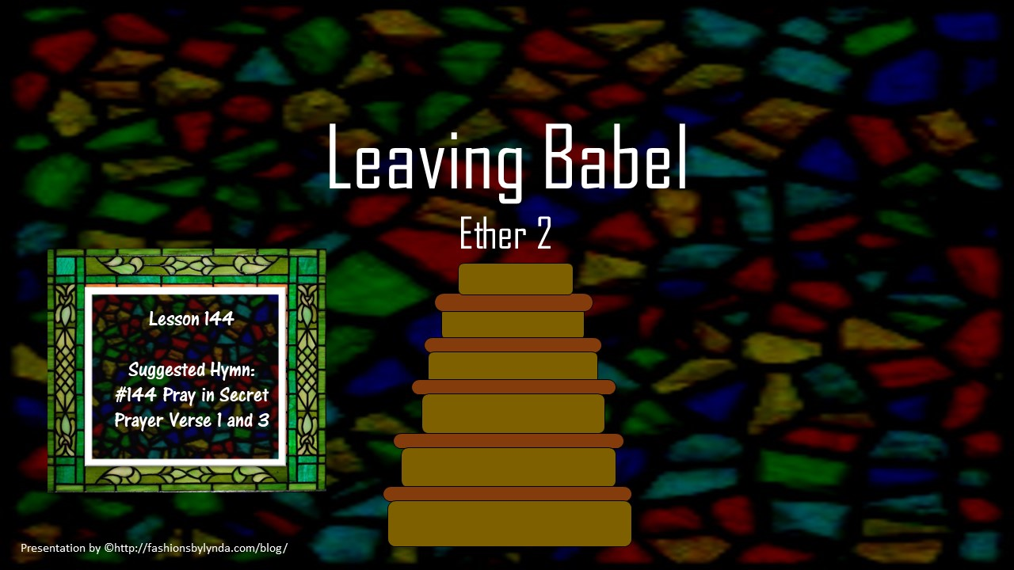

Slide 2
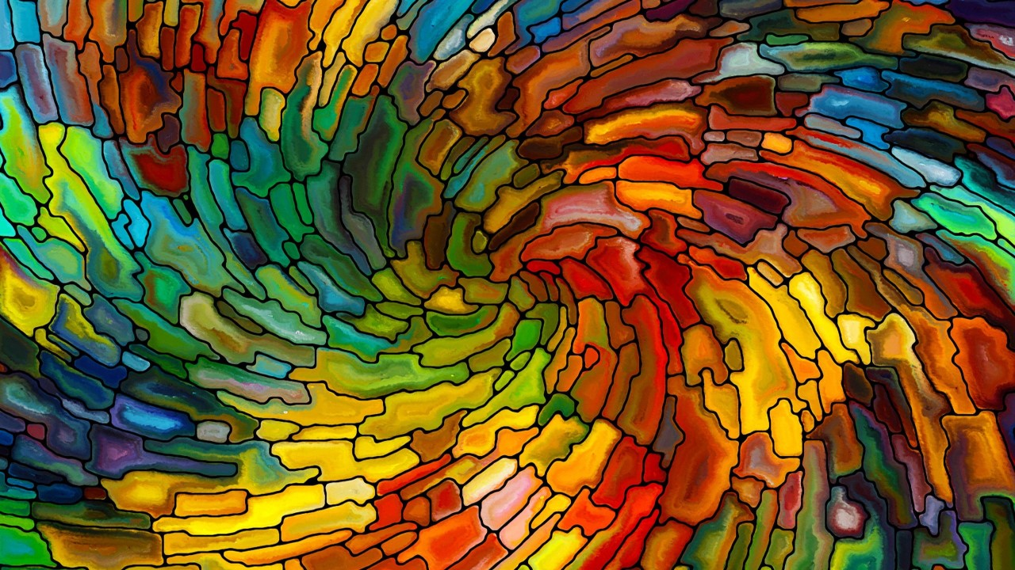
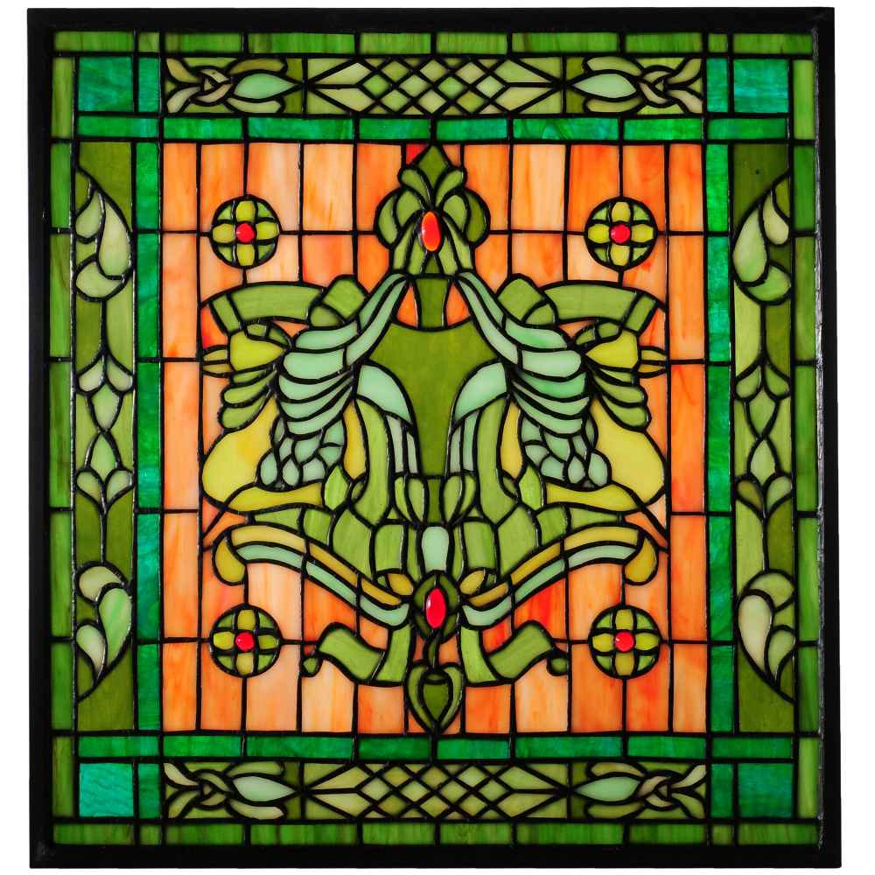
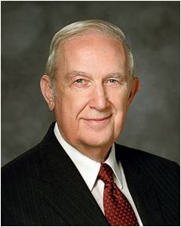
“It will come a piece at a time, in packets, so that you will grow in capacity.
As each piece is followed in faith, you will be led to other portions until you have the whole answer.
That pattern requires you to exercise faith in our Father’s capacity to respond. While sometimes it’s very hard, it results in significant personal growth.” Richard G. Scott
As we act in faith on direction the Lord has given us, we can receive further guidance from Him.
Ether 2:2-3

Slide 3

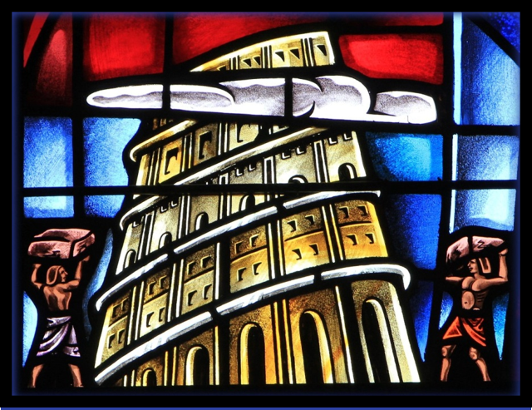
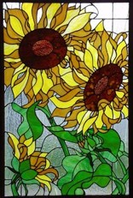
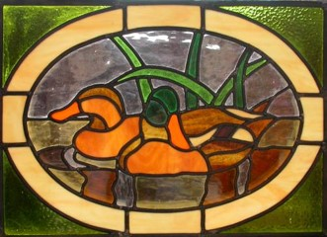
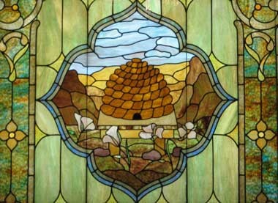
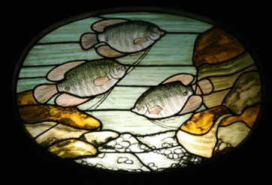
A Time To Leave
And they did also lay snares and catch fowls of the air; and they did also prepare a vessel, in which they did carry with them the fish of the waters.
And they did also carry with them deseret, which, by interpretation, is a honey bee; and thus they did carry with them swarms of bees, and all manner of that which was upon the face of the land, seeds of every kind.
Ether 2:2-3

Slide 4
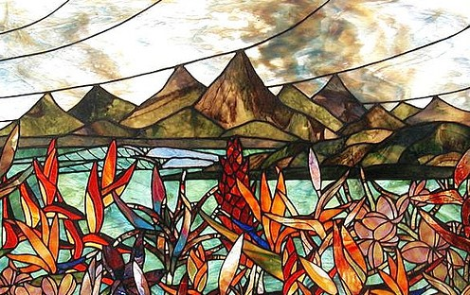
Valley of Nimrod
The brother of Jared and his family and friends were directed to go to the Valley of Nimrod.
“…The Lord came down and talked with the brother of Jared; and he was in a cloud, and the brother of Jared saw him not.”
Ether 2:4-5

Slide 5
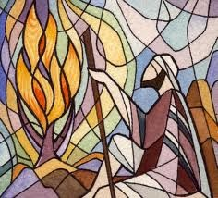
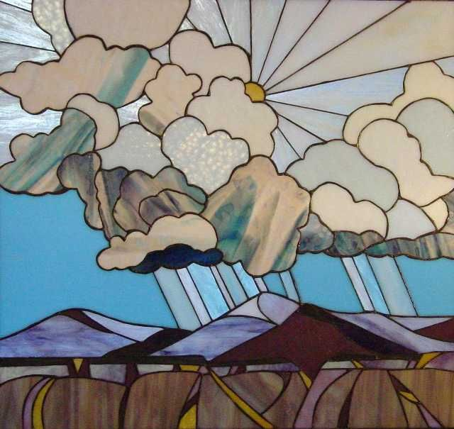
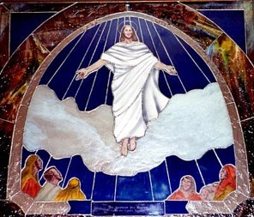
Cloud of Glory
The cloud will surround Him when He again returns to earth and appears to man
Moses:
The Lord led the children of Israel in the wilderness in a cloud by day and in a pillar of fire at night
Exodus 13:21
Jaredites:
The Lord led them by a cloud to the wilderness
“For behold, verily, verily, I say unto you, the time is soon at hand that I shall come in a cloud with power and great glory.”
D&C 34:7
Ether 2:4-5

Slide 6
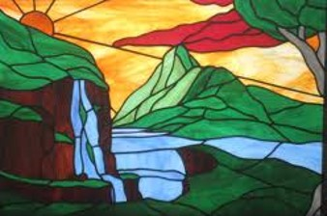
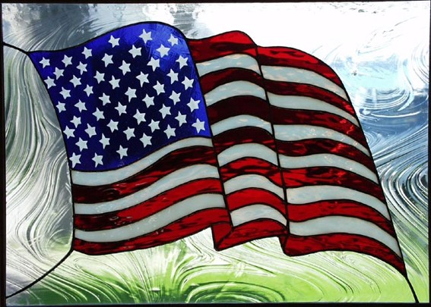
A Choice Land
“This consecrated land has been placed under the everlasting decree of God. That decree is recorded in the sacred Book of Mormon, a new witness for Christ, in these words:
“‘For behold, this is a land which is choice above all other lands; wherefore he that doth possess it shall serve God or shall be swept off; for it is the everlasting decree of God. …
“Righteousness exalteth a nation (Proverbs 14:34). This is the key to understanding our heritage and this is the key to maintaining it. The foundations of America are spiritual…”
Ezra Taft Benson
Ether 2:7-12

Slide 7
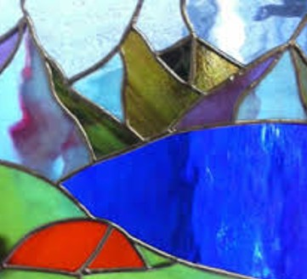
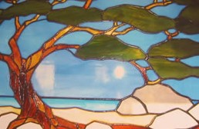
Moriancumer
They pitched their tents by the sea
They stayed there for 4 years
Ether 2:7-12

Slide 8
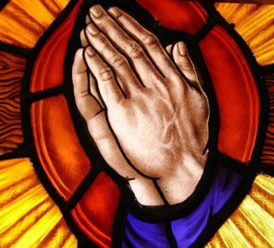
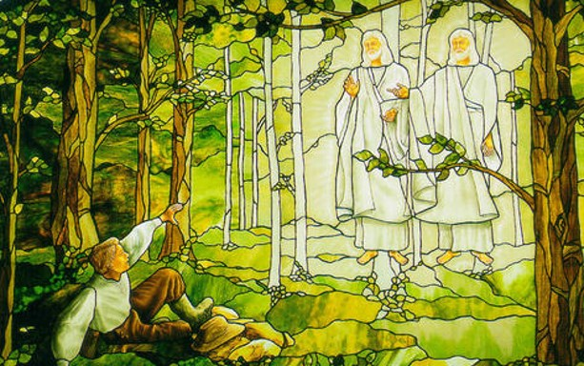
Chastening
The brother of Jared is chastened by the Lord:
They may have waited too long (4 years) to proceed to their next destination, which was across the ocean
Or
The brother of Jared’s prayers became trite
“We would not ask a Church leader for advice, then disregard it. We must never ask the Lord for blessings, then ignore the answer.”
Spencer W. Kimball
Ether 2:7-12

Slide 9
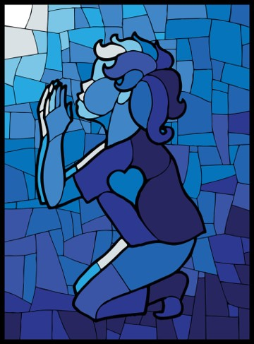
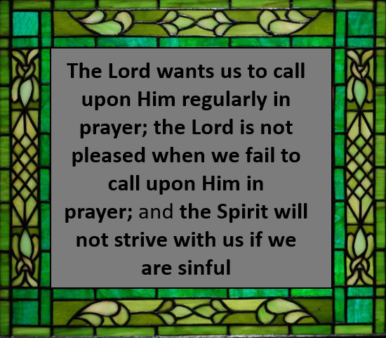
Fervent Prayer
“Daily fervent prayers seeking forgiveness and special help and direction are essential to our lives and the nourishment of our testimonies. When we become hurried, repetitive, casual, or forgetful in our prayers, we tend to lose the closeness of the Spirit, which is so essential in the continual direction we need to successfully manage the challenges of our everyday lives” Elder Donald L. Staheli
Ether 2:14-15

Slide 10
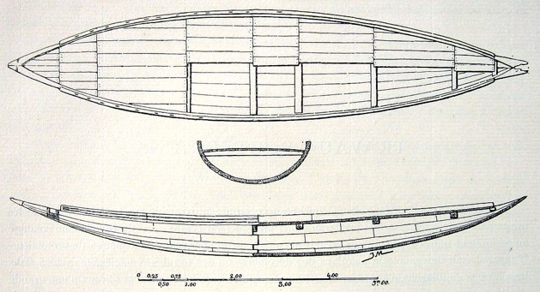
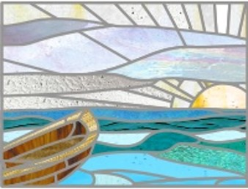
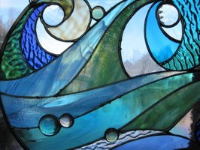
What Did the Barges Look Like?

Slide 11
Preparing to Leave
Problem with the barges
No air
No steering
No light
The Solution
Make holes that can be opened and closed in the top and bottom of the barges
Wind will blow the barges toward the promised land
Prepare special stones and ask the Lord to touch them so they will shine
What the Lord Did
Gave Jared instructions
Caused the wind to blow
Advised the brother of Jared about things that would not work and instructed him to find a solution that would work.
Touched the stones after the brother of Jared prepared them
What the brother of Jared did
Made the holes
Trusted in the Lord
Prepared the stones and asked the Lord to touch them so they would shine in the dark
Ether 2:16-25

Slide 12


Based on the solution to the concern about air, how does the Lord sometimes help us solve our problems or answer our questions?
Sometimes the Lord tells us how to solve a problem and expects us to follow His instructions
Based on the solution to the concern about steering, how does the Lord sometimes help us solve our problems or answer our questions?
Sometimes the Lord takes care of the solution Himself
Based on the solution to the concern about light, how does the Lord sometimes help us solve our problems or answer our questions?
Sometimes the Lord requires us to come up with a solution and ask for His approval and help in carrying it out
Ether 2:16-25

Slide 13

As we call upon the Lord and do our part to solve our problems, we can receive the Lord’s help.

Slide 14
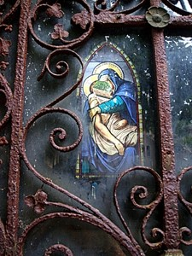
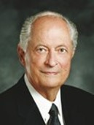
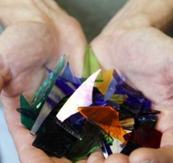
“The fate of [the Jaredites and Nephites], as recorded in scripture, is a testimony to all the world: if we don’t have the word of God or don’t cling to and heed the word of God, we will wander off in strange paths and be lost as individuals, as families, and as nations”
Elder Robert D. Hales

Slide 15
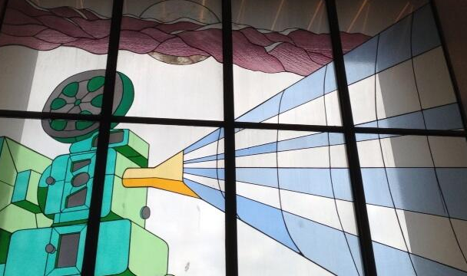
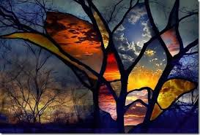
Sources:
Video: The Faith and Diligence of the Brother of Jared (2:26)
Richard G. Scott, “Using the Supernal Gift of Prayer,” Ensign or Liahona, May 2007, 9
Ezra Taft Benson (“A Witness and a Warning,” Ensign, Nov. 1979, 31, 33).
The Teachings of Ezra Taft Benson pp. 569, 580
Spencer W. Kimball Prayer pg. 19
Elder Donald L. Staheli (“Securing Our Testimonies,” Ensign or Liahona, Nov. 2004, 39).
Elder Robert D. Hales(“Holy Scriptures: The Power of God unto Our Salvation,” Ensign or Liahona, Nov. 2006, 26).
How to Make Stained Glass
https://www.youtube.com/watch?v=0NIC_qvadEw
Presentation by ©http://fashionsbylynda.com/blog/

Slide 16
Directions: You have a 5 minute time limit to complete the parts of this test. Carefully read all of the parts of the test before doing anything. In order to ensure the accuracy of this exam, you should not use more than the allotted time of 5 minutes. You may start the timer and begin whenever you choose.
1. Write today's date--month-day-year in the top right hand corner of your test paper.
2. Write the answer to the following multiplication problem directly underneath the date on your test paper--6 X 5 = ?
3. Write the name of the month that begins with the letter "D" in the top left hand corner of your test paper.
4. Add 15 to the answer you got in part #2, and write this new total directly underneath your answer for part #3.
5. In the lower left hand corner of your test paper, write the names of your favorite singer and your favorite group.
6. Just above your answer to part #5, write "This test is very easy."
7. In the lower right hand corner of your test paper, draw a rectangle and inside the rectangle draw a five pointed star. The size of these drawings is not important.
8. Directly above your answer to part #7, draw a row of three small circles. Once again, size is not important.
9. Write the name of the first president of the United States on the back of your test paper anywhere you choose. If you don't know who this is, write your own name instead.
10.Write the name of any country that begins with the letter "I" directly underneath you answer to part #2.
11. Take the number of dwarfs in the Snow White story and add it to the number of bears in the Goldilocks story. Divide by 2. Write this total in the approximate center of your test paper.
12. Think of a number between 1 and 50. Double that number. Add 20. Add 6. Subtract 17. Subtract 9. Divide by 2. Write this number on your test paper directly underneath your answer to part #11.
13. Now that you have carefully read all of the parts so far, and you have not carried out any of the actual work, read the next 2 parts just to see what they say and then go back and only complete part #3.
14. The name of the first president of the United States is George Washington. He was president from 1789 until 1797. Add the 2 dates together to see if the total is less than 5000.
15. You should not be reading the end of the exam before the beginning of the exam, but now that you are here, you have just wasted some of the time you may need to complete the test.
http://www.justriddlesandmore.com/direct.html

Slide 17
Problem with the barges | The Solution | What the Lord Did | What the brother of Jared did
No air | Make holes that can be opened and closed in the top and bottom of the barges | Gave Jared instructions | Made the holes
No Steering | Wind will blow the barges toward the promised land | Caused the wind to blow | Trusted in the Lord
No Light | Prepare special stones and ask the Lord to touch them so they will shine | Advised the brother of Jared about things that would not work and instructed him to find a solution that would work. Touched the stones after the brother of Jared prepared them | Prepared the stones and asked the Lord to touch them so they would shine in the dark

