Slide 2
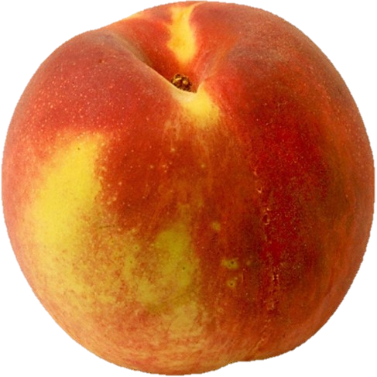
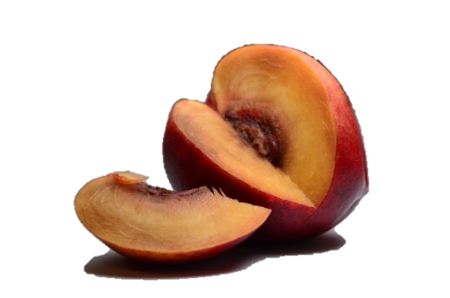
Righteous In Our Hearts
In what ways might a person be like a piece of fruit that appears good on the outside but is rotten on the inside?

Slide 3
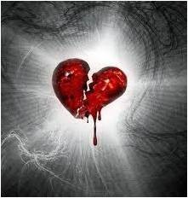
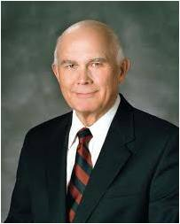
Real Intent—Inner Spirituality
The fruit worthy of baptism is seen in action
The broken heart and contrite spirit are reflected in one’s attitudes and desires
“To have a broken heart and contrite spirit is to be broken down with deep sorrow for sin, to be humbly and thoroughly penitent, to have attained sincere and purposeful repentance.”
Bruce R. McConkie
“We must not only do what is right. We must act for the right reasons. The modern term is good motive. The scriptures often signify this appropriate mental attitude with the words full purpose of heart or real intent.
“The scriptures make clear that God understands our motives and will judge our actions accordingly”
Dallin H. Oaks

Slide 4
Motives For Righteousness
“…if a man being evil giveth a gift, he doeth it grudgingly; ”
”if he shall pray and not with real intent of heart”
“…it is right to pay one’s tithing or to engage in prayer, but if one does these things to “be seen of men,” they are not counted as righteous acts.”
Student Manual
Is it possible to do the right thing for the wrong reason?
To be blessed for our good works, we must act with real intent
Moroni 7:4-11

Slide 5
Because I Had To
“Have you ever found yourself doing something
you thought was right, but doing it because
you ‘had’ to?
Did you ever keep a commandment of God with
an attitude of resentment?
Do you think such feelings will be ignored by a Father in Heaven who gave us the willpower we call agency?
We are accountable for our feelings and desires as well as our acts.
Acts that seem to be good bring blessings only when they are done with real and righteous intent.
On the positive side, we will be blessed for the righteous desires of our hearts even though some outside circumstance has made it impossible for us to carry those desires into action.”
Dallin H. Oaks
Moroni 7:4-11

Slide 6
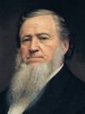
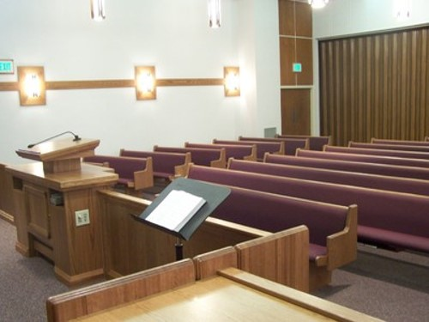
I Don’t Feel Like It
“It matters not whether you or I feel like praying, when the time comes to pray, pray. If we do not feel like it, we should pray till we do”
Brigham Young
Some people might not attend church with real intent. However, if they continue attending church and do all they can to participate and worship, they will have experiences that will help them find joy in attending church. Their reasons for attending will change. They will attend because they want to be there—they want to worship God, renew their covenants, and serve others.
Moroni 7:9

Slide 7
Evil Good, Good Evil
¶Woe unto them that call evil good, and good evil; that put darkness for light, and light for darkness; that put bitter for sweet, and sweet for bitter! (Isaiah 5:20)
“Wo unto them that call evil good, and good evil, that put darkness for light, and light for darkness, that put bitter for sweet, and sweet for bitter!”
2 Nephi 15:20
Moroni 7:12-14

Slide 8
How to Judge Good From Evil
All things cometh from God are good
How can we know that something comes from God?
All things cometh from Satan are bad
How can we know that something comes from the devil?
That which is of God invites us to do good, believe in Jesus Christ, and love and serve God
Anything that persuades us to do evil, deny Jesus Christ, or fight against God comes from the devil
Moroni 7:12-14

Slide 9
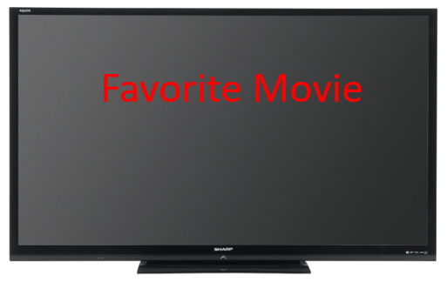
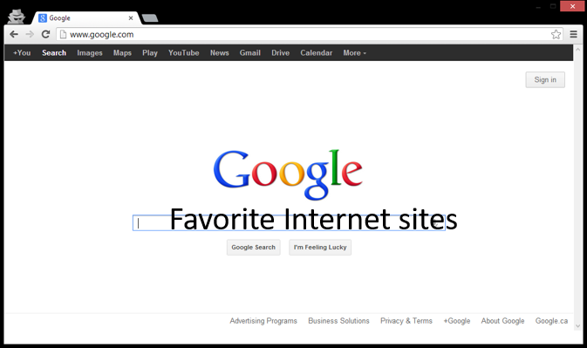
Ways God entices us to do good
Ways Satan entices us to do evil
Moroni 7:12-14

Slide 10
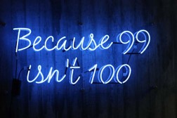
The Appearance of Good
A misjudgment
If ninety-nine truths are told to perpetrate one lie, the one hundred statement taken together constitute a falsehood.
The scriptures never credit Lucifer with good intent in anything he does.
The devil persuades no one to do good…he may seek to make it appear that he leads one to good so that he can entrap a person in an evil deed.
However….
Can the devil make us do evil?
Only we allow ourselves to be persuaded by Satan
Moroni 7:12-14 Student Manual

Slide 11
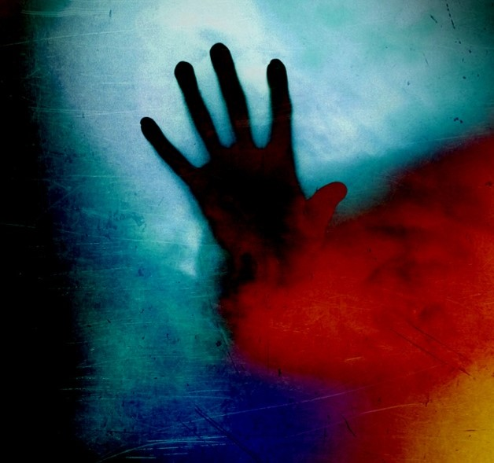
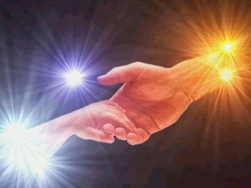
“Satan, or Lucifer, or the father of lies—call him what you will—is real, the very personification of evil.
His motives are in every case malicious. …
He is eternally opposed to the love of God, the Atonement of Jesus Christ, and the work of peace and salvation.
He will fight against these whenever and wherever he can.
He knows he will be defeated and cast out in the end, but he is determined to take down with him as many others as he possibly can.”
Elder Jeffrey R. Holland

Slide 12
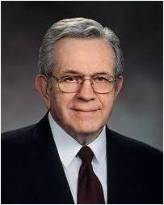
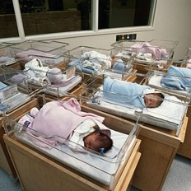
Spirit of Light Given to All
“Every man or woman born into this world is born with what the scriptures call the Light of Christ or the Spirit of Jesus Christ…
“And the Spirit giveth light to every man that cometh into the world; and the Spirit enlighteneth every man through the world, that hearkeneth to the voice of the Spirit.”
D&C 84:46
…This same light is planted in the spirit of man by a benevolent God and serves as the source of reason and conscience and discernment. It is a moral monitoring device.”
Moroni 7:14-19

Slide 13
“The Holy Ghost and the Light of Christ are different from each other. …
“Regardless of whether this inner light, this knowledge of right and wrong, is called the Light of Christ, moral sense, or conscience, it can direct us to moderate our actions—unless, that is, we subdue it or silence it. …
“Every man, woman, and child of every nation, creed, or color—everyone, no matter where they live or what they believe or what they do—has within them the imperishable Light of Christ.”
President Boyd K. Packer
As we search diligently in the Light of Christ, we can discern between good and evil. If we lay hold upon every good thing, we will be children of Christ.

Slide 14
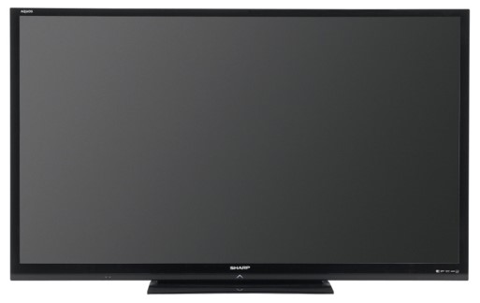
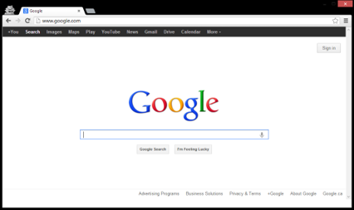
How well do these things invite you to do good, to believe in Jesus Christ, and to love God and serve Him?
Do any of these things try to persuade you to do evil, to doubt Jesus Christ, or to stop serving God?
Do you feel that you should eliminate any of these things from your life? If so, how will you do it?
Sometimes it may be difficult to do what we know is right when it requires giving up something we enjoy

Slide 15
Sources:
Bruce R. McConkie Mormon Doctrine pg 161
Dallin H. Oaks Pure in Heart [1988], 15).
(BYU 1985-86 Devotional & Fireside Speeches pp. 29, 31)
Student Manual Book of Mormon Religion 121-122 pg 516
(Teachings of Presidents of the Church: Brigham Young [1997], 45)
Joseph Fielding McConkie and Robert L. Millet Doctrinal Commentary on the Book of Mormon Vol. 4 pg. 335
President Boyd K. Packer (“The Light of Christ,” Ensign, Apr. 2005, 8–10).
Elder Jeffrey R. Holland (“We Are All Enlisted,” Ensign or Liahona, Nov. 2011, 44).
Presentation by ©http://fashionsbylynda.com/blog/

Slide 16
"We do not find this doctrine so clearly defined in the New Testament as in the Doctrine and Covenants and the Book of Mormon. But we discover this: The Lord has not left men (when they are born into this world) helpless, groping to find the light and truth, but every man that is born into the world is born with the right to receive the guidance, the instruction, the counsel of the Spirit of Christ, or Light of Truth, sometimes called the Spirit of the Lord in our writings.
"If a man who has never heard the gospel will hearken to the teachings and manifestations of the Spirit of Christ, or the Light of Truth, which come to him, often spoken of as conscience-every man has a conscience and knows more or less when he does wrong, and the Spirit guides him if he will hearken to its whisperings-it will lead him eventually to the fulness of the gospel. That is, he is guided by the Light, and when the gospel comes he will be ready to receive it. This is, he is guided by the Light, and when the gospel comes he will be ready to receive it. This is what the Lord tells us in section 84 of the Doctrine and Covenants.
"This Spirit of Truth, or Light of Christ, also has other functions. We read this in the revelation: 'This ... glory is that of the church of the Firstborn, even of God, the holiest of all, through Jesus Christ, his Son-He that ascended up on high, as also he descended below all things, in that he comprehended all things, that he might be in all and through all things, the light of truth; Which truth shineth. This is the light of Christ.' " (Joseph Fielding Smith, Doctrines of Salvation, 1:51.)

