Slide 2
Good Blessings From Heavenly Father
Who is the source of all good things?

Slide 3
“All That He Has”
He wants us to “lay hold upon every good thing”, and He wants to give us all that He has.
How is it possible that ye can lay hold upon every good thing?
“And he that receiveth my Father receiveth my Father’s kingdom; therefore all that my Father hath shall be given unto him.”
D&C 84:38
Moroni 7:19, 20

Slide 4
All good things come because of Jesus Christ
The doctrine taught in Moroni:
As descendants of Adam and Eve, we are “fallen” and unable to receive any blessings on our own.
Without Jesus Christ and His Atonement, “there could no good thing come unto [us].” Everything good that we have ever received from our Heavenly Father has come through the Savior and His Atonement.
Aaron to Lamoni’s Father:
“And since man had fallen he could not merit anything of himself; but the sufferings and death of Christ atone for their sins, through faith and repentance, and so forth; and that he breaketh the bands of death, that the grave shall have no victory, and that the sting of death should be swallowed up in the hopes of glory; and Aaron did expound all these things unto the king.” Alma 22:14
The Brother of Jared:
“O Lord, thou hast said that we must be encompassed about by the floods. Now behold, O Lord, and do not be angry with thy servant because of his weakness before thee; for we know that thou art holy and dwellest in the heavens, and that we are unworthy before thee; because of the fall our natures have become evil continually; nevertheless, O Lord, thou hast given us a commandment that we must call upon thee, that from thee we may receive according to our desires.” Ether 3:2
Moroni 7:24

Slide 5
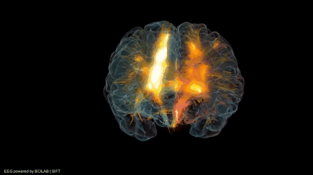
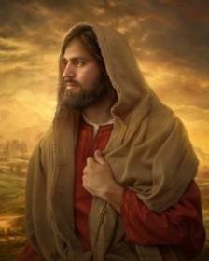
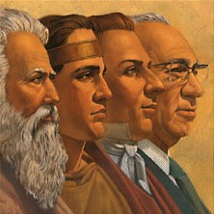
What Makes Faith Possible?
The knowledge of God
The ministering of angels which is one way in which the knowledge and authority of God comes
The reality of Christ
The Prophets of God
Moroni 7:26

Slide 6
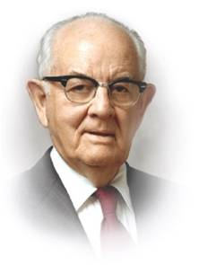
Miracles
Because Jesus has ascended to heaven…Have miracles ceased?
For it is by faith that miracles are wrought;…wherefore if these things have ceased, then has faith ceased also?”
“Some churches teach that the day of miracles ended with the ministry of Jesus Christ and his apostles in Jerusalem. Not so with The Church of Jesus Christ of Latter-day Saints. For us the day of miracles has not passed. Many still have faith and have miracles follow in their lives.” Student Manual
“The Lord will not force himself upon people; and if they do not believe, they will receive no visitation. If they are content to depend upon their own limited calculations and interpretations, then, of course, the Lord will leave them to their chosen fate.”
Spencer W. Kimball
The greatest of all miracles is the Atonement.
Moroni 7:27-39

Slide 7
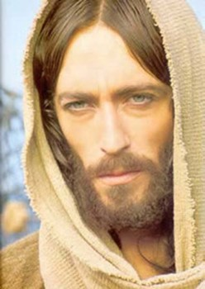
"In faith we plant the seed, and soon we see the miracle of the blossoming. Men have often misunderstood and have reversed the process.
They would have the harvest before the planting, the reward before the service,
the miracle before the faith.
Even the most demanding labor unions would hardly ask the wages before the labor.
But many of us would have the vigor without the observance of the health laws,
Prosperity through the opened windows of heaven without the payment of our tithes.
We would have the close communion with our Father without fasting and praying;
we would have rain in due season and peace in the land without observing the Sabbath and keeping the other commandments of the Lord.
We would pluck the rose before planting the roots;
we would harvest the grain before sowing and cultivating."
Elder Spencer W. Kimball

Slide 8
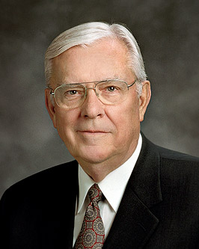
Hope
“faith is the substance of things hoped for, the evidence of things not seen” Hebrews 11:1
“And now abideth faith, hope, charity, these three; but the greatest of these is charity.”
1 Corinthians 13:13
FAITH
CHARITY
HOPE
“Three divine principles form a foundation upon which we can build the structure of our lives. … Together they give us a base of support like the legs of a three-legged stool”
Elder M. Russell Ballard
Moroni 7:40-48

Slide 9
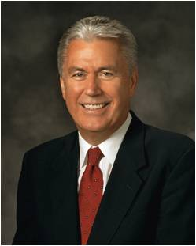
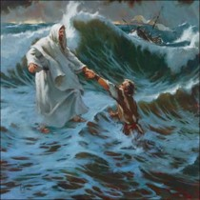
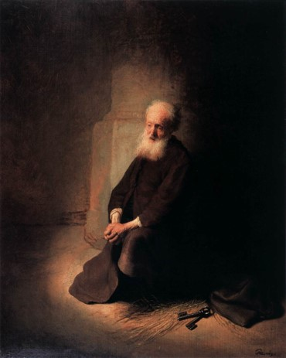
“Hope is a gift of the Spirit. …
“Hope is not knowledge, but rather the abiding trust that the Lord will fulfill His promise to us.
It is confidence that if we live according to God’s laws and the words of His prophets now, we will receive desired blessings in the future.
It is believing and expecting that our prayers will be answered. It is manifest in confidence, optimism, enthusiasm, and patient perseverance.”
President Dieter F. Uchtdorf

Slide 10
Charity—The Pure Love of Christ
“there must be faith; and if there must be faith there must also be hope; and if there must be hope there must also be charity.” Moroni 10:20
“and except ye have charity ye can in nowise be saved in the kingdom of God…(faith and hope included)” Moroni 10:21

Slide 11
Doctrinal Mastery
“And charity suffereth long, and is kind, and envieth not, and is not puffed up, seeketh not her own, is not easily provoked, thinketh no evil, and rejoiceth not in iniquity but rejoiceth in the truth, beareth all things, believeth all things, hopeth all things, endureth all things.”
Moroni 7:45

Slide 12
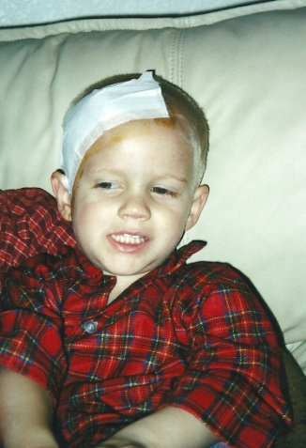
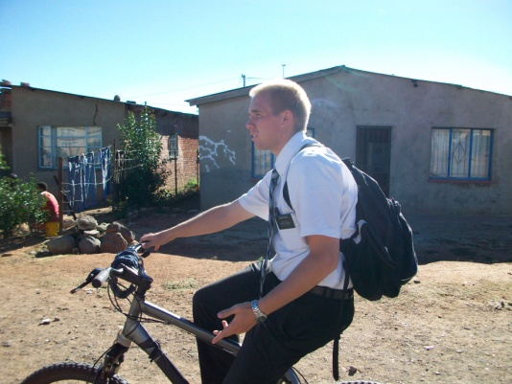
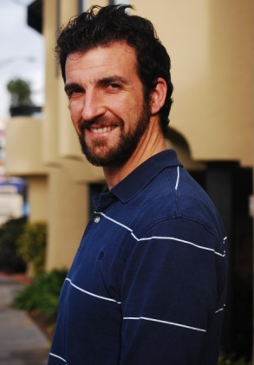
Moroni 7:45
“suffereth long” means that someone endures trials patiently.
“Envieth not” means that a person is not jealous of others.
“Not puffed up” means that someone is humble.
“Seeketh not her own” describes the quality of putting God and others before self.
“Not easily provoked” means not angered easily.
“Believeth all things” describes someone who accepts all truth

Slide 13
Doctrinal Mastery
“But charity is the pure love of Christ, and it endureth forever; and whoso is found possessed of it at the last day, it shall be well with him.
Wherefore, my beloved brethren, pray unto the Father with all the energy of heart, that ye may be filled with this love, which he hath bestowed upon all who are true followers of his Son, Jesus Christ; that ye may become the sons of God; that when he shall appear we shall be like him, for we shall see him as he is; that we may have this hope; that we may be purified even as he is pure. Amen.”
Moroni 7:47-48

Slide 14
“[Charity] is shown perfectly and purely in Christ’s unfailing, ultimate, and atoning love for us. … It is Christ’s love for us that ‘beareth all things, believeth all things, hopeth all things, endureth all things.’ It is as demonstrated in Christ that ‘charity never faileth.’ It is that charity—his pure love for us—without which we would be nothing, hopeless, of all men and women most miserable.
Truly, those found possessed of the blessings of his love at the last day—the Atonement, the Resurrection, eternal life, eternal promise—surely it shall be well with them.”
Jeffrey R. Holland

Slide 15
If you were filled with Charity…
What would you do?
1. People make fun of you or someone else at school.
2. You have a brother or sister who frequently annoys you.
3. Someone you know has committed a serious sin.
4. You do not like a new quorum or class adviser as much as you liked a previous adviser.

Slide 16
If we pray unto the Father with all the energy of heart and live as true followers of Jesus Christ, we can be filled with charity.

Slide 17
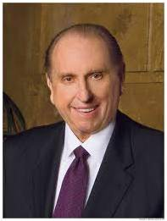
“There is a serious need for the charity that gives attention to those who are unnoticed, hope to those who are discouraged, aid to those who are afflicted. True charity is love in action. The need for charity is everywhere. …
“Charity is having patience with someone who has let us down. It is resisting the impulse to become offended easily. It is accepting weaknesses and shortcomings. It is accepting people as they truly are. It is looking beyond physical appearances to attributes that will not dim through time. It is resisting the impulse to categorize others. …
“… Life is perfect for none of us. Rather than being judgmental and critical of each other, may we have the pure love of Christ for our fellow travelers in this journey through life. …
“… May [charity] guide you in everything you do. May it permeate your very souls and find expression in all your thoughts and actions”
President Thomas S. Monson

Slide 18
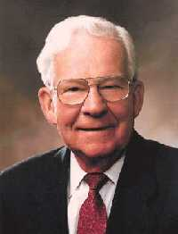
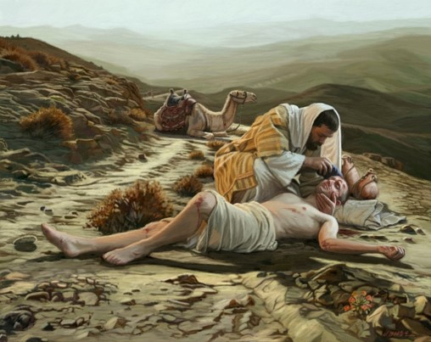
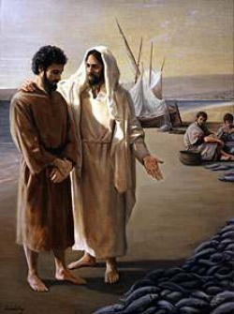
“Real charity is not something you give away; it is something that you acquire and make a part of yourself. …
“Perhaps the greatest charity comes when we are kind to each other, when we don’t judge or categorize someone else, when we simply give each other the benefit of the doubt or remain quiet.
Charity is accepting someone’s differences, weaknesses, and shortcomings; having patience with someone who has let us down; or resisting the impulse to become offended when someone doesn’t handle something the way we might have hoped.
Charity is refusing to take advantage of another’s weakness and being willing to forgive someone who has hurt us. Charity is expecting the best of each other”
Elder Marvin J. Ashton

Slide 19
Sources:
Video: Pure Love of Christ (2:07)
Spencer W. Kimball Conf. Report Oc. 1966
Elder Spencer W. Kimball (Faith Precedes the Miracle, p. 4.)
Student Manual Book of Mormon Religion 121-122 pg. 518
Elder M. Russell Ballard (“The Joy of Hope Fulfilled,” Ensign, Nov. 1992, 33).
President Dieter F. Uchtdorf (“The Infinite Power of Hope,” Ensign or Liahona, Nov. 2008, 21–22).
Jeffrey R. Holland, Christ and the New Covenant: The Messianic Message of the Book of Mormon [1997], 336).
President Thomas S. Monson (“Charity Never Faileth,” Ensign or Liahona, Nov. 2010, 124–25).
Elder Marvin J. Ashton (“The Tongue Can Be a Sharp Sword,” Ensign, May 1992, 19).
Presentation by ©http://fashionsbylynda.com/blog/

Slide 20
On Hope:
"From this we learn that faith is the assurance which men have of the existence of things which they have not seen, and the principle of action in
all intelligent beings.. .
" ... Faith ... is the moving cause of all action
in [intelligent beings]. . . . .
"And as faith is the moving cause of all action in temporal concerns, so it is in spiritual. ...
" ... But faith is not only the principle of action, but of power also, in all intelligent beings, whether in heaven or on earth ....
"Faith, then, is the first great governing principle which has power, dominion, and authority over all things; by It they exist, by It . they are upheld, by it they are changed, or by It they remain, agreeable to the will of. God. Without it there is no power, and Without power there could be no creation nor existence! ...
"How would you define faith in its most unlimited sense? It is the first great governing principle which has power, dominion, and authority over all things." Joseph Smith (Lectures on Faith, pp. 7-12.)
Elder Dallin H. Oaks of the Quorum of the Twelve Apostles described the ministry of angels:
“‘The word “angel” is used in the scriptures for any heavenly being bearing God’s message’ (George Q. Cannon, Gospel Truth, sel. Jerreld L. Newquist [1987], 54). The scriptures recite numerous instances where an angel appeared personally. Angelic appearances to Zacharias and Mary (see Luke 1) and to King Benjamin and Nephi, the son of Helaman (see Mosiah 3:2; 3 Ne. 7:17–18) are only a few examples. …
“… The ministering of angels can also be unseen. Angelic messages can be delivered by a voice or merely by thoughts or feelings communicated to the mind. President John Taylor described ‘the action of the angels, or messengers of God, upon our minds, so that the heart can conceive … revelations from the eternal world’ (Gospel Kingdom, sel. G. Homer Durham [1987], 31).
“Nephi described three manifestations of the ministering of angels when he reminded his rebellious brothers that (1) they had ‘seen an angel,’ (2) they had ‘heard his voice from time to time,’ and (3) also that an angel had ‘spoken unto [them] in a still small voice’ though they were ‘past feeling’ and ‘could not feel his words’ (1 Ne. 17:45). The scriptures contain many other statements that angels are sent to teach the gospel and bring men to Christ (see Heb. 1:14; Alma 39:19; Moro. 7:25, 29, 31–32; D&C 20:35). Most angelic communications are felt or heard rather than seen” (“The Aaronic Priesthood and the Sacrament,” Ensign, Nov. 1998, 38–39).
Elder Jeffrey R. Holland of the Quorum of the Twelve Apostles taught:
“It is instructive to note that the charity, or ‘the pure love of Christ,’ we are to cherish can be interpreted two ways. One of its meanings is the kind of merciful, forgiving love Christ’s disciples should have for one another. That is, all Christians should try to love as the Savior loved, showing pure, redeeming compassion for all. Unfortunately, few, if any, mortals have been entirely successful in this endeavor, but it is an invitation that all should try to meet.
“The greater definition of ‘the pure love of Christ,’ however, is not what we as Christians try but largely fail to demonstrate toward others but rather what Christ totally succeeded in demonstrating toward us. True charity has been known only once. It is shown perfectly and purely in Christ’s unfailing, ultimate, and atoning love for us. It is Christ’s love for us that ‘suffereth long, and is kind, and envieth not.’ It is his love for us that is not ‘puffed up … , not easily provoked, thinketh no evil.’ It is Christ’s love for us that ‘beareth all things, believeth all things, hopeth all things, endureth all things.’ It is as demonstrated in Christ that ‘charity never faileth.’ It is that charity—his pure love for us—without which we would be nothing, hopeless, of all men and women most miserable. Truly, those found possessed of the blessings of his love at the last day—the Atonement, the Resurrection, eternal life, eternal promise—surely it shall be well with them.
“This does not in any way minimize the commandment that we are to try to acquire this kind of love for one another. We should ‘pray unto the Father with all the energy of heart, that [we] may be filled with this love.’ [1 Corinthians 13:4–5, 7–8; Moroni 7:48.] We should try to be more constant and unfailing, more longsuffering and kind, less envious and puffed up in our relationships with others. As Christ lived so should we live, and as Christ loved so should we love. But the ‘pure love of Christ’ Mormon spoke of is precisely that—Christ’s love. With that divine gift, that redeeming bestowal, we have everything; without it we have nothing and ultimately are nothing, except in the end ‘devils [and] angels to a devil.’ [2 Nephi 9:9.]
“Life has its share of fears and failures. Sometimes things fall short. Sometimes people fail us, or economies or businesses or governments fail us. But one thing in time or eternity does not fail us—the pure love of Christ. …
“… The miracle of Christ’s charity both saves and changes us. His atoning love saves us from death and hell as well as from carnal, sensual, and devilish behavior. That redeeming love also transforms the soul, lifting it above fallen standards to something far more noble, far more holy. Wherefore, we must ‘cleave unto charity’—Christ’s pure love of us and our determined effort toward pure love of him and all others—for without it we are nothing, and our plan for eternal happiness is utterly wasted. Without the redeeming love of Christ in our lives, all other qualities—even virtuous qualities and exemplary good works—fall short of salvation and joy” (Christ and the New Covenant: The Messianic Message of the Book of Mormon[1997], 336–37).
Elder Bruce R. McConkie has written this:
"As used in the revelations, hope is the desire of faithful people to gain eternal salvation in the kingdom of God hereafter. It is not a flimsy, ethereal desire, one without assurance that the desired consummation will be received, but a desire coupled with full expectation of receiving the coveted reward. Paul, for instance, was not hesitant in affirming that he lived, 'In hope of eternal life, which God, that cannot lie, promised before the world began' (Tit. 1:2), and Peter assured all the elect that 'by the resurrection of Jesus Christ from the dead,' their 'lively hope' of 'an inheritance incorruptible, and undefiled, and that fadeth not away; reserved in heaven' for the saints, had been renewed or 'begotten' again. (1 Pet. 1:1-5.)" (Mormon Doctrine, p. 365.)

