Slide 1
109

Slide 2
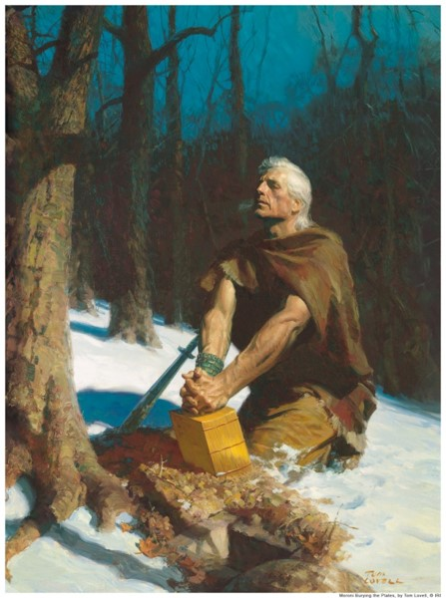
Sealed Up The Records
More than 420 years have passed since the coming of the Savior
Read and Remember
Search, Ponder, and Pray
Ask and you will know
Ask with sincerity and real intent
Ask if the words are true
By the power of the Holy Ghost, you shall know of the truth
What is good is just and true
Nothing is good that denies Christ
God is the power of all things yesterday, today, and forever
Moroni 10:1-7

Slide 3
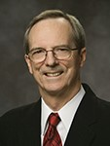
Research “My Church”
A 14-year-old girl … said that she had been discussing religion with one of her friends at school.
‘What religion do you belong to?’
Because, I have researched it
‘The Church of Jesus Christ of Latter-day Saints, or Mormons.’
Have you read the Book of Mormon?
I know that church, and I know it’s not true.
No, I haven’t
Then you haven’t researched my church.
How do you know?
I have read every page of the Book of Mormon and I know it’s true
Elder Tad R. Callister

Slide 4
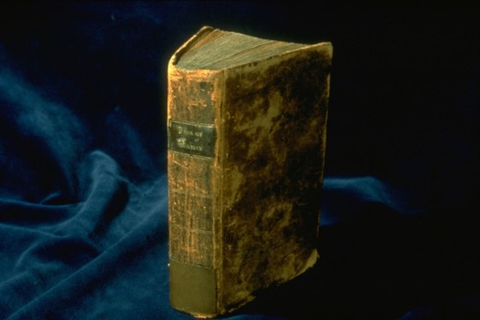
The Key
To gain a testimony of the Book of Mormon we must read and search the book itself
How can you possibly know it is not true if you don’t search or ponder what is written?
Moroni taught that those who read the Book of Mormon and desire to know of its truthfulness should “remember how merciful the Lord hath been”
Recognizing and remembering instances of the Lord’s mercy can soften our hearts and prepare us to feel the influence of the Holy Ghost.
One meaning of the word merciful is compassionate.
Moroni 10:3-4

Slide 5
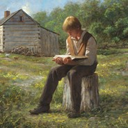
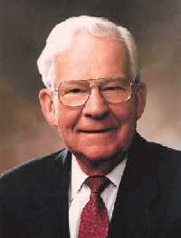
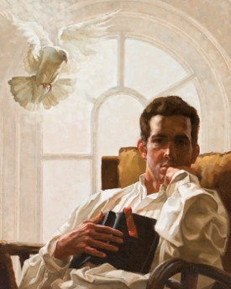
Pondering
We must ponder the Lord’s mercy in our hearts.
The Lord has been merciful to others and ourselves prepares us to receive the influence of the Holy Ghost.
“Dictionaries say that ponder means to weigh mentally, think deeply about, deliberate, meditate. …
“By pondering, we give the Spirit an opportunity to impress and direct. Pondering is a powerful link between the heart and the mind. As we read the scriptures, our hearts and minds are touched. If we use the gift to ponder, we can take these eternal truths and realize how we can incorporate them into our daily actions. …
“Pondering is a progressive mental pursuit. It is a great gift to those who have learned to use it. We find understanding, insight, and practical application if we will use the gift of pondering.”
Elder Marvin J. Ashton
Moroni 10:3-4

Slide 6
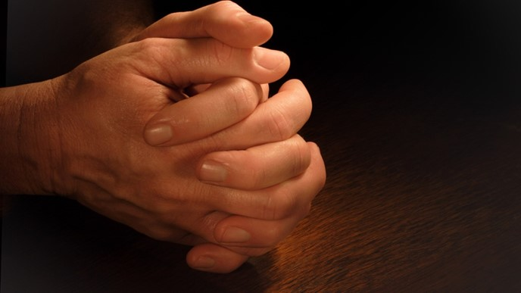
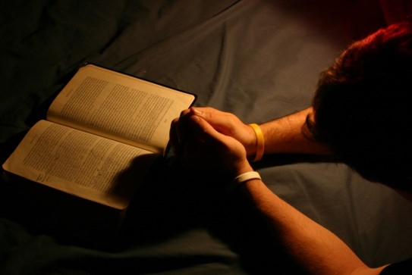
Ask With Sincerity
Moroni taught that if we want to receive a witness of the truthfulness of the Book of Mormon, we must ask God “with a sincere heart, with real intent, having faith in [Jesus] Christ.”
To pray sincerely and with real intent means that we “intend to act on the answer [we] receive from God.”
If we ask God in faith and with real intent, we can receive a testimony of the Book of Mormon and of Jesus Christ through the Holy Ghost
Moroni 10:4

Slide 7
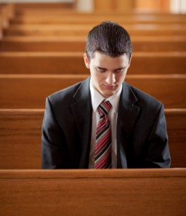
“Occasionally I prayed to know what was right, but it was more of a passing thought than a sincere question. Then one night I decided to pray with ‘real intent.’
“I told Heavenly Father that I wanted to know Him and to be part of His true Church. I promised: ‘If Thou will let me know whether Joseph Smith is a real prophet and whether the Book of Mormon is true, I’ll do whatever Thou would have me do. If The Church of Jesus Christ of Latter-day Saints is the true Church, I’ll follow it and never give it up.’
Moroni 10:4

Slide 8
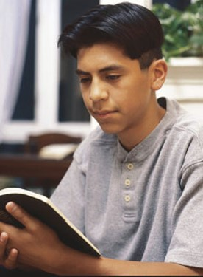
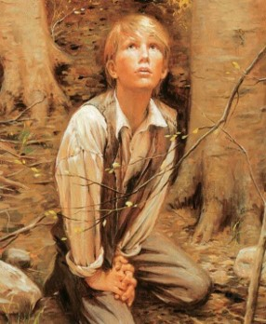
“I had no spectacular manifestation, but I felt at peace and went to bed. Several hours later I awoke with a distinct thought: ‘Joseph Smith is a true prophet, and the Book of Mormon is true.’ The thought was accompanied by indescribable peace. I fell asleep again, only to awake later with the exact same thought and feeling.
“Since that time, I have never doubted that Joseph Smith is a true prophet. I know that this is the Savior’s work and that Heavenly Father will answer our sincere petitions.”
Rodolfo Armando Pérez Bonilla
Moroni 10:4

Slide 9
Doctrinal Mastery
And when ye shall receive these things, I would exhort you that ye would ask God, the Eternal Father, in the name of Christ, if these things are not true; and if ye shall ask with a sincere heart, with real intent, having faith in Christ, he will manifest the truth of it unto you, by the power of the Holy Ghost.
And by the power of the Holy Ghost ye may know the truth of all things.
Moroni 10:4-5

Slide 10
If we read the Book of Mormon, remember and ponder the Lord’s mercy, and ask God sincerely with faith in Jesus Christ, then we will receive a testimony of the Book of Mormon by the power of the Holy Ghost.
Moroni 10:4

Slide 11
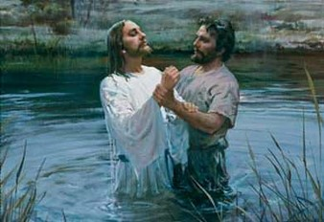
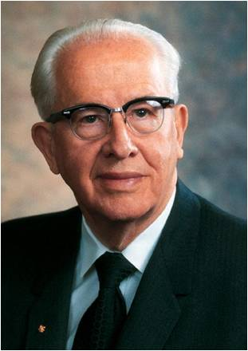
Receive
Those who have received the Book of Mormon will be accountable to God for how they respond to it
“After indicating that those who receive the Book of Mormon with faith, working righteousness, will receive a crown of eternal glory (see D&C 20:14),
the Lord follows with this warning: “But those who harden their hearts in unbelief, and reject it, it shall turn to their own condemnation.” (D&C 20:15.)
“The word testament is the English rendering of a Greek word that can also be translated as covenant. Is this what the Lord meant when He called the Book of Mormon the “new covenant”?
It is indeed another testament or witness of Jesus. This is one of the reasons why we have recently added the words Another Testament of Jesus Christ to the title of the Book of Mormon.”
Moroni 10:27-29 Ezra Taft Benson

Slide 12
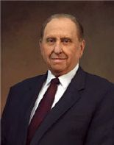
“If you are not reading the Book of Mormon each day, please do so. If you will read it prayerfully and with a sincere desire to know the truth, the Holy Ghost will manifest its truth to you. If it is true—and I solemnly testify that it is—then Joseph Smith was a prophet who saw God the Father and His Son, Jesus Christ.
“Because the Book of Mormon is true, The Church of Jesus Christ of Latter-day Saints is the Lord’s Church on the earth, and the holy priesthood of God has been restored for the benefit and blessing of His children.”
Thomas S. Monson

Slide 13
Sources:
Videos:
The Power of the Book of Mormon
Test Moroni’s Promise (2:43)
A Book With A Promise (2:21)
Elder Tad R. Callister (“The Book of Mormon—a Book from God,” Ensign or Liahona, Nov. 2011, 76).
Elder Marvin J. Ashton (“There Are Many Gifts,” Ensign, Nov. 1987, 20).
President Ezra Taft Benson The Keystone of Our Religion Jan. 1992 Ensign
Rodolfo Armando Pérez Bonilla, “How I Know,” Ensign, Oct. 2011, 64).
Thomas S. Monson, “The Power of the Book of Mormon,” Ensign or Liahona, May 2017, 86–87).
Presentation by ©http://fashionsbylynda.com/blog/

Slide 14
Ponder in Your hearts:
“The last five words of the verse offer an important admonition—‘ponder it in your hearts.’ What is the antecedent of ‘it’—the thing that we are to ponder? It is ‘how merciful the Lord hath been unto the children of men, from the creation of Adam even down until the time that ye shall receive these things.’ We are to remember how loving, how provident, how good, how forgiving our Heavenly Father has been toward us” (“Moroni’s Promise,” Ensign, Apr. 1994, 12).
This admonition near the end of the Book of Mormon to remember and ponder the Lord’s mercy is a fitting bookend to Nephi’s declaration that “I, Nephi, will show unto you that the tender mercies of the Lord are over all those whom he hath chosen” (1 Nephi 1:20).
In addition to pondering the merciful nature of the Lord, those who read the Book of Mormon should ponder the eternal truths they discover within its pages (see the introduction to the Book of Mormon).
Real Intent:
Elder Dallin H. Oaks of the Quorum of the Twelve Apostles commented on Moroni’s exhortation that we ask God with “real intent” regarding the truth of the Book of Mormon:
“Moroni did not promise a manifestation of the Holy Ghost to those who seek to know the truth of the Book of Mormon for hypothetical or academic reasons, even if they ‘ask with a sincere heart.’ The promise of Moroni is for those who are committed in their hearts to act upon the manifestation if it is received. Prayers based on any other reason have no promise because they are not made ‘with real intent’” (Pure in Heart [1988], 19–20).
Our salvation depends on how we receive the Book of Mormon
President Ezra Taft Benson emphasized the importance of the Book of Mormon when he extended the following exhortation to all members of the Church:
“Brethren and sisters, I implore you with all my heart that you consider with great solemnity the importance of the Book of Mormon to you personally and to the Church collectively.
“Over ten years ago I made the following statement regarding the Book of Mormon. …
“‘Every Latter-day Saint should make the study of this book a lifetime pursuit. Otherwise he is placing his soul in jeopardy and neglecting that which could give spiritual and intellectual unity to his whole life. There is a difference between a convert who is built on the rock of Christ through the Book of Mormon and stays hold of that iron rod, and one who is not’ (Ensign, May 1975, p. 65).
“I reaffirm those words to you this day. Let us not remain under condemnation, with its scourge and judgment, by treating lightly this great and marvelous gift the Lord has given to us. [See D&C 84:54–58.] Rather, let us win the promises associated with treasuring it up in our hearts” (“The Book of Mormon—Keystone of Our Religion,” Ensign, Nov. 1986, 7).

