Slide 1
Sacred Truths and Labors of Love
Jacob 1
and
Jacob 2:1-11

Slide 2
Jacob
Jacob, the fifth son of Sariah and Lehi, wrote this book. He was born in the wilderness during his family’s journey to the promised land.
Lehi promised Jacob that God would “consecrate [his] afflictions for [his] gain” and that he would spend his days “in the service of [his] God”.
In his youth, Jacob “suffered afflictions and much sorrow, because of the rudeness of [his] brethren”.
Nephi consecrated Jacob to be a priest and teacher of the Nephites, and later entrusted him with the small plates of Nephi.
2 Nephi 2:1-32 Nephi 5:26; Jacob 1:1-4

Slide 3
Jacob’s Later Years
As a faithful priesthood leader and teacher, Jacob labored diligently to persuade his people to believe in Christ
He received revelations concerning the Savior, experienced the ministering of angels, and heard the voice of the Lord
see Jacob 7:5
He saw his Redeemer (see 2 Nephi 11:2–3)
Jacob was the father of Enos, to whom he entrusted the plates before his death.
Jacob wrote this while living in the land of Nephi around the year 544 BC and concluded nearly at the end of Jacob’s life.
Jacob 1:7

Slide 4
For The People
Nephi instructed Jacob to record sacred teachings, revelations, and prophecies “for Christ’s sake, and for the sake of our people”
(Jacob 1:4).
Jacob obeyed this instruction and preserved writings that he “considered to be most precious” Jacob 1:2
“We labor diligently to engraven these words upon plates, hoping that our beloved brethren and our children will receive them with thankful hearts. … For this intent have we written these things, that they may know that we knew of Christ, and we had a hope of his glory many hundred years before his coming”.
Jacob 4:3-4
Central theme of his writings:
“Why not speak of the atonement of Christ, and attain to a perfect knowledge of him … ?” (Jacob 4:12).

Slide 5
The Book of Jacob
The Book of Jacob begins in approximately 544 BC, when Nephi entrusted Jacob with the small plates.
The Book contains information concerning the Nephite government following Nephi’s death..
Nephi anointed a man to succeed him as king and ruler of the people, while Jacob and his brother Joseph continued as spiritual leaders of the Nephites
Jacob’s condemnation of the unauthorized practice of plural marriage. The only reference to this subject in the Book of Mormon occurs in Jacob 2..
The Book of Jacob also includes the longest chapter in the Book of Mormon, Jacob 5, which contains Zenos’ allegory of the olive trees.
…And the first appearance of an anti-Christ (Sherem) among the Nephites.
Jacob 1:7

Slide 6
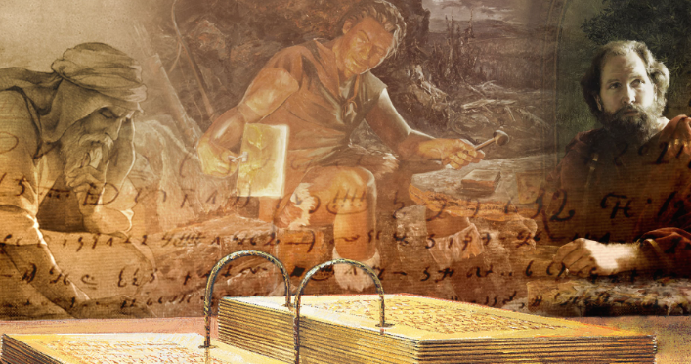
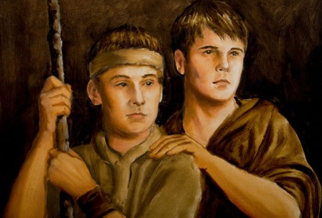
Recording Sacred Truths
Jacob was a noble and righteous man…a man filled with the spirit
The Book of Mormon is a Spiritual Record with the soul purpose to bring men unto Christ; an invitation.
Usually, records were passed from Father to son.
James Fullmer
The Nephite prophets desired above all else that their people “taste of the richness and goodness” and avoid “bitter fruits of disobedience.”
The Lord showed Jacob and Joseph what would happen to the Nephites in the future, and He revealed details about the coming of Christ.
Jacob 1:1-4

Slide 7
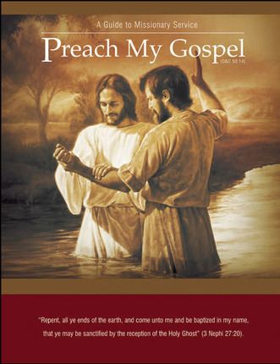
Come Unto Christ
To come unto Christ, a person “must have faith in Him unto repentance—making the necessary changes to bring their life into agreement with His teachings.”
Knowing of Jesus Christ and His kingdom can motivate us to labor diligently to help others come unto Him.
Jacob 1:7-8; (Preach My Gospel: A Guide to Missionary Service [2004], 2).

Slide 8
Partake of the Goodness
…an invitation to receive God’s blessings through obedience to the commandments and ordinances of the gospel.
Priesthood leaders labor diligently to persuade us to come unto Christ and partake of the goodness of God
If we come unto Christ and partake of the goodness of God, then we will enter into God’s rest
Jacob 1:7-8

Slide 9
Enter Into His Rest
Enjoying peace in this life and receiving “the fulness of [God’s] glory” in the next life (D&C 84:24)
To Qualify for the “rest” through faith and obedience
“Suffer his cross”—Our willingness to deny ourselves of ungodliness and worldly lusts and to keep the Lord’s commandments (Our willingness to endure and sacrifice as we follow the Savior).
“Bear the shame of the world”—keeping the commandments despite the worldly pressure, humiliation, and opposition that often come to disciples of Jesus Christ.
JST Matthew 16:24; Luke 9:23; 2 Nephi 9:18
Jacob 1:8

Slide 10
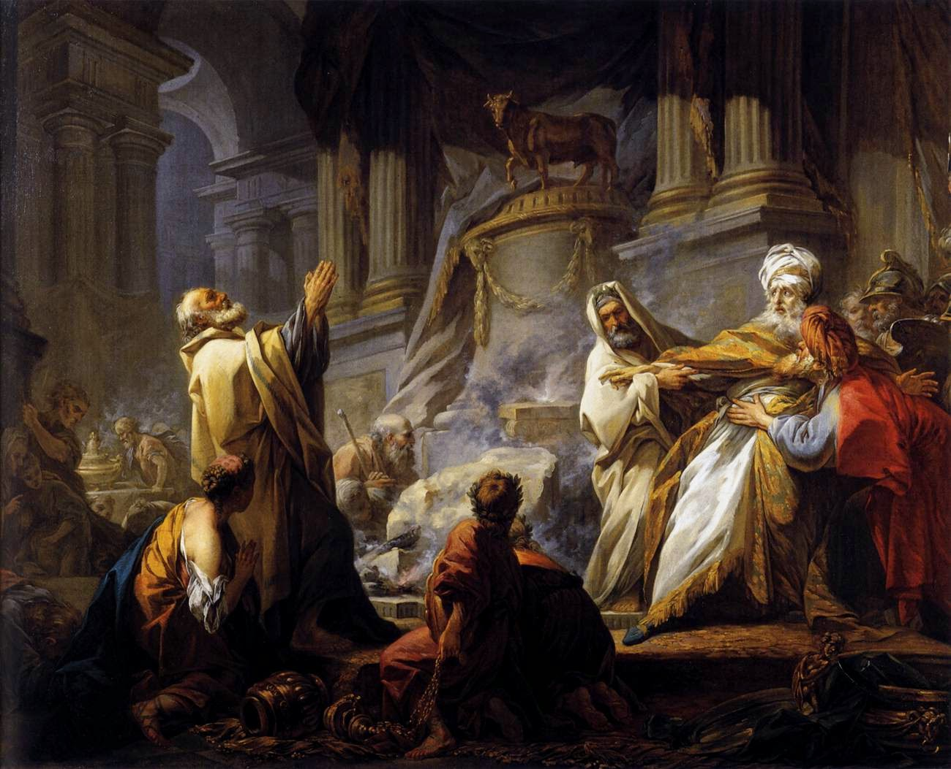
Provocation In The Days of Temptation
In the day of the ancient Israelites who provoked God’s anger by rebelling against Him in the wilderness
Jacob 1:7-8

Slide 11
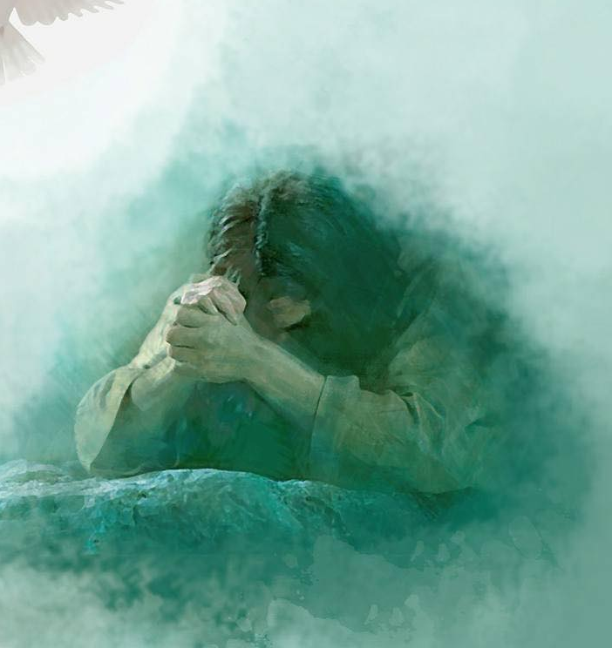
View Christ’s Death
When Jacob wrote that he wanted to persuade people to “believe in Christ, and view his death,” he may have meant that he wanted them to examine the Atonement of Jesus Christ attentively, realize its importance, and gain a personal testimony of it.
Yongsung Kim
Jacob 1:7-8

Slide 12
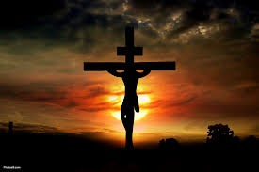
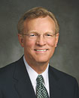
Suffer His Cross
Our willingness to deny ourselves of ungodliness and worldly lusts and to keep the Lord’s commandments
“We may wonder why we Latter-day Saints don’t place a cross on our churches or wear a cross to show that we are Christians, thereby making it easier for others to identify in whom we believe. Is the cross important to our faith?
The answer is an unequivocal yes! The Redeemer’s suffering on the cross is vitally important to us and is an inseparable part of the Atonement, through which He suffered and died for our sins and thereby provided us with a clear path to salvation and exaltation.
The Savior was clear when He stated that in following Him we should take upon ourselves a cross—not the Roman cross that was the instrument of death but our own cross, whereby we present a sacrifice to the Lord of our own heart to be obedient to His commandments.
“And he that taketh not his cross, and followeth after me,” Jesus said, “is not worthy of me” (Matthew 10:38).
“The message of the gospel of Jesus Christ includes what happened on the cross, but this message and meaning is within each of us and requires no external symbol to manifest our faith. Our cross is the giving up of
worldly sins and following the
Savior with a humble heart and
an obedient spirit.”
Gregory A. Schwitzer
Jacob 1:8

Slide 13
Bare The Shame of the World
Keeping the commandments despite the worldly pressure, humiliation, and opposition that often come to disciples of Jesus Christ.
Jacob 1:7-8

Slide 14
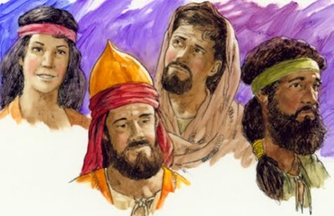
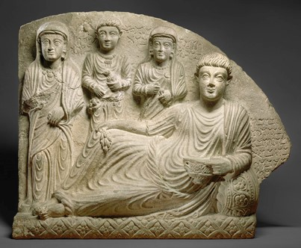
The Nephite Dynasty
To retain Nephi’s name in remembrance they established a Nephite monarchy…Second Nephi Dynasty, third Nephi and so on.
Nephi had been appointed as king by the voice of the people and chose another king to reign in his stead.
This was much like the system used by the Egyptians and the Romans with their Pharaohs and Caesars.
The Nephite Dynasty continued for almost 500 years, in which a system of judges was established. (Mosiah 29)
Jacob 1:9-12; 2 Nephi 5:18; 62

Slide 15
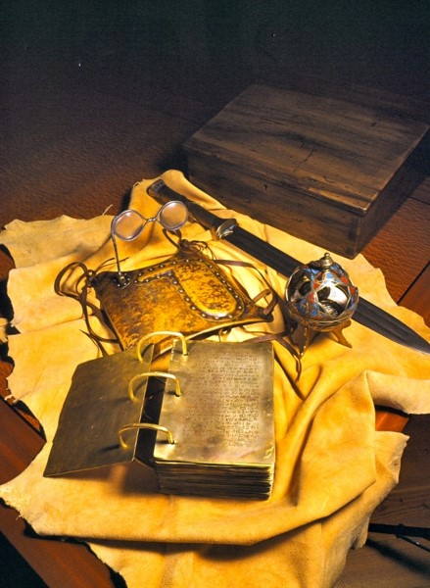
Anointed King and Sword
From ancient times it was the practice and tradition among the people of the Lord, at times when they had a monarchical government, to anoint their kings. The anointing, a symbol of the outpouring of the spirit, was a sacramental charge, one in which the king effectually covenanted to lead his people in righteousness. Prophets, priest, and kings—all of which were anointed—thus became messianic testimonies of the King of kings.
Wielding the sword of “Laban”
The sword was emblematic of the arm of the Lord, a promise that He would strengthen and bless them. It was a reminder that there was a price to be paid, even the shedding of blood, that the world of God might be had and honored.
The Three Witness—were promised they would see the sword of Laban, as well as the gold plates, the breastplate, and the Urim and Thummim
D&C 17:1
Jacob 1:9

Slide 16
All In A Name
Nephites
Lamanites
Lemuelites
Ishmaelites
Jacobites
Josephites
Zoramites
Nephites
Those people who chose to follow the Savior.
Those who believed in the commandments of God and the traditions of their fathers.
Lamanites
Those people who rebelled against righteousness and against the things of God.
Those who seek to destroy the people of Nephi.
Jacob 1:13-14

Slide 17
Warnings
Why do Church leaders warn us against sin?
Jacob recorded that after the death of his brother Nephi, the people began to indulge in certain wicked practices
Immorality
Worldliness
Pride
Jacob 1:15-16

Slide 18
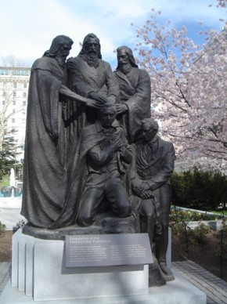
Errand of the Lord
We believe that a man must be called by prophecy, and by laying on of hands by those who are in authority, to preach the Gospel and administer in the ordinances thereof”
Article of Faith 1:5
”Again I say unto you, that it shall not be given to any one to go forth to preach my gospel, or to build up my church, except he be ordained by some one who has authority, and it is known to the church that he has authority and has been regularly ordained by the heads of the church.” (D&C 42:11)
Jacob 1:17-19

Slide 19
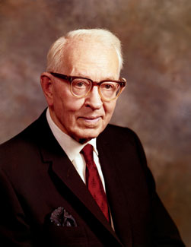
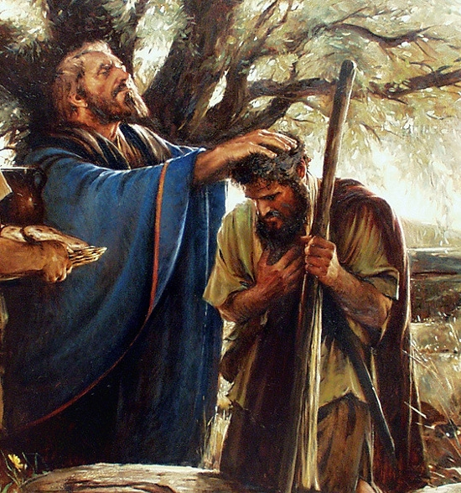
Consecrated Priests and Teachers
“The Nephites officiated by virtue of the Melchizedek Priesthood from the days of Lehi to the days of the appearance of our Savior among them. It is true that Nephi ‘consecrated Jacob and Joseph’ that they should be priests and teachers over the land of the Nephites, but the fact that plural terms priests and teachers were used indicates that this was not a reference to the definite office in the priesthood in either case, but it was a general assignment to teach, direct, and admonish the people.”
Joseph Fielding Smith
Jacob 1:18

Slide 20
“Perhaps you already know (but if you don’t you should) that with rare exception, no man or woman who speaks [in general conference] is assigned a topic.
Each is to fast and pray, study and seek, start and stop and start again until he or she is confident that for this conference, at this time, his or hers is the topic the Lord wishes that speaker to present regardless of personal wishes or private preferences. … Each has wept, worried, and earnestly sought the Lord’s direction to guide his or her thoughts and expression.”
Jeffrey R. Holland
Fast
Pray
Study
Seek
Priesthood leaders have a divinely given responsibility to teach the word of God and warn against sin.

Slide 21
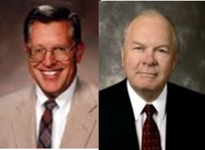
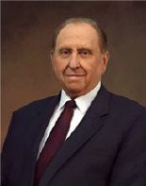
Magnify
“A person’s errand is his or her assignment, his or her calling—the task to be undertaken.
A member of the Church is able to proceed in the magnification of a calling much more powerfully when he or she knows that the call came from God, that the word of prophecy, the spirit of inspiration, was the directing influence in knowing full well that with the assignment will come also the needed strength and direction for accomplishment of labor.”
JFM and RLM
“What does it mean to magnify a calling? It means to build it up in dignity and importance, to make it honorable and commendable in the eyes of all men, to enlarge and strengthen it, to let the light of heaven shine through it to the view of other men.
“And how does one magnify a calling? Simply by performing the service that pertains to it. An elder magnifies the ordained calling of an elder by learning what his duties as an elder are and then by doing them. As with an elder, so with a deacon, a teacher, a priest, a bishop, and each who holds office in the priesthood” Thomas S. Monson

Slide 22
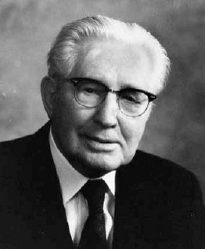
Sins Upon Our Head If We Don’t Teach
“For behold, this is my work and my glory—to bring to pass the immortality and eternal life of man.”
Moses 1:39
Those who have leadership duties in the Church bear a sobering responsibility. Jacob taught that when leaders neglect to teach the word of God to those whom they are called to lead, they become partly responsible for the people’s sins.
“If you do not magnify your callings, God will hold you responsible for those whom you might have saved had you done your duty.” John Taylor
“This is a challenging statement. If I by reason of sins of commission or omission lose what I might have had in the hereafter, I myself must suffer and, doubtless, my loved ones with me. But if I fail in my assignment as a bishop, a stake president, a mission president, or one of the General Authorities
of the Church—if any of us fail to teach, lead, direct, and help to save
those under our direction and within our jurisdiction, then the Lord
will hold us responsible if they are lost as the result of our failure.”
Hugh B. Brown

Slide 23
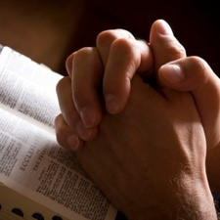
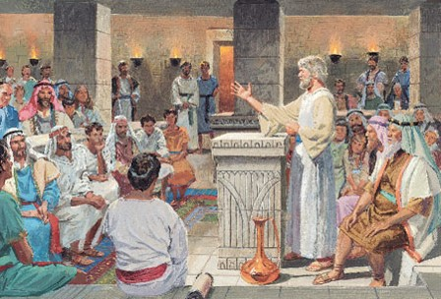
Calling People to Repentance
Jacob’s message is not his message, but a message from God
How does Jacob feel toward calling his people to repentance?
Just like our prophets and general authorities—the messages are from God
Parents all to frequently mourn out their days because of the mistakes of loved one.
There are no heavier burdens in life than those associated with sin. It is not the sinner alone..often the burden of sin rests upon the righteous.
Although Jacob found this responsibility difficult, he carried it out because he cared about the people and because he wanted to obey God’s commands.
Jacob 2:1-3

Slide 24
The Gift of Discernment
All powerful Creator
The gift of discernment, as well as the spirit of prophecy and revelation, is the rightful province of those on the Lord’s errand.
“And Jesus, perceiving the thought of their heart, took a child, and set him by him,”
Luke 9:47
“Now when the king had heard these words, he marveled again, for he beheld that Ammon could discern his thoughts; ”
Alma 18:18
Concerning our thoughts
“He comprehendeth all things, and all things are before him, and all things are round about him; and he is above all things, and in all things, and is through all things, and is round about all things; and all things are by him, and of him, even God, forever and ever.”
D&C 88:41
“Yea, I tell thee, that thou mayest know that there is none else save God that knowest thy thoughts and the intents of thy heart.
D&C 6:16
Jacob 2:5

Slide 25
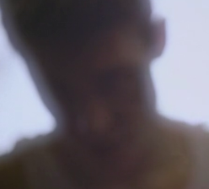
Shrink With Shame
Jacob cannot recommend his people to God. He is ashamed and embarrassed that the deeds of those he has been called to serve are so offensive to their Maker.
Jacob must teach the consequences of sin with boldness
“No doubt many of the mothers and children were already aware of the abominations of their husbands and fathers.
…Many of Jacob’s words would revive many memories, poignant and painful memories, cold and bleak memories know only to those whose confidence and trust have been shattered by the callous infidelity of one with whom sacred covenants had been made.”
JFM and RLM
Jacob 2:6, 7-10

Slide 26
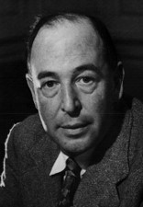
Healeth the Soul
Moroni 10:5—“And by the power of the Holy Ghost ye may know the truth of all things.”
When new information is confusing or bothersome to gospel learners, it is better for them to seek answers from God, who knows all things, than to conduct a general search on the Internet or turn to anti-Mormon material. Going directly to God for answers shows our faith in Him and allows us to receive answers through the Holy Ghost.
We should also turn to the scriptures and the words of latter-day apostles and prophets, which can answer difficult questions and heal wounds.
Will the Lord do for us to help heal our souls?
“[God] has infinite attention to spare for each one of us. He does not have to deal with us in the mass. You are as much alone with Him as if you were the only being He had ever created. When Christ died, He died for you individually just
as much as if you had been the only man
[or woman] in the world.”
C.S. Lewis
James 1:5–6—“If any of you lack wisdom, let him ask God, … and it shall be given him. But let him ask in faith.”
Jacob 2:6, 7-10

Slide 27
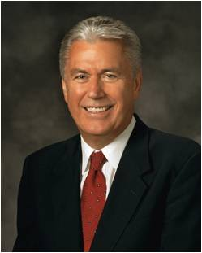
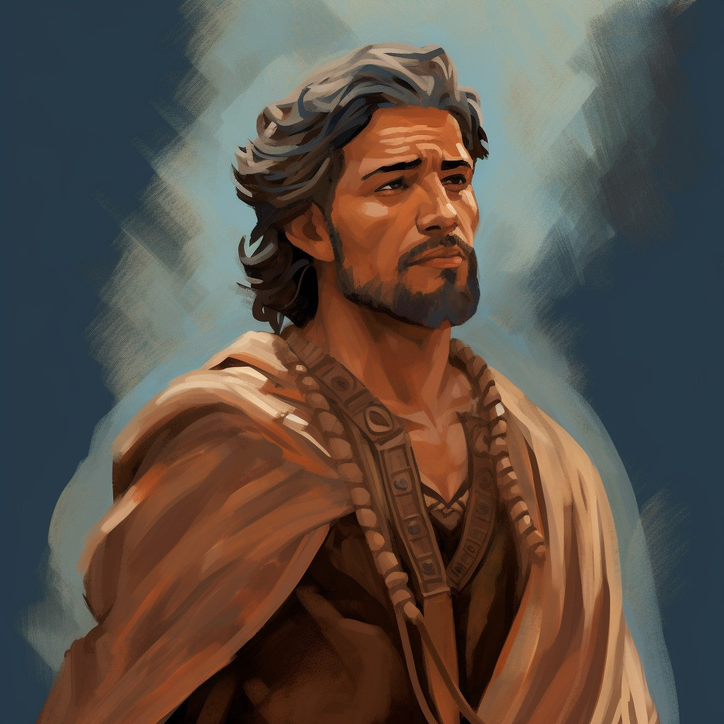
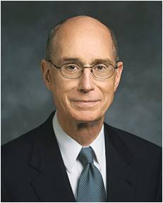
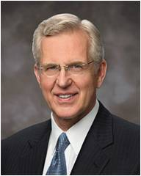
Boldly—Strict Commands
Jacob
“But, notwithstanding the greatness of the task, I must do according to the strict commands of God, and tell you concerning your wickedness and abominations, in the presence of the pure in heart, and the broken heart, and under the glance of the piercing eye of the Almighty God.”
Dieter F. Uchtodorf
“And, to be perfectly frank, there have been times when members or leaders in the Church have simply made mistakes. There may have been things said or done that were not in harmony with our values, principles, or doctrine.
I suppose the Church would be perfect only if it were run by perfect beings. God is perfect, and His doctrine is pure. But He works through us—His imperfect children—and imperfect people make mistakes.”
Henry B. Eyring
D. Todd Christofferson
“My plea to women and girls today is to protect and cultivate the moral force that is within you. Preserve that innate virtue and the unique gifts you bring with you into the world. Your intuition is to do good and to be good, and as you follow the Holy Spirit, your moral authority and influence will grow. To the young women I say, don’t lose that moral force even before you have it in full measure. Take particular care that your language is clean, not coarse; that your dress reflects modesty, not vanity; and that your conduct manifests purity, not promiscuity. You cannot lift others to virtue on the one hand if you are entertaining vice on the other.”
“You young men cannot know what acts of priesthood service the Lord is preparing you to give. But the greater challenge for every priesthood holder is to give spiritual help. All of us have that charge. It comes with being a member of a quorum. It comes with being a member of a family. If the faith of anyone in your quorum or your family is attacked by Satan, you will feel compassion. Much like the service and mercy given by the Samaritan, you will also minister to them with healing balm for their wounds in their time of need.”
Jacob 2:10

Slide 28
What About Today?
?
?
What have Church leaders of today taught you?
How can you apply these teachings in your life?
How can you apply what you have learned in your callings such as priesthood quorums or class presidencies?
Jacob 2:10

Slide 29
Sources:
Joseph Fielding McConkie and Robert L. Millet Doctrinal Commentary on the Book of Mormon vol. 2 pg. 2-13
Elder Gregory A. Schwitzer The Meaning of the Cross for Latter-day Saints July Ensign 2011
Jeffrey R. Holland (“An Ensign to the Nations,” Ensign or Liahona, May 2011, 111).
Joseph Fielding Smith (Answers to Gospel Questions, comp. Joseph Fielding Smith Jr., 5 vols. [1957–66]
Thomas S. Monson (“The Sacred Call of Service,” Ensign or Liahona, May 2005, 54).
John Taylor (Teachings of Presidents of the Church: John Taylor [2001], 164).
Hugh B. Brown (in Conference Report, Oct. 1962, 84).
C.S. Lewis (Mere Christianity [1943], 131).
Dieter F. Uchtodorf Come, Join with Us Oct. 2013 Conference
D. Todd Christofferson The Moral Force of Women Oct. 2013 Conference
Henry B. Eyring Bind Up Their Wounds Oct. 2013 Conference
Presentation by ©http://fashionsbylynda.com/blog/

