Slide 1
Two Prevalent Sins
Jacob 2:12-35

Slide 2
Comes from Heavenly Father
Money
Friends
Blessings
Intelligence
Gospel Knowledge
Talents

Slide 3
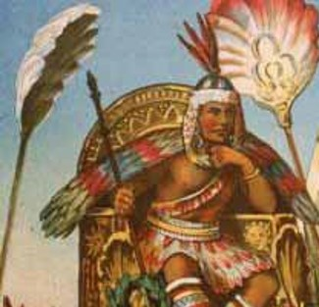
Wealth = Pride
Whenever any group chose to keep the commandments of God, he blessed and prospered them. ..Most of the people in the Book of Mormon (Nephite and Jaredites alike) lost sight of the source of their blessings. Wealth became the end in life rather than a means to accomplishment of good…
…Things became more important than people, then it was only a matter of time before class distinctions, caste systems, and the persecution of the poor followed.
JFM and RLM
Jacob 2:12-13

Slide 4
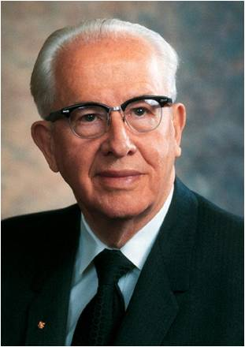
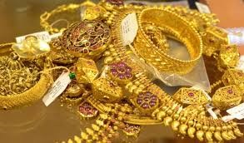
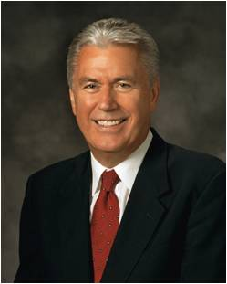
Gold Diggers
Many of the blessed people started to seek riches that were in abundance on the land:
Gold, silver, precious ores
Providence = God
“Pride is a sin that can readily be seen in others but is rarely admitted in ourselves.” Ezra Taft Benson
Pride began to be their occupation.
Things became more important than service to fellow men.
Selfishness overcame their characters
“At its core, pride is a sin of comparison, for though it usually begins with ‘Look how wonderful I am and what great things I have done,’ it always seems to end with ‘Therefore, I am better than you.’ …
“… This is the sin of ‘Thank God I am more special than you.’ At its core is the desire to be admired or envied. It is the sin of self-glorification.” Dieter F. Uchtdorf
Pride Can Destroy Our Souls
Jacob 2:12-13

Slide 5
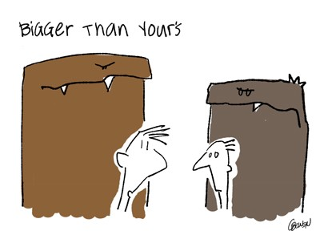
Power to Destroy Souls
Satan seeks to destroy the righteous by using things of this world. Things that are obtainable.
“Keeping up with the Joneses”
This is an idiom in many parts of the English-speaking world referring to the comparison to one's neighbor as a benchmark for social caste or the accumulation of material goods. To fail to "keep up with the Joneses" is perceived as demonstrating socio-economic or cultural inferiority. Wikipedia
It is a phrase of one who has to have what his neighbor has and more…then more…then more.
Jacob 2:14-16

Slide 6
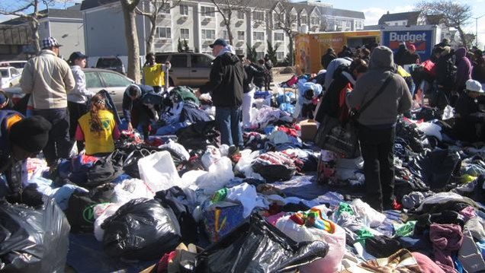
Material Wealth
What are some inappropriate attitudes toward wealth?
What are some appropriate attitudes toward Wealth?
”And after ye have obtained a hope in Christ ye shall obtain riches, if ye seek them; and ye will seek them for the intent to do good—to clothe the naked, and to feed the hungry, and to liberate the captive, and administer relief to the sick and the afflicted.”
To Do = Action
Jacob 2:19

Slide 7
Think of Others
Jacob exhorts them to think of others rather than themselves. Look upon their brethren equally as themselves
“Think of your brethren like unto yourselves, and be familiar with all and free with your substance, that they may be rich like unto you.
But before ye seek for riches, seek ye for the kingdom of God.”
Seek for the riches of God…not the world
Jacob 2:17-18

Slide 8
The Parable of the Foolish Rich Man
Luke 12:16-21

Slide 9
What shall I do, because I have no room where to bestow my fruits?

Slide 10
I will pull down my barns, and build greater; and there will I bestow all my fruits and my goods

Slide 11
Soul, thou hast much goods laid up for many years; take thine ease, eat, drink, and be merry

Slide 12
“My power and the might of mine hand hath gotten me this wealth. But thou shalt remember the Lord thy God; for it is he that giveth thee power to get wealth”
(Deuteronomy 8:17-18)
“Seek Not after riches nor the vain things of this world; for behold, you cannot carry them with you”
(Alma 39:14)
As in the movie Spaceballs:
“Take only what you need to survive”

Slide 13
Other Violations
Jacob rebukes people who have violated the law of chastity
“The plaguing sin of this generation is sexual immorality. This, the Prophet Joseph said, would be the source of more temptations, more buffetings, and more difficulties for the elders of Israel than any other.”
Ezra Taft Benson
Jacob 2:19

Slide 14
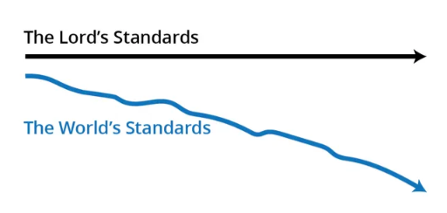
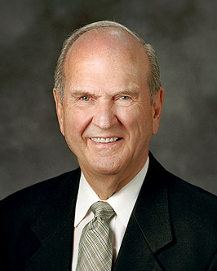
How would you describe what this diagram shows about the Lord’s standards and the world’s standards?
In what ways do you see the world’s standards moving away from the Lord’s standards?
“It takes faith to live a chaste life when the world shouts that God’s law of chastity is now outmoded.”
Russell M. Nelson

Slide 15
Chastity
The Lord’s law of chastity is clear and unchanging. “Chastity is sexual purity”.
Those who are chaste are morally clean in their thoughts, words, and actions.
Chastity means not having any sexual relations before marriage.
It also means complete fidelity between husband and wife during marriage”
For I, the Lord God, delight in the chastity of women. And whoredoms are an abomination before me; thus saith the Lord of Hosts.
Jacob 2:22-28

Slide 16
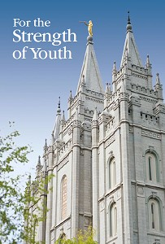
Avoidance of Grosser Crimes
Whoredoms = Sexual Sins
“The Lord’s standard regarding sexual purity is clear and unchanging. Do not have any sexual relations before marriage and be completely faithful to your spouse after marriage. …
“Never do anything that could lead to sexual transgression. Treat others with respect, not as objects used to satisfy lustful and selfish desires. Before marriage, do not participate in passionate kissing, lie on top of another person, or touch the private, sacred parts of another person’s body, with or without clothing. Do not do anything else that arouses sexual feelings. Do not arouse those emotions in your own body.”
Jacob 2:22-28
(For the Strength of Youth [booklet, 2011], 35–36).

Slide 17
Excuses
How do people sometimes seek to excuse sexual immorality today?
“It is a free country, and I can do what I like, when I like with my body”
“We need to see if we are sexually compatible with each other”
“I can repent of it later and be okay”
“Everyone else is doing it”
“We love each other”
Jacob 2:23-24

Slide 18
Avoiding Temptations
What are some things you can do to avoid being overcome by sexual temptations?
Praying for strength
Associating with good friends
Choosing wholesome entertainment
Avoiding situations and places where temptation is likely
“Nothing good comes from staying up past 12:00 at night while dating”
Jacob 2:23-24

Slide 19
One Man One Wife
One of the sins of the Nephite’s appears to have been the unauthorized practice of plural marriage
Concubine = a woman who was legally married to a man but who had a lower status than a wife
The Lord has commanded that a man should be married to one wife
“And again, verily I say unto you, that whoso forbiddeth to marry is not ordained of God, for marriage is ordained of God unto man.
Wherefore, it is lawful that he should have one wife, and they twain shall be one flesh, and all this that the earth might answer the end of its creation;
D&C 49:15-16
Jacob 2:27-30

Slide 20
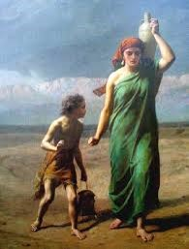
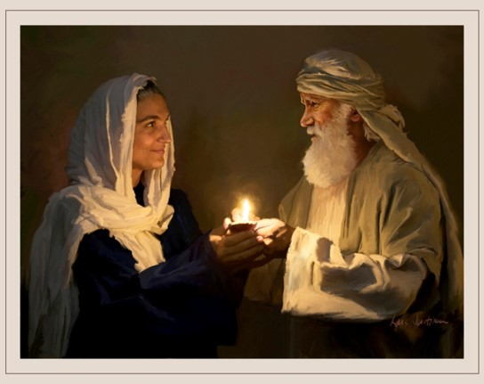
Many Wives
When are the Lord’s people authorized to practice plural marriage?
When the Lord commands it.
Certain times in the history of the world, the Lord has commanded His people to practice plural marriage.
For example, plural marriage was practiced in Old Testament times by Abraham and Sarah (see Genesis 16:1–3; D&C 132:34–35, 37)
and by their grandson Jacob (see D&C 132:37),
and it was practiced for a time during the early days of
the restored Church, beginning with Joseph Smith
(see D&C 132:32–33, 53).
Jacob 2:30

Slide 21
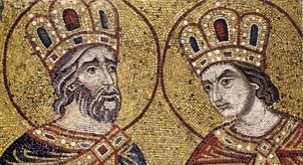
Plural Marriage
In Jacob’s day, some Nephites had begun to participate in plural marriage, saying that they were following the examples of David and Solomon. Jacob condemned this practice for at least two reasons:
The Lord, through the prophet Lehi, had commanded this people not to participate in plural marriage
2. David and Solomon were not worthy examples. Although they had married some plural wives in compliance with the Lord’s commandments in their day, they had also committed serious sexual sins (see Jacob 2:24; D&C 132:38–39).
Jacob 2:24-27

Slide 22
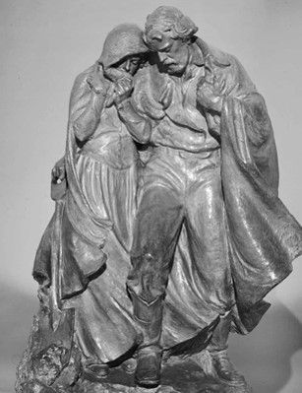
A Short Period of Time
“If I will … raise up seed unto me, I will command my people; otherwise they shall hearken unto these things”
In other words, the Lord’s general command is to not participate in plural marriage. However, He may command His people to participate in plural marriage for a time when He deems it necessary to “raise up seed” unto Him—in other words, when He wants His people to, in a short period of time, bring more children into the world who will be born in the covenant and raised in gospel-centered homes.
In obedience to direction from God through a revelation to the Prophet Joseph Smith, some Latter-day Saints followed this practice for years during the 1800s (see D&C 132). In 1890, when conditions had changed in the Church and in the laws of the United States, the Lord withdrew His approval of the practice in a revelation to President Wilford Woodruff, who was then serving as President of the Church (see D&C, Official Declaration 1).

Slide 23
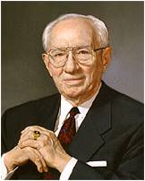
Practice—Not Approved
Since that time, plural marriage has not been approved by the Lord or authorized by The Church of Jesus Christ of Latter-day Saints. Any Latter-day Saint who adopts this practice is subject to losing his or her membership in the Church. President Gordon B. Hinckley taught:
“I wish to state categorically that this Church has nothing whatever to do with those practicing polygamy. They are not members of this Church. Most of them have never been members. They are in violation of the civil law. They know they are in violation of the law. They are subject to its penalties. …
“If any of our members are found to be practicing plural marriage, they are excommunicated, the most serious penalty the Church can impose. Not only are those so involved in direct violation of the civil law, they are in violation of the law of this Church. An article of our faith is binding upon us. It states, ‘We believe in being subject to kings, presidents, rulers, and
magistrates, in obeying, honoring, and sustaining the law’
(A of F 1:12). …

Slide 24
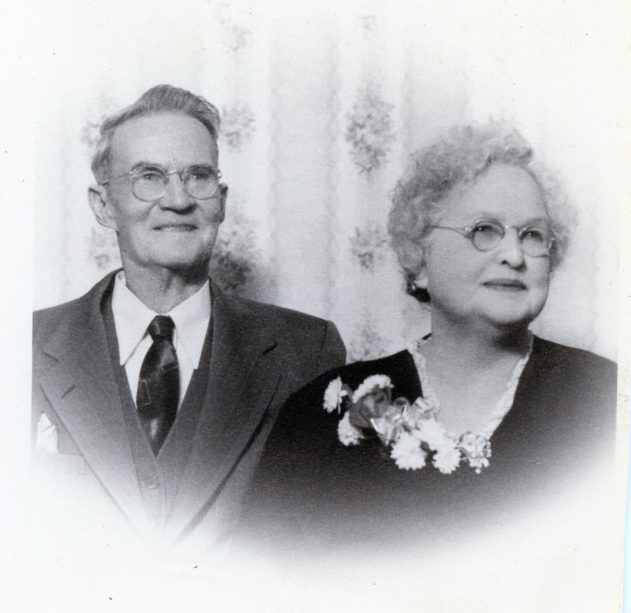
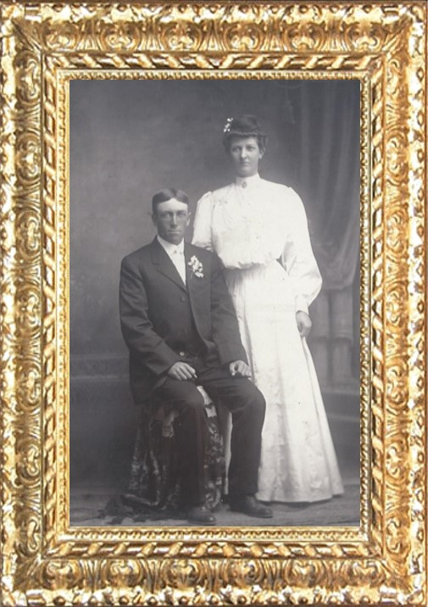
Discontinued…
“More than a century ago God clearly revealed unto His prophet Wilford Woodruff that the practice of plural marriage should be discontinued, which means that it is now against the law of God. Even in countries where civil or religious law allows polygamy, the Church teaches that marriage must be monogamous and does not accept into its membership those practicing plural marriage.”
Gordon B. Hinckley
Unless the Lord commands otherwise, He has ordained that marriage is to be between one man and one woman.

Slide 25
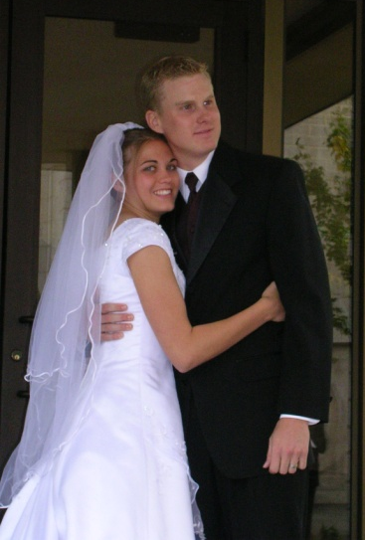
Families Affected by Immorality
Sexual immorality has a destructive influence on families:
“the Lord, have seen the sorrow, and heard the mourning of the daughters …because of the wickedness… of their husbands.”
“The cries of the fair daughters of this people.”
What are the Consequences of immorality for women and men?
Some (young) people rationalize that they can break the law of chastity because their actions do not hurt anyone else.
“Nothing shatters hope and destroys feelings of warmth and self-worth in members of a family like sexual infidelity on the part of a mother or father.”
JFM and RLM
The gift of procreation: An authorized matrimony union of a man and a woman.
Jacob 2:31-35

Slide 26
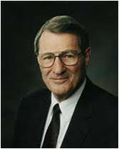
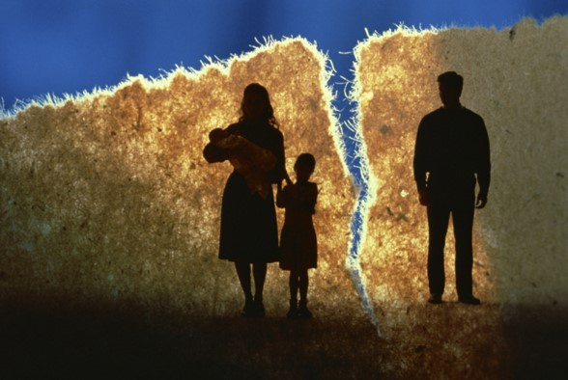
Consequences of Immorality in Marriage
“Clearly, unchastity and infidelity bring serious consequences such as the rippling, even haunting, effects of illegitimacy and fatherlessness, along with disease and the shredding of families.
So many marriages hang by a thread or have already snapped.
This quiet but deep crisis coexists with vexing international crises in our time, including war. Jesus spoke of latter days when there would be “distress of nations, with perplexity” and how all things would be in commotion.”
Elder Neal A. Maxwell
Luke 21:25; see also D&C 88:91; D&C 45:26).”

Slide 27
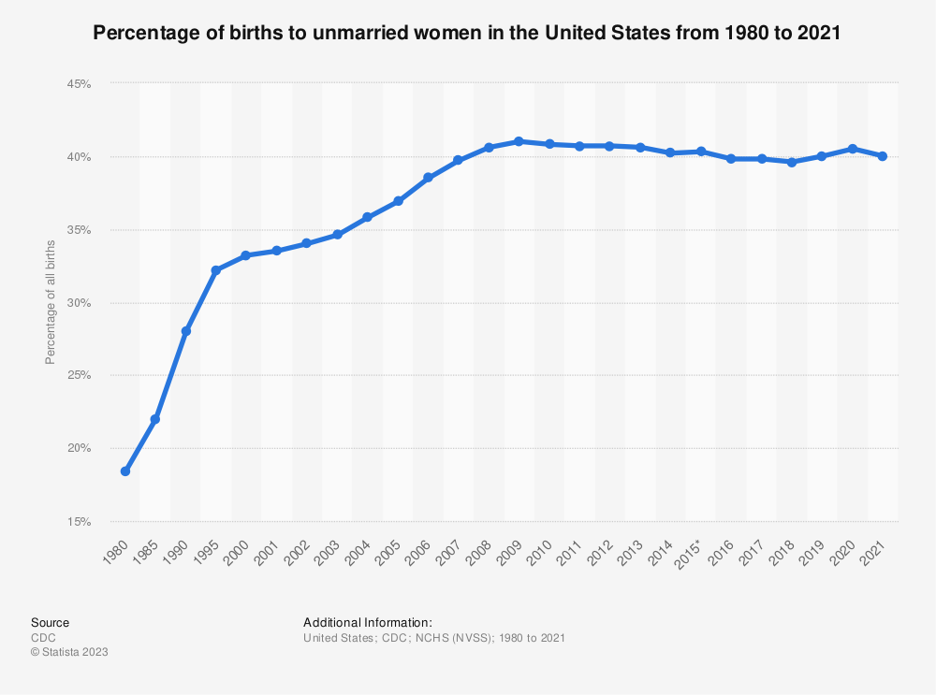
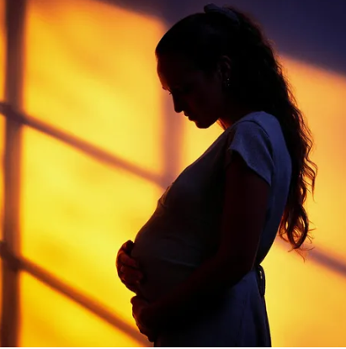
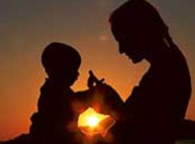
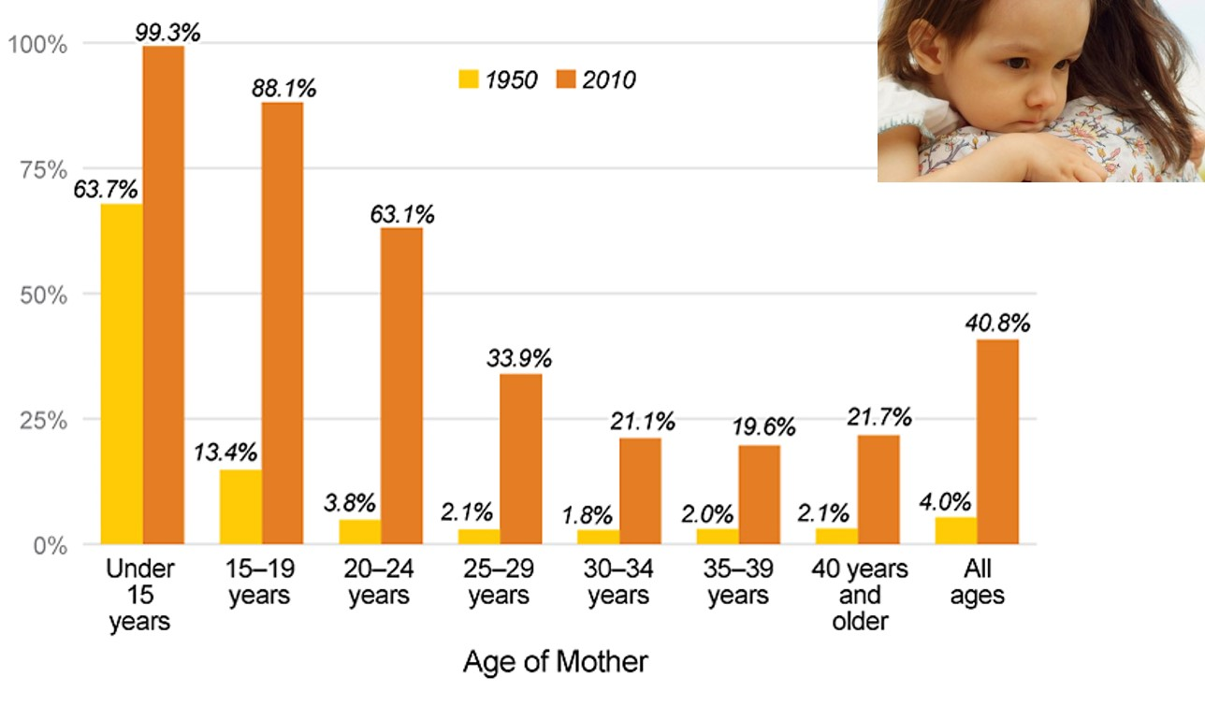
Unwed Mothers
Today, nearly nine in 10 children born to teenage mothers are born outside of marriage - a more than six-fold increase since 1950. The increase among mothers in their early twenties was especially pronounced: a 16-fold jump. The increase among unwed mothers’ age 30 and older is at least 10-fold.
Unwed Mother’s Chart

Slide 28
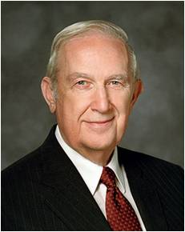
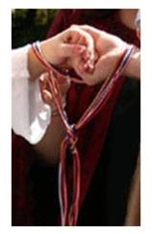
Making the Right Choices
“Those intimate acts (sexual immorality) are forbidden by the Lord outside the enduring commitment of marriage because they undermine His purposes. Within the sacred covenant of marriage, such relationships are according to His plan. When experienced any other way, they are against His will. They cause serious emotional and spiritual harm. Even though participants do not realize that is happening now, they will later. Sexual immorality creates a barrier to the influence of the Holy Spirit with all its uplifting, enlightening, and empowering capabilities. It causes powerful physical and emotional stimulation. In time that creates an unquenchable appetite that drives the offender to ever more serious sin.”
Richard G. Scott

Slide 29
Blessings From Living the Law of Chastity
Physical intimacy between husband and wife is beautiful and sacred. It is ordained of God for the creation of children and for the expression of love between husband
and wife. God has commanded that sexual intimacy be reserved for marriage.
When you are sexually pure, you prepare yourself to make and
keep sacred covenants in the temple. You prepare yourself to
build a strong marriage and to bring children into the world as
part of an eternal and loving family. You protect yourself from
the spiritual and emotional damage that come from sharing
sexual intimacy outside of marriage. You also protect yourself
from harmful diseases. Remaining sexually pure helps you to be
confident and truly happy and improves your ability to make
good decisions now and in the future.
For the Strength of Youth Pamphlet

Slide 30
Sources:
Joseph Fielding McConkie and Robert L. Millet Doctrinal Commentary on the Book of Mormon Vol. 2 pg. 13
Dieter F. Uchtdorf Pride and the Priesthood Ensign or Liahona, Nov. 2010, 56
Wikipedia http://en.wikipedia.org/wiki/Keeping_up_with_the_Joneses
Ezra Taft Benson(The Teachings of Ezra Taft Benson [1988], 277). Pride: Teachings of Presidents of the Church: Ezra Taft Benson [2014], 235
Chastity in an Unchaste World see Oct. 2012 for more information on Chastity— in the eyes of the youth.
Gordon B. Hinckley What Are People Asking about Us? Ensign, Nov. 1998, 71–72
Unwed Mother’s chart http://www.familyfacts.org/charts/207/unwed-childbearing-has-increased-dramatically-regardless-of-mothers-age
Neil A. Maxwell The Seventh Commandment: A Shield Jan. 2002 Liahona
Richard G. Scott Making the Right Choices Ensign, Nov. 1994, 38
For the Strength of Youth Pamphlet Pg 35
Russell M. Nelson, “Christ Is Risen; Faith in Him Will Move Mountains,” Liahona, May 2021, 104
Presentation by ©http://fashionsbylynda.com/blog/

Slide 31
Free With Your Substance Jacob 2:17:
“How much should we pay in fast offerings? My brothers and sisters, the measure of our offering to bless the poor is a measure of our gratitude to our Heavenly Father. Will we, who have been blessed so abundantly, turn our backs on those who need our help? Paying a generous fast offering is a measure of our willingness to consecrate ourselves to relieve the suffering of others.
“Brother Marion G. Romney, who was the bishop of our ward when I was called on a mission and who later served as a member of the First Presidency of the Church, admonished: ‘Be liberal in your giving, that you yourselves may grow. Don’t give just for the benefit of the poor, but give for your own welfare. Give enough so that you can give yourself into the kingdom of God through consecrating of your means and your time’ [“The Blessings of the Fast,” Ensign, July 1982, 4]” (Joseph B. Wirthlin, “The Law of the Fast,” Ensign, May 2001, 75).
Jacob 2:25-28
The power of procreation is spiritually significant. Misuse of this power subverts the purposes of the Father’s plan and of our mortal existence. Our Heavenly Father and His Beloved Son are creators and have entrusted each of us with a portion of Their creative power. Specific guidelines for the proper use of the ability to create life are vital elements in the Father’s plan. How we feel about and use that supernal power will determine in large measure our happiness in mortality and our destiny in eternity. …
The Church of Jesus Christ of Latter-day Saints has a single, undeviating standard of sexual morality: intimate relations are proper only between a man and a woman in the marriage relationship prescribed in God’s plan. Such relations are not merely a curiosity to be explored, an appetite to be satisfied, or a type of recreation or entertainment to be pursued selfishly. They are not a conquest to be achieved or simply an act to be performed. Rather, they are in mortality one of the ultimate expressions of our divine nature and potential and a way of strengthening emotional and spiritual bonds between husband and wife. We are agents blessed with moral agency and are defined by our divine heritage as children of God—and not by sexual behaviors, contemporary attitudes, or secular philosophies. (David A. Bednar, “We Believe in Being Chaste,” Ensign or Liahona, May 2013, 41–42)
“Chastity is sexual purity, a condition that is ‘pleasing unto God’ (Jacob 2:7). To be chaste, you must be morally clean in your thoughts, words, and actions. You must not have any sexual relations before you are legally married. When you are married, you must be completely faithful to your husband or wife.
“Physical intimacy between husband and wife is beautiful and sacred. It is ordained of God for the creation of children and for the expression of love within marriage” (True to the Faith: A Gospel Reference [2004], 29).
Is Sexual Sin Forgiven?
To you is extended the peace and renewal of repentance available through the atoning sacrifice of the Lord Jesus Christ. In such serious matters the path of repentance is not easily begun nor painlessly traveled. But the Savior of the world will walk that essential journey with you. He will strengthen you when you waver. He will be your light when it seems most dark. He will take your hand and be your hope when hope seems all you have left. His compassion and mercy, with all their cleansing and healing power, are freely given to all who truly wish complete forgiveness and will take the steps that lead to it. (Jeffrey R. Holland, “Personal Purity,” Ensign or Liahona, Nov. 1998, 78)
“Never do anything that could lead to sexual transgression. Treat others with respect, not as objects used to satisfy lustful and selfish desires. Before marriage, do not participate in passionate kissing, lie on top of another person, or touch the private, sacred parts of another person’s body, with or without clothing. Do not do anything else that arouses sexual feelings. Do not arouse those emotions in your own body. …
“Avoid situations that invite increased temptation. … Do not participate in discussions or any media that arouse sexual feelings. Do not participate in any type of pornography. The Spirit can help you know when you are at risk and give you the strength to remove yourself from the situation” (For the Strength of Youth [booklet, 2011], 36).
Overcoming Pornography sites:
Dallin H. Oaks, “Recovering from the Trap of Pornography,” Ensign or Liahona, October 2015, 32–38
AddressingPornography.ChurchofJesusChrist.org

