Slide 1
Comfort and Promises
Jacob 3-4

Slide 2
Advice
What Advice would you give?
1. A young woman is striving to live righteously but suffers because her father is addicted to alcohol.
2. A young man does his best to live the gospel but experiences trials because of his parents’ divorce.
3. A young woman diligently tries to love her family but struggles at home because of her sister’s selfishness and inconsiderate actions.
“But behold, I, Jacob, would speak unto you that are pure in heart. Look unto God with firmness of mind, and pray unto him with exceeding faith, and he will console you in your afflictions, and he will plead your cause, and send down justice upon those who seek your destruction.
O all ye that are pure in heart, lift up your heads and receive the pleasing word of God, and feast upon his love; for ye may, if your minds are firm, forever.”
Jacob 3:1-2

Slide 3
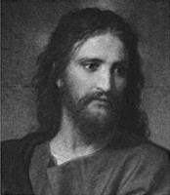
Pure in Heart
Look unto God with firmness of mind
Pray unto him with exceeding faith
Lift up your heads and receive the pleasing word of God
Feast upon His love.
Eyes single to the glory of God, walking in the light through the mists of darkness. A constant determination—steadfast in Christ
The assuredly that your prayers will be answered
Those who daily live worthy of the peace of the spirit shall eventually gain the ultimate peace
Partake freely of the powers of the Savior’s atonement and the blessings of His gospel
Jacob 3:1-2

Slide 4
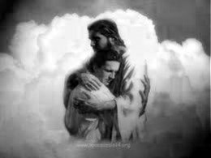
Console
God will console the pure in heart in their afflictions.
Comfort someone who is sad or troubled
How has the Lord consoled you?
How has praying with faith helped you during a time of trial?
When has God’s word helped you feel His love?
“Behold, I say unto you, go forth as I have commanded you; repent of all your sins; ask and ye shall receive; knock and it shall be opened unto you.
Behold, I will go before you and be your rearward [your guard from behind]; and I will be in your midst, and you shall not be confounded.”
D&C 49:26-27
If we look unto God with firmness of mind and pray with exceeding faith, He will console us in our afflictions
Jacob 3:1-2

Slide 5
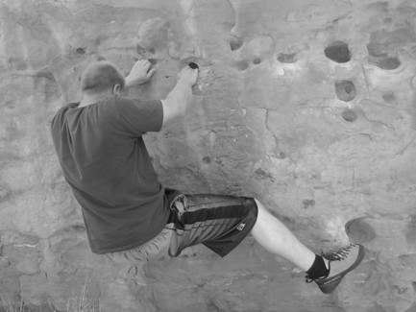
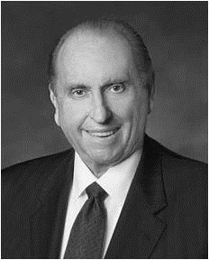
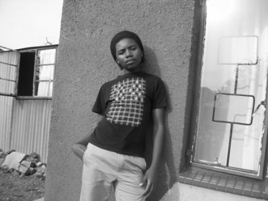
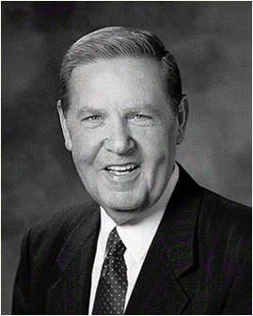
Challenges
“We live at a time in the world’s history when there are many difficult challenges but also great opportunities and reasons for rejoicing. There are, of course, those times when we experience disappointments, heartaches, and even tragedies in our lives. However, if we will put our trust in the Lord, He will help us through our difficulties, whatever they may be. The Psalmist provided this assurance: “Weeping may endure for a night, but joy cometh in the morning.” Psalms 30:5
^{Thomas S. Monson}
How do we overcome challenges and trials?
1. “Live as faithfully as we possibly can. … We must not be paralyzed just because [of events] ahead of us somewhere.”
2. “Never let fear and the father of fear (Satan himself) divert us from our faith and faithful living.”
3. “Be faithful. God is in charge. He knows your name and He knows your need.”
Jeffrey R. Holland

Slide 6
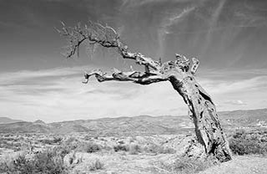
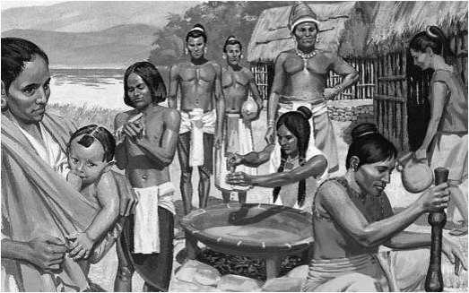
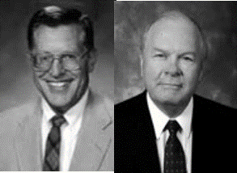
The Unrepentant
Those who are not repentant:
Land will be cursed
Sore cursing and even destruction
Those unrighteous will possess your lands and all righteousness will ‘lead away’ from among you.
Lamanites more righteous?
“The Lamanites, despite their dark and lowly existence in the days of Jacob, still are faithful to their wives and children, and, in this sense, are more righteous than many of the Nephites who—professing membership in the church--revel in immorality and unauthorized plural marriages.” JFM and RLM
Jacob 3:3-5

Slide 7
Withdrawn
The protective hand of the Lord is withdrawn from any people who revel in whoredoms.
Promises to the Lamanites:
“For there are many promises which are extended to the Lamanites; for it is because of the traditions of their fathers that caused them to remain in their state of ignorance; therefore the Lord will be merciful unto them and prolong their existence in the land.
And at some period of time they will be brought to believe in his word, and to know of the incorrectness of the traditions of their fathers; and many of them will be saved, for the Lord will be merciful unto all who call on his name.”
Alma 9:16-17
Jacob 3:6

Slide 8
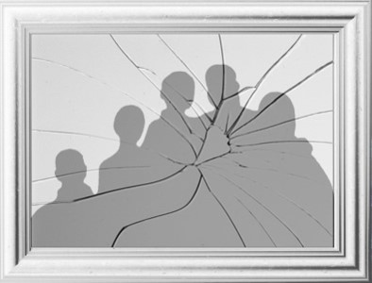
Behaviors Inherited
Husbands and wives are to love one another, and parents are to love their children
What are some consequences that can result when family members fail to love one another and do not fulfill their family responsibilities?
Behavioral patterns and attitudes frequently continue from generation to generation. Posterity is often beholden to ancestry for their views of god, man, and the purposes of life.
“And again, inasmuch as parents have children in Zion, or in any of her stakes which are organized, that teach them not to understand the doctrine of repentance, faith in Christ the Son of the living God, and of baptism and the gift of the Holy Ghost by the laying on of the hands, when eight years old, the sin be upon the heads of the parents.”
D&C 68:25
Jacob 3:7

Slide 9
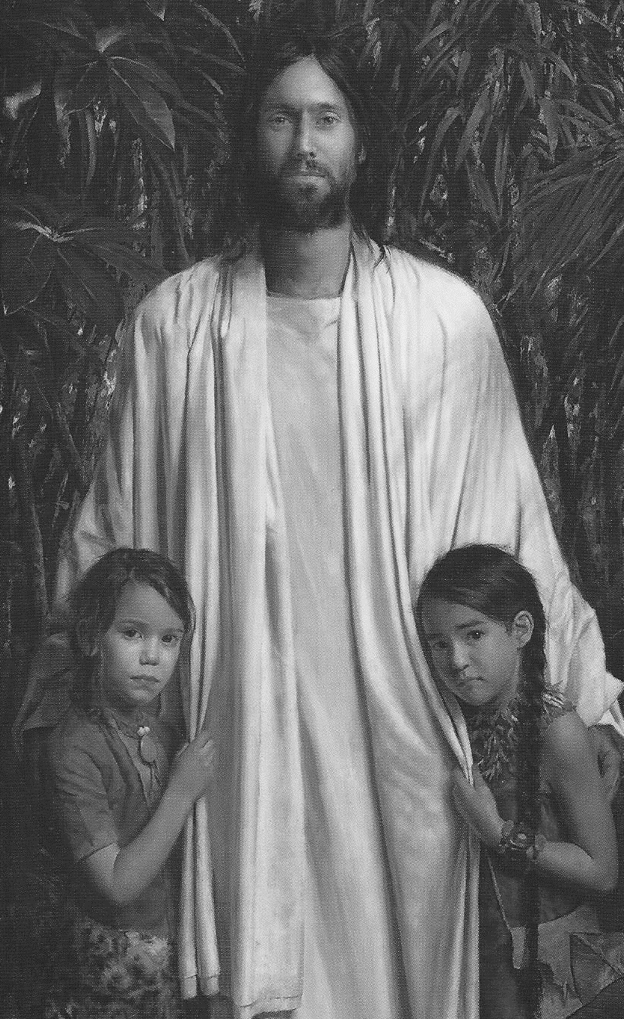
Revile
Why did some of the Nephites revile against the Lamanites?
Because of the Lamanites’ filthiness and the darkness of the Lamanites’ skin.
Also, filthiness of sin.
Rather than criticizing others for their sins, we are to recognize and repent of our own sins
“God loves all of His children and makes salvation available to all. God created the many diverse races and ethnicities and esteems them all equally. As the Book of Mormon puts it, ‘all are alike unto God.”
Jacob 3:9; 2 Nephi 26:33; (“Race and the Priesthood,” Gospel Topics, topics.lds.org).

Slide 10
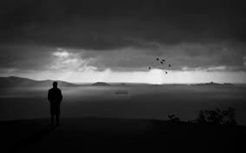
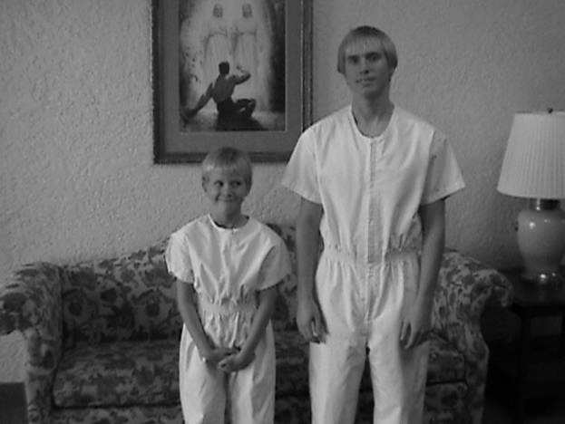
Nephite’s Punishments
“O my brethren, I fear that unless ye shall repent of your sins that their skins will be whiter than yours, when ye shall be brought with them before the throne of God.”
Revile against—To despise, to regard as vile, or to physically or verbally abuse, all of which are alien to the Spirit of God.
“And thou shalt do it with all humility, trusting in me, reviling not against revilers.”
D&C 19:30
Bring your children unto destruction:
Taking away the light through disobedience
”The glory of God is intelligence, or, in other words, light and truth. Light and truth forsake that evil one.
And that wicked one cometh and taketh away light and truth, through disobedience, from the children of men, and because of the tradition of their fathers.” D&C 93:36-37, 39
Is it important to set good examples for your family members?
Jacob 3:8-10

Slide 11
Hearken—Jacob’s Warning
“arouse the faculties of your souls” -- the need to wake up spiritually.
“shake yourselves”
“Awake from slumber”
“loose yourselves from the pains of hell”
“Do not become angels to the devil”—the second death
“fornication and lasciviousness” -- sexual sins.
The best way to receive the promises of Heavenly Father is to always be pure in heart
Those who have committed sexual sins can seek help from their bishop or branch president, who will help them repent, become clean through the Atonement of Jesus Christ, and receive the blessing promised to the pure in heart.
Jacob 3:11-12

Slide 12
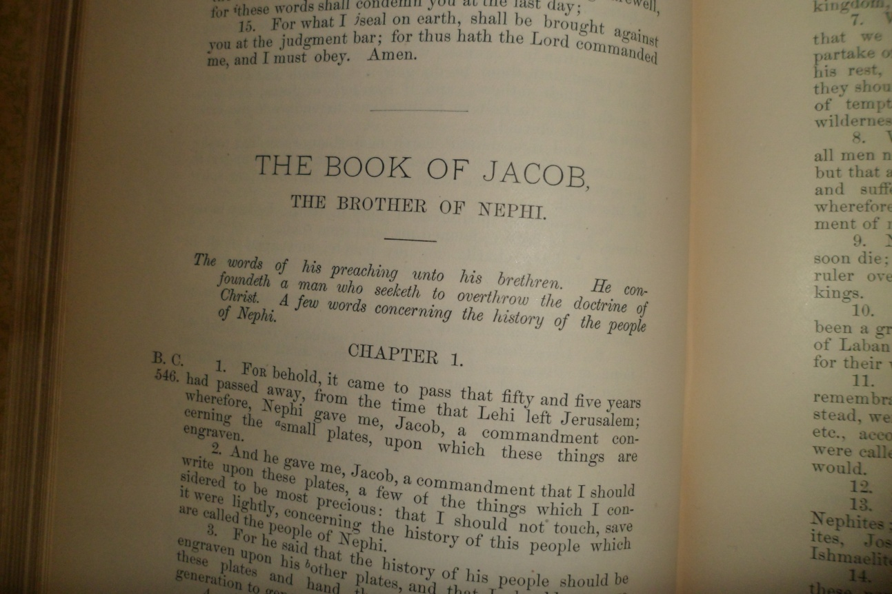
A Hundredth Part
Knowing that only a small portion of the doings and teachings of the Nephites is found in our present Book of Mormon.
“Wherefore, I chose these things, to finish my record upon them, which remainder of my record I shall take from the plates of Nephi; and I cannot write the hundredth part of the things of my people.”
Words of Mormon 1:5
“These plates are called the plates of Jacob, and they were made by the hand of Nephi. And I make an end of speaking these words.”
It would appear that the plates were named after their keepers. See 1 Nephi 9:2; Omni 1:4
JFM and RLM
Jacob 3:13-14

Slide 13
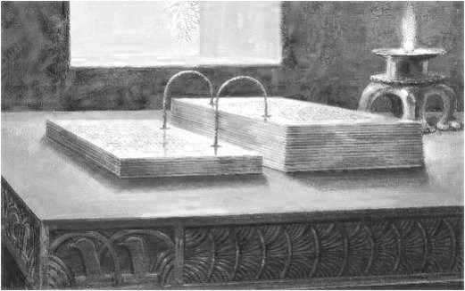
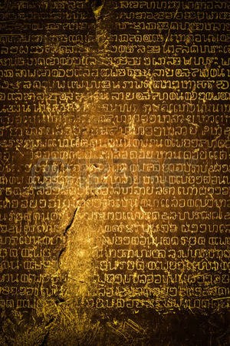
Difficulty of Writing
“Writing upon metal plates was a burden which proved to be a blessing. No doubt many of the writers were, like Jacob, prevented from expounding at length upon various matters.”
The record keepers would have chosen their words carefully for their audience. They knew that the things they would write must be kept from corrosion, the perils of handling and repeated use so it could be available for future generations.”
Scripture requires the spirit of revelation to properly expound and expand the meaning intended by its authors.”
Jacob 4:1-2
JFM and RLM

Slide 14
Precious and Lost Truths
“Surely the most plain and precious of all truths lost from the Bible, particularly the Old Testament, are the clear and unequivocal declarations of the mission of Jesus Christ, his foreordained role as Messiah and Savior of the world, and the covenantal elements of his gospel, which have been taught from Adam down through each succeeding dispensation.
Thus the Book of Mormon’s highest purpose is to restore to the universal family of God that crucial knowledge of Christ’s role in the salvation of every man, woman, and child who now lives, has ever lived, or will yet live upon the earth.” Jeffrey R. Holland
Jacob 4:4

Slide 15
Staying Focused
Knowing of Christ—Worshipping the Father in His name (Moses 5:8)—
Emulate--His example and seek to pattern our lives after His. (D&C 18:40)
Hope in His glory and all holy prophets before us (Numbers 11:29)
Keeping the law of Moses (Alma 34:14)
Remembering the sacrifice of Isaac, a similitude of Christ’s Atonement
Receiving revelations and the spirit of prophecy. Obtaining hope and faith (Moroni 7:41)
Are You Able To Stay Focused?
Jacob 4:4-6

Slide 16
Strengthening Your Muscles
How is the process of strengthening your muscles similar to the process of strengthening your faith in Jesus Christ?
Both require consistent effort on our part
Both require consistent effort on our part

Slide 17
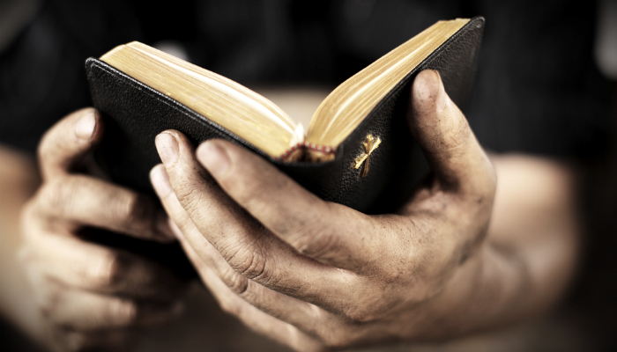
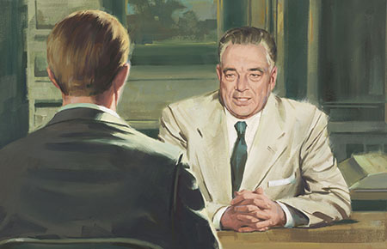
We can strengthen our faith in Jesus Christ by choosing to believe in Him and by worshipping the Father in His name
We can strengthen our faith in Jesus Christ by choosing to search the words of the prophets
We can strengthen our faith in Jesus Christ by choosing to take counsel from His hand
We can strengthen our faith in Jesus Christ by choosing to be reconciled to God through the Atonement of Christ
Jacob 4:5

Slide 18
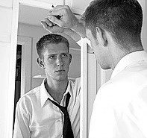
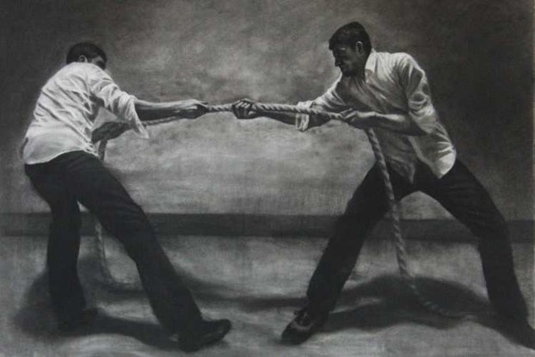
Weaknesses
“Nevertheless, the Lord God showeth us our weakness that we may know that it is by his grace, and his great condescensions unto the children of men, that we have power to do these things.”
Weaknesses: the Lord often provides reminders to his servants of the ever-present need to rely upon him.
(Ether 12:27)
That they may humble themselves before me…
Will make weak things strong.
Jacob 4:7

Slide 19
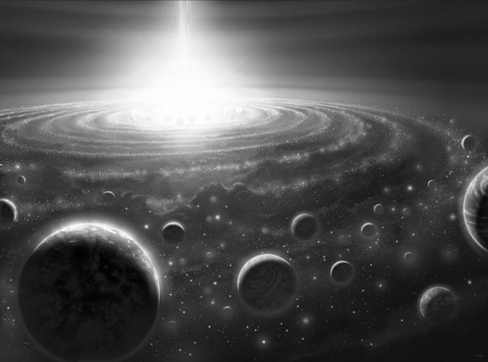
God’s Nature VS Man’s Nature
“…And no man knoweth of his ways save it be revealed unto him; wherefore, brethren, despise not the revelations of God.”
The Mysteries
God is infinite and man is finite.
God is immortal and man is mortal
God is all powerful and man is impotent in contrast with omnipotence.
God is limitless and knows all things while man is still growing, still floundering, still grappling with his own survival.
Jacob 4:8

Slide 20
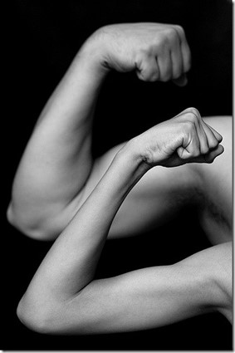
Seek Not…
“Wherefore, brethren, seek not to counsel the Lord, but to take counsel from his hand. For behold, ye yourselves know that he counseleth in wisdom, and in justice, and in great mercy, over all his works.”
When we follow our own whims, we fail to take the counsel of our own prophets
“Remember, remember that it is not the work of God that is frustrated, but the work of men;
For although a man may have many revelations, and have power to do many mighty works, yet if he boasts in his own strength, and sets at naught the counsels of God, and follows after the dictates of his own will and carnal desires, he must fall and incur the vengeance of a just God upon him.”
D&C 3:3-4
Jacob 4:10

Slide 21
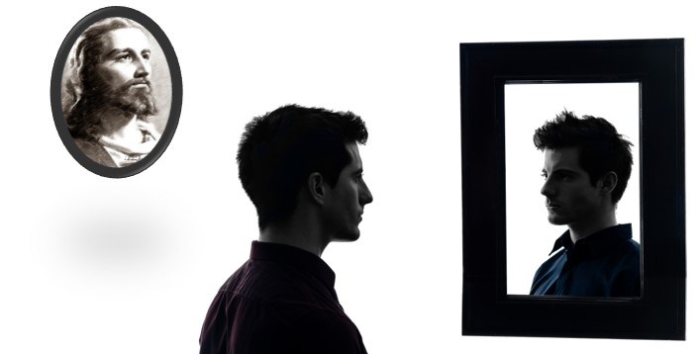
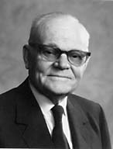
“I do not think that many members of the Church consciously [follow] the persuasions of men or their own counsel instead of heeding the Lord’s.
However, when we do not keep ourselves advised as to what the counsel of the Lord is, we are prone to substitute our own counsel for His.
As a matter of fact, there is nothing else we can do but follow our own counsel when we do not know the Lord’s instructions.”
Jacob 4:10
Marion G. Romney

Slide 22
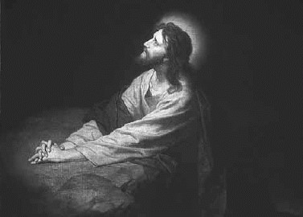
Reconcile
Bring into harmony.
How does the Atonement help us come into harmony with our Heavenly Father?
Jacob reminded us of the importance of teaching about the Atonement, by asking,
“Why not speak of the atonement of Christ … ?”
Following this principle—
Sharing our Testimonies—with the Spirit
The Holy Ghost is the “Spirit of Truth”
D&C 93:24-26
Jacob 4:11-13

Slide 23
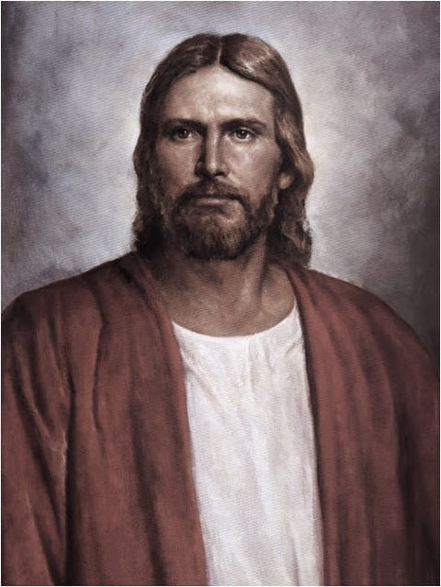
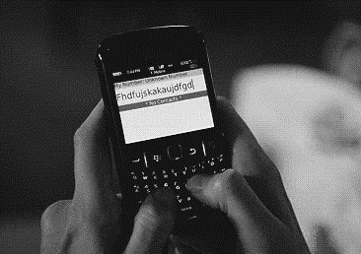
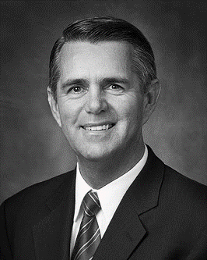
Beyond the Mark
I invite us to identify the time-wasting distractions in our lives that may need to be figuratively ground into dust. We will need to be wise in our judgment to ensure that the scales of time are correctly
balanced to include the Lord, family, work, and wholesome
recreational activities.
Ian S. Ardern

Slide 24
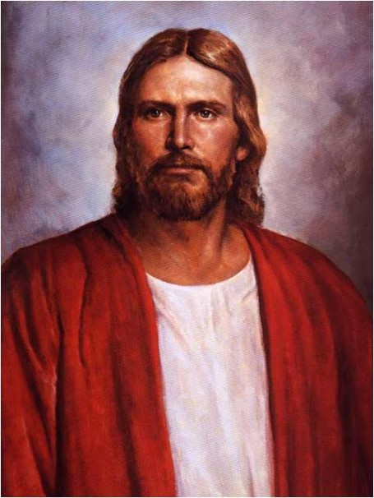
If we center our lives on anything other than the Savior and His gospel, then we will become blind to the truth and we will stumble and fall spiritually.

Slide 25
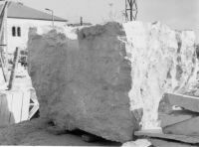
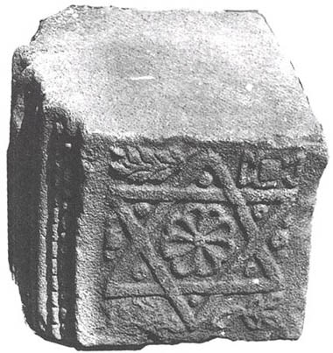
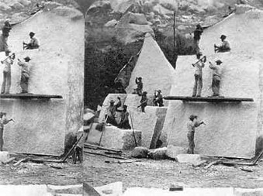
Reject the Stone
“Tradition holds that at the time of the construction of the second temple, the builders rejected and discarded a chief cornerstone by mistake (Psalm 118:22; Isaiah 8:14-15)
All men and women who turn a deaf ear to the message or messengers of Jesus Christ—shatter the very foundation upon which they might have built their house of faith. (Helaman 5:12)
Jacob is aware that Jesus will eventually be the rock and chief cornerstone for the house of Judah and for all.
Jacob 4:15-18

Slide 26
Sources:
Thomas S. Monson Until We Meet Again April 2013
Jeffrey R. Holland This, the Greatest of All Dispensations Ensign July 2007; Christ and the New Covenant: The Messianic Message of the Book of Mormon [1997], 6–7).
Joseph Fielding McConkie and Robert L. Millet Doctrinal Commentary on the Book of Mormon Vol. 2 pgs 24-48
Ian S. Ardern A Time to Prepare Oct 2011 Ensign
Marion G. Romney Seek Not to Counsel the Lord, Ensign, Aug. 1985, 5
Presentation by ©http://fashionsbylynda.com/blog/

