Slide 1
Opposing Forces
Story of Jacob and Sherem
Jacob 7

Slide 2
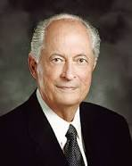
“One of mortality’s great tests comes when our beliefs are questioned or criticized.”
Elder Robert D. Hales.
Has there been a time in your life that someone has questioned or criticized your beliefs?

Slide 3
Sherem
He was a skilled and proud public speaker during the tenure of the prophet Jacob
He was learned and had knowledge of the language of the people
He knew how to flatter people through speech
His message to the people was a total denial of the being and mission of Christ (Jacob 7:7)
He insisted on signs
He was an anti-Christ
Jacob 7:1

Slide 4
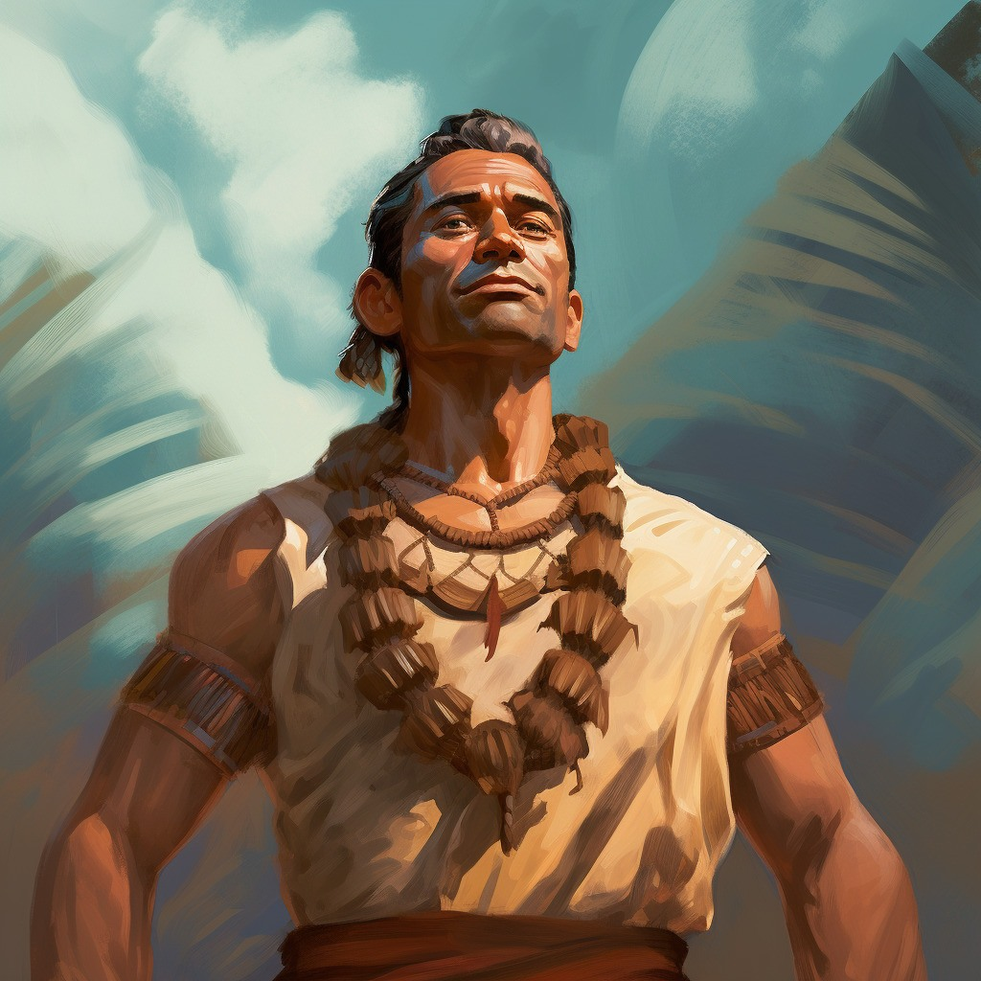
Spirit of Rebellion
Anti-Christ--“anyone or anything that counterfeits the true gospel or plan of salvation and that openly or secretly is set up in opposition to Christ” [Bible Dictionary, “Antichrist”]
Those who say: “…that there should be no Christ…”
Those who want to “overthrow the doctrine of Christ.”
Those who seek to challenge the faith of someone.
Sherem sought Jacob out to challenge his faith.
Jacob 7:2

Slide 5
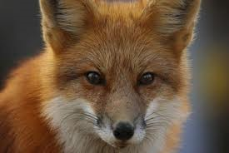
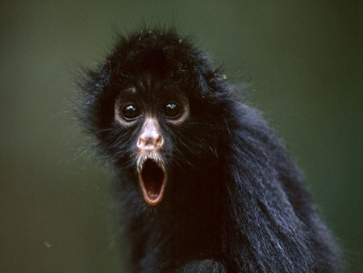
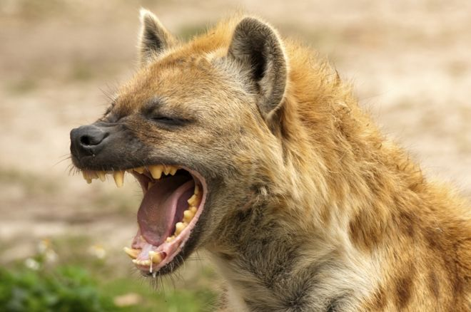
Flattery
Those who know how to persuade and dissuade
Those who know how to attract attention and create a following
Those who popularize the rage of immodest speech, thoughts, and actions.
Those who know how to make their listeners feel secure and comfortable in their sins (A Form of Pride)
Jacob 7:2

Slide 6
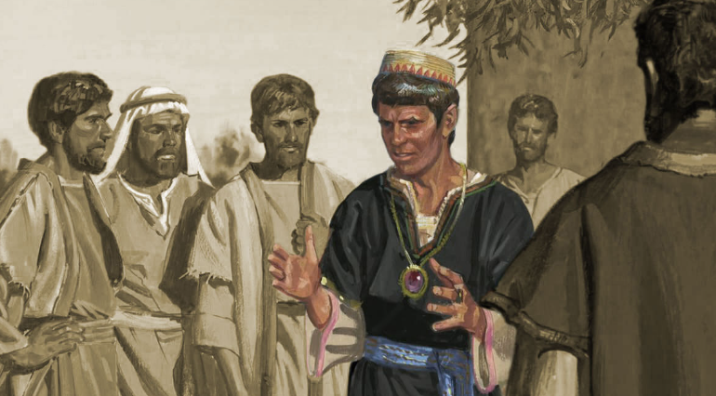
Effects on the People
Not all people who question or criticize our faith have the same motives as Sherem.
While some people like Sherem deliberately seek to destroy faith, others may question our faith because they are curious or because they have been misinformed concerning our beliefs.
What did Sherem do to destroy the people’s faith?
Labored diligently
led away the hearts of many people
used flattery…power of speech…power of the devil
had hopes to shake Jacob from the faith
Jacob 7:3-5

Slide 7
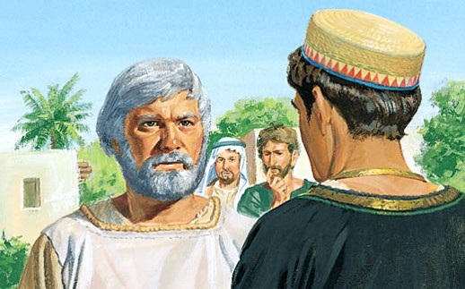
Jacob’s Faith
Jacob received many revelations
Jacob had seen angels and they ministered unto him
Jacob also heard the voice of the Lord from time to
Therefore:
Jacob could not be “shaken”
Jacob chose to remember past experiences that had strengthened his faith.
We can overcome challenges to our faith by remembering past experiences that have strengthened our faith
Jacob 7:3-5

Slide 8
Interaction
I have heard you preach…you have led people to not keep the law of Moses…this is blasphemy … no one knows such things. You can not predict the future.
Don’t you believe in Christ who shall come?
Jacob 7:6-9

Slide 9
I would not deny him, but I know that there is no ‘Christ’. There never has been and there will never be one.
Do you believe in the scriptures?
Yes
Jacob 7:9-10

Slide 10
Then you do not understand them, for they truly testify of Christ. All the prophets have spoken of a Christ
I have seen and heard through the power of the Holy Ghost that through Atonement of Jesus Christ we will not be lost
Jacob 7:11-13

Slide 11
I should not tempt God in this way… I know you know the doctrine to be true…but you deny it
Prove to me of this power of the Holy Ghost…Show me a sign
But if God will let this be so, then He will show you of His powers both in heaven and on earth
This will be God’s will, not mine
Jacob 7:13-14

Slide 12
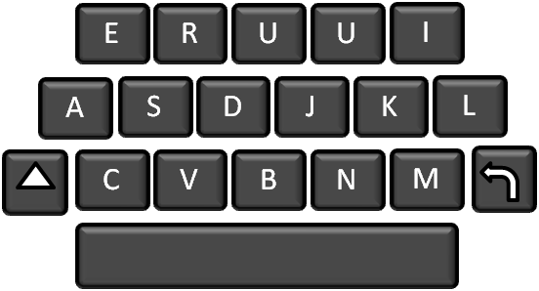
Next Day
The Texter
is it ok if go to pauls after schol
Yes
Can i stay the night at pauls tonight
can i spend the night at pauls
no
No dad will pick u up
Why?
But y?
Because it is a school night
School night
Whatever
i could get to schol with paul
u guys let travis spend the night i dont understand y!
No…dad is on his way
Ugh…..
Just like Sherem…Even though the texter knew it was a school night he still persisted to ask what he knew he couldn’t do.
Please

Slide 13
Jacob’s Response
1. Jacob 7:5
2. Jacob 7:8
3. Jacob 7:10–11
4. Jacob 7:12
5. Jacob 7:13–14
a. Testified of the scriptures and the words of prophets.
b. Left the outcome in God’s hands.
c. Relied on guidance and strength from the Holy Ghost.
d. Remembered past experiences that had strengthened his faith.
e. Shared the testimony he had received through the Holy Ghost.
Jacob 7:3-5

Slide 14
Faith
What happened to Jacob in the past that made his faith unshakable?
What are some experiences that have strengthened your faith?
How can remembering these experiences help you when someone questions or criticizes your faith?
When has the Holy Ghost helped you respond to questions or criticisms about your faith?
How can a daily habit of studying the scriptures and the words of latter-day prophets help you when others question or criticize your faith?
When have you shared your testimony with someone who has questioned or criticized your faith? What was the result?
When Sherem demanded a sign, why was it wise for Jacob to leave the outcome in the Lord’s hands rather than seek to prove the truthfulness of his testimony himself?
How does it help you to know that it is
not necessary for you to prove the
truthfulness of your testimony to those
who challenge your faith?
We can overcome challenges to our faith by relying on guidance from the Holy Ghost
Jacob 7:5-14

Slide 15
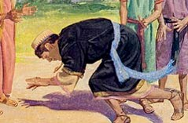
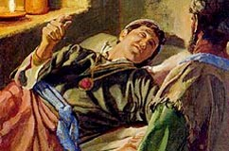
Sherem’s Fate
Power of the Lord came upon Him
He fell to the earth
Asked the people to gather
Knew he was going to die
On the Morrow:
He denied the things he had taught them and confessed the Christ, and the power of the Holy Ghost, and the ministering of angels.
Confessed that he had been deceived by the power of the devil
Spoke of hell, eternity and eternal punishment
“And he said: I fear lest I have committed the unpardonable sin, for I have lied unto God; for I denied the Christ, and said that I believed the scriptures; and they truly testify of him. And because I have thus lied unto God I greatly fear lest my case shall be awful; but I confess unto God.”
He gave up the ghost--died
Jacob 7:15-20

Slide 16
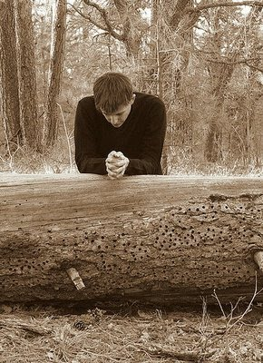
“Through the years we learn that challenges to our faith are not new, and they aren’t likely to disappear soon. But true disciples of Christ see opportunity in the midst of opposition. …
“… Fortunately, the Lord knows the hearts of our accusers and how we can most effectively respond to them.
As true disciples seek guidance from the Spirit, they receive inspiration tailored to each encounter. And in every encounter, true disciples respond in ways that invite the Spirit of the Lord.”
Robert D. Hales
We can overcome challenges to our faith by relying on the words of prophets and sharing our testimonies of the gospel.
“…see opportunity in the midst of opposition”
Good can result as we respond to challenges to our faith in ways that invite the Spirit of the Lord

Slide 17
Truths from Jacob
All prophets testify of Jesus Christ
Searching the scriptures will help us avoid being deceived.
As we respond to questions or criticisms of our faith in ways that invite the Spirit, we can help others turn to the Lord.
Those who rebel against God and actively preach against the truth will face severe consequences from the Lord.
.
Prophets help us recognize and overcome Satan’s deceptions.
Jacob 7:5-14

Slide 18
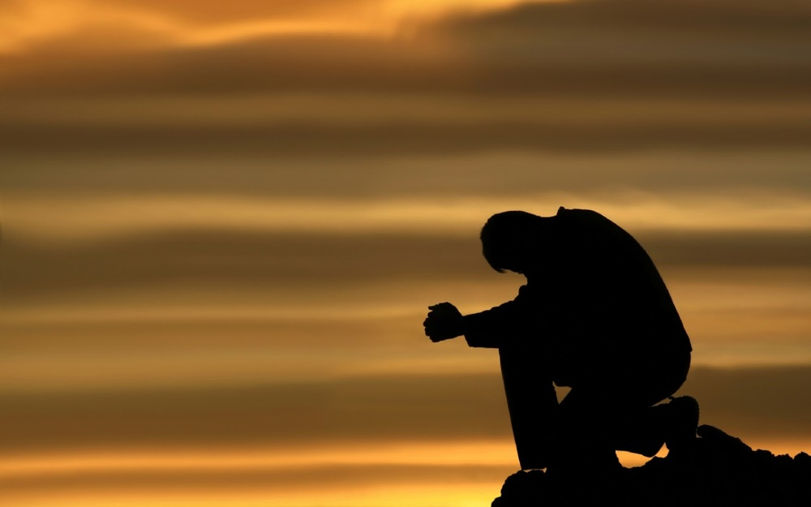
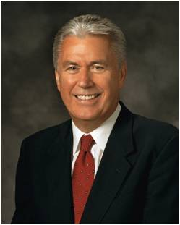
“God commands us to seek answers to our questions and asks only that we seek ‘with a sincere heart, with real intent, having faith in Christ.’” When we do so, the truth of all things can be manifested to us ‘by the power of the Holy Ghost.’”
“Fear not; ask questions. Be curious, but doubt not! Always hold fast to faith and to the light you have already received. Because we see imperfectly in mortality, not everything is going to make sense right now. In fact, I should think that if everything did make sense to us, it would be evidence that it had all been made up by a mortal mind. Remember that God has said:
“‘My thoughts are not your thoughts, neither are your ways my ways. …
“‘For as the heavens are higher than the earth, so are my ways higher than your ways, and my thoughts than your thoughts.’”
Dieter F. Uchtdorf
James 1:5–6; Moroni 10:4-5; Isaiah 55:8-9

Slide 19
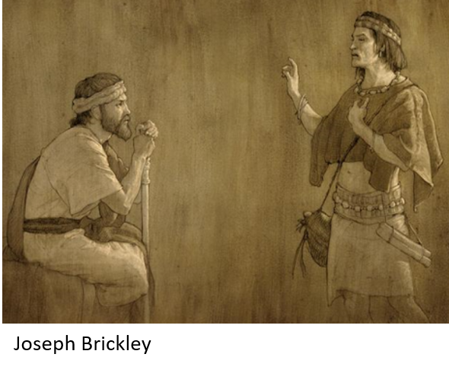
Jacob’s Fear
“And it came to pass that many means were devised to reclaim and restore the Lamanites to the knowledge of the truth; but it all was vain, for they delighted in wars and bloodshed, and they had an eternal hatred against us, their brethren. And they sought by the power of their arms to destroy us continually.”
The efforts of the Nephites to the Lamanites to bring the truth were repeatedly rejected.
“Wherefore, the people of Nephi did fortify against them with their arms, and with all their might, trusting in the God and rock of their salvation; wherefore, they became as yet, conquerors of their enemies.”
Jacob 7:24-25

Slide 20
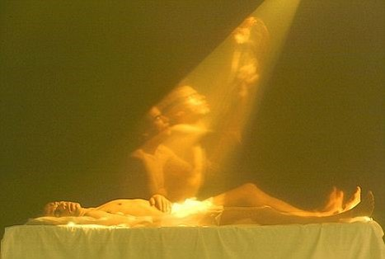
Saw My Life Flash Before Me
The other plates= reference to the large plates of Nephi, containing details of the kings and journeyings of the people, and the battles with the Lamanites.
Like a dream=fleeting moments of a mortal existence—poetic..the day of probation is over in an instant.
Lonesome and solemn people, wanderers—the life of the Nephites was, during the greater part of their history, one of loneliness and heartache.
Like all those who are faithful--
“Strangers and pilgrims on the earth”
Hebrew 11:13
D&C 45:13
Jacob 7:26

Slide 21
Jacob’s Farewell
Jacob gives his son Enos the Plates
Enos promises to be obedient in the commandments
Jacob hopes for his brethren read his words
Jacob 7:27

Slide 22
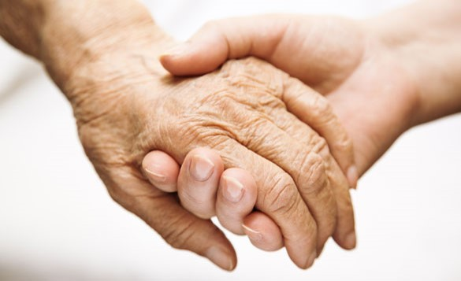
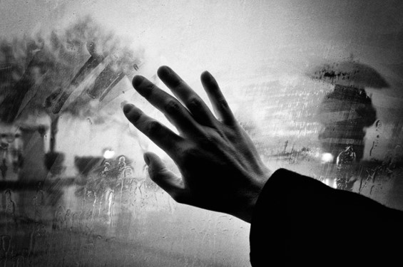
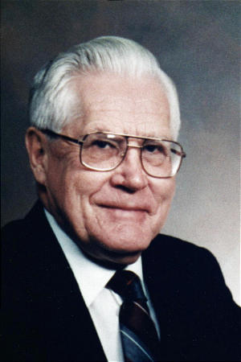
Adieu
Adieu-
“Some anti-LDS critics of the Book of Mormon have raised the question as to how Jacob could possibly have used such a word as adieu when this word clearly comes from the French language, which was not developed until hundreds of years after the time of Jacob. Such critics evidently overlook the fact that the Book of Mormon is translation literature, and Joseph Smith felt free in his translation to use any words familiar to himself and his readers that would best convey the meaning of the original author.
…there is a Hebrew word Lehitra’ot, which has essentially the same meaning in Hebrew as the word adieu has in French. Both of these words are much more than a simple farewell; they include the idea of a blessing.
Would it be unreasonable to remind these critics that none of the words contained in the English translation of the book of Jacob were used by Jacob himself? These words all come from the English language, which did not come into existence until long after Jacob’s time!” Daniel H. Ludlow
Jacob 7:27

Slide 23
Sources:
Elder Robert D. Hales Christian Courage: The Price of Discipleship, Ensign or Liahona, Nov. 2008, 72
Joseph Fielding McConkie and Robert L. Millet Doctrinal Commentary on the Book of Mormon Vol. 2 pg 84-89
Bruce R. McConkie Mormon Doctrine p. 712
Robert D. Hales Christian Courage: The Price of Discipleship, 72–73; italics in original
Dieter F. Uchtdorf The Reflection in the Water [Church Educational System fireside for young adults, Nov. 1, 2009]
Daniel H. Ludlow A Companion to Your Study of the Book of Mormon p. 163
Presentation by ©http://fashionsbylynda.com/blog/

Slide 24
Commentary on Interaction between Sherem and Jacob (JFM and RLM)
Vs. 6—Sherem correctly observes that the gospel is the doctrine of Christ.
Vs. 7 It is strange that Sherem, an anti-Christ would argue for the sufficiency of the law of Moses when, in fact, the law was given by god to point toward the coming of Christ.
—Sherem uses the Law of Moses to deny the principle of revelation
--Those who have opposed the Prince of Truth have maintained the same ironic and inconsistent arguments.
Hence: Christians reject modern revelation in the name of the Bible—see Alma 30:13,15,24,26
Vs. 9 What Sherem really means is ‘If there should be a Christ—here and now, one that I can see and feel and hear, one which requires no faith or hope—then I would not deny him; I would believe.’ Proof is the last thing that those demanding it really desire. The louder the shouts for evidence, the less the inclination to accept it.
--The doubter errs through generalizing beyond his own experiences. What he has not experienced, no one else can. Because he does not know, no one knows, because he cannot feel, surely no on has felt. Those who dare not believe dare not allow others to believe (see Alma 30:48)
--Sherem did not search for truth…he searched for justification, not sanctification.
Vs. 14 Sherem is unworthy of a confirming sign.
Vs. 8 Outpouring of Spirit—an expression for receiving the Spirit in rich abundance, of receiving the power and direction of the Holy Ghost
Vs. 10-11 it is one thing to read the scriptures and quite another to understand them. To fully comprehend the message of scripture one must become acquainted with all that God has reveled. To grasp the full meaning of scripture one must enjoy the same spirit of inspiration which actuated the original writer…persons in this day must seek that level of holiness which would allow them to receive the intent and content of that written by holy men of old. (see 2 Peter 1:20-21)
Vs. 12 The Holy Ghost is the source of a sure witness unto all persons in all generation.
Vs. 13 Signs=Miracles or wonders or gifts of the Spirit always follow true believers. Signs may “have the effect of strengthening the faith of those who are already spiritually inclined, but their chief purpose is not to convert people to the truth, but to reward and bless those already converted.”
Bruce R. McConkie
Jesus taught Matthew 12:39 -- Signs come by faith, not by man D&C 63:9-10
Vs. 14 Jacob knew that Sherem knew that the doctrine of Christ was true…this is frequently the case among anti-Christs (Alma 11:24; 30:42)

