Slide 2
Enos
He was the grandson of Sariah and Lehi, and the son of Jacob
He was a nephew of Nephi
He lived about 544 to 421 BC
He was a Nephite
He kept the records handed down to him by Jacob
He demonstrated an important lesson on prayer, repentance, and revelation
He heard the voice of the Lord
He prayed earnestly for his brethren the Lamanites and the Nephites
The Book of Enos is the first to describe in detail the apostate condition of the descendants of Laman and Lemuel (see Enos 1:20).
The Small Plates

Slide 3
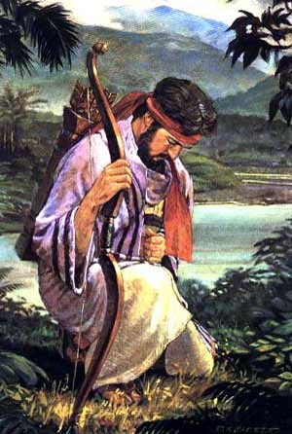
The Book of Enos—Small Plates
The Book of Enos illustrates the power of the Atonement of Jesus Christ to cleanse people from sin and make them whole. Enos wrestled before God in mighty prayer before his sins were forgiven.
He then prayed for the spiritual welfare of the Nephites and the Lamanites, and he spent the remainder of his life laboring for their salvation.
The Book of Enos

Slide 4
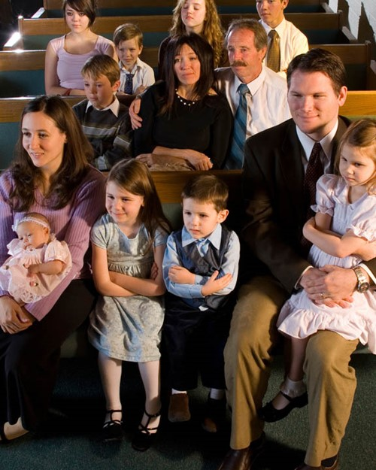
Who Are These Records For?
When Enos received the small plates from his father, he promised to engrave only the writings that he considered to be most precious, which included sacred teachings, revelation, and prophecy.
Enos knew that his people, the Nephites, eventually would be destroyed.
He prayed that the Lord would preserve a record of the Nephites “that it might be brought forth at some future day unto the Lamanites, that, perhaps, they might be brought unto salvation” (Enos 1:13).
Enos 1:1; Jacob 1:1-4; 7:27

Slide 5
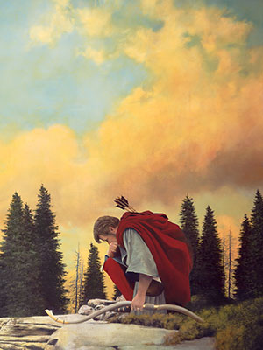
“Wrestle With God”
Enos did not physically wrestle with God.
The record states that Enos wrestled before God in prayer.
Such wrestling is the struggle to find and express one’s real desires under the inspiration of the Holy Ghost.
Praying in this manner requires that a person eliminate vain, trite, or insincere repetitions and to pour the deepest desires of his or her heart into words.
…an expression of yearning and desire to do God’s will.
“for we know not what we should pray for as we ought: but the Spirit itself maketh intercession for us with groanings which cannot be uttered”
(Romans 8:26).
Enos 1:2-4
Book of Mormon Student Manual

Slide 6
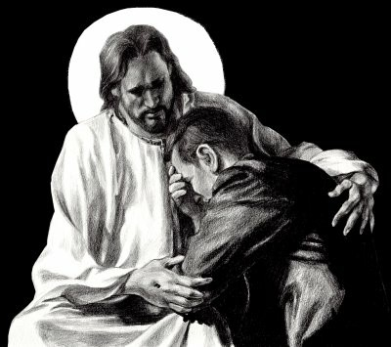
My Soul Hungered
Spiritual Emptiness:
Anxious feeling
Questionable testimony
Knowing that repentance is required
Longing for a spiritual experience
Physical Hunger:
A Feeling of emptiness
Pain
Weakness
A desire to be full
Enos 1:4

Slide 7
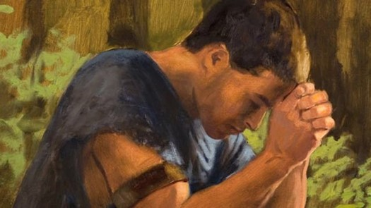
A Desire
What Enos Desired
Enos 1:2
Enos 1:3
What Enos Did
Enos 1:2
Enos 1:4
Enos 1:8
Results of what Enos Did
Enos 1:5
Enos 1:6
Enos 1:8
Remission of Sins
Eternal Life
Joy of the Saints
Wrestled--prayed
Kneeled down before his Maker
Prayed all day long
Raised his voice to the heavens
Had faith in the Lord
His sins were forgiven
His guilt was swept away
His faith had made him whole
Enos 1:2-8

Slide 8
Desires Today
Our Desires
What Can We Do?
What will be the results?
Remission of Sins
Eternal Life
Joy for our families and friends
Pray with real intent
Kneel down in private
Submit your will to the Lord
Pray out loud
Praise Him in song
Have Faith in the Lord
Our sins will be forgiven
We will no longer feel guilty
Through our faith in Jesus Christ we will be made whole
Enos 1:2-8

Slide 9
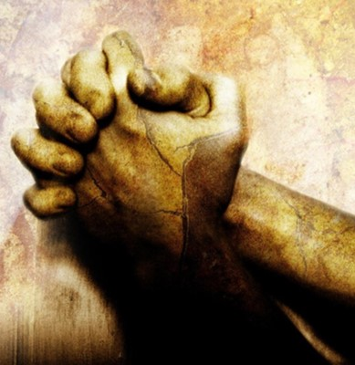
Spiritually Empty and Seeking Forgiveness
Why does sin cause us to feel spiritually empty?
Sin causes the Holy Ghost to withdraw from us and we feel distanced from the Lord.
In what ways can we show our sincerity as we seek the Lord’s forgiveness?
Our prayers may not need to be as long as Enos’, but they need to be sincere.

Slide 10
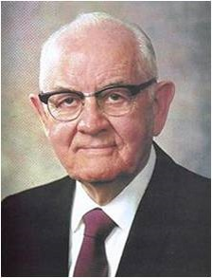
Remission of Sins
Enos did not mention the nature or extent of his sins, but rather described the process of repentance that we must each undertake to receive divine forgiveness.
President Spencer W. Kimball taught:
“I have always loved the story of Enos, who had great need. Like all of us—for none of us is perfect—he had strayed. How dark were his sins I do not know, but he wrote, ‘I will tell you of the wrestle which I had before God, before I received a remission of my sins’. …
“What a blessing and a joy for each of us to know that our Father lives and that he loves us, that he forgives us when repentance is forthcoming, that he is ever willing to help and give love to his beloved children.”
As we exercise faith in Jesus Christ, our sins can be forgiven of our sins, and we can be made whole
Enos 1:2

Slide 11
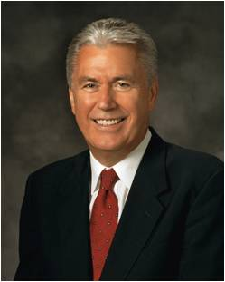
“Once we have truly repented, Christ will take away the burden of guilt for our sins. We can know for ourselves that we have been forgiven and made clean. The Holy Ghost will verify this to us; He is the Sanctifier. No other testimony of forgiveness can be greater.”
Enos 1:2
Dieter F. Uchtdorf

Slide 12
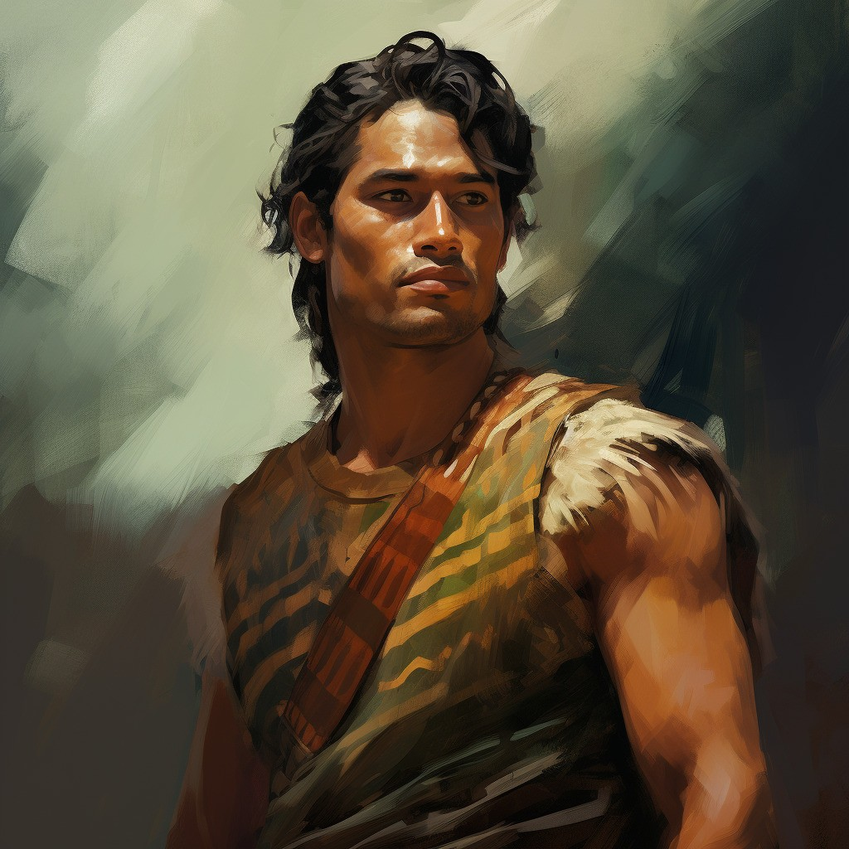
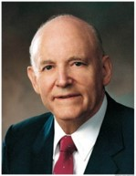
The Welfare of My Brethren
When Lehi partook of tree of life—his thought
went immediately to his family, he was
desirous for them also to have the fruit (truth).
When Enos tasted of the goodness of God, he sought above all else that the promise given Joseph be given him that his brethren may share in the goodness of God also.
“Any time we experience the blessings of the Atonement in our lives, we cannot help but have a concern for the welfare of our brethren. …
“A great indicator of one’s personal conversion is the desire to share the gospel with others”
Howard W. Hunter
Enos 1:9-10; 1 Nephi 8:12

Slide 13
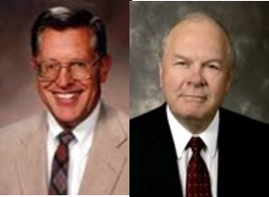
Voice—Revelation—of the Lord’s Promise
Holy Land—the promised land a land which is consecrated, dedicated, and set apart, a land blessed by the hand of the Lord for his service and his purposes.
JFM and RLM
Adam-ondi-Ahman—a place of New Jerusalem.
The birthplace of the book of Mormon and Restoration
JFM and RLM
Enos 1:11

Slide 14
Labor—the Power in Prayer
“There is a power in the prayer of the humble and diligent servant never to be known by the great master of eloquence who has not learned the grace of service and humility.”
JFM and RLM
The Savior taught:
“‘When thou prayest, thou shalt not be as the hypocrites are: for they love to pray standing in the synagogues and in the corners of the streets, that they may be seen of men. …
“‘But thou, when thou prayest, … pray to thy Father which is in secret; and thy Father which seeth in secret shall reward thee openly. …”
Matthew 6:5-6
“Those who obtain the promise of the Lord that they will receive according to their desires are those who have so attuned themselves with the mind and will of God”
JFM and RLM
Enos 1:12

Slide 15
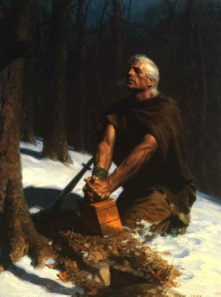
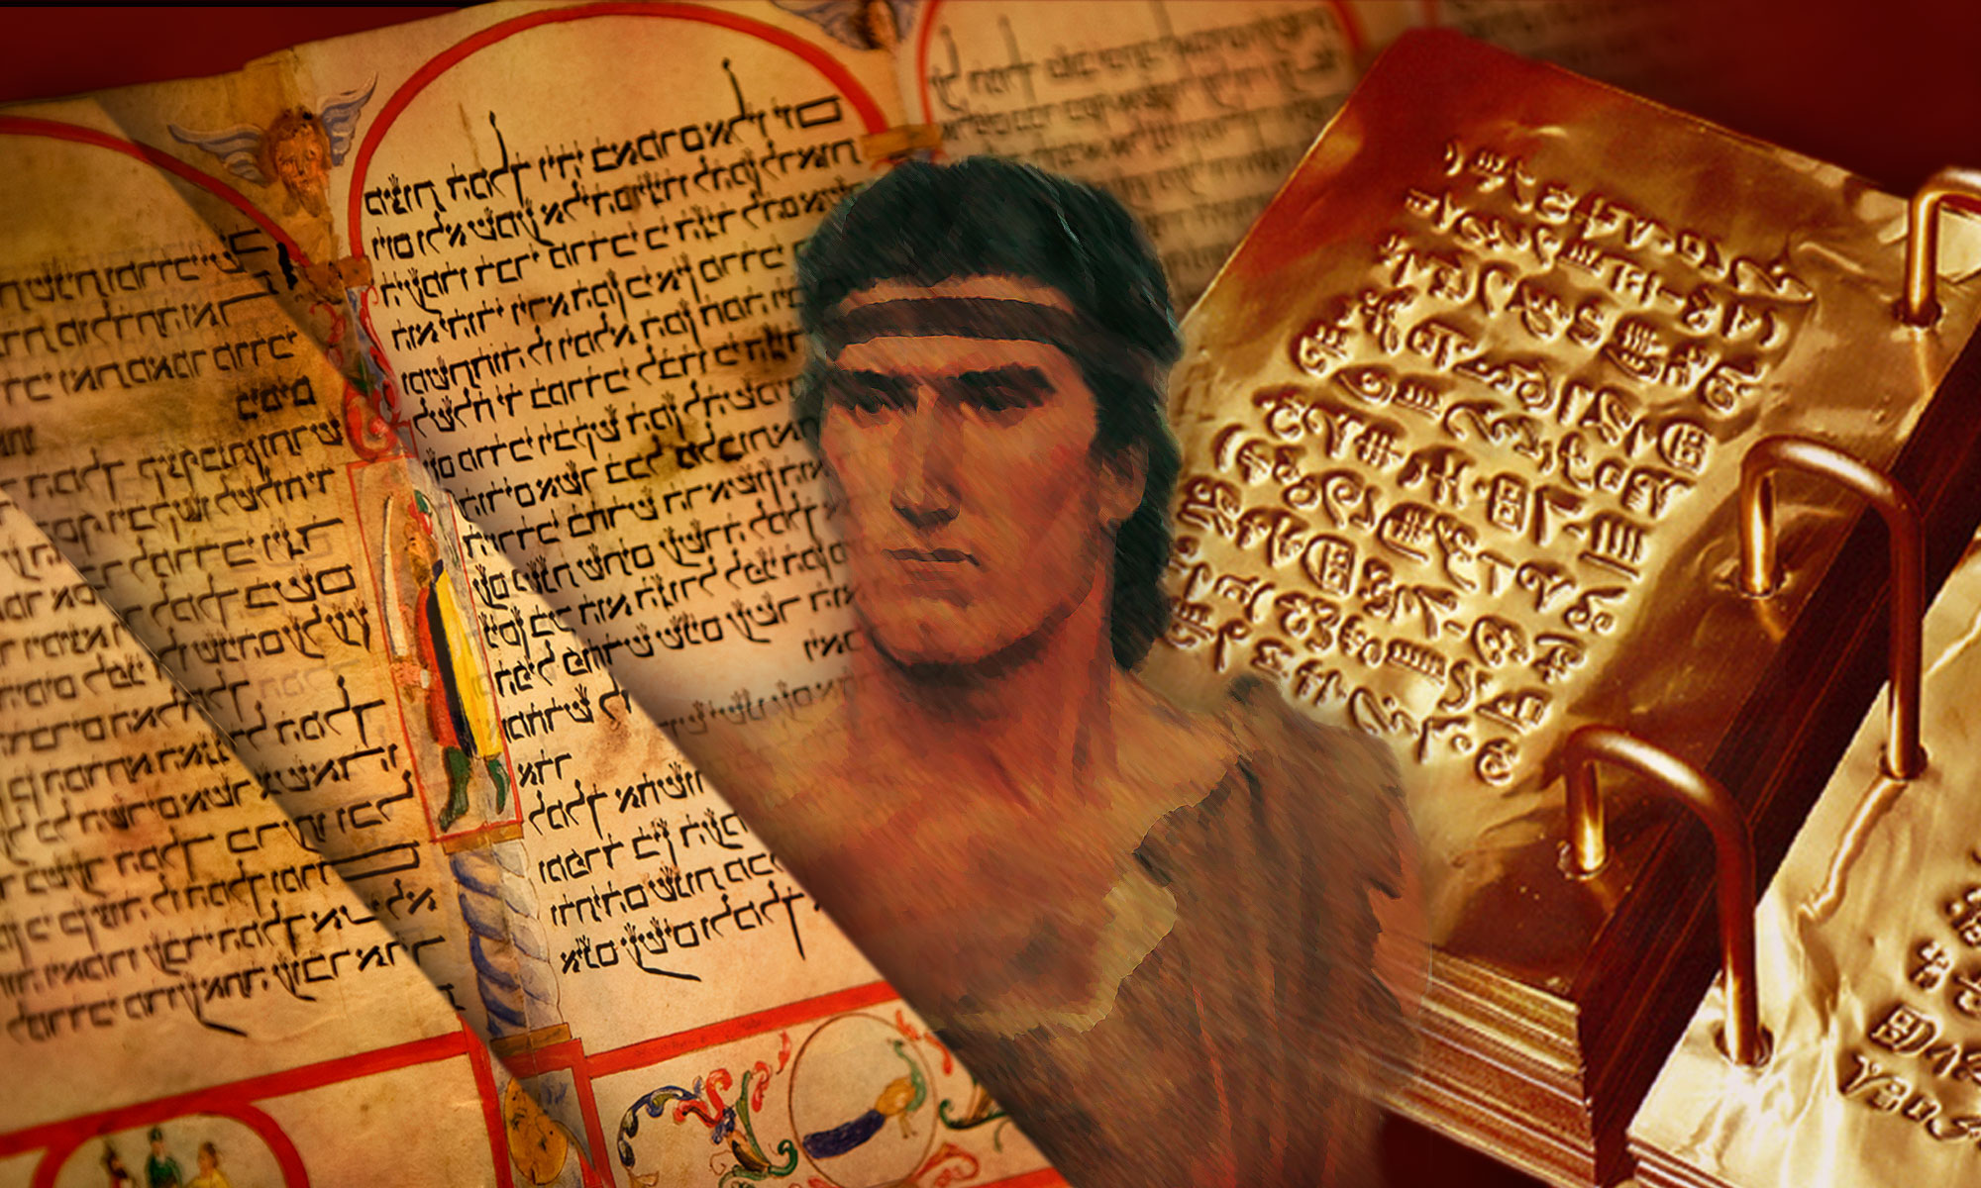
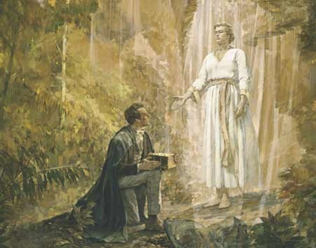
The Gift by the Power of God
The Book of Mormon declares itself to have come forth by the “gift and power of God.”
This is a treasure to those descendants of Lehi and the family of Joseph
The book comes by the power of God
It is written by the power of God
It is preserved by the power of God
It is brought forth by the power of God
And it is only understood by the power of God
The Promise:
Read D&C 10:47-52
Enos 1:13-18

Slide 16
Like Enos…
Enos prayed for the Lamanites, who were considered his enemies.
The Lord answers our prayers according to our faith and diligence
I desire to receive a remission of my sins. I will show the Lord that I am sincere in this desire by…
I desire to help my family members and friends come unto Christ. One person I will seek to help is…I will seek to help this person by…
I want to show the Lord’s love toward those who are unkind to me. One way I will do this is…

Slide 17
Faithfully Taught—and Testimony
Throughout all his days Enos taught and prophesied to a ‘stiffnecked’ people (Enos 1:26)
His joy was full
He had been true and faithful in all things
He magnified his calling
“Then shall I see his face with pleasure, and he will say unto me: Come unto me, ye blessed, there is a place prepared for you in the mansions of my Father” (Enos 1:27).
Before his death, Enos passed the small plates of Nephi to his son Jarom (Jarom 1:1).
The Small Plates
Enos 1:19-27

Slide 18
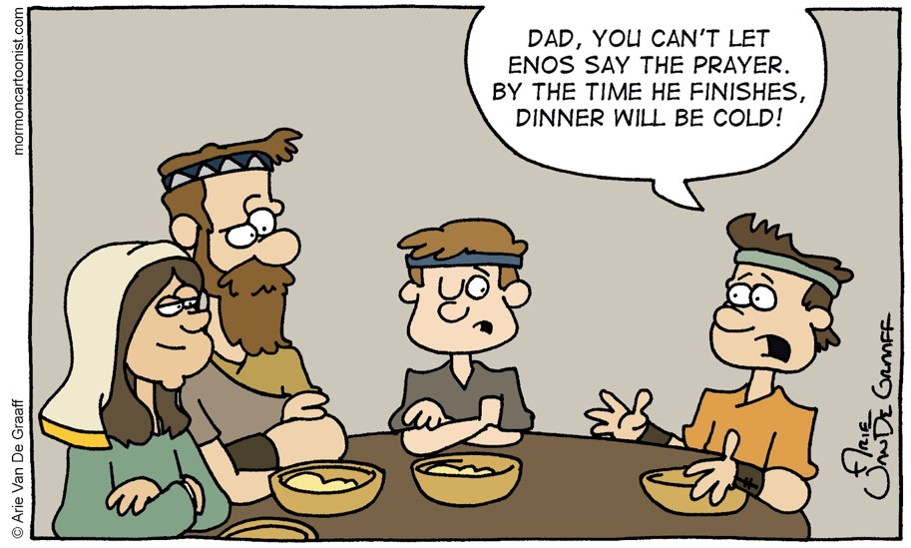
Sources:
Book of Mormon Student Manual, (2009), 130–35
Spencer W. Kimball Pray Always Ensign, Oct. 1981, 6.
Dieter F. Uchtdorf, “Point of Safe Return,” Ensign or Liahona, May 2007, 101).
Joseph Fielding McConkie and Robert L. Millet Doctrinal Commentary on the Book of Mormon Vol. 2 pg. 98-99
The Teachings of Howard W. Hunter, ed. Clyde J. Williams [1997], 248–49).
Presentation by ©http://fashionsbylynda.com/blog/

Slide 19
Faith in the Lord is trust in the Lord. We cannot have true faith in the Lord without also having complete trust in the Lord’s will and in the Lord’s timing. As a result, no matter how strong our faith is, it cannot produce a result contrary to the will of Him in whom we have faith. Remember that when your prayers do not seem to be answered in the way or at the time you desire. The exercise of faith in the Lord Jesus Christ is always subject to the order of heaven, to the goodness and will and wisdom and timing of the Lord. When we have that kind of faith and trust in the Lord, we have true security and serenity in our lives. (Dallin H. Oaks, “The Atonement and Faith” [address given at the seminar for new mission presidents, June 2001])
The object of our prayers should not be to present a wish list or a series of requests but to secure for ourselves and for others blessings that God is eager to bestow, according to His will and timing. Every sincere prayer is heard and answered by our Heavenly Father, but the answers we receive may not be what we expect or come to us when we want or in the way we anticipate. …
Prayer is a privilege and the soul’s sincere desire. We can move beyond routine and “checklist” prayers and engage in meaningful prayer as we appropriately ask in faith and act, as we patiently persevere through the trial of our faith, and as we humbly acknowledge and accept “not my will, but Thine, be done.” (David A. Bednar, “Ask in Faith,” Ensign or Liahona, May 2008, 97)

