Slide 1
3 Nephi 1-7

Slide 2
Miraculous Signs
3 Nephi 1

Slide 3
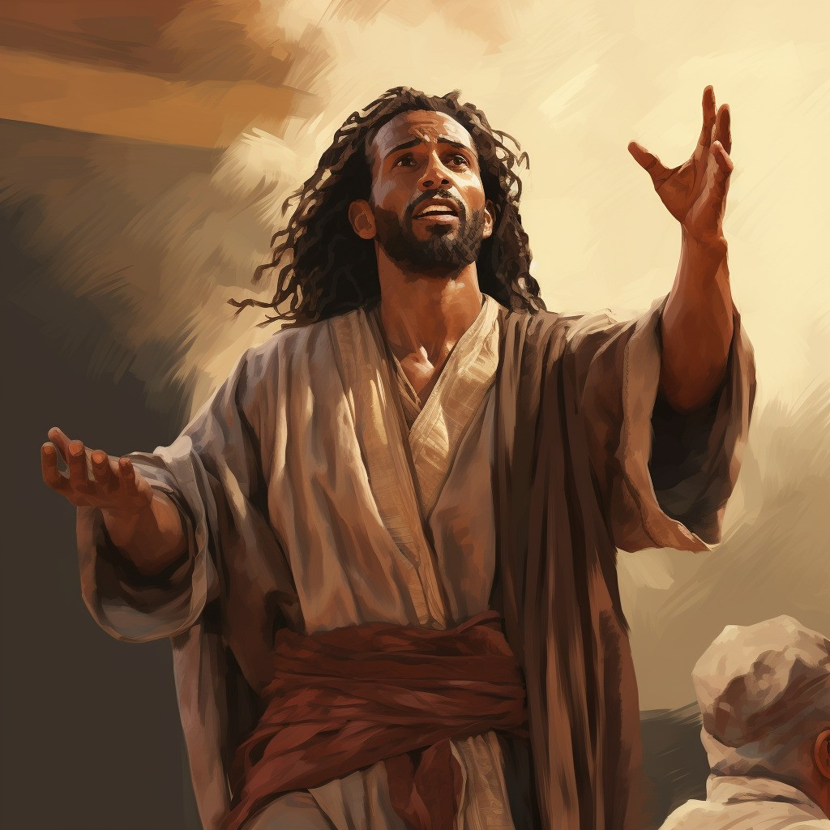
Previously…
Nephite believers watched for the signs Samuel the Lamanite prophesied would come, but unbelievers threatened to kill them if the signs did not appear.
When Samuel the Lamanite came among the Nephites, he prophesied that “five years more cometh, and behold, then cometh the Son of God”.
Prophets had prophesied about the coming of Jesus Christ for thousands of years, and the anticipated time for His birth had arrived.
The book of 3 Nephi begins at the end of those five years.
Helaman 14

Slide 4
King Benjamin
Nephi II
The Sacred Record Keepers
Nephi I
King Mosiah
Helaman II
Alma the Younger
Shilbon
Helaman I
3 Nephi 1:2

Slide 5
3 Nephi—The Book
“3 Nephi contains some of the most moving and powerful passages in all scripture. It testifies of Jesus Christ, His prophets, and the doctrines of salvation.”
Ezra Taft Benson
Mormon abridged records from the large plates of Nephi to create the book of 3 Nephi. The book is named for Nephi (the son of Nephi), whose labors spanned the periods before, during, and after the Savior’s appearances to the people.
During the time of great wickedness that preceded Jesus Christ’s visits, Nephi ministered “with power and with great authority” (3 Nephi 7:17).
His efforts were a prelude to the ministry of Jesus Christ, whose words and deeds constitute the focus of 3 Nephi. While abridging Nephi’s record, Mormon also included his own commentary and testimony (see 3 Nephi 5:8–26; 26:6–12; 29–30).
3 Nephi

Slide 6
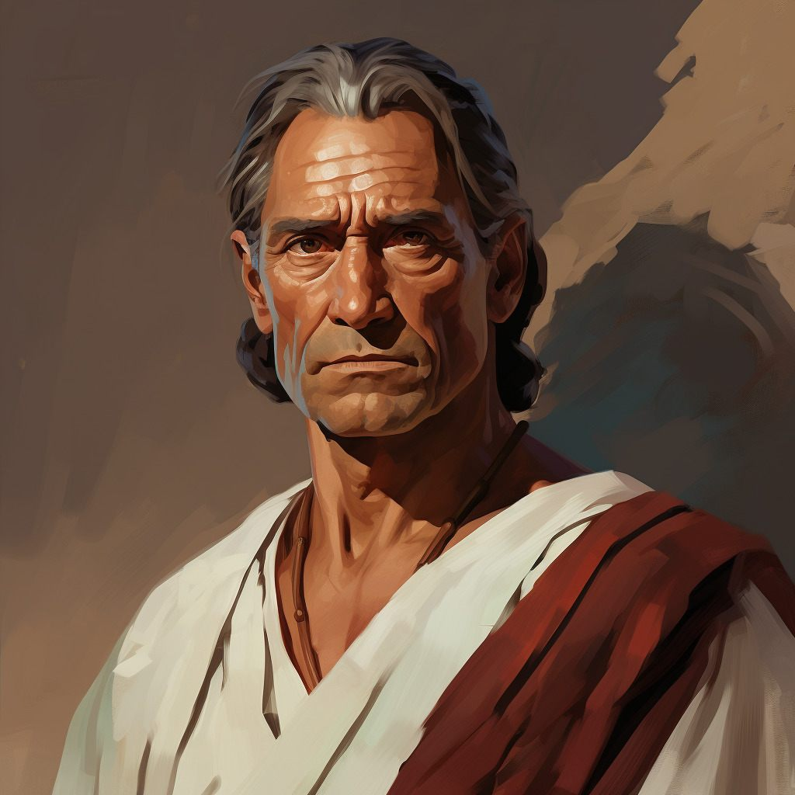
Who is the Book For?
Two groups:
First, the descendants of Lehi (see 3 Nephi 26:8).
Second, Mormon addressed Gentiles in the latter days and recorded the Lord’s admonition that they come unto Him and become part of His covenant people (see 3 Nephi 30).
When and Where was it written?
The original records used as sources for the book of 3 Nephi were likely written between 1 B.C. and A.D. 35.
Mormon abridged those records sometime between A.D. 345 and A.D. 385. Mormon did not record where he was when he compiled this book.

Slide 7
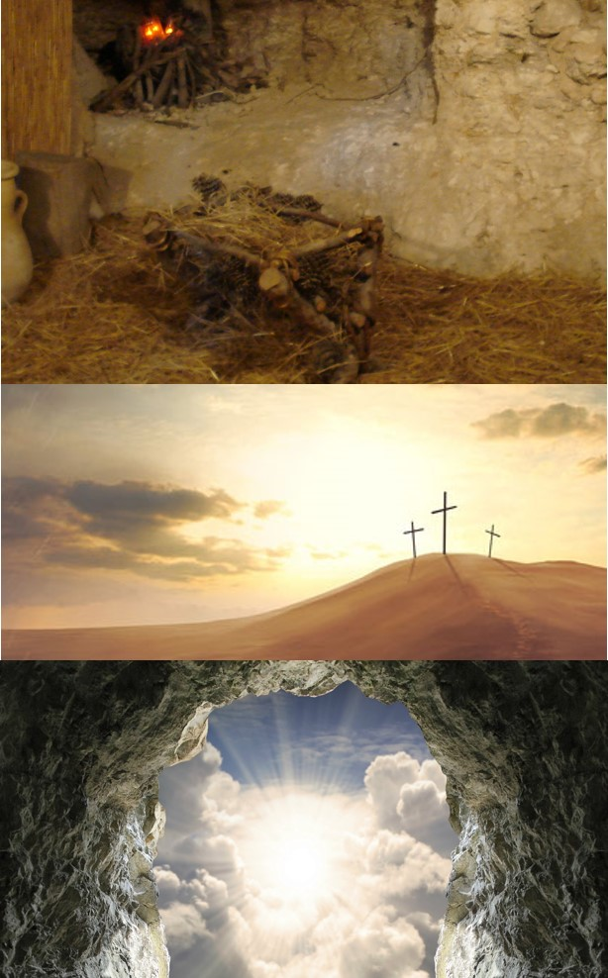
Preview
3 Nephi documents the fulfillment of prophecies regarding Jesus Christ’s birth, death, and Resurrection.
Its record of the Savior’s appearance to the Nephites represents “the focal point, the supreme moment, in the entire history of the Book of Mormon.”
Elder Jeffrey R. Holland
Twenty of the thirty chapters in 3 Nephi contain teachings the Savior delivered directly to the people
The book of 3 Nephi underscores this invitation with its powerful witness of Jesus Christ and its emphasis on the importance of covenants.

Slide 8
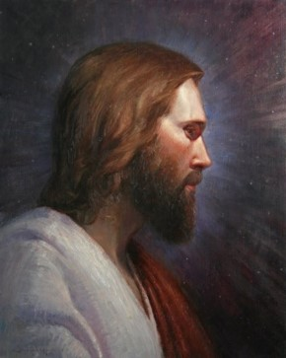
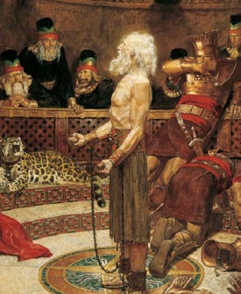
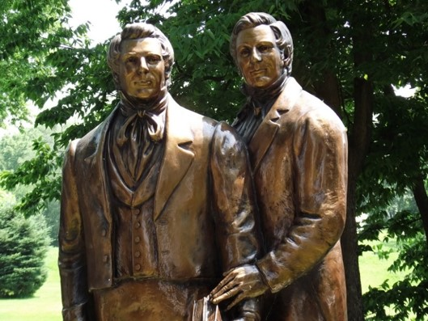
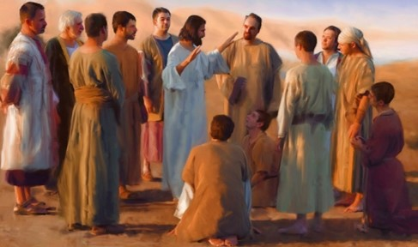
Those Who Sacrifice For Their Faith
What are you willing to sacrifice for your faith?
All the Apostles of Jesus Christ died a martyr’s death except for two

Slide 9
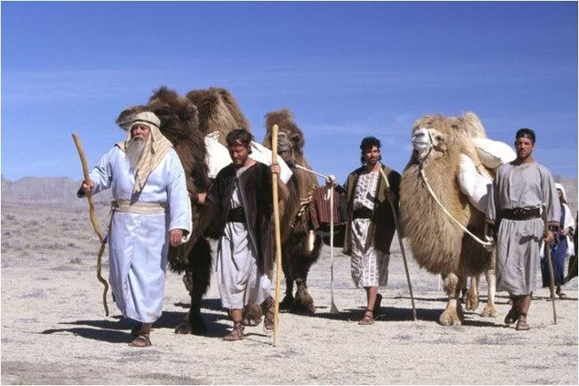
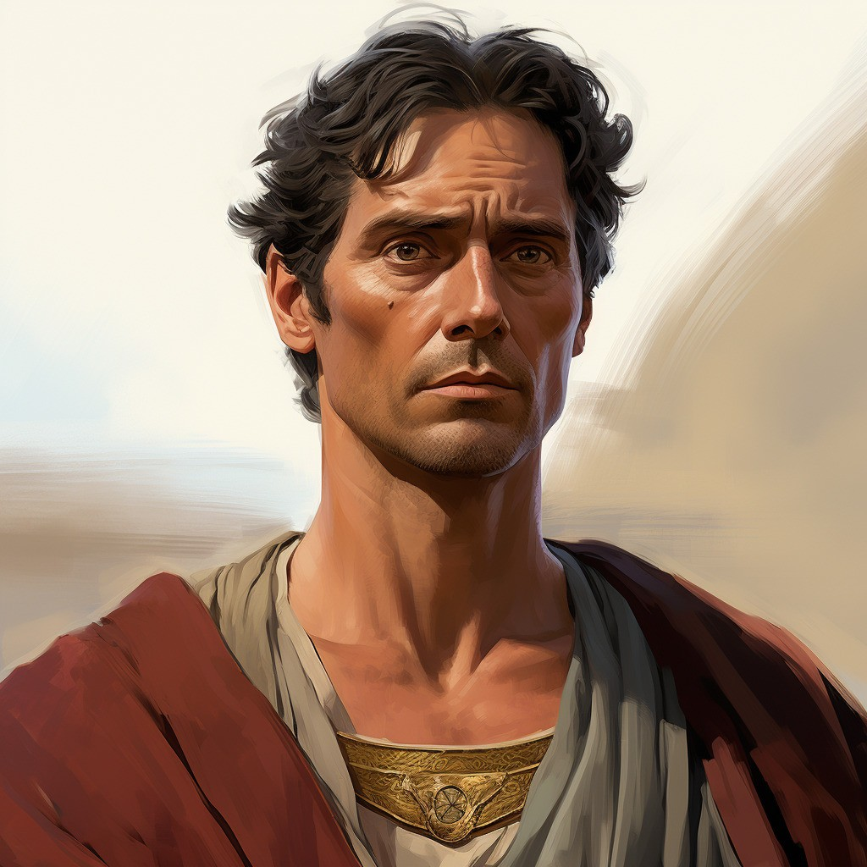
600 Years in the Promise Land
91st Year of the Reign of the Judges
Lachoneus—chief judge and governor over the land
Nephi—departs, giving charge to his eldest son Nephi the sacred records
3 Nephi 1:1-3

Slide 10
Lachoneus
He became chief judge and governor over the Nephite nation in the year AD 1 for about 30 years
During this time Nephi, son of Nephi, received the sacred records
He presided over a period of time when the people were lapsing again into prideful and wicked ways after Samuel, the Lamanite, left
He took the leadership in defeating the Gadianton movement around AD 16 to AD 21
He was asked by Giddianhi, leader of the Gadianton robbers, to turn over their lands, cities, and possessions or become extinct
Lachoneus asked for the Lord’s protection
He eventually established peace in the land
Who’s Who

Slide 11
Nephi
He was the eldest son of Nephi and grandson of Helaman
He succeeded his father and carried the sacred records about 1 AD
He bridged the transition to a new dispensation, one defined by the fulfillment of the Mosaic Law through the visit and ministration of the resurrected Lord and Savior bringing a new covenant of salvation and exaltation
His descendants included: Alma the Elder, Alma the younger, Helaman, the leader of 2,000 warriors, Helaman, the chief judge and Nephi, son of Helaman
He was chosen by Jesus Christ to become one of the first of the Twelve disciples and baptized the other Twelve disciples
He heard ‘the voice of the Lord’ on the eve of His birth and was visited daily by angels
He raised his brother Timothy from the dead (3 Nephi 7:19; 19:4)
He preformed miracles in the name of Jesus and ministered to the chosen as chief disciple by the resurrected Lord
His role was one of many to prepare the way for the coming of the Lord
Having lived in a peaceful land after Jesus’ visit, he died “with the passing of the first generation from Christ” (4 Nephi 1:18) in about AD 60
He passed the sacred records over to his son, Nephi
Who’s Who

Slide 12
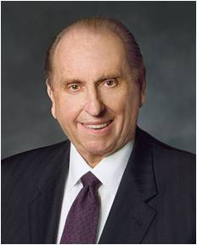
Prophecies Began to be Fulfilled
Some did not believe Samuel’s words because the time had past and his word’s had not been fulfilled
92nd Year of the Reign of the Judges
What challenges did the Nephites who believed Samuel have to face?
“As we go about living from day to day, it is almost inevitable that our faith will be challenged. We may at times find ourselves surrounded by others and yet standing in the minority or even standing alone concerning what is acceptable and what is not. Do we have the moral courage to stand firm for our beliefs, even if by so doing we must stand alone?...
Increasingly, some celebrities and others who—for one reason or another—are in the public eye have a tendency to ridicule religion in general and, at times, the Church in particular. If our testimonies are not firmly enough rooted, such criticisms can cause us to doubt our own beliefs or to waver in our resolves.” --Pres. Thomas S. Monson
3 Nephi 1:4-9

Slide 13
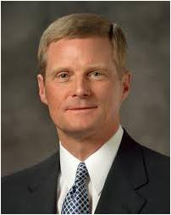
Living in Times of Uncertainty
Faithfulness is not foolishness or fanaticism.
Rather, it is trusting and placing our confidence in Jesus Christ as our Savior, on His name, and in His promises.
As we “press forward with a steadfastness in Christ, having a perfect brightness of hope, and a love of God and of all men” we are blessed with an eternal perspective and vision that stretches far beyond our limited mortal capacity.
We will be enabled to “gather together, and stand in holy places” and “be not moved, until the day of the Lord come.”
David A. Bednar
2 Nephi 31:20, Doctrine and Covenants 101:22, 87:8

Slide 14
A Painful Witness
“And it came to pass that he went out and bowed himself down upon the earth, and cried mightily to his God in behalf of his people, yea, those who were about to be destroyed because of their faith in the tradition of their fathers.”
What was Nephi’s response to those who ridiculed the believers?
What should we do when we see someone being ridiculed for their belief?
3 Nephi 1:11-12

Slide 15
Struggling With Your Faith
Being ridiculed or attacked for your beliefs in Jesus Christ
Having troubled family relationships, including parents separated through divorce
Experiencing anxiety or depression
Worrying about loved ones who experience same-sex attraction
Suffering from addiction or struggling to overcome damaging habits
Fearing that the blessings of the gospel are unattainable
Feeling unworthy or unforgiven

Slide 16
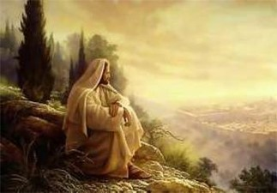
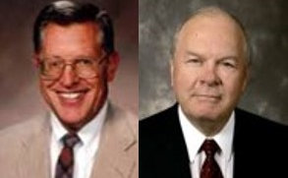
Show Unto the World
What was the sign to be given?
The Lord will fulfill all the words that He has caused to be spoken by His prophets
“Jesus was and is the Lamb slain from the foundation of the world. The plan of salvation, which is the gospel of God the Father, was taught and understood in our first estate. There it was decreed that this plan would entail a creation, a fall, and an atonement.”
JFM and RLM
What is the ‘foundation of the world’?
3 Nephi 1:13-14

Slide 17
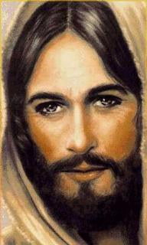
It is clear that [Jesus Christ] is the Son because of the flesh, meaning that he was born into the world as other mortals are.
He had a body that was conceived and nurtured in the womb of a mortal woman. It is more difficult to envision how he was Father because of himself.
This can only be taken to mean that he [the Savior] was the Father because he had the power of the Father; that his will was swallowed up in the will of the Father; that he could do all things because of his inheritance from that Supreme Being. …
Christ is God and he comes to redeem his people.
He is the Son because he is born into mortality.
He is the Father because he inherits from his Father all the might of omnipotence, and what he says and what he does become and are the words and works of him whose name he bears.
Bruce R. McConkie

Slide 18
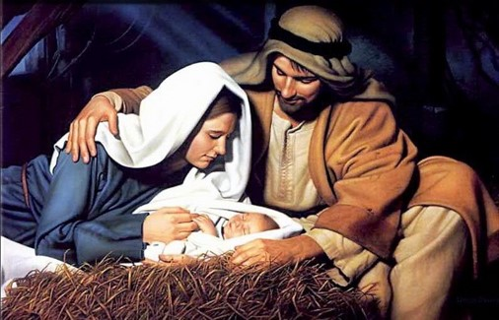
No Darkness
“…and they knew that it was the day the Lord should be born, because of the sign which had been given.”
What did the sign represent?
“And behold, this will I give unto you for a sign at the time of his coming; for behold, there shall be great lights in heaven, insomuch that in the night before he cometh there shall be no darkness, insomuch that it shall appear unto man as if it was day.”
Helaman 14:3
3 Nephi 1:15-20

Slide 19
Facing Satan’s Lies
“Satan always seeks to sow lies whenever there has been a great manifestation of the truth. He tries desperately to confuse, to confound, to complicate things.”
What happened to the people?
What did Nephi do?
What did the wicked do?
They started to have peace and prosper in the land
They started to become converted
Went forth baptizing unto repentance, and began to preach
Went about lying and deceiving to the people to which they saw these signs
“Despite Satan’s efforts, great numbers of humble and teachable souls now receive fuel for their faith…They are not convinced because of the sign, but rather their faith in Christ is now sustained by signs.”
3 Nephi 1:22-25 JFM and RLM

Slide 20
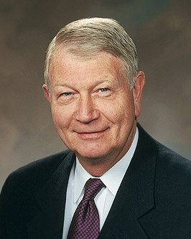
When we face Satan’s lies, we can choose to believe in Jesus Christ and be converted
“Because of the conflicts and challenges we face in today’s world, I wish to suggest a single choice—a choice of peace and protection and a choice that is appropriate for all.
That choice is faith. … Choose faith over doubt, choose faith over fear, choose faith over the unknown and the unseen, and choose faith over pessimism. …
“When logic, reason, or personal intellect come into conflict with sacred teachings and doctrine, or conflicting messages assault your beliefs … , choose to not cast the seed out of your heart by unbelief.
Remember, we receive not a witness until after the trial of our faith.”
Richard C. Edgley
3 Nephi 1:22-25; Alma 32:28; Ether 12:6 JFM and RLM

Slide 21
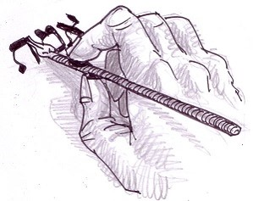
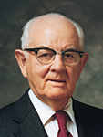
Jot or Tittle—a Tiny Amount
“Heaven and earth shall pass away, but not one jot or tittle of his revealed word shall fail to be fulfilled.”
Messages of the First Presidency, 1:263–64
jot is the name of the least letter of an alphabet or the smallest part of a piece of writing. It is the Anglicized version of the Greek iota - the smallest letter of the Greek alphabet, which corresponds to the Roman 'i'. This, in turn, was derived from the Hebrew word jod, or yodr, which is the the smallest letter of the square Hebrew alphabet. Apart from its specialist typographical meaning, we still use the word jot more generally to mean 'a tiny amount'. Hence, when we have a brief note to make, we 'jot it down'.
A tittle, rather appropriately for a word which sounds like a combination of tiny and little, is smaller still. It refers to a small stroke or point in writing or printing. In classical Latin this applied to any accent over a letter, but is now most commonly used as the name for the dot over the letter 'i'. It is also the name of the dots on dice. In medieval calligraphy the tittle was written as quite large relative to the stem of the 'i'. Since fixed typeface printing was introduced in the 15th century the tittle has been rendered smaller. --The Phrase Finder
“The principles of the gospel are unaltered. All of men’s evil speaking and all of men’s evil acting cannot alter one jot or tittle of the commandments of God.”
Pres. Spencer W. Kimball
3 Nephi 1:25

Slide 22
Gadianton Robbers
93rd-94th Year of the Reign of the Judges
“Dissenters from the Nephites and the Lamanites, as is almost always the case in the Book of Mormon record, find their way into the camps of the enemies, in this case the Gadianton hands.”
JFM and RLM
What happened to some of the Lamanite youth?
They “were led away by some who were Zoramites,” and they joined the Gadianton robbers.
If we give in to temptation, our example can have a negative impact on the faith and righteousness of others
3 Nephi 1:27-30

Slide 23
Lost Individuals
“The young people of the Church … hold the future in their hands. The Church has always been one generation away from extinction. If a whole generation were lost, which will not happen, we would lose the Church.
But even a single individual lost to the gospel of Jesus Christ closes doors for generations of descendants, unless the Lord reaches out to bring some of them back.”
President Henry B. Eyring

Slide 24
Sources:
David A. Bednar, “We Will Prove Them Herewith,” Ensign or Liahona, Nov. 2020, 11
Ezra Taft Benson (“The Savior’s Visit to America,” Ensign, May 1987, 6).
Bruce R. McConkie, The Promised Messiah: The First Coming of Christ [1978], 371–73
Jeffrey R. Holland (Christ and the New Covenant: The Messianic Message of the Book of Mormon [1997], 250).
The Book of Mormon Who’s Who by Ed J. Pinegar and Richard J. Allen pg. 98-99, 142-144
Elder Allan F. Packer Finding Strength in Challenging Times! April 2009 Gen. Conf.
President Thomas S. Monson Dare to Stand Alone Oct. 2011 General Conf.
Joseph Fielding McConkie and Robert L. Millet Doctrinal Commentary on the Book of Mormon Vol. 4 pg. 6, 9-10
The Phrase Finder: Jot and Tittle: It has passed into English via William Tindale's translation of the New Testament in 1526. It appears there in Matthew 5:18:
President Spencer W. Kimball “Hold Fast to the Iron Rod” Oct. 1978 Gen. Conf.
Richard C. Edgley, “Faith—the Choice Is Yours,” Ensign or Liahona, Nov. 2010, 31, 32–33
President Henry B. Eyring (“We Must Raise Our Sights” [address to CES religious educators, Aug. 14, 2001], 1,si.lds.org).
Presentation by ©http://fashionsbylynda.com/blog/

Slide 25
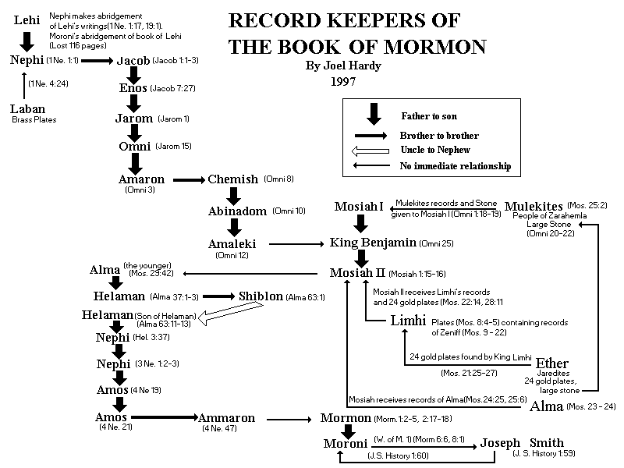

Slide 26
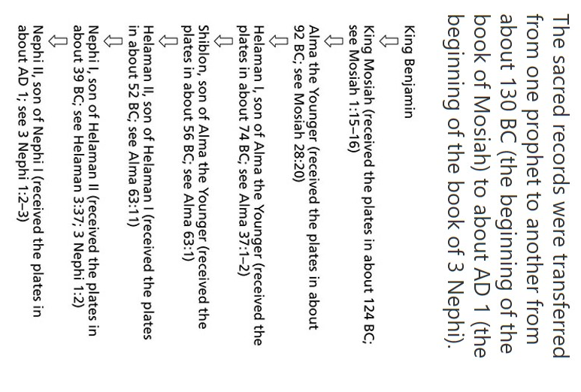

Slide 27
Gadianton Robbers

Slide 28
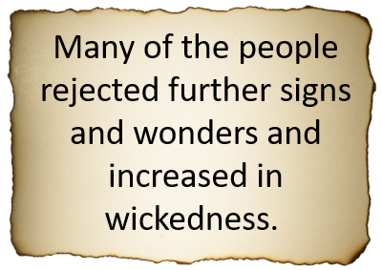
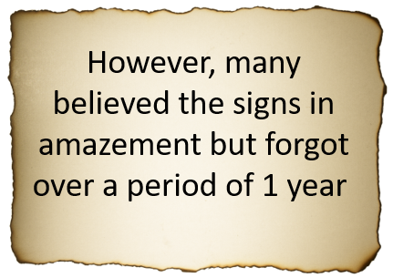
Remember the Signs?
Press any key to forget
3 Nephi 2:1-3

Slide 29
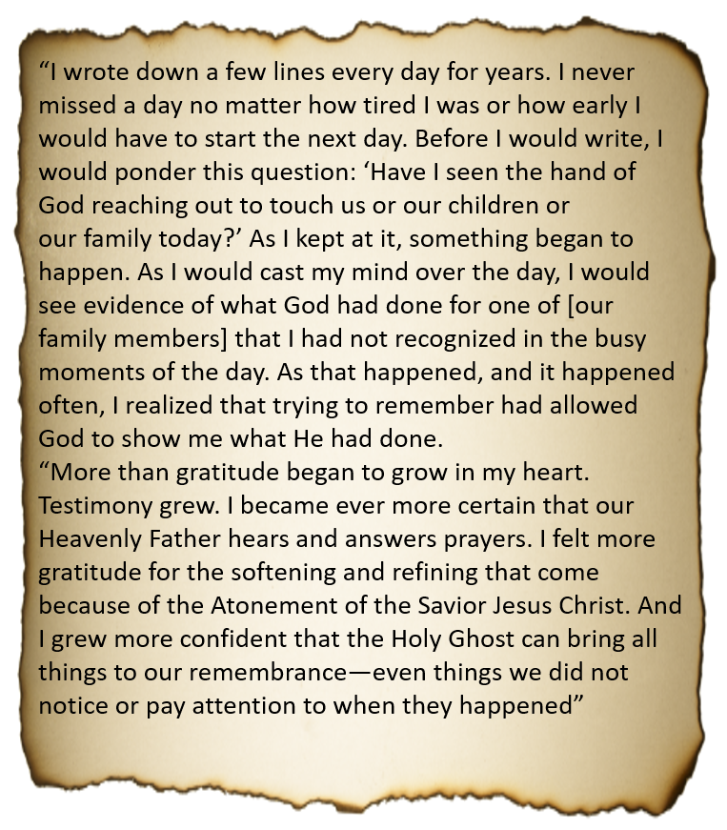
How to Remember
President Henry B. Eyring
3 Nephi 2:1-3

Slide 30
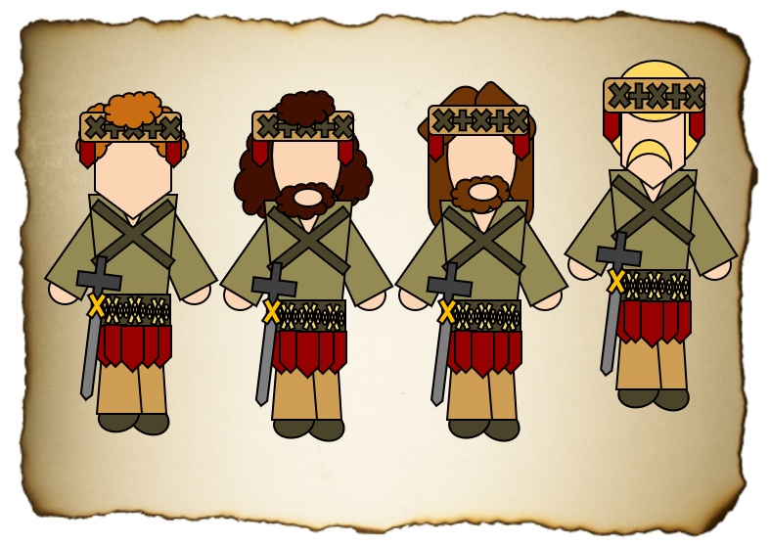
Gadianton Robbers
They followed the ancient secret combinations instituted by Satan from around 50 BC to the end of the Book of Mormon
They were both Nephites and Lamanites
They were destructive and would vanish into the shadows
They would gain wealth and property by secret plots and murders
They were destroyed after Jesus’ visit
They again revived a third century later after Christ was among the Nephites
Mormon was one who fought against them
They were also among the Jaradite nation and played a major role in their destruction of that civilization

Slide 31
Giddianhi
He was the leader of the Gadianton robbers following the birth of the Savior
After Samuel’s plea from the wall, the Gadianton robbers began to emerge as a growing threat
He sent an epistle to Lachoneus to ‘yield up your cities, your land, and your possession or become extinct’. His deadline was set for a month in about AD 18
He and the robbers went to claim the city, but the Nephites had abandoned the city taking refuse elsewhere
Resources became scare for the robbers in the wilderness, and they came upon the Nephites and there was a great battle
He was killed while some of the robbers disappeared into the wilderness, and some where slain
His successor was Zemnarihah
Who’s Who

Slide 32
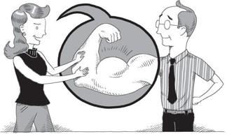
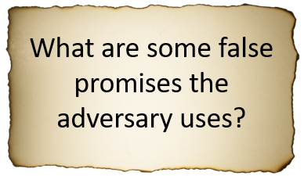
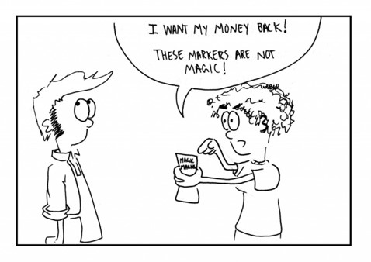
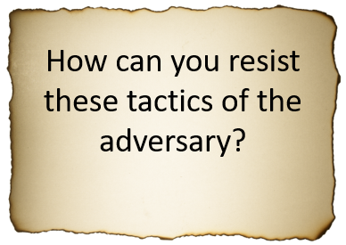
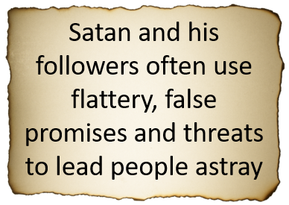
The Threat
3 Nephi 3:1-10

Slide 33
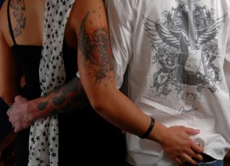
Satan’s Tactics
Technology
Entertainment
3 Nephi 3:2-10

Slide 34
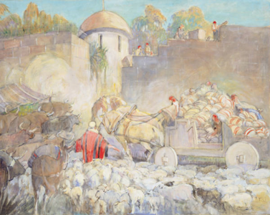
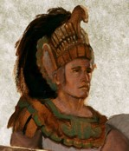
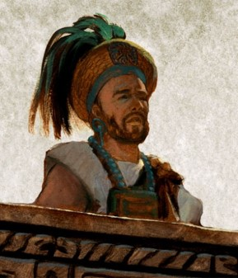
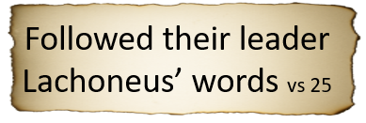
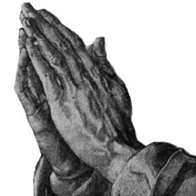
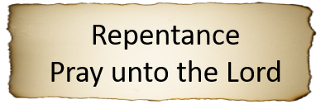
Lachoneus Fortifies the Nephites
16th year before the coming of Christ
AD 16-18
Minerva Teichert
3 Nephi 2:12-25

Slide 35
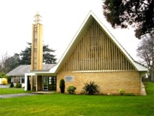
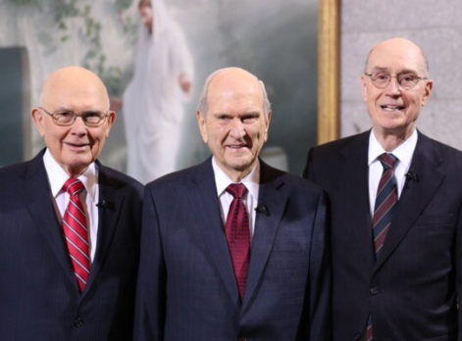
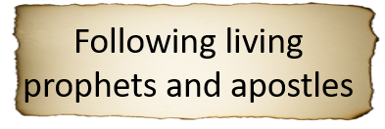
Fortifying Our Homes

Slide 36
Gidgiddoni
He was a captain over the Nephite forces during a fierce engagement with the Gadianton robbers around AD 16 to AD 21
Under the direction of Lachoneus, chief judge and governor, he strengthened the Nephite military forces
He was a spiritual and great prophet among them
(3 Nephi 3:19)
In AD 19 they were under attack by Giddianhi, who was killed and then Zemnariha, but their attempt to overtake the Nephites was not successful
Under his direction, the Nephite military staged nightly forays to decimate the enemy forces and prevent their escape. Those who were not slain were taken prisoners.
Zemnariha was one of the prisoners who was tried and executed
Who’s Who

Slide 37
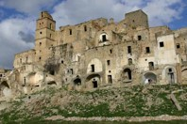
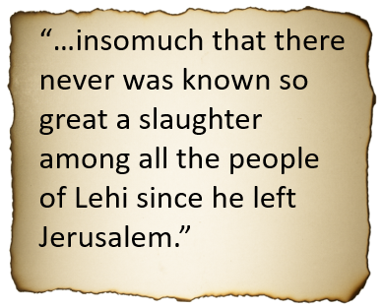
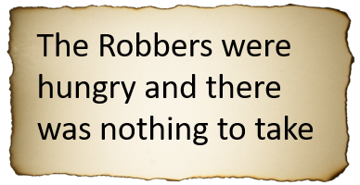
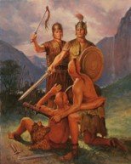
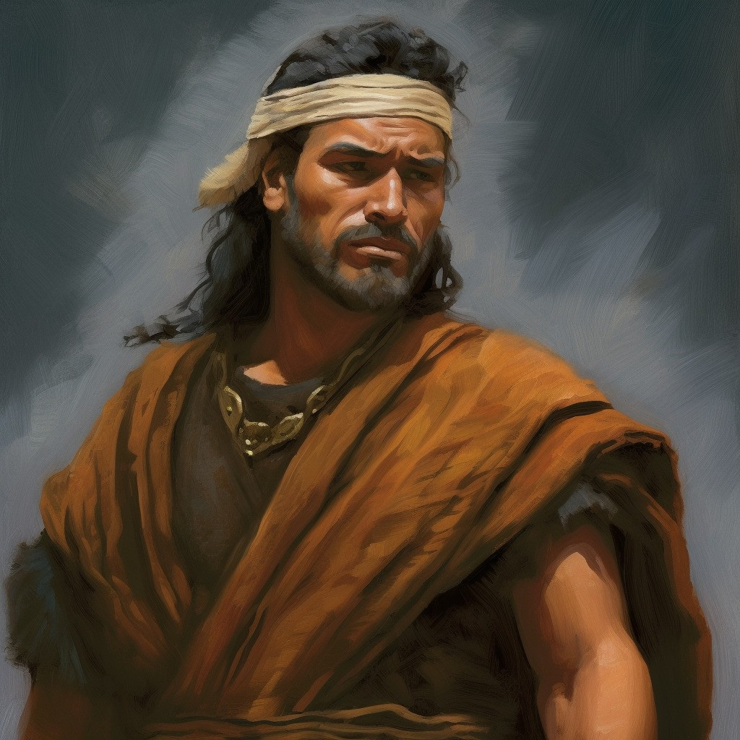
The Great Slaughter
18th -21st Year before the coming of Christ
3 Nephi 4

Slide 38
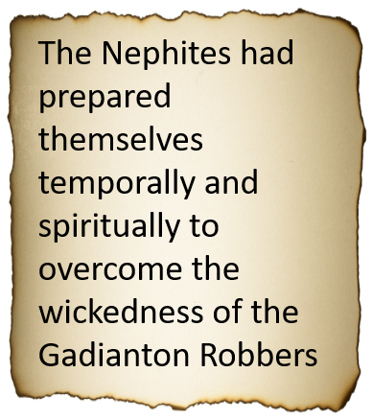
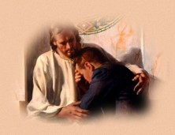
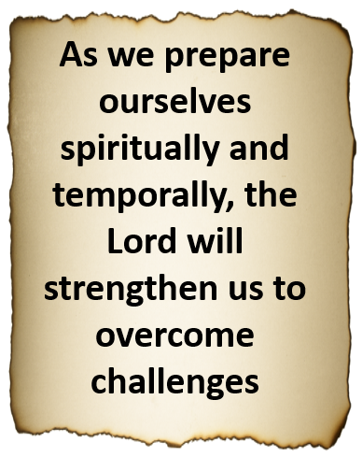
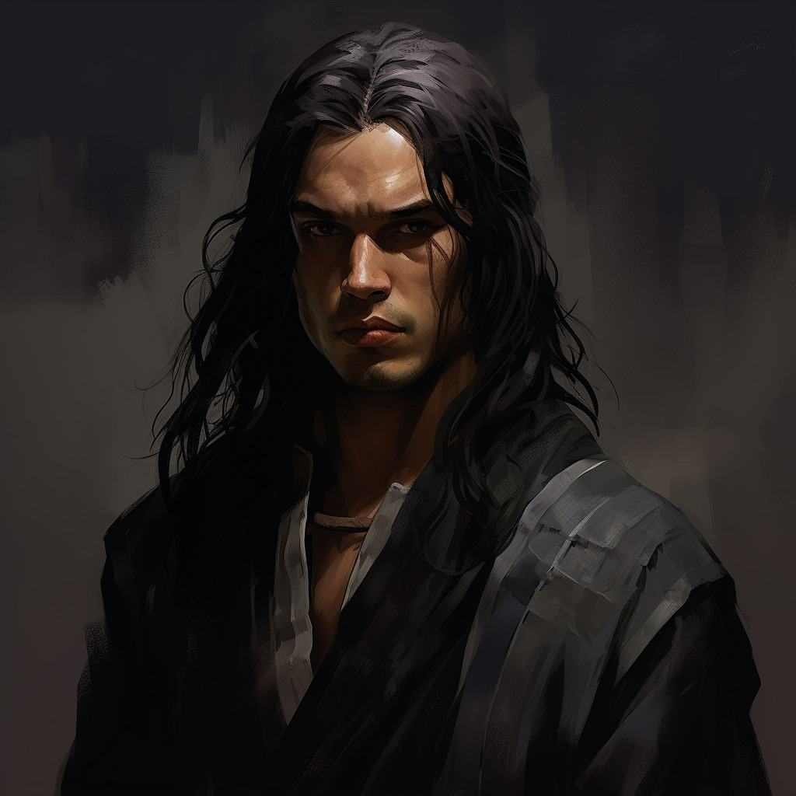
Temporal and Spiritual Blessings
18th -19th Year before the coming of Christ
3 Nephi 4:14-32

Slide 39
Zemnarihah
He was the successor of Giddianhi around AD 16 to AD 21
He tried to take over the capital Zarahemla
The Nephites had a stronghold led by Gidgiddoni
He was captured along with others and taken prisoner
He was ‘hanged upon a tree’ until dead (3 Nephi 28-29)
Some of the other prisoners were taught the gospel and renewed their covenants and were liberated by Lachoneus around AD 21
Those who did not change were punished ‘under the law’
Who’s Who

Slide 40
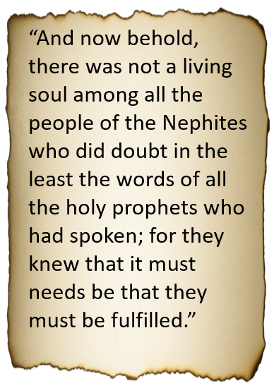
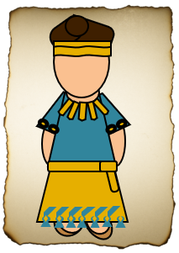
Peace is Restored
22nd-26th Year before the coming of Christ
3 Nephi 5

Slide 41
To Us Today:
“Yea, and surely shall he again bring a remnant of the seed of Joseph to the knowledge of the Lord their God.
And as surely as the Lord liveth, will he gather in from the four quarters of the earth all the remnant of the seed of Jacob, who are scattered abroad upon all the face of the earth.
And as he hath covenanted with all the house of Jacob, even so shall the covenant wherewith he hath covenanted with the house of Jacob be fulfilled in his own due time, unto the restoring all the house of Jacob unto the knowledge of the covenant that he hath covenanted with them.
And then shall they know their Redeemer, who is Jesus Christ, the Son of God; and then shall they be gathered in from the four quarters of the earth unto their own lands, from whence they have been dispersed; yea, as the Lord liveth so shall it be. Amen.
3 Nephi 5:23-26

Slide 42
Sources:
Henry B. Erying (“O Remember, Remember,” Ensign or Liahona, Nov. 2007, 67).
The Book of Mormon Who’s Who by Ed J. Pinegar and Richard J. Allen pg. 53-54, 56-60, 192-193
Presentation by ©http://fashionsbylynda.com/blog/

Slide 43
The adversary never stops attacking. So, we can never stop preparing! The more self-reliant we are—temporally, emotionally, and spiritually—the more prepared we are to thwart Satan’s relentless assaults. …
I am not saying that the days ahead will be easy, but I promise you that the future will be glorious for those who are prepared and who continue to prepare to be instruments in the Lord’s hands. (Russell M. Nelson, “Embrace the Future with Faith,” Ensign or Liahona, Nov. 2020, 75–76)
Prepare: We have been promised that “if [we] are prepared [we] shall not fear” [Doctrine and Covenants 38:30]. This assurance has profound implications today. The Lord has declared that despite today’s unprecedented challenges, those who build their foundations upon Jesus Christ, and have learned how to draw upon His power, need not succumb to the unique anxieties of this era. (Russell M. Nelson, “The Temple and Your Spiritual Foundation,” Liahona, Nov. 2021, 94)
We need to make both temporal and spiritual preparation for the events prophesied at the time of the Second Coming. And the preparation most likely to be neglected is the one less visible and more difficult—the spiritual. (Dallin H. Oaks, “Preparation for the Second Coming,” Ensign or Liahona, May 2004, 9)
Our efforts to prepare for the proving experiences of mortality should follow the example of the Savior, who incrementally “increased in wisdom and stature, and in favour with God and man” [Luke 2:52]—a blended balance of intellectual, physical, spiritual, and social readiness. (David A. Bednar, “We Will Prove Them Herewith,” Ensign or Liahona, Nov. 2020, 9)
The storms and temptations of this life are often unpredictable. But this we know: they will come! In order to overcome the challenges and temptations that each of us inevitably faces, it will require righteous preparation and the use of divinely provided protections. We must determine to be temple worthy regardless of what befalls us. If we are prepared, we shall not fear. (Quentin L. Cook, “Shipshape and Bristol Fashion: Be Temple Worthy—in Good Times and Bad Times,” Ensign or Liahona, Nov. 2015, 39)

Slide 44
Throughout their history, the Nephites used three different points of reference for measuring time with their calendars:
(1) the time when Lehi left Jerusalem;
(2) the time when the government changed from kings to judges;
(3) the time when the sign of the birth of Jesus Christ was given.
It is not known exactly when the Nephites began to reckon their calendar from the time of Jesus Christ’s birth, but Mormon acknowledges this change in 3 Nephi 2:7–8.
REFERENCE POINT | APPROXIMATELY WHEN USED | SCRIPTURE BLOCK
From the time when Lehi left Jerusalem | 600–92 B.C. | 1 Nephi 1–Mosiah 29
From the time when the government changed from kings to judges | 92 B.C.–A.D. 1 | Mosiah 29–3 Nephi 1
From the time the sign of the birth of Jesus Christ was given | A.D. 1–421 | 3 Nephi 1–Moroni 10

Slide 45
Helaman- 3 Nephi 1-5
Righteousness
11:18-19
Reign of Judges
76th Year
Humility and Repentance
Prosperity and Blessings
3 Nephi 2-5
AD 5– 26 AD
Unite, Repentant, and give thanks
11:20-21
Reign of Judges
76th Year
Nephite Cycle
Destruction and Suffering
Pride
3 Nephi 1
1 AD – 4 AD
Gadianton Robbers
11:24 (War)
11:37
Reign of Judges
80th-85th Year
Wickedness
13:1
Reign of Judges
86th Year

Slide 47
A Few Good Men
Before the Coming of the Savior
3 Nephi 6-7

Slide 48
Rebuilding
After defeating Giddianhi and the Gadianton robbers with the help of the Lord, the Nephites “put an end to all those wicked, and secret, and abominable combinations”
There was order in the land
The cities were built ‘anew’ and highways connecting the cities
Gidgiddoni and Lachoneus were the leaders
They returned to their homes and began to rebuild their lives. But Satan continually worked to deceive the people into following him. In a short time, the Nephites changed.
3 Nephi 6:1-10

Slide 49
Is It Possible?
To Be Rich and Humble
Poor and Prideful
Educated and Humble
Uneducated and Prideful

Slide 50
Great Are the Riches
Prideful
Some were lifted up unto pride and boastings because of their exceedingly great riches, yea, even unto great persecutions
Some did receive great learning because of their riches
Some did return railing for railing
Humble
Some were exceedingly humble
Some were ignorant because of their poverty
Some would receive railing (angry criticizing) and persecution and all manner of afflictions
Some would not turn and revile again, but were humble and penitent before God
People began to be distinguished by ranks, according to their riches and their chances for learning
3 Nephi 6:10-13

Slide 51
Equality VS Inequality
“Equity and justice are chief among the laws that rule the kingdom of heaven”
JFM and RLM
“Nevertheless, in your temporal things you shall be equal, and this not grudgingly, otherwise the abundance of the manifestations of the Spirit shall be withheld.” D&C 70:14
“For if ye are not equal in earthly things ye cannot be equal in obtaining heavenly things.” D&C 78:6
Inequality—
“It’s the unbalanced distribution of power and control over wealth and innovation, government and culture, society and neighborhoods…
…The same top end that gets the money also controls the …ways of defining morality, culture, and public life…”
--R.R.Reno
3 Nephi 6:10-14

Slide 52
Satan Strikes Again
With great power
Stirring up the people
Puffing them up with pride and authority
Tempting them to seek for power, riches, and the vain things of the world
He leads them away to do “all manner of iniquity”
Peace is destroyed
Power
Riches
Authority
“How ironic it is that this threesome make so many susceptible to the wiles of the adversary when each of the three could be used to such a marvelous effect in the cause of righteousness!”
JFM and RLM
3 Nephi 6:15

Slide 53
Pride VS The Holy Ghost
Why is it dangerous to no longer listen for the voice of the Spirit?
When we ignore the whisperings of the Holy Ghost, we are more susceptible to the temptations of the devil
“Pride creates a noise within us which makes the quiet voice of the Spirit hard to hear. And soon, in our vanity, we no longer even listen for it. We can come quickly to think we don’t need it”
President Henry B. Erying

Slide 54
Lachoneus II
He was the son of Lachoneus, the chief judge, and succeeded his father in about AD 30
This was a time that the lawyers and judges of high rank became prideful and corrupt in which they put prophets to death
The lawyers and judges also wanted to replace Lachoneus II with a king
With secret oaths and covenants, the wicked leaders murdered Lachoneus II
Thereafter, the government disintegrated, and the people separated themselves into self-governing tribes
These dissenters eventually died when the Savior appeared to the Nephites in AD 33 – AD 34
Who’s Who

Slide 55
“The proud make every man their adversary by pitting their intellects, opinions, works, wealth, talents, or any other worldly measuring device against others.
In the words of C. S. Lewis: ‘Pride gets no pleasure out of having something, only out of having more of it than the next man. … It is the comparison that makes you proud: the pleasure of being above the rest. Once the element of competition has gone, pride has gone.’
“…Pride adversely affects all our relationships—our relationship with God and His servants, between husband and wife, parent and child, employer and employee, teacher and student, and all mankind. Our degree of pride determines how we treat our God and our brothers and sisters”
Ezra Taft Benson
When we are prideful, we allow Satan greater power to tempt us and lead us to commit more sin.
We can choose to be humble and faithful regardless of our circumstances
The central feature of pride is enmity—enmity toward God and enmity toward our fellowmen. Enmity means “hatred toward, hostility to, or a state of opposition.” It is the power by which Satan wishes to reign over us.

Slide 56
3 Nephi 6:19-24
3 Nephi 6:25-30
3 Nephi 7:1-8
3 Nephi 7:9-14
Vasili Golinsky
Secret combinations destroyed the Nephite government, and the people divided into tribes

Slide 57
Works of Darkness
Satan is the author =
A brotherhood, group, society, or governments that operate in secrecy to perform evil acts for the purpose of gaining power over the minds and actions of people.
As the enemies of honest men and women governed by the rule of law, such secret combinations see to subvert public virtue and legally constituted authority.
They defile, defraud, murder, deceive, and destroy the elements of good government, religious or secular.
Their goal is to seize power and to rule over all the people which results in the destruction of human freedom and agency and the paralysis of peaceful and just communities.
3 Nephi 6:27-30
Ray Cole Hillam

Slide 58
Jacob
He was the King of the Nephite dissenters during AD 24 to AD 30
He was selected as the leader by the ‘secret brotherhood’ to be their king
He had a role in slaying the prophets who were sent to declare repentance among the people
He retreated to the north to gather strength in numbers to organize and contend with the other tribes
He made unholy oaths and covenants that bound his group together
His purpose was to destroy the republic and establish a monarchy—kings
His followers had assassinated the chief judge
During the Lord’s cleansing of the earth, the followers of secret combinations, including Jacob, were destroyed
Who’s Who & JFM and RLM

Slide 59
A Few Good Men
Nephi was visited by angels
Nephi testified of repentance and remission of sins through faith on the Lord Jesus Christ
Nephi cast out devils and unclean spirits
Nephi raise his brother Timothy from the dead who had been stoned by the people
Nephi did more miracles in the sight of the people in the name of Jesus.
Only a few were converted unto the Lord; but as many as were converted ‘did truly signify unto the people that they had been visited by the power and Spirit of God, which was in Jesus Christ, in whom they believed.’
3 Nephi 7:21
“Therefore, there were ordained of Nephi, men unto this ministry, that all such as should come unto them should be baptized with water, and this as a witness and a testimony before God, and unto the people, that they had repented and received a remission of their sins”
3 Nephi 7:25
3 Nephi 7:15-26

Slide 60
Baptism
“Baptism witnesses to both God and man that our spirit is contrite and humble and that we are willing to take the name of Christ upon us.
Baptism by immersion symbolizes the Christian commitment to Christ, the acceptance of our Lord’s death, burial, and rise unto a newness of life.”
JFM and RLM
“And again, by way of commandment to the church concerning the manner of baptism—All those who humble themselves before God, and desire to be baptized, and come forth with broken hearts and contrite spirits, and witness before the church that they have truly repented of all their sins, and are willing to take upon them the name of Jesus Christ, having a determination to serve him to the end, and truly manifest by their works that they have received of the Spirit of Christ unto the remission of their sins, shall be received by baptism into his church.”
D&C 20:37
3 Nephi 7:25

Slide 61
Righteousness
3 Nephi 6-7
3 Nephi 5
AD 22 – AD 26
Give thanks
Humility and Repentance
Prosperity and Blessings
3 Nephi 8
AD 33
The Awakening
3 Nephi 6:1-9
AD 26- AD 28
Nephite Cycle
Before the coming of the Savior
Destruction and Suffering
Pride
3 Nephi 7:1
AD 31-AD 32
Murder, separation, secret combinations, stoning of Prophets
3 Nephi 6:10-16
AD 29
Wickedness
3 Nephi 6:17-30
AD 30
6:25 Judges secretly put righteous to death
6:28 Covenant administered by the devil
6:30 subject to kings

Slide 62
Sources:
R.R. Reno http://www.firstthings.com/article/2014/03/the-public-square?gclid=CL3Owqmakr0CFY6Ufgod3m0AmA
Joseph Fielding McConkie and Robert L. Millet Doctrinal Commentary on the Book of Mormon Vol. 4 pg. 25-27, 34
Book of Mormon Who’s Who by Ed J. Pinegar and Richard J. Allen pgs. 75-76, 99
President Henry B. Eyring (“Prayer,” Ensign, Nov. 2001, 16).
Ezra Taft Benson (“Beware of Pride,” Ensign, May 1989, 4, 6).
C.S. Lewis (Mere Christianity, New York: Macmillan, 1952, pp. 109–10.)
Ray Cole Hilliam “The Gadianton Robbers and Protracted War” BYU Studies 15 (Winter 1975): 214-24.
Presentation by ©http://fashionsbylynda.com/blog/

Slide 63
Pride: In our day, the scriptural imperative for unity is largely ignored, and for many people the emphasis is on tribalism, often based on status, gender, race, and wealth. In many countries, if not most, people are deeply divided about how to live. In the Lord’s Church, the only culture we adhere to and teach is the culture of the gospel of Jesus Christ. The unity we seek is to be unified with the Savior and His teachings. …
… The Book of Mormon makes it clear that there must be no -ites, tribes, or classes. We must be united and equal before God. (Quentin L. Cook, “Prepare to Meet God,” Ensign or Liahona, May 2018, 116)
When prideful, we tend to take honor to ourselves rather than giving it to others, including the Lord. Pride is often competitive; it is a tendency to seek to obtain more and presume we are better than others. Pride often results in feelings of anger and hatred; it causes one to hold grudges or to withhold forgiveness. (Elder Gary E. Stevenson, “Spiritual Eclipse,” Ensign or Liahona, Nov. 2017, 47)

Slide 64
If I Were The Devil By Paul Harvey
I would gain control of the most powerful nation in the world;
I would delude their minds into thinking that they had come from man's effort, instead of God's blessings;
I would promote an attitude of loving things and using people, instead of the other way around;
I would dupe entire states into relying on gambling for their state revenue;
I would convince people that character is not an issue when it comes to leadership;
I would make it legal to take the life of unborn babies;
I would make it socially acceptable to take one's own life, and invent machines to make it convenient;
I would cheapen human life as much as possible so that life of animals are valued more than human beings;
I would take God out of the schools, where even the mention of His name was grounds for a lawsuit;
I would come up with drugs that sedate the mind and target the young, and I would get sports heroes to advertise them;
I would get control of the media, so that every night I could pollute the minds of every family member for my agenda;
I would attack then family, the backbone of any nation. I would make divorce acceptable and easy, even fashionable. If the family crumbles, so does the nation;
I would compel people to express their most depraved fantasies on canvas and movies screens, and I would call it art;
I would convince the world that people are born homosexuals, and that their lifestyles should be accepted and marveled;
I would convince the people that right and wrong are determined by a few who call themselves authorities and refer to their agendas as politically correct;
I would persuade people that the church is irrelevant and out of date; the Bible is for the naive:
I would dull the minds of Christians, and make them believe that prayer is not important, and that faithfulness and obedience are optional;
I GUESS I WOULD LEAVE THINGS PRETTY MUCH THE WAY THEY ARE!

