Slide 1
3 Nephi 12-16

Slide 2
The Higher Law
3 Nephi 12
The
Book
of
Mormon
ANOTHER TESTAMENT
OF JESUS CHRIST

Slide 3
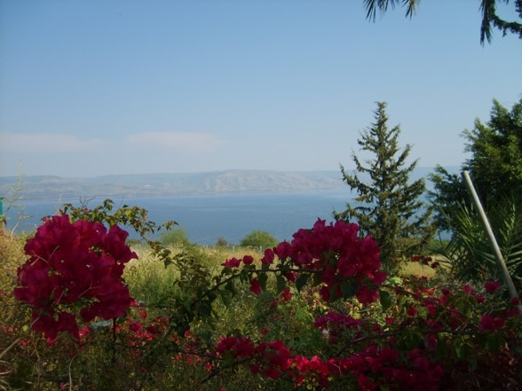
The Beatitudes
The term beatitude comes from the Latin adjective beātitūdō which means "happy", "fortunate", or "blissful“
The Beatitudes describe 8 blessings in the
Sermon on the Mount in Matthew.
Each Beatitude consists of two phrases:
the condition and the result.
In almost every case the condition is from familiar Old Testament context, but Jesus teaches a new interpretation.
Together, the Beatitudes present a new set of Christian ideals that focus on a spirit of love and humility different in orientation than the usual force and exaction taken. They echo the highest ideals of the teachings of Jesus on mercy, spirituality, and compassion.--wikipedia

Slide 4
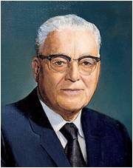
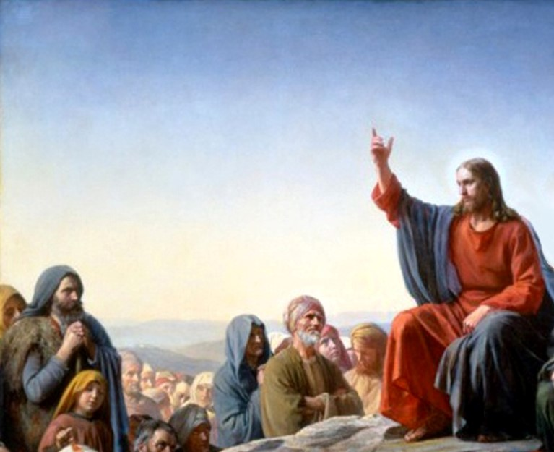
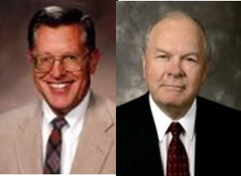
A Constitution for a perfect life
-- Harold B. Lee
“(The Beatitudes) not only set forth the blessed or happy life but also describe the kind of person our Savior was and is.”
JFM and RLM
We are blessed as we come unto Jesus Christ and follow His teachings

Slide 5
The Condition
Blessed are the poor in spirit who come unto me
Blessed are all they that mourn
Blessed are the meek
Blessed are all they who
do hunger and thirst after
righteousness
Blessed are the merciful
Blessed are all the pure in heart
Blessed are all the peacemakers
Blessed are all they who are persecuted for my name’s sake
3 Nephi 12:3-10
The Result
For theirs is the kingdom of heaven.
For they shall be comforted.
For they shall inherit the earth.
For they shall be filled with the Holy
Ghost.
For they shall obtain mercy.
For they shall see God.
For they shall be called the children of God.
For theirs is the kingdom of heaven.

Slide 6
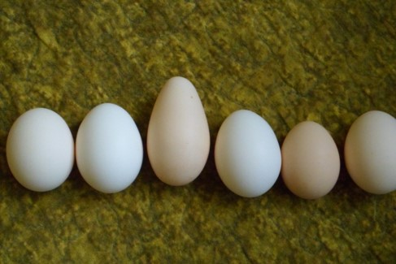
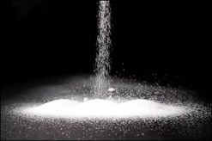
The Salt of the Earth
“The Saints are asked to stand as a spice, a seasoning, a flavor among the bland and often tasteless elements of the world. Because they are there, things are better; like salt, the people of the Lord are empowered to bring out the best in others…
In reality we can only make a difference if we are different. Not necessarily strange. Different. Indeed disciples of Christ are to stand in stark contrast to those who conform, concede, and thereby compromise.”
Salt is a healing medium.
Salt is a preservative. It preserves food from corruption.
“Salt will not lose its savor with age. Savor is lost through mixture and contamination…Flavor and quality flee a man when he contaminates his mind…”
Elder Carlos E. Asay
(See D&C 103:9-10)
3 Nephi 12:13 JFM and RLM

Slide 7
In what ways can we, as followers of
Jesus Christ, be like salt?
We are to help preserve or save people and to improve the world by influencing others for good.

Slide 8
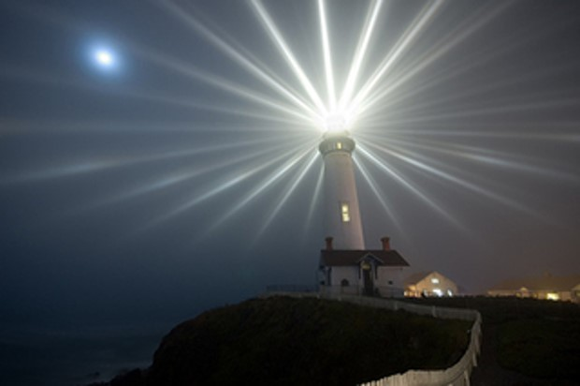
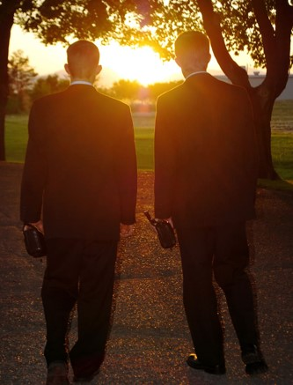
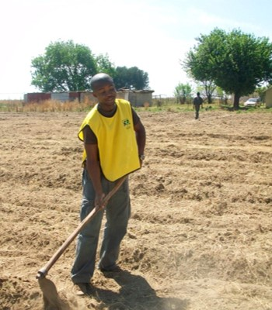
To Be The Light
Let our light shine.
To stand as beacons.
To certify our discipleship by teaching and living the gospel.
We can allow our light to shine through our testimonies, our witnesses of the truthfulness.
We allow our light to shine through our service to one another
3 Nephi 12:14-16

Slide 9
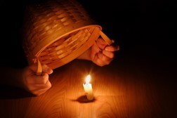
Why do some people cover their light?
Fear of rejection?
Fear of losing a friend?
Not quite certain of gospel principles?
Fear of inadequacy of knowledge of scriptures?
PS—you don’t have to a scriptorian to share your beliefs
Why does the Savior want us to let our light shine?
As we set a righteous example, we can help others glorify Heavenly Father
Regarding Member –missionary work:
1. Identify, prayerfully, your friends and neighbors who would be the most receptive to the gospel message.
2. Introduce the identified individuals to the missionaries.
3. Involve yourself in the teaching of the gospel, preferably in your home.
4. Integrate your friends and any other new members into the Church by being attentive and helpful.
3 Nephi 12:14-16

Slide 10
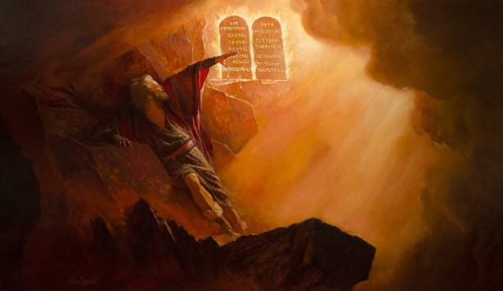
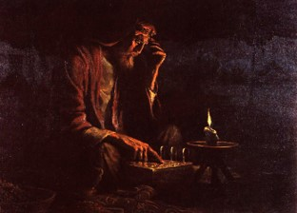
The Law
Jesus, as Jehovah, gave the law to Moses on Sinai.
He did not come to destroy the very system which he had set up and established among ancient Israel
He came to restore the gospel in it’s fulness…to a higher law
Did the Nephites have the Higher Law at this time?
3 Nephi 12:17

Slide 11
The Higher Law—Luke 6:27-30
Love your enemies
Do good to them which hate you
Bless them that curse you
Pray for them which despitefully use you
Unto him that smiteth thee on the one cheek offer also the other
Him that taketh away thy cloak forbid not to take thy coat also
Give to every man that asketh of thee
As ye would that men should do to you, do ye also to them likewise.

Slide 12
Thou Shalt Not Kill
…or have thoughts of it
The prohibition against murder remained intact. People still were forbidden from wanton shedding of men’s blood.
One must require control over one’s emotions and avoid anger…(see wikihow article)
Bite your tongue
Stifle angry impulses
Throttle temper tantrums
3 Nephi 12:21

Slide 13
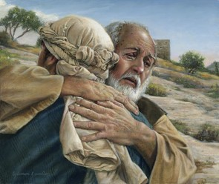
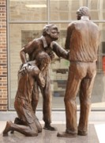
Forgive Your Brother
…and be responsible for him/her
The obligation of seeking peace
Resolving differences peaceably
Becoming peacemakers even if we are not responsible for the misunderstanding
“Am I my brother’s keeper” (Genesis 4:9)
Avoid law suits—
“…It is more important that they (apostles and missionaries) suffer legal wrongs than that their ministries be hindered or halted by legal processes.”
Bruce R. McConkie
Raca—Aramaic word meaning literally “empty head,” a statement of derision and abuse
“Then came Peter to him, and said, Lord, how oft shall my brother sin against me, and I forgive him? till seven times?
Jesus saith unto him, I say not unto thee, Until seven times: but, Until seventy times seven.”
Matthew 18:21-22
3 Nephi 12:22-26

Slide 14
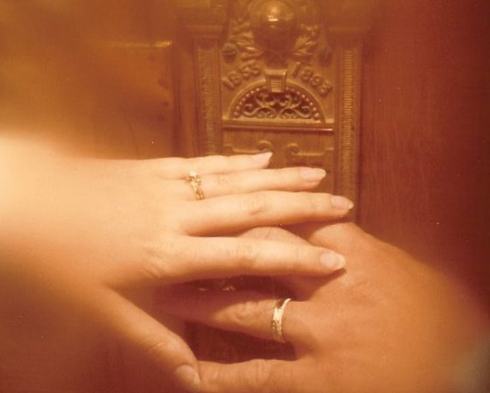
Do Not Commit Adultery
…even in your thoughts
“Thou shalt love thy wife with all thy heart, and shalt cleave unto her and none else.
And he that looketh upon a woman to lust after her shall deny the faith, and shall not have the Spirit; and if he repents not he shall be cast out.”
D&C 42:22-23
In the Old World, carnal and fallen men had begun to take advantage of the divorce laws in their culture.
JFM and RLM
“And verily I say unto you, as I have said before, he that looketh on a woman to lust after her, or if any shall commit adultery in their hearts, they shall not have the Spirit, but shall deny the faith and shall fear.”
D&C 63:16
3 Nephi 12:27-32

Slide 15
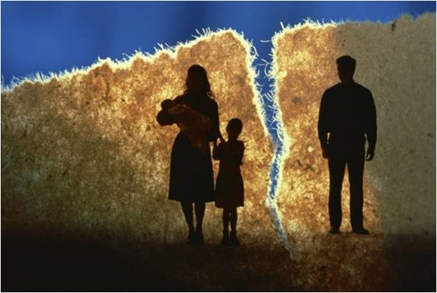
“Why is lust such a deadly sin? Well, in addition to the completely Spirit-destroying impact it has upon our souls, I think it is a sin because it defiles the highest and holiest relationship God gives us in mortality—the love that a man and a woman have for each other and the desire that couple has to bring children into a family intended to be forever. … Love makes us instinctively reach out to God and other people. Lust, on the other hand, is anything but godly and celebrates self-indulgence.
Love comes with open
hands and open heart;
lust comes with only an
open appetite”
Elder Jeffrey R. Holland
Personal Actions to avoid this kind of sin:
Start by separating yourself from people, materials, and circumstances that will harm you.
Acknowledge that people bound by the chains of true addictions often need more help than self-help, and that may include you.
Along with filters on computers and a lock on affections, remember that the only real control in life is self-control.
Cultivate and be where the Spirit of the Lord is.

Slide 16
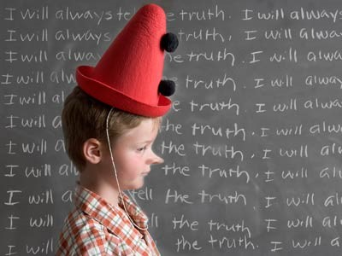
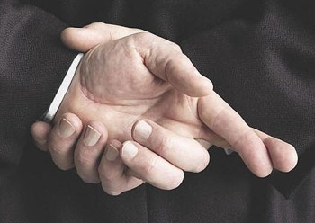
Do Not Lie
…especially under oath
From the beginning of time the oath was the most sacred, solemn attestation a person could make to affirm a statement or his word on a matter.
We believe in being honest…true—trustworthy
The oath, over time, had been misused—referring to secret combinations
3 Nephi 12:23-37

Slide 17
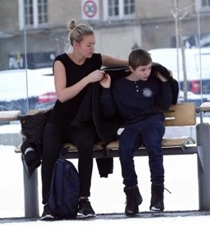
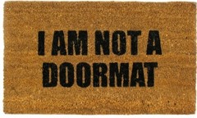
Turn the Other Cheek
…and avoid confrontations and counterattacks
“Though the Saints are in no way called upon to become the doormats of society, yet they are directed here to avoid reviling or striking back at an enemy.”
JFM and RLM
“And unto him that smiteth thee on the one cheek offer also the other; and him that taketh away thy cloak forbid not to take thy coat also.
Give to every man that asketh of thee; and of him that taketh away thy goods ask them not again.”
Luke 6:29-30
3 Nephi 12:38-42

Slide 18
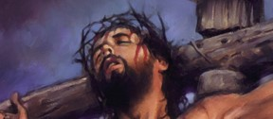
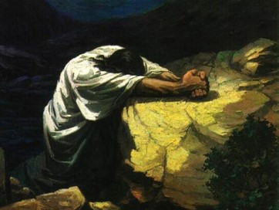
Love Your Enemies
…no matter how bad the situation is
“Thou shalt not hate thy brother in thine heart: thou shalt in any wise rebuke thy neighbour, and not suffer sin upon him.
Thou shalt not avenge, nor bear any grudge against the children of thy people, but thou shalt love thy neighbour as thyself: I am the Lord.”
Leviticus 19:17-18
“The followers of Christ is not just to tolerate or avoid his enemies…He bids us to do away with our enemies by making friends of them.”
JFM and RLM
We need to:
Act in loving and kind ways toward our enemies
Pray for them and asking for help in forgiving them
Be an example to them that have offended us in any manner
Zenos: “…yea, thou wast merciful when I prayed concerning those who were mine enemies, and thou didst turn them to me.”
Alma 33:4
3 Nephi 12:43-46

Slide 19
Being Perfect
Do we need to become perfect in this life to enter the celestial kingdom?
Does Heavenly Father expect us to be perfect?
Can we ever be perfect?
Heavenly Father does not expect us to become perfect during our mortal lives but that as we diligently strive to keep the commandments and as we rely upon the Atonement, we can ultimately be perfected.
3 Nephi 12:48

Slide 20
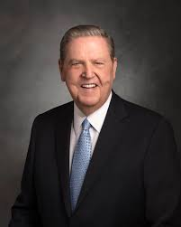
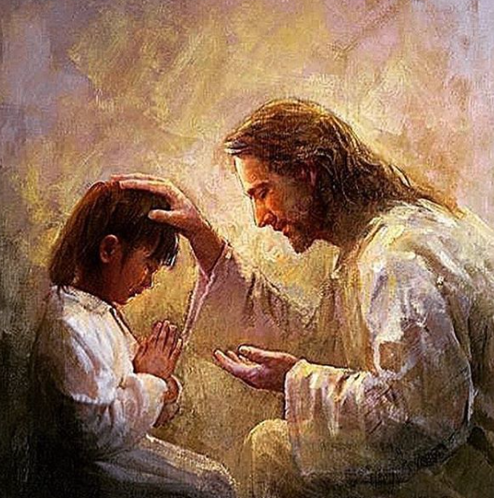
I am grateful to know that in spite of my imperfections, at least God is perfect—that at least He is, for example, able to love His enemies, because too often, due to the “natural man” and woman in us, you and I are sometimes that enemy.
How grateful I am that at least God can bless those who despitefully use Him because, without wanting or intending to do so, we all despitefully use Him sometimes.
Jeffrey R. Holland

Slide 21
Doctrinal Mastery
“Therefore I would that ye should be perfect even as I, or your Father who is in heaven is perfect.”
3 Nephi 12:48

Slide 22
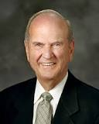
“We need not be dismayed if our earnest efforts toward perfection now seem so arduous [difficult] and endless.
Perfection is pending.
It can come in full only after the Resurrection and only through the Lord.
It awaits all who love him and keep his commandments”
Elder Russell M. Nelson

Slide 23
Sources:
Russell M. Nelson (“Perfection Pending,” Ensign, Nov. 1995, 88).
Wikipedia-- http://en.wikipedia.org/wiki/Beatitudes
Elder Carlos E. Asay (CR, April 1980)
Robert C. Oaks Sharing the Gospel Oct. 2000 Gen. Conf.
Bruce R. McConkie Doctrinal New Testament Commentary 1:223
Joseph Fielding McConkie and Robert L. Millet Doctrinal Commentary of the Book of Mormon Vol. 4 pgs. 69-77
Elder Jeffrey R. Holland (“Place No More for the Enemy of My Soul,” Ensign or Liahona, May 2010, 44–45).
“Be Ye Therefore Perfect—Eventually,” Ensign or Liahona, Nov. 2017, 41)
Presentation by ©http://fashionsbylynda.com/blog/

Slide 24
WHAT WAS THE TRADITIONAL UNDERSTANDING IN THE LAW OF MOSES? | HOW DID THE SAVIOR COUNSEL THE NEPHITES TO LIVE? | WHAT MIGHT A YOUNG MAN OR WOMAN DO TO FOLLOW THE SAVIOR’S TEACHING TODAY?
3 Nephi 12:21 | 3 Nephi 12:22–26
3 Nephi 12:27 | 3 Nephi 12:28–30
3 Nephi 12:38 | 3 Nephi 12:39–42
3 Nephi 12:43 | 3 Nephi 12:44–45
WHAT WAS THE TRADITIONAL UNDERSTANDING IN THE LAW OF MOSES? | HOW DID THE SAVIOR COUNSEL THE NEPHITES TO LIVE? | WHAT MIGHT A YOUNG MAN OR WOMAN DO TO FOLLOW THE SAVIOR’S TEACHING TODAY?
3 Nephi 12:21 | 3 Nephi 12:22–26
3 Nephi 12:27 | 3 Nephi 12:28–30
3 Nephi 12:38 | 3 Nephi 12:39–42
3 Nephi 12:43 | 3 Nephi 12:44–45

Slide 25
The Beatitudes
Reference | Attribute
3 Nephi 12:3 | Poor in spirit. To be humble, or “to recognize gratefully [one’s] dependence on the Lord—to understand that [one has] constant need for His support. Humility is an acknowledgment that [one’s] talents and abilities are gifts from God” (True to the Faith: A Gospel Reference [2004], 86).
3 Nephi 12:4 | Mourn. To feel and express sorrow about something. A person may mourn for the trials of mortality that they and others experience. A person may also mourn because of sorrow for sin.
3 Nephi 12:5 | Meek. To be “Godfearing, righteous, humble, teachable, and patient under suffering” (Guide to the Scriptures, “Meek, Meekness,” scriptures.ChurchofJesusChrist.org).
3 Nephi 12:6 | Hunger and thirst after righteousness. To have a great desire to know and do the will of God.
3 Nephi 12:7 | Merciful. To be “compassionate, respectful, forgiving, gentle, and patient, even when you are aware of others’ shortcomings” (True to the Faith, 103).
3 Nephi 12:8 | Pure in heart. To be counted among those who “love the Lord, who seek to follow Him and keep His commandments, who are striving to live virtuous lives and endure faithfully to the end. The pure in heart are those who control their thoughts to keep themselves free from immoral fantasies and deeds” (Sheldon F. Child, “Words of Jesus: Chastity,” Ensign or Liahona, Jan. 2003, 44).
3 Nephi 12:9 | Peacemaker. “To help people find common ground when others are seeing differences” (Henry B. Eyring, “Learning in the Priesthood,” Ensign or Liahona, May 2011, 63).
3 Nephi 12:10–12 | Persecuted for Christ’s name’s sake. To be willing to obey and defend Jesus Christ and His teachings, even when one may be mocked or mistreated for doing so.

Slide 26
Matthew Chapter 5: 3-11
The Beatitudes
Blessed are the poor in spirit
Blessed are they that morn
Blessed are the meek
Blessed are they which do hunger and thirst after righteousness
Blessed are the merciful
Blessed are the pure in heart
Blessed are the peacemakers
Blessed are they which are persecuted

Slide 27
The word perfection … is sometimes misunderstood to mean never making a mistake. Perhaps you or someone you know is trying hard to be perfect in this way. Because such perfection always seems out of reach, even our best efforts can leave us anxious, discouraged, or exhausted. We unsuccessfully try to control our circumstances and the people around us. We fret over weaknesses and mistakes. In fact, the harder we try, the further we may feel from the perfection we seek. …
A misunderstanding of what it means to be perfect can result in perfectionism—an attitude or behavior that takes an admirable desire to be good and turns it into an unrealistic expectation to be perfect now. Perfectionism sometimes arises from the feeling that only those who are perfect deserve to be loved or that we do not deserve to be happy unless we are perfect. (Gerrit W. Gong, “Becoming Perfect in Christ,” Ensign, July 2014, 14–15, 17)
Step by Step
When you climb up a ladder, you must begin at the bottom, and ascend step by step, until you arrive at the top; and so it is with the principles of the Gospel—you must begin with the first and go on until you learn all the principles of exaltation. But it will be a great while after you have passed through the veil before you will have learned them. It is not all to be comprehended in this world; it will be a great work to learn our salvation and exaltation even beyond the grave. (Teachings of Presidents of the Church: Joseph Smith [2007], 268)

Slide 28
For Parents:
6 Ways To Help Your Kids Be A Good Influence On Their Friends
BY KARLA BOND
Many parents are concerned with who their kids are hanging out with, often unaware that their own children are the ones who are the bad influence. It’s important to incorporate certain values in the home to ensure that your children are a positive influence on their friends. Children who set good examples to others often learn how to be that way from their parents. Here are some ways you can help your kids be a good influence, which will keep them from making bad decisions that can affect them long-term:
Establish Communication
Spend time with your child both inside and outside of the home, and establish communication to form a strong relationship that will carry into their social life. Children who have a closer relationship with their family succeed outside of the home by having more self-confidence and respect for both themselves and others.
Teach the Dangers of Drugs and Alcohol
Children are often exposed to or offered drugs or alcohol as early as middle school, making it important to communicate the dangers at an early age. Discuss the consequences and how drugs or alcohol can often lead to jail time, addictions, and even poverty. It’s important that your children know how to deal with friends and peers struggle with addictions to drugs or alcohol as well. It’s nearly impossible to avoid someone at school who uses these substances, so teaching them how to help others and deal with it is essential.
Monitor Entertainment
The media is often the first place that children hear curse words, view mature scenes, and are overly exposed to adult content. Block certain channels on the television, while also monitoring their Internet use on a consistent basis. It’s also important to know what your children are doing on their social media accounts, if they have any. Although you can’t control everything they see and do on the internet, setting filters to block obscene material is crucial. The more they are exposed to questionable content, the more normal it becomes for them. Children who are positive influences on their friends aren’t exposed to many of the things teenagers are seeing and talking about at school. They typically don’t want to associate with those things.
Practice Discipline
Discipline is often difficult to establish in the home for parents who may have been raised in a strict environment and want to provide their children with freedom. However, the most rebellious children are often those who were never raised with rules, making it important to establish guidelines in and out of the home. By learning to respect authority inside of the home, they’ll be able to practice it in school.
Teach Respect
Children commonly model what they see their parents doing, which makes it important to watch your own behavior with your own friends. Avoid gossiping or slandering other people in the home, and show your child what it means to be a friend by serving those you’re around. If your children learn to respect their peers, they will get respect from them in return.
Serve in the Community
By establishing a routine of helping others or volunteering in the community as a family, it will naturally teach your children gratitude and the importance of living a selfless life. They’ll be able to help those in need, which will change their perspective on their role in school and amongst their friends in a positive way.
Knowing that your children are setting good examples for their friends can make raising your children much easier. Follow these steps, and you will give your children the tools they need to make good decisions and choose good friends.
http://bondwithkarla.com/6-ways-help-kids-good-influence-friends/

Slide 29
How to Control Your Temper
Edited by Flickety, Sondra C, Ben Rubenstein, Dave Crosby and 46 others
1. Remember that the reward for patience is happiness.
2. Realize that things can be handled well at all times; it's just a matter of what kind of attitude you put into it. Take deep breaths.
3. Get away from situations where your anger might get the better of you, such as when someone is teasing you. Ignore the other person and walk away. If you must, do this a few times until the person gets the hint that you will not tolerate it. It's okay to use your words or body language to tell somebody you will not tolerate how they are treating you, as long as you respond to them in a calm and matter of fact manner, without being overtly hurtful or trying to embarrass them as they have you. It's never okay to hit somebody for making fun of you.
4. Realize that no one likes to be around people who get angry easily and act abusive. The only way you can change the situation is by starting with yourself.
5. Be considerate of others, and ultimately, yourself. The way you react will ultimately affect your surroundings. If you have to rebuke someone for doing something wrong, you can always do it calmly, in a private place. This method is always better for everyone in the long run.
6. If you are angry and you are standing, sit down; if you are sitting, lie down.
7. Remember, 5 seconds stand between you and logic. Count to 5 and remember that logic always beats anger.
8. Stop talking to that person for a few minutes to whom you are angry and take deep breath around 5-7 times. Try breathing slowly in through your nose, and out through your mouth. This will calm you down.
9. Take a deep breath.
10. Think about the good things that person has done for you. What bad have you done to them? Chances are, you've done at least something to them to make them resentful towards you. Make sure you have a clear conscience-then speak.
http://www.wikihow.com/Control-Your-Temper

Slide 30
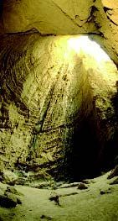
Something of Interest
Salt 3 Nephi 12:13:
In ancient days, salt was used as payment. Ezra 4:14 refers to this, using an idiom we don’t relate to in our day: “Now because we are in the service of the palace…” The word “service” is sometimes translated “maintenance,” but a literal translation would be, “Now because we eat the salt of the palace,” meaning the king provided their salary. It could be it just refers to their dependence on the king or that he actually paid them with salt. The Latin word for a Roman’s salt ration is where we get our word “salary.” Slaves were exchanged for salt, from which came the expression that someone is “not worth his salt.”
In the days of Yeshua and Second Temple times, King Herod held a monopoly on salt coming from the Dead Sea, which supplied the priests with the salt needed for Temple ritual. Earlier, in Ezra’s time, it was the king of Persia who supplied the salt (Ezra 7:21–22). The worshipper, in fact, was not required to supply the salt for the sacrifices. Salt, as well as wood and oil, were provided by the Temple and kept in special chambers on the Temple compound. Other cultures of the time used salt in their religious rituals as well…and still do. In my search on salt through the Internet, I came across an article a Japanese man wrote, showing the similarities between some Japanese traditions and Jewish traditions. Here are some fascinating facts concerning salt in both cultures (my comments in brackets):
Japanese have the custom to use salt for sanctification. People sometimes sow the Samurai: a woman threw salt on the place where a man she hated left. This custom is the same as that of the ancient Israelites. After Abimelech captured an enemy city, “he sowed it with salt” (Judges 9:45). We Japanese quickly interpret this to mean to cleanse and sanctify the city. [Josephus mentions such a thing also: “and when he had overthrown the city to the very foundations, for it was not able to bear a siege, and had sown its ruins with salt, he proceeded on with his army” (Antiquities, V, 7). Rather than sanctifying the ground, some say it was used as a means to curse the ground of the enemy and make it unproductive.]
I hear that when Jews move to a new house, they sow it with salt to sanctify it and cleanse it. This is true also in Japan. In Japanese-style restaurants, they usually place salt near the entrance. [In 18th–century Scotland, Scots would carry a salt box into a new house!] Jews use salt for Kosher meat. [Salt draws the blood from the meat. It’s done in accordance with God’s command not to eat blood (Lev. 17:10–12).] All Kosher meat is purified with salt and all meals start with bread and salt.
Several commentators point out that the “salt of the covenant” mentioned in Leviticus 2:13 follows the prohibition of using leaven and honey (vs. 11). Both honey and leaven cause “corruption” or fermentation. Salt did not, but purified and preserved, or was “incorruptible.” Bridge for Peace.com
Salt Cave near the Dead Sea

Slide 31
Something of Interest
To cross one's fingers is a hand gesture commonly used to wish for luck. Occasionally it is interpreted as an attempt to implore God for protection. The gesture is referred to by the common expressions "cross your fingers", "keep your fingers crossed", or just "fingers crossed". Some people, mostly children, also use the gesture to excuse their telling of a white lie. By extension, a similar belief is that crossing one's fingers invalidates a promise being made.
The origin of the gesture traces back to the biblical Kingdom of Israel. Courts of Mosaic law would often render verdicts with the phrase "May God have mercy upon your soul" in order to reaffirm God's supreme authority over the law. Most judges felt that while they could pass a sentence of death upon a person, they personally did not have the authority to destroy souls and that only God had the authority to do that. As a result, some judges would cross their fingers whenever they said the phrase as a result of concern for the criminal's soul as they said it as a prayer.
Common usage of the gesture traces back to the early centuries of the Catholic Church. Common use of crossed fingers is found in the Christians who would cross their fingers in order to invoke the power associated with Christ's cross for protection, when faced with evil. Moreover, Christians, when persecuted by the Romans, used the symbol of crossed fingers in order to recognize one another and assemble for Holy Mass. "When they were persecuted in Rome, Christians would secretly come together with the sign of the fish, and they would hold up their crossed fingers, as a Sign of the crossed emblem that had once been on the vestments of the army of Barabbas. It became a custom everywhere, for Christians when meeting, to make the sign of a cross by crossing their fingers." In 16th century England, people continued to cross fingers or make the sign of the cross in order to ward off evil, as well as when people coughed or sneezed.
This superstition thus became popular among many early European Christian cultures. In some places, a comrade or well-wisher placed his index finger over the index finger of the person making the wish, the two fingers forming a cross. The one person makes the wish, the other empathizes and supports. Over centuries, the custom was simplified, so that a person could wish on his own, by crossing his index and middle fingers to form an X. But traces remain—two people hooking index fingers as a sign of greeting or agreement is still common in some circles today.
Charles Panati believes that the act of crossing one's fingers as a sign of luck or making a wish traces back to pre-Christian times, speculating that the cross was a symbol of unity and benign spirits dwelt at the intersection point. A wish made on a cross was a way of "anchoring" the wish at the intersection of the cross until the wish was fulfilled. wikipedia

Slide 32
Seeking the Kingdom of God
2 Nephi 13
3 Nephi 13:21 and Luke 12:34
For where your treasure is, there will your heart be also

Slide 33
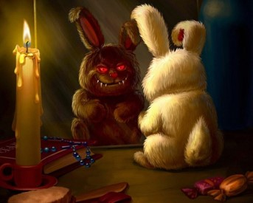
Hypocrite
A person who puts on a false appearance of virtue or religion
“But when thou doest alms let not thy left hand know what thy right hand doeth;”
Signs of a hypocrite:
Whenever he speaks, he lies;
Whenever he promises, he breaks his promise:
Whenever he is trusted, he betrays the trust.
Avoid ulterior motives…
giving to someone to impress others
3 Nephi 13:2-3

Slide 34
1. I do alms (acts of religious devotion or service for others) because:
2. I pray because:
3. I fast because:
a. Fasting helps me draw closer to the Lord.
b. Other people will think I’m weak if I don’t.
c. My parents tell me I should.
a. I am supposed to.
b. I love the Lord and enjoy helping other people.
c. I want others to think well of me.
a. I want to be able to tell my parents or my bishop “yes” when they ask me if I pray.
b. It is just part of my daily routine.
c. I want to communicate with my Heavenly Father.

Slide 35
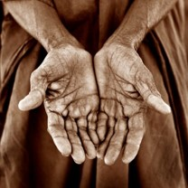
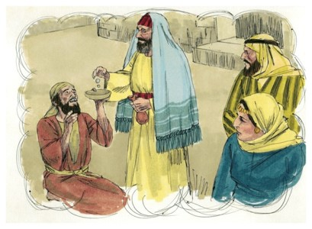
Alms
Donations for the poor, mentioned frequently in the New Testament.
This was an organized and united welfare program of the Church. Although not mentioned in the Old Testament as alms, the principle is given in many instances
—Bible Dictionary
Alms or almsgiving:
involves giving to others as an act of virtue, either materially or in the sense of providing capabilities for free.
“Take heed that ye do not your alms before men, to be seen of them: otherwise ye have no reward of your Father which is in heaven.”
Matthew 6:1
“…do not sound a trumpet before you…”
Anonymously-- a gift from an unknown source
Given in secret
3 Nephi 13:1-4

Slide 36
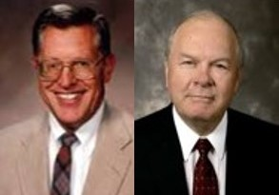
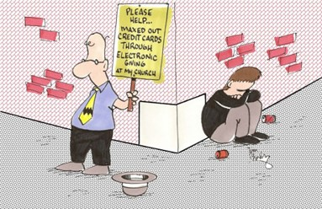
“Self-Serving Purposes”
“Service that is self-serving is something less than service. Though we may not be evil individuals, yet to do good acts in order to be seen or noticed or heard is certainly less than noble and may be symptomatic of inner evil.”
JFM and RLM
“For behold, God hath said a man being evil cannot do that which is good; for if he offereth a gift, or prayeth unto God, except he shall do it with real intent it profiteth him nothing.
For behold, it is not counted unto him for righteousness.”
Moroni 7:6-7
3 Nephi 13:1-4

Slide 37
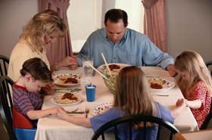
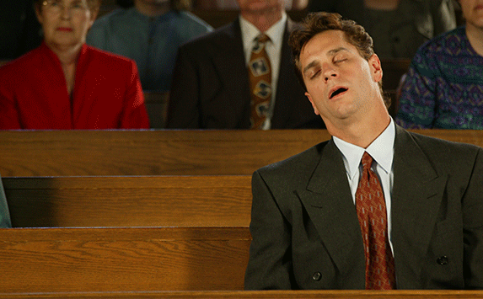
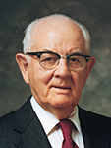
Prayer
Vain Repetitions
“The problem is in the vainness, not in repetition.
In how many different ways can we bless our food?
How many original prayers—original in the sense of novel or unusual language—can we offer?
God is not offended by repetition, so long as the words are spoken from the heart and are sincere.
The heavens withdraw themselves, however, in the face of vanity. Something is vain when it is empty, meaningless, or hollow.
Whenever our prayers are meaningless and thus become trite or ritualistic religious jargon, having no feeling or emanating from a duplicitous heart, they accomplish little.”
JFM and RLM
“How often do we hear people who wax eloquent in their prayers to the extent of preaching a complete sermon? The hearers tire and the effect is lost, and I sometimes wonder if perhaps the dial of the heavenly radio is not turned off when long and wordy prayers are sent heavenward.”
Spencer W. Kimball
3 Nephi 13:5-7

Slide 38
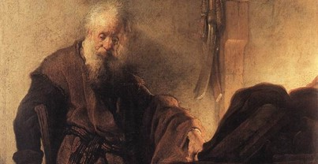
What We Need
“The Lord will bless us in terms of our needs, not just our wants.
When we are inspired by the Holy Ghost our prayers become instructive; we learn something from them, generally about ourselves.”
“For who hath known the mind of the Lord, that he may instruct him? But we have the mind of Christ.”
1 Corinthians 2:16
Paul said,
“Likewise the Spirit also helpeth our infirmities: for we know not what we should pray for as we ought: but the Spirit itself maketh intercession for us with groanings which cannot be uttered.
And he that searcheth the hearts knoweth what is the mind of the Spirit, because he maketh intercession for the saints according to the will of God.”
Roman 8:26-27
3 Nephi 13:8

Slide 39
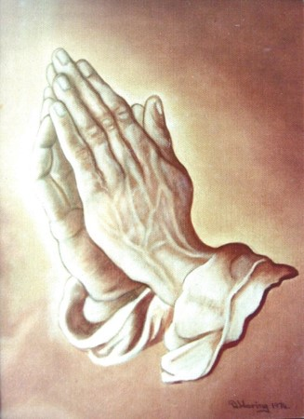
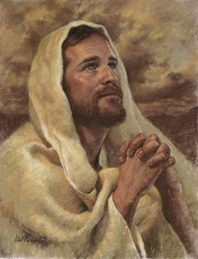
The Lord’s Prayer
The Savior gave these words of prayer to the Nephites, not that they should memorize and use it in repetition, but rather that they might be guided by the words to use the Spirit of the Holy Ghost in praying for what they need, also in thanking Him for what they have received.
The Lord’s Prayer consists of 6 parts:
3 thy-petitions directed toward God
3 we-petitions focusing on the needs of men
3 Nephi 13:8

Slide 40
3 Nephi 13:9-15
Our Father who art in heaven,
Hallowed be thy name
(Thy kingdom come is not mentioned –perhaps because the of God is about to be established among the Nephites in its eternal fulness)
Thy will be done on earth as it is in heaven
And forgive us our debts, as we forgive our debtors.
And lead us not into temptation, but deliver us from evil.
For thine is the kingdom, and the power, and the glory, forever. Amen
Matthew 6:9-13
Our Father which art in heaven
Hallowed be thy name
Thy kingdom come.
Thy will be done in earth, as it is in heaven.
Give us this day our daily bread.
And forgive us our debts, as we forgive our debtors.
And lead us not into temptation,
but deliver us from evil:
For thine is the kingdom, and the power, and the glory, for ever. Amen
Luke 11:2-4
Our Father which art in heaven.
Hallowed be thy name.
Thy kingdom come.
Thy will be done, as in heaven, so in earth.
Give us day by day our daily bread.
And forgive us our sins; for we also forgive every one that is indebted to us.
And lead us not into temptation; but deliver us from evil.

Slide 41
Fasting—For the Right Reason
“…not as hypocrites”
“Anoint thy head, and wash thy face”
When is it appropriate to fast?
At a time of tragedy or sorrow.
When we need spiritual guidance or direction.
When we seek for a remission of sins.
When we are struggling with a particularly difficult problem or challenge in life.
When we feel the need to draw near to God.
When others are struggling because of tragedy or sorrow…we may fast for them.
How often should one fast?
There is a regular fasting day, for Latter-day Saints, set aside for fasting. It is generally the first Sunday of the month.
This is a time to participate in, not to be observed in by others.
Fasting is a private time between the individual and the Lord.
3 Nephi 13:16-18

Slide 42
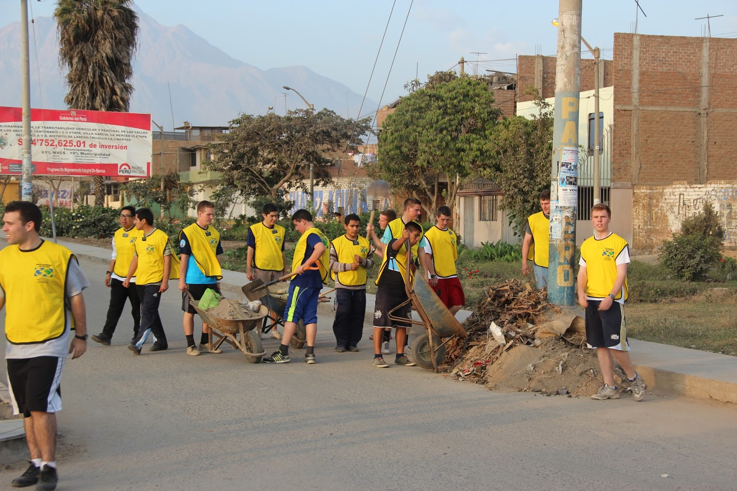
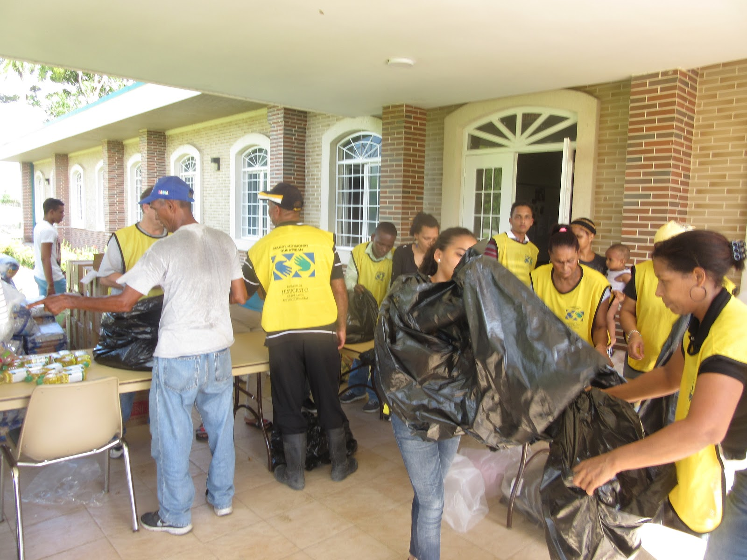
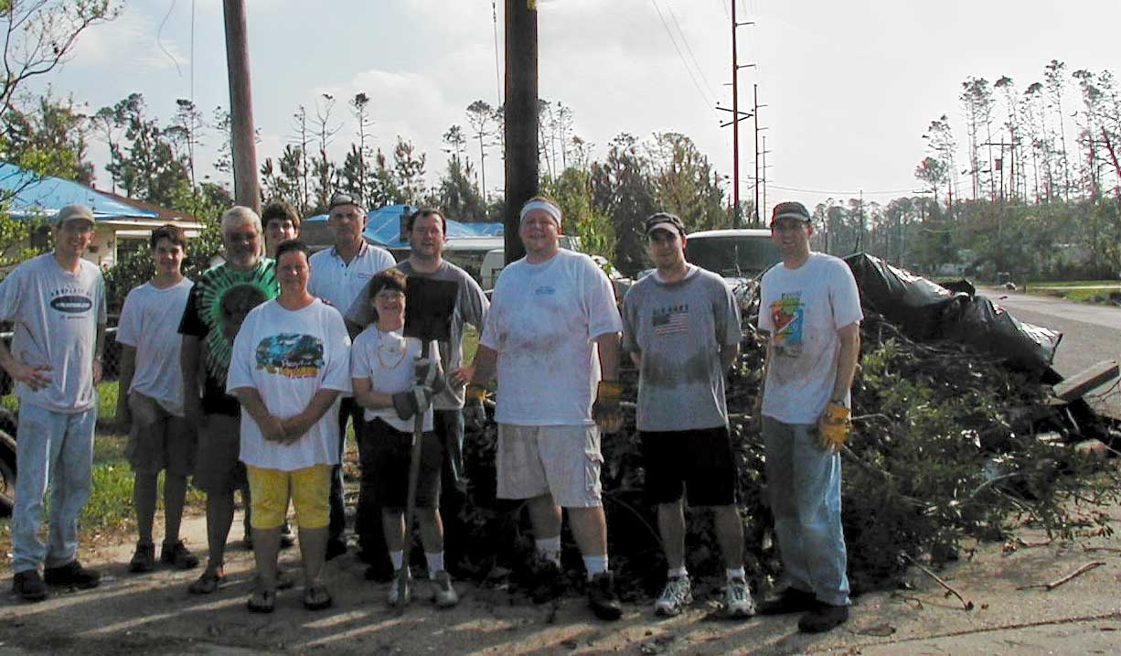
If we do righteous works to please Heavenly Father, He will reward us openly

Slide 43
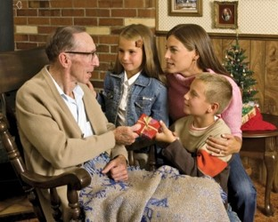
Treasures on Earth or in Heaven?
We can not take temporal things with us into the eternal world
Everlasting worth:
Nobility of character
Charitable actions
Meaningful and cherished relationships
These are the treasures worth seeking
3 Nephi 13:19-24

Slide 44
God or Worldliness?
1. A young man declines a job that would require him to miss his Sunday meetings and instead chooses a lower-paying job that does not require him to miss his meetings.
2. A young woman frequently complains to her parents about her need for new clothes. The clothes she desires to purchase cost more than her family can afford.
3. A young man pays his tithing regularly with the money he receives from his job. However, he uses all of his remaining income to purchase entertainment items, including some inappropriate movies and songs, and has saved no money to pay for a mission or education.
4. A young woman frequently uses some of her income to purchase small gifts to show love for others.

Slide 45
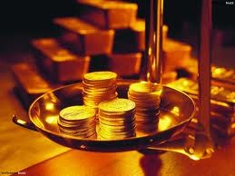
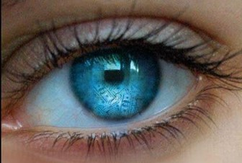
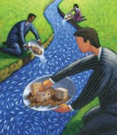
Searching For Mammon
An Aramaic word meaning “riches”
“No man can serve two masters: for either he will hate the one, and love the other; or else he will hold to the one, and despise the other. Ye cannot serve God and mammon.”
Matthew 6:24
“And I say unto you, Make to yourselves friends of the mammon of unrighteousness; that, when ye fail, they may receive you into everlasting habitations.”
Luke 16:9
3 Nephi 13:24

Slide 46
What Might You Leave Behind?
While searching for Mammon?
Family
Spouse and children
Friends
Gospel Principles
Membership in the Church
The Loss of the Holy Ghost
The Companionship of the Savior

Slide 47
“Consider the Lilies of the Field”
“For behold, ye are they whom I have chosen to minister unto this people. Therefore I say unto you, take no thought for your life, what ye shall eat, or what ye shall drink; nor yet for your body, what ye shall put on. Is not the life more than meat, and the body than raiment?”
Turning from the world and placing total faith in him.
The Lord’s directive is to the Twelve, who had been chosen, was to avoid being worried about the necessities of life.
“If the God of heaven chooses to feed the fowls of the air, if he provides means for the growth and beautification of grass and flowers on earth, then will he not help us provide for the crowning creatures of his creative enterprise—man?”
JFM and RLM
3 Nephi 13:25-34

Slide 48
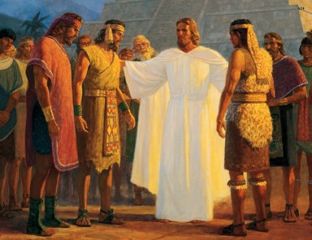
Seek Ye First the Kingdom of God
If we seek God and His kingdom first, He will help us provide for our needs
“But seek ye first the kingdom of God, and his righteousness; and all these things shall be added unto you.”
Matthew 6:33
“There’s enough to worry about today without making ourselves sick over tomorrow. For example: there’s enough evil and temptation in today’s world without fretting over what we will face in a future day.”
JFM and RLM
3 Nephi 13:25-34

Slide 49
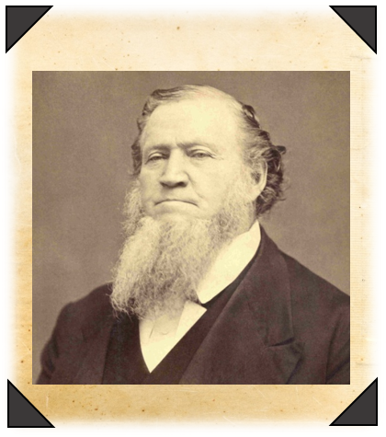
“…Sufficient is the day unto the evil thereof.”
“The men and women who desire to obtain seats in the Celestial Kingdom will find that they must battle with the enemy of all righteousness every day.”
--Brigham Young
3 Nephi 13:25-34

Slide 50
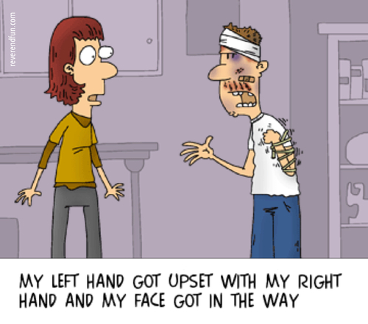
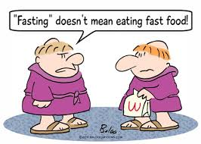
Sources:
Joseph Fielding McConkie and Robert L. Millet Doctrinal Commentary on the Book of Mormon Vol. 4 pgs. 81,88-89
Spencer W. Kimball Teachings of Spencer W. Kimball pg. 119-120
Signs of Hypocrite [Sahih Bukhari, Volume 1, Book 2, Number 33]
Further Reading: Jesus’ Sermon to the Nephites by Arthur R. Bassett Feb. 1978 Ensign
Brigham Young Journal of Discourses 11:14
Presentation by ©http://fashionsbylynda.com/blog/

Slide 51
I do alms (acts of religious devotion or service for others) because:
a. I am supposed to.
b. I love the Lord and enjoy helping other people.
c. I want others to think well of me.
2. I pray because:
a. I want to be able to tell my parents or my bishop “yes” when they ask me if I pray.
b. It is just part of my daily routine.
c. I want to communicate with my Heavenly Father.
3. I fast because:
a. Fasting helps me draw closer to the Lord.
b. Other people will think I’m weak if I don’t.
c. My parents tell me I should.
I do alms (acts of religious devotion or service for others) because:
a. I am supposed to.
b. I love the Lord and enjoy helping other people.
c. I want others to think well of me.
2. I pray because:
a. I want to be able to tell my parents or my bishop “yes” when they ask me if I pray.
b. It is just part of my daily routine.
c. I want to communicate with my Heavenly Father.
3. I fast because:
a. Fasting helps me draw closer to the Lord.
b. Other people will think I’m weak if I don’t.
c. My parents tell me I should.

Slide 52
Profile of a Christlike Character
One who seeks to understand others—does not have the spirit of contention (3 Nephi 11:28-30)
One who believes in Christ (3 Nephi 11:33)
One who is striving to repent (3 Nephi 11:38)
One who has been baptized (3 Nephi 11:38)
One who has received the gift of the Holy Ghost (3 Nephi 11:35)
One who gives heed to words of God’s chosen leaders (3 Nephi 12:1)
One who mourns for personal sins (3 Nephi 12:4)
One who hungers and thirsts after righteousness (3 Nephi 12:6)
One who is merciful to others (3 Nephi 12:7)
One who is pure in heart (3 Nephi 12:8)
One who is a peacemaker (3 Nephi 12:9)
One who endures persecution patiently (3 Nephi 12:10-12)
One who controls his/her temper (3 Nephi 12:21-22)
One who keeps their thoughts pure—does not lust (3 Nephi 12:27-29)
One who is honest—has absolute integrity (3 Nephi 12: 33-37)
One who seeks to bless and love their enemies (3 Nephi 12:39-45)
One who gives financial contributions without desiring praise of man (3 Nephi 13:1-4)
One who prays and fasts in secret (3 Nephi 13:5-18)
One who dose not judge his fellowman harshly (3 Nephi 14:1-5)
--Book of Mormon Religion 121-122 pg. 407 Student Manuel

Slide 53
3 Nephi 13:9-15
Our Father who art in heaven,
Hallowed be thy name
(Thy kingdom come is not mentioned –perhaps because the of God is about to be established among the Nephites in its eternal fulness)
Thy will be done on earth as it is in heaven
And forgive us our debts, as we forgive our debtors.
And lead us not into temptation, but deliver us from evil.
For thine is the kingdom, and the power, and the glory, forever. Amen
Matthew 6:9-13
Our Father which art in heaven
Hallowed be thy name
Thy kingdom come.
Thy will be done in earth, as it is in heaven.
Give us this day our daily bread.
And forgive us our debts, as we forgive our debtors.
And lead us not into temptation,
but deliver us from evil:
For thine is the kingdom, and the power, and the glory, for ever. Amen
Luke 11:2-4
Our Father which art in heaven.
Hallowed be thy name.
Thy kingdom come.
Thy will be done, as in heaven, so in earth.
Give us day by day our daily bread.
And forgive us our sins; for we also forgive every one that is indebted to us.
And lead us not into temptation; but deliver us from evil.
The Lord’s Prayer

Slide 54
Judge not, that ye be not judged
3 Nephi 14

Slide 55
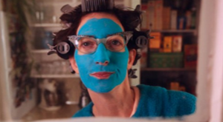
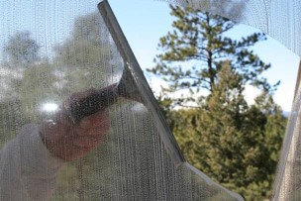
A young couple, Lisa and John, moved into a new neighborhood. One morning while they were eating breakfast, Lisa looked out the window and watched her next-door neighbor hanging out her wash.
“‘That laundry’s not clean!’ Lisa exclaimed. ‘Our neighbor doesn’t know how to get clothes clean!’
“John looked on but remained silent.
“Every time her neighbor would hang her wash to dry, Lisa would make the same comments.
“A few weeks later Lisa was surprised to glance out her window and see a nice, clean wash hanging in her neighbor’s yard. She said to her husband, ‘Look, John—she’s finally learned how to wash correctly! I wonder how she did it.’
“John replied, ‘Well, dear, I have the answer for you.
You’ll be interested to know that I got up early this morning and washed our windows!’”
President Thomas S. Monson

Slide 56
Judge not, that ye be not judged
The phrase “with what measure ye mete” refers to the standard a person uses to measure or judge other people.
Mete-- to measure or judge.
“What I am suggesting is that each of us turn from the negativism that so permeates our society and look for the remarkable good among those with whom we associate, that we speak of one another’s virtues more than we speak of one another’s faults.”
Gordon B. Hinckley
We will be judged according to the way we judge others
3 Nephi 14:1-2

Slide 57
“Final judgment … is that future occasion in which all of us will stand before the judgment seat of Christ to be judged according to our works. … I believe that the scriptural command to ‘judge not’ refers most clearly to this final judgment. …
“… The gospel is a gospel of hope, and none of us is authorized to deny the power of the Atonement to bring about a cleansing of individual sins, forgiveness, and a reformation of life on appropriate conditions”
Dallin H. Oaks
“… Why did the Savior command that we not judge final judgments? I believe this commandment was given because we presume to make final judgments whenever we proclaim that any particular person is going to hell (or to heaven) for a particular act or as of a particular time. When we do this—and there is great temptation to do so—we hurt ourselves and the person we pretend to judge.
3 Nephi 14:1-2

Slide 58
Mote--Beam
Mote (Speck)-- A fault we see in someone else
Beam-- Our own faults
Focusing on the faults we perceive in others can prevent us from recognizing our own faults
The Savior’s analogy focuses on objects that are lodged in the eye.
Such objects would affect a person’s vision.
How can our faults affect the way we see others?
3 Nephi 14:3-5

Slide 59
Unrighteous Judgment
“When the Lord warned against judging, he was counseling his people against condemning someone for his sins as well as against seeking to attribute motivation to a person when the observer cannot really know what is in that person’s heart.”
JFM and RLM
“He that is without sin among you, let him first cast a stone at her”
Read John 8:1-11
“Judge not unrighteously, that ye be not judged: but judge righteous judgment” JST Matthew 7:1
3 Nephi 14:3-5

Slide 60
Making Judgments
“Sometimes people feel that it is wrong to judge others in any way. While it is true that you should not condemn others or judge them unrighteous, you will need to make judgments of ideas, situations, and people throughout your life. The Lord has given many commandments that you cannot keep without making judgments.”
(True to the Faith: A Gospel Reference [2004], 90).
What are some judgments you must face in keeping the commandments?

Slide 61
Keeping Things Sacred
“We all make judgments in choosing our friends, in choosing how we will spend our time and our money, and, of course, in choosing an eternal companion. …
“… A righteous judgment will be guided by the Spirit of the Lord, not by anger, revenge, jealousy, or self-interest”
Elder Dallin H. Oaks
“Give not that which is holy unto the dogs, neither cast ye your pearls before swine, lest they trample them under their feet, and turn again and rend you.”
To share something that is sacred with those who will not appreciate it or honor its sacredness
3 Nephi 14:6

Slide 62
Ask—Seek--Knock
“Ask, and it shall be given unto you; seek, and ye shall find; knock, and it shall be opened unto you.”
?
Heavenly Father blesses us when we pray for His help.
and he that seeketh, findeth;
For every one that asketh, receiveth;
and to him that knocketh, it shall be opened.
“Whatsoever thing ye shall ask the Father in my name, which is good, in faith believing that ye shall receive, behold, it shall be done unto you.” (Moroni 7:26)
3 Nephi 14:7-11

Slide 63
Do Ye Even So to Them
“Jesus did not intend to suggest that each person strive to love himself, nor did he mean to indicate that we should spend much time at all in trying to build our love for ourselves. He taught instead the ironic but infinitely true principle that only as we lose ourselves can we find ourselves…
(see Matthew 26:25)
“Therefore, all things whatsoever ye would that men should do to you, do ye even so to them, for this is the law and the prophets.”
We gain the inner peace and stability of soul promised by the Savior only as we lose ourselves in our quest for God and as we give of ourselves selflessly in service to others….
Love your neighbor as you would want him or her to love you. Treat others as you would want to be treated.
3 Nephi 14:12 JFM and RLM

Slide 64
Doing His Will
3 Nephi 14:13-14
3 Nephi 14:15
3 Nephi 14:16-20
How is obeying the teachings of Jesus Christ like walking on a narrow path?
How is rejecting the teachings of Jesus Christ like walking on a wide path?
What are some ways the Savior’s teachings are different from the teachings of the world?
Why would a wolf dress in sheep’s clothing?
What does this analogy tell us about the desires and actions of false prophets?
If the trees represent people, what might the fruits represent?
Possible answers:
people’s thoughts, words, actions, and influence on others

Slide 65
Not Just Those
“Not every one that saith unto me, Lord, Lord, shall enter into the kingdom of heaven; but he that doeth the will of my Father who is in heaven.”
3 Nephi 14:21
“It is not just those who cry out to the Lord, not just those whose voices are raised to Jehovah, not just those whose display of righteousness is public and whose commitment to the faith is spoken regularly, who shall be save. Rather, it is those who trust in the Lord, who perform the works of righteousness in a quiet but steadfast manner…
It is not just those who did all the right things, who carried out the assignments, who will be save….
The Lord’s true saints are the ones who do His works, under the influence of His Spirit.
JFM and RLM
We must do the will of Heavenly Father in order to enter into the kingdom of heaven

Slide 66
Building On A Rock
3 Nephi 14:24-27
When we hear the Savior’s words and follow them, how are we like a man who builds his house on a rock?
If we choose not to follow the Savior’s words, how are we like a man who builds his house on the sand?

Slide 67
Sources:
Video:
Looking Through the Windows (2:19)
President Thomas S. Monson(“Charity Never Faileth,” Ensign or Liahona, Nov. 2010, 122).
President Gordon B. Hinckley The Continuing Pursuit of Truth Ensign April 1986
Dallin H. Oaks (“‘Judge Not’ and Judging,” Ensign, Aug. 1999, 7, 9).
Joseph Fielding McConkie and Robert L. Millet Doctrinal Commentary on the Book of Mormon Vol. 4 pg. 89-90, 93, 96
Presentation by ©http://fashionsbylynda.com/blog/

Slide 68
The Law of Moses and the Law of Christ
3 Nephi 15-16

Slide 69
Previously
The Savior’s Teachings
Spiritual condition and blessings of those who obey the Savior’s commandments
Judging others
“let your light so shine”
Avoid having a sad countenance
3 Nephi 12:16.
3 Nephi 13:16.
3 Nephi 14:2-5.
3 Nephi 14:24
Jesus Christ is the law and the light. If we look to Jesus Christ and endure to the end, He will give us eternal life.

Slide 70
The Law of the Prophets
At the time of Jesus, the Jewish scriptures (our Old Testament) were divided into three major sections.
The Law, or the Torah, including the five books of Moses:
(Genesis, Exodus, Leviticus, Numbers, and Deuteronomy).
2. The Prophets included the writings of the various prophets:
(Isaiah, Jeremiah, Ezekiel and Daniel).
3. The Writings, included the historical books:
Joshua, Judges, Samuel, Kings
And
The poetic books:
Psalms and Proverbs
Student Manual

Slide 71
Done Away With
Sacrifice under the Law of Moses was done away with and replaced with Sacrament under the Law of Christ
“The law that was done away with in Christ was the strict ceremonies, observances and offerings peculiar to the law of Moses” Student Manual
The Nephite people, at this time, had only known what was in the brass plates; living the law of Moses.
All worship, teachings, religious rites, and Church organization was built upon the law of Moses
“…for they understood not the saying that old things had passed away, and that all things had become new.”
3 Nephi 15:1-2

Slide 72
Jehovah as the Lawgiver
“…the law is fulfilled that was given unto Moses.”
…I am he who covenanted with my people Israel…
“Behold, I am he that gave the law…
…therefore, the law in me is fulfilled, for I have come to fulfill the law; therefore it hath an end.”
3 Nephi 15:3-5

Slide 73
Saving the Prophet’s Words
Many Nephites must have wondered if the words of the prophets of old were no longer relevant
Many prophecies from the previous prophets had not been fulfilled
“…I do not destroy that which hath been spoken concerning things which are to come…
…the law which was given unto Moses hath an end in me.”
3 Nephi 15:6-8

Slide 74
Changes in the Church
“There are those within the Church who are disturbed when changes are made with which they disagree or when changes they propose are not made. They point to these as evidence that the leaders are not inspired…changes in organization or procedures are a testimony that revelation is ongoing. While doctrines remain fixed, the methods or procedures do not?”
Elder Boyd K. Packer
“The underlying purpose or doctrine of the law of Moses was not being done away with—there was still the need to come unto Christ and partake of the Atonement. The means or procedures by which men embraced the eternal gospel were all that were being change.”
JFM and RLM
“Keep in mind that the principles of the gospel of Jesus Christ are divine. Nobody changes the principles and doctrines of the Church except the Lord by revelation.
…If you will analyze all that is being done and the changes that are taking place, you will realize that the fundamental doctrines of the Church are not changing.”
President Harold B. Lee

Slide 75
“I Am The Law and the Light”
Jesus reminds the Nephites:
All the Prophets had testified of Him
All the practices, laws and ordinances had testified of Him being the Creator, the Redeemer, the Christ
The Savior requires:
the continual keeping of the commandments
resisting temptation
repenting of our sins
exercising faith in Christ
rendering service
being prayerful
loving God and our fellowmen
“…look unto me,…and live…endureth unto the end…”
Jesus Christ is the source of the law. All laws of the gospel point us to Jesus Christ and His Atonement. If we follow His commandments, we will receive eternal life.
.”
”…but endure them, for, lo, I am with thee, even unto the end of thy days.”
D&C 24:8
3 Nephi 15:9-10

Slide 76
“One Fold, One Shepherd”
Jesus speaks to the Twelve whom he had chosen:
You are the Light (truth) to this people
You are the remnant of the house of Joseph
You have inherited this land from the Father
I was not given authority to tell Israel about the other tribes (because of their “stiffneckedness and unbelief”)
“As far as we degenerate from God. We descend to the devil and lose knowledge, and without knowledge we cannot be saved.”
Joseph Smith
“And other sheep I have, which are not of this fold: them also I must bring, and they shall hear my voice; and there shall be one fold, and one shepherd.” John 10:16
3 Nephi 15:11-21

Slide 77
The American Israelites
God cares for all His children, and He manifests Himself to them.
The people of the Nephite nation and other seed of Lehi—are here definitively identified as one group of the “other sheep” of which Jesus had spoken in Jerusalem.
The Lord told the Nephites that they were the other sheep of whom He had spoken; however, the Jews in Jerusalem had thought He was speaking of the Gentiles, or non-Israelites. They had not understood that the Gentiles would not personally hear His voice.
“I am not sent but unto the lost sheep of the house of Israel”
Matthew 15:24
3 Nephi 15:21-24

Slide 78
Other Sheep
Other sheep not of the land of the Nephites or of the land in Jerusalem
In 721 BC the ten northern tribes of Israel were taken captive into Assyria. From there they were led into the land of the north and were thereafter lost from the annals of history. They have thus come to be known as the Lost Ten Tribes.
“I write unto all the ends of the earth; yea, unto you, twelve tribes of Israel…”
Mormon 3:18
3 Nephi 16:1-3

Slide 79
“The Book of Mormon is written to the twelve tribes of Israel. And this included the lost Ten Tribes. For that matter, the New Testament is addressed ‘ to the twelve tribes which are scattered abroad.”
Bruce R. McConkie
“The Savior broadens our understanding of his statement in Jerusalem regarding his “other sheep”; they consist of the Nephites, the ten tribes, and possibly other branches of Israel of which we have no knowledge.”
JFM and RLM
“James, a servant of God and of the Lord Jesus Christ, to the twelve tribes which are scattered abroad, greeting.” James 1:1
3 Nephi 16:1-3

Slide 80
Times of the Gentiles
The Gospel is restored through the Gentiles in a Gentile Nation in this final dispensation
“To some degree we are today in a period of transition: the gospel is going forth to the Gentile nations, but at the same time wickedness is increasing and more of the children of men are sinning against the light of the gospel.”
JFM and RLM
“…may be brought in, or may be brought to a knowledge of me, their Redeemer.” 3 Nephi 16:4

Slide 81
Four Corners of the Earth
“And he shall set up an ensign for the nations, and shall assemble the outcasts of Israel, and gather together the dispersed of Judah from the four corners of the earth.”
2 Nephi 21:12
“And after these things I saw four angels standing on the four corners of the earth, holding the four winds of the earth, that the wind should not blow on the earth, nor on the sea, nor on any tree.”
Revelation 7:1
“And he shall set up an ensign for the nations, and shall assemble the outcasts of Israel, and gather together the dispersed of Judah from the four corners of the earth.”
Isaiah 11:12
“… And then will I gather them in from the four quarters of the earth; and then will I fulfil the covenant which the Father hath made unto all the people of the house of Israel.” 3 Nephi 16:5
“Which Twelve hold the keys to open up the authority of my kingdom upon the four corners of the earth, and after that to send my word to every creature.”
D&C 124:128
3 Nephi 16:5

Slide 82
Blessings and Warnings to Israel
Blessings
These things will be made know unto them
He will have mercy and He will remember His covenant to them
He and His servants will bring the gospel to them
They will come to the knowledge of the fulness of the gospel
They can, if they repent, be numbered among His people
Woes
They have been cast out and trodden down
Smitten and afflicted, and to be slain, and cast out
To be hated “a hiss and a byword” among them
They will suffer
Be as ‘salt that has lost its savor’
If we repent and return to Jesus Christ, then we will be numbered among His people.

Slide 83
Isaiah’s Prophecy
“Thy watchmen shall lift up the voice; with the voice together shall they sing, for they shall see eye to eye when the Lord shall bring again Zion.
Break forth into joy, sing together, ye waste places of Jerusalem; for the Lord hath comforted his people, he hath redeemed Jerusalem.
The Lord hath made bare his holy arm in the eyes of all the nations; and all the ends of the earth shall see the salvation of God.”
Watchmen—guardians and keepers of the people
“And there shall be mine abode, and
it shall be Zion, which shall come
forth out of all the creations which I have made; and for the space of a thousand years the earth shall rest.”
Moses 7:64
“The most worthy calling in life … is that in which man can serve best his fellow man.”
President David O. McKay
3 Nephi 16:18-20 and Isaiah 52:8-10

Slide 84
Sources:
Book of Mormon 121-122 Student Manual pg. 120
Elder Boyd K. Packer Revelation in a Changing World Conf. Report Oct. 1989
President Harold B. Lee God’s kingdom—Kingdom of Order Ensign, Jan. 1971
Joseph Fielding McConkie and Robert L. Millet Doctrinal Commentary on the Book of Mormon Vol. 4 pg. 101
Joseph Smith Teachings pg. 217
Compass art by Judy Merrell---Map by Teri Johnson
Bruce R. McConkie Millennial Messiah pg. 215-217 For more information of the Gathering of Israel
President David O. McKay (Instructor, Mar. 1961, pp. 73–74).
Presentation by ©http://fashionsbylynda.com/blog/

Slide 85
As the Good Shepherd, Jesus Christ views disease in His sheep as a condition that needs treatment, care, and compassion. This shepherd, our Good Shepherd, finds joy in seeing His diseased sheep progress toward healing. …
The Savior’s mortal ministry was indeed characterized by love, compassion, and empathy. He did not disdainfully walk the dusty roads of Galilee and Judea, flinching at the sight of sinners. He did not dodge them in abject horror. No, He ate with them. He helped and blessed, lifted and edified, and replaced fear and despair with hope and joy. Like the true shepherd He is, He seeks us and finds us to offer relief and hope. (Dale G. Renlund, “Our Good Shepherd,” Ensign or Liahona, May 2017, 30)
One Fold: There is only one way into the fold of God and only one way to be saved. It is by and through Jesus Christ.
We learn how to come into the fold from the word of God, which is the doctrine taught by Jesus Christ and His prophets. When we follow the doctrine of Christ and come into the fold through faith in Jesus Christ, repentance, baptism and confirmation, and continuing faithfulness, Alma promised four specific, personal blessings. You may (1) “be redeemed of God,” (2) “be numbered with those of the first resurrection,” (3) “have eternal life,” and (4) the Lord will “pour out his Spirit more abundantly upon you” [Mosiah 18:9, 10]. Within the fold of God, we experience [the Good Shepherd’s] watchful, nurturing care and are blessed to feel His redeeming love. He said, “I have graven thee upon the palms of my hands; thy walls are continually before me” [Isaiah 49:16]. Our Savior has graven upon His palms our sins, pains, afflictions, and all that is unfair in life. All are welcome to receive these blessings, as they “are desirous to come” [Mosiah 18:8] and choose to be in the fold.(Randy D. Funk, “Come into the Fold of God,” Liahona, May 2022, 119–20)

