Slide 1
3 Nephi 17-19

Slide 2
3 Nephi 17

Slide 3
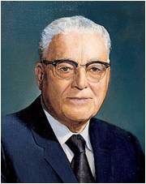
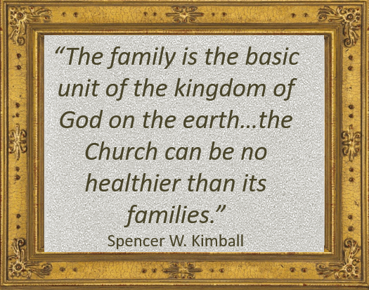
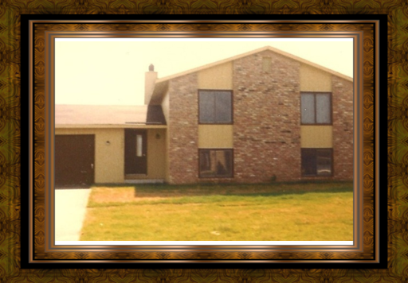
“My Time is At Hand”
“God be with you. I have the same feeling as perhaps the Master had when he bid goodbye to the Nephites. He said he perceived that they were weak, but if they would go to their homes and ponder what he said he would come again and instruct them on other occasions.
So likewise, you cannot absorb all that you have heard and that we have talked about, but go to your homes now and remember what you can, and get the spirit of what has been done and said, and when you come again, or we come to you, we will try to help you further with your problems.”
President Harold B. Lee
The most important gospel instruction should be in the home
3 Nephi 17:1-4

Slide 4
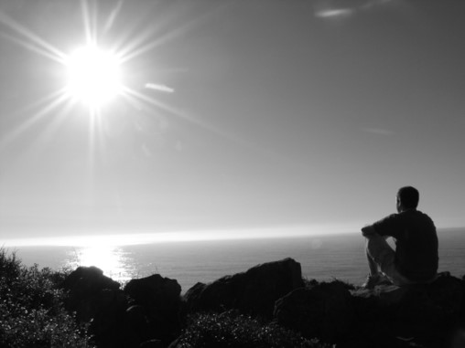
Ponder
To Ponder:
To meditate
To think
To feast
To treasure
It is more than a mental method, it is a spiritual striving to obtain an to understand truth then it is to pray about the things
you pondered.
“Reading, studying, and pondering are not the same.
We read words and we may get ideas.
We study and we may discover patterns and connections in scripture.
But when we ponder, we invite revelation by the Spirit.
Pondering, to me, is the thinking and the praying I do after reading and studying in the scriptures carefully.”
Henry B. Eyring
How do you think pondering and prayer can work together to help us understand what we learn in church or seminary?
3 Nephi 17:3

Slide 5
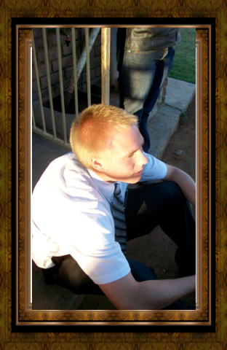
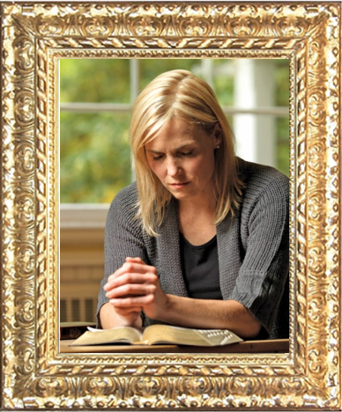
Preparing to Receive
How should you prepare to understand and learn what is taught during church or seminary?
What difference does it make when we prepare our minds for learning opportunities?
Pondering opens the mind to the Spirit
3 Nephi 17:3

Slide 6
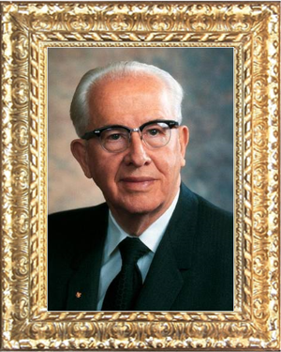
“Man must take time to meditate, to sweep the cobwebs from his minds, so that he might get a more firm grip on the truth and spend less time chasing phantoms and dallying in projects of lesser worth…Take time to mediate. Ponder the meaning of the work in which you are engaged. The Lord has counseled, “Let the solemnities of eternity rest upon your minds’ (D&C 43:34). You cannot do that when your minds are preoccupied with the worries and cares of the world.”
--Ezra Taft Benson

Slide 7
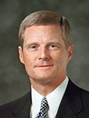
“Writing down what we learn, think, and feel as we study the scriptures is another form of pondering and a powerful invitation to the Holy Ghost for continuing instruction.”
David A. Bednar

Slide 8
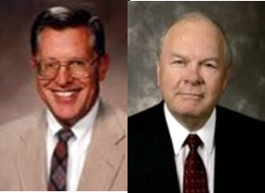
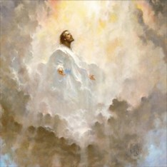
“I Go to the Father”
“The record does not tell us why he returns to the Father. Presumably he returned to report of his ministry among the Nephites and to receive any instructions that the Father would have him deliver when he came again”
JFM and RLM
“And now I go unto the Father, because it is expedient that I should go unto the Father for your sakes.”
3 Nephi 18:35
3 Nephi 17:4

Slide 9
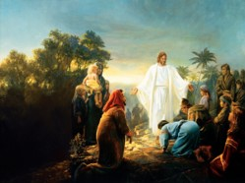
Tarry a Little Longer
Why did Jesus stay a little longer?
Bowels= The Semitic Root for “Mercy”
refers to that which is deep within
He saw tears in their eyes
He had compassion on them
“And he will take upon him death, that he may loose the bands of death which bind his people; and he will take upon him their infirmities, that his bowels may be filled with mercy, according to the flesh, that he may know according to the flesh how to succor his people according to their infirmities.”
Alma 7:12
The Savior feels great compassion for us. Jesus Christ can heal every kind of affliction. As we come unto Jesus Christ in faith, we can experience His healing power.
3 Nephi 17:5-6

Slide 10
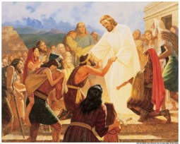
Faith To Be Healed
Jesus shows the Nephites what had been done in Jerusalem to their brethren
“…for I see that your faith is sufficient that I should heal you.”
“Healing of a physical nature and also healing of the spirit—forgiveness of sin—come to people as gifts of the grace of God as they exercise faith in the Lord Jesus Christ.”
JFM and RLM
“And again, to some it is given to have faith to be healed;”
D&C 46:19
“…thy faith hath made thee whole.”
Matthew 9:22
3 Nephi 17:7-9

Slide 11
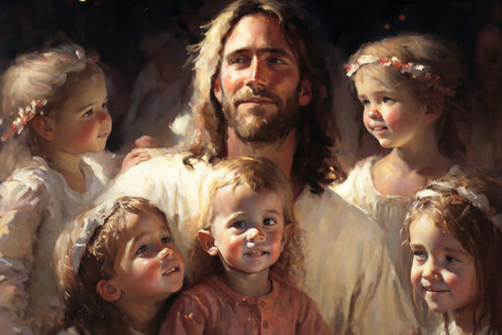
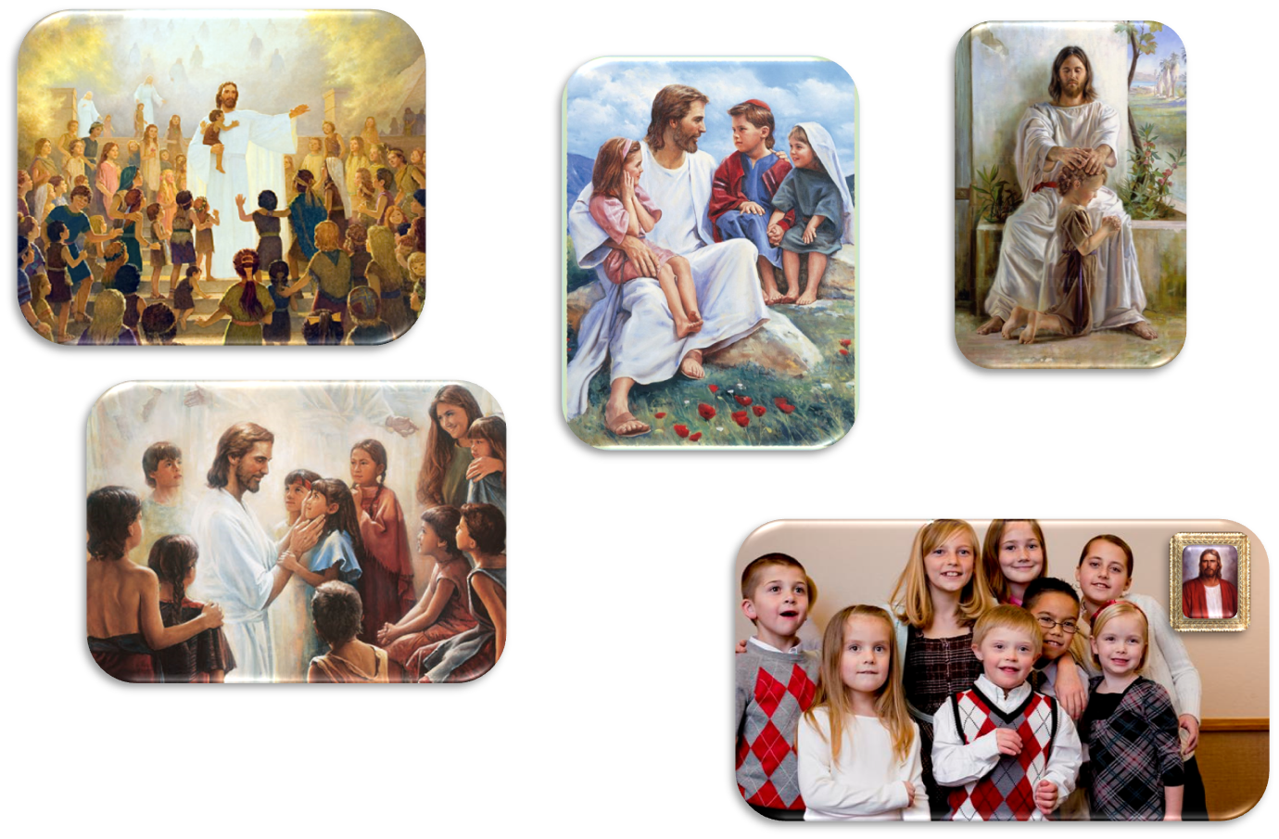
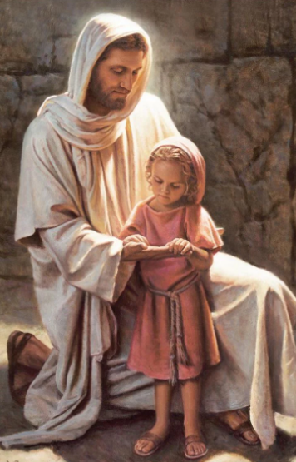
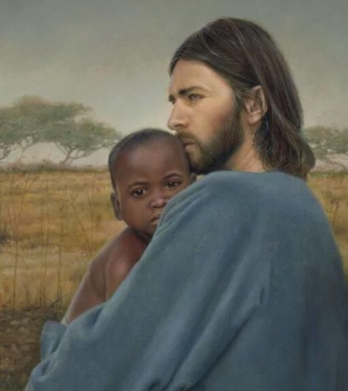
“My Joy is Full”
3 Nephi 17:13-20
There are no words to describe the prayer He offered upon the
little children

Slide 12
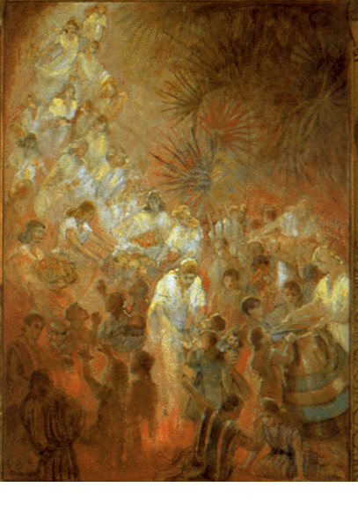
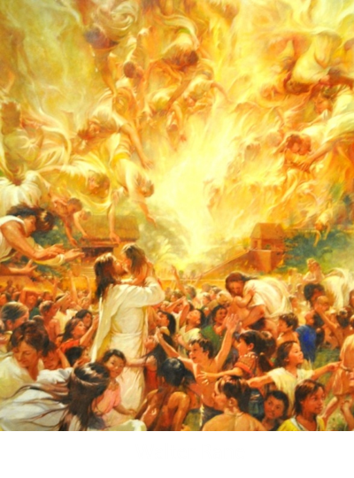
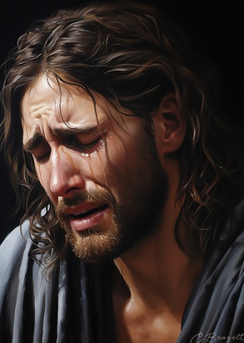
“Behold Your Little Ones”
“And when he had said these words, he wept, and the multitude bare record of it, and he took their little children, one by one, and blessed them, and prayed unto the Father for them.
And when he had done this he wept again;”
3 Nephi 17:21-25

Slide 13
Sources:
President Harold B. Lee Conf Report Oct 1972
Spencer W. Kimball The Teachings of Spencer W. Kimball pg. 331-332
The Teachings of Ezra Taft Benson pg. 390
(David A. Bednar, “Because We Have Them before Our Eyes,” New Era, Apr. 2006, 6–7).
Henry B. Eyring (“Serve with the Spirit,” Ensign or Liahona, Nov. 2010, 60).
Joseph Fielding McConkie and Robert L. Millet Doctrinal Commentary on the Book of Mormon Vol. 4 pg. 114,115
Illustration of Jesus Healing—Gary Kapp
Presentation by ©http://fashionsbylynda.com/blog/

Slide 14
Compassion:
It is meaningful to observe that Jesus’s compassionate acts were not occasional or mandated manifestations based on a list of tasks to be completed but everyday expressions of the reality of His pure love for God and His children and His abiding desire to help them.
The compassionate attitude of Jesus is rooted in charity, namely, in His pure and perfect love, which is the essence of His atoning sacrifice. Compassion is a fundamental characteristic of those who strive for sanctification, and this divine quality intertwines with other Christian traits such as mourning with those who mourn and having empathy, mercy, and kindness. The expression of compassion for others is, in fact, the essence of the gospel of Jesus Christ and a marked evidence of our spiritual and emotional closeness to the Savior. Furthermore, it shows the level of influence He has on our way of life and demonstrates the magnitude of our spirits. (Ulisses Soares, “The Savior’s Abiding Compassion,” Liahona, Nov. 2021, 13–14)
Bring Them Hither:
When the Savior appeared to the righteous in the New World, He called for persons to come forward who were lame or blind or had other physical ailments. He extended the same invitation to those “that are afflicted in any manner” (3 Nephi 17:7). “Bring them hither,” He said, “and I will heal them” (v. 7). The Book of Mormon tells how the multitude brought forward “all them that were afflicted in any manner” (v. 9). This must have included persons with every kind of physical or emotional or mental affliction, and the scripture testifies that Jesus “did heal them everyone” (v. 9). (Dallin H. Oaks, “He Heals the Heavy Laden,” Ensign or Liahona, Nov. 2006, 6)

Slide 15
THE SAVIOR HEALS THE SICK AND AFFLICTED (SEE 3 NEPHI 17:6–10) | THE SAVIOR PRAYS FOR THE PEOPLE (SEE 3 NEPHI 17:11–18) | ANGELS APPEAR AND MINISTER TO THE CHILDREN (SEE 3 NEPHI 17:19–25)
THE SAVIOR HEALS THE SICK AND AFFLICTED (SEE 3 NEPHI 17:6–10) | THE SAVIOR PRAYS FOR THE PEOPLE (SEE 3 NEPHI 17:11–18) | ANGELS APPEAR AND MINISTER TO THE CHILDREN (SEE 3 NEPHI 17:19–25)

Slide 16
3 Nephi 18
3 Nephi 18

Slide 17
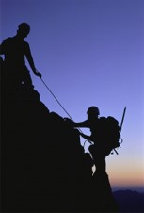
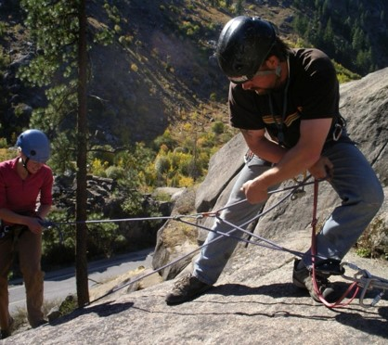
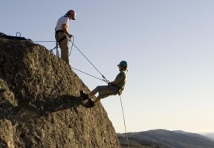
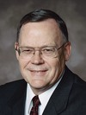
“Some time ago there was an interesting article about mountain climbing in a medical magazine. …
“The article was about a man named Czenkusch (ZEN-kush) who runs a climbing school. … Czenkusch was describing to the interviewer the belay system in mountain climbing.
This is the system by which climbers protect themselves from falls. One climber gets in a safe position and secures the rope for the other climber, usually around his or her own body.
‘You’re on belay,’ means, ‘I’ve got you. If something happens, I will stop you from falling.’ It is an important part of mountain climbing…

Slide 18
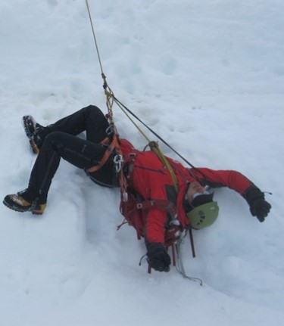
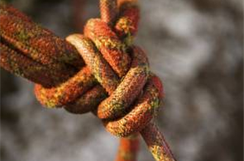
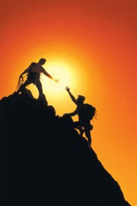
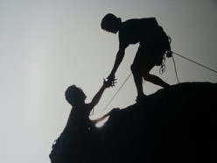
...‘Belaying has brought Czenkusch his best and worst moments in climbing.
Czenkusch once fell from a high precipice, yanking out three mechanical supports and pulling his belayer off a ledge. He was stopped, upside down, 10 feet from the ground when his spread-eagled belayer [Don] arrested the fall with the strength of his outstretched arms.
“Don saved my life,” says Czenkusch.
“How do you respond to a guy like that? Give him a used climbing rope for a Christmas present?
No, you remember him. You always remember him”’
Gerald Lund

Slide 19
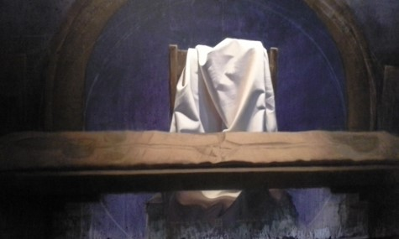
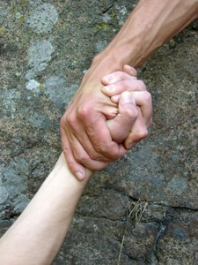
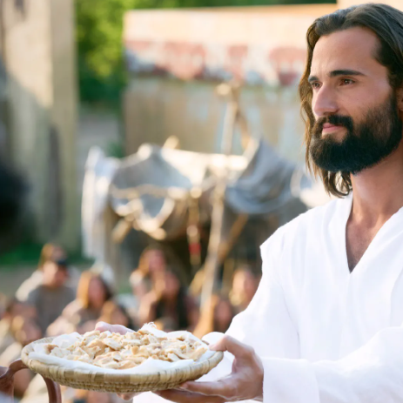
Our Rescuer
Who is our rescuer and how do we give thanks?
Jesus implements the sacrament to the Nephites as he did with His disciples at the Last Supper---in remembrance of Him who has rescued us from sin
3 Nephi 18:1-7

Slide 20
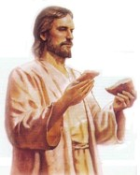
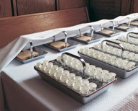
Hunger and Thirst—Bread and Wine
Hunger and thirst for the Spirit of Christ
We must come to the sacrament table hungry
We eat food to stimulate our physical bodies
It is also necessary for our spiritual body to receive spiritual strength
Bread and wine to always remember Him
Symbols of body and flesh
A merciful blessing
How does partaking of the sacrament help us remember the Savior’s sacrifice in our behalf?
3 Nephi 18:1-4

Slide 21
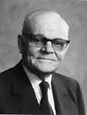
A Full Participant
“…witness before the church that they have truly repented of all their sins, and are willing to take upon them the name of Jesus Christ,…
D&C 20:37
As we partake of the sacrament, we witness unto the Father that we will always remember Jesus Christ.
“Now partaking of the sacrament is not to be a mere passive experience. We are not to remember the Lord’s suffering and death only as we may remember some purely secular historical event. Participating in the sacrament service is meant to be a vital and a spiritualizing experience.”
Elder Marion G. Romney
As we partake of the sacrament, we witness unto the Father that we are willing to do all that the Savior has commanded

Slide 22
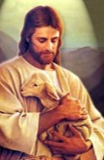
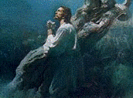
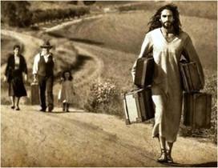
Remembering Him
We remember the life of the Jesus and the model He set for us by His own life.
We remember His atoning sacrifice made in our behalf through which He endured shame and incomprehensible pain in order to pay for our sins and bring about the Resurrection
We remember the covenants we have made with Him and examine how well we are keeping those covenants.
We remember him in our everyday life by asking ourselves:
“What would Jesus do in this situation?” or
“How would He respond to this challenge” or
“What would He say if he were here now?”
We use Him as the constant standard by which we measure all of our own thoughts, words, and actions.
Student Manual

Slide 23
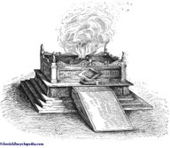
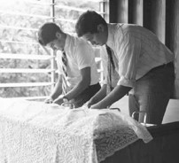
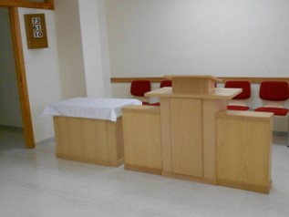
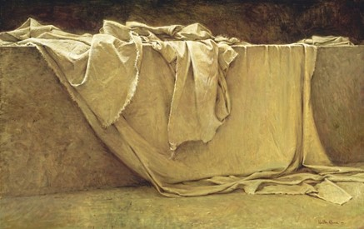
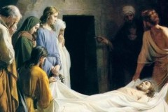
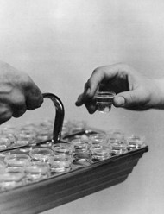
Submitting to the Will of the Lord
Where is our sacred alter?
Who prepares the sacrament?
What are we asked to do?
We partake of the sacrament. We submit our whole selves to the will of God
To Cover—Atonement
The Savior has covered for our sins and transgressions, our sorrows and trials, our afflictions and pain
What happens at the alter when the sacrament is over?

Slide 24
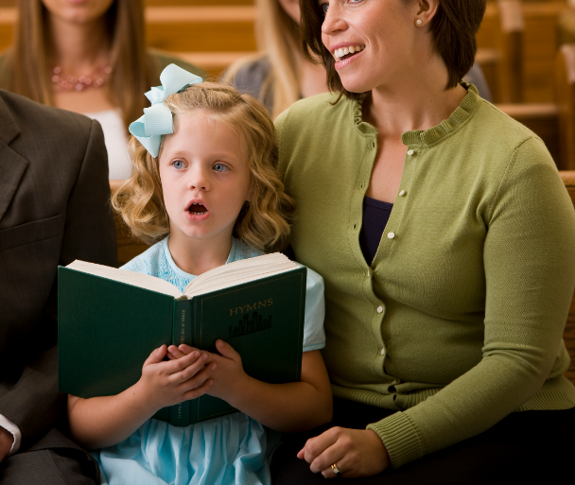
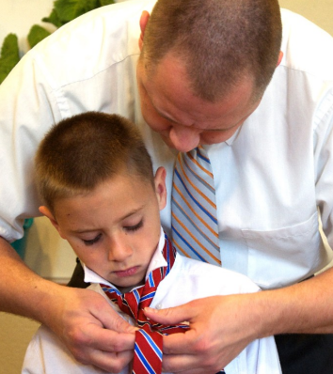
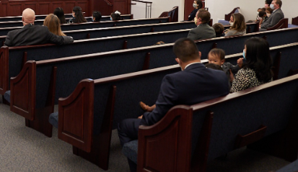
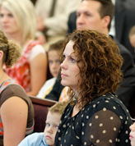
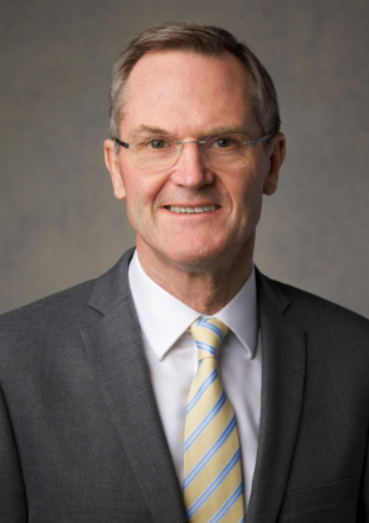
Preparing to For Sacrament
I invite all of us to consider five ways to increase the impact and power of our regular participation in the sacred ordinance of the sacrament, an ordinance that can help us become holy.
Prepare in Advance. …
Arrive Early. …
Sing and Learn from the Words of the Sacrament Hymn. …
Spiritually Participate in the Sacrament Prayers. …
Ponder and Remember Him as the Sacrament Emblems Are Passed. …
I testify of the multitude of blessings available to us as we increase our preparation for and spiritual participation in the ordinance of the sacrament. Peter F. Meurs

Slide 25
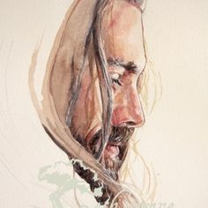
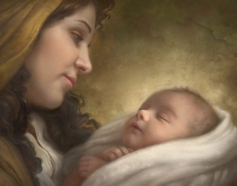
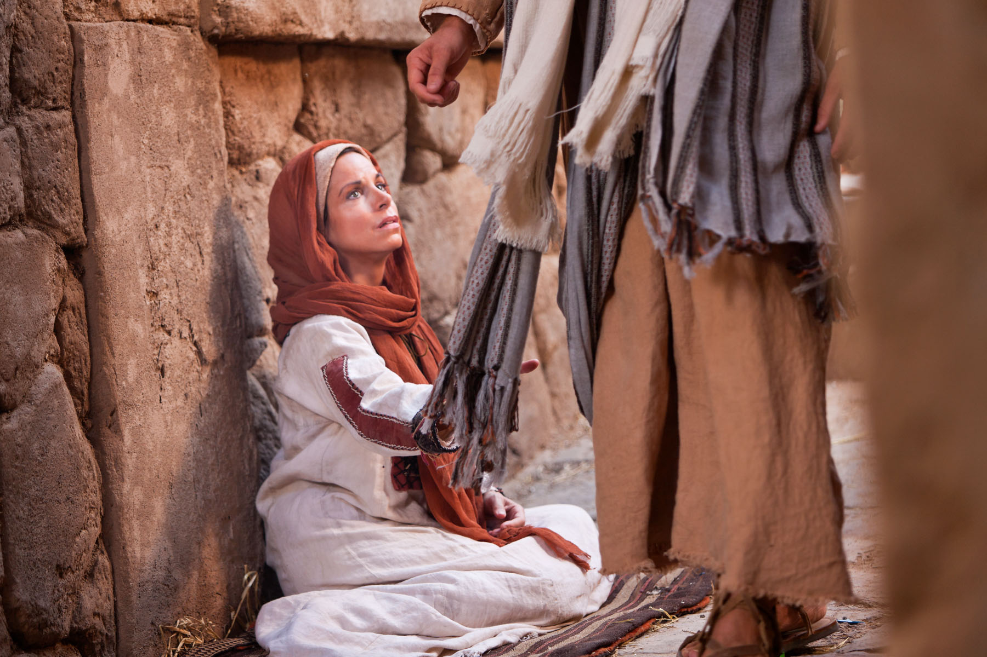
3 Nephi 18:7
Always Remember Him
And if ye do always remember me ye shall have my Spirit to be with you.

Slide 26
Pray Always
“Prayer is an act of faith
Bible Dictionary: ‘The object of prayer is not to change the will of God, but to secure for ourselves and for others blessings that God is already willing to grant, but that are made conditional on our asking for them.’
Surely, as our creator He knows our cares, our worries, our joys, our struggles without our informing Him. The reason our Heavenly Father asks us to pray cannot be that we are able to tell Him something He does not already know. Rather, the reason He asks us to pray is that the process of learning to communicate effectively with Him will shape and change our lives.”
David E. Sorensen
3 Nephi 18:15-25
Student Manual

Slide 27
“Family prayer is a powerful and sustaining influence.
During the dark days of World War II, a 500-pound bomb fell outside the little home of Brother Patey, a young father in Liverpool, England, but the bomb did not go off.
His wife had died, so he was rearing his five children alone. He gathered them together at this very anxious time for family prayer. They ‘all prayed … earnestly and when they had finished praying, the children said: “Daddy, we will be all right. We will be all right in our home tonight.”
“‘And so they went to bed, imagine, with that terrific bomb lying just outside the door half submerged in the ground. If it had gone off it would have destroyed probably forty or fifty houses and killed two or three hundred people. …
“‘The next morning the … whole neighborhood was removed for forty-eight hours and the bomb was finally taken away. …
“‘On the way back Brother Patey asked the foreman of the A.R.P. Squad: “Well, what did you find?”
“‘“Mr. Patey, we got at the bomb outside of your door and found it ready to explode at any moment. There was nothing wrong with it. We are puzzled why it did not go off.”’
James E. Faust

Slide 28
Hold Up Your Light
“Therefore, hold up your light that it may shine unto the world. Behold I am the light which ye shall hold up—that which ye have seen me do. Behold ye see that I have prayed unto the Father, and ye all have witnessed.”
“Ye are the light of the world. A city that is set on an hill cannot be hid.”
Matthew 5:14
“Let your light so shine before men, that they may see your good works, and glorify your Father which is in heaven.”
Matthew 5:16
Christ as the light in our lives:
Individually—By taking on His name—that it shine in our countenances
Institution of the Church—giving meaning to all that we do…all our ministering, meetings and efforts to build up the kingdom of God
3 Nephi 18:15-24

Slide 29
Instruction for the Disciples
They are to:
“fulfill other commandments”
Do not partake of sacrament unworthily
Minister to them and pray for them who are unworthy, but do not cast them out
“And now I go unto the Father, because it is expedient that I should go unto the Father for your sakes.”
“Forbidding someone from partaking of the sacrament on the grounds of person unworthiness is the responsibility of the “judge in Israel” who holds the key of the priesthood which direct priesthood ordinances. It is not the prerogative of members of the congregation to forbid anyone from partaking of the sacrament.
If they are aware of unworthiness, they may discuss it with the bishop or the appropriate priesthood leader, but it remains the right of the priesthood leader, through the spirit of discernment, to allow or disallow someone the blessing of the sacrament.”
JFM and RLM
3 Nephi 18:26-34

Slide 30
Ordaining the Twelve
Touching---laying on of hands—setting apart or ordination
“As a result of the fulfillment of the law and as part of the establishment of a new dispensation and new Church, the Savior ordains and sets apart his disciples and gives them authority to confer the gift of the Holy Ghost and set in order the new organization. The words spoken by Christ to the Twelve—which were not heard by the multitude—were preserved.”
JFM and RLM
Jorge Cocco
Read Moroni 2
3 Nephi 18:36-38

Slide 31
Day 1 of the Savior’s Visit
“And while they were overshadowed he departed from them, and ascended into heaven. And the disciples saw and did bear record that he ascended again into heaven.”
Compared with Acts 1:9-11
“And when he had spoken these things, while they beheld, he was taken up; and a cloud received him out of their sight.
And while they looked steadfastly toward heaven as he went up, behold, two men stood by them in white apparel;
Which also said, Ye men of Galilee, why stand ye gazing up into heaven? this same Jesus, which is taken up from you into heaven, shall so come in like manner as ye have seen him go into heaven.”
3 Nephi 18:39

Slide 32
Sources:
Gerald Lund [Eric G. Anderson, “The Vertical Wilderness,” Private Practice, November 1979, 21; emphasis added]” (“The Grace and Mercy of Jesus Christ,” in Jesus Christ: Son of God, Savior, ed. Paul H. Peterson, Gary L. Hatch, and Laura D. Card [2002], 48).
Elder Marion G. Romney Improvement Ira May 1946 p. 315
Student Manual 121-122 pg. 419
David E. Sorensen Prayer Ensign May 1993
James E. Faust [Andre K. Anastasiou, in Conference Report, Oct. 1946, 26.] Miraculous things happen when families pray together” (“The Lifeline of Prayer,” Ensign, May 2002, 61).
World War II children image--A scene from "Lore," a film by director Cate Shortland. (Courtesy of Music Box Films )
Joseph Fielding McConkie and Robert L. Millet Doctrinal Commentary on the Book of Mormon
Vol. 4 pgs. 129-130,131
Peter F. Meurs, “The Sacrament Can Help Us Become Holy,” Ensign or Liahona, Nov. 2016, 85–87
Presentation by ©http://fashionsbylynda.com/blog/

Slide 33
President David O. McKay taught that when a spiritual price is paid, we can reap the blessings of being filled with the Spirit.
"No more sacred ordinance is administered in the Church of Christ than the administration of the sacrament ....
"There are three things fundamentally important associated with the administration of the sacrament. The first is self-discernment. It is introspection. 'This do in remembrance of me,' but we should partake worthily, each one examining himself with respect to his worthiness.
"Secondly, there is a covenant made; a covenant even more than a promise ....
"Thirdly, there is another blessing, and that is a sense of close relationship with the Lord. There is an opportunity to commune with oneself and to commune with the Lord ....
"Brethren, we recommend that we surround this sacred ordinance with more reverence, with
perfect order, that each one who comes to the house of God may meditate upon his goodness and silently and prayerfully express appreciation for God's goodness. Let the sacrament hour be one experience of the day in which the worshiper tries at least to realize within himself that it is possible for him to commune with his God.
"Great events have happened in this Church because of such communion, because of the responsiveness of the soul to the inspiration of the Almighty. I know it is real. ...
"But the lesson I wish to leave tonight is: Let us make that sacrament hour one of the most impressive means of coming in contact with God's spirit. Let the Holy Ghost, to which we are entitled, lead us into his presence, and may we sense that nearness, and have a prayer offered in our hearts which he will hear." (David O. McKay in CR, Apr. 1946, pp. 112, 114, 116.)
Student Manual 121-122 pg. 418
(43-4) 3 Nephi 18:22-32. What Does It Mean to Partake of the Sacrament Unworthily?
The sacrament is a very sacred ordinance and should be participated in only when one is striving sincerely to keep the covenants thereof. However, if one waits until he is totally free from sin, he will never partake of the sacrament. The sacrament is a source of spiritual power. Not to partake cuts one off from that power and compounds the problem of becoming more worthy. However, sins of a serious nature may cause us to lose the privilege of partaking of the sacrament through disfellowshipment or excommunication. Generally, if a sin is serious enough to warrant one's not partaking of the sacrament for any length of time, it is probably serious enough to warrant a discussion of that transgression with priesthood leaders. As Elder Delbert L. Stapley explained, there is a way to become worthy to partake again even in the case of transgression.
"Emphasizing as I have, the importance of worthiness in partaking of the sacrament of our Lord, maybe there are some of you, I hope not, that have a feeling you have been unworthily partaking. Remember, we have in the Church the principles of repentance, and of forgiveness.
Certainly one who truly repents with all their heart and [does] the works of righteousness can be forgiven and the Lord will remember their sins no more. Such an individual can reinstate himself [with the help and counsel of priesthood leaders] to worthily partake of the emblems of our Lord." (Delbert L. Stapley, The Sacrament, Brigham Young University Speeches of the Year, 8 May 1956, p. 9.)
There are perhaps other ways of being unworthy besides those we normally think of as serious sins. In the Sermon on the Mount, Jesus taught:
"Therefore if thou bring thy gift to the altar, and there rememberest that thy brother hath ought against thee;
"Leave there thy gift before the altar, and go thy way; first be reconciled to thy brother, and then come and offer thy gift." (Matthew 5:23,24.)
In giving that sermon to the Nephites, Jesus changed this particular admonition somewhat, saying: "If ye shall come unto me, or shall desire to come unto me, and rememberest that thy
brother hath aught against thee-Go thy way unto thy brother, and first be reconciled to thy brother, and then come unto me with full purpose of heart, and I will receive you." (3 Nephi 12:23,24.)
Occasionally there are Saints in the Church who have bitter or hostile feelings toward another ward member for some real or imagined offense. How can they come to the Lord with full purpose of heart when they are seething inwardly with enmity? Or what of the person who thoughtlessly partakes of the sacrament week after week without a serious contemplation of the covenants he is making?
The Lord said that he that eats and drinks unworthily eats and drinks "damnation to his soul." (3 Nephi 18:29.) Damnation is a scriptural term meaning stoppage or a halt in progress. As noted above, the sacrament can provide one of the most direct channels of spiritual power for mankind. To partake of those sacred emblems unworthily blocks that channel of power.
Student Manual 121-122 pg.420
What does it mean to partake of the sacrament worthily? Or how do we know if we are unworthy?
If we desire to improve (which is to repent) and are not under priesthood restriction, then, in my opinion, we are worthy. If, however, we have no desire to improve, if we have no intention of following the guidance of the Spirit, we must ask: Are we worthy to partake, or are we making a mockery of the very purpose of the sacrament, which is to act as a catalyst for personal repentance and improvement? (John H. Groberg, “The Beauty and Importance of the Sacrament,” Ensign, May 1989, 38)

Slide 34
Tomorrow Will Come and the Savior Will Be There
3 Nephi 19

Slide 35
Nephi
He was the son of Nephi
He was chosen by Jesus Christ to become one of the first of the Twelve disciples and baptized the other Twelve disciples
He raised his brother Timothy from the dead (3 Nephi 7:19; 19:4)
He preformed miracles in the name of Jesus and ministered to the chosen as chief disciple by the resurrected Lord
Having lived in a peaceful land after Jesus’ visit, he died “with the passing of the first generation from Christ” (4 Nephi 1:18) in about AD 60
He passed the sacred records over to his son, Amos
Who’s Who

Slide 36
Timothy and Jonas
Timothy was the brother of Nephi, son of Nephi
Timothy was one of the twelve disciples chosen by the resurrected Savior when He organized the Church among the remnant of Israel in ancient America
He was raised from the dead by Nephi
Jonas was the son of Timothy
Jonas was one of the twelve disciples—the second by this name—chosen by the resurrected Savior when He organized the Church among the remnant of Israel in ancient America
Who’s Who

Slide 37
Mathoni, Mathonihah, Kumen,and Kumenonhi
Mathoni and Mathonihah were disciples chosen by the resurrected Savior when Jesus organized His Church among the remnant of Israel in ancient America
They were brothers
Kumen and Kumenonhi were also chosen to be the Savior’s disciples when Jesus reorganized His Church among the remnant of Israel in ancient America
Who’s Who

Slide 38
Jeremiah, Shemnon, Jonas, Zedekiah, and Isaiah
Also chosen by the Savior when He organized His Church among the remnant of Israel in ancient America were:
Jeremiah
Shemnon
Jonas
Zedekiah
Isaiah
Who’s Who

Slide 39
Preparing to Meet the Savior
What would you do to prepare to meet the Savior?
How would you get there?
OR

Slide 40
Separated Into 12 Bodies
So numerous were the people when they returned the second day, they had to separate into 12 divisions…
I am assuming each of the disciples had a congregation and taught the principles of the Savior.
3 Nephi 19:1-8

Slide 41
Nephite Apostles Are Baptized
Nephi received the authority from the Savior to baptize (3 Nephi 11:21)
“The record testifies that the greatest thing for which the disciples prayed was that they could receive the Holy Ghost and experience in their own lives what had been demonstrated by the Savior.”
JFM and RLM
“The cleansing sanctifying power of the Holy Ghost not only spiritually prepared these disciples for (their upcoming ministry) but it also transfigured them so that they could endure the presence of glorified heavenly beings.”
JFM and RLM
“And behold, they were encircled about as if it were by fire; and it came down from heaven, and the multitude did witness it, and did bear record; and angels did come down out of heaven and did minister unto them.”
3 Nephi 19:9-14

Slide 42
Jesus Came and Stood in the Midst
“Jesus was present before them as the symbol of the Father. Seeing him, it was as though they saw the Father; praying to him, it was as though they prayed to the Father. It was a special and unique situation that as far as we know has taken place only once on earth during all the long ages of the Lord’s hand-dealings with his children.”
Bruce R. McConkie
“He that asketh in the Spirit asketh according to the will of God; wherefore it is done even as he asketh.”
D&C 46:30
We can be filled with the Holy Ghost as we sincerely desire and pray for His companionship and as we participate in the ordinances of the gospel.
Faith and Spiritual desire lead to one who will commune with the Father in prayer
3 Nephi 19:15-24

Slide 43
“The Holy Ghost … is the source of our testimony of the Father and the Son. …
“We need the Holy Ghost as our constant companion to help us make better choices in the decisions that confront us daily. …
Companionship with the Spirit will give them [our youth] the strength to resist evil and, when necessary, repent and return to the strait and narrow path. …
We all need the fortification available through the Holy Ghost. … Having the gift of the Holy Ghost helps family members make wise choices—choices that will help them return with their families to their Father in Heaven and His Son, Jesus Christ, to live with Them eternally.”
Robert D. Hales

Slide 44
The Prayers
The Savior’s first prayer:
3 Nephi 19:19–23
The disciples’ prayer:
3 Nephi 19:24–26, 30
The Savior’s second prayer:
3 Nephi 19:27–29
We should express gratitude to God in our prayers.
The Holy Ghost can help us know what to pray for.
If we pray with the Spirit, our prayers will not include vain repetitions.
The Lord blesses us when we pray without ceasing.

Slide 45
Literal and Symbolic Light
Disciples: Literal
Literal transfiguration –filled with light and their countenances shone with light like that of the Savior’s.
The Nephites: Symbolic
Feeling the Savior’s perfect love for us
Like feeling the joy when you are serving others and obeying the commandments
3 Nephi 19:25

Slide 46
White As White
White is the symbol of purity, virtue, and cleanliness
“…Yea, and I beheld that the fruit thereof was white, to exceed all the whiteness that I had ever seen.”
1 Nephi 8:11
“But after repenting, and humbling himself sincerely, through faith, God ministered unto him by an holy angel, whose countenance was as lightning, and whose garments were pure and white above all other whiteness;”
D&C 20:6
3 Nephi 19:25

Slide 47
So Great the Words
Jesus gives the glory to His Father…not Himself
“Father, I pray not for the world, but for those whom thou hast given me out of the world, because of their faith, that they may be purified in me, that I may be in them as thou, Father, art in me, that we may be one, that I may be glorified in them.”
“And tongue cannot speak the words which he prayed, neither can be written by man the words which he prayed.
And the multitude did hear and do bear record; and their hearts were open and they did understand in their hearts the words which he prayed.
Nevertheless, so great and marvelous were the words which he prayed that they cannot be written, neither can they be uttered by man.”
3 Nephi 19:29-34

Slide 48
Miracles
“And he could there do no mighty work, save that he laid his hands upon a few sick folk, and healed them.”
Mark 6:5
“As great as were the miracles performed by Jesus among the Jews during his mortal ministry, they could not compare with the marvelous things seen, heard, and experienced by the Nephites. The great miracle and spiritual manifestations to which the Nephites were witnesses came as a result of their faith. Where there is greater faith there are greater miracles and spiritual outpourings.”
JFM and RLM
“And now, O all ye that have imagined up unto yourselves a god who can do no miracles, I would ask of you, have all these things passed, of which I have spoken? Has the end come yet? Behold I say unto you, Nay; and God has not ceased to be a God of miracles.”
Mormon 9:15.
3 Nephi 19:35-36

Slide 49
Sources:
Book of Mormon’s Who’s Who by Ed J. Pinegar and Richard J. Allen pgs. 69, 82, 86, 96, 119, 142-143, 182, 170,191
Joseph Fielding McConkie and Robert L. Millet Doctrinal Commentary on the Book of Mormon Vol. 4 pg. 133, 137
Robert D. Hales (“The Covenant of Baptism: To Be in the Kingdom and of the Kingdom,” Ensign, Nov. 2000, 8).
Bruce R. McConkie Promise Messiah pg. 561
Temple art Harry Conrad Winborg
Presentation by ©http://fashionsbylynda.com/blog/

Slide 50
Baptize Anew 3 Nephi 19:10-13:
“There is nothing strange in the fact that when the Lord came to the Nephites, Nephi was baptized and so was everybody else although they had been baptized before.
“The Church among the Nephites before the coming of Christ was not in its fulness and was under the law of Moses. The Savior restored the fulness and gave to them all the ordinances and blessings of the gospel. Therefore, it actually became a new organization, and through baptism they came into it. [See 3 Nephi 9:15–22; 11:10–40; 12:18–19; 15:4–10.]
“We have a similar condition in this dispensation. The Prophet Joseph Smith and Oliver Cowdery were baptized by command of the Angel John the Baptist [see Joseph Smith—History 1:68–72} Several others were baptized before the organization of the Church. However, on the day the church was organized, all who had been previously baptized were baptized again, not for the remission of sins, but for entrance into the Church. each case the reason was the same. [See Joseph Fielding Smith, Doctrines of Salvation, comp. Bruce R. McConkie (1955), 2:336.]” (Joseph Fielding Smith, Answers to Gospel Questions, comp. Joseph Fielding Smith Jr. [1960], 3:205–6).
Pray Unto Jesus 3 Nephi 19:18, 22:
“There was a special reason why this was done in this instance and on a onetime basis. Jesus had already taught them to pray in his name to the Father, which they first did. … Jesus was present before them as the symbol of the Father. Seeing him, it was as though they saw the Father; praying to him, it was as though they prayed to the Father. It was a special and unique situation” (Bruce R. McConkie, The Promised Messiah: The First Coming of Christ[1978], 560, 561).
What does it mean to partake of the sacrament worthily? Or how do we know if we are unworthy?
If we desire to improve (which is to repent) and are not under priesthood restriction, then, in my opinion, we are worthy. If, however, we have no desire to improve, if we have no intention of following the guidance of the Spirit, we must ask: Are we worthy to partake, or are we making a mockery of the very purpose of the sacrament, which is to act as a catalyst for personal repentance and improvement? (John H. Groberg, “The Beauty and Importance of the Sacrament,” Ensign, May 1989, 38)

